Slide 1
Measuring inequality

Slide 2
There are many ways of measuring income inequality
Difference between 10th /90th percentiles
Compare the income of different percentiles over time to see the trend
A widely used measure is the Lorenz curve and Gini coefficient
See the link for a tutorial on calculating in excel:
https://www.youtube.com/watch?v=tNoxEmfyNU0
https://www.youtube.com/watch?v=0Vv930-sDTI

Slide 3
Lorenz Curve of Income Distribution
Depicting:
quintile percentage of population vs.
cumulative percentage of income received
The closer the Lorenz curve to the line of equality, the better is the size distribution of income

Slide 4
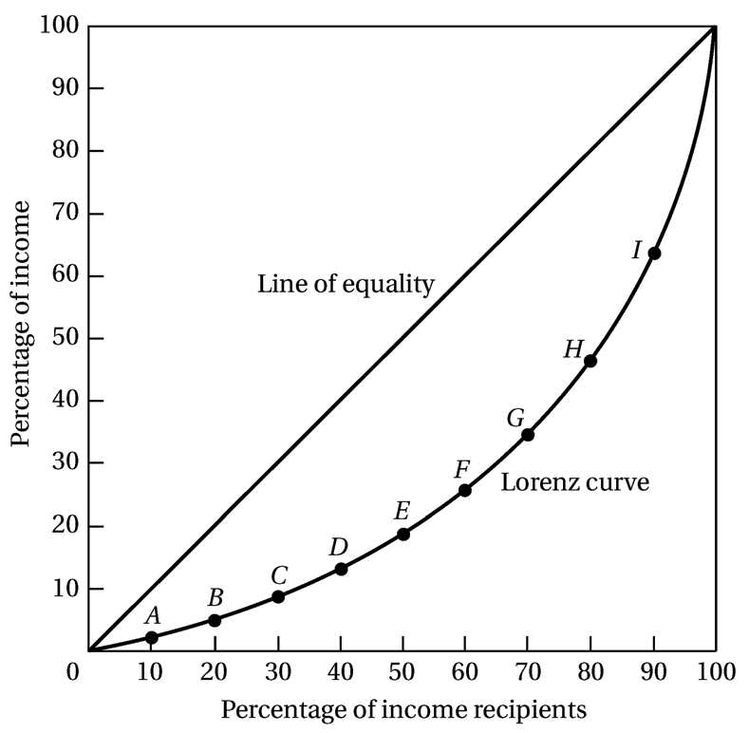
Lorenz Curve of Income Distribution
Data for the United States in 2000:
Quintile % Income % Cumulative Income
Lowest 20% 3.6 3.6
Second 20% 8.9 12.5
Third 20% 14.9 27.4
Fourth 20% 23.0 50.4
Richest 20% 49.6 100.0

Slide 5
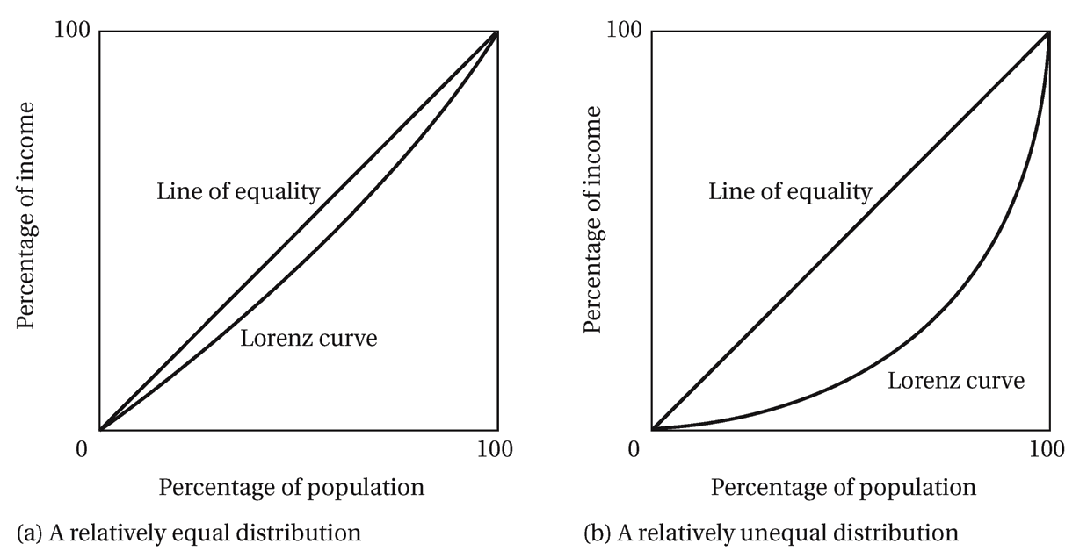
Lorenz Curve of Income Distribution
The greater the curvature of the Lorenz Curve, the greater is the degree of income inequality

Slide 6
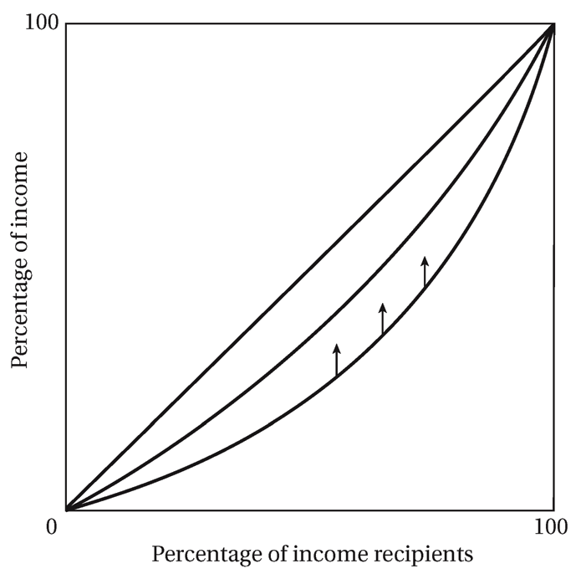
Improved Income Distribution (Lower inequality)

Slide 7
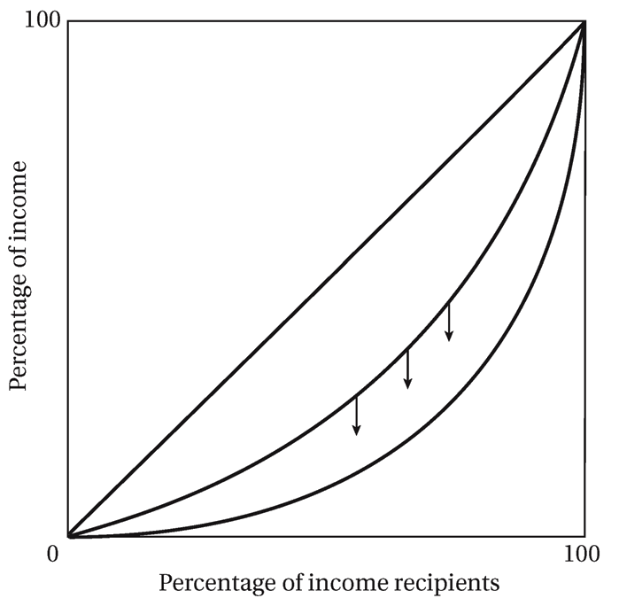
Worsened Income Distribution (Higher inequality)

Slide 8
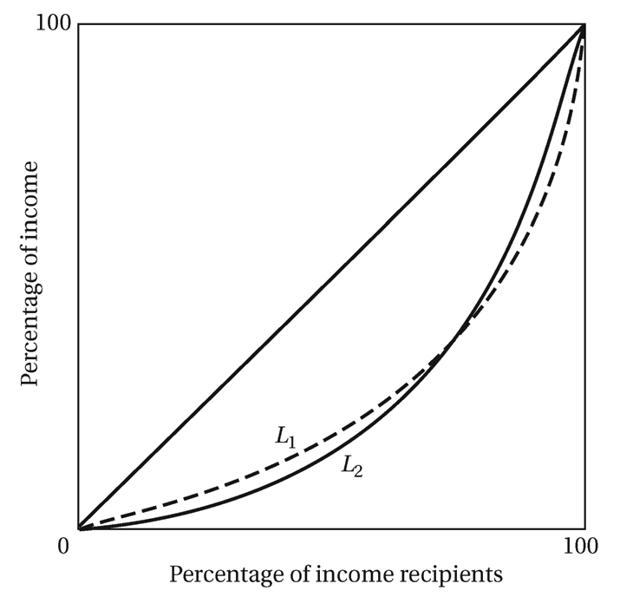
Crossing Lorenz Curves

Slide 9
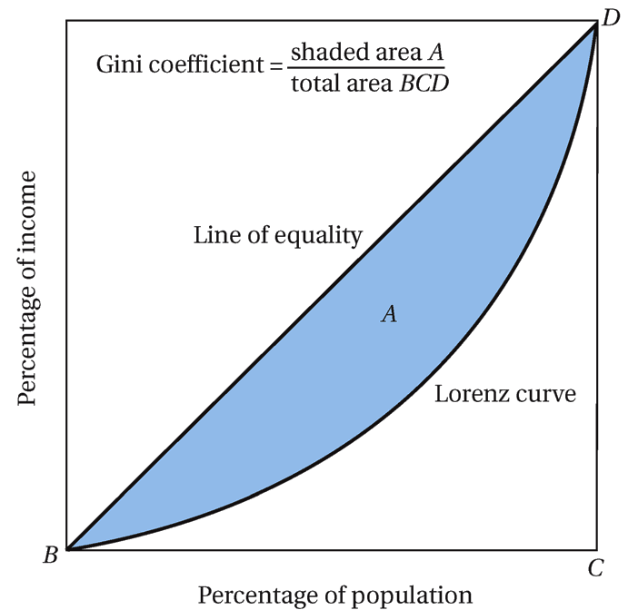
The Gini Coefficient

Slide 10
The Gini Coefficient
0 < The Gini Coefficient < 1
0.41 for U.S.
0.30 for Ethiopia
0.57 for Brazil
Gini Coefficient is higher for the OPEC and Middle-income countries than Low-income countries

Slide 11
Inequality (Some of the issues raised in Atkinson)
What kind of inequality should we be concerned with?
Equality of outcome (Income, Utility), of opportunities or other eg. Mankiws just desserts!
Should we focus on equality of opportunity only? Atkinson says no for three reasons:
(1) Do we ignore what may be very bad outcomes for some people?
(2) Swimming race analogy: the prize for winning is socially constructed and arbitrary
(market efficiency says nothing about distribution) so we can’t say much about what the distribution of income will be even if the race is fair
(3)Inequality of outcome is passed onto next generation
Instrumental vs intrinsic concern for inequality. Pickett & Wilkinson or Stiglitz OECD say inequality leads to bad outcomes, Amartya Sen and others inequality in itself is a very bad outcome

Slide 12
Nobel prize winner Amartya Sen emphasizes moving from Rawlsian framework of
inequality in primary goods to capabilities.
(Having the same opportunity set is an essential component of personal freedom)
This approach led to the Human Development index and a broader approach to measuring development
Until the 90s distribution and income inequality barely featured in the economics literature. eg Robert Lucas expressed view that focusing on redistribution a harmful distraction giventhe limitless possibilities of growth?
Should the focus be on poverty? Are these competing objectives? Should the focus be on households or individuals, income or consumption..?

Slide 13
Trends in inequality
See: “In it together, why less inequality benefits all” (OECD 2015)
http://www.keepeek.com/Digital-Asset-Management/oecd/employment/in-it-together-why-less-inequality-benefits-all_9789264235120-en#.V_PSS-UrLIU#page117

Slide 17
Market income inequality increased, but disposable (after tax/benefits) income inequality does not. Government policy is a cusion against rising inequality

Slide 18
Bottom 10% tended to lose more in the crisis:

