Slide 1
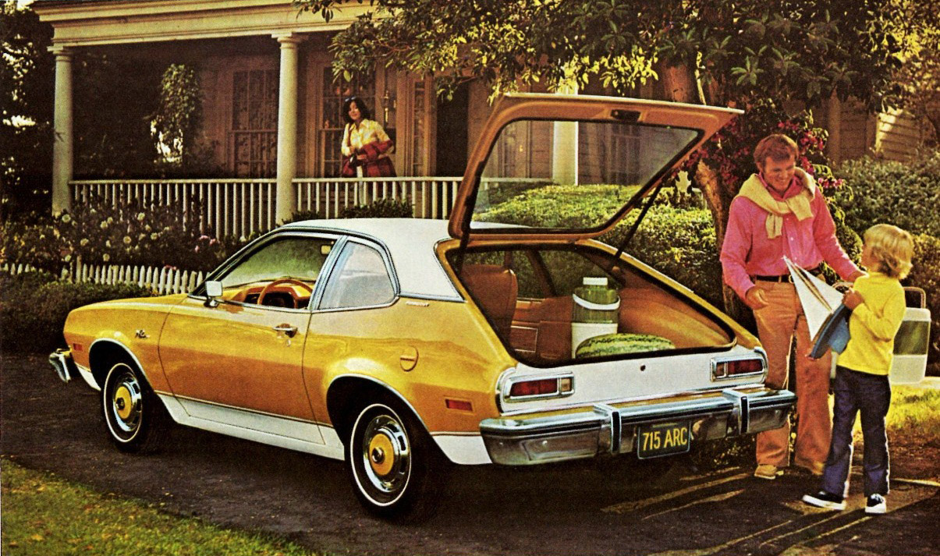
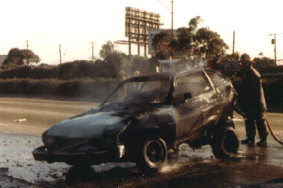
The Ford Pinto

Slide 2
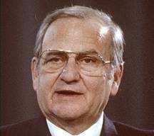
“I have found that being honest is the best technique I can use.”
Lee was honest and up front about what he wanted from the Ford Pinto, “Lee’s Car”:
  2000 lbs. for $2000
  Nothing else would compete with Datsun & VW
  23 months to roll-out (not 45)

Slide 3

PRODUCT OBJECTIVES:
1. TRUE SUBCOMPACT :
Size & Weight
2. LOW COST OF OWNERSHIP
Initial price, Fuel consumption, Reliability
Serviceability
3. CLEAR PRODUCT SUPERIORITY
Appearance, Comfort, Features,
Ride and Handling, Performance
Lee Iacocca was fond of saying, "Safety doesn't sell."

Slide 4
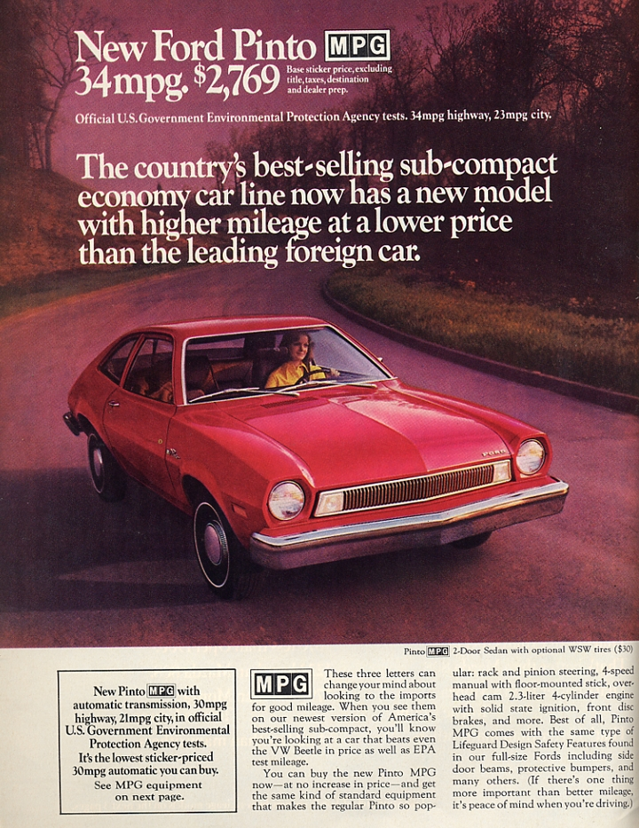

Slide 5
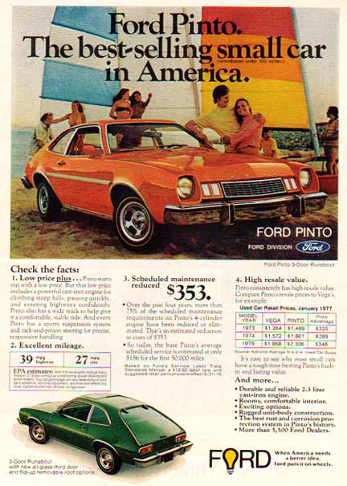
Notes:
http://www.engineering.com/Videos/VideoPlayer/tabid/4627/VideoId/1538/Ford-Pinto-Commercial.aspx
http://viralvideos.mobi/video/8Oc6s-9FToA/Ford-Pinto-vs-Japan-s-Best-1977-TV-commercial-with-Jackie-Stewart.html

Slide 6
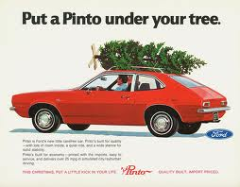

Slide 7
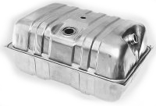
Gas Tank Configurations
Behind Rear-Axle
Over-the-Axle Tank

Slide 8
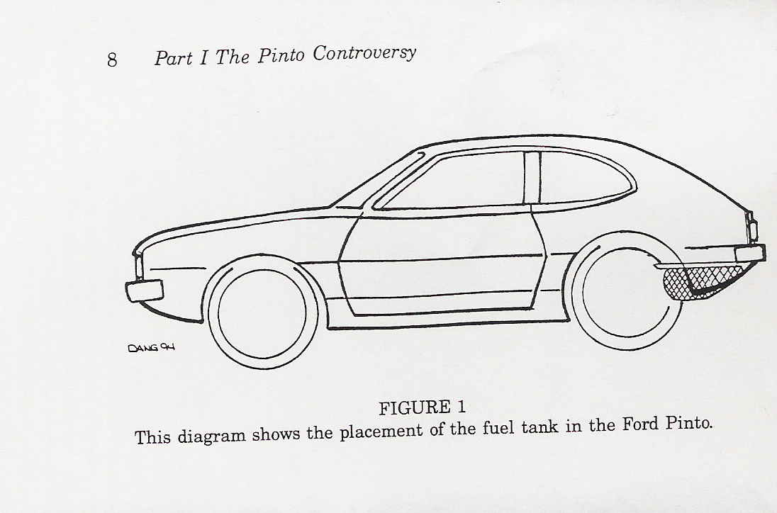
Gas Tank
Behind Rear-Axle Tank
Pros:
  More Luggage space
  Industry standard – felt it was safer
Con:
  Not as safe in rear-end collisions

Slide 9
Crash Test RESULTS
In a relatively low MPH rear-end collision, the gas tank is easily punctured by bolts on the differential.
Was Iacocca told?
"Hell no," replied an engineer who worked on the Pinto. "That person would have been fired. Safety wasn't a popular subject around Ford. Whenever a problem was raised that meant a delay on the Pinto, Lee would chomp on his cigar, look out the window and say 'Read the product objectives and get back to work.'"

Slide 10
Crash Test RESULTS
Of 40 tests, 37 resulted in ruptured gas tanks. The three that succeeded had:
--a plastic baffle between the tank and the differential bolts
-- a piece of steel between tank and bumper
-- a rubber “bladder” inside the gas tank

Slide 11
A possible solution?
More crash tests showed that a one-pound, one-dollar piece of plastic stopped the puncture of the gas tank.
The idea was thrown out as extra cost and extra weight.
Besides, production was already well under way.

Slide 12
In Short…
If you ran into that Pinto you were following at over 30 miles per hour, the rear end of the car would buckle like an accordion, right up to the back seat.
The tube leading to the gas-tank cap would be ripped away from the tank itself, and gas would immediately begin sloshing onto the road around the car.
The buckled gas tank would be jammed up against the differential housing (that big bulge in the middle of your rear axle), which contains four sharp, protruding bolts likely to gash holes in the tank and spill still more gas.

Slide 13
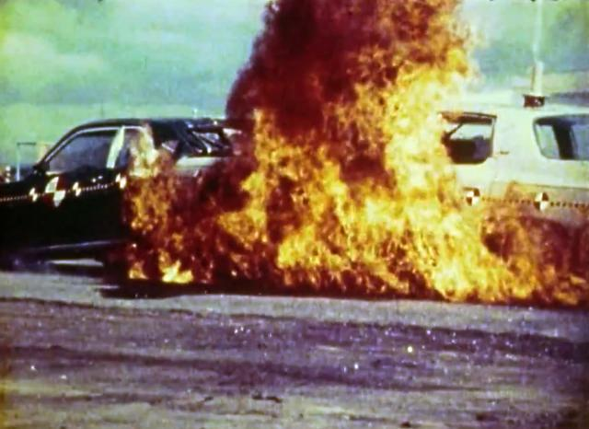
In Short…
Now all you need is a spark from a cigarette, ignition, or scraping metal, and both cars would be engulfed in flames.
If you gave that Pinto a really good whack—say, at 40 mph—chances are excellent that its doors would jam and you would have to stand by and watch its trapped passengers burn to death.

Slide 14
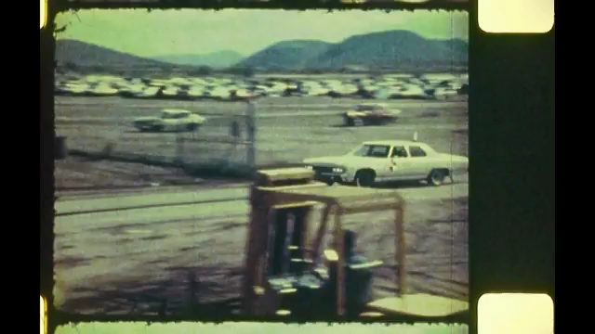
Actual Crash Test Video
Crash Test Footage

Slide 15
Meanwhile . . . .
Federal Motor Vehicle Safety Standard 301
Meant to require vehicles to withstand rear-end collision of 28 MPH
Henry Ford II lobbied relentlessly against.
Official auto industry line–cars don’t cause accidents; people and road conditions do.
Tactic: last-minute documents; challenges to test results; lawsuits; private negotiating.
The standard was delayed for 8 years.

Slide 16
A case in point…..
In 1972, “Sandra Gillespie” pulled her new Pinto onto a Minneapolis highway’s merge lane. The car stalled.
She was rear-ended at 28 MPH. The gas tank ruptured; fumes filled the car; a spark ignited; the car exploded in a ball of fire.
“Sandra” died in agony a few hours later at a hospital emergency room.
Her 13-year-old passenger underwent many surgeries to repair his face, burnt beyond recognition.

Slide 17
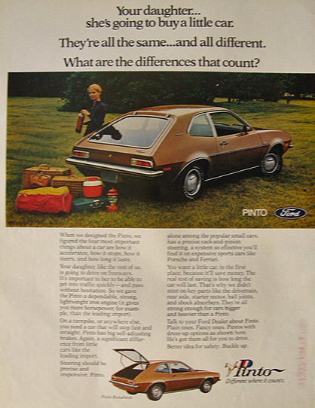
“Your daughter, like most of us is going to drive on freeways. It is important that she be able to get into traffic quickly….
you need a car that will stop fast and straight…
and we didn’t scrimp on key parts…

Slide 18
. A judgment was rendered against Ford and the jury awarded the Gray family $560,000 and Matthew Grimshaw $2.5 million in compensatory damages. The surprise came when the jury awarded $125 million in punitive damages as well. This was subsequently reduced to $3.5 million.2
B. The Criminal Case3
Six month following the controversial Grirnshaw verdict, 4 The fact that Ford had chosen earlier not to upgrade the fuel system design became an issue of public debate as a result of this case. The debate was heightened because the prosecutor of Elkart County, Indiana chose to prosecute Ford for reckless homicide and criminal recklessness.
Some felt the issues raised in the Ford Pinto cases were an example of the "deep pocket" company disregarding consumer safety in pursuit of the almighty dollar. Others feel they are an example of runaway media coverage blowing a story out of proportion.5 Regardless of opinion, the Ford Pinto case is a tangled web of many complex legal and ethical issues.
And there were others…..
In May 1972, Lily Gray was traveling with thirteen year old Richard Grimshaw in a 1972 Pinto when their car was struck by another car traveling approximately thirty miles per hour. The impact ignited a fire in the Pinto which killed Lily Gray and left Richard Grimshaw with devastating injuries

Slide 19
And others……
Ford was involved in yet another controversial case involving the Pinto. The automobile's fuel system design contributed (whether or not it was the sole cause is arguable) to the death of three women on August 10, 1918 when their car was hit by another vehicle traveling at a relatively low speed by a man driving with open beer bottles, marijuana, caffeine pills and capsules of "speed."

Slide 20

the prosecutor of Elkart County, Indiana chose to prosecute Ford for reckless homicide and criminal recklessness.

Slide 21
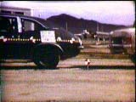
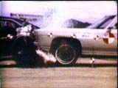
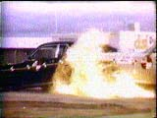
In a rear end collision….
A fiery death?

Slide 22

What was life worth in 1971?
The Ford Cost-Benefit Analysis
Component 1971 Costs
Future Productivity Losses
  Direct $132,000 Indirect $41,300
  Medical Costs
    Hospital $700
    Other $ 425
    Total $1,125
Notes:
Moral Issues in Business, W. Shaw & V. Barry. Copyright 2001

Slide 23
What is life worth in 1971? Cont’d
Property Damage $ 1,500
Insurance Administration $ 4,700
Legal and Court $3,000
Employer Losses $ 1,000
Victim's Pain and Suffering $10,000
Funeral $900
Assets (Lost Consumption) $5,000
Miscellaneous $200 Total Per Fatality $200,725
Notes:
Moral Issues in Business, W. Shaw & V. Barry. Copyright 2001

Slide 24
Cost/Benefit Analysis: Recall?
Benefit Analysis
Savings:
  180 burn deaths, 180 serious burn injuries, 2100 burned vehicles
Unit Cost
  $200,000 per death, $67,000 per injury, $700 per vehicle
Total Benefit
  (180 X $200,000) + (180 X $67,000) + (2,100 X $700) = $49.5 million
Cost Analysis
Sales
  11 million cars, 1.5 million light trucks
Unit Cost
  $11 per car, $11 per truck
Total Cost
  12.5 million X $11 = $137.5 million
Notes:
Moral Issues in Business, W. Shaw & V. Barry. Copyright 2001

Slide 25
Cost/Benefit Analysis Cont’d
Costs $137.5 Million
Benefits - $49.5 Million
Difference $ 88.0 Million

Slide 26
The Numbers:

Slide 27
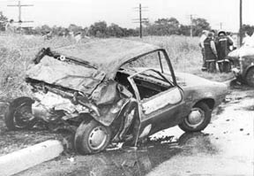
THE END ???

