Slide 1
Addressing Healthcare Disparities in a Particular Population: To Come
Your Name
RN-BSN Tempo Program, Walden University
Advocating for Diversity, Equity, and Inclusion in Healthcare
XD3002: Social Influences of Healthcare Disparities
Month XX, 202X

Slide 2
Slide Title
Presentation formatting tips
Go to the “Home” tab at the top and click the “New Slide” or “Layout” button to access different formatting for your slides.
Choose formatting that presents your information in the most logical way.
Use consistent, grammatically parallel format for bulleted lists (for example, on this slide, each element begins with an imperative verb).
You can also consult APA’s suggestions on formatting lists. Note: You are not required to use APA style in your presentation.
End bullet points consistently, either with or without a period.

Slide 3
Slide Title
Note: If you include any tables or figures in your presentation, refer to the slide that follows for guidance. Delete the slide if it is not relevant.
Presentation formatting tips
Keep font of text consistent.
Be sure headings are consistent in their spacing, placement, size, etc.
Consider using the slide after the title slide to summarize your presentation’s points (like an abstract for a paper).

Slide 4
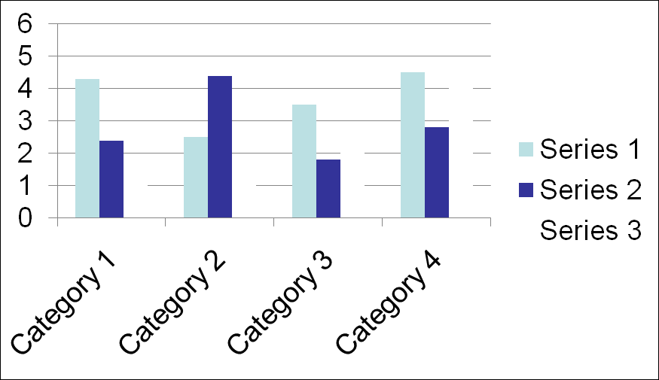
Use APA or the reference style rules with which you are familiar to format any tables and figures in your presentation:
Figure 1
Title Reflecting Figure Information
Note. Any needed general notes on figure. From “Utilizing Bar Graphs,” by A. Jones, 2020, Journal of Handy Graphs, 76(2), p. 3 (https://doi.org/10.123.45/abc). Reprinted with permission.

Slide 5
Slide Title
Presentation formatting tips
Your slides can also contain entire paragraphs, like this one does. In both paragraphs and bulleted lists in your presentation, citation rules apply just as they do in papers: when using or referencing another author’s ideas, you must cite that source. When incorporating a citation in a slide, do so just as you would in a traditional paper: According to Jones (2020), presentations are not very different from papers.
According to Smith and Cat (2020), you should make your presentation great, not just good.

Slide 6
Slide Title
Focus each slide on the information to provide to complete your presentation within the required length of 9–11 slides plus title and reference slides.

Slide 7
Slide Title
Focus each slide on the information to provide to complete your presentation within the required length of 9–11 slides plus title and reference slides.

Slide 8
Slide Title
Focus each slide on the information to provide to complete your presentation within the required length of 9–11 slides plus title and reference slides.

Slide 9
Slide Title
Focus each slide on the information to provide to complete your presentation within the required length of 9–11 slides plus title and reference slides.

Slide 10
Slide Title
Focus each slide on the information to provide to complete your presentation within the required length of 9–11 slides plus title and reference slides.

Slide 11
Slide Title
Presentation formatting tips
Remember to adhere to any assignment guidelines regarding presentation format. This template contains suggestions only.
Review our presentation tips for more information.
Visit the Academic Skills Center for more tips on how to use PowerPoint or visit Microsoft’s PowerPoint help and learning website.

Slide 12
Slide Title (References)
Include resources that you used to create your presentation. Use the reference format with which you are familiar, which may be APA or another.
Formatting tips
Always include a reference list at the end of your presentation, just like you would in a paper. Reference list entries take the same format they would in a paper, including a hanging indent. Visit the Common Reference List Examples page for the correct APA format. Here are a few examples:
Jones, P. (2020). This great book. Publisher.
Smith, W., & Cat, D. (2020). How to make a good presentation great. Presentations Quarterly, 45(4), 56–59. https://doi.org/10.123.45/abc

