Slide 1
Types of Long-Term Memories
Learning objectives: By the end of this presentation you will be able to…
distinguish between, describe relationships among and give examples of each of five kinds of long-term memories.
describe evidence which suggests that episodic and semantic memories are distinct kinds of memory
describe three examples of the interaction of episodic and semantic memories; define autobiographical memories and “semanticization of remote memories”
compare and contrast procedural memory, priming, and classical conditioning; explain how each illustrates implicit memory
describe how we demonstrated priming in class and how priming is exploited in marketing and advertising
describe the process of classical conditioning

Slide 2
Types of Long-Term Memories
I. Overview
A. Types of LTMs
  Episodic Memory- memory for personal events; involves mental time travel (Tulving, 195); “remembering” (e.g. coming to class this morning)
  Semantic Memory- memory for facts and knowledge; “knowing” (e.g. facts, terms, dates, concepts)
Procedural Memory- learning skills (e.g. tying shoes, typing, playing musical instrument)
Priming- exposure to one stimulus (the “prime”) influences the response to another (“test”) stimulus. (e.g. ambiguous stimuli).
Classical Conditioning- learning to associate two stimuli (e.g. Pavlov’s dog)

Slide 3
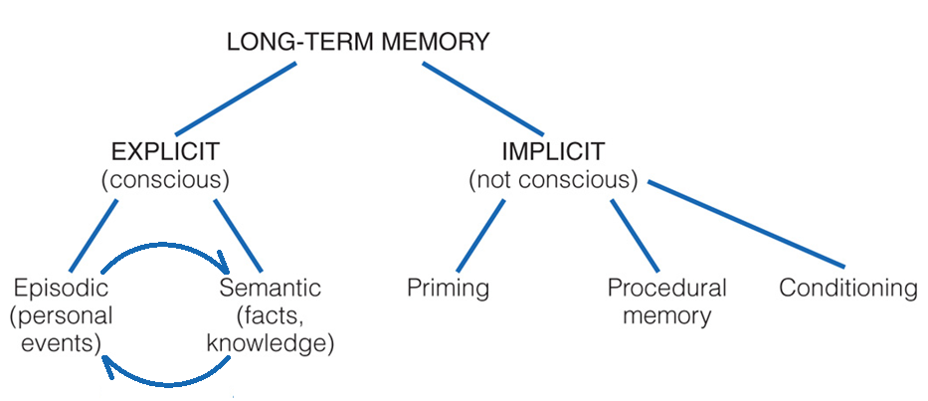
Types of Long-Term Memories
I. Overview
A. Types of LTMs
B. Relations Among LTMs: Explicit & Implicit Memories

Slide 4
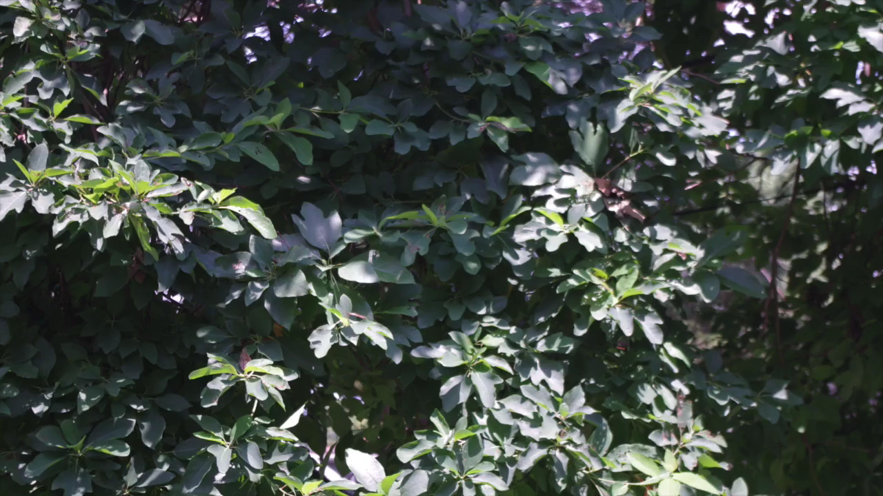
Types of Long-Term Memories
I. Overview
II. Explicit (Declarative) Memories
  A. Episodic & Semantic Memories Are Distinct, As Evidence By…
  dissociation of episodic and semantic memories (e.g. hydrocephalic woman with intact semantic memory and poor episodic memory)
  retrieving episodic and semantic memories activate different areas of the brain…

Slide 5
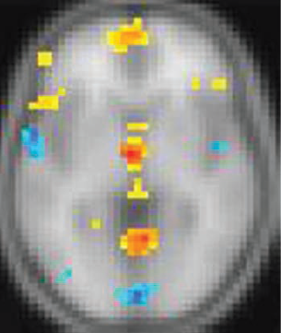
Levine et al (2004) …
participants kept daily audio-diaries of 1) personal events (episodic memories) and 2) facts as they occurred to them (semantic memories)
placed participants in fMRI and replayed tapes…
listening to recorded EPISODES lit up YELLOW areas, listening to FACTS lit up BLUE areas…

Slide 6
Types of Long-Term Memories
I. Overview
II. Explicit (Declarative) Memories: Episodic & Semantic Memory
  A. Episodic & Semantic Memories Are Distinct
  B. Episodic & Semantic Memories Interact
  1) Both comprise autobiographical memories-memories for specific life experiences
  2) Semantic memory can guide attention and so influence experience (e.g. knowing the rules of baseball—or of journal articles)
  3) semanticization of remote memories- over time, episodic memories (remembering) become semantic (knowing)…

Slide 7

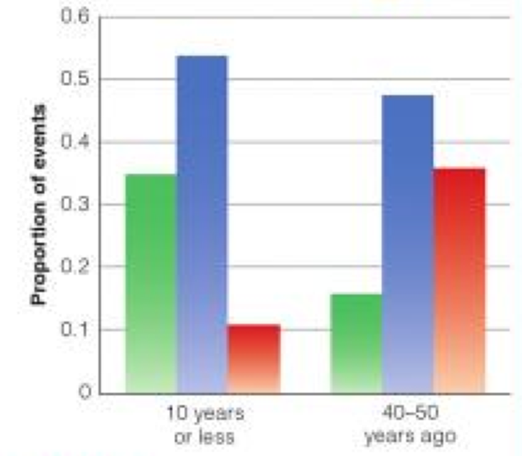
  Petrican et al (2010)…
described pubic events that occurred over the past 50 years to older adults (e.g. Nixon, Berlin Wall)
for each event, participant indicates that I…
Results: as events got older remember responses decreased more than did know responses…
Interpretation: remembering became knowing (do you remember learning your times tables?)

Slide 8
Types of Long-Term Memories
I. Overview
II. Explicit (Declarative) Memories
III. Implicit Memories
A. Priming
demo (Run PIM.exe)
  application of priming: propaganda effect- statements read or heard before (e.g. from ads) are more likely to be rated as true.

Slide 9
Types of Long-Term Memories
I. Overview
II. Explicit (Declarative) Memories
III. Implicit Memories
A. Priming
B. Procedural (Skills) memory
How do skills demonstrate implicit memory?
C. Classical Conditioning
Review Process of C.C.

Slide 10
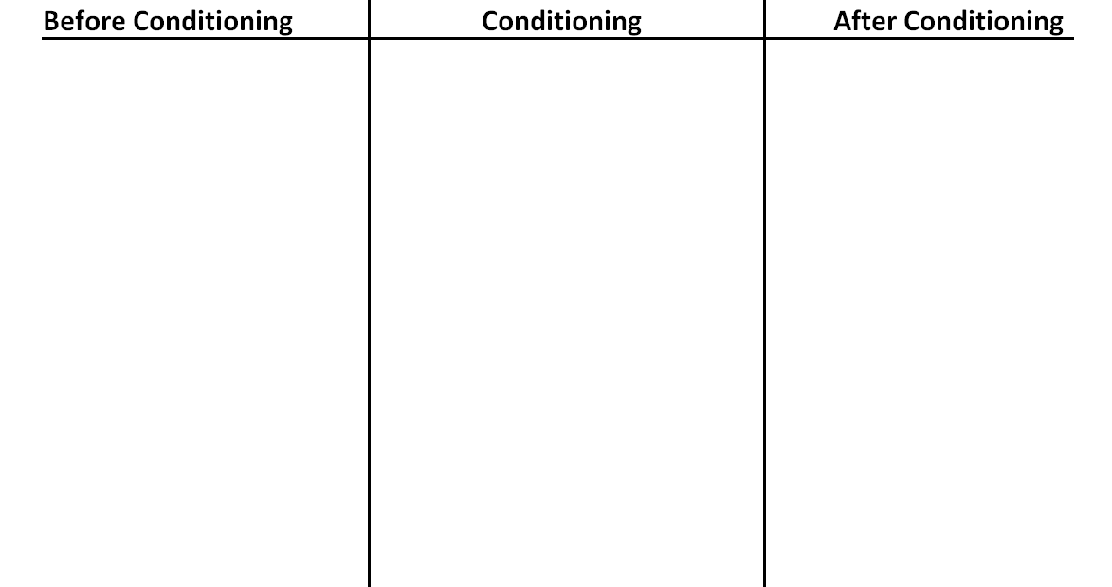
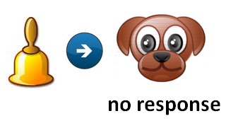
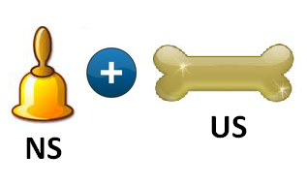
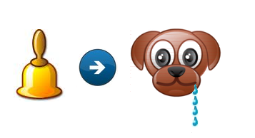






Classical Conditioning

Slide 11
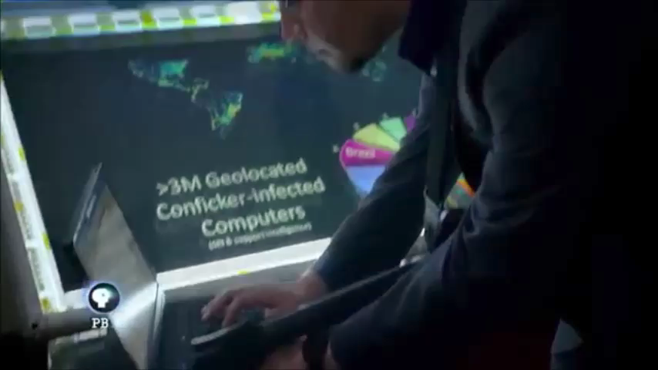
Types of Long-Term Memories
I. Overview
II. Explicit (Declarative) Memories
III. Implicit Memories
A. Priming
B. Procedural (Skills) Memory
C. Classical Conditioning
Review Process of C.C.
How does C.C. demonstrate implicit memory?
D. Implicit Memory Applied: The Password You Can’t Divulge
The played password illustrates which type of implicit memory?

Slide 12
Types of Long-Term Memories
I. Overview
II. Explicit (Declarative) Memories
III. Implicit Memories
A. Priming
B. Procedural (Skills) Memory
C. Classical Conditioning
D. Implicit Memory Applied: The Password You Can’t Divulge

