Slide 1

MN7031 Topic 3.3 – Why Do Companies Undertake Mergers, Acquisitions or Alliances?
Daniel Jones
londonmet.ac.uk

Slide 2
Module Overview
1. How and Why Do Businesses Grow?
2. How Do We Diagnose Company Strategy?
5. How Do We Make Sense of the VUCA External Environment?
8. Does Your Simulation Company Need A New Strategy?
9. Why Do Firms Undertale Acquisitions, Mergers and Alliances?
7. How Is Your Simulation Company Performing?
10. How Do Companies Innovate Successfully?
12. Does Strategic Alignment Matter?
4. Why Are Some Industries More Profitable Than Others?
3. How Does A Company Create Competitive Advantage?
6. How Do We Create Strategies?
11. Summative Assessment Presentations
Business Simulation – Cesim Global Challenge

Slide 3
Today’s Agenda
Lecture
Corporate integration – control and cooperation
Demand for multi-business synergy
International growth, management and configuration - Globalisation and Localisation
Mergers and acquisitions - The paradox of resources and synergies
Vertical integration - Portfolio and integrated organisations
Network strategy and strategic alliances
  Relational objectives
  Relative Power Positions
  Types of collaborative arrangements
Competition and Cooperation
International perspectives

Slide 4
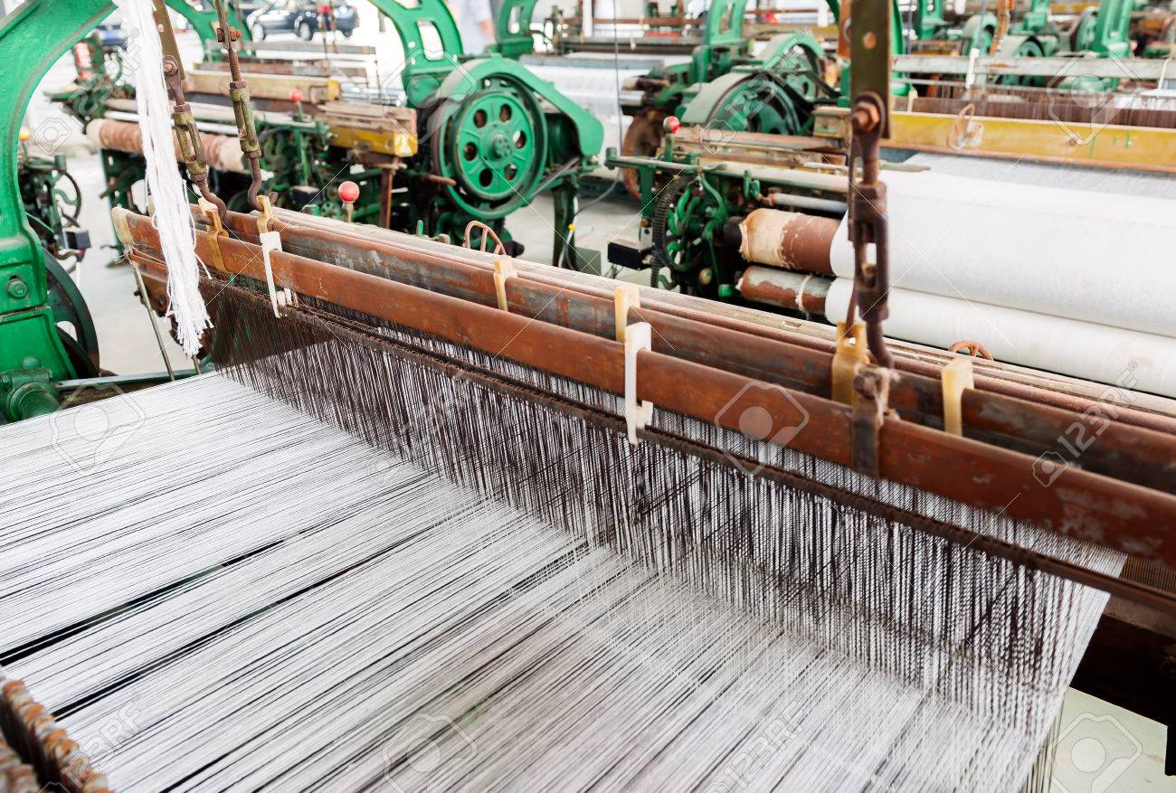
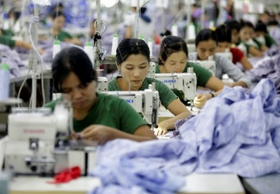




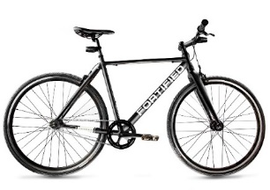
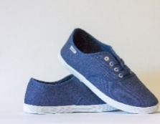

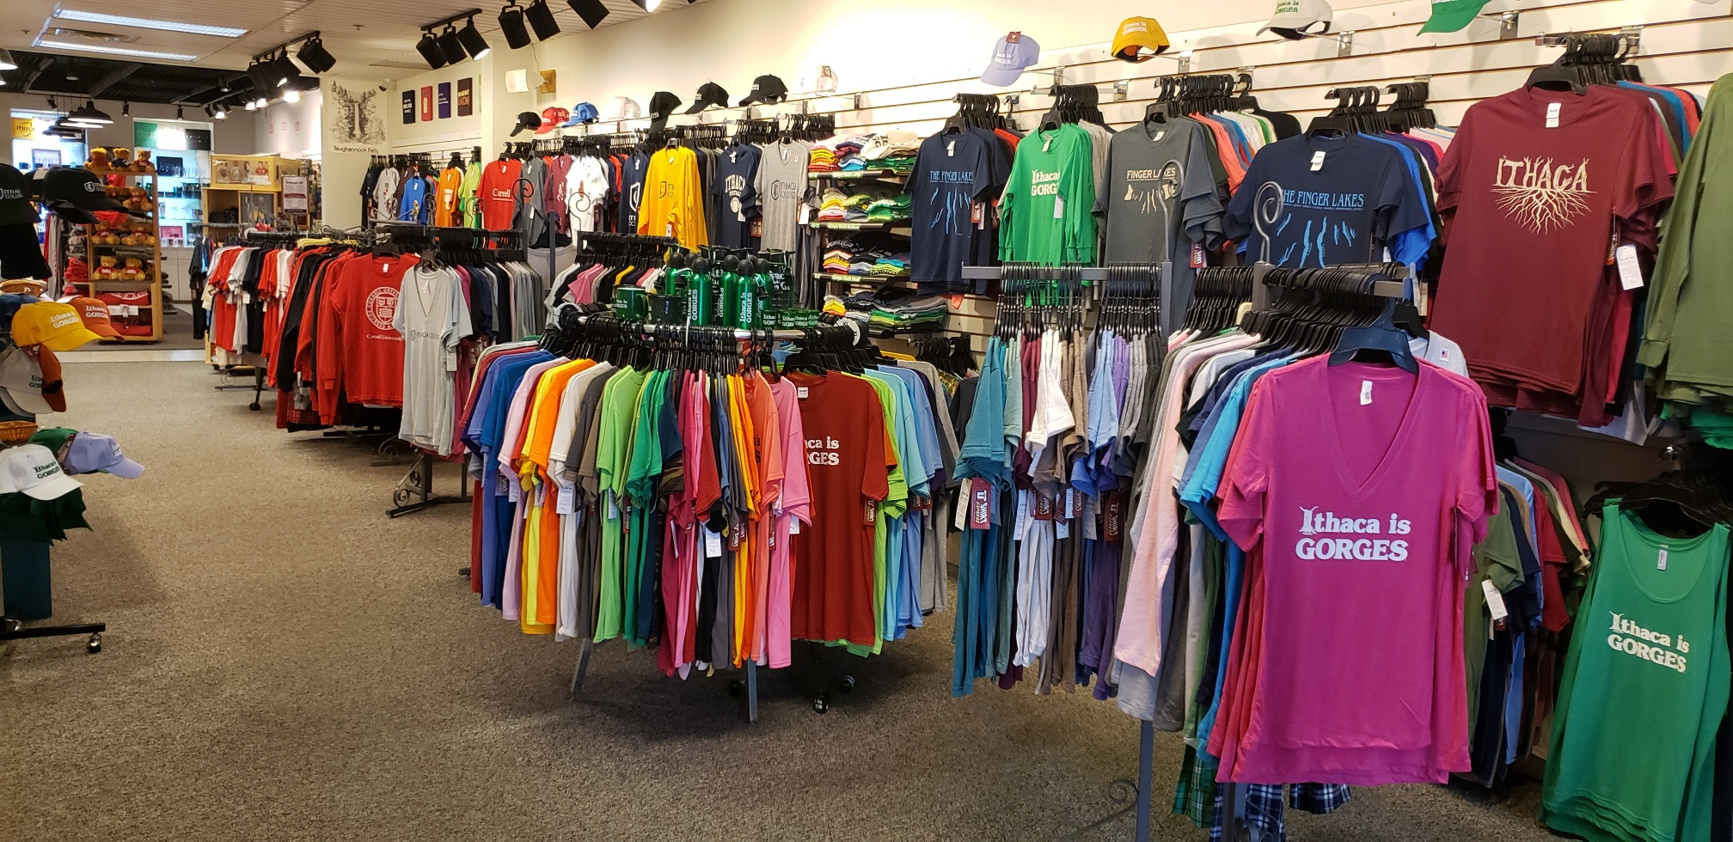



How Does a Business Grow Profitably?
Backwards
Integration
Portfolio of Products
Vertical Integration
Horizontal Diversification
Forward
Integration
New Market Entry
Innovation
Resource Capture
Learning
Alliances
Internationalisation

Slide 5
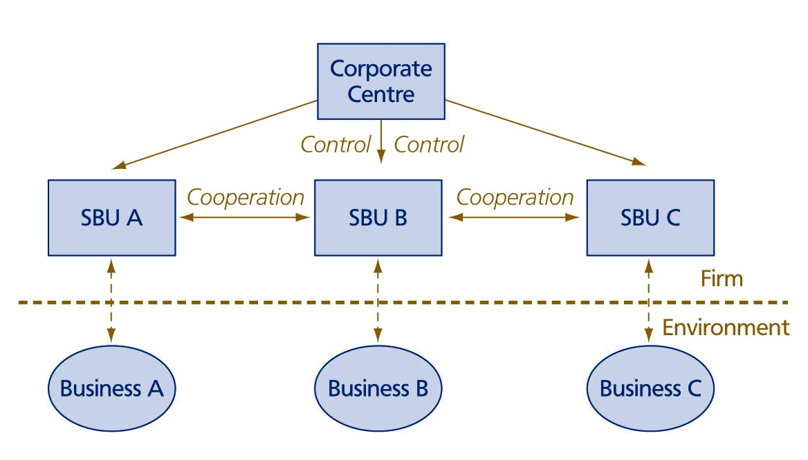
  Corporate Integration Through Control And Cooperation

Slide 6
The Issue Of Corporate Configuration
Who should take the initiative to realise integration?
Two organisational means:
  control
  Cooperation
  Three general corporate control styles:
    financial control
    strategic control
    strategic planning
    SBUs need to cooperate – multi-business synergy
    SBUs need to be highly responsible to specific demands of their own business area – business responsiveness

Slide 7






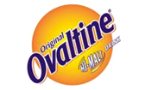
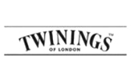



Demand For Multi-business Synergy
Associated British Foods
Diversification into new business areas only economically justified if it leads to value creation
Increase in shareholder value if three tests are passed:
  the attractiveness test
  the cost-of-entry test
  the better-off test

Slide 8
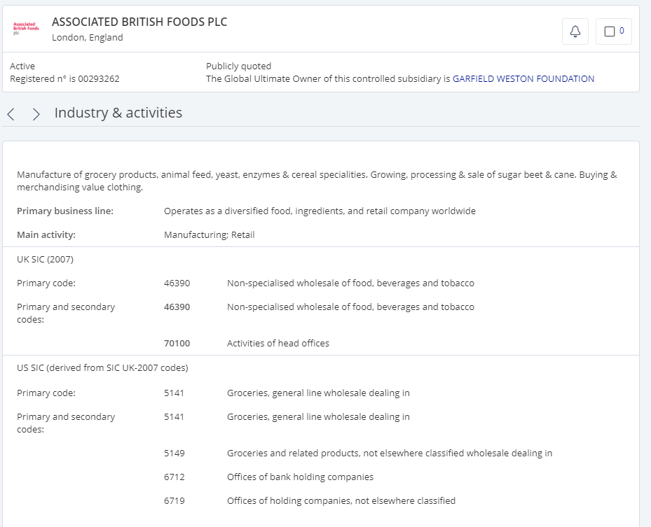
FAME Database

Slide 9
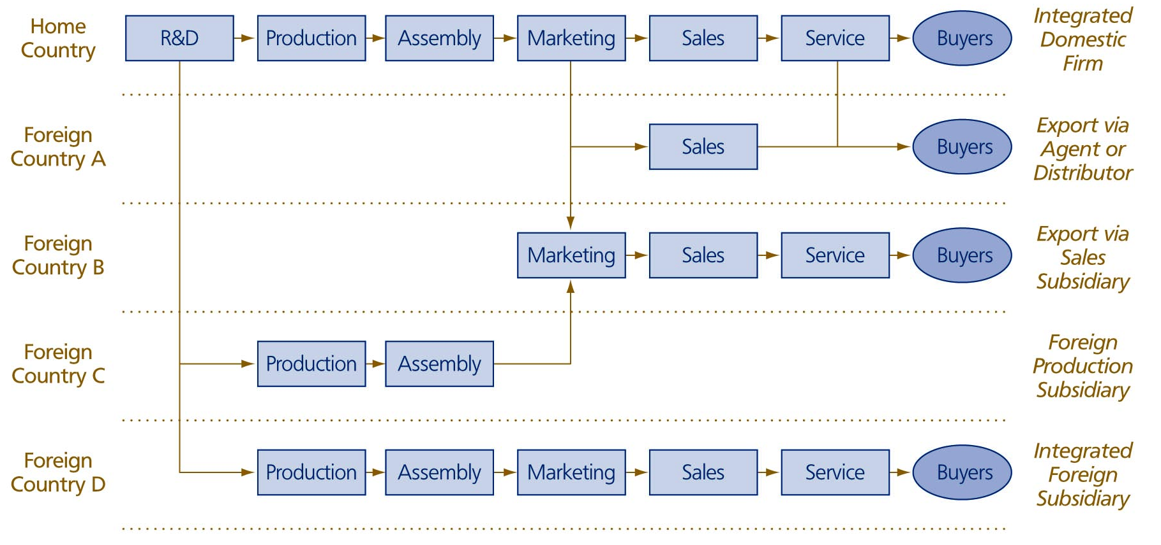
International Growth Options

Slide 10
International Management
Internationalisation only makes sense if enough cross-border synergies can be reaped to offset the extra cost of foreignness and distance
Three most important integration mechanisms:
  Standardisation – do the same thing in each country
  Coordination – align varied activities in different countries by cross-border coordination
  Centralisation – activities within the firm can be integrated at one central location

Slide 11
The Issue of International Configuration
Four generic organisational models:
Decentralised federation – firm is organised along geographic lines, with each country subsidiary largely self-sufficient and autonomous – multinational
Coordinated federation – firm is organised along geographic lines, but the country subsidiaries have a closer relationship with the international headquarters in the home country
Centralised hub – national units are relatively unimportant as all main activities are carried out in the home country
Integrated network – country subsidiaries have a close relationship with international headquarters but also a close relationship with each other

Slide 12
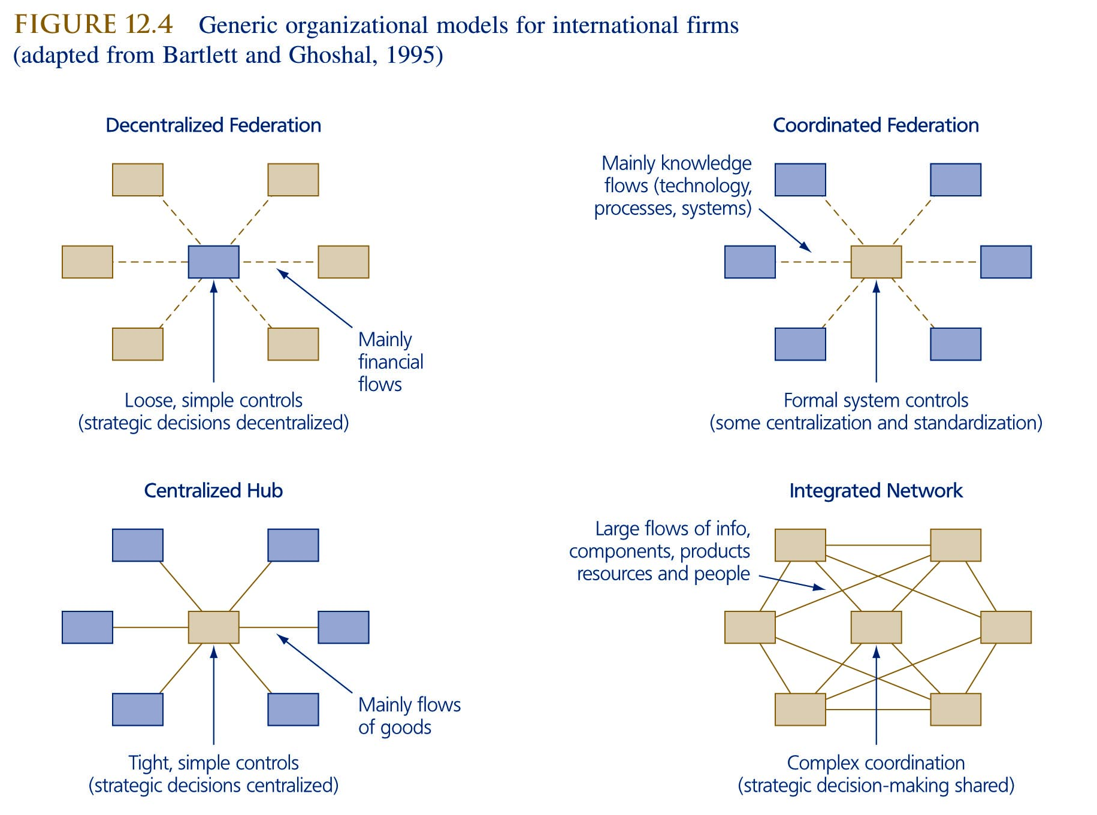
Generic Organisational Models For International Firms

Slide 13
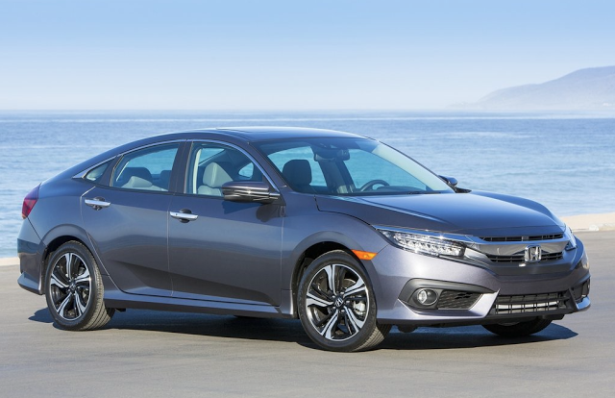
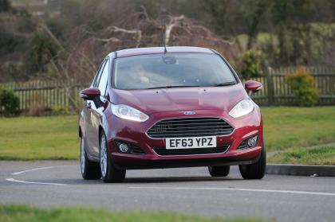
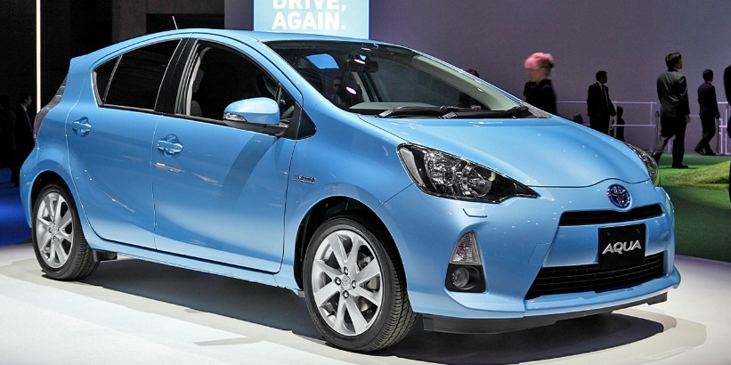
The Paradox of Globalisation and Localisation
Tension between international uniformity and meeting local demands
International standardisation is a means for achieving cross-border synergies
Synergies can be achieved by leveraging resources, integrating activities and aligning product offerings across two or more countries
US Best Seller - Toyota Camry
Japan Best Seller – Toyota Aqua
UK Best Seller – Ford Fiesta

Slide 14
The Demand for Global Synergy
Synergy by aligning positions – align market positions in the countries in which the firm operates
  Dealing with cross-border customers
  Dealing with cross-border competition
Synergy by integrating activities – integrating the value-creating processes across borders to realise economies of scale and take advantage of specific competitive advantages of each nation
  Reaping scale advantages
  Reaping location advantages
Synergy by leveraging resources – sharing resources across national markets
  Achieving resource reallocation
  Achieving resource replication

Slide 15
Mergers, Acquisitions and Alliances

Slide 16
A Career Experience of Mergers, Acquisitions and Alliances
Hoskyns – 1990’s
  Acquired by Plessey
  Acquired by Debis System Haus
  Acquired by Capgemini
  Alliance with a parking services firm to develop BPO business in decriminalised parking enforcement for Local authorities
EDS
  Acquired by GM – we all drove GM cars!
  Acquisition due diligence for a services firm in Local Government IT services
  Major bids in alliance with a range of companies, including ATKearney, PwC, IBM and Microsoft
  TTSC Alliance
Fujitsu
  Alliance with PwC, Tata Consulting Services and IDX – major NHS bid
  Alliance with Zensar Technologies for a BOT contract for an IT service centre in Pune
EDS
  Alliance bid for the National Identity Card
  Oyster Card – EDS, ICL (Fujitsu), Cubic, WSAtkins
  acquired by HP
TPI – acquired by ISG and merged with Compass
BPP University – acquired by US firm Apollo Global Inc

Slide 17
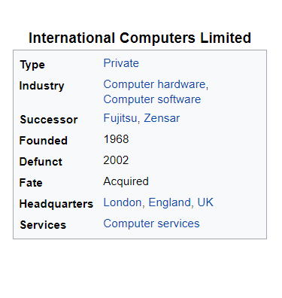
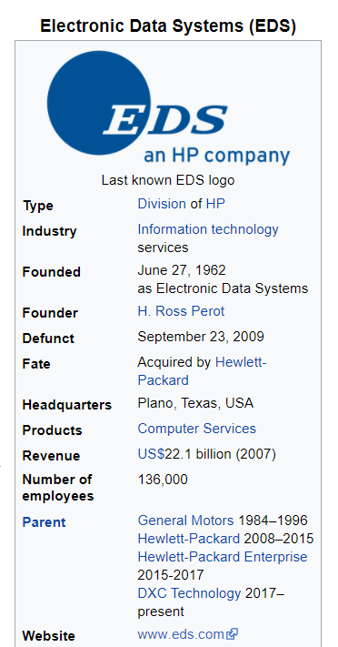
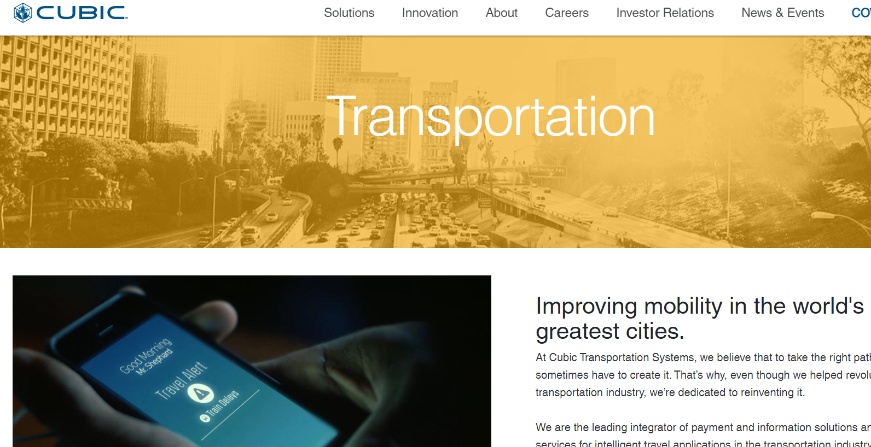

Oyster Card – Transys Ltd

Slide 18
Mergers and Acquisitions
Mergers - a merger technically means that two companies and their shareholders decide and approve the combinations of both the companies. After the merger is signed between the companies, they will not operate individually any longer.
Acquisitions - In an acquisition, the acquiring company takes control of the acquired company. The acquiring company usually keeps its name, does not seemingly alter its legal system, and usually maintains its stock symbols after an acquisition of a different company. The key to success is to create value for shareholders – 2+2 = 5

Slide 19
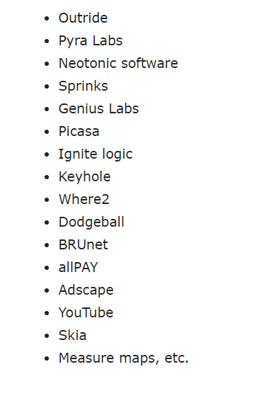
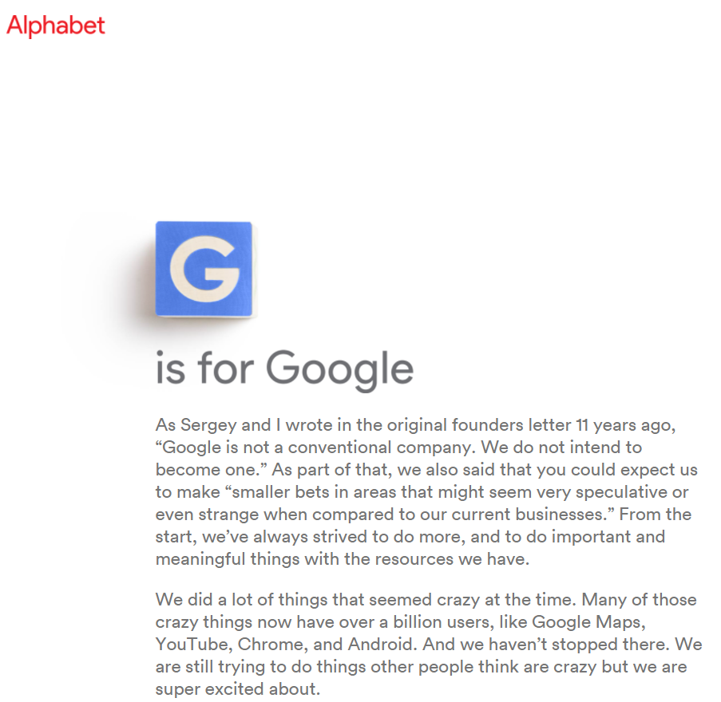
Reasons for Mergers and Acquisitions
Buy a new product that can be leveraged by the firm’s sales and distribution capabilities e.g. Beam Suntory bought Sipsmith, and Asahi Group bought Fullers Brewing and Distribution Operation
Buying distribution in new markets – Just Eat and Grubhub (US) = $7.3bn
Acquiring capabilities – Tesla, Cisco, Google. Microsoft
Diversification – Uber and Postmates, Alphabet

Slide 20
The Paradox Of Responsiveness And Synergy
Synergy by leveraging resources – two or more businesses are related if their resources can be productively shared:
  Resource reallocation – resources can be transferred to other SBUs where better use can be made of them e.g. money and personnel
  Resource replication – intangible resources can be copied from one business unit to another, e.g. knowledge and capabilities copied and reused in other business units
  Synergy by aligning positions – Improving bargaining position - offer a broad package of related products
    Improving competitive position – coordination of product offerings prevent SBUs from fighting amongst one another
    Synergy by integrating value chain activities –
      Sharing value-adding activities
      Linking value-adding activities

Slide 21
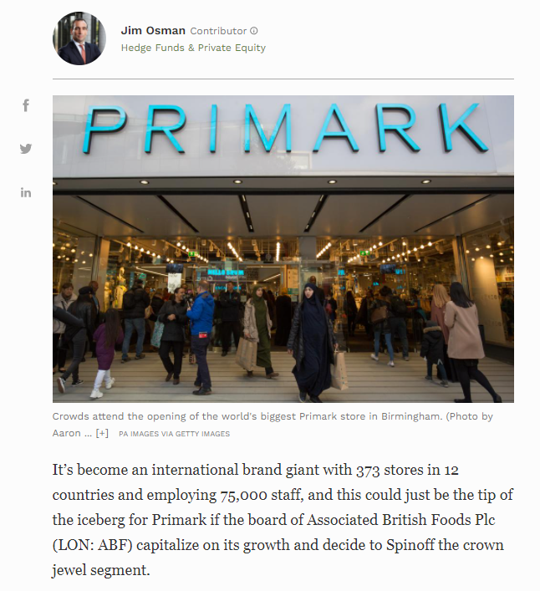
Why UK Discount Retailer Primark Should Spinoff To Unleash Real Value For Investors
https://www.forbes.com/sites/jimosman/2019/10/15/discount-retailer-primark-spin-off/?sh=2a8ce1d23f83

Slide 22
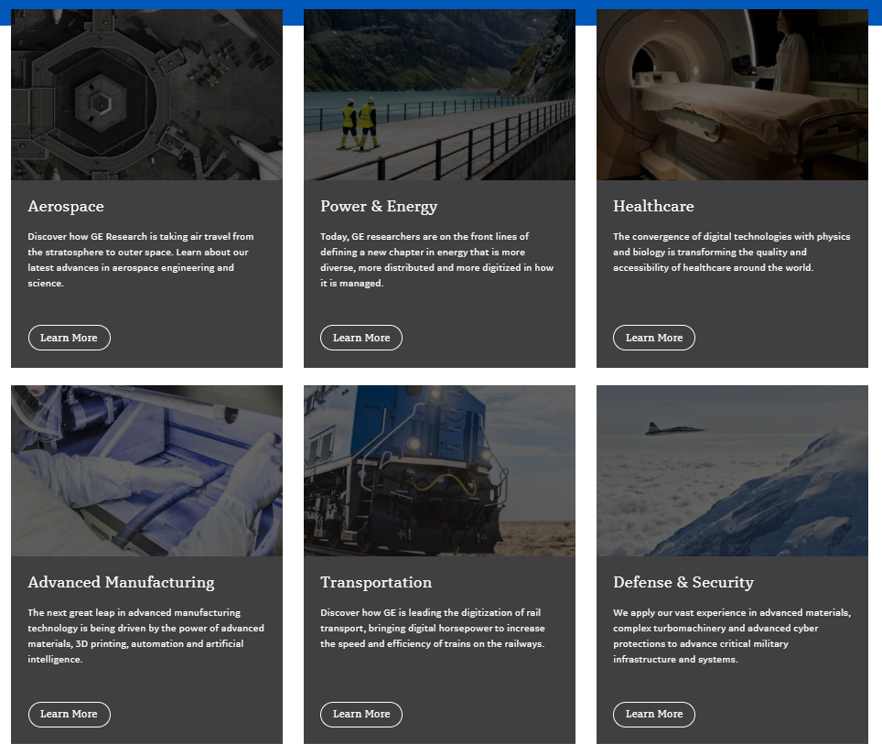
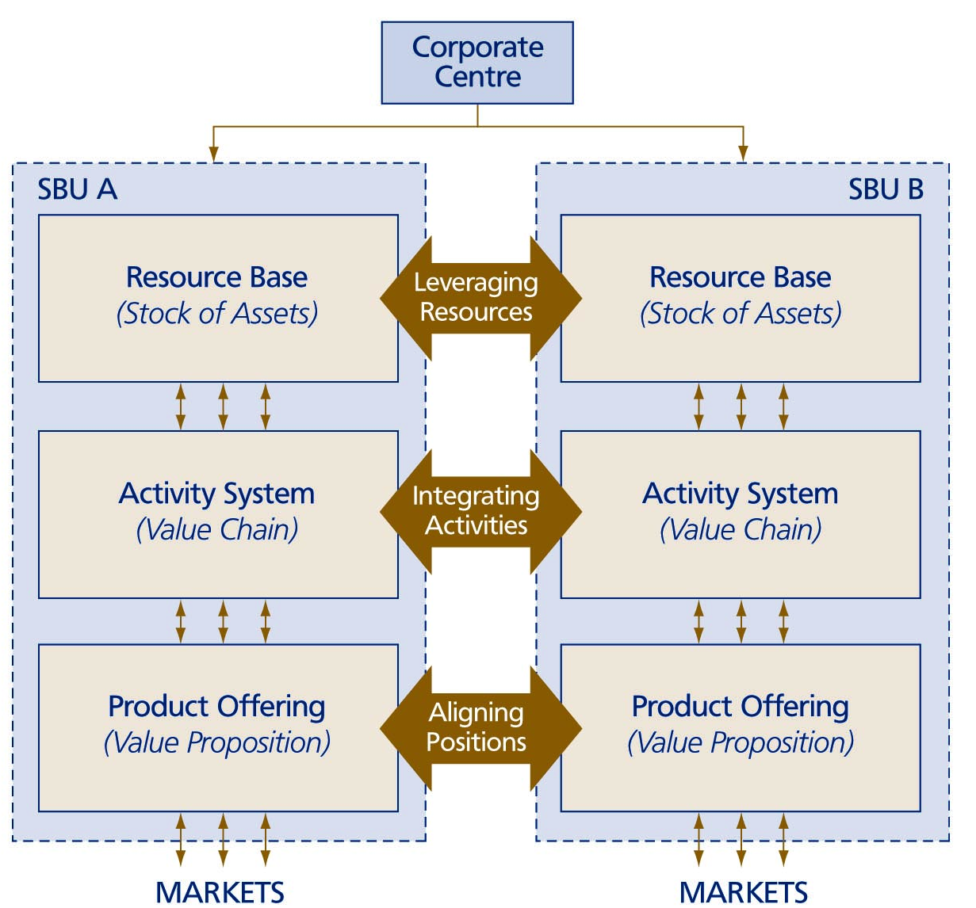
Forms Of Multi-business
Synergy

Slide 23
Vertical Integration
Vertical integration of activities – ‘internalisation’ – firms perform activities inside the firm instead of dealing with outside suppliers and buyers
Companies will integrate upstream or downstream activities if the following conditions are deemed important:
  operational coordination
  avoidance of transaction costs
  increased bargaining power
  learning curve advantages
  implementing system-wide changes

Slide 24
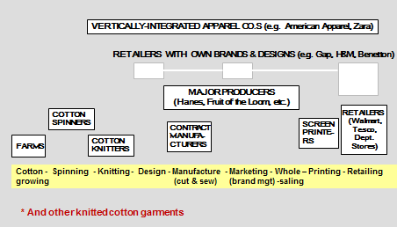
Garment Industry – Business Models with Varying Degrees of Vertical Integration

Slide 25
Demand for Business Responsiveness
Responsiveness is the ability to respond to the competitive demands of a specific business area in a timely and adequate manner
Major problems in a vertically integrated firm:
  high governance costs
  slower decision-making
  strategy incongruence
  dysfunctional control
  dulled incentives

Slide 26
Two Perspectives of Corporate Organisations
The Portfolio Organisation e.g. the South Korean Chaebol
  Samsung - gadgets, appliances, engineering, construction, shipbuilding, insurance and credit cards
  LG - smartphones, televisions, electronic components, chemicals and fertilizer. It also owns Korean baseball and basketball teams.
  Hyundai - Hyundai and Kia cars, elevators, logistics services, hotels and department stores
The Integrated Organisation

Slide 27
    The Portfolio Organisation Perspective
  Responsiveness is emphasised over synergy
  The only synergies emphasised are financial synergies
  Business units do not need to be ‘related’ in any other way than financial
  Portfolio approach well-suited to diversification through acquisition
  Business units must be responsible for their own competitive strategy
  Corporate centres should be modest in ambition and size
In the 1970s and 80s Lords Hanson and White turned Hanson into a multi-national concern with interests across the world ranging from chemical factories in the US to electricity supply in the UK and gold mines in Australia.
Hanson produced cigarettes and batteries, timber and toys, golf clubs and Jacuzzis, cod liver oil capsules and cranes.

Slide 28
    The Integrated Organisation Perspective
  A corporation should be a tightly knit team of business units grouped around a common core
  Corporate level strategists ‘lead from the centre’
  Core competence centred corporation – the corporation is like a tree, the trunk is the core products, smaller branches are businesses units, business unit branches can be cut off and new ones can grow on but all spring from the same tree
  All business units should tap into and contribute to the corporation’s core competences, thus the business units’ autonomy is limited
  Other synergies used e.g. product offerings can be aligned for a group of core customers; a multi-business firm can be built around shared activities; use of firm’s software e.g. for Disney Cinderella sells DVDs, encourages families to visit Disney theme parks, watch the Disney channel etc.
  Growth through acquisition is more difficult

Slide 29
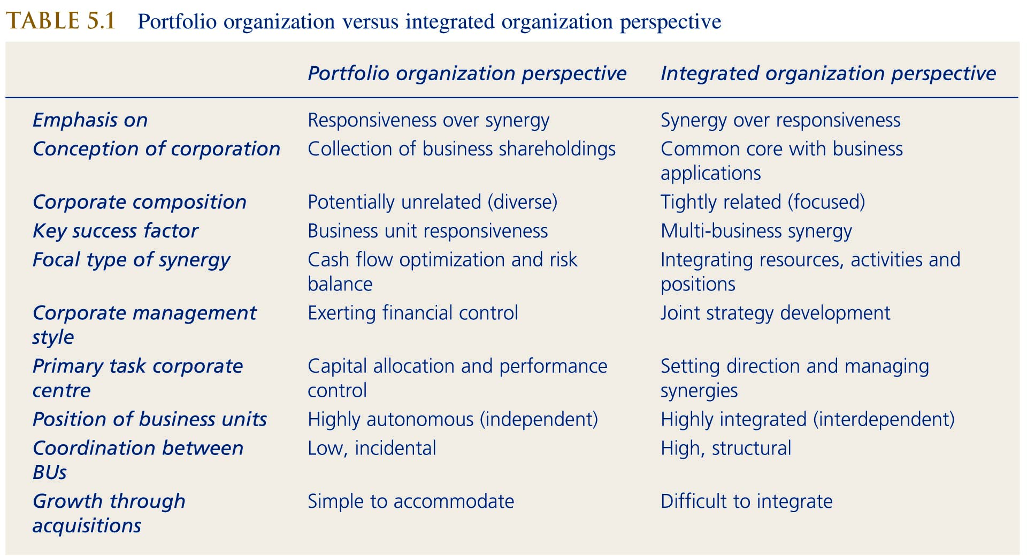
Portfolio Organisation Versus Integrated Organisation Perspective

Slide 30
Network Strategy and Strategic Alliances

Slide 31
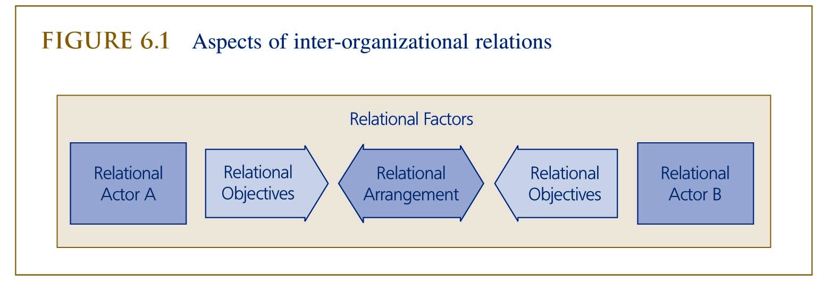
The Issue Of Inter-organisational Relationships
All firms interact with other organisations in their environment and therefore have inter-organisational relationships
Four aspects are particularly important:
  Who are the potential counterparts with whom a firm can have a relationship (relational actors)?
  Why do the parties want to enter into a relationship (relational objectives)?
  What type of influences determine the nature of the relationship?
  How can relationships be structured to let
  them function in the manner intended?

Slide 32
  Aspects Of Inter-organisational Relations
Relational actors
Upstream – vertical (supplier) relations
Downstream vertical (buyer) relations
Direct horizontal (industry insider) relations
Indirect horizontal (industry outsider) relations
There are also contacts with condition-setting parties in the broader environment:
socio-cultural actors
economic actors
political/legal actors
technological actors

Slide 33
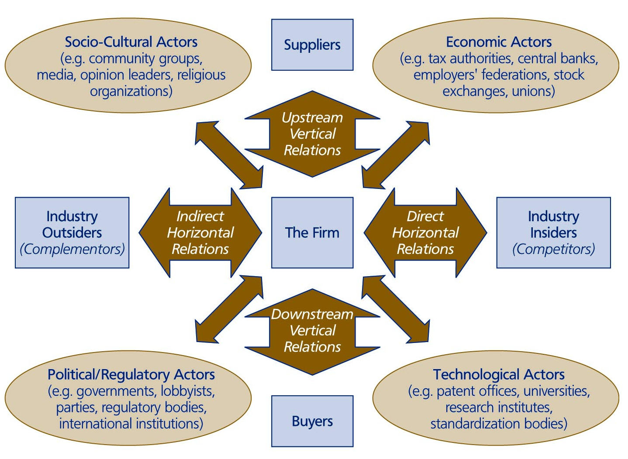
The Firm And Its Web Of Relational Actors

Slide 34
Relational Objectives
Relations oriented towards leveraging resources:
  Learning
  Lending
Relations oriented towards integrating activities:
  linking (e.g. vertical link between buyer and seller)
  lumping (bringing together similar activities to gain economies of scale)
Relations oriented towards aligning positions:
  leaning (two or more firms get together to improve their bargaining position)
  lobbying

Slide 35
Relational Factors
How inter-organisational relationships develop is influenced by the objectives of the parties but other factors also have an impact:
  legitimacy
  urgency
  frequency
  power
There are four specific types of inter-firm relationships from the perspective of the power position:
  mutual independence
  unbalanced independence
  mutual dependence
  unbalanced dependence

Slide 36
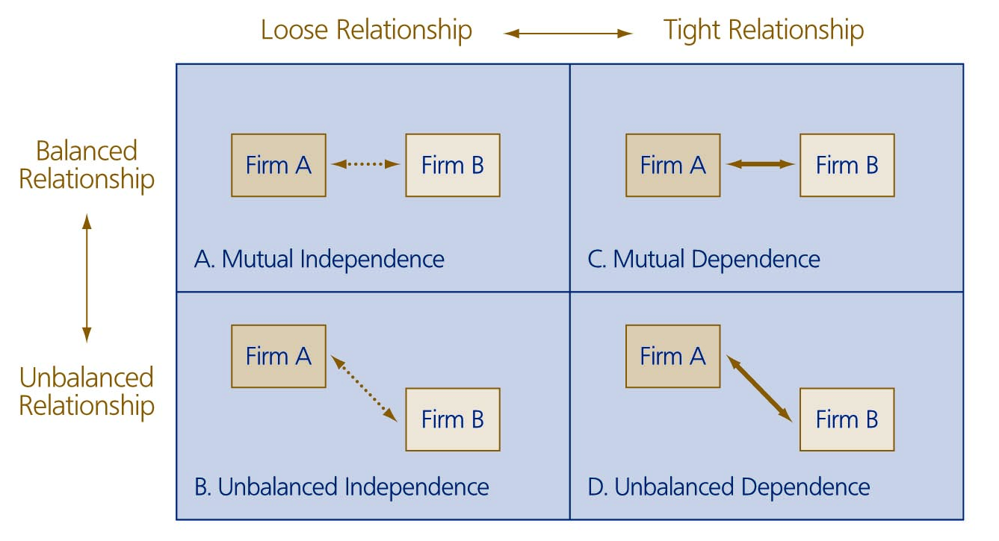
Relative Power Positions In Inter-organisational Relationships

Slide 37
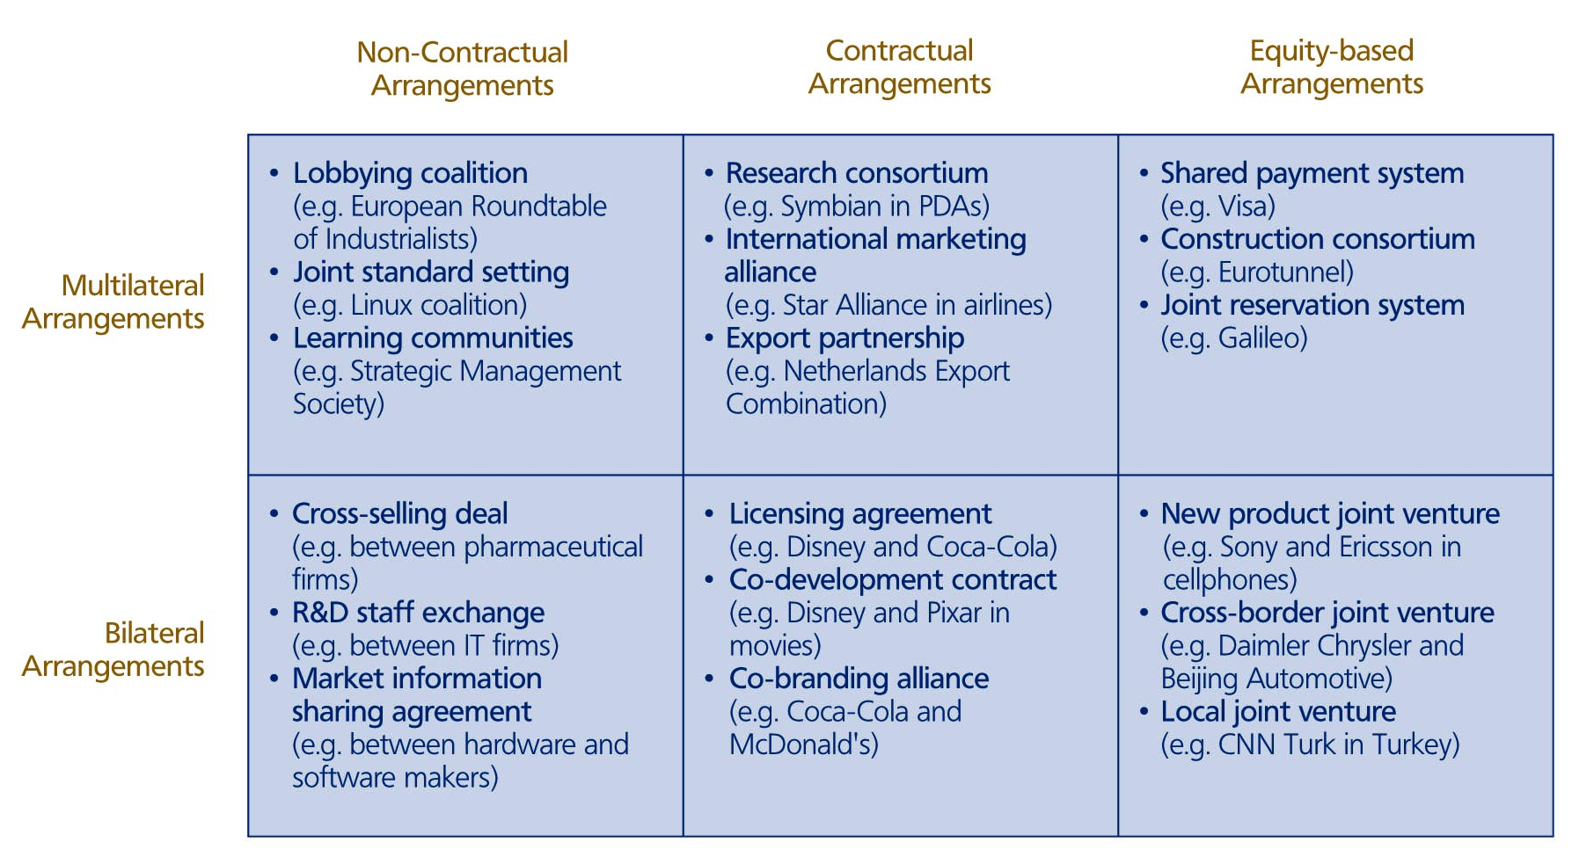
  Examples Of Collaborative Arrangements

Slide 38
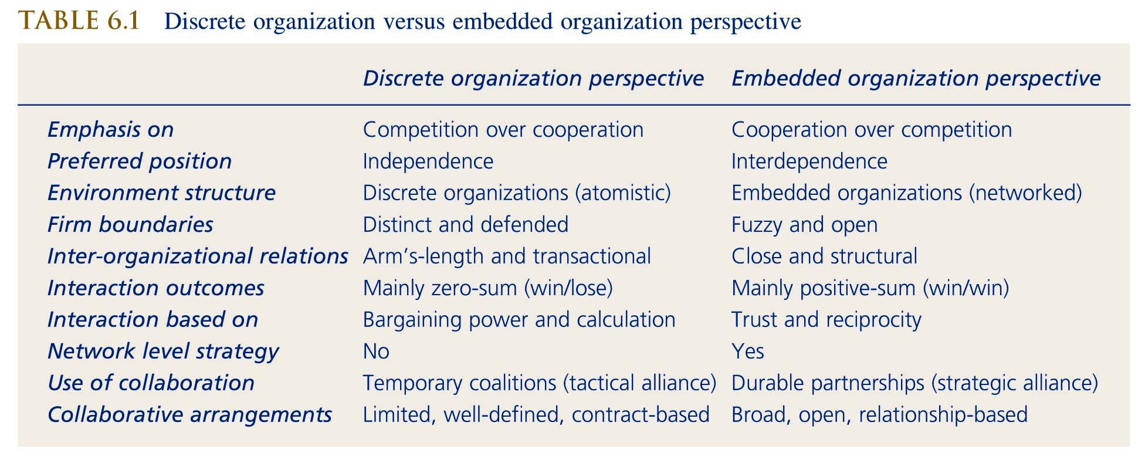
Managing The Paradox Of Competition And Cooperation
  Discrete Organisation Versus Embedded Organisation Perspective

Slide 39
Network Level Strategy In International Perspective
Firms from different countries display widely divergent propensities to compete and cooperate. There can also be significant variance within a country.
Cross-border collaborative arrangements, e.g. cooperative agreements to overcome entry barriers that exist due to import restrictions, and cross-border arrangements within trade blocks, e.g. the EU cooperated to face Japanese competitors in the core technologies and tried to learn lessons from Japanese practices.
Type of institutional environment, different institutional structures, governments, banks, universities and unions have developed in each country, and each country has developed its own economic system.
Market for corporate control, a relatively open market for corporate control facilitates vertical and horizontal integration.
Social networks and cultural values, can place more emphasis on competition or cooperation, e.g. US more individualist than Japan.
Negative effects of ‘groupism’, social networks do not always lead to higher efficiency.

Slide 40
References
De Wit, B. (2017). Strategy An International Perspective. 6th ed. Andover: Cengage
Grant, R.M. 2012. Contemporary strategy analysis : text and cases 8th ed. New York: John Wiley and Sons Ltd.
Hill, C., Jones, G. & Schilling, M. (2015) Strategic Management; Theory & Cases: an integrated approach, 11e, Stamford, Cengage
Reeves,M, Moose,S and Venema,V. (2014). BCG Classics Revisited: The Growth Share Matrix. Available: https://www.bcg.com/publications/2014/growth-share-matrix-bcg-classics-revisited.aspx. Last accessed 26th November 2019.

