Slide 1

MN7031 Topic 6 – How Do Firms Create Strategies?
Daniel Jones
londonmet.ac.uk

Slide 2
Module Overview
1. How and Why Do Businesses Grow?
2. How Do We Diagnose Company Strategy?
5. How Do We Make Sense of the VUCA External Environment?
8. Does Your Simulation Company Need A New Strategy?
9. Why Do Firms Undertale Acquisitions, Mergers and Alliances?
7. How Is Your Simulation Company Performing?
11. How Do Companies Innovate Successfully?
12. Does Strategic Alignment Matter?
4. Why Are Some Industries More Profitable Than Others?
3. How Does A Company Create Competitive Advantage?
6. How Do Firms Create Strategies
10. Summative Assessment Presentations
Business Simulation – Cesim Global Challenge

Slide 3
Today’s Agenda
The Strategy Process
Vision and Mission
Strategy formation activities
Strategy formation roles
Emergent and Deliberate Strategies
Strategic Planning
Strategic Incrementalism
Scenario Planning
SWOT Analysis
Superfluous Strengths
Corporate Strategy and Configuration

Slide 4
The Strategy Process

Slide 5
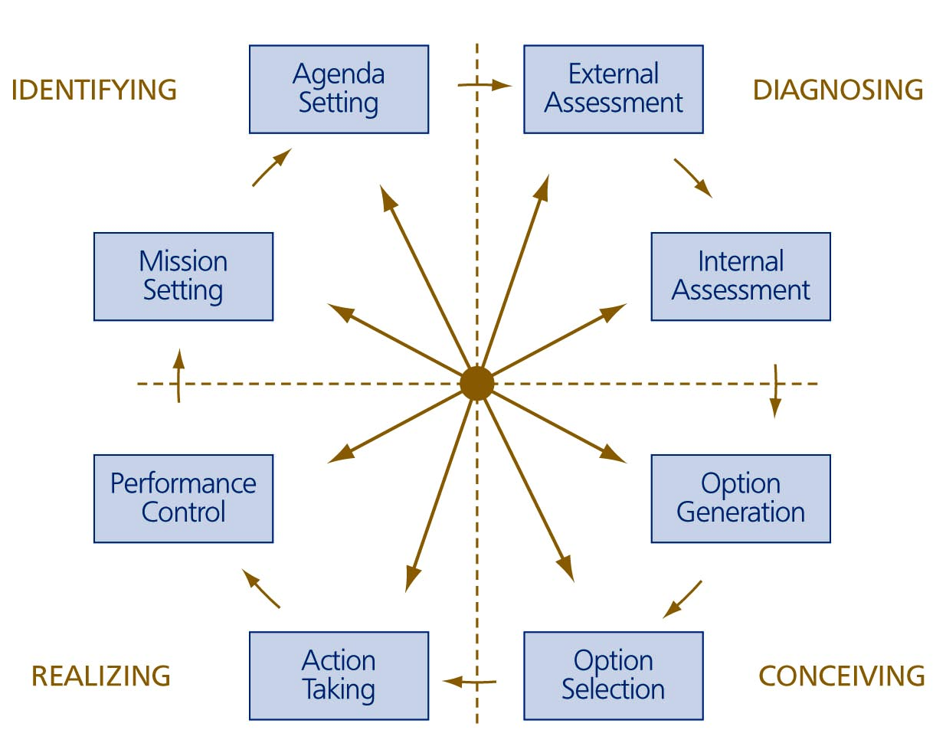
  The Main Strategy Formation Activities
PESTEL
Industry Analysis
Scenarios
Market Analysis
Competitors
Resources
Structure
Culture
Business Model
Value Network
Analysis and Synthesis
Options for Growth and Improvement
Evaluation
Scenario Testing

Slide 6
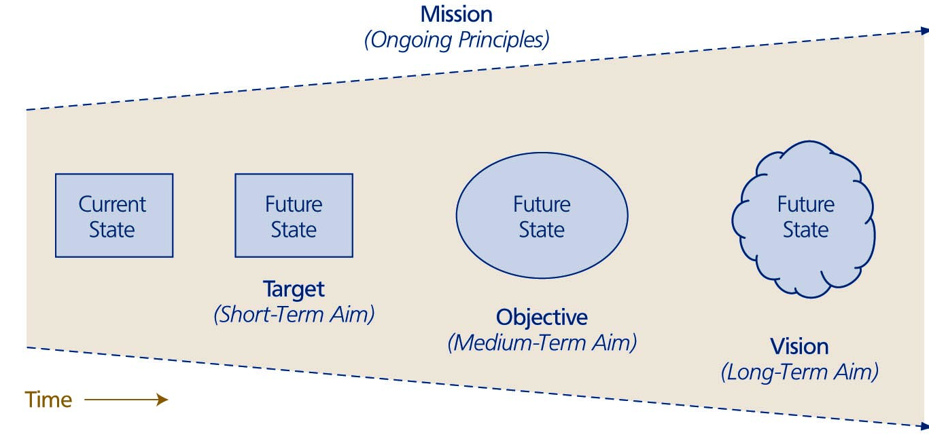
Vision and Mission
Corporate mission outlines the fundamental principles guiding strategic choices
Strategic vision outlines the desired future at which the company hopes to arrive
The corporate mission and strategic vision together send the firm in a particular direction

Slide 7
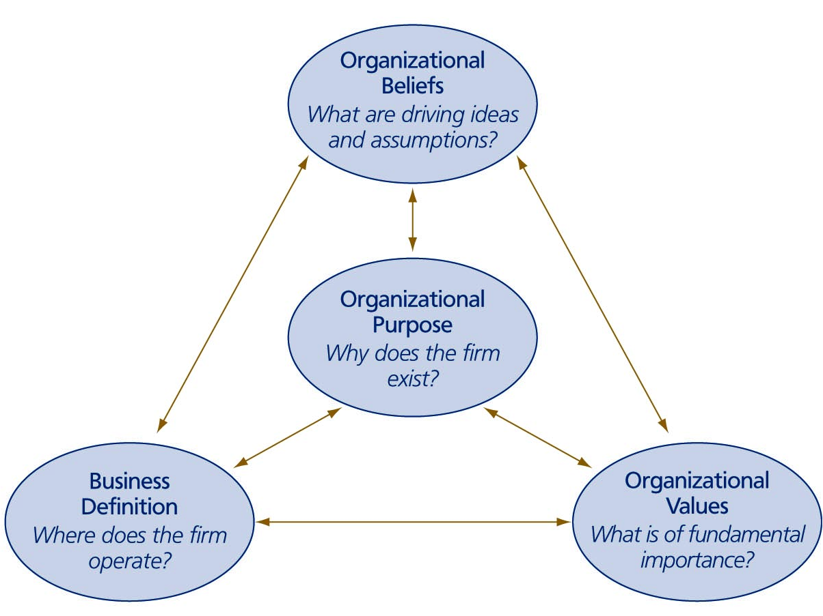
What Are the Elements of A Mission Statement?
Purpose – the reason the organisation exists
Beliefs – a common understanding is needed
Values – must become embodied in the organisation’s culture
Business definitions – focuses the direction in which the business develops
Tesla’s mission is to accelerate the world’s transition to sustainable energy.
Dave’s Mission is to build products that level the financial playing field.

Slide 8
Amazon – Who We Are
Amazon is guided by four principles:
customer obsession rather than competitor focus,
passion for invention,
commitment to operational excellence,
and long-term thinking.
Amazon strives to be Earth’s most customer-centric company, Earth’s best employer, and Earth’s safest place to work.
Customer reviews, 1-Click shopping, personalized recommendations, Prime, Fulfillment by Amazon, AWS, Kindle Direct Publishing, Kindle, Career Choice, Fire tablets, Fire TV, Amazon Echo, Alexa, Just Walk Out technology, Amazon Studios, and The Climate Pledge are some of the things pioneered by Amazon.

Slide 9
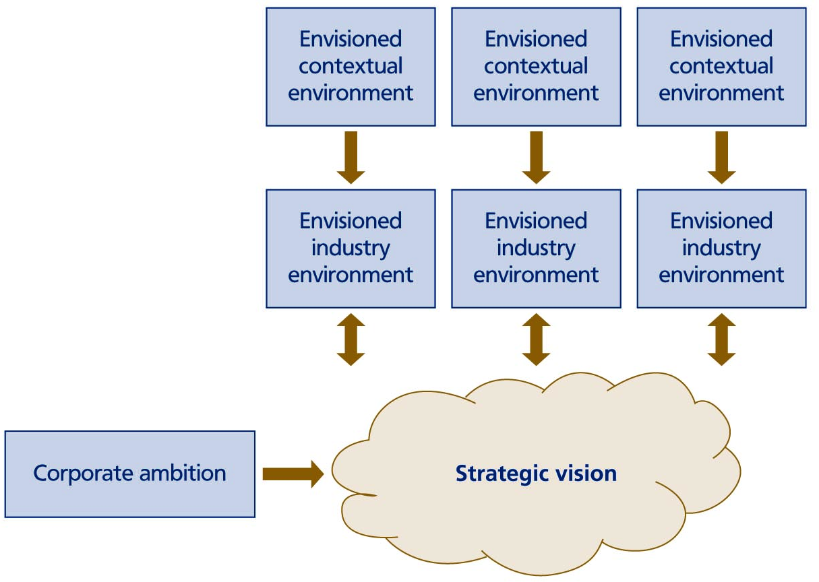
Forecasting the Future
What we anticipate seldom occurs; what we least expect generally happens.
Benjamin Disraeli (1804–1881)
British prime minister and novelist
Volatility
Uncertainty
Complexity
Ambiguity

Slide 10
Really Bad Technology Predictions
1889: “Fooling around with alternating current (AC) is just a waste of time. Nobody will use it, ever.” — Thomas Edison
1903: “The horse is here to stay but the automobile is only a novelty – a fad.” — President of the Michigan Savings Bank advising Henry Ford’s lawyer, Horace Rackham, not to invest in the Ford Motor Company.
1966: “Remote shopping, while entirely feasible, will flop.” — Time Magazine.
1981: “Cellular phones will absolutely not replace local wire systems.” — Marty Cooper, inventor.
1995: “I predict the Internet will soon go spectacularly supernova and in 1996 catastrophically collapse.” — Robert Metcalfe, founder of 3Com.
2005: “There’s just not that many videos I want to watch.” — Steve Chen, CTO and co-founder of YouTube expressing concerns about his company’s long term viability.
2006: “Everyone’s always asking me when Apple will come out with a cell phone. My answer is, ‘Probably never.’” — David Pogue, The New York Times.
2007: “There’s no chance that the iPhone is going to get any significant market share.” — Steve Ballmer, Microsoft CEO.
Szczerba (2015)

Slide 11


Strategy Formation Activities
Strategic issue identification activities – mission setting and agenda setting
Strategic issue diagnosis activities – external assessment (of both the direct market environment and the wider environment) and internal assessment (of the systems used by the company itself)
Strategy conception activities – option generation and option selection
Strategy realisation activities – action taking and performance control

Slide 12
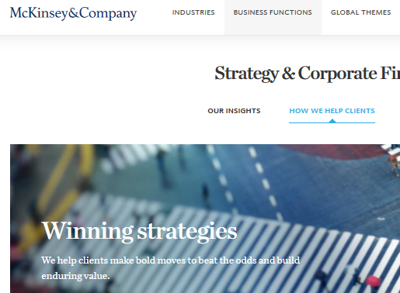
Strategy Formation Roles
There can be significant differences in who carries out the conception activities
Top vs. middle vs. bottom roles – different levels of management involved
Line vs. staff roles – many organisations have staff members involved in the strategy formation process
Internal vs. external roles – some roles can be outsourced

Slide 13
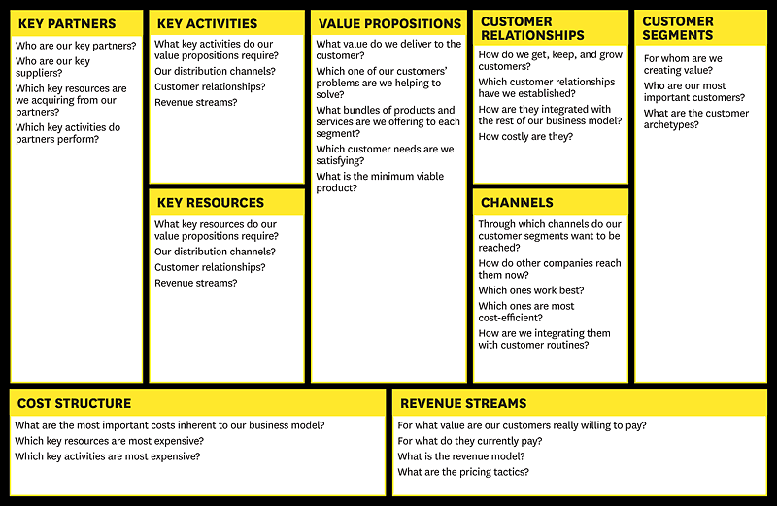
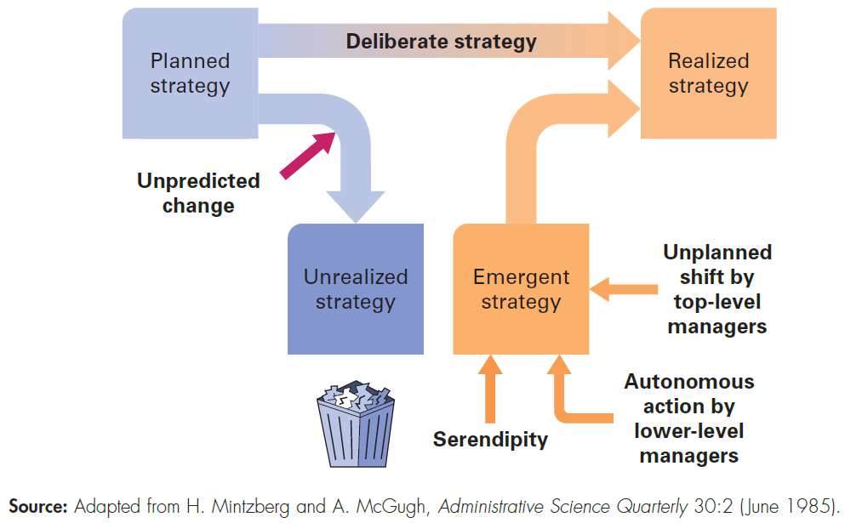

Emergent and Deliberate Strategies
Hill et al (2015)
Notes:
Henry Mintzberg identified that planned strategies often did not survive contact with managers, customers and the business environment.
He observed that unplanned events also shape strategy and that the realised strategy that actually unfolded over time was a combination of the deliberate planning and of emergence. Companies adapt and improvise as events occur; perhaps a serendipitous discovery or the emergence of a new business model in a rival firm.
We can see many changes occurring at present as a result of technology innovation and globalisation, particularly in the exploitation of platforms such as Amazon, Uber and e-bay and of ecosystems like Apple and Android. Amazon has disrupted retailing very significantly and Uber is changing the way we acquire and pay for taxi rides. Both firms are evolving rapidly. Amazon is now seeking to enter the groceries market place as well as extending its logistics and delivery activities in areas once dominated by state owned post offices. Uber is experimenting with add-on services to its platform and is expected in the future to become a platform for sharing driverless cars.

Slide 14
The Paradox of Deliberateness and Emergence
Duality of:
wanting to design the future while needing to explore, learn and adapt to an unfolding reality;
the need to figure things out in advance, versus the need to find things out along the way

Slide 15
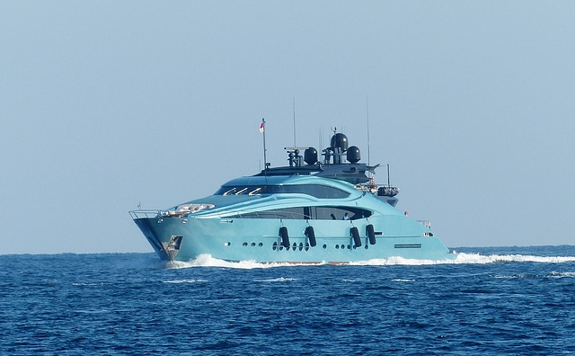
The Demand for Deliberate Strategising
Advantages:
Direction – plans give organisations a sense of direction
Commitment – by setting objectives and drawing up plans organisations can invest resources, train people, build up production capacity and take a clear position within their environment
Coordination – all strategic initiatives are brought into a single cohesive pattern
Optimisation – plans facilitate optimal resource allocation
Programming – plans allow activities to be programmed and controlled

Slide 16
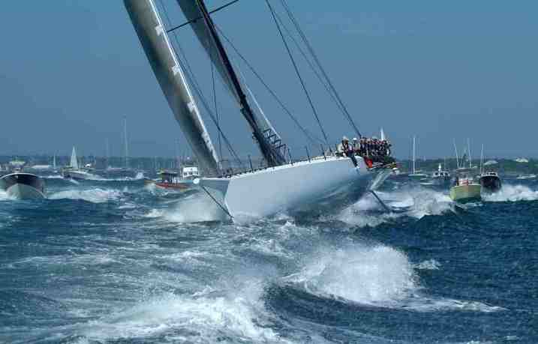
The Demand for Strategy Emergence
Advantages:
Opportunism – able to grab unforeseen opportunities as they emerge
Flexibility
Learning – learning by experimentation
Entrepreneurship
Support – building support is an on-going process – changes cannot always be imposed from the top down
A strategy emerges when it comes into being along the way, gradually shaped during an iterative process of thinking and doing

Slide 17
The Strategic Planning Perspective
Strategies should be deliberately planned and executed ‘Think before you act’
The purpose of strategising is to give organisations direction
Allows for formalisation and differentiation of strategy tasks
Encourages long-term thinking and commitment
But – plans will always be based on assumptions about future events which are hard to predict so useful to have contingency plans

Slide 18
The Strategic Incrementalism Perspective
New strategies emerge over time
Strategy is not about rigidly setting the course of action in advance but flexibly shaping the course of action by blending together initiatives into a pattern of action
Planning and control are valuable for routine activities but less suitable for non-routine activities – doing new things
Strategy formation is essentially an innovation process, inherently subversive
Planning is inappropriate when dealing with wicked problems

Slide 19
Wicked Problems

Slide 20
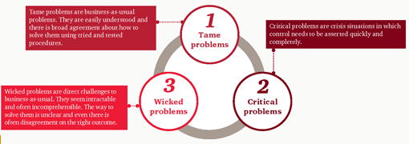
Tame, Critical and Wicked Problems
http://www.pwc.co.uk/services/human-resource-services/human-resource-consulting/who-will-solve-your-wicked-problems.html
A wicked problem is a direct challenge to business as usual, has innumerable causes, is tough to describe, and doesn’t have a right answer.
Camillus, J (2008) Strategy as a Wicked Problem, Harvard Business Review

Slide 21
The Strategic Incrementalism Perspective
Planning is inappropriate when dealing with wicked problems
Problems cannot be simply recognised and analysed, the strategising manager must make sense out of complex problems
A full analysis of a wicked problem is impossible
Dangerous to develop a comprehensive plan to tackle a wicked problem
As soon as an organisation starts to implement a plan, the plan will be outdated

Slide 22
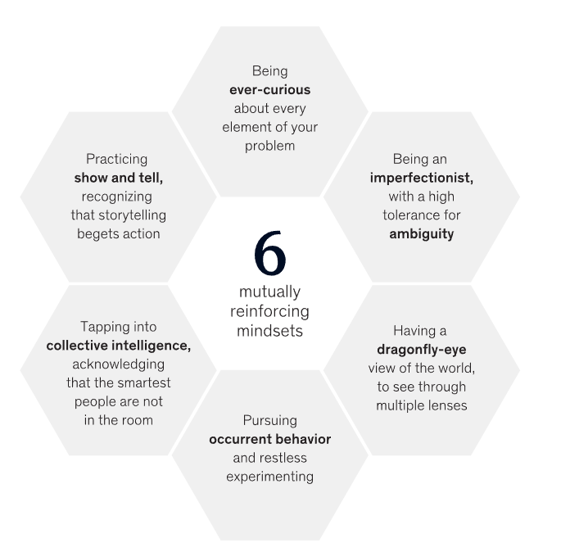
Inscrutable Problem Solving
https://www.mckinsey.com/business-functions/strategy-and-corporate-finance/our-insights/six-problem-solving-mindsets-for-very-uncertain-times
Conn, C and McLean, R. (2020). Six problem-solving mindsets for very uncertain times. Available: https://www.mckinsey.com/business-functions/strategy-and-corporate-finance/our-insights/six-problem-solving-mindsets-for-very-uncertain-times. Last accessed 3rd May 2022.

Slide 23
Scenario Planning

Slide 24
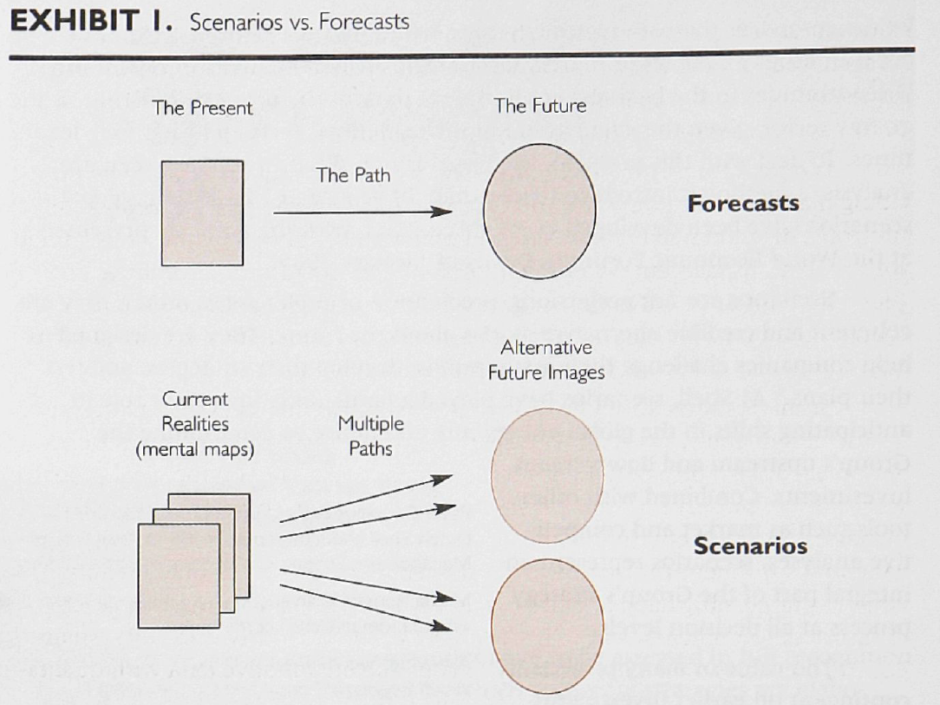
Scenario Planning
Cornelius, P, Van de Putte, A, & Romani, M 2005, 'Three Decades of Scenario Planning in Shell', California Management Review, 48, 1, pp. 92-109, Business Source Complete, EBSCOhost, viewed 6 March 2017.

Slide 25
Scenarios and Strategy
present a background for the design and selection of strategies. Since no single strategy can perform best in each scenario, special selection criteria, such as "bet on the most probable scenario" or "preserve flexibility" are needed“
help make managers aware of environmental uncertainties by confronting them with fundamentally different future states
provide a tool to identify what might possibly happen and how an organisation can act upon or react to future developments. As such, scenarios can serve as early warning systems.
offer the possibility to combine quantitative data with qualitative input, enabling scenario planners to incorporate results from other forecasting techniques and allow for soft and fuzzy variables
can help stretch managers' mental models by explicitly confronting them with their own biased viewpoints.
Cornelius, P, Van de Putte, A, & Romani, M 2005, 'Three Decades of Scenario Planning in Shell', California Management Review, 48, 1, pp. 92-109, Business Source Complete, EBSCOhost, viewed 6 March 2017.

Slide 26
Scenario Planning at Shell
Cornelius, P, Van de Putte, A, & Romani, M 2005, 'Three Decades of Scenario Planning in Shell', California Management Review, 48, 1, pp. 92-109, Business Source Complete, EBSCOhost, viewed 6 March 2017.

Slide 27
Scenarios Uncover Inevitable or Near-inevitable Futures
A sufficiently broad scenario-building effort yields another valuable result. As the analysis underlying each scenario proceeds, you often identify some particularly powerful drivers of change.
These drivers result in outcomes that are the inevitable consequence of events that have already happened, or of trends that are already well developed e.g. demographic changes in the UK
Shell, the pioneer in scenario planning, described these as “predetermined outcomes” and captured the essence of this idea with the saying, “It has rained in the mountains, so it will flood in the plains.”
In developing scenarios, companies should search for predetermined outcomes—particularly unexpected ones, which are often the most powerful source of new insight uncovered in the scenario-development process.
Mckinsey Quarterley Nov 2009, The Use and abuse of Scenarios

Slide 28
According to Mckinsey…..
Creating a range of scenarios that is appropriately broad, especially in today’s uncertain climate, can paralyse a company’s leadership.
The tendency to think we know what is going to happen is in some ways a survival strategy: at least it makes us confident in our choices (however misplaced that confidence may be).
In the face of a wide range of possible outcomes, there is a risk of acting like the proverbial deer in the headlights: the organisation becomes confused and lacking in direction, and it changes nothing in its behaviour as an uncertain future bears down upon it.
The answer is to pick the scenario whose outcome seems most likely and to base a plan upon that scenario.
It should be buttressed with clear contingencies if another scenario—or one that hasn’t been imagined—begins to emerge instead.
Ascertain the “no regrets” moves that are sound under all scenarios or as many as possible. Ultimately, the existence of multiple possibilities should not distract a company from having a clear plan.
Mckinsey Quarterley Nov 2009, The Use and abuse of Scenarios

Slide 29
Strategists Have to Deal With Uncertainty
Strategy is largely formulated for the future and is concerned with the world outside the organisation at least as much as with what is going on within its boundaries.
Scenario techniques are one of the few tools strategists have to help them formulate their ideas about both.
Environments and futures are increasingly turbulent, uncertain and complex.
More than any other strategy tool, scenarios engage with these characteristics rather than ignore them.
There is, however, a significant challenge for the leader who chooses to implement a scenario process in harnessing maximum return. Many things mitigate against success, including fundamental human psychology. But the benefits could be significant.
Verity, J 2003, 'Scenario planning as a strategy technique', European Business Journal, 15, 4, pp. 185-195, Business Source Complete, EBSCOhost, viewed 6 March 2017.

Slide 30
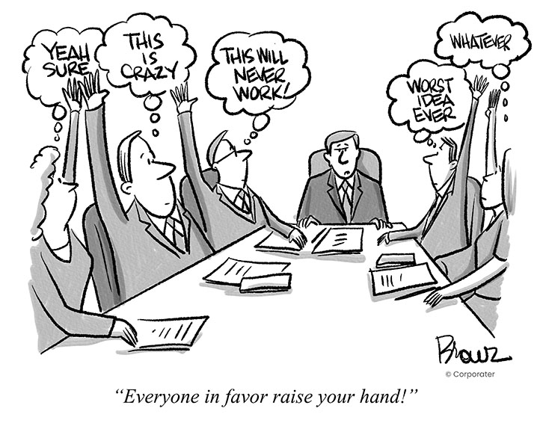
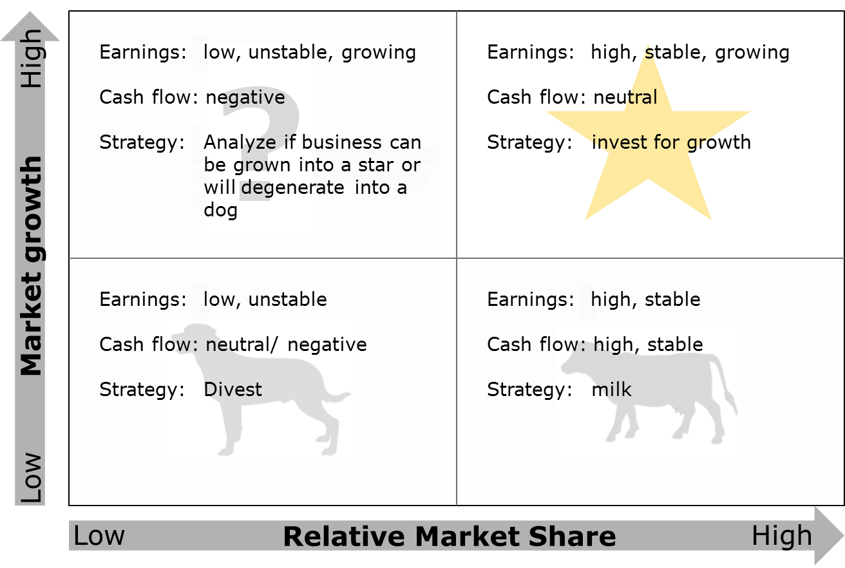
Remember When To Avoid Scenarios Altogether
Finally, bear in mind the one instance in which strategists will not want to use scenarios: when uncertainty is so great that they cannot be built reliably at any level of detail.
Just as scenarios help to avoid groupthink, they can also generate a groupthink of their own.
If everyone in an organisation thinks the world can be categorised into four boxes on a quadrant, it may convince itself that only four outcomes or kinds of outcomes can happen. That’s very dangerous.
Strategists should not think that they have all reasonable scenarios when there are quite different possibilities out there.
Mckinsey Quarterley Nov 2009, The Use and abuse of Scenarios

Slide 31
SWOT Analysis

Slide 32
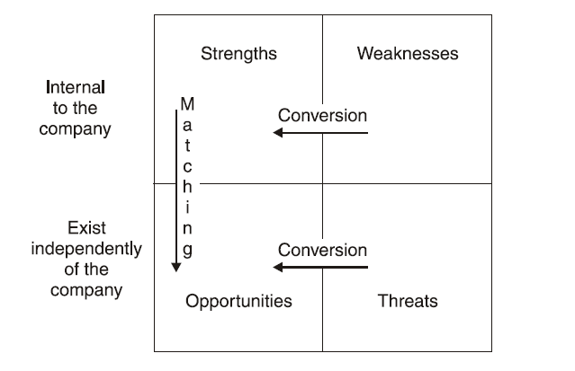
Understanding SWOT

Slide 33
What Is Wrong With SWOT?
“Which is better, a two-way distinction between internal and external influences or the four-way SWOT taxonomy?
The key issue is whether it is sensible and worthwhile to classify internal factors into strengths and weaknesses and external factors into opportunities and threats.
In practice, such distinctions are difficult.
Was Alex Ferguson a strength or a weakness for Manchester United Football Club in the final year of his time at the club? As the world’s most experienced and successful soccer coach, he was a strength. As a 70-year-old man who has no obvious successor, he was a weakness.
Is global warming a threat or an opportunity for the world’s automobile producers? By encouraging higher taxes on motor fuels and restrictions on car use, it is a threat. By encouraging consumers to switch to fuel-efficient and electric cars, it offers an opportunity for new sales.
The lesson here is that classifying external factors into opportunities and threats, and internal factors into strengths and weaknesses, is arbitrary. What is important is to carefully identify the external and internal forces that impact the firm, and then analyse their implications”.
GRANT, R.M., 2013. Contemporary Strategy Analysis. 8. ed., reprint with corr. edn. Chichester: Wiley. P11

Slide 34
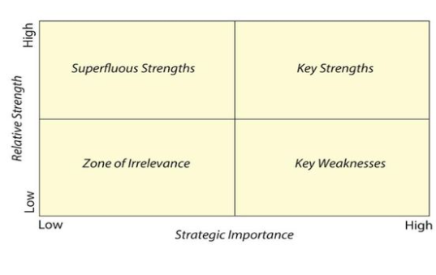

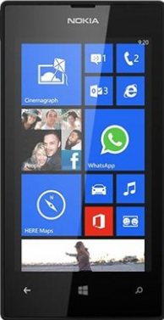
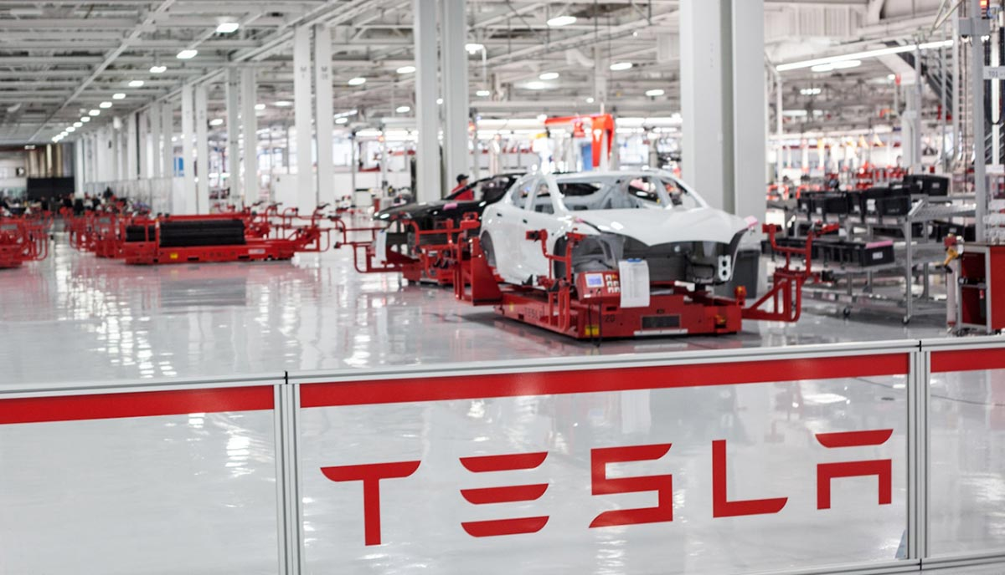
Not All Strengths and Weaknesses Are Equal

Slide 35
Understanding Strengths and Weaknesses
Relative Strength
High
Superfluous Strength
Key Strength
Zone of Irrelevance
Key Weakness
Low
Strategic Importance
Low
High

Slide 36
Analysing Weaknesses
Tesla Car Manufacturing Competency
Ability to Correct
High
Zone of Irrelevance
Addressable Weakness
Zone of Irrelevance
Key Weakness
Blockbuster Video Hire Competency
Blockbuster Digital Competency
Low
Strategic Importance
Low
High

Slide 37
Analysing Opportunities
Lack of Plants in Asia
Value of the Opportunity
High
Can we improve our competitive position?
Priority 1
Zone of Irrelevance
Priority 2
Outsourcing
Build Plants
Reduce Demand – niche focus
Low
Competitive Advantage
Low
High

Slide 38
Analysing Threats
Government Intervention in Car Design and Manufacture to Prevent Climate Change
Impact on Company Profitability
High
Take action to mitigate or avoid the threat occurring.
Take urgent action to mitigate the damage.
Zone of Irrelevance
Accept the risk.
Lobby
Acquisition of new competencies
Partnerships
Reduce ICE Environmental Impact
Low
Probability of Occurrence
Low
High

Slide 39
SWOT – Example Summary Based On Cesim Global Challenge
SWOT
Strengths
Weaknesses
Opportunities
Threats
25% Global Market Share
Only 3 plants in Asia
Launch Tech 2 and 3 in uncontested niche
Price reductions by competition
Low profitability
High Tech 4 Production costs
Tech 2 and Tech 3 Not Developed
10 Features available for Tech 1 and 4
High Market share in Tech 4 Europe
Build additional plants in Asia
Increase profit on Tech 1 and Tech 4 by seeking more profitable niches
Accept price leadership in the market – do not compete on price
Flat demand – industry maturity
Low cost of borrowing
16 plants in the US

Slide 40
3 Plants in Asia – So What?
Currently it costs an additional $24 per phone to manufacture in the US and to export to Asia compared to competitors manufacturing in Asia
This results in a significant pricing disadvantage
Current Asia market size is xx. Our market share is yy%, which to meet from plants in Asia would require 8 plants
Our Asia outsourcing capacity is insufficient to meet the demand
We need to align marketing and production if we are to be successful
Adopt a niche focus and sell higher priced phones with a smaller market share but improved profit.

Slide 41
Corporate Strategy

Slide 42
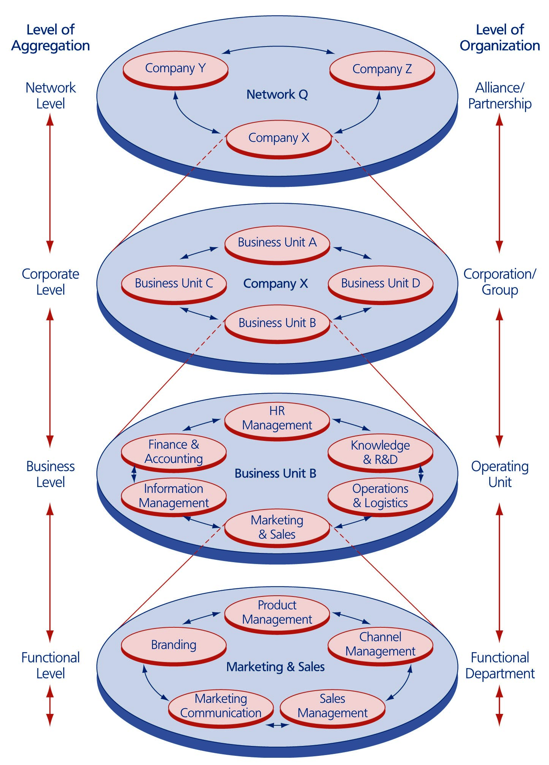
The Issue of Corporate Configuration
Corporate Composition - Where the firm wants to have which level of involvement – where to allocate resources, build up activities and achieve market sales
Corporate Scope – the more ‘business components’ chosen the broader the scope of the corporation
Corporate Distribution – the composition depends on the relative size of the activities in each business area

Slide 43
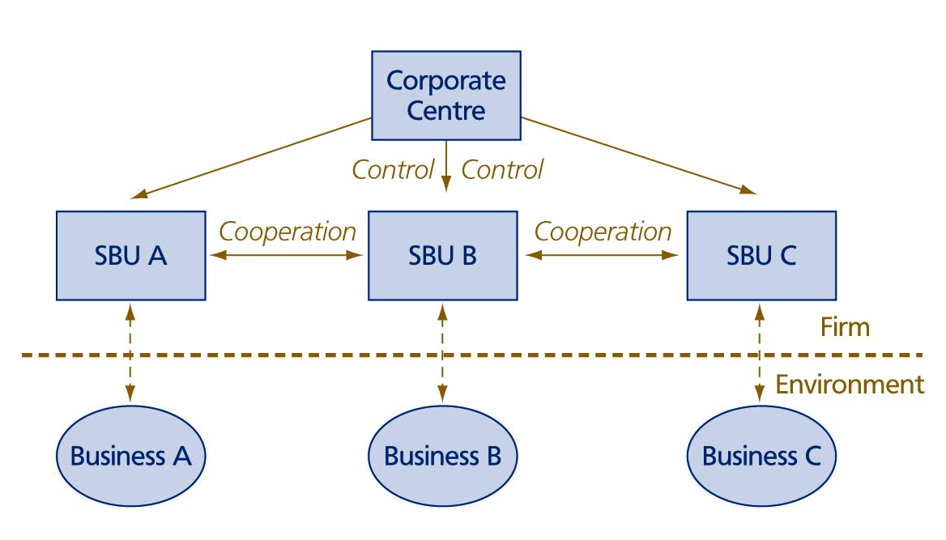
  Corporate Integration Through Control And Cooperation
Multi-business firms are typically organised into strategic business units (SBUs)
Each SBU serves the demands of one business area
Three key integration mechanisms to bring the SBUs together:
  centralisation
  coordination
  standardisation

Slide 44
The Issue Of Corporate Configuration
Who should take the initiative to realise integration?
Two organisational means:
  control
  Cooperation
  Three general corporate control styles:
    financial control
    strategic control
    strategic planning
    SBUs need to cooperate – multi-business synergy
    SBUs need to be highly responsible to specific demands of their own business area – business responsiveness

Slide 45
IT and Business Services
IT Services Firms
Consulting
System Integration and Software Development
Technology Services
Finance
Manufacturing
Public Sector
Service Delivery
IT Services Firms
Consulting
System Integration and Software Development
Technology Services
Application Management
Desktop Devices
Servers
Networks
Financial Services
Manufacturing
Travel and Transport
Government
SAP
Oracle
Mobile
Application Development
Notes:
Organisation by Service v organization by industry sector

Slide 46
The Paradox Of Responsiveness And Synergy
Synergy by leveraging resources – two or more businesses are related if their resources can be productively shared:
  Resource reallocation – resources can be transferred to other SBUs where better use can be made of them e.g. money and personnel
  Resource replication – intangible resources can be copied from one business unit to another, e.g. knowledge and capabilities copied and reused in other business units
  Synergy by aligning positions – Improving bargaining position - offer a broad package of related products
    Improving competitive position – coordination of product offerings prevent SBUs from fighting amongst one another
    Synergy by integrating value chain activities –
      Sharing value-adding activities
      Linking value-adding activities

Slide 47











Demand For Multi-business Synergy
Associated British Foods
Diversification into new business areas only economically justified if it leads to value creation
Increase in shareholder value if three tests are passed:
  the attractiveness test
  the cost-of-entry test
  the better-off test

Slide 48
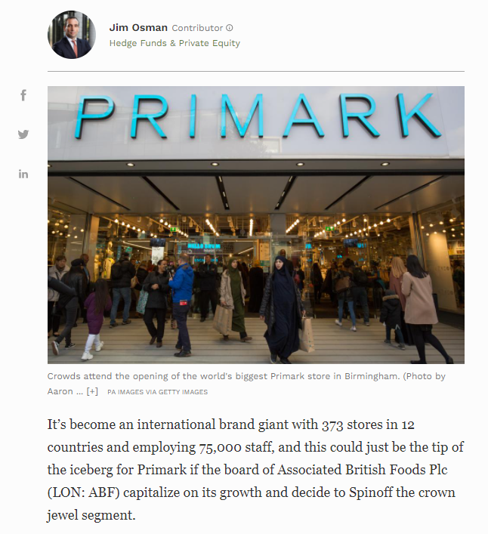
Why UK Discount Retailer Primark Should Spinoff To Unleash Real Value For Investors
https://www.forbes.com/sites/jimosman/2019/10/15/discount-retailer-primark-spin-off/?sh=2a8ce1d23f83

Slide 49
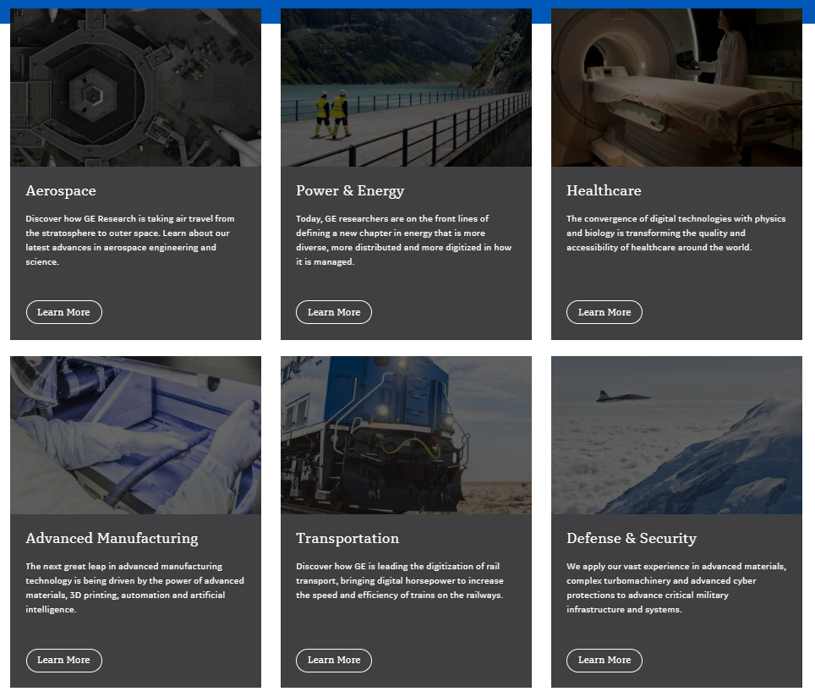
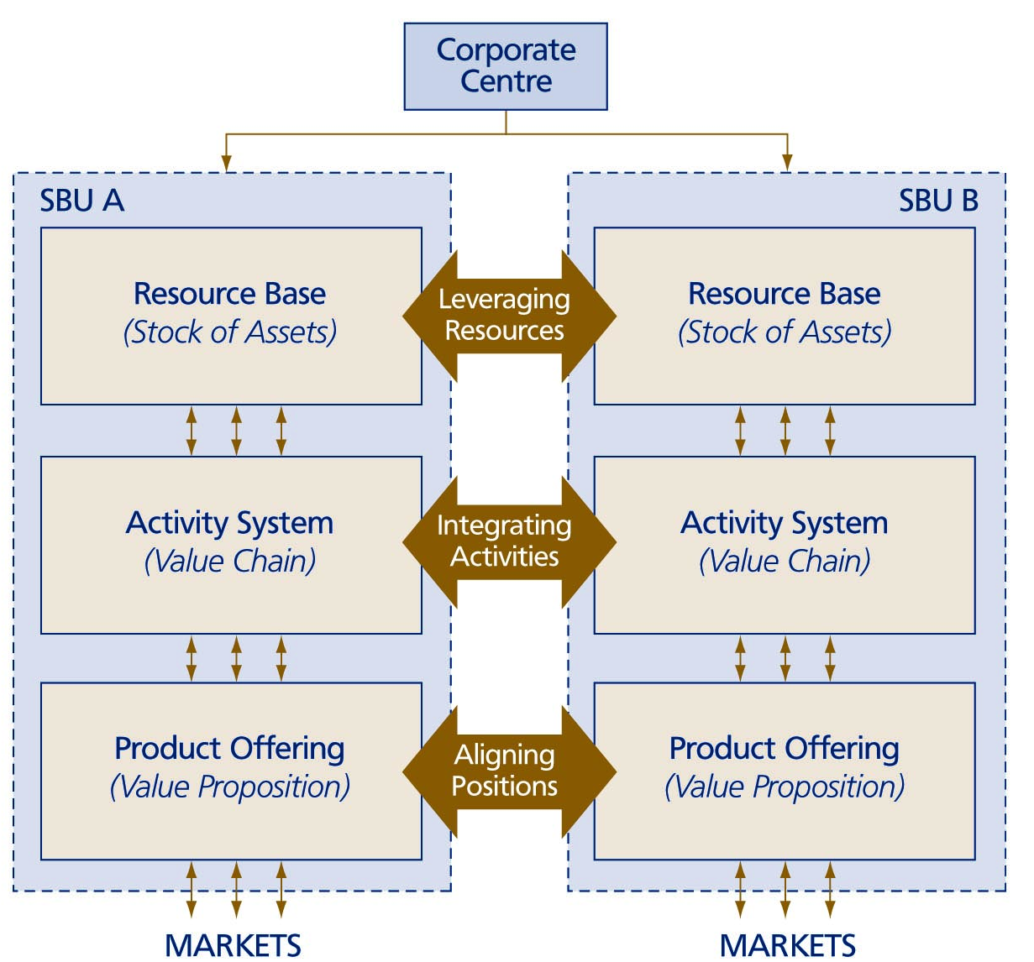
Forms Of Multi-business
Synergy

Slide 50
Vertical Integration
Vertical integration of activities – ‘internalisation’ – firms perform activities inside the firm instead of dealing with outside suppliers and buyers
Companies will integrate upstream or downstream activities if the following conditions are deemed important:
  operational coordination
  avoidance of transaction costs
  increased bargaining power
  learning curve advantages
  implementing system-wide changes

Slide 51
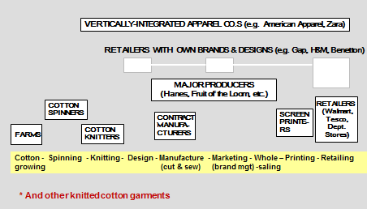
Garment Industry – Business Models with Varying Degrees of Vertical Integration

Slide 52
Demand for Business Responsiveness
Responsiveness is the ability to respond to the competitive demands of a specific business area in a timely and adequate manner
Major problems in a vertically integrated firm:
  high governance costs
  slower decision-making
  strategy incongruence
  dysfunctional control
  dulled incentives

Slide 53
Two Perspectives of Corporate Organisations
The Portfolio Organisation e.g. the South Korean Chaebol
  Samsung - gadgets, appliances, engineering, construction, shipbuilding, insurance and credit cards
  LG - smartphones, televisions, electronic components, chemicals and fertilizer. It also owns Korean baseball and basketball teams.
  Hyundai - Hyundai and Kia cars, elevators, logistics services, hotels and department stores
The Integrated Organisation

Slide 54
    The Portfolio Organisation Perspective
  Responsiveness is emphasised over synergy
  The only synergies emphasised are financial synergies
  Business units do not need to be ‘related’ in any other way than financial
  Portfolio approach well-suited to diversification through acquisition
  Business units must be responsible for their own competitive strategy
  Corporate centres should be modest in ambition and size
In the 1970s and 80s Lords Hanson and White turned Hanson into a multi-national concern with interests across the world ranging from chemical factories in the US to electricity supply in the UK and gold mines in Australia.
Hanson produced cigarettes and batteries, timber and toys, golf clubs and Jacuzzis, cod liver oil capsules and cranes.

Slide 55
    The Integrated Organisation Perspective
  A corporation should be a tightly knit team of business units grouped around a common core
  Corporate level strategists ‘lead from the centre’
  Core competence centred corporation – the corporation is like a tree, the trunk is the core products, smaller branches are businesses units, business unit branches can be cut off and new ones can grow on but all spring from the same tree
  All business units should tap into and contribute to the corporation’s core competences, thus the business units’ autonomy is limited
  Other synergies used e.g. product offerings can be aligned for a group of core customers; a multi-business firm can be built around shared activities; use of firm’s software e.g. for Disney Cinderella sells DVDs, encourages families to visit Disney theme parks, watch the Disney channel etc.
  Growth through acquisition is more difficult

Slide 56
References
Bennett, N. and Lemoine, G. J. (2014) ‘What VUCA Really Means for You’, Harvard Business Review, 92(1/2), p. 27.
Cornelius, P, Van de Putte, A, & Romani, M 2005, 'Three Decades of Scenario Planning in Shell', California Management Review, 48, 1, pp. 92-109, Business Source Complete, EBSCOhost, viewed 6 March 2017.
Hill, C., Jones, G. & Schilling, M. (2015) Strategic Management; Theory & Cases: an integrated approach, 11e, Stamford, Cengage
Kurtz, C. & Snowden, D. 2003. The new dynamics of strategy: Sense-making in a complex and complicated world, IBM Systems Journal, vol. 42 no. 3, pp. 462–483
Porter, M.E., 2008. The Five Competitive Forces That Shape Strategy. Harvard Business Review 86, 78–93.
Schoemaker, P.J.H., Heaton, S., Teece, D., 2018. Innovation, Dynamic Capabilities, and Leadership. California Management Review 61, 15–42. https://doi.org/10.1177/0008125618790246
Schoemaker, P. and Krupp, S. (2015) ‘THE ANTICIPATORY LEADER: How to See Sooner and Scan Wider’, Rotman Management, pp. 36–41. Available at: http://0-search.ebscohost.com.emu.londonmet.ac.uk/login.aspx?direct=true&db=bth&AN=102477054&site=ehost-live (Accessed: 28 August 2019).

