Slide 1
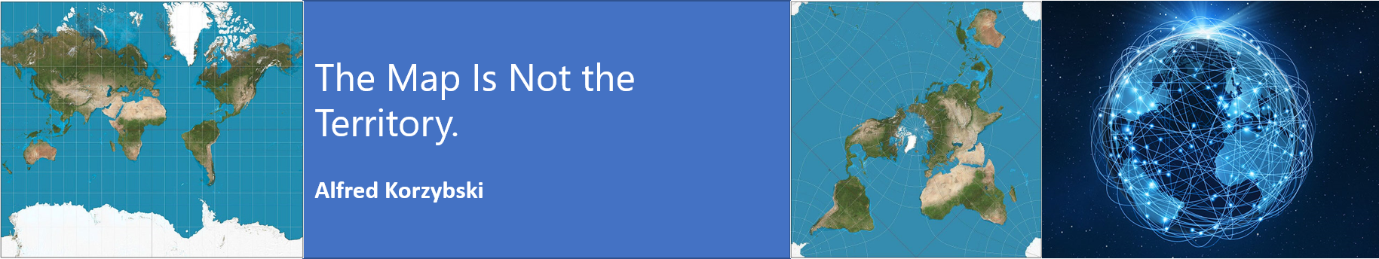
MN7031 Topic 5 – How Do We Make Sense of the VUCA Environment?
Daniel Jones
londonmet.ac.uk

Slide 2
Topic 5
1. How and Why Do Businesses Grow?
2. How Do We Diagnose Company Strategy?
5. How Do We Make Sense of the VUCA External Environment?
8. Does Your Simulation Company Need A New Strategy?
10. Why DO Firms Undertale Acquisitions, Mergers and Alliances?
7. How Is Your Simulation Company Performing?
11. How Do Companies Innovate Successfully?
12. Does Strategic Alignment Matter?
4. Why Are Some Industries More Profitable Than Others?
3. How Does A Company Create Competitive Advantage?
6. How Do We Identify future opportunities and threats?
9. Summative Assessment Presentations
Business Simulation – Cesim Global Challenge

Slide 3
Today’s Agenda
Lecture
VUCA Defined
Environmental scanning
Black Swan Events
Sense Making
PESTEL Analysis
Identifying major trends and issues
Climate Change
ESG Rankings
Cesim Global Challenge
Round 3

Slide 4
Strategic Diagnosis
Industry (or Sector)
Development stage
Markets and Competitors
Market Segments
Scope of activities
The Organisation
Resources
Capabilities
Competencies
Politics
The Macro-environment
Concentration
Value network
Products and/or services
Critical success factors
Resource commitment
Economics
Social
Technological etc.
Theories and Frameworks
PESTEL
Scenario Planning
5 Forces
Industry Lifecycle
External
Blue Ocean Theory
Red Queen Theory
Market Analysis
Competitor Analysis
Resource Based View
Business Model
Core Competencies
Internal
Organisational Structure
Culture
Global
Regional
National
Local
Systems
Notes:
We will look at competitors in a later topic.

Slide 5
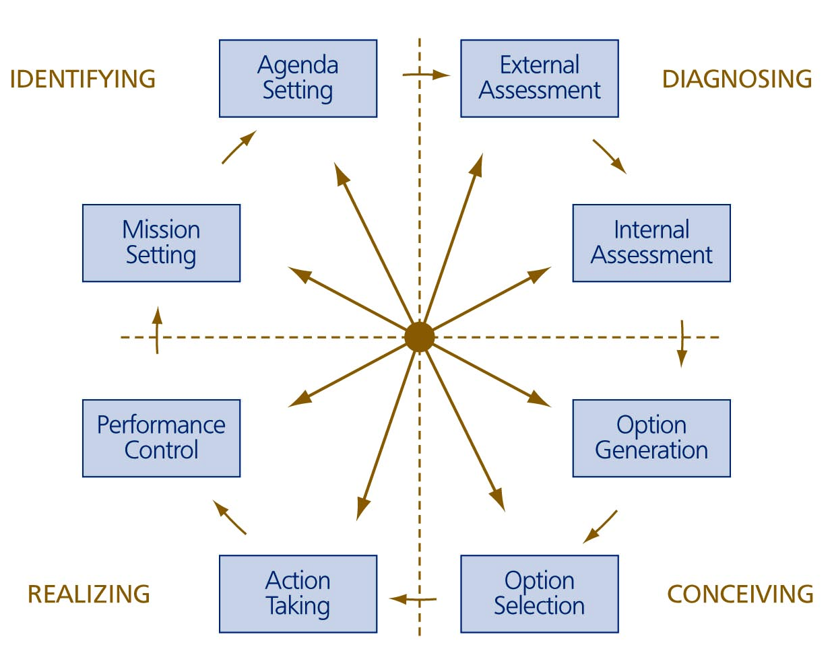
  The Main Strategy Formation Activities

Slide 6
Environmental Scanning
What Are We Interested In?
What is changing and how does that impact us; opportunities and threats
  Be specific
  Ask “So What” at least 3 times
What do we know has happened that will lead to change e.g. the aging population and workforce retirement
Indicators of change e.g. developments in other markets
What’s The Challenge?
Global, Regional, National and Local differences – many different environments
Information overload
Over-estimating the speed of change and underestimating the impact – how long before cars are all electric and all self driving? How long before AI is equal to Human Intelligence?
VUCA – Volatility, Uncertainty, Complexity, Ambiguity

Slide 7
VUCA
Word | Merriam Webster Definition
Volatile | characterised by or subject to rapid or unexpected change
Uncertain | not known beyond doubt, not clearly identified or defined, not constant
Complicated | consisting of parts intricately combined
Complex | a whole made up of complicated or interrelated parts
Ambiguous | capable of being understood in two or more possible senses or ways

Slide 8
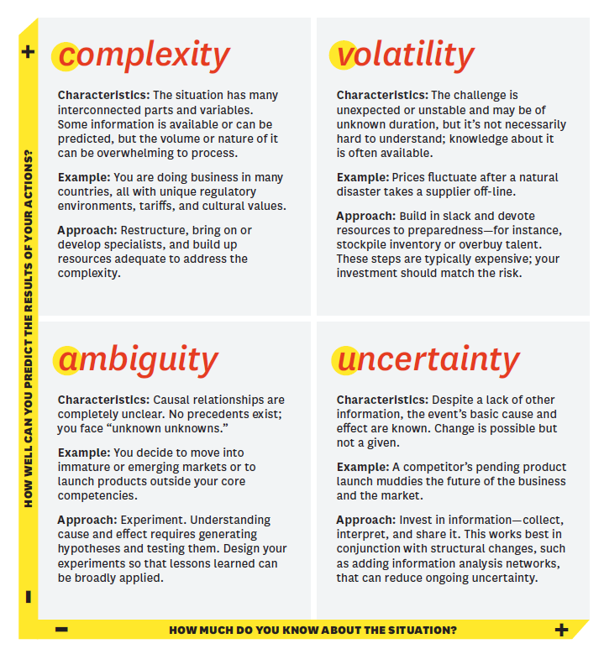
Another View of VUCA
Ukraine – energy price rises, sanctions, food shortages, refugees
Climate Change
Acceptance of the use of robots
Cars – what is the future?
Bennett and Lemoine (2014)

Slide 9
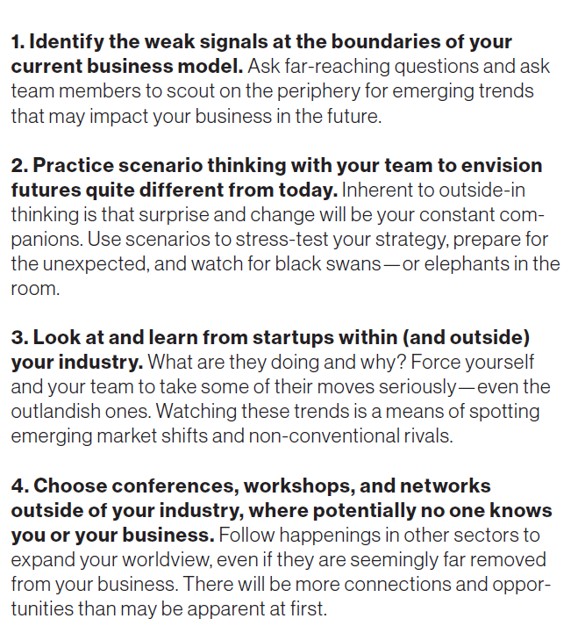
Tips For Scanning Wider
Schoemaker and Krupp (2015)

Slide 10
Black Swan Events

Slide 11
Black Swan Events
The term “Black Swan” to describe unanticipated events has seeped into public consciousness since the publication of “The Black Swan: The Impact of the Highly Improbable” by Nassim Nicholas Taleb 2007.
The idea was originally put forward by philosopher David Hume to represent the unexpected, an unlikely but not impossible catastrophe that no one ever seems to plan for, the things one does not know or does not know that one does not know.

Slide 12
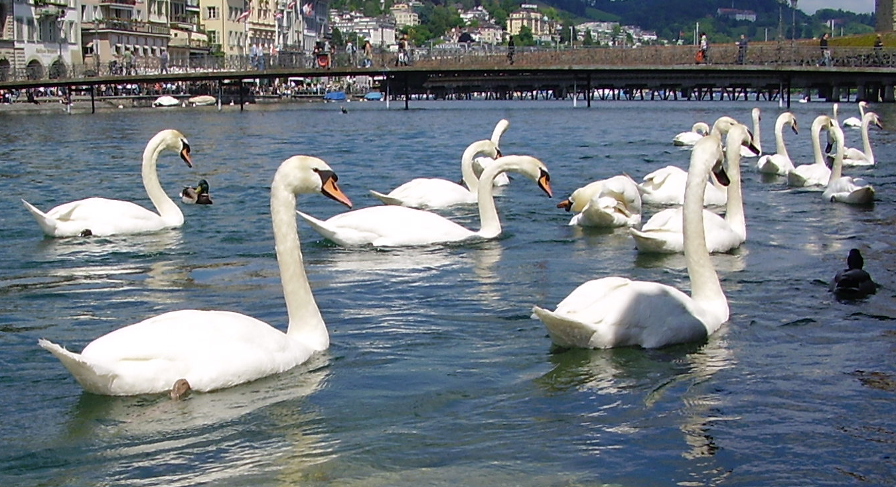
Black Swan Events – Unknown Unknowns
The 'Black Swan problem' states that, "no matter how many swans you find, the fact that they are all white, so far, can't prove that other colours don't exist".

Slide 13
Risk Management and Black Swans
Traditional risk management relies on identifying risks based on the experience of the teams involved in the enterprise.
If the risk is outside the experience of the group it is unlikely to be considered, and even if it is, it is likely to be prioritised as low by being allocated an extremely low probability rating.
Risk management concentrates of managing the risks to the enterprise that would have a significant impact and have a reasonable probability of occurring.
This is simply a way of prioritising potentially 'bad' events so that time and resource can be allocated.
Brainstorming risks is highly unlikely to capture Black Swans. The exercise will either be too narrow, by staying within the comfort zones of the participants, or too broad by considering risks that are not relevant to the business.

Slide 14
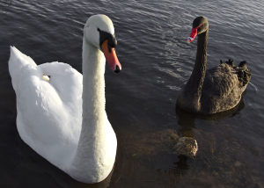
Why Are We Blind To Black Swans?
Taleb identifies five peculiarities of human behaviour responsible for blindness to Black Swans by people only familiar with white swans:
1. We tend to categorise, focusing on preselected data that reaffirm beliefs as opposed to any contradictions (confirmation bias)
2. We construct stories to explain events and see patterns in data when none exist, due to illusion of understanding (narrative fallacy)
3. We are not programmed to imagine Black Swans;
4. We tend to ignore the silent evidence and focus disproportionately either on the failures or successes;
5. We overestimate one’s knowledge and focus too narrowly on one’s field of expertise (tunnel vision), ignoring other sources of uncertainty, and mistaking concocted models for reality (ludic fallacy).
Nafday, AM 2009, 'Strategies for Managing the Consequences of Black Swan Events', Leadership & Management In Engineering, 9, 4, pp. 191-197, Business Source Complete, EBSCOhost, viewed 27 February 2013.

Slide 15
Features of A Black Swan Event
To be a true Black Swan event, an event must have three distinct features:
  The event is a surprise to the observer
  The event has an extreme impact
  After it happens, the event can be predicted with hindsight.
Black Swan events are unknown unknowns, and thus impossible to accurately predict or risk assess, but they can be prepared for.
The ability to rationalise a Black Swan event in hindsight separates it from being pure chance.
After the event, the cause can be seen or calculated and the precursor evidence will be seen to have been there all along.

Slide 16
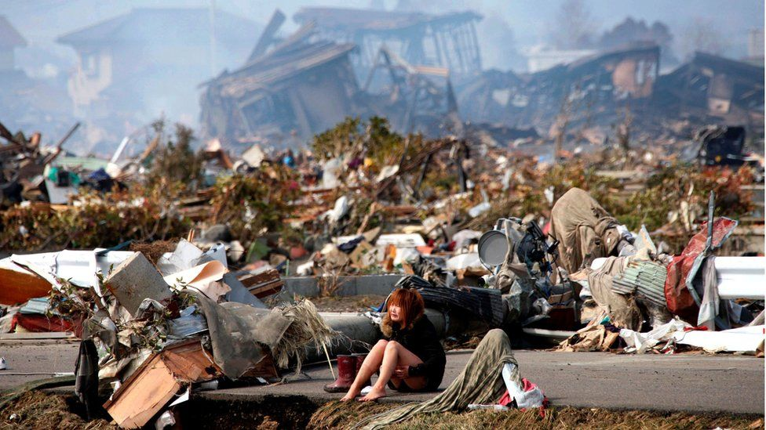
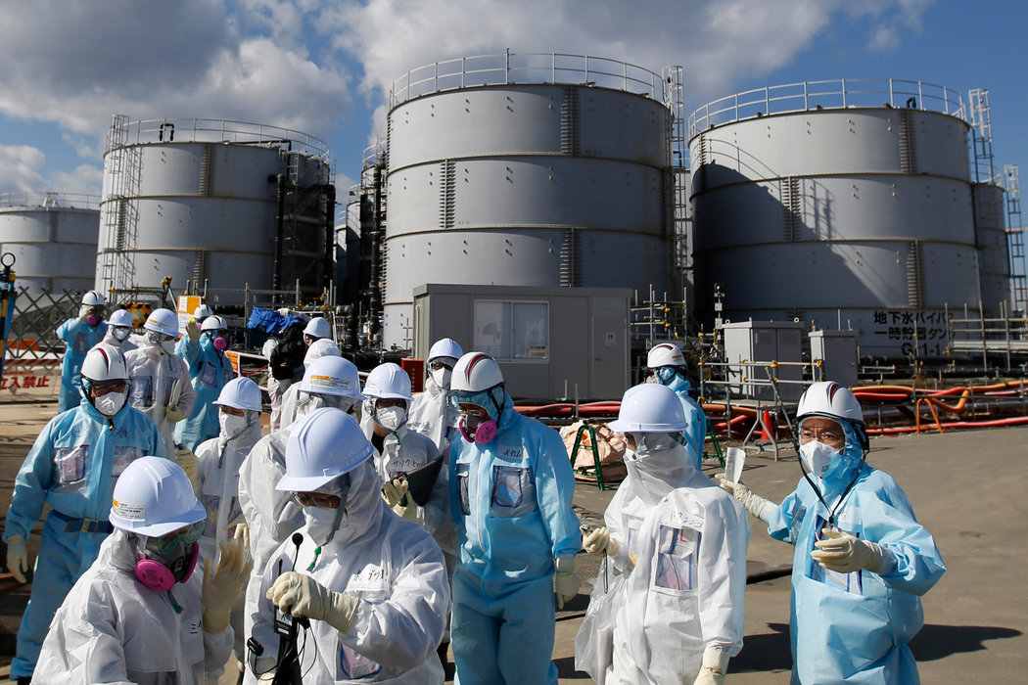
Fukushima
It was well known that earthquakes of magnitude 9 or more were possible and it was also known that fault lines lay off the coastline of Japan.
Given a tsunami of a certain size, it was obvious which areas would be inundated and that these would include the standby generators at Fukushima.
If a full risk assessment had been carried out looking at geological, seismic, reactor safety and emergency services factors, it may have concluded that the chain of events which occurred on 11 March were entirely possible, in effect a Black Swan event.

Slide 17

COVID 19
Numerous warnings of a pandemic over the past decade but the world was not prepared and reacted slowly to the problem.

Slide 18
Sense Making

Slide 19
Sense-making
Although there are others contributing to the study of sense-making, Dervin, Weick and Snowden are the three big names associated with different approaches
What is ‘on the tin’: sense-making is what people continuously do to work out what is going on in their situations (and in the external environment), where they fit, what the need for action
It implicitly encompasses change: change is not an error!
It recognises that people have different identities and these change
Sense-making is about filling in gaps in what we write down, talk about, build
Time and space have a big part to play in sense-making

Slide 20
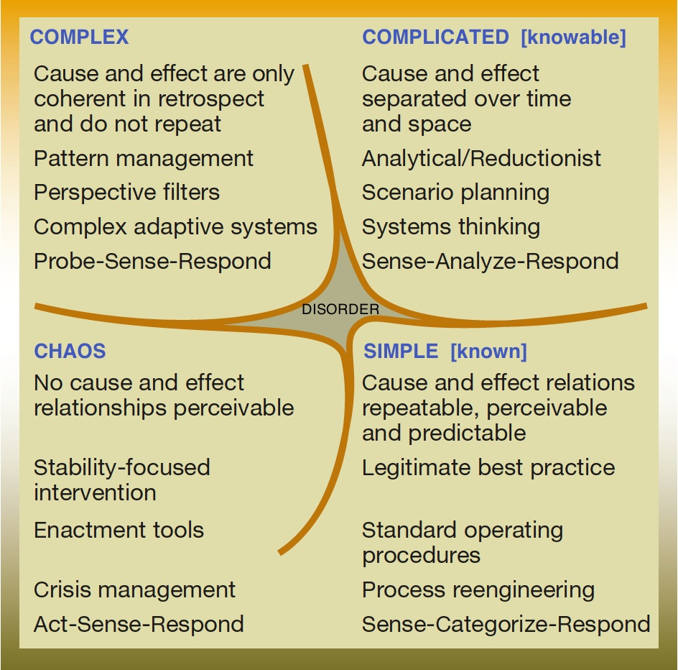
The Cynefin Framework
“The Cynefin framework originated in the practice of knowledge management as a means of distinguishing between formal and informal communities, and as a means of talking about the interaction of both with structured processes and uncertain conditions.”
unordered
ordered
from (Kurtz & Snowden 2003)

Slide 21
PESTEL - Environmental Scanning and Sense-making

Slide 22
PEST(LEE)
Environmental Scanning
……is the acquisition and use of information about events, trends, and relationships in an organisation's external environment, the knowledge of which would assist management in planning the organisation's future course of action.
It is a sense-making activity.
Political
Economic
Social
Technological
Legal
Environmental
Ethical

Slide 23
When Is PESTEL Useful?
A framework for environmental scanning and sense making – what is changing?
Strategy creation – identification of opportunities and threats
Scenario planning
Market Entry to a New Country
Outsourcing or creation of new production facilities
New Product Development

Slide 24
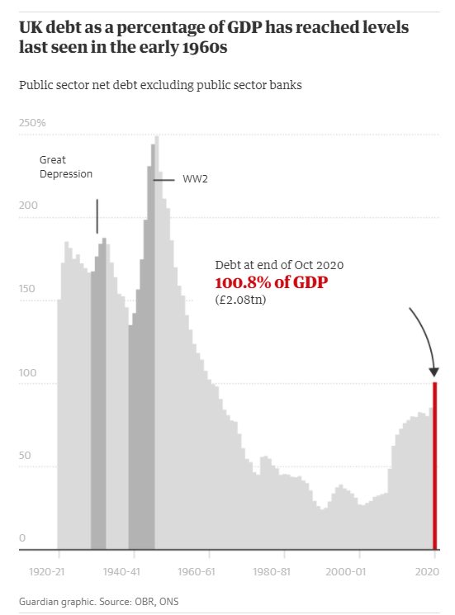
Macroeconomic Forces
Growth rate of the economy
Interest rates
Currency exchange rates
Inflation or deflation rates

Slide 25


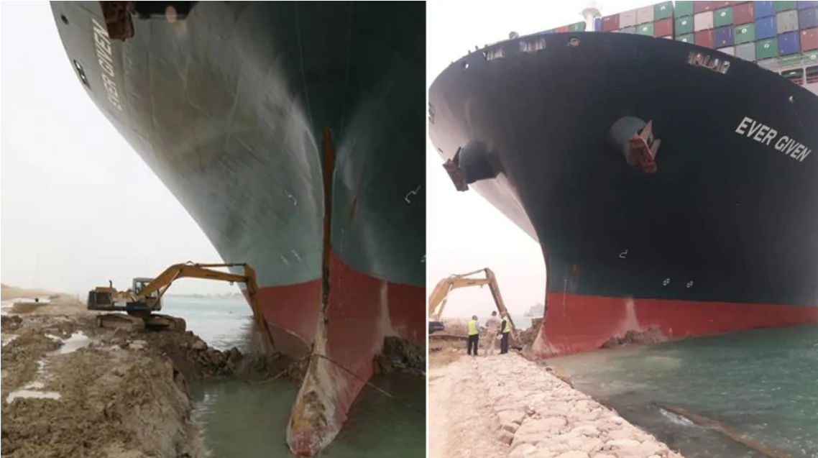
Global and Technological Forces
Global Forces e.g. falling barriers to international trade have enabled companies to expand into new geographic markets but……..Brexit, China – US disputes, Supply Chain Disruption, Ukraine
Technological Forces - technological change can:
  Make products obsolete
  Enable relocation of work
  Create a host of new product possibilities
  Impact the height of the barrier to entry and reshape industry structure

Slide 26
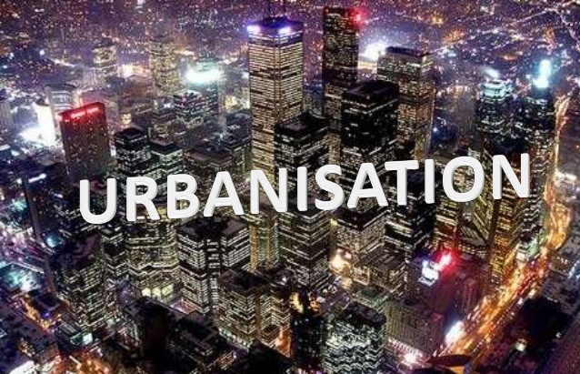
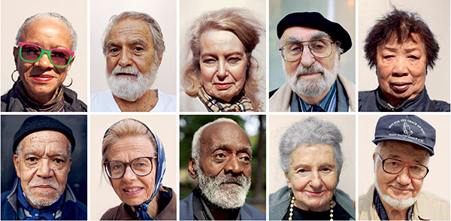
Demographic, Social, and Political Forces
Demographic forces - Outcomes of changes in the characteristics of a population – aging, immigration, birth-rates, death-rates, divorce
Social forces - Way in which changing social morals and values affect an industry e.g. popularism
Political and legal forces - Outcomes of changes in laws and regulations, tariffs, trade agreements, and climate change

Slide 27
PESTEL and Strategy
In scanning and making sense of the environment when formulating strategy, we are interested in the future, so what are the key trends that impact our industry and how far out should we look?
It is not sufficient just to analyse what is happening today and the recent past, although that is important
In the next topic we will look at using scenarios to examine the future implications for strategy
Managers and Executives should be constantly scanning the environment to detect indications of change

Slide 28
Major Trends – Change Is Opportunity

Slide 29
Major Trends According to McKinsey (2015)
1. Urbanisation and Growth in Emerging Markets in Asia, Latin America and the Middle East
Nearly half of global GDP growth between 2010 and 2025 will come from 440 cities in emerging markets—95 percent of them small- and medium-size cities that many Western executives may not even have heard of and couldn’t point to on a map.
2000, 95 percent of the Fortune Global 500—the world’s largest international companies including Airbus, IBM, Nestlé, Shell, and The Coca-Cola Company, to name a few—were headquartered in developed economies.
By 2025, when China will be home to more large companies than either the United States or Europe, we expect nearly half of the world’s large companies—defined as those with revenue of $1 billion or more—to be headquartered in emerging markets.

Slide 30
Major Trends According to McKinsey (2015)
2. Accelerating Technology Change
Twenty years ago, less than 3 percent of the world’s population had a mobile phone; now two-thirds of the world’s population has one, and one-third of all humans are able to communicate on the Internet.²
Technology allows businesses such as WhatsApp to start and gain scale with stunning speed while using little capital.
Entrepreneurs and start-ups now frequently enjoy advantages over large, established businesses.
The furious pace of technological adoption and innovation is shortening the life cycle of companies and forcing executives to make decisions and commit resources much more quickly.

Slide 31
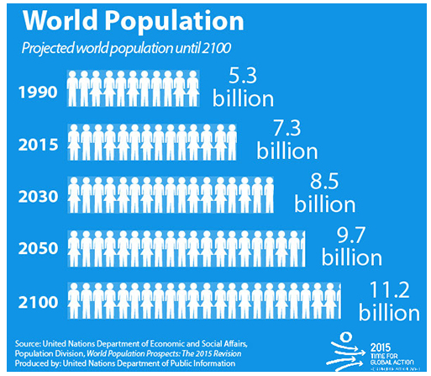
Major Trends According to McKinsey (2015)
3. Population Growth and Aging
By 2013, about 60 percent of the world’s population lived in countries with fertility rates below the replacement rate.
The European Commission expects that by 2060, Germany’s population will shrink by one-fifth, and the number of people of working age will fall from 54 million in 2010 to 36 million in 2060, a level that is forecast to be less than France’s.
China’s labor force peaked in 2012, due to income-driven demographic trends.
In Thailand, the fertility rate has fallen from 5 in the 1970s to 1.4 today.

Slide 32
Major Trends According to McKinsey (2015)
4. Greater Global Connections
The global trading system has expanded into a complex, intricate, sprawling web.
Asia is becoming the world’s largest trading region. “South–south” flows between emerging markets have doubled their share of global trade over the past decade.
The volume of trade between China and Africa rose from $9 billion in 2000 to $211 billion in 2012. Global capital flows expanded 25 times between 1980 and 2007.
More than one billion people crossed borders in 2009, over five times the number in 1980.
These three types of connections all paused during the global recession of 2008 and have recovered only slowly since.

Slide 33
McKinsey 2021
2021 will be the year of transition. Barring any unexpected catastrophes, individuals, businesses, and society can start to look forward to shaping their futures rather than just grinding through the present.
The return of confidence unleashes a consumer rebound
Leisure travel bounces back but business travel lags
The crisis sparks a wave of innovation and launches a generation of entrepreneurs
Digitally enabled productivity gains accelerate the Fourth Industrial Revolution
Pandemic-induced changes in shopping behavior forever alter consumer businesses
Supply chains rebalance and shift
The future of work arrives ahead of schedule
The biopharma revolution takes hold
Green, with a touch of brown, is the color of recovery
Healthcare systems take stock—and make changes
The hangovers begin as governments tackle rising debt
Stakeholder capitalism comes of age

Slide 34
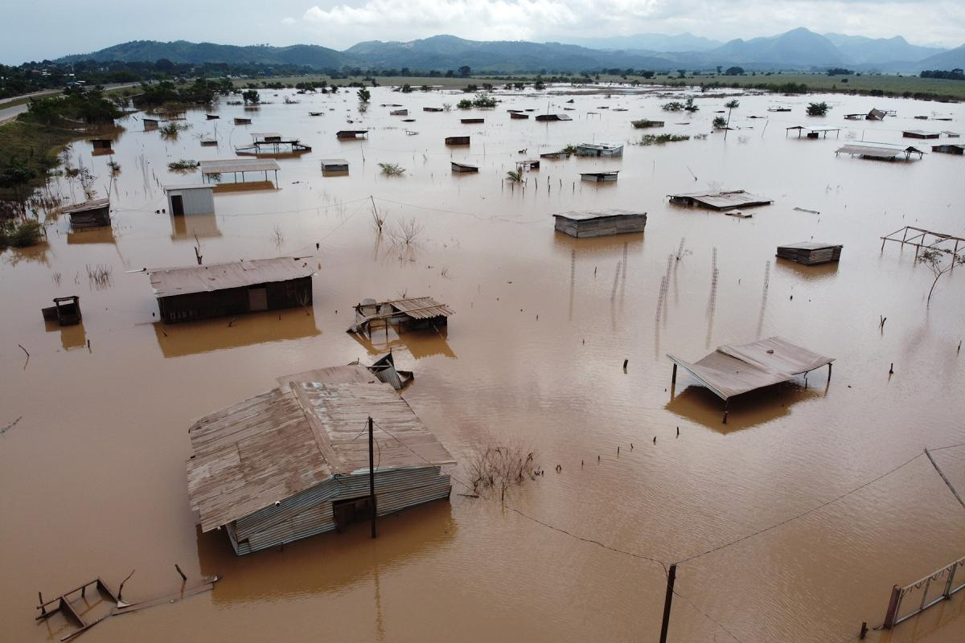

What Should We Be Focused On?
Environmental change will impact firms differently:
Impact of climate change – weather patterns, sea levels, agricultural production, migration
Global Population Growth - will require more energy, food and water and more energy use will add to climate change.
Global Tensions – USA-China, Russia and NATO, Middle East (Iran, Syria, Israel)

Slide 35
Climate Change

Slide 36
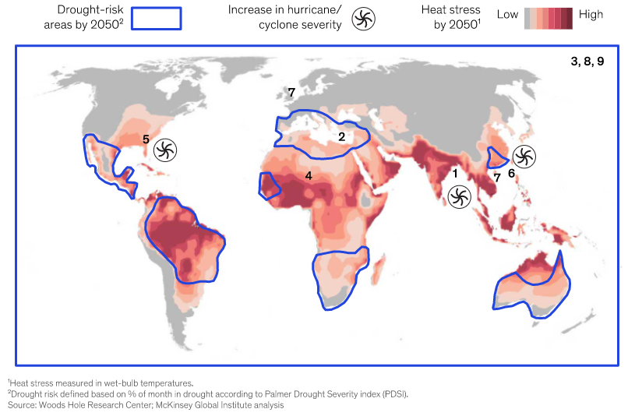
The Impact of Climate Change By 2050

Slide 37
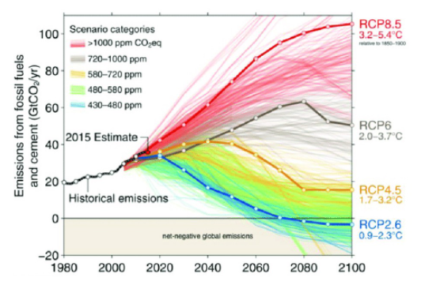
So What?
In India, by 2030 under a Representative Concentration Pathways (RCP) 8.5 scenario, between 160 million and 200 million people could live in regions with a 5 percent average annual probability of experiencing a heat wave that exceeds the survivability threshold for a healthy human being, absent an adaptation response.
RCP 8.5 is one of a suite of scenarios that describe several potential future pathways.
Each scenario defines a pathway in terms of the concentration of carbon in the atmosphere at any date – note that these pathways are defined in terms of the concentration (i.e. the level) of carbon in the atmosphere, not the volume of carbon emissions.
RCP 8.5 refers to the concentration of carbon that delivers global warming at an average of 8.5 watts per square meter across the planet. The RCP 8.5 pathway delivers a temperature increase of about 4.3˚C by 2100, relative to pre-industrial temperatures.
There is a scientific debate about whether RCP 8.5 is a plausible and accurate representation of the concentrations of atmospheric carbon that would be reached on the business-as-usual path
(climatenexus.org)

Slide 38
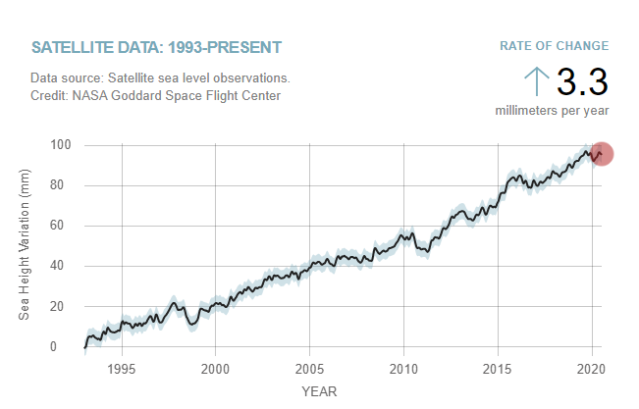
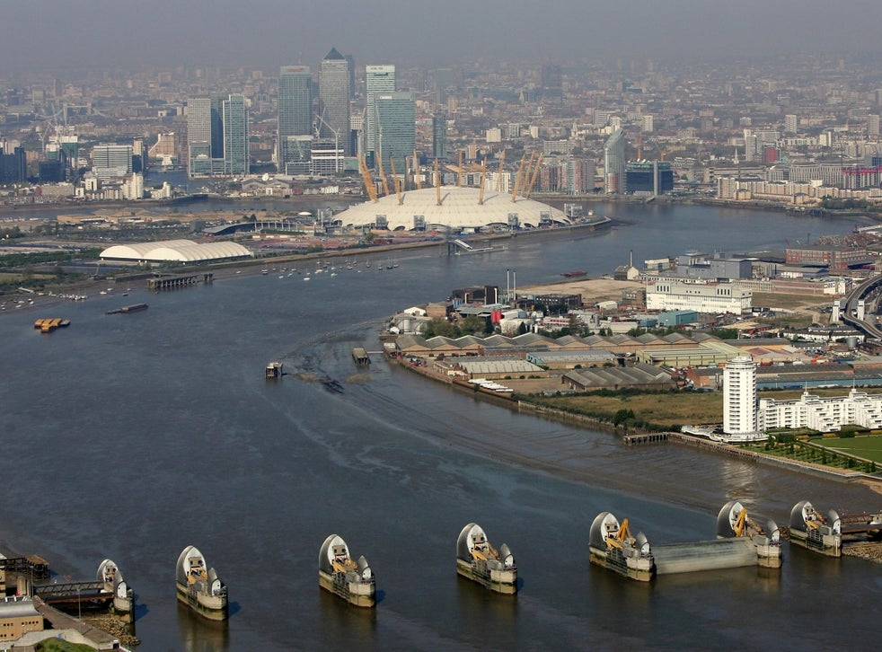
Climate Change

Slide 39
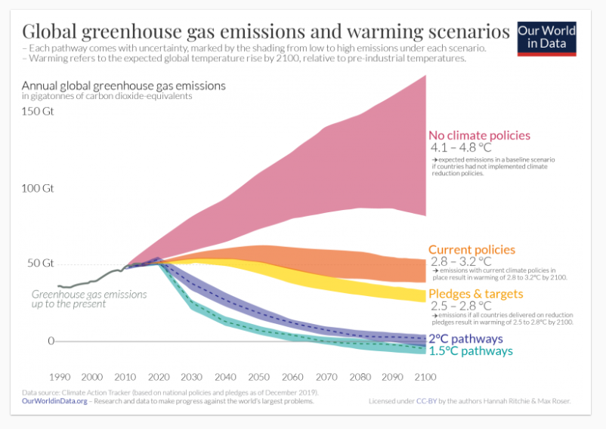
Global Warming Scenarios

Slide 40

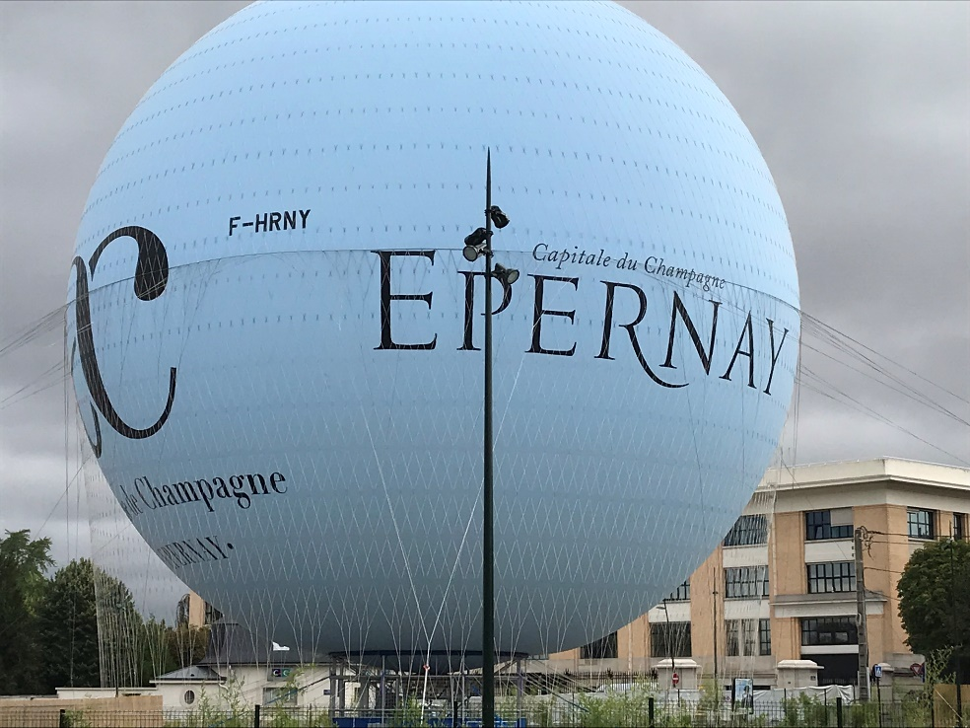
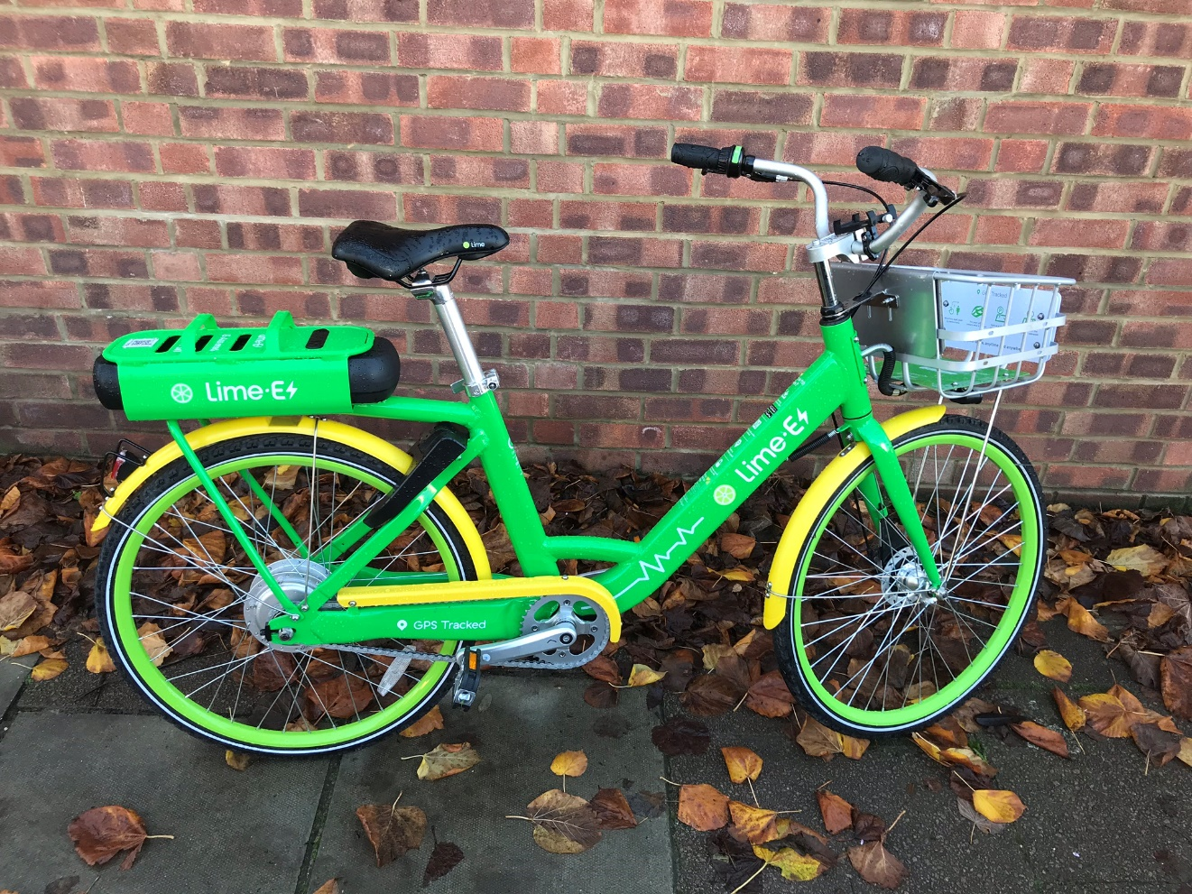
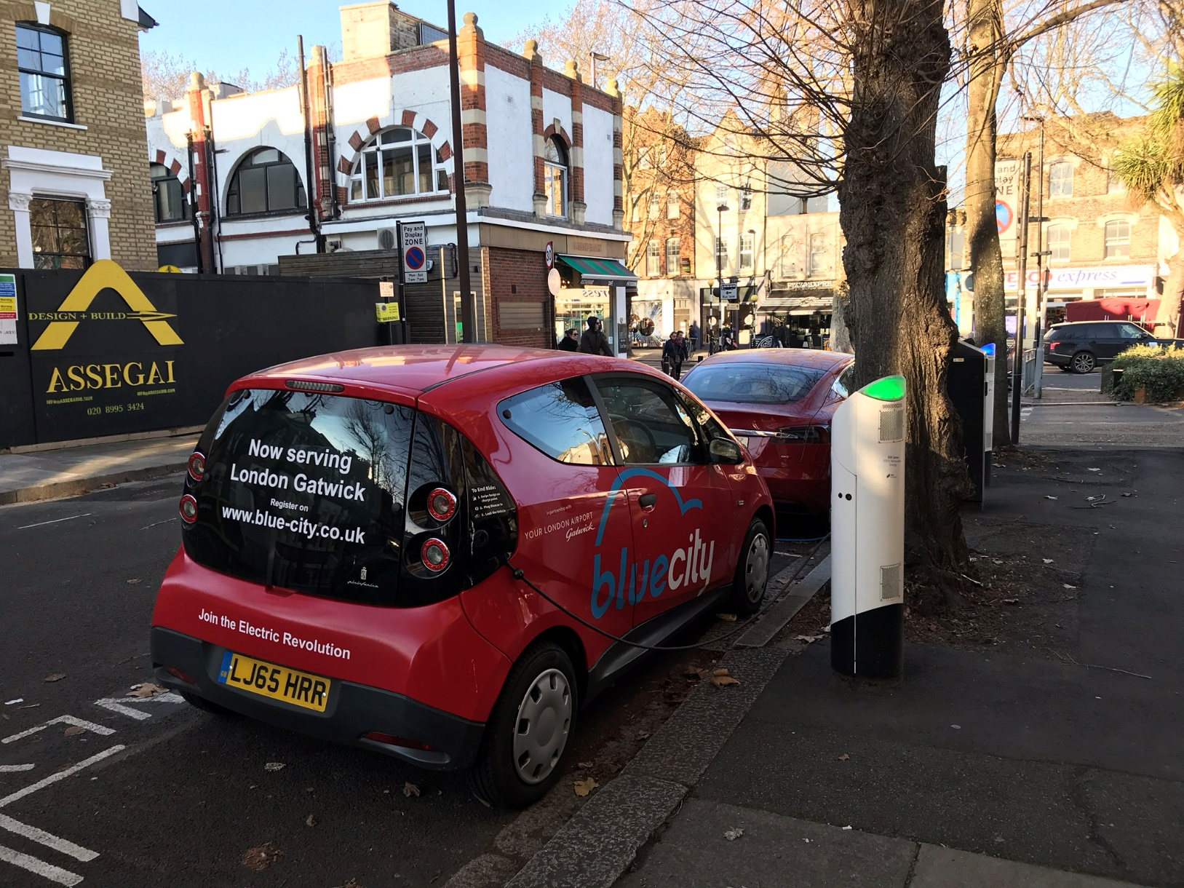
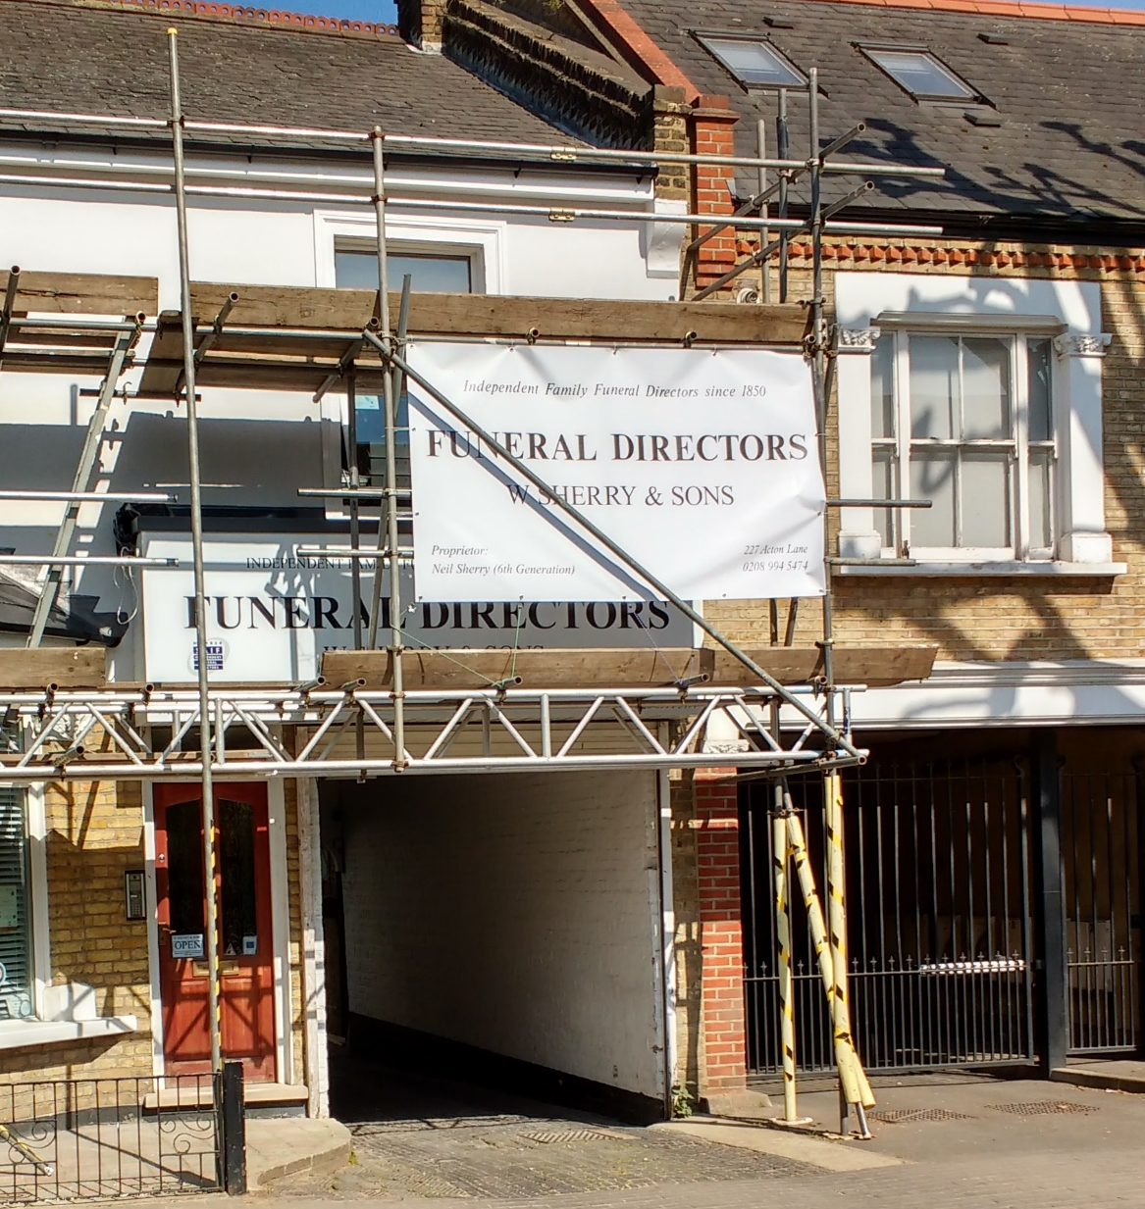
Climate Change - So What?

Slide 41
Cement
With about 10 billion tons of concrete produced every year, it is the most consumed substance in the world, second only to water.
It is also the world’s most widely used material for construction – from bridges to large buildings, concrete forms the very foundation of our infrastructure. Over 70% of the world’s population lives in a concrete structure.
Concrete is formed when portland cement creates a paste with water that binds with sand and rock to harden. Common materials used to manufacture cement include limestone, shells, and chalk or marl combined with shale, clay, slate, blast furnace slag, silica sand, and iron ore. These ingredients, when heated at high temperatures form a rock-like substance that is ground into the fine powder that we commonly think of as cement.
The cement industry alone is worth over $37 billion, and it is one of the largest producers of CO2, creating up to 5% of the world’s emissions of the greenhouse gas, of which 50% is from the chemical process, and 40% from burning fuel, according to the World Business Council for Sustainable Development.

Slide 42
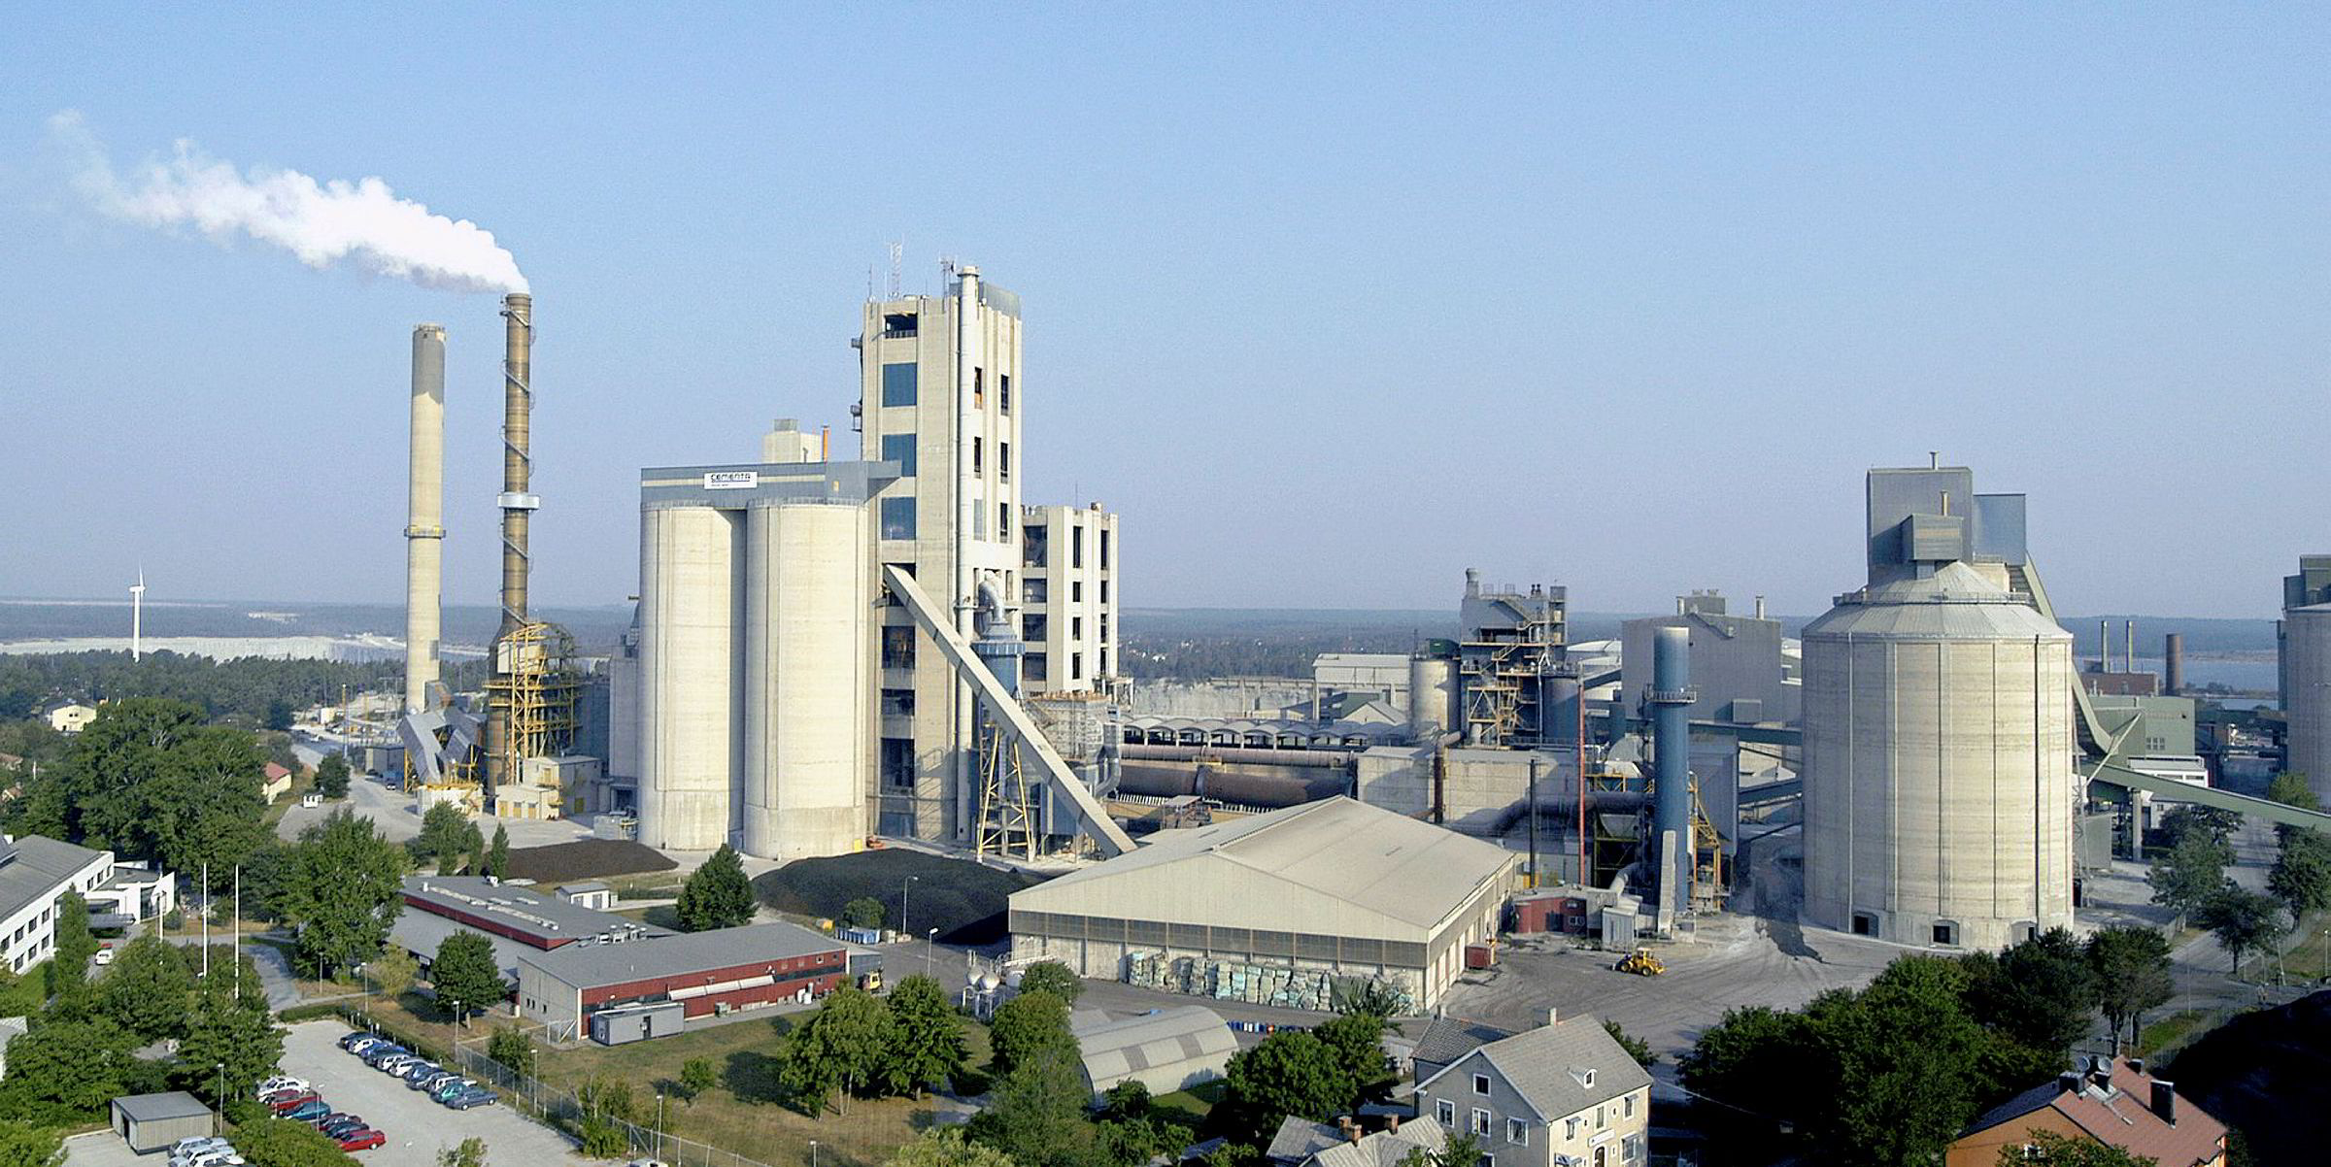
Global Warming Scenarios
“Utility Vattenfall and cement-maker Cementa may build a pilot plant in Sweden that for the first time in the world would produce cement from wind power instead of polluting fossil fuels, after positive results from a pilot study into the electrification of cement production.
The cement industry is one of the largest producers of CO2, creating up to 5% of the world’s emissions of the greenhouse gas, of which 50% is from the chemical process, and 40% from burning fuel, according to the World Business Council for Sustainable Development”.
https://www.rechargenews.com/transition/vattenfall-plans-world-s-first-zero-carbon-cement-plant/2-1-531250

Slide 43
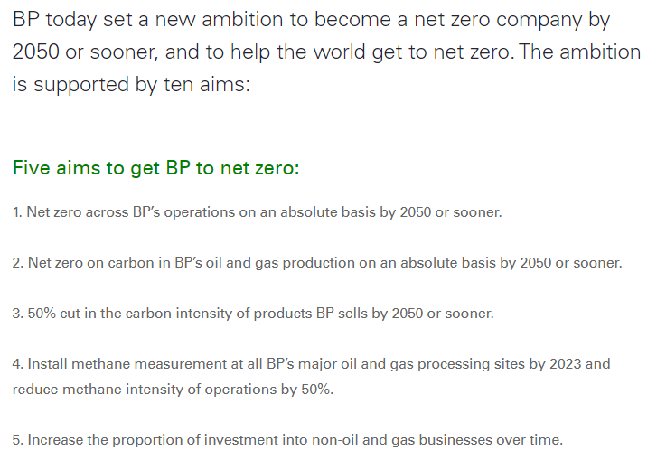
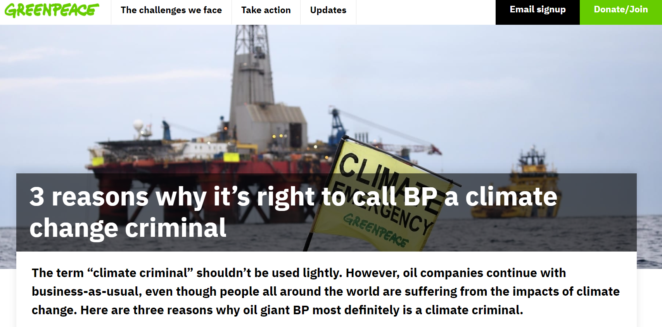
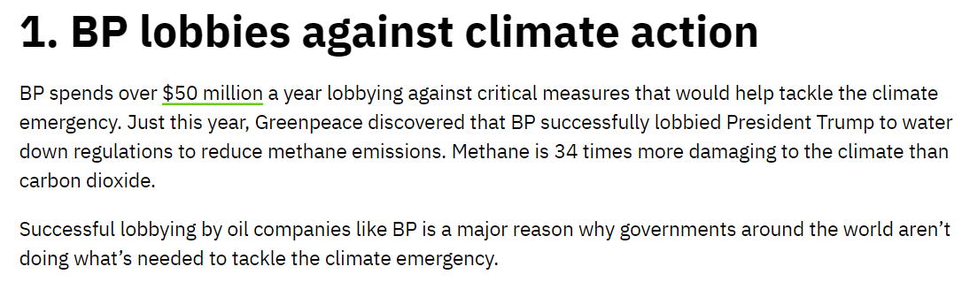
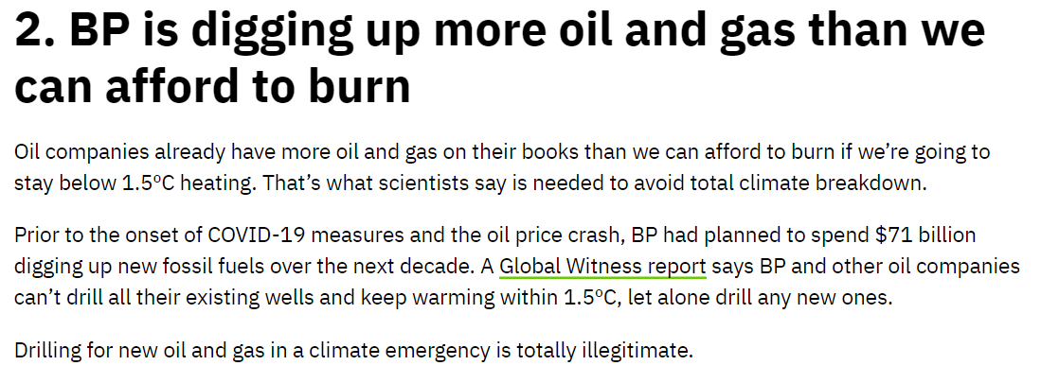
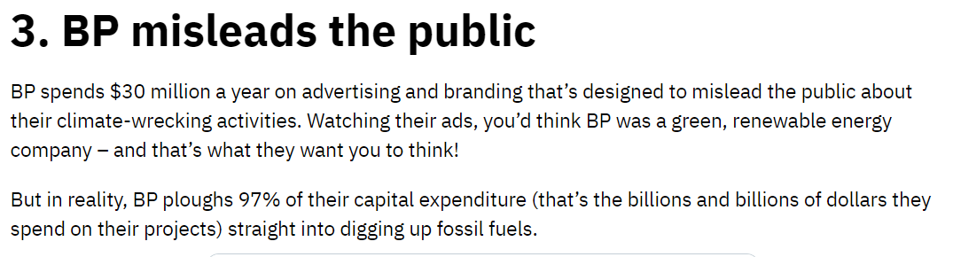
BP Sets Ambition For Net Zero By 2050

Slide 44
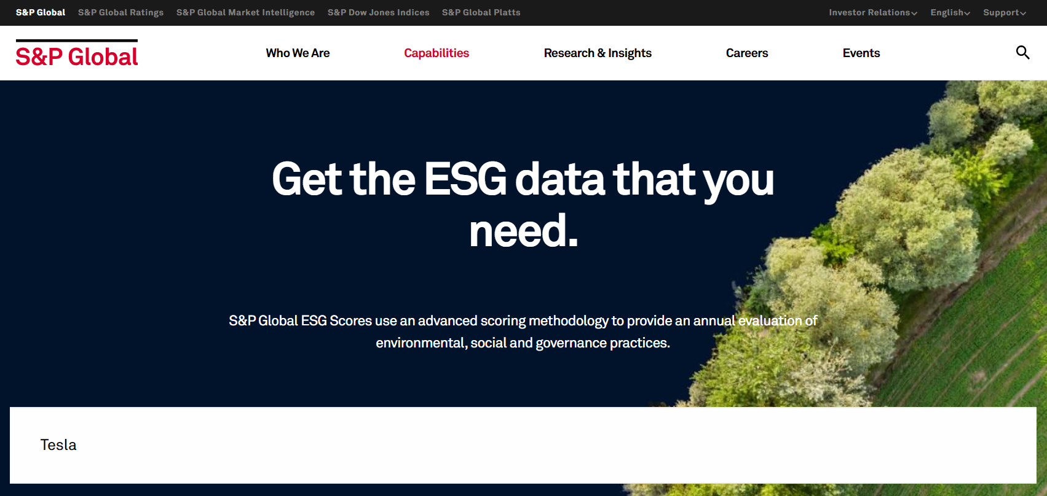
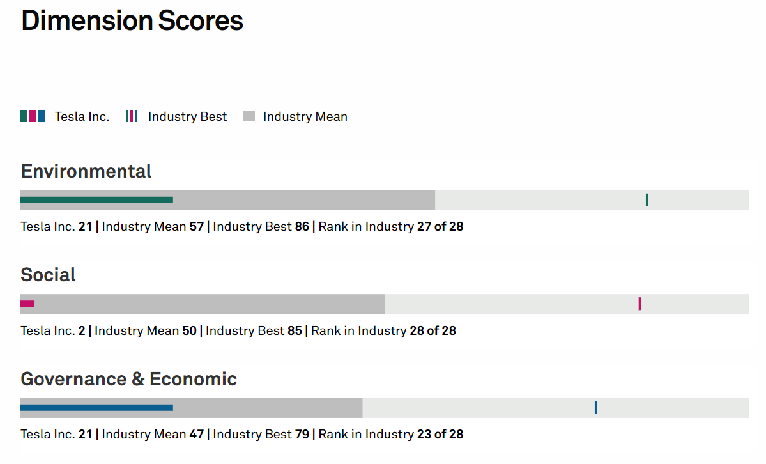
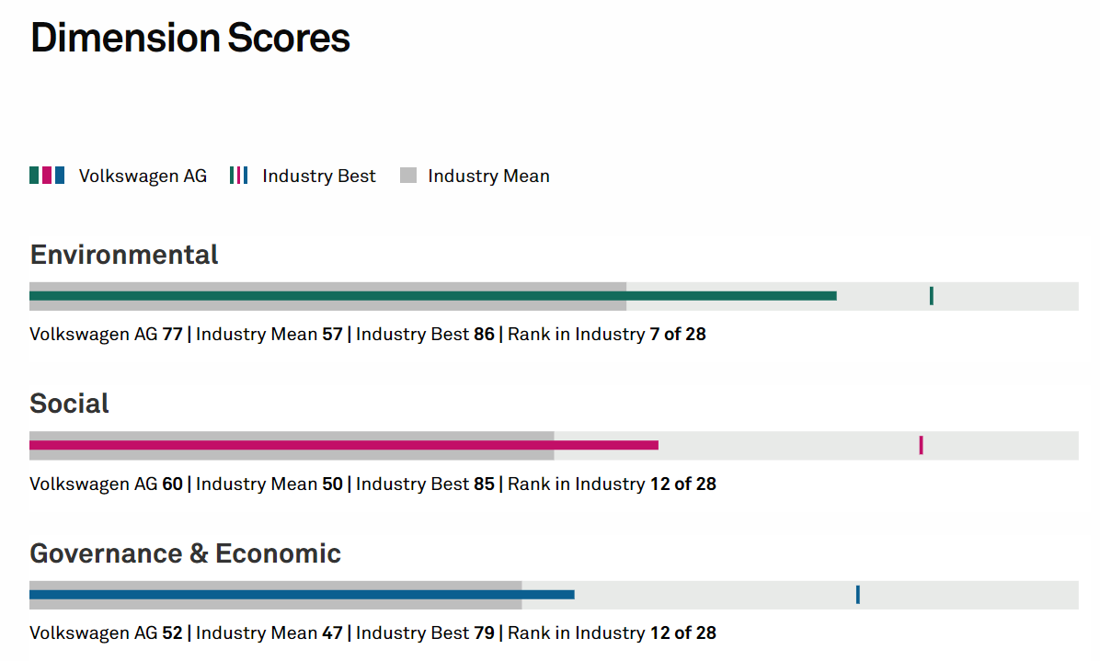
Environmental, Social and Governance Practices

Slide 45
References
Bennett, N. and Lemoine, G. J. (2014) ‘What VUCA Really Means for You’, Harvard Business Review, 92(1/2), p. 27.
Hill, C., Jones, G. & Schilling, M. (2015) Strategic Management; Theory & Cases: an integrated approach, 11e, Stamford, Cengage
Kurtz, C. & Snowden, D. 2003. The new dynamics of strategy: Sense-making in a complex and complicated world, IBM Systems Journal, vol. 42 no. 3, pp. 462–483
https://doi.org/10.1177/0008125618790246
Schoemaker, P. and Krupp, S. (2015) ‘THE ANTICIPATORY LEADER: How to See Sooner and Scan Wider’, Rotman Management, pp. 36–41. Available at: http://0-search.ebscohost.com.emu.londonmet.ac.uk/login.aspx?direct=true&db=bth&AN=102477054&site=ehost-live (Accessed: 28 August 2019).

