Slide 1

MN7031 Topic 4 – Why Are Some Industries More Profitable Than Others?
Daniel Jones
londonmet.ac.uk

Slide 2
Module Overview
1. How and Why Do Businesses Grow?
2. How Do We Diagnose Company Strategy?
5. How Do We Make Sense of the VUCA External Environment?
8. Does Your Simulation Company Need A New Strategy?
10. Why DO Firms Undertale Acquisitions, Mergers and Alliances?
7. How Is Your Simulation Company Performing?
11. How Do Companies Innovate Successfully?
12. Does Strategic Alignment Matter?
4. Why Are Some Industries More Profitable Than Others?
3. How Does A Company Create Competitive Advantage?
6. How Do We Identify future opportunities and threats?
9. Summative Assessment Presentations
Business Simulation – Cesim Global Challenge

Slide 3
Today’s Agenda
Review of Sprint 1
Lecture
Industry definition, boundaries and analysis
Industry Profitability - 5 Force and 5 Force plus 1 analysis
Industry rivalry – monopolies, oligopolies, and competitive markets
Strategic groups
Competitor Analysis
Industry Lifecycles, Development and Disruption
Cesim Global Challenge - Round 2
Portfolio - Case Study 1 Discussion
Nintendo Case Study

Slide 4
Strategic Diagnosis
Industry (or Sector)
Development stage
Markets and Competitors
Market Segments
Scope of activities
The Organisation
Resources
Capabilities
Competencies
Politics
The Macro-environment
Concentration
Value network
Products and/or services
Critical success factors
Resource commitment
Economics
Social
Technological etc.
Theories and Frameworks
PESTEL
Scenario Planning
5 Forces
Industry Lifecycle
External
Blue Ocean Theory
Red Queen Theory
Market Analysis
Competitor Analysis
Resource Based View
Business Model
Internal
Core Competencies
Organisational Structure
Culture
Global
Regional
National
Local
Systems
Notes:
We will look at competitors in a later topic.

Slide 5
Topic 1 – Starting and Growing a Business

Slide 6
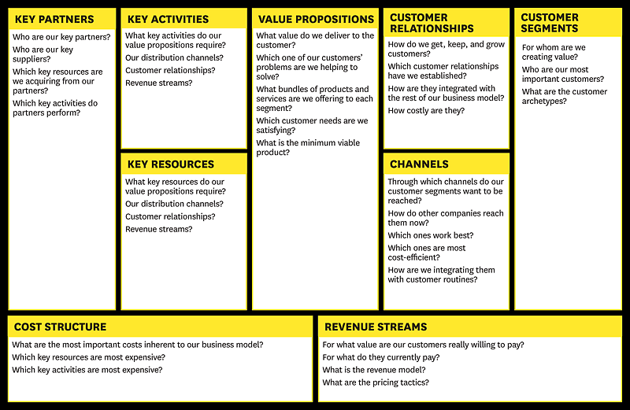
Business Model Canvas

Slide 7
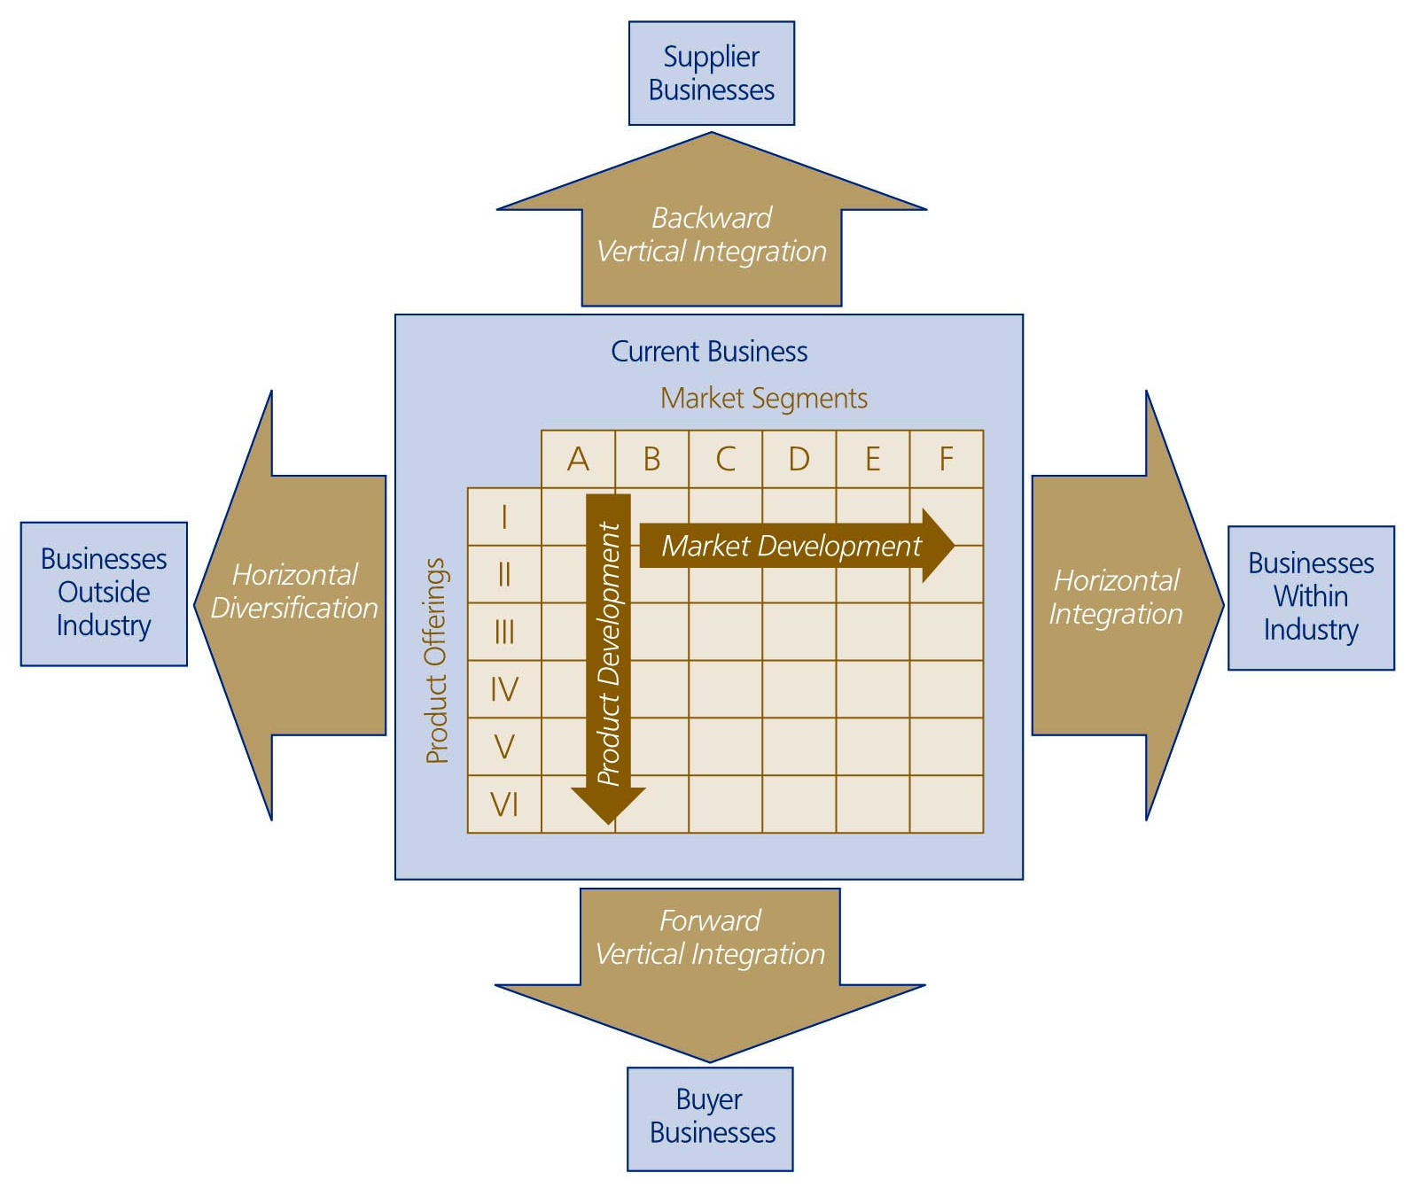
  Corporate Growth
  Directions

Slide 8
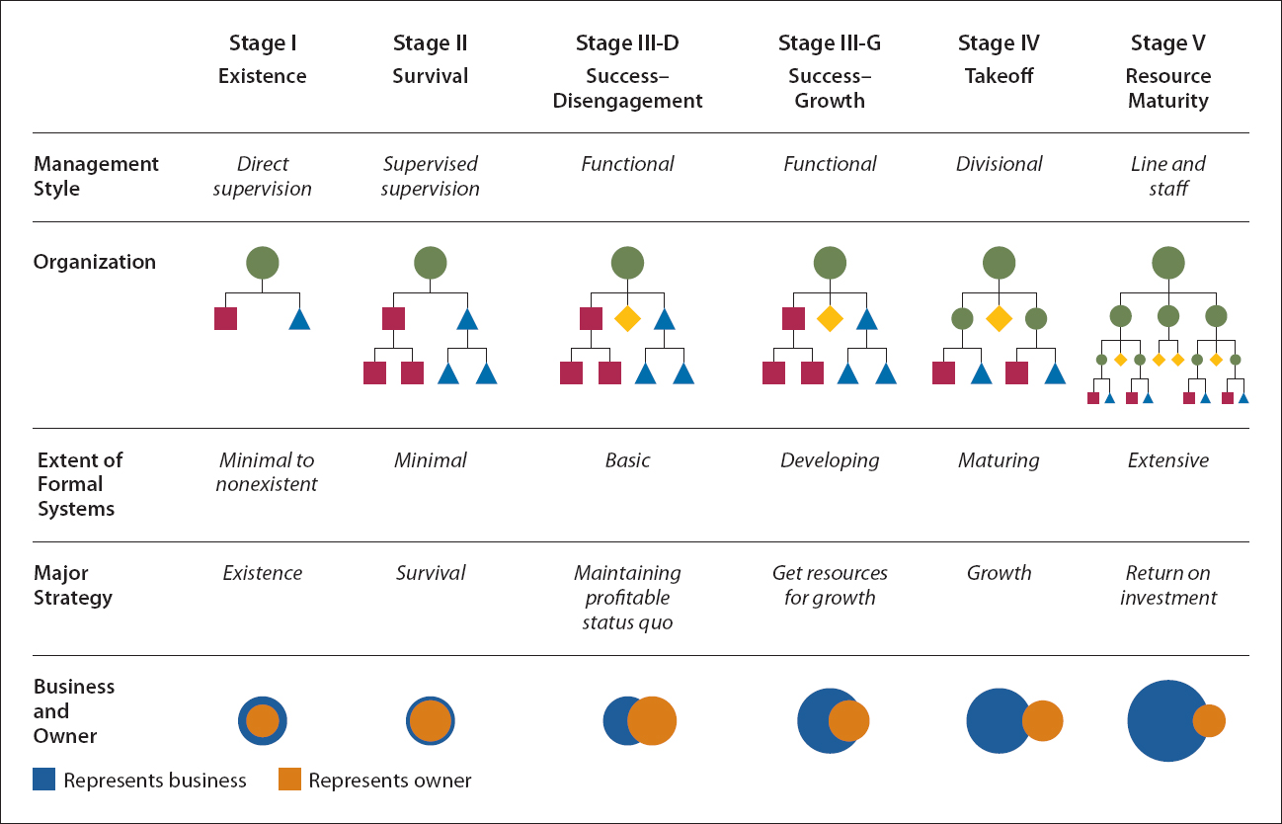
Stages of Business Growth
SOURCE: Reprinted by permission of Harvard Business Review. Exhibit. From “Five Stages of Small Business Growth,” by Neil C. Churchhill and Virginia L. Lewis, May–June 1983. Copyright © 1983 by the Harvard Business School Publishing Corporation; all rights reserved.

Slide 9
Topic 2 – Diagnosing A Firm’s Strategy

Slide 10
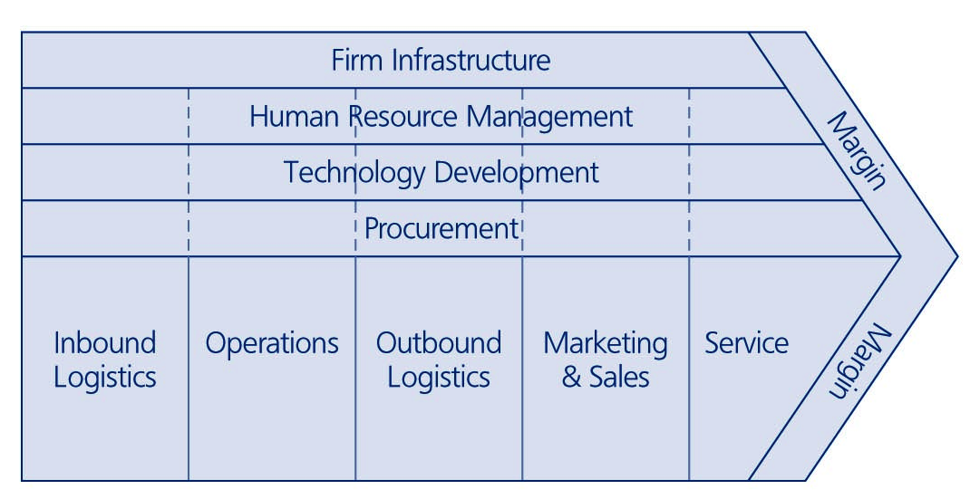
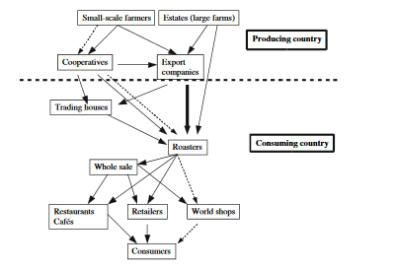
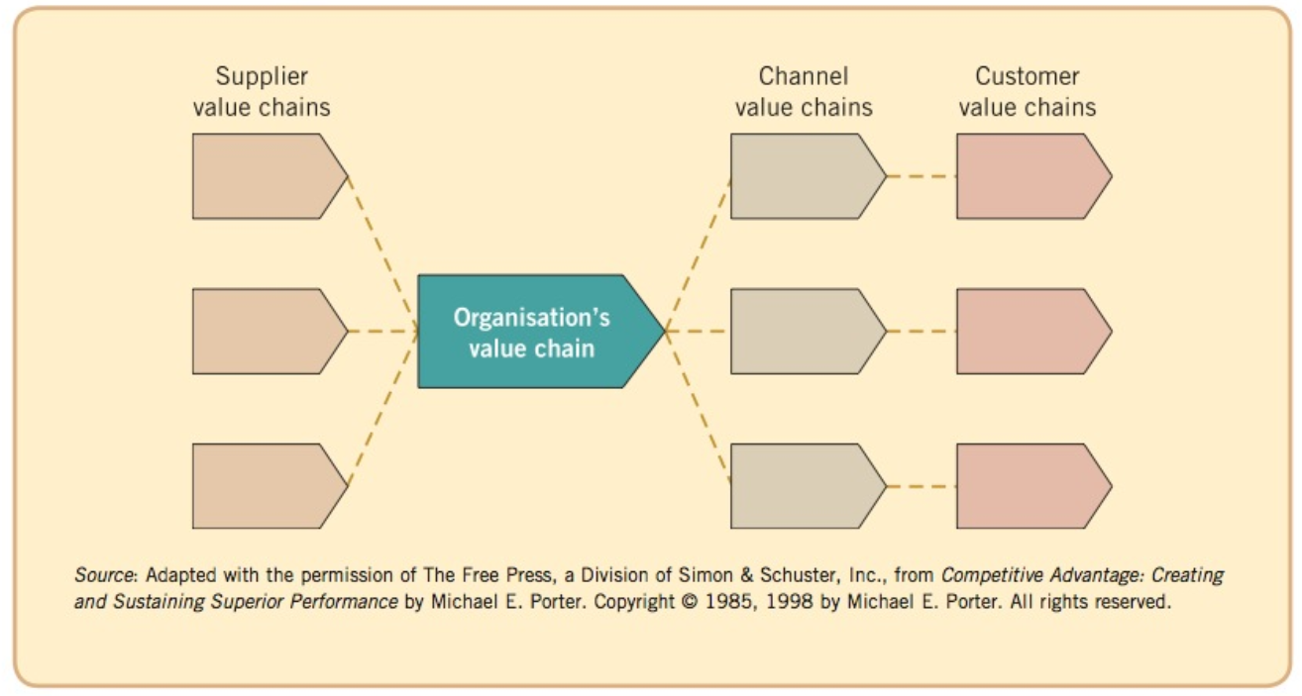
The Value System
Johnson, G. et al., 2013, Exploring Corporate Strategy: Texts and Cases, 10th, Harlow: Pearson p 87

Slide 11
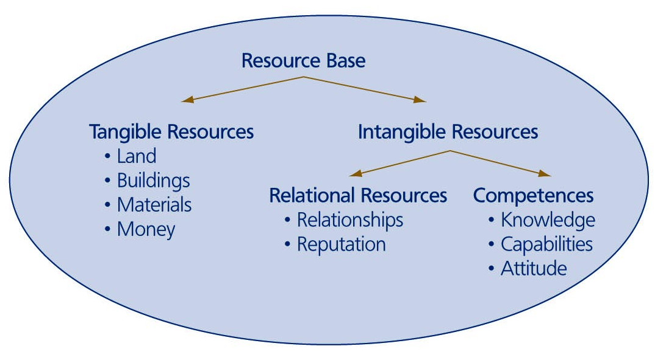
Types of Firm Resources

Slide 12
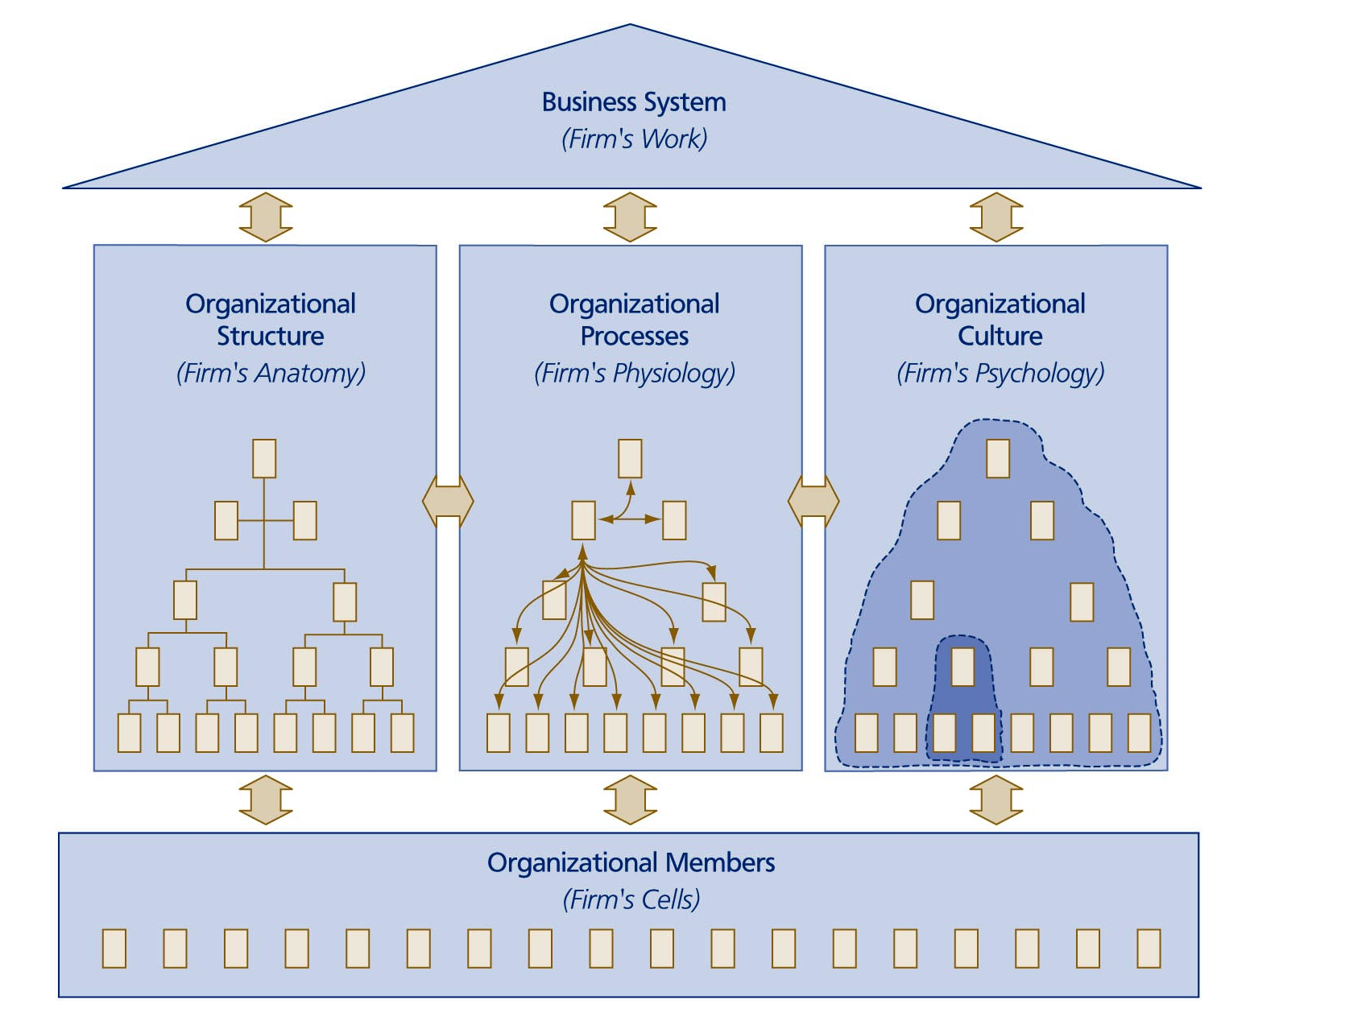
Components of the Organisational System

Slide 13
Strategy Diagnosis – An Iterative and Incremental Process
Financial Performance
Competencies
Industries, Product Offerings and Market Segments
Resources – Tangible and Intangible
Business Model and Value Network
Capabilities
Competitive Advantage
Start with the 7 areas in the diagram, beginning with financial performance over the last 5 years:
  Is the business profitable?
  Is it growing or declining?
  How does it compare with the rest of its industry?
  Share price and capitalisation
Investigate the other 5 areas
The process of diagnosis may lead to questions in other areas e.g.:
  Leadership
  Ownership
  Information Systems
  Acquisition Integration
  Culture
  Sustainability
  Etc..
Strategy
Diagnosis –
Initial Analysis

Slide 14
Strategy in Firms
1st Goal of a firm: survive
Corporate Strategy
Scope of business
Big choices; sustainability, structure etc
(Top management)
Industry Attractiveness
Where do we compete?
Rate of return above the cost of capital
Business Strategy
Markets, segments, (Divisional
management)
How do we make money?
Competitive Advantage
How do we compete?

Slide 15
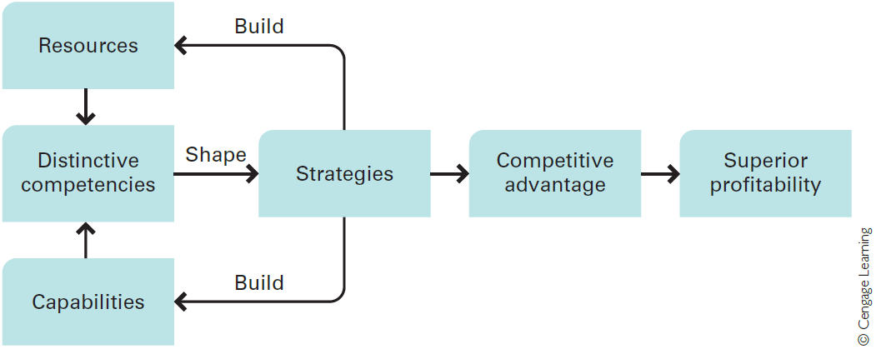
Resources, Capabilities and Competencies and the Link to Competitive Advantage
Able to do things successfully or efficiently
Hill et al, 2015
Able to do things
Notes:
Distinctive Competencies
Competitive advantage is based upon distinctive competencies. Distinctive competencies are firm-specific strengths that allow a company to differentiate its products from those offered by rivals, and/or achieve substantially lower costs than its rivals.
Resources
A company’s resources can be divided into two types:.
Tangible resources are physical entities, such as land, buildings, manufacturing plants, equipment, inventory, and money.
Intangible resources are nonphysical entities that are created by managers and other employees, such as brand names, the reputation of the company, the knowledge that employees have gained through experience. We could also include the intellectual property of the company, including patents, copyrights, and trademarks.
Valuable resources are more likely to lead to a sustainable competitive advantage if they are rare, in the sense that competitors do not possess them, and difficult for rivals to imitate; that is, if there are barriers to imitation.
Capabilities
Capabilities refer to a company’s resource-coordinating skills and productive use.
These skills reside in an organisation’s rules, routines, and procedures.
More generally, a company’s capabilities are the product of its organisational structure, processes, control systems, and hiring strategy. They specify how and where decisions are made within a company, the kind of behaviours the company rewards, and the company’s cultural norms and values.
Resources, Capabilities, and Competencies
The distinction between resources and capabilities is critical to understanding what generates a distinctive competency.
A company may have firm-specific and valuable resources, but unless it also has the capability to use those resources effectively, it may not be able to create a distinctive competency. Additionally, it is important to recognize that a company may not need firm-specific and valuable resources to establish a distinctive competency so long as it has capabilities that no other competitor possesses.
In sum, for a company to possess a distinctive competency, it must—at a minimum— have either:
(1) a firm-specific and valuable resource, and the capabilities (skills) necessary to take advantage of that resource, or
(2) a firm-specific capability to manage resources (as exemplified by Nucor).
Distinctive competencies shape the strategies that the company pursues, which lead to competitive advantage and superior profitability. However, it is also very important to realise that the strategies a company adopts can build new resources and capabilities or strengthen the existing resources and capabilities of the company, thereby enhancing the distinctive competencies of the enterprise.
I worked for 10 years for Capgemini, a firm that had a wide range of technology capabilities that enabled it to provide the design and build large and complex IT systems successfully. These capabilities, combined with the intangible resources of the firm, gave Capgemini a distinctive competence in Systems Integration. At the time. however. Capgemini lacked the ability to win large IT service contracts and was losing market share in services to EDS.
I moved to EDS to understand the companies deal making Competence, which was very strong, but embedded in a relatively small number of people. Unfortunately the EDS delivery capability, particularly System Integration, was far less strong than Capgemini.
Ultimately Capgemini acquired the deal making competence mainly through selective recruitment of key people, but EDS failed to with a number of over-ambitious projects because it lacked the necessary capabilities and some key resources; for example the right project management culture, to create the necessary delivery competence.

Slide 16
Walmart Strategy Map
WALMART | Productivity Strategy |  | Growth Strategy
Financial Perspective | Local discretion over pricing Drive down cost continuously Obsession with retail and cost reduction High asset and inventory turnover Low spend on advertising(lowest in the industry) |  | Locate in small towns and create a monopoly on discount retail in that area International expansion Multiple formats – discount stores, warehouse clubs, supercentres and neighbourhood stores, online
Customer Perspective | Everyday Low prices “Greeters” “Satisfaction Guaranteed |  | Adjust to local needs and preferences Wide range of goods Avoid stock-outs
Internal Perspective | Operations Management | Customer Management |  | Innovation Processes | Regulatory and Social Processes
 | Purchasing Centralised buying Limit supplier power – max 2.5% of total Exploit technology Use of EDI and Online buying Warehousing and Distribution Own distribution system – hub and spoke rather than supplier delivers to stores Total control and large drop volumes | Store location Store format Decentralised decision making High level of service |  | Insourced activities allow innovation in IT, warehousing, distribution and store operations | Patriotism Traditional American Values Environmental responsibility Counter the criticisms from Unions, politicians and environmentalists Employee empowerment
Learning and Growth Perspective | Human Capital - promote from within, career opportunities, profit sharing, share ownership, empowerment, decision and consultation rights, treat as individuals and show them respect, listen to suggestions. Family atmosphere.
 | Information Capital – pioneer the use of technology – EDI, EPOS, Satellite communication and RFID. Systems closely tailored to Walmart’s needs, constant analysis of POS data. Used to closely link the entire supply chain.
 | Organisational Capital – Principles and values of Sam Walton – thrift, hard work, fairness, simplicity and friendliness. Management culture – the Friday and Saturday meeting’s.

Slide 17
Topic 3 – Creating Competitive Advantage

Slide 18
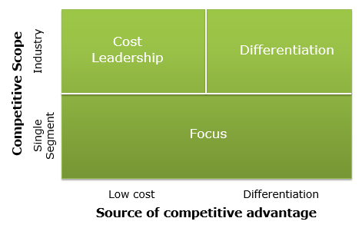
Positioning A Business
Where and How to compete?
Bases of competitive advantage:
  Price, Features, Bundling
  Efficiency
  Quality
  Innovation
  Customer responsiveness
  Availability
  Image and relations
Porter’s three generic competitive advantages:
  operational excellence
  product leadership
  customer intimacy
Stuck in
the Middle

Slide 19
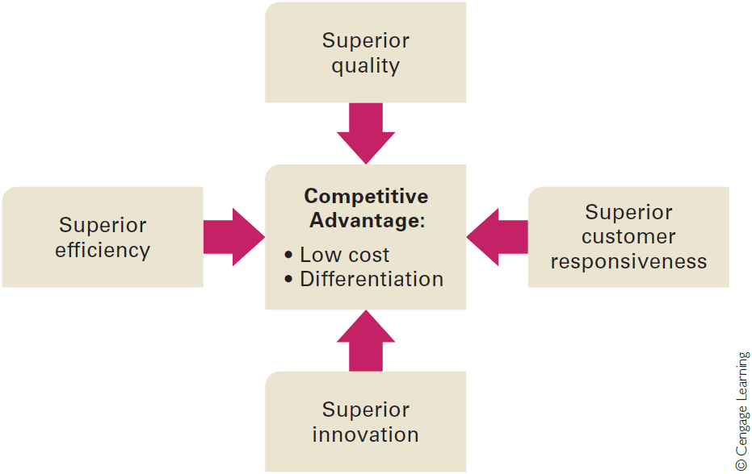
Sources of Competitive Advantage
Hill et al, 2015
Notes:
Four factors help a company to build and sustain competitive advantage:
superior efficiency
quality
innovation
and customer responsiveness
I am going to focus on quality and innovation.
Firstly quality – a simple way to understand quality if “fitness for purpose”. Does the product have the necessary attributes to satisfy my needs?
When customers evaluate the quality of a product, they commonly measure it against two kinds of attributes: those related to quality as excellence and those related to quality as reliability.
From a quality-as-excellence perspective, the important attributes are things such as a product’s design and styling, its aesthetic appeal, its features and functions. This is an are that Apple particularly understand.
With regard to quality as reliability, a product can be said to be reliable when it consistently performs the function it was designed for, performs it well, and rarely, if ever, breaks down. Apple in recent years have been less successful in this respect, as have a number of highly respected firms – Boeing, Toyota and Samsung currently to name but a few.
When products are reliable, less employee time is wasted making defective products, or providing substandard services, and less time has to be spent fixing mistakes—which means higher employee productivity and lower unit costs. Thus, high product quality not only enables a company to differentiate its product from that of rivals, but, if the product is reliable, it also lowers costs.
Innovation refers to the act of creating new products or processes. There are two main types of innovation: product innovation and process innovation.
Product innovation is the development of products that are new to the world or have superior attributes to existing products.
Process innovation is the development of a new process for producing products and delivering them to customers.
Innovation is linked very much to culture. In an organisation where there is a strong desire for centralised control, innovation will be less likely to occur. There is a tension then between control and creativity.

Slide 20
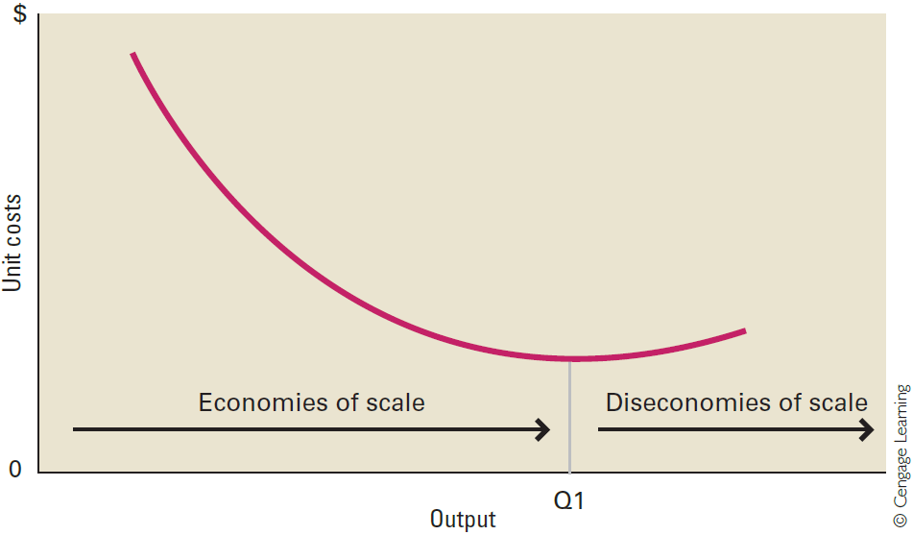
Efficiency and Economies of scale
Efficiency - Measured by the quantity of inputs that it takes to produce a given output
Economies of scale: Reductions in unit costs attributed to a larger output
  Ability to spread fixed costs over a large production volume and produce in large volumes
  To achieve greater division of labor and specialization
Diseconomies of scale: Unit cost increases associated with a large scale of output

Slide 21
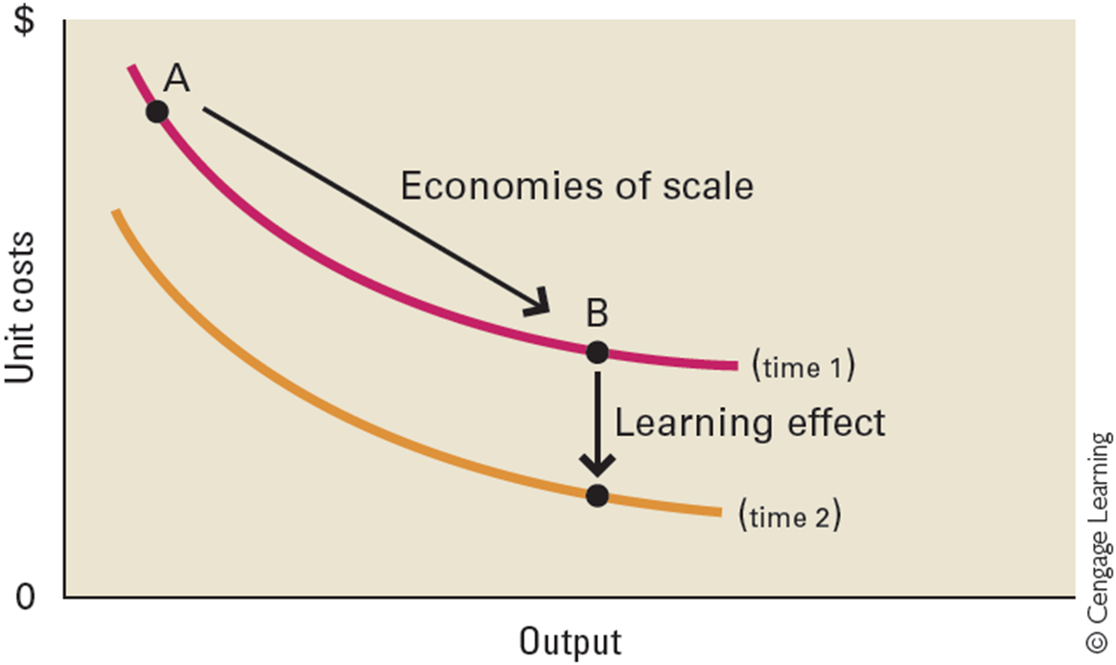
Learning Effects
Cost savings that come from learning by doing
More significant when a technologically complex task is repeated, as there is more to learn
Diminish in importance after a period of time
Triggered by changes in a company’s production system
Simulation
Developing and launching new products or features
Manufacturing a new phone
Commissioning new plants

Slide 22
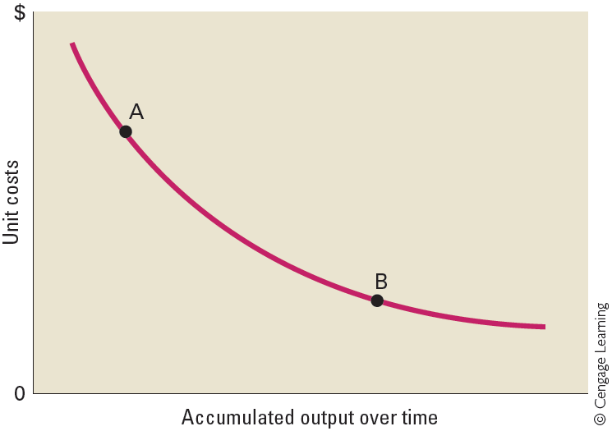
Experience Curve
Systematic lowering of the cost structure, and consequent unit cost reductions - occur over the life of a product
A product’s per-unit production costs decline each time its accumulated output doubles - accumulated output - Total output of a product since its introduction
Useful in industries that mass-produce a standardised output
Hill et al, 2015

Slide 23
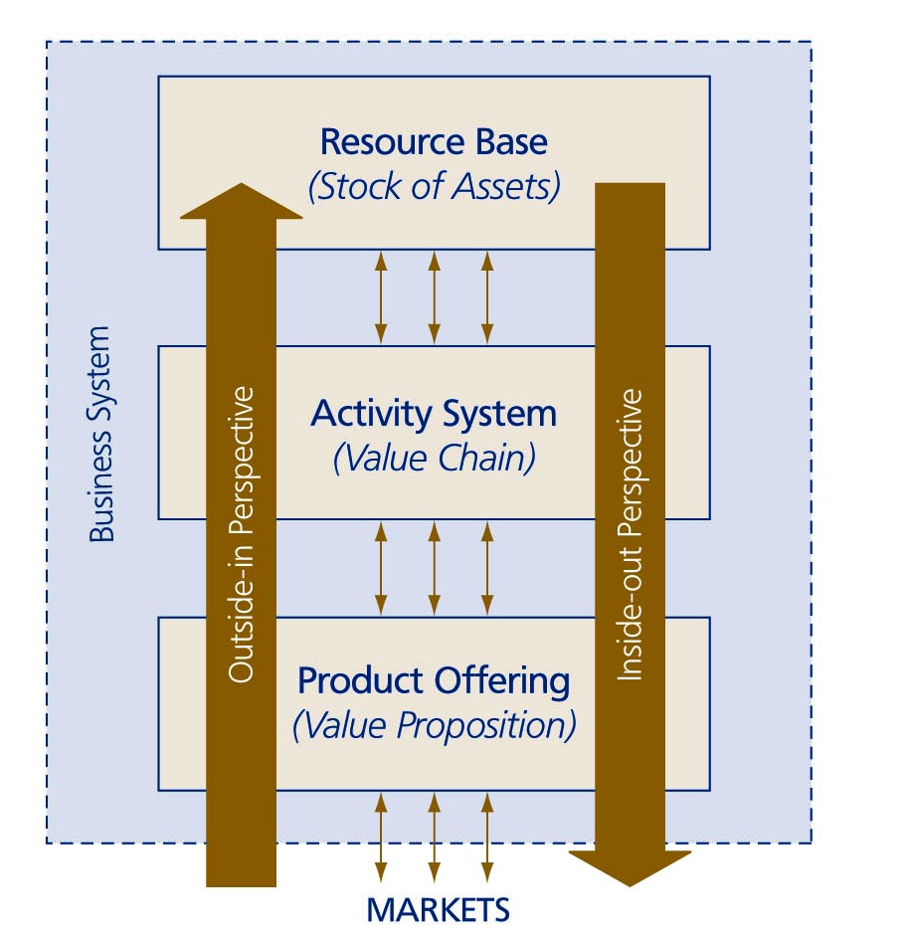
Two Perspectives On Shaping The Business Model

Slide 24
Topic 4 – Why Are Some Industries More Profitable Than Others?

Slide 25
Industry Structure

Slide 26


Defining an Industry
Industry:
Group of companies offering products or services that are close substitutes for each other
A group of firms making a similar type of product or employing a similar set of value-adding processes or resources
Sector: Group of closely related industries
Market segments - Distinct groups of customers within a market that can be differentiated on the basis of their:
Individual attributes
Specific demands
Notes:
Let’s consider two firms – one provides tap water piped to homes and businesses and the other provides bottled water.
Are they in the same industry? They have a common product – water and a considerable number of market segments in common.
First of all – are they close substitutes for each other? And secondly – do the firms use similar value adding processes or resources?
Tap water can be a close substitute for bottled water – indeed in many instances blind tasting suggests that the premium paid for bottled water is not merited. In most cases however these products are not close substitutes and the production processes and resources are quite different.

Slide 27
The Issue Of Industry Development
Industry rules are the demands dictated to the firm by the industry context, limiting the scope of potential strategic behaviors, e.g. ‘must have strong brand’
Industry rules arise from the structure of the industry
As industries develop, the rules of competition change. Strategising managers need to identify which characteristics in the industry structure and which aspects of competitive interaction are changing.
Strategists need to recognise the drivers and the inhibitors of industry development

Slide 28
What Makes One Industry More Profitable Than Another?

Slide 29
How Do We Understand Industry Profitability?
Suppliers
According to Porter (2008), competition for profit extends beyond direct rivals (e.g. Pepsi v Coke) to include 4 other industry components
This extended rivalry defines the structure of the industry and the level of profitability
Bargaining power of suppliers
Industry Competitors
Rivalry among
existing firms
Potential Entrants
Substitutes
Threat of new entrants
Threats of substitutes
Buyers
Bargaining power of buyers

Slide 30
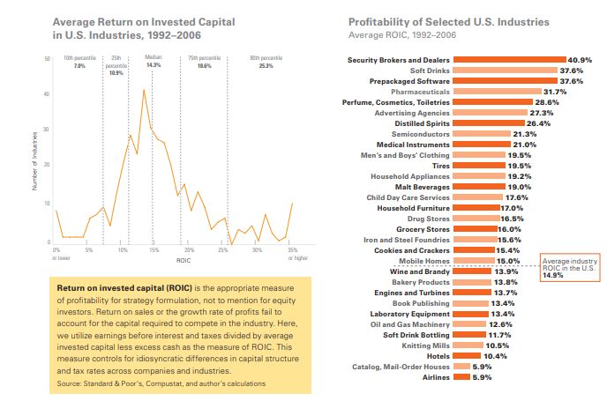
Return on Invested Capital (Porter, 2008)
ROIC – earnings before interest and tax divided by average invested capital less excess cash

Slide 31
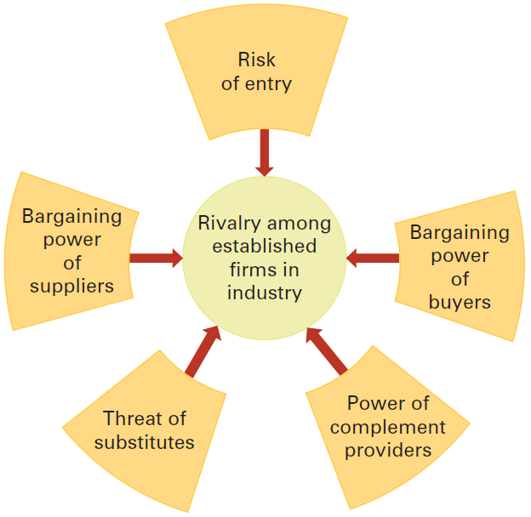
5 + 1 Competitive Forces
PESTEL
Social Resistance
Air pollution
Climate Change
Single Use Plastics
Deforrestation
Extinction Rebellion
Government?
Price control
Licensing
Tax rates and breaks
Subsidies
Regulation
Law Making
Hill, C., Jones, G. & Schilling, M. (2015) Strategic Management; Theory & Cases: an integrated approach, 11e, Stamford, Cengage
Notes:
Having decided on our industry boundary we can then analyse the industry. Michael Porter in 1985 created his 5 forces model for industry analysis and it remains a very popular choice for understanding an industry . His 5 forces are:
Rivalry among established firms in the industry
Risk of new entrants joining the industry – the potential competitors
The bargaining power of suppliers
The Threat of substitutes – tap water as a substitute for bottled water, for example, or an iPad or event iPhone in place of a PC
The bargaining power of buyers.
The text book adds a 6th force, the power of complement providers. Microsoft Windows and Office remain key complements for a PC, which has given the company a great deal of power and profit now at risk as people substitute a tablet or phone for a PC and also through the potential for an Android PC OS.

Slide 32
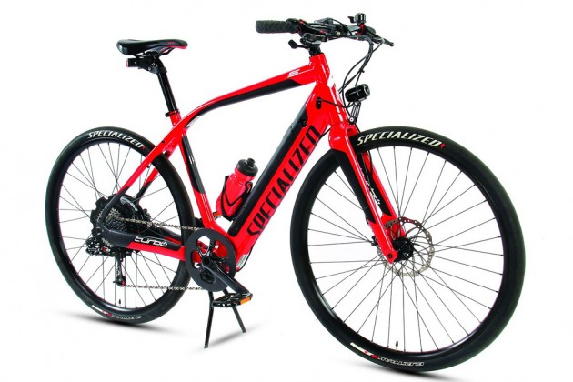

Substitute Products and Complementors
Substitute Products
Products of different businesses that satisfy similar customer needs – e.g. electric bikes as a substitute for motor driven scooters
Limit the price that companies in an industry can charge for their product
  Buyer propensity to substitute
  Relative prices and performance of substitutes
Complementors - Companies that sell products that add value to the other products
Windows and the PC
Game software and Gaming Machines
Charging points and battery powered cars
Notes:
There are clearly differing degrees of substitution for products. We have already looked at tap water and bottled water and determined that they are close substitutes only in limited circumstances. The iPad and iPhone are both substitutes for a PC in many circumstances but clearly cannot perform all its tasks. Microsoft initially did not see the opportunity and the threat of the smartphone and then tablet to its PC business and yet its lack of success is creating vulnerability, particularly from Alphabet and the Android operating system.
Complements can turn into a threat if the suppliers become too powerful, with the complement provider able to win a greater share of the profit than the main product provider.

Slide 33
Threat of Entry – What Factors Should a Firm Consider When Assessing the Potential for Successful Industry Entry?
Factors | Analysis
Capital requirements
Brand Loyalty
Customer Switching Costs
Economies of scale
Absolute cost advantage
Product differentiation
Access to distribution channels
Governmental and legal barriers
Retaliation by established firms

Slide 34
Bargaining Power Of Buyers
Factors | Analysis
Cost of product relative to total expenses.
Product differentiation
Competition between buyers
Size & concentration of buyers relative to producers
Buyer’s volume
Buyers’ switching costs
Buyer’s information
Buyer’s ability to multi-source
Buyer’s ability to backwards integration

Slide 35
Bargaining Power Of Suppliers
Factors | Analysis
Cost of product relative to total cost.
Product differentiation
Competition between suppliers
Size & concentration of suppliers relative to Producers
Buyer’s volume
Buyers’ switching costs
Supplier’s ability to forwards integrate

Slide 36
Industry Rivalry
Factors | Analysis
Industry demand
Number of competitors – fragmented or consolidated industry
Diversity of competitors
Product differentiation
Excess capacity and Exit barriers Investment in assets with no alternative use High fixed costs of exit Emotional attachment Dependence on the industry
Cost conditions (Fixed/Var. Costs)

Slide 37
Monopolies and Oligopolies

Slide 38
Monopolies
There is only one seller, so a single firm will control the entire market.
It can set any price it wishes since it has all the market power. Consumers do not have any alternative and must pay the price set by the seller.
Monopolies are extremely undesirable. Here the consumer loose all their power and market forces become irrelevant.
However, a pure monopoly is very rare in reality – typically US/UK/European Governments will regulate or break up monopolies. Examples:
UK Water companies – regulated by the government
Networks – rail, road, communications, power, gas – arms length ownership or regulation
British Plaster Board – investigated by the monopolies commission
London Black Cabs – displaced by Uber
BT – telephone network to homes

Slide 39
Competitive Markets and Industries
A large number of producers compete with each other to satisfy the wants and needs of a large number of consumers.
No single producer, or group of producers, and no single consumer, or group of consumers:
can dictate how the market operates.
can they individually determine the price of goods and services, and how much will be exchanged.
Impact of Competition
Higher quality at same prices
Differentiation
Increases Efficiency
Customer service and satisfaction
Awareness and market penetration
Consumption increases

Slide 40
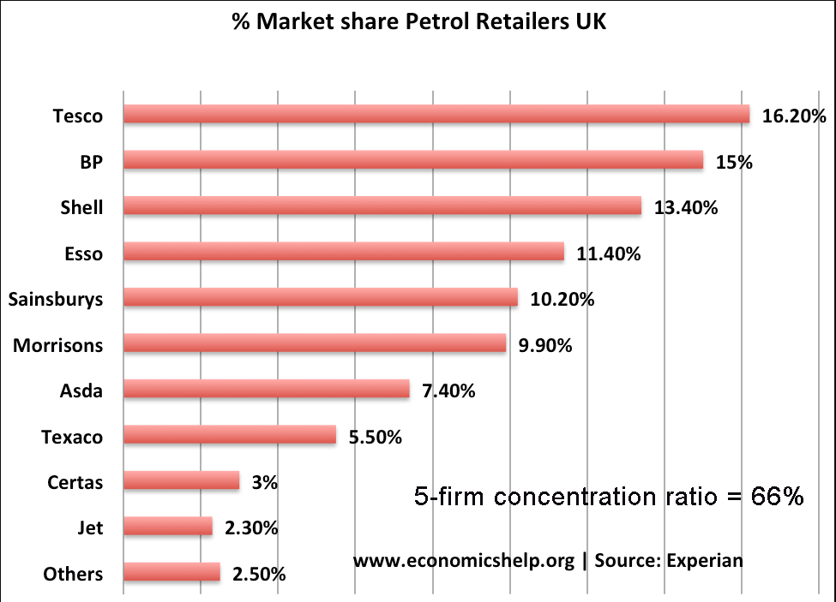
Oligopolies
Only a few firms in the market. The UK definition of an oligopoly is a five-firm concentration ratio of more than 50% (this means the five biggest firms have more than 50% of the total market share)
The buyers are far greater in number than the sellers.
The firms in an Oligopoly either compete with each another or collaborate together and may use their market influence to set the prices and in turn maximise their profits..
In an oligopoly, there are various barriers to entry in the market, and new firms find it difficult to establish themselves.

Slide 41
Strategic Groups

Slide 42




Strategic Groups Within Industries
Product positioning is determined by the:
Product quality, distribution channels and market segments served
Technological leadership and customer service
Pricing and advertising policy
Promotions offered
Notes:
Strategic Groups within Industries
Companies in an industry often differ significantly from one another with regard to the way they strategically position their products in the market.
Factors such as the distribution channels they use, the market segments they serve, the quality of their products, technological leadership, customer service, pricing policy, advertising policy, and promotions affect product position.
As a result of these differences, within most industries, it is possible to observe groups of companies in which each company follows a strategy that is similar to that pursued by other companies in the group, but different from the strategy pursued by companies in other groups. These different groups of companies are known as strategic groups. A simple example would be low cost airlines that typically fly point to point from minor airports and full service airlines operating long and short haul services from hub airports.
The concept of strategic groups has a number of implications for the identification of opportunities and threats within an industry. First, because all companies in a strategic group are pursuing a similar strategy, customers tend to view the products of such enterprises as direct substitutes for each other.
A second competitive implication is that different strategic groups can have different relationships to each of the competitive forces; thus, each strategic group may face a different set of opportunities and threats.
Some strategic groups are more desirable than others because competitive forces open up greater opportunities and present fewer threats for those groups.
Mobility barriers are within-industry factors that inhibit the movement of companies between strategic groups. They include the barriers to entry into a group and the barriers to exit from a company’s existing group. It is hard for a Low Cost Airline to start to offer services that would comete with Long Haul carriers using hub airports; it is also hard fro full service airlines to compete with the low cost carriers successfully. A number have tried and failed.

Slide 43
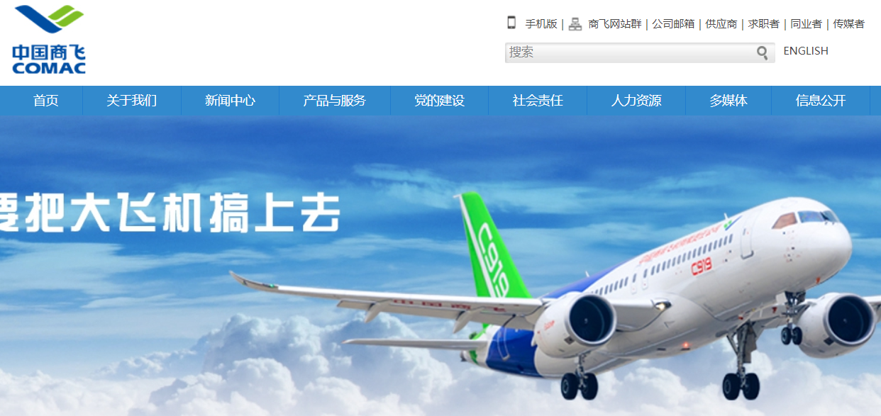
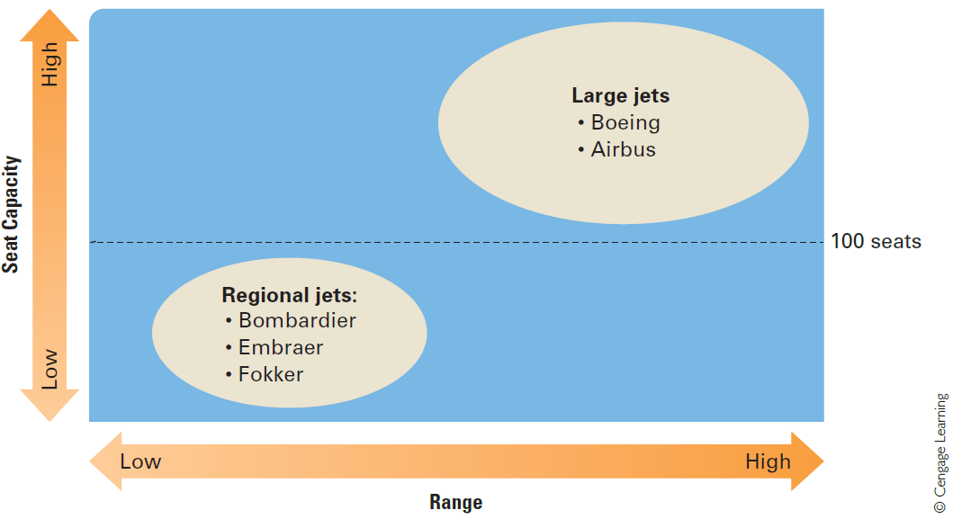
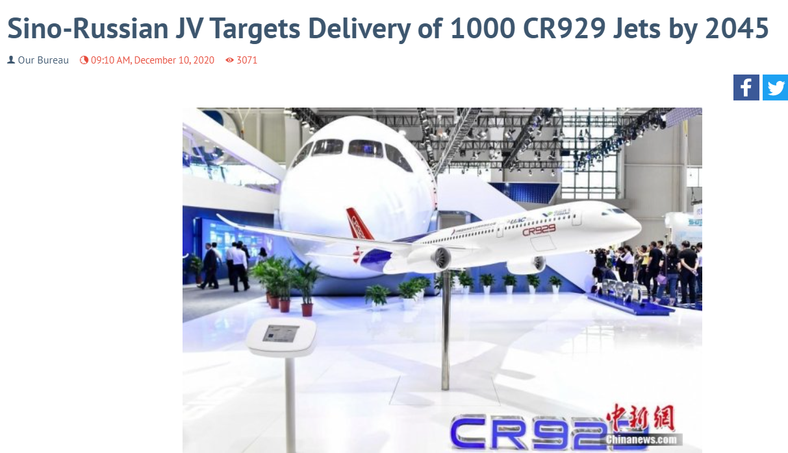
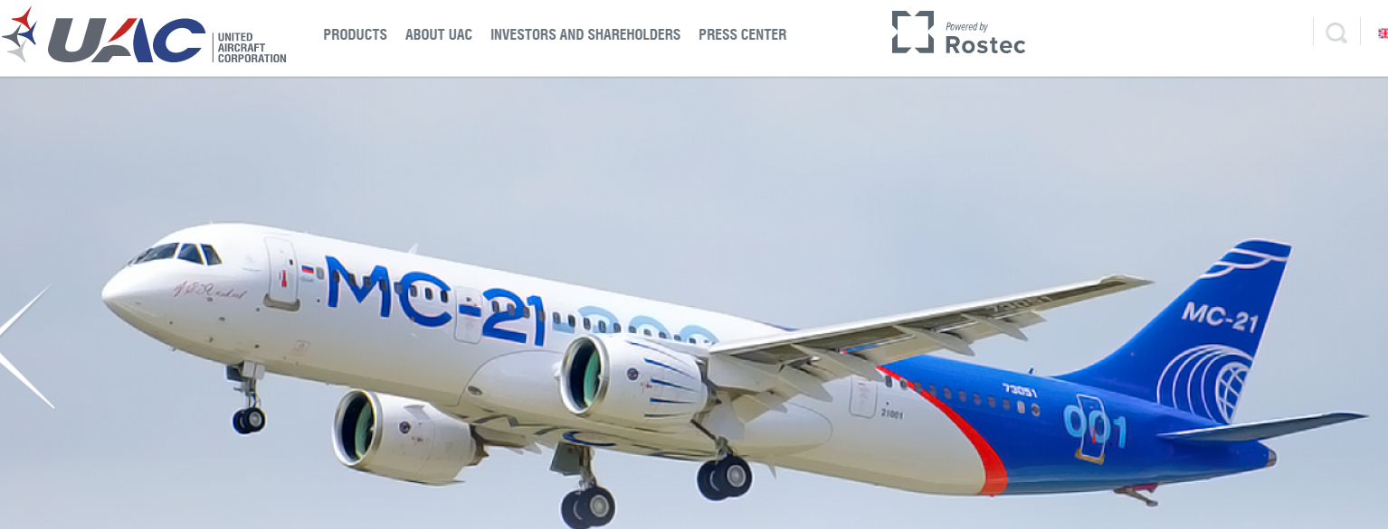
Strategic Groups in the Commercial Aerospace Industry
CR929
https://www.defenseworld.net/news/28513/Sino_Russian_JV_Targets_Delivery_of_1000_CR929_Jets_by_2045#.YJY-l7X0lPY

Slide 44
Strategic Groups in the Commercial Aerospace Industry
Boeing Dreamliner
248 – 336 seats
~15,000km
2017 - Bombardier gave Airbus a 50.01% share in the program, formerly known as the C-series, to stem the financial bleeding. The cost of developing the plane had almost doubled to $6 billion and sales had been disappointing amid a fierce competitive response by Airbus and Boeing.
Airbus 380 up to 853 seats
Bombardier C Series – 150 seats, 6,000km
2020 - Airbus and the government of Québec have become the sole owners of the A220 program with the exit of Bombardier, which developed the plane but was driven to the brink of bankruptcy by the spiraling costs of the ambitious program. The deal marks Bombardier’s exit from commercial aviation, with more divestitures expected as the Canadian manufacturer tries to reduce its crushing debt load of $9.7 billion.
Bombardier CRJ Series – 60-100 seats, 3,000km

Slide 45
Competitor Analysis

Slide 46
Understanding the Competition
There may be many firms competing in the industry, in which case treat then as a group or category e.g. discount retailers like Aldi and Lidl
Key competitors – which firms are in the same strategic group and most likely to be a close substitute? Focus on 3-5 main competitors and gather as much detail as possible
For each competitor acquire and analyse:
  Financial data – may be difficult for a firm like Ikea but UK accounts are available
  Products and Services Details
  Geographic scope
  Strategic actions e.g. mergers and acquisitions, expansion, contraction etc.
  Resources, Competencies and Competitive Advantage
  Ethics and Sustainability

Slide 47
Competitor Comparisons Over at Least 3 and Ideally 5 - 10 years
Revenues and Profits – trends, major and sudden changes
Share Price – trends, major and sudden changes
Degree of diversification
Degree of Internationalisation/Globalisation
Degree of vertical integration
Resources
Product or service characteristics (Strategic Groups?)
Market Share
Mergers and acquisitions
Ratios - trends, major and sudden changes
Debt - trends, major and sudden changes

Slide 48
Critical Success Factor Analysis
A critical success factor (CSF) analysis is something that a company must do well in order to succeed in the industry e.g. airline safety, product reliability, customer experience
Critical Success Factor | Harley Davidson | Competitor A | Competitor B | Competitor C | Competitor D | Competitor E
Engine Technology | 6 | 10
Styling and Features | 9 | 8
Brand Reputation | 10 | 7
Loyal Customers | 10 | 7
Strong Distribution Network | 8 | 9
Efficient manufacturing | 7 | 9
Frequent New Products | 5 | 8
Note – scores are indicative and not based on a detailed analysis

Slide 49
Industry Development and Disruption

Slide 50
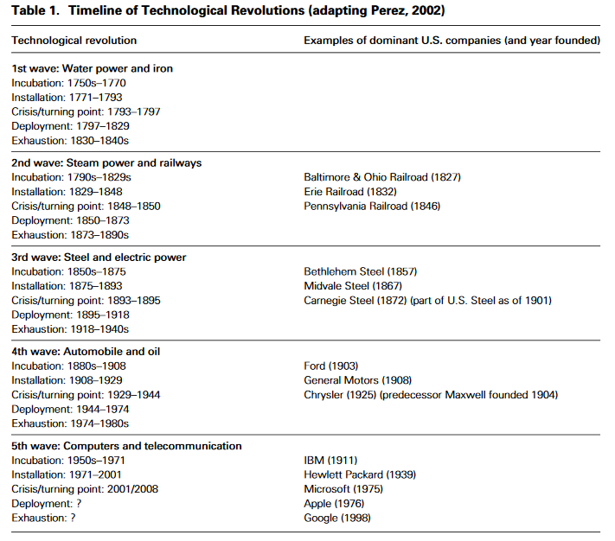
Business and Technology Revolutions 1750 - 2010
East India Company – 1600
Royal Africa Company - 1602
Vereenigde Oostindische Compagnie – 1602
French East India Company - 1664
London Stock Exchange - 1801
New York Stock Exchange – 1817
Siemens - 1847
Nokia - 1865
Tata - 1868
Heinz – 1869
Bombay Stock Exchange – 1875
Standard Oil - 1870
BP - 1909
Boeing – 1916
IBM - 1924
Toyota - 1937
Samsung - 1938
Walmart – 1962
Airbus – 1970
Boston Dynamics - 1992
Amazon - 1994
Facebook - 2004

Slide 51
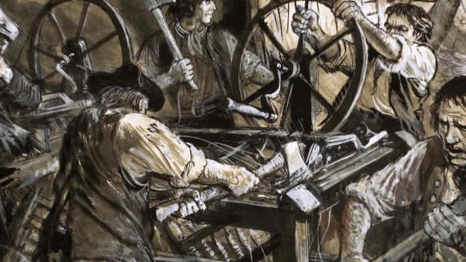
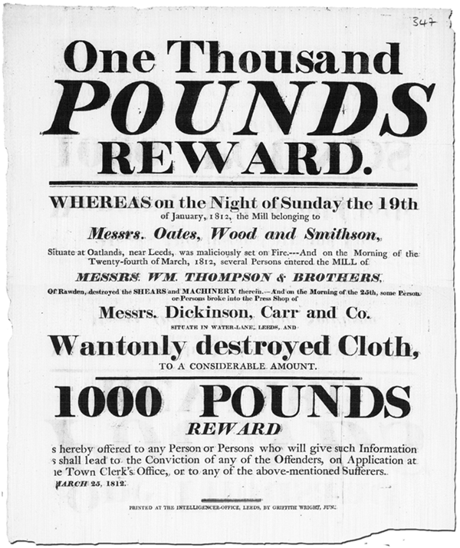
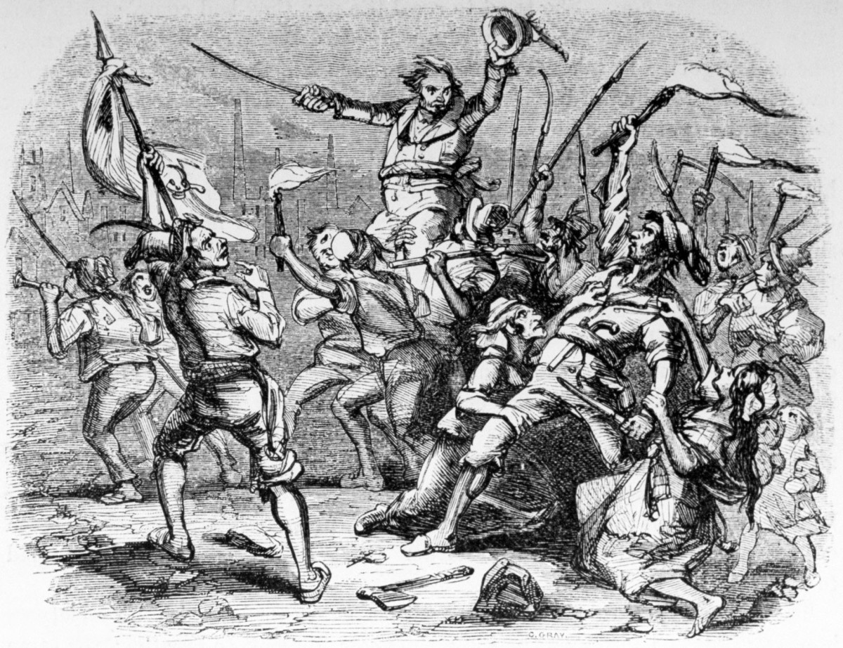
Luddites - 1812
Notes:
https://www.history.com/news/who-were-the-luddites#:~:text=%E2%80%9CLuddite%E2%80%9D%20is%20now%20a%20blanket,skilled%20craftsmen%20of%20the%20day
“Luddite” is now a blanket term used to describe people who dislike new technology, but its origins date back to an early 19th-century labor movement that railed against the ways that mechanized manufactures and their unskilled laborers undermined the skilled craftsmen of the day.
The original Luddites were British weavers and textile workers who objected to the increased use of mechanized looms and knitting frames. Most were trained artisans who had spent years learning their craft, and they feared that unskilled machine operators were robbing them of their livelihood. When the economic pressures of the Napoleonic Wars made the cheap competition of early textile factories particularly threatening to the artisans, a few desperate weavers began breaking into factories and smashing textile machines. They called themselves “Luddites” after Ned Ludd, a young apprentice who was rumored to have wrecked a textile apparatus in 1779.
READ MORE: The Original Luddites Raged Against the Machines of the Industrial Revolution
There’s no evidence Ludd actually existed—like Robin Hood, he was said to reside in Sherwood Forest—but he eventually became the mythical leader of the movement. The protestors claimed to be following orders from “General Ludd,” and they even issued manifestoes and threatening letters under his name.

Slide 52

Creative Destruction and Disruptive Technologies
Joseph Schumpeter coined the term creative destruction in his 1942 book
He defined the notion of creative destruction as a ‘process of industrial mutation that incessantly revolutionises the economic structure from within, incessantly destroying the old one, incessantly creating a new one’
The key role in creative destruction is reserved for technological innovations that can outflank existing products, designs, and processes
Incremental improvements are made redundant through creative destruction (e.g. PC vs. typewriter industry)
Notes:
https://americanhistory.si.edu/collections/object-groups/slide-rules
Slide rules are analog computing devices marked with linear or logarithmic scales, some on a moving slide and some stationary on the base of the instrument, so that two numbers may be added or multiplied by aligning the slide. Slide rules can perform the basic arithmetic operations of addition, subtraction, multiplication, and division, but they can also be marked for computing with logarithms, square and cube roots, exponents, trigonometric functions, and vectors. From the late 19th century until about 1970, slide rules served as the principal calculating instruments for engineers, scientists, electricians, navigators, high school and college students, and others. Firms in the United States, Europe, and Japan made millions of the objects, and slide rule cases that attached to a belt loop were as common a sight on the hips of technical students in the 1950s and 1960s as cell phone cases were in the 1990s and 2000s.

Slide 53
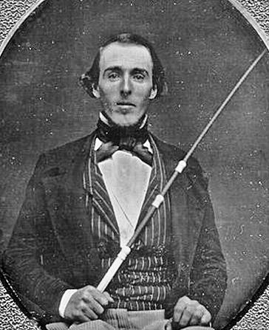
The Case of the Buggy Whip Makers
There were 13,000 businesses in the wagon and carriage industry in 1890.
A company survived not by conceiving of itself as being in the "personal transportation" business, but by commanding technological expertise relevant to the automobile.
"The people who made the most successful transition were not the carriage makers, but the carriage parts makers," he said, some of whom are still in business.
Thomas A. Kinney “The Carriage Trade: Making Horse-Drawn Vehicles in America.”

Slide 54
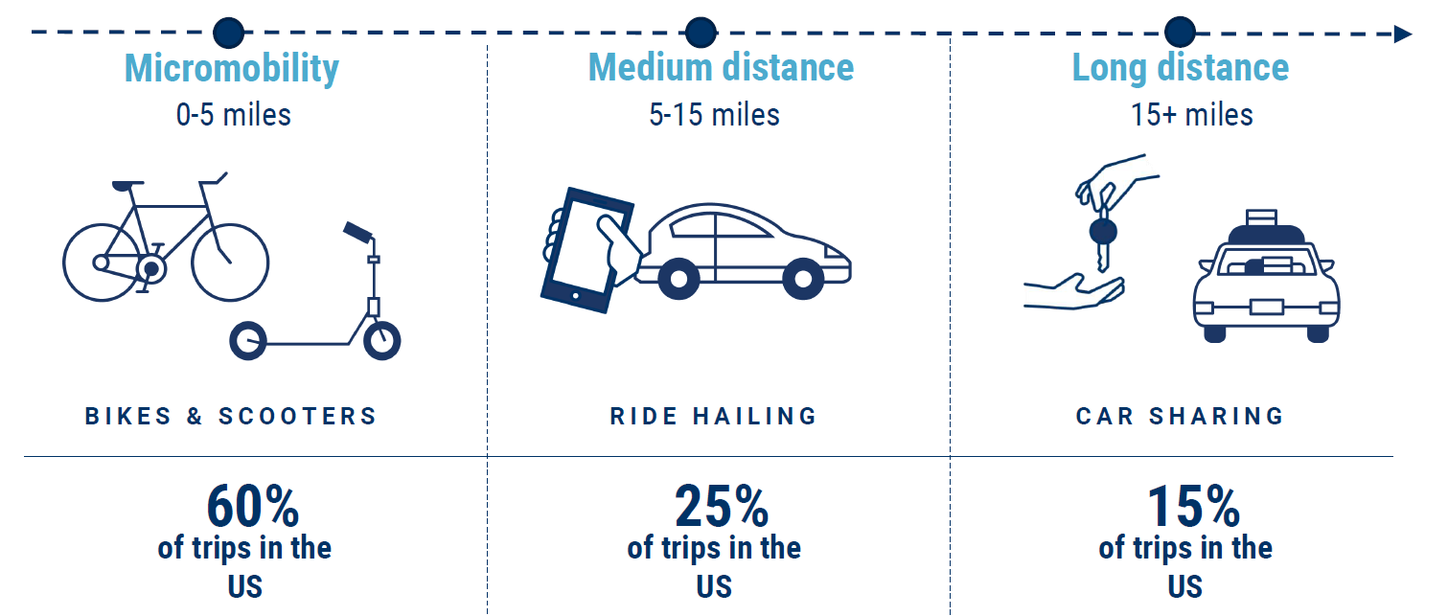
Disrupting the Car

Slide 55
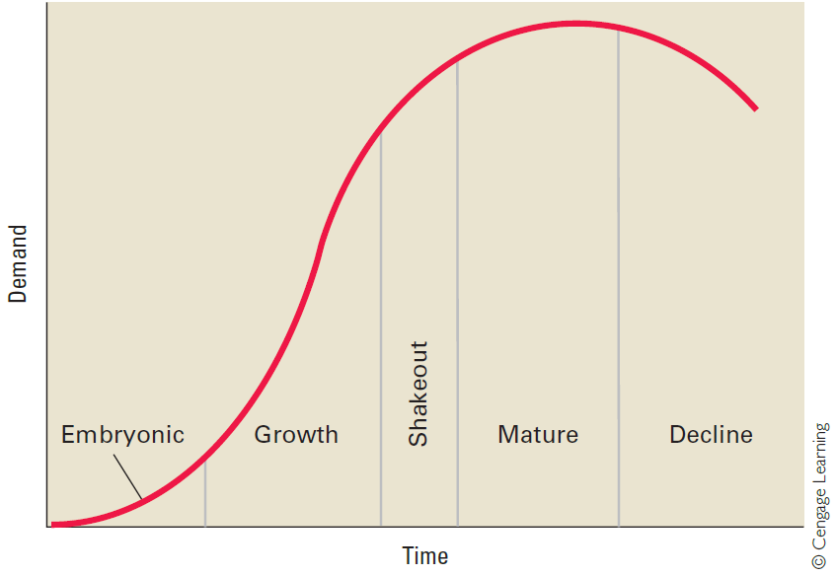
Stages in the Industry Life Cycle
Industries do not always follow the pattern of the industry life-cycle model
Time span of the stages vary from industry to industry
Punctuated equilibrium - Long periods of equilibrium are punctuated by periods of rapid change
Hill, Jones, & Schilling (2015)
Notes:
Embryonic Industries
An embryonic industry refers to an industry just beginning to develop (for example, personal computers and biotechnology in the 1970s, wireless communications in the 1980s, Internet retailing in the late 1990s, and AI today).
Growth at this stage is slow because of factors such as buyers’ unfamiliarity with the industry’s product, high prices due to the inability of companies to reap any significant scale economies, and poorly developed distribution channels.
Rivalry in embryonic industries is based not so much on price as on educating customers, opening up distribution channels, and perfecting the design of the product.
Growth Industries
Once demand for the industry’s product begins to increase, the industry develops the characteristics of a growth industry. In a growth industry, first-time demand is expanding rapidly as many new customers enter the market. We can see this happening today in the taxi ride platform industry, with now numerous companies seeking to grow their marker share – Uber, Gett, Juno, Kabbee, Hailo etc
Industry Shakeout
Explosive growth cannot be maintained indefinitely. Sooner or later, the rate of growth slows, and the industry enters the shakeout stage. In the shakeout stage, demand approaches saturation levels: more and more of the demand is limited to replacement because fewer potential first-time buyers remain.
Expect this soon in taxi app platforms!
Mature Industries
The shakeout stage ends when the industry enters its mature stage: the market is totally saturated, demand is limited to replacement demand, and growth is low or zero. Typically, the growth that remains comes from population expansion, bringing new customers into the market, or increasing replacement demand.
As a result of the shakeout, most industries in the maturity stage have consolidated and become oligopolies.
Declining Industries
Eventually, most industries enter a stage of decline: growth becomes negative for a va- riety of reasons, including technological substitution (for example, air travel instead of rail travel), social changes (greater health consciousness impacting tobacco sales), demographics (the declining birth rate damaging the market for baby and child products), and international competition (low-cost foreign competition helped pushed the U.S. steel industry into decline).
It is important to remember that the industry life-cycle model is a generalization and that the time span of these stages can also vary significantly from industry to industry.
A criticism of industry models is that they overemphasize the importance of industry structure as a determinant of company performance, and underemphasize the importance of variations or differences among companies within an industry or a strategic group.
Research by Richard Rumelt and his associates, for example, suggests that industry structure explains only about 10% of the variance in profit rates across companies.

Slide 56
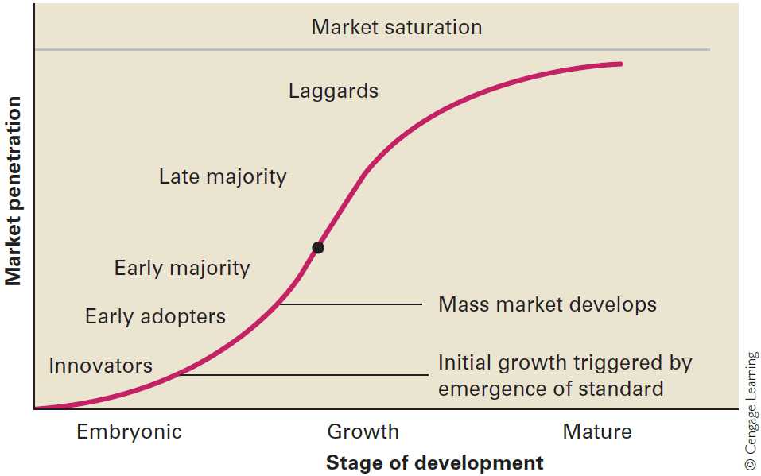
Market Development and Customer Groups
Hill, Jones, & Schilling (2015)

Slide 57
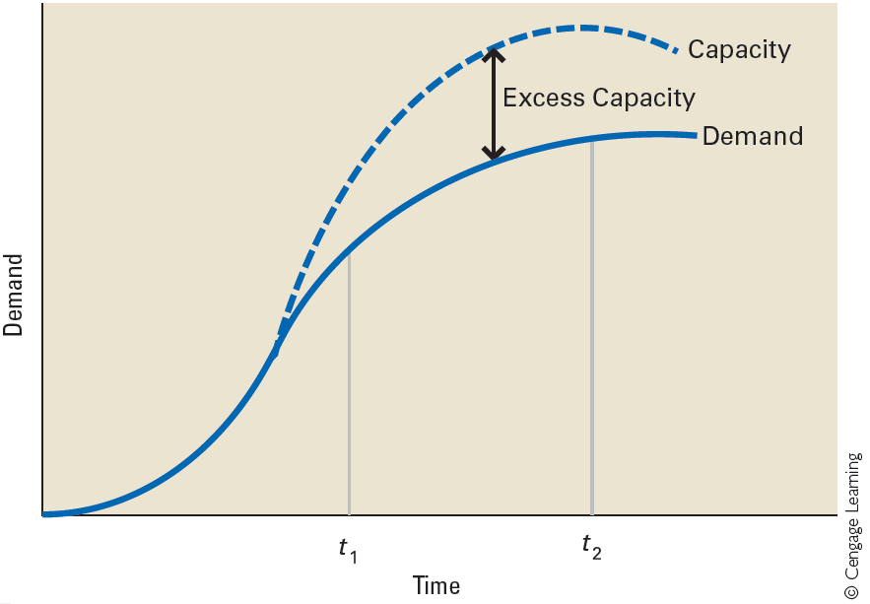
Growth in Demand and Capacity
Hill, Jones, & Schilling (2015)

Slide 58
Limitations of Models for Industry Analysis
Life-cycle issues
  Industries do not always follow the pattern of the industry life-cycle model
  Time span of the stages vary from industry to industry
Innovation
  Punctuated equilibrium - Long periods of equilibrium are punctuated by periods of rapid change
  Because competitive forces and strategic group models are static, they cannot capture periods of rapid change in the industry environment when value is migrating
Company differences
  Overemphasise importance of industry structure as a determinant of company performance
  Underemphasise importance of variations among companies within a strategic group

Slide 59
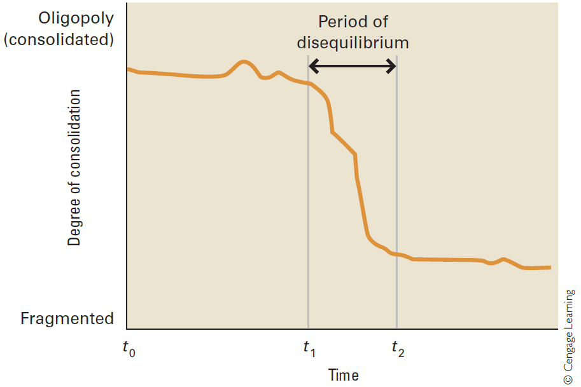
Punctuated Equilibrium and Competitive Structure
Hill, Jones, & Schilling (2015)
Notes:
Over any reasonable length of time, in many industries competition can be viewed as a process driven by innovation.18 Innovation is frequently the major factor in industry evolution and causes a company’s movement through the industry life cycle.
Michael Porter talks of innovations as “unfreezing” and “reshaping” industry structure. This is a model of change familiar to students of organisational change management in which in one common model of change it is first necessary to unfreeze the organisation in order to have change, and then re-freeze in a new configuration.
Porter argues that after a period of turbulence triggered by innovation, the structure of an industry once more settles down into a fairly stable pattern, and the five forces and strategic group concepts can once more be applied. This view of the evolution of industry structure is often referred to as “punctuated equilibrium.
This is what is happening with the taxi industry: the old model of hailing or calling a cab has been disrupted by the availability of smart phones, apps and taxi platforms. A new shape of the industry can be expected to become established although it too may be quickly disrupted by driverless cars replacing taxis and their drivers. It is interesting to note that car manufacturers are investing in platforms like Uber as part of preparing for the impact that driverless cars will have on their current business model. They are anticipating much lower levels of car ownership and much more sharing.

Slide 60
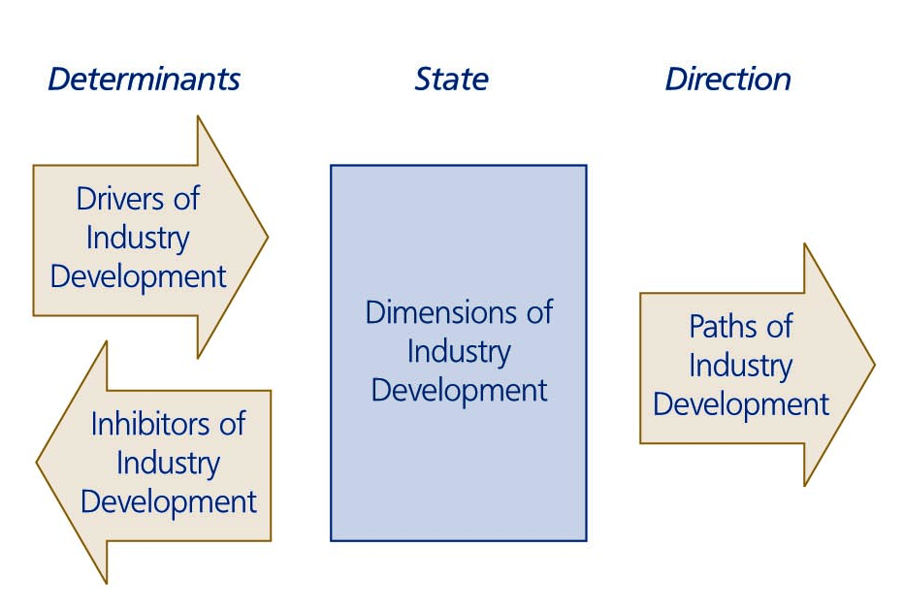
The Issue of Industry Development
Notes:
Industry rules are the demands dictated to the firm by the industry context, limiting the scope of potential strategic behaviours, e.g. ‘must have strong brand’
Industry rules arise from the structure of the industry
As industries develop, the rules of competition change.
Strategising managers need to identify which characteristics in the industry structure and which aspects of competitive interaction are changing.
Strategists need to recognise the drivers and the inhibitors of industry development

Slide 61
Dimensions Of Industry Development
Convergence–divergence
Concentration–fragmentation
Vertical integration–fragmentation
Horizontal integration–fragmentation
International integration–fragmentation
Expansion–contraction

Slide 62
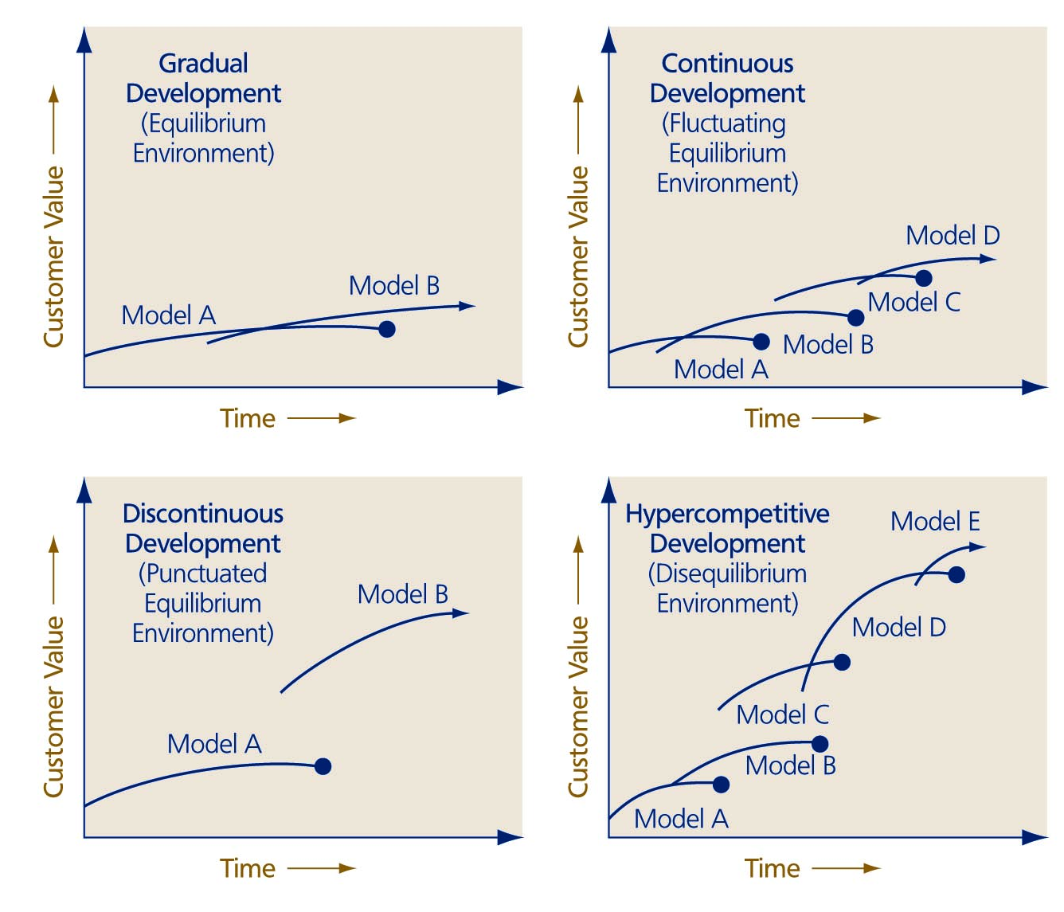
Patterns of Dominant Business Model Development
Notes:
Gradual development
Continuous development
Discontinuous development – where one business model is dominant for a long period of time and is then suddenly displaced by a radically better one
Hypercompetitive development – where business models are frequently pushed aside by radically better ones

Slide 63
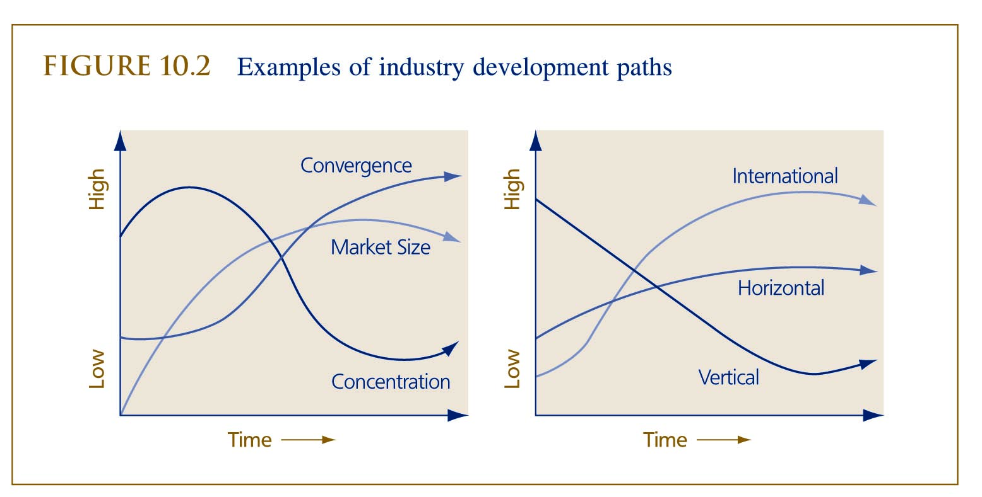
Dimensions of Industry Development
Convergence – Divergence (how alike are firms)
Concentration – Fragmentation (market shares)
Vertical integration – Fragmentation
Horizontal integration – Fragmentation
International integration – Fragmentation
Expansion – Contraction

Slide 64
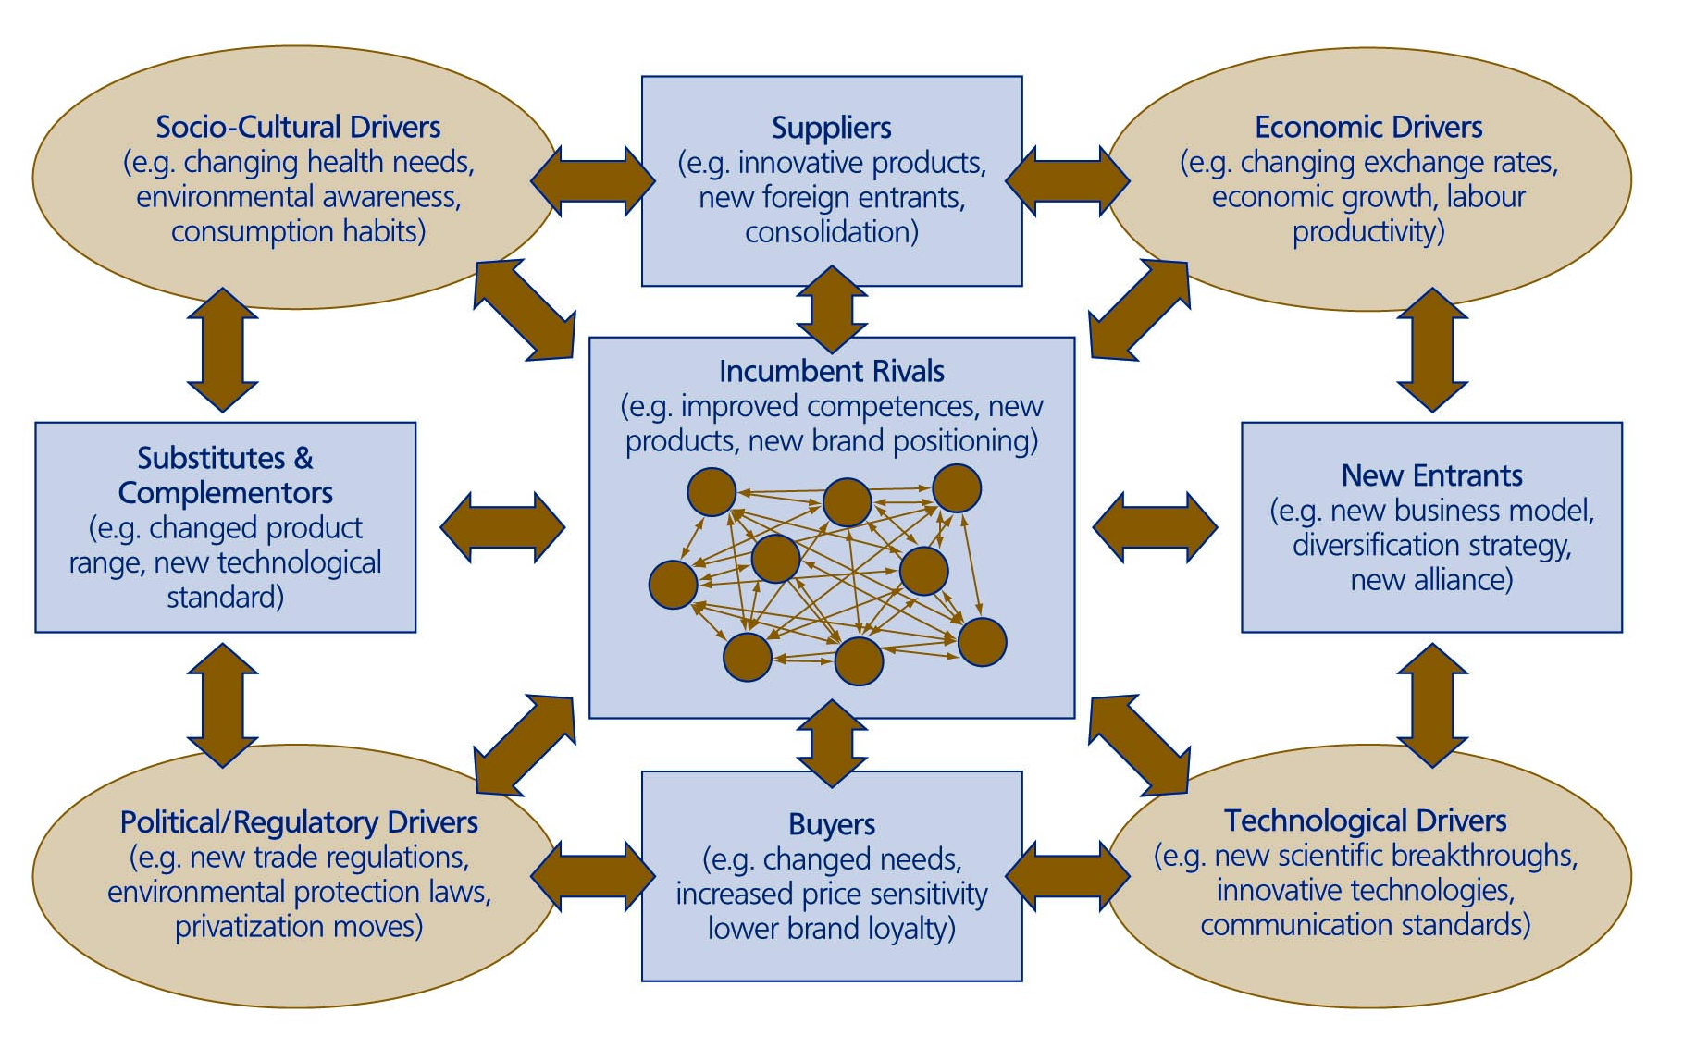
Drivers of Industry Development
Notes:
Environmental factors that are external or internal to the industry
Factors in the contextual environment include socio-cultural, economic, political/regulatory and technological forces of change
Factors in the industry environment can be divided into groups surrounding suppliers, buyers, incumbent rivals, new entrants, substitutes and complementors
Where one firm is the major driver of industry development it can claim industry leadership
If there is no industry leader, the industry dynamics determine the path of industry development

Slide 65

Inhibitors of Industry Development
Underlying conditions
Industry integration
Power structures
Risk averseness
Industry recipes
Institutional pressures
Notes:
https://www.nrdc.org/stories/fracking-101#whatis
What Is Fracking?
Modern high-volume hydraulic fracturing is a technique used to enable the extraction of natural gas or oil from shale and other forms of “tight” rock (in other words, impermeable rock formations that lock in oil and gas and make fossil fuel production difficult). Large quantities of water, chemicals, and sand are blasted into these formations at pressures high enough to crack the rock, allowing the once-trapped gas and oil to flow to the surface.
History of Fracking
The idea for fracking—or “shooting the well,” as the practice was once referred to—dates back to 1862 and has been credited to a Colonel Edward A. L. Roberts. In the midst of fighting during the Civil War’s Battle of Fredericksburg, Roberts noted the impact that artillery had on narrow, water-filled channels. A few years later, he applied his battlefield observations to the design of an “exploding torpedo” that could be lowered into an oil well and detonated, shattering surrounding rock. When water was then pumped into the well, oil flows increased—in some cases by as much as 1,200 percent—and fracking was established as a way to increase a well’s productive potential.
In the 1940s, explosives were replaced with high-pressure blasts of liquids, and so “hydraulic” fracking became the standard in the oil and gas industry. It wasn’t until the beginning of the 21st century, however, that two key changes helped spark fracking’s current boom. One was the use of a certain type of fracturing fluid: slickwater, a mix of water, sand, and chemicals to make the fluid less viscous. The other innovation was the pairing of fracking with horizontal drilling, a technique that increases the productive potential of each well because it can reach more of the rock formation that contains the oil and gas. These advances, combined with an influx of investment amid high global fossil fuel prices, sent fracking into overdrive. Indeed, of the approximately one million U.S. wells that were fractured between 1940 and 2014, about one-third of those were fractured after 2000.
How Does Fracking Work?
It involves blasting fluid deep below the earth’s surface to crack sedimentary rock formations—this includes shale, sandstone, limestone, and carbonite—to unlock natural gas and crude oil reserves.

Slide 66
The Paradox Of Compliance And Choice
The demand for firm compliance
Organisations must adapt themselves to their environments. Therefore all organisations need to understand the context in which they operate.
The demand for strategic choice
If firms only play by the current rules, it is difficult to gain a significant competitive advantage over their rivals. To be unique and develop a competitive advantage, firms need to do something different.

Slide 67
Perspectives On The Industry Context
The industry dynamics perspective
Belief that individual firms have the power to shape their industry is misplaced
Firms are small players in a large game – their behaviors cannot fundamentally shape the direction of changes
Also known as the industry evolution perspective – the survival and growth of entities depends on their fit with the environment
Changing the rules is difficult, slow and hazardous
The industry leadership perspective
Belief that in industry some rules are immutable but other environmental factors can be manipulated
Strategist must recognize the limits of the possible and the limitless possibilities
Leading firms need the intellectual ability to envision the industry’s future and be able to communicate this vision so that other firms and individuals will buy into it
A leading firm needs to work out a new competitive business model

Slide 68
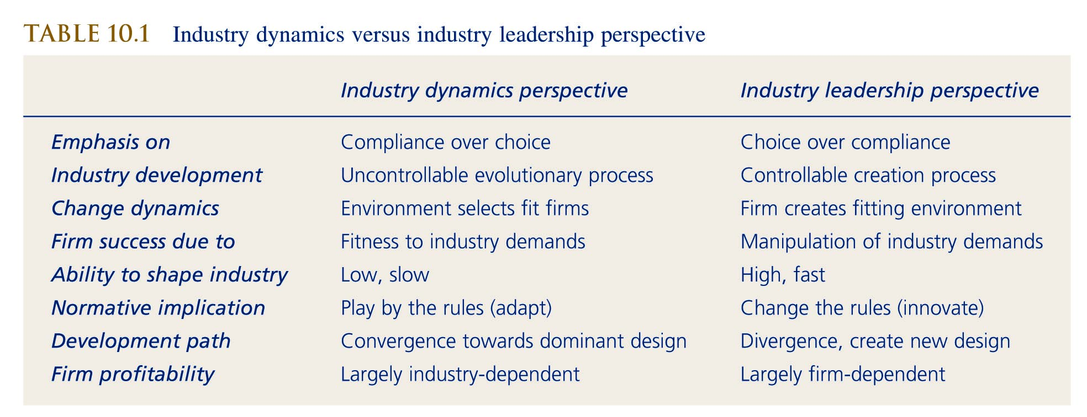
Managing The Paradox Of Compliance And Choice - Juxtaposing
The majority of industry rules cannot be broken, but it is important to know which can
The industry dynamics perspective is applicable in some occasions, the industry leadership perspective is preferred in others
Independent from perspectives strategists need to juxtapose between firm compliance and strategic choice

Slide 69
References
Bennett, N. and Lemoine, G. J. (2014) ‘What VUCA Really Means for You’, Harvard Business Review, 92(1/2), p. 27.
Cornelius, P, Van de Putte, A, & Romani, M 2005, 'Three Decades of Scenario Planning in Shell', California Management Review, 48, 1, pp. 92-109, Business Source Complete, EBSCOhost, viewed 6 March 2017.
De Wit, R & Meyer, R, (2017) Strategy, An International Perspective, Andover, Hampshire: Cengage Learning, 6th ed.
Hill, C., Jones, G. & Schilling, M. (2015) Strategic Management; Theory & Cases: an integrated approach, 11e, Stamford, Cengage
Kurtz, C. & Snowden, D. 2003. The new dynamics of strategy: Sense-making in a complex and complicated world, IBM Systems Journal, vol. 42 no. 3, pp. 462–483
Porter, M.E., 2008. The Five Competitive Forces That Shape Strategy. Harvard Business Review 86, 78–93.
Schoemaker, P.J.H., Heaton, S., Teece, D., 2018. Innovation, Dynamic Capabilities, and Leadership. California Management Review 61, 15–42. https://doi.org/10.1177/0008125618790246
Schoemaker, P. and Krupp, S. (2015) ‘THE ANTICIPATORY LEADER: How to See Sooner and Scan Wider’, Rotman Management, pp. 36–41. Available at: http://0-search.ebscohost.com.emu.londonmet.ac.uk/login.aspx?direct=true&db=bth&AN=102477054&site=ehost-live (Accessed: 28 August 2019).

