Slide 1

Breakthrough Leadership Skills
MN7028
Topic 7:Leading Change

Slide 2

Learning Outcomes
To distinguish and evaluate selected change theories.
To evaluate and apply a range of change management models.
To identify some of the reasons for resistance of change and apply theories to combat these.
To critically assess the contribution made by HRM/HRD specialists in the management of change.

Slide 3

The nature of change?
“You cannot step twice into the same river for other waters are continually flowing on... everything flows and nothing abides; everything gives way and nothing stays fixed...cool things become warm, the warm grows cool; the moist dries, the parched becomes moist ... It is in changing that things find repose...” [Heraclitus, approx 500 BC]

Slide 4
Models of change
Planned change
Emergent change
Change resulting from a deliberate decision to alter the organisation
Change as a continuous process....

Slide 5
Contrasting models of change...
Planned change (stability model): initiatives intended to improve organisational efficiency and operation, top down model, assumes underlying stable state, manager’s role to implement change in a way that will minimise resistance; assumes there is one best answer to the problem....
Emergent change (processual model): change is a continuous process of adaptation, includes informal change processes outside formal hierarchies and boundaries; manager’s role is to foster organisational climate that encourages risk taking and innovation...

Slide 6

Critiques of Planned Change
Assumption of stability (is ‘freezing’ viable?)
Assumption of predictability of the change process itself (will events derail it, what might derail it)
Arguably it ignores politics and conflict
> Logical incrementalism’ (Quinn, 1980)
> building supportive coalitions (Kotter, 1996)

Slide 7

Defining organisational change
‘The process by which an organisation moves from its present condition to a desired state; in particular improving its use of resources in its struggle to continue to create value and survive’ (Luhman and Cunliffe, 2013: 111)
Change management: ‘Attending to organisational change processes at organisational, group and individual levels’ (Hughes, 2010:4)

Slide 8

The importance of change management
“Every organisation has to prepare for the abandonment and reinvention of everything it does, not once but as an ongoing philosophy” [Peter Drucker - Harvard Business Review Sept 1990]
“Nothing is more important in a manager’s armament than the capacity to successfully effect change”. [Rosabeth Moss-Kanter Harvard Business School]
The ability to manage change is recognised as a core organisational competence.

Slide 9

Triggers for Organisational change
External
Competition
Technology
New materials
Changing tastes
Legislation
Economic trends
Political shifts
Social values
Internal
Poor performance
Inadequate skills
New ideas
Design innovations
New management
Relocation
Restructuring
[Source: Organizational Behaviour; Huczynski & Buchanan; 2004]

Slide 10

Common contexts/objectives for Organisational change
  Structural change
  Changes in goals or mission
  Technological change
  Change in work tasks
  Changes in attitudes and cultural values

Slide 11

Models of Change
Lewin (1947)
Thurley (1979)
Kubler-Ross (1969/1980)
Beckhard and Harris (1987)
Dunphy and Stace (1988)
Bandura (1986)
Eisenstat et al (1990)
Kotter (1996)

Slide 12

Eisenstat, Beer, and Spector’s
Six Steps to Effective Change (1990)
Mobilise commitment around business problem
Develop shared task aligned vision (of roles and responsibilities)
Foster consensus on that vision
Encourage spreading of revitalisation (but independently in their own respective forms – let them “reinvent the wheel”)
Institutionalise revitalisation (processes)
Monitor and adjust strategies
Eisenstat, R., Beer, M., and Spector, B. (1990)

Slide 13

The contribution of Kurt Lewin
Lewin was one of the ‘founding fathers’ of social psychology, group dynamics and action research
Highly influential in fields such as:
Gestalt theory
Tavistock Institute
Sensitivity training
Change Theory and Force Field Analysis

Slide 14
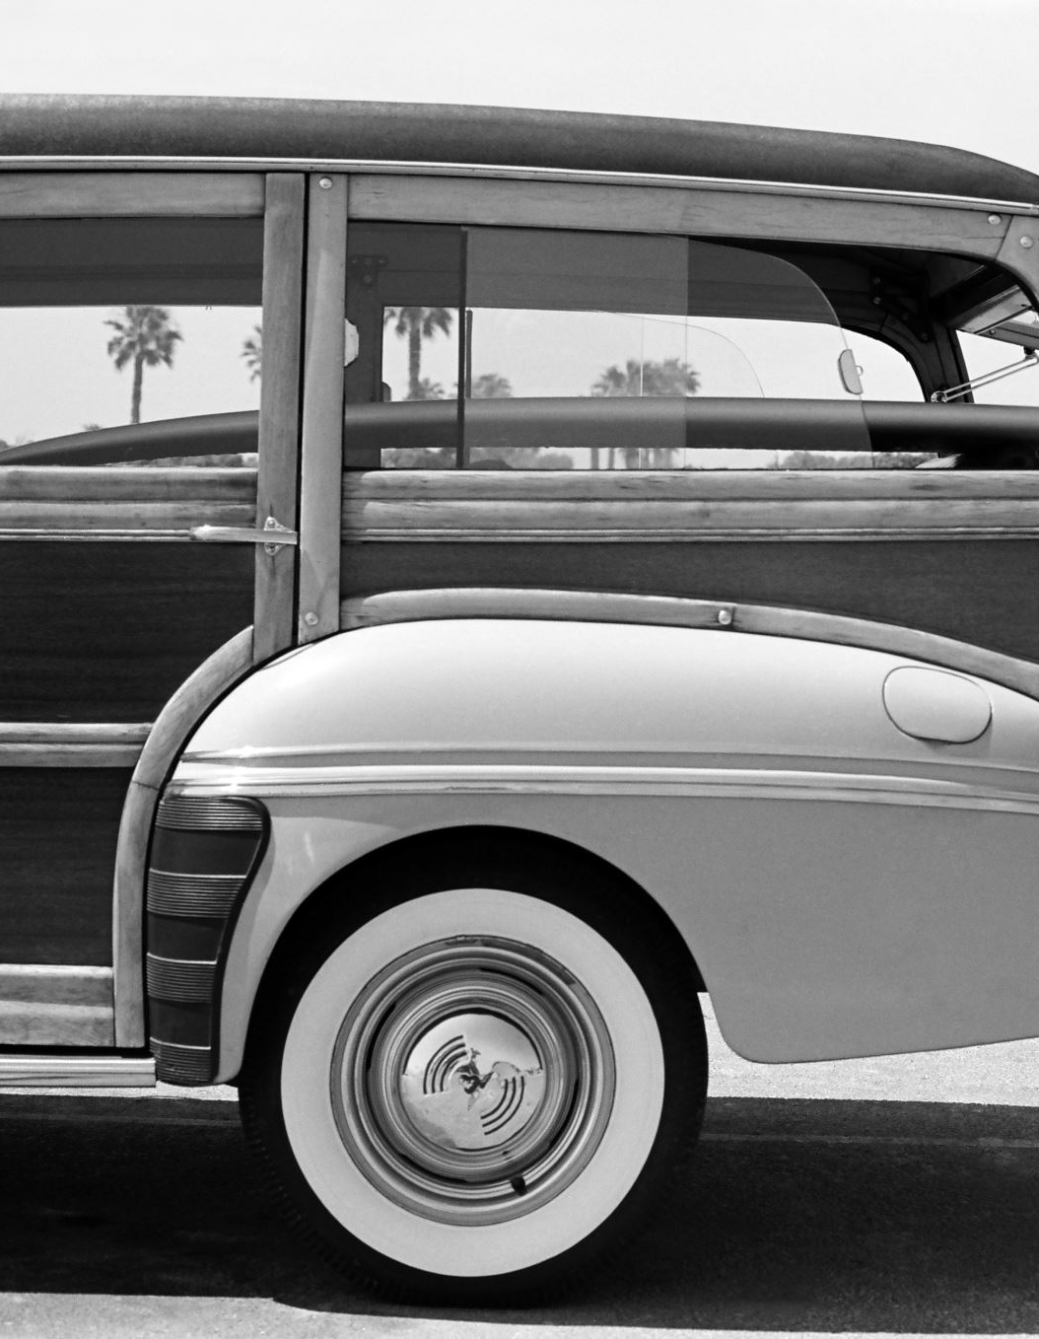
Lewin’s model
Unfreezing
Changing
Freezing
Force field analysis: driving vs restraining
Lewin, K. (1890-1947)

Slide 15

Beckhard and Harris: Change as a Planned Process
Three ‘states’ to the change process:
Diagnosing present conditions
Defining transition activities
Developing strategies and action plans
Beckhard, R. and Harris (1987)

Slide 16

Dunphy and Stace (1988): Contingency/Situational models for change
They propose four styles of change leadership: consultative, collaborative, directive and coercive, depending on external and internal context:
Collaborative
Consultative
Directive
Coercive

Slide 17

Thurley’s approaches
Directive
Bargained
Hearts and minds
Analytical
Action-based
Thurley, K. (1979)

Slide 18

Bandura’s Behavioural Approach
People make conscious choices
Information comes from their environment
Choices are based on values, views and consequences
Bandura, A. (1986)

Slide 19

Kotter’s 8 step change model
https://www.kotterinc.com/8-steps-process-for-leading-change/
Create a sense of urgency
Build a guiding coalition
Form a strategic vision and initiatives
Enlist a volunteer army
Enable action by removing barriers
Generate short-term wins
Sustain acceleration
Institute change

Slide 20

The role of HR in Change
Ulrich (1997) ‘change agent’ is one of four roles for the HR professional
HR should become ‘an agent of continuous transformation’ (ibid)
actively shaping organizational processes and culture (Ulrich, 1998)
‘clear, consistent and concensual messages’ about the change programme (Baddar AL-Husan and Kakavelakis in Perkinsd and Arvinen-Muondo, 2013)
Echoes of Pettigrew (1979) ‘management of meaning’

Slide 21

The 7 C’s of change (CIPD, 2005)
Choosing team
Crafting vision
Connecting hard issues with soft issues
Consulting with all stakeholders
Communicating
Coping with the process
Capturing learning

Slide 22

The corresponding 7 relevant HR practices (Thornhill et al, 2000)
Cultural change
Recruitment
Performance management practices
Resource development
Reward management
Management of employee relations
Downsizing

Slide 23

Overcoming Resistance to Change
Analysis of the impact
Identification of negative reactions
Involvement
Sense of ownership
Communications
‘replacing resistance with resolve, planning with results and fear of change with excitement about its responsibilities’ (Ulrich, 1998)

Slide 24

Is resistance irrational?
Resistance to change is not necessarily irrational or inappropriate – can stimulate re-examination of the assumptions and provide alternative assessments, enables discussion of the change rather than simple acceptance...
In many organisations we find the problem of ‘change for change’s sake’ – ideological and political reasons to introduce particular changes; isomorphism and management fads and fashions...

Slide 25

Change, loss and emotion
Application of the coping cycle, a psychological model originally developed in relation to those diagnosed with terminal illness, and later to the bereaved:
denial,
anger,
bargaining,
depression,
acceptance (Kubler-Ross 1969)

Slide 26
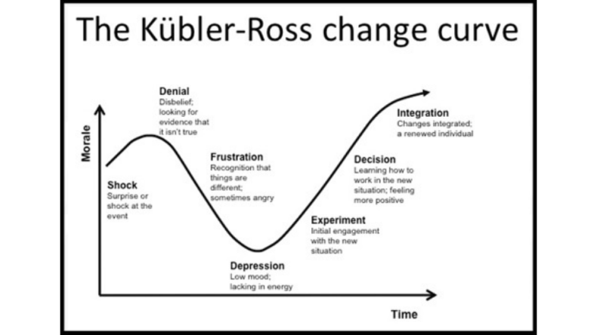
The association of organisational change with grieving and loss

Slide 27
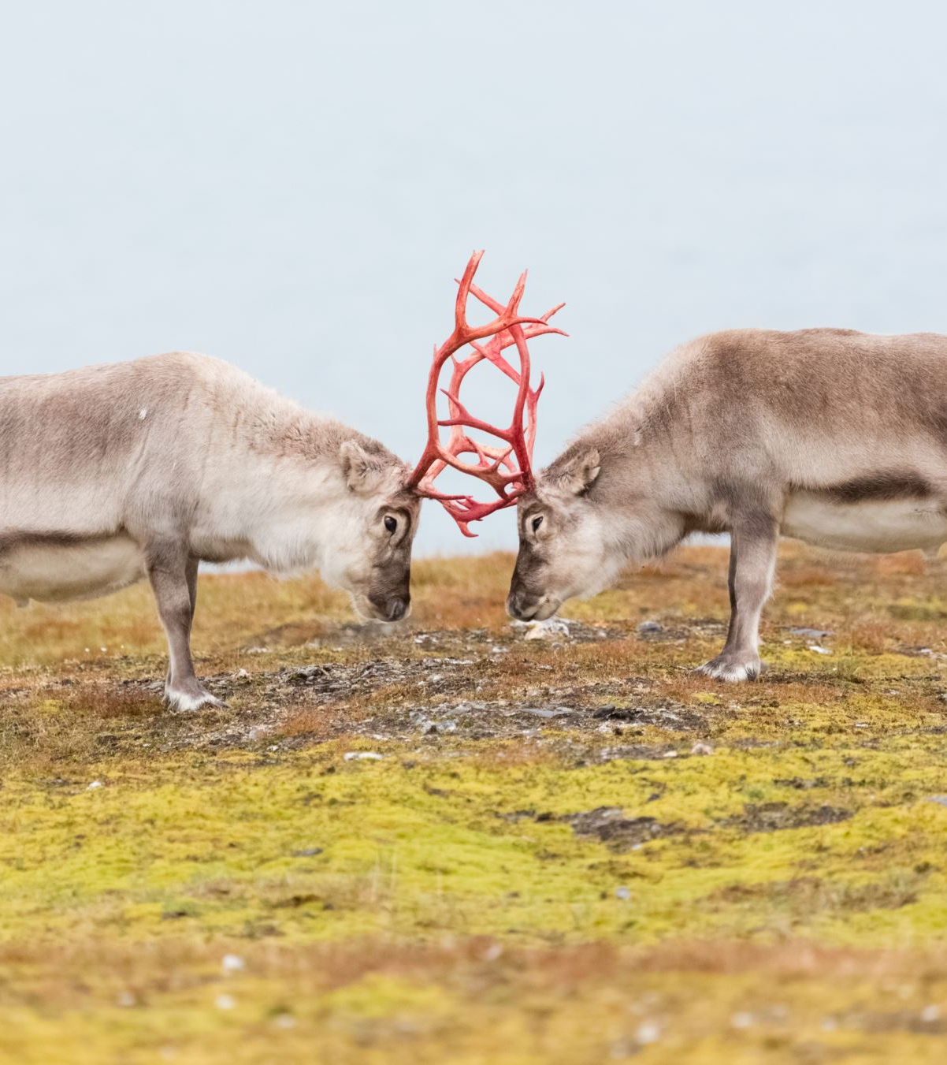
Managing conflict in change contexts (based on Clegg et al, 2016 cited in Hughes, 2019, p.191)
Establish your goals, what you want to achieve?
Inside and outside the org., which important/influential stakeholders can help you achieve the goals?
What are their views and what do they think of the proposed change?
Who can they in turn influence?
Who can you influence?
Which strategies of power will be effective?
Based on steps 1 to 6, choose an ethical approach.

Slide 28

Gaining commitment to change (Watson and Reissner, 2014, p.323)
Analysis
Planning
Communication
Implementation
Institutionalising change

Slide 29

People’s Skills for change (Watson and Reissner, 2014, p.328-330)
Stakeholder mapping and exploration of power
Sensemaking
Understanding oneself

Slide 30

Issues with mergers/acquistions (Kay and Skelton, 2000)
Retention of key talent
Effective communication
Executive retention
Cultural integration

Slide 31

Selected reading
Burnes, B. (2004) Kurt Lewin and the Planned Approach to Change. A Reappraisal. Journal of Management Studies. Vol 41, 6 pp. 977-1002
Eisenstat, R., Spector, B. & Beer, M. (1990) Why Change Programmes don’t Produce Change. Harvard Business Review Nov/Dec 1990 https://hbr.org/1990/11/why-change-programs-dont-produce-change
Hughes, M. (2010) Managing Change: a Critical Perspective. CIPD: London
Kotter, J. (1996) Leading Change. Harvard: Harvard University Press
Kotter, J. and Rathgeber, H. (2006) Our Iceberg is Melting. Macmillan: London
Lewin, K. (1951) Field Theory in Social Science, New York: Harper & Row.
Perkins, S. and Arvinen-Muondo, R. (2013) (eds.) Organizational Behaviour. People, Process Work and Human Resource Management. London: Kogan Page
Senior, B., Swailes, S., & Carnall, C. (1920). Organizational Change, 6th Edition. Harlow, United Kingdom, Pearson Education Canada. http://public.eblib.com/choice/PublicFullRecord.aspx?p=6131420.
Watson, G. and Reissner, S. (2016) Developing Skills for Business Leadership. London: CIPD, Ch. 12

