Slide 1
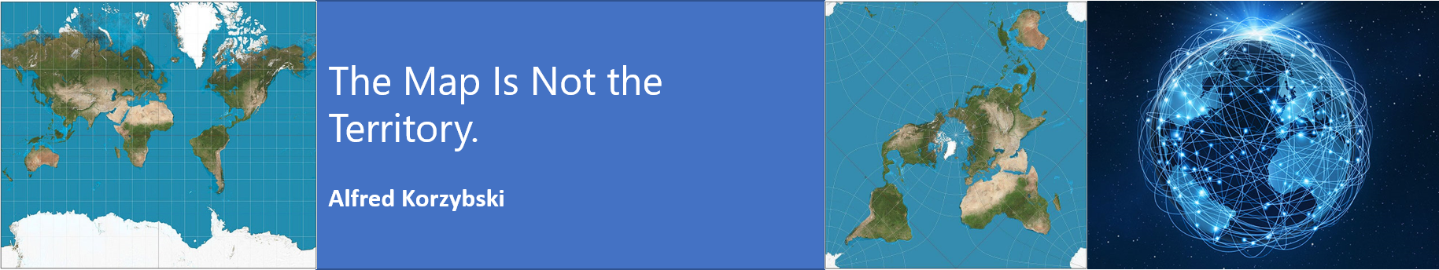
MN7031 Topic 2 – How Do We Diagnose Company Strategy?
Daniel Jones
londonmet.ac.uk

Slide 2
Module Overview
1. How and Why Do Businesses Grow?
2. How Do We Diagnose Company Strategy?
5. How Do We Make Sense of the VUCA External Environment?
8. Does Your Simulation Company Need A New Strategy?
10. Why DO Firms Undertale Acquisitions, Mergers and Alliances?
7. How Is Your Simulation Company Performing?
11. How Do Companies Innovate Successfully?
12. Does Strategic Alignment Matter?
4. Why Are Some Industries More Profitable Than Others?
3. How Does A Company Create Competitive Advantage?
6. How Do We Identify future opportunities and threats?
9. Summative Assessment Presentations
Business Simulation – Cesim Global Challenge

Slide 3
Strategic Diagnosis
Industry (or Sector)
Development stage
Markets and Competitors
Market Segments
Scope of activities
The Organisation
Resources
Capabilities
Competencies
Politics
The Macro-environment
Concentration
Value network
Products and/or services
Critical success factors
Resource commitment
Economics
Social
Technological etc.
Theories and Frameworks
PESTEL
Scenario Planning
5 Forces
Industry Lifecycle
External
Blue Ocean Theory
Red Queen Theory
Market Analysis
Competitor Analysis
Resource Based View
Business Model
Internal
Core Competencies
Organisational Structure
Culture
Global
Regional
National
Local
Systems
Notes:
We will look at competitors in a later topic.

Slide 4
Today’s Agenda
Lecture
Business models
Value Chains
Company Resources – Tangible and Intangible
Core Competencies
Evaluating company resources
Strategy – Outside-In or Inside Out?
Structure, Culture and Systems
Paradox of Control and Chaos
How To Analyse A Company
Strategy Mapping
Simulation – Practice Round 2

Slide 5
Business Model

Slide 6
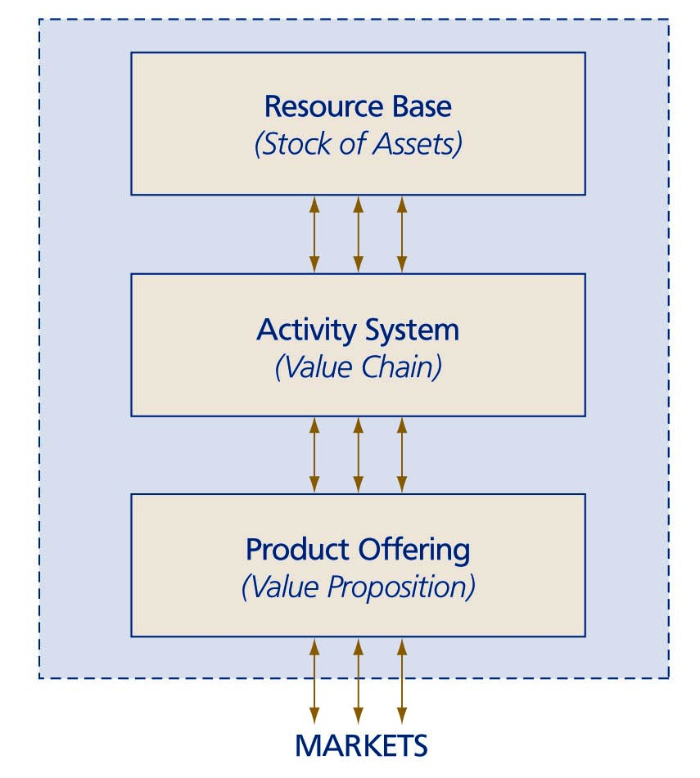
Business Model – How A Firm Makes Profit
A business model is the configuration of resources, activities and product/service offerings intended to create value for customers – the way a firm conducts its business
It shows how a firm is executing its strategy currently
A firm must be able to:
  design a product or service more closely fitted to client needs than rival firms
  develop and supply the superior product

Slide 7
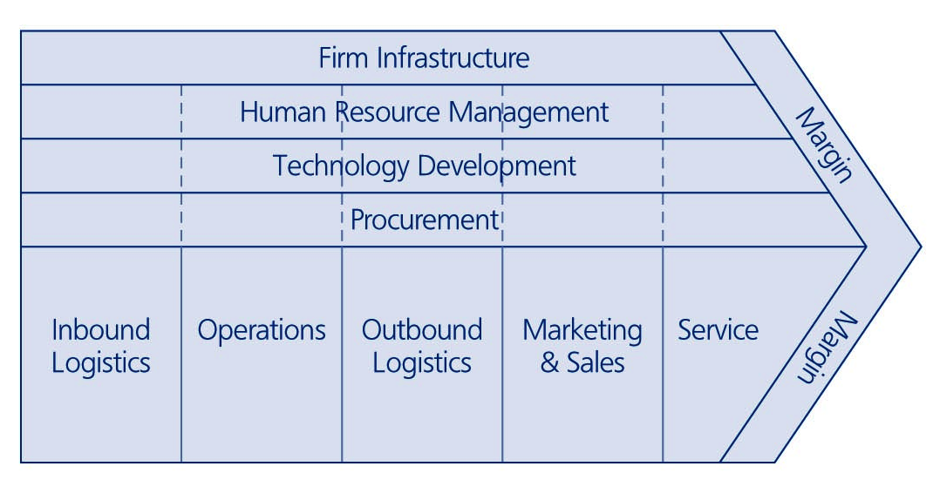
Value Chain
A value chain is an integrated set of value creation processes leading to the supply of product or service offerings
Value chains differ significantly but primary activities are:
inbound logistics
operations
outbound logistics
marketing and sales
service
Each firm also needs: procurement, technology development, human resource management, and firm infrastructure

Slide 8
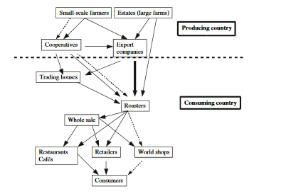
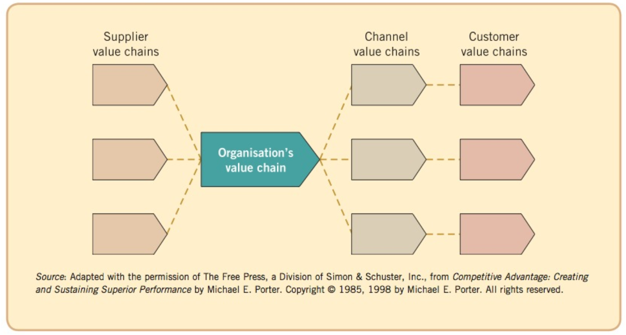
The Value System
Johnson, G. et al., 2013, Exploring Corporate Strategy: Texts and Cases, 10th, Harlow: Pearson p 87

Slide 9

Product and Service Offerings
The key question is which products and services should be developed and which markets should be served
Companies that do not focus on a limited set of product-market combinations risk:
  low economies of scale
  slow organisational learning
  unclear brand image
  unclear corporate image
  high organisational complexity
  limits to flexibility
M&S
Food
Clothing
Home Furnishings

Slide 10
Resources, Capabilities and Competencies

Slide 11
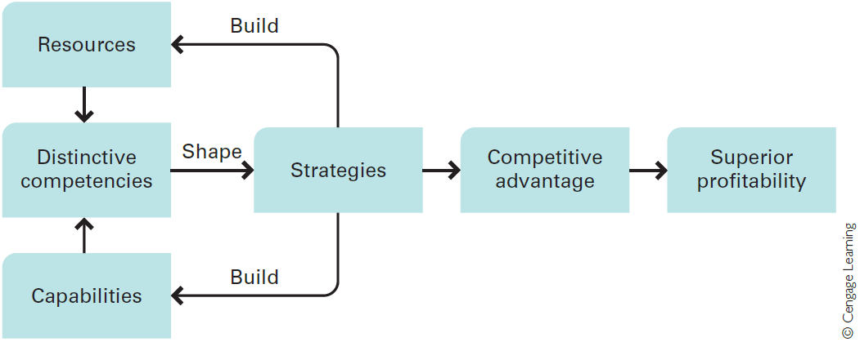
Resources, Capabilities and Competencies and the Link to Strategy
Able to do things successfully or efficiently
Hill et al, 2015
Able to do things
Notes:
Distinctive Competencies
Competitive advantage is based upon distinctive competencies. Distinctive competencies are firm-specific strengths that allow a company to differentiate its products from those offered by rivals, and/or achieve substantially lower costs than its rivals.
Resources
A company’s resources can be divided into two types:.
Tangible resources are physical entities, such as land, buildings, manufacturing plants, equipment, inventory, and money.
Intangible resources are nonphysical entities that are created by managers and other employees, such as brand names, the reputation of the company, the knowledge that employees have gained through experience. We could also include the intellectual property of the company, including patents, copyrights, and trademarks.
Valuable resources are more likely to lead to a sustainable competitive advantage if they are rare, in the sense that competitors do not possess them, and difficult for rivals to imitate; that is, if there are barriers to imitation.
Capabilities
Capabilities refer to a company’s resource-coordinating skills and productive use.
These skills reside in an organisation’s rules, routines, and procedures.
More generally, a company’s capabilities are the product of its organisational structure, processes, control systems, and hiring strategy. They specify how and where decisions are made within a company, the kind of behaviours the company rewards, and the company’s cultural norms and values.
Resources, Capabilities, and Competencies
The distinction between resources and capabilities is critical to understanding what generates a distinctive competency.
A company may have firm-specific and valuable resources, but unless it also has the capability to use those resources effectively, it may not be able to create a distinctive competency. Additionally, it is important to recognize that a company may not need firm-specific and valuable resources to establish a distinctive competency so long as it has capabilities that no other competitor possesses.
In sum, for a company to possess a distinctive competency, it must—at a minimum— have either:
(1) a firm-specific and valuable resource, and the capabilities (skills) necessary to take advantage of that resource, or
(2) a firm-specific capability to manage resources (as exemplified by Nucor).
Distinctive competencies shape the strategies that the company pursues, which lead to competitive advantage and superior profitability. However, it is also very important to realise that the strategies a company adopts can build new resources and capabilities or strengthen the existing resources and capabilities of the company, thereby enhancing the distinctive competencies of the enterprise.
I worked for 10 years for Capgemini, a firm that had a wide range of technology capabilities that enabled it to provide the design and build large and complex IT systems successfully. These capabilities, combined with the intangible resources of the firm, gave Capgemini a distinctive competence in Systems Integration. At the time. however. Capgemini lacked the ability to win large IT service contracts and was losing market share in services to EDS.
I moved to EDS to understand the companies deal making Competence, which was very strong, but embedded in a relatively small number of people. Unfortunately the EDS delivery capability, particularly System Integration, was far less strong than Capgemini.
Ultimately Capgemini acquired the deal making competence mainly through selective recruitment of key people, but EDS failed to with a number of over-ambitious projects because it lacked the necessary capabilities and some key resources; for example the right project management culture, to create the necessary delivery competence.

Slide 12
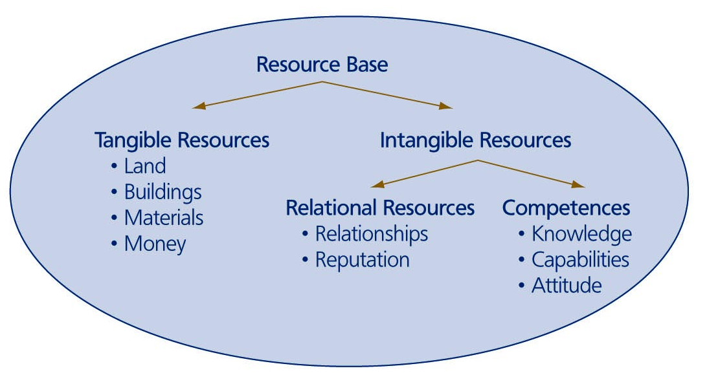
Types of Firm Resources

Slide 13
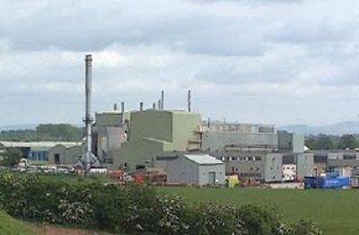

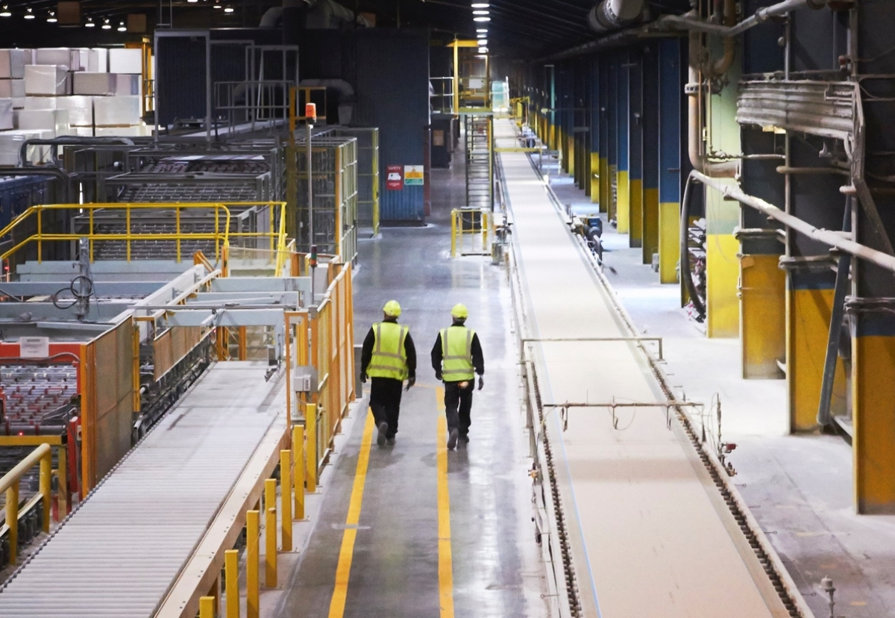
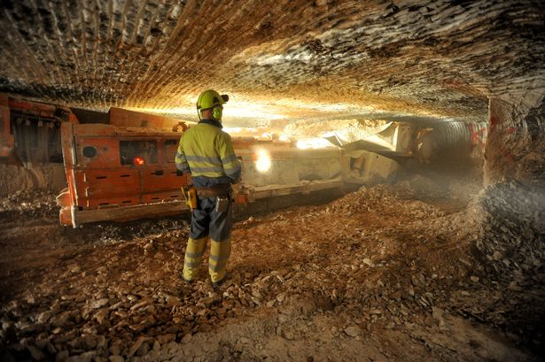
British Plaster Board
Notes:
British Plaster Board (BPB) achieved sustainable competitive advantage by gaining control of the locations in the UK where gypsum mining was possible.

Slide 14
3M: Evolution of Products & Capabilities
Minnesota Mining and Manufacturing
Sandpaper
Road signs
& markings
Videotape
Carborundum
mining
Floppy disks &
data storage
products
Scotchtape
Audio tape
Acetate
film
Post-it notes
PRODUCTS
Housewares/kit-
chen products
Surgical tapes
& dressings
Pharmaceuticals
Materials sciences
Flexible
circuitry
Health sciences
CAPABILITIES
Microreplication
New-product
development &
introduction
Abrasives
Adhesives
Thin-film
technologies

Slide 15
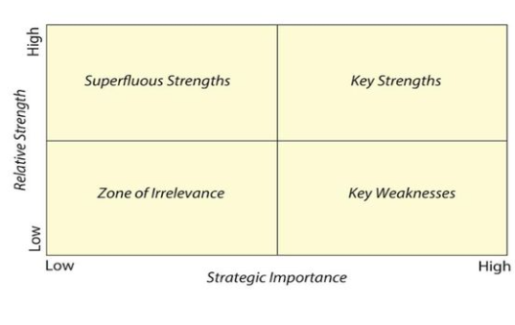
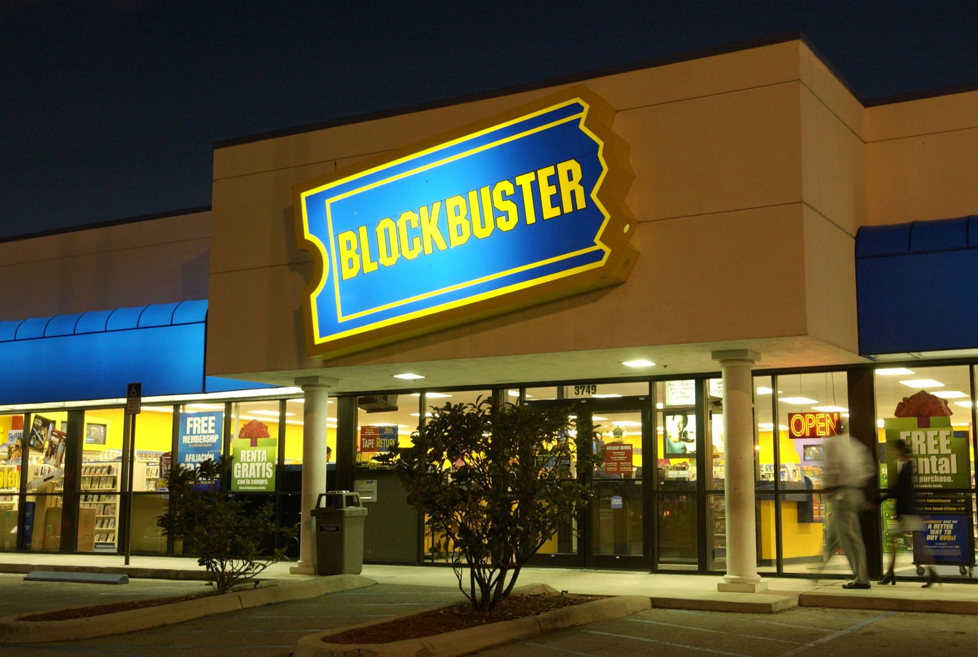
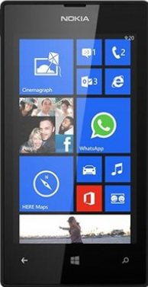
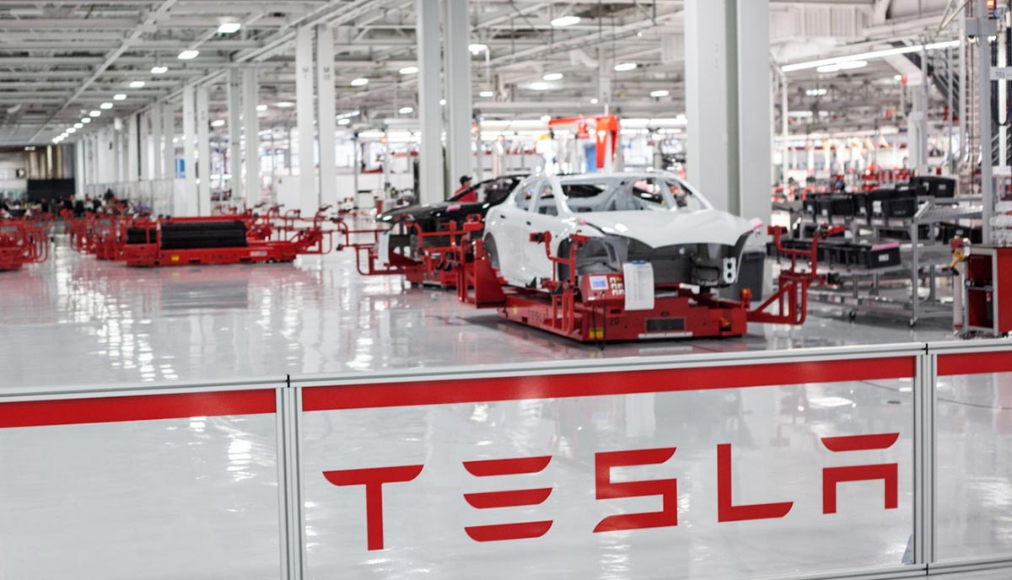
Not All Resources Are Equal

Slide 16
Core Competencies and Dynamic Capabilities
Core Competencies - Prahalad and Hamel(1990)
Those competencies that define a firm’s fundamental business
A core competence may be distinctive when a firm is markedly better than its competitors, or the competency is difficult to replicate
Should a firm outsource an activity that is part of a core competency?
Dynamic Capabilities
The firms ability to integrate, build and reconfigure internal and external competencies to address rapidly changing environments

Slide 17
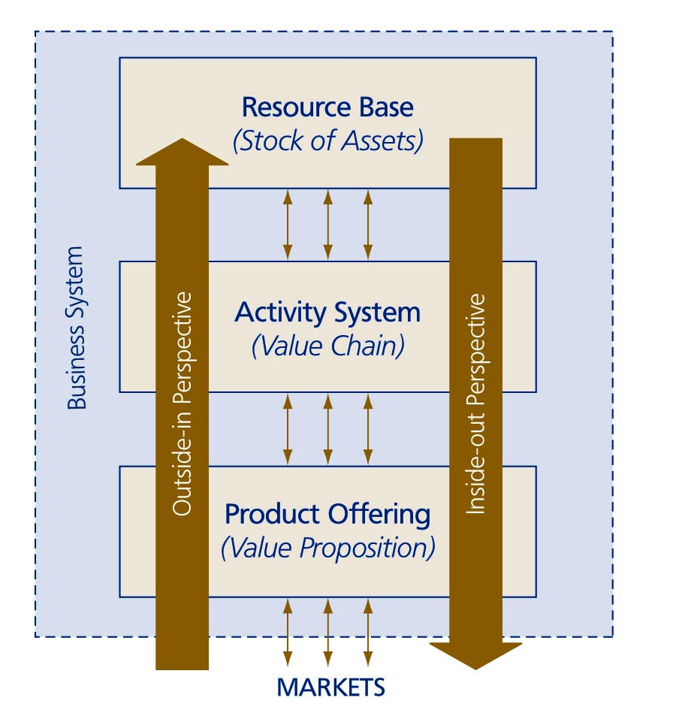
Two Perspectives On Shaping The Business Model

Slide 18
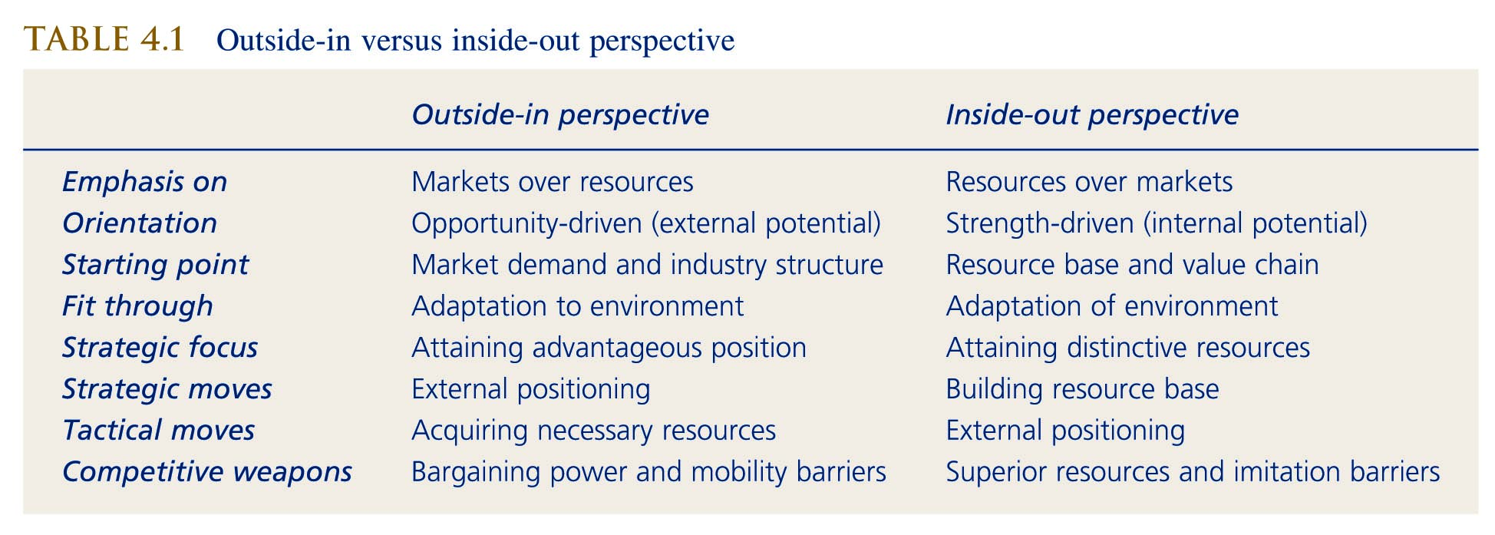
Outside-in versus inside-out perspective

Slide 19
Structure, Culture, and Systems

Slide 20
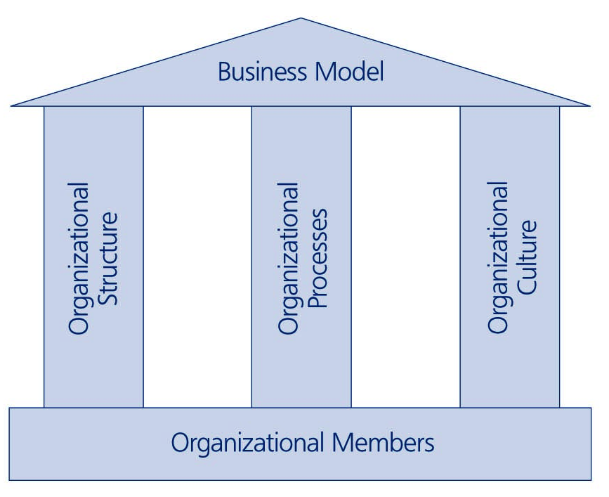
Linking Individuals to the Business Model
Organisational Structure - Refers to the clustering of tasks and people into smaller groups
Organisational Processes - Refers to the arrangements, procedures and routines used to control and coordinate the people and units within the organisation.
Organisational Culture - Refers to the worldview and behavioral patterns shared by the members of the same organisation.

Slide 21
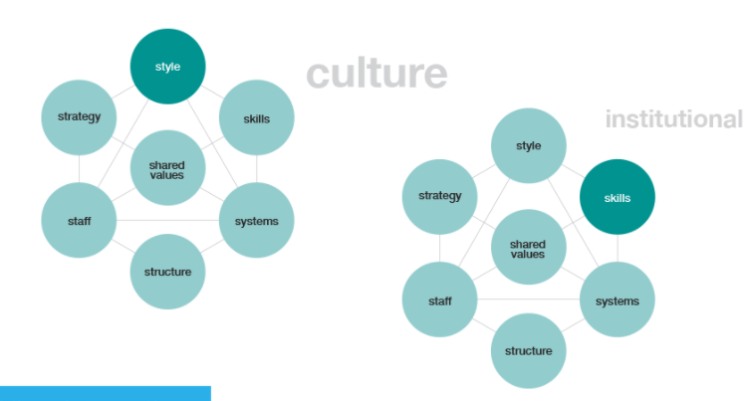
McKinsey 7 S Framework
https://www.mckinsey.com/business-functions/strategy-and-corporate-finance/our-insights/enduring-ideas-the-7-s-framework#

Slide 22
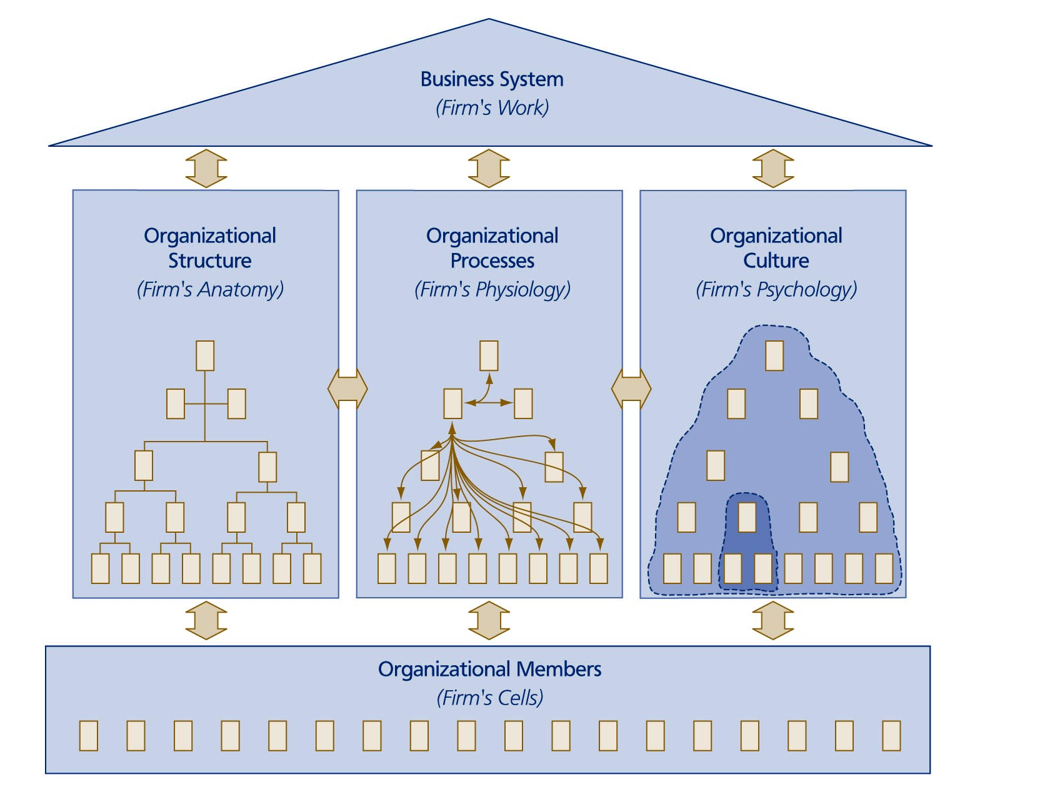
Components of the Organisational System

Slide 23
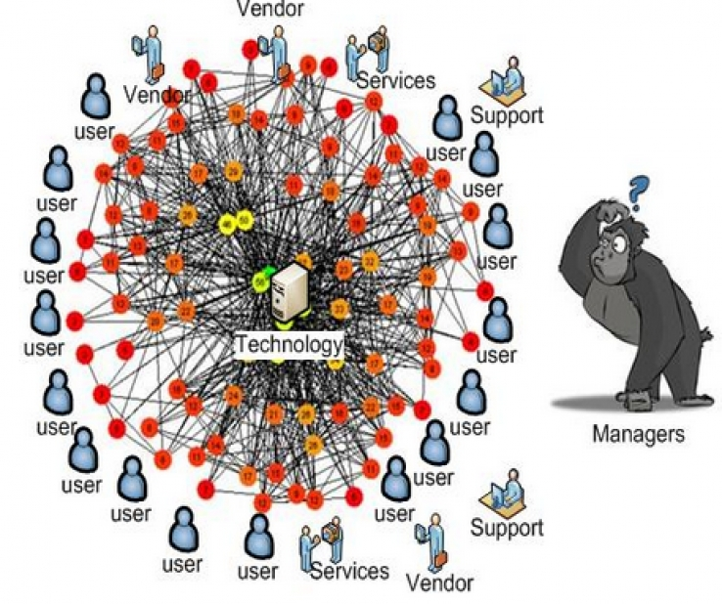
Organisational Processes Depend on the Enabling Information Systems
As organisations grow and acquire information systems in support of their processes they, to an extent, “hard-wire” their ways of working. Changing their information systems can be expensive and time consuming, particularly when change is radical.
See Mckensey article on Digital Transformation.
Notes:
https://www.itwire.com/business-it-news/storage/73038-machine-learning-helps-manage-complex-it-infrastructure.html

Slide 24
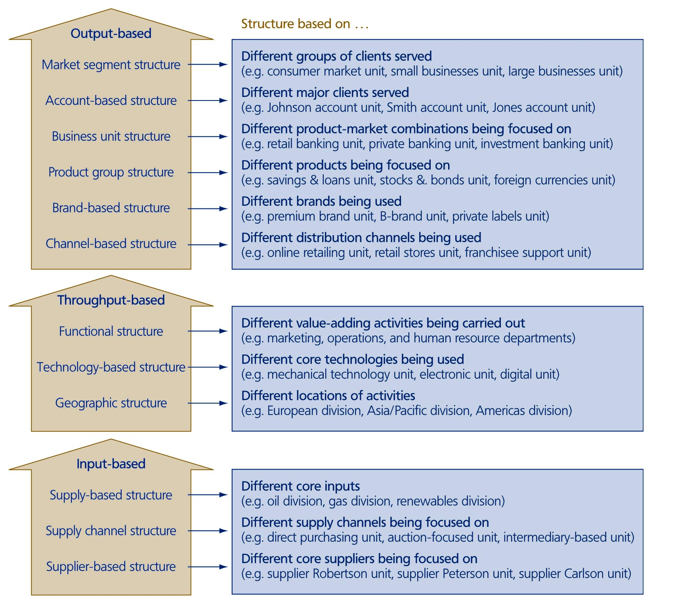
Organisational
Structuring
Criteria

Slide 25
Paradox Of Control And Chaos
Managers want to control the development of the organisation but understand that letting go of control is often beneficial
Need for top-down imposition and bottom-up initiative
Demand for top management control – top managers need to be able to direct developments in the organisation and to have the power to make the necessary changes. They need strategic control.
Demand for organisational chaos – a period of disorder is often a prerequisite for strategic renewal, allows experimentation, pilot projects, encourages self-organization and frees the way for bottom-up ventures

Slide 26
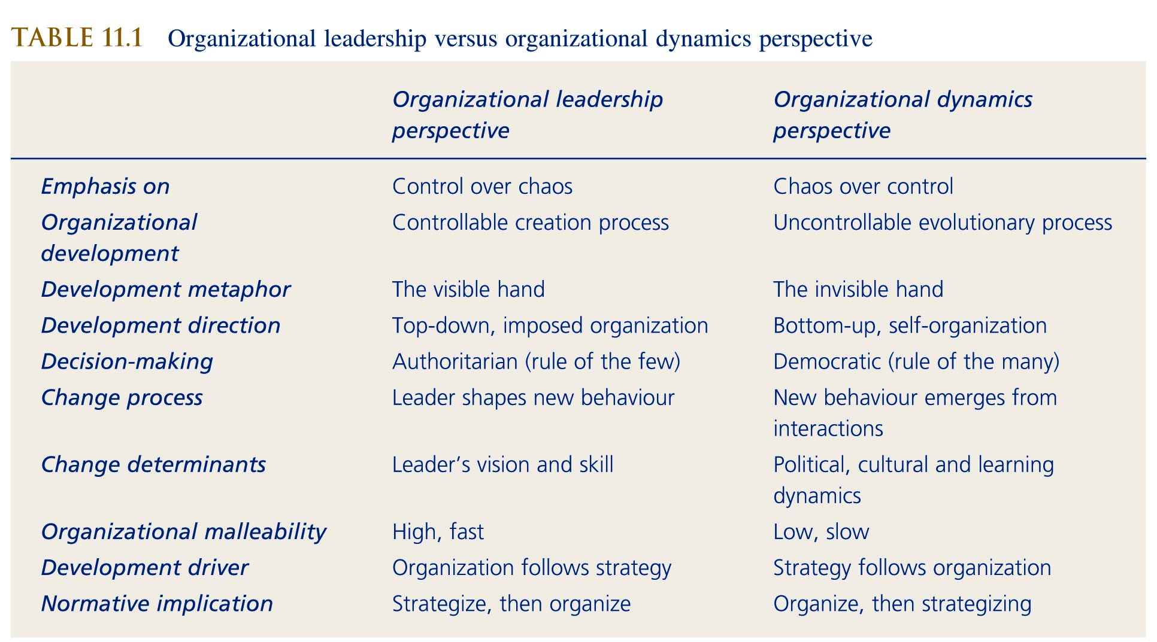
Organisational Leadership Versus Organisational Dynamics Perspective

Slide 27
Different Leadership Styles Among European Executives
Sweden and Finland consensus’ style (lower power distance, low masculinity)
Germany and Austria ‘working towards a common goal’ (specialists working together within a rule-bound structure)
France ‘managing from a distance’ (focus on planning, high power distance)
UK, Ireland and Spain ‘leading from the front’
Where was the company founded and where is the main centre of power?
Ikea – Sweden
Standard Bank – South Africa
Fujitsu – Japan
Capgemini – France?

Slide 28
Strategic Analysis of A Firm

Slide 29
Component Models
Mission
and
strategy
Leadership
Organisation
culture
One approach to diagnosis is to start by using component models to examine how the many different aspects of an organisation are working.
... and to combine these assessments to build a ‘big picture’ of how the organisation is functioning as a whole.
Difficult to do from outside the organisation.
Management
practices
Systems
(policies and procedures)
Structure
Work unit
climate
Tasks and individual roles
Individual needs and values
Motivation

Slide 30
Holistic Models
External
environment
An alternative approach is to start by looking at the ‘big picture’ before drilling down to explore particular components in more detail.
This might be by a series of executive and senior management interview to gain an overview of possible problems as perceived from above.
Leadership
Mission
and
strategy
Organization
culture
Management
practices
Systems
(policies and procedures)
Structure
Work unit
climate
Tasks and individual roles
Motivation
Individual needs and values
Individual and
organizational performance

Slide 31
Strategy Diagnosis – An Iterative and Incremental Process
Start with the 7 areas in the diagram, beginning with financial performance over the last 5 years:
  Is the business profitable?
  Is it growing or declining?
  How does it compare with the rest of its industry?
  Share price and capitalisation
Investigate the other 5 areas
The process of diagnosis may lead to questions in other areas e.g.:
  Leadership
  Ownership
  Information Systems
  Acquisition Integration
  Culture
  Sustainability
  Etc..
Financial Performance
Competencies
Industries, Product Offerings and Market Segments
Resources – Tangible and Intangible
Business Model and Value Network
Capabilities
Competitive Advantage
Strategy
Diagnosis

Slide 32
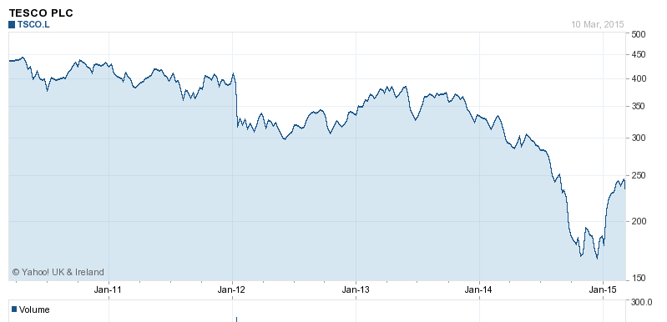
Key Sources
Mar 2011 –
Phillip Clarke
Appointed in Place of Terry Leahy
1st Sep 2014 –
Dave Lewis
Appointed
Company Web Site – particularly investor information and company presentations and reports.
Financial Data e.g. Yahoo Finance or
Research Reports e.g. Marketline
Industry Reports
Market Reports
Industry Publications
Investment Analysts
New Papers and Magazines – on and offline

Slide 33
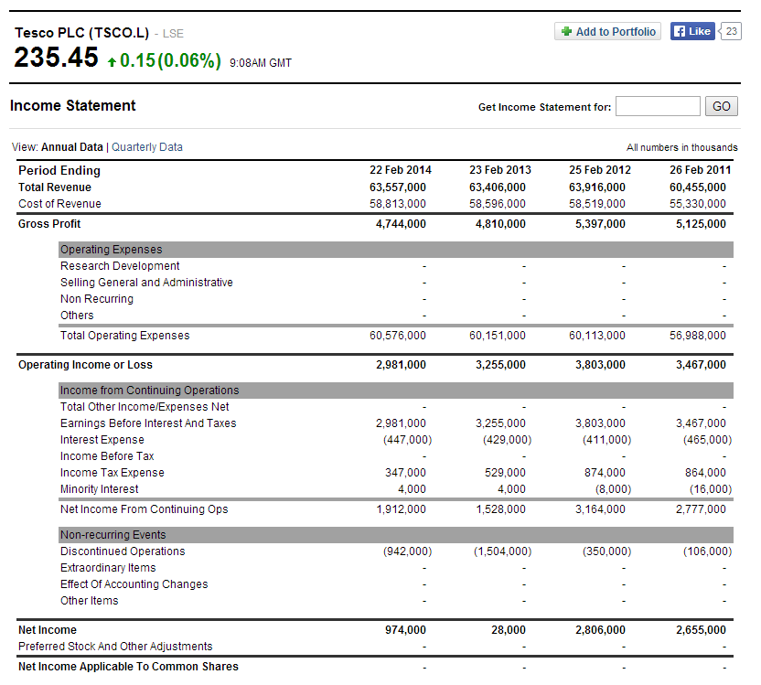

Slide 34


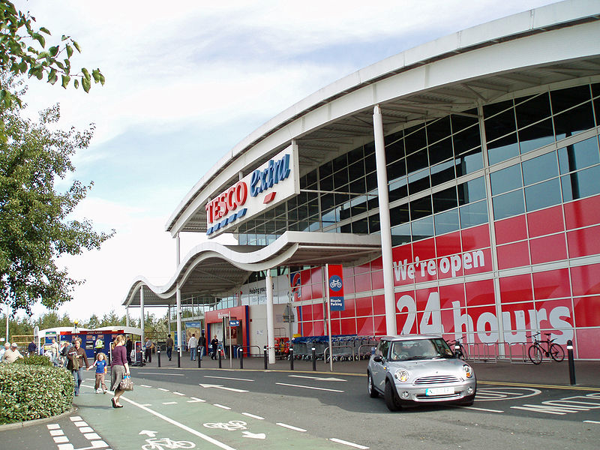
What’s The Problem?
New Entrants – from Germany
Changing consumer Habits
  More frequent shopping
  Local shopping
  Online – home delivery and “click and collect”
  Willing ness to switch in search of value
Reputation
  Horsemeat
  Profit Reporting
  Killing the High Street

Slide 35
Strategy Mapping

Slide 36
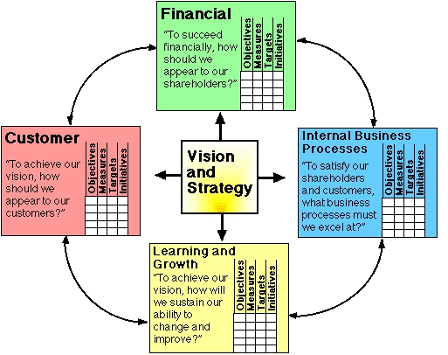
Balanced Scorecard
Financial - The outcome for all profit-making organisations is a financial result for stockholders measured by a range of metrics such as return on capital, net profit margin, or growth in revenues.
Customer - In most cases, it is a positive response from the customer that creates value for the organisation by profitable sales. The metrics may include sales penetration as well as the level of customer satisfaction and loyalty.
Internal Business Processes - To increase the quality of the customer relationship, operating processes will be continually improved to enhance the quality flexibility while reducing cost of these processes. Measurements may include cycle time, asset utilisation, and quality metrics.
Learning and Growth - The driving force of value creation is through the intellectual capital, the ideas, and innovation that bring about new products and services as well as processes, sometimes with rapid discontinuous innovation. It can be measured by the development of human capability, new products to market, and growth of strategic alliances.
Gurd (2013)

Slide 37
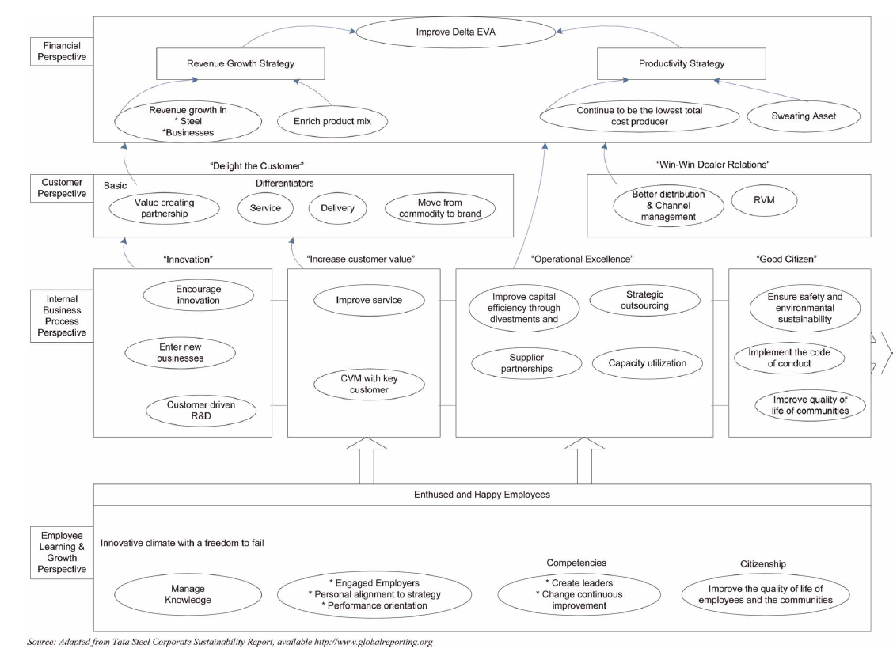
Strategy Mapping – Tata Steel
Joseph(2009)

Slide 38
Walmart Strategy Map
WALMART | Productivity Strategy |  | Growth Strategy
Financial Perspective | Local discretion over pricing Drive down cost continuously Obsession with retail and cost reduction High asset and inventory turnover Low spend on advertising(lowest in the industry) |  | Locate in small towns and create a monopoly on discount retail in that area International expansion Multiple formats – discount stores, warehouse clubs, supercentres and neighbourhood stores, online
Customer Perspective | Everyday Low prices “Greeters” “Satisfaction Guaranteed |  | Adjust to local needs and preferences Wide range of goods Avoid stock-outs
Internal Perspective | Operations Management | Customer Management |  | Innovation Processes | Regulatory and Social Processes
 | Purchasing Centralised buying Limit supplier power – max 2.5% of total Exploit technology Use of EDI and Online buying Warehousing and Distribution Own distribution system – hub and spoke rather than supplier delivers to stores Total control and large drop volumes | Store location Store format Decentralised decision making High level of service |  | Insourced activities allow innovation in IT, warehousing, distribution and store operations | Patriotism Traditional American Values Environmental responsibility Counter the criticisms from Unions, politicians and environmentalists Employee empowerment
Learning and Growth Perspective | Human Capital - promote from within, career opportunities, profit sharing, share ownership, empowerment, decision and consultation rights, treat as individuals and show them respect, listen to suggestions. Family atmosphere.
 | Information Capital – pioneer the use of technology – EDI, EPOS, Satellite communication and RFID. Systems closely tailored to Walmart’s needs, constant analysis of POS data. Used to closely link the entire supply chain.
 | Organisational Capital – Principles and values of Sam Walton – thrift, hard work, fairness, simplicity and friendliness. Management culture – the Friday and Saturday meeting’s.

Slide 39
Bibliography
De Wit, R & Meyer, R, (2017) Strategy, An International Perspective, Andover, Hampshire: Cengage Learning, 6th ed.
Prahalad, C. K. and Hamel, G. (1990) ‘The Core Competence of the Corporation’, Harvard Business Review, 68(3), pp. 79–91. Available at: http://0-search.ebscohost.com.emu.londonmet.ac.uk/login.aspx?direct=true&db=bth&AN=9006181434&site=ehost-live (Accessed: 10 May 2021).
Joseph, G. (2009) ‘Mapping, Measurement and Alignment of Strategy using the Balanced Scorecard: The Tata Steel Case’, Accounting Education, 18(2), pp. 117–130. doi: 10.1080/09639280802436731.
Osterwalder, A, & Pigneur, Y 2010, Business Model Generation : A Handbook for Visionaries, Game Changers, and Challengers, John Wiley & Sons, Incorporated, Chichester. Available from: ProQuest Ebook Central. [11 July 2019].
‘Porter’s generic strategies’ (2005) A to Z of Management Concepts & Models, pp. 272–277. Available at: http://0-search.ebscohost.com.emu.londonmet.ac.uk/login.aspx?direct=true&db=bth&AN=22366647&site=ehost-live (Accessed: 12 April 2021).

