Slide 1

Breakthrough Leadership Skills
MN7028
Topic 5: Organisational Performance

Slide 2

Learning Outcomes
To evaluate contemporary debates in - and models of - HRM and HRD to explain current practice employed in organisations for managing people.
To define and explore the concepts of performance and performance management
To discuss High Performance Work Systems (HPWS)
To evaluate the role of effective people management policies and practices in enhanced organisational performance.
To contribute to the effective implementation of systems and enhanced organisational performance.
To explain the main factors that can facilitate or impede effective organisational performance.

Slide 3

Hard versus soft HRM
Hard HRM: focus on profitability and well-being of the organisation; stresses the ‘resource’ aspect of HRM
Soft HRM: associated with the human relations movement; employees are valued assets and a source of competitive advantage
Short-term versus long-term focus?
A false dichotomy?

Slide 4
Ulrich’s (1997) Four Roles of HR Professionals
Future/ strategic focus
Strategic Partner
Change agent
Processes
People
Administrative expert
Employee Champion
Day to day /operational focus

Slide 5

What is Performance?
‘the outcomes of work’ or ‘a record of a person’s accomplishment’ (Bernadin et al, 1995) and Kane, 1996)
Or alternatively
‘the ways in which organizations, teams and individuals get work done’ (Campbell, 1990)
Or maybe a combination of outcomes and behaviours:
‘Performance means both behaviours and results … behaviours are also outcomes in their own right – the product of mental and physical effort applied to tasks – and can be judged apart from results’ (Brumbach, 1998 in Armstrong, 2012)

Slide 6

What are the components of Performance?
Job-specific task proficiency
Non-job specific task proficiency (e.g. Organizational Citizenship Behaviour)
Written and oral communication proficiency
Demonstration of effort
Maintenance of personal discipline
Facilitation of peer and team performance
Supervision/leadership
Management/administration
(Campbell et al, 1993)

Slide 7

Three dimensions of Performance Management (after Shields, 2007)
‘Individual results flow into group results, which in turn contribute to organization-wide results’
(Shields 2007, cited in Armstrong, 2017)
So Armstrong (2012) argues that you need to look at it at individual, team and organizational levels.
Performance culture
High Performance Work Systems (HPWS)

Slide 8

Four perspectives of Performance Measurement (after Kaplan and Norton 1992)
Financial Perspective– how do we look to shareholders?
Customer Perspective - how do customers see us?
Internal Business perspective - what we need to excel at?
Innovation and Learning Perspective – can we continue to create value?

Slide 9

Performance Management
‘A systematic process for improving individual, team and organisational performance’.
  (Armstrong, 2014 p.331)
  The continuous process of improving performance by setting individual teams and goals whiah are aligned to the strategic goals of the organization, planning performance to achieve the goals, reviewing progress, and developing the knowledge, skills and abilities of the people.’
  (Armstrong, 2017 p.391)

Slide 10

Best practice HRM
Definition:
“The best practice view identifies a set of HR policies that, it is argued, is associated with improved performance in all types of organisations and, by implication, for all types of employees” (Kinnie et al, 2005: 9)
Note: other terms – high commitment HRM, high involvement HRM, high performance work systems all embody the notion of Best Practice.

Slide 11
Best practice HRM and organisational performance
Assumption that particular bundles of HR practices have the potential to contribute to:
  improved employee attitudes and behaviours
  lower levels of absenteeism and labour turnover
  higher levels of productivity, quality and customer service in all types of organisation.
This has been argued to have the effect of generating higher levels of profitability
(Marchington and Wilkinson, 2009)

Slide 12

Components of best practice HRM
Employment security and internal labour markets
Selective hiring and sophisticated selection
Extensive training, learning and development
Employment involvement and participation: worker voice
Self-managed teams/team-working
High compensation contingent on performance
Performance review, appraisal and career development
Reduction of status differentials/harmonisation
Work-life balance
(‘adapted significantly’ from Pfeffer, 1998 and cited in Marchington et al, 2016)

Slide 13

‘Bundles’ of HR practices
Long history researching individual best practices
Best practice HRM is about combining these together into ‘bundles’.
Based on the idea that investment in individual practices will have limited effect whereas making changes together will have a more powerful effect.
This suggests there is a specific set of practices which can and should be adopted by firms which will lead to universal improvements in performance.
(Wilkinson and Redman, 2009)

Slide 14

The People and Performance link (Purcell et al, 2003)
Research programme to explain ‘how and why HR practices impact on performance’ (p.ix)
Starts with the framework of AMO: ‘performance is a function of Ability + Motivation + Opportunity’
A key to the HR- Performance link is the existence of a ‘Big Idea’ in the org. with ‘a clear mission, underpinned by values and a culture expressing what the company stands for and is trying to achieve’
The big idea displays 5 common characteristics: ‘embedded, connected, enduring, collective and ‘measured and managed’’

Slide 15
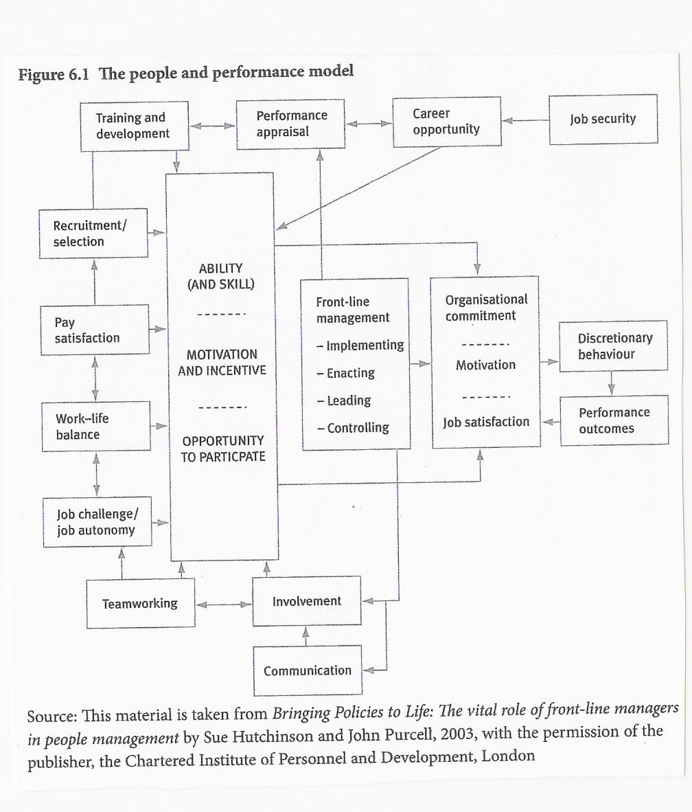

Slide 16

The People and Performance link (Purcell et al, 2003)
Bringing policies to life: the critical role of line managers
‘the exercise of employee discretion is crucially affected by the way in which managers exercise their own discretion’ (p.37)
Model for ‘Front-line management’
Implementing
Enacting
Leading
controlling

Slide 17
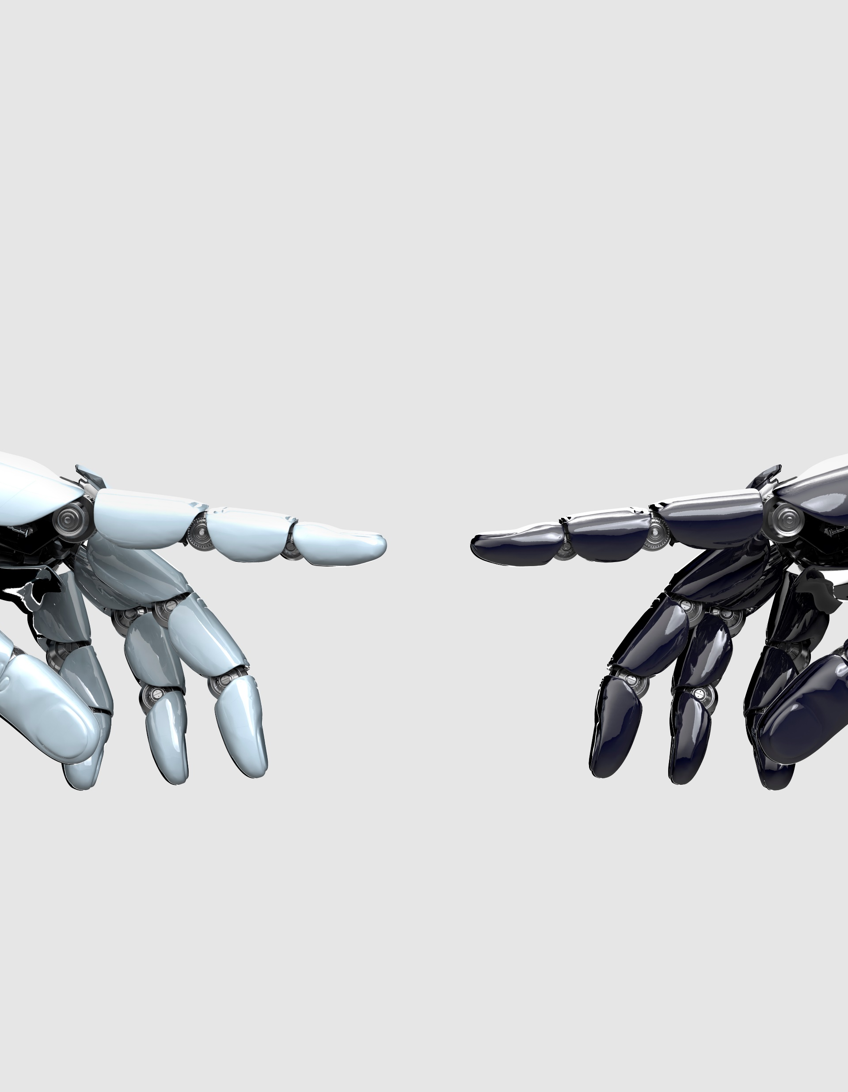
High Performance Work Systems (HPWS) and performance
‘HPWS are bundles of HR practices that facilitate employee involvement, skill enhancement and motivation. HPWS provide the means for creating a performance culture’ (Armstrong, 2017)
Definitions vary but Shih et al (2005) identify the following components:
Job infrastructure (AMO)
Training Programmes to enhance employee skills
Information sharing and worker involvement mechanisms
Reward and promotion opportunities that provide motivation

Slide 18
Characteristics of a high-performance work culture (Armstrong, 2010)
Management defines what it wants in terms of performance and its goals, with a ‘clear line of sight’ between strategic aims of org and team and individual levels
Job redesign, autonomous work teams, improvement groups, team briefing, flex work
Clarity on goals, underpinned by the PM processes
Cultural fit between org goals and individual capabilities
Empowered workforce
Strong leadership engendering shared belief in continuous improvement
Engaged, committed, motivated employees
Capacities of people are developed through learning
Climate of trust and teamwork aimed at delivering to the customer
People are valued according to their contributions
There is a steady pool of talent available from which to identify high performers

Slide 19

Three theories underpinning Performance Management
Goal Theory (Latham and Locke, 1979)
Reinforcement Theory (Skinner, 1938)
Social Cognitive Theory (Bandura, 1986)

Slide 20

Four elements of Performance Management
  Agreement
  Feedback
  Positive reinforcement
  Dialogue
  (Capelli: 2008)

Slide 21

Principles of Performance Management (after Egan, 1995)
Performance Management should provide:
Direction
Freedom to get their work done
Encouragement (and not control)
Leading to growth
Leading to strategic collaboration
  (Egan cited in Armstrong, 2017)

Slide 22

Principles of Performance Management (after Strebler et al, 2001)
Performance Management systems should:
Have clear aims and measurable success criteria
Be designed and implemented with the involvement of the employee
Be simple
Be aligned (and contribute to) organisational goals, ‘line of sight’
Focus on role clarity and performance improvement
Be aligned with complementary L and D initiatives
Explain rationale which links them to rewards
Be equitable, transparent
Be regularly assessed themselves against success criteria
  (Strebler et al cited in Armstrong, 2017)

Slide 23

People Managers are a crucial element
Reinforce the link between organizational objectives and individual ones
Give feedback
Keep employees on course, or steer them back on course
Hold employees ‘accountable’ (CIPD, 2017)
Senior leaders meanwhile define and demonstrate the desired culture, mission, vision and values

Slide 24

Why Manage Performance?
Individual goals can be aligned with organizational goals and specifically (according to Jones et al, 1995) to:
Build a Shared vision
Avoid ambiguity by clearly defining roles of all employees
Provide an unambiguous framework for individuals
Provide an unambiguous framework for teams
Provide an unambiguous framework for rewards
Key notion of ‘accountability’ (CIPD, 2017)

Slide 25
Why Manage Performance? (after Henderson, 2010)
Motivation to perform is increased.
Self-esteem is increased.
The job definition and criteria for job success are clarified.
Managers gain insight about subordinates, which helps the manager build relationships with their staff.

Slide 26

Why Manage Performance? (Henderson, 2010, cont’d)
Self-insight and development are enhanced.
Employees become more competent.
HR actions are likely to be fairer (and perceived as such)
There is better protection from lawsuits.
There is better and more timely differentiation between competent and poor performers.

Slide 27

Why Manage Performance? (Cont’d)
Supervisors are forced to address performance problems before they become too costly, and cannot be remedied.
Supervisors’ views of performance are communicated more clearly.
Organizational goals are made clear.
Organizational change is facilitated.

Slide 28

Typical Performance Management System
An agreement between individual and manager setting out objectives and development needs.
Performance is continually monitored, assessed and reacted to.
Regular formal review of performance against objectives, and setting of new performance agreement.
‘holds people to account’ (CIPD, 2017)

Slide 29

Planning for Performance
The manager must know the criteria for success or failure, in order to assess performance.
Specifically, the manager must be aware of the knowledge, skills and abilities (KSAs) needed to do the job competently.
The KSAs and criteria for job success should be explicit in the relevant job descriptions.

Slide 30

Supporting Performance
Maintaining continuous awareness of how the employee is performing, and giving feedback on this on a mainly informal basis.
Revising initial objectives, standards, key accountabilities and competency areas if required without waiting for scheduled formal performance appraisal meetings.
Supporting Personal Development Plans.

Slide 31

Personal Development Plan
Personal Development Plans are a key component of Performance Management (according to Henderson, 2010)
A good development plan assist employees to:
  do better in the future
  avoid past performance problems

Slide 32
Constructive Performance Management
‘Performance management should be a continuous process which links together performance, motivation, individual goals, departmental purpose and organisational objectives; these in turn should be overseen by management but engage the workforce’ (Marchington, 2012)

Slide 33

Key components of performance management (Mearns in Watson and Reissner, 2014, p.259)
Recruitment and selection
Induction
Reviewing, appraisal and feedback
Reward and reinforcement
Training and Development
Communication, support and counselling
Management of poor performance
Organisational Culture

Slide 34

Good Induction offers these benefits (Mearns in Watson and Reissner, 2014, p.278)
Relaxed and settled employee
Employee more open to training and development
Retention levels are higher (Fritz and Vonderfecht, 2007)
Links between good induction and positive ER/IR

Slide 35

Poor Induction risks these outcomes (CIPD in Watson and Reissner, 2014, p.278)
Weak integration into team
Low morale and low motivation
Reduced levels of performance and productivity
and if they leave
Additional recruitment costs
Wasted time/money in training
Knock on impact in team productivity/performance

Slide 36

Performance Appraisal Process offers these benefits (Mearns in Watson and Reissner, 2014, p.280)
Clarify expected standards and measure against them
Allocate rewards
Identify high performers
Highlight training and development needs
Discuss career progression
Counsel employees (where needed)
Give constructive feedback
Establish future aims, objectives, targets
Motivate employee and increase their morale
Improve communication

Slide 37

Some conclusions about Performance
Research findings as to the links between performance management and performance are mixed and inconclusive. CIPD (Gifford) says their research found no clear evidence.
Armstrong argues for Employee involvement in the process on the basis that ‘people are more likely to respond positively and are more likely to work to improve their performance and develop their capabilities if they share in the processes of defining expectations [and] are involved in creating and developing their skills and competencies’ (Armstrong, 2017. p.396)
Performance management has benefits for the employer, not least in informing decisions on remuneration for outcomes.
From the employee’s point of view it can facilitate rewarding people ‘by recognition through feedback, the provision of opportunities to achieve, the scope to develop skills, and guidance on career paths’ (ibid). These are all non-financial sources of Employee Engagement. Furthermore they all require leadership from the line manager.

Slide 38

Selected References
Armstrong, M and Taylor, S. (2015) Armstrong’s Handbook of Performance Management. 5th Edn. London: Kogan Page (available online from Lon Met)
Boxall, P. and Purcell,, J. (2008) Strategy and Human Resource Management. 2nd ed. Basingstoke: Palgrave Macmillan
Boxall, P. and Purcell,, J. (2015) Strategy and Human Resource Management. 4th ed. Basingstoke: Palgrave Macmillan
CIPD: numerous factsheets and reports available for the CIPD website at www.cipd.co.uk, including Could do better? Assessing what works in performance management.
Henderson, I. (2010) Human Resource Management for MBA Students. London: CIPD
Kaplan, R. S. and Norton, D. P. (1992) ‘The Balanced Scorecard--Measures That Drive Performance’, Harvard Business Review, 70(1), pp. 71–79. Available at: http://0-search.ebscohost.com.emu.londonmet.ac.uk/login.aspx?direct=true&db=bth&AN=9205181862&site=ehost-live (Accessed: 31 March 2020).
Purcell, J., Kinnie, N., Hutchinson, S., Raylon, B. and Swart, J (2003). Understanding the People and Performance Link: Unlocking the Black Box. London: CIPD.
Watson, G. and Reissner, S. (2014) Developing Skills for Business Leadership. London: CIPD

