Slide 1

MN7031 Topic 1 – How and Why Do Businesses Grow?
Daniel Jones
londonmet.ac.uk

Slide 2
Today’s Agenda
Introduction to the Module
How and Why Do Businesses Grow – Lecture

Slide 3
Introduction to the Module

Slide 4
Module Overview
1. How and Why Do Businesses Grow?
2. How Do We Diagnose Company Strategy?
5. How Do We Make Sense of the VUCA External Environment?
8. Does Your Simulation Company Need A New Strategy?
10. Why DO Firms Undertale Acquisitions, Mergers and Alliances?
7. How Is Your Simulation Company Performing?
11. How Do Companies Innovate Successfully?
12. Does Strategic Alignment Matter?
4. Why Are Some Industries More Profitable Than Others?
3. How Does A Company Create Competitive Advantage?
6. How Do We Identify future opportunities and threats?
9. Summative Assessment Presentations
Business Simulation – Cesim Global Challenge

Slide 5
Learning and Teaching
There are 6 key elements to your learning:
the workshops – lecture and discussions
case studies - you will be asked to analyse the case information and answer key questions. Some of these will be part of your final portfolio.
your reading - the reading list identifies key articles and textbooks
the assessments – group presentation in Week 9 and your final assignment.
learning from the MBA group.

Slide 6
The Nature of Strategy
There is no widespread agreement about what strategy is
There is no common definition of the term ‘strategy’
Understanding of the topic can only be gained by examining the diversity of insights and acknowledging that there is no simple answer to the question of what strategy is
“A Strategy is a set of related actions that managers take to increase their companies performance”
Hill, Jones and Schilling (2015)
Competitive strategy is about being different from one’s rivals and has a number of possible meanings:
Plan
Ploy
Pattern
Position
Perspective
Mintzberg (2014)
Porter argues that competitive strategy is "about being different." He adds, "It means deliberately choosing a different set of activities to deliver a unique mix of value.“ Porter (1996)
“One person’s strategy are another’s tactics.”
Rumelt (1980)

Slide 7
Common Elements in Strategy
1
Simple, consistent long-term
goals
4
2
Effective Implementation
Profound understanding of the competitive environment
Successful Strategy
3
Objective appraisal of resources

Slide 8
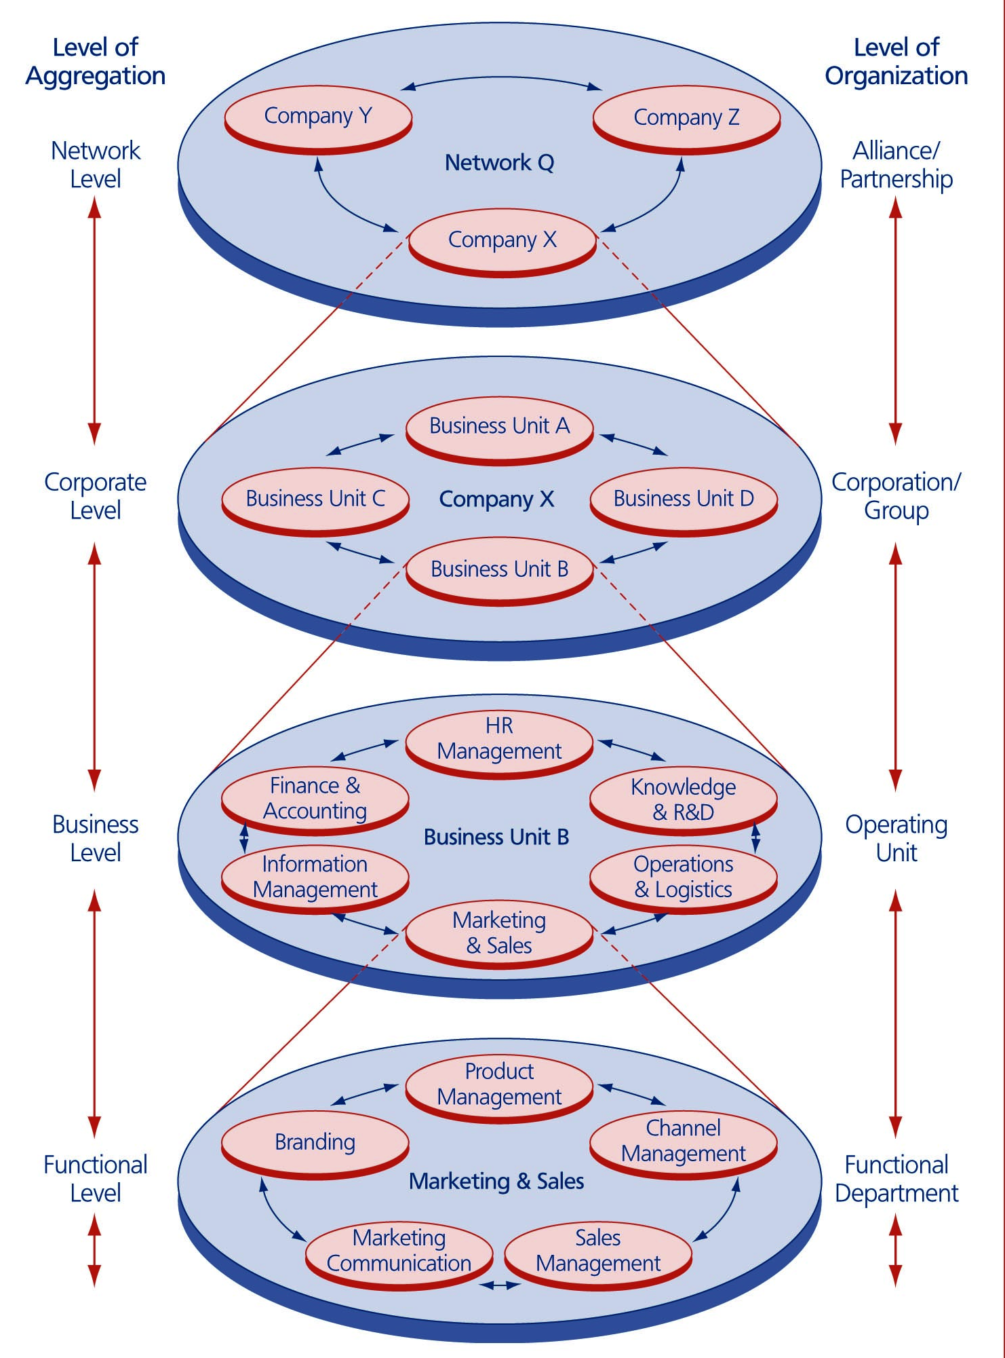
Levels of Strategy
Network Level
Corporate Level
Business Level
Marketing
Operations
Finance and Accounting
Human Resource Management
Functional Level
Wit, B. de (2017)

Slide 9
Porter’s Basic Strategies
Cost
Leadership
Industry
Differentiation
Competitive Scope
Single Segment
Focus
Cost
Focus
Differentiation
Focus
Low cost
Differentiation
Source of Competitive Advantage

Slide 10
Creating And Growing A Business

Slide 11
Today’s Key Topics
Lecture
Why Do Businesses Need to Grow?
What Is A Startup?
The Lean Start Up and the Business Model Canvas
Analogs and Antilogs
Value propositions
Stages of Business Growth
The need for Systemisation
Why do start ups succeed?
Approaches to business growth
Cesim Global Challenge
Introduction
Practice Round 1

Slide 12
Why Grow?
“Some business leaders who attain a certain level of success are content to stay at this plateau. They feel assured within the space their business occupies in the marketplace and have little motivation to change anything.
This is a risky stance for any business leader to take. Growth isn’t just important for a company—it’s absolutely essential. Without continued growth, operations will stagnate. This can result in lowered standards of quality for products or services, decreased customer service, poor employee morale, and a host of other issues.
Growth “is crucial to the long-term survival of a business,” notes nibusinessinfo.co.uk, pointing to these clear-cut benefits:
  Easier to add resources
  Locate and identify new sales opportunities
  Expand range of products or services
  Acquire new customers
Also, growth can “boost your business’ credibility, allowing you to broaden your supply base and increase stability and profits.”
All compelling benefits gained by the pursuit of business growth!”
https://www.thealternativeboard.com/blog/why-is-growth-important-for-a-company

Slide 13

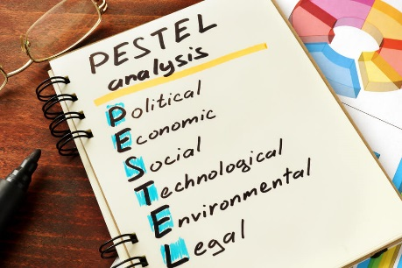
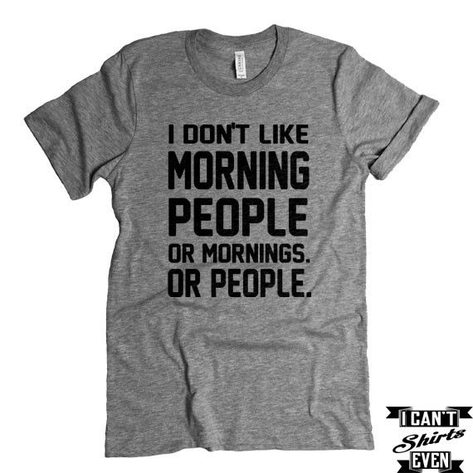

Creating A Business
Potential
Competitors
The Business
Environment
Resources
know how
funding
people
4
5
Competitors
Substitutes
3
Mission and
Vision
2
Suppliers
Business Operation
Processes
Information systems
Facilities and equipment
Channels
1
Value Chain

Slide 14
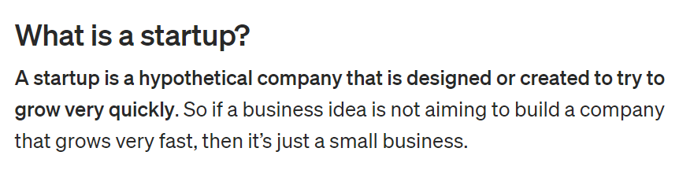
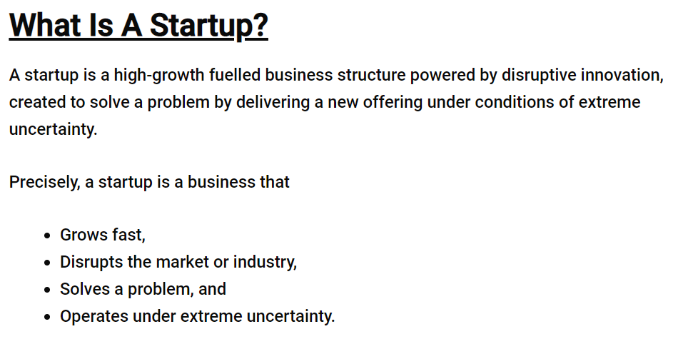
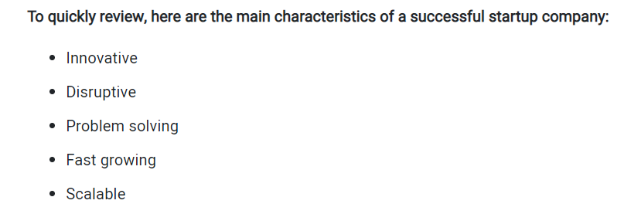
What Is A Start-Up?
Clusters are geographic concentrations of firms focused largely on one industry of the overall ecosystem to produce innovations. Boni and Gunn (2021)
An ecosystem is a sustainable economic region comprised of a community or critical mass of interacting organizations and individuals that produce goods and services of value to customers.

Slide 15
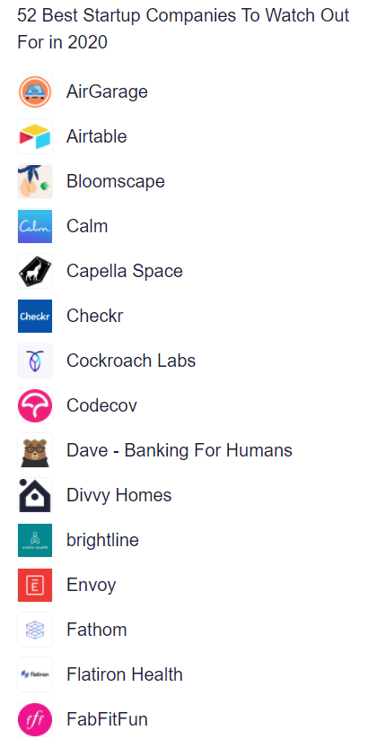
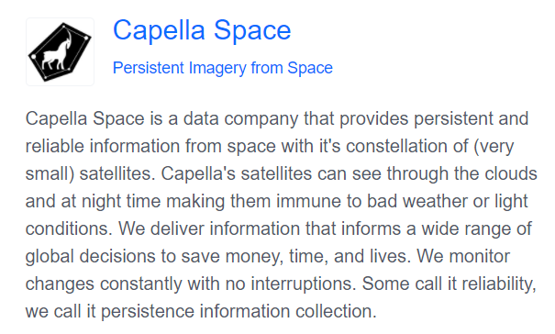
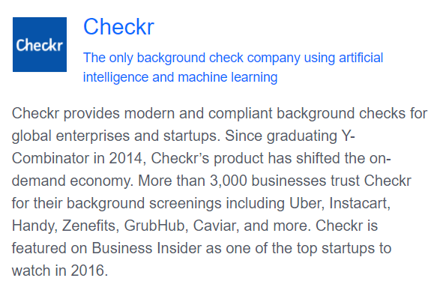
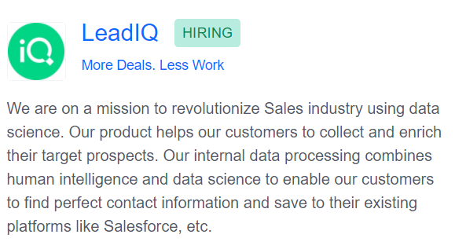
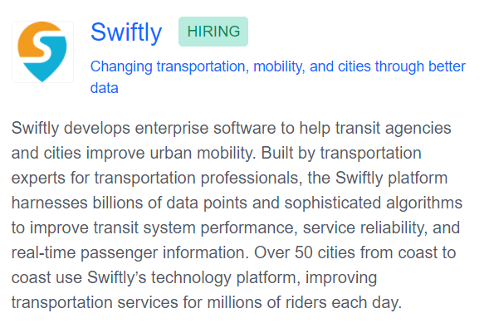
Angel.co – 50 Best Startup Companies to Watch Out For in 2020

Slide 16
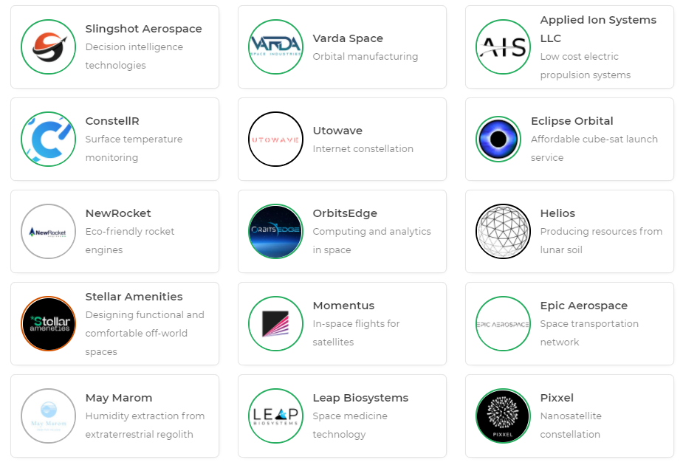
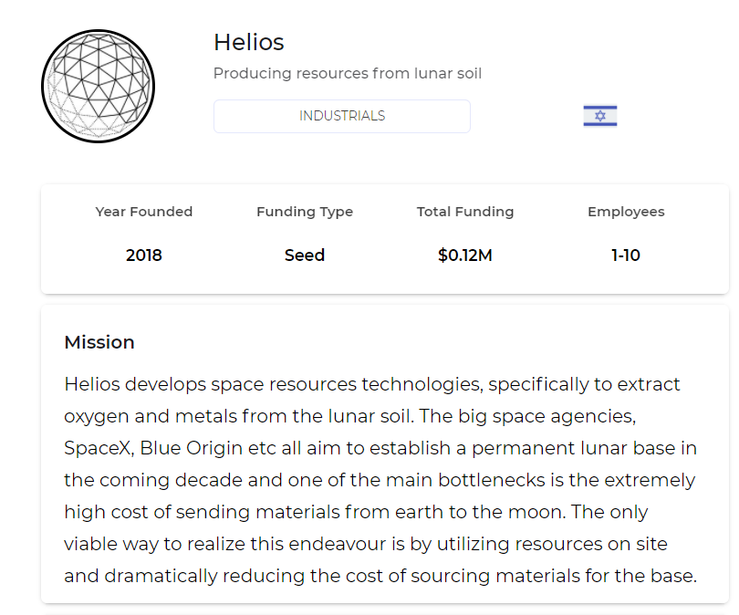
Space Bandits – Startups in the Space Industry

Slide 17
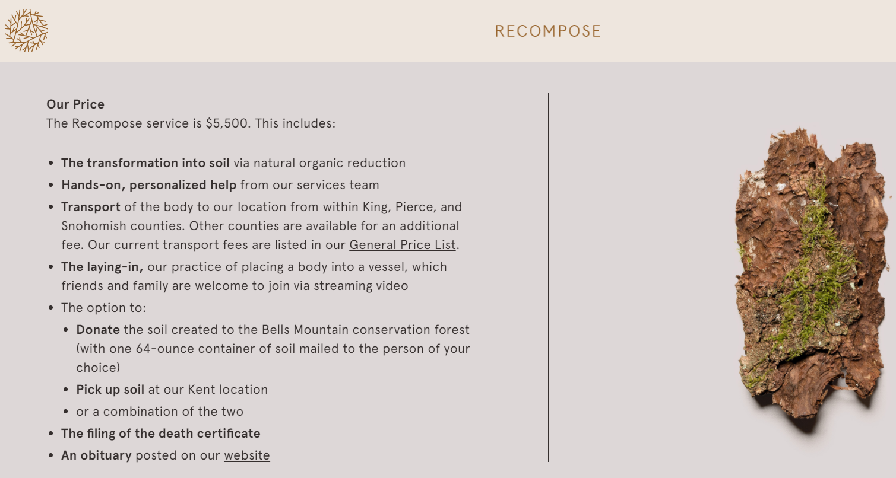
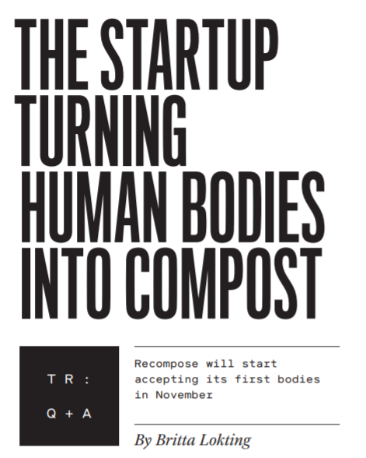
Lokting (2020)

Slide 18
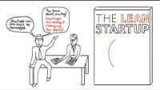
The Lean StartUp

Slide 19
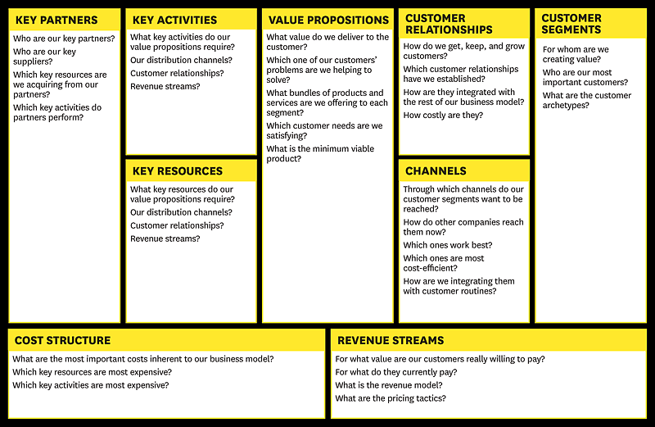
Business Model Canvas

Slide 20
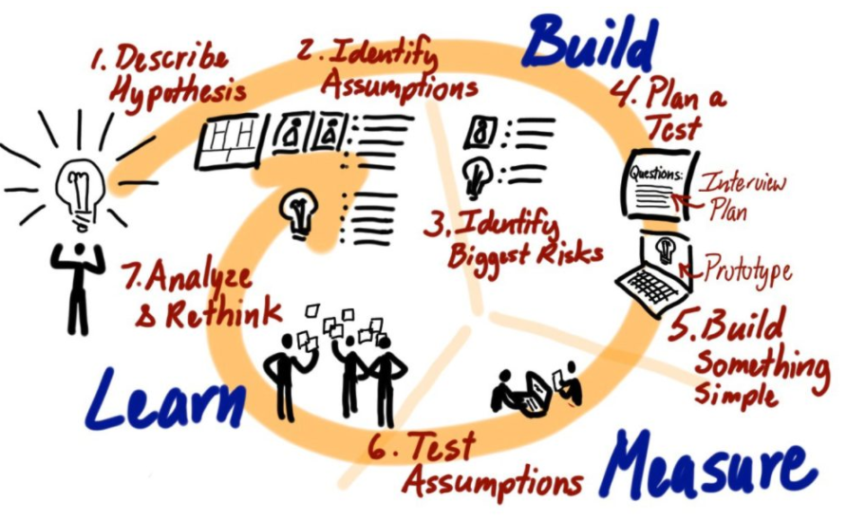
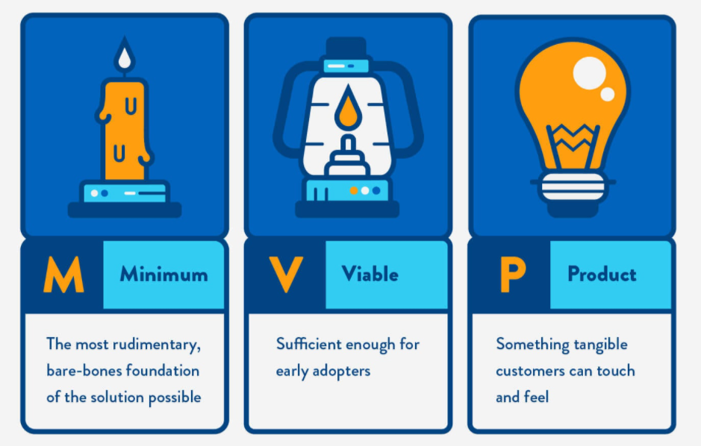
The Lean Start Up

Slide 21

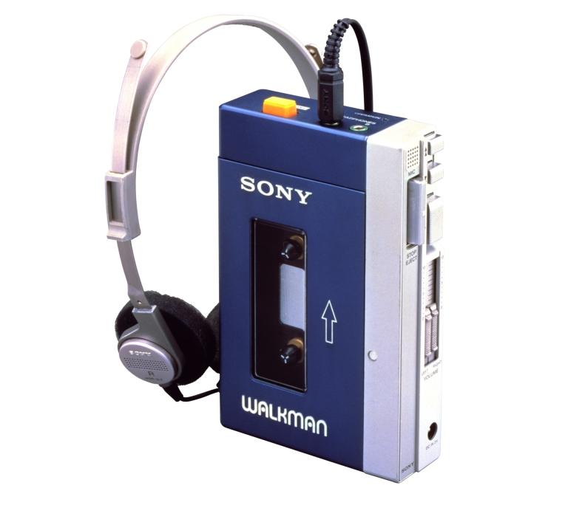

Analogs & Antilogs
Analogs - Whatever you’re doing is likely to have been done before: SO, learn from them.
Antilogs - By looking at previous failures – can be instructive in constructing your own approach.
The iPod Analog and Antilog

Slide 22
Value Proposition
A customer value proposition - a promise of value to be delivered. It's the primary reason a prospect should buy from you. It explains how your product solves customers' problems or improves their situation, or delivers specific benefits
What Makes a Good Value Proposition?
Clarity – it is easy to understand.
It communicates the concrete results a customer will get from purchasing and using your products and/or services.
It can be read and understood quickly.
“We help large companies reduce the cost of their employee benefits programs without impacting benefit levels.
With the spiralling costs of health care today, this is a critical issue for most businesses.
One of our recent clients, a large manufacturing company similar to yours, was struggling with how to reduce spending in this area.
We saved them over $800,000 in just six months. Plus, they didn’t cut any services to their employees, nor did their employees have to pay more.”
http://www.jillkonrath.com/sales-blog/bid/140981/Value-Proposition-Examples-Words-That-Get-Meetings

Slide 23

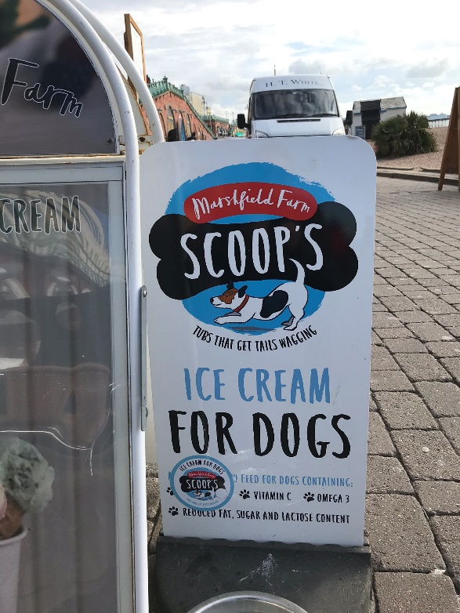
All Businesses Need An Offering of Value…..
What is it of value that we are offering our customers?
Who is our ideal customer?
How big is the market?
Is the market growing?
Is it price sensitive?
What influences the market size?
How do we tell potential customers about our offering?
Market for Ice Cream.
Niche Market

Slide 24
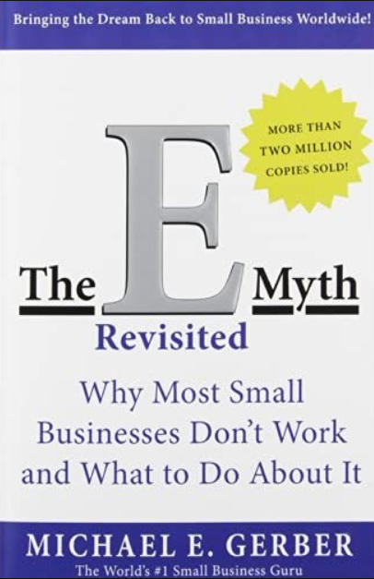
Small Business Growth
Existence stage: the owner runs the business alone
Survival stage: the entrepreneur is no longer responsible for just her own efforts
Success stage: the owner accepts a degree of disengagement as a level of supervision is added
Takeoff stage: the business includes multiple departments
Resource maturity stage: the company has arrived
The business is an effective system that makes money when the owner is not there.

Slide 25
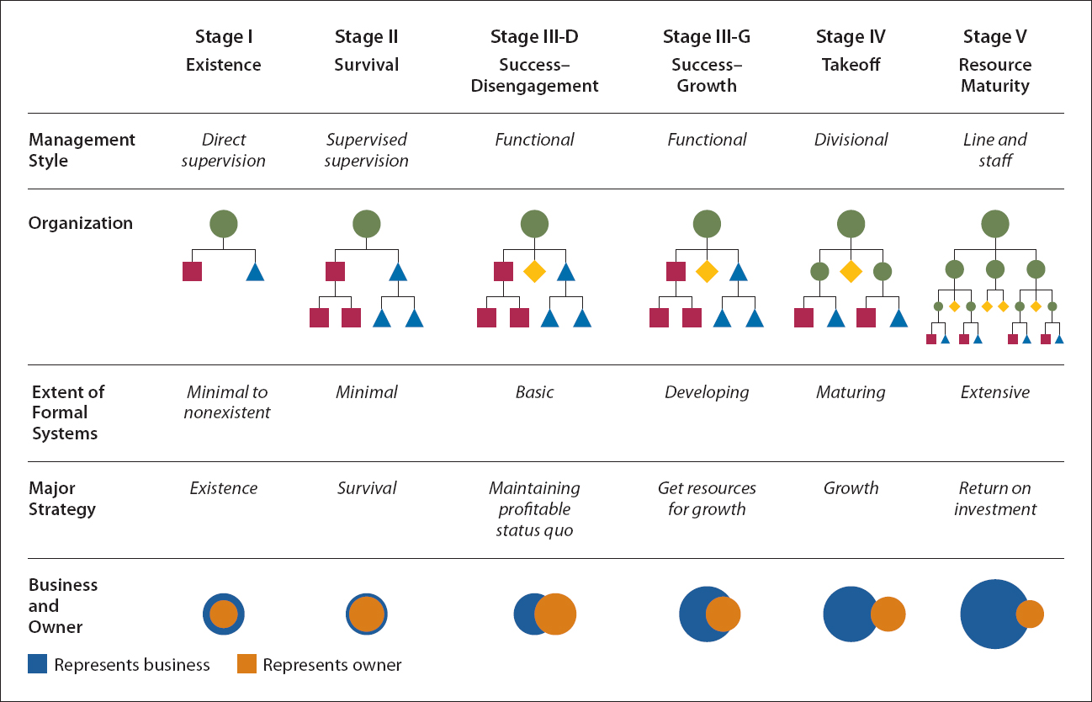
Stages of Business Growth
SOURCE: Reprinted by permission of Harvard Business Review. Exhibit. From “Five Stages of Small Business Growth,” by Neil C. Churchhill and Virginia L. Lewis, May–June 1983. Copyright © 1983 by the Harvard Business School Publishing Corporation; all rights reserved.

Slide 26
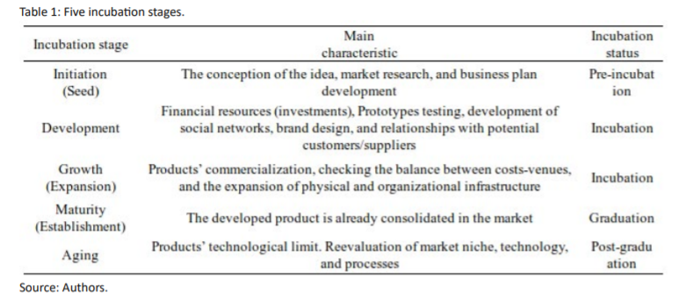
Startup Incubation
Casado et al (2020)

Slide 27
A Business Is A System Made up of Processes
Objectives of Systemisation In Small Businesses:
Reduces risk by enabling employees to perform a range of processes by following the procedures
Enables work to be allocated to the lowest possible cost resource, improving profitability
Allows measurement and improvement of the business processes
Frees up the owner (s) to work more on growing the businesses
Allows the owner to be absent from the business once processes are established and the team are operating them successfully
Paves the way to being a business of value that can be sold, since the business will operate without the owner.
Provides a platform for further growth
The first step towards Knowledge Management, making explicit the knowledge of the owner and key staff
Paves the way to using more complex information systems that will improve management information, aid forecasting and allow greater control; systems that the owner can access when he is away from the business

Slide 28
Why Do Start Ups Succeed?

Slide 29
Some Lists
Hot Not to Get Funding
Focusing on the solution and not the problem (‘This is a game changing technology’).
Relying on secondary data to project market penetration (‘If only we could sell this to 1 per cent of the China market …’).
A faulty business model (‘Just look at the revenue (not cash) we are generating’)
A team that can’t execute on the critical success factors (‘Our leadership team consists of people with a track record of success in several other industries’).
A plan where everything is rosy, there is no competition, and all we need is money. (When was the last time someone gave a pitch and said ‘This is a terrible idea and is bound to fail?’).
Randy Komisar – Getting to Plan B (2010)
Be Passionate
Execute Flawlessly
Delight your customer
100% commitment
Bisht (2012)
Key Success Factors
Timing: How early or late was the execution of the idea relevant to the time it was pursued?
Team/Execution: How effective or efficient was the team? How adaptable were they?
Idea: How novel or differentiable is it? Is there any unique truth in the idea? Are there “competitive moats” you can build around it?
Business Model: Was there a clear path to generating customer revenues?
Funding: How much money did they raise based on initial funding, follow-up, & growth?
Bill Gross (2015) - IdeaLab

Slide 30
And Yet More Lists
“If a new venture does succeed, more often than not it is:
• In a market other than the one it was originally intended to serve
• With products and services not quite those with which it had set out
• Bought in large part by customers it did not even think of when it started
• And used for a host of purposes besides the ones for which the products were frst designed.”
Peter Drucker
The economics of the business model must work:
revenue
gross margin (revenue – direct costs)
operating expenses
working capital - difference between a company's current assets, such as cash, accounts receivable (customers' unpaid bills) and inventories of raw materials and finished goods, and its current liabilities, such as accounts payable.
investment characteristics of the model.
Mullins (2010)
• Are the market and industry attractive?
• Does the opportunity offer compelling customer benefits as well as a sustainable advantage over other solutions to the customer’s needs?
• Can the team deliver the results they seek and promise to others?
Mullins (2014)

Slide 31
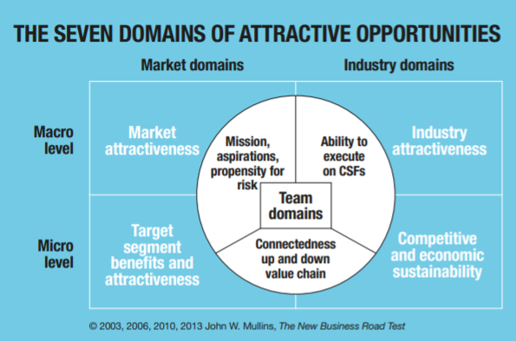

Slide 32
Business Growth

Slide 33
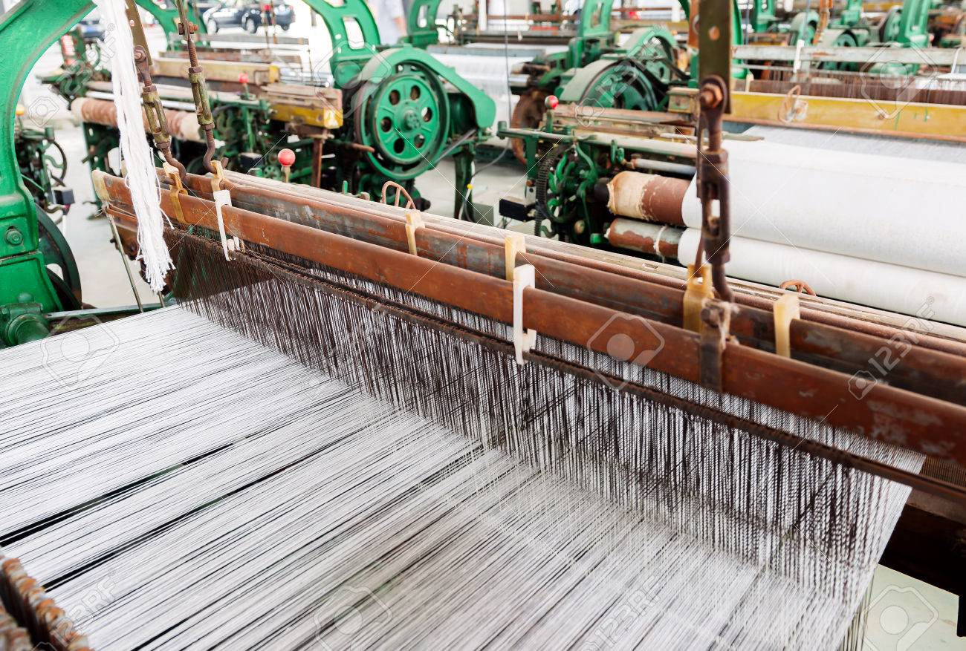
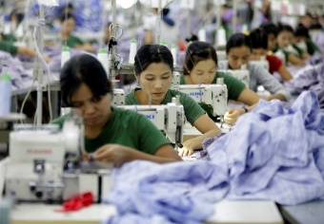




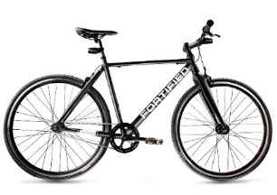


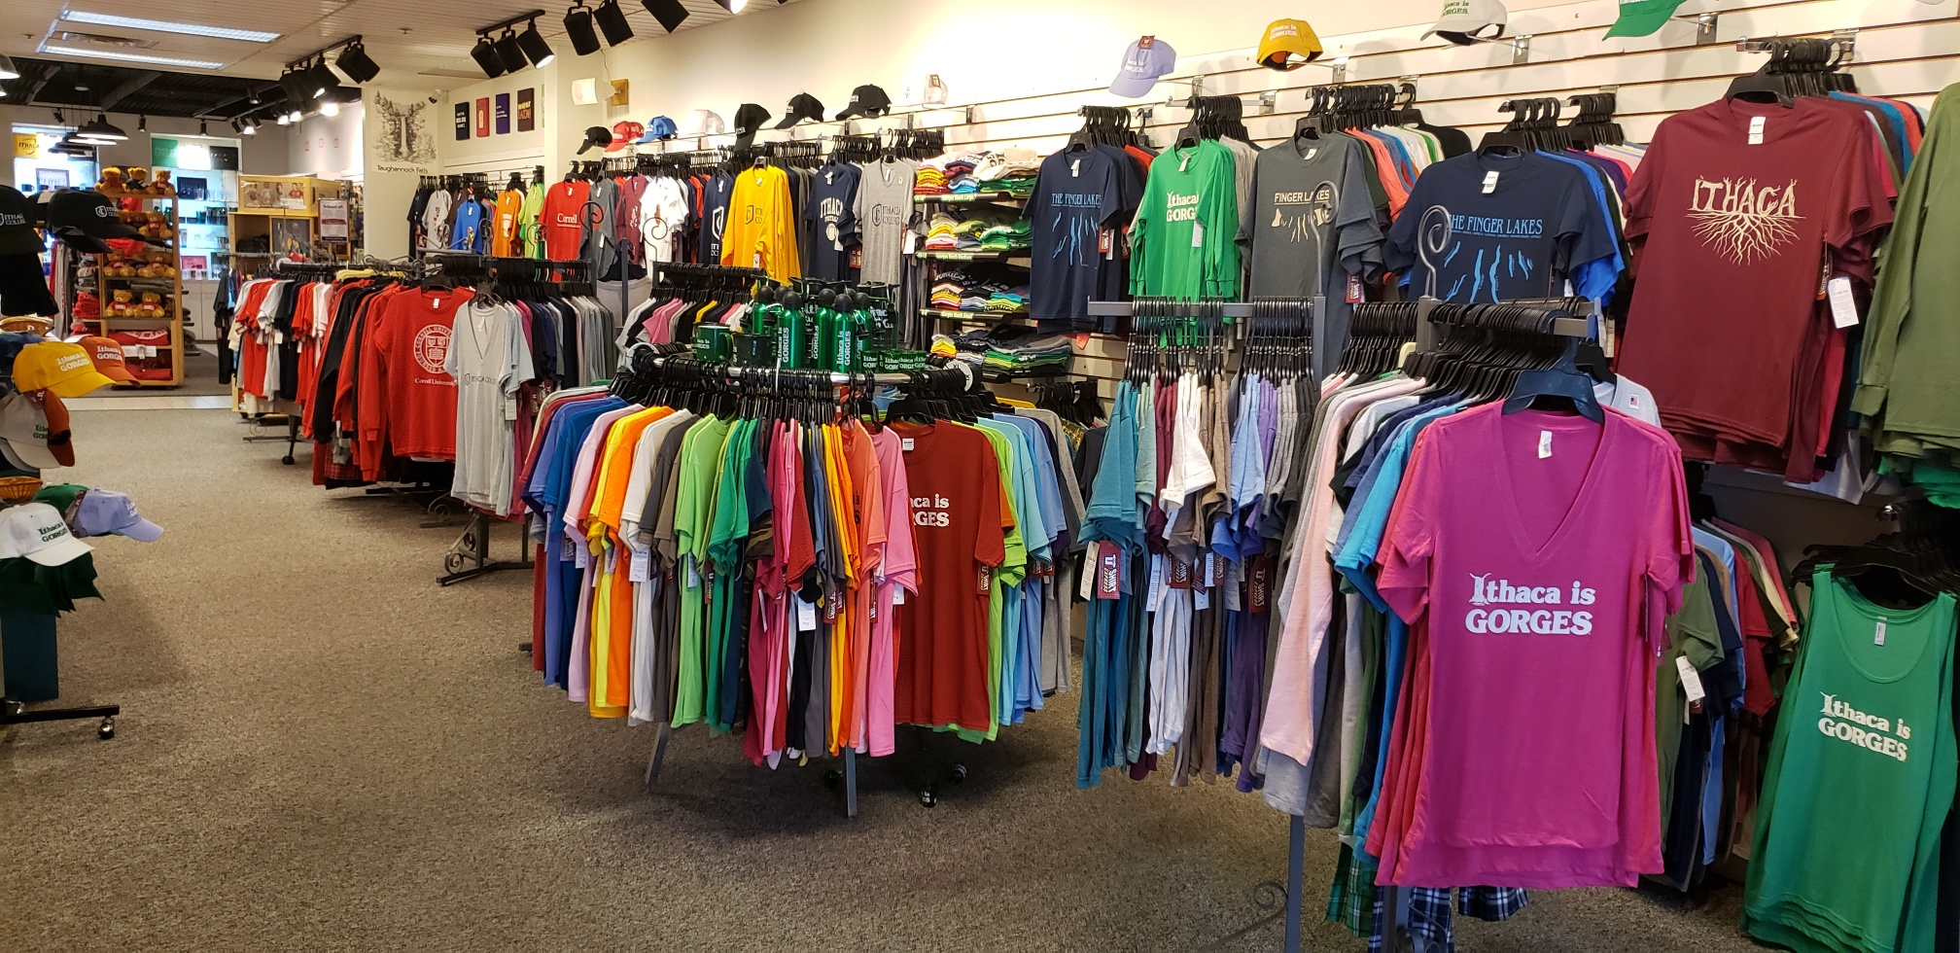
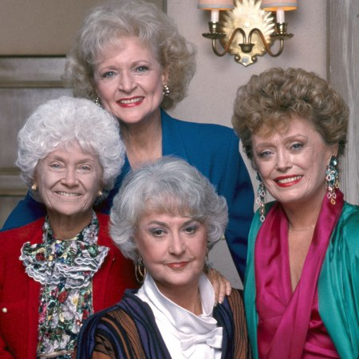


How Does a Business Grow Profitably?
Backwards
Integration
Portfolio of Products
Vertical Integration
Horizontal Diversification
Forward
Integration
New Market Entry
Innovation
Resource Capture
Learning
Internationalisation

Slide 34
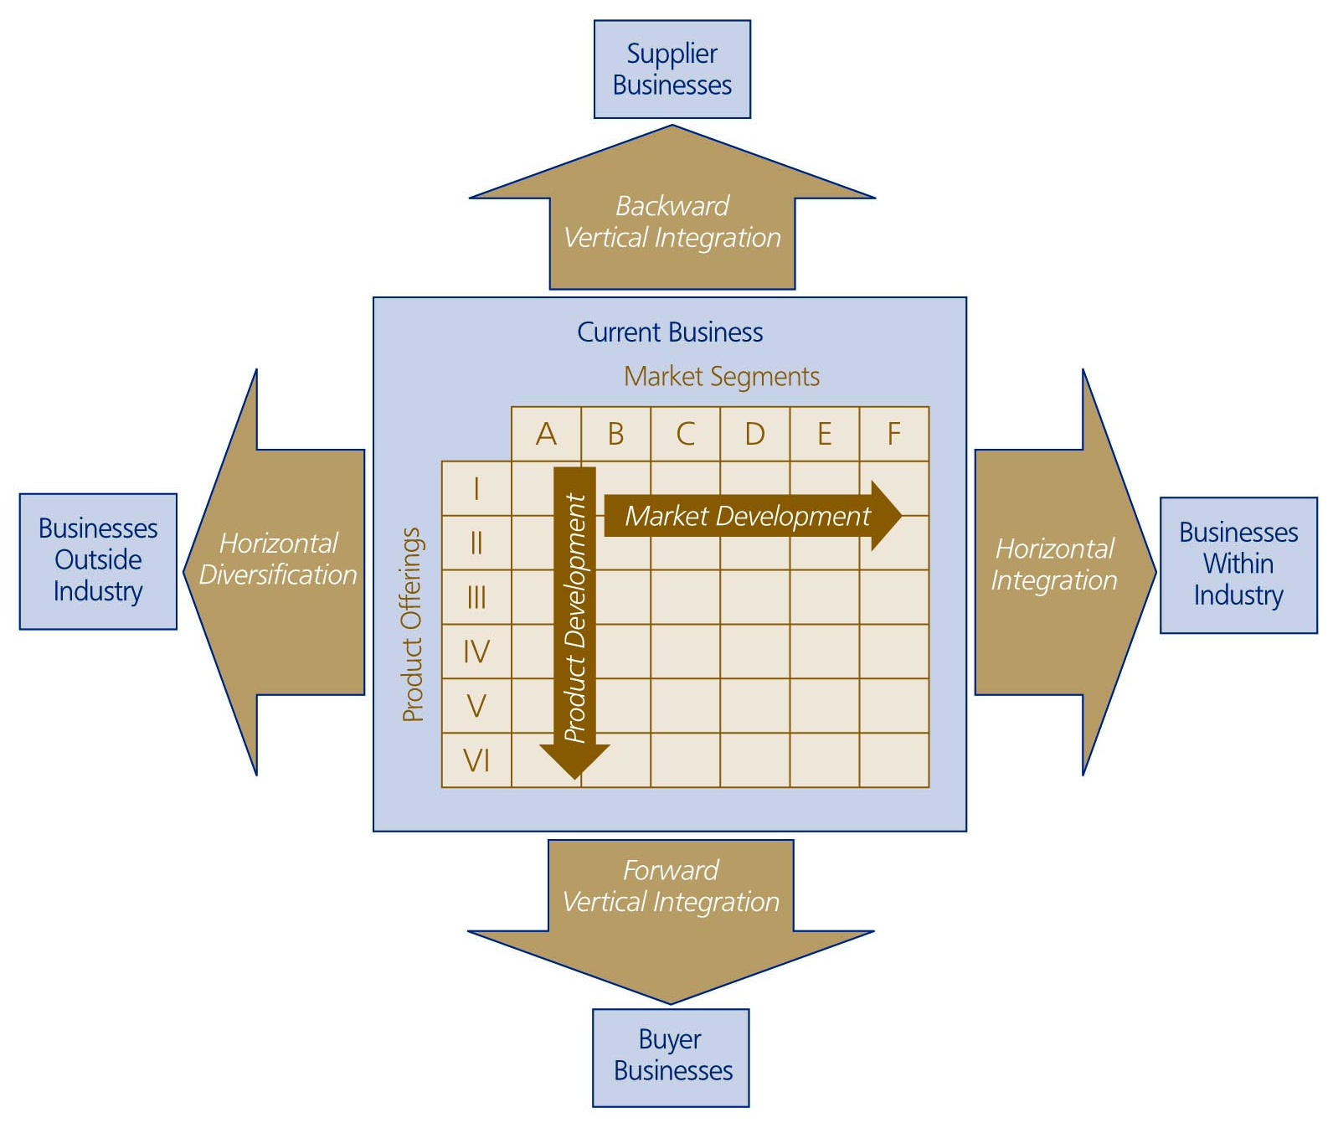
  Corporate Growth
  Directions

Slide 35
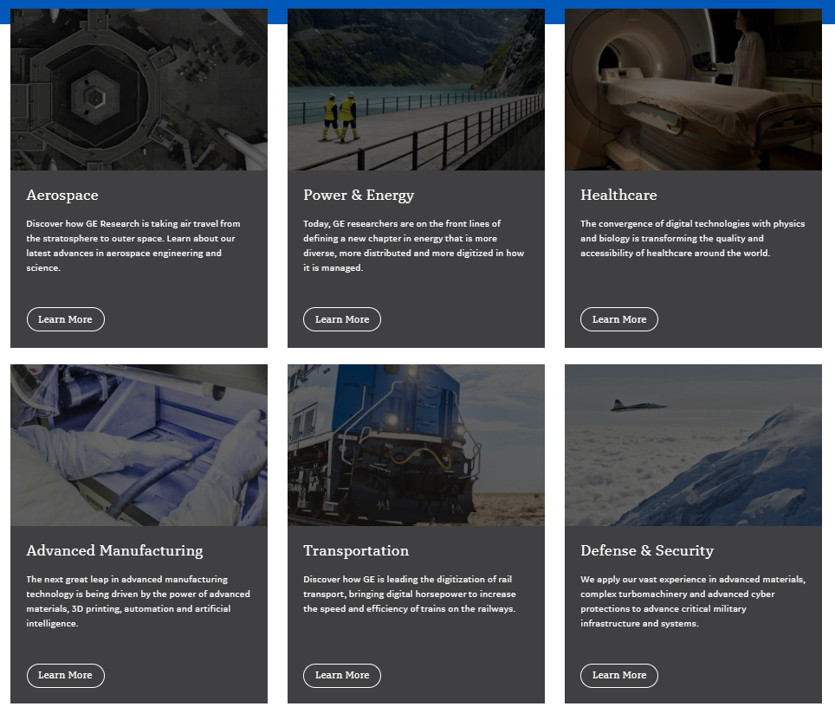

GE
 | 12/31/2016 | 12/31/2017 | 12/31/2018 | 12/31/2019 | TTM
Total Revenue | 119,687,000 | 120,468,000 | 121,616,000 | 95,215,000 | 83,928,000
Net Income Common Stockholders | 8,163,00 | -6,246,000 | -22,802,000 | -5,439,000 | 3,325,000

Slide 36


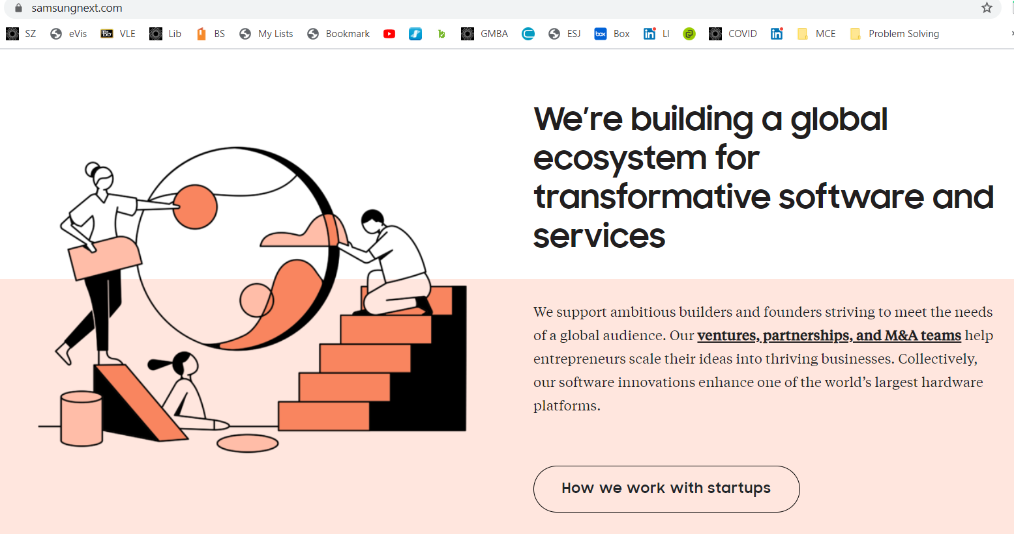

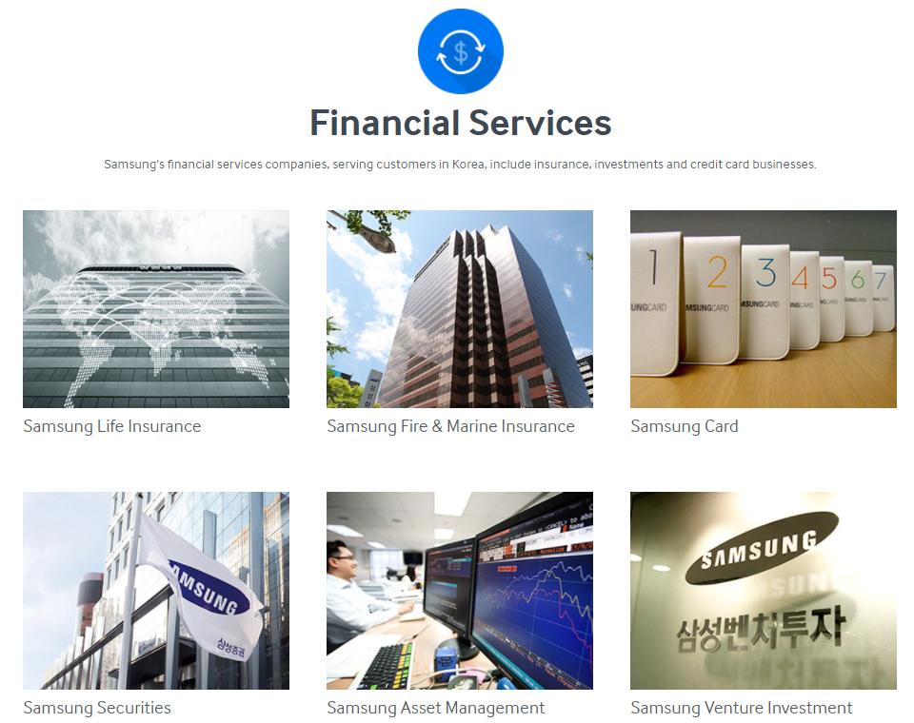
Samsung

Slide 37
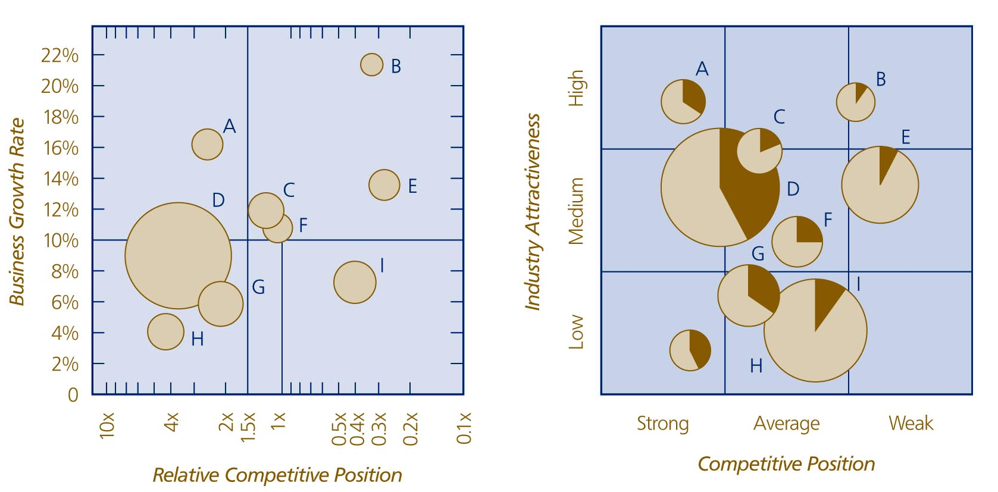




  The BCG Matrix And GE Business Screen
Bubble size indicates revenue.

