Slide 1
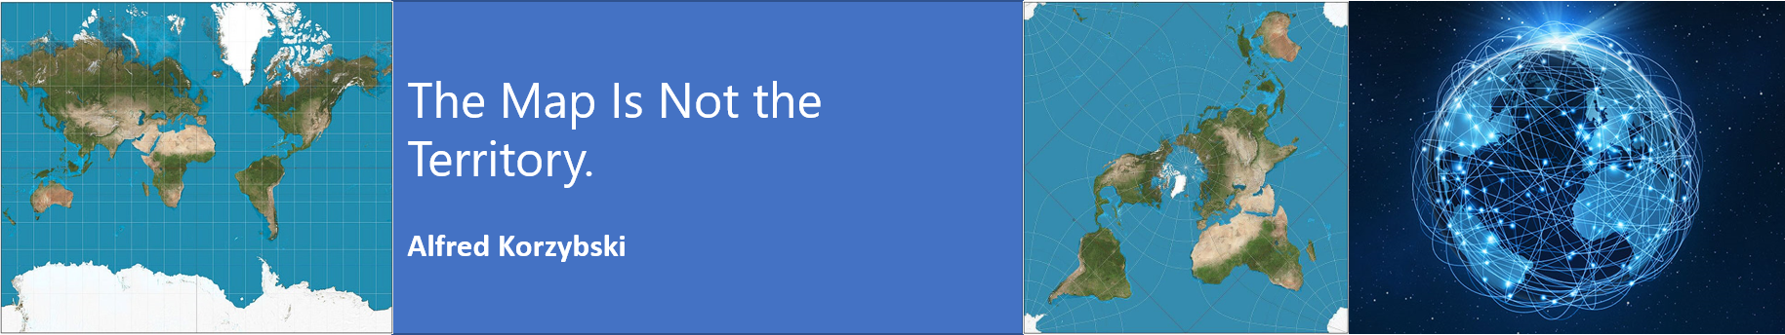
MN7031 Topic 12 – Strategic Alignment
Daniel Jones
londonmet.ac.uk

Slide 2
Today’s Agenda
Lecture – Strategic Alignment
The business environment
Strategic alignment
Revolutionary and evolutionary change
International Perspective
Recap - Key models and theories
Simulation – R7
Assessment 2 – Q and A

Slide 3
The Context of Strategic Alignment

Slide 4
The Alignment Challenge
Industry (or Sector)
Development stage
Markets and Competitors
Market Segments
Scope of activities
The Organisation
Resources
Capabilities
Competencies
Politics
The Macro-environment
Concentration
Value network
Products and/or services
Critical success factors
Resource commitment
Economics
Social
Technological etc.
Theories and Frameworks
PESTEL
Scenario Planning
5 Forces
Industry Lifecycle
External
Blue Ocean Theory
Red Queen Theory
Market Analysis
Competitor Analysis
Resource Based View
Business Model
Internal
Core Competencies
Organisational Structure
Culture
Global
Regional
National
Local
Systems
Notes:
We will look at competitors in a later topic.

Slide 5
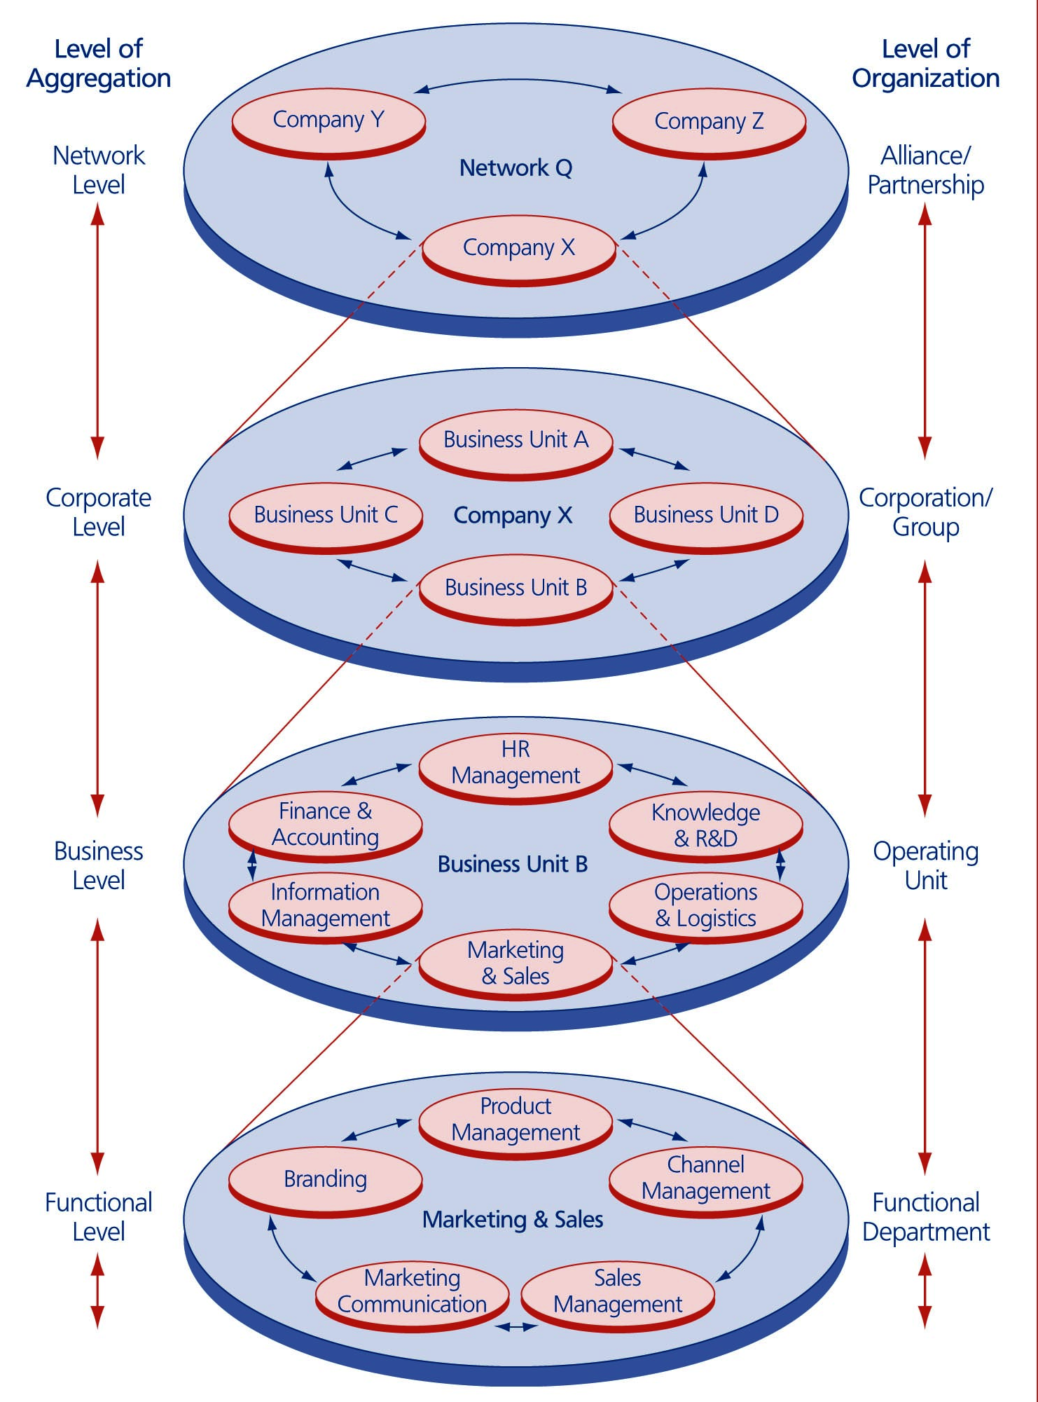
Levels of Strategy
Network Level
Corporate Level
Business Level
Marketing – MN7032
Operations – MN7030
Finance and Accounting – MN7029
People Management – MN70028
Functional Level
Wit, B. de (2017)

Slide 6
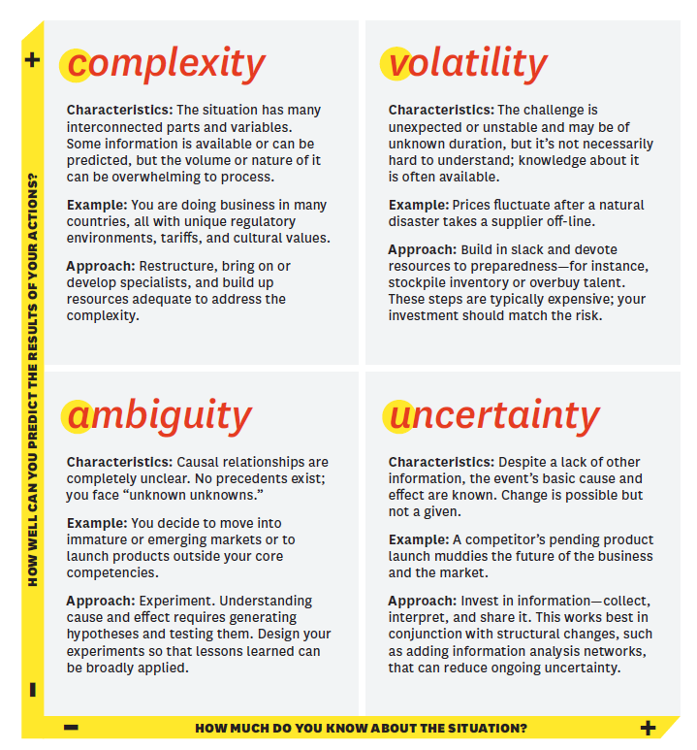
Another View of VUCA
Conflict
Climate Change
Acceptance of the use of robots
Energy supplies
Bennett and Lemoine (2014)

Slide 7
Strategic Alignment

Slide 8
For A ‘Living’ Organisation, Change Is A Given
Not all change is “strategic” – much change is ‘fine-tuning’ alterations where changes are directed at increasing the performance of the firm within the confines of the existing system
Strategic changes are directed at creating a new type of alignment between the basic set-up of the firm and the characteristics of the environment
The process of enacting strategic changes to remain in harmony with external conditions is called ‘strategic alignment’

Slide 9
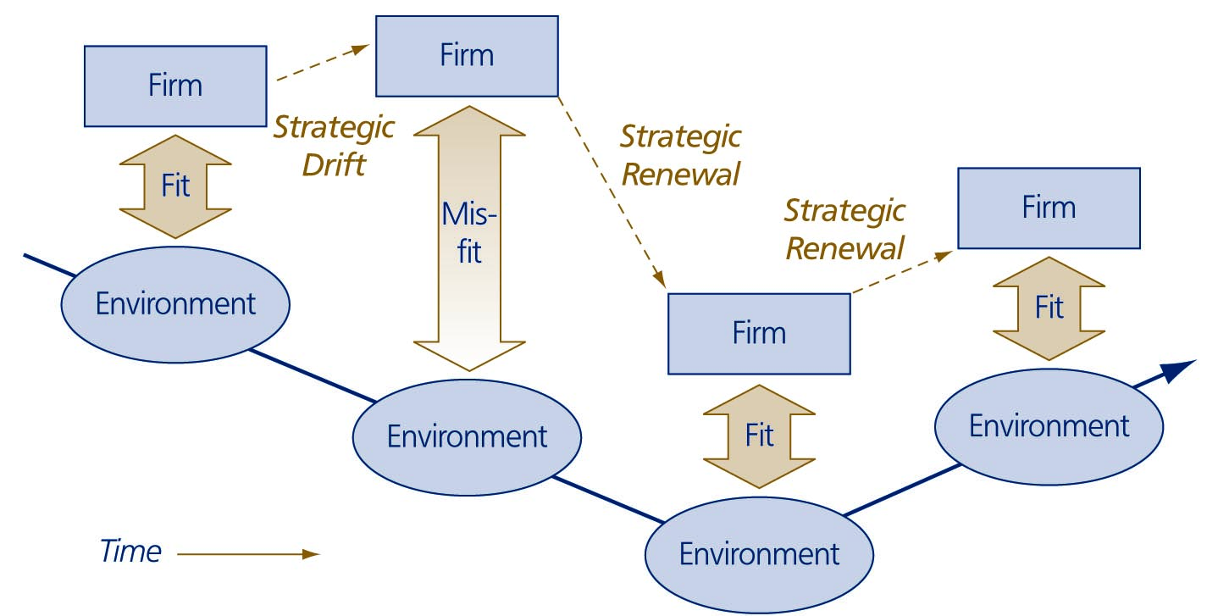
The Issue Of Strategic Alignment
Many actions constitute a strategic change e.g.: a reorganisation, a diversification move, a shift in core technology, a business process redesign or a product portfolio reshuffle.

Slide 10
Areas Of Strategic Alignment
Business model – ‘how a firm makes money’ or ‘the specific configuration of resources, value-adding activities and product/service offerings directed at creating value for customers’
Organisational system – ‘how a firm is organised’ or ‘how the individuals populating a firm have been configured, and relate to one another, with the intention of facilitating the business model’
  Stakeholders
  Ownership
  Culture
  Purpose
The business model is supported by the organisational system

Slide 11
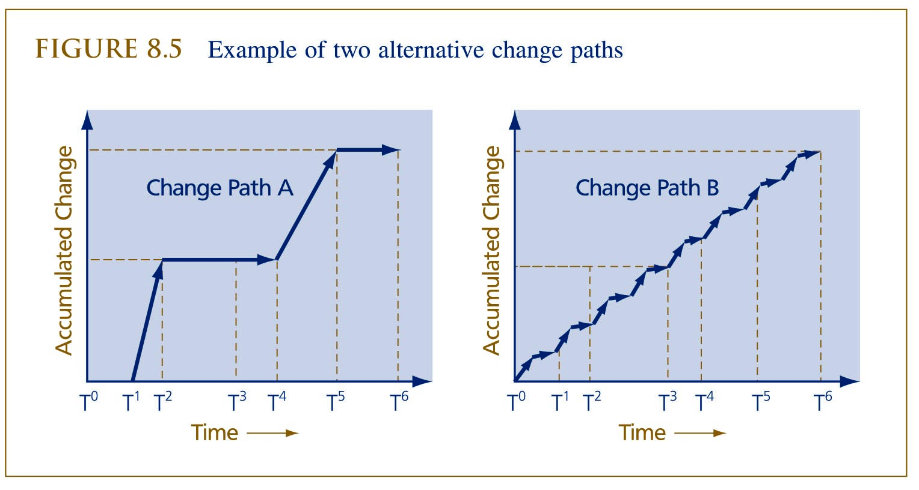
Example Of Two Alternative Change Paths

Slide 12
The Demand For Revolutionary Change Processes
Revolutionary change is needed where an organisation is very rigid so that smaller changes do not bring the firm into movement
Typical sources of organisational rigidity include:
  psychological cultural politica lresistance to change
  Investment, competence, systems, and stakeholder lock-in
A radical approach to strategic alignment is often necessary if there is only a short time span available for a large change
Common triggers for revolutionary strategic change are:
  competitive pressure
  regulatory pressure
  first mover advantage

Slide 13
The Demand For Evolutionary Change Processes
Evolution is a process whereby a constant stream of moderate changes gradually accumulates over a longer period of time. A new business model and/or organisational system can evolve from the old.
Reasons for evolutionary change:
  Learning – the process is used where organisational learning is involved as learning is a slow process
  Power is too dispersed for revolutionary changes to be imposed upon the firm

Slide 14
Navigating
Over the long term the pattern of environmental change is episodic. Periods of relative stability are interrupted by short and dramatic periods of instability – ‘punctuated equilibrium’.
When the environment is in flux, organizations must align. Strategizing managers must possess a variety of options in dealing with environmental change.
During periods of relative stability, the emphasis should be on evolutionary adaption.
During periods of discontinuous change, firms need to be able to be revolutionary.

Slide 15
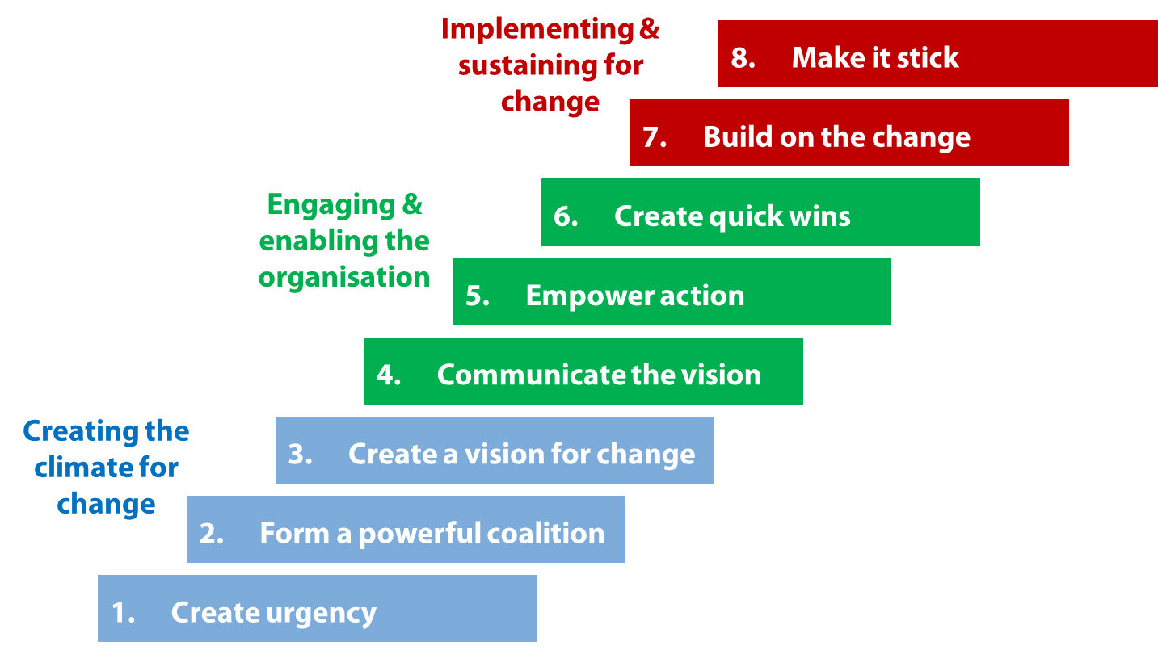
How Do You Create Change In An Organisation?
Kotter (1995) has developed ‘8 steps’ to transform organisations:
Notes:
Change Management is part of a project and is planned prior to implementation.
Some businesses can planned for months or even years in advance if they are aware of the changes. This is particularly evident in the public sector relating to specific legislation changes.

Slide 16
Hayes (2018) Model of Change
Managing change involves seven core activities:
Recognising the need for change and starting the change process
Diagnosing what needs to be changed and formulating a vision of a preferred future state
Planning how to intervene in order to achieve the desired change
Implementing plans and reviewing progress
Sustaining the change
Leading and managing the people issues
Learning
Recognition and
starting the process
Leading and managing the people issues
Diagnosis
Learning
Planning
Implementation and reviewing progress
Current
state
The Change Process
Future
state
A
B
C
Sustaining the change

Slide 17
Strategic Change – An International Perspective

Slide 18
Prevalence Of Mechanistic Organisations
In some countries, e.g. English-speaking countries and France, the machine bureaucracy is dominant – clear hierarchical authority relationships, strict differentiation of tasks, formal communication, reporting and decision-making processes. Internal relationships are depersonalised and calculative.
In more organic forms of organisation, e.g. in Japan and Germany, management and production activities are not strictly separated leading to less top-down decision-making. Internal relationships are based on trust, cooperation and a sense of community.
Machine bureaucracies are more resistant to change and therefore revolutionary change is more common
Clan-like organisations are better able to reorganise around new issues so there is a preference for continuous alignment

Slide 19
Position Of Employees
In a mechanistic organisation people work for the organisation, seen as valuable but expendable.
  Employers want to minimise their dependence on employees so organisational learning should be captured in formal systems and procedures so employees can be replaced.
  Employees will not tie themselves too strongly to the organisation.
  More conducive to revolutionary change.
In a clan, people are the organisation.
  Employees’ positions within the organisation are more secure, information is more readily shared.
  Employers can invest in people instead of systems as employees are loyal to the firm.
  More conducive to continuous change.

Slide 20
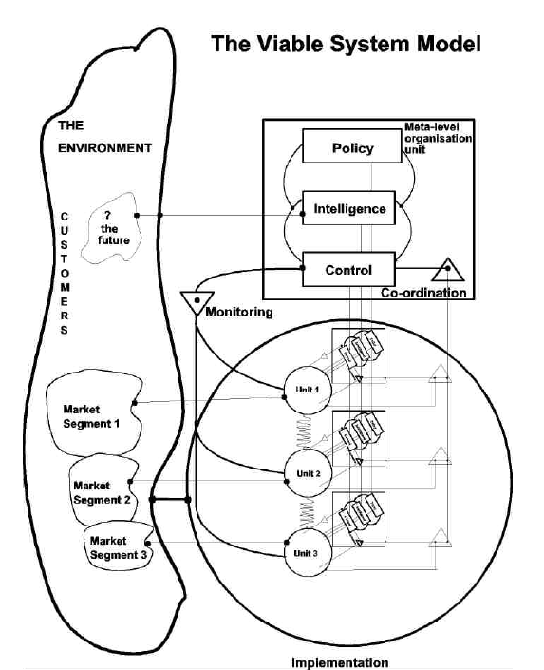
Role Of Top Management
In some countries top management is the ‘central processing unit’ of the organisation and visible top-down leadership is the norm and strategic change top managers’ responsibility. This leads to a discontinuous alignment perspective.
In other countries management is less direct and less visible. Change comes from within the body of the organisation and will be more
evolutionary.

Slide 21
Time Orientation
Cultures that are short-term oriented exhibit a stronger preference for fast radical change, e.g. in most English-speaking countries there are pressures for rapid results due to:
  sensitivity to stock prices
  bonus systems
  stock option plans
  frequent job-hopping
In long-term oriented cultures, e.g. Japan, China and South Korea, there is less pressure to achieve short-term results. More emphasis is placed on facilitating long-term change processes due to:
  long-term employment relationship
  lack of short-term bonus systems
  accent on growth not profit

Slide 22
Key Skills, Models and Theories To Master

Slide 23
Strategy Diagnosis – An Iterative and Incremental Sense Making Process
Financial Performance
Industries, Product Offerings and Market
Business Model and Value Network
Capabilities, Resources and Competencies
Competitive Advantage
Scan the Environment
Analyse the External Environment
Start with the 7 areas in the diagram, beginning with financial performance over the last 5 years:
  Is the business profitable?
  Is it growing or declining?
  How does it compare with the rest of its industry?
  Share price and capitalisation
Investigate the other 5 areas
The process of diagnosis may lead to questions in other areas e.g.:
  Leadership
  Ownership
  Information Systems
  Acquisition Integration
  Culture
  Sustainability
  Etc..
Strategic
Sense Making

Slide 24
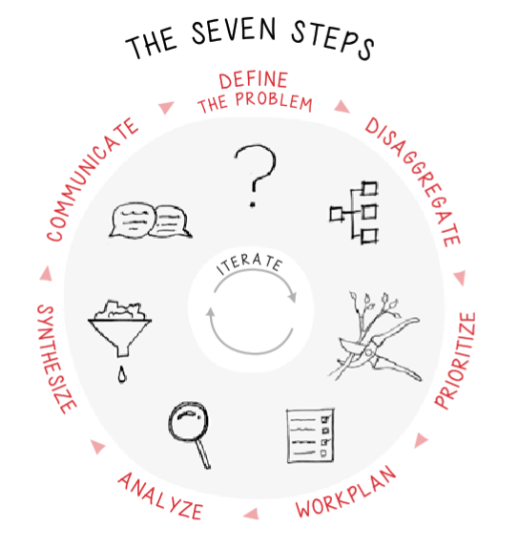
Bullet Proof Problem Solving (MN7027)
The bulletproof problem-solving process is both a complete process and an iterative cycle.
This cycle can be completed over any timeframe with the information at hand.
Once you reach a preliminary end point, you can repeat the process to draw out more insight for deeper understanding.
The one-day solution.
Iterative and emergent.

Slide 25
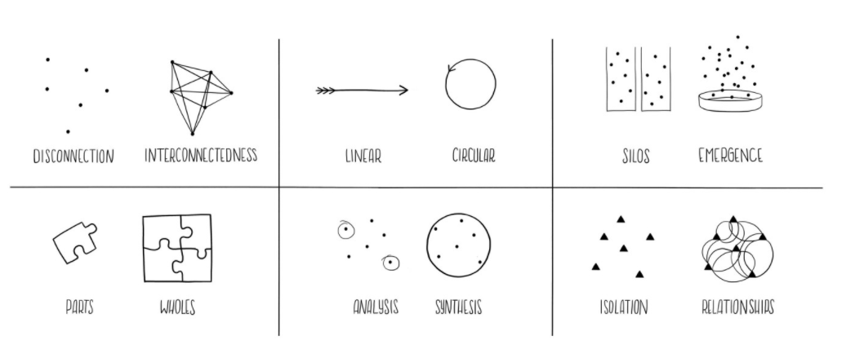
Systems Thinking
https://medium.com/disruptive-design/tools-for-systems-thinkers-the-6-fundamental-concepts-of-systems-thinking-379cdac3dc6a

Slide 26
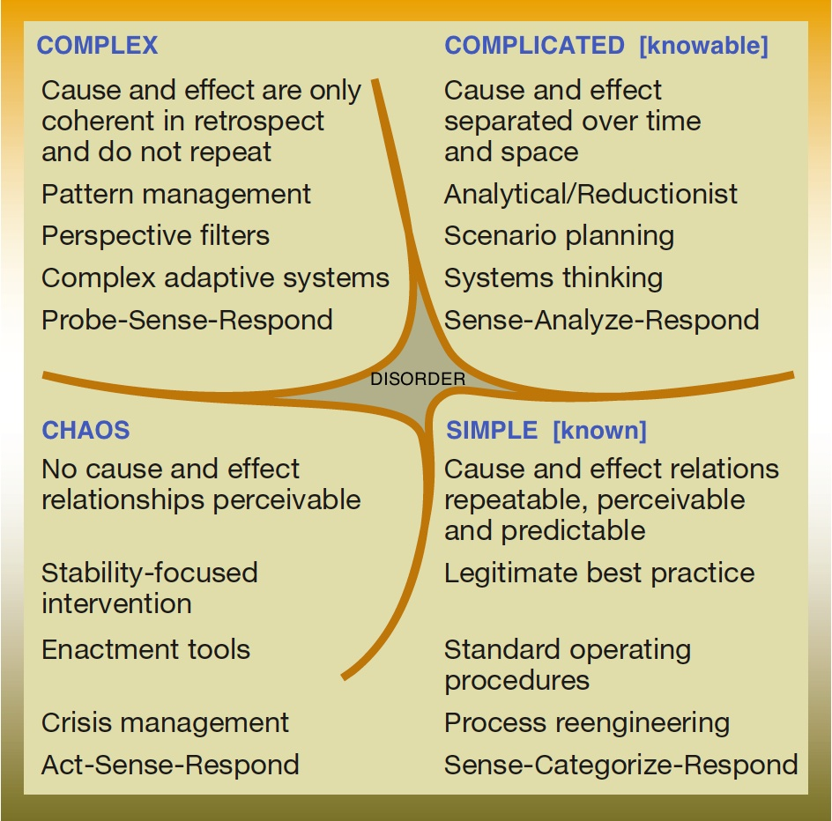
The Cynefin Framework
“The Cynefin framework originated in the practice of knowledge management as a means of distinguishing between formal and informal communities, and as a means of talking about the interaction of both with structured processes and uncertain conditions.”
unordered
ordered
from (Kurtz & Snowden 2003)

Slide 27
PESTEL (LEE)
Environmental Scanning
……is the acquisition and use of information about events, trends, and relationships in an organisation's external environment, the knowledge of which would assist management in planning the organisation's future course of action.
It is a sense-making activity.
Political
Economic
Social
Technological
Legal
Environmental
Ethical

Slide 28
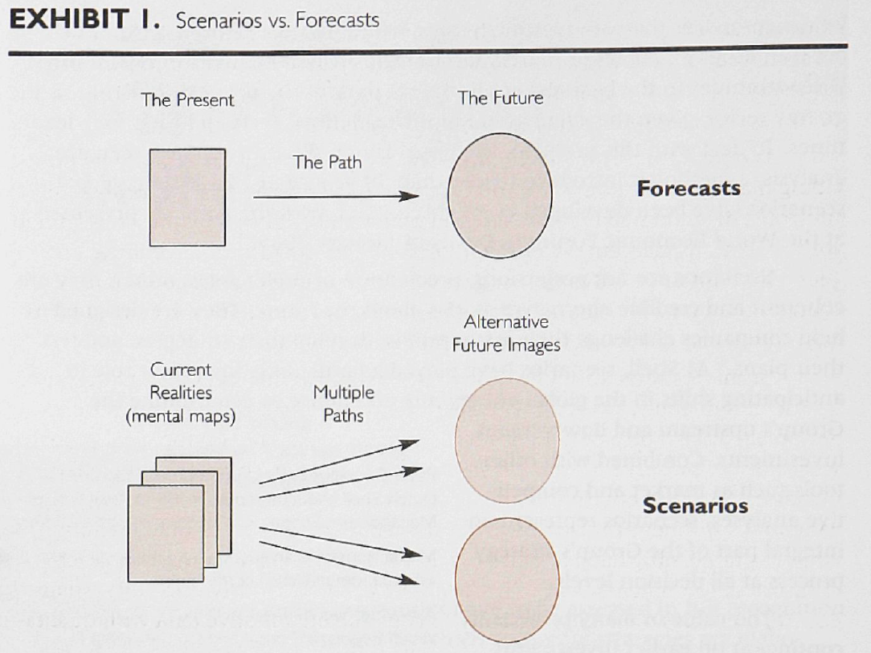
Scenario Planning
Cornelius, P, Van de Putte, A, & Romani, M 2005, 'Three Decades of Scenario Planning in Shell', California Management Review, 48, 1, pp. 92-109, Business Source Complete, EBSCOhost, viewed 6 March 2017.

Slide 29
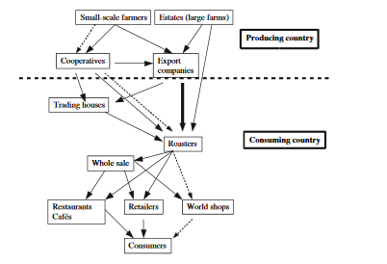
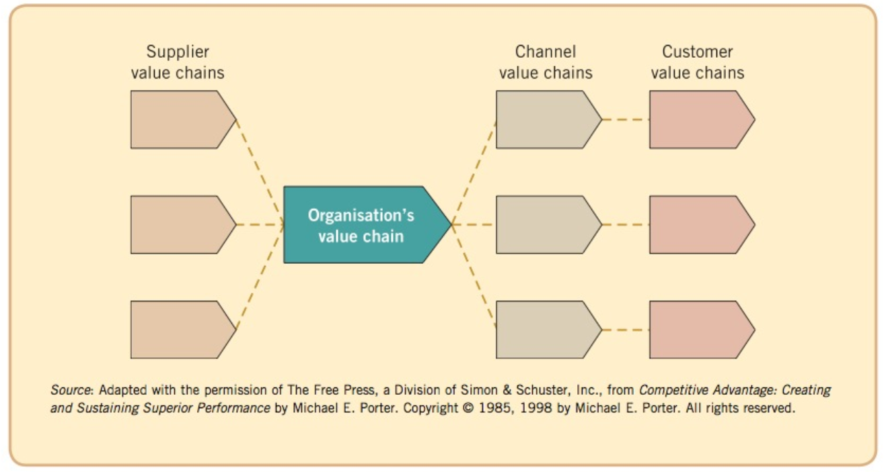
The Value System or Value Network
Johnson, G. et al., 2013, Exploring Corporate Strategy: Texts and Cases, 10th, Harlow: Pearson p 87

Slide 30
How Do We Understand Industry Profitability?
Suppliers
According to Porter (2008), competition for profit extends beyond direct rivals (e.g. Pepsi v Coke) to include 4 other industry components
This extended rivalry defines the structure of the industry and the level of profitability
Bargaining power of suppliers
Industry Competitors
Rivalry among
existing firms
Potential Entrants
Substitutes
Threat of new entrants
Threats of substitutes
Buyers
Bargaining power of buyers

Slide 31
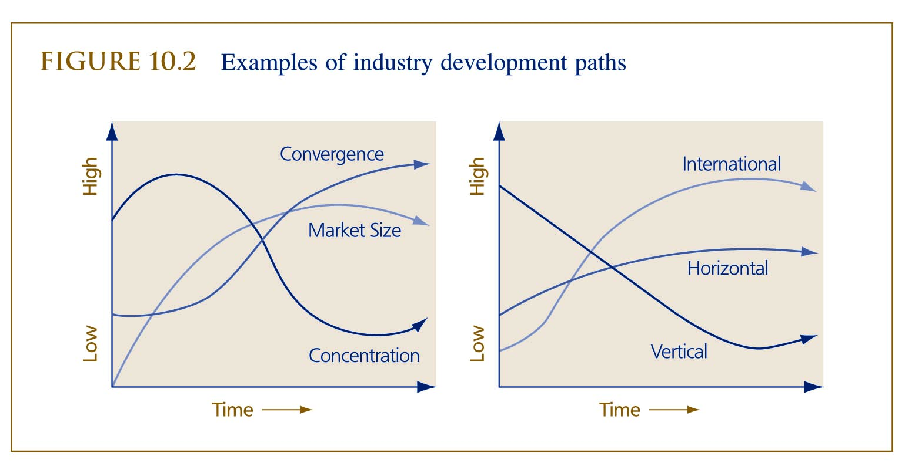
Dimensions of Industry Development
Convergence – Divergence (how alike are firms)
Concentration – Fragmentation (market shares)
Vertical integration – Fragmentation
Horizontal integration – Fragmentation
International integration – Fragmentation
Expansion – Contraction

Slide 32
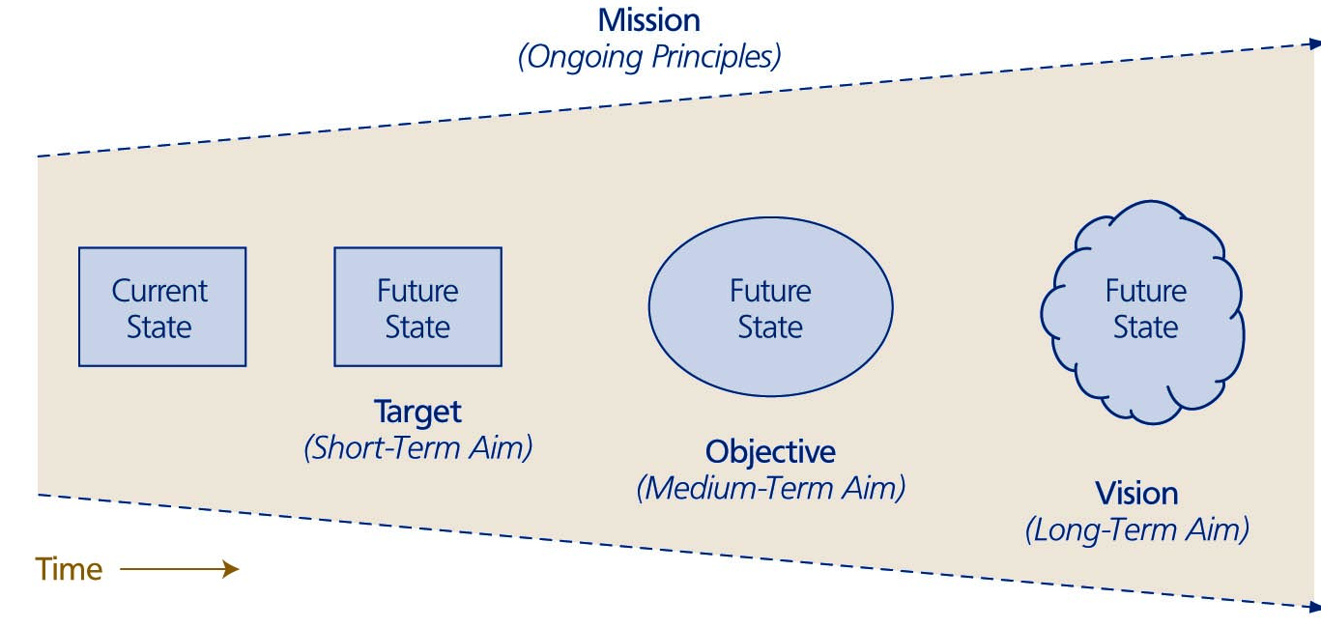
Vision and Mission
Corporate mission outlines the fundamental principles guiding strategic choices
Strategic vision outlines the desired future at which the company hopes to arrive
The corporate mission and strategic vision together send the firm in a particular direction

Slide 33
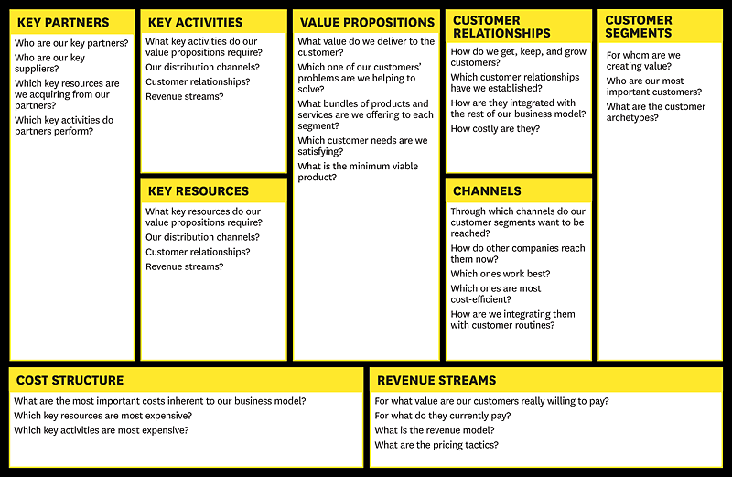
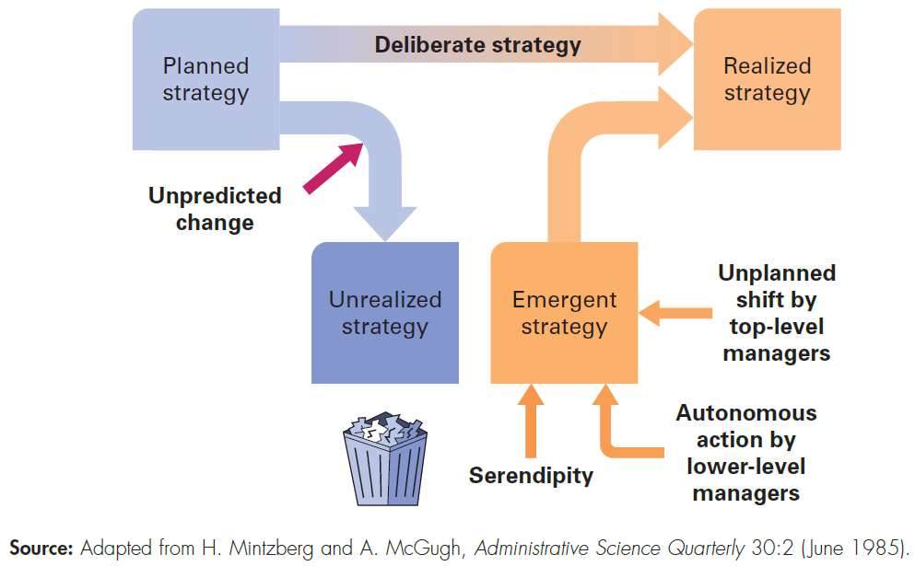

Emergent and Deliberate Strategies
Hill et al (2015)
Notes:
Henry Mintzberg identified that planned strategies often did not survive contact with managers, customers and the business environment.
He observed that unplanned events also shape strategy and that the realised strategy that actually unfolded over time was a combination of the deliberate planning and of emergence. Companies adapt and improvise as events occur; perhaps a serendipitous discovery or the emergence of a new business model in a rival firm.
We can see many changes occurring at present as a result of technology innovation and globalisation, particularly in the exploitation of platforms such as Amazon, Uber and e-bay and of ecosystems like Apple and Android. Amazon has disrupted retailing very significantly and Uber is changing the way we acquire and pay for taxi rides. Both firms are evolving rapidly. Amazon is now seeking to enter the groceries market place as well as extending its logistics and delivery activities in areas once dominated by state owned post offices. Uber is experimenting with add-on services to its platform and is expected in the future to become a platform for sharing driverless cars.

Slide 34
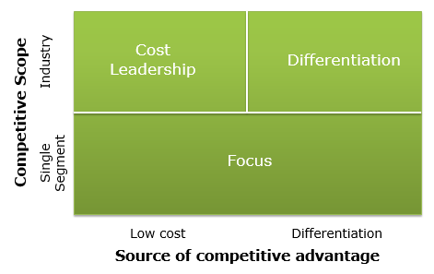
Positioning A Business
Where and How to compete?
Bases of competitive advantage:
  Price, Features, Bundling
  Efficiency
  Quality
  Innovation
  Customer responsiveness
  Availability
  Image and relations
Porter’s three generic competitive advantages:
  operational excellence
  product leadership
  customer intimacy
Stuck in
the Middle
Choosing What Not to Do

Slide 35
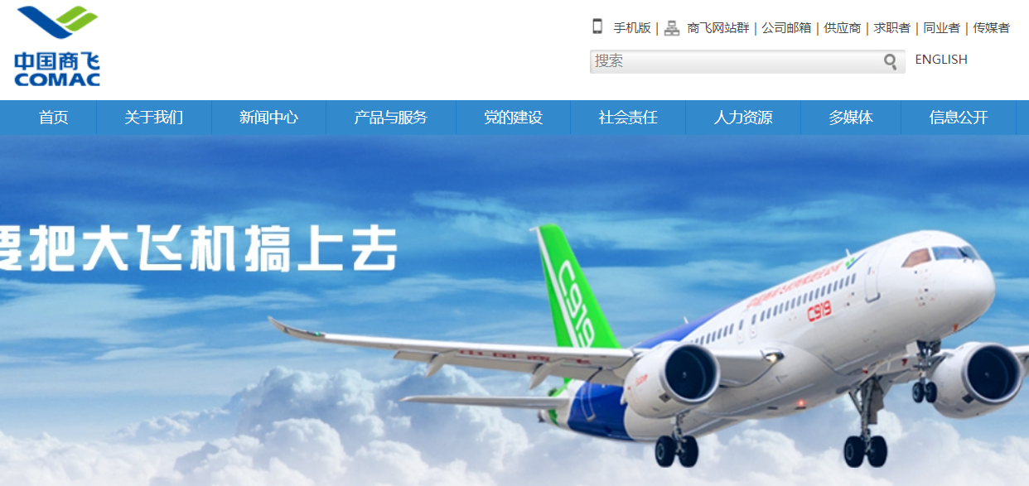
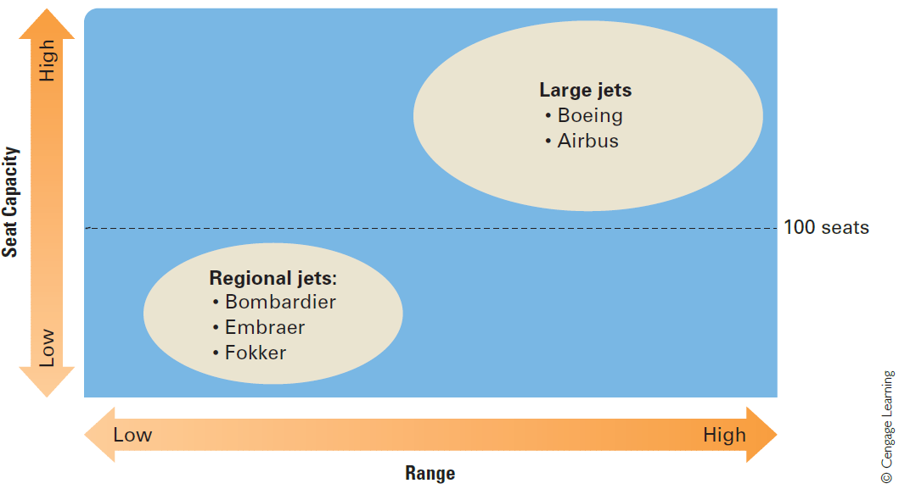
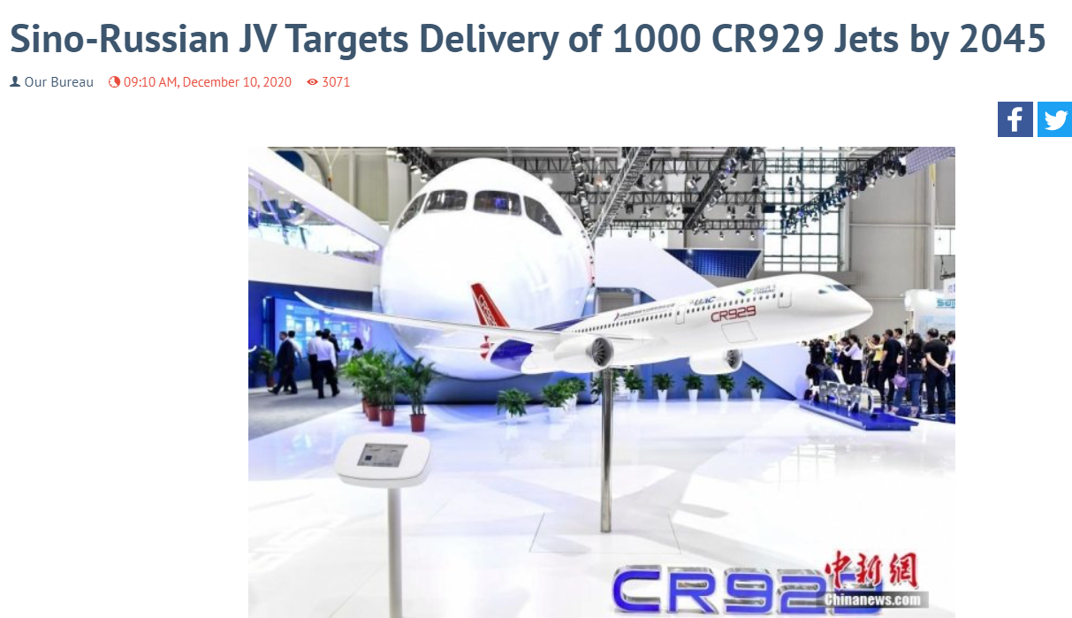
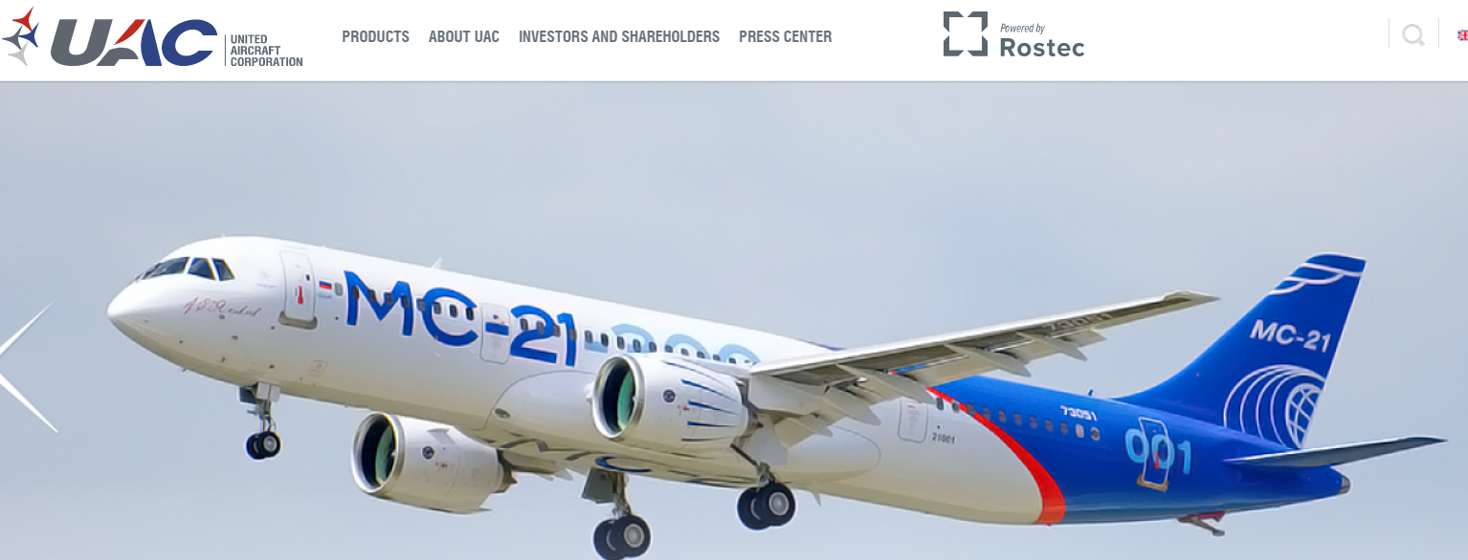
Strategic Groups in the Commercial Aerospace Industry
CR929
https://www.defenseworld.net/news/28513/Sino_Russian_JV_Targets_Delivery_of_1000_CR929_Jets_by_2045#.YJY-l7X0lPY

Slide 36
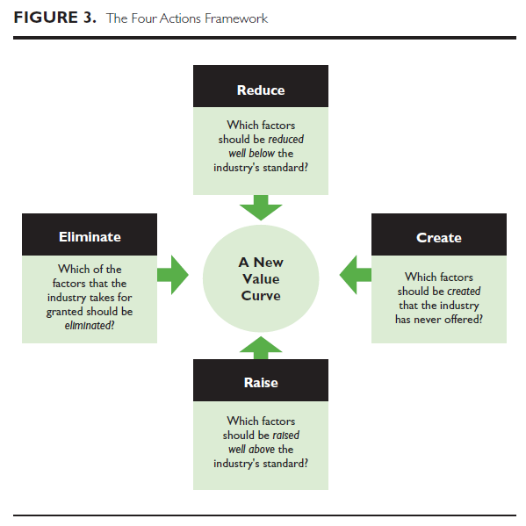
Blue Ocean Strategy
Companies can build competitive advantage by redefining their product offering through value innovation - creating a new market space
Blue Ocean - Wide open market space where a company can chart its own course
Red Ocean – fiercely competitive
W. Chan, K, & Mauborgne, R 2005, 'Blue Ocean Strategy: FROM THEORY TO PRACTICE', California Management Review, 47, 3, pp. 105-121, Business Source Complete, EBSCOhost, viewed 10 August 2016.

Slide 37
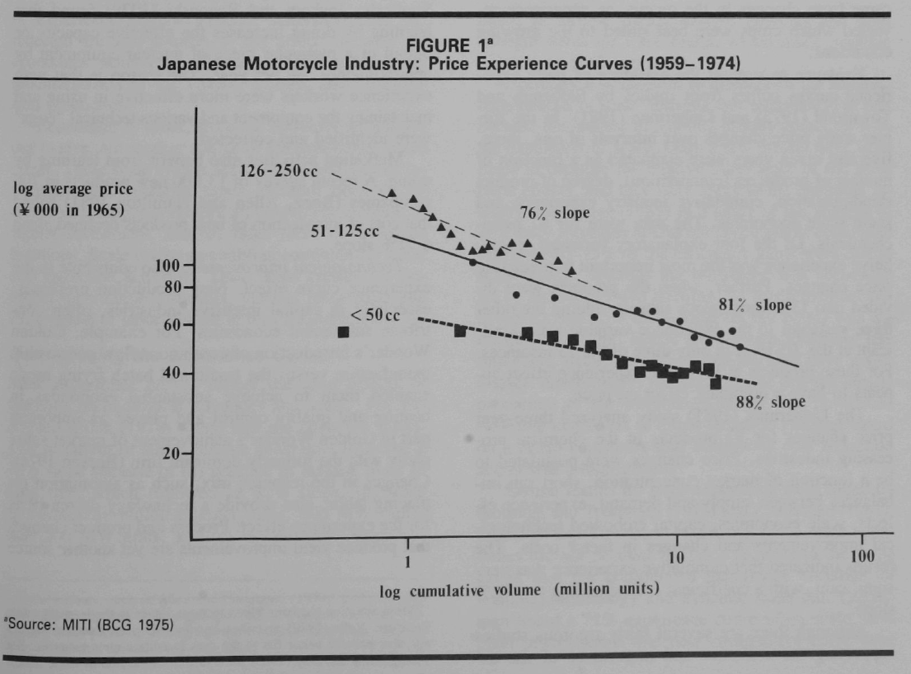

Experience and Learning

Slide 38
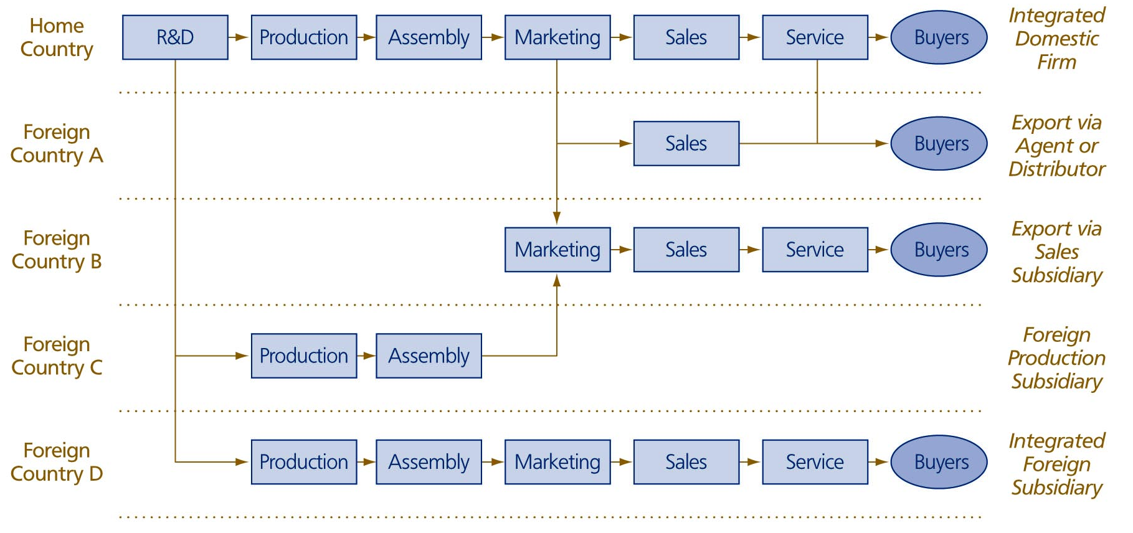
International Growth Options

Slide 39
Business Model Canvas

Slide 40
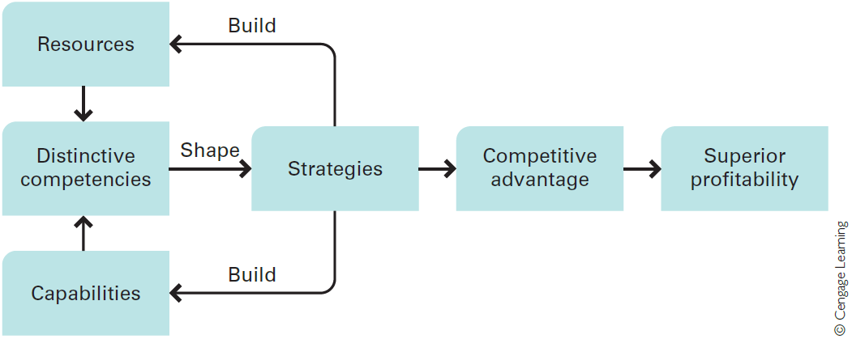
Resources, Capabilities and Competencies and the Link to Strategy
Able to do things successfully or efficiently
Hill et al, 2015
Able to do things
Notes:
Distinctive Competencies
Competitive advantage is based upon distinctive competencies. Distinctive competencies are firm-specific strengths that allow a company to differentiate its products from those offered by rivals, and/or achieve substantially lower costs than its rivals.
Resources
A company’s resources can be divided into two types:.
Tangible resources are physical entities, such as land, buildings, manufacturing plants, equipment, inventory, and money.
Intangible resources are nonphysical entities that are created by managers and other employees, such as brand names, the reputation of the company, the knowledge that employees have gained through experience. We could also include the intellectual property of the company, including patents, copyrights, and trademarks.
Valuable resources are more likely to lead to a sustainable competitive advantage if they are rare, in the sense that competitors do not possess them, and difficult for rivals to imitate; that is, if there are barriers to imitation.
Capabilities
Capabilities refer to a company’s resource-coordinating skills and productive use.
These skills reside in an organisation’s rules, routines, and procedures.
More generally, a company’s capabilities are the product of its organisational structure, processes, control systems, and hiring strategy. They specify how and where decisions are made within a company, the kind of behaviours the company rewards, and the company’s cultural norms and values.
Resources, Capabilities, and Competencies
The distinction between resources and capabilities is critical to understanding what generates a distinctive competency.
A company may have firm-specific and valuable resources, but unless it also has the capability to use those resources effectively, it may not be able to create a distinctive competency. Additionally, it is important to recognize that a company may not need firm-specific and valuable resources to establish a distinctive competency so long as it has capabilities that no other competitor possesses.
In sum, for a company to possess a distinctive competency, it must—at a minimum— have either:
(1) a firm-specific and valuable resource, and the capabilities (skills) necessary to take advantage of that resource, or
(2) a firm-specific capability to manage resources (as exemplified by Nucor).
Distinctive competencies shape the strategies that the company pursues, which lead to competitive advantage and superior profitability. However, it is also very important to realise that the strategies a company adopts can build new resources and capabilities or strengthen the existing resources and capabilities of the company, thereby enhancing the distinctive competencies of the enterprise.
I worked for 10 years for Capgemini, a firm that had a wide range of technology capabilities that enabled it to provide the design and build large and complex IT systems successfully. These capabilities, combined with the intangible resources of the firm, gave Capgemini a distinctive competence in Systems Integration. At the time. however. Capgemini lacked the ability to win large IT service contracts and was losing market share in services to EDS.
I moved to EDS to understand the companies deal making Competence, which was very strong, but embedded in a relatively small number of people. Unfortunately the EDS delivery capability, particularly System Integration, was far less strong than Capgemini.
Ultimately Capgemini acquired the deal making competence mainly through selective recruitment of key people, but EDS failed to with a number of over-ambitious projects because it lacked the necessary capabilities and some key resources; for example the right project management culture, to create the necessary delivery competence.

Slide 41
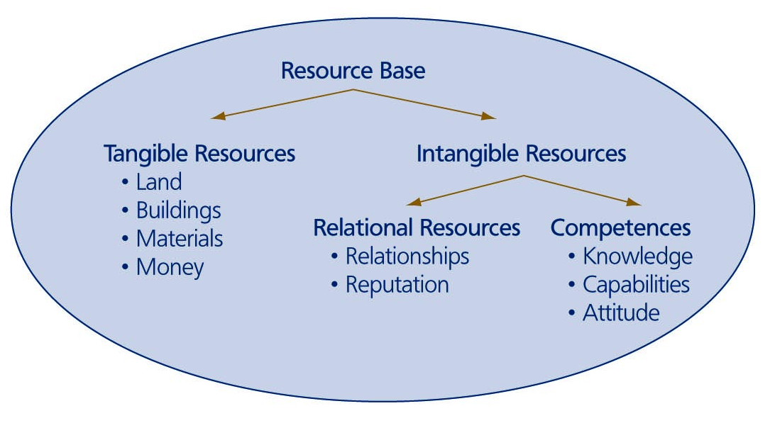
Types of Firm Resources

Slide 42
Core Competencies and Dynamic Capabilities
Core Competencies - Prahalad and Hamel(1990)
Those competencies that define a firm’s fundamental business
A core competence may be distinctive when a firm is markedly better than its competitors, or the competency is difficult to replicate
Should a firm outsource an activity that is part of a core competency?
Dynamic Capabilities
The firms ability to integrate, build and reconfigure internal and external competencies to address rapidly changing environments

Slide 43
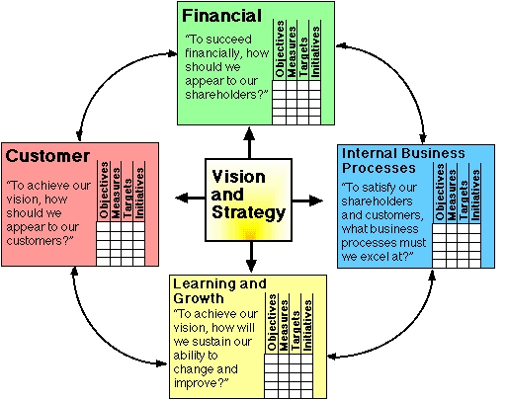
Balanced Scorecard
Financial - The outcome for all profit-making organisations is a financial result for stockholders measured by a range of metrics such as return on capital, net profit margin, or growth in revenues.
Customer - In most cases, it is a positive response from the customer that creates value for the organisation by profitable sales. The metrics may include sales penetration as well as the level of customer satisfaction and loyalty.
Internal Business Processes - To increase the quality of the customer relationship, operating processes will be continually improved to enhance the quality flexibility while reducing cost of these processes. Measurements may include cycle time, asset utilisation, and quality metrics.
Learning and Growth - The driving force of value creation is through the intellectual capital, the ideas, and innovation that bring about new products and services as well as processes, sometimes with rapid discontinuous innovation. It can be measured by the development of human capability, new products to market, and growth of strategic alliances.
Gurd (2013)

Slide 44
Walmart Strategy Map
WALMART | Productivity Strategy |  | Growth Strategy
Financial Perspective | Local discretion over pricing Drive down cost continuously Obsession with retail and cost reduction High asset and inventory turnover Low spend on advertising(lowest in the industry) |  | Locate in small towns and create a monopoly on discount retail in that area International expansion Multiple formats – discount stores, warehouse clubs, supercentres and neighbourhood stores, online
Customer Perspective | Everyday Low prices “Greeters” “Satisfaction Guaranteed |  | Adjust to local needs and preferences Wide range of goods Avoid stock-outs
Internal Perspective | Operations Management | Customer Management |  | Innovation Processes | Regulatory and Social Processes
 | Purchasing Centralised buying Limit supplier power – max 2.5% of total Exploit technology Use of EDI and Online buying Warehousing and Distribution Own distribution system – hub and spoke rather than supplier delivers to stores Total control and large drop volumes | Store location Store format Decentralised decision making High level of service |  | Insourced activities allow innovation in IT, warehousing, distribution and store operations | Patriotism Traditional American Values Environmental responsibility Counter the criticisms from Unions, politicians and environmentalists Employee empowerment
Learning and Growth Perspective | Human Capital - promote from within, career opportunities, profit sharing, share ownership, empowerment, decision and consultation rights, treat as individuals and show them respect, listen to suggestions. Family atmosphere.
 | Information Capital – pioneer the use of technology – EDI, EPOS, Satellite communication and RFID. Systems closely tailored to Walmart’s needs, constant analysis of POS data. Used to closely link the entire supply chain.
 | Organisational Capital – Principles and values of Sam Walton – thrift, hard work, fairness, simplicity and friendliness. Management culture – the Friday and Saturday meeting’s.

Slide 45
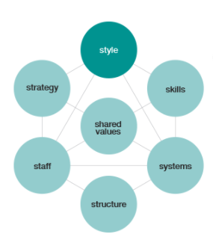
McKinsey 7 S Framework
https://www.mckinsey.com/business-functions/strategy-and-corporate-finance/our-insights/enduring-ideas-the-7-s-framework#

Slide 46
Kotter’s Process for Change Management
Kotter (1995) has developed ‘8 steps’ to transform organisations:
Notes:
Change Management is part of a project and is planned prior to implementation.
Some businesses can planned for months or even years in advance if they are aware of the changes. This is particularly evident in the public sector relating to specific legislation changes.

Slide 47
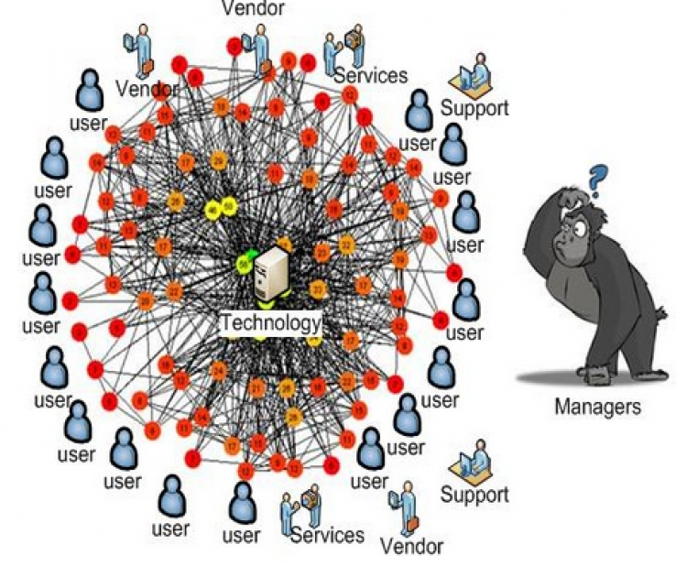
Organisational Processes Depend on the Enabling Information Systems
As organisations grow and acquire information systems in support of their processes they, to an extent, “hard-wire” their ways of working. Changing their information systems can be expensive and time consuming, particularly when change is radical.
See Mckensey article on Digital Transformation.
Notes:
https://www.itwire.com/business-it-news/storage/73038-machine-learning-helps-manage-complex-it-infrastructure.html

Slide 48
Bibliography
De Wit, R & Meyer, R, (2017) Strategy, An International Perspective, Andover, Hampshire: Cengage Learning, 6th ed.
Prahalad, C. K. and Hamel, G. (1990) ‘The Core Competence of the Corporation’, Harvard Business Review, 68(3), pp. 79–91. Available at: http://0-search.ebscohost.com.emu.londonmet.ac.uk/login.aspx?direct=true&db=bth&AN=9006181434&site=ehost-live (Accessed: 10 May 2021).
Joseph, G. (2009) ‘Mapping, Measurement and Alignment of Strategy using the Balanced Scorecard: The Tata Steel Case’, Accounting Education, 18(2), pp. 117–130. doi: 10.1080/09639280802436731.
Osterwalder, A, & Pigneur, Y 2010, Business Model Generation : A Handbook for Visionaries, Game Changers, and Challengers, John Wiley & Sons, Incorporated, Chichester. Available from: ProQuest Ebook Central. [11 July 2019].
‘Porter’s generic strategies’ (2005) A to Z of Management Concepts & Models, pp. 272–277. Available at: http://0-search.ebscohost.com.emu.londonmet.ac.uk/login.aspx?direct=true&db=bth&AN=22366647&site=ehost-live (Accessed: 12 April 2021).

