Slide 1
Chapter 4.8
Art of Protest and
Social Conscience

Slide 2
Introduction
Art can:
  Reflect historical, social, and political concerns
  Provoke change
  Become the target of protest
  Inspire us

Slide 3
Art as Protest and Activism
Artworks that activate emotional responses can instigate social change
Artists have sought to combat cruelty, poverty, and inequality
Does the artist inspire you to agree with his or her point of view?

Slide 4
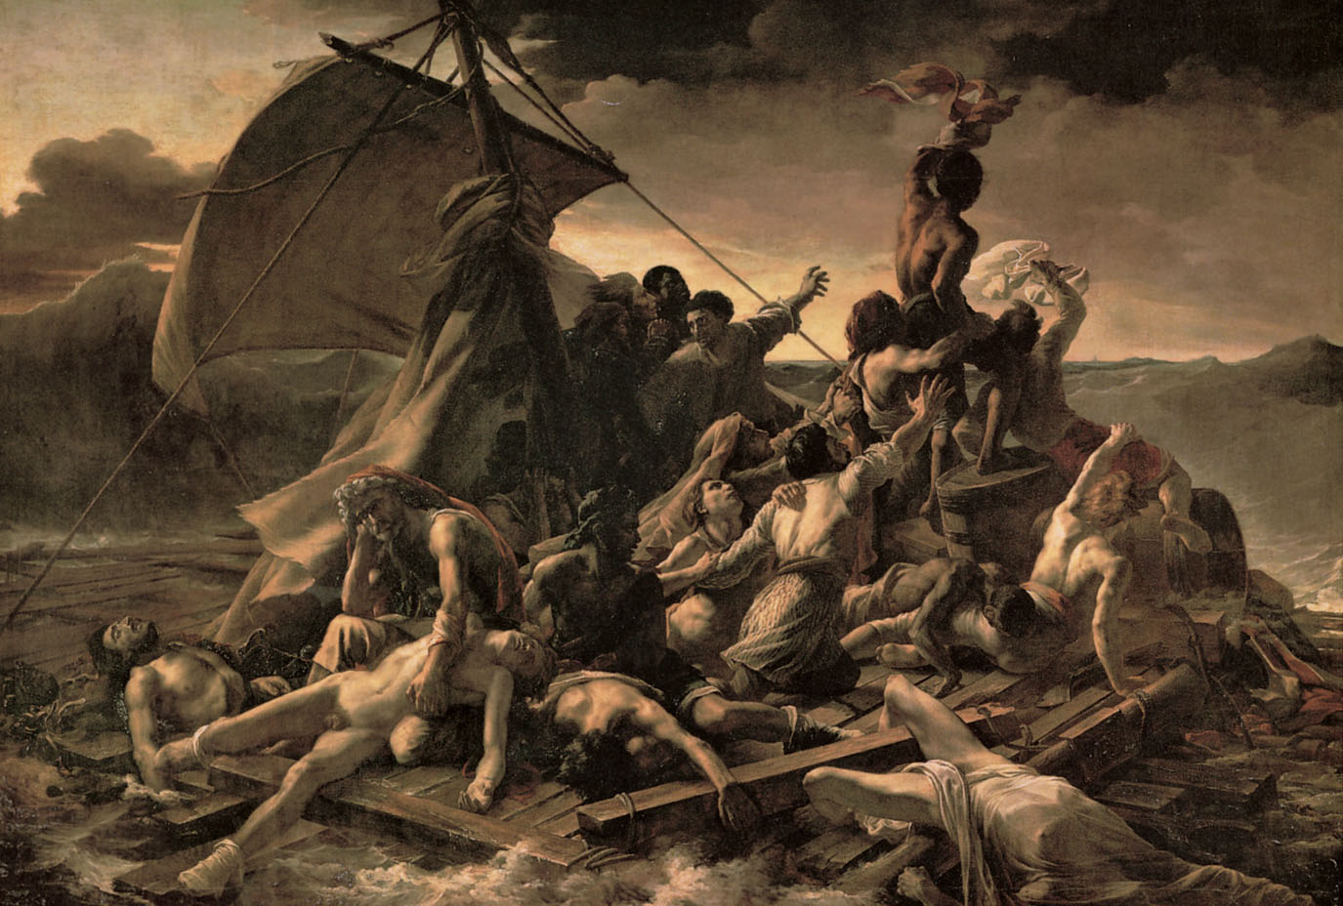
Artwork: Théodore Géricault, Raft of the Medusa
4.8.1 Théodore Géricault, Raft of the Medusa, 1819. Oil on canvas, 12’1⅜” × 17’9⅞”. Musée du Louvre, Paris, France

Slide 5
Théodore Géricault,
Raft of the Medusa
A French naval vessel Medusa ran aground; crew abandoned passengers
Only 15 of 146 people survived on a makeshift raft
Artist interviewed survivors, studied corpses, and made a replica of raft
Notes:
French artist Théodore Géricault (1791–1824), memorializes on a grand scale a scandalous event in history (July 2, 1816)
Left to battle starvation, sunburn, disease, and dehydration, only fifteen men survived the horrors of the sea; some cannibalized their shipmates
The survivors, all close to death, were rescued after 13 days, and they told the world the story of their abandonment
The dramatic intensity is heightened by the use of diagonal lines that compose the figures into a large X
Only one African survived the tragic journey, and Géricault includes him as the powerful figure trying to attract the attention of the distant ship
This artwork criticizes the disaster, colonization, and slavery

Slide 6
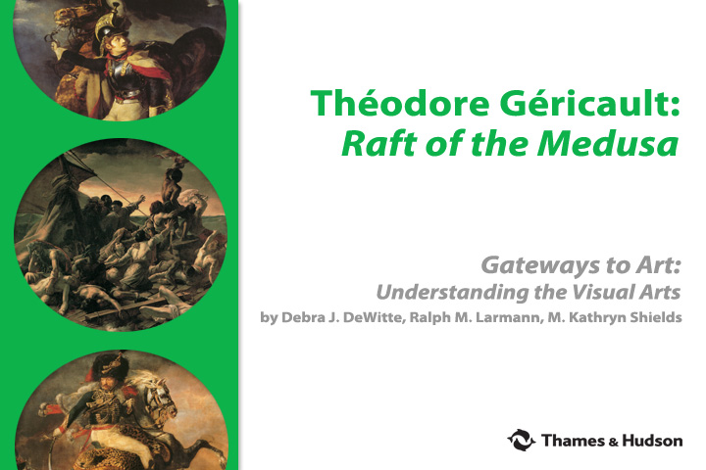
Théodore Géricault: Raft of the Medusa
To find out more about this artwork watch:

Slide 7
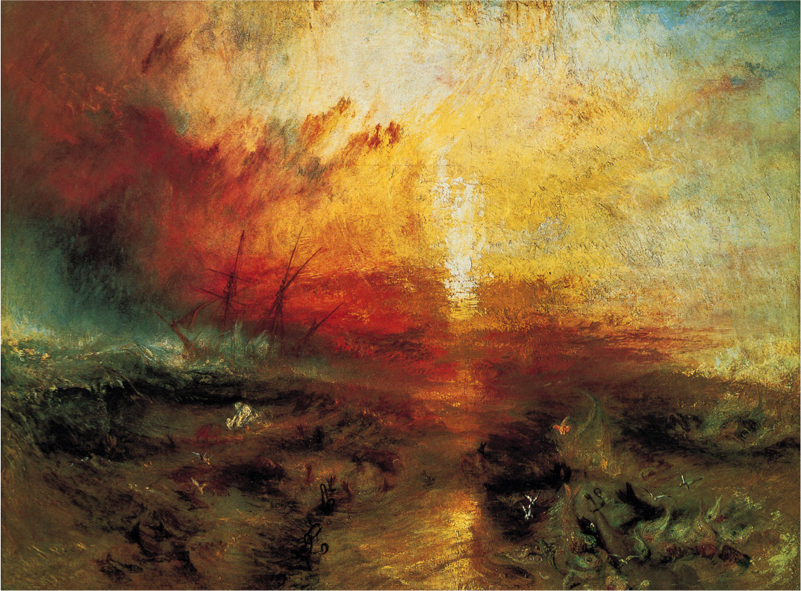
Portal Artwork: J M W Turner, Slave Ship […]
3.7.15 Turner, Slave Ship (Slavers Throwing Overboard the Dead and Dying, Typhoon Coming On), 1840. Oil on canvas, 35¾ × 48¼". Museum of Fine Arts, Boston, Massachusetts
Notes:
British Romantic artist J. M. W. Turner used the sublime power of nature to convey the horror of human tragedy.

Slide 8
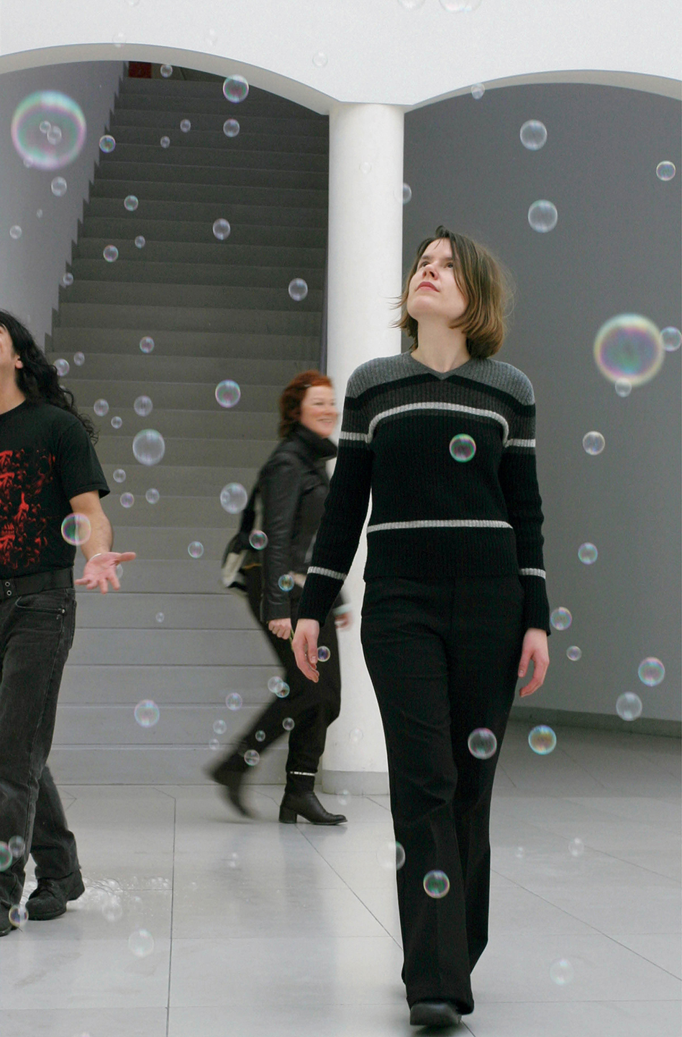
Artwork: Margolles,
En el aire (In the Air)
4.8.2 Teresa Margolles, En el aire (In the Air), 2003. Installation view, “Muerte sin Fin”, Museum für Moderne Kunst, Frankfurt, Germany, 2004

Slide 9
Teresa Margolles,
En el aire (In the Air)
Appears to be peaceful and playful
Bubbles made from water used to cleanse corpses
Bringing attention to violence of narcotic-related crimes
“Each bubble is a body”
Notes:
Using her experience as a trained medical examiner who worked in a morgue in Mexico City, Margolles wishes to activate greater awareness of the large number of violent deaths in Mexico due to narco (drug-related) crimes.
Trauma of the viewer is necessary, Margolles argues, in order to trigger disgust and horror at the tragedy of the numerous violent deaths.

Slide 10
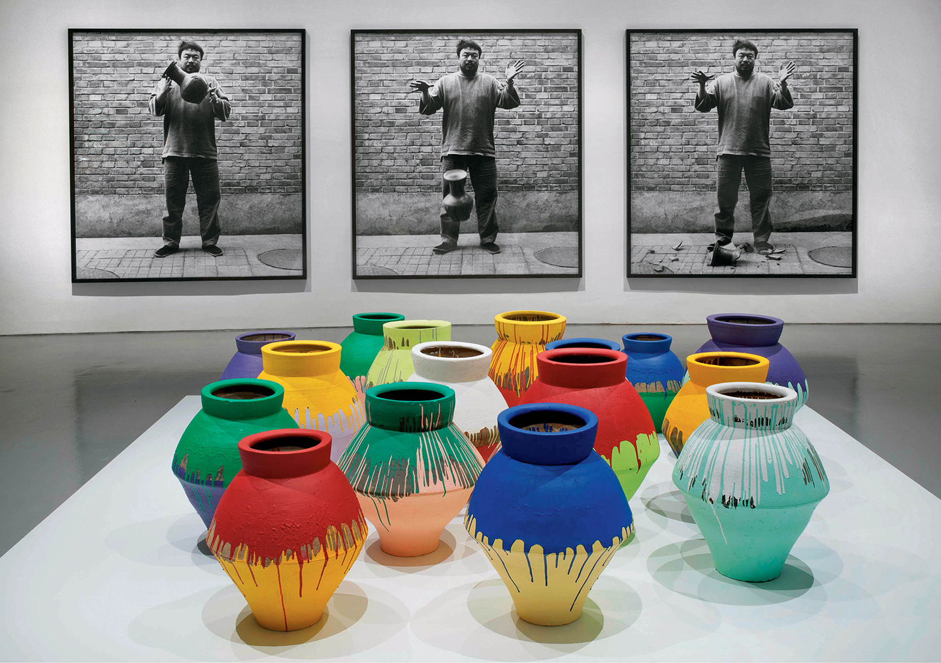
Artwork: Ai Weiwei, Dropping a Han Dynasty Urn/Colored Vases
4.8.3 Installation view showing Ai Weiwei’s Colored Vases in front of his Dropping a Han Dynasty Urn, displayed at the “According to What?” exhibition, held at the Hirshhorn Museum and Sculpture Garden, Washington, D.C.

Slide 11
Dropping a Han Dynasty Urn/Colored Vases
Work confronts restrictions on freedoms in Chinese society
Artist has had artworks destroyed, been severely beaten by police, and been imprisoned for criticizing the Chinese government
Work shown around the world, but rarely in China
Notes:
His father, regarded as one of the finest modern Chinese poets, was imprisoned and exiled for opposing the Nationalist Party of China
Studied in U.S. from 1981 to 1993 and influenced by Andy Warhol and Marcel Duchamp
When he returned to Beijing, Ai created many works that have been censured by the Chinese government.
The photographs Dropping a Han Dynasty Urn (4.8.3) were made the same year he photographed himself raising the middle figure toward Tiananmen Square
In 2005, he began a blog in China that criticized government policies.
His blog was shut down by the police in 2009 after he exposed poor construction standards as the cause of the high number of deaths from the 2008 Sichuan province earthquake (more than 69,000 people killed and at least 4.8 million left homeless). He also posted the names of all 5,385 children killed in the earthquake.
Ai was beaten by the police for his intention to testify about his observations of the earthquake aftermath. His injuries were so severe that brain surgery was required to treat them.
In 2011, he filmed the government’s destruction of his studio and, two months later, he, like his father had been, was imprisoned.

Slide 12
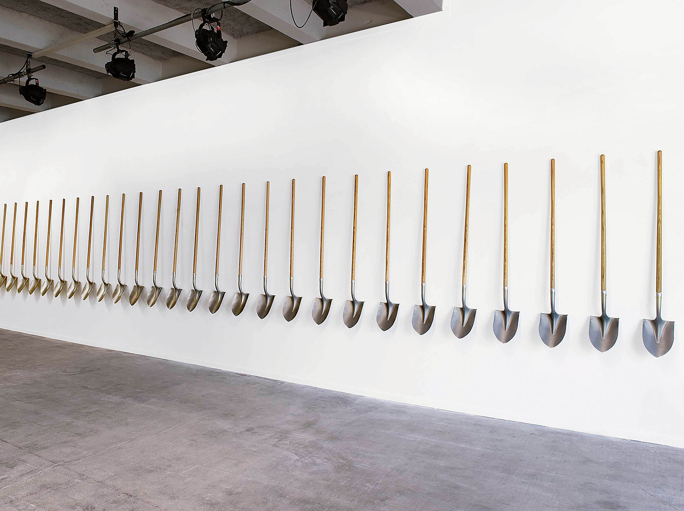
Artwork: Reyes, Palas por Pistolas (Guns for Shovels)
4.8.4 Pedro Reyes, Palas por Pistolas (Guns for Shovels), 2007–present. Installation view, Biennale de Lyon, France, 2009

Slide 13
Reyes, Palas por Pistolas (Guns for Shovels)
Reyes (Mexico City) produced art and tools from weapons
Began as public campaign asking citizens to turn in weapons
Uses shovels to plant trees
Shovels exhibited around the world
Notes:
Many of the shovels have since been exhibited in galleries to bring awareness to the scale of the Mexican weapons trade.
Equaling the number of guns initially donated, the 1,527 shovels Reyes created for this project were used to plant 1,527 trees around the world.

Slide 14
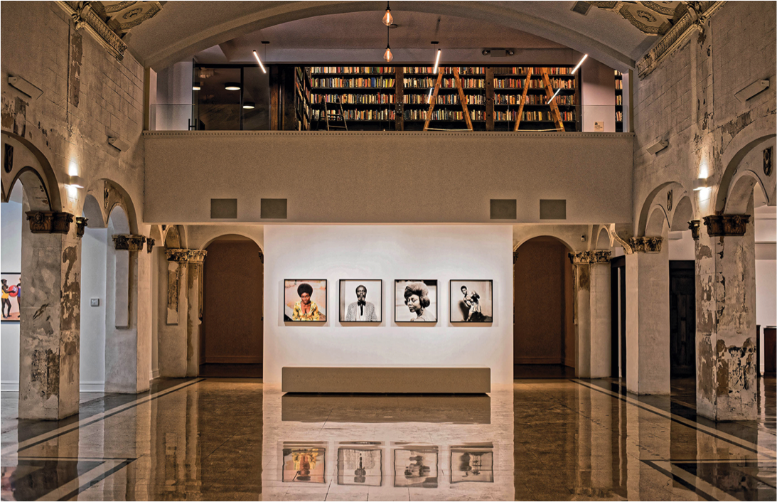
Portal Artwork: Theaster Gates, Stony Island Arts Bank
3.10.21b Theaster Gates, Stony Island Arts Bank after restoration (photo by Cecil MacDonald)
Notes:
The artist Theaster Gates revitalizes buildings in downtown Chicago to create safe cultural and living spaces for the community:

Slide 15
Art as the Victim of Protest: Censorship and Destruction
Art can inspire a forceful response
May be censored or removed from public view
Sometimes, the work is so powerful that viewers wish to destroy it

Slide 16
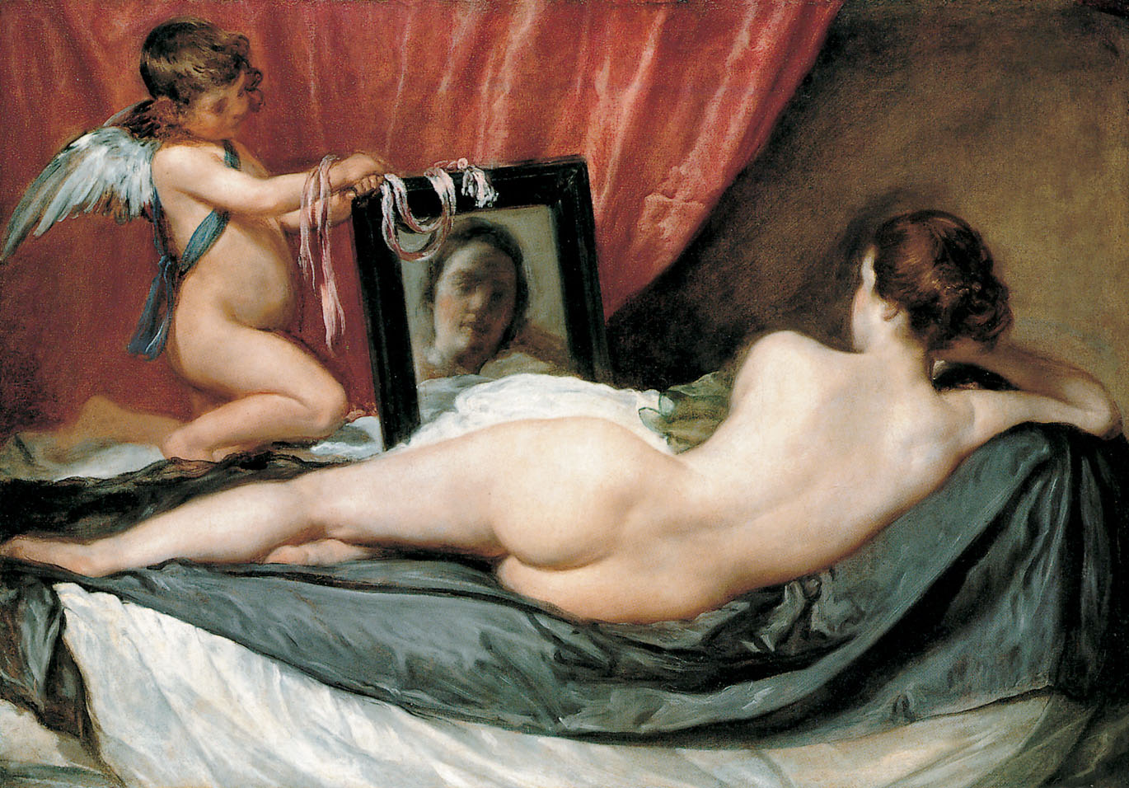
Artwork: Velázquez, The Toilet of Venus (Rokeby Venus)
4.8.5a Velázquez, The Toilet of Venus (Rokeby Venus), 1647–51. Oil on canvas 48½ × 69¾”. National Gallery, London, England

Slide 17
Diego Velázquez,
The Toilet of Venus (Rokeby Venus)
Considered one of the most beautiful and sensuous images of a female nude
Situated in the National Gallery in London, England

Slide 18
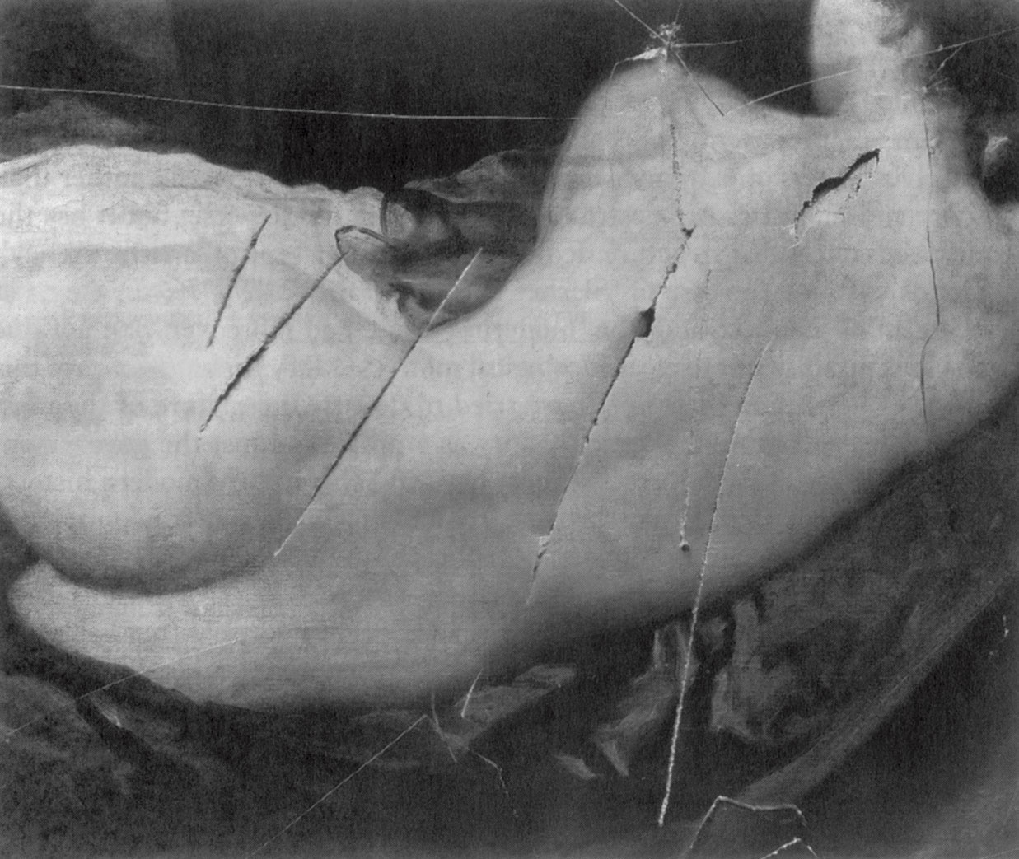
Photograph of damage to the Rokeby Venus
4.8.5b Photograph of damage to the Rokeby Venus, 1914

Slide 19
Photograph of damage to the Rokeby Venus
Slashed by Mary Richardson in 1914
Protest against imprisonment of Suffragette leader Emmeline Pankhurst
Results: damage repaired; Richardson imprisoned temporarily; women forbidden to enter the National Gallery without male chaperone

Slide 20
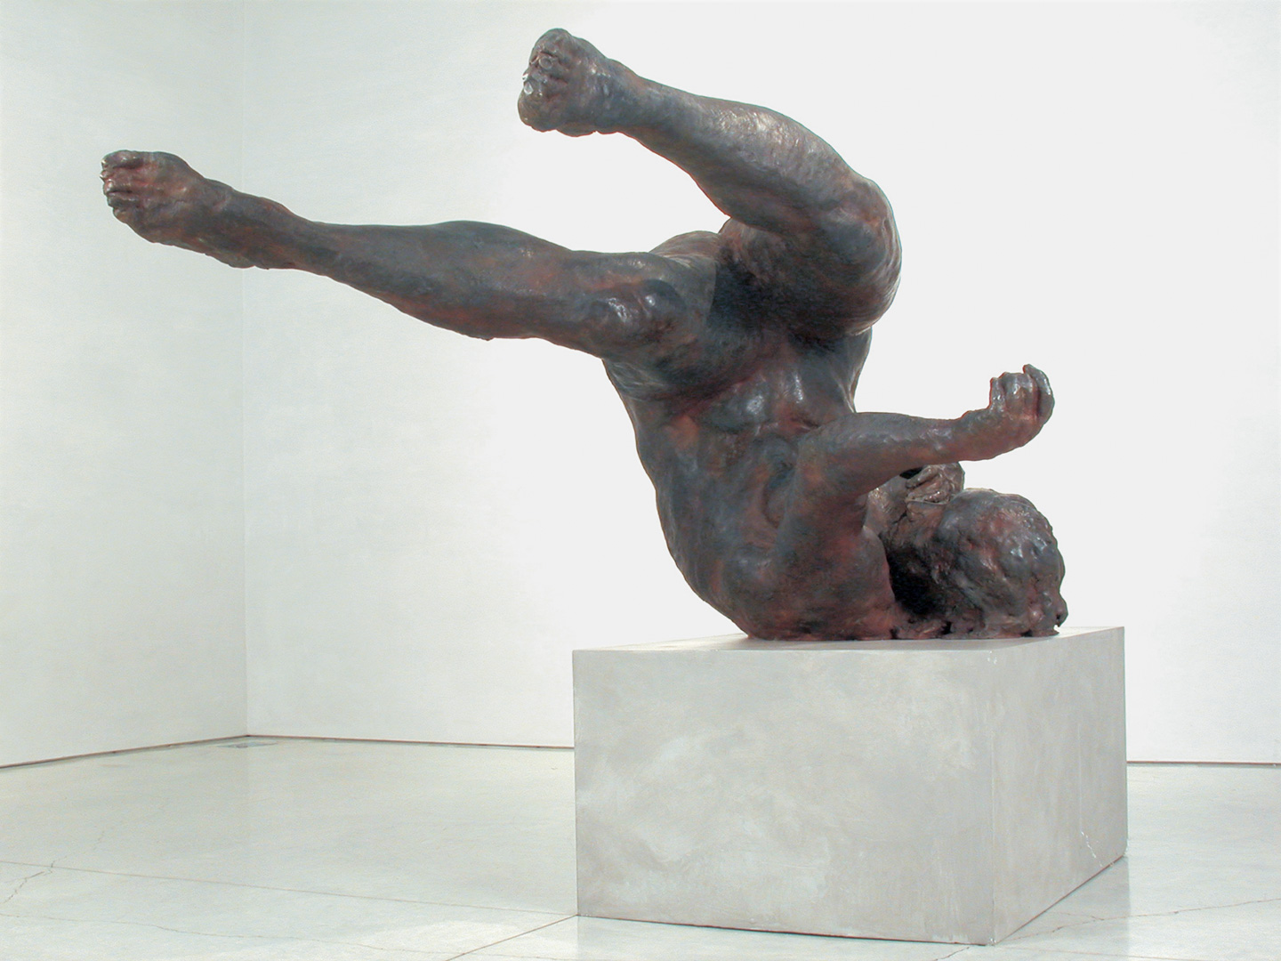
Artwork: Eric Fischl,
Falling Woman
4.8.6 Eric Fischl, Falling Woman, 2001–2. Bronze, 38 × 72 × 48”. Private collection

Slide 21
Eric Fischl,
Falling Woman
Intended as a tribute to the victims of September 11, 2001
Shows a woman falling from one of the burning towers
Too upsetting to many who had witnessed the tragedy
Covered soon after its unveiling
Notes:
American artist Eric Fischl’s (b. 1948) Falling Woman provoked an instantaneous reaction
Would Fischl’s sculpture have been accepted if it had been unveiled many years later, when the event was no longer fresh in the minds of so many?
Or was it simply too graphic, depicting a moment too shocking and too unbelievable for people ever to want to remember?
Some viewers were upset that the sculpture was covered up, considering it a powerful reminder of what happened, which could provide a sense of emotional release, or catharsis

Slide 22
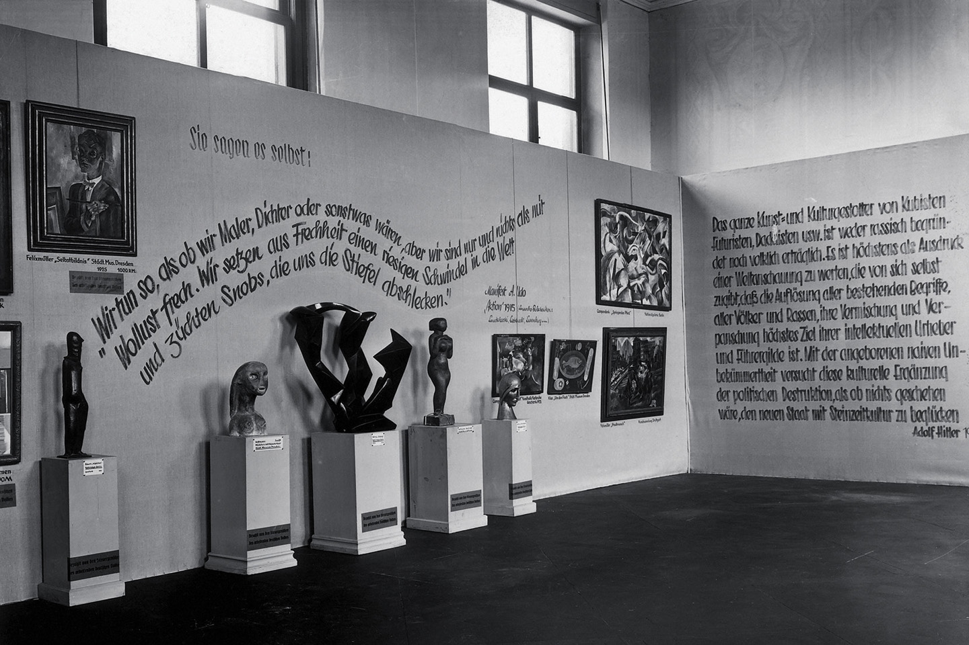
“Degenerate Art” (“Enkartete Kunst”)
4.8.7 Photograph of the Nazi-curated traveling exhibition “Degenerate Art” (“Enkartete Kunst”) at its first stop at the Hofgarten, Munich, Germany, 1937

Slide 23
Censorship of Art: The Nazi Campaign against
Modern Art
Hitler launched an attack on modern art that failed to conform to Nazi goals
Confiscated thousands of artworks; sold or destroyed
1937 exhibition: “Degenerate Art” ridiculed 730 artworks
Notes:
Hitler abhorred modern art, particularly by German Expressionists
On July 19, 1937 the Nazis opened an exhibition of “Great German Art,” which displayed the kind of art approved by the regime
The next day they opened another show of 730 works called “Degenerate Art,” to suggest that these were the work of mentally deficient artists
Works were deliberately displayed awkwardly, and labels on the walls ridiculed the artworks
Artworks that were confiscated became the property of Nazi collectors, were sold for Nazi profit, or burned
Attendance at the Degenerate Art exhibition was unparalleled for its time, with more than two million visitors in Munich alone, and one million more when the show went on tour through the rest of Germany and Austria

Slide 24
Artwork: Nolde, Crucifixion
Digital rights not available for this image. See p. 658 of the textbook.
4.8.8 Emil Nolde, The Crucifixion, 1912, from a polyptych, The Life of Christ. Oil on canvas, 7’2⅝" × 6’3¼". Stiftung Seebüll A. & E. Nolde, Neukirchen, Germany

Slide 25
Censorship of Art (contd.): Nolde, Crucifixion
Many artists fled Germany, committed suicide or sent to camps
Emil Nolde was a Nazi and a modern artist; shocked to see his work in Degenerate exhibition; ordered to stop making art.
Notes:
Nolde’s series of nine panels on the Life of Christ were hung together next to writing on the wall that said: “Mockery of the Divine.”
He was so appalled to see his work in the exhibition that he wrote to Paul Joseph Goebbels, the Nazi Minister of Propaganda, demanding that the “defamation” against him cease.
He continued to create watercolors in secret, fearing that he would be discovered if he used strong-smelling oil paint
Disliked by Nazis because of bright and unnatural colors and modern appearance

Slide 26
Art that Raises
Social Awareness
Artists use the power of visual language to spur involvement in social issues
Can call for punishment of those responsible for a wrong
Use art to shine light on social, racial, and environmental issues

Slide 27
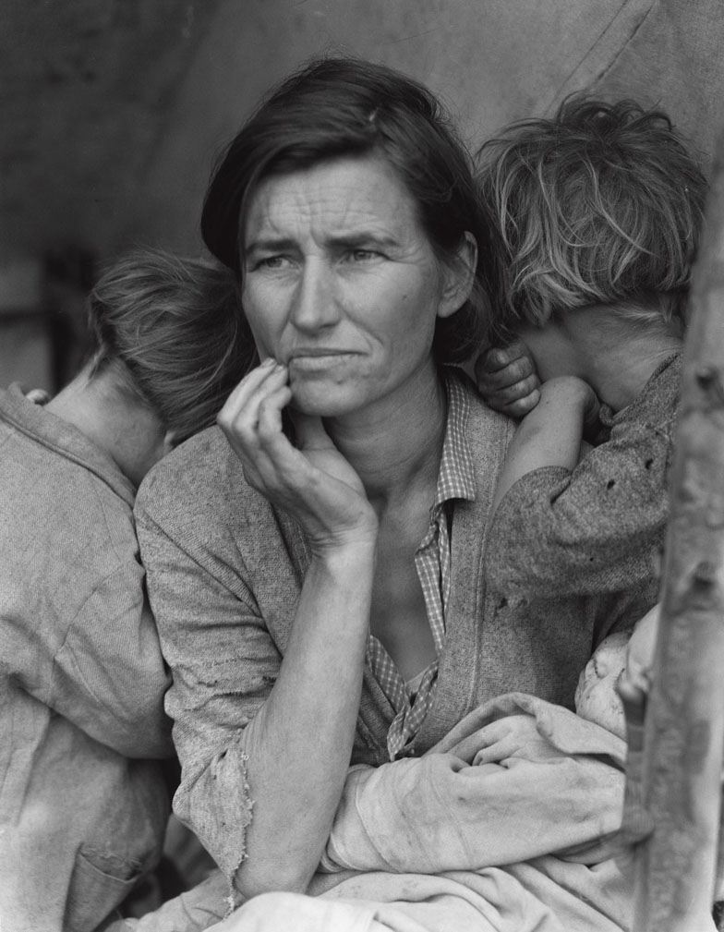
Artwork: Dorothea Lange, Migrant Mother
4.8.9 Dorothea Lange, Migrant Mother, 1936. Library of Congress, Washington, D.C.

Slide 28
Lange, Migrant Mother
Helped many realize the devastation of the Great Depression
Florence Thompson was ashamed of photograph; she was not paid
Raises questions about the subject’s rights and the role of
an artist
Notes:
The picture was taken in 1936 when Florence Thompson and her children were living in the remains of a Californian pea-picker’s camp
In response to the public outcry caused by the photograph, the government sent 20,000 lbs. of food to camp
Thompson family had migrated elsewhere before the supplies arrived
The identity of Thompson was not discovered until 1978
To what extent should the subject’s privacy be protected, and to what extent should he or she be compensated, if at all, when his or her image has demonstrable effects on the social conscience?

Slide 29
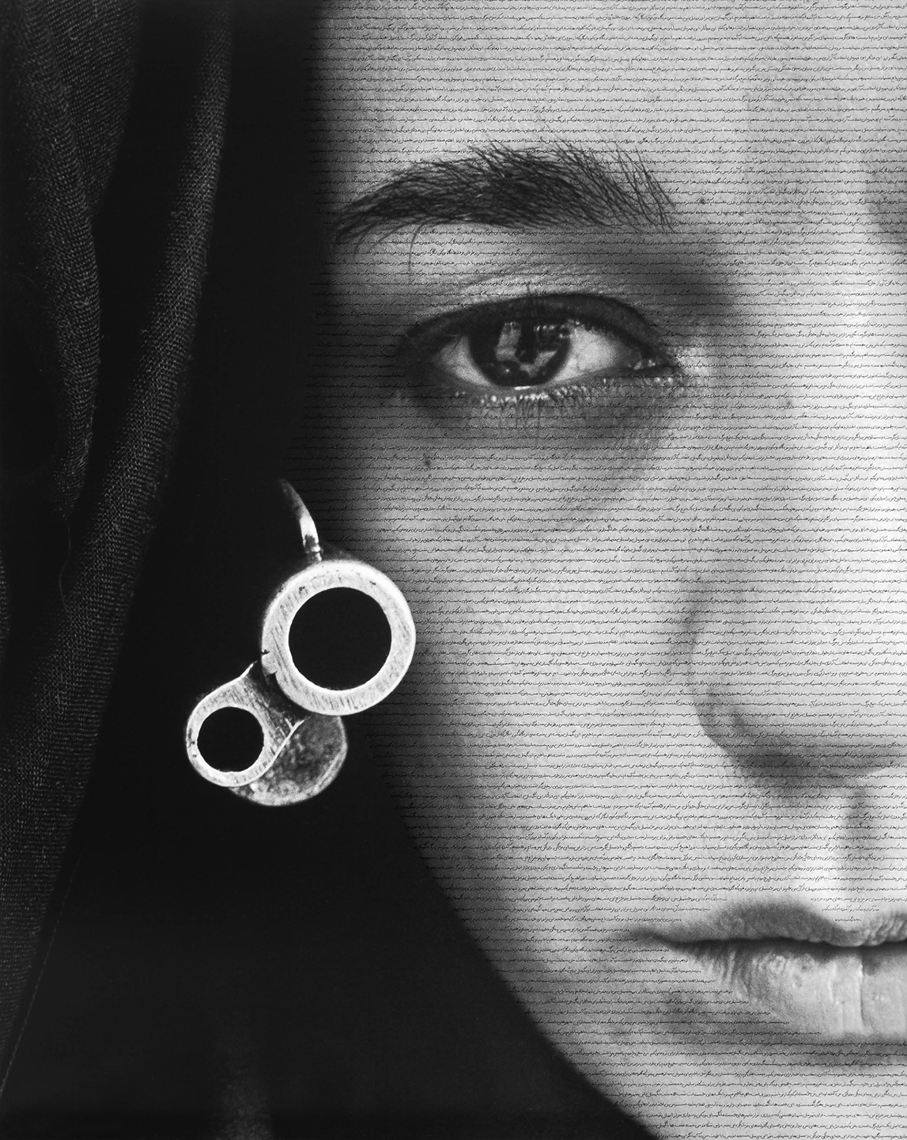
Artwork: Neshat, “Speechless”
4.8.10 Shirin Neshat, “Speechless” (from Women of Allah series), 1996. RC print and ink, 3'10¾" × 2’9⅞"

Slide 30
Neshat, “Speechless”
Series Women of Allah
Explore western stereotypes of Islamic women
Beautiful/powerful
Calligraphy on face: text describing correspondence from a woman to her brother in the Iranian Revolution
Notes:
Iranian-born artist Shirin Neshat
The muzzle of a gun is placed beside the woman’s face, at first appearing to be an earring.
Written on her face in Farsi calligraphy is text written by the female poet Tahereh Saffarzadeh, in which a woman addresses her brothers in the Iranian Revolution (1978–79) asking if she can participate as well.
Neshat herself was exiled from Iran, but disagrees with Western interventions in her home country

Slide 31
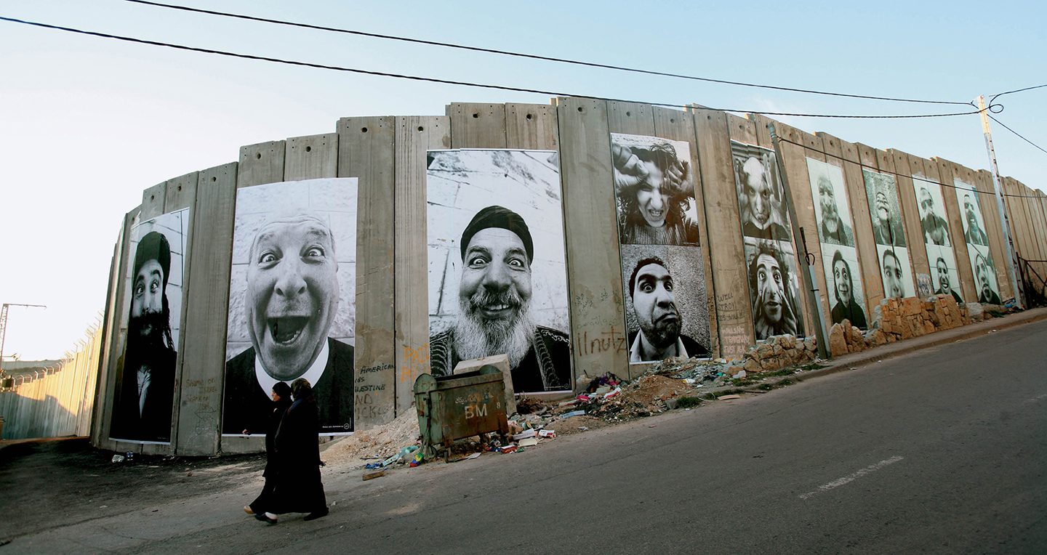
Artwork: JR and Marco,
28 Millimeters, Face2Face
4.8.11 JR and Marco,28 Millimeters, Face2Face, Separation Wall, Palestinian Side In Bethlehem, March 2007

Slide 32
JR and Marco,
28 Millimeters, Face2Face
Colossal photos on West Bank wall dividing Israel from Palestine
Photos of Israelis and Palestinians
Shows similarities of people
3 portraits on left are all religious men who all discuss how the human face is a reflection of God
Notes:
Portraits of people that have the same jobs or roles in society, such as doctors, teachers, and children
The artists hung large posters of these photographs throughout the Near East
Residents and visitors on either side of the wall were intrigued and entertained by the images, which highlighted how similar the two groups of people really are
The Face2Face project enabled many Israelis and Palestinians to see one another not as stereotypes but as actual people

Slide 33

Artwork: Roland,
The Jumpsuit Project
4.8.12 Sherrill Roland III, The Jumpsuit Project, 2016– 2017, Socially Engaged Art, A Year-Long Performance

Slide 34
Sherill Roland III,
The Jumpsuit Project
Graduate art student at UNC
In 2003, wrongfully imprisoned for 10 months
Returned to graduate school in 2016
Performance: wears jumpsuit everywhere he goes
Notes:
The artist Sherrill Roland III was a graduate student at the University of North Carolina in Greensboro when he was wrongfully imprisoned
This act altered his interactions with others, just as being jailed had, and served to trigger conversations about the impact of the prevalence of false incarcerations, especially for African American males.
Roland wants to raise awareness of the many lives affected by this social issue: “Incarceration happens every day. I could be anybody. It could be me today, it could be you tomorrow.”

Slide 35
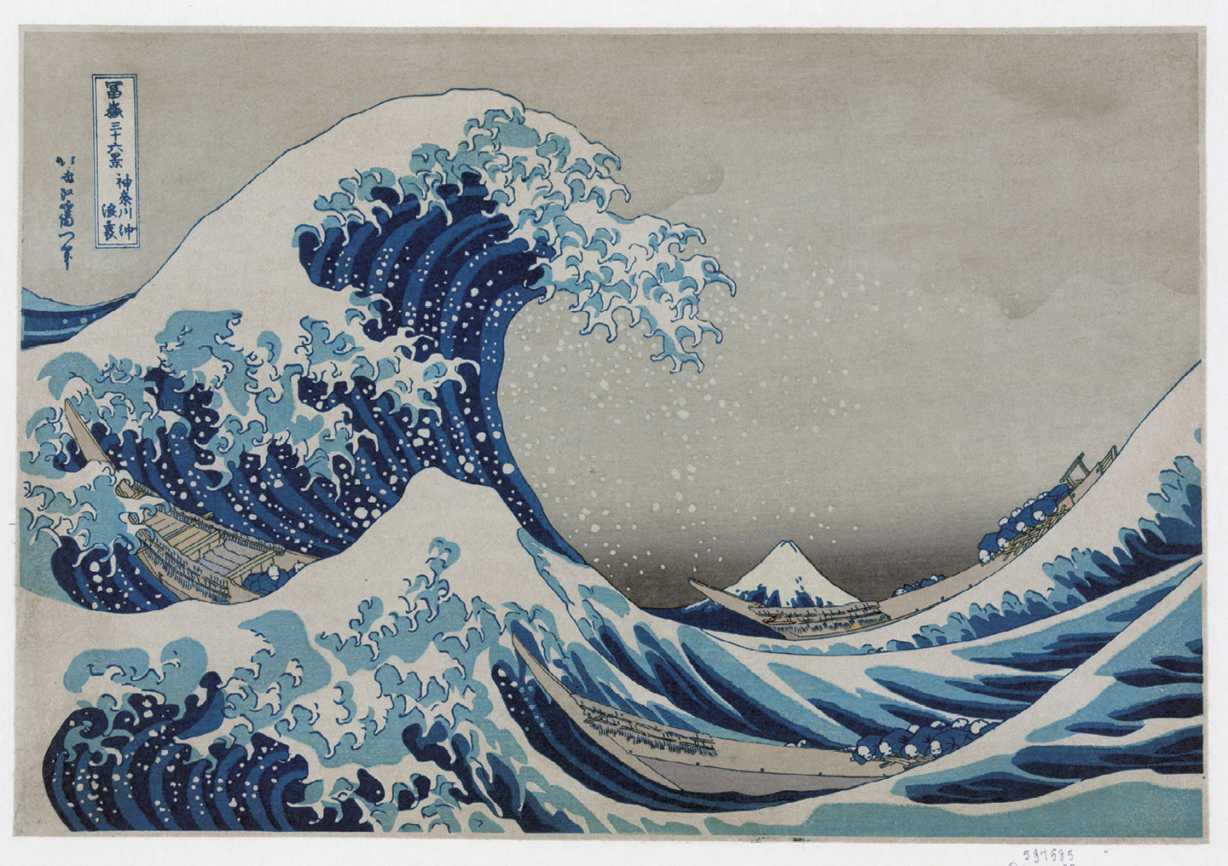
Artwork: Hokusai, “The Great Wave off Shore at Kanagawa”
4.8.13 Katsushika Hokusai, “The Great Wave off Shore at Kanagawa”, from Thirty-Six Views of Mount Fuji, 1826–33 (printed later). Print, color, woodcut. Library of Congress, Washington, D.C.

Slide 36

Artwork: Chris Jordan, “Gyre”
4.8.14a Chris Jordan, “Gyre,” from the series Running the Numbers II: Portraits of global mass culture, 2009. 2.4 million plastic pieces, digitally assembled, 8 x 11’

Slide 37
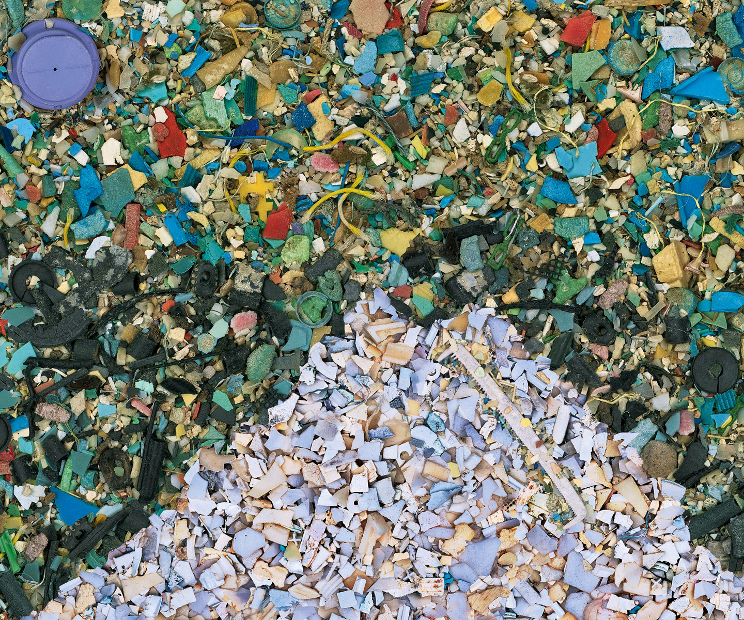
Detail of Chris Jordan’s “Gyre”
4.8.14b Chris Jordan “Gyre,” 2009 (detail)

Slide 38
Hokusai, “The Great Wave off Shore at Kanagawa”
Jordan highlights the environmental problem of consumer waste
2.4 million pieces of plastic
  Represents the amount entering the oceans every hour
Notes:
Hopes to show how individual trash contributes to the larger problem

Slide 39
Chapter 4.8 Copyright Information
This concludes the PowerPoint slide set for Chapter 4.8
Gateways to Art: Understanding the Visual Arts
Third Edition
By Debra J. DeWitte, Ralph M. Larmann, and M. Kathryn Shields
Copyright © 2015 Thames & Hudson

Slide 40
Picture Credits for Chapter 4.8
4.8.1 Musée du Louvre, Paris
4.8.2 Photo Axel Schneider. Courtesy the artist and Galerie Peter Kilchmann, Zurich
4.8.3 Hirshhorn Museum and Sculpture Garden, Smithsonian Institution, Washington, D.C. Photo Cathy
4.8.4 Image courtesy Biennale de Lyon, France, and the artist
4.8.5a National Gallery, London/Scala, Florence
4.8.5b
4.8.6 Courtesy Mary Boone Gallery, New York
4.8.7 Photo Heinrich Hoffmann, Presse-Illustrationen, 1937.
4.8.8 Erich Lessing/akg- images. © Nolde Stiftung Seebüll
4.8.9 Library of Congress, Washington, D.C., Prints & Photographs Division, FSA/OWI Collection, LC-DIG- fsa-8b29516
4.8.10 © Shirin Neshat. Courtesy the artist and Gladstone Gallery, New York and Brussels
4.8.11 JR-art.net
4.8.12 Photo Todd Turner. Courtesy the artist/www.JumpsuitProject.com
4.8.13 Library of Congress, Washington, D.C., Prints & Photographs Division, H. Irving Olds collection, LC-DIG-jpd-02018
4.8.14a Courtesy Chris Jordan
4.8.14b Courtesy Chris Jordan

