Slide 1
Texas Government Online
Death Penalty Paper Project
Cindy Casey Brown
El Centro College
Summer 1 Term 2019

Slide 2
Overview
In this presentation you will read about the death penalty in Texas, see pictures, explore websites and see videos.
You will also learn about the insanity defense in Texas.
You will also be presented with a statute (a law) regarding the duty to report child abuse.
The purpose of this exercise is to educate you on the laws in Texas that are significant - and - during you lifetime you may see the United States Supreme Court take up and comment on.
At the end of my presentation I will present you with a fictional case study and then you will write me a paper about your reflections on the work you did and what you saw in this presentation, whether you think the defendant should be charged with the death penalty, whether an insanity defense would be successful, and whether another individual in the case study had a duty to report child abuse and should be charged with a crime. The case study is based on a compilation of a few true Texas cases.
If you want to read the case study first then you can go to the case study slides and start there to get an idea of what you will be writing about. More specific details on the paper are at the end of the power point.

Slide 3
Why are we doing this?
I want you to leave this class being well-versed in the death penalty and the insanity defense.
Texas executes more people than any other state in the country (Texas is a big state) – this is a Texas Government class so you should know about this topic because it is a big topic in this state. During your lifetime the United States Supreme Court will take cases on this topic and make comments on it – you should be familiar with the topic.
The insanity defense – this is a big topic in the news today so I want you to work with it. With the unfortunate mass public shootings going on - if the shooter survives – the shooter is likely to plead the insanity defense – so I want you to understand it.
I think you learn so much more about these topics by doing this exercise and critically thinking through this case study than by reading about it and taking a test on it.
I know this topic can be disturbing and hard to think about – but in a college course like this it is important to address.
And remember – I am NOT trying to make you think one way or the other or push any opinion on you – I am trying to present many sides to a hard topic that will make you think – whatever your opinion is it does not impact your grade – your grade on this project is based on your hard work and critical thinking and analysis and your ability to form opinions and back them up.

Slide 4
Do Not Do This
Assignment Around Children
This is a hard topic and many of these photos are hard to see and stories are hard to hear. You are a in a college level course so I know you can handle this material.
But please DO NOT watch these videos or explore these websites around children or in a public place as some of the material is not appropriate for everyone.
Thank you!!

Slide 5
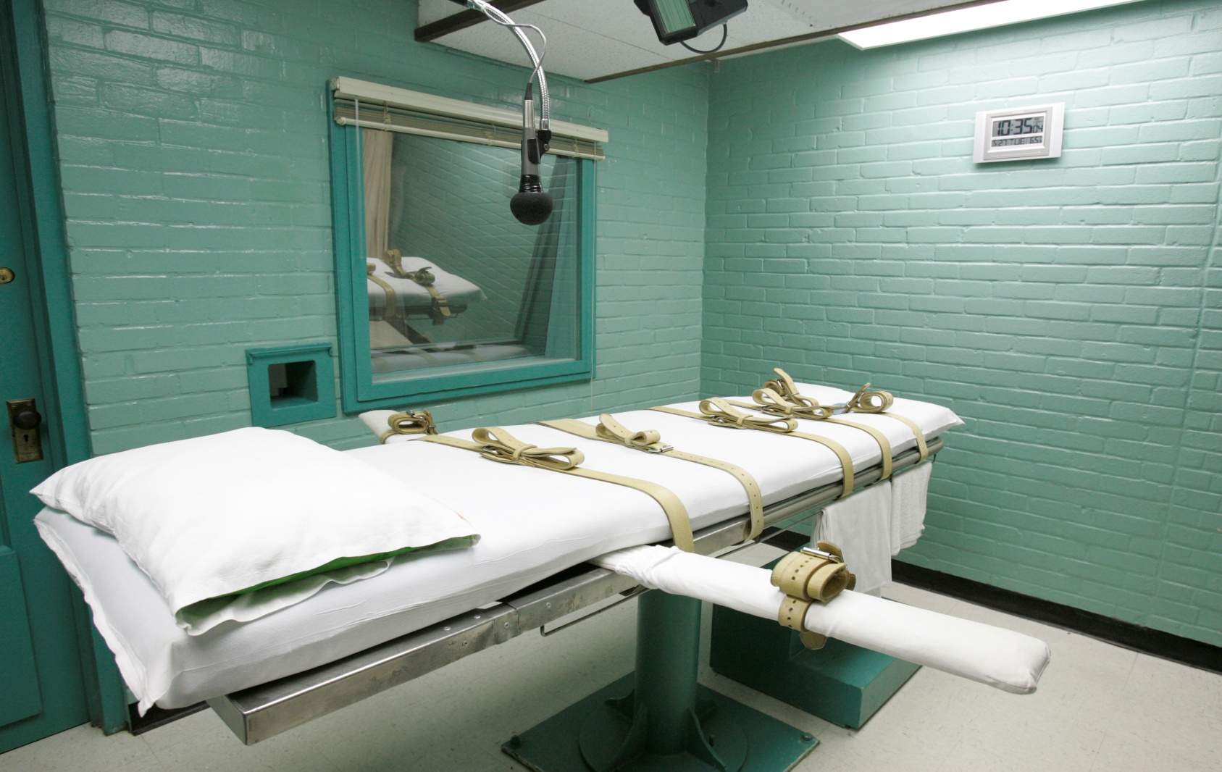
The Death Penalty in Texas

Slide 6
Four degrees of murder in Texas
Murder
  Intentionally or knowingly causes the death of an individual.
Manslaughter
  Recklessly causes the death of an individual.
  Example: Two men get into a physical fight and one kills the other by beating him severely.
Criminally Negligent Homicide
  Causes death by criminal negligence.
  Death when driver is drunk.
  Death when driver is texting.
Capital Murder / The Death Penalty
  This is what we are talking about in this presentation.

Slide 7
Capital Murder - Definition
Sec. 19.03. CAPITAL MURDER.
A defendant can be eligible for the offense of capital murder IF the person commits a murder AND:
  (1) murder a police officer or fireman acting in their official duty AND the defendant KNOWS the person is a police officer or fireman.
  (2) defendant intentionally commits the murder in the course of committing OR attempting to commit kidnapping, burglary, robbery, aggravated sexual assault, arson, obstruction or retaliation, or a terroristic threat.

Slide 8
  (3) the defendant commits the murder for remuneration or the promise of remuneration or employs another to commit the murder for remuneration or the promise of remuneration;
  (4) the defendant commits the murder while escaping or attempting to escape from a penal institution;
  (5) the person, while incarcerated in a penal institution, murders someone who is employed by the penal institution.

Slide 9
(7) the defendant murders more than one person:
  (A) during the same criminal transaction; or
  (B) during different criminal transactions but the murders are committed pursuant to the same scheme or course of conduct;
(8) the defendant murders an individual under 10 years of age; or
(9) the defendant murders another person in retaliation for or on account of the service or status of the other person as a judge or justice of the supreme court, the court of criminal appeals, a court of appeals, or trial court.

Slide 10
Photos of Death Row Inmates
https://apps.texastribune.org/death-row/
You can go to this link and click on the photos and it will tell you what the person did – scroll through here and you will realize there are women and men of all races, ethnicities, and backgrounds.

Slide 11
Picking a Jury
This can take up to two weeks because potential jurors come in, fill out a questionnaire, then come back a week or so later to the courtroom where the lawyers go through the process of VOIR DIRE – this is the process of questioning the jurors in open court with the goal of seating a jury that is fair and impartial.
Sample Juror Questionnaire
  Given to jurors, attorneys review it, then Voir Dire.
  http://www.juryinstructions.ca8.uscourts.gov/quest_juror.pdf
Seating the Jury
  A jury of 12 is seated for the trial and usually 2 alternates are selected (an alternate will enter deliberations if any of the 12 members cannot finish the trial).

Slide 12
Bifurcated Trial
Trial is bifurcated = meaning there are two parts
  Guilt / Innocence Phase
  Punishment Phase
In Guilt / Innocent phase if defendant is found innocent then trial is over.
In Guilt / Innocent phase if found guilty – then Punishment Phase starts.

Slide 13
Punishment Phase of Trial
  If the defendant makes it to the punishment phase of a capital murder trial (capital murder = death penalty) then there are two options – 1) life in prison OR 2) the death penalty.
  During the punishment phase the jury will hear testimony from witnesses regarding any mitigating factors that exist. Mitigating factors are things in the defendant’s life that would warrant giving life in prison and not the death penalty.
  IF you get to the punishment phase of the trial in a death penalty case, the jury answers TWO questions:
    (1) Does the defendant pose a risk to society because of the probability that he or she will continue to commit criminal acts.
    (2) Do mitigating factors exist like mental retardation or child abuse to warrant a sentence in life in prison instead of death?
The Jury MUST answer YES to (1) and NO to (2).
The Jury MUST be UNANIMOUS. If the jury is not unanimous it is a life sentence.
If the defendant is found guilty but the jury is not unanimous then the defendant is given LIFE in prison.

Slide 14

Texas Death Row
Polunsky Unit – Livingston, Texas

Slide 15
https://www.tdcj.state.tx.us/death_row/
Go to this link – if you cannot get there by clicking here then go to your favorite search engine and type in “Texas Department of Criminal Justice Death Row” and you will be directed.
Spend some time on this website and explore the offenders, the crimes committed, the victims of the crimes and the information about last statements.
I want you to pay close attention to the crimes committed which you find by clicking on each offender so that you get an idea of the perspective of the family and friends of the victim(s) in these cases.

Slide 16
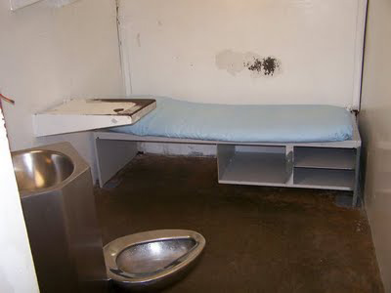
Texas Death Row Cell

Slide 17
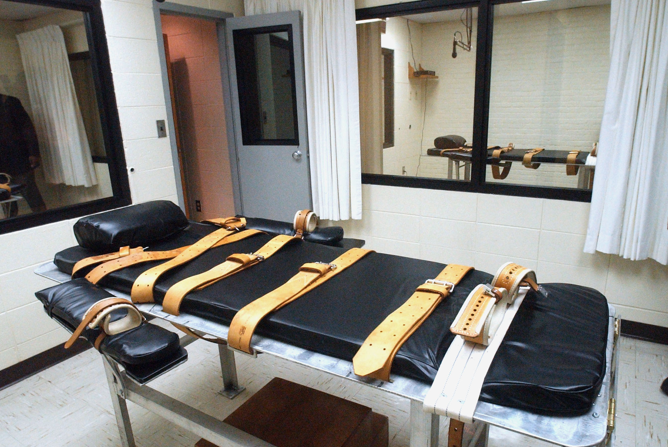
Texas Execution Chamber

Slide 18
Texas Death Row
https://www.youtube.com/watch?v=9w1ANeiohXo
You can cut and paste this link into your browser. This is a 45 minute video to watch that discusses Texas Death Row from the perspective of employees, inmates / those on death row, the victim’s families, and attorneys. **Some of these facts and interviews are very disturbing. DO NOT watch this around children.**

Slide 19
Jim Willett
Retired Texas Prison Warden.
Wrote Book: Warden: Texas Prison Life and Death from the Inside Out
Oversaw 89 executions in Texas.
He has many videos on You Tube where he has been interviewed – the link below is to a short video where he discusses overseeing his first execution:
https://www.youtube.com/watch?v=vzmr0FHBd-4

Slide 20
What does the United States Supreme Court say about the death penalty?
Gregg v. Georgia (1976)
  The Death Penalty is constitutional under the 8th Amendment of the US Constitution.
  The 8th Amendment guarantees that in the United States you have the right to be free from cruel and unusual punishment – this case tells us that the death penalty is not considered cruel and unusual punishment.
Glass v. Louisiana (1985)
  Electrocution does not violate the 8th Amendment.

Slide 21
Ford v. Wainwright (1986)
  Execution of insane persons is a violation of the 8th Amendment.
Atkins v. Virginia (2002)
  Execution of “mentally retarded” violates 8th Amendment.
Roper v. Simmons (2005)
  Execution of someone who committed crime at under age 18 is violation of 8th.
Baze v. Rees (2008)
  Lethal injection does not violate 8th.
Kennedy v. Louisiana (2008)
  You have to have a murder to impose the death penalty – crimes without a murder cannot get the death penalty under the 8th.

Slide 22
Are there innocent people on death row?
http://www.deathpenaltyinfo.org/innocence-and-death-penalty
There are many websites that explore innocent people on death row and this is one of the most well-respected in terms of accuracy. Spend a few minutes exploring this website and form some impressions about what you find so you can write your reflections in your paper.
One note on “innocence” – many times someone will be taken off of death row and given life or a lesser sentence but still be “guilty” – when you look at statistics of people taken off of death row look and see if they were found innocent or were given a lesser sentence for some reason.

Slide 23
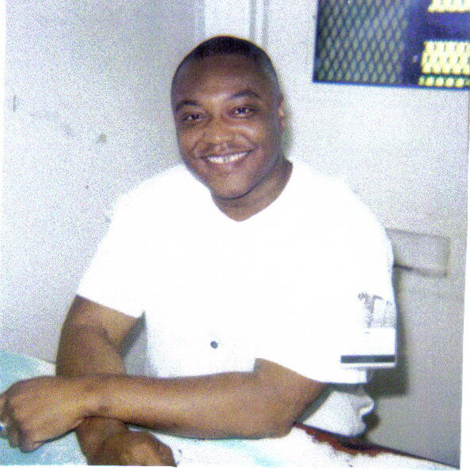
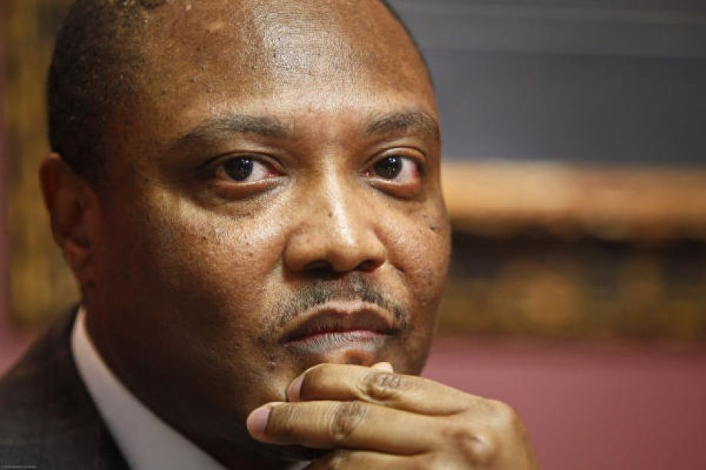
Anthony Graves – one example of an innocent man on Texas Death Row

Slide 24
In 1992 he was charged and convicted of the murder of six people in Somerville, Texas.
No criminal record.
No motive or physical evidence linking Graves to the crime scene.
Conviction based on testimony of Robert Carter that they committed the crime together.
On the eve of his death Carter admitted he committed the crime on his own – executed the next day.
Graves served 18 years when his conviction was overturned and he was released.
He received $1.4 million for his time served.
Click the link below for a short news story on Mr. Graves and what he is doing now:
  http://www.nbcnews.com/news/us-news/how-anthony-graves-went-death-row-overseeing-his-local-crime-n381891

Slide 25
Anthony Graves’ Testimony Before Texas Senate on Texas Death Row
Click here to watch his testimony:
Please note I am not trying to make you think one way or the other about Texas Death Row – since Mr. Graves was there and can tell us about it that is why I want you to watch his testimony. Most people do not leave Texas Death Row and so we cannot interview them.
http://www.motherjones.com/politics/2013/05/10-worst-prisons-america-allan-polunsky-unit-texas-death-row

Slide 26
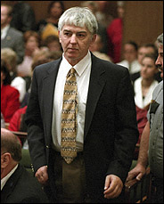
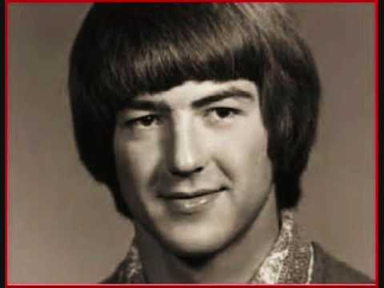
Ron Williamson

Slide 27
Williamson’s wrongful conviction was the subject of author John Grisham’s true story An Innocent Man.
One of two men wrongfully convicted in 1988 in Oklahoma in the rape and murder of Debra Sue Carter.
Both were released 11 years later when DNA evidence cleared them both from the crime.
City gave defendants $500K and the state settled for an undisclosed amount.
Williamson maintained his innocence throughout his time on death row and his mental health rapidly declined – hair turned white, pulled out his teeth.
Williamson died in a nursing home five years later of cirrhosis (liver damage).
John Grisham read the obituary and then wrote the book called An Innocent Man so you may have heard of his story.

Slide 28
The Insanity
Defense in Texas

Slide 29
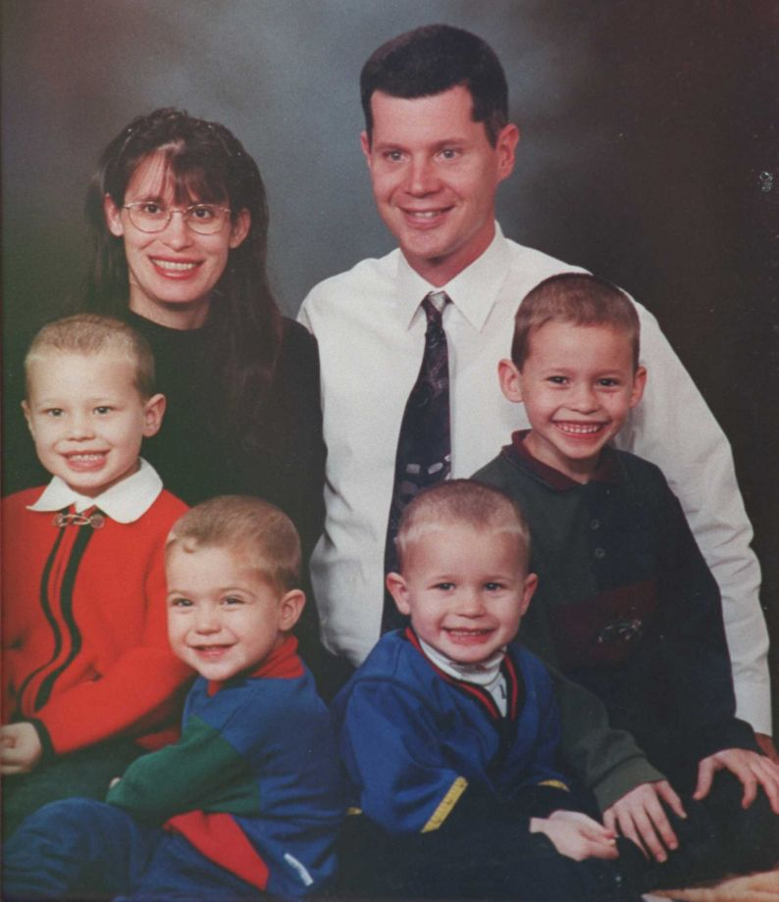
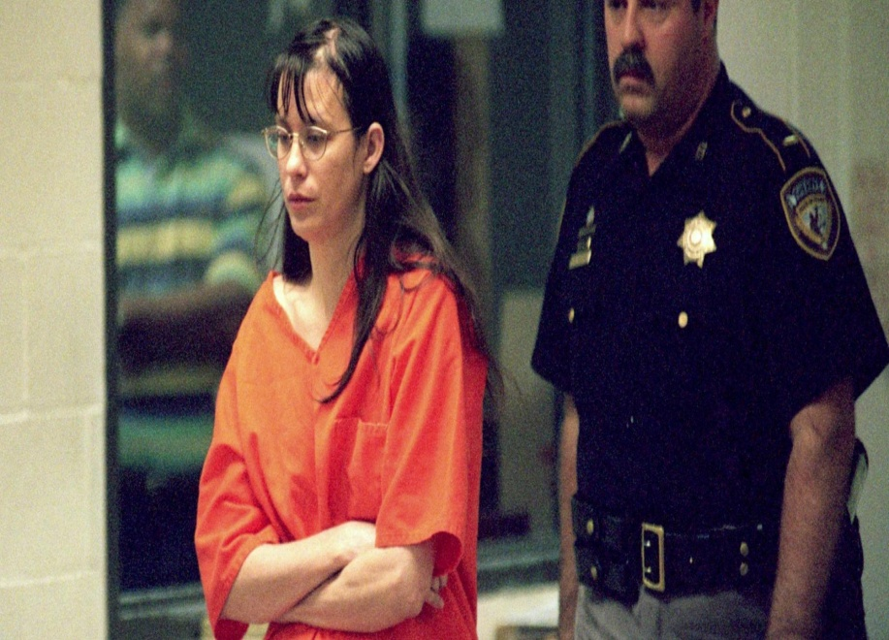
Why do you want to know this?
You will hear of criminal defendants committing crimes and claiming the insanity defense.
There are so many gun violence crimes today – people who are caught may claim an insanity defense so you want to understand it.

Slide 30
Chapter 46c of
Texas Code of Criminal Procedure
Defendant must file a notice of intent to plead the insanity defense at least 20 days before trial.
Court then appoints one or more disinterested psychiatric experts to examine the defendant and render an opinion on defendant’s insanity.
This same expert(s) may also examine the defendant on the issue of competency to stand trial.

Slide 31
The defendant may also request an examination by an expert(s) of his own choosing.
County pays their expert(s) and defendant pays his expert(s).
Expert submits a report within 30 days.
The defendant can choose to be tried by the judge OR a jury.
The trier of fact will find the defendant
  Guilty
  Not Guilty
  Not Guilty by Reason of Insanity

Slide 32
If the defendant is found not guilty by reason of insanity – what happens?
The judge immediately makes a determination whether the conduct of the defendant:
  Caused serious bodily injury to another person
  Placed another person in imminent danger of serious bodily injury
  Consisted of a threat of serious bodily injury to another person through the use of a deadly weapon.

Slide 33
If the answer to any of those questions is YES then the court retains jurisdiction over the person until the court:
  Terminates jurisdiction and releases the person
  OR
  The total period of inpatient and/or outpatient treatment equals the maximum term allowed for punishment under the offense of which the person was acquitted by reason of insanity.

Slide 34
Standard for Insanity:
What Do Psychiatrists Testify About?
Texas follows the “McNaghten Rule”
Did the Defendant comprehend right from wrong at the time the offense was committed?
Some kind of mental illness that existed at the time of the offense prevented the Defendant from understanding that his/her actions were of a wrongful nature.
The Defendant has to prove INSANITY by “a preponderance of the evidence” / means “more likely than not.”

Slide 35
EXAMPLE OF
INSANITY DEFENSE
**Note the following is an incredibly difficult case to study but this is considered “the” example of how to study the insanity defense in Texas – do not watch these videos or stories around children**

Slide 36
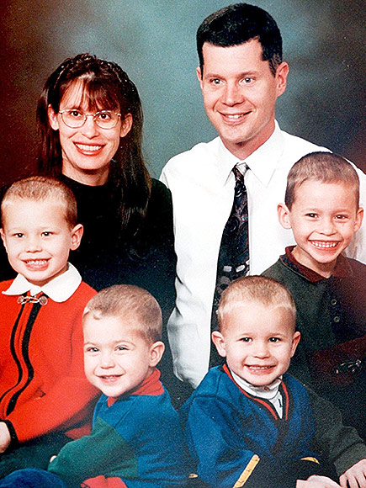
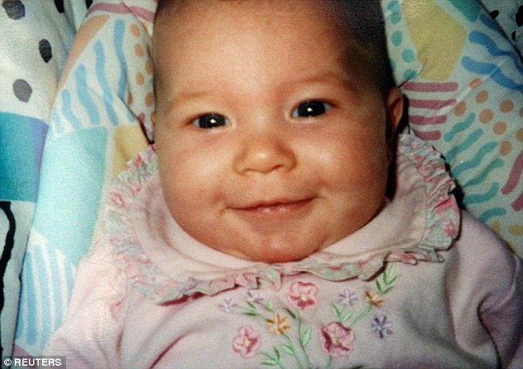
The Andrea Yates Case

Slide 37
Video Overview
https://www.youtube.com/watch?v=FjJuN9Qfr0I

Slide 38
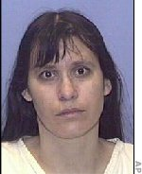
June 20, 2011 – Andrea Yates feeds breakfast to her children, her husband Rusty goes to work at NASA in Houston, she fills a bathtub with water then drowns her five children: John (5), Paul (3), Luke (2), and Mary (6 months), then Noah (7)
Before she filled the tub she pulled
the keys out of the door to
make sure the kids could not leave.
She admits she had to chase Noah around
the house to catch him because he realized
what was happening.
She called 911 and then
called her husband.
Police arrived and she calmly
confessed and was arrested.

Slide 39
Mental History
  She has a history of post partum depression / psychosis post birth of children
  Husband found her shaking and trying to eat her hands in the past.
  Multiple suicide attempts over the years (at least 4)
  Nervous breakdown
  Had been treated as an inpatient for depression

Slide 40
  Had taken drugs for severe depression in the past.
  Psychiatrist urged couple not to have any more kids because it would guarantee a relapse of the postpartum depression. Medical records note that she will discontinue her medications because she and husband want to have “as many children as nature will allow” and psychiatrist disagrees with this.
  She conceives her fifth child 7 weeks post discharge.
  Seemed to be doing okay until father passes away.
  Started mutilating herself, reading Bible feverishly, stopped feeding baby, was catatonic – put back in hospital.

Slide 41
April 1, 2001 – treated by Dr. Mohammed Saeed after a suicide attempt – treated and released.
May 3, 2001 – filled bathtub full in middle of the day – tells doctor the next day and he assumes she did it to drown herself and puts her in hospital.
Continued in Dr. Saeed’s care until June 20, 2001 when murders occurred.

Slide 42
While in prison, Andrea stated she had considered killing the children for two years, adding that they thought she was not a good mother and claimed her sons were developing improperly.
She told her jail psychiatrist: "It was the seventh deadly sin. My children weren't righteous. They stumbled because I was evil. The way I was raising them, they could never be saved. They were doomed to perish in the fires of hell."
She also told her jail psychiatrist that Satan influenced her children and made them more disobedient.

Slide 43
Facts That Jury Heard That Show
She Knew What She Was Doing
She was a nurse and told police she knew how long it would take for someone to drown.
Removed keys from locks and put them up high so kids could not get them and get out.
Locked up the family dog so it could not interfere.

Slide 44
Started with youngest boys – after drowning them she removed them from the bath tub and lined them up in her bed side by side.
Then drowned the baby, Mary – left her floating in tub.
Oldest son comes in and asks what is wrong with Mary – then he RUNS – she chases him and drowns him and then leaves him in tub. He fought very hard. Came up for air twice per her testimony. She testified Mary was floating in the tub when she drowned the oldest.
Water was very dirty because all in the same water – photos upset jury greatly. (This is a horrible fact to include for you I know but this was a huge point for the jury so I did not want to exclude it).
Did she do it to get back at her husband (prosecution theory).

Slide 45
Trials
Yates admits committing the crime but pleads not guilty by reason of insanity.
In March 2002 the jury found her guilty, rejected her insanity defense, and sentenced her to life in prison (she did not get the death penalty).
Yates appealed the conviction.

Slide 46
The conviction was reversed – in part because of a psychiatrist’s testimony that she had seen an episode of Law and Order where a woman drowned her kids (showed motive) – that was NOT TRUE – she never did b/c no episode existed.
The case was remanded for a new trial.
In July 2006 she was found not guilty by reason of insanity by new jury and put into a mental institution.
Currently at Kerville State Hospital in Kerville, Texas.

Slide 47
Was Andrea Yates Insane? Would you have accepted the insanity defense?
Texas follows the “McNaghten Rule”
Did the Defendant comprehend right from wrong at the time the offense was committed?
Some kind of mental illness that existed at the time of the offense prevented the Defendant from understanding that his/her actions were of a wrongful nature.
The Defendant has to prove INSANITY by “a preponderance of the evidence” / more likely than not.
There are many people who believe she was insane and many people who believe she was not.

Slide 48
Where is Andrea Yates now?
http://people.com/crime/andrea-yates-now-she-grieves-for-her-children-15-years-after-drownings/
http://time.com/4375398/andrea-yates-15-years-drown-children/

Slide 49
Because everyone will be curious –What about her husband?
He had been told by psychiatrist not to leave her alone with kids.
Weekend before murders told family he started to leave her alone for an hour in AM and PM with kids so she would not get too dependent on him and her mom for childcare.
He told her brother that all someone depressed needs is a “swift kick in the pants.”
Testimony Andrea did not want to have more kids and he did.
Where is he now?

Slide 50
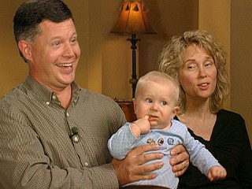
Where is Rusty Yates?
http://abcnews.go.com/GMA/story?id=6278872&page=1
https://www.youtube.com/watch?v=zJXgM-mL4RM

Slide 51
YOUR PAPER
For your paper you are going to do the following:
  Introduction Paragraph
  I want you to write a few paragraphs on your reflections based on what you just watched and researched in this presentation – at least 1 page.
  Read the case study that follows and tell me in at least 2 pages:
    1) Based on the facts presented in the following case study, if YOU were the District Attorney would YOU file a death penalty case against the defendant and fully explain your answer and rationale including your feelings on the death penalty.
    2) If a death penalty case were filed against the defendant father in the following case study do you think the defendant would be found guilty and get the death penalty – why or why not and fully explain your answer.
    3) If the defendant pled the insanity defense do you think the jury would accept it or reject it? Explain.
    4) Do you think the mother should be charged with a violation of Texas Family Code 261.101? Fully explain.
  Conclusion Paragraph

Slide 52
What will your paper look like?
Make sure you include an introduction and conclusion.
Make sure you address everything you are asked to address.
Make sure you use complete sentences, great grammar, and perfect capitalization and punctuation.
Make sure you spell check AND proofread.
The paper should be at least three (3) pages typed, double-spaced, 1 inch margins, 12 point font.
Any pages over three (3) pages are Enhancements – 5 points extra credit per page.
Turn the paper in on BlackBoard.

Slide 53
The Case Study
The following case study is based on several Texas cases. Names and certain facts have been changed for this project in order to allow you to fully study and critically think about the death penalty, the Texas capital punishment statute, the insanity defense in Texas, and the law in Texas regarding the mandatory duty to report suspected child abuse.

Slide 54
Case Study
Jane and John have been married for 10 years. They have a 5 year old son named Patrick and 4 months ago Jane gave birth to a baby boy named Russell.
John is a lawyer and works many hours each week in a high stress position.
Jane worked for many years as a realtor and now stays at home with Patrick and Russell. When Russell was born he was diagnosed with Down Syndrome. Being a one-income household is not easy on them financially with the high out-of-pocket medical bills they must pay and special doctor’s visits they must pay for but they are trying to make it work.
Neither Jane nor John have a criminal record.
Jane knows that with John’s high-stress job he has a hard time being patient with the children.

Slide 55
Facts of the Case, Continued….
Jane does not routinely leave the children alone with John and considers childcare her job now.
Before their oldest son, Patrick, was born John and Jane had too much alcohol to drink one night and got into an argument. John hit Jane, threw her against a wall, and threw a coffee table at her. She was upset and had never see that kind of temper in John before. She knew that he had a lot on his plate at the time with trying to finish law school, study for his bar exam, and begin work for a big law firm. They had lots of student loans between them and John’s job was going to help ease the financial burdens. John was very sorry and Jane forgave him. She never told anyone.

Slide 56
Facts of the Case, Continued…
After that incident sometimes John would raise his voice to Jane or pound his fists on the counter when he was upset with her about bills, the house not being clean, if she forgot to pick up something at the store, or if he was really stressed out at work. Occasionally John would throw something at Jane. Jane knew John did not mean to upset her and would never hit her again. She loved John and thought once they had children he would relax and realize how important it was to keep your cool.
When Patrick was born he had colic and kept Jane and John up many nights.

Slide 57
Facts of the Case, Continued…
Although Jane was working as a realtor, her job was more flexible than John’s and so she did not expect John to stay up at night with the baby. But their house was small and when the baby cried many nights from 2:00 a.m. – 6:00 a.m. they both heard it no matter how hard Jane tried to keep the baby quiet. Some nights John would get upset with Jane, raise his voice to her to tell her to quiet the baby down, and one night he threw a baby bottle at her across the room while she was holding the baby. The bottle hit her and the baby was not harmed. She never told anyone and hid the bruise on her arm so no one would see it.
Jane knew that John would never hurt her or the baby – he loved them – and his job was stressful and he needed rest. She figured all households had some of this going on and tried her best to make sure things at home were as stress-free as possible for John. Her realtor job did not carry the load of the expenses and John was a good provider for their family of three. She figured John would be less stressed and have more patience when he was promoted to partner at his law firm. She knew he did not mean to loose his temper. She figured everyone did it from time to time.

Slide 58
Facts of the Case, Continued…
As Patrick grew older and John became a more successful lawyer, Jane noticed that John could be hard on Patrick. Jane knew the hard work John had engaged in to become successful and John held himself to a high standard. He did not accept second best. It was part of what Jane loved about John. But she worried though John was too hard on Patrick.
John never spanked Patrick in front of Jane and she was the primary caregiver so she didn’t worry about John harming Patrick. Jane wished John wouldn’t raise his voice so much and wouldn’t put so much pressure on their young son to be quiet, behave, work hard, and be perfect. Jane wanted Patrick to just be able to be a kid and have fun sometimes - but John disagreed - he expected Patrick to be on his best behavior at all times and it caused stress in their household. Jane figured if that was her biggest problem she should not complain.
Jane did notice that Patrick never wanted to be alone with his dad when she left the room and seemed really timid around him. It bothered her but she never questioned John. She didn’t want to upset her husband.

Slide 59
Facts of the Case, Continued…
Jane and John tried for many years to have a second child and were thrilled when they learned they were having another baby boy. This was the happiest time Jane can remember with John – he was so proud to tell everyone he would have two perfect sons.
When baby boy Russell was born, he was immediately diagnosed with Down Syndrome and many medical issues consistent with this diagnosis. This was totally unexpected. Jane did everything she could to research the best doctors, the best treatments for her son’s specific issues, and worked hard to make sure she was fully educated on how to handle everything in the best way for baby Russell.

Slide 60
Facts of the Case, Continued…
John did not accept the diagnosis so easily. He simply could not accept that their son had Down Syndrome and that it could not be “fixed.”
John often screamed at Jane that this was “her fault” and questioned her about what “she did” to make this happen. A baby with severe medical issues was not what he had planned on and was not the kind of “perfection” he demanded. It seemed to Jane that John was angry all the time.
Jane often talked to John the first few months about moving to a different home in a different school district where home care for infants with Down Syndrome was provided even at this young age. The visits from the home health aids would benefit baby Russell a lot and ease financial burdens. John refused. He said he was not going to change his home or lifestyle for this baby and told Jane it was “all her fault” and “her problem.”

Slide 61
Facts of the Case, Continued…
As the weeks went on the costs of the baby’s extra medical expenses, home health aide visits, and special evaluations caused a lot of stress for the couple. Jane worked as a realtor for herself and if she was not working she was not making money. Jane was not comfortable leaving the baby alone with a babysitter given some of his medical issues so over time she just did not go back to work. The loss of her income was something the couple fought about on a daily basis.
John continued to express his anger towards Jane verbally about the situation they were now in – she no longer was contributing financially, they had a baby with medical issues that were not planned on, and the baby was costing them too much money that they did not have to spend.

Slide 62
Facts of the Case, Continued…
Jane felt sad, stressed, and trapped in a hard situation. She just focused on her two boys and how much she adored them and figured her husband’s attitude would get better over time.
One Saturday morning Jane got a phone call from her father that her mother was in the hospital with what appeared to be a heart attack. Her parents lived an hour away and so she started to pack up items for herself and the two boys so they could go to the hospital to be with her parents.
John became furious. This was the one day off he had all week and there were things he wanted them to accomplish together around the house. This was not convenient for him – he told her she should stay at the house for the day to work then she could go this evening to the hospital. Jane adored her parents and really wanted to go see her mother and support her father. She was so worried. John was also angry that taking the kids to the hospital would make him “look bad” to her family – like he couldn’t take care of his own kids for a few hours so she had to drag them along. He said if she insisted on going and leaving him then she would have to leave the boys as well so he did not look bad and she needed to be back in time to make dinner. Jane – feeling stressed and upset about her mother and about her husband’s behavior – agreed. She left the boys in the care of her husband and went to the hospital to be with her mother and father.

Slide 63
Facts of the Case, Continued…
Jane arrived at the hospital to check on her mother safely and tried to reach John a few times to check on thing at the house. She could never reach him.
At 3 p.m. Jane got a call from John. He sounded stressed and nervous. He said the baby wasn’t acting normal and was really lethargic. She questioned whether John had been able to feed the baby, whether the baby was having stomach trouble consistent with his medical issues and whether he had a temperature. John said he would try and feed him and asked when Jane was coming home. Jane asked to talk to their son, Russell, and John said Russell was playing in the backyard so could not come to the phone.
At 5 p.m. John called Jane to say the baby was more lethargic – he sounded nervous and jittery and very stressed. Jane briefly felt that maybe this was what her husband needed to “bond” with their baby and was happy John was finally engaged in the care of their son. John said he thought he should take the baby to the local Children’s Hospital and Jane said she would leave her mother now and be there in one hour.

Slide 64
Facts of the Case, Continued…
When John got to the Children’s Hospital the hospital staff immediately saw signs of abuse and called the local authorities – as required.
Upon examination the baby immediately went into what appeared to be cardiac arrest and the hospital started life saving measures but could not save the baby. The baby died within minutes of arriving at the hospital.
Local authorities removed Russell from John’s care at the hospital – as required – and started questioning John as to what happened.
Jane arrived at the hospital, was told what happened, and had to be sedated she was so hysterical.

Slide 65
Facts of the Case, Continued…
Given the physical signs of abuse on the baby the police began investigating the baby’s death as a potential homicide and an autopsy is performed.
The autopsy revealed the following:
  The baby died from peritonitis and sepsis either caused by a defect in the bowel wall or from inflicted trauma (i.e. hitting or punching) causing the bowel to tear and the contents to empty and cause sepsis.
  The baby had blunt-force injuries including cuts, bruises, a fractured skull and a rib fracture that are suspicious as being not accidental.

Slide 66
Facts of the Case, Continued…
You are the District Attorney and you must decide whether to charge this case as a death penalty case. Based on the police investigation you have everything in your file that is in this case study to use to make your decision.
FYI – if a District Attorney does not charge a defendant with capital murder then the DA will charge the defendant with a lesser form of murder with a lesser punishment – i.e. not death.
You also have to determine whether to charge the mother based on the following statute:

Slide 67
Mandatory Duty to Report Suspected Child Abuse in the State of Texas
Texas Family Code 261.101
Texas law requires anyone with knowledge of suspected child abuse or neglect to report it to the appropriate authorities.
This mandatory reporting applies to all individuals and is not limited to teachers or health care professionals.
The law even extends to individuals whose personal communications may be otherwise privileged, such as attorneys, clergy members, and health care professionals.
The report may be made to (1) any local or state law enforcement agency; or (2) the Department of Family and Protective Services.

Slide 68
All persons are required to make the report immediately, and individuals who are licensed or certified by the state or who work for an agency or facility licensed or certified by the state and have contact with children as a result of their normal duties, such as teachers, nurses, doctors, and day-care employees, must report the abuse or neglect within 48 hours.
Texas law broadly defines abuse and neglect – so physical AND mental welfare is covered.
A person who makes a report in good faith is IMMUNE from criminal and civil liability.

Slide 69
You now have all of the information you need to write your paper – please make sure you answer the questions listed out on Slide 51 and proofread your papers!
Thank you for your hard work!

