Slide 1
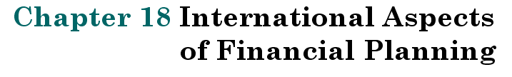

Slide 2
Key Concepts and Skills
After studying this chapter, you should be able to:
  Explain how exchange rates are quoted, assess what they mean, and differentiate between spot and forward exchange rates.
  Discuss purchasing power parity and interest rate parity, and analyzetheir implications for exchange rate changes.
  Identify the different types of exchange rate risk and ways firms manage exchange rate risk.
  Discuss the impact of political risk on international business investing.

Slide 3
Chapter Outline
18.1 Terminology
18.2 Foreign Exchange Markets and Exchange Rates
18.3 Purchasing Power Parity
18.4 Exchange Rates and Interest Rates
18.5 Exchange Rate Risk
18.6 Political Risk

Slide 4
International Finance Terminology
American Depositary Receipt (ADR)
  Security issued in the U.S. representing shares of a foreign stock
  Can be traded in the U.S.
Cross-rate
  Implicit exchange rate between two currencies when both are quoted in a third (usually dollars) currency.
Eurobond
  Bond issued in multiple countries but denominated in the issuer’s home currency

Slide 5
International Finance Terminology (2)
Eurocurrency (Eurodollars)
  Money deposited in a financial center outside the country of the currency involved
  “Eurodollars” = dollar-denominated deposits in banks outside the U.S. banking system
Foreign bonds
  Sold by foreign borrower
  Denominated in currency of the country of issue
Gilts
  British and Irish government securities

Slide 6
International Finance Terminology (3)
London Interbank Offer Rate (LIBOR)
  Rate international banks charge each other for loans of Eurodollars overnight in the London market
  Frequently used as a benchmark rate for money market instruments
Swaps
  Interest rate swap = two parties exchange a floating-rate payment for a fixed-rate payment
  Currency swap = agreement to deliver one currency in exchange for another

Slide 7
Global Capital Markets
Number of exchanges in foreign countries continues to increase, as does the liquidity on those exchanges
Exchanges facilitate the flow of capital
  Extremely important to developing countries
  Differences:
    Market Structure
    Regulation
    Trading rules
United States = most developed capital markets in the world, but:
  Foreign markets becoming more competitive
  Often more willing to innovate
Click on this link for further information about global markets.

Slide 8
Example: Work the Web
Thinking about going to Mexico for spring break or Japan for your summer vacation?
How many pesos or yen can you get in exchange for $1,000?
Click on this link to find out.

Slide 9
FOREX Trading
Foreign Exchange
  Largest financial market in the world
  Trading = 24/7 over-the-counter
  Most trading in USD, £, ¥, and €
FOREX quotations:
  Direct = USD per foreign currency
  Indirect = Units of foreign currency per USD

Slide 10
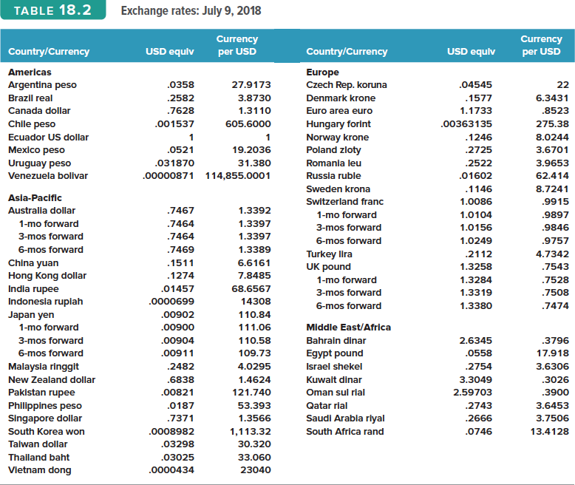
Foreign Exchange Quotes

Slide 11
Exchange Rates
The price of one country’s currency in terms of another
  Most currency quoted in terms of dollars
Direct Quotation = price of foreign currency expressed in U.S. dollars. (dollars per currency); Figure 18.1 “in US$”
Indirect quotation = the amount of a foreign currency required to buy one U.S. dollar (currency per dollar); Figure 18.1 “per US$”
Return to Quick Quiz

Slide 12
Direct Exchange Rate Quotations
 | USD to buy 1 Unit
Euro | 1.1733
Swedish krona | 0.1146
Direct Quotation = price of FC in USD
$1.1733 to buy 1 Euro:
“Euro selling at $1.1733”
$0.1146 to buy 1 Krona:
“Krona selling at $.1146”
Copyright ©2020 McGraw-Hill Education. All rights reserved. No reproduction or distribution without the prior written consent of McGraw-Hill Education.

Slide 13
Indirect Exchange Rate Quotations
 | Units of FC to buy 1 USD
Euro | 0.8523
Swedish krona | 8.7241
Indirect quotation = FC per USD
0.8523 Euros to buy 1 USD
“USD at 0.8523 Euros”
8.7241 Kronas to buy 1 USD
“USD at 8.7241 Kronas”
Copyright ©2020 McGraw-Hill Education. All rights reserved. No reproduction or distribution without the prior written consent of McGraw-Hill Education.

Slide 14
Direct & Indirect Exchange Rate Quotations
An indirect quotation is the reciprocal of a direct quotation
  Direct Quotation = 1/Indirect Quotation
Euros and British pounds normally quoted as direct quotations
  “The pound is selling at 1.3258 USD”
All other currencies quoted as indirect

Slide 15
Example: Exchange Rates
Suppose you have $10,000. Based on the rates in Figure 18.1, how many Norwegian krone can you buy?
  Exchange rate = 8.0244 krone per U.S. dollar
  Buy 10,000(8.0244) = 80,244 krone
Suppose you are visiting London and you want to buy a souvenir that costs 1,000 British pounds. How much does it cost in U.S. dollars?
  Exchange rate = $1.3258 dollars per pound
  Cost = 1,000 × 1.3258 = $1,325.80

Slide 16
Cross Rates
The exchange rate between any two currencies not involving U.S. dollars
Usually calculated from direct or indirect rates
Based on U.S. dollar exchange rates

Slide 17
Cross Rates: Euros and Swedish Kronas
Euros Dollars
Dollar Krona
Cross Rate =
×
= 0.8523 × 0.1146
= 0.0511 Euros/Krona
Cross Rate =
Kronas Dollars
Dollar Euros
×
= 8.7241 × 1.1733
= 10.2360 Kronas/Euro

Slide 18
Arbitrage
A violation of the “Law of One Price”
Arbitrage:
  A positive cash flow
  No risk
Triangle Arbitrage
  Moves through 3 exchange rates
Return to Quick Quiz

Slide 19
Example: Triangle Arbitrage
Quoted Rates:
  10.00 Mexican Pesos (Ps) per $1
  2.00 Swiss Francs (SF) per $1
  4.00 Ps per SF
Implied Cross-Rate
  (10.00 Ps/$1) / (2.00 SF/$1) =
  5.00 Ps per SF

Slide 20
Example: Triangle Arbitrage (2)
Use $100 to buy Pesos
  100 × (10 Ps/$1) = 1000 Ps
Use 1000 Pesos to buy SF
  1000 Ps / (4 Ps/SF) = 250 SF
Use 250 SF to buy USD
  250 SF / (2 SF/$1) = $125
$25 risk-free profit

Slide 21
Triangle Arbitrage

Slide 22
Currency Appreciation and Depreciation
Suppose the exchange rate goes from 7.45 Kronas per USD to 12 Kronas per USD.
A USD now buys more Kronas, so:
  The USD is appreciating (strengthening)
  The Krona is depreciating (weakening)

Slide 23
Transaction Terminology
Spot rate (S)
  The exchange rate for an immediate trade
Forward rate (F)
  The exchange rate specified today in a forward contract to exchange currency at some future date
  Normally reported as indirect quotations

Slide 24
The Forward Rate at a Premium to the Spot Rate
F > S  Foreign currency selling at a premium
Example: Spot rate = 0.7 £/$
Forward rate = 0.6 £/$
  The pound is expected to appreciate
  £ will buy more dollars in the future
  Forward rate for the pound is at a premium

Slide 25
The Forward Rate at a Discount to the Spot Rate
F < S  Foreign currency selling at a discount
Example: Spot rate = 0.7 £/$
Forward rate = 0.8 £/$
  The pound is expected to depreciate
  £ will buy fewer dollars in the future
  Forward rate for the pound is at a discount

Slide 26
Spot/Forward Relationship
Primary determinant of the spot/forward rate relationship = relationship between domestic and foreign interest rates.

Slide 27
Absolute Purchasing Power Parity
Price of an item is the same regardless of the currency used to purchase it or where it is selling:
Requirements for Absolute PPP to hold
  No transaction costs
  No barriers to trade (no taxes, tariffs, etc.)
  No difference in the commodity between locations
Absolute PPP rarely holds in practice
  Usually only for uniform, traded goods
P = Price of goods
S₀ = Spot rate
Return to Quick Quiz
Copyright ©2020 McGraw-Hill Education. All rights reserved. No reproduction or distribution without the prior written consent of McGraw-Hill Education.

Slide 28
Relative Purchasing Power Parity
Quantifies inflation-exchange rate relationship
Provides information about what causes changes in exchange rates
Exchange rates depend on relative inflation between countries
  E(S_{t} ) = S₀[1 + (h_{FC} – h_{US})]^{t}
  S₀ = Current spot exchange rate
  E(S_{T}) = Expected exchange rate at time t
  h_{US} = Inflation rate in the U.S.
  h_{FC} = Inflation rate in foreign country
(18.3)
Return to Quick Quiz

Slide 29
PPP Example
Given:
  Canadian$ spot rate (S₀) = 1.1417 C$/USD
  Expected U.S. inflation (h_{US}) = 3% per year
  Expected Canadian inflation (h_{FC}) = 2%
Will the USD appreciate or depreciate relative to the Canadian dollar?
What is the expected exchange rate in one year?

Slide 30
PPP Example (contin.)
Will the USD appreciate or depreciate relative to the Canadian dollar?
  Since inflation is higher in the US, we would expect the US dollar to depreciate relative to the Canadian dollar
What is the expected exchange rate in one year?
E(S_{t} ) = S₀[1 + (h_{FC} – h_{US})]^{t}
  E(S₁) = 1.1417[1 + (.02 - .03)]¹ = 1.1303

Slide 31
Covered Interest Arbitrage
  Capitalizing on the interest rate
  differential between two countries
  while covering exchange rate risk with
  a forward contract.
Return to Quick Quiz

Slide 32
Example: Covered Interest Arbitrage
Consider the following information
  S₀ = 2 SF / $ R_{US} = 10%
  F₁ = 1.9 SF / $ R_{S} = 5%
What is the arbitrage opportunity?
  Profit = 110.53 – 100(1.1) = $.53 risk free
Now:
Borrow $100 at 10%
Buy $100(2 SF/$) = 200 SF
Invest 200 SF at 5% for 1 year
Contract to exchange SF in 1 year at 1.90 SF/US$
In 1 year:
Receive 200(1.05) = 210 SF
Convert 210 SF back to dollars
210 SF / (1.9 SF / $) = $110.53
Repay loan = 100(1.10) = $110

Slide 33
Covered Interest Arbitrage (2)
Copyright ©2020 McGraw-Hill Education. All rights reserved. No reproduction or distribution without the prior written consent of McGraw-Hill Education.

Slide 34
Interest Rate Parity
Interest rate parity investors should expect to earn the same return on similar-risk securities in all countries:
Forward and spot rates are direct quotations.
R_{US} = periodic interest rate in the home country (US)
R_{FC} = periodic interest rate in the foreign country
(18.4)
(18.5)
Return to Quick Quiz

Slide 35
Exchange Rate Risk
The risk that the value of a cash flow in one currency translated from another currency will decline due to a change in exchange rates.
A natural consequence of international operations in a world where relative currency values move up and down.

Slide 36
Short-Run Exposure
Risk from day-to-day fluctuations in exchange rates and the fact that companies have contracts to buy and sell goods in the short-run at fixed prices
Managing risk
  Enter into a forward agreement to guarantee the exchange rate
  Use foreign currency options to lock in exchange rates if they move against you, but benefit from rates if they move in your favor
Return to Quick Quiz

Slide 37
Long-Run Exposure
Long-run fluctuations from unanticipated changes in relative economic conditions
Managing risk
  More difficult to hedge
  Try to match long-run inflows and outflows in the currency
  Borrowing in the foreign country may mitigate some of the problems
Return to Quick Quiz

Slide 38
Translation Exposure
Income from foreign operations translated back to U.S. dollars for accounting, even if foreign currency not actually converted:
  If gains/losses flowed through directly to the income statement  significant EPS volatility
  Accounting regulations require:
    All cash flows be converted at the prevailing exchange rates
    Currency gains and losses accumulated in a special account within shareholders’ equity

Slide 39
Managing Exchange Rate Risk
Large multinational firms may need to manage the exchange rate risk associated with several different currencies
The firm needs to consider its net exposure to currency risk instead of just looking at each currency separately
Hedging individual currencies could be expensive and may actually increase exposure

Slide 40
Political Risk
Changes in value due to political actions in the foreign country
Investment in countries that have unstable governments should require higher returns
Extent of political risk depends on the nature of the business:
  The more dependent the business is on other operations within the firm, the less valuable it is to others
  Natural resource development can be very valuable to others, especially if much of the ground work has already been done
Local financing can often reduce political risk
Return to Quick Quiz

Slide 41
Quick Quiz - 1
What does an exchange rate tell us?
(Slide 18.11)
What is triangle arbitrage? (Slide 18.18)
What is absolute purchasing power parity? (Slide 18.27)
What is relative purchasing power parity? (Slide 18.28)
What is covered interest arbitrage?
(Slide 18.31)

Slide 42
Quick Quiz - 2
What is interest rate parity? (Slide 18.34)
What is the difference between short-run interest rate exposure and long-run interest rate exposure and how can you hedge each type? (Slide 18.36) (Slide 18.37)
What is political risk and what types of business face the greatest risk? (Slide 18.40)

Slide 43
Chapter 18
END

