Slide 1
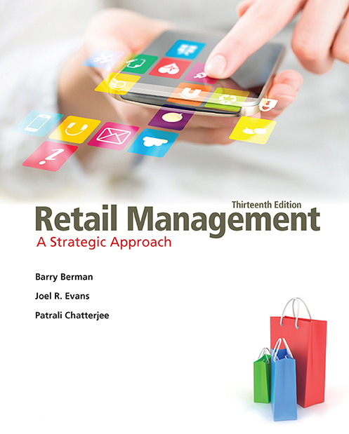
Retail Management: A Strategic Approach
Thirteenth Edition
Chapter 13
Operations Management: Operational Dimensions
Copyright © 2017, 2015, 2013 Pearson Education, Inc. All Rights Reserved.
Notes:
If this PowerPoint presentation contains mathematical equations, you may need to check that your computer has the following installed:
1) MathType Plugin
2) Math Player (free versions available)
3) NVDA Reader (free versions available)

Slide 2
Learning Objectives
13.1 To describe the operational scope of operations management
13.2 To examine several specific aspects of operating a retail business: operations blue-print; store format, size, and space allocation; personnel utilization; store maintenance, energy management and renovations; inventory management; store security; insurance; credit management; computerization; outsourcing; and crisis management

Slide 3
Operations Management
Operations management is the efficient and effective implementation of the policies and tasks that satisfy a retailer’s customers, employees, and management (and stockholders, if publicly owned).

Slide 4
Omni channel Retail: Digital Store
Please click URL to view:
http://www.cognizant.com/retail
Notes:
http://www.cognizant.com/retail URL
3:48 mins.
Omnichannel Retailing | The Digital Store of the Future | Cognizant
Today’s consumers want to seamlessly shop whenever and wherever they are. In order to meet these demands, retailers must bring the physical and digital shopping worlds into one omnichannel experience.
While online shopping has become a defining activity of the 21st century, 95% of all sales are the result of a combination of online, mobile, and in-store interactions. Unifying these provides a more seamless experience for the shopper and more sales opportunities for businesses.
For example, mobile alerts inform nearby shoppers of new products and promotions in order to capture their attention while RFID tags and QR codes on product tags help them learn about item details and read reviews. Arming store associates with data about a shopper and product information helps them to provide a more personalized experience to the consumer.
Using social interactions as a visual focal point in a store can help positively influence shoppers. Virtual dressing rooms allow shoppers to virtually try on outfits in-store or at home. And data gathered from the dressing room can inform product recommendations and customer insight. Similarly, interactive displays attract shoppers by sending rich media to their mobile devices when they pick up a product. The transitioning to an omnichannel experience can be daunting,

Slide 5
Operational Decisions (1 of 3)
What operating guidelines are used?
What is the optimal format and size of a store? What is the relationship between shelf space, shelf location, and sales for each item in the store?
How can personnel be matched to customer traffic flows? Would increased staffing improve or reduce productivity? What impact does self-service have on sales?

Slide 6
Operational Decisions (2 of 3)
What effect does the use of various building materials have on store maintenance? How can energy costs be better controlled? How often should facilities be renovated?
How can inventory best be managed?
How can the personal safety of shoppers and employees be ensured?

Slide 7
Operational Decisions (3 of 3)
What levels of insurance are required?
How can credit transactions be managed most effectively?
How can computer systems improve operating efficiency?
Should any aspects of operations be outsourced?
What kind of crisis management plans should be in place?

Slide 8
Operating A Retail Business
Operations Blueprint
Store Format, Size, and Space Allocation
Personnel Utilization
Store Maintenance, Energy Mgt., Renovations
Inventory Management
Store Security
Insurance
Credit Management
Computerization
Outsourcing
Crisis Management

Slide 9
Operations Blueprint
An operations blueprint systematically lists all the operating functions to be performed, their characteristics, and their timing.
The retailer specifies, in detail, every operating function from the store’s opening to closing – and those responsible for them.
Notes:
Blueprints offer these advantages:
They standardize activities.
They isolate points at which operations may be weak or prone to failure.
They outline a plan that can be evaluated for completeness.
They show personnel needs.
They help identify productivity improvements.

Slide 10
Elements of an Operations Blueprint
Customer actions– customer steps taken as part of service delivery
Onstage/visible contact employee actions– face-to-face encounters with the customer
Backstage/employee actions– not-face-to-face with consumers
Support processes– necessary functions crucial to carrying out the services
Physical evidence– tangibles that customers are exposed to during contact with the retailer

Slide 11
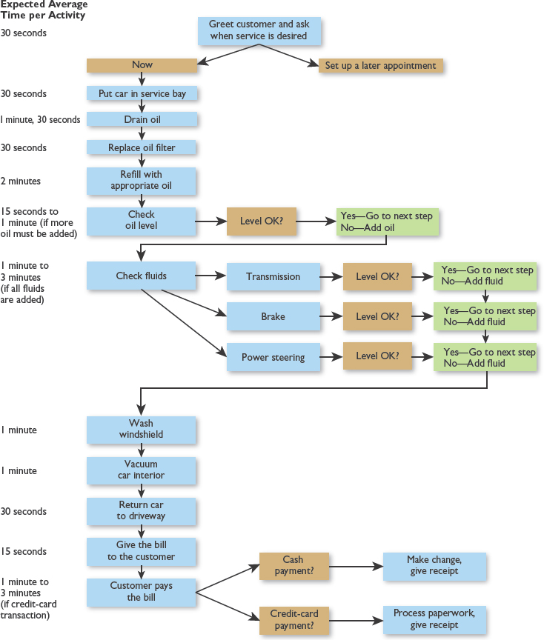
Figure 13.1 An Operations Blueprint

Slide 12
Store Format, Size, and Space Allocation (1 of 2)
With prototype stores, multiple outlets conform to relatively uniform construction, layout, and operations.
Rationalized retailing programs combine centralized management control with strict operating procedures.
Notes:
With regard to store format, a retailer needs to consider which tactics will increase productivity.
One such decision for chain retailers is whether to use prototype stores, whereby multiple outlets conform to relatively uniform construction, layout, and operations standards.
They offer several benefits:
Easier centralized management control.
Reduced construction costs.
Standardized operating methods.
Interchange of employees among outlets.
Quantity purchases for fixtures and other materials.
A consistent chain image.
Strict reliance on prototypes may lead to inflexibility, a failure to adapt to or capitalize on local customer needs, and too little creativity.
McDonald’s, Pep Boys, Office Depot, Starbucks, and most supermarket chains are among those with prototype stores.
Rationalized retailing programs combine a high degree of centralized management control with strict operating procedures for every phase of business. Dunkin’ Donuts, Old Navy, and Radio Shack use rationalized retailing. See Figure 13-2.

Slide 13
Store Format, Size, and Space Allocation (2 of 2)
With a top-down space management approach, a retailer starts with its total available store space, divides space into categories, and then works on product layouts.
A bottom-up space management approach begins planning at the individual product level and proceeds to the category, total store, and overall company levels.
Notes:
Retailers are engaging in two contrasting store-size approaches to be distinctive and to deal with high rents in some metropolitan markets.
Home Depot, Barnes & Noble, and Sports Authority have category killer stores with huge assortments that try to dominate smaller stores. Food-based warehouse stores and large discount-oriented stores (e.g., Cub Foods and Wal-Mart) often situate in secondary sites, where rents are low. Retailers that are situated in high rent areas, or that realize large stores are not efficient in serving saturated or small markets, are opening smaller stores or downsizing existing ones. An example is provided for Tiffany.
Retailers need to place emphasis on allocating store space. J.C. Penney has dropped merchandise lines (e.g., home electronics, large sporting goods, and photo equipment) that occupy too much store space in relation to sales and profit.
With a top-down space management approach, a retailer starts with its total available store space, divides the space into categories, and then works on product layouts.
A bottom-up space management approach begins planning at the individual product level and then proceeds to the category, total store, and overall company levels.

Slide 14
Maximizing Personnel Productivity
Hiring Process
Workload Forecasts
Job Standardization and Cross-Training
Employee Performance Standards
Compensation
Self-Service
Length of Employment
Notes:
Personnel Utilization
The efficient utilization of retail personnel is vital for several reasons.
Labor costs are high.
High employee turnover means increased recruitment, training, and supervision costs.
Poor personnel may have weak sales skills, mistreat shoppers, misring transactions, and make other errors.
Productivity gains in technology have exceeded those in labor.
Labor scheduling is often subject to unanticipated demand.
There is less flexibility for firms with unionized employees.
Tactics to maximize personnel productivity include the following:
Careful hiring processes.
Forecasting workloads.
Job standardization and cross-training. Through job standardization, the tasks of personnel with similar positions in different departments are rather uniform.
With cross-training, personnel learn tasks associated with more than one job.
Good communications. (See Figure 13-3.)
Setting employee performance standards.
Compensation for performance.
Self-service facilities.
Self-service requires better displays, popular brands, ample assortments, and products with clear features.
By reducing sales personnel, some shoppers may feel service is inadequate.
There is no cross-selling.
Length of employment.

Slide 15
Figure 13.4 Store Maintenance Decisions
Notes:
Store Maintenance, Energy Management, and Renovations
Store maintenance encompasses all the activities in managing a retailer’s physical facilities.
These are some of the facilities that must be managed:
Exterior—parking lot, points of entry and exit, outside signs and display windows, and common areas adjacent to a store.
Interior—windows, walls, flooring, climate control and energy use, lighting, displays and signs, fixtures, and ceilings.
See Figure 13-4.
The quality of store maintenance affects consumer perceptions, the life span of facilities, and operating costs.
Thorough, ongoing maintenance may extend current facilities for a longer period before having to invest in new ones.

Slide 16
Inventory Management Decisions (1 of 2)
How can handling of merchandise from different suppliers be coordinated?
How much inventory should be on the sales floor versus in a warehouse or storeroom?
How often should inventory be moved from non-selling to selling areas of a store?
What inventory functions can be done during non-store hours?
Notes:
Inventory Management
A retailer uses inventory management to maintain a proper merchandise assortment while ensuring that operations are efficient and effective. See Figure 13-5.)
These are some operational factors to consider:
Coordination of merchandise received from different suppliers.
Amount of inventory on the selling floor versus a warehouse or storeroom.
Frequency of moving inventory from nonselling to selling areas.
Functions that can be performed during nonstore hours.
Trade-offs between faster supplier delivery and higher shipping costs.
Support expected from suppliers in storing merchandise or setting up displays.
Level of in-store merchandise breakage that is acceptable.
Items which require delivery to customers.

Slide 17
Inventory Management Decisions (2 of 2)
What are the trade-offs between faster supplier delivery and higher shipping costs?
What supplier support is expected in storing merchandise or setting up displays?
What level of in-store merchandise breakage is acceptable?
Which items require customer delivery? When? By whom?

Slide 18
ABC Analysis Applied to Inventory
“A” goods– never out of stock, ample stock to supply 99 percent of demand
‘B” goods– niche goods, ample stock for 80-90 percent of demand
“C” goods– filler goods, can order goods without customer resentment, ample stock for 70-80 percent of demand

Slide 19
Product Proliferation
Retail Chain | Average SKUs per unit
Aldi | 1,400
Costco | 3,800
Stew Leonard’s | 2,000
Kroger | 30,000-52,000
Safeway | 30,000-52,000
Supervalu | 30,000-52000
Winn Dixie | 30,000-52,000

Slide 20
Figure 13.5 Inventory Management
Notes:
Inventory Management and Retailing
For many retailers, the way they handle inventory management can mean the difference between success and failure.
Inventory management decisions can be complex, based on the product assortment, speed of inventory turnover, order
time, and more.

Slide 21
Store Security
Employees
  Limited access to back areas
  Locking up trash bins
Customers
Curfews
Electronic article surveillance
Prosecute offenders
Frequent bank deposits
Employees and Customers
      Uniformed security guards
  Undercover personnel
  TV cameras and other devices
Notes:
Store Security
Store security relates to two basic issues: personal security and merchandise security. Personal security is discussed in this chapter, while merchandise security is covered in Chapter 15.
Many shoppers and employees feel less safe at retail shopping locations than before, with these results:
Some people are unwilling to shop at night.
Some shoppers believe malls are not as safe as they once were.
Parking is a source of anxiety for people who worry about walking through a dimly lit parking lot.
These are among the practices retailers are utilizing to address this issue:
Uniformed security guards provide a visible presence; some shopping areas even have horse-mounted guards.
Undercover personnel are used to complement uniformed guards.
Brighter lighting is used in parking lots, which are also patrolled more frequently by guards.
TV cameras and other devices scan the areas frequented by shoppers and employees. See Figure 13-6.
Some shopping areas have curfews for teenagers (a controversial tactic).
Access to store backroom facilities has been tightened.
Bank deposits are made more frequently—often by armed security guards.

Slide 22
Insurance Issues
Rising premiums
Reduced scope of coverage by insurers
Fewer insurers servicing retailers
Greater need for insurance against environmental risks
Notes:
Insurance
The importance of insurance decisions is the result of increasing insurance premiums, the reduction of coverage, the decrease in the number of insurance carriers that service retailers, and the government’s concern that companies should ensure against environmental risks.
Retailers have embarked on a number of costly programs aimed at lessening their vulnerability to employee and customer insurance claims:
No-slip carpeting, flooring, and rubber entrance mats.
Frequent mopping and inspection of wet floors.
More elevator and escalator maintenance checks.
Having regular fire drills.
Building more fire-resistant facilities.
Setting up separate storage areas for dangerous items.
Discussing safety in employee training.
Keeping records showing proper maintenance activity.

Slide 23
Types of Insurance
Business Interruption insurance
Life insurance to pay estate tax (second to die insurance)
Life insurance to buy out partner’s estate on his/her death
Disability insurance to offset disability of key executive
Flood, fire insurance
Liability insurance
Notes:
In addition, many retailers are required by law (ACA) to offer health insurance to full-time employees.

Slide 24
Credit Management Decisions
What form of payment is acceptable?
Who administers the credit plan?
What are customer eligibility requirements for a check or credit purchase?
What credit terms will be used?
How are late payments or non-payments to be handled?
Notes:
Credit Management: These are the operational decisions -
Forms of payment that are acceptable: cash only, cash and personal checks, cash and credit card(s), cash and debit cards, or all of these.
Administration of the credit plan: a retailer’s own credit system and/or acceptance of major credit cards as well as working with PayPal and Google Checkout for online payments.
Eligibility requirements for check or credit purchases: types of identification that are sufficient, as well as minimum purchase amounts for credit transactions.
Credit terms to be used: interest rates and minimum monthly payments.
Handling of late payments or nonpayments.
The retailer must weigh the ability of credit to increase revenues against the costs of processing credit payments—screening, transaction, and collection costs, as well as bad debts. The average transaction involving a credit/debit card or check is far higher than a cash one.
With retailers’ own credit operations, they incur all the processing costs; but they also get to collect the interest on unpaid balances.
Many retailers are now placing greater emphasis on a debit card system, whereby the purchase price of a good or service is immediately deducted from a consumer’s bank account and entered into a retailer’s account through a computer terminal.
Retailers will have to deal with several new operational challenges as the mobile payment landscape evolves with Google Wallet, Apple Pay, and PayPal.

Slide 25
Computerization
Many retailers have substantially improved their operations productivity through computerization.
With the continuing decline in the price of computer systems and related software, even more small firms will computerize in the near future.
The computerized checkout is used to efficiently process transactions and monitor inventory. Firms rely on UPC-based systems.
Notes:
Many retailers have improved their operations productivity through computerization. Videoconferencing is being used by major retailers to link store employees with central headquarters and allows for interaction with vendors. It can be done through satellite technology and by computer.
In-store telecommunications (e.g., lightweight pocket phones) aid operations via low-cost, secure in-store transmissions. Software provides computerized inventory control and customer order tracking.
The computerized checkout- the most important operational effect of retail computerization - is used by both large and small retailers to efficiently process transactions and monitor inventory. Firms rely on UPC-based systems.
It lowers costs by reducing transaction time, employee training, misrings, and the need for item pricing.
Retailers can increase productivity and also get data on an item-by-item basis. Recent technological developments include wireless scanners, radio frequency identification tags, speech recognition, and portable card readers.
Two potential problems that face retailers using computerized checkouts: (1) UPC-based systems do not reach peak efficiency unless all suppliers attach UPC labels to merchandise. (2) Because UPC symbols are unreadable by humans, some states have laws that require price labeling on individual items.
Recent advances in scanning technology include hand-held scanners; wearable, hands-free scanners; miniaturized data transceivers; wireless scanners; and scanning via smart phones making self-scanning possible.

Slide 26
How Mobile Point of Sale Works
Please click URL to view:
URL: https://youtu.be/9ZNNz-GabWo
Notes:
URL: https://youtu.be/9ZNNz-GabWo
1:53 mins.
How Mobile Point of Sale Works
VisaCommunication
Learn how your business can open new doors to expanded revenue by accepting card payments with m-POS. Learn more at www.visa.com/mpos.

Slide 27
Figure 13.7 Portable Card Reader

Slide 28

Figure 13.8 How Computerization Improves Productivity

Slide 29
Outsourcing
More retailers have turned to outsourcing for some of the operating tasks they previously performed themselves.
With outsourcing, a retailer pays an outside party to undertake one or more of its operating functions.
The goals are to reduce the costs and employee time devoted to particular tasks.
Notes:
Outsourcing
With outsourcing, a retailer pays an outside party to undertake one or more of its operating functions. The goals are to reduce the costs and employee time devoted to particular tasks. Limited Brands, Crate & Barrel, Apple Stores, Payless Shoes, Sports Chalet, Kmart, Home Depot, GE Capital, and Wal-Mart all benefit from outsourcing.

Slide 30
Crisis Management
There should be contingency plans for as many different crisis situations as possible.
Essential information should be communicated to all affected parties as soon as a crisis occurs.
Cooperation – not conflict – among the parties involved is essential.
Responses should be as prompt as possible.
The chain of command should be clear with decision makers given adequate authority.
Notes:
Crisis Management
Retailers may sometimes be faced with crisis situations that need to be managed as smoothly as possible. Crises include an in-store fire, broken water pipe, access to a store being partially blocked due to picketing by striking workers, a car accident in the parking lot, a burglary, a sudden illness by the owner or a key employee, a storm that knocks out a retailer’s power, unexpectedly high or low consumer demand, or other factors.
Although many crises may be anticipated, these principles are important:
There should be contingency plans for as many different types of crisis situations as possible.
Essential information should be communicated to all affected parties as soon as a crisis occurs.
Cooperation—not conflict—among the involved parties is essential.
Responses should be as swift as feasible.
The chain of command should be clear and decision makers given adequate authority.

Slide 31
Examples of Crises
Natural disaster--Hurricane, tornado, flood
No heat, no electricity
Product recall on private label good
Catastrophic event that affects key managers
Loss of important goods due to incapacity of key supply source

Slide 32
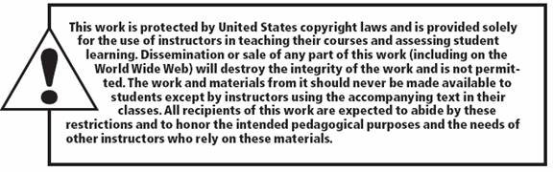
Copyright

