Slide 1
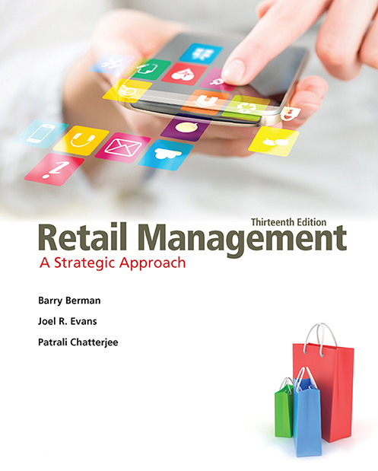
Retail Management: A Strategic Approach
Thirteenth Edition
Chapter 15
Implementing Merchandise Plans
Copyright © 2017, 2015, 2013 Pearson Education, Inc. All Rights Reserved.
Notes:
If this PowerPoint presentation contains mathematical equations, you may need to check that your computer has the following installed:
1) MathType Plugin
2) Math Player (free versions available)
3) NVDA Reader (free versions available)

Slide 2
Learning Objectives
15.1 To describe the steps in the implementation of merchandise plans: gathering information, selecting and interacting with merchandise sources, evaluation, negotiation, concluding purchases, receiving and stocking merchandise, reordering, and re-evaluation
15.2 To examine the prominent roles of logistics and inventory management in the implementation of merchandise plans

Slide 3
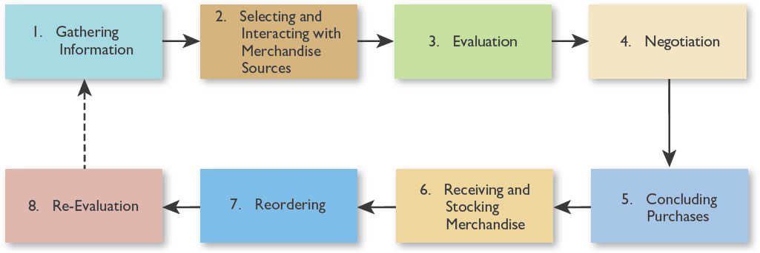
Figure 15.1 Implementing Merchandise Plans
Notes:
This comprises eight sequential steps as shown in Figure 15.1.
Gathering Information
After overall merchandising plans are set, more information about the target market and prospective suppliers is required. Sources of information in gathering data about the marketplace include the following:
Consumers.
Suppliers (manufacturers and wholesalers).
Retail sales and display personnel.
A want book (want slip) system is a formal way to record consumer requests for unstocked or out-of-stock merchandise.
Competitors. (Figure 15-2 next slide shows a competition shopping report.)
The government.
Independent news.
Commercial data.

Slide 4
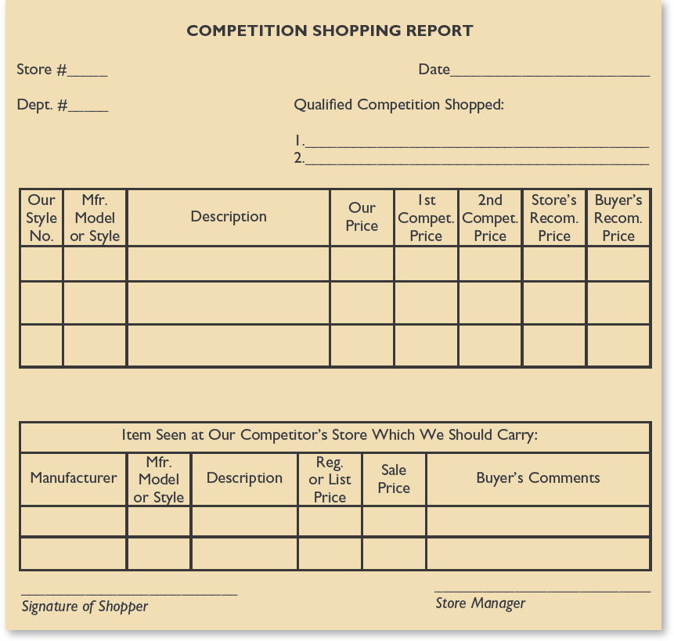
Figure 15.2 A Competition Shopping Report

Slide 5
Selecting Merchandise Sources
Company-owned
Outside, regularly used supplier
Outside, new supplier
Notes:
Selecting and Interacting with Merchandise Sources
Retailers must select sources of merchandise and interact with them. Three major options exist:
With the company-owned supplier, the retailer owns manufacturing and/or wholesaling facilities.
An outside, regularly used supplier is not owned by the retailer, but is used regularly by the retailer.
An outside, new supplier is not owned by the retailer, and the retailer has not bought from it before.
A retailer can rely on one kind of supplier or a combination. Figure 15-3 next slide describes the types of outside suppliers. Figure 15-4 lists the criteria to be considered in choosing vendors.

Slide 6
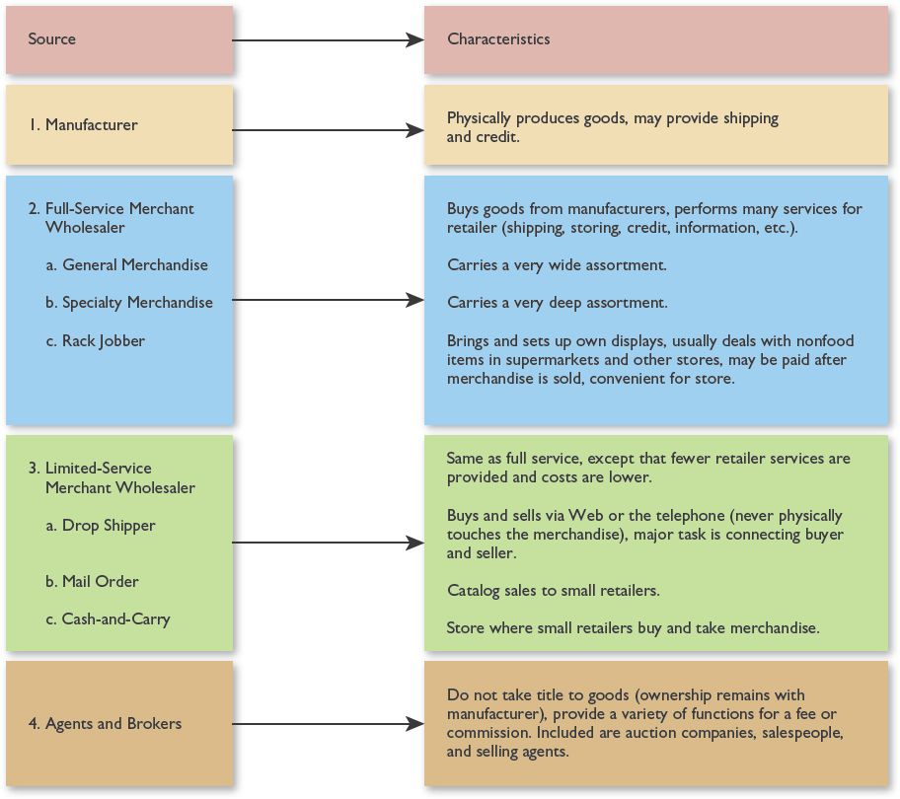
Figure 15.3 Outside Sources of Supply
Notes:
To learn about the attributes of specific suppliers and their merchandise, retailers can do the following:
Talk to suppliers, get specification sheets, read trade publications, and seek references.
Attend trade shows that feature numerous exhibitors (suppliers).
Visit year-round merchandise marts (e.g., AmericasMart Atlanta).
Search the Web.
The information gathered should be sufficient so that the retailer is comfortable making decisions.

Slide 7
Americas Mart Tradeshow: World’s Global Market
Please click URL to view:
https://youtu.be/BjjQ8HfkvcA
Notes:
URL: https://youtu.be/BjjQ8HfkvcA
1:04 mins.
The Best of the Best in Atlanta
Published on Feb 15, 2016
Explore a premier destination for buyers and designers – High Design in January 2016.

Slide 8
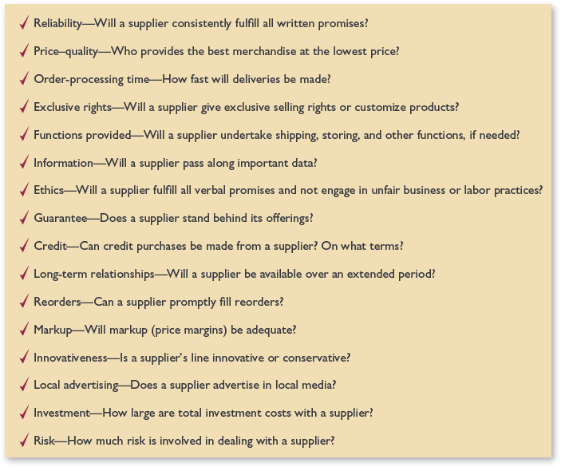
Figure 15.4 A Checklist in Choosing Vendors

Slide 9
Negotiating the Purchase
Special considerations
  Opportunistic buying— due to closeouts, bankruptcies, overstocks, cancelled orders, lack of a well balanced assorted lot sizes and colors
  Slotting allowances—common for new products in supermarkets in Northeast and in freezer sections
Notes:
Negotiating the Purchase
In a negotiated contract, the retailer and supplier carefully discuss all aspects of a new or special order. A regular order or reorder often involves a uniform contract because terms are standard. The order is handled routinely. Off-price retailers and other deep discounters may require negotiated contracts. This is because these firms employ opportunistic buying, by which especially low prices are negotiated for merchandise whose sales have not lived up to expectations, end-of-season goods, returned items, and closeouts.
Purchase terms must be specified. They include the following:
Delivery date.
Quantity purchased.
Price and payment arrangements.
Discounts.
Form of delivery.
Point of transfer of title.
Special clauses may be inserted by either party. Sometimes, they are beneficial to both parties. Other times, the clauses are inserted by the more powerful party. An example is the use of slotting allowances—payments that retailers require of vendors for providing shelf space.

Slide 10
Slotting Fees: Grocery Shelf Space
There's a hidden war in the supermarket—Vox's Phil Edwards explains. Read the article here:
http://www.vox.com/2016/11/22/1370702...
Notes:
There's a hidden war in the supermarket—Vox's Phil Edwards explains. Read the article here: http://www.vox.com/2016/11/22/1370702...

Slide 11
Concluding Purchases
The retailer takes title immediately upon purchase.
The retailer assumes ownership after titles are loaded onto the mode of transportation.
The retailer takes title when a shipment is received.
The retailer does not take title until the end of a billing cycle, when the supplier is paid.
The retailer accepts goods on consignment and does not own the items. The supplier is paid after merchandise is sold.
Notes:
Concluding Purchases
For medium and large retailers, purchases are computerized.
Smaller retailers often write up and process orders manually.
Multi-unit retailers must determine whether to use central, regional, or local purchase approval.
Transfer of title to the buyer must be specified. These are the options:
Immediately upon purchase.
After items are loaded onto the mode of transportation.
When a shipment is received by a buyer.
At the end of a billing cycle, when the supplier is paid.
When merchandise is sold on consignment. (It is not owned by the retailer while in stock.)

Slide 12
Figure 15.6 Receiving and Stocking Merchandise
Notes:
Receiving and Verifying Inventory
Every time merchandise orders are received by the retailer, they must be verified in terms of the quantity, assortment, and condition of the goods.
Receiving and Stocking Merchandise
At this point, a retailer is ready to receive and handle items. This involves these varied tasks (See Figure 15-6):
Receiving and storing goods.
Items may be shipped from suppliers to warehouses (for storage and disbursement) or directly to retailers’ stores.
One important emerging technology involves RFID (radio frequency identification) systems. It is a method of storing and remotely retrieving data using RFID tags or transponders. At present, its use is limited.
Checking and paying invoices.
Price and inventory marking.
Completing transactions.
Arranging delivery or pickup.
Processing returns and damaged goods.
The retailer must determine the party responsible for customer returns (supplier or retailer).
The situations in which damaged goods would be accepted for refund or exchange also must be determined.
Monitoring and reducing inventory losses, a major problem due to the high costs of merchandise theft.
Controlling merchandise. This involves assessing sales, profits, turnover, inventory shortages, seasonality, and costs for each product category and item carried by a retailer. Control is usually achieved by preparing computerized inventory data and doing physical inventories.
See Figure 15-8.

Slide 13
Figure 15.7 Shirt Assortment
Notes:
Supermarket price marking on individual items costs an amount equal to annual profits. Prices can be hand-posted or rely on UPC or other package labels.
Setting up displays. See Figure 15-7. (Displays and on-floor merchandising are discussed in Chapter 18.) Figuring on-floor assortments like the one on this slide.
On-Floor Assortments and Men’s Shirts
On-floor inventory planning is complicated for items such as men’s shirts—due to the choices that must be offered and the various sizes that must be readily available.

Slide 14
Modernizing Inventory Management
Please click URL to view:
URL: https://youtu.be/-l9rIMekpfs
Notes:
URL: https://youtu.be/-l9rIMekpfs
3;33 mins.
Managing Inventory in a Small Store
NRHA tv
Published on Oct 27, 2016
This video shows some of the techniques owners of small stores use to manage inventory.

Slide 15
Reordering Merchandise
Four critical factors:
  Order and delivery time
  Inventory turnover
  Financial outlays
  Inventory versus ordering costs
Notes:
Reordering Merchandise
A procedure is necessary for the items a retailer purchases more than once.
These four factors are critical in devising a plan:
Order and delivery time.
Inventory turnover.
Financial outlays.
Inventory versus ordering costs.
Re-evaluating on a Regular Basis
The overall procedure, as well as the handling of individual goods and services, should be monitored. Conclusions during this stage become part of the information-gathering stage for future efforts.

Slide 16
Logistics
Logistics is the total process of planning, implementing, and coordinating the physical movement of merchandise from manufacturer (wholesaler) to retailer to customer in the most timely, effective, and cost-efficient manner possible.

Slide 17
Logistical Performance Goals (1 of 2)
Relate costs incurred to specific logistics activities
Place and receive orders as easily, accurately, and satisfactorily as possible
Minimize the time between ordering and receiving merchandise
Coordinate shipments from various suppliers
Have enough goods on hand to satisfy demand without having so much inventory that heavy markdowns will be needed
Notes:
It regards order processing and fulfillment, transportation, warehousing, customer service, and inventory management as interdependent functions in the value delivery chain. See Figure 15-9.
Performance Goals: These are among retailers’ major logistics goals:
Match the costs incurred to specific logistics activities.
Place and receive orders as easily, accurately, and satisfactorily as possible.
Minimize the time between ordering and receiving merchandise.
Coordinate shipments from various suppliers.
Have enough merchandise on hand to satisfy customer demand, without having so much inventory that heavy markdowns will be necessary.
Place merchandise on the sales floor efficiently.
Process customer orders efficiently and in a manner satisfactory to customers.
Work collaboratively and communicate regularly with other supply chain members.
Handle returns effectively and minimize damaged products.
Monitor logistics performance.
Have backup plans in case of breakdowns in the system.

Slide 18
Logistical Performance Goals (2 of 2)
Place merchandise on the sales floor efficiently
Process customer orders properly and in a manner satisfactory to customers
Work collaboratively and communicate regularly with other supply chain members
Handle returns effectively and minimize damaged products
Monitor logistics’ performance
Have backup plans in case of system breakdowns

Slide 19
Supply Chain Management
The supply chain is the logistics aspect of a value delivery chain.
  Parties involved:
    Manufacturers
    Wholesalers
    Third-party specialists
    Retailers
Notes:
Supply Chain Management
The supply chain is the logistics aspect of a value delivery chain and comprises all of the parties that participate in the retail logistics process: manufacturers, wholesalers, third-party specialists, and the retailer. Many retailers and suppliers are seeking closer logistical relationships with a technique known as collaborative planning, forecasting, and replenishment. This is a holistic approach to supply chain management among a network of trading partners. Third-party logistics (outsourcing) is now more popular. An example is provided. The Web is a growing force in supplier–retailer communications. Target Corporation has a very advanced Web site called Partners Online.

Slide 20
Order Processing and Fulfillment
Quick Response inventory planning (QR)
Floor-ready merchandise
Efficient Consumer Response (ECR)
Notes:
Order Processing and Fulfillment
Many retailers engage in quick response (QR) inventory planning, by which a retailer reduces the amount of inventory it holds by ordering more frequently and in lower quantity. Inventory costs are reduced, the space required for storage is minimized, and retailers are better able to match orders with market conditions. For the manufacturer, a QR system can also improve inventory turnover and better match supply and demand. Among the firms using QR are Dillard’s, Giant Food, Home Depot, Limited Brands, Macy’s, J.C. Penney, Sears, Target Corporation, and Wal-Mart.
A QR system works best in conjunction with floor-ready merchandise, lower minimum order sizes, properly formatted store fixtures, and electronic data interchange (EDI). Floor-ready merchandise refers to items that are received at the store in condition to be put directly on display without any preparation by retail workers. EDI lets retailers do QR inventory planning efficiently—via a paperless, computer-to-computer relationship between retailers and their vendors. An example is provided in the textbook for Wal-Mart. Many firms in the food sector of retailing are using efficient consumer response (ECR) planning. ECR permits supermarkets to incorporate aspects of QR inventory planning, EDI, and logistics planning.
Two other aspects of order processing and fulfillment are being addressed by retailers:
With advanced ship notices, retailers that utilize QR and EDI receive an alert when bills of lading are sent electronically as soon as a shipment leaves a vendor. Because more retailers are buying from multiple suppliers, multi-location sources, and overseas, they must better coordinate order placement and fulfillment. Sometimes, the order-processing and fulfillment process can be especially challenging.

Slide 21
Inside Amazon’s Warehouse
Please click URL to view:
https://youtu.be/M5xvCGGDISk
Additional videos at:
http://www.techinsider.io/
Notes:
URLhttps://youtu.be/M5xvCGGDISk
2:35 mins.
Published on Sep 28, 2016
Winston Sih gets a look inside Amazon's robotic warehouse at the core of the Internet giant's system.
Additional videos at : http://www.techinsider.io/

Slide 22
Transportation and Warehousing
How often will merchandise be shipped to retailer?
How will small order quantities be handled?
What shipper will be used?
What transportation form will be used? Are multiple forms required?
What are the special considerations for perishables and expensive merchandise?
How often will special shipping arrangements be necessary?
How are shipping terms negotiated with suppliers?
What delivery options will be available for the retailer’s customers?
Notes:
Transportation and Warehousing
Several transportation decisions are necessary:
How often will merchandise be shipped to the retailer?
How will small order quantities be handled?
What shipper will be used (the manufacturer, the retailer, or a third-party specialist)? See Figure 15-10.
What transportation form will be used? Are multiple forms required?
What are the special considerations for perishables and expensive merchandise?
How often will special shipping arrangements be necessary?
How are shipping terms negotiated with suppliers?
What delivery options will be available for the retailer’s customers? This is especially critical for retailers selling through the Web.

Slide 23
Figure 15.10 Shipping Possibilities
Notes:
Transportation effectiveness is impacted by the logistics infrastructure, traffic congestion, parking, and other factors. There are special issues in foreign countries.
Shipping Possibilities
A lot of merchandise is transported by at least two types of transportation— such as train and truck or air and truck. These
shipments must be delivered as scheduled for the retail supply chain to operate well. With the growth of foreign
suppliers, this is tougher
to accomplish.

Slide 24
Problems Balancing Inventory Levels
The retailer wants to be appealing and never lose a sale by being out of stock; it does not want to be “stuck” with excess merchandise.
What is fad merchandise and how much should be carried?
Customer demand is never completely predictable.
Shelf space allocation should be linked to current revenues.
Notes:
Inventory Levels: Deciding on the proper amount of inventory is difficult for retailers for these reasons:
They never want to lose a sale by being out of stock; yet, they don’t want to be “stuck” with excess merchandise.
Fad merchandise, new items for which there is no track record, and new business formats make inventory level decisions even more challenging.
Customer demand is never completely predictable—even for staple items. Shelf space allocations should be linked to current revenues, which means that allocations must be regularly reviewed and adjusted. An advantage of QR and EDI is that retailers hold “leaner” inventories since they receive new merchandise more often. However, stockouts may still occur.

Slide 25
Figure 15.12a Ways Retailers Can Deter Employee and Shopper Theft
Employee Theft
Use honesty tests as employee screening devices.
Lock up trash to prevent merchandise from being thrown out and then retrieved.
Verify through cameras and undercover personnel whether all sales are rung up.
Centrally control all exterior doors to monitor opening and closing.
Divide responsibilities–have one employee record sales and another make deposits.
Give rewards for spotting thefts.
Have training programs.
Vigorously investigate all known losses and fire offenders immediately.
Notes:
Merchandise Security
Each year, $45 billion in U.S. retail sales—and about $120 billion worldwide—are lost due to inventory shrinkage caused by employee theft, customer shoplifting, vendor fraud, and administrative errors. Of the global amount, employees account for 35 percent, customers 43 percent, vendors 6 percent, and administrative errors 16 percent. To reduce merchandise theft, there are three key points to consider:
Loss prevention measures should be incorporated as stores are designed and built.
A combination of security measures should be enacted, such as employee background checks, in-store guards, electronic security equipment, and merchandise tags.
Retailers must communicate the importance of loss prevention to employees, customers, and vendors, as well as the actions they will take to reduce losses.

Slide 26
Figure 15.12b Ways Retailers Can Deter Employee and Shopper Theft
Shopper Theft While Store Is Open
Use uniformed guards.
Set up cameras and mirrors to increase visibility–especially in low-traffic areas.
Use electronic article surveillance for high-value and theft-prone goods.
Develop comprehensive employee training programs.
Offer employee bonuses based on an overall reduction in shortages.
Inspect all packages brought into store.
Use self-locking showcases for high-value items such as jewelry.
Attach expensive clothing together.
Alternate the direction of hangers on clothing near doors.
Limit the number of entrances and exits to the store, and the dollar value and quantity of merchandise displayed near exits.
Prosecute all individuals charged with theft.
Notes:
These are some measures that reduce losses due to theft:
The use of product tags, guards, video cameras, point-of-sale computers, employee surveillance, and burglar alarms, as well as storefront protection. See Figure 15-11A.
The use of electronic article surveillance and nonelectronic tags. See Figure 15-11B.
Detailed background checks for every employee.
Employee training programs on the impact of losses and incentives for reducing them, as well as written policies on ethical behavior.
Firing employees and prosecuting shoplifters involved with theft.
Hiring mystery shoppers to watch for shoplifting.

Slide 27
Loss Prevention (Farmers store)
Please click URL to view:
https://youtu.be/giFprF8nsKg
Notes:
URL: https://youtu.be/giFprF8nsKg
7:05 mins.
Innovative Loss Prevention Tactics
NRHA tv
Published on Feb 28, 2017
Buchheit Stores is making investigations related to shoplifting easier for the local police department with a couple of major loss prevention tactics. Brian Clubb, former law enforcement officer and corporate loss prevention officer with Buchheit Stores, explains the security measures that help the company mitigate loss.

Slide 28
Figure 15.12c Ways Retailers Can Deter Employee and Shopper Theft
Employee/Shopper Theft While Store Is Closed
Conduct a through building check at night to make sure no one is left in store.
Lock all exits, even fire exits.
Utilize ultrasonic/infrared detectors, burglar alarm traps, or guards with dogs.
Place valuables in a safe.
Install shatterproof glass and/or iron gats on windows and doors to prevent break-ins.
Make sure exterior lighting is adequate.
Periodically test burglar alarms.
Notes:
When devising a merchandise security plan, a retailer must assess the plan’s impact on its image, employee morale, shopper comfort, and vendor relations.

Slide 29
Reverse Logistics
Decisions
  Under what conditions are customer returns accepted by retailer and by manufacturer?
  What is the customer refund policy? Is there a fee for returning an opened package?
  What party is responsible for shipping a returned product to the manufacturer?
  What customer documentation is needed to prove the date of purchase and the price paid?
  How are customer repairs handled?
  To what extent are employees empowered to process customer returns?
Notes:
Reverse Logistics
Reverse logistics encompasses all merchandise flows from the customer and/or the retailer back through the supply channel. It typically involves items returned because of shopper second thoughts, damages or defective products, or retailer overstocking. In the United States, customer returns alone are estimated at about nine percent of total retail sales, with $15 billion of returns being fraudulent.
U.S. firms spend more than $50 billion per year for the handling, transportation, and processing costs associated with returns.
These are among the decisions that must be made for reverse logistics:
Under what conditions are customer returns accepted by the retailer and by the manufacturer?
What is the customer refund policy? Is there a fee for returning an opened package?
What party is responsible for shipping a returned product to the manufacturer?
What customer documentation is needed to prove the date of purchase and the price paid?
How are customer repairs handled?
To what extent are employees empowered to process returns?

Slide 30
Reverse Logistics at Amazon
Please click URL to view:
How Amazon Receives Your Inventory
https://youtu.be/2xoFbK_Y7AI
Notes:
How Amazon Receives Your Inventory
https://youtu.be/2xoFbK_Y7AI
Published on Jan 22, 2017
4:44 mins.
Take a tour of an Amazon fulfillment center and see how our Associates receive your inventory from your inbound shipments. You will also learn what happens when your shipments are missing vital prep, labels or packaging or are otherwise not e-Commerce ready.

Slide 31
Inventory Management Metrics
Metrics used to measure inventory management performance include:
  Gross margin dollars.
  Inventory turnover.
  Gross profit percentage.
  Gross margin return on inventory.
  The weeks of supply available.
  The average in-stock position.
Notes:
Inventory status and performance must be analyzed regularly to gauge the success of inventory management. Recent advances in computer software have made such analysis this much more accurate and timely.
These are the elements of inventory performance that are deemed most important:
Gross margin dollars.
Inventory turnover.
Gross profit percentage.
Gross margin return on inventory.
The weeks of supply available.
The average in-stock position.

Slide 32
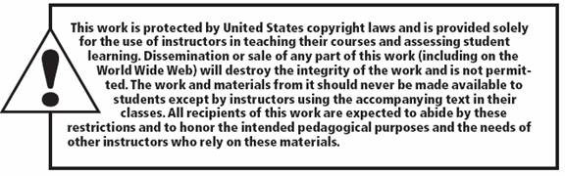
Copyright

