Slide 1
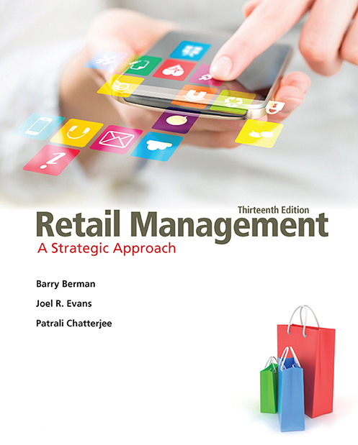
Retail Management: A Strategic Approach
Thirteenth Edition
Chapter 2
Building And Sustaining Relationships In Retailing
Copyright © 2017, 2015, 2013 Pearson Education, Inc. All Rights Reserved.
Notes:
If this PowerPoint presentation contains mathematical equations, you may need to check that your computer has the following installed:
1) MathType Plugin
2) Math Player (free versions available)
3) NVDA Reader (free versions available)

Slide 2
Learning Objectives (1 of 2)
2.1 To explain what “value” really means and to highlight its pivotal role in retailers’ building and sustaining relationships
2.2 To describe how both customer relationships and channel relationships may be nurtured in today’s highly competitive marketplace

Slide 3
Learning Objectives (2 of 2)
2.3 To examine the differences in relationship building between goods and services retailers
2.4 To discuss the impact of technology on relationships in retailing
2.5 To consider the interplay between retailers’ ethical performance and relationships in retailing

Slide 4
Definition of Value
Value = Results + Process Quality
Price + Customer Access Costs
Results = Overall quality, instructions, ease of assembly, taste/quality/health, warranty, product testing by retailer
Process Quality = Wide aisles, ease of finding, high in-stock position, fun experience, short waiting times
Price = Costs + delivery + assembly + credit
Customer access costs = Warehouse club membership fees, inconvenient location, poor store hours, inadequate parking

Slide 5
What is Value?
Channel Perspective
Value is a series of activities and processes (the “value chain”) that provide a certain value for the consumer.
Customer Perspective
Value is a perception that the shopper has of the value chain.
It is the view of all the benefits from a purchase versus the price paid.

Slide 6
Retail Value Chain
Represents the total bundle of benefits offered to consumers through a channel of distribution
  Store location and parking, retailer ambience, customer service, brands/products carried, product quality, retailer’s in-stock position, shipping, prices, image, and other elements

Slide 7
Potential Pitfalls to Avoid in Planning a Value-Oriented Retail Strategy
Planning value solely from a price perspective
Providing value-enhanced services that customers do not want or will not pay extra for
Competing in the wrong value/price segment
Believing augmented elements alone create value
Paying lip service to customer service

Slide 8
Figure 2.2 A Value-Oriented Retailing Checklist (1 of 2)
Is value defined from a consumer perspective?
Does the retailer have a clear value/price point?
Is the retailer’s value position competitively defensible?
Are channel partners capable of value-enhancing services?
Does the retailer distinguish between expected and augmented value chain elements?
Has the retailer identified potential value chain elements?
Is the retailer’s value-oriented approach aimed at a distinct market?
Is the retailer’s value-oriented approach consistent?

Slide 9
Figure 2.2 A Value-Oriented Retailing Checklist (2 of 2)
Is the retailer’s value-oriented approach effectively communicated?
Can the target market clearly identify the retailer’s positioning?
Does the retailer’s positioning consider sales versus profits?
Does the retailer set customer satisfaction goals?
Does the retailer measure customer satisfaction levels?
Is the retailer careful to avoid the pitfalls in value-oriented retailing?
Is the retailer always looking out for new opportunities that will create customer value?

Slide 10
Figure 2.3 Retailing Relationships
Notes:
The Many Relationships in Retailing
In most instances, the retail supply chain is quite complex. It requires that the many relationships be satisfying to all arties, including both various channel members and customers.

Slide 11
Customer Service
Expected customer service is the service level that customers want to receive from any retailer such as basic employee courtesy.
Augmented customer service includes the activities that enhance the shopping experience and give retailers a competitive advantage.

Slide 12
Zappos Company Culture
Please click URL to view:
https://youtu.be/SCwfxEpQlHk
Notes:
9:16 mins.
Published on Mar 4, 2014
Interview with Tony Hsieh on how Zappos delivers happiness to customers and has become a success as a result.

Slide 13
Expected Versus Augmented Levels of Customer Service
Expected– Must have elements; do not differentiate retailer. While absence of these expected values provides anguish, presence does not provide satisfaction
Augmented—Services that can provide a competitive advantage. Double warranty, special delivery, product demonstrations

Slide 14
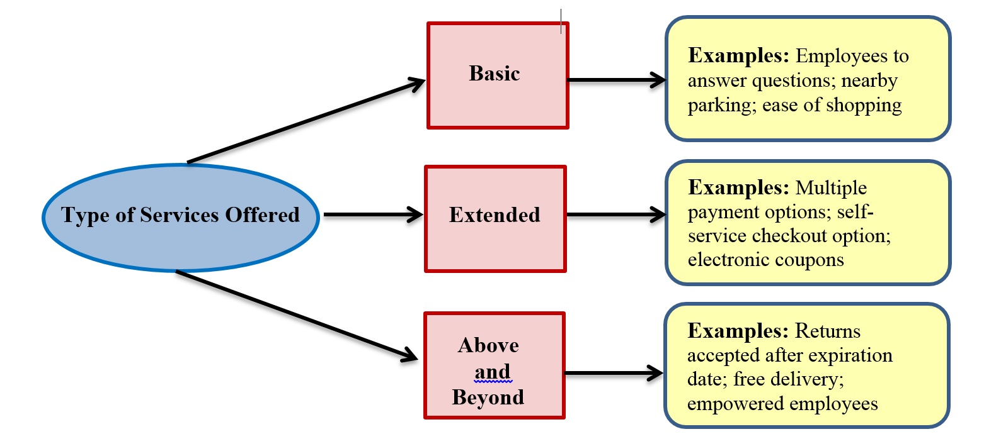
Figure 2.4 Classifying Customer Services

Slide 15
Fundamental Decisions
What customer services are expected and what customer services are augmented for a particular retailer?
What level of customer service is proper to complement a firm’s image?
Should there be a choice of customer services?
Should customer services be free?
How can a retailer measure the benefits of providing customer services against their costs?
How can customer services be terminated?

Slide 16
Table 2.1 Typical Customer Services
Credit
Delivery
Alterations/ Installations
Packaging/gift wrapping
Complaints/Returns handling
Gift certificates
Trade-ins
Trial purchases
Special sales
Extended store hours
Mail/phone orders

Slide 17
Table 2.1b Miscellaneous Customer Services
Bridal registry
Interior designers
Personal shoppers
Ticket outlets
Parking
Water fountains
Pay phones
Baby strollers
Restrooms
Restaurants
Babysitting
Fitting rooms
Beauty salons
Fur storage
Shopping bags
Information

Slide 18
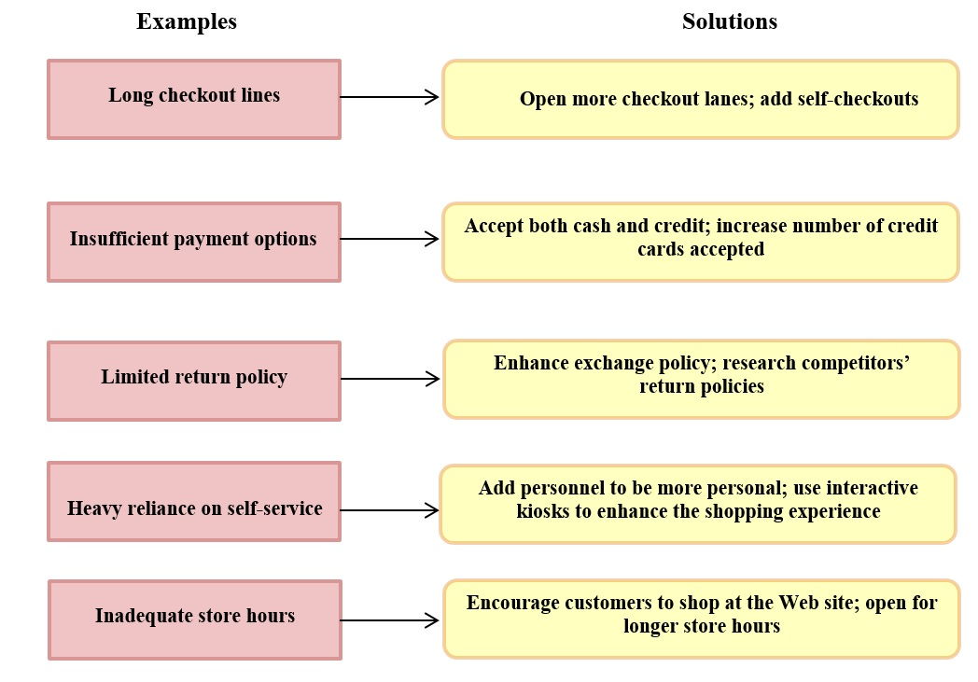
Figure 2.6 Turning Around Weak Customer Service
Notes:
Turning around Weak Customer Service
All of these solutions incur costs. Thus, the retailer must weigh the benefits of improving their services versus the additional costs.

Slide 19
Types of Loyalty Programs
Additional discounts at register
  Not a real loyalty program
1 free with every “n” items purchased
  Easily copied, no customer database
Rebates based on cumulative purchases
  Customer maintains records
  Can develop “heavy half” programs like Hilton
Targeted offerings and mailing based on purchase history
  Tesco example “Market research staff know more about my customers than board chairperson”

Slide 20
Rewards Program Categories
Economic
Hedonistic
Social-relational
Informational
Functional
Notes:
Retailers in categories with less differentiation (e.g., airlines and supermarkets) offer loyalty
programs with the goal of increasing repeat business and profitability. In these cases, a decision
to join a loyalty program may have a big impact by increasing customer perceptions of switching
costs that increase behavioral loyalty. Firms can collect customer contact and socio-demographic
information when they sign up, and track browsing and purchase behavior that they can use to
personalize offers and strengthen the exchange with customers.

Slide 21
Types of Economic Loyalty Programs
Additional discounts at register
  Not a real loyalty program
1 free with every “n” items purchased
  Easily copied, no customer database
Rebates based on cumulative purchases
  Customer maintains records
  Can develop “heavy half” programs like Hilton
Targeted offerings and mailing based on purchase history
  Tesco example “Market research staff know more about my customers than board chairperson”

Slide 22
Principles of Category Management
Retailers listen more to customers
Profitability is improved because inventory more closely matches demand
By being better focused, each department is more desirable for shoppers
Retail buyers are given more responsibilities and accountability for category results
Retailers and suppliers must share data and be more computerized
Retailers and suppliers must plan together

Slide 23
Category Management: Juice
Please click URL to view:
https://youtu.be/-2p-pn-au-0
Notes:
4:55 mins.
Published on May 27, 2016
Chris Marks in Category Management reviews why shelf stable juice is important to consumers and provides keys for freshening up your juice aisle.

Slide 24
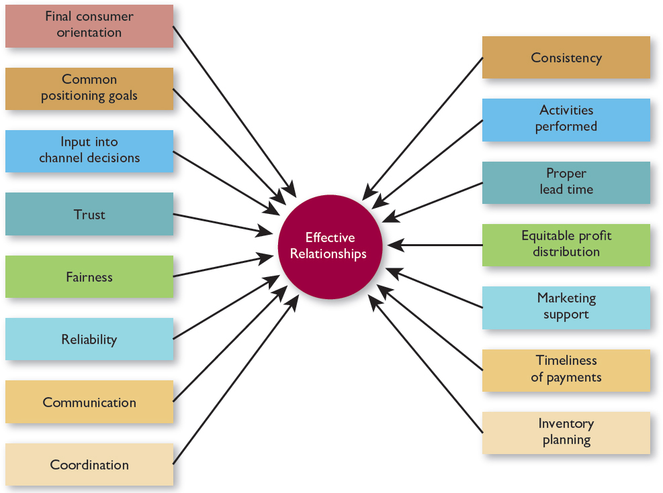
Figure 2.7 Elements Contributing to Effective Channel Relationships

Slide 25
Three Kinds of Service Retailing
Rented goods services– leased cars, hotel rooms, carpet cleaning equipment
Owned goods services– plumbing, appliance repair,
Non-goods services– haircut, professional services (physician, lawyer)
Notes:
Rented-goods services, whereby consumers lease and use goods for specified periods of
time. Tangible goods are leased for a fixed time, but ownership is not obtained and the goods
must be returned when the rental period is up. Examples are Hertz car rentals, carpet cleaner
machine rentals from a supermarket, and video rentals at Redbox kiosks.
Owned-goods services, whereby goods owned by consumers are repaired, improved, or
maintained. In this grouping, the retailer providing the service never owns the good involved.
Illustrations include watch repair, lawn care, and an annual air-conditioner tune-up.
▶▶ Nongoods services, whereby intangible personal services are offered to consumers who
then experience the services rather than possess them. The seller offers personal expertise
for a specified time in return for a fee; tangible goods are not involved. Some examples are
accountants, stockbrokers, travel agents, real-estate brokers, and personal trainers.

Slide 26
Four Characteristics of Services Retailing
Intangibility
Inseparability
Perishability
Variability
Notes:
Four unique aspects of service retailing impact relationship building and customer retention:
(1) The intangibility of many services makes a consumer’s choice of competitive offerings more
difficult than with goods, (2) the service provider and his or her services are sometimes inseparable
(thus localizing marketing efforts), (3) the perishability of many services prevents storage and
increases risks, and (4) the human nature involved in many services makes them more variable.

Slide 27
Figure 2.8a Managing Unique Characteristics of Service Retailing
Intangibility
Display/distribute customer testimonials.
Explain in detail how the service will be performed and what the expected results will be.
Have strong, clearly stated guarantees of performance.
Be competitively priced.
Notes:
The intangible (and possibly abstract) nature of some services makes it harder for a firm to
develop a clear consumer-oriented strategy, particularly because many retailers (such as opticians,
repairpeople, and landscapers) start service businesses on the basis of their product expertise.
Characteristics:
No patent protection possible
Difficult to display/communicate
service benefits
Quality judgment is subjective
Some services involve
performances/experiences

Slide 28
Figure 2.8b Managing Unique Characteristics of Service Retailing
Inseparability
Prominently promote major points of distinction with competition
At the time a service is completed, encourage customers to schedule appointments for a follow-up service visit or call.
If possible, rotate employees who interact with customers each time they buy a service so that customers do not leave if a popular employee goes elsewhere.
Call customers after a service is performed to demonstrate the firm’s interest in them.
Notes:
Characteristics of Inseparability:
Consumer may be involved in
service production
Centralized mass production difficult
Consumer loyalty may rest
with employees

Slide 29
Figure 2.8c Managing Unique Characteristics of Service Retailing
Perishability
Carefully plan each work day to optimize service visits or calls.
Be prepared to do alternative tasks if the weather is bad.
Offer appropriate other services that are popular during off-season.
Be willing to work longer hours during peak periods and fewer hours during slower times.
Notes:
Characteristics of perishability:
Services cannot be inventoried
Lost revenues from unsold services are lost forever
Effects of seasonality can be severe
Planning employee schedules can be complex
Need to balance supply and demand
(yield management pricing)

Slide 30
Figure 2.8d Managing Unique Characteristics of Service Retailing
Variability
Develop and implement systematic procedures for performing each service—including a series of steps to be undertaken every time the same service is requested.
Train employees well.
Computerize as many steps as possible, such as inputting customer information, verifying that each step has been completed, and billing.
Regularly observe employee actions to be sure they are done correctly.
Notes:
Characteristics of variability:
Standardization and quality control hard to achieve
Customers may perceive variability even when it does not actually occur
Need to industrialize/mechanize/service blueprint services to factor out variability

Slide 31
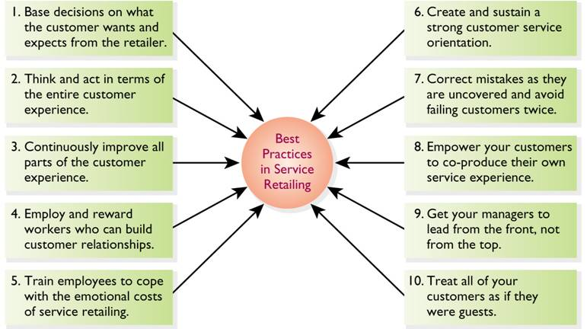
Figure A2.1 Lessons in Service Retailing

Slide 32
Figure 2.10 Technology Icons

Slide 33
Retail Challenge: Service Strategy Through Technology
Please click URL to view:
https://youtu.be/T7HXleiYTYY
Notes:
1:24 mins.
Retail Challenge: Service Strategy Through Technology
Published on Dec 5, 2016
This video is about retailers using technology as a competive advantage

Slide 34
Examples of Consumerism in Retailing
Proper testing of items for safety issues
Programming cash registers not to accept payment for recalled goods
Charging fair prices for goods in short supply--Home Depot plywood example in hurricane
Age labeling of toys, warning labels on goods beyond legal requirements

Slide 35
Figure 2.11 Store Sale

Slide 36
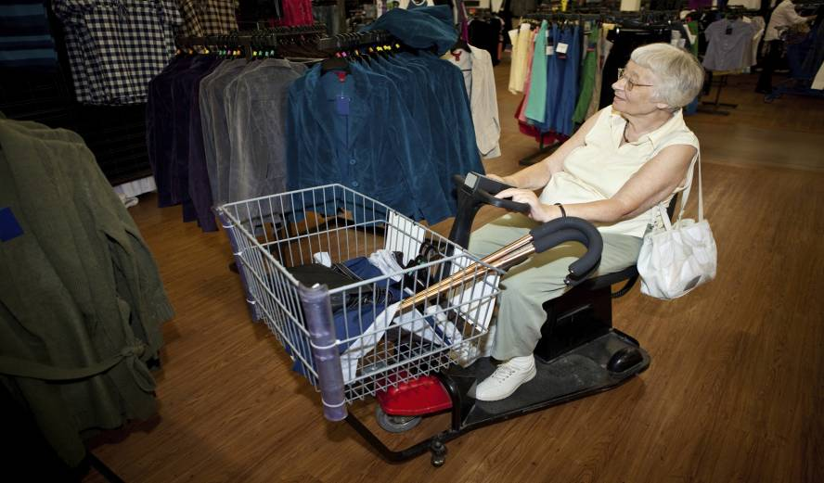
Figure 2.12 Understanding the Americans with Disabilities Act

Slide 37
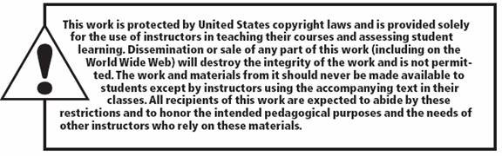
Copyright

