Slide 1
Real Options Analysis
Individual Project

Slide 2
Limitations of Net Present Value Analysis
While net present value (NPV) is the most commonly used method for evaluating investment opportunities, it does have some drawbacks that should be carefully considered. Key challenges to NPV analysis include:
A long list of assumptions has to be made
Sensitive to small changes in assumptions and drivers can be manipulated to produce the desired output
May not capture second- and third-order benefits/impacts (i.e., on other parts of a business)
Assumes a constant discount rate over time
Accurate risk-adjustment is challenging to perform (hard to get data on correlations, probabilities)

Slide 3
Goals and Objectives
Real Options Valuation Project: The assignment is to evaluate both parts, the traditional NPV calculation as well as the Real Options approach.
For example, let’s say the probability of a successful pilot project is now .4 (instead of .5) and the probability of an unsuccessful pilot is .6 (instead of .5). What is the expected NPV in each case now? What do you recommend? Why? If you don't know the probability of success for the pilot, is there a value that is critical to your recommendation?
Is there a probability of success above or below which you will recommend undertaking the pilot and below or above which you will recommend a go/ no go decision on the underlying project without undertaking a pilot test? This presentation includes an example to assist you in your calculations.

Slide 4
Summary of the Current Situation
SIMPLE EXAMPLE: A company must decide whether to invest $100 million in developing and implementing a new enterprise system in the face of considerable technological and market (demand for product and market share) uncertainty. The firm's cost of capital is 10%.
1. Evaluate Using Conventional NPV Analysis
There can be a good and bad result for this investment.
Good Result: A good result has a probability of .5 of occurring. Here the planned cost reductions have been realized and better integration of the supply chain is possible. These benefits are reinforced by strong market demand for the firm's product. There have also been feedback benefits, the enterprise systems has significantly improved perceived quality and service from the customer's point of view. Annual benefits under this scenario equal $15 million in after tax cash flow per year.

Slide 5
Summary of the Current Situation (Con’t)
Bad Result: The system proves to be more difficult to implement and improvements in management of the supply chain are less. In addition, the growth in market demand for the product is lower. Annual benefits under this scenario are $2 million in after tax cash flow per year.
Using traditional "all or nothing" NPV analysis, calculate the expected NPV of the project:
Given: Year 0 (now) cash flows: $-100 million for ERP purchase and implementation

Slide 6
NPV Analysis

Slide 7
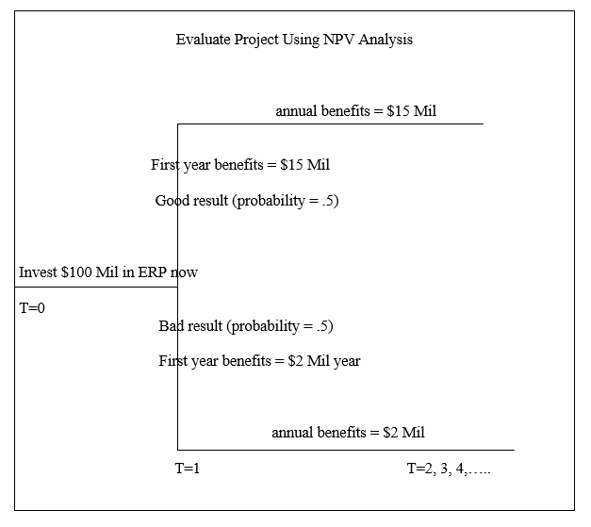
A Diagram of How Did We Got Here

Slide 8
Alternatives: Use the Real Options Approach
2. Evaluate using the Real Options Approach (all cash flows are after tax)
Now, evaluate the investment using managerial flexibility and a real options approach.
The real options alternative allows for flexibility and the delay of the investment for 1 year.
In this case, if we do a pilot project we will be better able to evaluate ERP implementation complexities, achievable supply chain benefits, and the market share our products will achieve.
However, the cost of the project will rise to $110 Million ($10 Million this year and $100 Million next year) with the one-year delay and additionally management decides to purchase and implement the financial module in year 1 at a cost of $10 Million (real option).

Slide 9
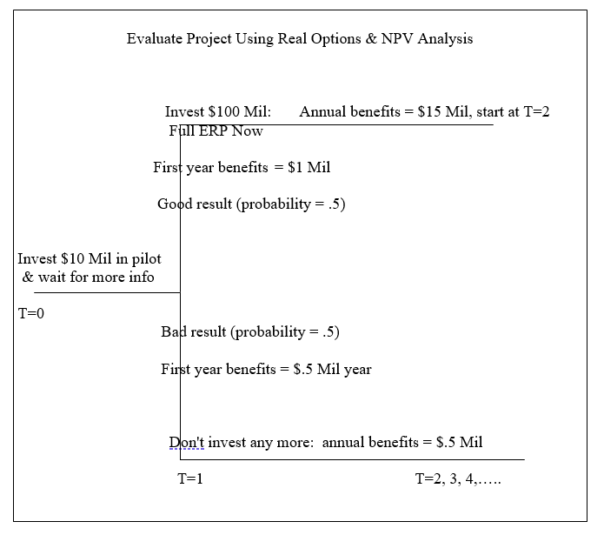
Real Options & NPV Analysis Evaluation

Slide 10
Part I: Conventional NPV Analysis
Example Problem

Slide 11
NPV Evaluation of the Project
Example Problem:
A company must decide whether to invest $100 million in developing and implementing a new enterprise system in the face of considerable technological and market (demand for product and market share) uncertainty. The firm’s cost of capital is 10%.
Given:
The Present Value of the Perpetuity is as follows:
  In the Good Case : Free Cash Flow (FCF) is $15 MM in perpetuity
  In the Bad Case: Free Cash Flow (FCFP is $2 MM in perpetuity
Probabilities of Cash Flows (after tax)
  Good Result = .5 Probability
  Bad Result = .5 Probability

Slide 12
NPV Evaluation of the Project
Step #1: Present Value of Perpetuity, adjusted for Cost of Capital
In the Good Case : Amount Invested Free Cash Flow (FCF) is $15 MM in perpetuity / .10 = $150,000,000 (a)
In the Bad Case: Free Cash Flow (FCF) is $2 MM in perpetuity / .10 = $20,000,000 (b)

Slide 13
NPV Evaluation of the Project
Step #2: NPV of the Project
In the Good Case : Amount Invested+ PV of Perpetuity, Adjusted for COC (Step #1) = ($100 Million ) + $150 Million = $50 Million
In the Bad: Amount Invested+ PV of Perpetuity, Adjusted for COC (Step #1) = ($100 Million) + $ 20 Million = ($80 Million)

Slide 14
NPV Evaluation of the Project
Step #3: Expected NPV
Expected NPV = .5 X “Good NPV” + .5 X “Bad NPV” =
Expected NPV = .5 X $50 Million + .5 X ($80 Million) =
Expected NPV = $25 Million + ($40 Million)
Expected NPV = ($15 Million)

Slide 15
NPV Evaluation of the Project
Conclusion:
The NPV of this Project is negative .
Today, if the choice is to invest or not, we would not undertake the project.

Slide 16
NPV Evaluation of the Project
Narrative about decision:
However, completing a financial analysis on zero and negative NPV investments is as important as doing analysis for positive NPV investments. This will help in evaluating alternatives to find the least negative NPV solution and in setting up minimum milestones that can be used to track performance after the investment.

Slide 17
Part II: Real Options Approach
Example Problem

Slide 18
Part II: Real Options Approach
The real options alternative allows for flexibility and the delay of the investment for 1 year. In this case, if we can complete a pilot project. This will allow us to better evaluate the ERP implementation complexities, achievable supply chain benefits, and the market share our products will achieve.
The cost of the project will rise to $110 ($10 Million this year and $100 Million next year) with the one-year delay. Additionally, management decides to purchase and implement the financial module in year 1 at a cost of $10 million (real option).

Slide 19
Real Options Evaluation of the Project
Given:
The firm’s cost of capital is 10%.
Probabilities of Cash Flows (after tax)
  Good Result = .5 Probability
  Bad Result = .5 Probability
In the Good Case:
  Year 0 (now) = Cash Flows = $10 Million for the pilot project, the financial module
  After Year 1 if conditions indicate a Good Result, the firm will invest $100 Million
  Beginning Year 2 in the Good Case : Free Cash Flow (FCF) is $15 MM. Benefits for Year 1 are $1 Million

Slide 20
Real Options Evaluation of the Project
Given (Continued):
In the Bad Case:
Year 0 (now) = Cash Flows = $10 Million for the pilot project, the financial module
After Year 1 if conditions indicate a Bad result, the firm does not make any further investments, which yield $0.5 Million in Year 1 and each Year and each year thereafter.
Here the firm has the flexibility and has exercised its option to make no future investments based on better information / knowledge of expected future benefits.

Slide 21
Real Options Evaluation of the Project
Benefits of completing a pilot:
We have the opportunity to do a pilot program by installing the financial module only at a cost of $10 Million . A year from now, the company can decide where or not to invest $100 Million in developing and implementing in the full enterprise system or not.

Slide 22
Real Options Evaluation of the Project
Step #1: Present Value of Cash Flows Outflows
Total PV of Project Cash Outflows: [-$10 Million + (- $100 Million/1+.10) X .5] = ($55.45 Million)
Step #2: Present Value of Expected Cash Flows
In the Good Case: {($1 Million /1+ COC) + [($15 Million /(COC)/1+COC)] *.5 }=
{($1 Million /1 + 0.10) + [($15 Million / (0.10 /1 + 0.10)]*.5 }=
[ .90909 Million + (150 Million/1.10)] * .5 =
( .90909 Million + 136.3636)*.5 = $68.636 Million = $68.64 Million
In the Bad Case: {($.5Million /1+ COC) + [($.5 Million /(COC)/(1+COC)] *.5 }=
{($.5 Million /1 + 0.10) + [($.5 Million / 0.10) /( 1+ 0.10)]*.5 }=
[ .(4546 Million + 5.0/1.1)*.5]
( .4546 Million + 4.545)*.5 = $2.5 Million

Slide 23
Real Options Evaluation of the Project
Step #3:Total NPV of expected cash flows
Present Value of Good Result + Present Value of Bad Result
PV Good Result ($68.64 Million) + PV of Bad Result ($2.5 Million) = $71.14 Million
Step #4: NPV of the Project
PV of cash outflows (Step #1) + Total NPV of expected cash flows (Step #3)
PV of cash outflows ($55.45 Million) + NPV of expected cash flows ($71.14 Million) = $15.69 Million
The right decision is to GO FORWARD WITH THE PILOT PROJECT

Slide 24
Real Options Evaluation of the Project
Narrative about decision:
We should go ahead with the financial module pilot project. The cost of the pilot is low enough relative to the gain if we learn that the full program will not be a success that we should undertake the pilot, even though we would accept the full project today if we had to make a final go/no-go decision.

Slide 25
Next Steps
Individual Project #2
Real Options

Slide 26
Individual Project #2: Real Options Assignment
The assignment is to evaluate both parts, the traditional NPV calculation as well as the Real Options approach. Using the Example Problem, the probability of a successful pilot project is now .7 (instead of .5) and the probability of an unsuccessful pilot is .3 (instead of .5).
Answer the following questions:
What is the expected NPV in each case now? What do you recommend? Why?
If you don't know the probability of success for the pilot, is there a value that is critical to your recommendation? Is there a probability of success above or below which you will recommend undertaking the pilot and below or above which you will recommend a go/ no go decision on the underlying project without undertaking a pilot test?
Please submit your Individual Project #2: Real Options homework to your Individual Project #2 Assignment Folder by the end of Week 11 at 11:59 PM ET.

Slide 27

Questions?

