Slide 1
Steps to take in doing your Quality of Character Power Point Presentation
Prof. Mark A. Davis

Slide 2
Canvas
In Canvas, scroll down to Week #8 to review all documents necessary to complete the Quality of Character Power Point Presentation

Slide 3
Examples of Power Point Presentation by Topic
Check Week #8 for Example PPTs

Slide 4
Quality of Character Power Point Requirements Checklist

Slide 5
Requirements for the power point:
15 slides (minimum) (10 Points)
Font size: 32 point or more (5 Points)

Slide 6
3.Content of Slide Presentation (65 Points)
a. Title slide with topic and the presenter’s name
b. Introduction Slide
c. Define or explain the Quality of Character
(In your own words)
d. Give an example of the Quality of Character
e. Apply the Quality of Character to coaching or athletic
administration and the role of a leader in athletics
f. One direct quote from one of the four required
textbooks with APA Citation
g. Conclusion Slide

Slide 7
h. URL for the oral presentation on last slide (24-36 Hours to process link)
i. Evidence of proof reading for spelling / punctuation / grammar
j. Slides are imaginative, memorable and compelling
K. Contents is organized, logical and clear

Slide 8
m. Implement at least two of the options below: (10 Points)
1. Bible passages or Biblical examples
2. Research data
3. Movie clips (Just provide link to watch)
4. Poems or sayings

Slide 9
B. Requirement for Oral Presentation of Power Point: (70 Points)
1. 6 minutes (minimum) – 10 minutes (maximum) -2 points per minute under minimum or over maximum
2. Eye contact with audience (look at the “camera”) Practice,Practice!
3. Posture is welcoming and professional.
4. Gestures are inviting and natural
5. Varied tone of voice and good expression
6. Topic is clearly communicated to the audience
7. Speaker is confident and well spoken(Does not read the slides). Avoid: “Uh”… “Um”… “OK”… “Alright”…
4.

Slide 10
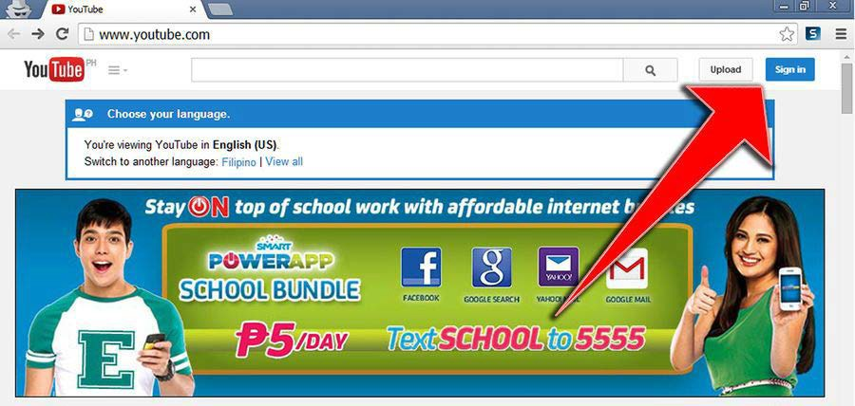

Slide 11
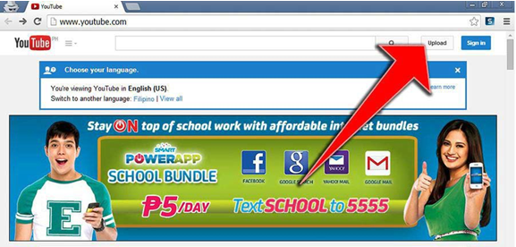
2. Once that’s done, click “Upload” at the top right corner to begin uploading your video.

Slide 12
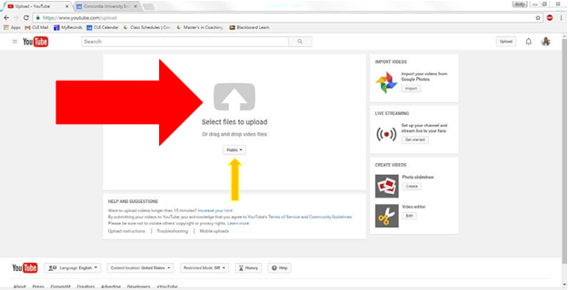
3. Select the file you wish to upload by clicking on the center of the white arrow. Or, you can drag and drop video files into the center area. Be sure to leave the drop down menu as “Public” so you can share your video with others.

Slide 13
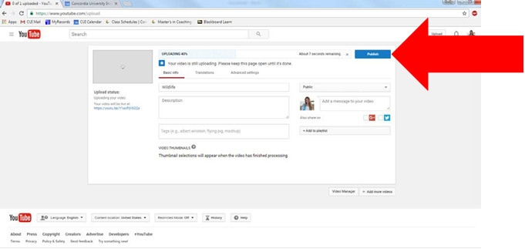
4. Once you have selected your file, it will begin to upload. This may take a few minutes so be sure to not exit out of the screen. Once it is finished, click “Publish” and YouTube will generate a URL for your video within 36 hours. This will be the URL you can send to others in order for them to view your video

Slide 14
Questions?
Contact Emily Lathrop at Emily.lathrop@cui.edu or 949-214-3266

Slide 15
Copy URL
Paste URL Link in the last Power Point slide of
your presentation!

Slide 16
Submit Assignment in Canvas

