Slide 1
PHAR 150G
Biochemistry
Glycolysis
Vicky Mody, PhD
vickymo@pcom.edu

Slide 2
Objectives
Steps Involve in glycolysis
Difference between aerobic vs anaerobic respiration.
Regulation of Glycolysis

Slide 3
Glycolysis
Must Know
The Glycolytic pathway describes the oxidation of glucose to pyruvate with the generation of ATP and NADH
It is also called as the Embden-Meyerhof Pathway
Glycolysis is a universal pathway; present in all organisms: from yeast to mammals.
In eukaryotes, glycolysis takes place in the cytosol

Slide 4
Glycolysis
The process of glycolysis does not require oxygen but in the presence of O₂, pyruvate is further oxidized to CO₂.
In the absence of O₂, pyruvate can be fermented to lactate or ethanol.
Net Reaction:
Glucose (C₆H₁₂O₆) + 2NAD+ + 2 Pi + 2 ADP = 2 pyruvate + 2 ATP + 2 NADH + 2 H₂O

Slide 5
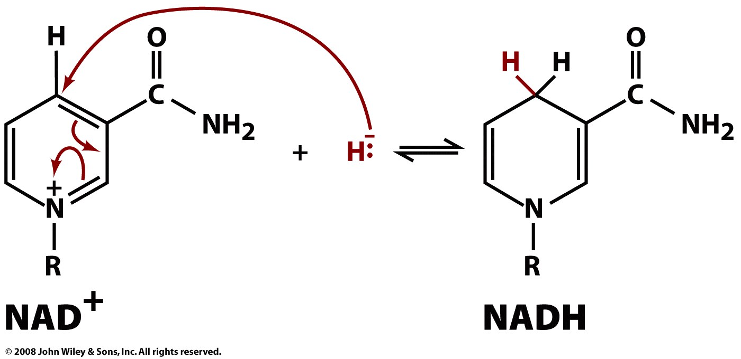
Must Know what is Niacin and its importance in making NAD+/NADH
Notes:
5

Slide 6
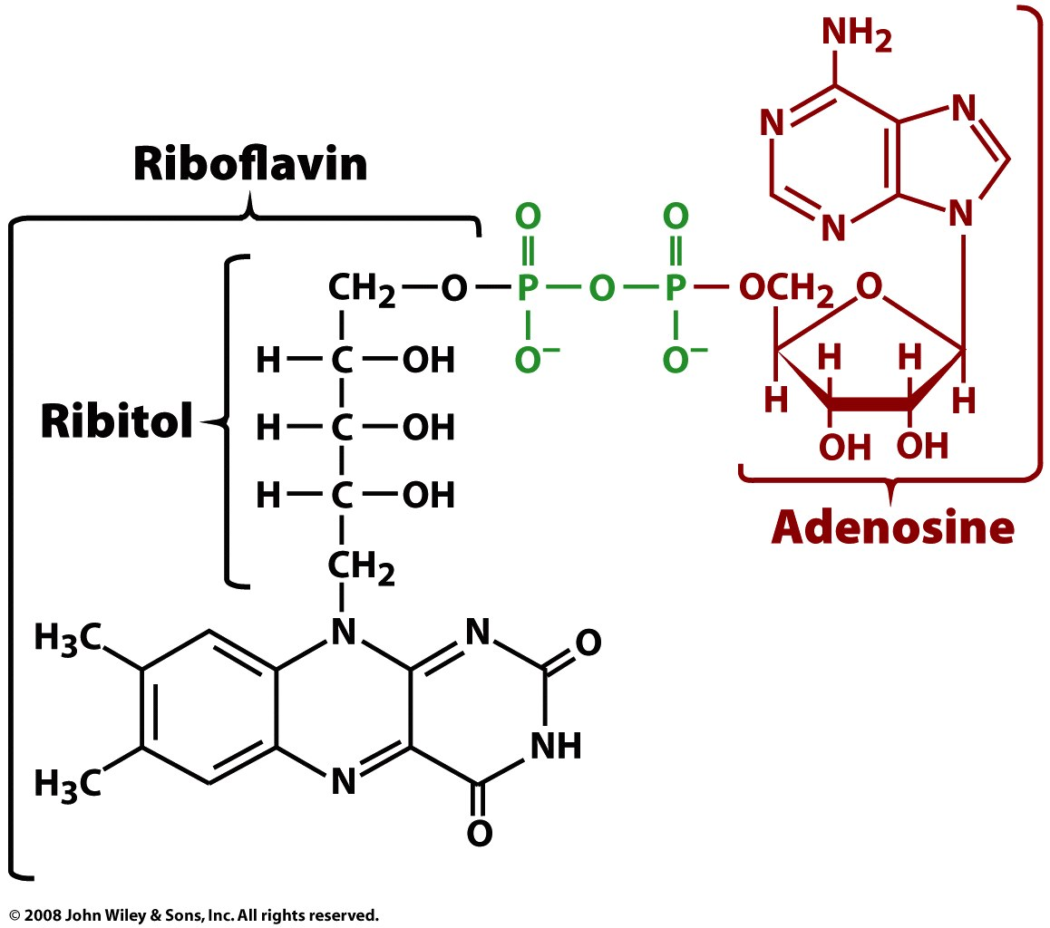
Must Know what is Riboflavin and its importance in making FAD/FADH2
Figure 14-12
Notes:
6

Slide 7
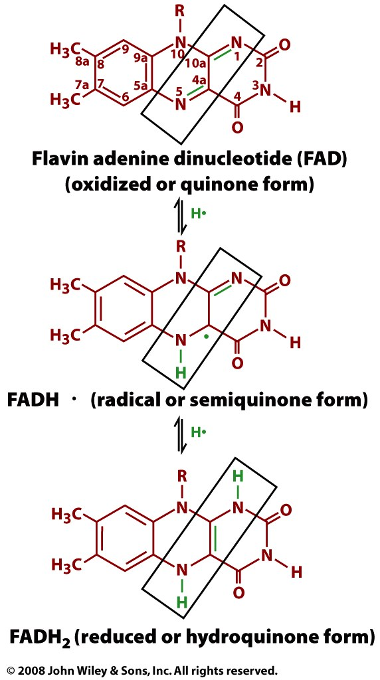
Figure 14-13
Notes:
7

Slide 8
The 3 stages of Glycolysis
Stage 1 is the investment stage. 2 mols of ATP are consumed for each mol of glucose
Glucose is converted to fructose-1,6-bisphosphate.
Glucose is trapped inside the cell and at the same time converted to an unstable form that can be readily cleaved into 3-carbon units.

Slide 9
The 3 stages of Glycolysis
In stage 2 fructose-1,6-bisphosphate is cleaved into two 3-carbon units of glycerladehyde-3-phosphate.
Stage 3 is the harvesting stage. 4 mols of ATP and 2 mols of NADH are gained from each initial mol of glucose. This ATP is a result of substrate-level phosphorylation
Glyceraldehyde-3-phosphate is oxidized to pyruvate

Slide 10
Stage 1

Slide 11
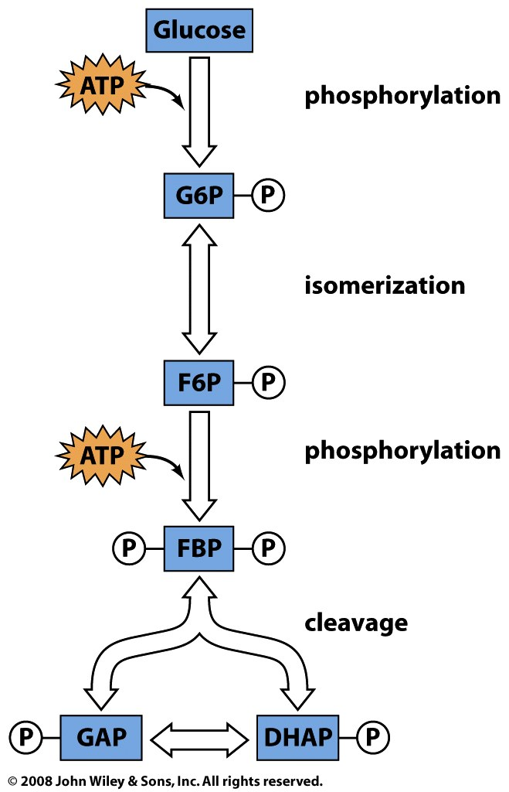
Must Know
The 1st stage

Slide 12
Must Know
The 1st stage
Stage 1 is the investment stage.
2 mols of ATP are consumed for each mol of glucose
Glucose is converted to fructose-1,6-bisphosphate.
Glucose is trapped inside the cell and at the same time converted to an unstable form that can be readily cleaved into 3-carbon units.

Slide 13
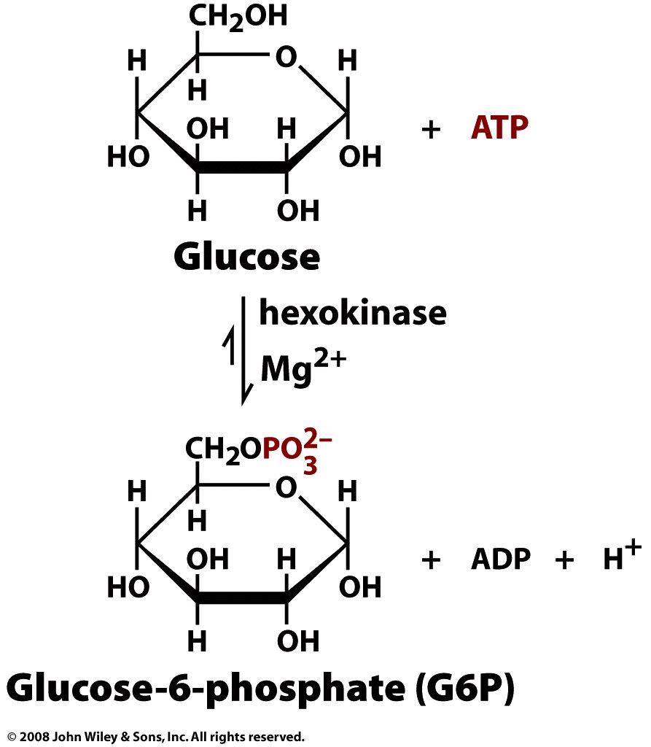
Phosphorylation of glucose to glucose-6 phosphate.
Must Know
Reaction 1: Phosphorylation of glucose to glucose-6 phosphate.
This reaction requires energy and so it is coupled to the hydrolysis of ATP to ADP and Pi.
Enzyme: hexokinase.

Slide 14
Phosphorylation of glucose to glucose-6 phosphate.
Must Know
Once glucose enters the cell, it gets phosphorylated.
This step is irreversible. So the glucose gets trapped inside the
cell. (Glucose transporters transport only free glucose, not
phosphorylated glucose)

Slide 15
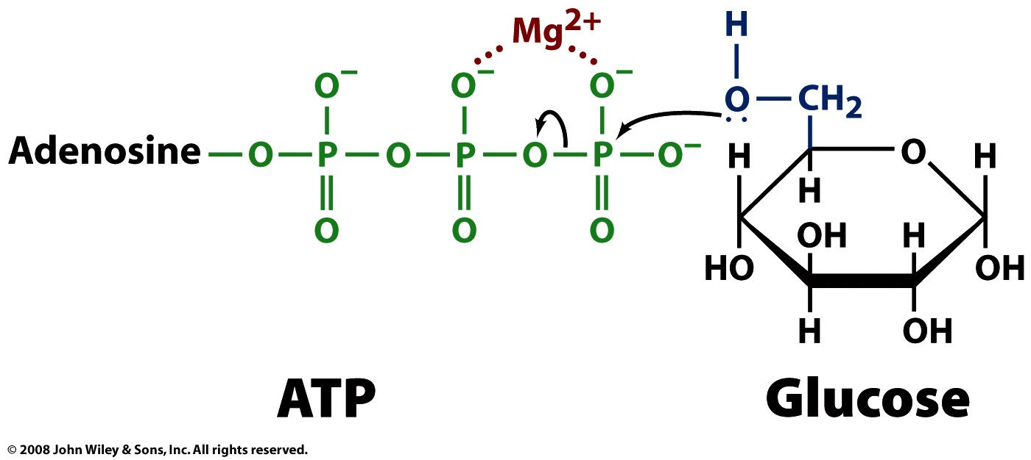
Must Know the use of Mg in Kinase reactions
The reaction involves nucleophilic attack of the C6 hydroxyl O of glucose on P of the terminal phosphate of ATP.
ATP binds to the enzyme as a complex with Mg++.
Mg++ interacts with negatively charged phosphate oxygen atoms, providing charge compensation & promoting a favorable conformation of ATP at the active site of the Hexokinase enzyme.
Notes:
The reaction catalyzed by Hexokinase is highly spontaneous.
A phosphoanhydride bond of ATP (~P) is cleaved.
The phosphate ester formed in glucose-6-phosphate has a lower ΔG of hydrolysis.
Glucose binding to Hexokinase stabilizes a conformation in which the C6 hydroxyl of the bound glucose is close to the terminal phosphate of ATP, promoting catalysis.
water is excluded from the active site. This prevents the enzyme from catalyzing ATP hydrolysis, rather than transfer of phosphate to glucose.
It is a common motif for an enzyme active site to be located at an interface between protein domains that are connected by a flexible hinge region.
The structural flexibility allows access to the active site, while permitting precise positioning of active site residues, and in some cases exclusion of water, as substrate binding promotes a particular conformation

Slide 16
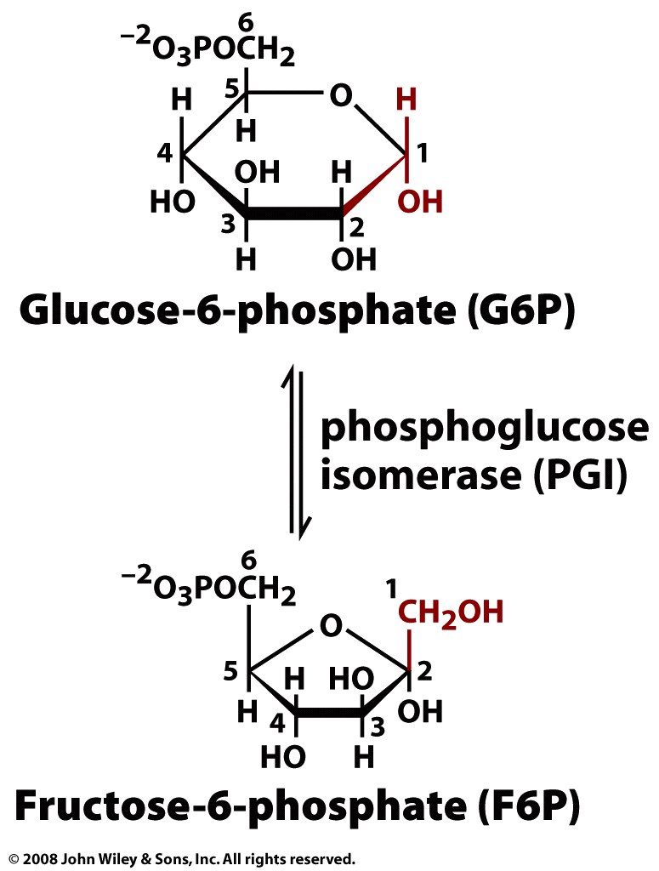
Isomerization of glucose-6-phosphate to fructose 6-phosphate.
Must Know
Reaction 2: Isomerization of glucose-6-phosphate to fructose 6-phosphate.
Enzyme: phosphoglucoisomerase.

Slide 17
Isomerization of glucose-6-phosphate to fructose 6-phosphate.
This is a reversible reaction.
The fructose-6-phosphate is quickly consumed and the forward reaction is favored.

Slide 18
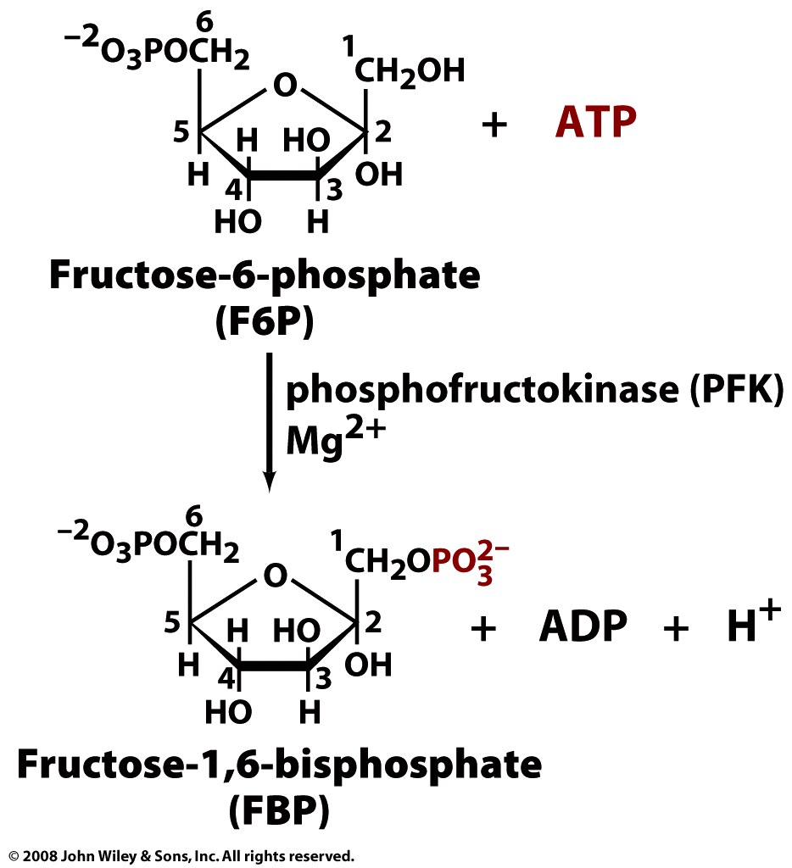
Phosphorylation of fructose-6-phosphate to fructose-1,6-biphosphate.
Must Know
Reaction 3: is another kinase reaction. Phosphorylation of the hydroxyl group on C1 forming fructose-1,6- bisphosphate.
Enzyme: phosphofructokinase. This allosteric enzyme regulates the pace of glycolysis.
Notes:
This highly spontaneous reaction has a mechanism similar to that of Hexokinase.
The Phosphofructokinase reaction is the rate-limiting step of Glycolysis.
The enzyme is highly regulated,

Slide 19
Phosphorylation of fructose-6-phosphate to fructose-1,6-biphosphate.
Reaction is coupled to the hydrolysis of an ATP to ADP and Pi.
This is the second irreversible reaction of the glycolytic pathway.
Notes:
This highly spontaneous reaction has a mechanism similar to that of Hexokinase.
The Phosphofructokinase reaction is the rate-limiting step of Glycolysis.
The enzyme is highly regulated,

Slide 20
Stage 2

Slide 21
Must Know
The 2nd Stage

Slide 22
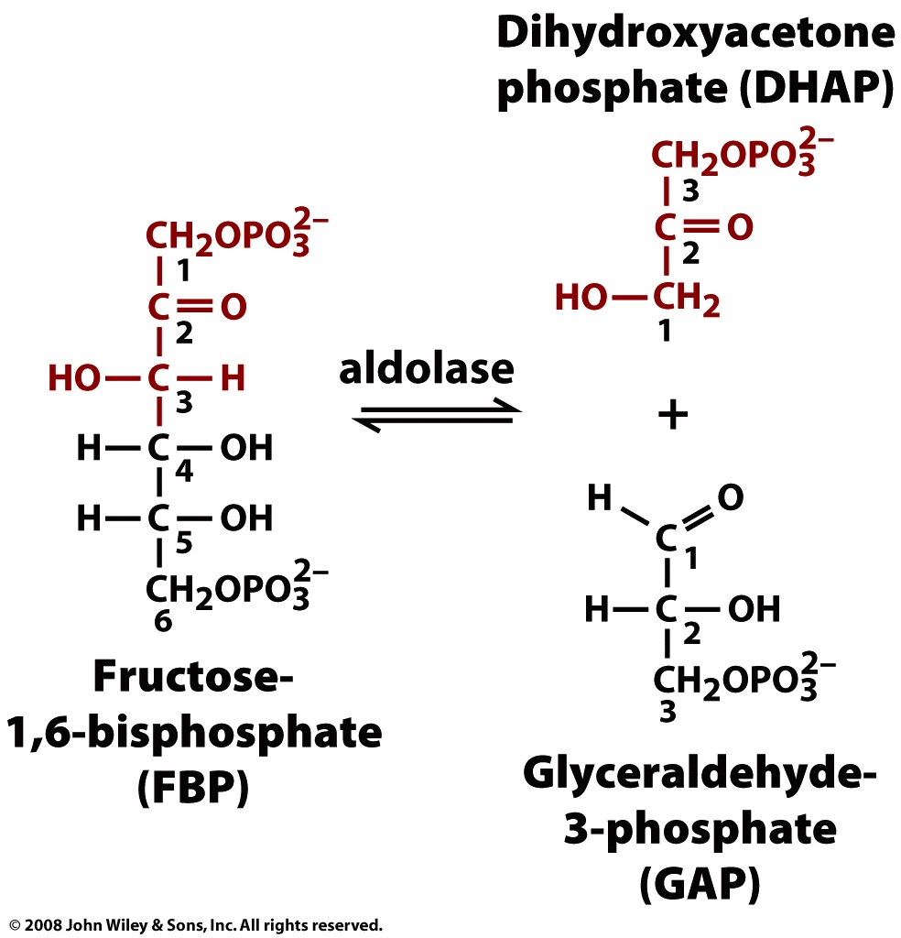
Splitting of fructose-6-phosphate to fructose-1,6-biphosphate.
Must Know
Reaction 4: fructose-1,6-bisphosphate is split into two 3-carbon molecules, one aldehyde and one ketone: dihyroxyacetone phosphate (DHAP) and glyceraldehyde 3-phosphate (GAP).
The enzyme is aldolase.

Slide 23
Splitting of fructose-6-phosphate to fructose-1,6-biphosphate.
Note that C atoms are renumbered in products of Aldolase

Slide 24
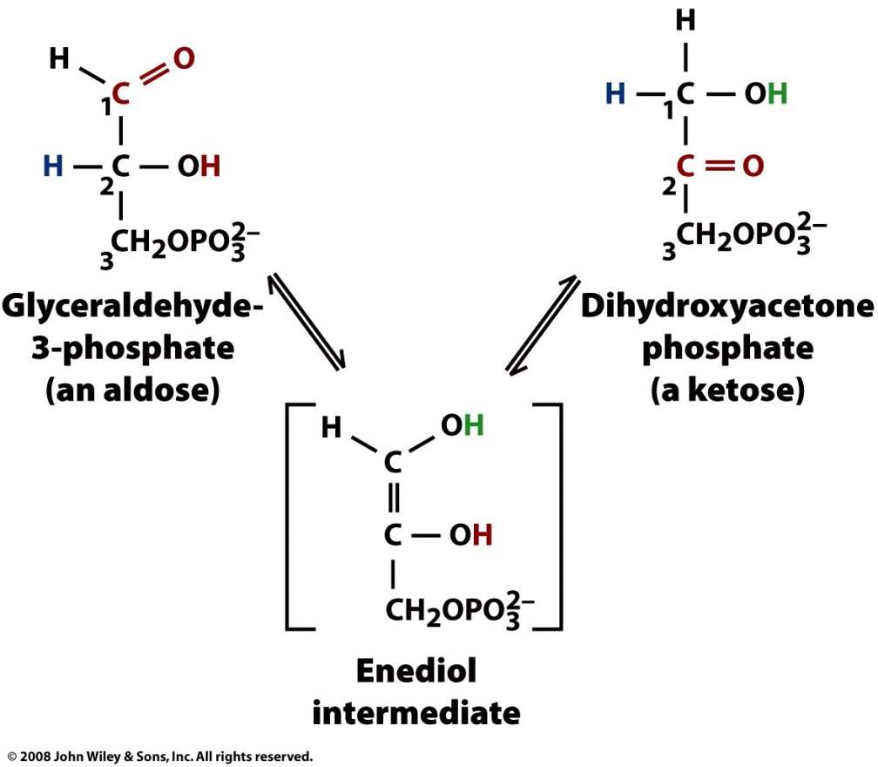
Isomerization of DHAP to GAP
Must Know
Reaction 5: DHAP and GAP are isomers of each other and can readily inter-convert by the action of the enzyme triose-phosphate isomerase.
GAP is a substrate for the next step in glycolysis so all of the DHAP is eventually depleted. So, 2 molecules of GAP are formed from each molecule of glucose.
Notes:
2-Phosphoglycolate is a transition state analog that binds tightly at the active site of Triose Phosphate Isomerase (TIM).
This inhibitor of catalysis by TIM is similar in structure to the proposed enediolate intermediate.
TIM is judged a "perfect enzyme." Reaction rate is limited only by the rate that substrate collides with the enzyme.
Triosephosphate Isomerase structure is an αβ barrel, or TIM barrel.
In an αβ barrel there are 8 parallel β-strands surrounded by 8 α-helices.
Short loops connect alternating β-strands & α-helices.
TIM barrels serve as scaffolds for active site residues in a diverse array of enzymes.
Residues of the active site are always at the same end of the barrel, on C-terminal ends of β-strands & loops connecting these to α-helices.
There is debate whether the many different enzymes with TIM barrel structures are evolutionarily related.
In spite of the structural similarities there is tremendous diversity in catalytic functions of these enzymes and little sequence homology.
Explore the structure of the Triosephosphate Isomerase (TIM) homodimer, with the transition state inhibitor 2-phosphoglycolate bound to one of the TIM monomers.
Note the structure of the TIM barrel, and the loop that forms a lid that closes over the active site after binding of the substrate.

Slide 25
Isomerization of DHAP to GAP
Glycolysis continues from glyceraldehyde-3-P. Removal of glyceraldehyde-3-P by a subsequent spontaneous reaction allows throughput
The ketose/aldose conversion involves acid/base catalysis, and is thought to proceed via an enediol intermediate, as with Phosphoglucose Isomerase.
Notes:
2-Phosphoglycolate is a transition state analog that binds tightly at the active site of Triose Phosphate Isomerase (TIM).
This inhibitor of catalysis by TIM is similar in structure to the proposed enediolate intermediate.
TIM is judged a "perfect enzyme." Reaction rate is limited only by the rate that substrate collides with the enzyme.
Triosephosphate Isomerase structure is an αβ barrel, or TIM barrel.
In an αβ barrel there are 8 parallel β-strands surrounded by 8 α-helices.
Short loops connect alternating β-strands & α-helices.
TIM barrels serve as scaffolds for active site residues in a diverse array of enzymes.
Residues of the active site are always at the same end of the barrel, on C-terminal ends of β-strands & loops connecting these to α-helices.
There is debate whether the many different enzymes with TIM barrel structures are evolutionarily related.
In spite of the structural similarities there is tremendous diversity in catalytic functions of these enzymes and little sequence homology.
Explore the structure of the Triosephosphate Isomerase (TIM) homodimer, with the transition state inhibitor 2-phosphoglycolate bound to one of the TIM monomers.
Note the structure of the TIM barrel, and the loop that forms a lid that closes over the active site after binding of the substrate.

Slide 26
Must Know
Upto this step, 2 molecules of ATP were required for each molecule of glucose being oxidized
The remaining steps release enough energy to shift the balance sheet to the positive side. This part of the glycolytic pathway is called as the payoff or harvest stage.

Slide 27
Must Know
Since there are 2 GAP molecules generated from each glucose, each of the remaining reactions occur twice for each glucose molecule being oxidized.

Slide 28
Stage 3

Slide 29
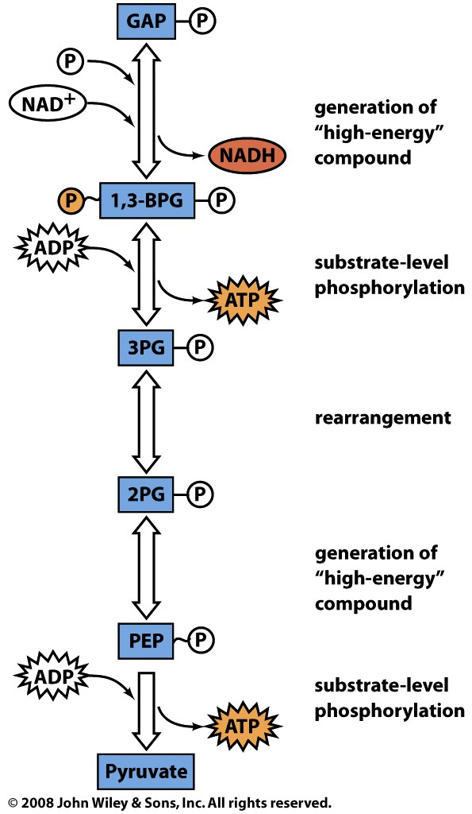
Must Know

Slide 30
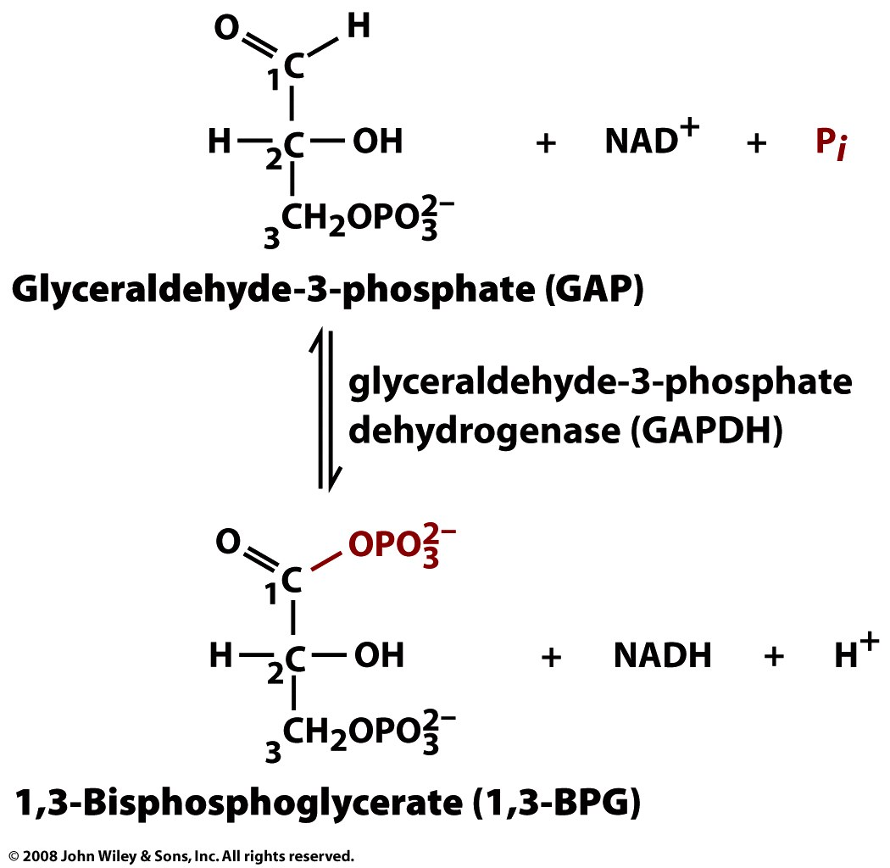
Oxidation of GAP to 1,3-BPG
Must Know
Reaction 6: GAP is dehydrogenated by the enzyme glyceraldehyde 3-phosphate dehydrogenase (GAPDH).
This is the only process in glycolysis in which, NAD+ is reduced to NADH + H+ from NAD.
Notes:
A cysteine thiol at the active site of Glyceraldehyde-3-phosphate Dehydrogenase has a role in catalysis.
The aldehyde of glyceraldehyde-3-phosphate reacts with the cysteine thiol to form a thiohemiacetal intermediate

Slide 31
Oxidation of GAP to 1,3-BPG
Oxidation is coupled to the phosphorylation of the C1 carbon. The product is 1,3-bisphosphoglycerate.
Exergonic oxidation of the aldehyde in glyceraldehyde- 3-phosphate, to a carboxylic acid, drives formation of an acyl phosphate, a "high energy" bond (~P).
Notes:
A cysteine thiol at the active site of Glyceraldehyde-3-phosphate Dehydrogenase has a role in catalysis.
The aldehyde of glyceraldehyde-3-phosphate reacts with the cysteine thiol to form a thiohemiacetal intermediate

Slide 32
Oxidation of GAP to 1,3-BPG
Oxidation to a carboxylic acid (in a ~ thioester) occurs, as NAD+ is reduced to NADH.
The “high energy” acyl thioester is attacked by Pi to yield the acyl phosphate (~P) product.
http://rpi.edu/dept/bcbp/molbiochem/MBWeb/mb1/part2/glycolysis.htm

Slide 33
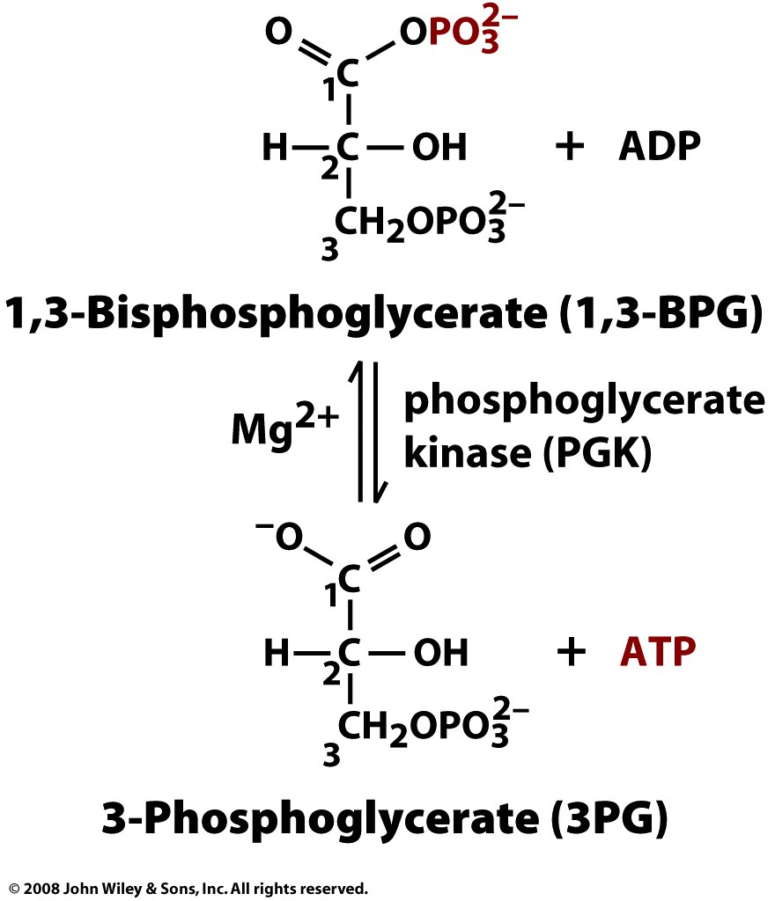
Must Know
Hydrolysis of 1,3-BPG to 3PG
Reaction 7: BPG has a mixed anhydride, a high energy bond, at C1. This high energy bond is hydrolyzed to a carboxylic acid and the energy released is used to generate ATP from ADP. Product: 3-phosphoglycerate (3PG).
Enzyme: phosphoglycerate kinase.

Slide 34
Hydrolysis of 1,3-BPG to 3PG
This phosphate transfer is reversible, since one ~P bond is cleaved & another synthesized.
The enzyme undergoes substrate-induced conformational change similar to that of Hexokinase.

Slide 35
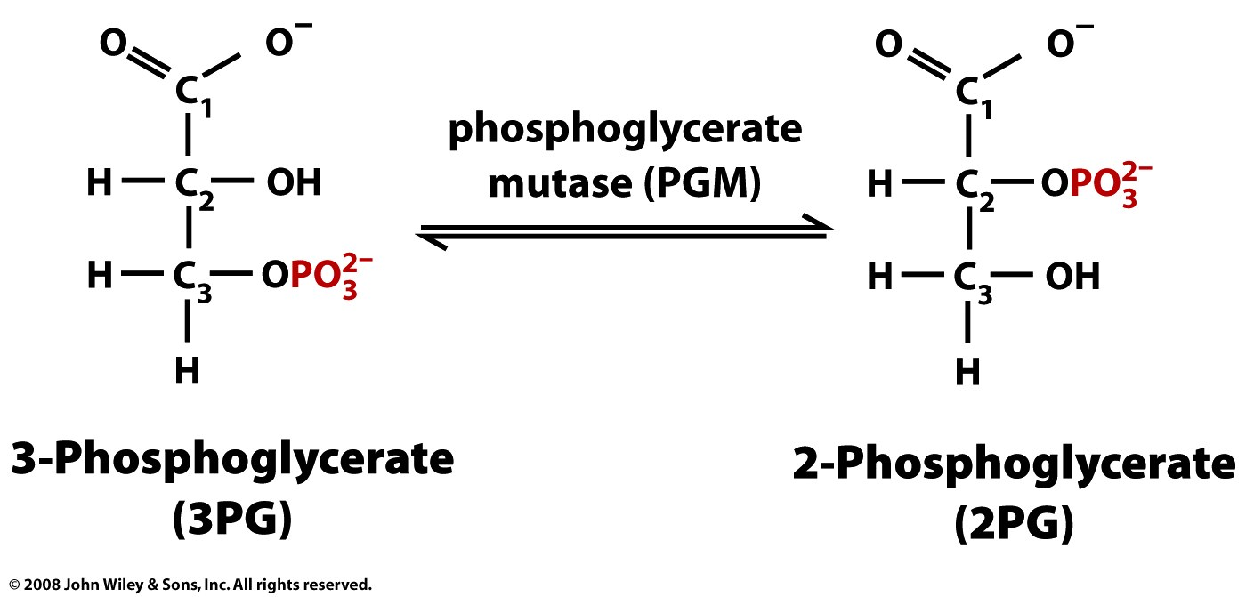
Isomerization of 3PG to 2PG
Must Know
Reaction 8: The phosphate shifts from C3 to C2 to form 2- phosphoglycerate.
Enzyme:phosphoglycerate mutase.

Slide 36
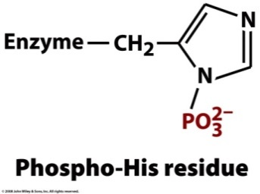
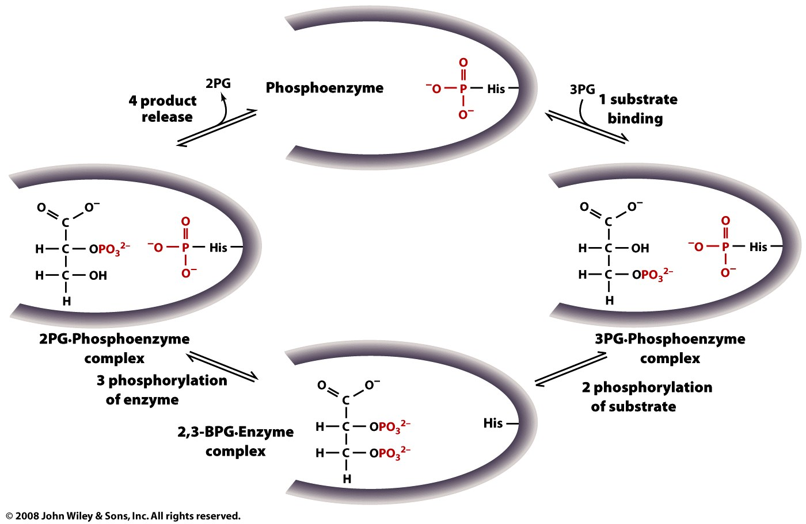
An active site histidine side-chain participates in Pi transfer, by donating & accepting phosphate. The process involves a 2,3-bisphosphate intermediate
Page 500
Notes:
36

Slide 37
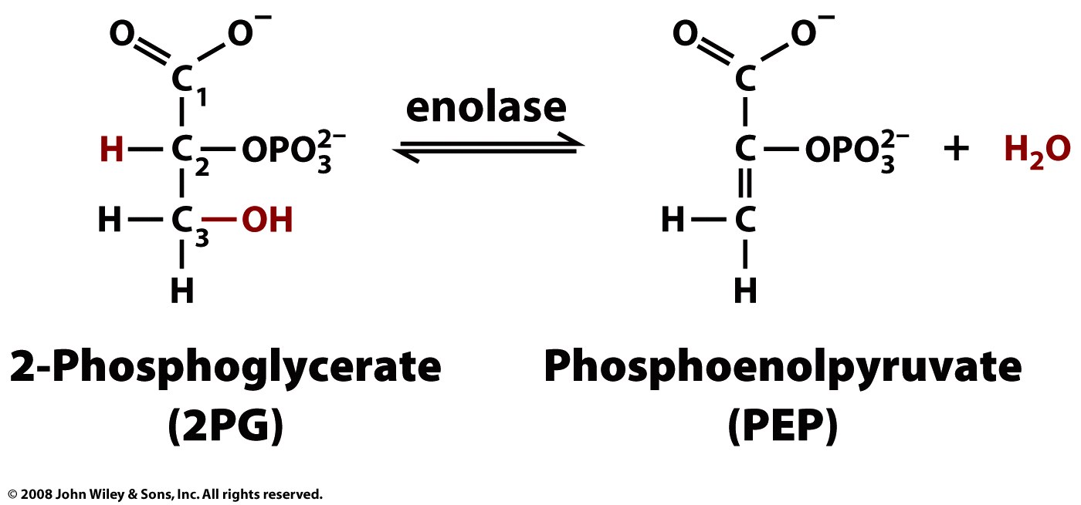
Dehydration of 2PG to PEP
Must Know
Reaction 9: Dehydration catalyzed by enolase (a lyase). A water molecule is removed to form phosphoenolpyruvate which has a double bond between C2 and C3.
This dehydration reaction is Mg++-dependent.

Slide 38
Dehydration of 2PG to PEP
2 Mg++ ions interact with oxygen atoms of the substrate carboxyl group at the active site.
The Mg++ ions help to stabilize the enolate anion intermediate that forms when a Lys extracts H+ from C #2.

Slide 39
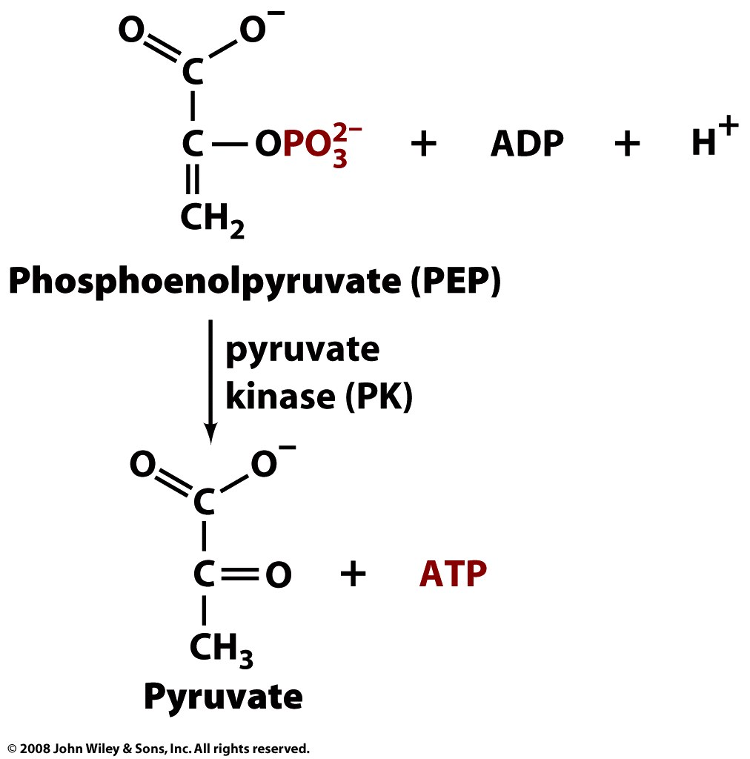
Conversion of PEP to Pyruvate
Must Know
Reaction 10: Enolphosphate is a high energy bond. It is hydrolyzed to form the enolic form of pyruvate with the synthesis of ATP. The irreversible reaction is catalyzed by the enzyme pyruvate kinase. Enol pyruvate quickly changes to keto pyruvate which is far more stable.

Slide 40
Conversion of PEP to Pyruvate
This phosphate transfer from PEP to ADP is spontaneous.
Removal of Pi from PEP yields an unstable enol, which spontaneously converts to the keto form of pyruvate.
Required inorganic cations K+ and Mg++ bind to anionic residues at the active site of Pyruvate Kinase

Slide 41
Must Know
Since there are 2 GAP molecules generated from each glucose, each of the reactions occur twice for each glucose molecule being oxidized.
Since oxidation of 1 GAP molecule leads to 2 molecules of ATP, overall 4 molecules of ATP are formed in the reaction in second half. Whereas, two molecules of ATP are consumed in the first half.

Slide 42
Must Know
Glycolysis: Energy balance sheet
Hexokinase: - 1 ATP
Phosphofructokinase: -1 ATP
GAPDH: +2 NADH
Phsophoglycerate kinase: +2 ATP
Pyruvate kinase: +2 ATP
Total/ molecule of glucose: +2 ATP, +2 NADH

Slide 43
Fate of Glycolysis

Slide 44
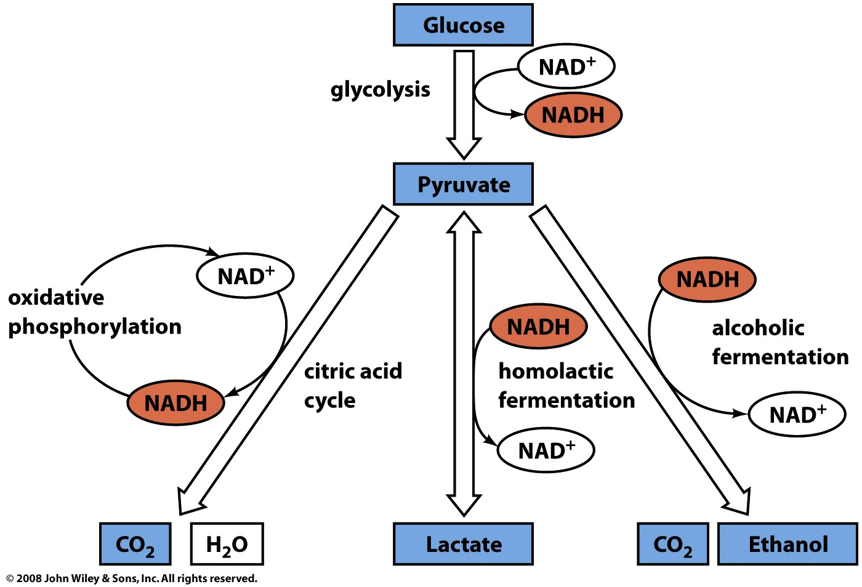
Must Know VERY IMPORTANT
Aerobic
Anaerobic

Slide 45
Must Know
Fate of Pyruvate
NADH is formed from NAD+ during glycolysis.
The redox balance of the cell has to be maintained for further cycles of glycolysis to continue.
NAD+ can be regenerated by one of the following reactions /pathways:
In absence of Oxygen:
  Pyruvate is converted to lactate
  Pyruvate is converted to ethanol

Slide 46
Fate of Pyruvate
In the presence of O2, NAD+ is regenerated and Pyruvate is converted to acetyl CoA which enters TCA cycle and gets completely oxidized to CO₂.

Slide 47
Lactate Fermentation

Slide 48
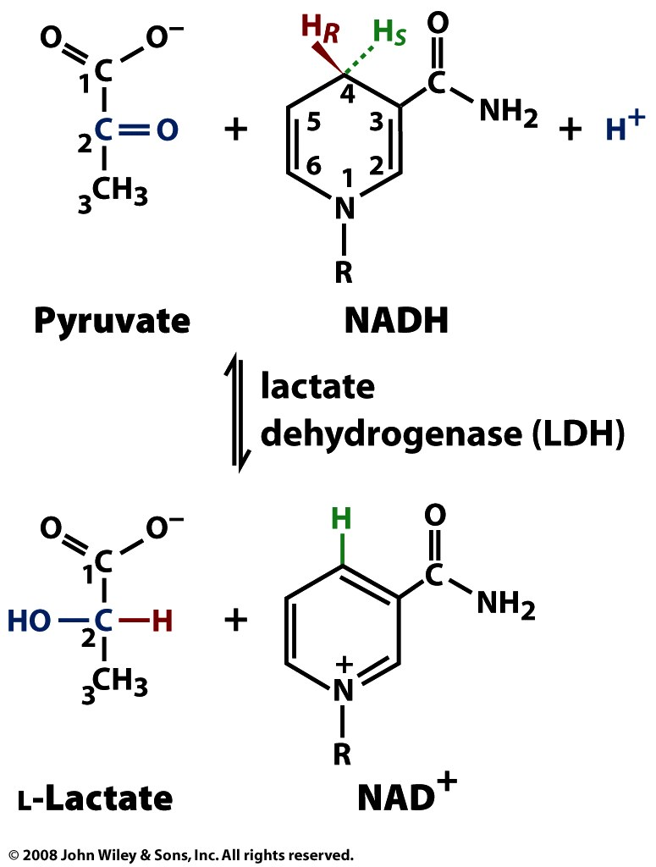
Must Know very IMPORTANT TOPIC
Lactate Fermentation
Anaerobic organisms lack a respiratory chain.
They must reoxidize NADH produced in Glycolysis through some other reaction, because NAD+ is needed for the Glyceraldehyde-3-phosphate Dehydrogenase reaction.
Usually NADH is reoxidized as pyruvate is converted to a more reduced compound.

Slide 49
Must Know very IMPORTANT TOPIC
Lactate Fermentation
The complete pathway, including Glycolysis and the reoxidation of NADH, is called fermentation.
Formation of lactate catalyzed by lactate dehydrogenase

Slide 50
Must Know very IMPORTANT TOPIC
Lactate Fermentation
In highly active muscle, there is anaerobic glycolysis because the supply of O2 cannot keep up with the demand for ATP.
Lactate builds up causing a drop in pH which inactivates glycolytic enzymes. End result is energy deprivation and cell death; the symptoms being pain and fatigue of the muscle.

Slide 51
Must Know very IMPORTANT TOPIC
Lactate Fermentation
Lactate is transported to the liver where it can be reconverted to pyruvate by the LDH reverse reaction
But are there any uses of anereboic respiration

Slide 52
Ethanol Fermentation

Slide 53
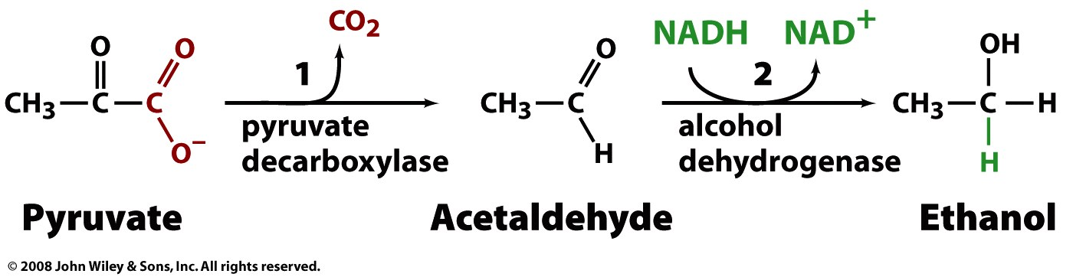
Must Know very IMPORTANT TOPIC
Ethanol Fermentation
Some anaerobic organisms metabolize pyruvate to ethanol, which is excreted as a waste product.
NADH is converted to NAD+ in the reaction catalyzed by Alcohol Dehydrogenase.
Pyruvate decarboxylase catalyzes the first irreversible reaction to form acetaldehyde:
Acetaldehyde is reduced by alcohol dehydogenase is a reversible reaction: Ethanol fermentation is used during wine-making

Slide 54
Regulation of Glycolysis

Slide 55
Regulation of Hexokinase

Slide 56
Regulation of Hexokinase
Must Know
Hexokinase catalyzed phosphorylation of glucose is the first irreversible step of glycolysis
Regulated only by excess glucose-6-phosphate. If G6P accumulates in the cell, there is feedback inhibition of hexokinase till the G6P is consumed.
Notes:
Flux through the Glycolysis pathway is regulated by control of 3 enzymes that catalyze spontaneous reactions:
Hexokinase, Phosphofructokinase & Pyruvate Kinase.
Local control of metabolism involves regulatory effects of varied concentrations of pathway substrates or intermediates, to benefit the cell.
Global control is for the benefit of the whole organism, & often involves hormone-activated signal cascades.
Liver cells have major roles in metabolism, including maintaining blood levels various of nutrients such as glucose. Thus global control especially involves liver.
Some aspects of global control by hormone-activated signal cascades will be discussed later.
Hexokinase is inhibited by product glucose-6-phosphate:
by competition at the active site
by allosteric interaction at a separate enzyme site.
Cells trap glucose by phosphorylating it, preventing exit on glucose carriers.
Product inhibition of Hexokinase ensures that cells will not continue to accumulate glucose from the blood, if [glucose-6-phosphate] within the cell is ample.
Glucokinase is a variant of Hexokinase found in liver.
Glucokinase has a high K_{M} for glucose.
It is active only at high [glucose].
One effect of insulin, a hormone produced when blood glucose is high, is activation in liver of transcription of the gene that encodes the Glucokinase enzyme.
Glucokinase is not subject to product inhibition by glucose-6-phosphate. Liver will take up & phosphorylate glucose even when liver [glucose-6-phosphate] is high.
Glucokinase is subject to inhibition by glucokinase regulatory protein (GKRP).
The ratio of Glucokinase to GKRP in liver changes in different metabolic states, providing a mechanism for modulating glucose phosphorylation.
Glucokinase, with high K_{M} for glucose, allows liver to store glucose as glycogen in the fed state when blood [glucose] is high
Glucose-6-phosphatase catalyzes hydrolytic release of P_{i} from glucose-6-P. Thus glucose is released from the liver to the blood as needed to maintain blood [glucose].
The enzymes Glucokinase & Glucose-6-phosphatase, both found in liver but not in most other body cells, allow the liver to control blood [glucose].

Slide 57
Regulation of Hexokinase
Must Know
Glucose-6-phosphate is required for other pathways including the pentose phosphate shunt and glycogen synthesis. So hexokinase step is not inhibited unless G-6-P accumulates.
Actually, liver, the site of glycogen synthesis, has a homologous enzyme called glucokinase. This has a high affinity for glucose. This allows brain and muscle to utilize glucose prior to its storage as glycogen
Notes:
Flux through the Glycolysis pathway is regulated by control of 3 enzymes that catalyze spontaneous reactions:
Hexokinase, Phosphofructokinase & Pyruvate Kinase.
Local control of metabolism involves regulatory effects of varied concentrations of pathway substrates or intermediates, to benefit the cell.
Global control is for the benefit of the whole organism, & often involves hormone-activated signal cascades.
Liver cells have major roles in metabolism, including maintaining blood levels various of nutrients such as glucose. Thus global control especially involves liver.
Some aspects of global control by hormone-activated signal cascades will be discussed later.
Hexokinase is inhibited by product glucose-6-phosphate:
by competition at the active site
by allosteric interaction at a separate enzyme site.
Cells trap glucose by phosphorylating it, preventing exit on glucose carriers.
Product inhibition of Hexokinase ensures that cells will not continue to accumulate glucose from the blood, if [glucose-6-phosphate] within the cell is ample.
Glucokinase is a variant of Hexokinase found in liver.
Glucokinase has a high K_{M} for glucose.
It is active only at high [glucose].
One effect of insulin, a hormone produced when blood glucose is high, is activation in liver of transcription of the gene that encodes the Glucokinase enzyme.
Glucokinase is not subject to product inhibition by glucose-6-phosphate. Liver will take up & phosphorylate glucose even when liver [glucose-6-phosphate] is high.
Glucokinase is subject to inhibition by glucokinase regulatory protein (GKRP).
The ratio of Glucokinase to GKRP in liver changes in different metabolic states, providing a mechanism for modulating glucose phosphorylation.
Glucokinase, with high K_{M} for glucose, allows liver to store glucose as glycogen in the fed state when blood [glucose] is high
Glucose-6-phosphatase catalyzes hydrolytic release of P_{i} from glucose-6-P. Thus glucose is released from the liver to the blood as needed to maintain blood [glucose].
The enzymes Glucokinase & Glucose-6-phosphatase, both found in liver but not in most other body cells, allow the liver to control blood [glucose].

Slide 58
Regulation of Phosphofructokinase

Slide 59
Regulation of Phosphofructokinase
Must Know
The phosphofructokinase step is rate-limiting step of glycolysis and is allosterically inhibited by high levels of ATP.
Thus high AMP/ADP levels (Low ATP levels) are activators of this enzyme, while high ATP levels are inhibitory (energy charge).
Notes:
Phosphofructokinase is usually the rate-limiting step of the Glycolysis pathway.
Phosphofructokinase is allosterically inhibited by ATP.
At low concentration, the substrate ATP binds only at the active site.
At high concentration, ATP binds also at a low-affinity regulatory site, promoting the tense conformation.
Formation of Fructose-2,6-bisphosphate
• Concentration of F-2,6-BP is regulated by the action of
phosphofructokinase 2 (PFK2) and fructose bisphosphatase 2
(FBPase2).
• Both enzymes are distinct domains of the same polypeptide
• When glucose levels are low, glucagon levels are high (insulin
and glucagon have opposing functions). PKA is activated, which
in turn inactivates PFK2 by phosphorylation. At the same time
FBPase2 is activated. F-2,6-BP is converted to F-6-P which
enters gluconeogensis for synthesis of glucose. In the absence of
F-2,6-BP, PFK is not activated and glycolysis pauses
• When glucose levels are high, glucagon levels are low. PKA is
inactive but a phosphatase dephosphorylates PFK2 and activates
it. PFK2 converts F-6-P to F-2,6-BP which is a allosteric
activator of PFK, the glycolytic enzyme.

Slide 60
Regulation of Pyruvate kinase

Slide 61
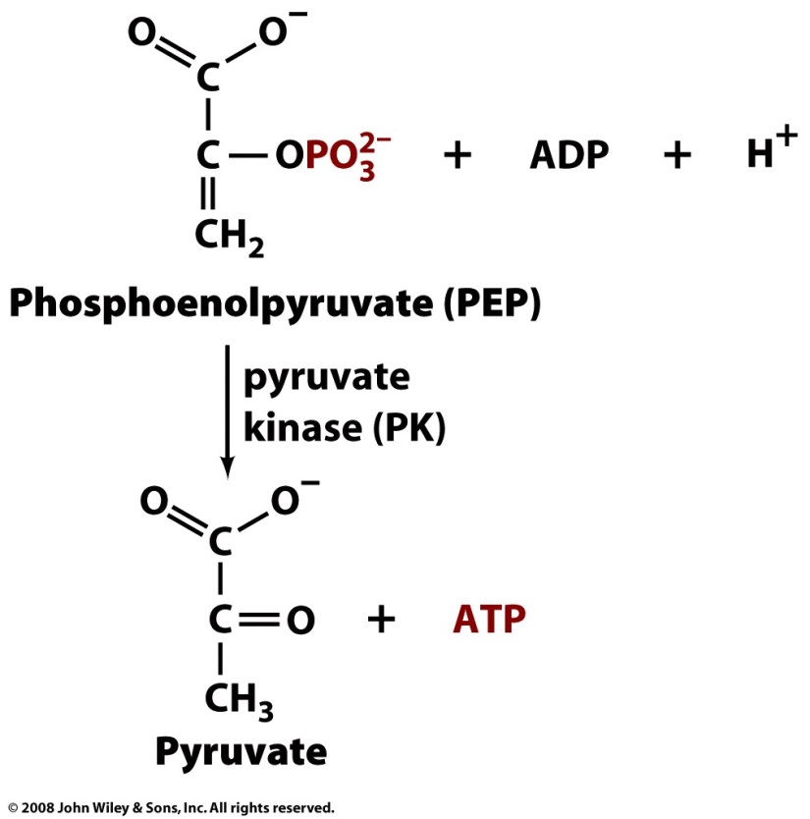
Regulation of Pyruvate kinase
Must Know very IMPORTANT for lot of process in the body
If glycolysis gets past the phosphofructokinase step, then regulation is at the pyruvate kinase step.
Pyruvate kinase activity is inhibited under low glucose conditions by covalent phosphorylation
If fructose 1,6 bisphosphate is formed, it acts a allosteric feedforward activator and drives the pyruvate kinase reaction forward.
Notes:
Pyruvate Kinase, the last step Glycolysis, is controlled in liver partly by modulation of the amount of enzyme.
High [glucose] within liver cells causes a transcription factor carbohydrate responsive element binding protein (ChREBP) to be transferred into the nucleus, where it activates transcription of the gene for Pyruvate Kinase.
This facilitates converting excess glucose to pyruvate, which is metabolized to acetyl-CoA, the main precursor for synthesis of fatty acids, for long term energy storage.
The tense conformation of PFK, at high [ATP], has lower affinity for the other substrate, fructose-6-P. Sigmoidal dependence of reaction rate on [fructose-6-P] is seen.
AMP, present at significant levels only when there is extensive ATP hydrolysis, antagonizes effects of high ATP.

Slide 62

Regulation of Pyruvate kinase
Must Know very IMPORTANT for lot of process in the body
Other positive effectors are AMP and ADP while ATP is a negative effector.
Alanine, an aminoacid derived from pyruvate, is a negative effector of catabolism. Alanine levels signal the anabolic state of a cell. High alanine levels indicate that the cell has enough starting material for anabolic reactions and so catabolism (which provides the ingredients for anabolism) can be paused.
Notes:
Pyruvate Kinase, the last step Glycolysis, is controlled in liver partly by modulation of the amount of enzyme.
High [glucose] within liver cells causes a transcription factor carbohydrate responsive element binding protein (ChREBP) to be transferred into the nucleus, where it activates transcription of the gene for Pyruvate Kinase.
This facilitates converting excess glucose to pyruvate, which is metabolized to acetyl-CoA, the main precursor for synthesis of fatty acids, for long term energy storage.
The tense conformation of PFK, at high [ATP], has lower affinity for the other substrate, fructose-6-P. Sigmoidal dependence of reaction rate on [fructose-6-P] is seen.
AMP, present at significant levels only when there is extensive ATP hydrolysis, antagonizes effects of high ATP.

Slide 63
Summary
Steps Involve in glycolysis
Difference between aerobic vs anaerobic respiration.
Regulation of Glycolysis

