Slide 1

Master of Business Administration
Session 7 Lean and Quality Management
Professor Nigel Caldwell

Slide 2
Agenda
Once upon a time in mass production land
Synchronised flow
The four key elements of lean
Lean tools
What is lean?
Does lean work?
N.B. statistical process control comes later

Slide 3
“ Defects are not free, someone makes them and gets paid for the privilege”
W. Edwards Demming
Quality Guru

Slide 4
Preventing mistakes (‘waste’) is cheaper than putting mistakes right
Total cost of quality
Appraisal
Internal failure
Costs of quality
Appraisal
Prevention
Time

Slide 5
Investment in Prevention leads to a Decrease in Total Quality Costs
Increasing quality costs
Total Quality Costs
Failure costs
Appraisal costs
Prevention costs
Increasing ability to meet customer requirements

Slide 6
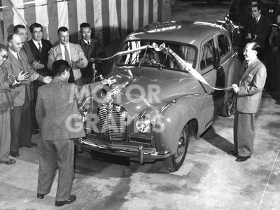
Nissan factory Yokohama Japan circa 1954 Austin A40 Somerset celebrations of the first model built in Japan from parts supplied by Longbridge, Birmingham, UK

Slide 7
Lean – born in Japan out of necessity
1945 - End of WW11
Toyota faces a daunting prospect: How to compete against Western Auto Giants entering the Japanese market?
Kiichiro Toyoda to Taiichi Ohno “Catch up with US in 3 Years”
Ohno’s challenge: How to design a production system exploiting the central weakness of mass production
Japan’s dilemmas:
  Small & fragmented market, depleted workforce, scarce natural resources, little capital
  Lean evolved as a response to this challenge over a number of decades

Slide 8
Upfront investment: Japan vs the US
Contrast between Japanese and USA’s traditional approach to NPD
Japan
% Resources
USA
Time
Concept
development
Design &
prototyping
Manufacturing
& assembly
Trials
Ramp-up
Launch

Slide 9
Involving Suppliers in New Product Development
High
Cost of design changes
Flexibility in design
Low
Time
Design Flexiblity and Cost of Design Changes

Slide 10
Traditional & concurrent NPD
From sequential to concurrent: lead time reduction
Strong influence from Japanese auto industry
  By 1990 Japan had a NPD lead-time advantage of between 12 -18 months*
Concept
generation
Product
planning
Advanced
engineering
Product
engineering
Stages
Process
engineering
Pilot run
Time
*Source: Clark and Fujimoto (1991) ‘Product Development Performance’

Slide 11
The 80s arguments against
Japanese success
They inspect everything and only send over their best built cars
They only know how to build small cars (i.e. more complex cars would be ‘too difficult for them’)
They are selling in Europe at a loss
They can only copy, never innovate
The Japanese workers had to work non stop in appalling conditions – far harder than western labour had to work
And why didn’t they have strikes!

Slide 12
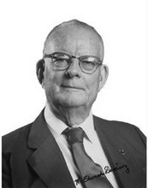
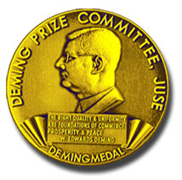
(Total) Quality Management?
Deming’s 14 points, include:
  long-term commitment to improve
  cease dependence on inspection
  stop purchasing on price alone
  aim for continuous improvement
  institute QC training
  eliminate slogans
  end Performance Measurement based solely on output
  put everyone in the company to work in the transformation

Slide 13
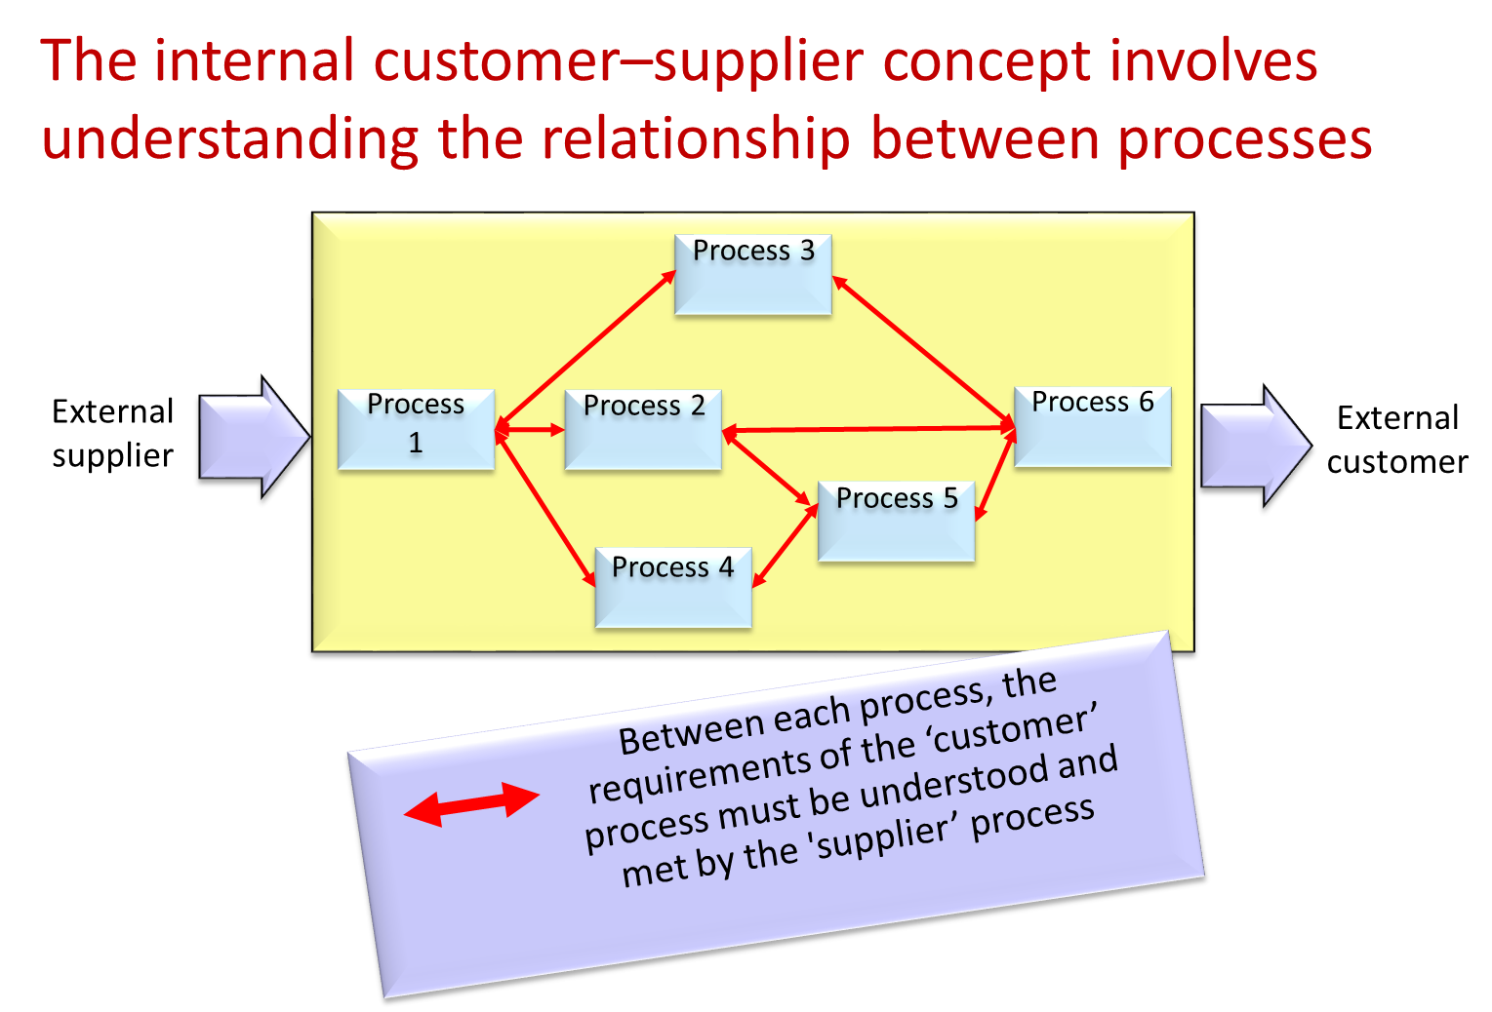



Slide 14
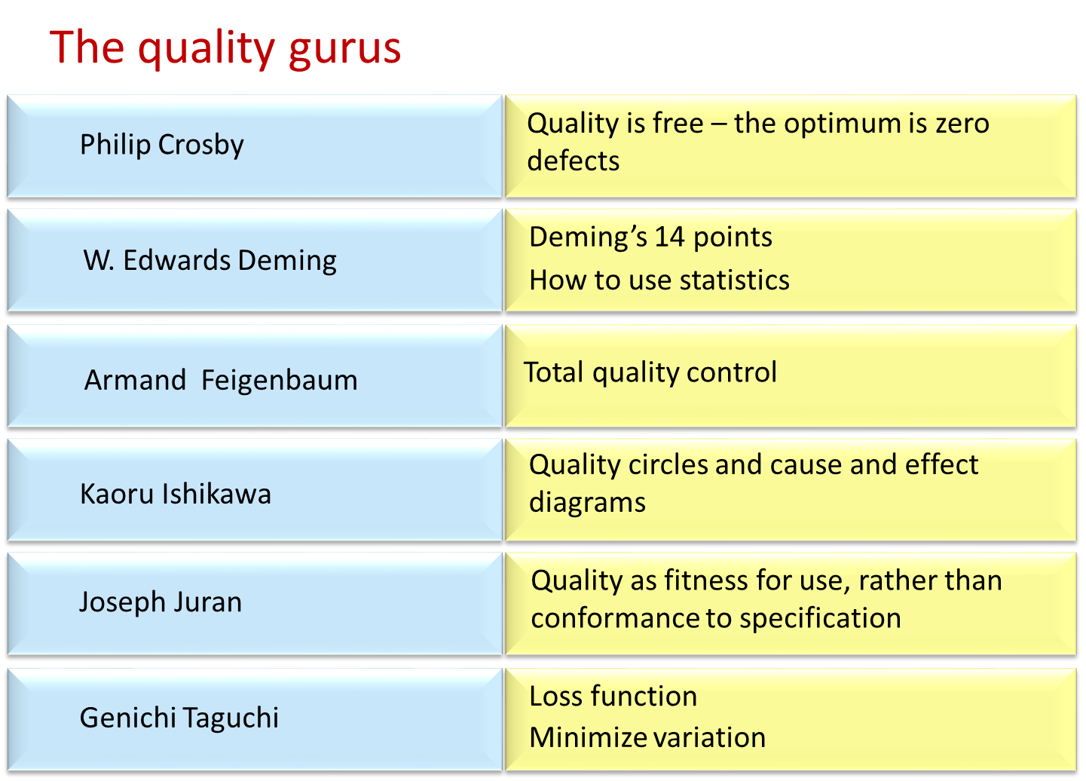


Slide 16
Feigenbaum (generally held to be the originator of the term) defines TQM as………
‘an effective system for integrating the quality development, quality maintenance and quality improvement efforts of the various groups in an organisation so as to enable production and service at the most economical levels which allow for full customer satisfaction’

Slide 17
Total Quality Management
Includes all parts of the organization
Includes all staff of the organization
Includes consideration of all costs
Includes every opportunity to get things right
Includes all the systems that affect quality
And it never stops!

Slide 18
LEAN
Synchronised Flow
Customer demand triggers
Enhanced improvement Behaviour
Waste elimination

Slide 19
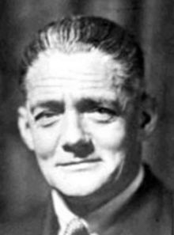
The traditional approach creates inventories…
Inventory
Who cares?
Cost
Ties up capital
Needs warehouse
Defects are hidden
Space
Quality
Decoupling
Makes stages independent
Utilization
Stages kept busy by W.I.P.
Lord Nuffield William Morris
Coordination
Avoids having to synchronise
flow

Slide 20
Traditional and synchronised flow
Traditional approach:
One way information flow
buffer inventory
buffer inventory
stage A
stage B
stage C
Lean approach:
Information/ orders
Information/orders
stage A
stage B
stage C
deliveries
deliveries

Slide 21
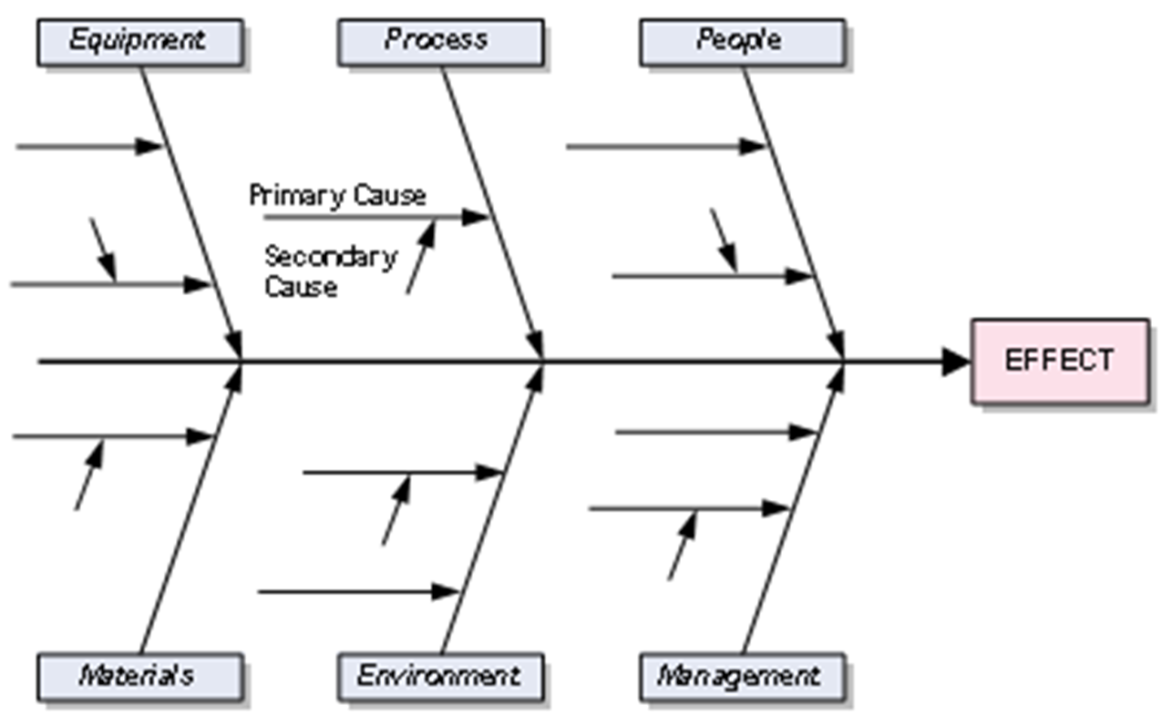
Flow at Smart
Eisenmann Paintshop
Magna Space Frame
Smart Sales
Krupp Hoesch Rear Power train
Dynamit Nobel Plastic Panels
Bosch Front Power train
Unipart Doors

Slide 22
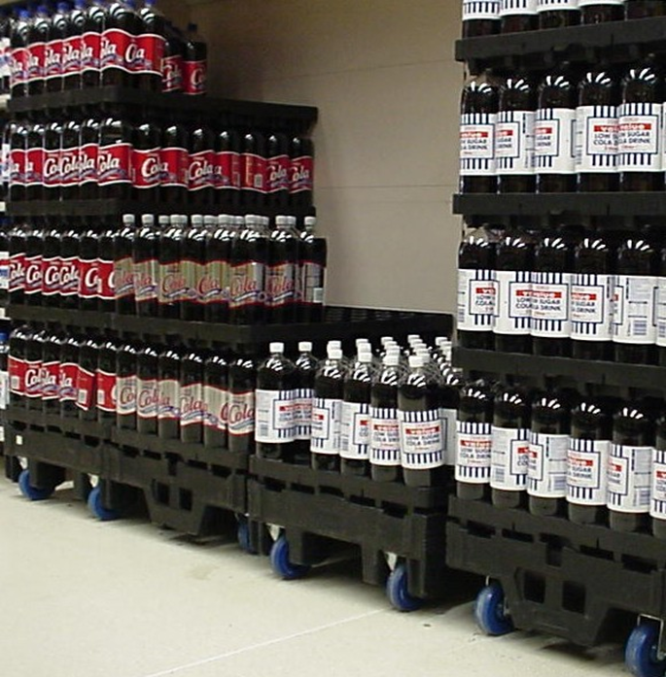
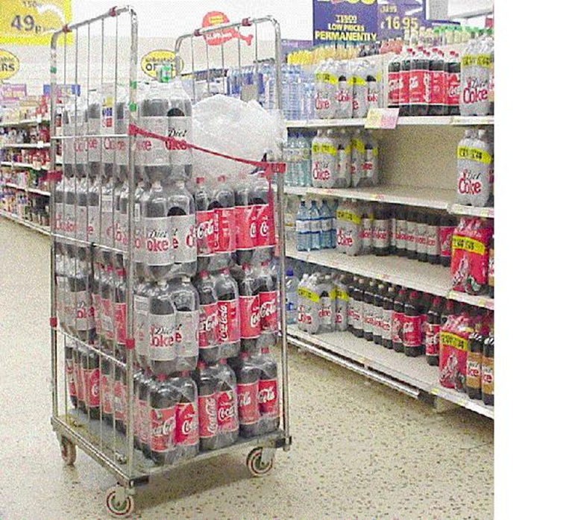
Flow at Tesco
Making product flow
Before Merchandisable units
After Merchandisable units

Slide 23
Flow Principle
A process consists of 3 steps - A , B and C.
It takes one minute to finish each step of the process. (A, B and C)
Batch Flow (units processed in batches of 10)
How much time will it take for 10 units to move through the process?
A
B
C
10 Minutes
+
10 Minutes
+
10 Minutes
= 30 Minutes

Slide 24
Flow Principle
A process consists of 3 steps - A , B and C.
It takes one minute to finish each step of the process. (A, B and C)
Continuous Flow (unit processed individually, that is, process one, move one)
How much time will it take for 10 units to move through the process?
Note – The total amount of work required to complete each batch has not changed, but the throughput time of each batch is reduced from 30 to 12 minutes
A
B
C
+
+
1 Minute
1 Minute
10 Minutes
= 12 Minutes

Slide 25
Levelled scheduling equalizes the mix of products made each day
Over an eight day period, need to make............1200 of A
400 of B
400 of C
Scheduling in large batches, where batch size A = 600, B = 200, C = 200
250 A
250 A
100 A
50 B
250 A
250 A
100 A
50 B
150 B
200 C
150 B
200 C
600 A
200 B
200 C
600
A
200 B
200 C
Every day, the schedule needs to be calculated. Each day can be different

Slide 26
Levelled scheduling equalizes the mix of products made each day
Over an eight day period, need to make............1200 of A
400 of B
400 of C
With levelled scheduling, where batch size A = 150, B = 50, C = 50
150 A
150 A
150 A
150 A
150 A
150 A
150 A
150 A
50 B
50 B
50 B
50 B
50 B
50 B
50 B
50 B
50 C
50 C
50 C
50 C
50 C
50 C
50 C
50 C
150 A
50 B
50 C
150 A
50 B
50 C
150 A
50 B
50 C
150 A
50 B
50 C
150 A
50 B
50 C
150 A
50 B
50 C
150 A
50 B
50 C
150 A
50 B
50 C
Every day is the same. Easy to notice if falling behind schedule

Slide 27
LEAN
Synchronised Flow
Customer demand triggers
Enhanced improvement Behaviour
Waste elimination

Slide 28
Lean operations
Lean approach
focus on producing only when needed
Traditional approach
focus on high capacity utilisation
fewer stoppages
lower capacity utilisation, but
more stoppages because of problems
low inventory so problems are exposed and solved
more production at each stage
high inventory means less chance of problems being exposed and solved
no surplus production goes into inventory
extra production
goes into inventory because of continuing stoppages at stages

Slide 29
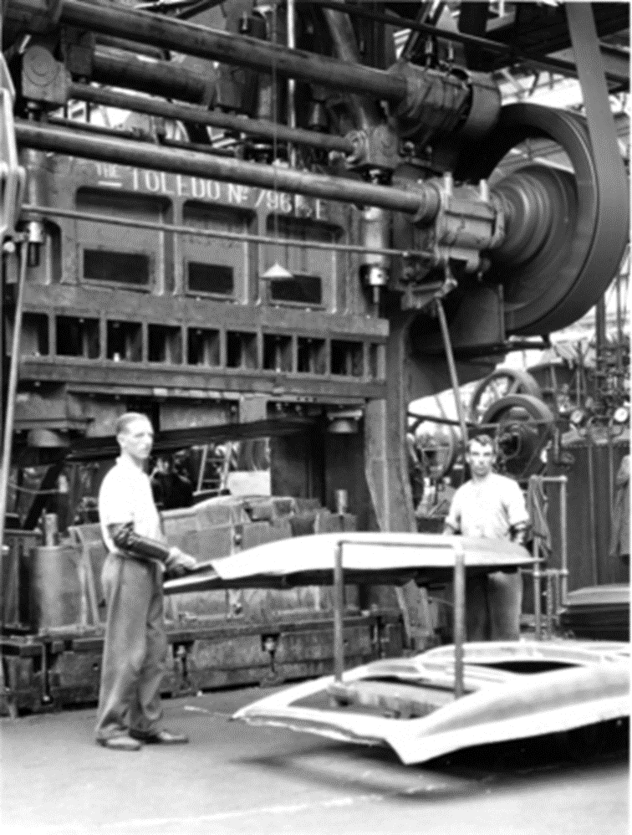
Cowley factory Pressed
Steel 1933 pressing
metal sheets to make
body panels in the
Toledo Pressing machine

Slide 30
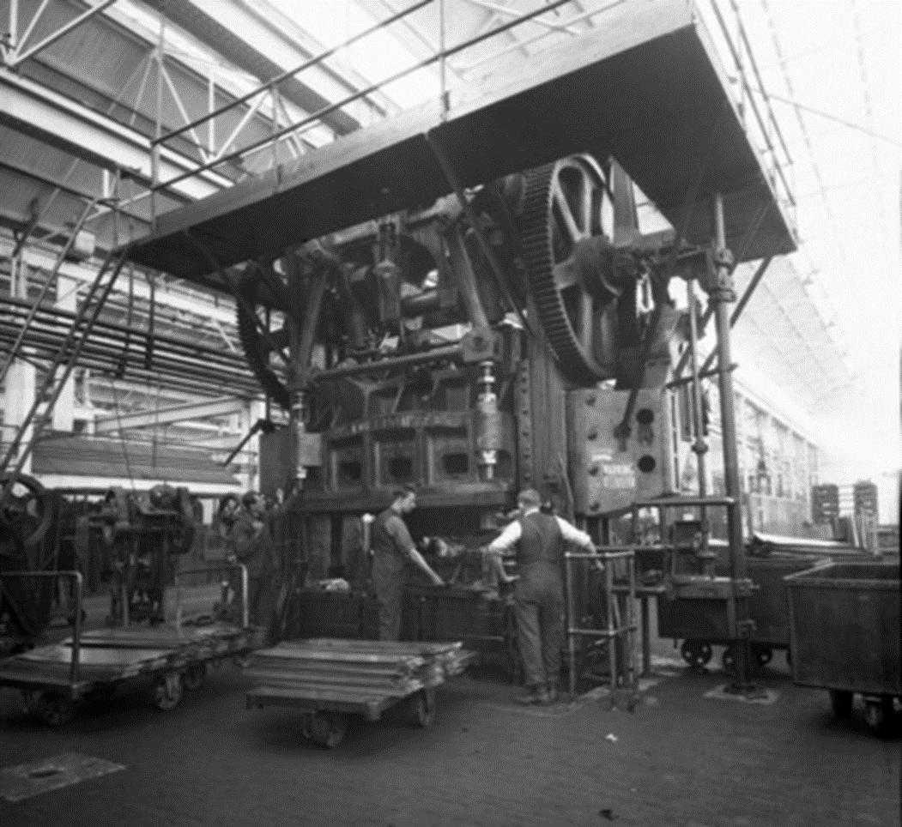
Cowley factory Pressed Steel 1933 pressing metal sheets to make body panels in the Toledo Pressing machine

Slide 31
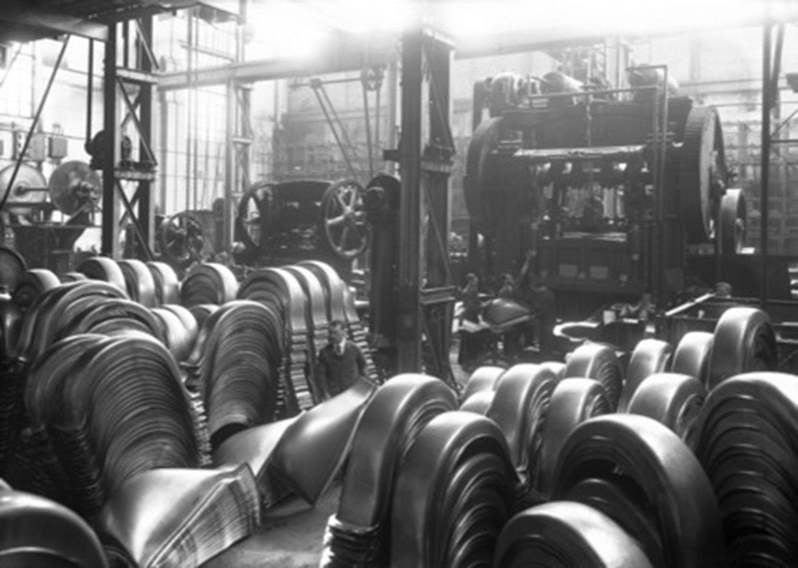
Longbridge factory Austin Motor Company 1930s large presses with metal pressings of wings in the foreground

Slide 32
Small machines
Conventional Western approach is to purchase large machines to get “economies of scale”.
These often have long, complex set-ups, and make big batches quickly creating “waste”.
Changeovers
Inventory levels
Time

Slide 33
Small machines
Using several small machines rather than one large one allows simultaneous processing, is more robust and is more flexible.....
Inventory levels
Time

Slide 34
LEAN
Synchronised Flow
Customer demand triggers
Enhanced improvement Behaviour
Waste elimination

Slide 35
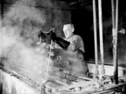
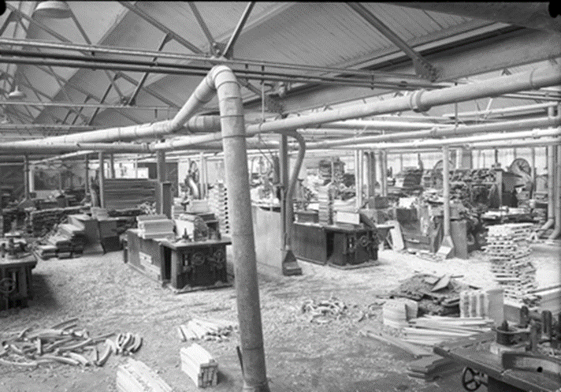
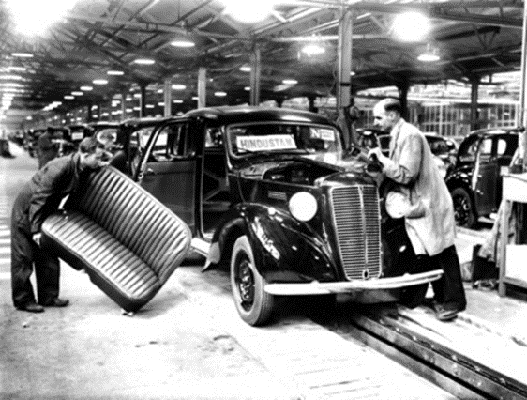
Morris Radiators Coventry 1960
Cowley factory Morris Motors 1925 Sawmill
where timber was cut to make wooden body frames
Cowley factory Morris Motors 1946 production
of the Hindustan for export to the Indian market
based on the prewar Morris Ten

Slide 36
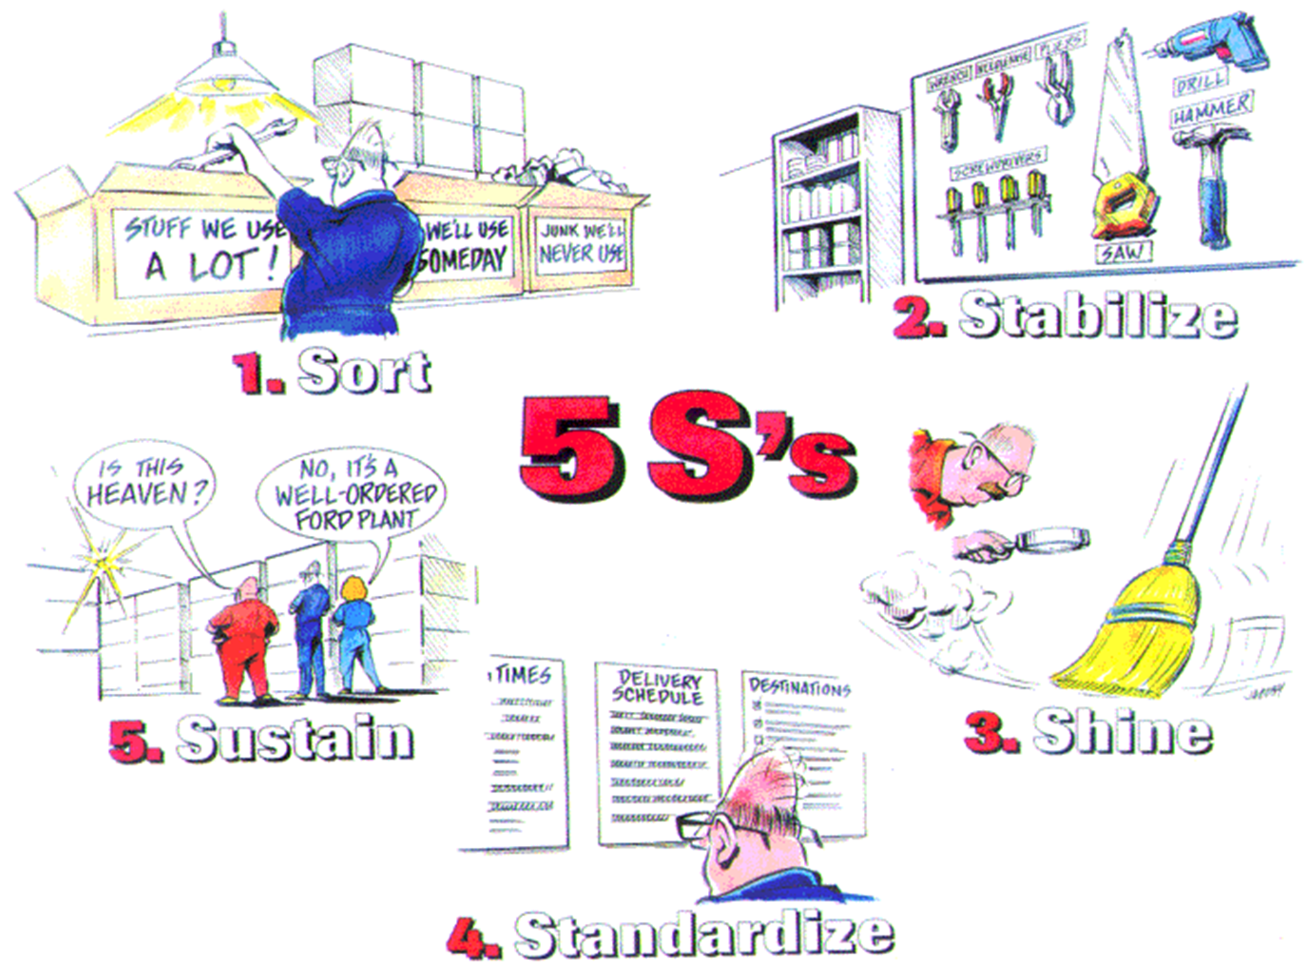
Notes:
What 5S tools do you observe?

Slide 37
The 5S’s
System to reduce waste and optimize productivity through maintaining an orderly workplace and using visual cues to achieve more consistent operational results
“Clearing the clouds” – eliminate the waste of motion from moving things and the waste of looking for tools and materials
As much to do with the mind as with the physical situation!
  Seiri Sort Clean-out Clear
  Seiton Stabilise Configure Arrange
  Seiso Shine Clean and Check Neatness
  Seiketsu Standardise Conformity Discipline
  Shitsuke Sustain Custom and practise On-going
  Improve

Slide 38

Continuous Improvement
Uses techniques such as:
Benchmarking
Pareto Analysis
Quality circles
Suggestion schemes
Quality audits
Customer surveys
Poke-Yoke (Fail-Safe) devices

Slide 39
LEAN
Synchronised Flow
Customer demand triggers
Enhanced improvement Behaviour
Waste elimination

Slide 40
Lean Production
Providing more value with less waste
Waste consists of muda (non-value adding work), muri (overburden) and mura (unevenness)
Closely linked with Just-In-Time and Autonomation
  Smooth flow of materials arriving just as needed
  Automation with a human touch

Slide 41
The lean approach aims to meet demand instantaneously, with perfect quality and no waste
It means that the flow of products and services always delivers….
exactly what customers want (perfect quality)
in exact quantities (neither too much nor too little)
exactly when needed (not too early or too late)
exactly where required (not to the wrong location)
at the lowest possible cost.
It results in items flowing rapidly and smoothly through processes, operations and supply networks.

Slide 42
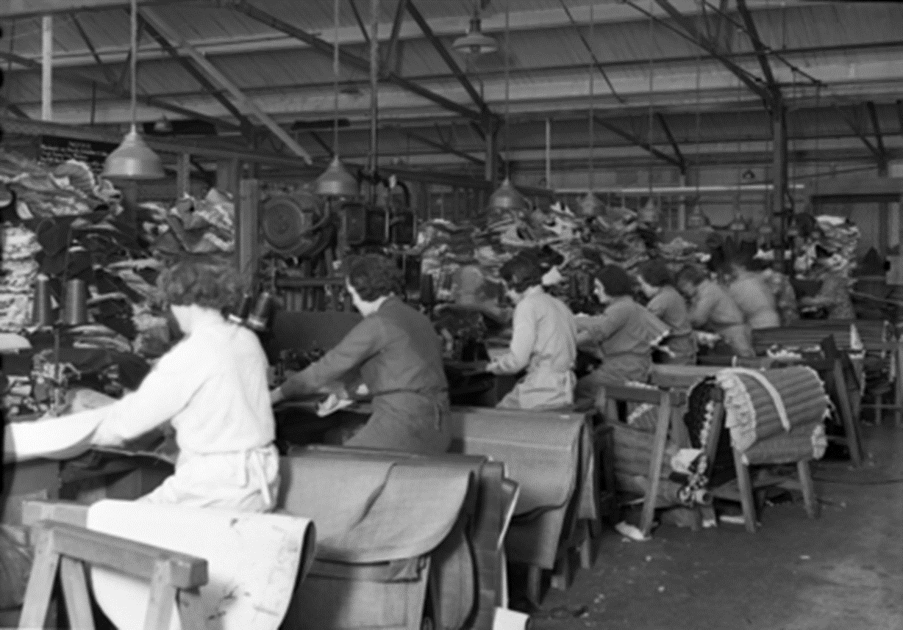
Cowley factory Morris Motors 1934

Slide 43
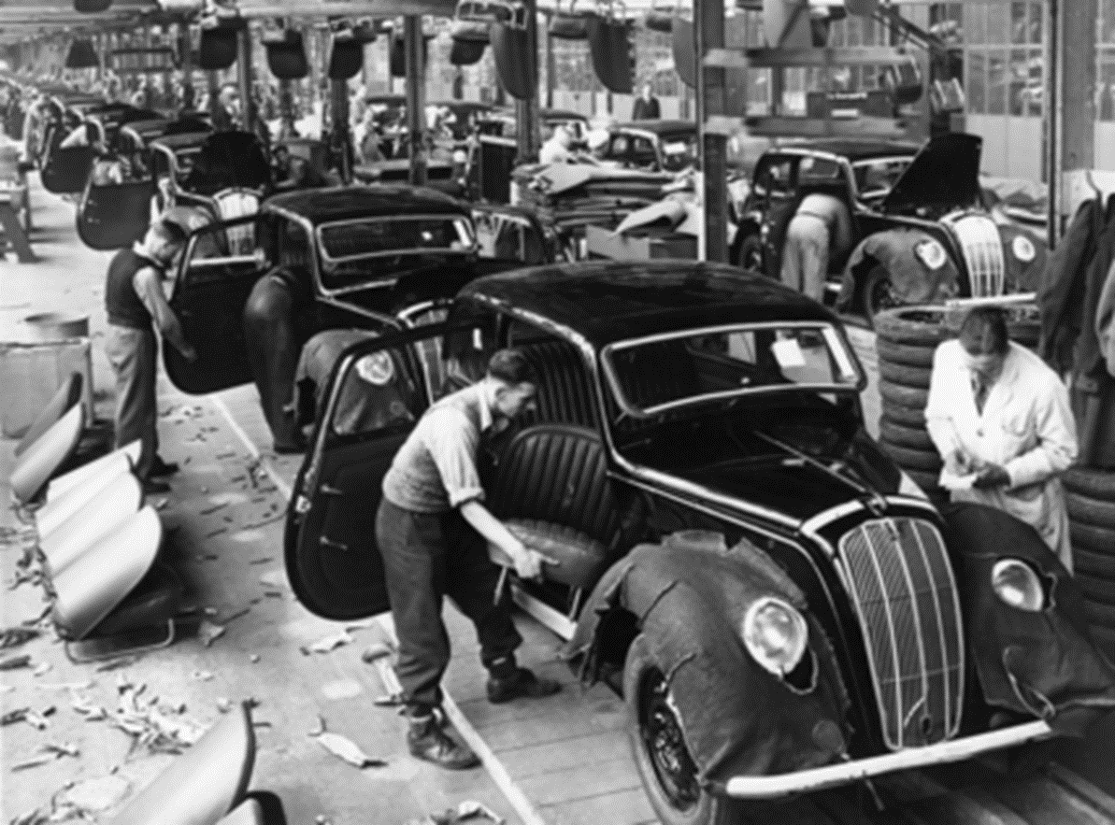
Cowley Factory Morris Motors 1945 fitting seats to the Morris Eight Series E, a prewar design which resumed once the World War Two was over

Slide 44
LEAN
Synchronised Flow
Customer demand triggers
Enhanced improvement Behaviour
Waste elimination

Slide 45
Value add v. Non Value add
Value Add – Anything that changes or further transforms a product, sub-assembly, information or service into something that the customer is willing to pay for
Non Value Add – Any activity that absorbs or consumes resources (e.g.- material, time, equipment, people, paper, space), without creating value. Typically, two types:
Type 1 – can be eliminated immediately
Type 2 – due to current state, cannot yet be eliminated
Notes:
Value add is typically < 5% of total cost
Non value add is typically > 95% of total cost
True cost is the size of a plum seed
Specifying value accurately is the critical first step in lean thinking
Question: Which activity do you think most people focus on first? Value add activities or non-value add activities?
Need to be careful how and who you use throw this term around.

Slide 46
So what are these [7] wastes?
Over production…ahead of demand
Waiting…for information, materials, people, equipment, etc., causing inefficient use of time
Transportation…conveyance of materials, product, paperwork, etc., more than is necessary
Over-processing...often associated with “overkill”, includes any form of inspection
Inventories…having more than absolute minimum.
Motion…of people more than necessary to complete task
Defects or Rework…correcting defects
Talent…mismatch between ability and job
Notes:
One of the reason for categorizing the wastes is to help identify or “see” what needs to be fixed and with what tools. Traditionally, 7 wastes are broken down into components. 8th was added to emphasize using the people and teams who are expert in the work. These are not mutually exclusive or separate from each other.
1. Root of all manufacturing evil - building things that don’t sell
2. Talk about air con plant - lots of waiting and especially at end of day.
3. Transportation - Necessary but should be minimised - link to green, link to batch size of bullwhip. Why do you think Japanese OEM’s have constructed U.S. plants?
4. Making things that don’t add value - refer to previous EPSRC project with architects
5. Push versus Pull
6. Often related to poor ergonomics and therefore to worker safety
7. Relate to TQM - building quality in
The sources of Waste creates cost and adds no value. All of these can be converted to time and/or inhibitors to flow.

Slide 47
Value Stream Map for an industrial air conditioning installation service
T/T = Task time
TTT = Total throughput time
V-A T = Value-added time
C/T = Cycle time
Sales office
Operations planning
Cash management
Forecasts
Invoice status
Job tracking confirmations
Completion confirmation
Survey
Order
Assemble
Frame
Install
Wait in branch
Wait for assembly
Ship to branch and wait
Wait for installers
T/T = 0.5
T/T = 0.5
T/T = 5.0
T/T = 0.75
T/T = 0.75
Avail = 100%
Avail = 100%
Avail = 100%
Avail = 100%
Avail = 100%
C/T= 30
C/T= 10
C/T= 12.5
C/T= 17
C/T= 35
58 hrs.
96 hrs.
48 hrs.
48 hrs.
TTT = 258 hrs
30 mins.
30 mins.
5 hrs.
60 mins.
60 mins.
V-AT = 8 hrs

Slide 48
Value add v. Non Value add
1. ______ Delivery of supplies Just In Time (JIT) from the supplier to the plant
2. ______ Locating the proper tools and equipment needed to changeover for the next operational run
3. ______ Having operators collect SPC data and fill out quality forms
4. ______ Performing open heart surgery on a patient
5. ______ Inspecting product for defects so they don’t reach the customer
6. ______ Moving a patient from the operating room to cardiac rehab
7. ______ Final assembly of gears to be located in differential case
8. ______ Billing the cell phone customer for services rendered

Slide 49
Lean Principles – 4 Steps
Specify Value
  Value can only be defined by the ultimate customer
Identify the Value Stream
  Specific actions required to bring a product or service through the critical tasks of the business
  Eliminate wasteful steps in the process
Flow
  Make the remaining value creating steps flow (not batch & queue)
Pull
  Eliminate forecasting and make what customers tell you
Perfection
  Four initial steps represent a virtuous circle to constantly improve
  Need for transparency with all partners
Womack & Jones, 1996

Slide 50
Applied to Services
Delay on the part of customers waiting for service, for delivery in queues, for response, in queues, not arriving as promised. The customer’s time is not free to the provider!
Duplication. Having to re-enter data, repeat details on forms, copy information across, answer queries from several sources within the same organisation
Unnecessary movement. Queuing several times, lack of “one-stop shopping”, poor ergonomics in the service encounter
Unclear communication, and the wastes of seeking clarification, confusion over product or service use, wasting time finding a location that may result in misuse or duplication
Incorrect inventory. Being out-of-stock, unable to get exactly what was required to the customer
Opportunity lost to retain or win customers, failure to establish rapport, ignoring customers, unfriendliness, rudeness
Errors in the service transaction, product defects in the product-service bundle, lost or damaged goods
Source: Bicheno and Holweg (2009) “The Lean Toolbox”

Slide 51
LEAN TOOLS
Easy to use
Highly visual

Slide 52
Some common techniques for process improvement
Input/output analysis
Flow charts
Scatter diagrams
x
x
Input
Output
x
x
x
x
x
x
x
x
x
Cause-effect diagrams
Pareto diagrams
Why-why analysis
Why?
Why?
Why?

Slide 53
What techniques can be used for improvement?
Many techniques could be considered improvement techniques. Specific ‘improvement techniques’ include…
Scatter diagrams, which attempt to identify relationships and influences within processes
Flow charts, which attempt to describe the nature of information flow and decision-making within operations
Cause–effect diagrams, which structure the brainstorming that can help to reveal the root causes of problems;
Pareto diagrams, which attempt to sort out the ‘important few’ causes from the ‘trivial many’ causes.
Why-why analysis that pursues a formal questioning to find root causes of problems

Slide 54
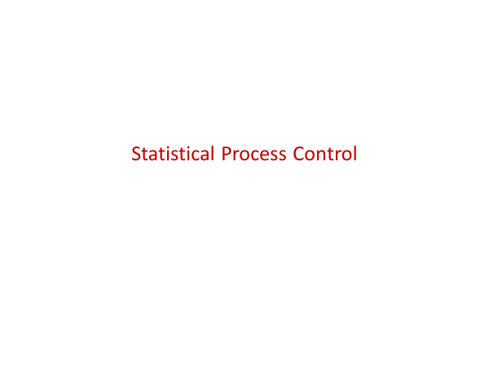

Slide 55
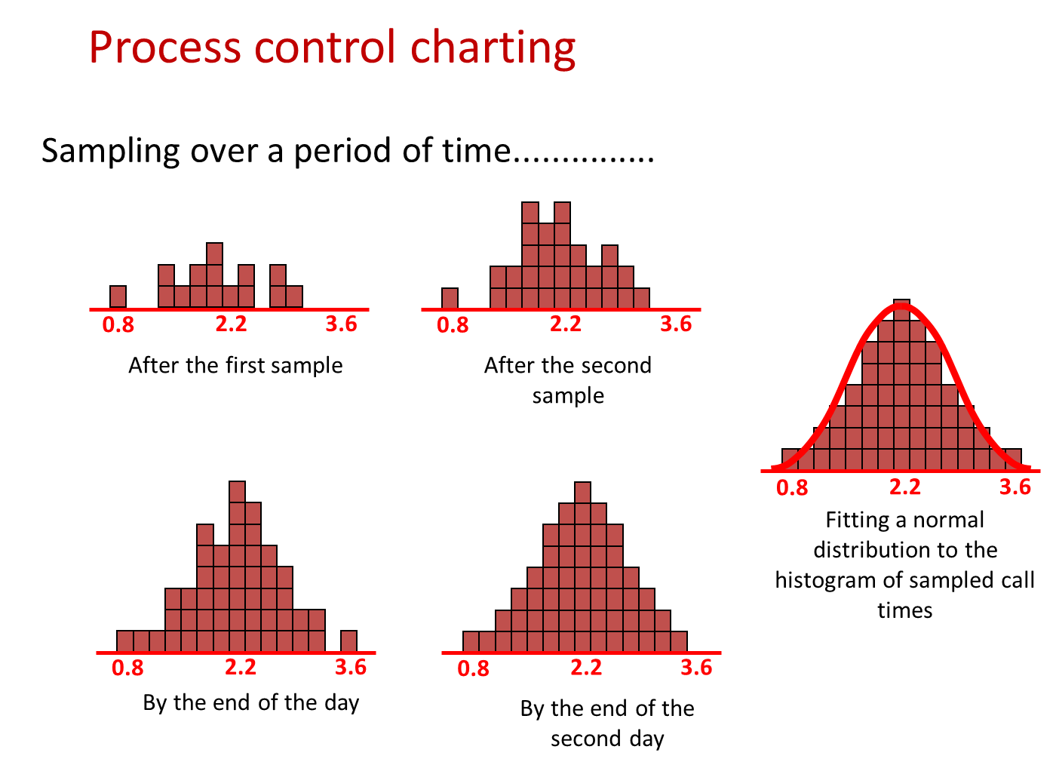

Slide 56
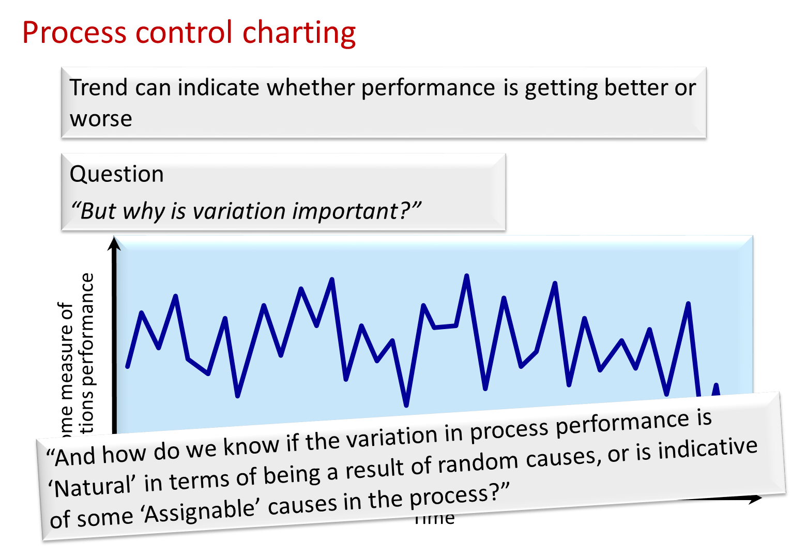

Slide 57
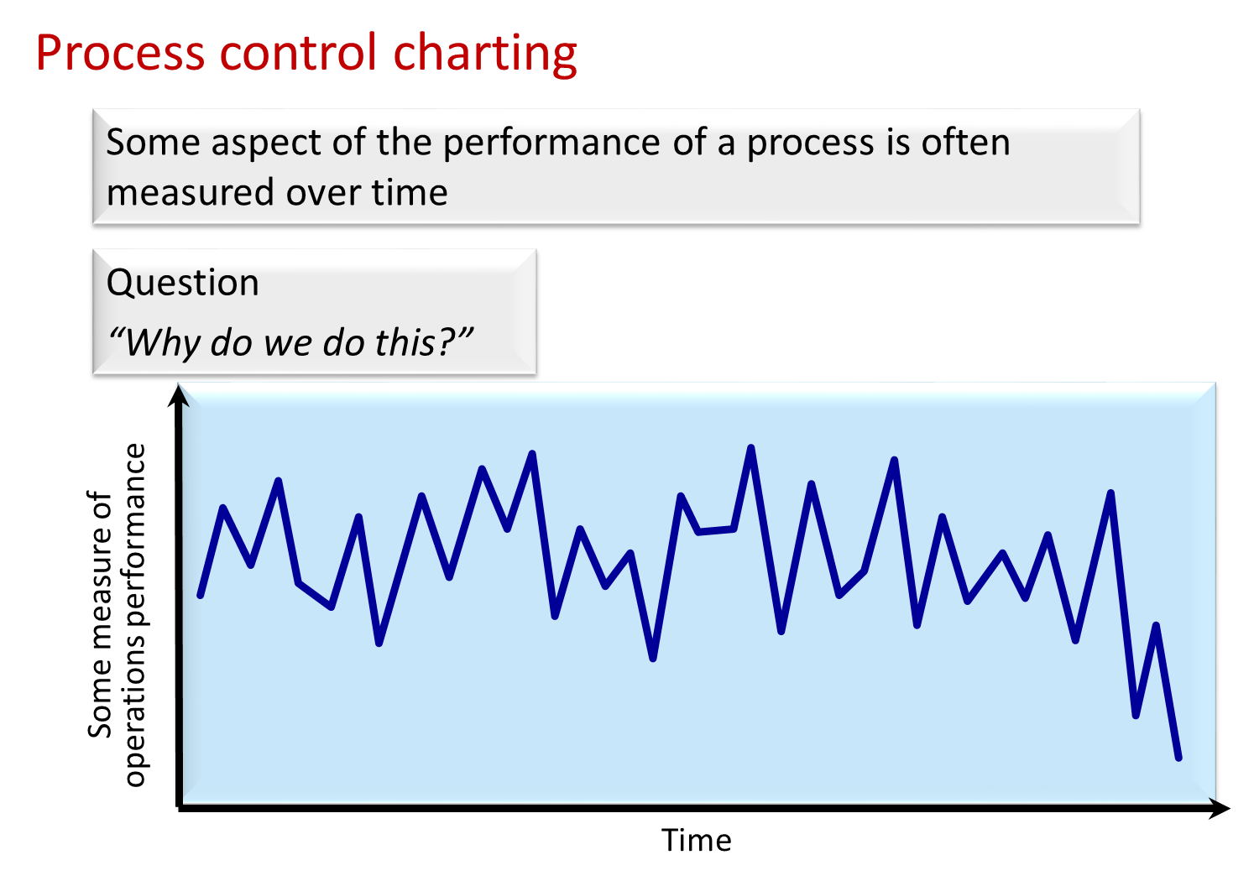

Slide 58
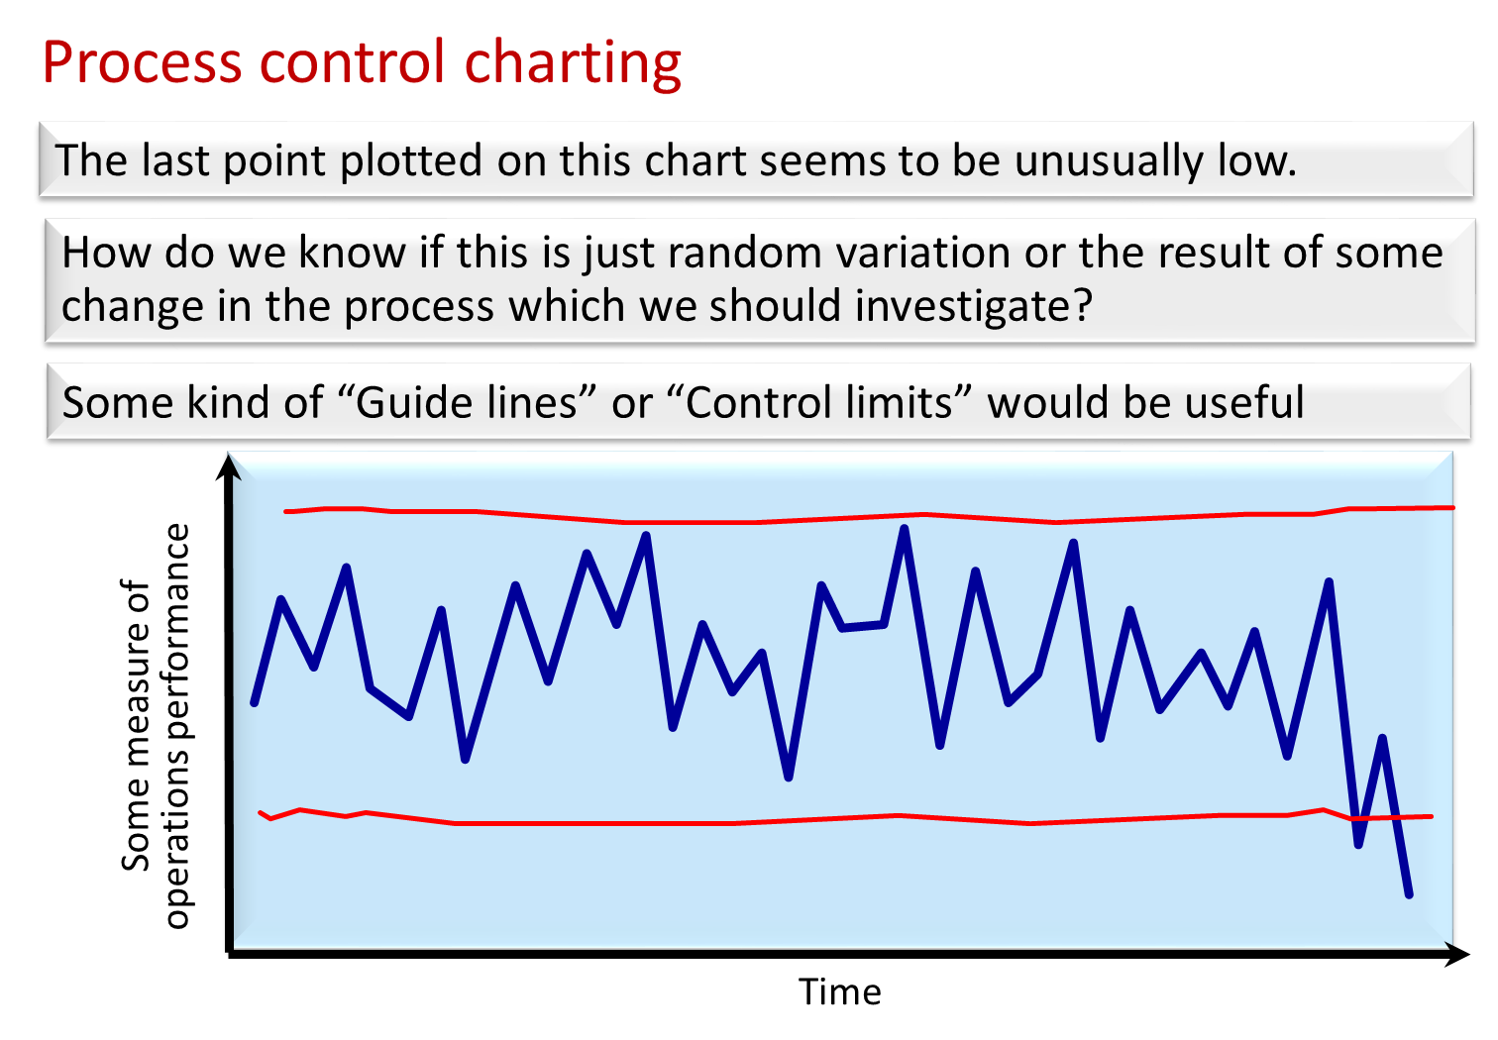

Slide 59
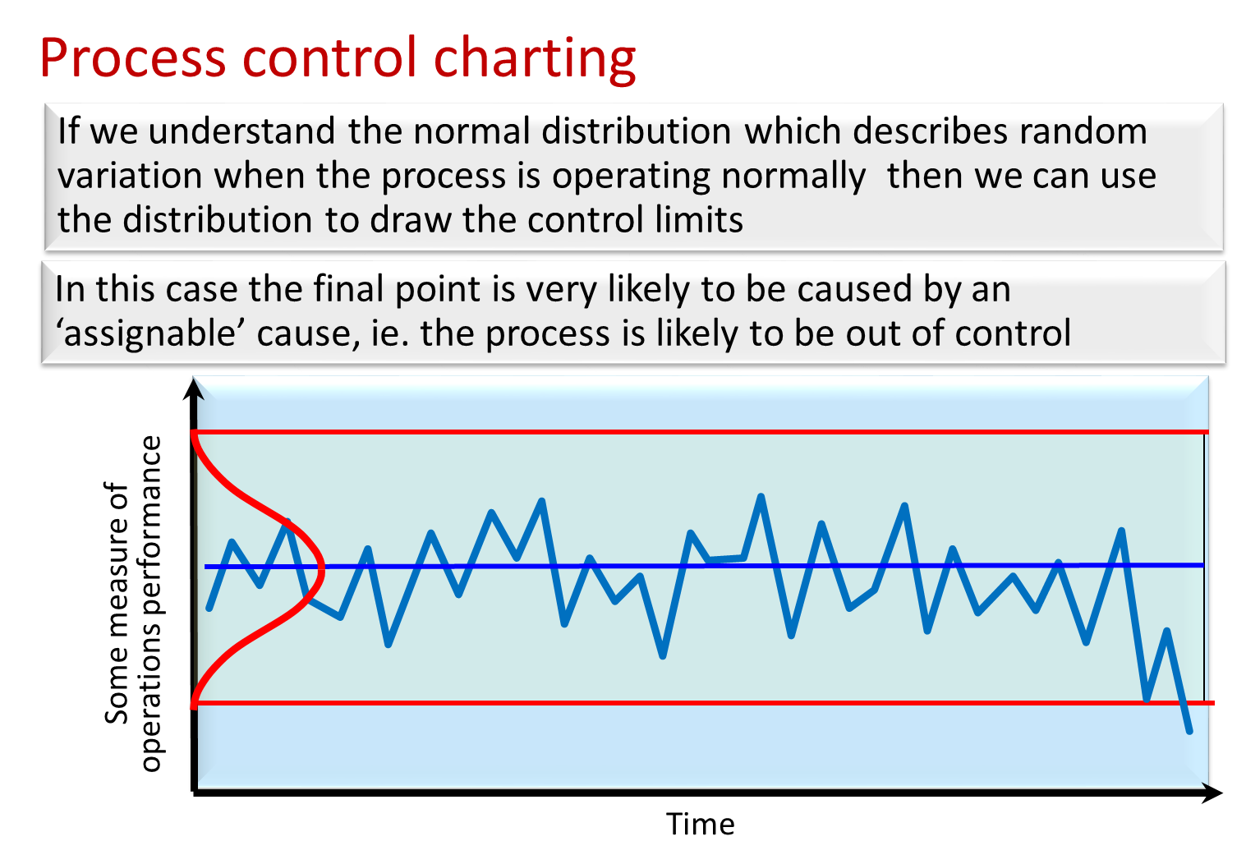

Slide 60
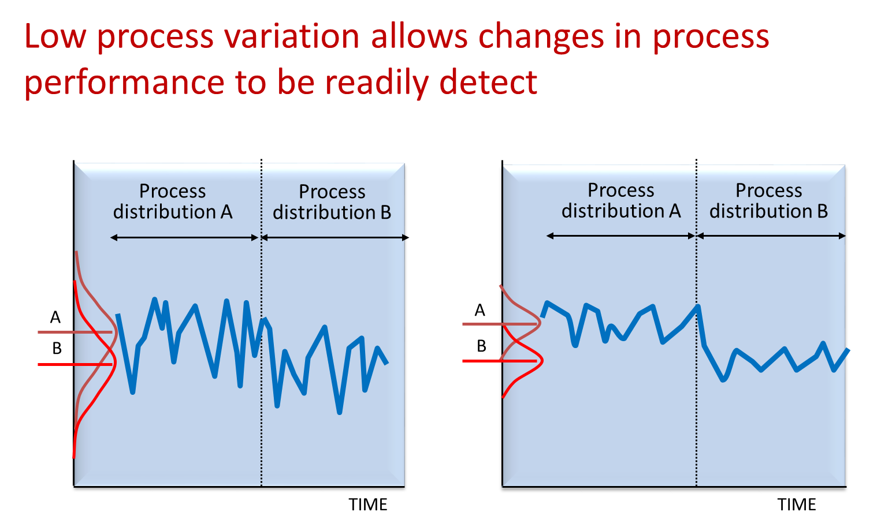

Slide 61
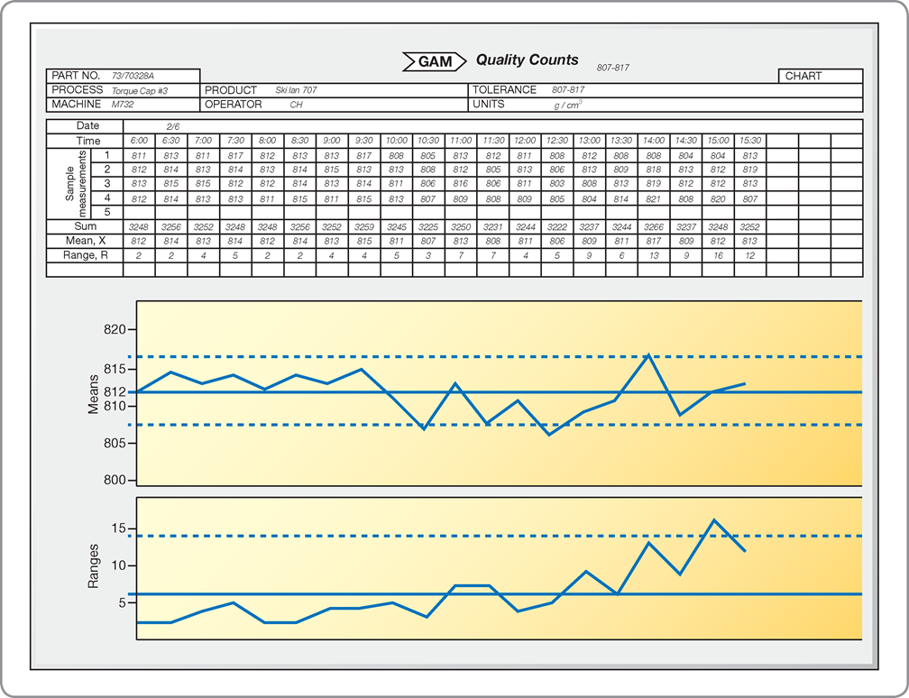
The completed control chart for GAM’s torque machine

Slide 62
Lean Six Sigma

Slide 63
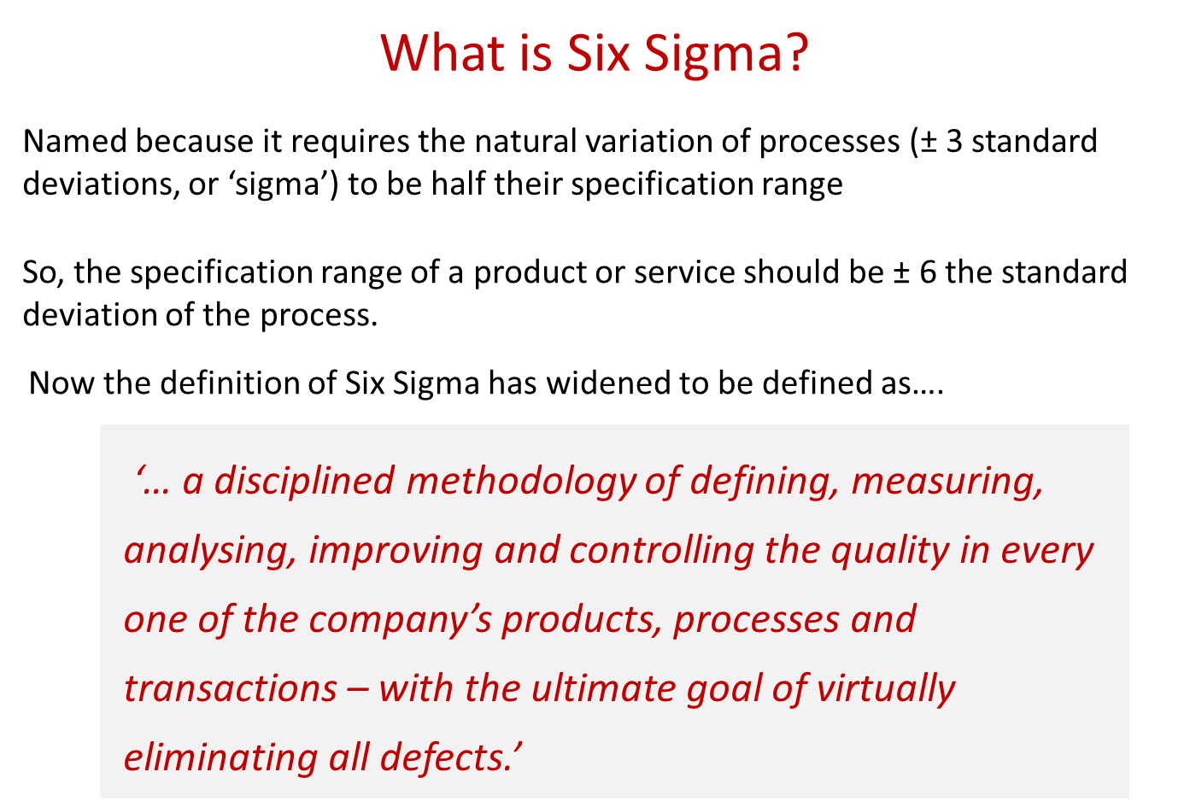

Slide 64
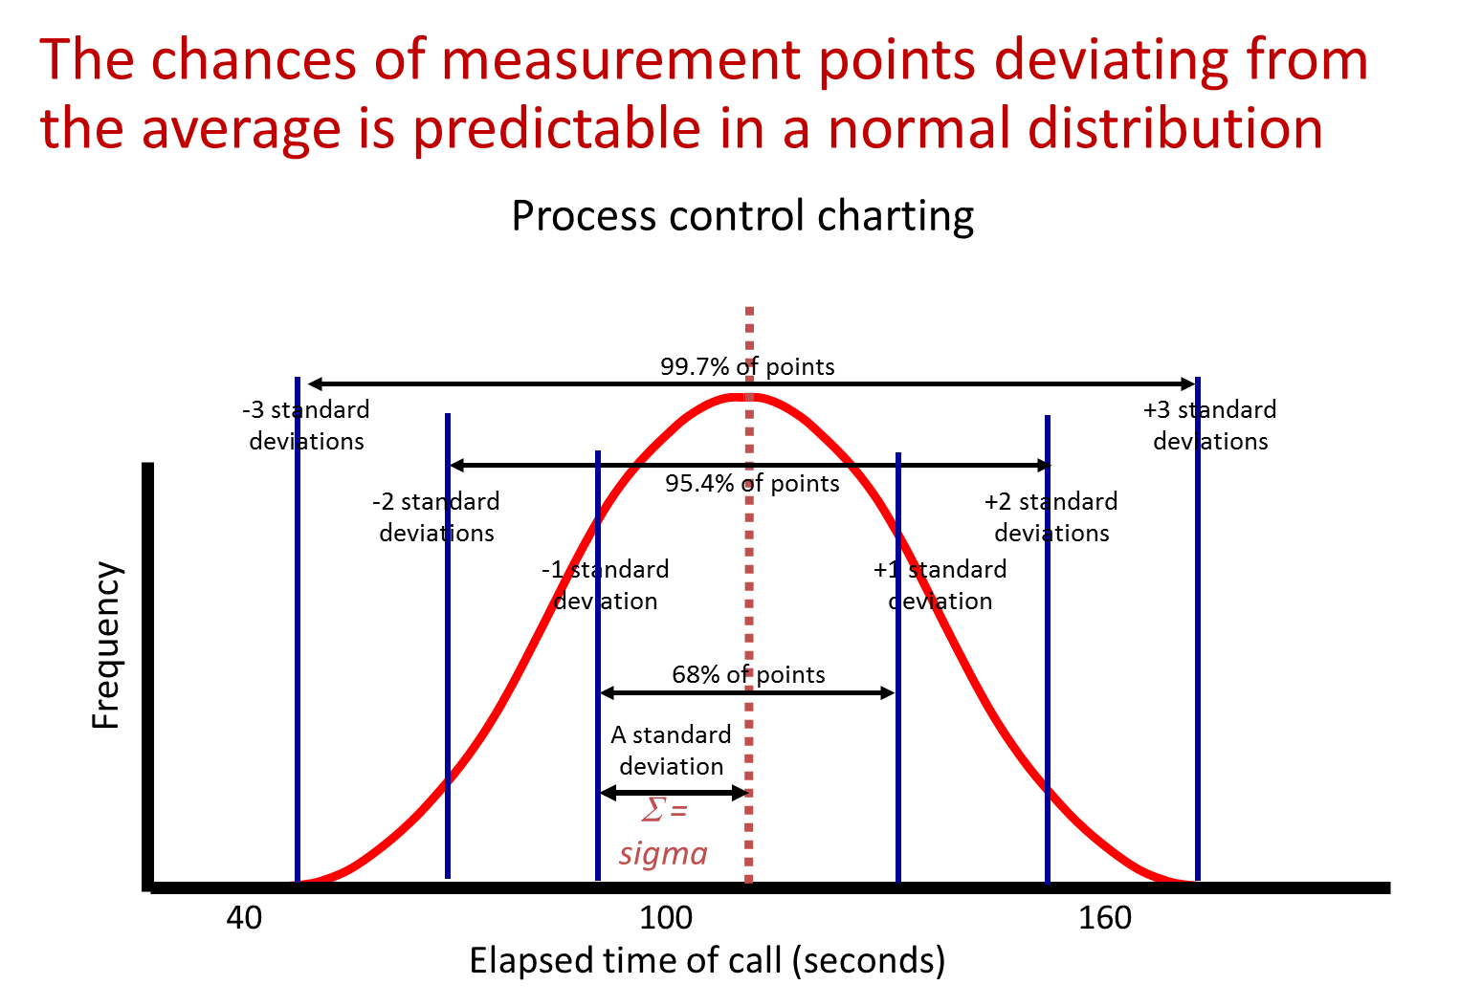

Slide 65
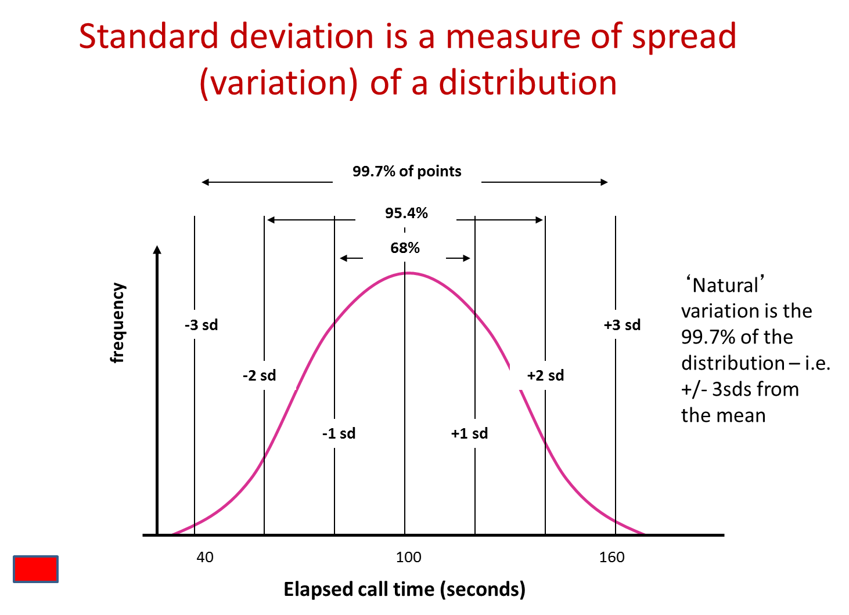

Slide 66
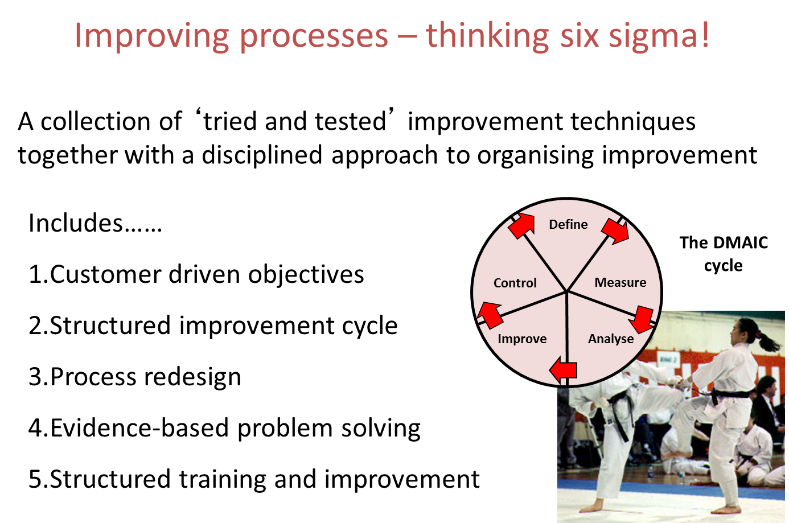

Slide 67
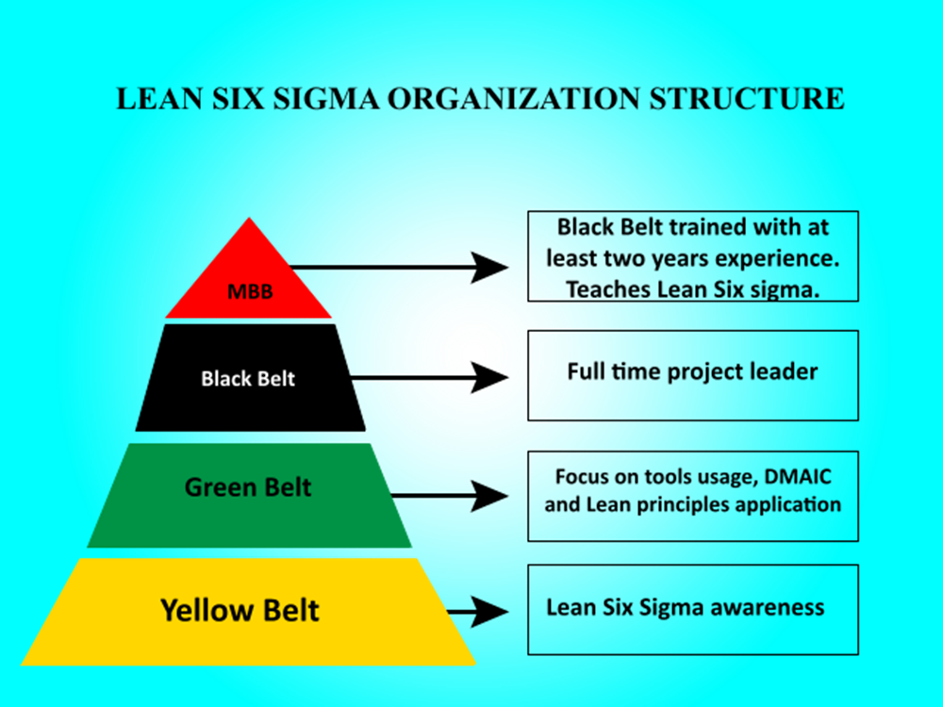

Slide 68
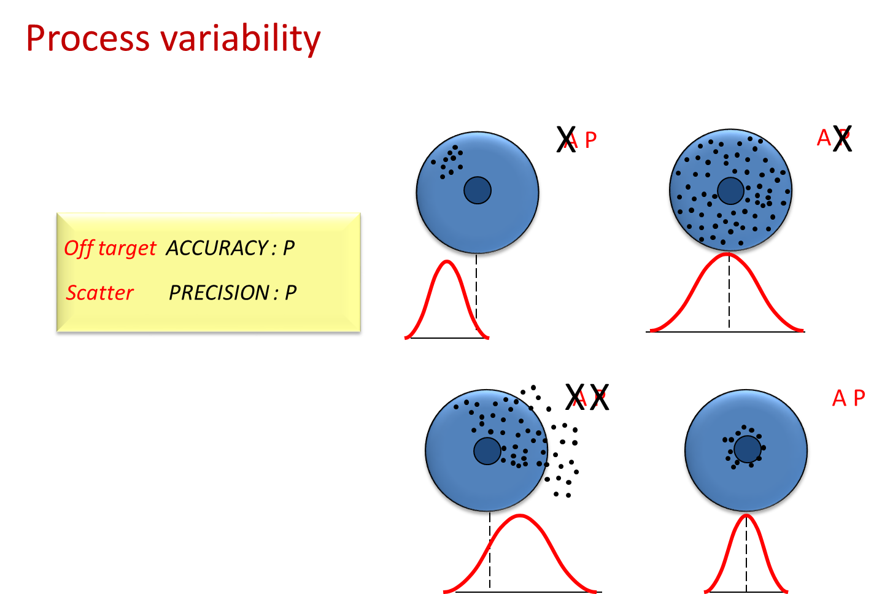

Slide 69
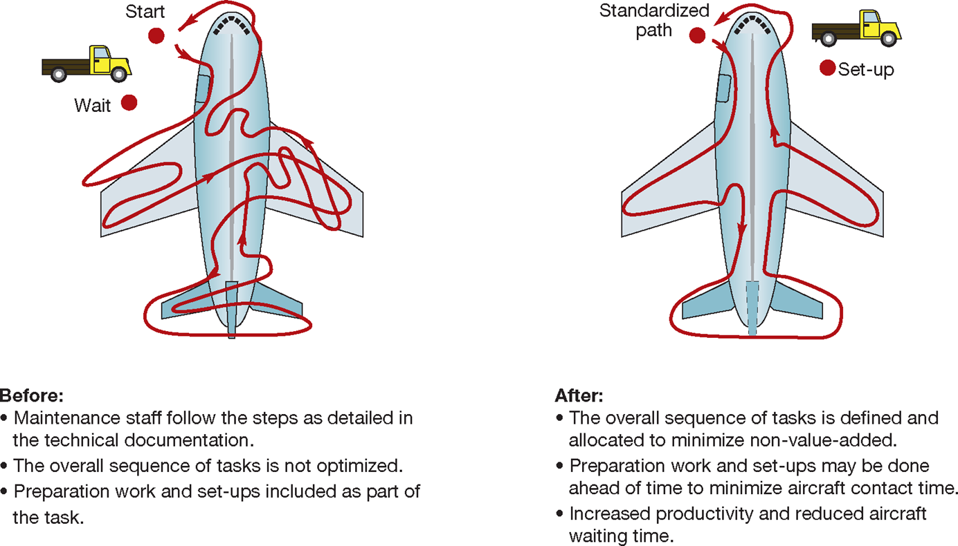
Aircraft maintenance procedures

Slide 70
Ishikawa / Cause and Effect diagrams

Slide 71
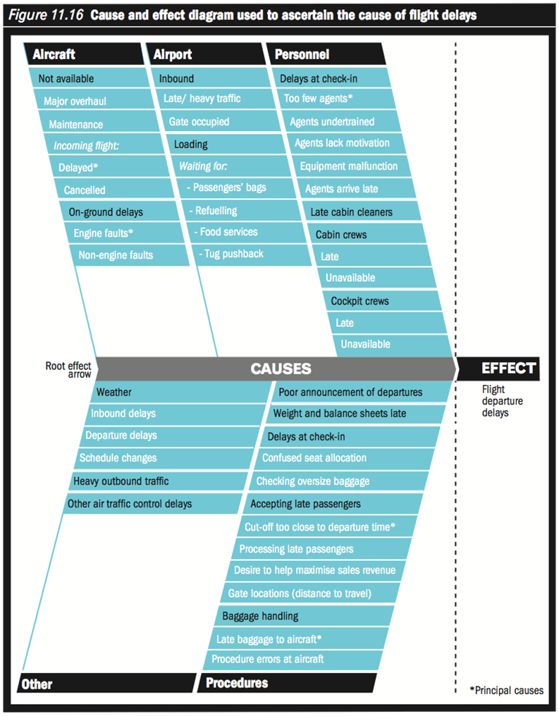
Source Alex Hill and Terry Hill, Operations Management, 2012/3

Slide 72
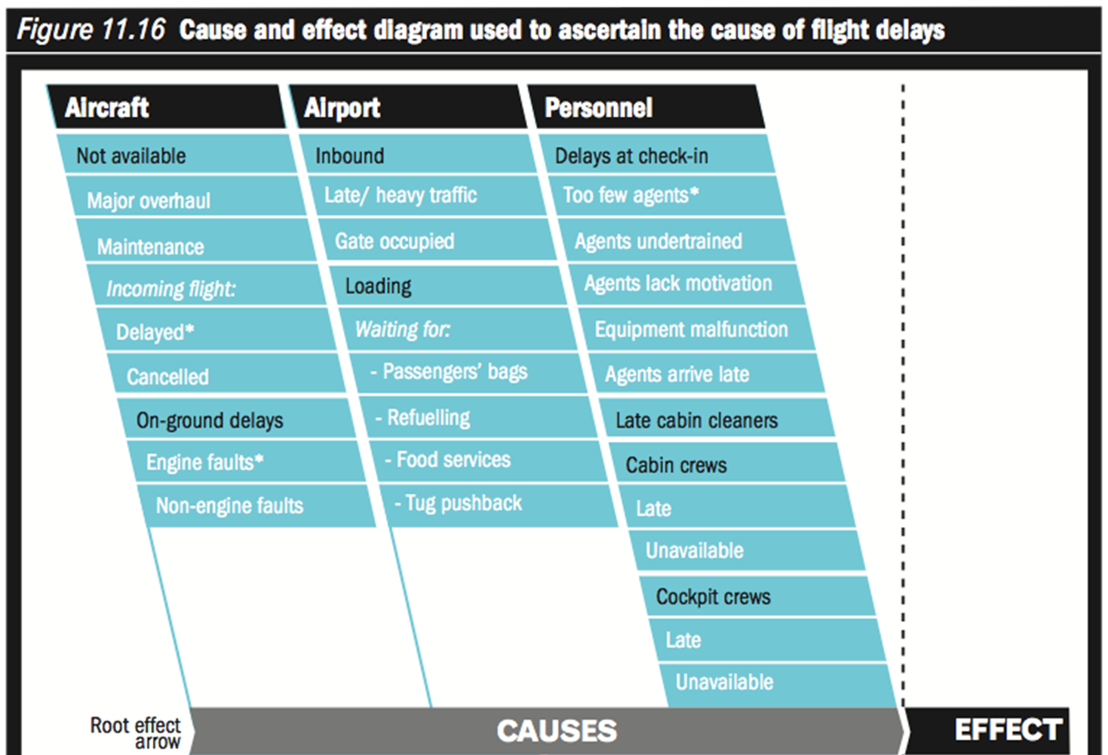
Cause and Effect
Diagram – or –
Fishbone or
Ishikawa
diagram
Source Alex Hill and Terry Hill,
Operations Management,
2012/3

Slide 73
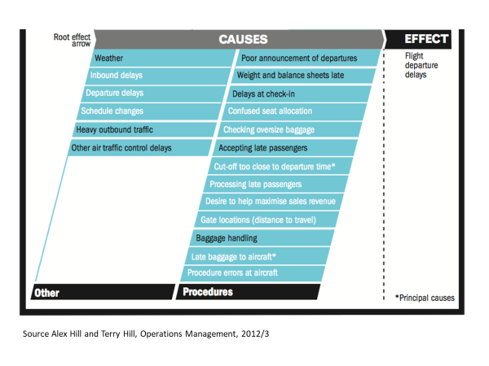
Source Alex Hill and Terry Hill, Operations Management, 2012/3

Slide 74
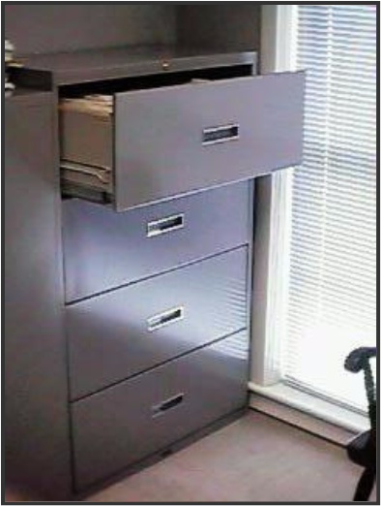

Failsafeing (Poka Yoke)
Examples?
File cabinets can fall over if too many drawers are pulled out. For some file cabinets, opening one drawer locks all the rest, reducing the chance of the file cabinet tipping. It is a control method.
The window in the envelope is not only a labour saving device. It prevents the contents of an envelope intended for one person being inserted in an envelope address to another. It is a control method.

Slide 75
Identifying key suppliers via Pareto analysis
Identify Candidates for Supplier Development
SUPPLIERS REQUIRING DEVELOPMENT FROM OPTIMIZED SUPPLY BASE
TOP TEN
LIST
High
Supplier Performance
Defects/
Total Cost/
Late Delivery/
Cycle Time/
Service/
Safety/
Environment
High Performance
Eliminate
Minimally acceptable performance driven by customer requirements
Eliminate
Low
Critical
Commodity A
Critical
Commodity B
Critical
Commodity C

Slide 76
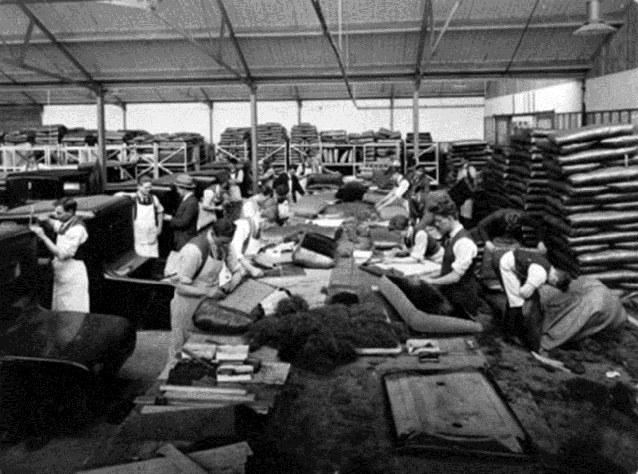
Cowley factory Morris Motors 1925 stuffing seats with horsehair in the trim shop

Slide 77
The problem with inventory
Reduce the level of inventory (water) to reveal the operations’ problems
WIP
productivity problems
Defective materials
Scrap
Rework
Downtime
WIP
Defective materials
productivity problems
Scrap
Rework
Downtime

Slide 78
Just-in-time
Not just a technique but a philosophy of waste removal and continuous improvement
Parts pulled through the process ‘just-in-time’ thus minimising inventories and waste
Use of materials at any stage creates a ‘trigger’ for production and replenishment from previous stage
JIT emphasises: reduction of waste, continuous improvement, sychronisation of material flows, collaboration in the supply chain

Slide 79
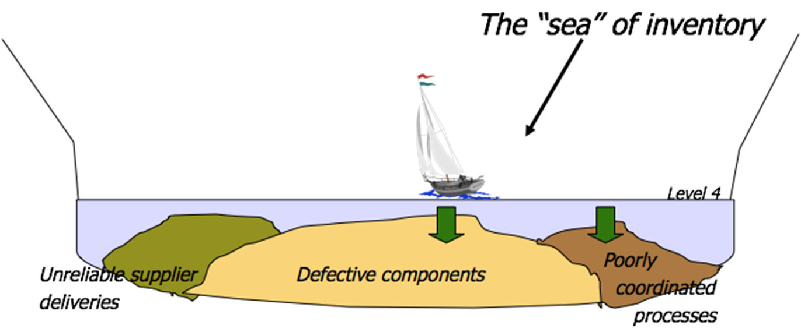
The JIT pond analogy v)

Slide 80
Inventory levels
Milk-round delivery approach to reduce inventory levels
Inventory levels
…or co-location

Slide 81
Enablers of JIT
Continuous flow: Layout, Level scheduling, Reduce lot sizes, Reduce set-up/changeover time
Improve product design: Standardisation, Few BOM levels, Achievable and appropriate quality
Working with suppliers: Greater collaboration, reduced supply base, reduced lead times, increased delivery frequency
Human resources: cross training/job rotation, continuous improvement, autonomation

Slide 82
Total Quality Management
Includes all parts of the organization
Includes all staff of the organization
Includes consideration of all costs
Includes every opportunity to get things right
Includes all the systems that affect quality
And it never stops!

Slide 83
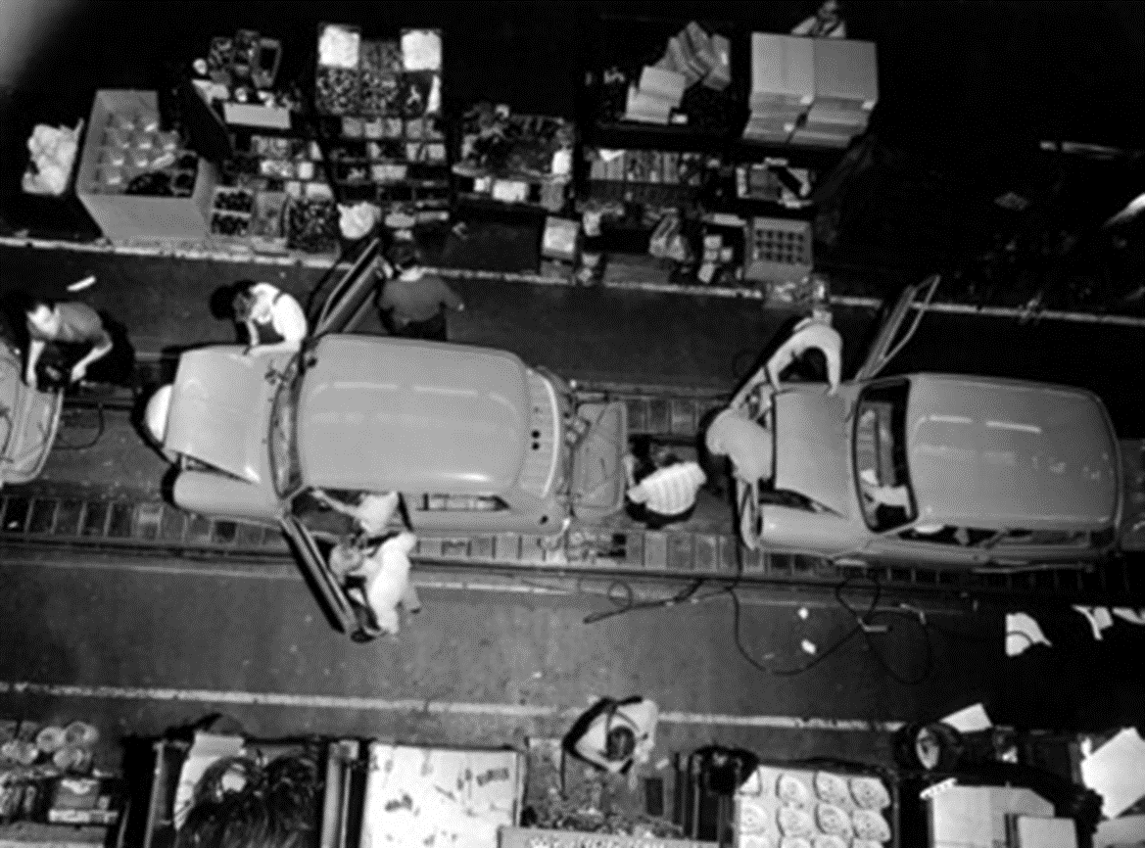
Cowley factory BMC 1965

Slide 84
Lean in Positively reinforcing
Delivering Just-In-Time: Pull based production
Striving for perfect quality: Defect free parts flowing through the process, quality designed in not based on inspection.
Flexibility: Small batch sizes and quick set-up times (SMED) to drive level scheduling
Trust-based relationships: Mutual commitments and obligations, internally and external with suppliers
Continuous improvement (Kaizen): work standardisation, productive maintenance, root cause analysis, worker empowerment

Slide 85
Beyond the Operation: Lean Supply
JIT
Basic contracts – relational elements
Sourcing decisions faced on Total Cost not price
A trend to local sourcing / co-located suppliers
Supply base reduction (not tiering)
Shortest SC possible

Slide 86
Relationship Management
Supplier involvement in new product development
Joint cost reduction
Trust & collaboration
Kanban system for deliveries - JIT approach
Need for suppliers to deliver in small batches, more frequently with guaranteed zero defects.
Pressure

Slide 87
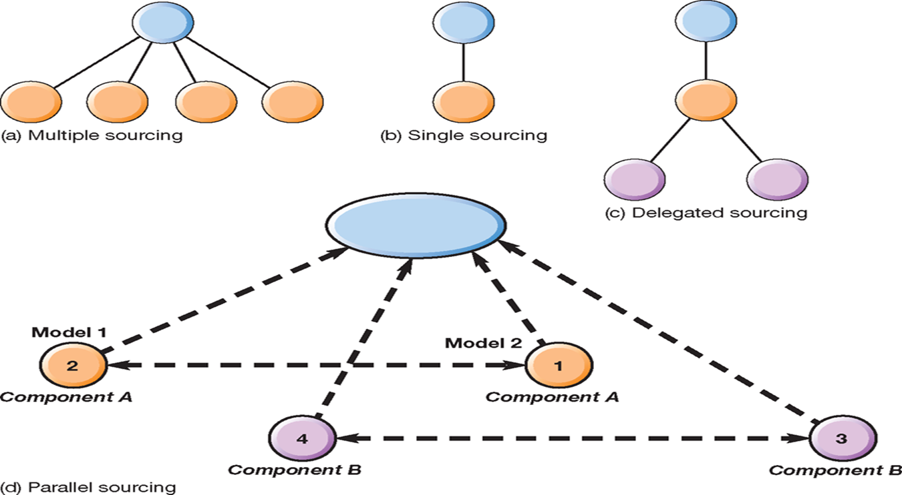
Sourcing

Slide 88
What would this look like?
Ship
Ship
Buyer
Tier One
Tier Two
Pull
Pull
Goals:
1. Share demand data as far upstream as possible
2. Change to pull system
3. Smooth production scheduling across chain
4. Use value stream mapping to reduce waste
5. Maintain open communication

Slide 89
‘Advantages and problems of ESI’
Advantages | Problems
Reduced development time | Release of confidential business information
Improved specifications | Technology sharing
Enhanced quality | Cost and pricing sharing
Lower development costs | Decision making
Access to new technology | Ownership of IPRS
Joint problem-solving | Teamwork
Interchange of knowledge | Accountability
Improved manufacturability

Slide 90
The Concept of Supplier Development
Traced to lean Japanese car assemblers pursuing Continuous Improvement - or kaizen - in their suppliers
Supplier development is concerned with:
  1. Improving the suppliers’ capabilities rooting out wasteful (non-value adding) activities achieving long-term improvement of suppliers’ quality, cost and delivery performance
  2. Improving supplier performance

Slide 91
Some Challenges
JIT requires frequent deliveries
  How does this sit with low cost, global suppliers
  Green issues
  Resilience
The need for level scheduling - more responsiveness required?
‘Saviour’ complex
Finished goods inventory

Slide 92
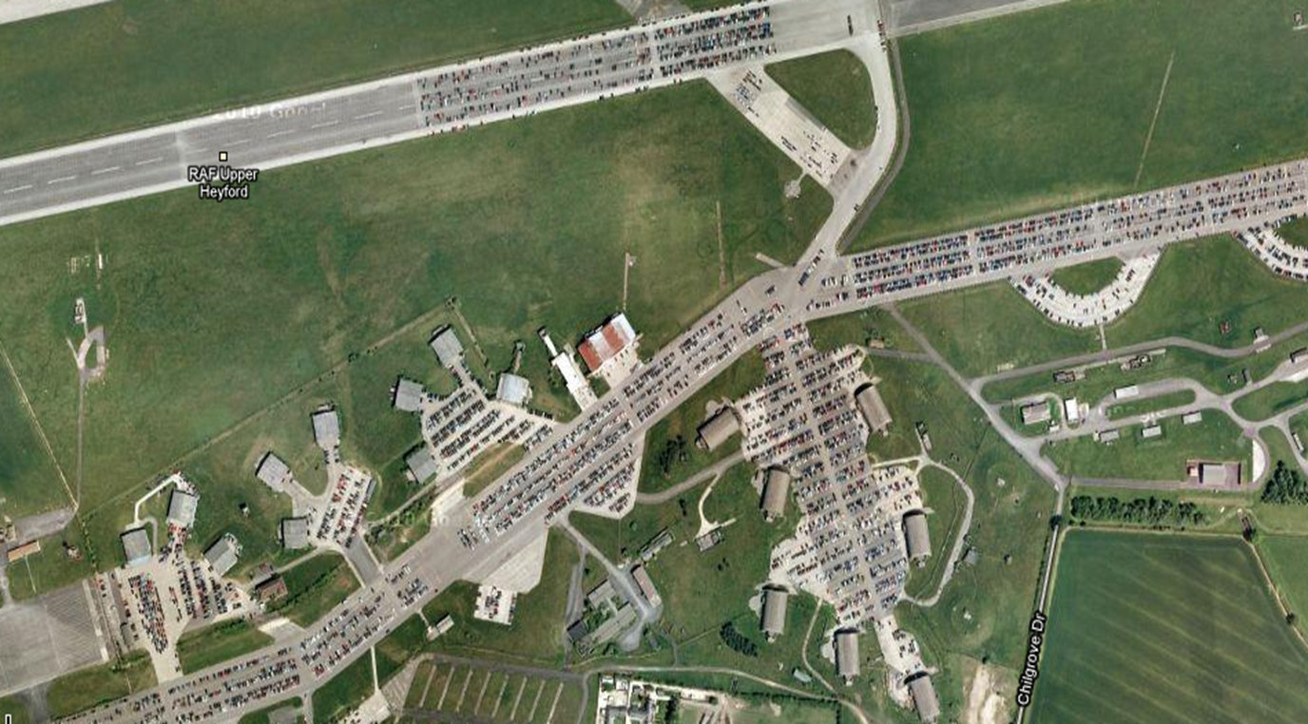
Fields of Cars
http://maps.google.co.uk/maps?ie=UTF8&t=h&ll=51.93433,-1.25948&spn=0.011113,0.027509&z=15
Notes:
Upper Heyford is only one airbase in the UK being used as a car park. RAF Thurleigh is another example. But the largest such place stands in full public view. Portbury Docks at Bristol is familiar to everyone who crosses the Avonmouth M5 bridge.
Portbury docks: http://maps.google.co.uk/maps?hl=en&tab=wl

Slide 93
Conclusions
Lean philosophy is the elimination of waste in all its forms
Synchronised flow to meet customer based demand triggers (JIT) is the centre of the pillars that from the lean approach
Implementation of lean is not easy and involves continuous learning and improvement
Not just a manufacturing technique!
Potential benefits include reductions in lead-time, inventory and cost
Can have wide benefits in the supply chain but also faces big challenges in practice

Slide 94
Learning objectives
You can now differentiate the contributions of lean to OM – (as a philosophy, as a set of techniques and as a way of controlling movement between processes)
That through critical evaluation you understand the true the costs of in process inventory
You can now identify the difference and different implications of, push and pull inventory
You can now critique lean i.e. evaluate what it does well and some of the inherent weaknesses

