Slide 1

Master of Business Administration
Digital Business Delivery
S9 Value creation in Networks
Professor Nigel Caldwell

Slide 2
Agenda
Network effects
The strong importance of weak ties
Platforms and business models
Future networks: the circular supply chain, sustainability and eco-systems

Slide 3
Network effects

Slide 4
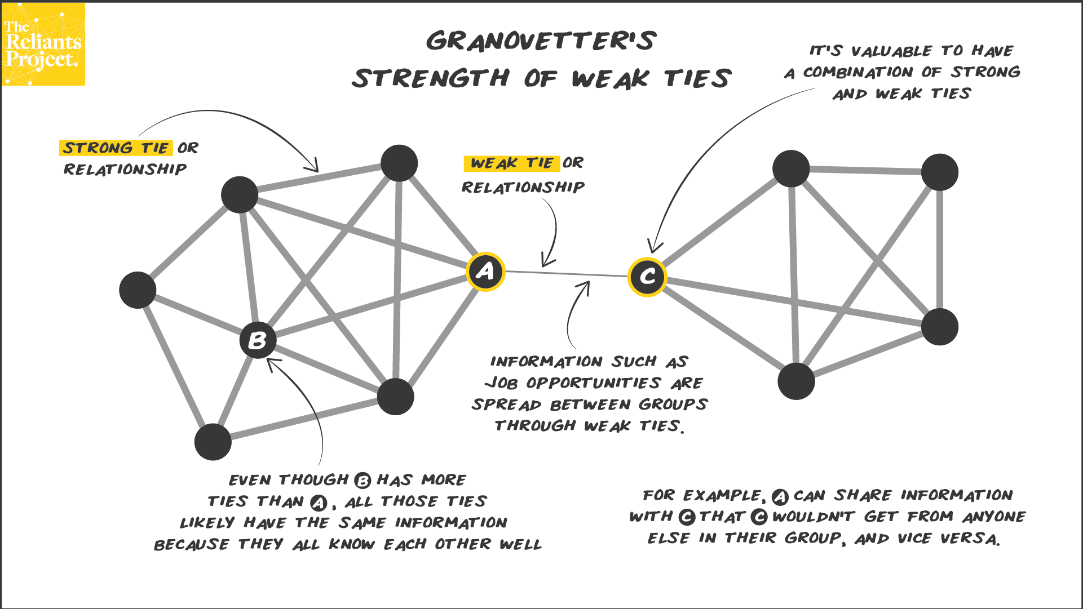
https://www.reliantsproject.com/2020/06/10/concept-4-job-opportunities-and-granovetters-strength-of-weak-ties/

Slide 5
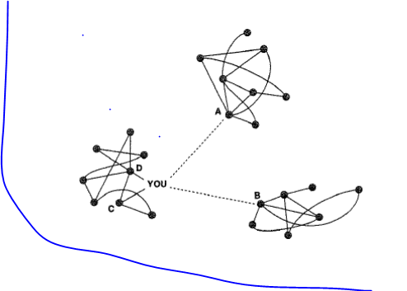
Structural Hole
Theory
Burt, 1992

Slide 6
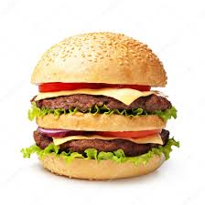

Network effects
Usually activities yield less value as consumption increases –
The law of diminishing returns e.g. burgers
Networks are different
The more people or organisations participate
The more valuable the network is to participants
The law of diminishing returns does not apply

Slide 7
The Network growth model
“The value of a communications network is proportional to the square of the number of connected users of the system” Bob Metcalfe
Attract users quickly e.g. no charge
Dominate market raising high barriers for new entrants (F/B 2.91bn)
Virtuous circle – bigger network attracts new users which makes network bigger and attracts new users … repeat Or, ???
Vicious circle – smaller network drives users elsewhere which makes network [even] smaller and drives more users elsewhere …Think about Microsofts Bing search engine vs. Google …
What does this mean with AI?

Slide 8


The Network growth model
Subsidised subscription prices – to attract subscribers
Pioneered streaming instead of posting DVDs
Subscription model = data advantage – better targeting of users’
Create own content [N.B. Talents pay decreasing, supporting services salaries growing]
Hyper competition
growth slowing – shares down 25%

Slide 9

Facebook / Meta
Unparalleled growth based on data harvesting
Ageing demographic – parents/grand parents
Hyper competition – TikTok
Competitors (Apple requiring consent to be tracked by advertisers (ATT) – FB lost $10bn – 8.5% of 2021 revenue but 25% of profit
Growth in numbers stalled – active daily users fell 500,000
Recent (but slightly recovered) 25% drop in share price

Slide 10
Not relationships but Data
New uses of data – e.g. US AI led House buying firms
Customisation through data – anticipating customer choices
New delivery Amazon Prime
New market creation – E-Bay, Etsy,

Slide 11

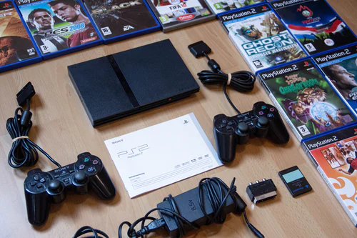


Digital technologies generate, store or process Data

Slide 12
Platforms and business models

Slide 13
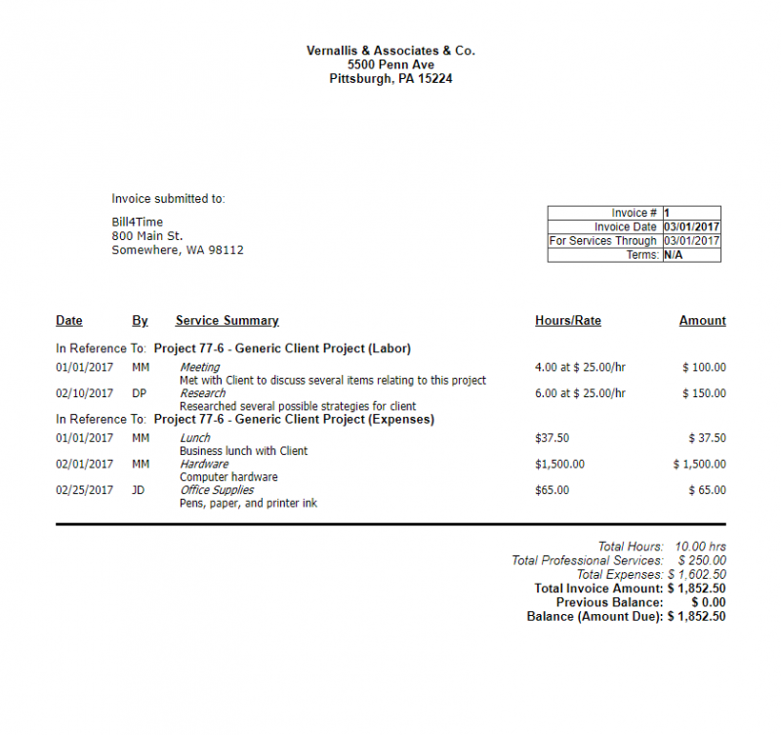
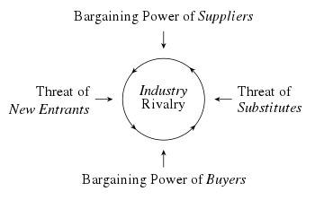
Pre digital models
You either made something and then sold it or performed a service and billed for it

Slide 14
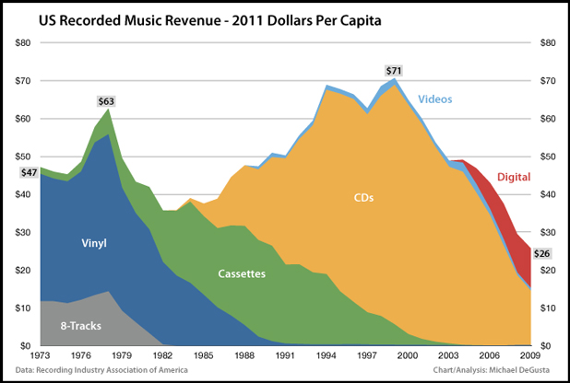
Death of the music industry
Is this servitization?
Shows risk of applying new technology to an established market

Slide 15
Digital networks = Disruptive Innovation
New business models
From subscription to freemium
Amazon – bookshops (Supermarkets?)
Digital cameras – Photo developing, Canon
Digital music – the Music labels as all powerful
Digital phone – fixed location landlines, access
Netflicks – TV, cinema, viewing habits/waiting/bingeing
Facebook – TV, radio, letter writing ….

Slide 16
The circular supply chain, sustainability and eco-systems
Future network forms

Slide 17


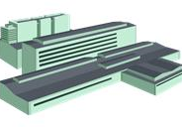
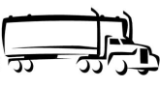






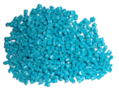

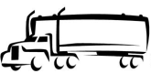
From chains..
to a circular economy
Raw materials
Supplier
Manufacturer
Logistics
Customer
Consumer
‘Take, make, waste’
Product
Disposal
Manufacturer
  Such a transition for firms in the past often meant focusing on green or ‘eco-efficiency’ issues.
  SCM’s association with sustainability owes much to closed loop & remanufacturing (Thierry et al., 1995, Fleischmann et al., 1997; Jayaraman et al., 1999).
  Product recycling was rarely seen as a value creating system (Guide et al., 2003).
  Carter & Rogers (2008) the first to demonstrate a relationship between enviro. social & economic.
Customer
The circular
economy
Supplier
Consumer
Raw materials
Re-manufacture
Used material
Return & recycle
Figure 7.8 A closed-loop supply chain (Johnsen, Howard & Miemczyk 2014) p231

Slide 18

The rise of sustainability
Definition is continuously evolving
  A desired outcome of systems that need to achieve economic, environmental & social targets
Clear warnings in the recent past
  Brundtland (1987), OECD (1997), Stern (2006)
Supply chain & suppliers: a re-occurring theme
  Lamming R. & Hampson J (1996), Cousins & Lamming (2004), Walker et al (2008), Anderson & Skjoett (2009)
Very complex, multi-facetted problem
  Poses a unique set of challenges and trade-offs to business & mankind
  (Carter & Rogers 2008)

Slide 19
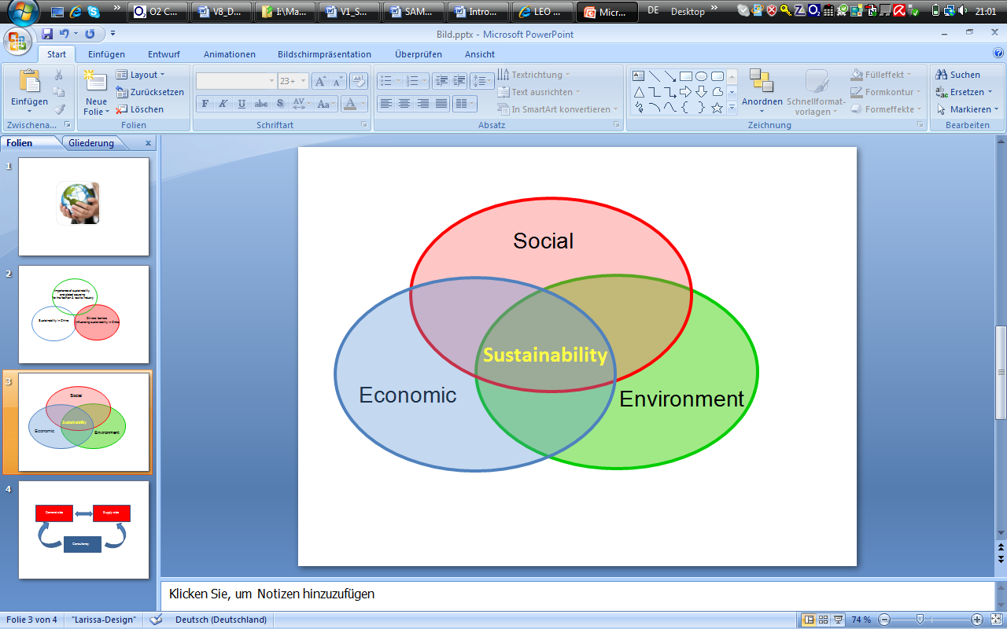
Components of sustainability
Social – Corporate social responsibility, ethics, trade unions
Economic – R&D investment, new technology, ‘Green to Gold’
Environmental - Climate change, impact on ecosystems, and depletion of wildlife & natural resources
‘Equitable’
‘Durable’
Sustainable
‘Responsible’
Adapted: Carter & Rogers (2008)

Slide 20
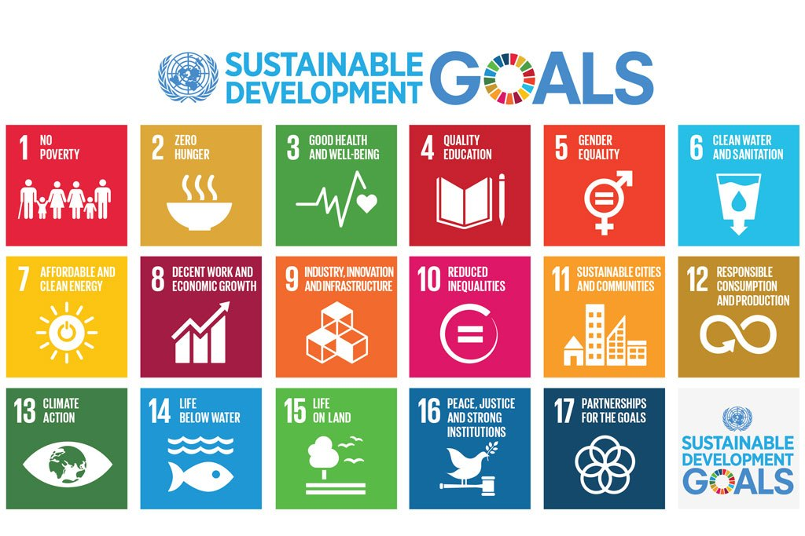

Expand
Source: UN in collaboration with Project Everyone
Close
SDGs
SDGs
Photo: Source: UN in collaboration with Project Everyone
In 2015 the UN General Assembly formally accepted a new set of 17 measurable SDGs

Slide 21
Natural Resource Based View (NRBV)
Builds on RBV to focus on the natural environment
  See: Hart (1995), Hart & Dowell (2011)
Adopts a more dynamic view than RBV
  Argues RBV is too firm centric, insular and static (i.e. see below)
  Why would a firm share a resource nominally considered core to SCA?
Porter (1980, 1985)
Competitive advantage
Cost
Differentiation
Hamel & Prahalad (1994)
Capabilities
Technology Production
Design Distribution
Procurement Service
Prahalad & Hamel (1990)
Resources
Basic requirements Key characteristics
Valuable Tacit (causally ambiguous)
Non-substitutable Socially complex
Rare (firm specific)
Teece (1987)
Wernerfelt (1984)
Barney (1991)
Figure: The Resource Based View (RBV)

Slide 22
Hart (1995) paper
Natural Resource Based View (NRBV)
  Needs a more dynamic view: criticisms of RBV
  Argues basic assumptions of RBV focus on resource heterogeneity & immobility (Wernerfelt, 1984)
Interconnectedness of overlapping strategies
  Pollution prevention & product stewardship
  Developed through repeated learning & experience
Socially complex
    Requires highly coordinated activities involving large numbers of people and teams
Few individuals grasp overall phenomenon

Slide 23
NRBV: key concepts & model
  Companies seeking the goal of sustainable development access resources through fostering supply chain relationships involving external institutional and internal firm interactions
  The 3 environmental strategies below are path dependent, embedded and interconnected:
Pre-empt
Competitors
Future
Position
Lower costs
1. Pollution
Prevention
Minimise emissions,
Effluents & waste
2. Product
Stewardship
Minimise life-cycle cost of products
Minimise environmental burden of firm’s growth and development
3. Sustainable
Development

Slide 24
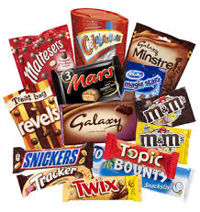
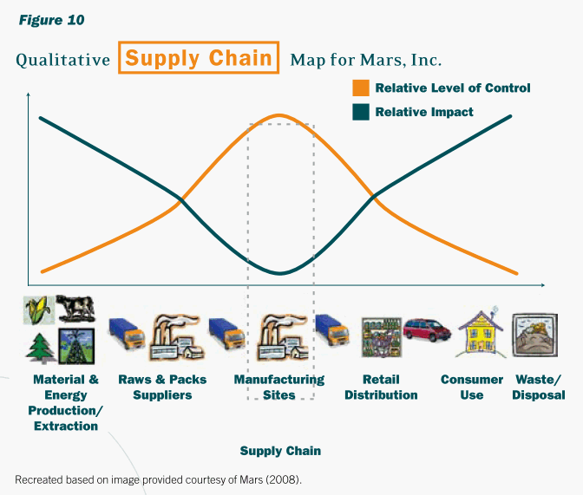
Mars: supply chain impact vs. control

Slide 25
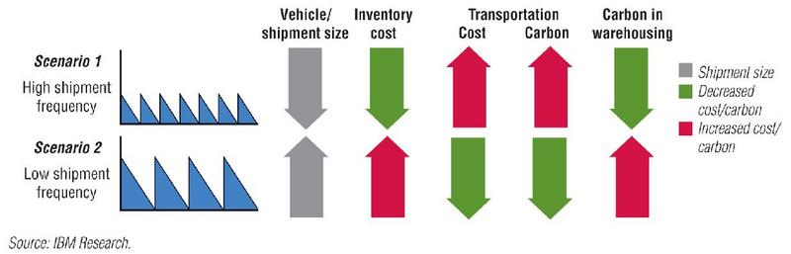
IBM: carbon’s impact on shipment scenarios

Slide 26
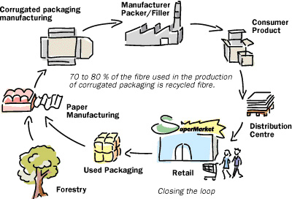
From linear chains to cyclical closed loops
Reverse engineering, remanufacture, design for disassembly
  Recognises the wastefulness of linear, ‘input-output’ supply chains
‘Closing the loop’ by thinking about cycles of supply
  Biomimicry: mankind copying nature’s cycle of re-use

Slide 27
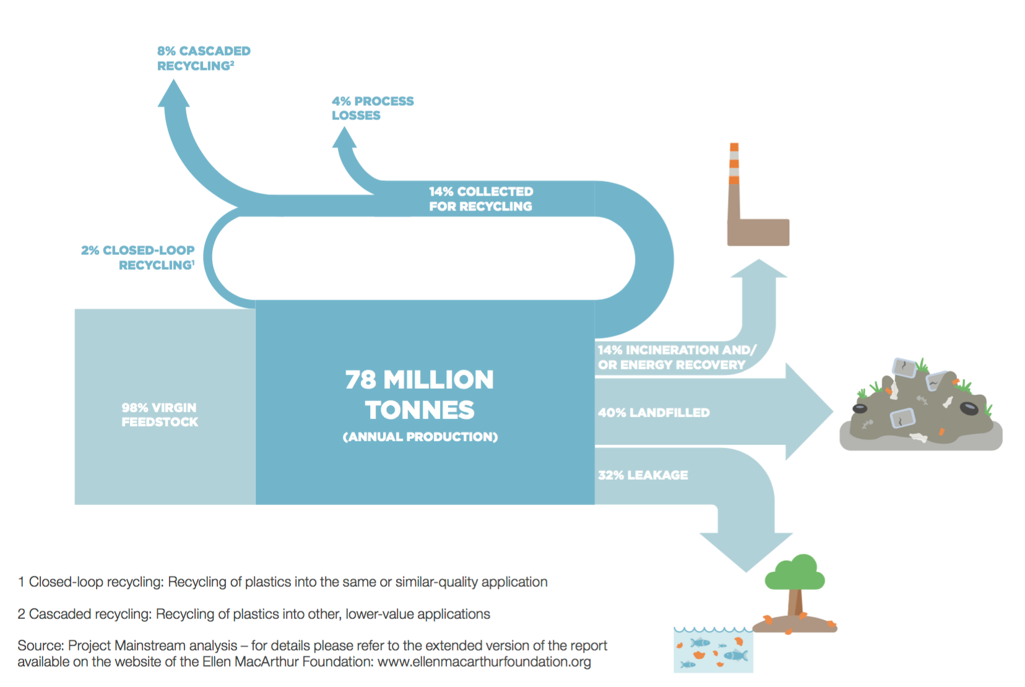
Plastics recycling
It is estimated that only between 2 - 8% of all plastic is currently reused
‘.more plastics than fish in the ocean by 2050’ (EMF, 2016)

Slide 28
Traditional, sustainable & circular SCs
Traditional
Sustainable
Circular
Raw materials & resources
Limited raw materials & resources
Limited natural resources
Recycle
Recycle
Refurbish
Repair
Repair
Reuse
Cascade
Landfill
Limited landfill
Zero landfill
Adapted: EMF and McKinsey & Co (2012)
 | Traditional | Sustainable | Circular
Strategy | Price-based | Whole cost | Resilient
Structure | Linear, open | Partially closed | Closed loop
Flow | Input-output | Mixed throughput | Iterative, locked in
Focus | Efficiency | Customer effective | Nature, business & value
Scale | High volume | High-medium volume | Medium-low
Scope | Global | Global & regional | Regional & local

Slide 29
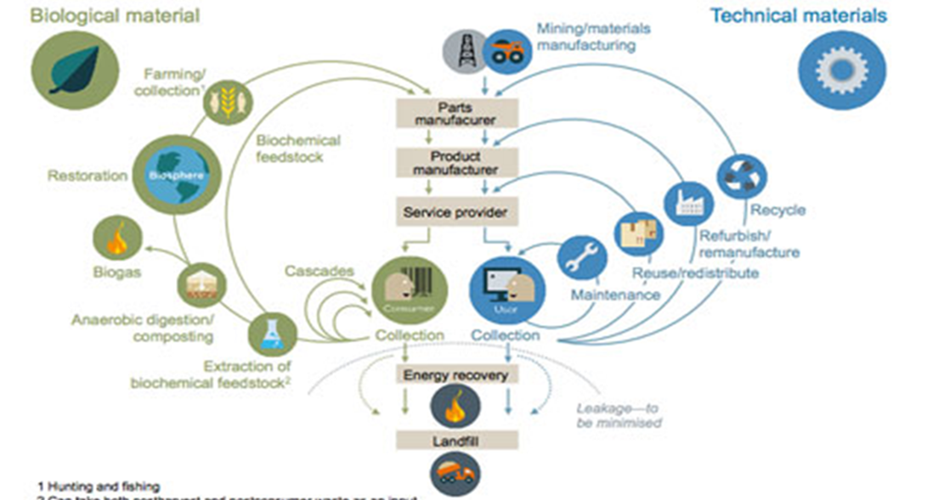
Circular economy (CE)
“..an industrial economy that is producing no waste and pollution, by design or intention, and in which material flows are of two types, biological nutrients, designed to re-enter the biosphere safely, and technical nutrients, which are designed to circulate at high quality in the production system without entering the biosphere as well as being restorative and regenerative by design”
Source: Ellen MacArthur Foundation (2012).

Slide 30
A new era?
Sustainable consumption
Circular economy
1955
Low
High
1980
Mass
Production
Mass
Customization
2010
Production volume
Networks or
Eco systems?
Production cost
1910
Craft
Production
1850
High
Low
Product variety
High
Homogenous
Heterogeneous
Figure 7.5 The evolution of production (Johnsen, Howard & Miemczyk 2014) p215

Slide 31
Networks create value that is not additive like manufacturing or co produced like services; network size is critical in many business models through creating data that is an involuntary co-creation.

Slide 32
Master of Business Administration
Digital Business Delivery
Professor Nigel Caldwell

