Slide 1

Master of Business Administration
Digital Business Delivery
Session 5 : Value Creation Services
Professor Nigel Caldwell

Slide 2
Recap Process design and mapping
Basic location issues
Basic layouts and layout design
How do volume and variety affect process design
Process mapping and Bottlenecks ARAPU case
Little’s Law
Fat vs. Thin layouts

Slide 3
Todays agenda
Why is service so important
Servitisation
How do services add value?
Resource d

Slide 4
Agenda
Basic location issues
Basic layouts and layout design
What should be the objectives of process design?
How do volume and variety affect process design
Process mapping and Bottlenecks
Little’s Law
Fat vs. Thin layouts

Slide 5
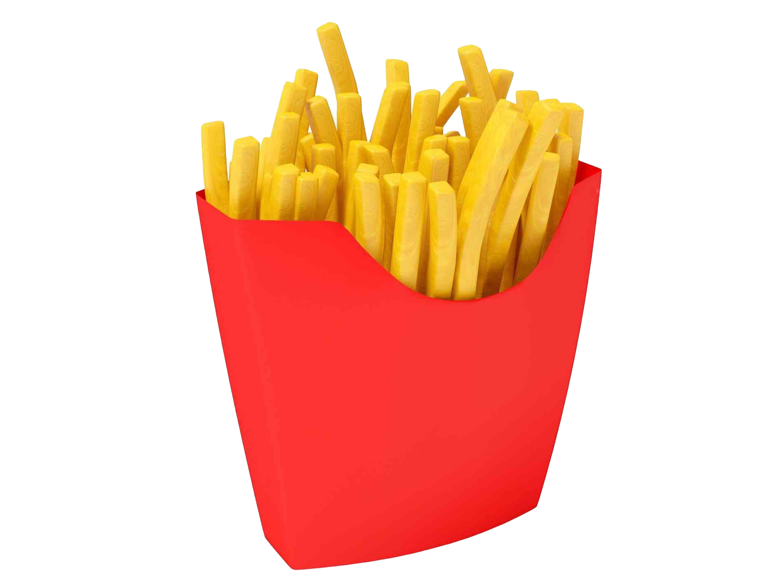

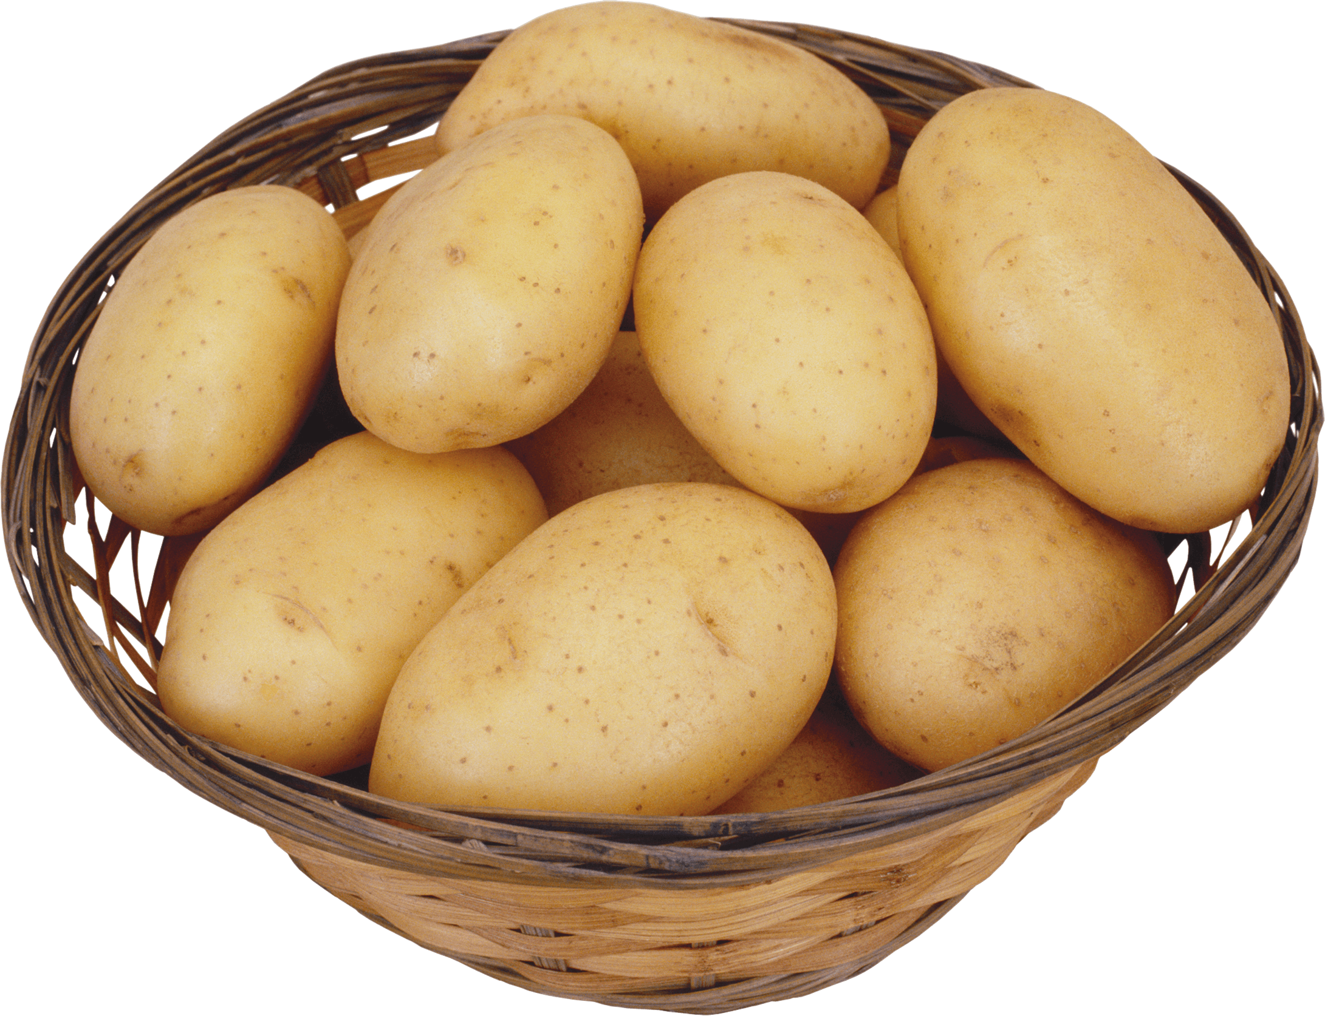
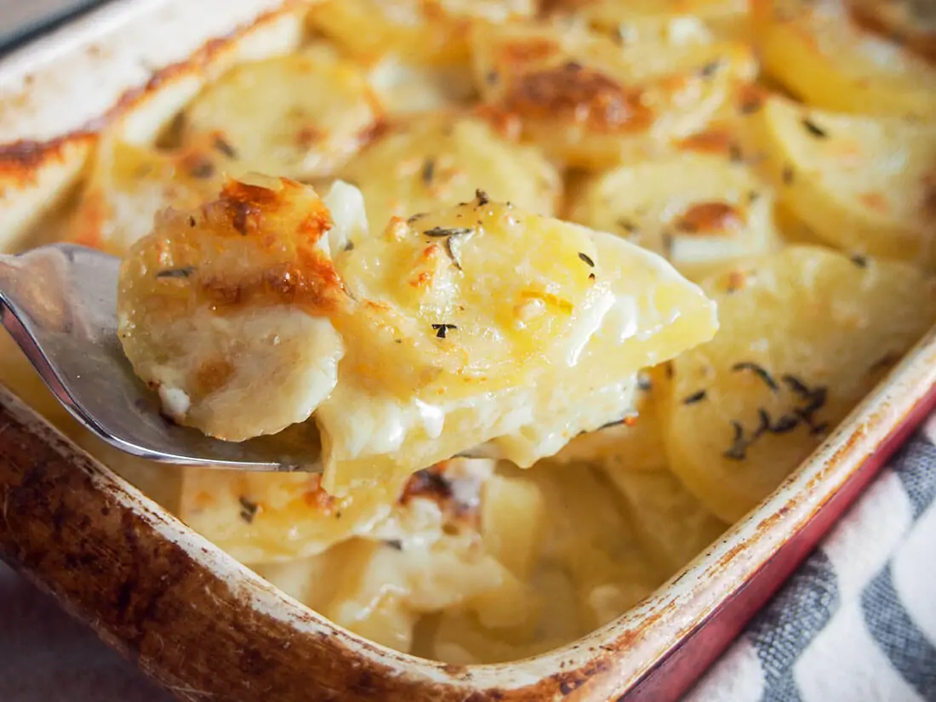
This Photo by Unknown Author is licensed under CC BY-NC
This Photo by Unknown Author is licensed under CC BY-NC

Slide 6
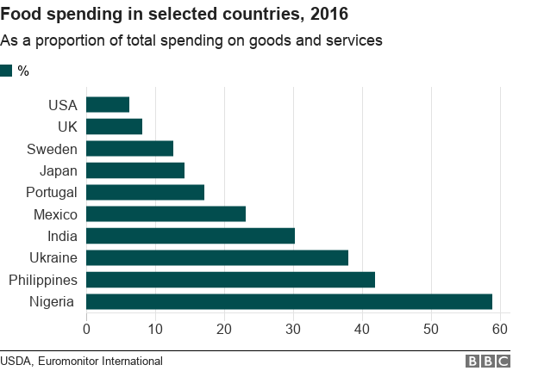

Slide 7
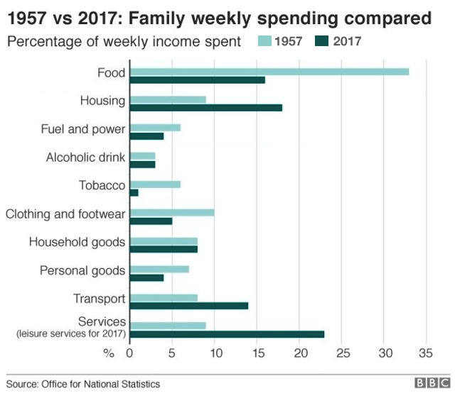

Slide 8
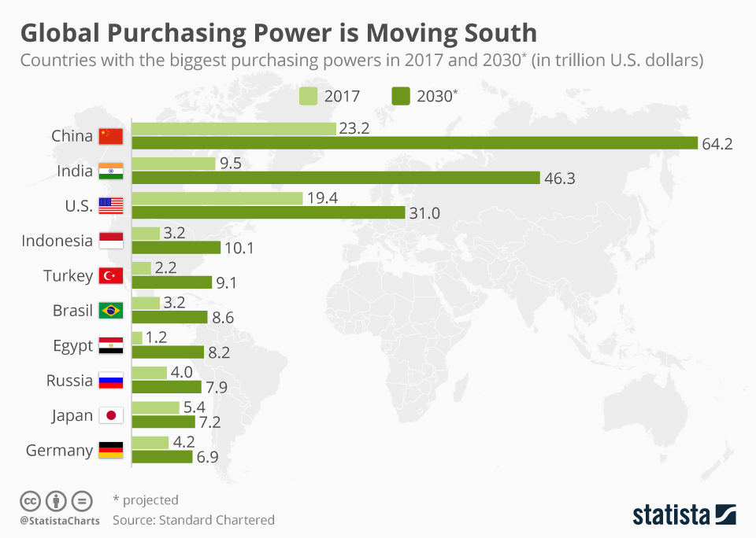

Slide 9

The importance of services
Services in the United States represent
    Three quarters of Gross National Product
    Around 90% of new jobs created in the economy
United Kingdom..
    Services: 70% of GDP (Gross Domestic Product)*
    Industry: 27.5%
    Agriculture: 2.5%
    (Source: Office of National Statistics – ONS)
    *GDP measures the total income generated by the production of goods and services within the economy.

Slide 10
The inexorable rise of service
Service industry in the US represents
¾ of Gross National Product
Around 90 % of new jobs created in the economy
... And in the UK
70 % of GDP
... Industry 27.5 %
... Agriculture 2.5 %
IBM and the rise of services

Slide 11
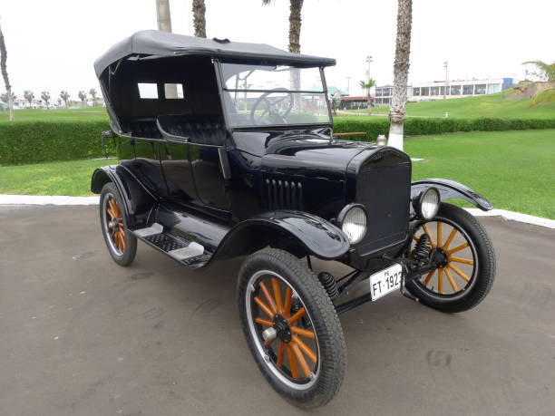
Making products isn’t where the money is!
Volume auto firms depend on aftermarket services to capture 99% of value
c.f. Henry Ford’s
Repairable Model T
(Waller / ICDP 2007)

Slide 12
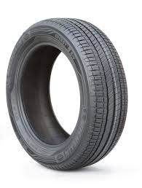
The rise of services
Increasing dominance of the service sector
  Finance, Legal, Tourism, Health, ICT
Explosion in services terminology
  Servitization, service science, service innovation, service-dominant logic (Vargo and Lusch, 2004 , 2008)
Ops & Supply still equated with manufacturing
  A need to rethink traditional Operations models
  Increased blurring of the product-service package: e.g. car tyre fitting: either OE or MRO?
OE: Original Equipment (a component fitted as part of initial manufacture)
MRO: Maintenance, Repair & Overhaul (downstream aftermarket care)

Slide 13
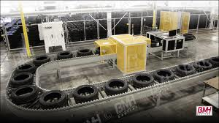
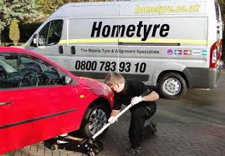
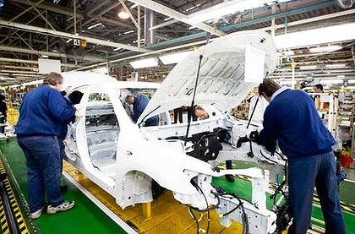
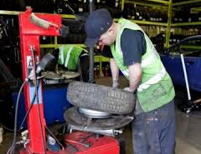
Production or service?
‘OE’
‘MRO’

Slide 14
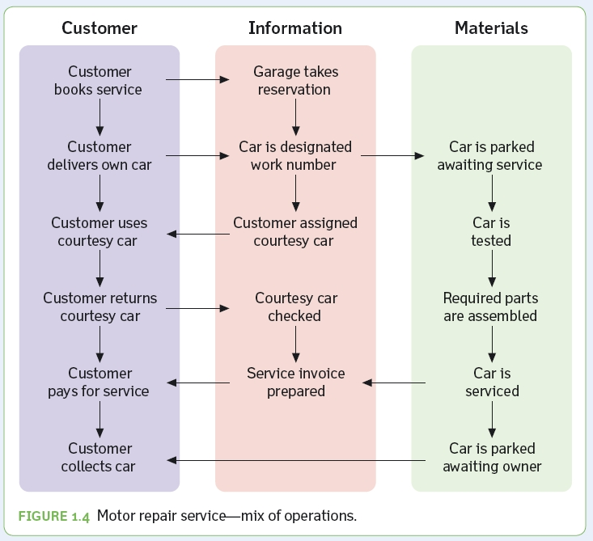
Example – Car Repair Service
Jones and Robinson, Operations Management

Slide 15
IHIP model
Intangibility (cant touch it)
Heterogeneity (variability)
Perishability (cant store it)
Simultaneity (and Inseparability)
Ref: Sasser, Wyckoff and Olsen (1978)
Jones and Robinson, Operations Management

Slide 16
Services: intangible & heterogeneous?
Operation
SERVICE OPERATION
INPUTS
materials
equipment
customers
staff
technology
facilities
OUTCOMES
including
value
emotions
judgements
intentions
PROCESS
EXPERIENCE
SERVICE PRODUCT
Customer
Managing the service operation (Adapted: Johnson & Clark, 2005)

Slide 17
Services: co-produced & simultaneous
Operation
SERVICE OPERATION
INPUTS
materials
equipment
customers
staff
technology
facilities
OUTCOMES
including
value
emotions
judgements
intentions
PROCESS
EXPERIENCE
SERVICE PRODUCT
Customer
Managing the service operation (Adapted: Johnson & Clark, 2005)

Slide 18
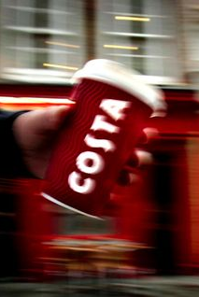
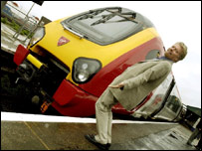
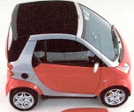
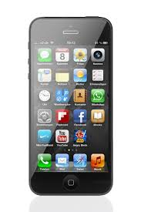
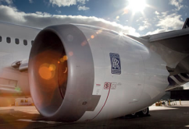
Service-based supply chains: complex!
Operation
SERVICE OPERATION
INPUTS
materials
equipment
customers
staff
technology
facilities
OUTCOMES
including
value
emotions
judgements
intentions
PROCESS
EXPERIENCE
SERVICE PRODUCT
Customer
Successful ‘SBSC’ delivery requires a complex blend of operational processes, products, services, technology & the customer experience
This is not the same as more conventional product-based supply chains which focus on high volume delivery such as FMCG

Slide 19
Limitations of some operations models
Manufacturing & production dominant
  Shift in outlook towards marketing & services
Distinguishing products from services
  IHIP now seen as ambiguous & simplistic
Traditional
Intangibility
Heterogeneity
Inseparability
Perishability
Proposed
Degree of Stockability
Degree of Intensity of
Interaction
Degree of Simultaneousness
between Production and
Consumption
Degree of Ease in
Performance Assessment
(Corrêa et al 2007)

Slide 20
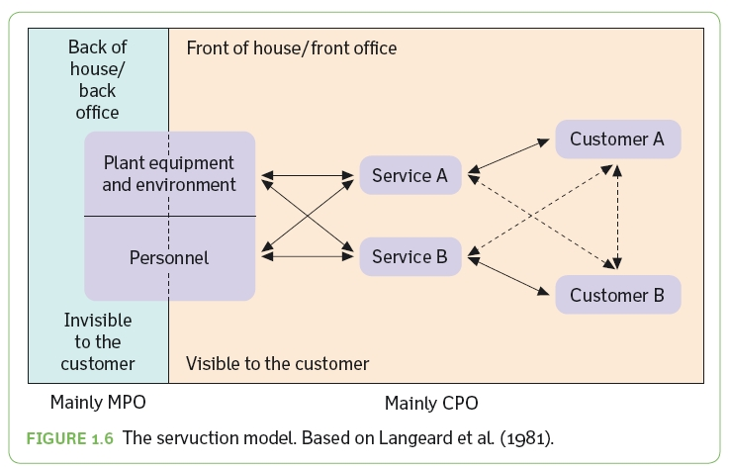
Front Office vs. Back Office
Jones and Robinson, Operations Management

Slide 21
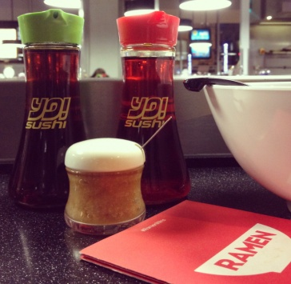
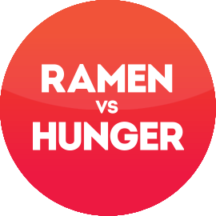


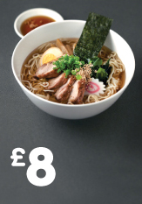
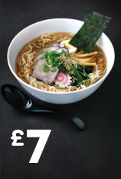

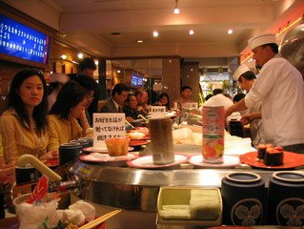
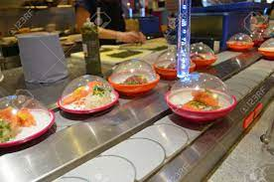
Ramen
with
a
little
garlic
purée.
What’s
your
favourite?
Five
Miso-Daré
Kaisen
Sesame
siû
Kitsune
Oil
Spice
Ramen
Pork
Ramen
Gyû
Chicken
(V)
Ramen
Ramen
Ramen
Chilli
Oil

Slide 22
Vargo and Lusch’s Service Dominant logic
We look at the world as if it is manufacturing based when it is really service based
Co-production

Slide 23
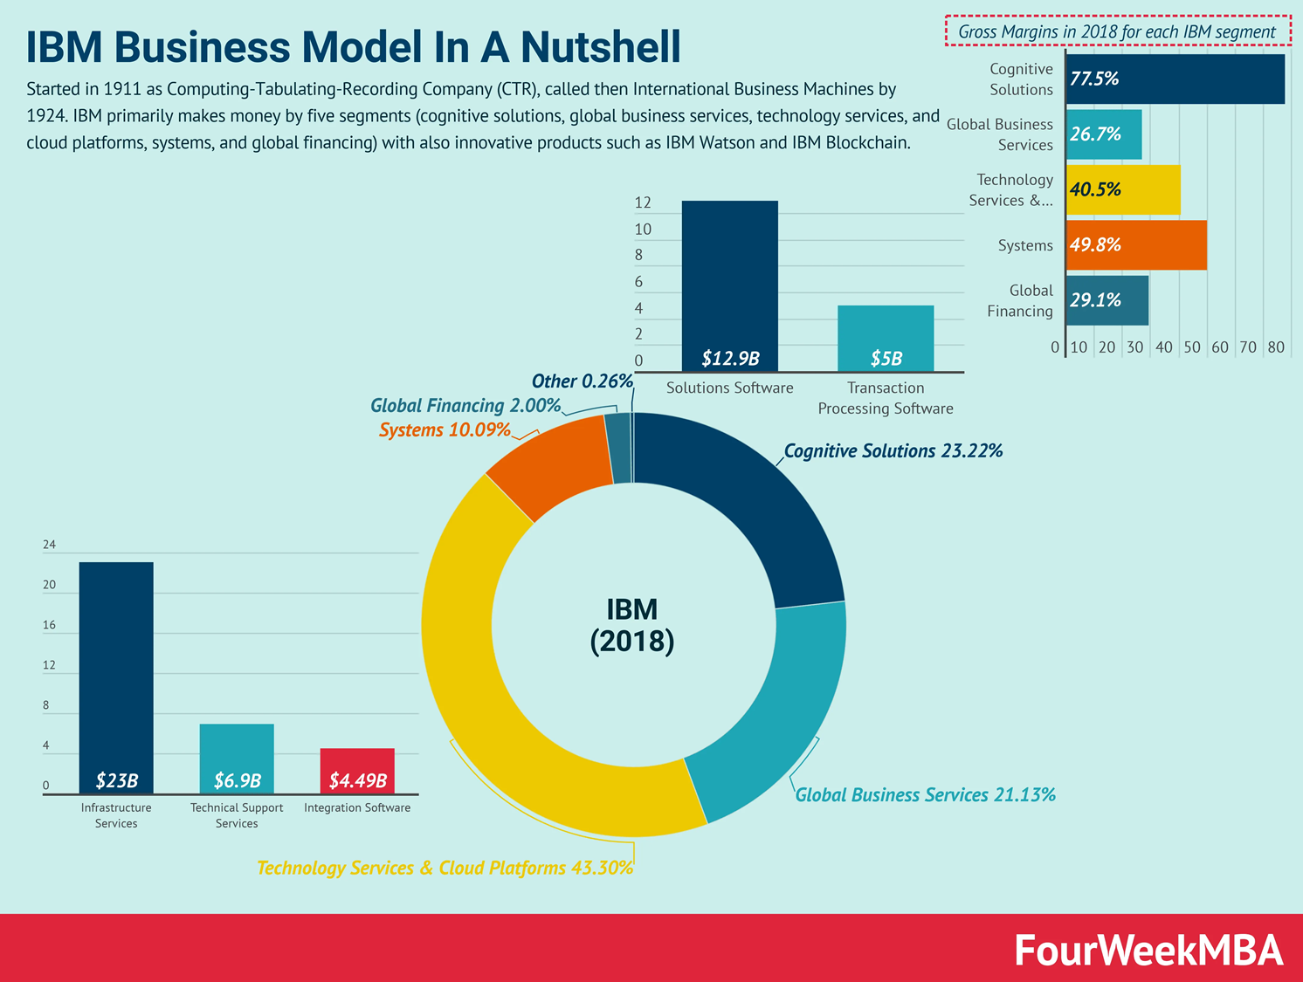

Slide 24

https://www.youtube.com/watch?v=wwEL7Zlpmq4

Slide 25


Edinburgh
Table 1: Service offered by Harley-Davidson Edinburgh
Goods | Services
Harley-Davidson bikes | Customization of bikes
Used bikes | Breakdown service
Parts & accessories | Servicing monthly subscription
Motor clothes (online and in the shop) | MOT

Slide 26

from mass production to mass customization
catalogue of parts and customization system, because many consumers have the need for uniqueness
On Facebook, they have more than 22,000 followers, targeted ads on Facebook and Instagram can bring more than 300 inquiries a day.
Sense of community from branded clothing through talks to meetings
https://www.castrum.mobi/harley-davidson-t-shirt/?sku=1045-19305-312879-504363&gclid=Cj0KCQiAt_PuBRDcARIsAMNlBdr0aw2aOUhEmEh2pOitKqep9tctqhykMm0-sqM8vf0xxkJoUcUqdqIaAgXOEALw_wcB

Slide 27
Servitisation
The rise of services

Slide 28
Servitisation
“Involves (often manufacturing companies) developing the capabilities they need to provide services and solutions that supplement their traditional product offering”.
Think help lines, upgrades, maintenance, one stop solutions, “bundling” where products and services are sold as a package, financing, consultancy, contracts for outcomes …
Also opex vs. capex issues
Notes:
Pets

Slide 29



Servitization ..and the US auto industry
Servitization: an emerging phenomenon
  It is where organizations increasingly develop services in order to add or extend product value e.g. 24hr recovery & support, vehicle finance packages, extended warranty..
Revenue
(Billions)

Slide 30
Product-service systems (PSS)
Physical product
components
Non-physical service
components
Combine to create:
Technical product-service system
Physical core
Non-physical
shell
Customers provided with
Lifecycle benefits
e.g. maintenance, support, upgrade, disposal
The structure of Product-Service Systems (Adapted: Aurich et al, 2006)

Slide 31
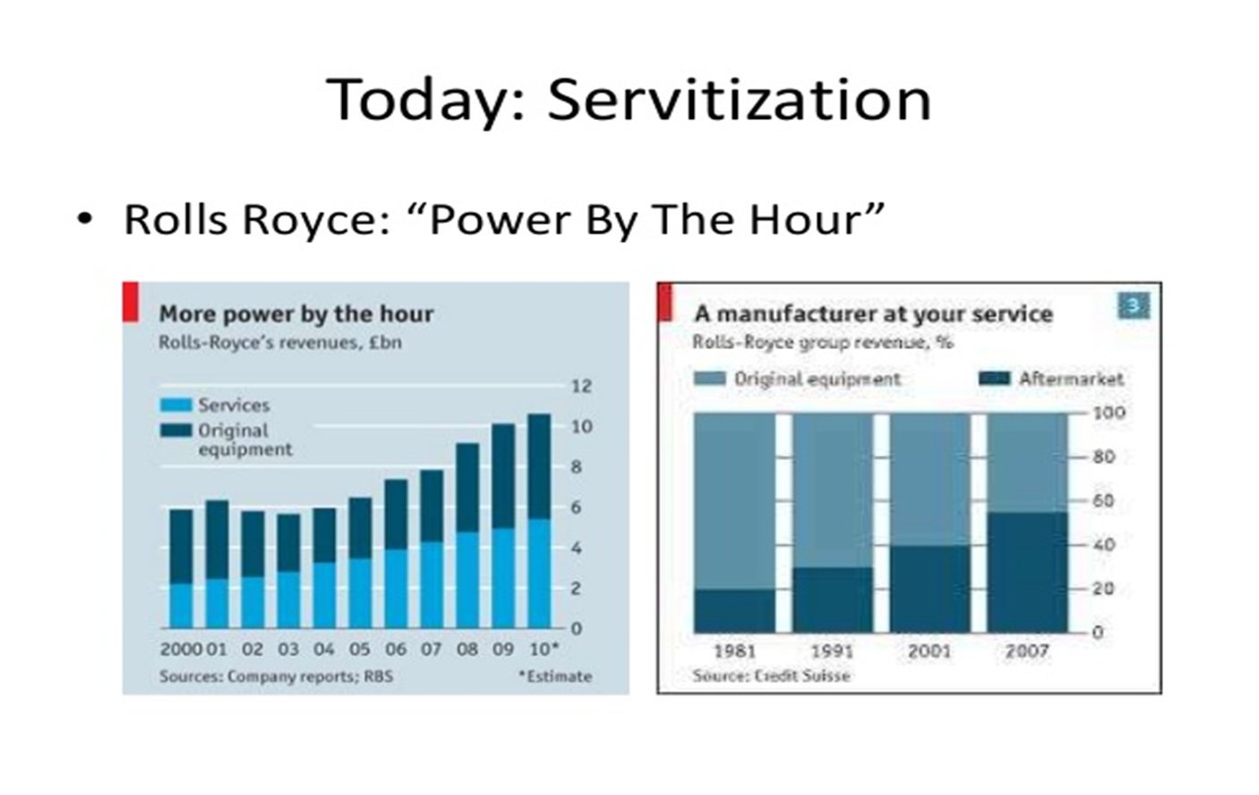

Slide 32


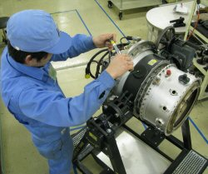

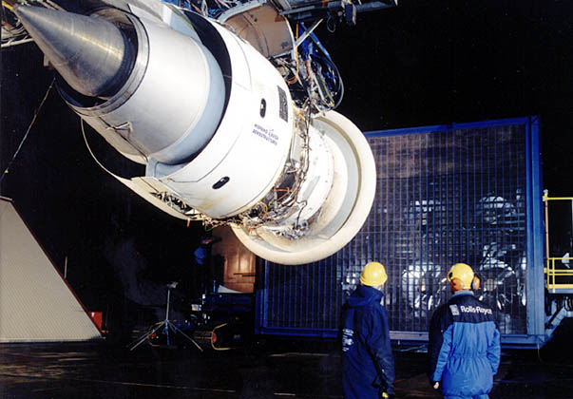
Make it, sell it, service it
Rolls Royce: “By harmonising our products & services we are stepping towards total service solutions, ranging from traditional support such as spare parts, to engine leasing and state of the art predictive maintenance services…”
MoD: “..delivering a fully integrated…capability, ..managing the project throughout the product lifecycle”
Prime supplier selection in the aerospace sector depends on the firm’s through-life management capability
+
+
=
(See: Economist article on RR, 2009)

Slide 33
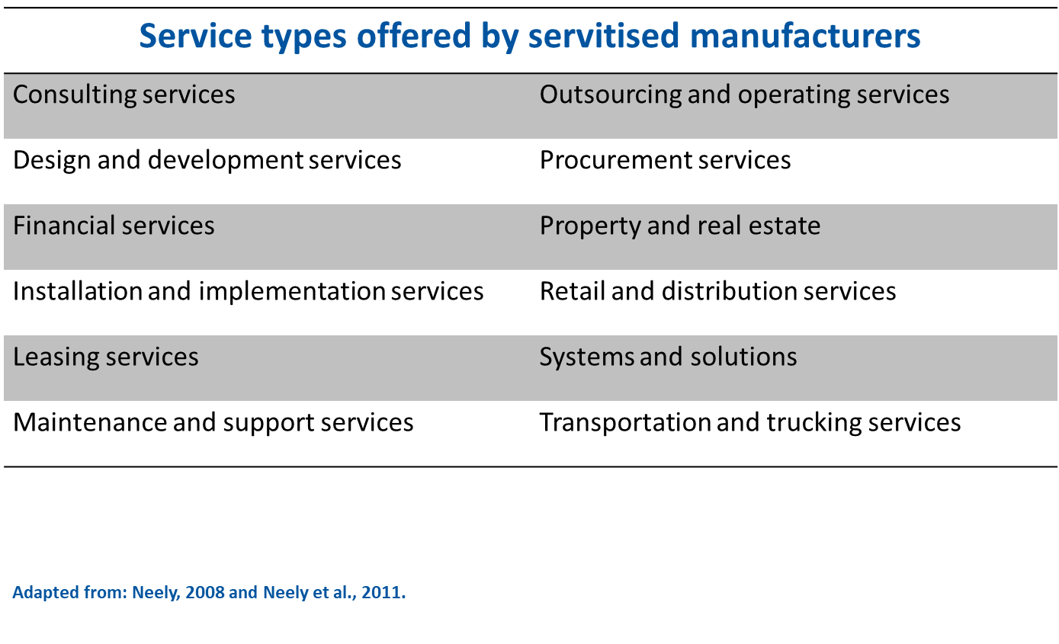

Slide 34
The Economist (2022) Can you get hooked on video games? January 1st, p46-47

Slide 35
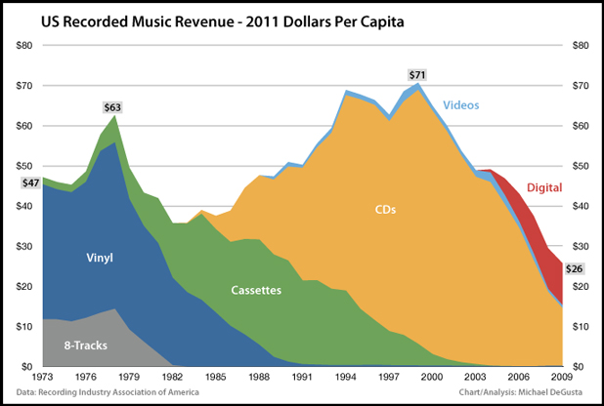
Death of the music industry
Is this servitization?
Shows risk of applying new technology to an established market

Slide 36
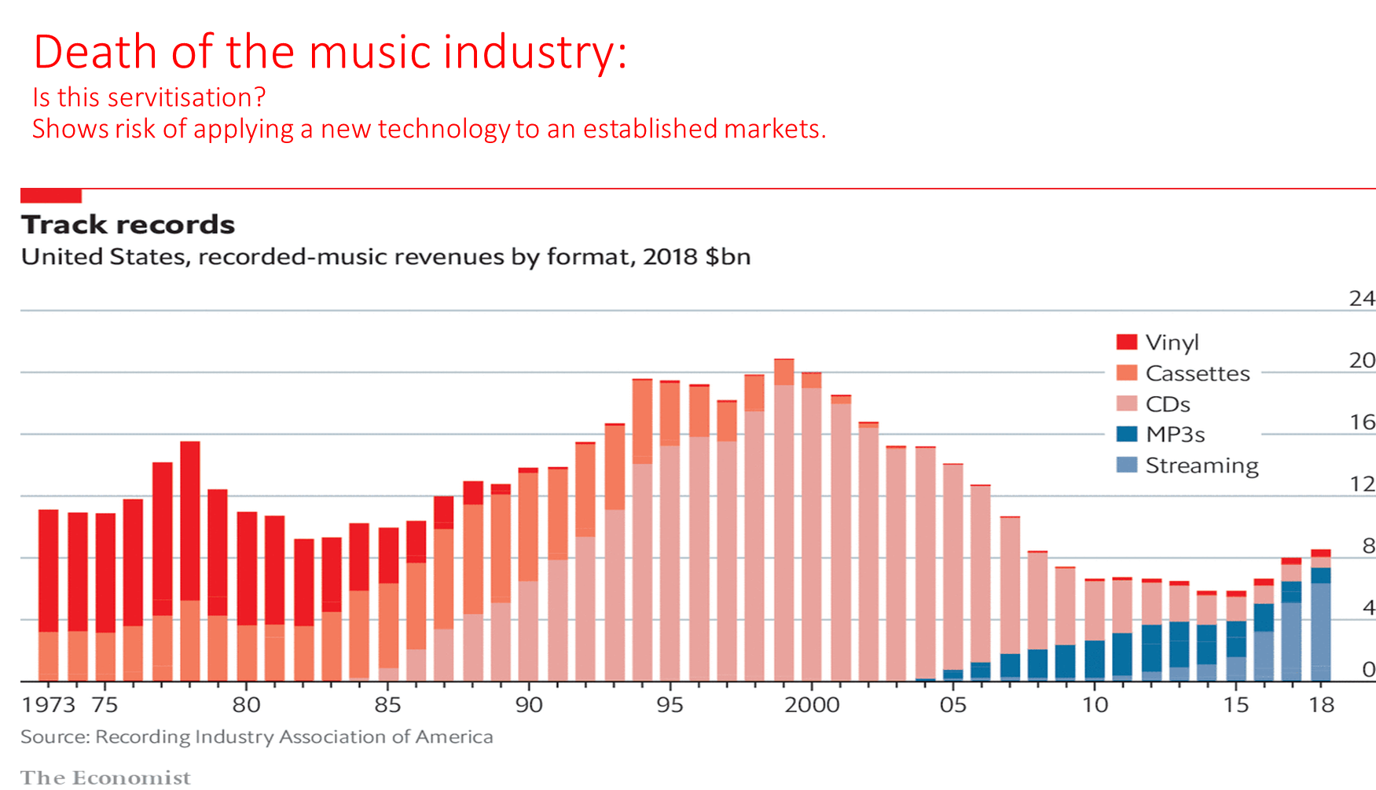

Slide 37
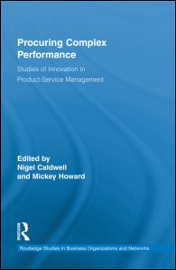
Going beyond service ‘bundling’
‘Bundling’ (Porter 1985) is simply a product of a standardised component, offered at set prices, and sold to the customer irrespective of their needs
ROEHRICH J., CALDWELL, N.D. (2012). Delivering integrated solutions in the public sector: the unbundling paradox. Industrial Marketing Management. Vol. 41(6), p995-1007
Co-existence (Araujo & Spring 2006)
Rather than define differences, seek to understand combination or co-existence of products & services
Integration (Davies & Hobday 2005: see their work on Complex Product Systems – ‘COPS’, also ‘PCP see Caldwell & Howard (2010)
Leading firms e.g. IBM, GE, Rolls & EDS compete by providing integrated solutions
Move into downstream activities to provide more customized, customer-centric solutions

Slide 38
The value stream framework
How firms change SC position to provide value
  Based on the value stream (Womack & Jones 1996)
  Framework identifies implications of ‘moving base’ on capabilities, but also systems integration function
Manufacturing Services
Downstream
Upstream
Earlier
stages
Manufacture
Systems
integration
Operational
services
Final
Service
Provision
Final
consumer
(Backwards)
Vertical moves
(Forwards)
Raw materials,
intermediate
goods, primary
product
manufatcure
Design and
physically make
components and
subsystems
Design and
integrate
products and
systems
Maintain and
operate
products and
systems
Buy in
maintenance
and operational
capacity to
provide
services to
final customers
Consumption of
service by final
consumer or end
user (e.g. train
passenger)
(Davies & Hobday 2005)

Slide 39
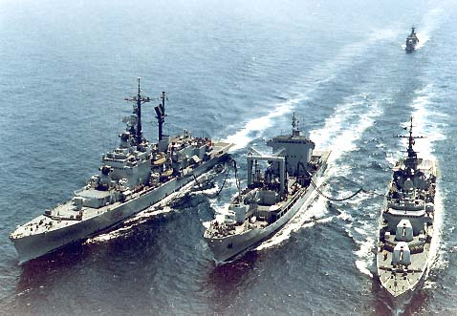
‘Go downstream…’ (Wise & Baumgarter, 1999)
Traditional emphasis
Future: In-service support & through-life capability
Upgrades
Planned expenditure profile
Strategic approach to through-life support
Logistics data
Cost
Innovation
cycle
Supplier representation
Time (Capability days led by the Director Equipment Capability with support from DPA & DLO)
C
Concept
A
Assessment
D
Demonstration
M
Manufacture
I
In-service
D
Disposal
(Adapted: DIS 2005)
Traditional emphasis
  Build-to-print, cost-plus contracts
  Central government ownership & control
Future focus: in-service support
  Through-life management
  Product platform life extension through service enhancement
  Outsourcing & public-private partnership structures

Slide 40
Through-life management
Is about managing the extended lifecycle
Through-life supply management and integrated support
Planned expenditure
Product upgrades
Strategic approach
Supplier involvement
Use of logistics data
Traditional scope of purchasing
Cost
Typical timescale: 5 -10 years
10-50 years
Time
C
A
D
M
I
D
Concept
Assessment
Demonstration
Manufacture
In
-service support
Disposal
Figure 8.3 Purchasing and the CADMID cycle (Adapted: MoD, 2005; Johnsen et al. 2009)

Slide 41
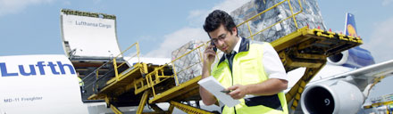
Services core to competitive advantage
Innovation today often occurs downstream from manufacturing
  ‘24/7’ customer support centres, MRO packages
Leverage technology & supply structure
  Added services, features, product upgrades
Emergence of service-orientated business models by global brands
  Power by the Hour - PbtH (Rolls Royce)
  Total Cost of Maintenance – TCM (Lufthansa)

Slide 42
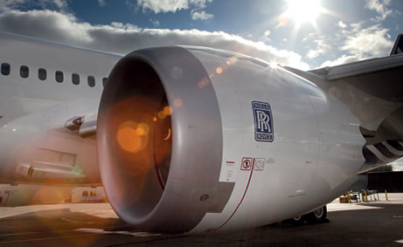
‘Full Service’ systems providers
Through-life management “Delivering a fully integrated…capability”, “Managing the project throughout the life-cycle”
Rolls Royce: “By harmonising our products & services we are stepping towards total service solutions, ranging from traditional support such as spare parts, to engine leasing and state of the art predictive maintenance services…”
Full or total service means offering a whole solution

Slide 43
RBV approach to make or buy decision
Considers the firm as a bundle of resources and capabilities (Penrose 1959)
Effective core competencies are sources of SCA:
  Valuable
  Rare
  Inimitable: difficult to copy by other firms
  Non-substitutable: unique skills or knowledge sets
  Areas where company can dominate
  Embedded in the organisation’s systems
Valuable
Rare
Inimitable
  History dependent
  Causally ambiguous
  Socially complex
Non-Substitutable
Sustained Competitive Advantage (SCA)
Figure 5.2 Simplified version of Barney’s Model of Sources of Sustained Competitive Advantage
(Adapted from Barney, 1991)
Notes:
Example of Micro compact Car and mercedes Benz
Capability is the combination of resources to create value
Examples of core capabilities from book

Slide 44
Examples of core competencies
Company | Core Competency
Apple | Design flair & portable technology
Honda | Internal combustion engine and drive train technology
Ocado | Fresh groceries & logistics
Walmart | Integrating information technology with customer delivery systems
Nike | Athletic shoe research & design
Notes:
Ref: Book of strategic outsourcing
Eg: nike and walmart

Slide 45
RBV approach to make or buy
Outsourcing must be considered as a strategic decision rather than a short-term cost-saving solution (Gadde and Håkansson, 2001)
Outsourcing is not about finding someone who can do it cheaper: it’s about leveraging knowledge capabilities
Companies seek to develop core competencies internally, leaving those that are ‘non-core’ to be developed and supplied externally
NRBV & the Interaction approach put the emphasis on understanding individual companies as parts of complex business networks
Notes:
Also called the core competency approach
Example of Micro compact Car and mercedes Benz
Leveraging:

Slide 46
Control
Exploit via licensing
Do
RR develop, invest & own
Wholly within RR
High
Buy
Tactical sourcing from the supply chain
Protect within strategic supplier partnership
Both RR and supply chain required
Depends on affordability & strategic relationship
Firm Capability
Either within RR or SC
Protect
Depends on unique or commoditised capability relationship
Wholly within SC
Irrelevant
Not differentiating, but beneficial
Differentiating & beneficial
Essential
Low
Business Criticality
High
Business Analysis Matrix (Adapted: Rolls Royce Engines)

Slide 47
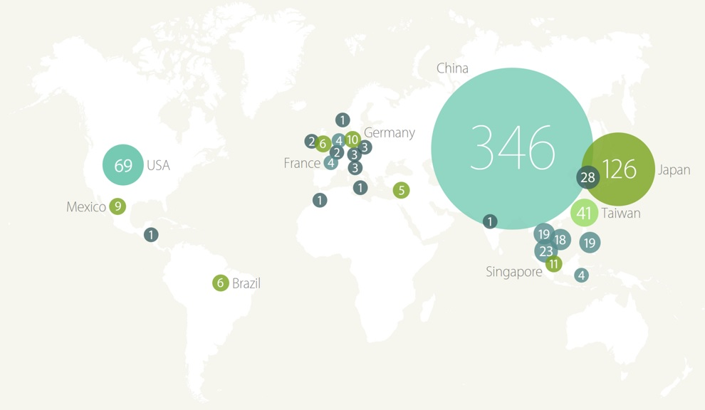
A Worldwide map displaying Apple’s Suppliers (Apple, 2016)

Slide 48
Strategic resources and sustainable competitive advantage
Operations resources can give sustainable competitive advantage if they are...
Scarce
Not very mobile
Difficult to imitate
Difficult to substitute for

Slide 49
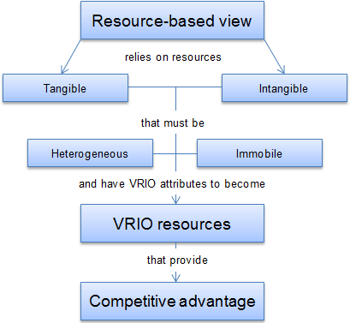

Slide 50
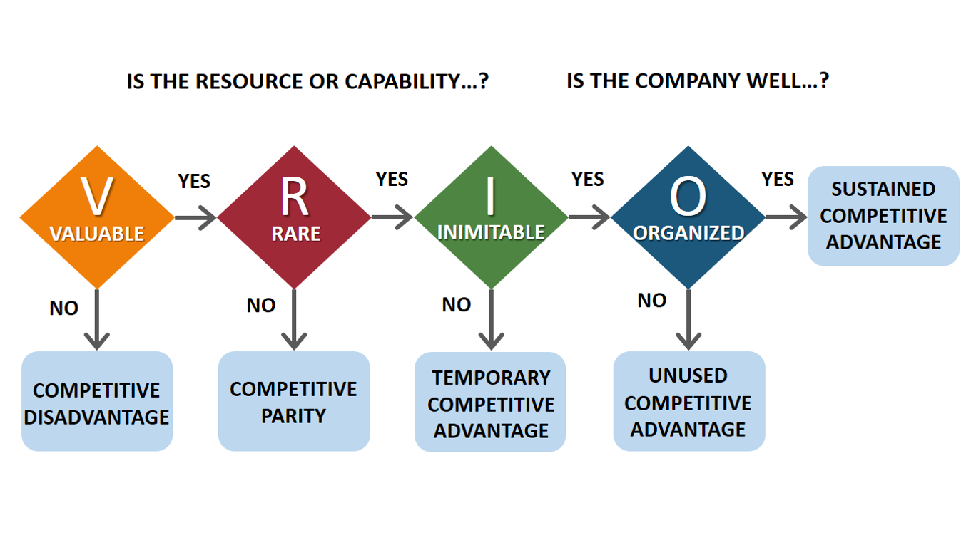

Slide 51
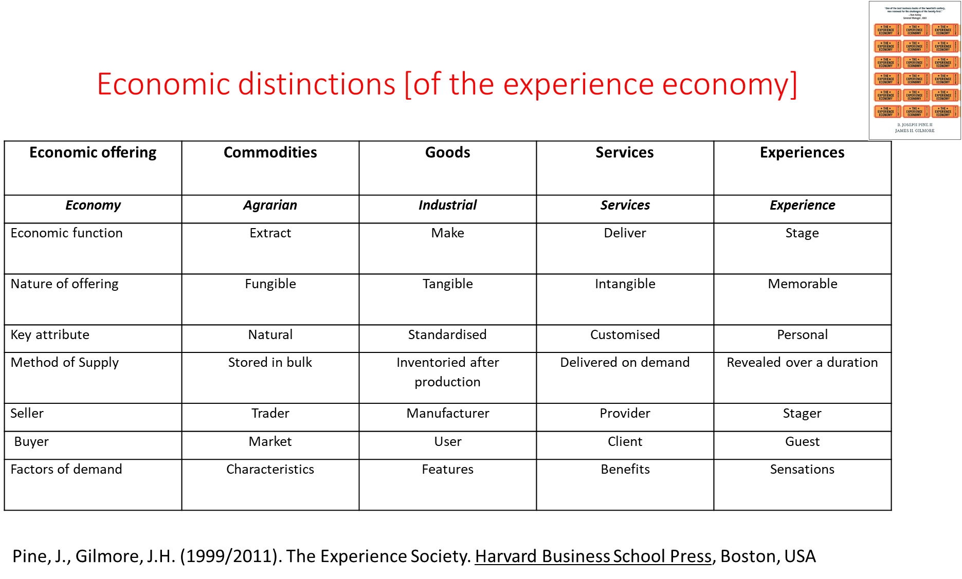

Slide 52
Conclusions
Services become more important as incomes/economies grow
Old models of what is a service do not work
Adding or increasing services is a competitive strategy ‘servitisation’
The Experience economy is arguably an extension of the service economy

