Slide 1

Master of Business Administration
Digital Business Delivery
Session 4: From craft to capital to data
Professor Nigel Caldwell

Slide 2
Operations management is about the way organisations deliver service and goods. Everything you wear, eat, sit on, use, read or knock about on the sports field comes to you courtesy of the operations managers who organised its delivery. Every book you borrow from the library, every treatment you receive at the hospital, every service you expect in the shops and every lecture you attend at university - all have been delivered.
The core activity of any organisation is its operations, and the performance of the organisation is determined by how well these operations are managed. This course takes a detailed look at the decisions managers need to make about operations.

Slide 3
[Global] Learning objectives / what is the big idea here?
Learn a series of analytical approaches, technologies and problem solving tools for operations issues
Acquire an empathy for the issues operations managers and front line employees face
Become familiar with, and able to use, appropriate vocabulary in tackling operations issues from the digital and strategic to the individual’s workstation, applying analysis and tools with empathy
How?
By exploring all the above through interaction with the course material, with me, and above all interaction with your peers

Slide 4
Agenda: Why digital delivery of operations?
Adam Smith and the division of labour
Craft to mass production & management
“Manufacturing” or “Production” Operation Management
Adding value
Servitisation
From a “capital” economy to a “Data” economy
The experience economy / The circular economy

Slide 5
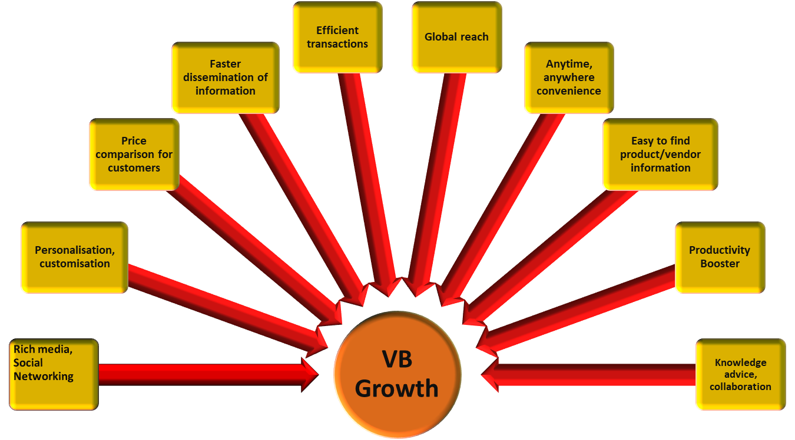
Capabilities that drive digital delivery
Source: Adapted from Turban et al. (2012)

Slide 6
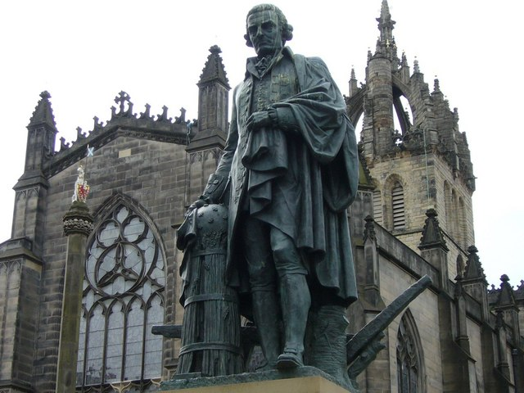
The division of labour
Adam Smith
[The Wealth of Nations]
Notes:
Adam Smith statue near St Giles Cathedral in Edinburgh, Scotland. The statue of Adam Smith is located in the heart of Old Town along the Royal Mile. He was a Scottish economist, philosopher, and author - a key figure during the Scottish Enlightenment era.
18th century
Smith's ideas–the importance of free markets, assembly-line production methods, and gross domestic product (GDP)–formed the basis for theories of classical economics.
From Smith comes the idea of the "invisible hand" that guides the forces of supply and demand in an economy. According to this theory, by looking out for themselves, every person inadvertently helps create the best outcome for all.

Slide 7
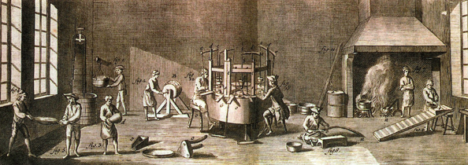
Adam Smith and the Pin factory
…I have seen a small manufactory … where ten men … [even lacking] … the necessary machinery, could make…upwards of 48,000 pins in a day. Each person, therefore, ….might be considered as making 4,800 pins in a day. But… separately and independently … they could not [each]…have made 20, perhaps not one pin in a day…
Smith, A. (2001 / 1776). The Wealth of Nations, Hayes Barton Press.

Slide 8
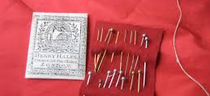
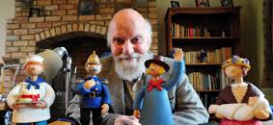
Adam Smith and the division of labour
… this business is now … divided into a number of branches, of which the greater part are likewise peculiar trades. One man draws out the wire, another straights it, a 3rd cuts it, a 4th points it, a 5th grinds it at the top for receiving the head; to make the head requires 2 or 3 distinct operations; to put it on, is a peculiar business, to whiten the pins is another; it is even a trade by itself to put them into the paper; and the important business of making a pin is, in this manner, divided into about 18 distinct operations

Slide 9

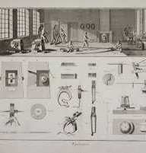
Why does the division of labour add value?
Each worker gets better at their task
Minimises movement and change over between tasks
Encourages the development of labour saving machinery
No need to employ expensive trades
New opportunities for management to co-ordinate [?] / pressure [?] the workers
Notes:
This where management class comes from coordination and also the difference between capitalism and communism

Slide 10
The Magical Number Seven, Plus or Minus Two (Miller, 1956)

Slide 11
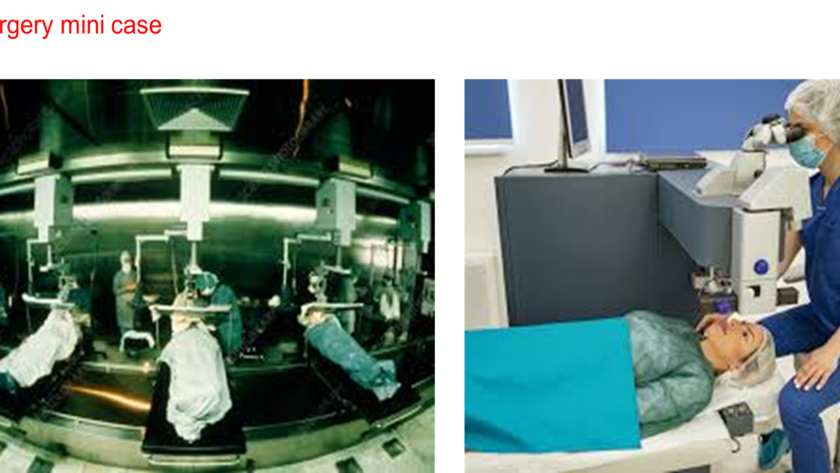

Slide 12
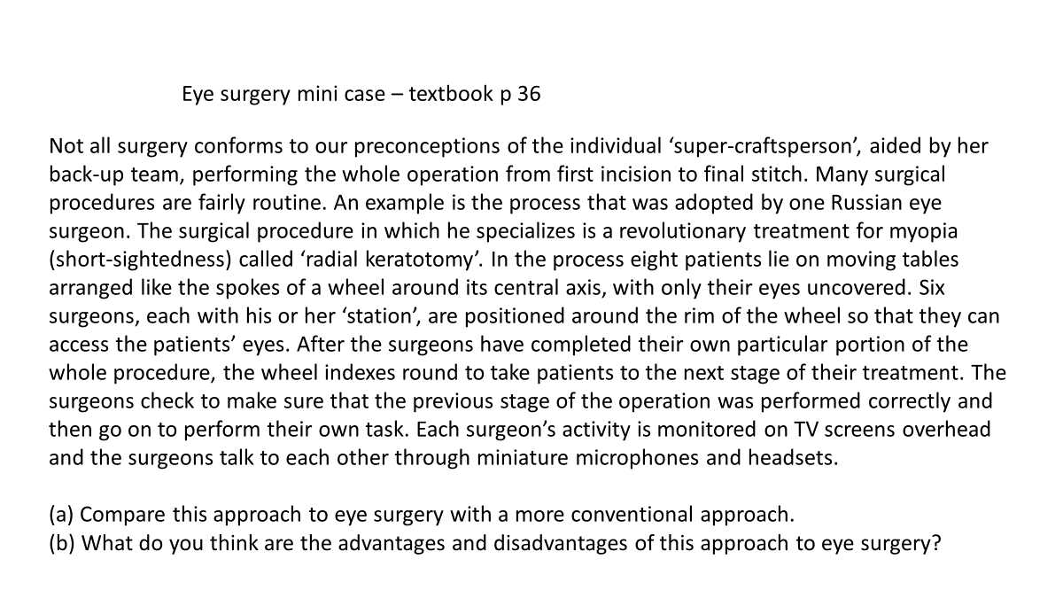

Slide 13
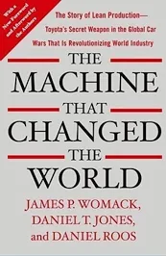
From craft to mass production
Womack, Jones and Roos. The Machine that changed the world

Slide 14
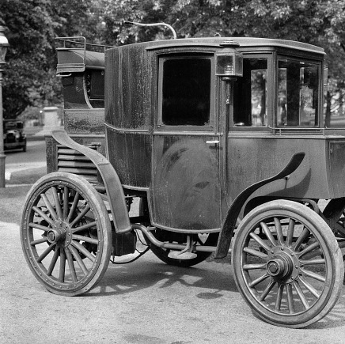
Craft car production - 1
Skilled craftspeople – often small business owners - carefully hand built cars in small numbers
All the individual production was scattered
No two cars were or could be identical
No standard gauges
Notes:
The prime alone spoke to the customer and designed the vehicle
1890s machine tools could not cut hardened steel – so they steel parts were made by hand
Oven baked to harden the steel parts warped and needed further skilled rectification

Slide 15
Craft car production – 2
At the Prime
When the parts arrive to be assembled into a car – none fit
Skilled craftspeople hand craft part Aa to fit part B and then Part C…
Complete this process for 100s of parts and create a new, unique car
For wealthy customers with chauffeurs and staff, cost, driving ease and simple maintenance not concerns
Then you test and test what today would be called a “prototype”
Notes:
“Sequential fitting” produced “dimensional creep”
So the one off, unique nature of the vehicle was made a sales feature
Appearance, speed and customization were primary
Customization was easy

Slide 16
The drawbacks of craft production
High production costs
Production costs that do not drop with higher volumes
Little consistency, durability or reliability – LOW QUALITY!
Only the rich could afford craft products
Small sub contractors could not develop technological innovation through systematic research
But a basic design was evolving – four wheels, engine at the front…

Slide 17
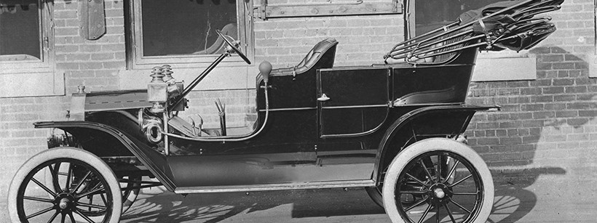
1908 Model T Ford
Designed to be easy to manufacture & to repair

Slide 18
Ford’s Mass Production
“Complete and consistent interchangeability of parts and the simplicity of attaching them to each other”
Eliminate skilled fitters
The division of labour to its ultimate extreme
Easy to train workers in hours
Line workers as easy to replace as the parts on the car
Specialist engineers: process, product, manufacturing
One model in massive volume

Slide 19
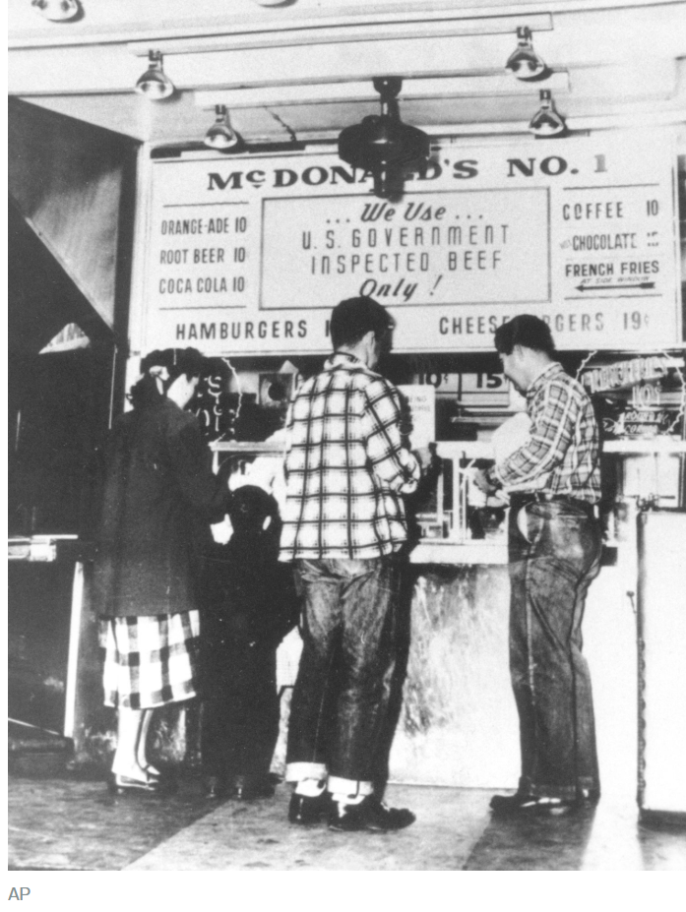
Ford’s Mass Consumption
The common “man” or at first maybe doctors, lawyers, accountants, farmers people with some money, could afford a Model T
The increasing number of buyers led to expansion and prices dropping, so more and more workers could afford a model T – and repair it themselves, if necessary
Mass production across industries lowered prices and opened up ownerships to ordinary working people - fridges, air conditioning, washing machines, cheap clothes, cheap dining out
Regular working people Eating out – Reserved for the very rich in Europe – was directly influenced by Ford’s ideas culminating in McDonald’s and KFC forming in the 1950s

Slide 20
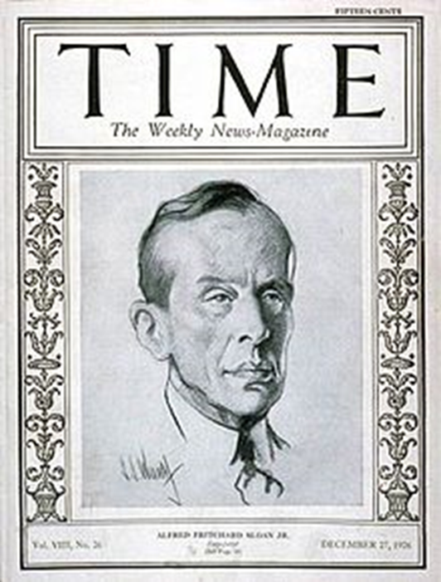
What did Sloan achieve at General Motors?
Under Sloan, GM became the largest industrial enterprise the world had ever seen. GM dominated for 70+ years..
A family of cars to grow with the buyer’s family Chevrolet, Pontiac, Oldsmobile, Buick and Cadillac ‘the ladder of success’ — models did not compete with each other. Added choice
Sloan invented annual styling changes, creating the concept of “planned obsolescence”. Added “marketing”
He also created a management structure…

Slide 21
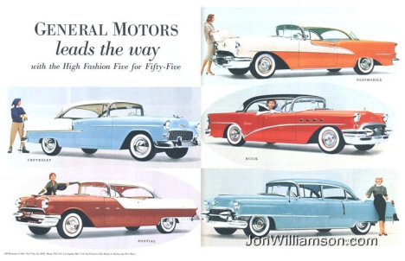

Slide 22
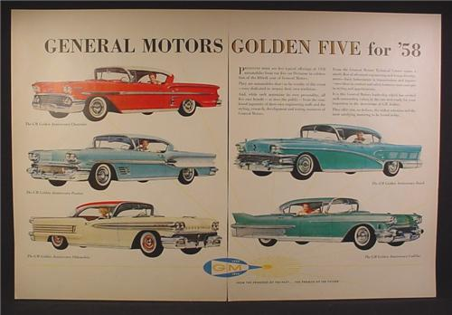

Slide 23
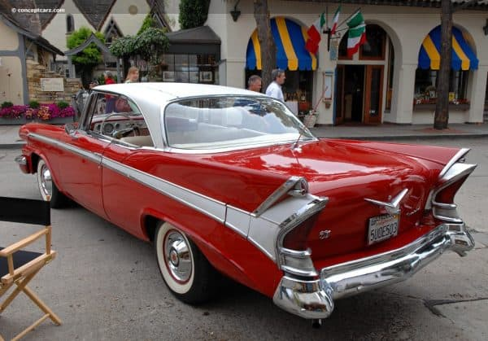
https://www.theatlantic.com/business/archive/2011/10/apples-marketing-playbook-was-written-in-the-1920s/247417/
Notes:
1959 Chevrolet

Slide 24
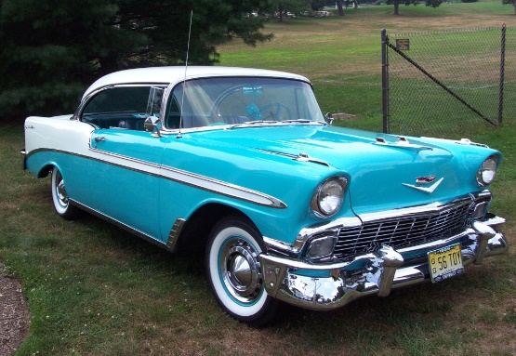
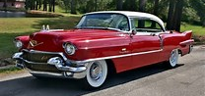
Sloan’s divisional structure
CEO
Management
Division 1
Chevrolet
Division 2
Pontiac
Division 3
Cadillac

Slide 25
1950s was boom time: Sloan’s system was rigid
Sloan an engineer built an organisation to function like an engine, a fool proof system; but it left out employees and society. For the 21st century Sloan’s system was all about "policies, systems, and structures” nothing on people, principles, and values.
One consequence of this management philosophy was a culture that resisted change (O'Toole, 1995). You could say – mass production + mass marketing - was not agile.
c.f. Michael Porter

Slide 26
Porter’s Five Forces Model
Barriers to New
Entrants
e.g. Patents, high capital investment, technology
Power of
Suppliers
Industry
Rivalry
Power of
Buyers
The intensity of competition
among current participants
Substitutes or
Alternatives
e.g. coke/water
Notes:
Key elements of porter’s model all have an influence on the amount of supply-side risk and complexity in a given marketplace … To derive five forces that determine the competitive intensity and therefore attractiveness of a market
Industrial rivalry – refers to the level of competition within an industry
Barriers to new entrants
– concerned with the costs of investment of entering the marketplace. This might be because market channels are expensive, logistics networks are required or there is a substantial amount of investment in tooling, machinery and processes
Threat of new competition
Profitable markets that yield high returns will attract new firms. This results in many new entrants, which eventually will decrease profitability for all firms in the industry. Unless the entry of new firms can be blocked by incumbents, the abnormal profit rate will tend towards zero (perfect competition).
The existence of barriers to entry (patents, rights, etc.) The most attractive segment is one in which entry barriers are high and exit barriers are low. Few new firms can enter and non-performing firms can exit easily.
Economies of product differences / Brand equity / Switching costs or sunk costs Capital requirements / Access to distribution / Customer loyalty to established brands / Absolute cost / Industry profitability; the more profitable the industry the more attractive it will be to new competitors.

Slide 27
Make or buy analysis
Outsourcing used to focus on periphery activities
  E.g. Catering, cleaning, security
Today it increasingly involves more strategic areas
  Manufacturing, design and logistics (McIvor, 2009)
  Strategic evaluation of the firm: ‘what are we & what do we do?’
A number of outsourcing models inform the so-called ‘make or buy’ decision
  Arnold (2000)
  TCE: Williamson (1975, 2005, 2008)
  RBV: (Wernfelt, 1984; Barney, 1991, Teece et al, 1997) & NRBV
  Interaction approach / IMP (Hakansson, 1982, 1987)
Third option: make, buy or ‘ally’: inter-firm alliance
  Alliance based collaboration (Jacobides & Billinger, 2006)
Notes:
Outsourcing: “moving functions or activities outside of the organisation” (e.g. Lonsdale and Cox, 1997)
¼ of European/US companies now use 3rd party Procurement Service Providers (PSPs) for e.g. hosting e-sourcing and e-procurement applications: expected to grow (Accenture Procurement Survey, 2003)

Slide 28
Outsourcing Model (Arnold, 2000)
Key question: is an activity core or non-core to the business?
Company
core
Outsourcing
Partner
or supplier
Functions close to core
Complementary functions
Peripheral functions
Figure 5.1 Outsourcing Model (Adapted: Arnold 2000).
Arnold’s 2000 model provides a useful starting point
  However, the boundary between the company & its environment is no longer clear cut

Slide 29
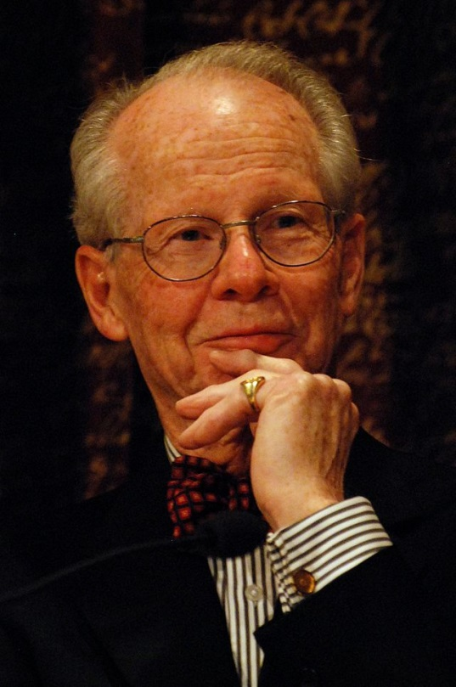
Transaction Cost Economics
Transaction costs involve:
  Costs of making each contracts
  Search and information costs
  Bargaining and decision costs
  Policing and enforcement costs
  Also called ‘frictional costs’ that arise from buyer-supplier negotiation, drafting and monitoring of contracts
Oliver Eaton Williamson (born September 27, 1932) is an American economist, a professor at the University of California, Berkeley, and recipient of the 2009 Nobel Memorial Prize in Economic Sciences.
Notes:
The transaction cost approach to the theory of the firm was created by Ronald Coase: The Nature of the Firm (1937) and Coase won the Nobel prize in 1991!!
Transaction cost refers to the cost of providing for some good or service through the market rather than having it provided from within the firm.
In order to carry out a market transaction it is necessary to discover who it is that one wishes to deal with, to conduct negotiations leading up to a bargain, to draw up the contract, to undertake the inspection needed to make sure that the terms of the contract are being observed, and so on. More succinctly transaction costs are:
search and information costs
bargaining and decision costs
policing and enforcement costs
Coase contends that without taking into account transaction costs it is impossible to understand properly the working of the economic system and have a sound basis for establishing economic policy.
Outsourcing activities from a transaction cost perspective
Specificity refers to asset specificity as well as human capital specificity
Goods and services with low specificity can be governed by an external outsourcing design - little information has to be exchanged with the transaction partner. External outsourcing partners are able to bundle demand and exploit economies of scale
Goods and services with high specificity result in high market transaction costs. It makes sense to establish an internal outsourcing design for these transactions
Based on firms core competencies - so insource
Come onto core competencies in a moment

Slide 30
TCE approach to make or buy decision
Asset specificity is the most important aspect of a transaction (Williamson, 1989, 1991)
High asset specificity
High transaction cost
High risk of opportunism
Low asset specificity
Low transaction cost
Low risk of opportunism
In-sourcing
Outsourcing
Make
Buy
Notes:
Asset specificity means many information needs to be shared among partners
Transactions can be dimensionalized in terms of
Uncertainty.
Frequency.
Asset specificity
Various kinds of asset specificity.
Asset specificity implies the existence of quasi-rents.
For a given ”governance structure” (e.g., the market), varying these dimensions means varying transaction costs.
Williamson:
He assumes opportunism as standard behaviour. Williamson only one proponent/one strand of TCE
Theory of the firm perspective.
Williamson- fixation: Asset specificity central; central concern with hold-up.
The firm’s environment not really brought into focus.

Slide 31
Transaction Cost Analysis
Hierarchies are more expensive than markets to establish, govern and maintain
Hierarchies are used where the transaction cost is minimised relative to markets
This occurs when the product or service is not available in the market, or the governance of it through the market mechanism is prohibitive, due to specificity or uncertainty issues
Notes:
Use as notes

Slide 32
Transaction Cost Analysis (2)
Governance structures
  Market
  Hierarchy
  Hybrid
Asset specificity
  Site, physical, human, brand, dedicated assets, temporal
Environmental uncertainty
Behavioural uncertainty e.g. opportunism
  Mitigate through performance measurement
  Source: Williamson, O.E. (1983) The Economics of Organization: The Transaction Cost Approach. American Journal of Sociology
Notes:
Use as notes

Slide 33
Criticisms of the TCE approach
TCE focuses on cost minimization, not on value maximization
It assumes that capabilities pre-exist and can be developed equally in all firms: which is not always possible
It implies that all firms facing the similar set of transactional attributes will reach similar conclusions regarding in-sourcing and outsourcing
TCE - ‘bad for practice’ (Ghoshal & Moran, 1996):
“..organizations are not mere substitutes for structuring efficient transactions when markets fail.”
Notes:
Because it is just based on the transaction cost and internal capability is not taken in account
Last point example: having in same industry DELL and IBM have 2 different philosophy. Dell is highly disintegrated and outsource most of the products while IBM is highly integrated and not outsource much of the resources like dell.

Slide 34
In praise of mass production
It feeds us
It clothes us
It provides healthcare, contraception and VACCINES!
It provides sanitation
It lets us experience art and music and culture from around the planet
We can afford cool stuff

Slide 35
Operations Management as Manufacturing or Operations Research
The age of Best Practice (and the auto industry)

Slide 36
Configuring value for competitive advantage on chains, shops and networks
This section is based on this paper by CHARLES B. STABELL and ØYSTEIN D. FJELDSTAD
Strategic Management Journal, Vol. 19, 413–437 (1998)

Slide 37
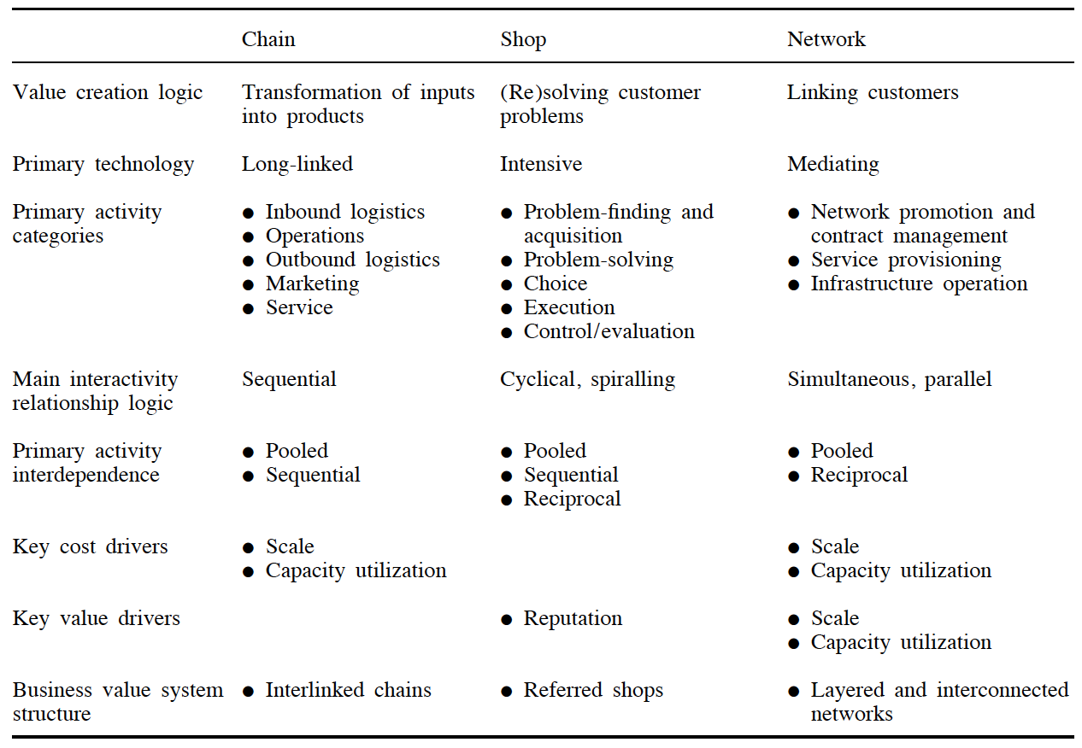

Slide 38
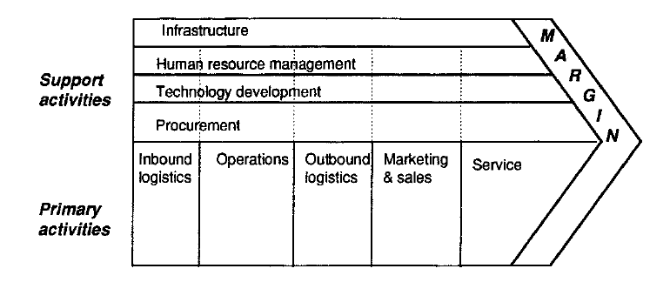
The value chain

Slide 39
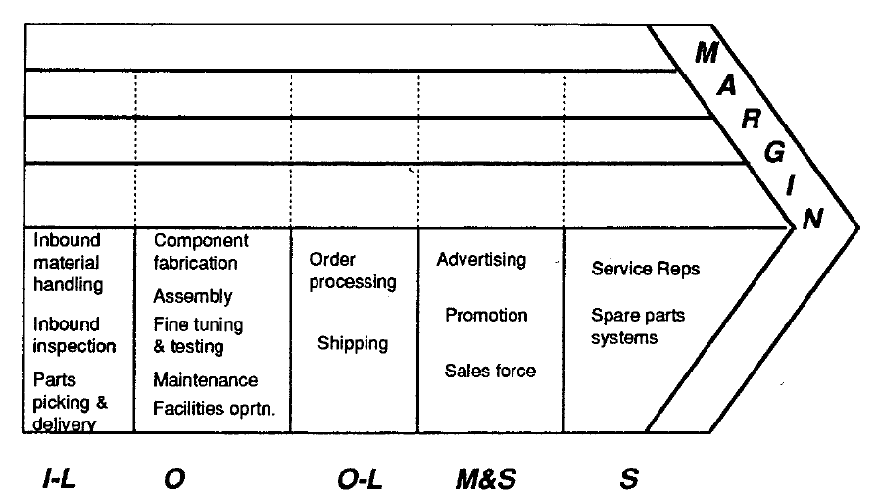
Value chain diagram for a copier manufacturer

Slide 40
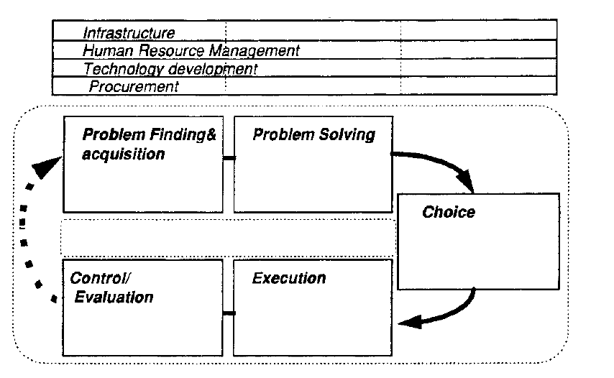
The value shop

Slide 41
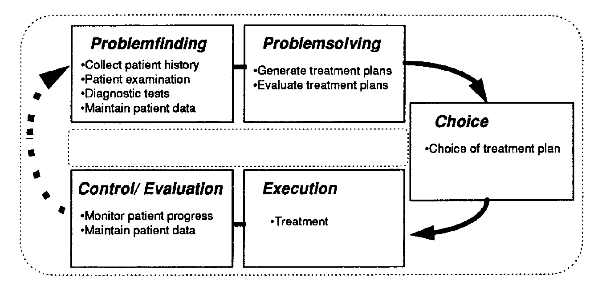
Value shop diagram for a general practitioner

Slide 42
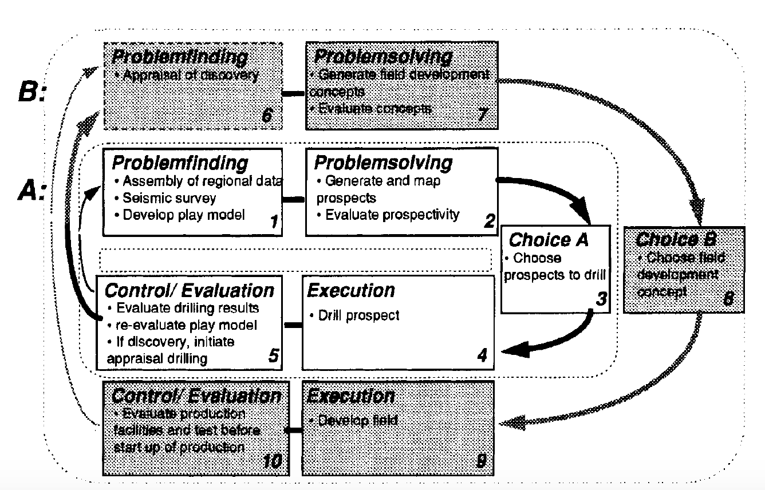
Value shop diagram for a petroleum explorer (A) and field developer (B)

Slide 43
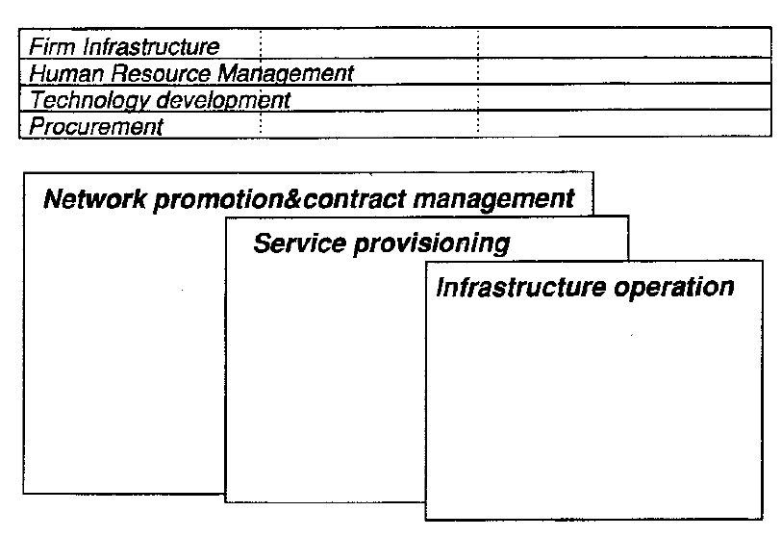
The value network

Slide 44
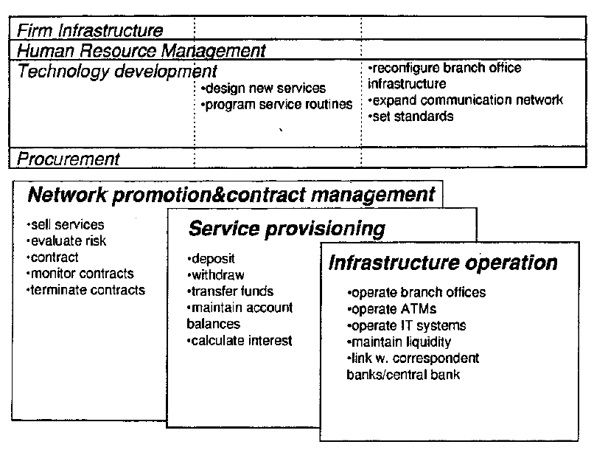
Value network diagram for a retail bank

Slide 45

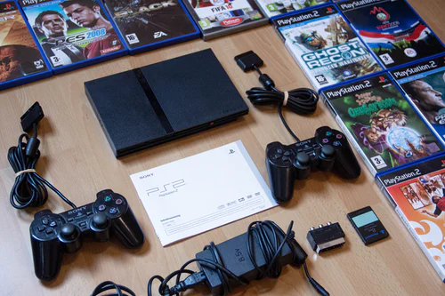


Digital technologies generate, store or process Data

Slide 47
The circular economy

Slide 48
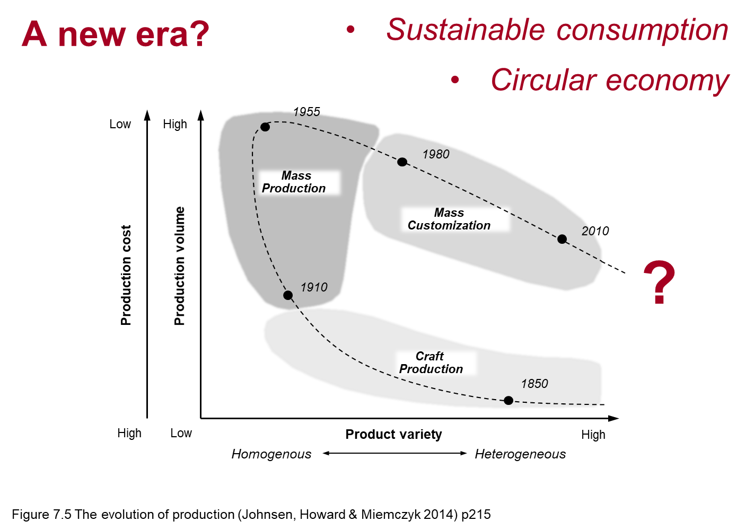

Slide 49
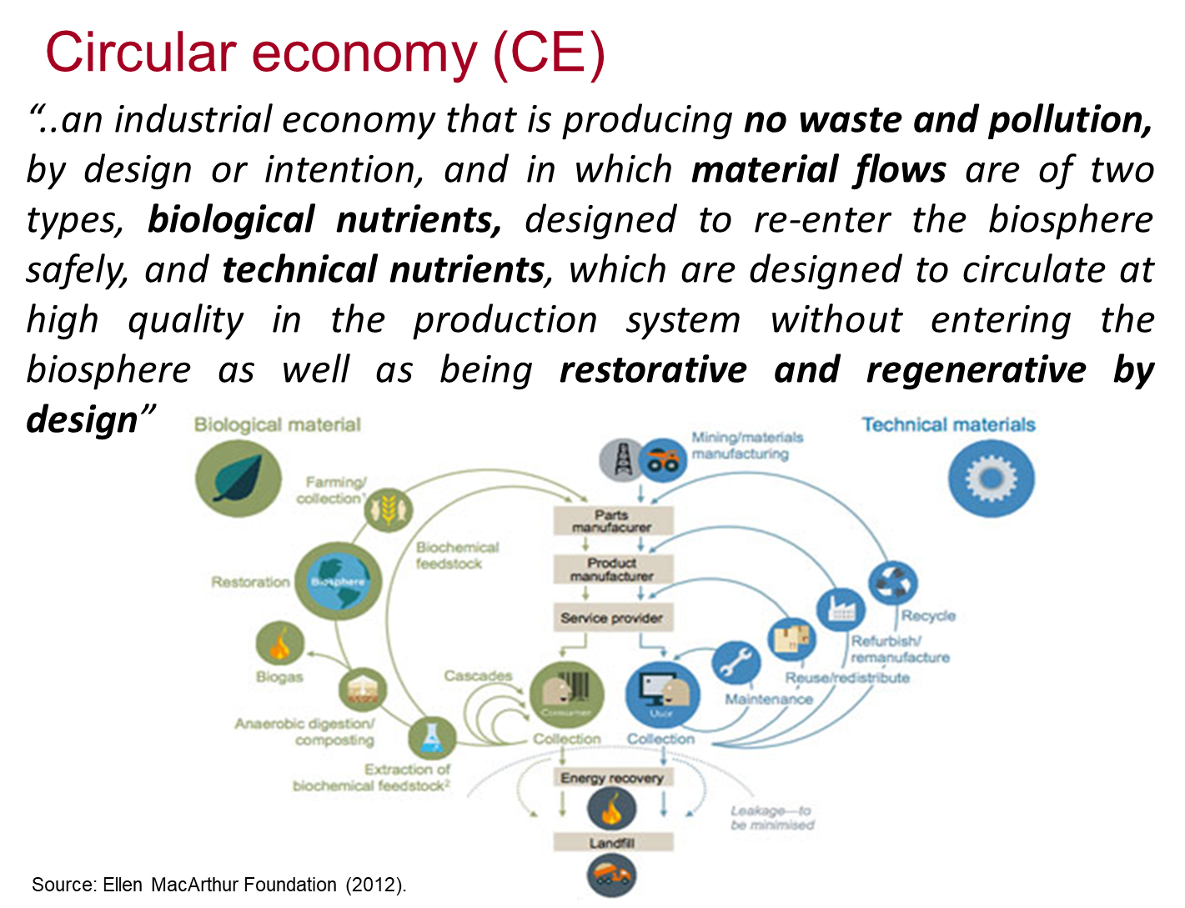

Slide 50
How does an organisation, enterprise, public body add value?
One approach is to frame adding value in terms of a chain or a service shop or a network
How then does digital technology improve/increase/enhance the value added – I have argued it is contingent to the way value is added in the domain not categoric or fixed irrespective of the business model
So… there is good practice but no best practice

Slide 51
Master of Business Administration
Digital Business Delivery
Professor Nigel Caldwell

Slide 52
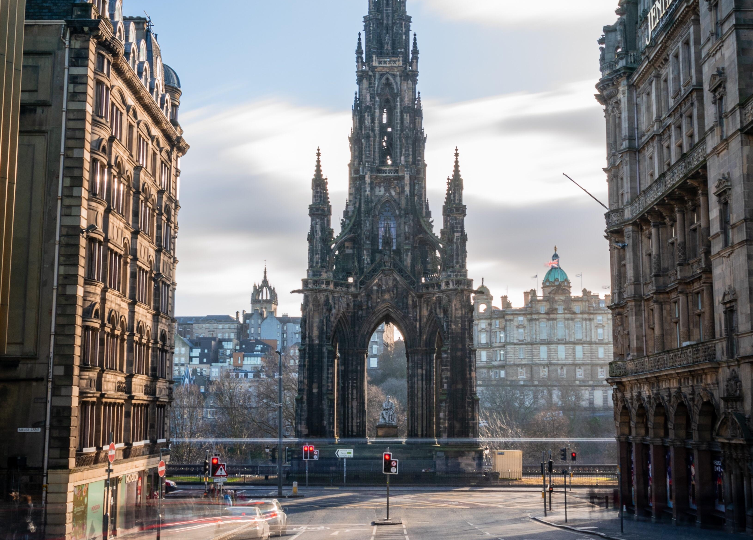

The Walter Scott
Monument,
Edinburgh –
another
unreadable
Scottish
author
Notes:
Ridley Scott

