Slide 1

Master of Business Administration
Digital Business Delivery
Session 3 : Process design, mapping and improvement
Professor Nigel Caldwell

Slide 2
Recap last session
What is operations management ?
What are the competitive advantages OM can offer?
Introduced the idea of performance trade offs – e.g. IKEA
Some businesses and clubs have to manage multiple products or services
OM strategy as a pattern of decisions e.g IKEA – 4Vs
Production Game

Slide 3
Agenda
Basic location issues
Basic layouts and layout design
What should be the objectives of process design?
How do volume and variety affect process design
Process mapping and Bottlenecks
Little’s Law
Fat vs. Thin layouts

Slide 4

Location design
A data centre is ‘a facility composed of networked computers and storage that businesses or other organizations use to organize, process, store and disseminate large amounts of data. A business typically relies heavily upon the applications, services and data contained within a data centre, making it a focal point and critical asset for everyday operations’. These facilities can contain network equipment, servers, data storage and back-up facilities, software applications for large companies, and more.
Businesses and people rely on them, determining their location is a crucial decision for those operations running them.

Slide 5
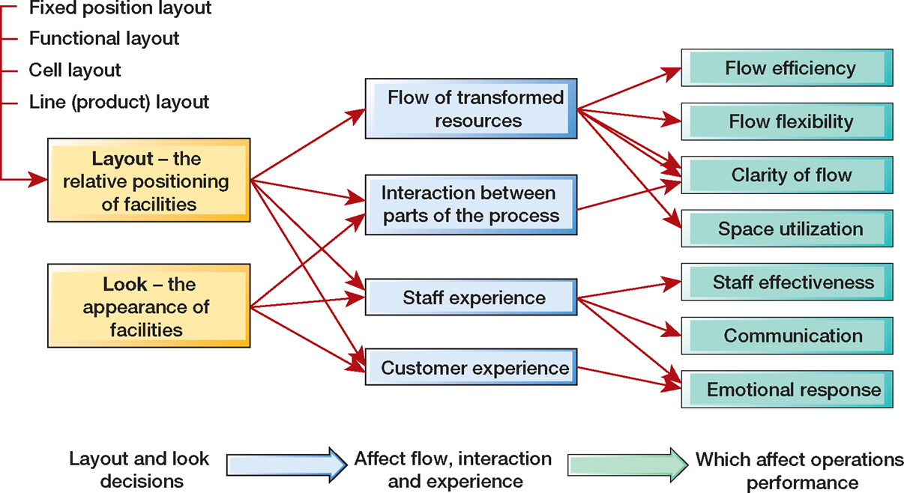
The impact of layout and look of facilities

Slide 6
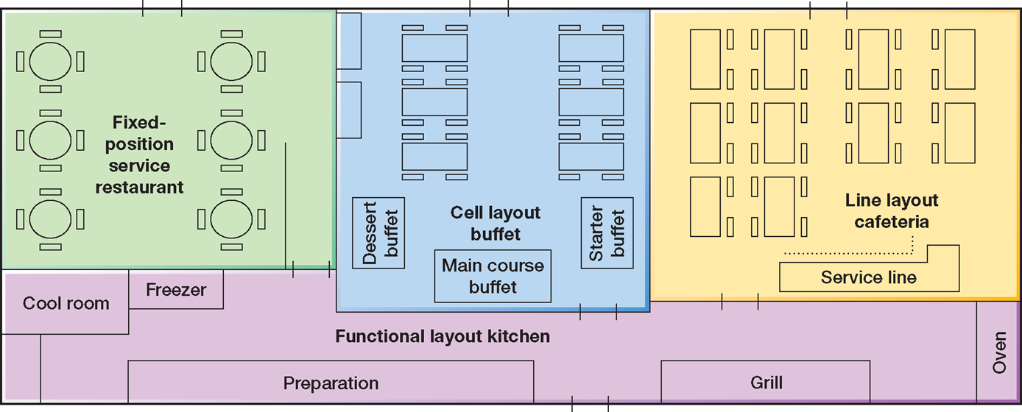
A restaurant with all four types of basic layout

Slide 7
A computer games developer is moving into new offices. The new office has a floor space of
approximately 300 square metres in the form 20 metres by 15 metres. The company has six
departments, (Textbook Figure 7.21). This also shows the approximate area required by each department and the degree of closeness required between each department. Below: The required areas and closeness for the six departments of the computer games developer

Slide 8
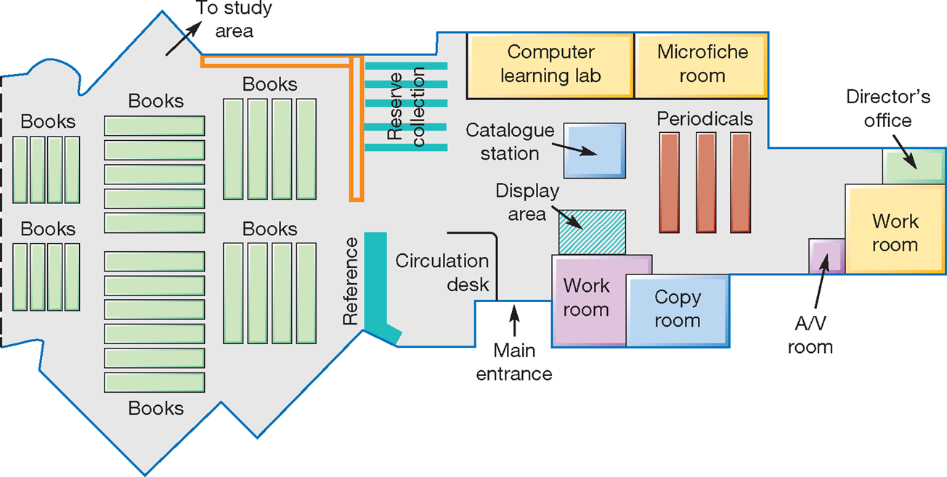
Functional layout in a library

Slide 9
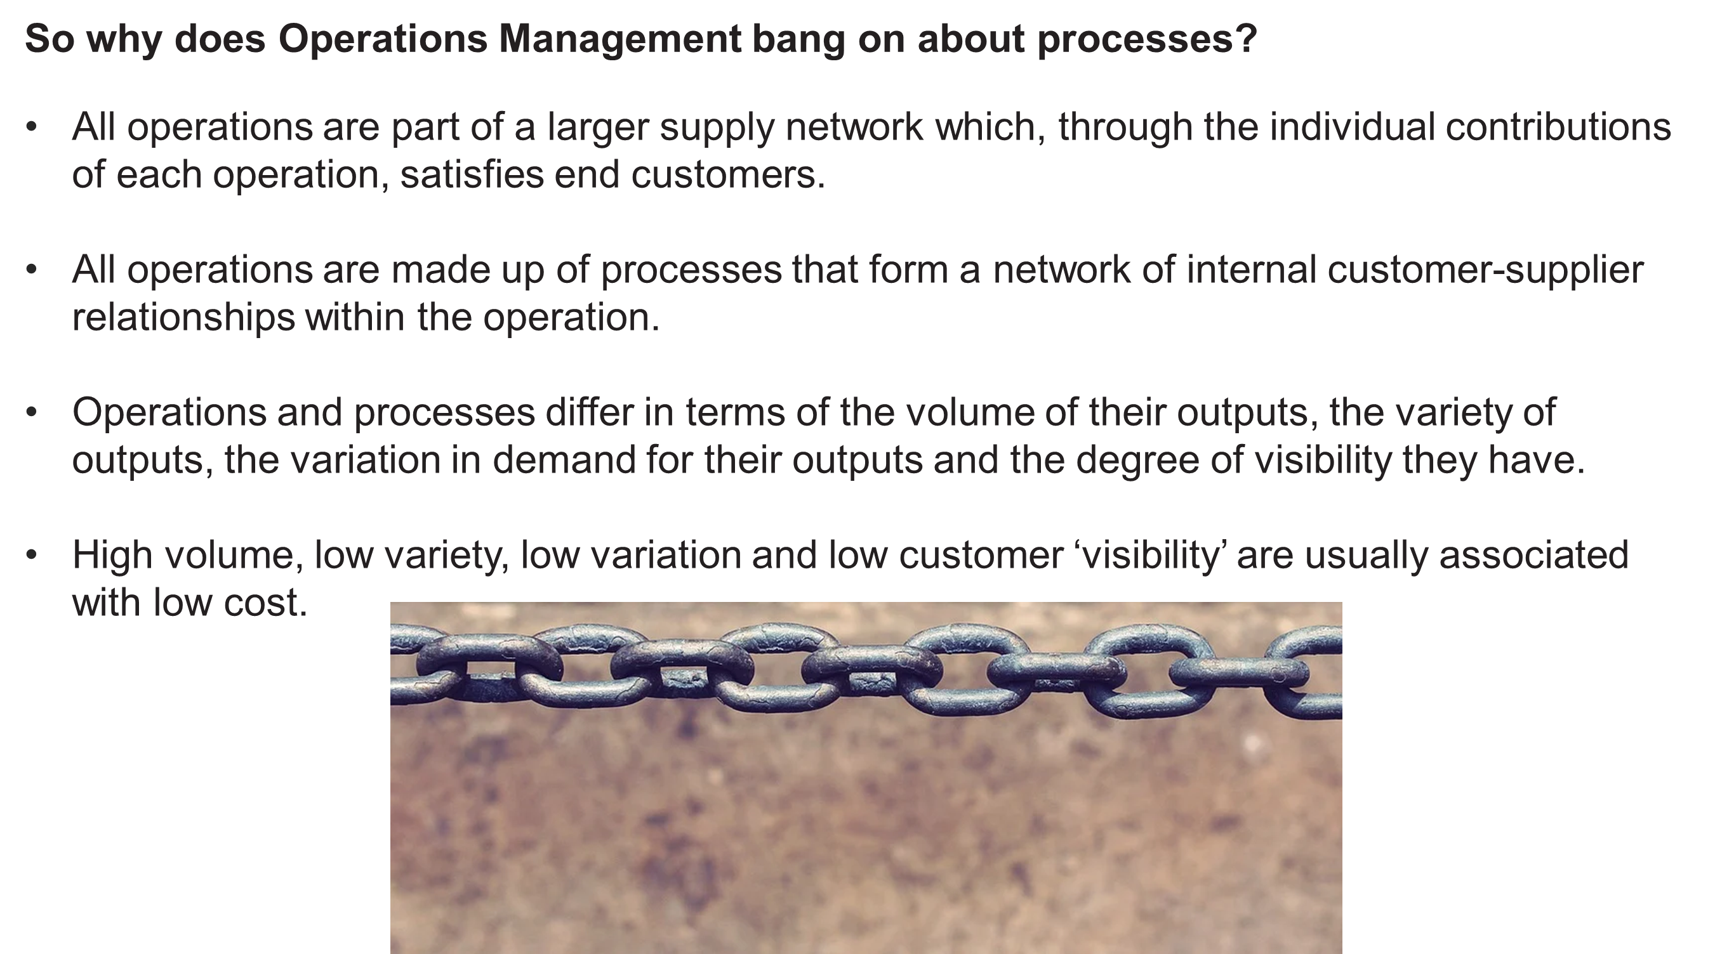

Slide 10
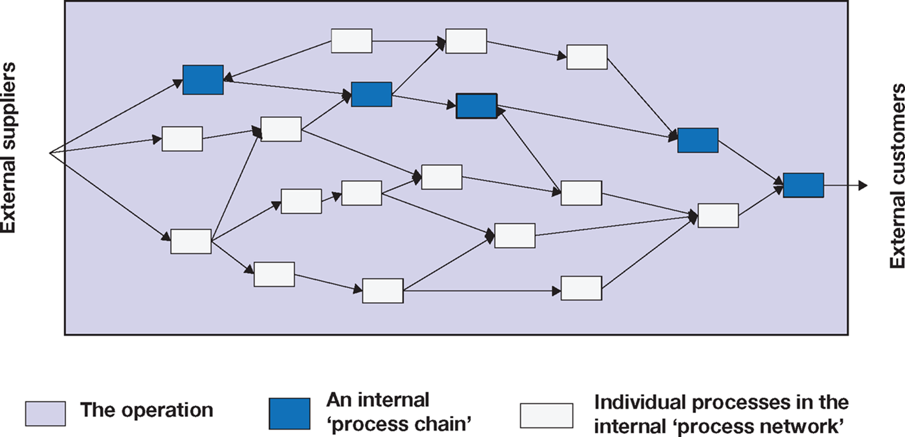
Process network within an operation showing an internal chain showing an internal “process chain”

Slide 11
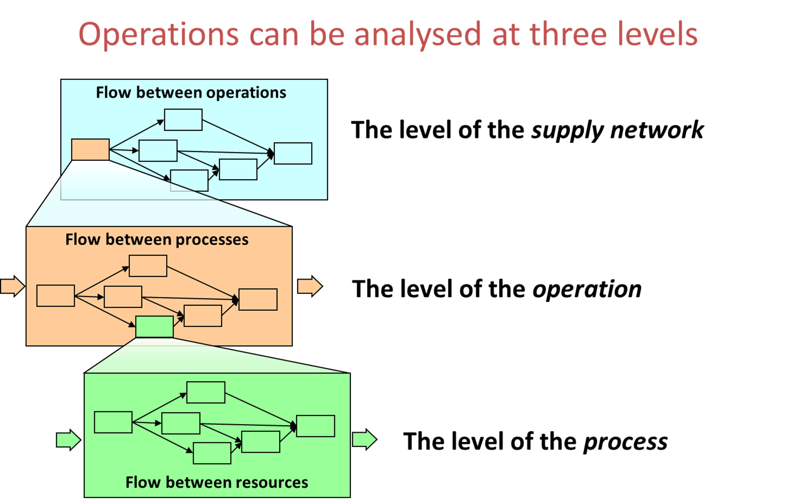

Slide 12
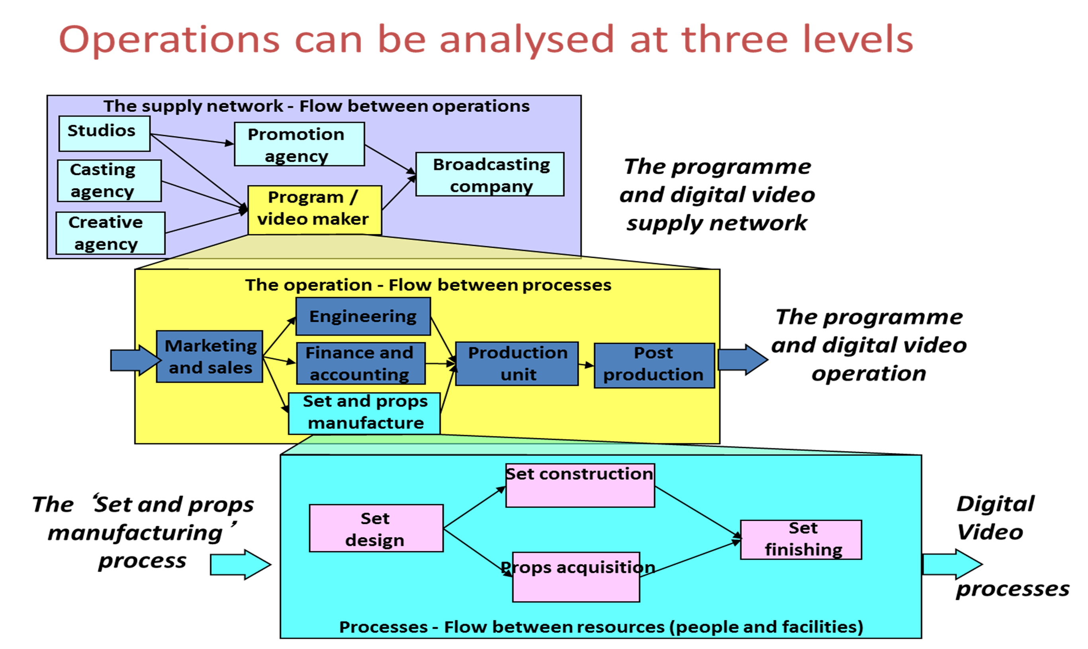

Slide 13
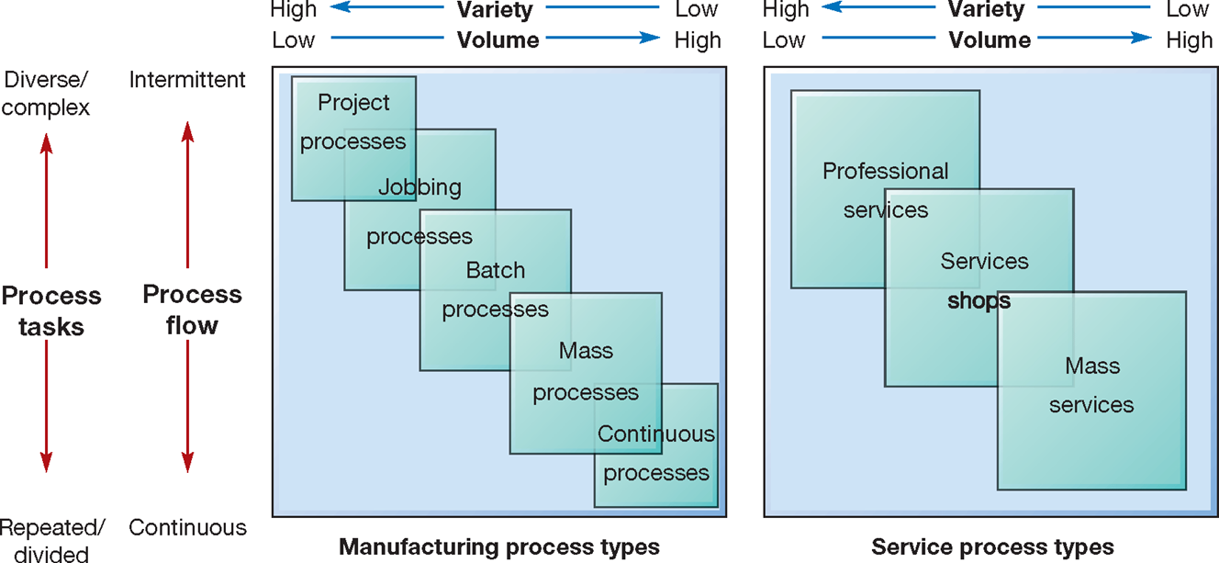
Different process types imply different Volume- Variety
processes characteristics for the process

Slide 14
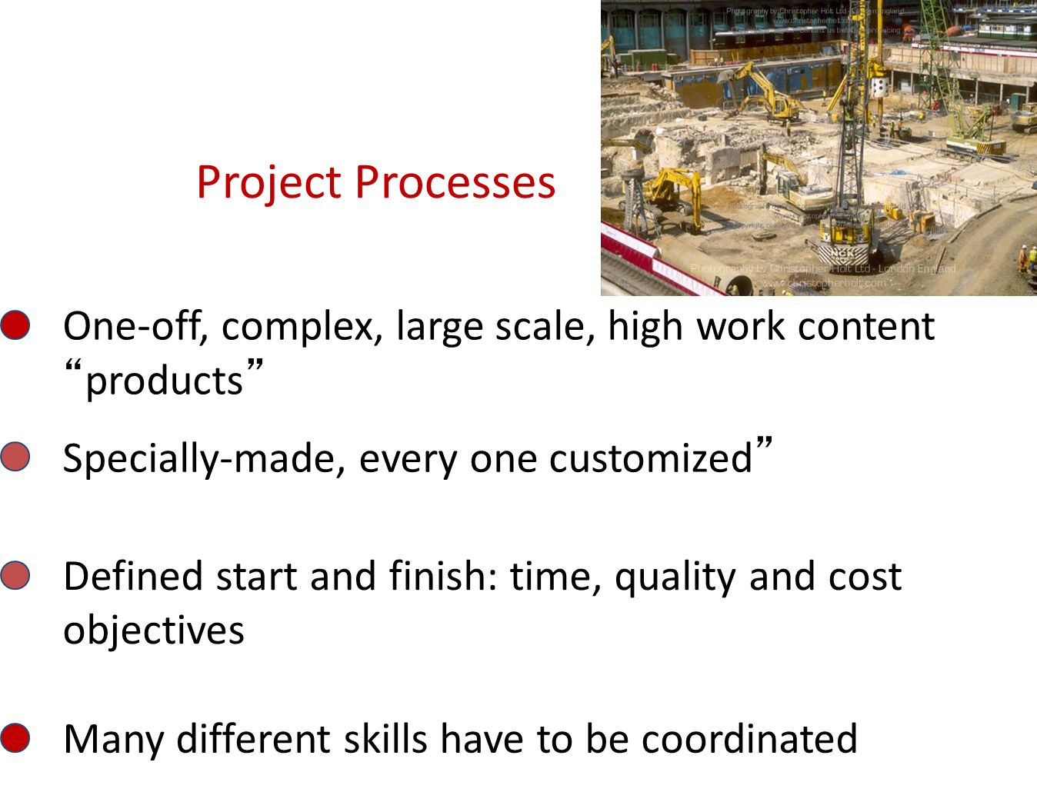

Slide 15
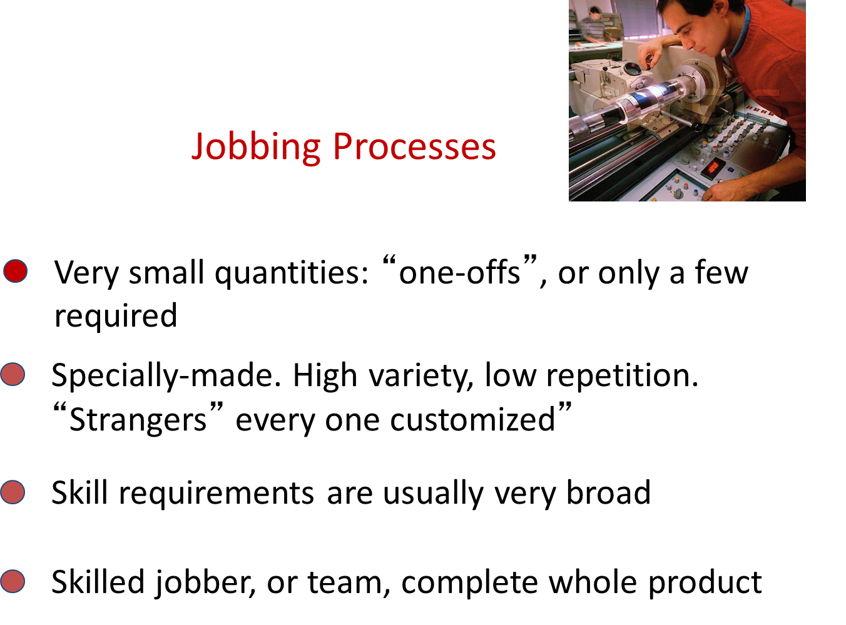

Slide 16
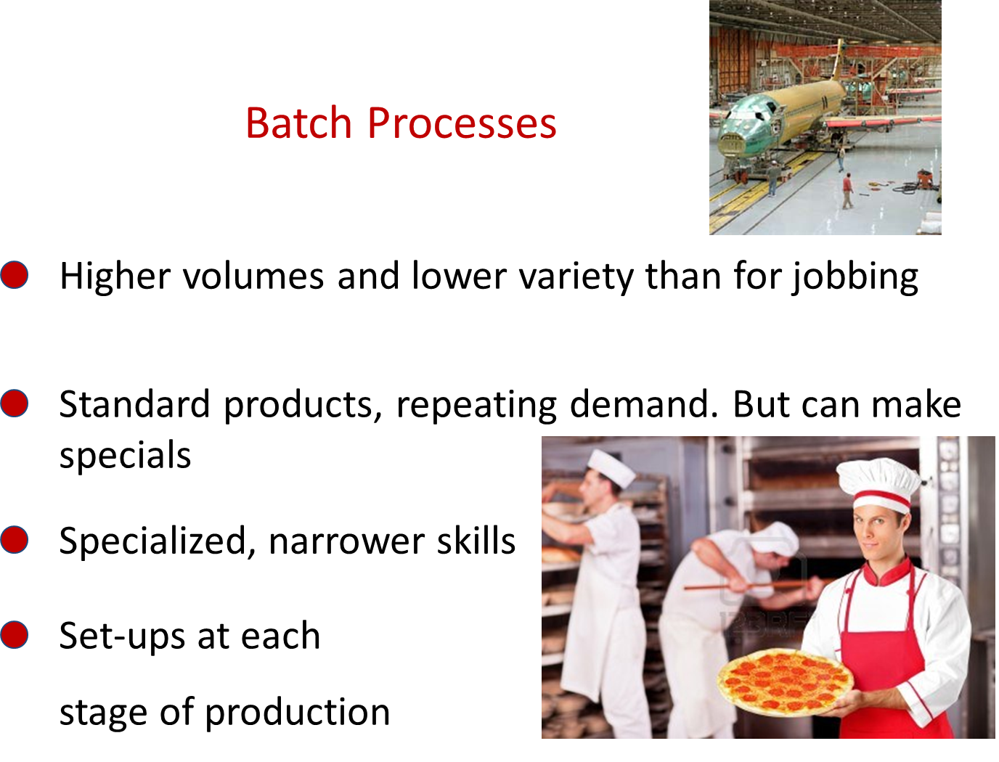

Slide 17
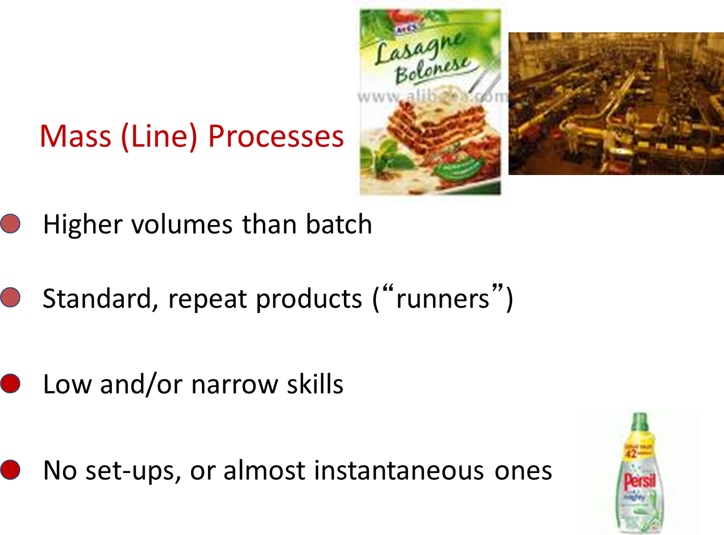

Slide 18
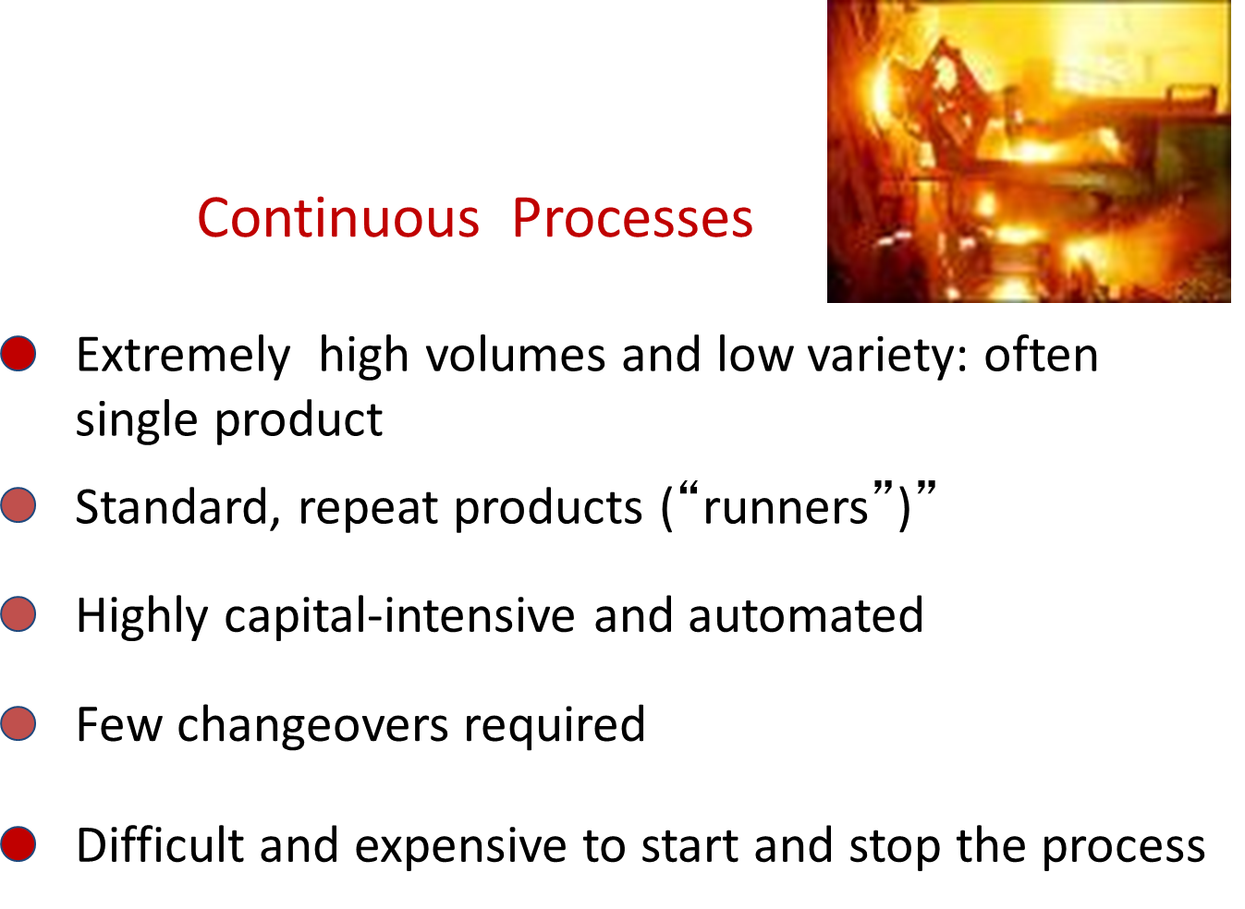

Slide 19
Different process types imply different Volume- Variety processes characteristics for the process

Slide 20
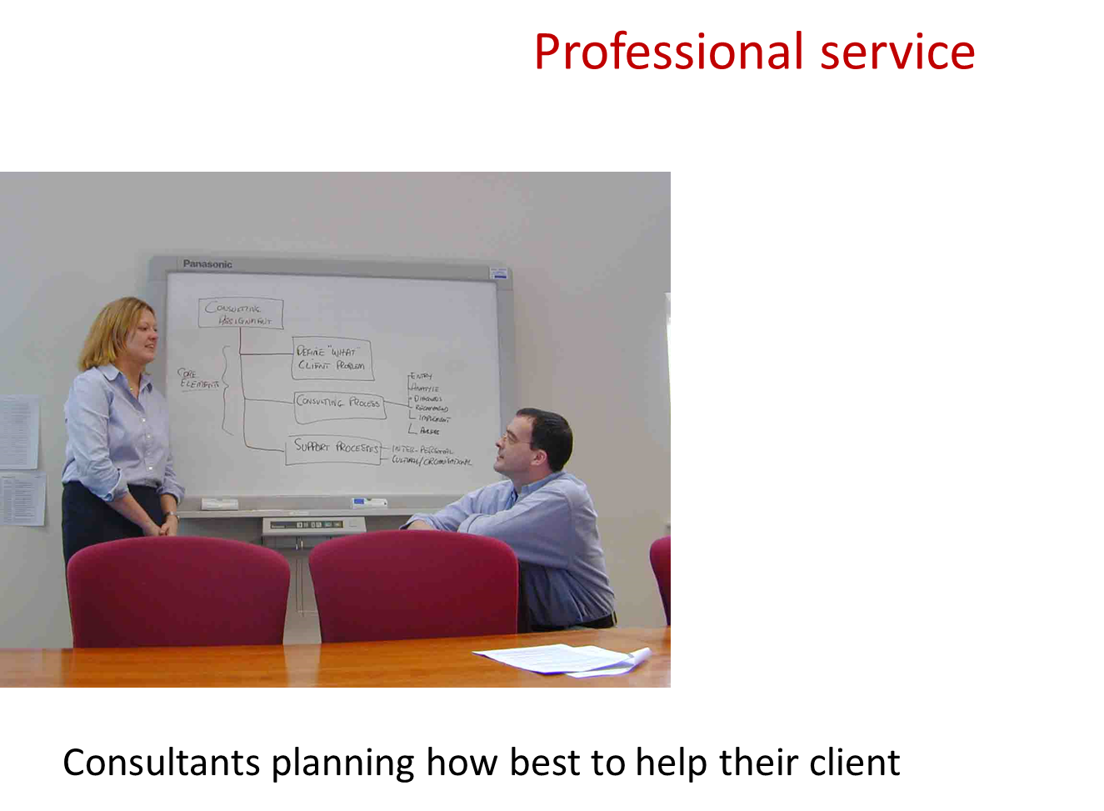

Slide 21
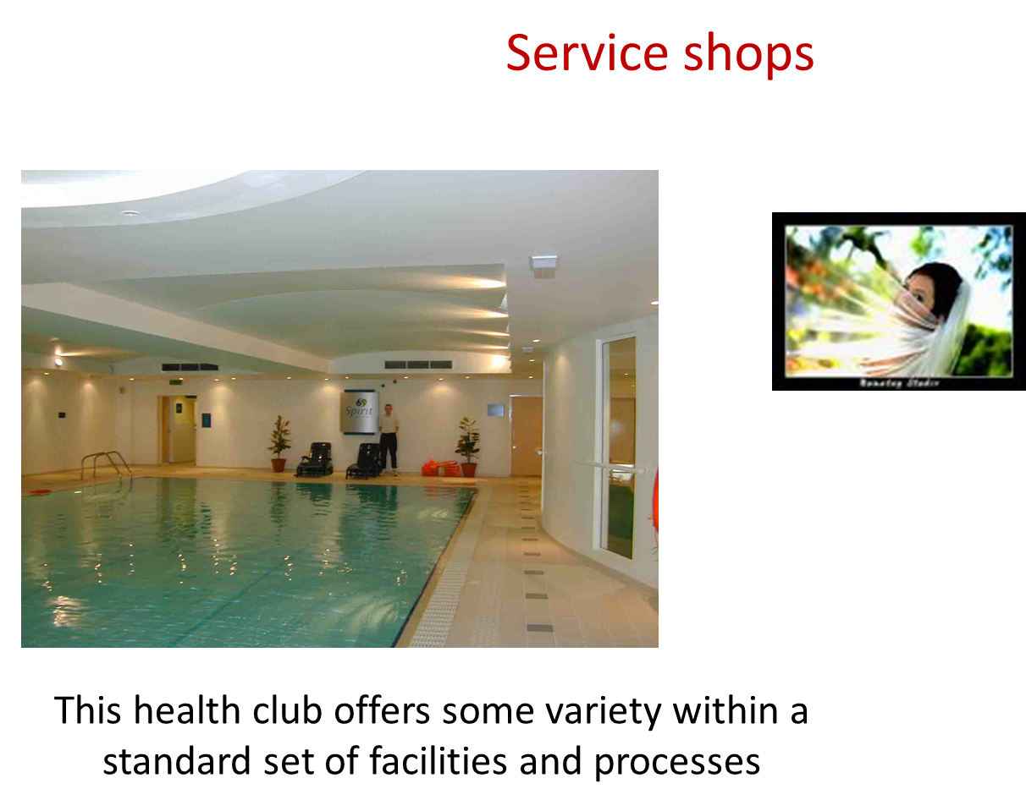

Slide 22
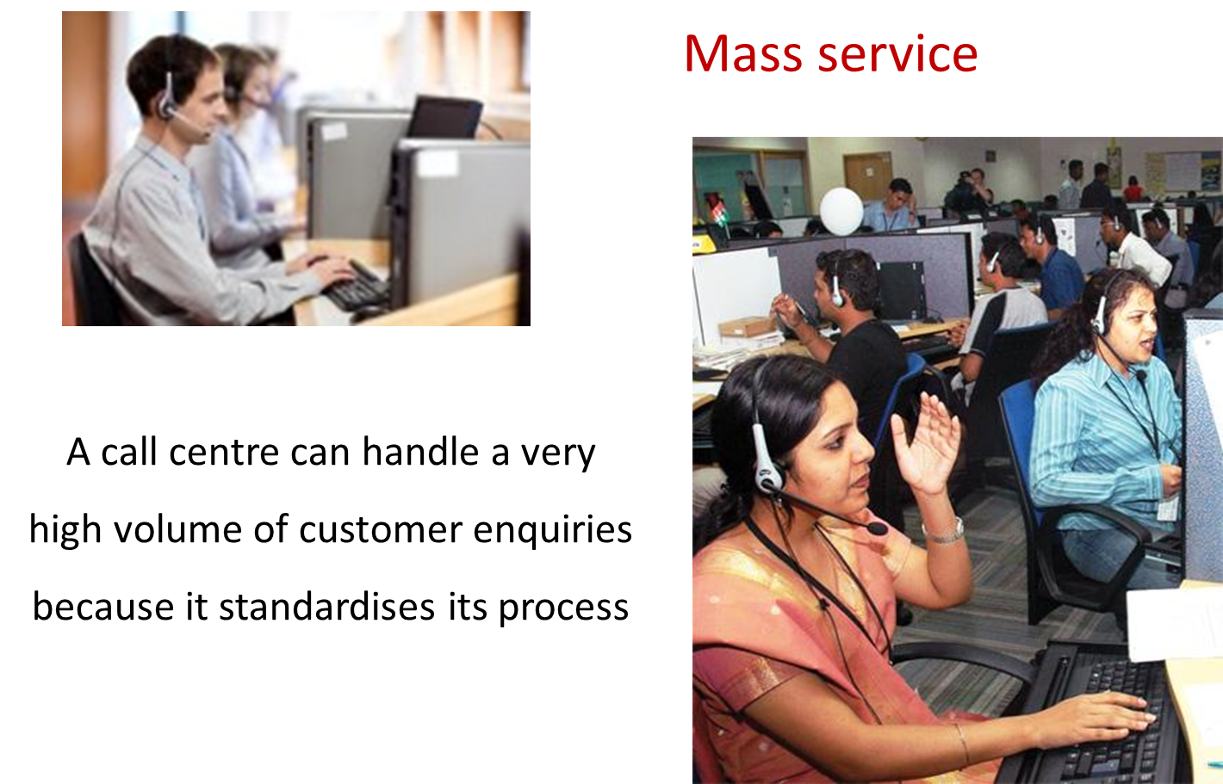
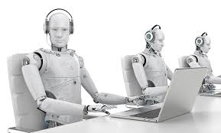

Slide 23
Different process types imply different Volume- Variety processes characteristics for the process

Slide 24
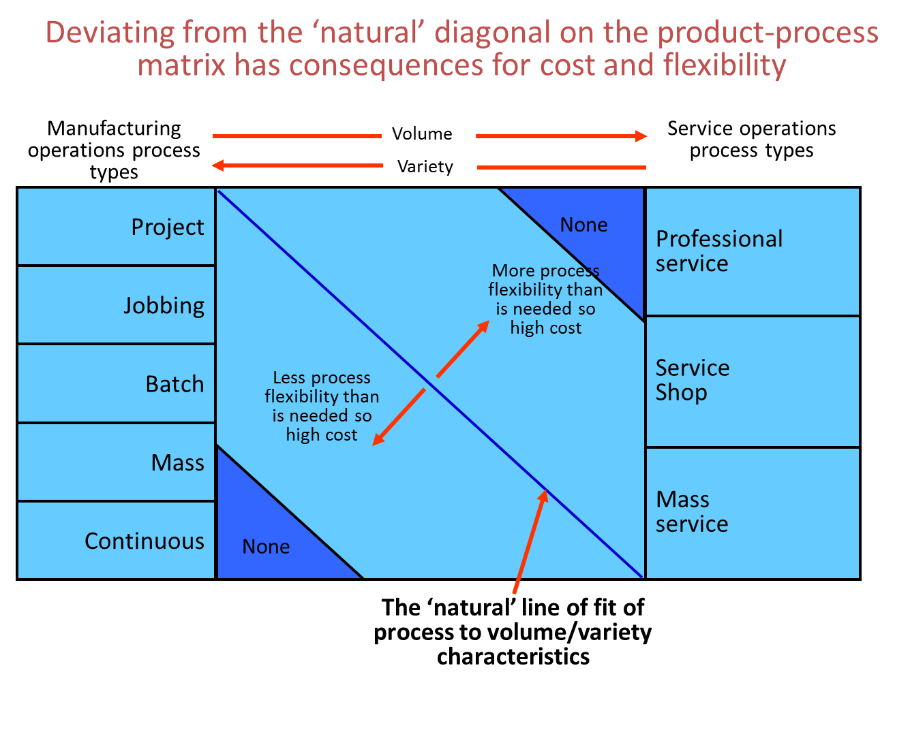

Slide 25
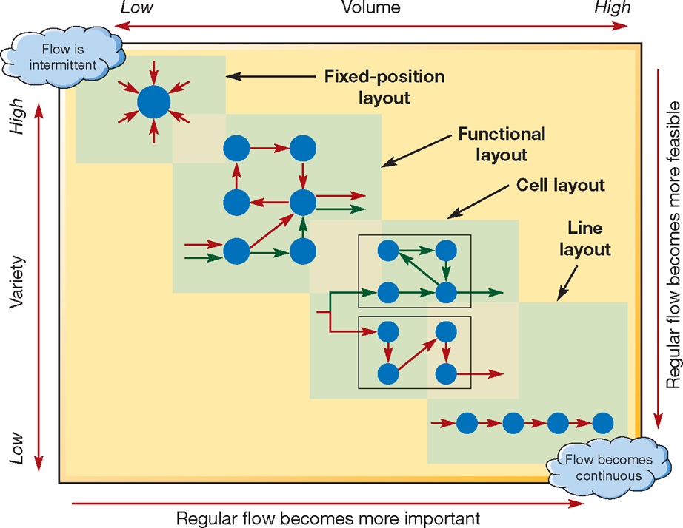
Different layouts are appropriate for different volume-variety combinations

Slide 26
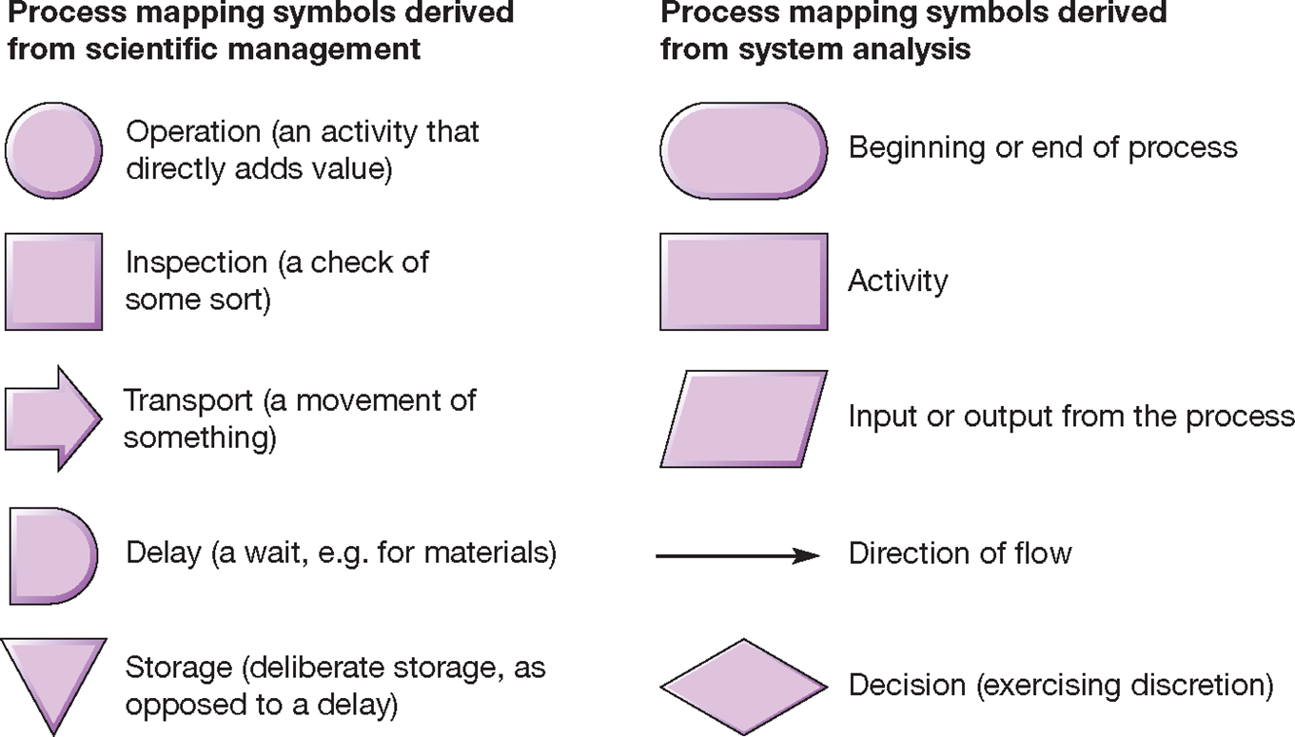
Common process mapping symbols

Slide 27
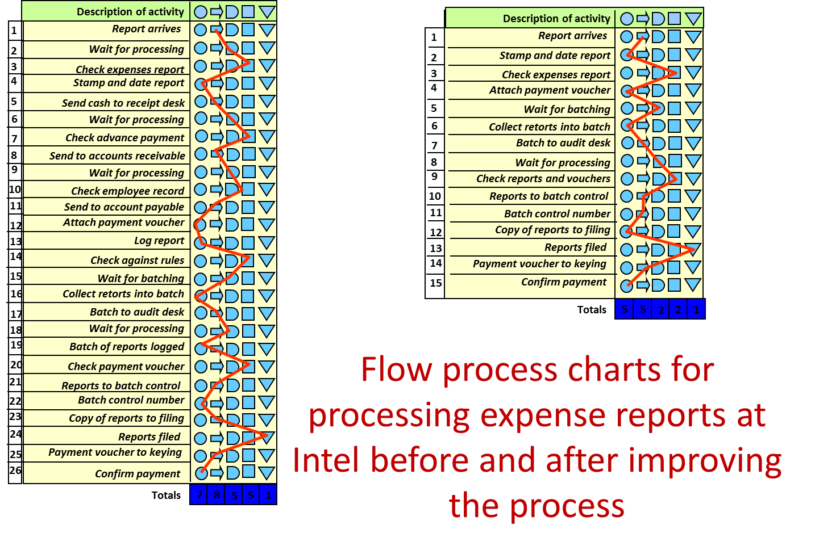

Slide 28
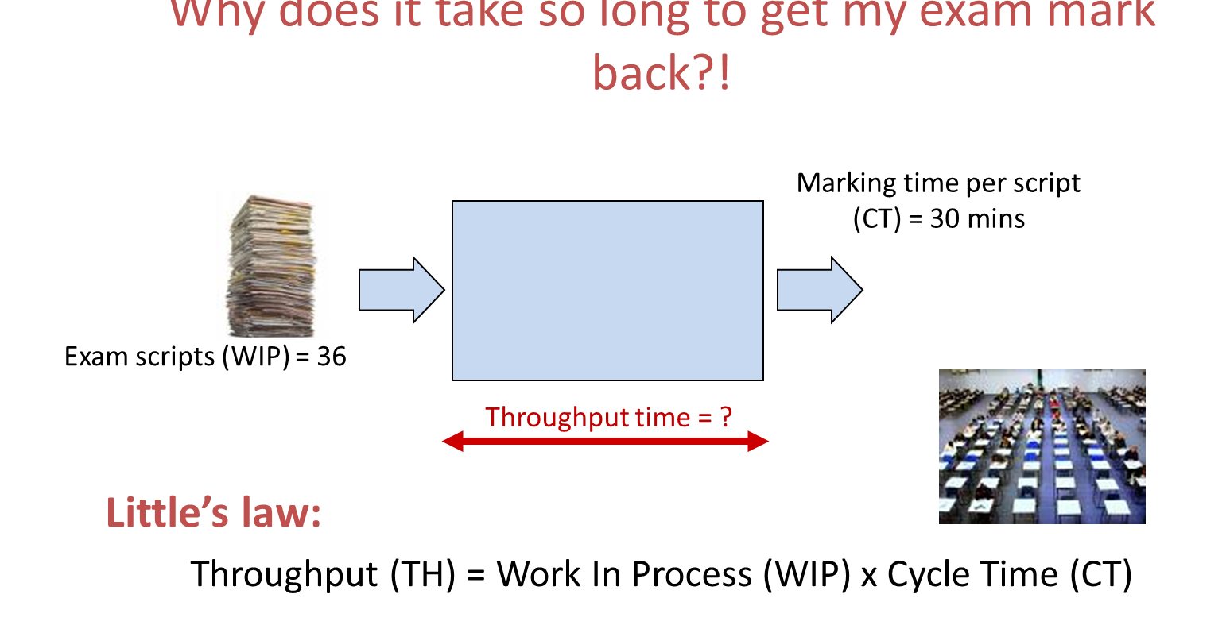

Slide 29
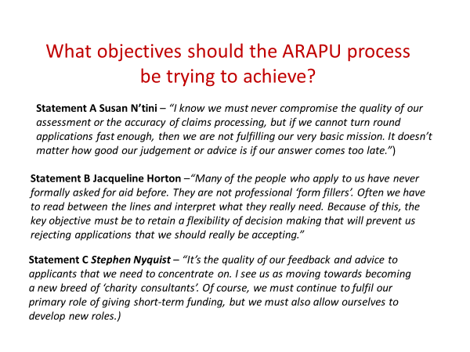

Slide 30
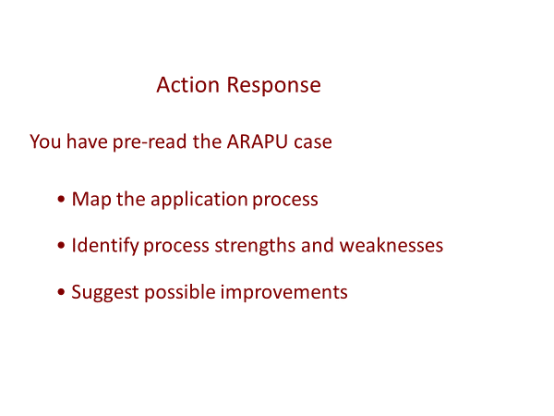

Slide 31
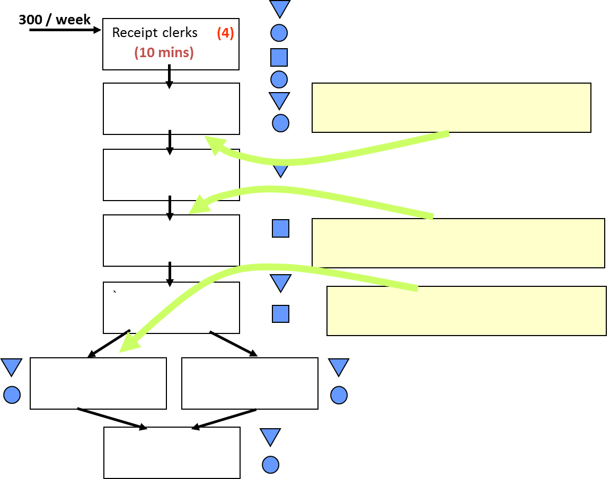

Slide 33
How Digital Transformation Affects Process Design
Process design is about determining how to convert something from one state into another state to create value for someone. E.G., if someone wins a sales order, what are the steps that need to happen in order to fulfil the order? In a traditional approach, we start by defining the beginning and end of the process. Then, we map out the ideal steps to achieve or accomplish the desired outcome.
A digital approach demands that we ask ourselves similar questions, but to do it in a way that essentially rethinks how work might be done (the customer or worker experience) while utilizing new intelligent and intuitive technologies and tools.
https://alignorg.com/digital-transformation-implications-process-design/
Notes:
In the sales transaction scenario, for example, we might ask ourselves how we can use data to expedite the process. This might lead us to realize that, instead of requiring the customer to fill out order information, we can tap into our organization’s existing database to automatically pre-fill that information out. In so doing, we can create a faster and easier experience for the customer, while at the same time avoiding unnecessary work or setbacks that might result from incorrectly entered or inconsistent data.

Slide 34
Applying a Digital Mindset to Process Design
The following prompts can be useful in applying a digital mindset to process design:
Software: Is there any software that can be leveraged or developed to perform or enable some of the tasks in the process?
Hardware: Is there a tool or device that can be inserted into the process to allow the work to be done more effectively or more efficiently? For example, a couple of years ago the airlines began equipping their flight attendants with mobile devices. Now they can help passengers in real time by performing tasks like checking the status of a flight, and function as mini credit card readers.
Data: Is there some repository of data that can be brought to bear in the process to provide insight or make something in the process easier or more meaningful?
Artificial Intelligence: Taking data a step further requires the application of machine learning–the ability for a machine or computer to take a vast amount of information around preferences, buying patterns, shipping history, etc. and draw conclusions from it that change the way we approach a process. For instance, behavioral targeting in advertising that ensures that online ad offers are relevant to the individual shopper.
https://alignorg.com/digital-transformation-implications-process-design/

Slide 35
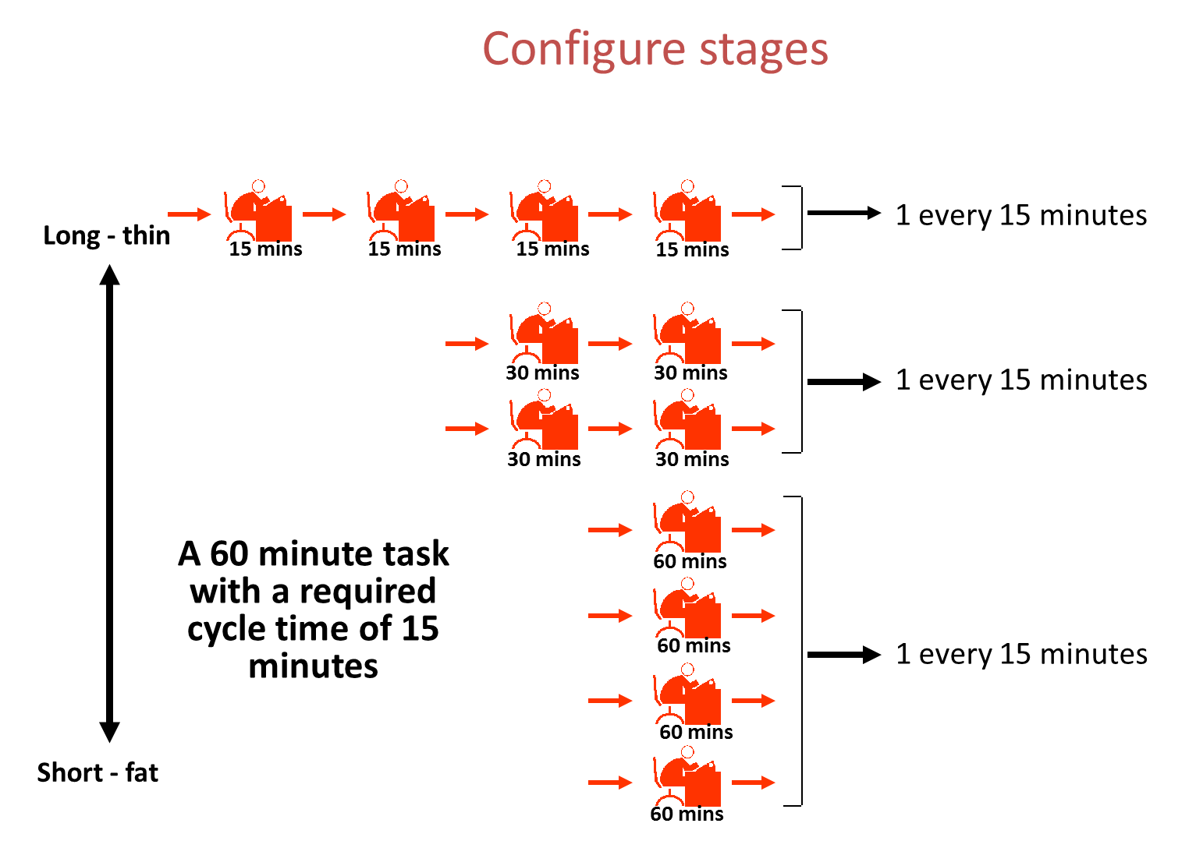

Slide 36
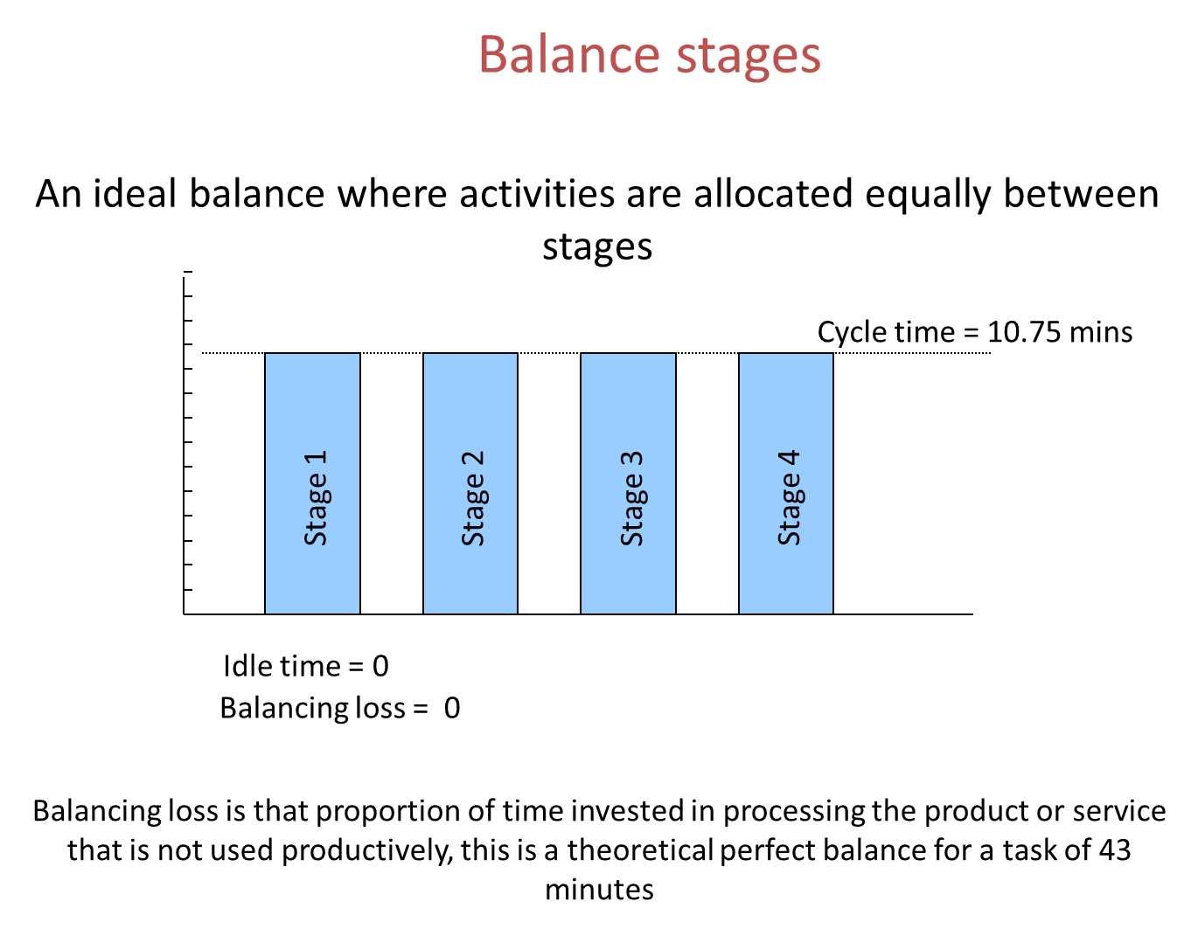

Slide 37
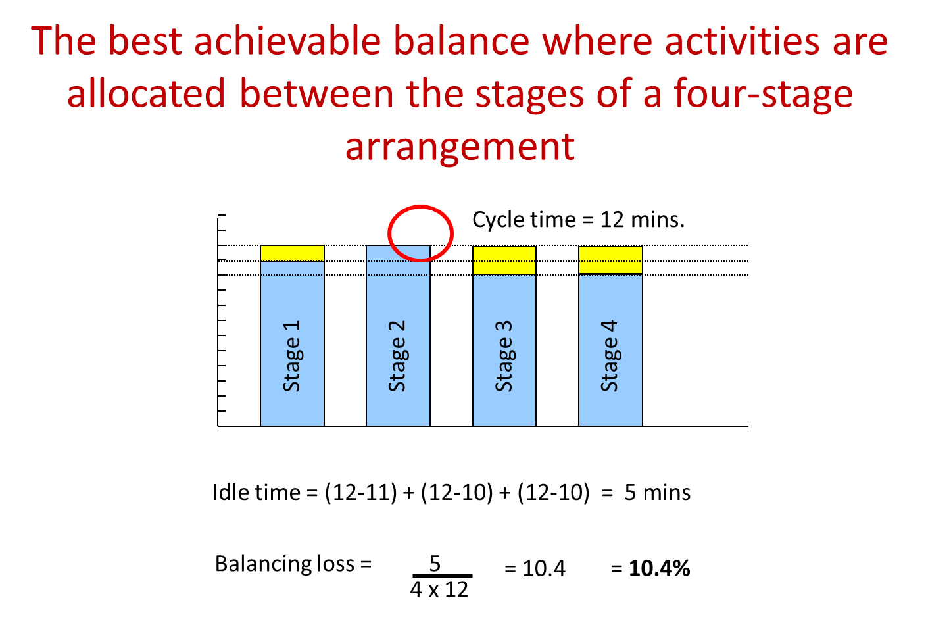

Slide 38
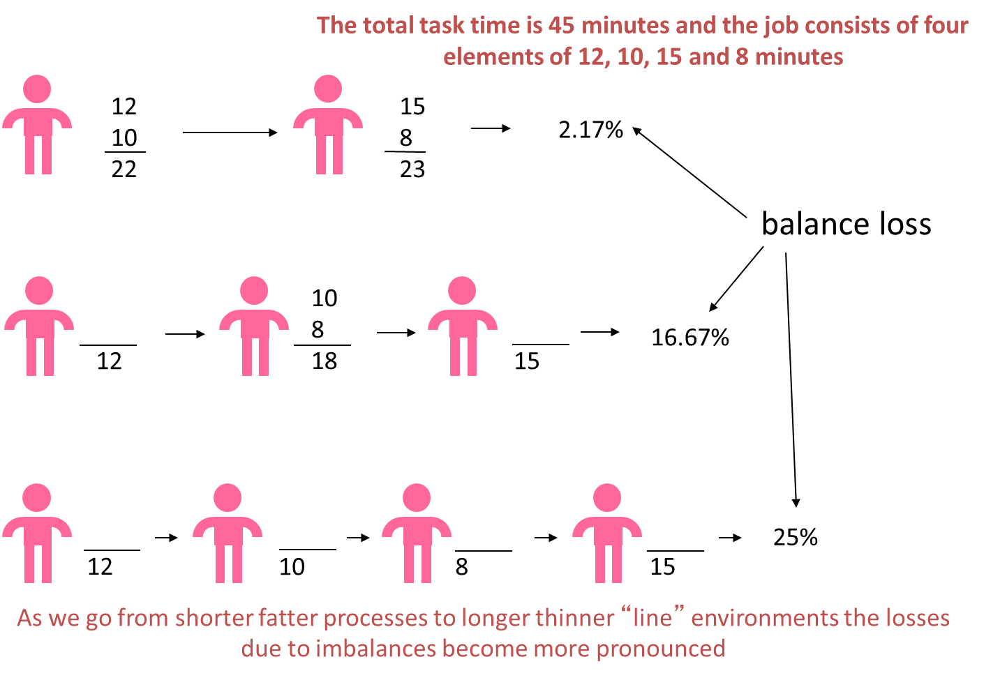

Slide 39
Process design is strongly influenced by volume and variety
There are serious consequences of moving off the ‘natural diagonal’ on the volume-variety continuum
Different layout options have different implications for quality, speed, dependability, flexibility, and cost.
Mapping processes is the first step towards improving them
When designing processes, we need to consider performance objectives, operating characteristics, stage configuration, balancing, and variability
The layout and look decisions of an operation dictate flow (especially people)

