Slide 1

Master of Business Administration
Digital Business Delivery
S1 Fundamentals of OM
Professor Nigel Caldwell

Slide 2
Agenda
Introductions: me, the course, how it works and you
What is Operations Management and what do Operations Managers do
What is the input-transformation output process
What can OM offer competitive advantage
Trade offs
OM strategy as a [coherent] pattern of decisions
The 4 Vs
How do operations and Processes differ

Slide 3

Me, MBA, PhD, Director, Professor

Slide 5
The basics
Four weeks of classes
Mondays 14.00 to 20.30 – Thursdays 17.30 to 20.30
My office hours Mon 13:00-14:00 and Thurs: 16:30-17.30.
Contact me email – n.caldwell@londonmet.ac.uk
2 assessments, group and individual
Call me Nigel

Slide 6


Assessment
Group work 30%
Deadline
Monday 13th February Monday classes
Tuesday 14th February Tuesday classes
Individual assignment 70%
Deadline
Sunday 5th March

Slide 7
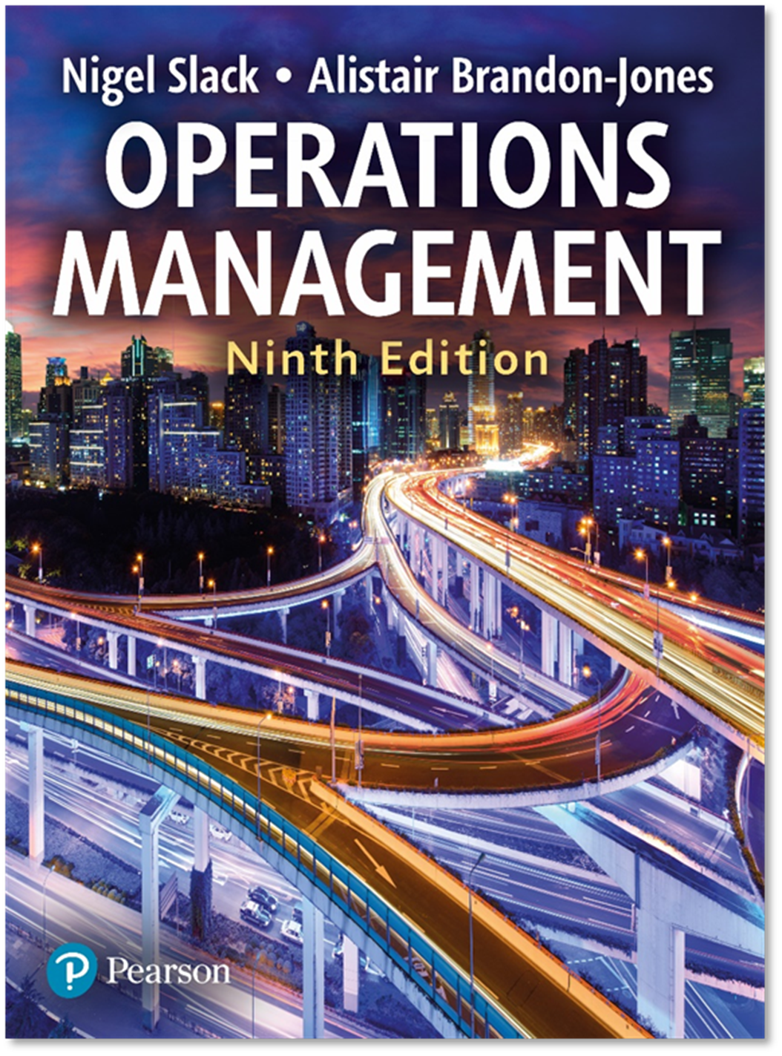

Slide 8
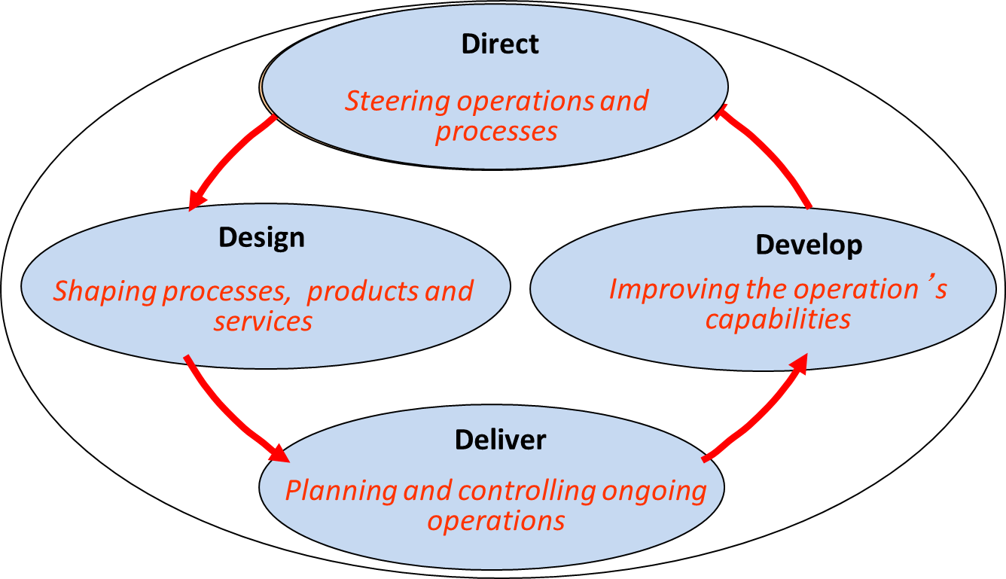




Activities of OM where digital adds value
Weeks 2-6
Weeks 9, 10, 11
Weeks 7- 8

Slide 9

So – introducing you -
1. Please say your name so we can all hear it – a basic but v. important skill
2. Do you have some work experience to talk about or what were you doing or what course were you studying or anything else …
3. What do you know about operations management?

Slide 10
Agenda
Introductions: me, the course, how it works and you
What is Operations Management and what do Operations Managers do
What is the input-transformation output process
What is the process hierarchy
How do operations and Processes differ

Slide 11
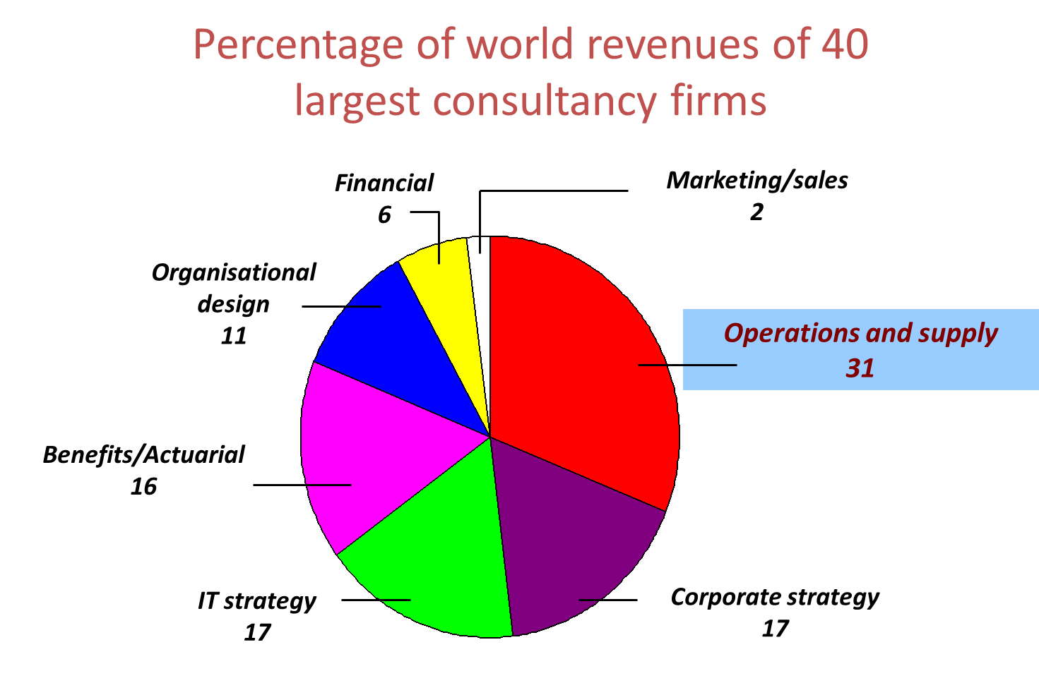

Slide 12

What do I have to study OM?
Operations function typically accounts for the majority of assets
Largely determines the unit cost of the good or service sold
More importantly the way operations are run also determines the day-to-day service levels we offer customers in terms of quality, quantity, and time.

Slide 13

Operations Management
OM is the activity of managing the resources that create and deliver services and products.
What do OM Managers do?
Directing the overall strategy of the operation
Designing the operations services .. products and processes.
Planning and controlling process delivery
Developing process performance – developing capabilities to improve process performance

Slide 14
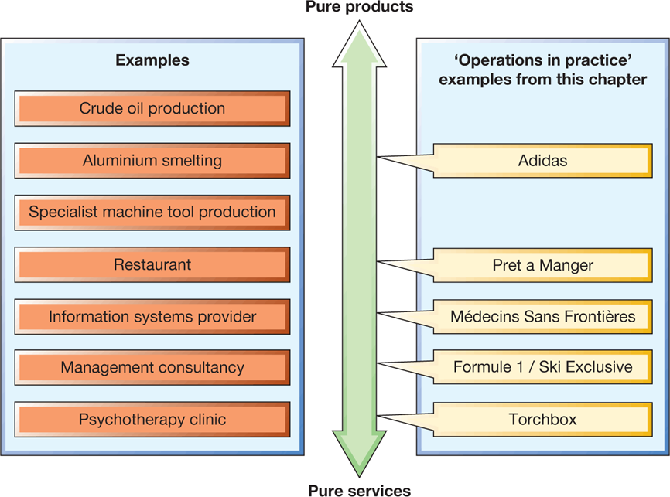
Most operations produce products and services

Slide 15
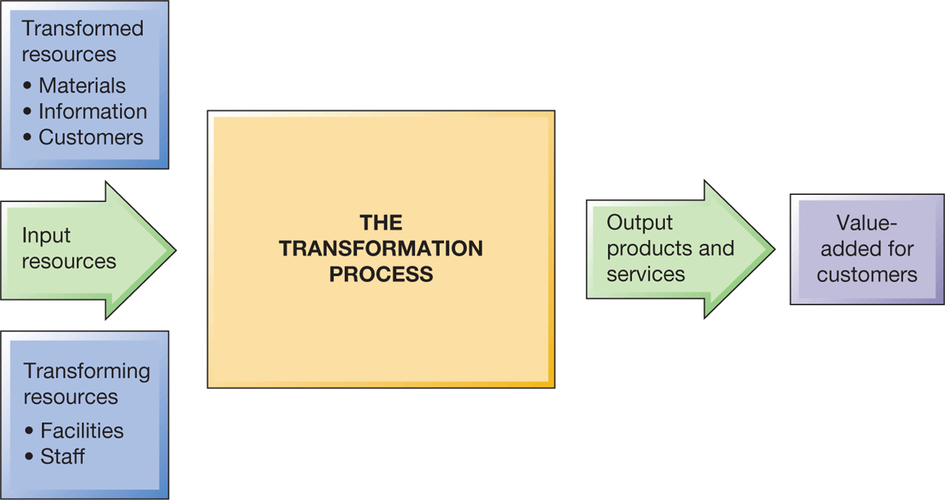
Input Output model of operations

Slide 16
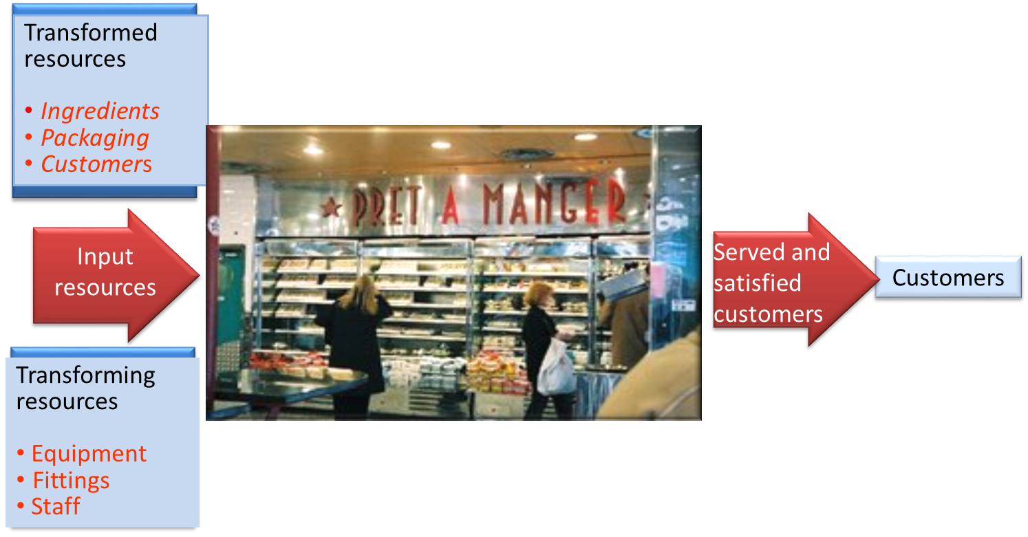
Inputs and outputs at Pret a Manger

Slide 17
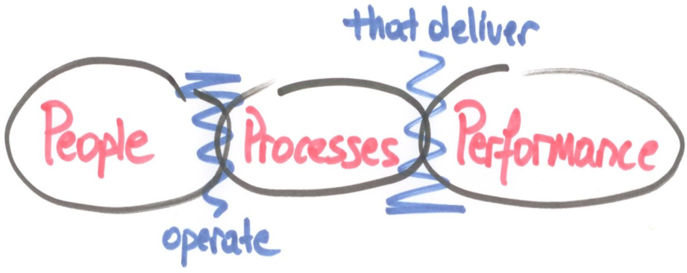
Input Output model of operations

Slide 18
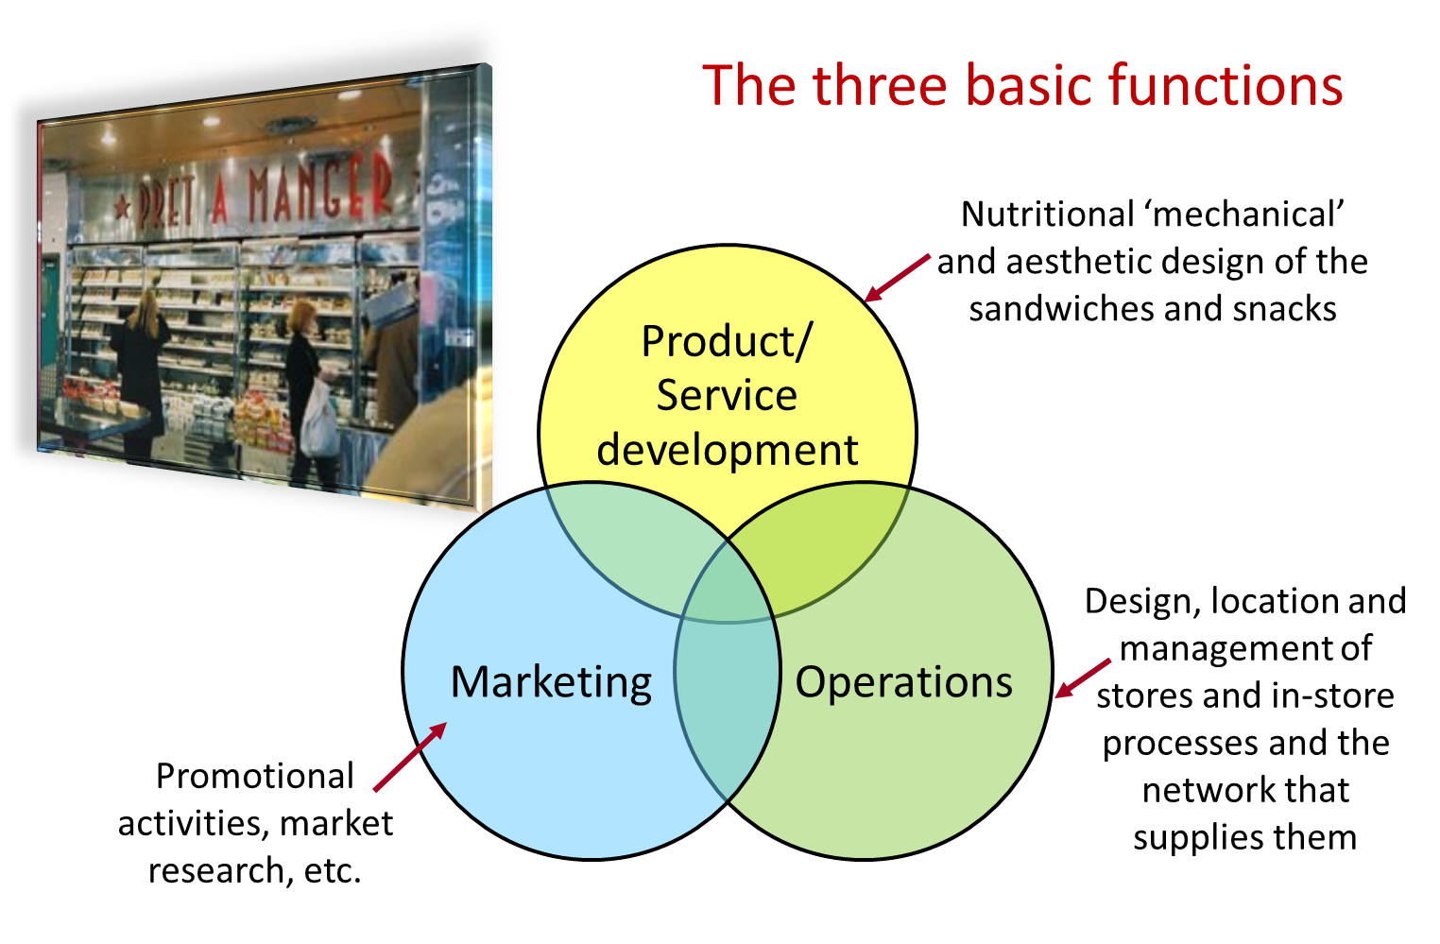
The three basic functions

Slide 19
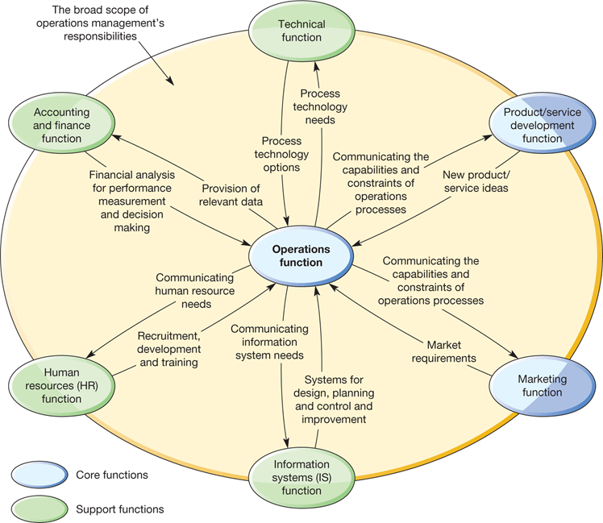
OM relationship with other functions

Slide 20
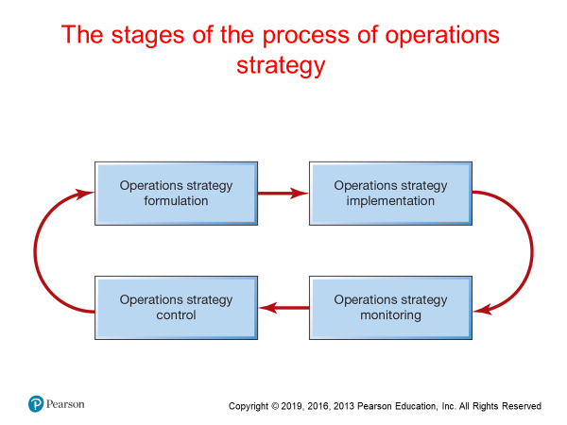

Slide 21
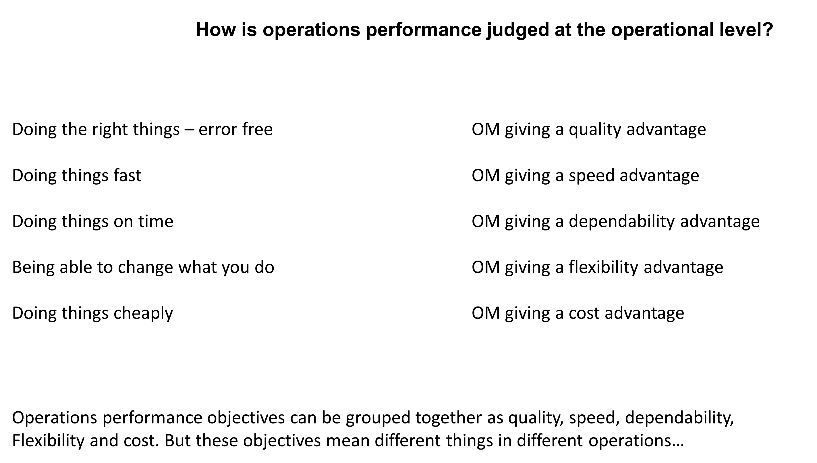

Slide 22
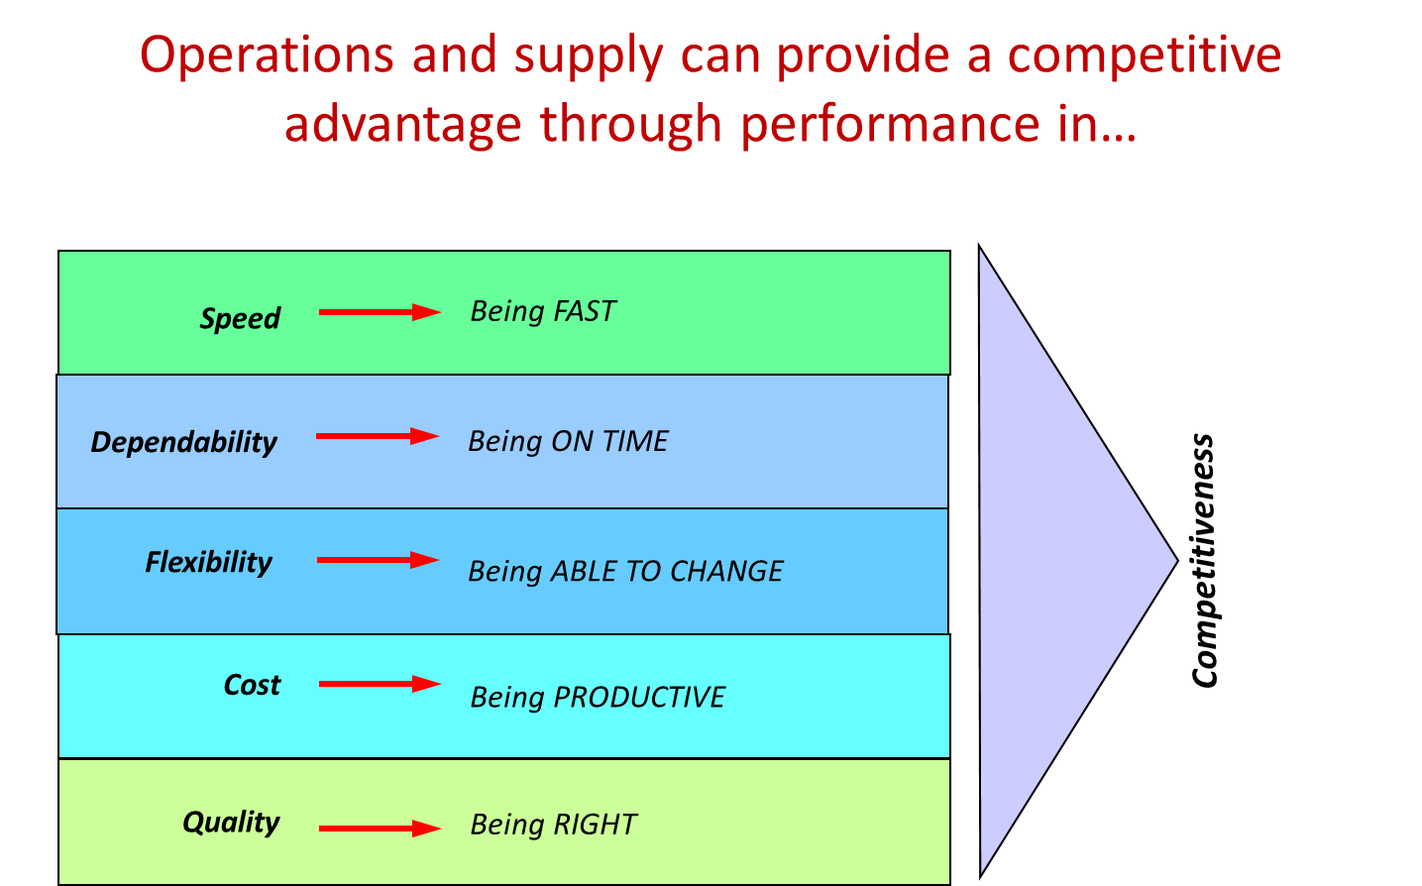
Trade Offs

Slide 23
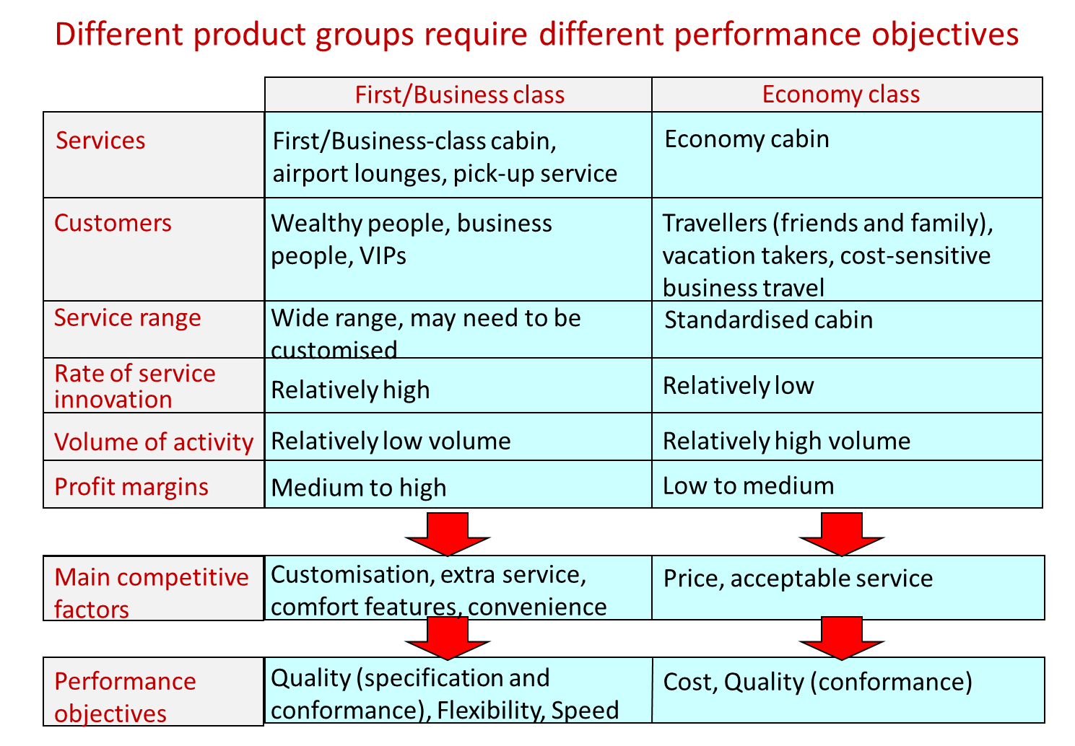

Slide 24
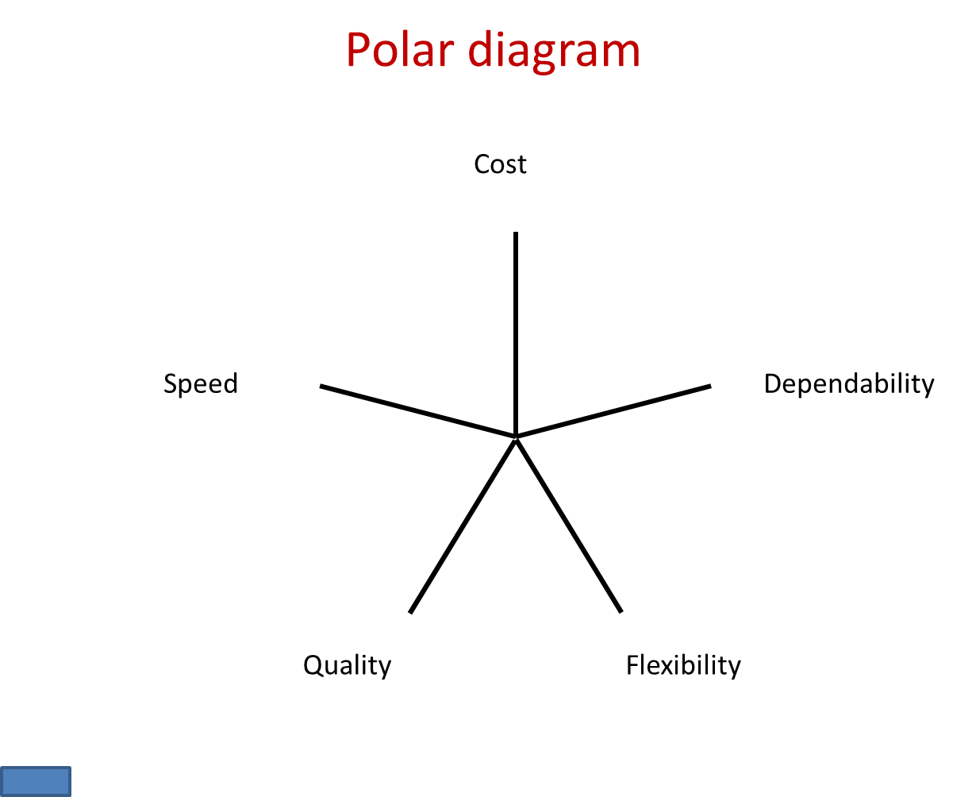

Slide 25
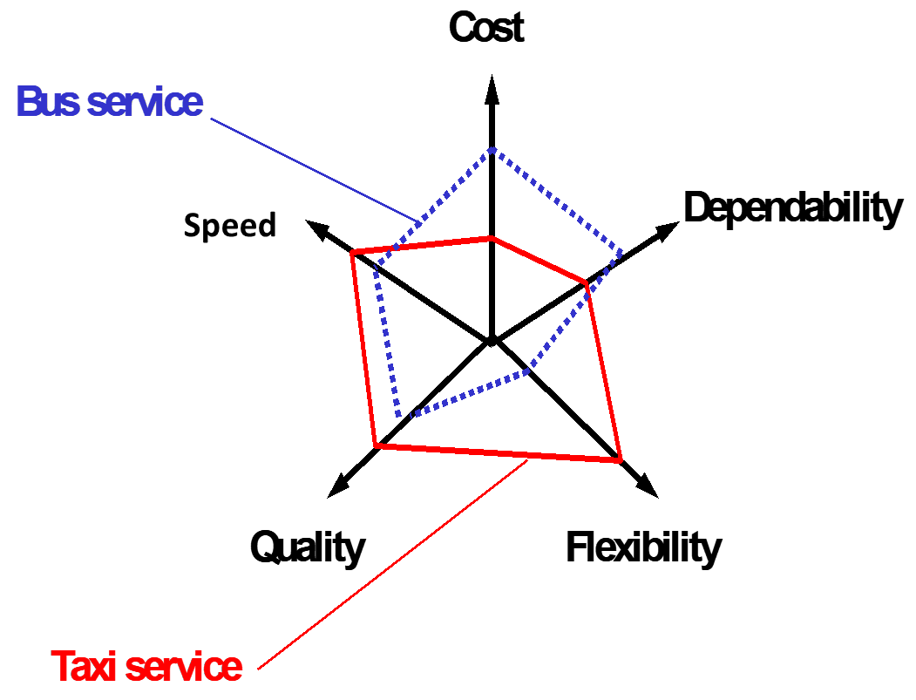

Slide 26
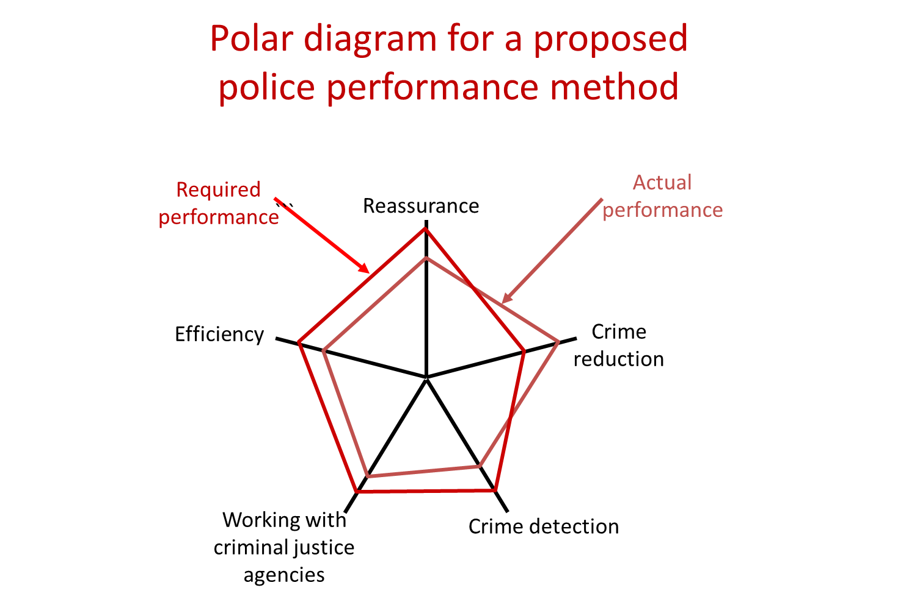

Slide 27
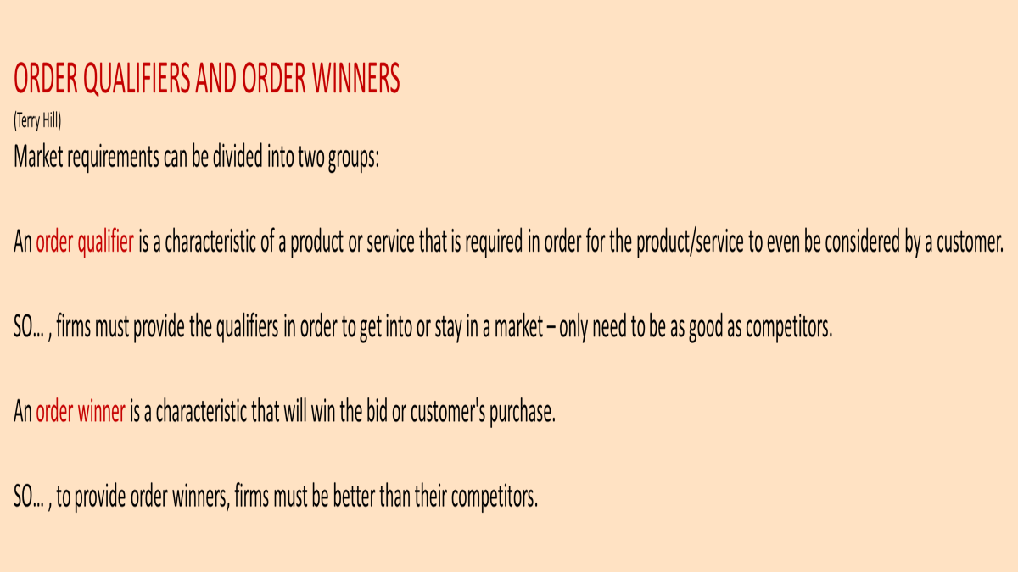

Slide 28
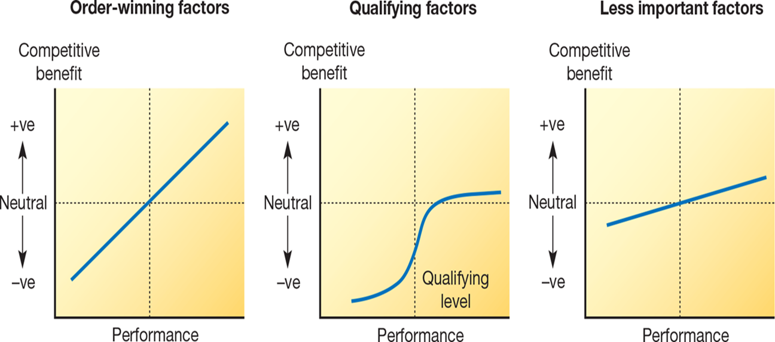
Order winners and qualifiers

Slide 29
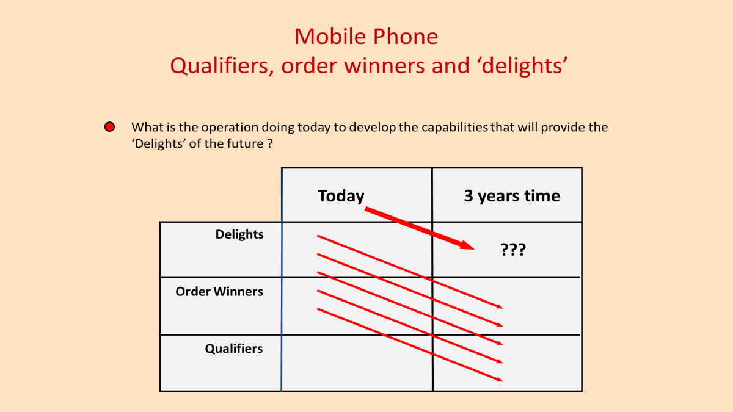

Slide 30
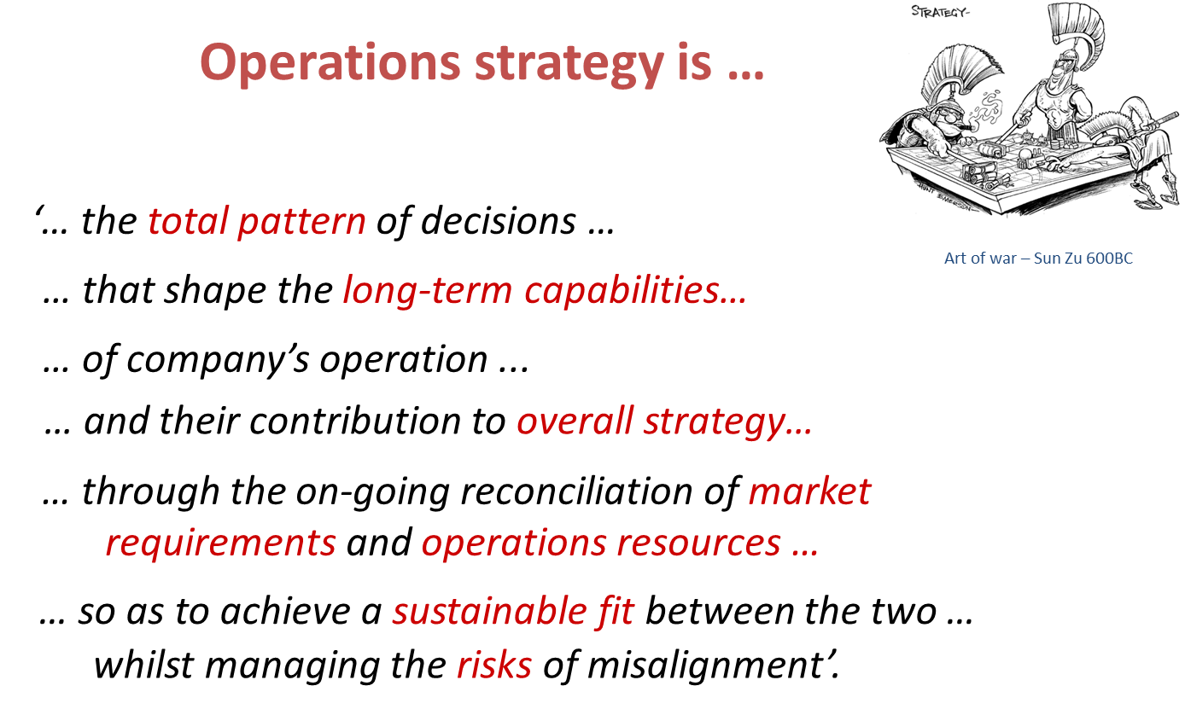

Slide 31

Class exercise: using the four D’s framework
Visualise IKEA
Think of all the activities (processes) that IKEA do
Allocate those activities to either Direct, Design, Deliver and Develop
Digital opportunities?

Slide 32
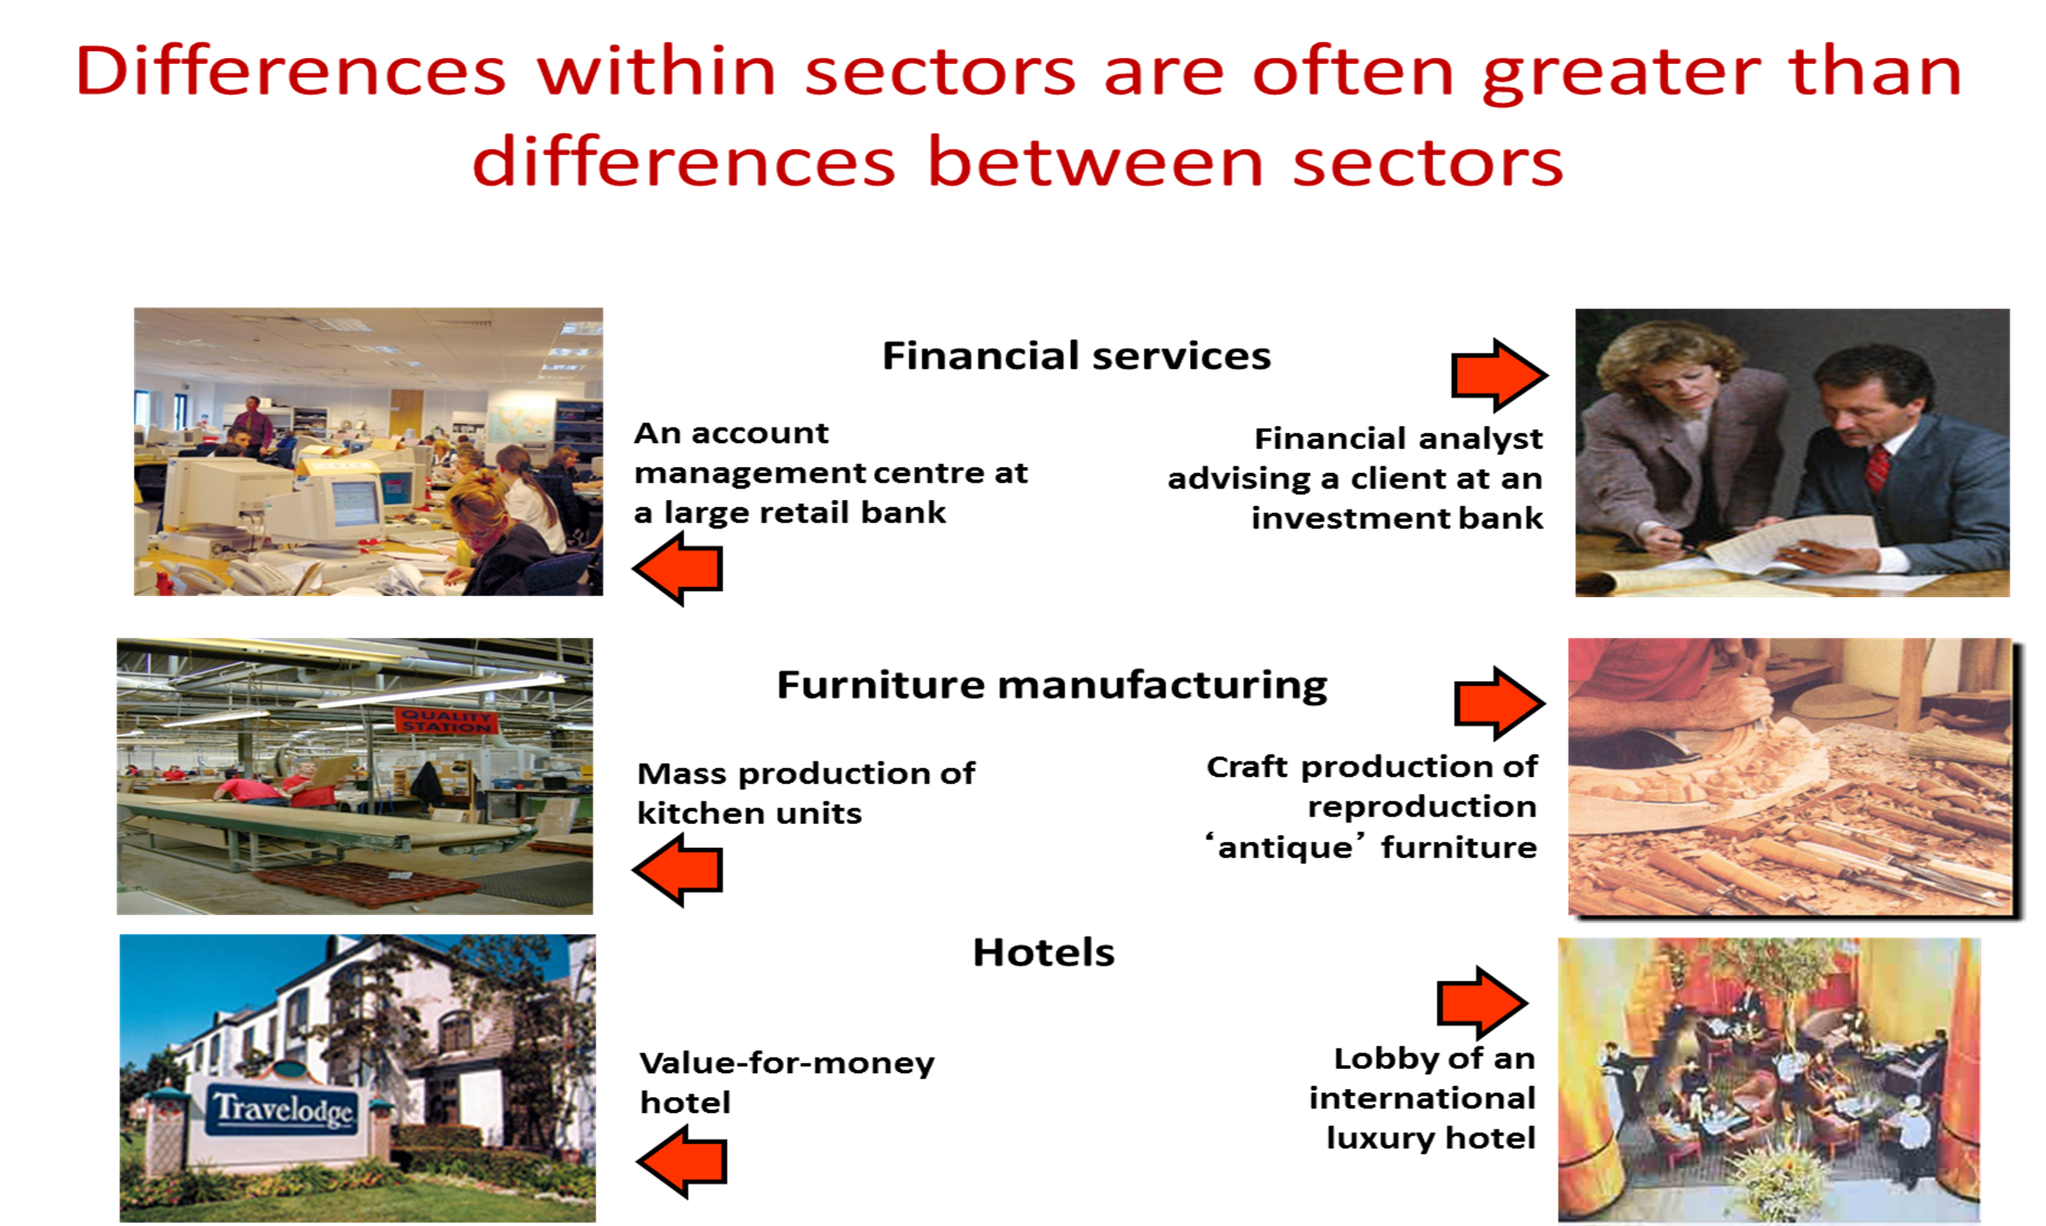

Slide 33
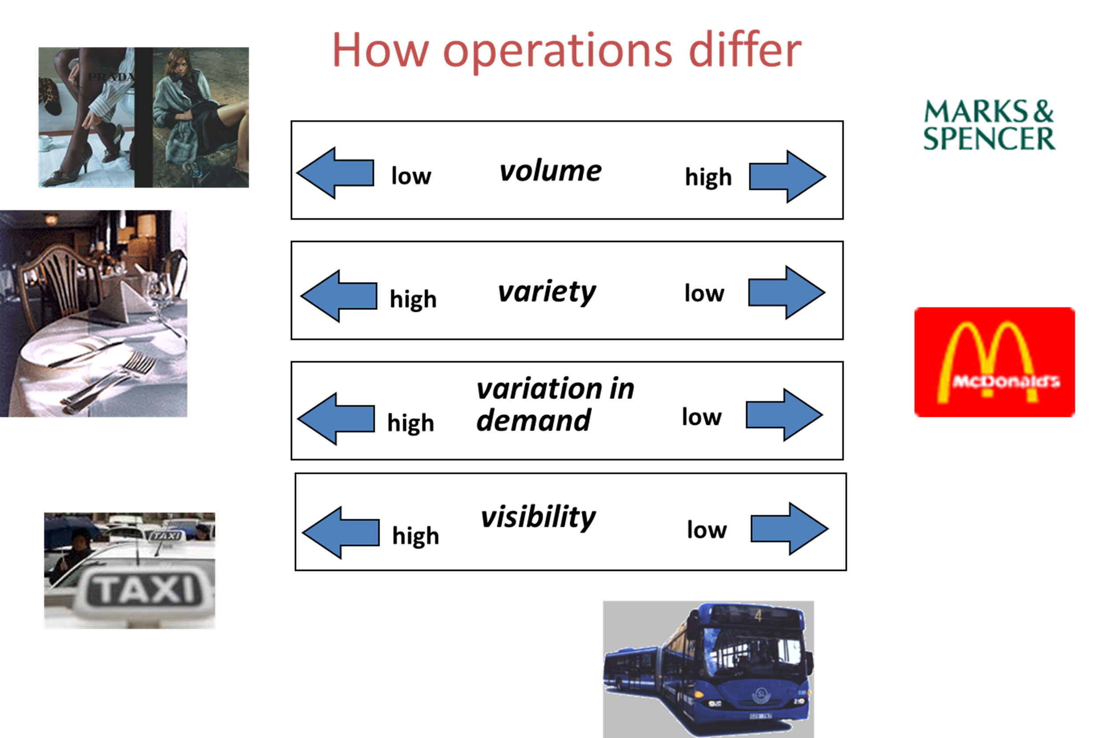

Slide 34
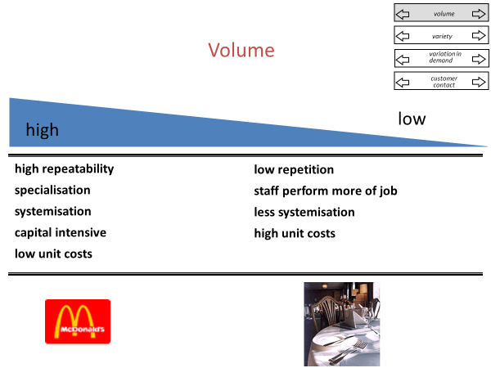

Slide 35
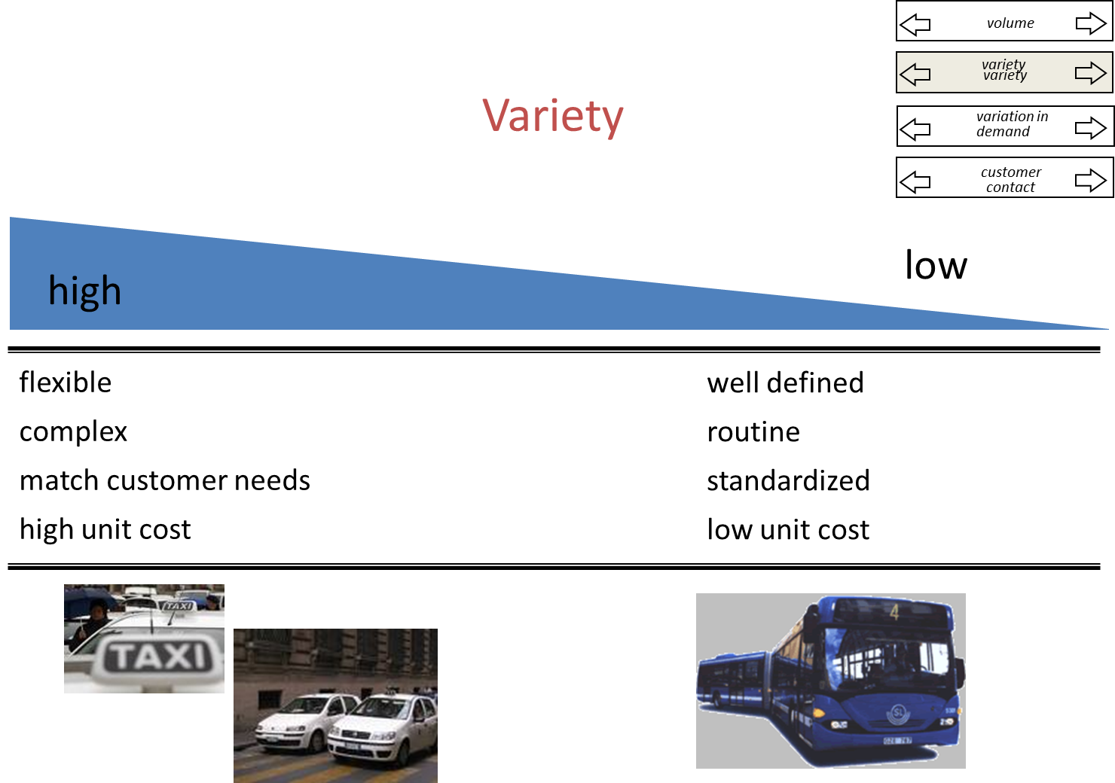

Slide 36
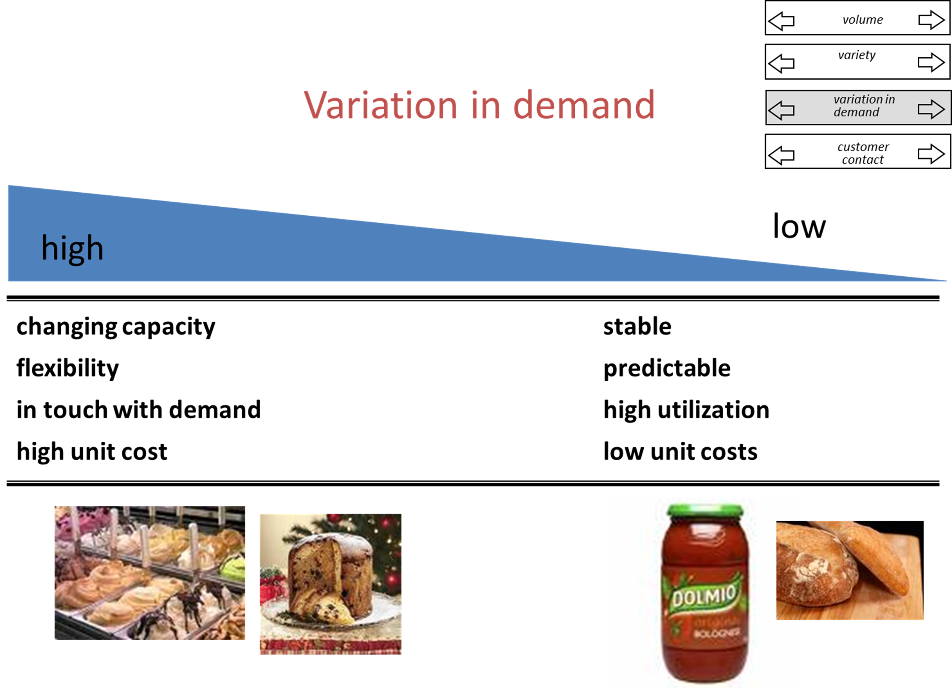

Slide 37
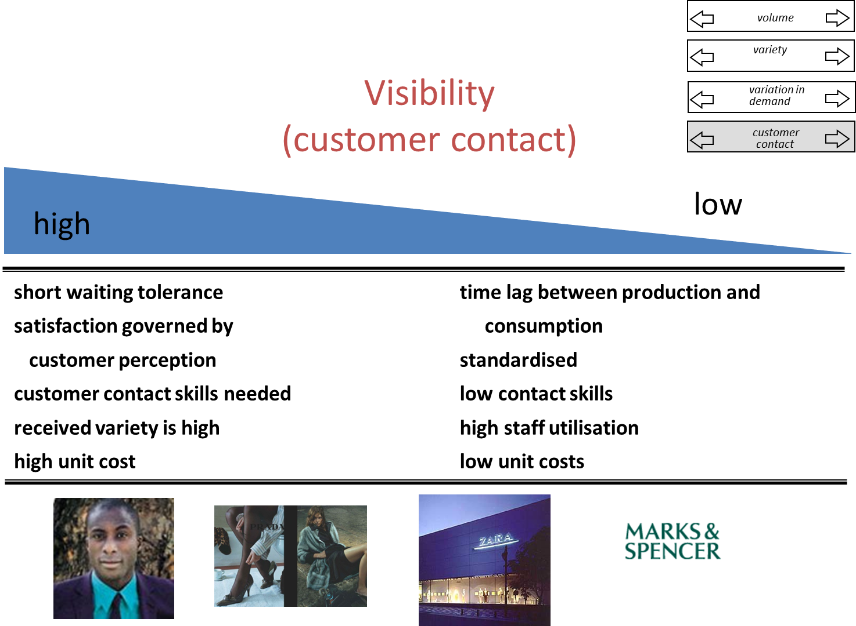

Slide 38
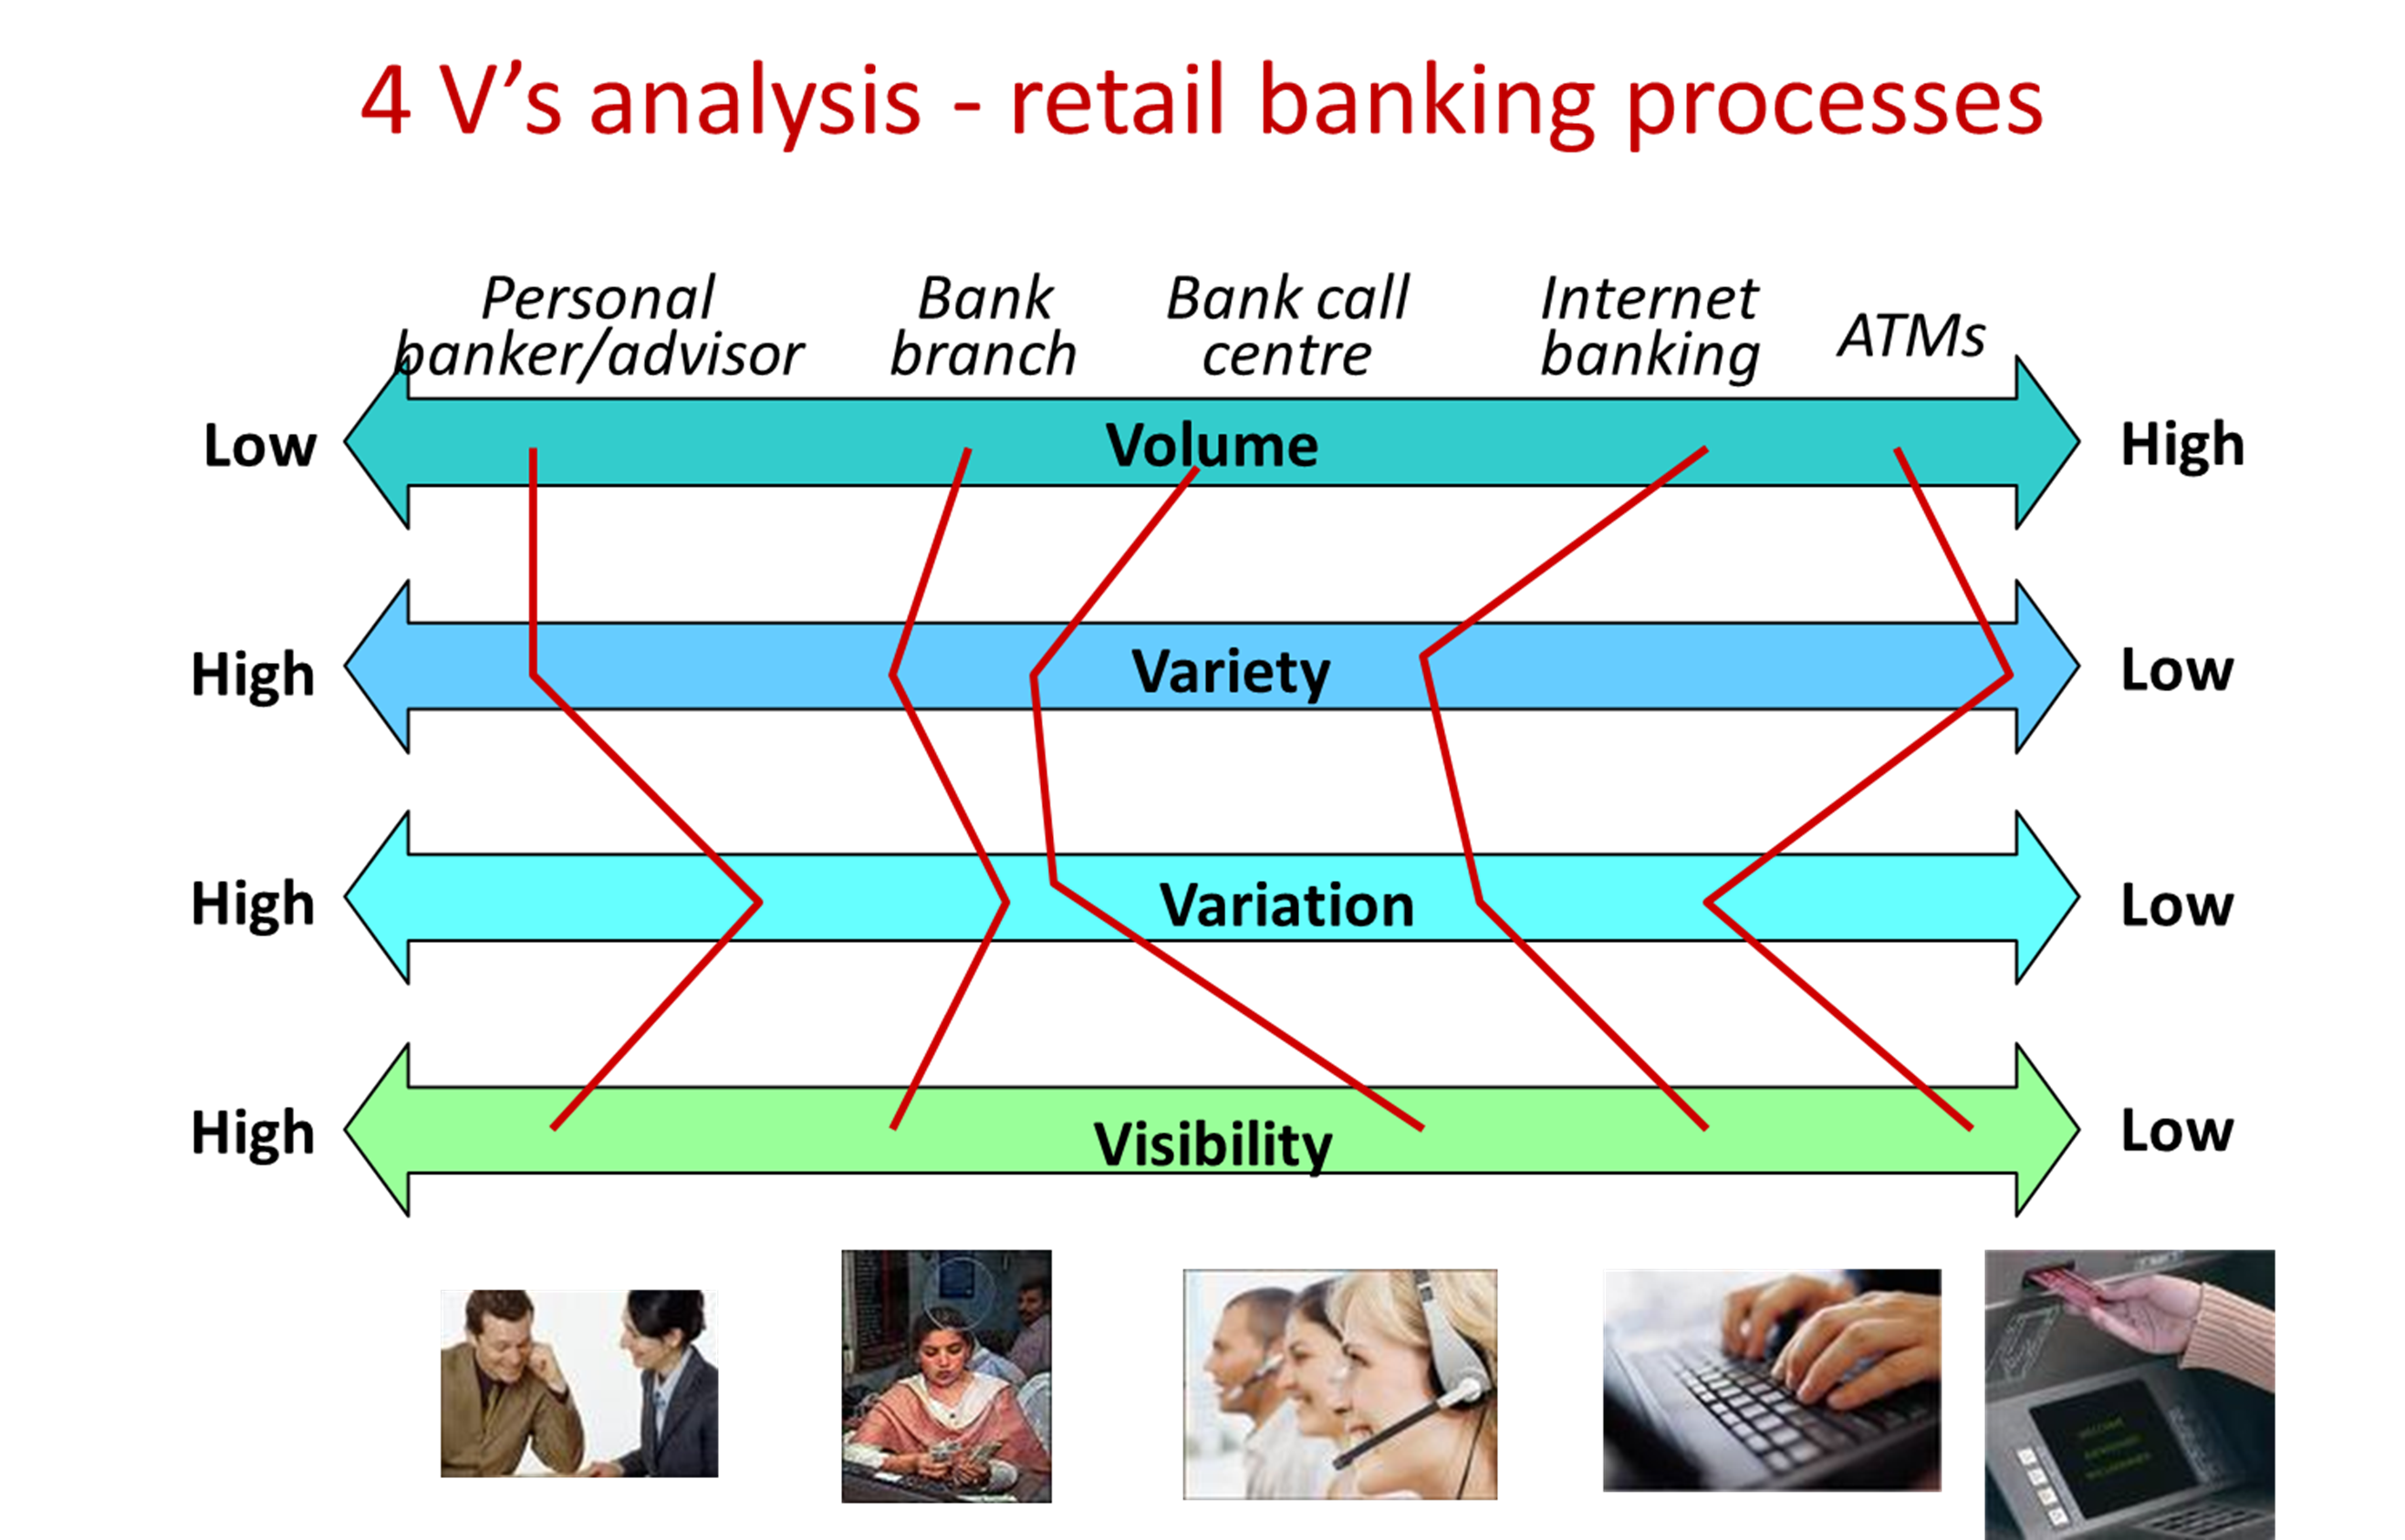

Slide 39
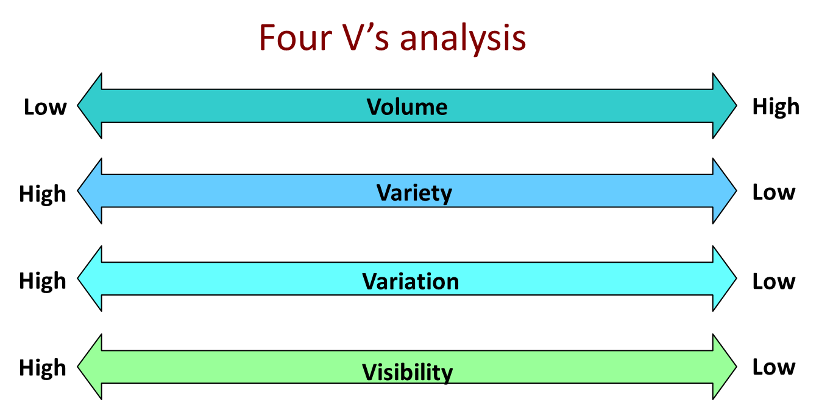

Slide 40
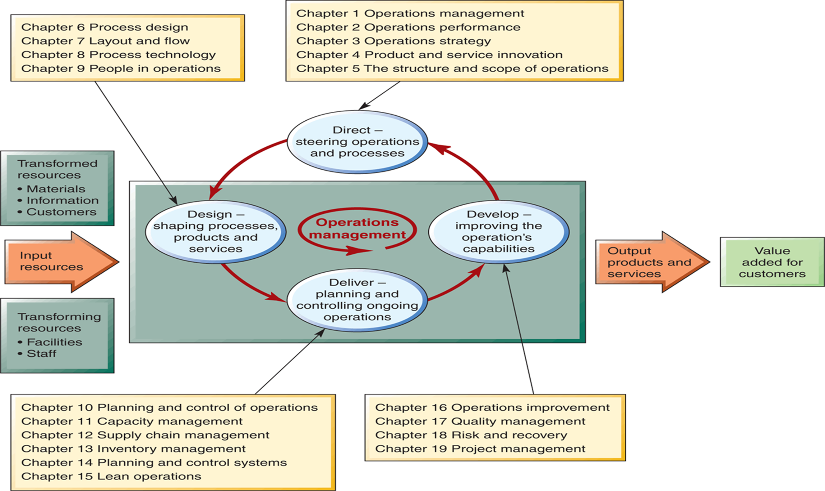

Slide 41
What we covered
Introductions: me, the course, how it works and you
What is Operations Management and what do Operations Managers do
What is the input-transformation output process
Trade offs and competitive / value adding priorities
The 4Vs – there is no such thing as best practice!

Slide 42
What is operations management?
Managing the resources that create and deliver services and products
What do OM managers (whatever their title) do?
Direct, Design, Deliver and Develop operations
Input-Output transformation
Transformed resources and transforming resources create output services/products
The process [analysis] hierarchy
At the level of the Network or the flow between process or the process flow between resources (people and facilities)
How do Operations and Processes differ?
All operations processes transform but differ according to the 4Vs model

Slide 43
Master of Business Administration
Digital Business Delivery
Professor Nigel Caldwell

