Slide 1

Master of Business Administration
Digital Business Delivery
Session 11: Supply Chain Management systems
Professor Nigel Caldwell

Slide 2
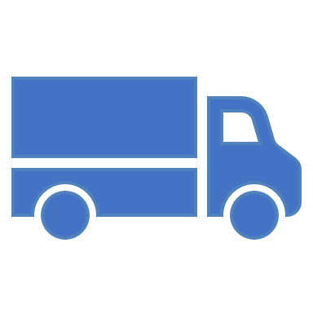
Todays agenda
What is supply chain management?
SCM has a Supply side (Purchasing and relationships) and a Demand side (SC design and logistics including location planning).
SCM, outsourcing and the boundary of the firm
Transparency, Traceability and Blockchain

Slide 3
Unit of analysis
Dyadic exchange
relationship
Consumer marketing
Industrial marketing /
Supply Chain
Management / B2B
Relationship portfolio
Supply chain
Focal firm supply chain
Industry as network
Industry as Eco System…

Slide 4
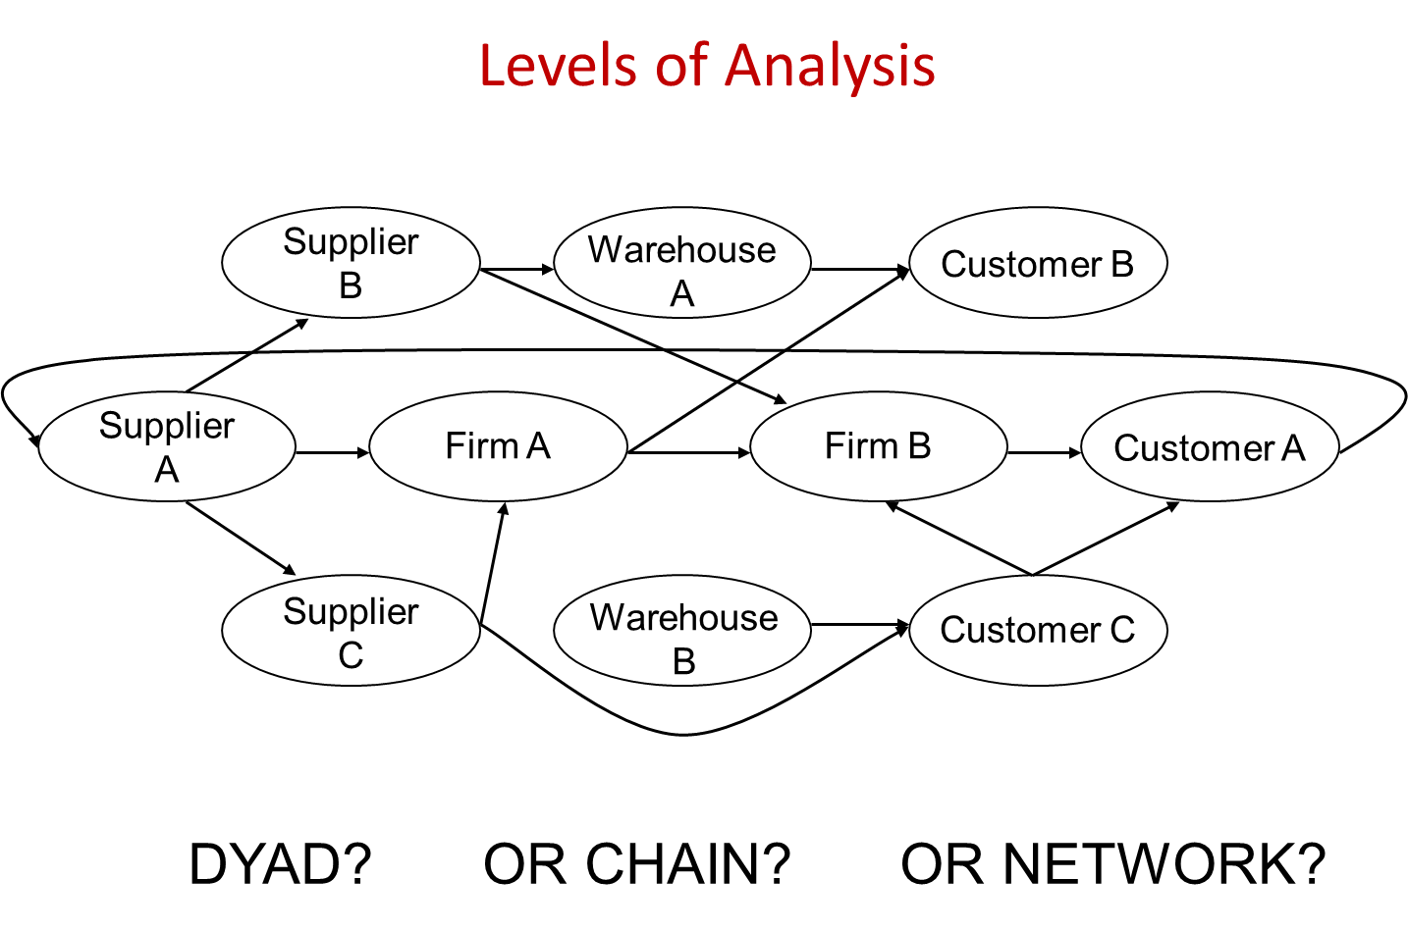

Slide 5
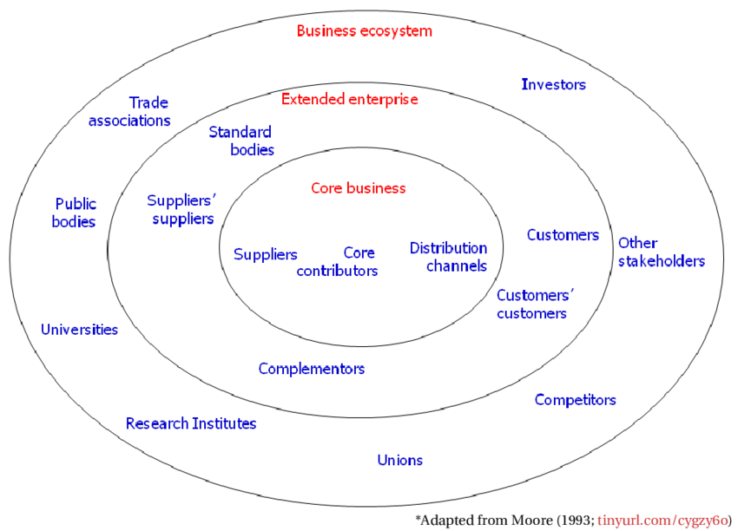

Slide 6
Supply chain management
is the management of the interconnection of organisations that relate to each other through upstream and downstream linkages between the processes that produce value to the ultimate consumer in the form of products and services.

Slide 7

What is a Supply Chain?
“A supply chain consists of all parties involved, directly or indirectly, in fulfilling a customer request” (Chopra and Meindl, 2004, p4).
Involving: manufacturer, suppliers, transporters, warehouses, retailers and customers.
Flows of products, finances, information and services
A```AAA`

Slide 8

Martin Christopher - Logistics
Logistics is the process of strategically managing the procurement, movement and storage of materials, parts and finished inventory (and the related information flows) through the organisation and its marketing channels in such a way that current and future profitability are maximised through the cost effective fulfilment of orders.
This section draws heavily on Martin Christopher’s excellent book Logistics and Supply Chain Management
Notes:
Demand creation and physical supply

Slide 9
The mission of logistics management
To serve customers in the most cost effective way
Christopher’s insight is that the way we reach and serve customers has become a critical competitive dimension
That is why it is necessary to look at logistics in a wider business sense and as linked to competitive advantage and not just a collection of tools and techniques.

Slide 10
SCM is broader than logistics
Logistics is essentially a planning orientation and framework that seeks to create a single plan for the flow of products and information through the business.
SCM builds upon this framework and seeks to achieve linkage and co-ordination between the processes of other entities in the pipeline, i.e. suppliers and customers and the organisation itself.
Notes:
e.g. one goal of SCM might be to eliminate buffers of inventory through sharing information on demand and stocks

Slide 11
SCM is different: its about relationships
So SCM is a different to the arm’s length even adversarial relationships of business past
The focus is on co-operation and trust and that
The whole can be greater than the sum of the parts.. so… SCM is
The management of upstream and downstream relationships with customers and suppliers in order to deliver superior customer value at less cost to the supply chain.
Notes:
Names – demand chain management better than supply?
Actually a network not a chain with multiple suppliers and multiple customers

Slide 12
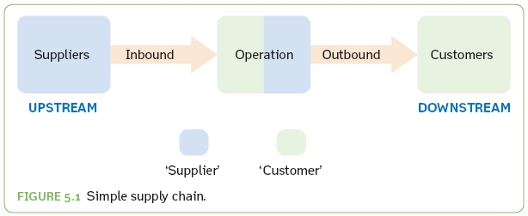

Supply Chain
A simple supply chain showing suppliers upstream and customers downstream. Note that the operation is both a supplier and a customer.
Source: Jones and Robinson, 2013

Slide 13
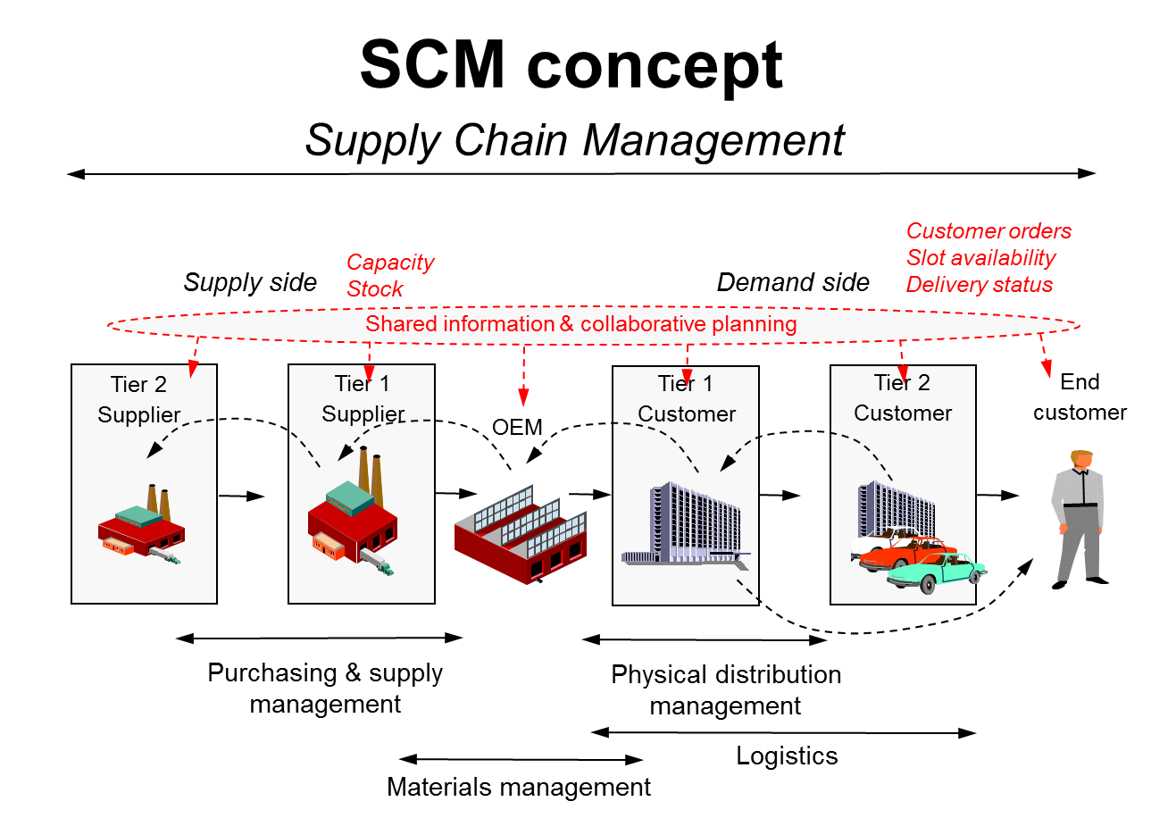

Slide 14
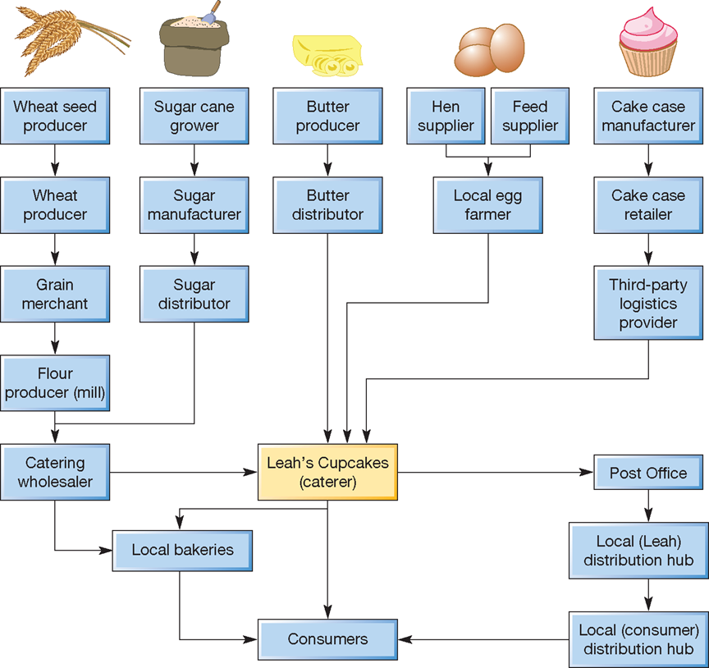
A simple supply network for a small catering company
Notes:
Downstream has Never heard of Leah’s cupcakes – HOW MUCH OF THIS SUPPLY COULD BE consolidated through the catering wholesaler

Slide 15
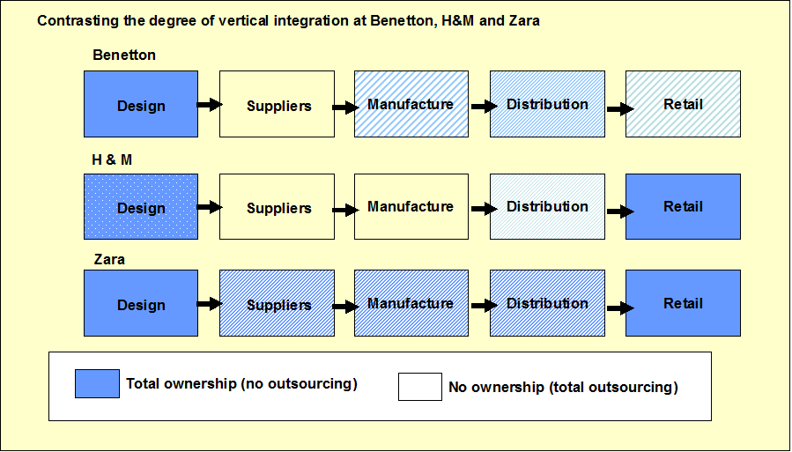
Vertical integration?

Slide 16

Returning to Outsourcing
Abbreviation for: Outside
Resource
Using
Outsourcing is the act of sub-contracting some of the firm’s internal activities to outside providers e.g.
  Warehousing & Logistics
  Catering
  Cleaning
  Call centre services
  Manufacturing
Outsourcing is followed by the decision to
source a suitable supplier or service provider
  Typically involves global sourcing
Notes:
Outsourcing: “moving functions or activities outside of the organisation” (e.g. Lonsdale and Cox, 1997)
¼ of European/US companies now use 3rd party Procurement Service Providers (PSPs) for e.g. hosting e-sourcing and e-procurement applications: expected to grow (Accenture Procurement Survey, 2003)

Slide 17
Core outsourcing benefits
Economies of scale
  Aggregating orders means a supplier can take advantage of economies of scale to reduce operations costs and then offer lower prices to customers.
Risk pooling
  Outsourcing offers customers to transfer demand uncertainty to suppliers
Reduce capital investment
  Capital investment is transferred to the supplier. Suppliers can do that because it is implicitly shared with many of their customers
Focus on core competencies
  Enables company to focus on skills & knowledge that differentiate it from its competitors and gives an advantage in the eye of the customer
Increased flexibility
  Ability to react more quickly to customer demand using supplier’s technical knowledge & ability to gain access to new technologies

Slide 18
Primary outsourcing risks
Loss of competitive knowledge
  Outsourcing may open up opportunities for competitors (IBM PC).
  Outsourcing implies that companies may lose their ability to introduce new designs based on their own agenda
  Outsourcing may prevent the development of new skills, insights, innovations and solutions by parent company staff
Conflicting objectives
  Increased flexibility for the buyer is in direct conflict with supplier’s objectives for long-term commitment from the buyer
  The supplier may have business relationships with many of the buyer’s competitors and could leak confidential information
Delegation of operational control
  Outsourcing means some loss of day-to-day control in return for greater focus on other parts of the business
  Is there potential for critical loss of quality through suppliers sub-contracting? Think about Apple, Mattel, BP, Benetton, Primark..

Slide 19
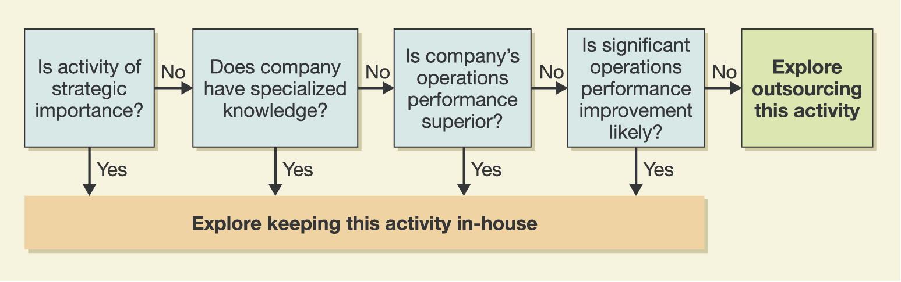
Make or buy?
Other options..
  Vertically integrate and ‘buy out’ the supplier
  Create a virtual company and only use suppliers on ‘needs basis’
  Alliance or Keiretsu approach: have suppliers become part of a company coalition

Slide 20
Outsourcing Model (Arnold, 2000)
Key question: is an activity core or non-core to the business?
Company
core
Outsourcing
Partner
or supplier
Functions close to core
Complementary functions
Peripheral functions
Figure 5.1 Outsourcing Model (Adapted: Arnold 2000).
Arnold’s 2000 model provides a useful starting point
  However, the boundary between the company & its environment is no longer clear cut

Slide 21
RBV approach to make or buy decision
Considers the firm as a bundle of resources and capabilities (Penrose 1959)
Effective core competencies are sources of SCA:
  Valuable
  Rare
  Inimitable: difficult to copy by other firms
  Non-substitutable: unique skills or knowledge sets
  Areas where company can dominate
  Embedded in the organisation’s systems
Valuable
Rare
Inimitable
  History dependent
  Causally ambiguous
  Socially complex
Non-Substitutable
Sustained Competitive Advantage (SCA)
Simplified version of Barney’s Model of Sources of Sustained Competitive Advantage
(Adapted from Barney, 1991)
Notes:
Example of Micro compact Car and mercedes Benz
Capability is the combination of resources to create value
Examples of core capabilities from book

Slide 22
Make or buy summary
Reasons for making
Core competencies
Lower production cost
Unsuitable suppliers
Assure adequate supply
Utilise surplus labour
Obtain desired quantity
Remove supplier collusion
Unique item
Protect proprietary design/ quality
Increase/maintain company size
Reasons for buying
Free management time
Lower acquisition cost
Preserve supplier commitment
Obtain technical/management skill
Inadequate capacity
Reduce inventory costs
Flexibility/alternate supply source
Inadequate own resource/skill
Reciprocity
IP protected or trade secret
Notes:
Supplier selection criteria
Company - Financial stability, Management, Location, Capacity/technical skill
Product/Service – Quality, Price, IP/license, Delivery on time, Condition on arrival, Technical support, Training
Other - Risk management, Political/principal

Slide 23
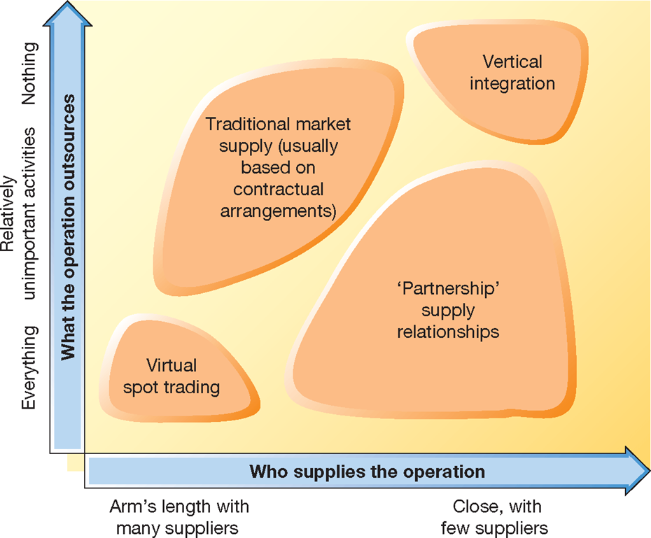
Types of supply network arrangements

Slide 24
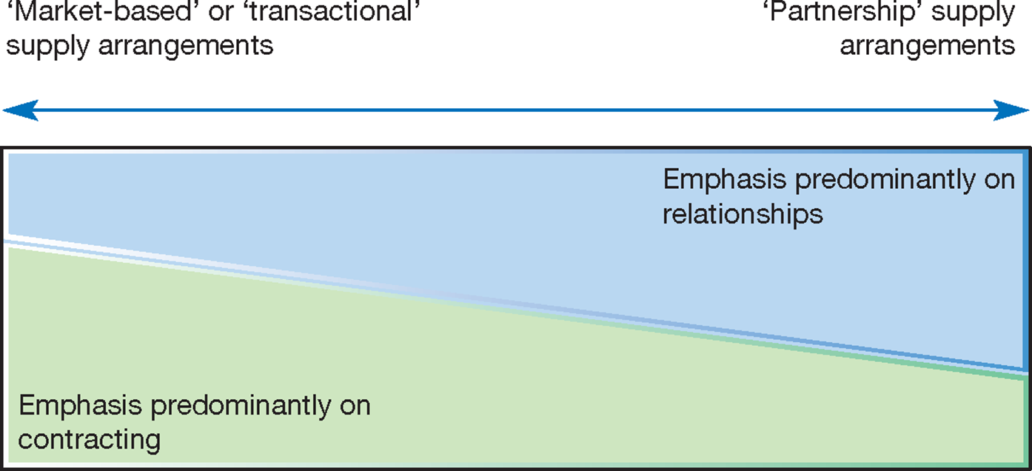
Supply Management (nee purchasing) balances contracting and relationships

Slide 25
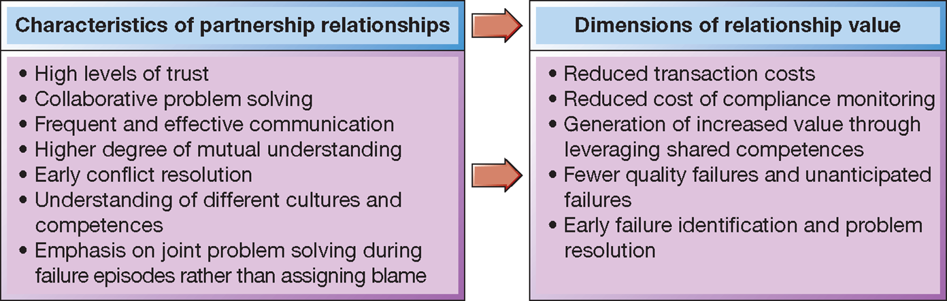
The value of partnership style relationships

Slide 26


Supply strategies change
  High-tech industry
    1980s: Sourcing in the US
    1990s: Singapore and Malaysia
    2000s: Taiwan and mainland China
    2020 Reshoring…
          ?

Slide 27
Supply chains management is concerned with the flow of information and the flow of products and services
‘Upstream’ flow of customer
Requirements
Long-term plans and requirements
Market research information
Individual orders
Payment
Potential new products and services
Flow between processes
Flow between processes
Flow between processes
Consumer
Operation 1
Operation 2
Operation 3
Products and services
New products and services
Delivery information
Payment request/credit
‘Downstream’ flow of products and services for customer
Fulfilment

Slide 28
Supply Chain Managerial Decisions
Decisions, decisions!
Make or buy?
Designing the supply chain
Locations
Coordinating the spend portfolio
Selecting suppliers
Negotiating with suppliers
Supplier performance measurement & management
New product development
Green & ethical issues
Managing risk

Slide 29
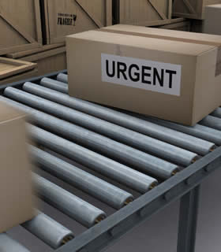
Supply Management
(‘Purchasing / Buying / Procurement’)

Slide 30
What is Supply Management?
Ensuring that the enterprise is supplied with what it needs, so that it can provide what it sells to its market.
Operations
Logistics
Procurement
SOURCE
MAKE
DELIVER
Reverse Logistics
RETURN

Slide 31
The Make-Buy Decision
Which items to produce in-house and which items to purchase externally
Fundamental to supply chain management
Starting point for sourcing process
Make or buy?
Supplier selection
Relationship management
Negotiation
The Sourcing Process

Slide 32
A Simplified Sourcing Process
Step 1
Step 2
Step 3
Step 4
Step 5
Step 1 = Analyse
Opportunities
Step 2 = Develop
Sourcing Strategies
Step 3 =
Supplier Selection
Step 4 = Negotiation and Contracting
Step 5 = Supplier relationship management

Slide 33
Step 2: Position Products/Sourcing Group on Matrix
High
LEVERAGE
STRATEGIC
EXAMPLE:
Bicycle Manufacturer
Where:
A = Stem & Bars
B = Groupset
C = Inner Tubes
D = Tubing
B
A
Impact on Business
NON-CRITICAL
BOTTLENECK
D
C
Low
Low
High
Complexity of Supply Market

Slide 34
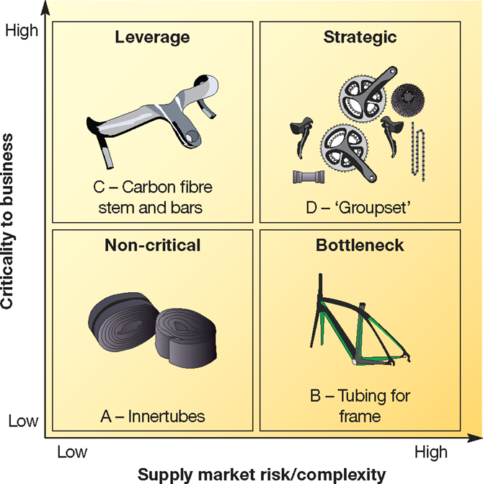
Category management strategies for a high-end bicycle manufacturer

Slide 35
Step 2: Categorise spend – The Kraljic Matrix
High
LEVERAGE
Multiple sources
Abundant supply
Medium-term focus
STRATEGIC
Single/parallel sources
Natural scarcity
Long-term focus
Impact on Business
NON-CRITICAL
Multiple sources
Abundant supply
Short-term focus
BOTTLENECK
Single/tiered sources
Production scarcity
Variable focus
Low
Low
High
Complexity of Supply Market

Slide 36
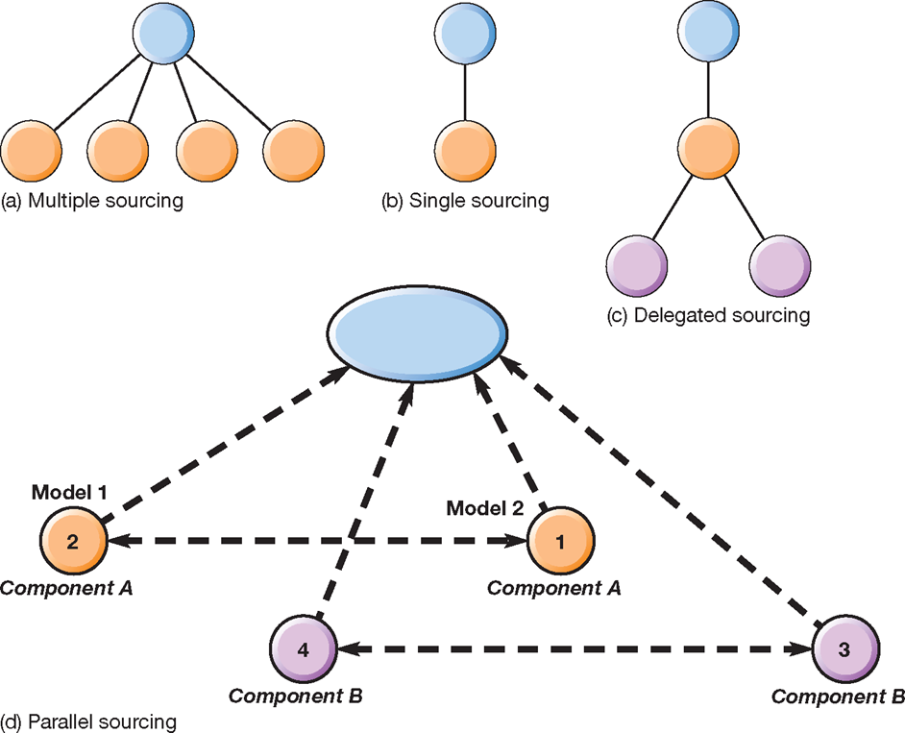
Four key sourcing approaches
Notes:
Why would we want to mainatain more than one supplier like parallel sourcing ?

Slide 37
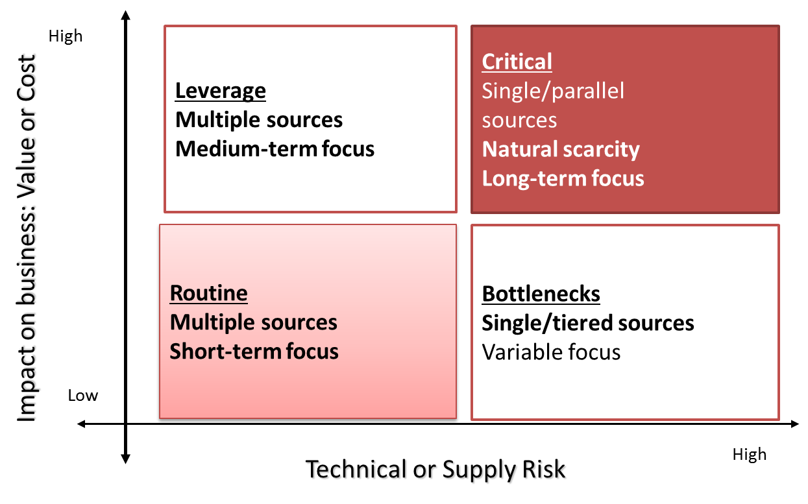
Categorising Spend – The Kraljic Matrix

Slide 38
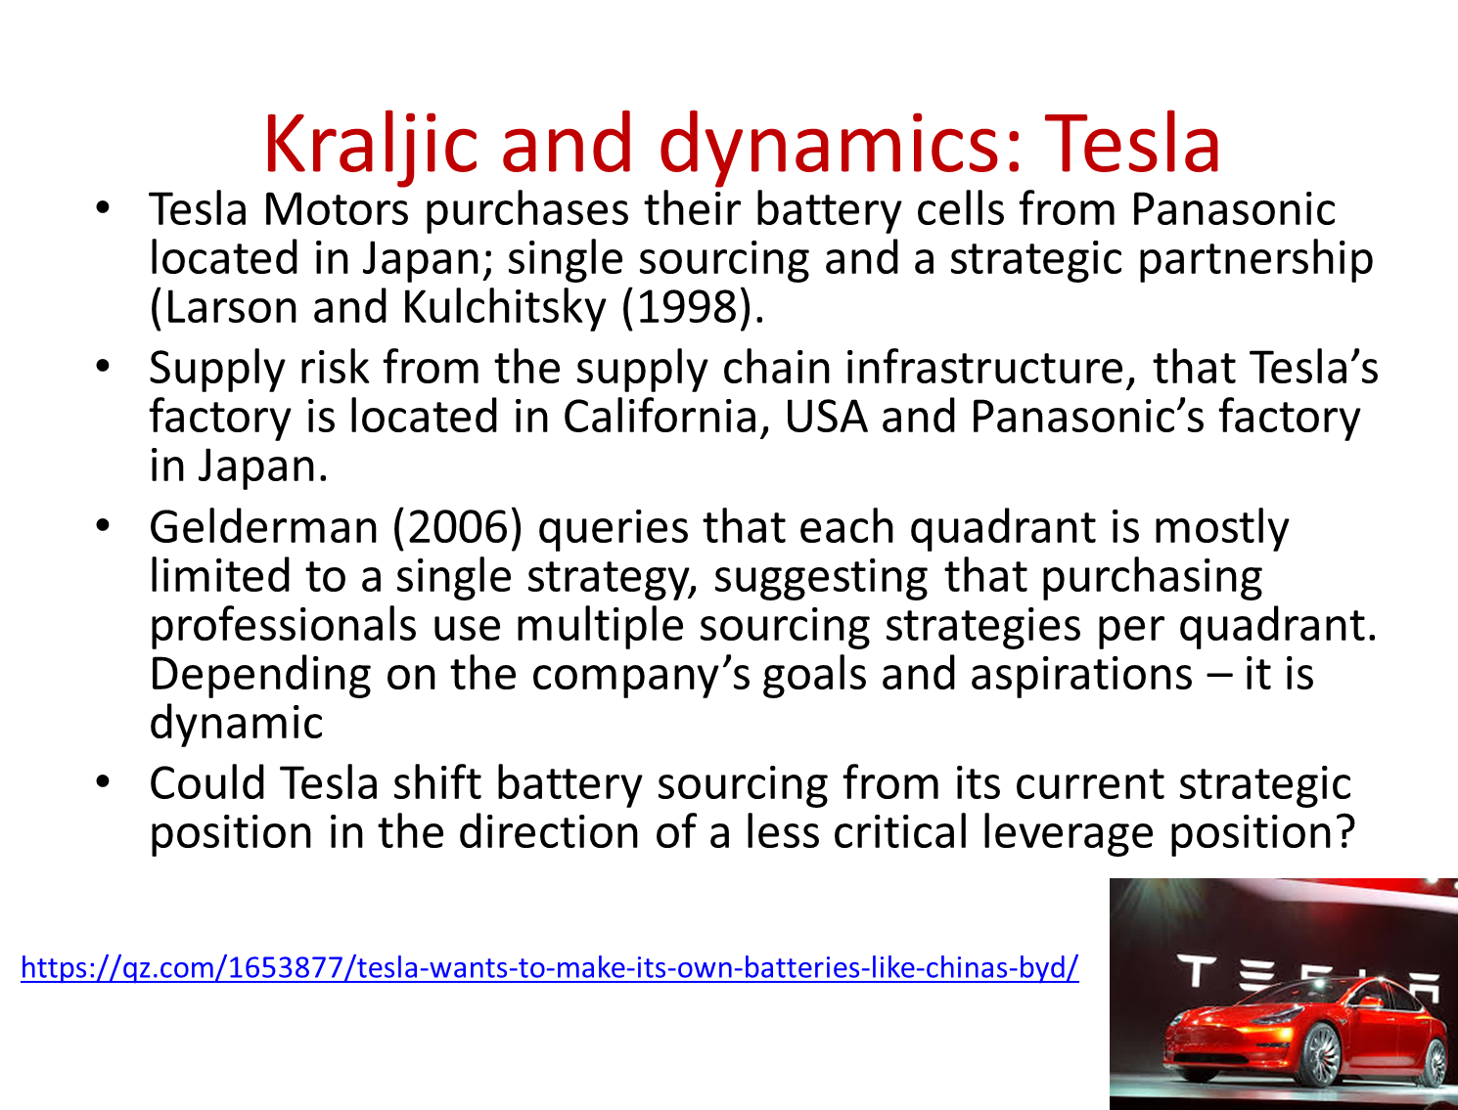

Slide 39
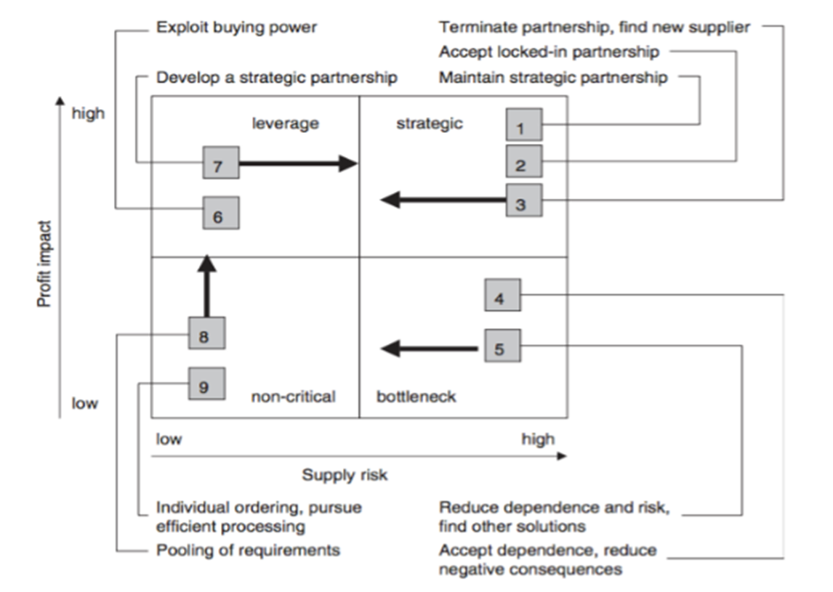
A more dynamic perspective on Kraljic

Slide 40
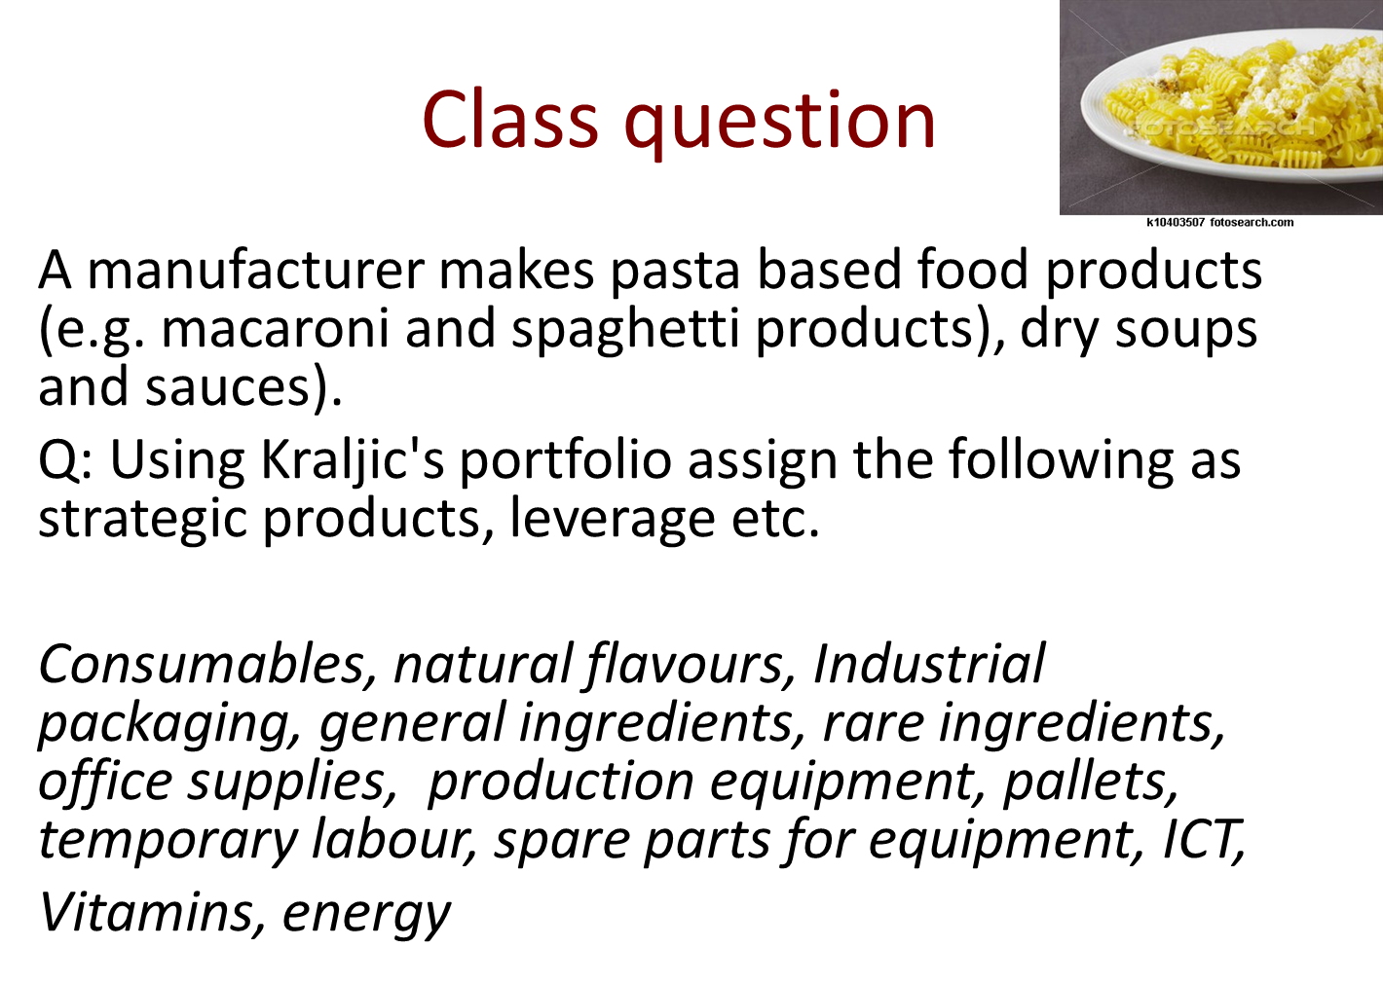

Slide 41
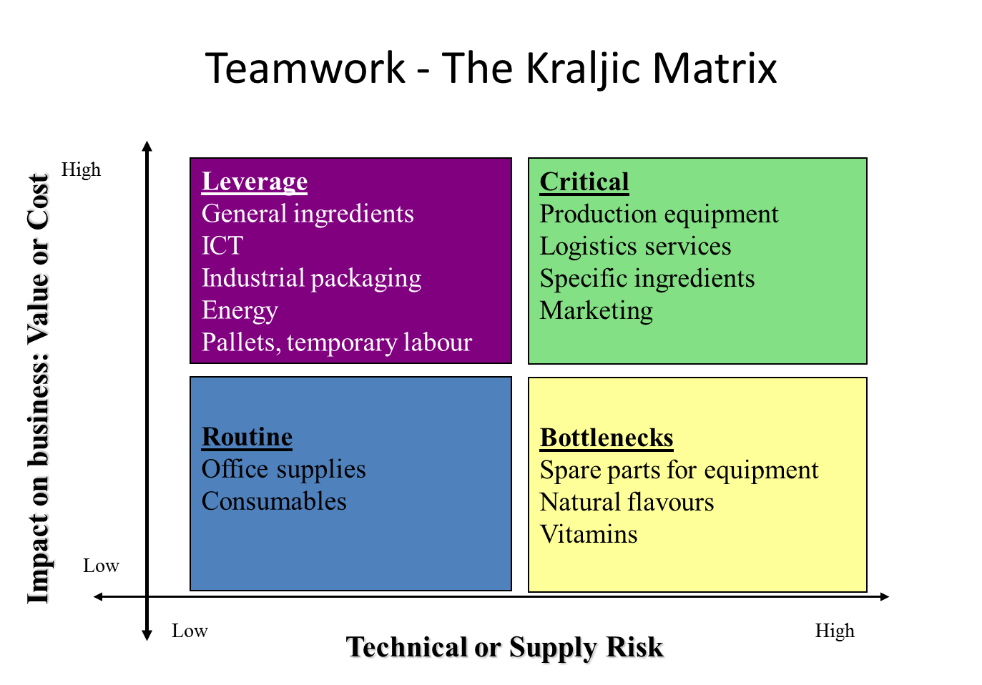

Slide 42
Strategic Sourcing Practices
VOLUME CONCENTRATION
PRODUCT SPECIFICATION IMPROVEMENT
BEST PRICE EVALUATION
STRATEGIC SUPPLY MANAGEMENT
JOINT PROCESS IMPROVEMENT
GLOBAL SOURCING
RELATIONSHIP RESTRUCTURING

Slide 43

Step 3: Supplier Selection
How do firms select among potential suppliers?
Supplier selection requires definition and evaluation of wide range of factors:
  ‘Hard’ factors: cost, quality, delivery…
  ‘Soft’ factors: capability, complementarity, culture…
Some factors more important than others: weighting system
Simplicity = cost
Complexity = cost + others

Slide 44

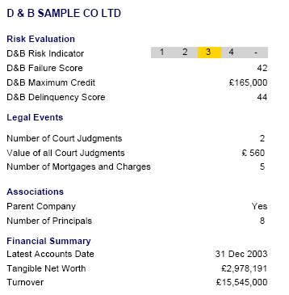
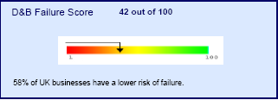
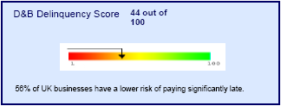

Slide 45
Step 4: Negotiation and Contractual Arrangements
Will cost you…
Tactics
Emotion
Logic
Threat
Bargaining
Compromise

Slide 46
The best negotiators…
…have no tricks up their sleeve
…play it straight
…ask a lot of questions
…listen carefully
…and concentrate on what they and the other party are trying to accomplish at the negotiating table
G.R. Shell (2006) Bargaining for Advantage, Penguin,

Slide 47
Prepare, Prepare, Prepare
Comprehensive market knowledge
A wide range of quotations/tenders
Economic analysis
Product knowledge
Raw material sources and prices
Product or service cost analysis
Supplier financial data
Supplier activity/capacity data
BATNA – best alternative to a negotiated agreement

Slide 48
Listening
Most people can listen at about 450 words per minute, but they can only talk about 175 words per minute (39%).

Slide 49
Step 5: Implementation and Management
Performance & Relationship Management
  Contract management
  Performance measurement
  Supply base optimisation
  Supplier development
Green and Ethical Sourcing
Supply Chain Risk Management

Slide 51
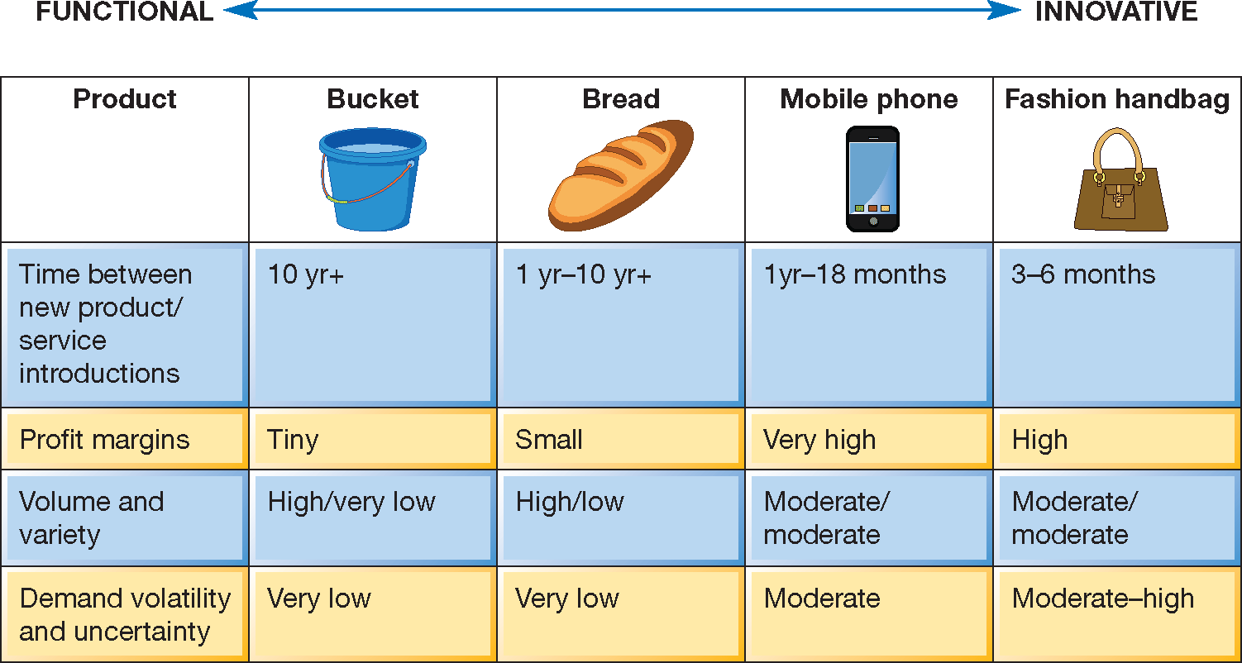
Functional Vs. Innovative products

Slide 52
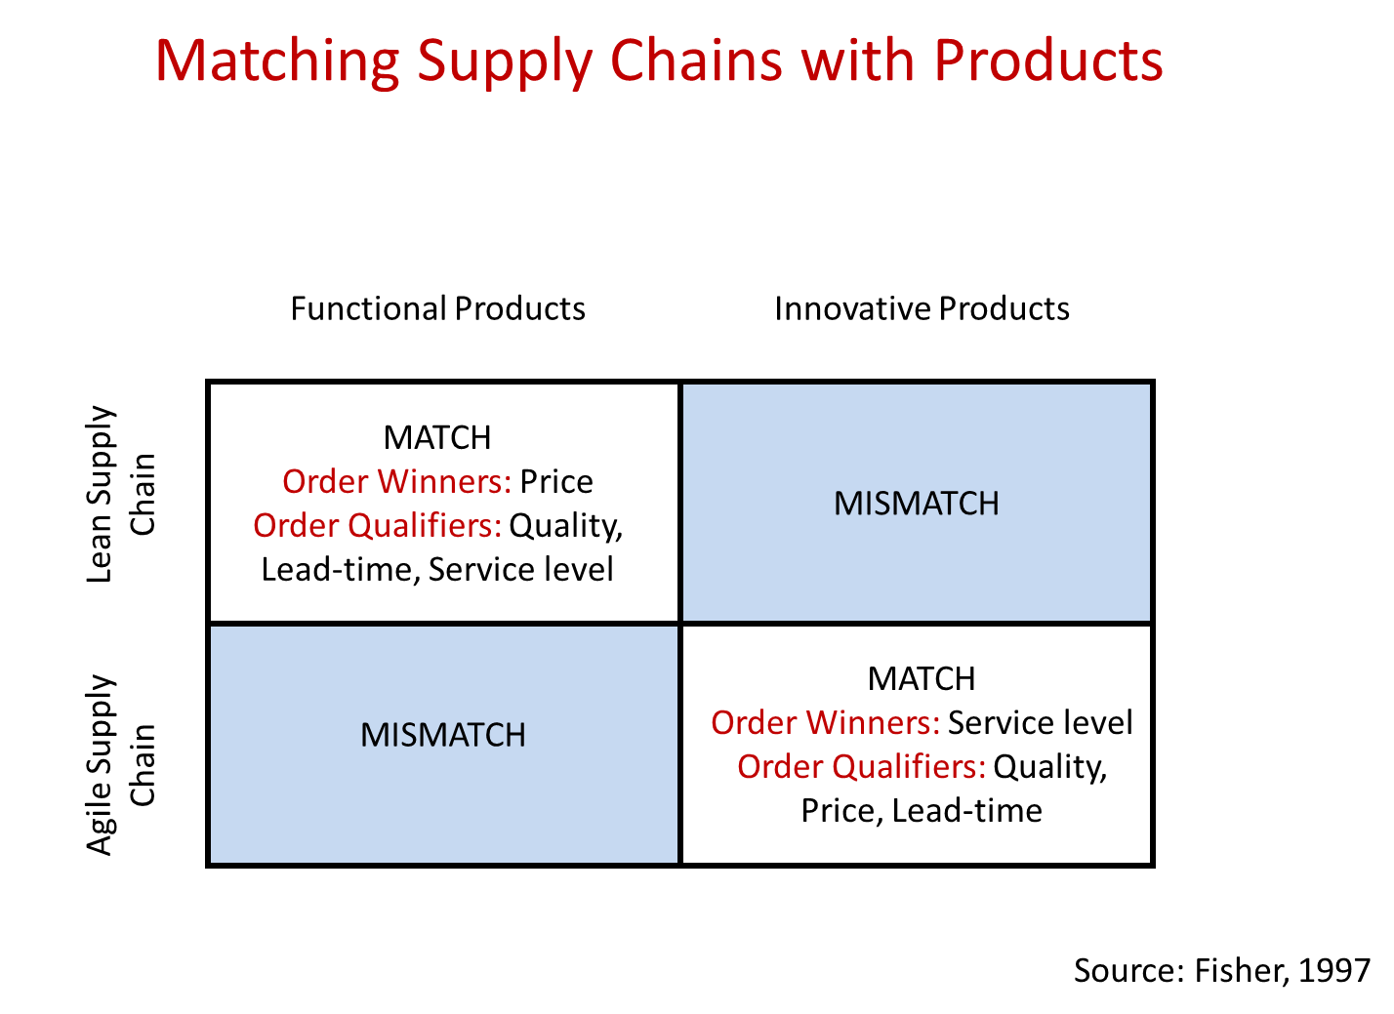

Slide 53
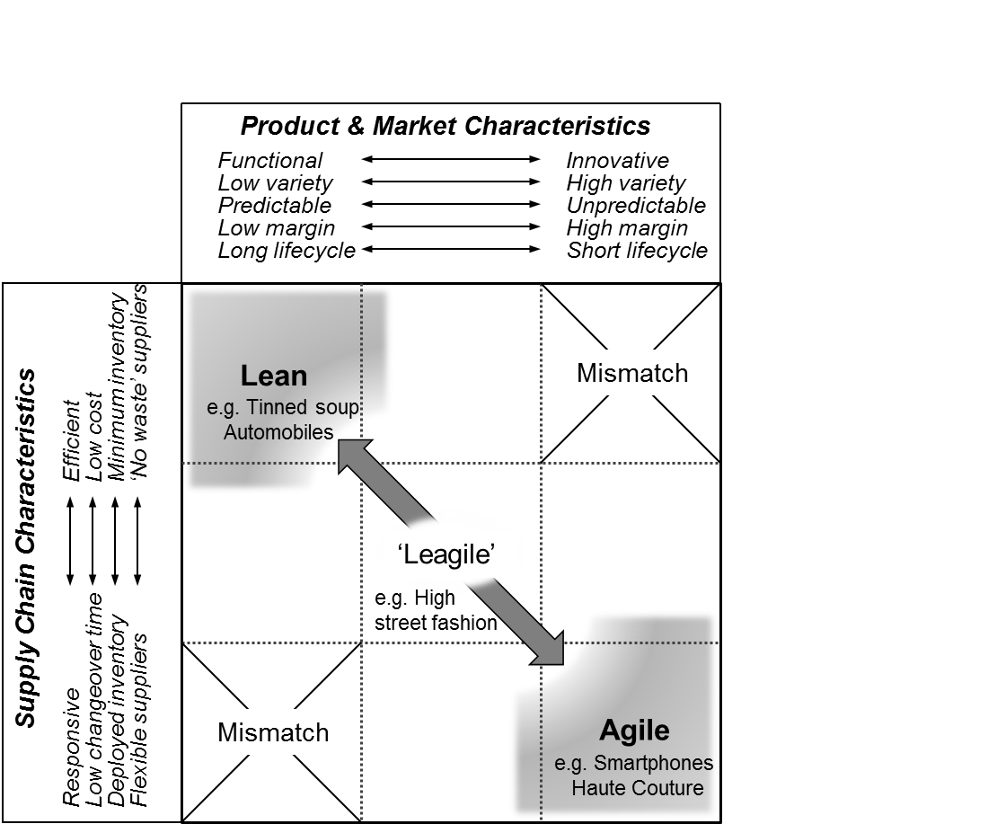
Matching supply chain with market requirements
Lean & Agile Supply Chain Strategy Johnsen, Howard & Miemczyk (2014) p213

Slide 54

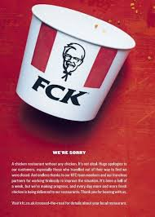

Slide 56
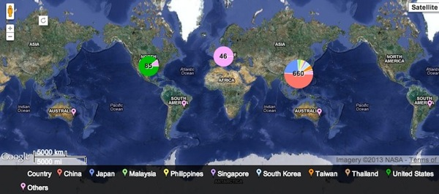
Global supply chain for iPhone
https://www.iphoneincanada.ca/news/interactive-map-apples-worldwide-supply-chain/

Slide 57
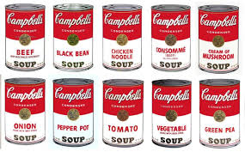
Andy Warhol’s Campbell’s Soup Cans
Notes:
More recently Volvo and green carts – Campbells soups funded the original project into the Foerester effect or Bull whip

Slide 58
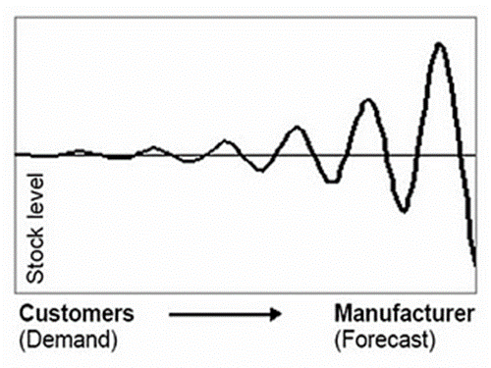
The bullwhip effect and Inventory
Also known as the ‘Forrester Effect’
  Is the effect of information delay & demand amplification across a supply chain
  It is why supply chains run best when one common strategy is adopted by all partners

Slide 59
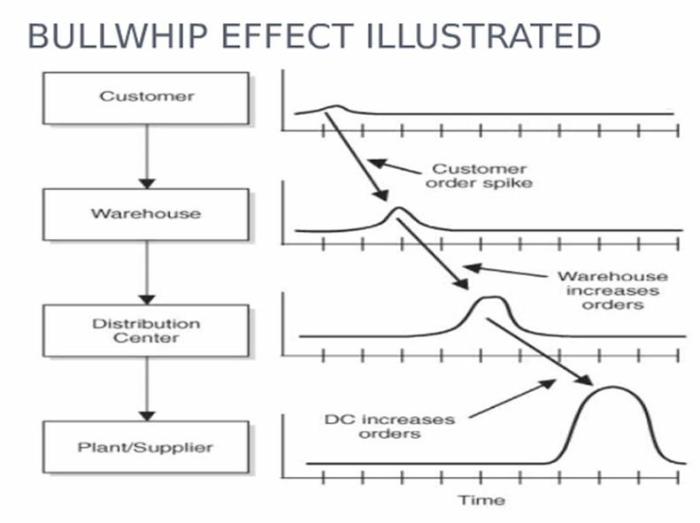
Inventory ‘spikes’ and fluctuation
  Illustrates the tensions & mismatch in a supply chain
  Operations run most effectively in stable conditions, but the reality is often constant market uncertainty See Lee et al. 1997

Slide 60
So what we need is to share more information right?
So if the relatively simple answer is sharing more information across the supply chain why has this not happened before?
Lets look at technology in supply chains

Slide 61

Transparency & traceability
Successful supply chains rely on transparency of shared supply and demand information
  Technology such as RFID (radio frequency identification) helps SC actors to track stock as it moves in and out warehouse
  GPS (Global positioning system) technology can even track trucks or ships as they ship goods to their destination.
Traceability involves the tracking & tracing of items in the supply chain as part of delivery, quality & security
Rise of importance of sustainability means a new level of traceability is required for supply chain assurance
  E.g. Horsemeat scandal
  Blockchain

Slide 62
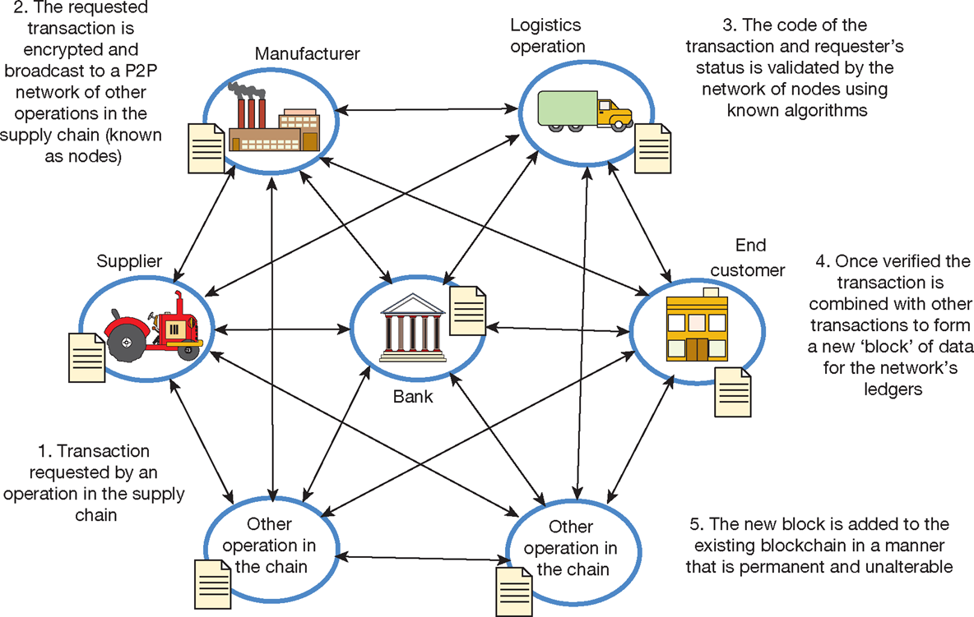
How blockchain technology works to record
and verify transactions in supply chains

Slide 63
Trends in Supply Chain management
Low carbon …
Omni channel retailing / Reverse logistics – return of products to source
Disintermediation – ‘cutting out the middleman’
Blockchain and smart contracts
IoT, E-Procurement – use of the internet to improve cost and time ERP, SAP, track and trace technologies, RFID, Drones, SD vehicles
AI???

Slide 64

Critical commentary
SCM is the management of relationships and flows between operations and processes – different to the network.
Supply chains have supply, demand and sharing/collaboration elements, firms are suppliers and customers
[Supply] Sourcing strategy depends on the complexity and risk of the supply market and its criticality to the business.
[Demand] Supply chains should be designed to serve the needs of the end customer; e.g. choosing functional vs. responsive chain
[Sharing/collaboration] Blockchain is reportedly going to revolutionise chains through trusted overviews of supply chain transactions.

