Slide 1

Master of Business Administration
Digital Business Delivery
Session 7: Planning, Control and Capacity Management
Professor Nigel Caldwell

Slide 2

Recap last session
Innovation

Slide 3
Todays Agenda
OM Planning and control organises the delivery of products and services on an on-going basis so that customers’ demands are satisfied.
What are the activities of planning and control
Capacity Management explains how operations decide to vary their capacity (if at all) as demand for their products and services fluctuates.
How is demand/capacity measured?
How is the demand/supply side managed?
Notes:
First 3 issue before the break and the last 2 after the break

Slide 4
Effectiveness
The extent to which the output meets expectations
Expectations
Action
Inputs
Outputs
Resources
Efficiency
Resources consumed in producing the output?

Slide 5
Quality
control
Third part warehouses
Test results
Problem reporting
Product receipts for consolidation
Orders for third party products
Wet goods
Wet goods
Product
Product
Spirit Warehouse
Sprit processing
Bottling & Palletising
Shipping & Dispatch
Customers
Documentation
Documentation
Documentation
Invoice
External suppliers
Dry
goods
Dry goods
Orders
Product orders
Materials manag’t
Customer service
Stock updates
Planning
Orders
Call-offs
Long term demand
Capacity planning at a Scottish Whiskey
maker with a high end and a low end
product
Blanket orders
Procure-ment

Slide 6
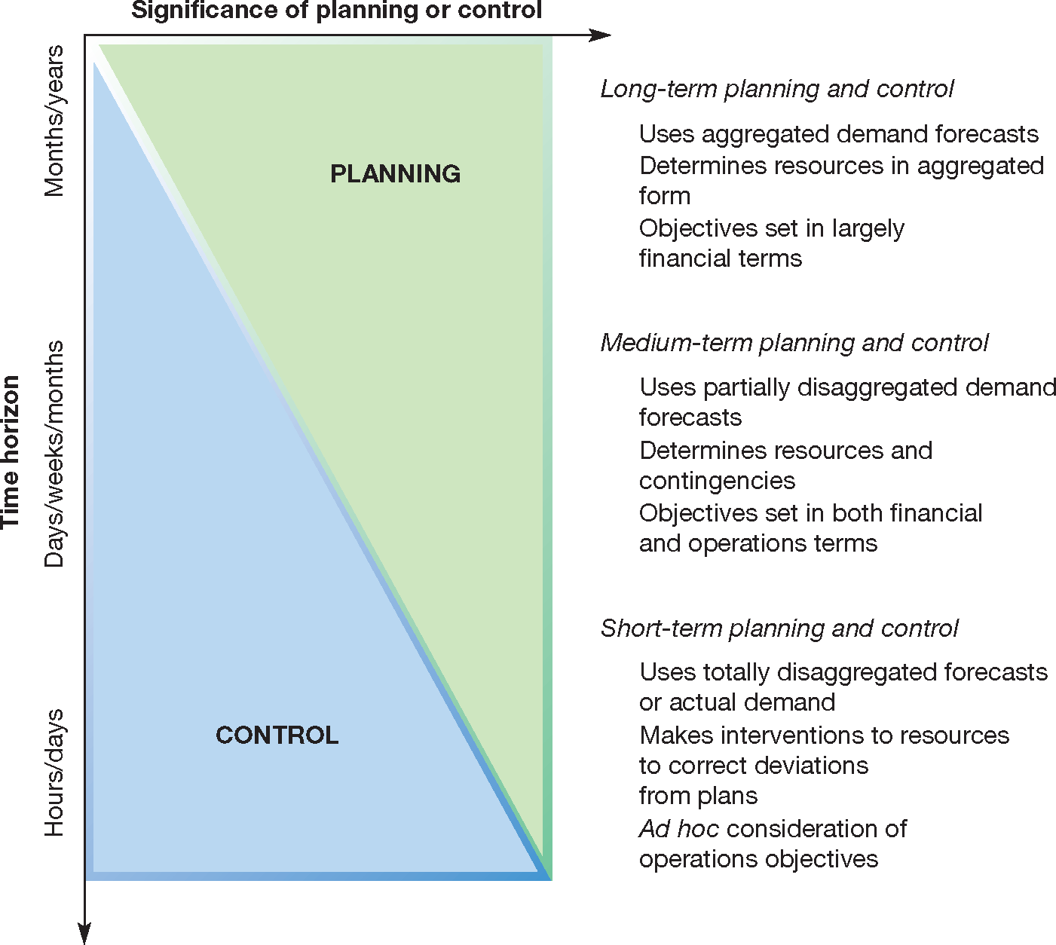
Balance between planning and control activities changes in the long, medium and short term

Slide 7
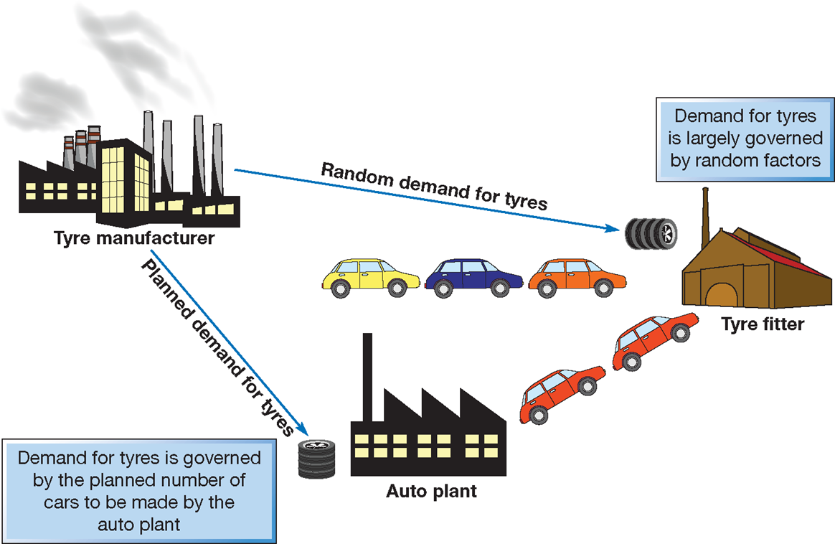
Dependent vs. Independent demand

Slide 8
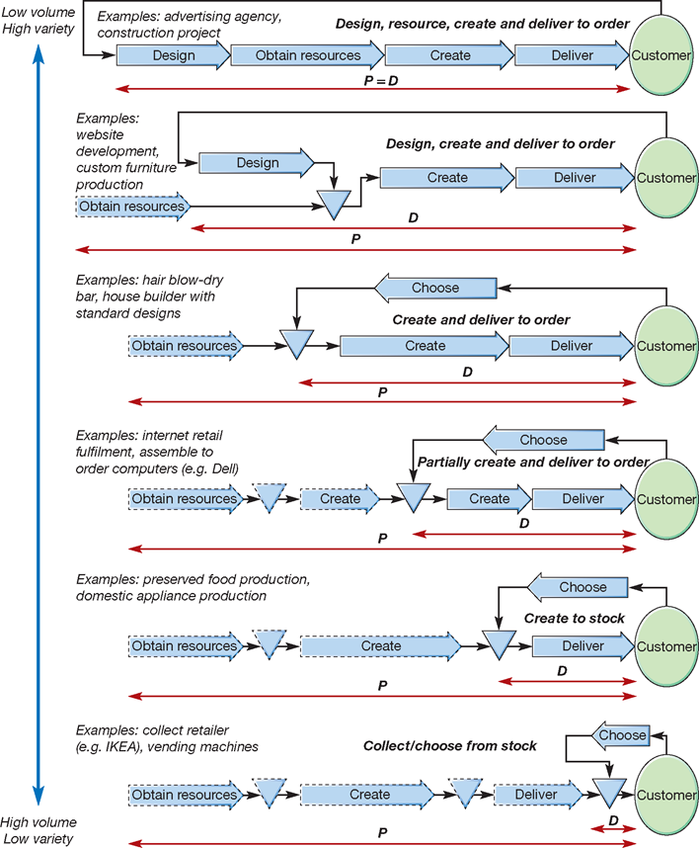
P:D ratio, how long a customer has to wait compared to total time it takes to make P or S available.

Slide 9
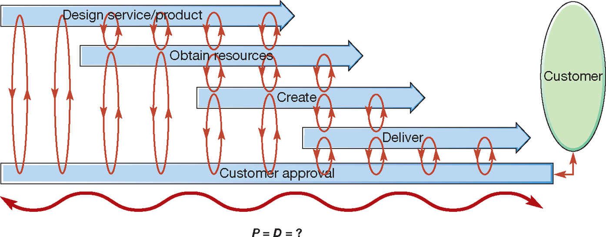
Manufacturing dominated by make to stock (low customer involvement). Any Make to order has higher customer involvement and complexity

Slide 10
Sales and Order Planning (S&OP)
Marketing want to maximise revenue and reliable delivery
Operations want stability and low cost – long production runs of the same things
Finance to reduce working capital and inventory, as well as fixed costs etc.
S&OP is a planning process that attempts to ensure that all tactical plans are aligned across the business’s various functions and strategic goals.

Slide 11
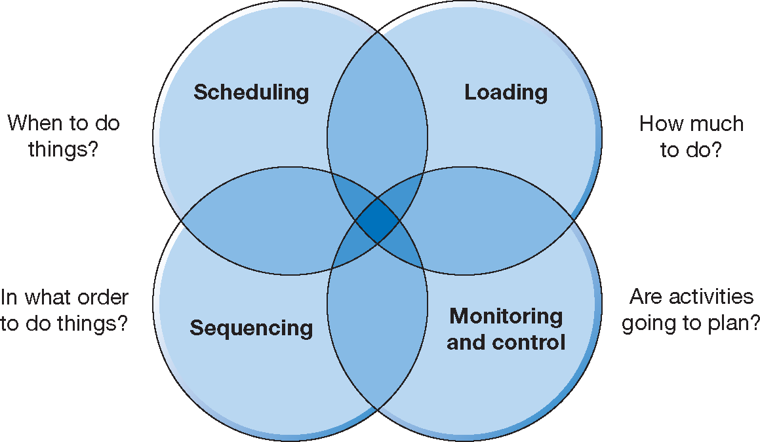
Planning and Control activities

Slide 12
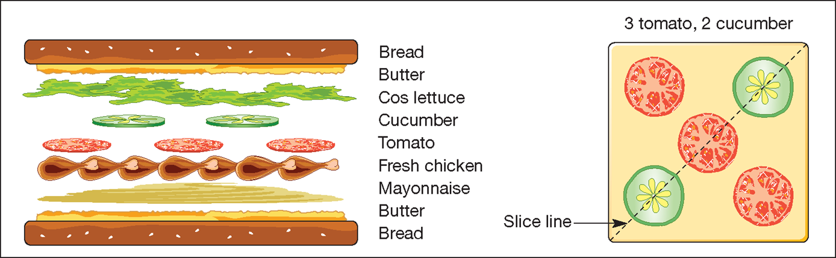
Design for a chicken salad sandwich

Slide 13
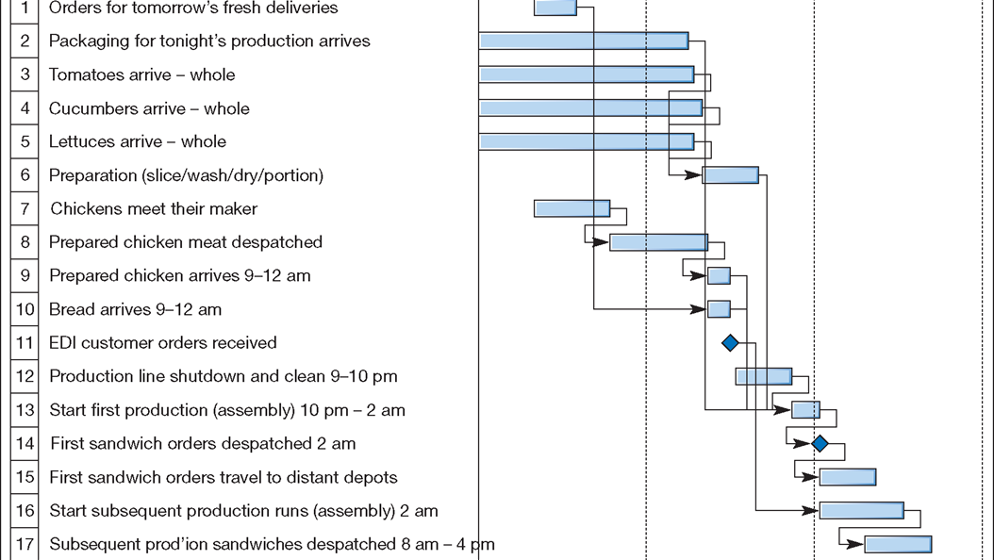
Simplified schedule for the manufacture and delivery of a chicken salad sandwich

Slide 14
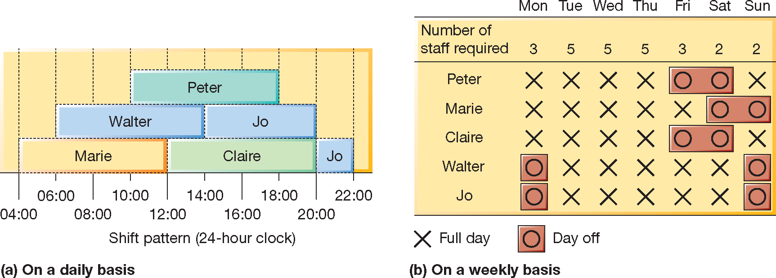
Shift scheduling in a support service for a small software company

Slide 15
Scheduling in 2 Cinemas – textbook Q5. p353
Kinepolis, Brussels, one the largest cinema complexes in the world, with 28 screens, 8000 seats, and four showings of each film every day. It is equipped with the latest projection technology. All the film performances are scheduled to start at the same times every day: 4 pm, 6 pm, 8 pm and 10.30 pm. Most customers arrive in the 30 minutes before the start of the film. Each of the 18 ticket desks has a networked terminal and a ticket printer. For each customer, a screen code is entered to identify and confirm seat availability of the requested film. Then the number of seats required is entered, and the tickets are printed, though these do not allocate specific seat positions. The operator then takes payment by cash or credit card and issues the tickets. This takes an average of 19.5 seconds, a further 5 seconds is needed for the next customer to move forward. An average transaction involves the sale of approximately 1.7 tickets.
The UCI cinema, Birmingham has 8 screens and fully computerized ticketing. In total, the 8 screens can seat 1,840 people; the capacity (seating) of each screen varies, so the cinema management can allocate the more popular films to the larger screens and use the smaller screens for the less popular films. The starting times of the 8 films at UCI are usually staggered by 10 minutes, with the most popular film in each category (children’s, drama, comedy, etc.) being scheduled to run first. Because the films are of different durations, and since the manager must try to maximize the utilization of the seating, the scheduling task is complex. Ticket staff are continually aware of the remaining capacity of each ‘screen’ through their terminals. There are up to 4 ticket desks open at any one time. The target time per overall transaction is 20 seconds. The average number of ticket sales per transaction is 1.8. All tickets indicate specific seat positions, and these are allocated on a first-come-first-served basis.

Slide 16
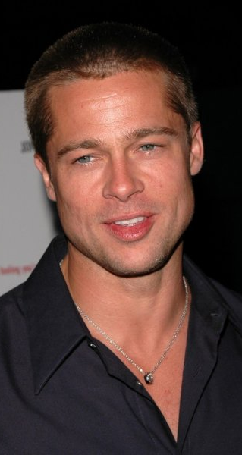
Questions on cinema scheduling
(a) What are the main differences between the two cinemas from the perspective of the operations managers?
(b) What are the advantages and disadvantages of the two different methods of scheduling the films on screen?
(c) Imaginate 8 films with different running times and classifications. Try to schedule these on to the UCI Solihull screens, taking account of what popularity you might expect at different times. You should allow at least 20 minutes for emptying and cleaning, 10 minutes for admitting the next audience, and 15 minutes for advertising, before the start of the film.

Slide 17
Scheduling
Respect! One of the most complex tasks in OM
Generally not well regarded or well paid – but never patronise or make an enemy of (although they tend to be stressed and grumpy!)
Listened to by senior management
Have to have deep knowledge of intricacies of the business / operation over years – or can easily mess the business up!

Slide 18
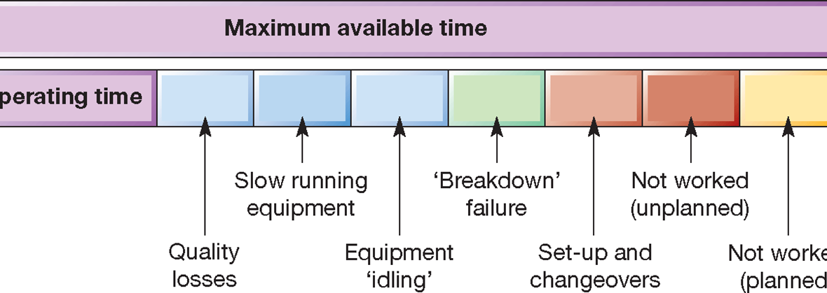
Loading
  Simply the amount of work that can be allocated to a work centre.
  In theory any machine can run 24 hours a day for 7 days a week (168 hours) we come back to this next in capacity.

Slide 19
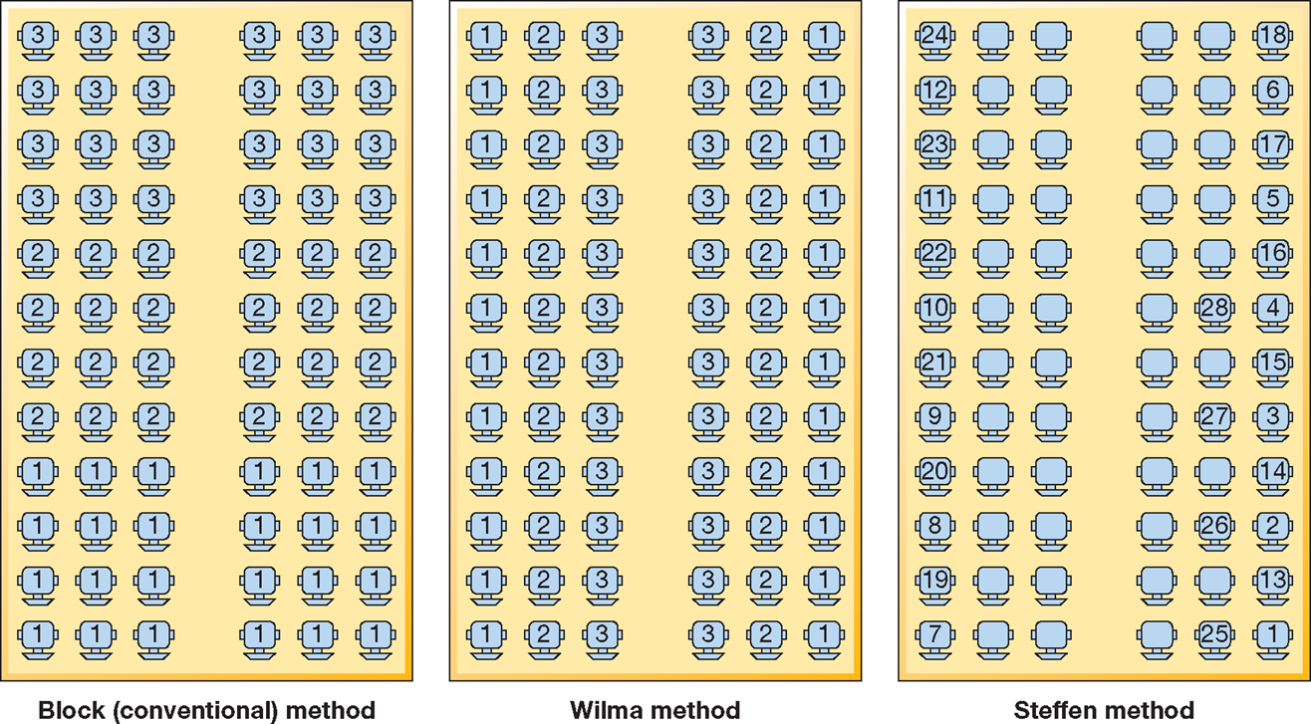
The best way to sequence passengers onto an aircraft

Slide 20
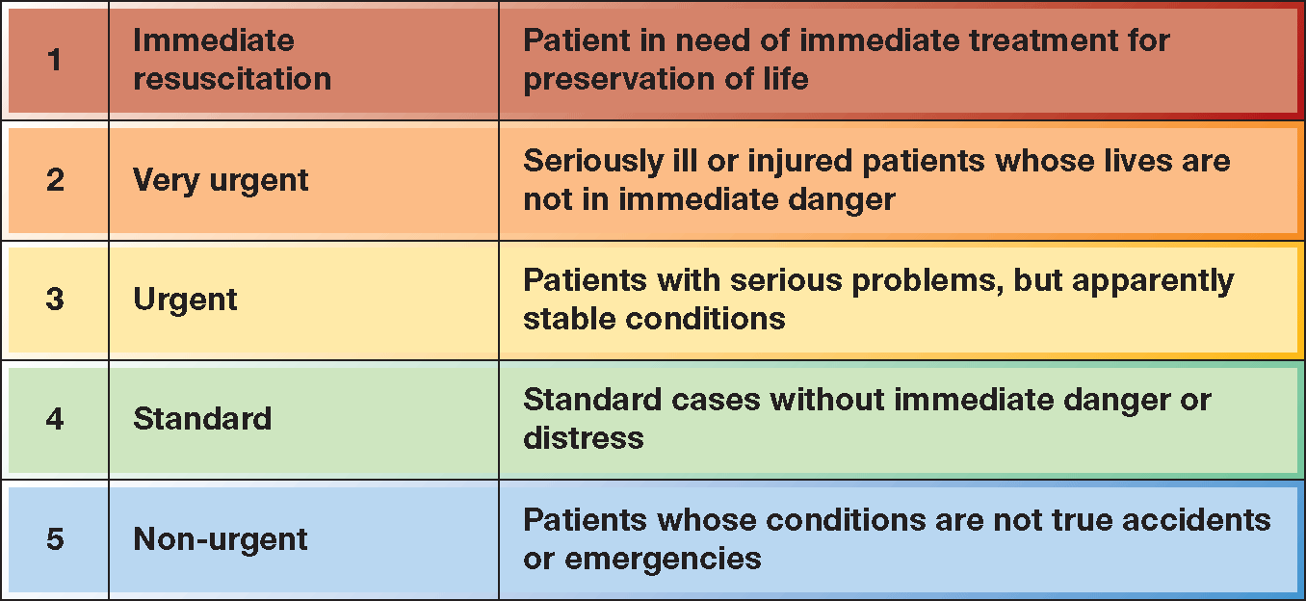
A triage prioritisation scale

Slide 21
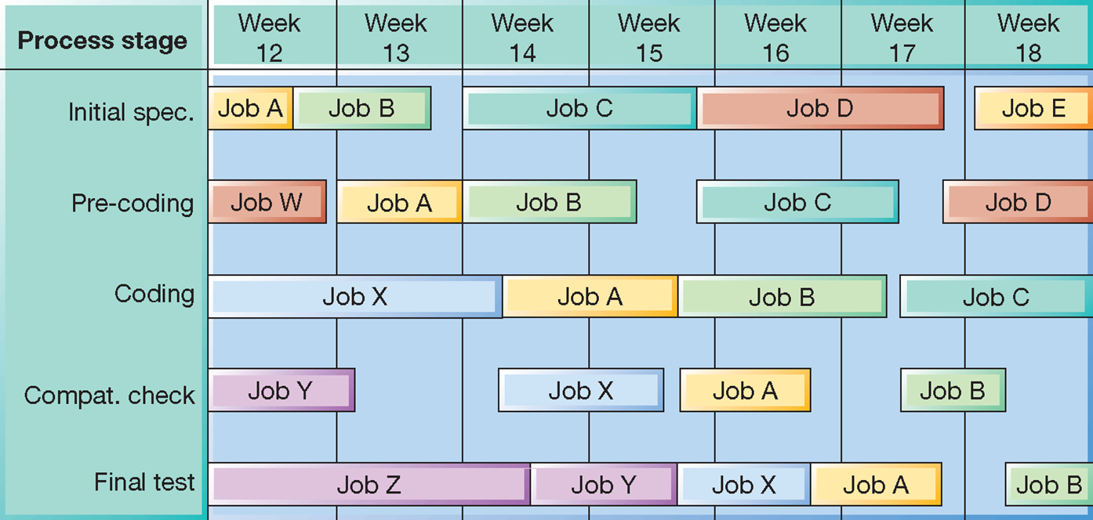
Gantt chart showing the schedule for jobs at each process stage

Slide 22
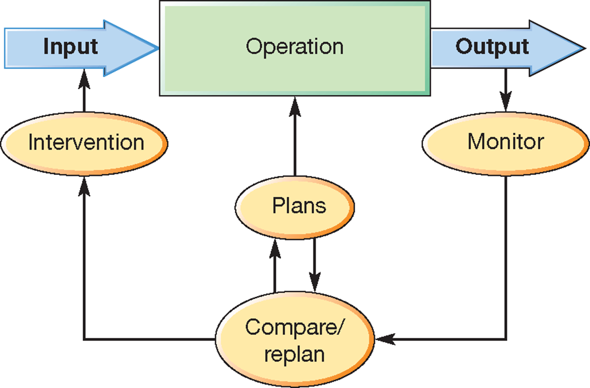
A simple model of control

Slide 23

Critical commentary
Control in this session – and in reality - is a “simplification of a far messier reality”
Control theory is based on machines but neither people or organisations are machines.
“They are social systems full of complex and ambiguous interactions … organizations are political entities where different and often conflicting objectives compete...”

Slide 24
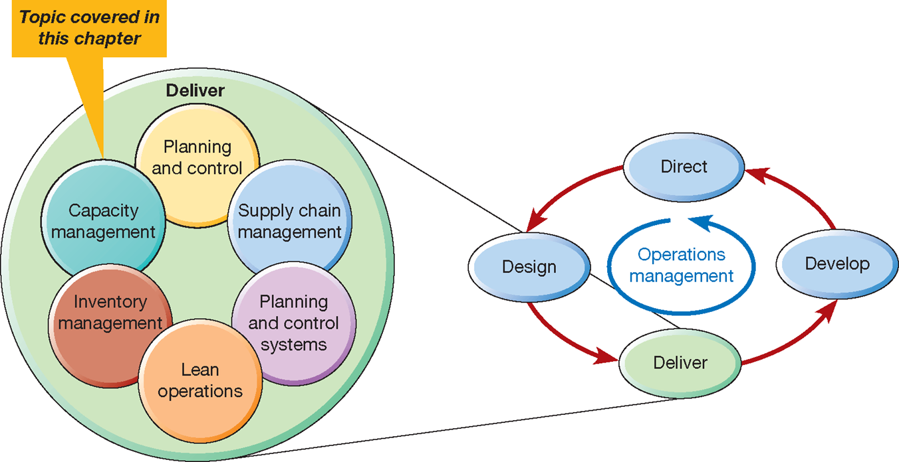
This session examines capacity management

Slide 25

What is capacity?
Capacity in the static, physical sense means the scale of an operation.
However, this may not reflect the operation’s processing capability.
Hence, we must incorporate a time dimension appropriate to the use of assets.
For example, 24,000 litres per day;
10,000 calls per day;
57 patients per session;
Etc.
Capacity can be defined as the maximum
possible output in a given time.

Slide 26
How capacity and demand are measured
Actual output
Efficiency
=
Effective capacity
Planned loss of 59 hours
Design capacity
Effective capacity
Avoidable loss – 58 hours per week
168 hours per week
109 hours per week
Actual output – 51 hours per week
Utilization
Actual output
=
Design capacity

Slide 27
Definitions…..
planned loss
design capacity
Unplanned loss
effective capacity
actual output
utilisation = actual output
design capacity
efficiency = actual output
effective capacity
The THEORY
The ACTUAL or FACTS

Slide 28
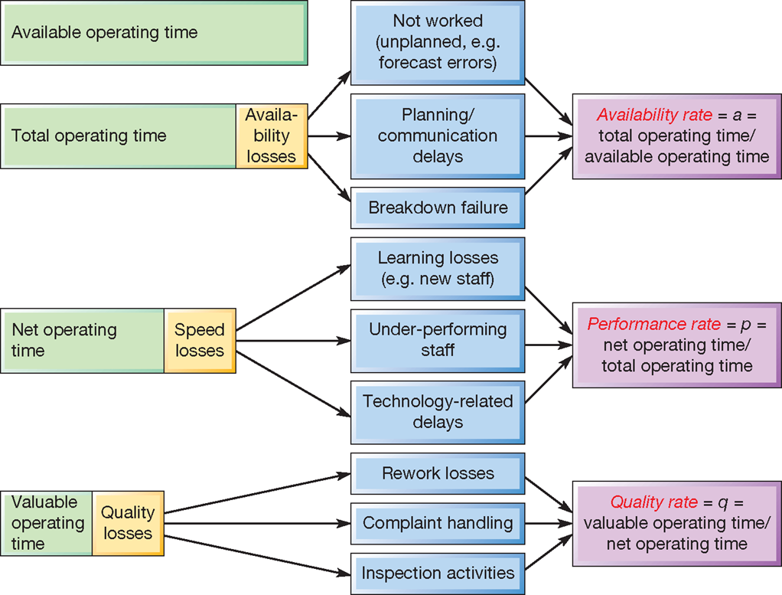
Overall equipment effectiveness
OEE = A x P x Q

Slide 29
Todays agenda
What is capacity management?
How are demand and capacity measured?
How are the demand side / supply side managed?
How can Operations understand the consequences of their capacity management decisions?
Is capacity the ultimate barrier to growth?
Is all capacity the same?

Slide 30
Capacity as binary decision
Expansion & Contraction
Transitional or
“Lumpy”
Does capacity limit growth?
Why is growth so hard to achieve?
Why are Construction firms started by brothers
e.g. Barrat Homes took over Greensitt Bros…
https://thestoryexchange.org/8-siblingrun-businesses-celebrate-nationalsiblingsday/

Slide 31
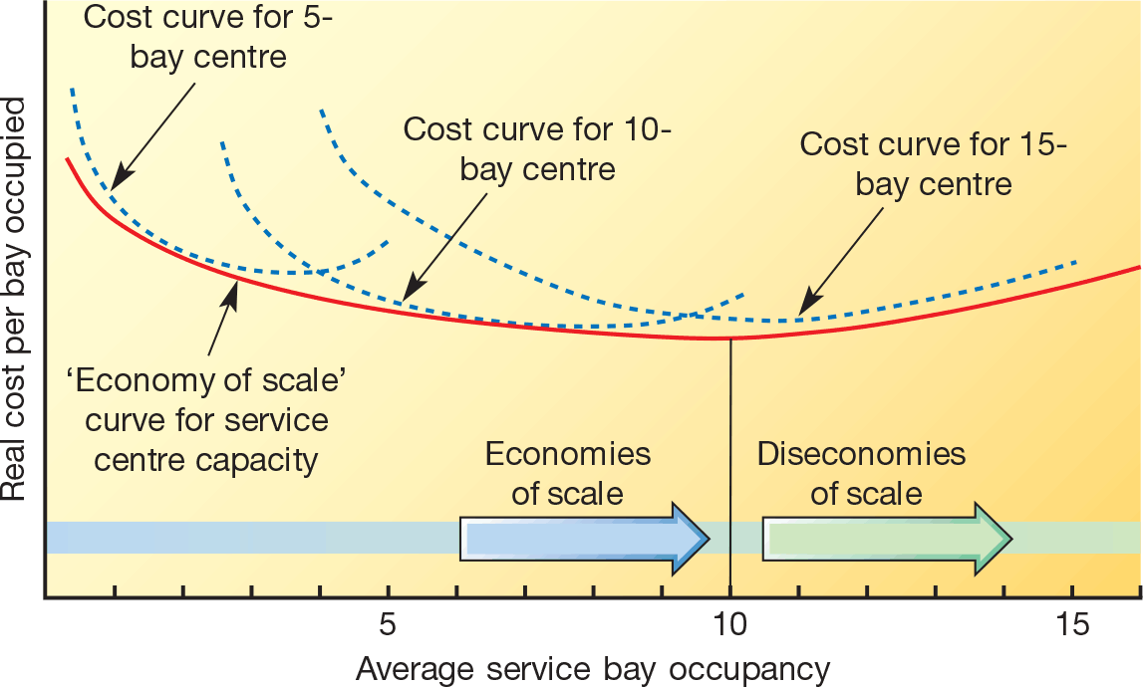
Unit cost curves for individual truck service centres of varying capacities

Slide 32
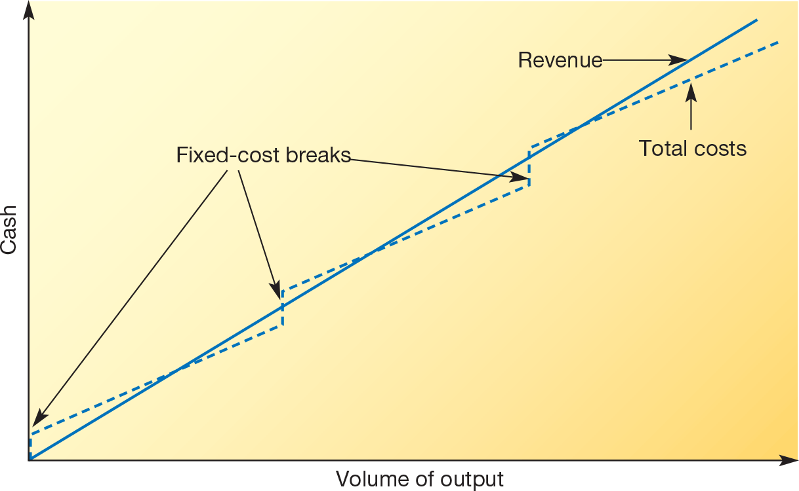
Repeated incurring of fixed costs can raise total costs above revenue

Slide 33
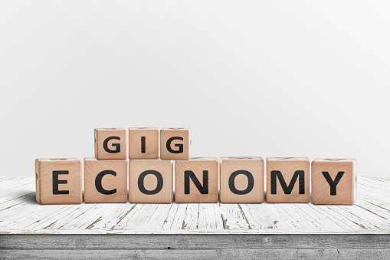
Factors affecting capacity
Operations resources
Availability of capital
Cost structure of capacity increments
Economies of scale
Quality / flexibility of capacity
Market requirements
Forecast level of demand
Changes in future demand
Uncertainty of future demand
Consequences of over / under supply

Slide 34
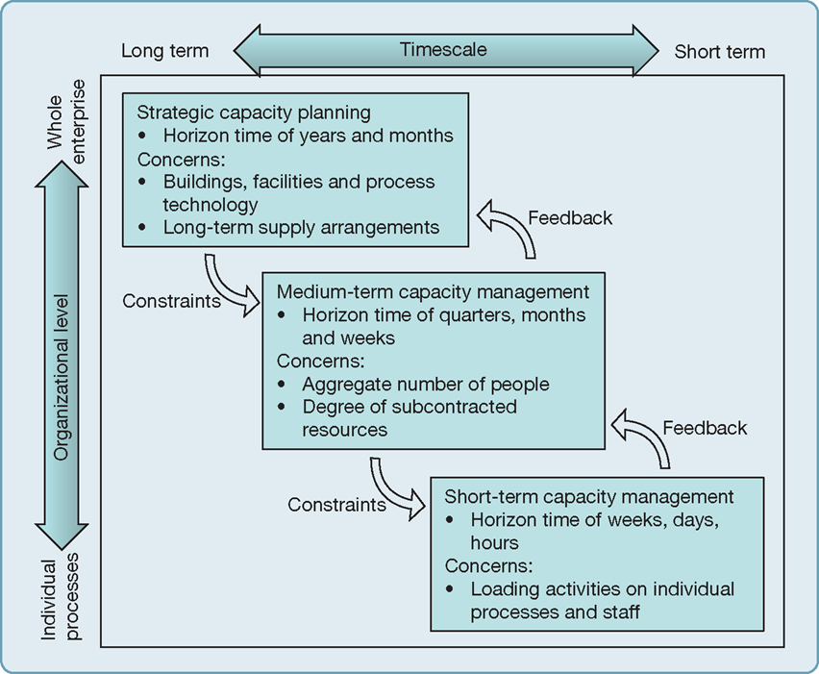
Capacity management should be integrated across levels as each level constrains what can be done in the level below and can feedback to the level above

Slide 35
Understanding demand and managing capacity
Supply of products
and services
The operation’s resources
Demand for product and service
The operation’s customers
The activities which
reconcile supply and
demand
Capacity Management
Capacity
Demand
Notes:
Capacity management: matching supply and demand
Ops Manager’s challenge:
to optimise utilisation of resources such that the operation achieves:
high levels of quality and customer satisfaction even when busy
without wasting resources during quiet periods
If there’s one way to screw up an operation it is by getting a long term capacity management decision wrong:
affects QUALITY, FLEXIBILITY, SPEED, DEPENDABILITY & COST
and hence PROFIT AND GROWTH
I have chosen to focus on staff scheduling because in the service sector (for-profit and public) it is increasingly becoming:
the critical capacity management issue
the key constraining factor on the operation
EXAMPLES of industries where there are shortages? See next page
WHY?
Staff shortages in many key professions
declining working population
strong economy: people refusing to work in low paid public sector
global labour markets: teachers, nurses, doctors choosing to work elsewhere for more pay
in public sector people have come to ‘expect’ early retirement over 15 yrs.

Slide 36
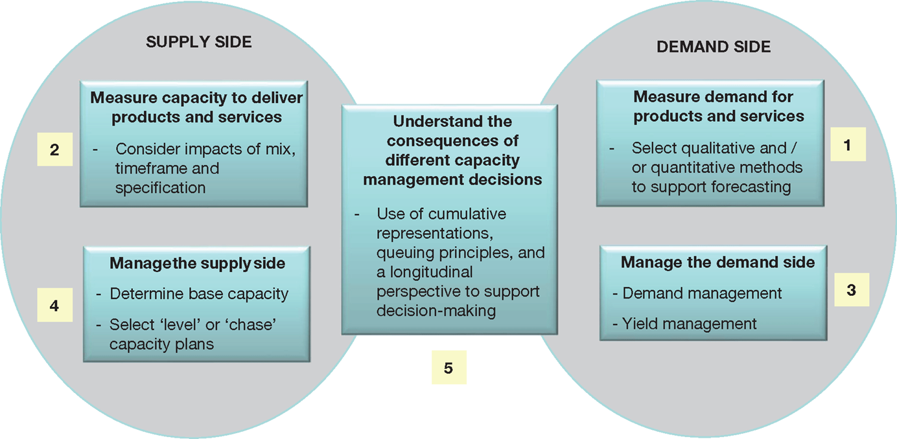
Capacity Management framework

Slide 37
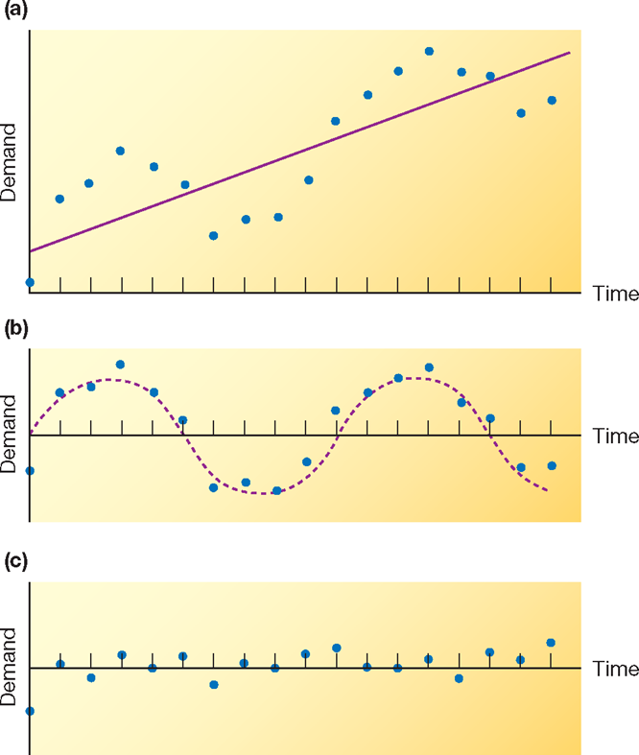

Capacity Management, Demand and Forecasting
Understanding patterns of demand is critical successful capacity management.
Qualitative approaches to forecasting include panels, Delphi method and scenario planning (p360).
Quantitative approaches include Time series analysis, moving average forecasts, exponential smoothing and causal
models (360-p367)
Big Data

Slide 38
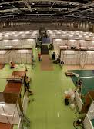
Better forecasting Vs. Better responsiveness
“It’s important for forecasts to be as accurate as possible. We cannot plan operations capacity otherwise. This invariably means we end up with too much capacity (thereby increasing costs), or too little capacity (thereby losing revenue And dissatisfying customers)”.
Vs.
“Demand will always be uncertain, that is the nature of demand. Get used to it. The only way to satisfy customers is to make the operation sufficiently responsive to cope with demand, almost irrespective of what it is”.
A third way – compromise?
Notes:
What is this a picture of ??

Slide 39
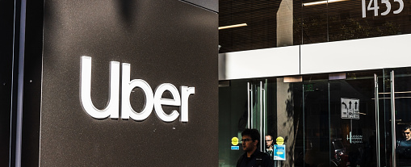
Demand side management
Peak pricing – holidays
Promotion
Reservation and appointments
Creating an alternative offering?

Slide 40
Revenue (Yield) Management
A system for managing advanced reservations through pricing to maximize profitability.
Commonly used in many sectors with fixed capacity, such as hotels and airlines.
Friday, 2 nights, Standard Room, 150€
Monday, 2 nights, Deluxe Room, 250€
Monday, 1 night, Deluxe Room, 300€
Saturday, 4 nights, Standard Room, 100€

Slide 41
Ways of reconciling capacity and demand
Demand
Demand
Demand
Capacity
Capacity
Capacity
Chase demand
Demand management
Level capacity

Slide 42
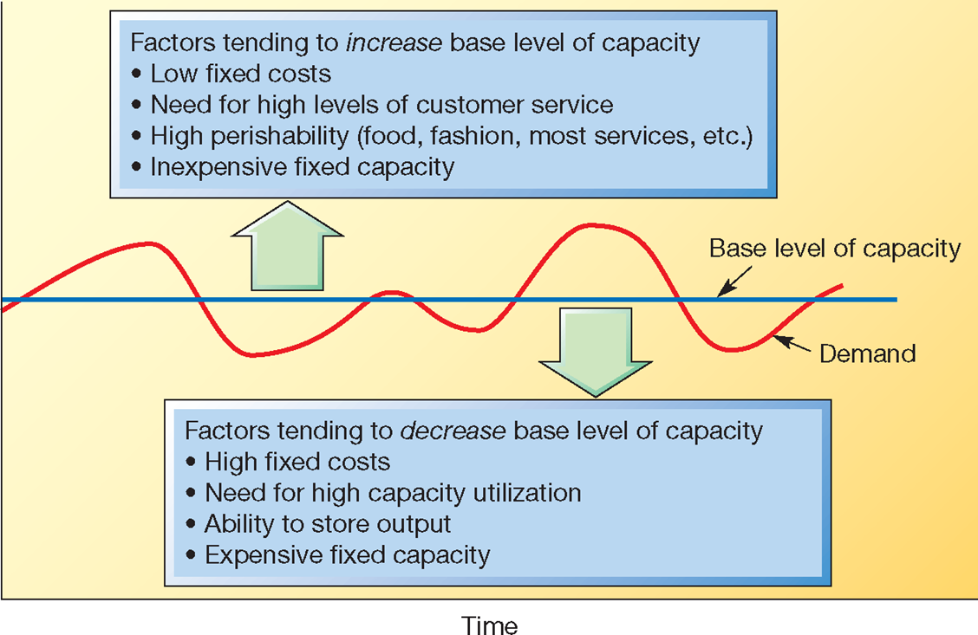
Base level of capacity should reflect the relative importance of the operations’ performance objectives

Slide 43
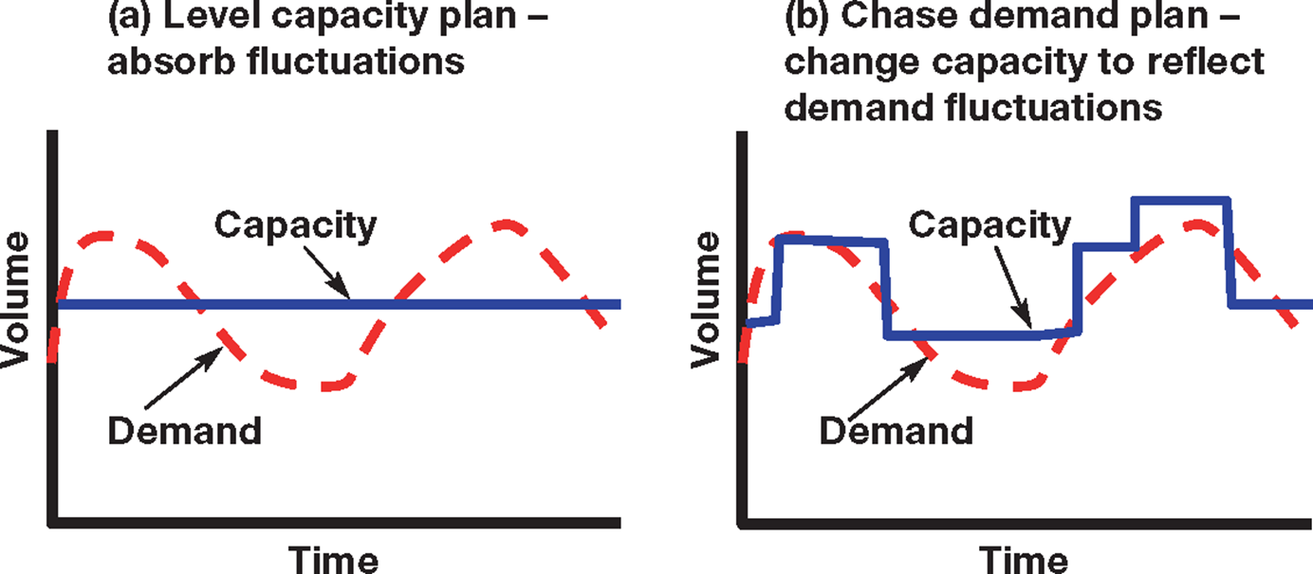
Level Vs. Chase capacity plan

Slide 44
Netflix Vs Blockbuster
Blockbuster had more resources – shops, WoM, new release volume
Netflix – DVD oriented – introduced an inhouse recommendation system to push older films, utilise back catalogue and reduce pressure on new release volume
Pursued relationship with customers/users
Production studios. Netflix secured investments for projects such as ‘Arrested development’ after the success of their first original series, ‘House of cards’. Unlike the competitors Netflix was able to provide more accurate recommendations with customer reviews by having more subscribers.

Slide 45
Netflix managed to increase the value of their product to their customers. They identified that despite the widespread availability of Blockbuster stores, and their catalogue of up-to-date films, that there were pain points for customers that they could exploit and provide value for customers from.
Their starting point was using DVDs, which were a new technology that was becoming more popular, and they avoided VHS cassettes which were popular at that time. The introduction of DVDs allowed them to mail films to their customers, which was added value for customers, as they did not have to go in person to collect their films, and as a result there was no in store rental from Netflix. Furthermore, Netflix quickly realized that the pay per rental model and late fees were a pain point for customers. They addressed this by adopting a monthly subscription model without late fees, which not only

Slide 46
differentiated their product from Blockbuster and the Mom & Pop shops, but also potentially lowered their price due to the lack of late fees (Which were a huge source of profit for Blockbuster). Even by this point Netflix had a huge advantage in terms of differentiation and price, but it only got worse for Blockbuster as Netflix continually improved their service. They decreased the time to send and return movies through the services of the USPS, they acquired more content for their library and eventually even started producing their own original series and movies. Even by the time Blockbuster realized that their value offering was significantly inferior, and tried to replicate Netflix, Netflix kept innovating their offering with the introduction of video streaming. By this point Blockbuster had lost out and could not compete with either price or product to keep on finding new ways of value creation. Netflix developed warehouses in various parts of the country to speed up delivery times to enhance customer value.

Slide 47
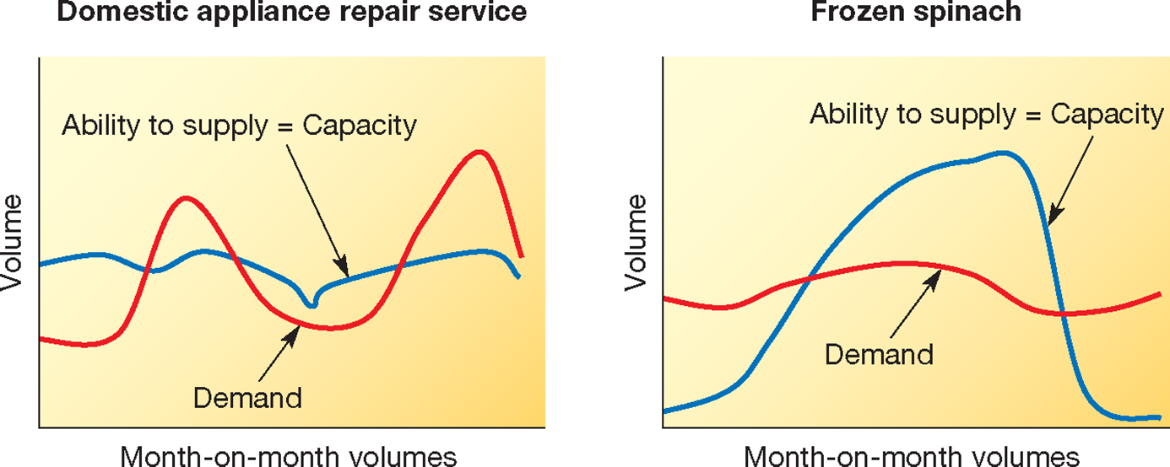
Volatility in demand vs. volatility in supply

Slide 48
Level Capacity Plan
tonnes per month
J
F
M
A
M
J
J
A
S
O
N
D
: inventory built up in anticipation of future demand
Level Capacity strategy – inputs are kept constant during periods of low demand
to create inventory to meet periods of high demand
Notes:
Hide and just draw on the white board

Slide 49
Level Capacity Plan
room nights sold
J
F
M
A
M
J
J
A
S
O
N
D
: capacity under-utilised
Notes:
In service operations, the level capacity plan may not be ideal

Slide 50
Chase Demand Strategy
units per month
J
F
M
A
M
J
J
A
S
O
N
D
: capacity throughout the year
Chase Demand strategy – inputs are adjusted so that outputs match demand

Slide 51
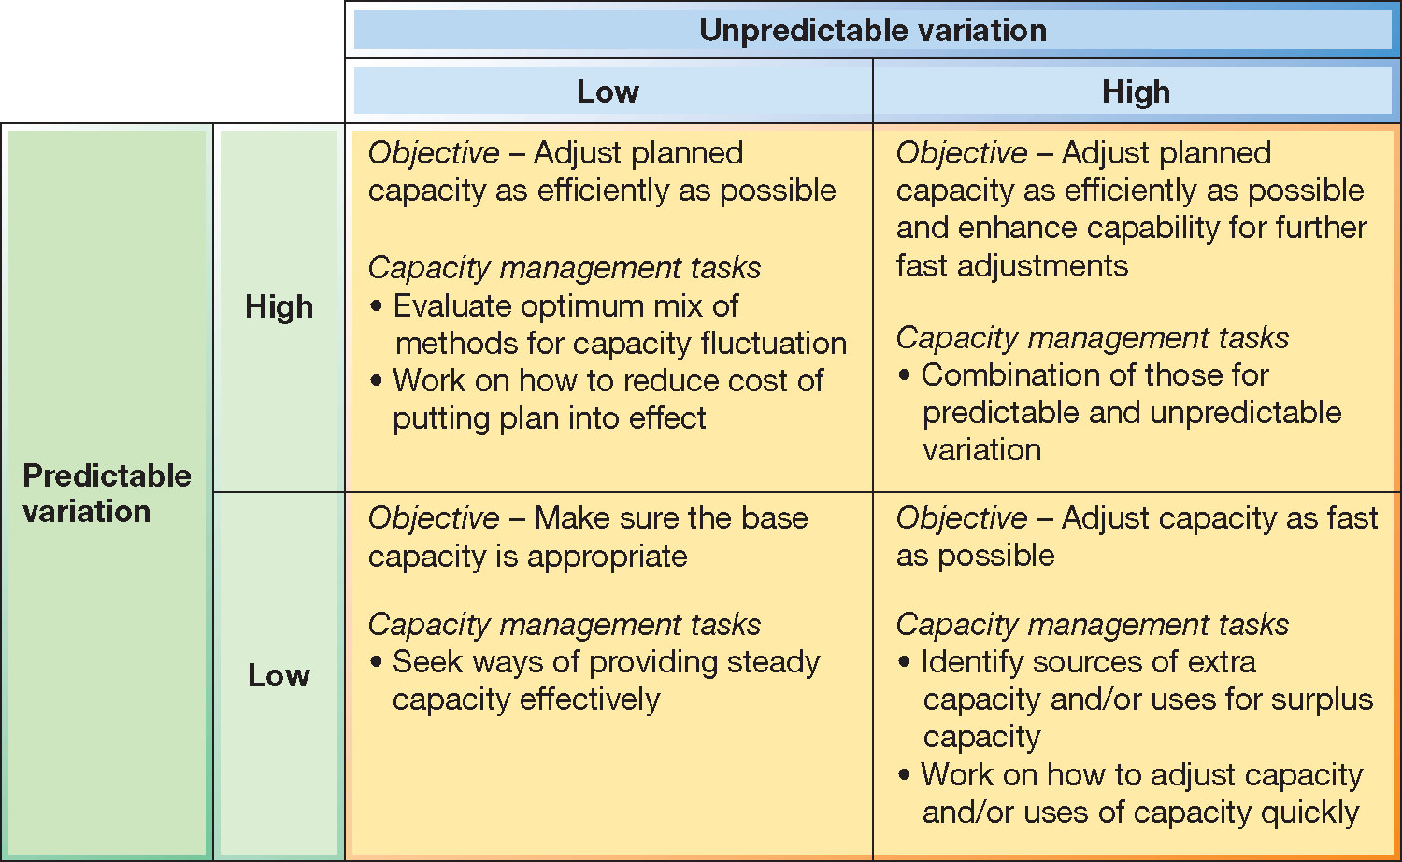
The nature of capacity management depends on the mix of predictable and unpredictable demand

Slide 52
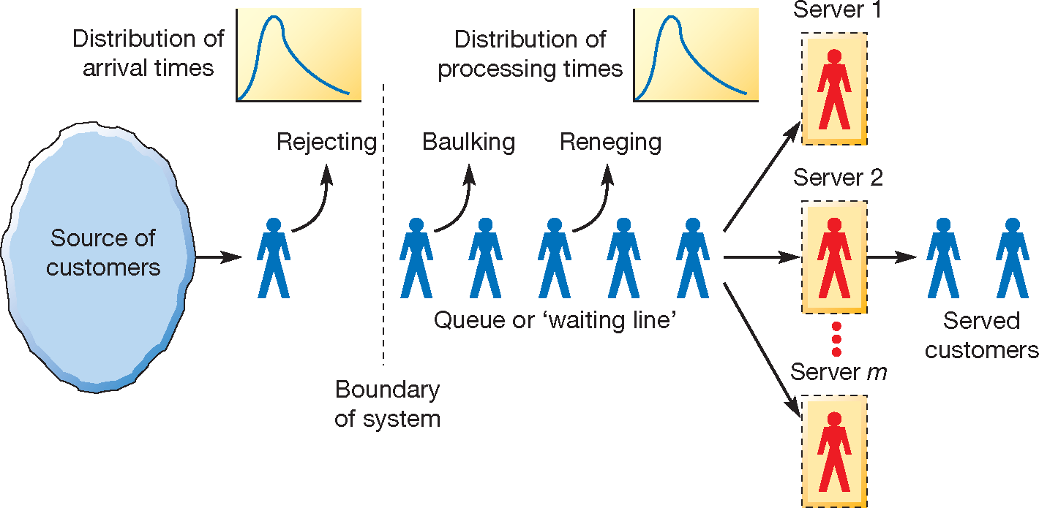
Capacity management as a queuing problem

Slide 53
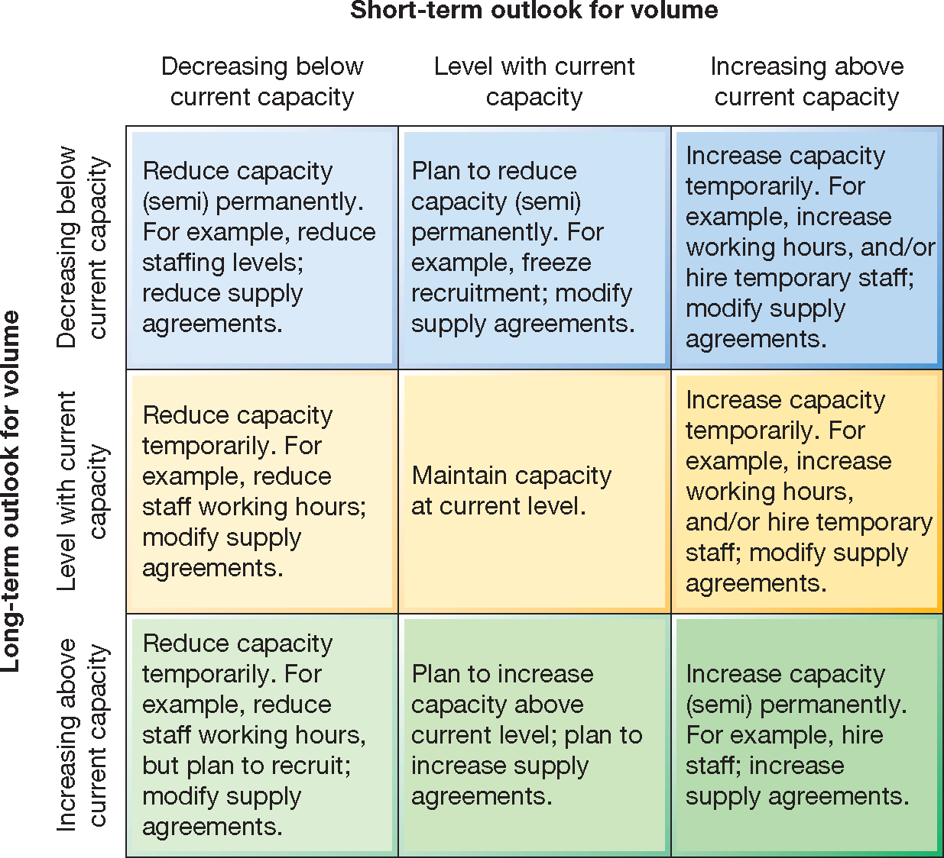
Capacity management strategies are partly dependent on short/long term volume

Slide 54
Critical commentary
Capacity can be tricky to add and it can be lumpy and involves putting numbers of things that can be hard to measure for many organisations
Most organisations chose to follow a mix of capacity management approaches because single ‘pure’ approaches do not match their overall operational objectives.
There is predictable and unpredictable variation – organisations are political entities with different and often conflicting objectives

Slide 55
Master of Business Administration
Digital Business Delivery
Professor Nigel Caldwell

