Slide 1
MGT 501 Lesson 8
Change

Slide 2
Objectives of This Presentation
Kurt Lewin’s 3-Stage Model
How it works
Why it works
  Trust Conditions
  The Power of Words
When it won’t work
Kotter’s 8 steps

Slide 3
Kurt Lewin’s 3-Stage Model
Two kinds of training:
Lecture:
  A formal presentation aimed at informing the recipients of training as to what to believe, how to do something, and why they should believe or do it.
Group Discussion:
  With the help of a facilitator, the members reason out amongst themselves what to believe is true and right, how best to do something, and why they should do it.
Both of these methods can be effective, but if you want to change people’s thinking, one of them is better than the other.

Slide 4
Kurt Lewin’s 3-Stage Model
In support of the second of these approaches, Kurt Lewin (1947) gave the following example:
Two groups of mothers were presented with information about the benefits of fresh milk.
The first group was presented a “good” lecture on this topic.
The second group was involved in a discussion leading step by step to the decision to increase milk consumption.
Pressure was intentionally avoided.
The amount of time used by the two groups was equal.

Slide 5
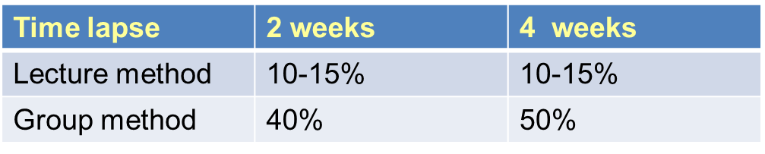
Kurt Lewin’s 3-Stage Model
Percentage of mothers who reported an increase in the use of fresh milk after 2 and 4 weeks:

Slide 6
Kurt Lewin’s 3-Stage Model
The question is, why did the group discussion method work better?
Before we answer this question, we need to first describe how it works...
So, here are the three stages of all successful change methods, according to Lewin:
Unfreezing
Moving
Re-freezing

Slide 7
Kurt Lewin’s 3-Stage Model
Unfreezing
Present a desirable vision that differs from the way things are today, and are likely to continue to be if nothing is done differently
If necessary, present some valid facts that support the likelihood of the unwanted future
Agree on these facts, and on the desirability of the preferred future
Identify what needs to be done differently, in order to attain that future

Slide 8
Kurt Lewin’s 3-Stage Model
Moving
Leader guides a discussion in which the members of the group suggest and debate the best ways to accomplish the new objectives
Typically, they need to start doing new things
Stop doing some of the things they have been doing by habit
Do less of some things they are already doing
Do more of some things they are already doing*
The facilitator should try to guide the group to a consensus
The group then tries to implement the changes
Notes:
*Note: And most likely, there will be things that should be kept the same.

Slide 9
Kurt Lewin’s 3-Stage Model
After possibly a number of repetitions, the group discovers—and then, most importantly, begins to routinely perform—new actions that are aimed at bringing about the vision.
Re-freezing
Begins when people have begun to routinely perform—and expect one another to perform the new actions and to discard the old, undesirable ones.
When people account to one another, and to themselves in terms of this new set of standards, the change is complete.

Slide 10
Kurt Lewin’s 3-Stage Model
Industrial applications of Lewin’s model are widespread
It differs from old-school ways of increasing productive effort supply
When a manager just tries to order an increase in production, he or she might be successful, but it is also possible, and not uncommon, for them to achieve the result on the next slide...

Slide 11
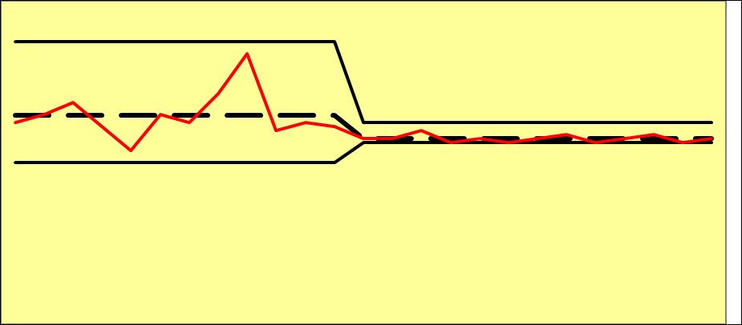
Kurt Lewin’s 3-Stage Model

Slide 12
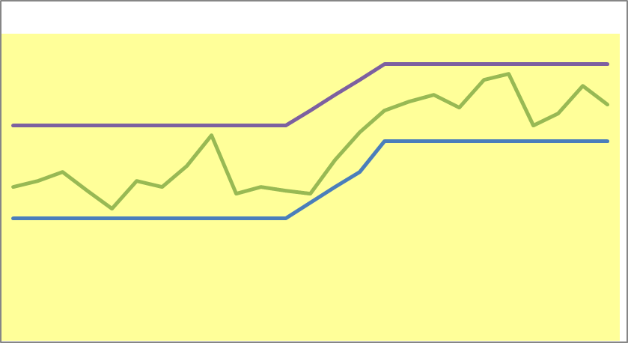
But what a manager really hopes to see is this:
Force
Field
Analysis
Safety Zone, t₀
Transition Phase
Safety Zone, t₁

Slide 13
The Trust Conditions and the Power of the Spoken Word
What keeps the new safety zone at t₁ in place?
The answer lies in how it got there...
It has to do with the Trust Conditions and the Power of Words
The Trust Conditions cause us to try to make our actions and our words consistent*
If we make a public promise that we will do something, and then don’t, what happens?
The cause of the creation and maintenance of the new safety zone is a result of the “Power of the Spoken Word.”
Notes:
*Note: It boils down to “integrity.”

Slide 14
The Trust Conditions and the Power of the Spoken Word
The Power of the Spoken Word
I promised in public that I would do this.
Higher
I said to someone, “I’m gonna do this.”
I mentioned it to someone.
Commitment Energy
I made a plan to do it.
I thought about doing it.
I had a fleeting thought about it.
Lower

Slide 15
The Trust Conditions and the Power of the Spoken Word
So, the answer to how the safety zone got to its new, higher level is that the people who observe it “spoke it into existence.”
And once it was in existence, it stayed there because of the Trust Conditions.
This is the Power of the Spoken Word.
The leader who would use it has to do only three things:
Communicate a vision
Be honest about what is negotiable and what isn’t
...Ask questions, and LISTEN*
Notes:
*Note: Edgar Schein, Professor Emeritus at the Sloan School of Management at MIT, was a significant contributor to the field of Organizational Development (OD), which grew out of Lewin’s work. He is considered to be one of the founders of the field of OD. After many years of experience, research, executive training, and reflection, he wrote a short little book, Humble Inquiry: The Gentle Art of Asking Instead of Telling (2013).

Slide 16
When the 3-Stage Method Won’t Work
The method gives people the “right to speak.”
In order for it to do its work, this right must exercised “in good faith.”
Therefore, if the leader (or rather, a manager who wants to lead) is not trusted, people will resist engagement in the conversation.
And then, little or no change, and almost surely no lasting change, will occur.
Consider this next time your manager calls a meeting and wants you and your peers to suggest ways of improving your productivity.

Slide 17
Kotter’s 8 Steps
After three decades of the use of Lewin’s model by management consultants, Joseph Kotter (the one who wrote the book, The General Managers), wrote another book, Leading Change (1996) in which he reflected on three decades of corporate change efforts.
He found that there were 8 steps that were followed by all successful change efforts...

Slide 18
Kotter’s 8 Steps
Establish a sense of urgency by creating a compelling reason why change is needed
Form a coalition with enough power to lead the change
Create a new vision to direct the change and strategies for achieving the vision
Communicate the vision throughout the organization
Empower others to act on the vision by removing barriers to change and encouraging risk taking and creative problem solving.
Plan for, create, and reward short-term “wins” that move the organization toward the new vision.
Consolidate improvements, reassess changes, and make necessary adjustments in the new programs.
Reinforce the changes by demonstrating the relationship between new behaviors and organizational success.

Slide 19
Kotter’s 8 Steps
As an exercise, you may want to assign Kotter’s 8 steps to Lewin’s 3-Stage Model, and to explain why you have made these assignments.
Don’t just quote the text by Robbins and Judge [2018], where this is treated in Chapter 17. They don’t explain why this matching of Lewin’s model with that of Kotter is valid.

Slide 20
Segue to Next Lesson
If it is not already clear that using the 3-Stage Model results, among other things, in the creation of a “team,” you will know this by the end of the next lesson.
You will also see how it relates to the concept of Management by Objectives (MBO).

Slide 21
End of Lesson 8—
Thank You!

Slide 22
References
Kotter, John. (1996). Leading change. Cambridge MA: Harvard Business School Press.
Lewin, Kurt. Formalization and progress in psychology. University of Iowa Studies in Child Welfare 16.3 (1940): 9-42. Reproduced in Lewin (1951 1-29).
Lewin, Kurt. Frontiers in group dynamics. Human Relations I (1947): 2-38. Reproduced in Lewin (1951 188-237)
Lewin, Kurt. (1951). Field theory in the social sciences (ed. Dorwin Cartwright). Chicago: University of Chicago Press.
Robbins, S. P., & Judge, T. (2018). Essentials of organizational behavior. New York, NY : Pearson
Schein, Edgar. (2013). Humble inquiry: the gentle art of asking instead of telling. San Francisco: Berrett-Koehler Publishers, Inc.

