Slide 1
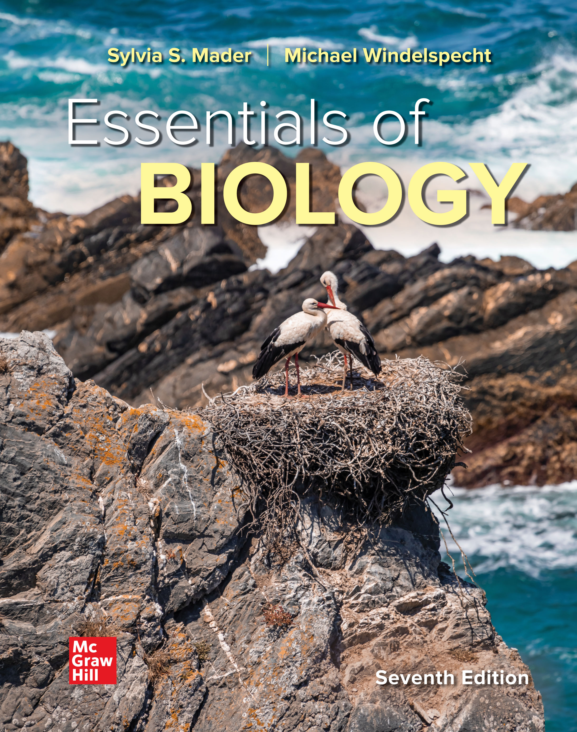
Chapter 9
Meiosis and the Genetic Basis of Sexual Reproduction
Essentials of Biology
SEVENTH EDITION
Sylvia S. Mader
Michael Windelspecht
© McGraw Hill LLC. All rights reserved. No reproduction or distribution without the prior written consent of McGraw Hill LLC.

Slide 2
9.1 An Overview of Meiosis
Meiosis serves two major functions:
  Reducing chromosome number
  Shuffling chromosomes in the cell to produce genetically different gametes
Homologous chromosomes
  Members of a pair of chromosomes
  Also called homologues
  Have the same size, shape, and construction (location of centromere)
  Contain the same genes for the same traits

Slide 3
An Overview of Meiosis
A child receives one member of each homologous pair from each parent.
Homologous pairs may contain different versions of the same gene
  Alleles—alternate forms of a gene
Both males and females have 23 pairs of chromosomes.
  23 pairs or 46 total chromosomes = diploid (2n)
    Haploid number (n) in gametes—23 total chromosomes
  22 pairs of autosomes
  1 pair of sex chromosomes
    XX female or XY male

Slide 4
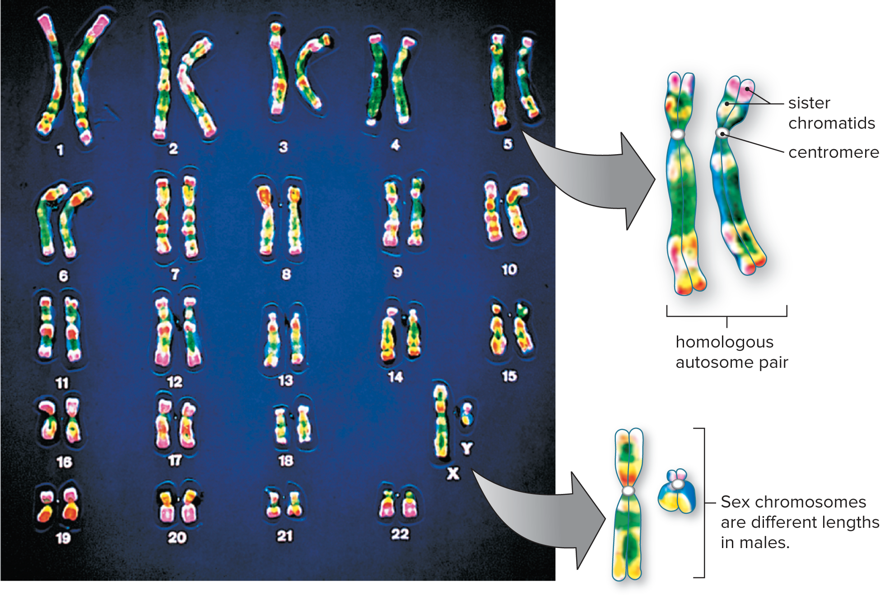
Figure 9.1 A Human Karyotype
Access the text alternative for slide images.
CNRI/Science Source

Slide 5
Human Life Cycle
Life cycle—in sexually reproducing organisms refers to all the reproductive events that occur from one generation to the next
Involves both mitosis and meiosis
Mitosis involved in continued growth of a child and repair of tissues throughout life
  As a result, somatic (body) cells are diploid.
  Meiosis reduces the chromosome number from diploid to haploid.
  Gametes (egg and sperm) have only one member of each homologous pair.
  Spermatogenesis produces sperm in the testes.
  Oogenesis produces eggs in the ovaries.
  Egg and sperm join to form diploid zygote.

Slide 6
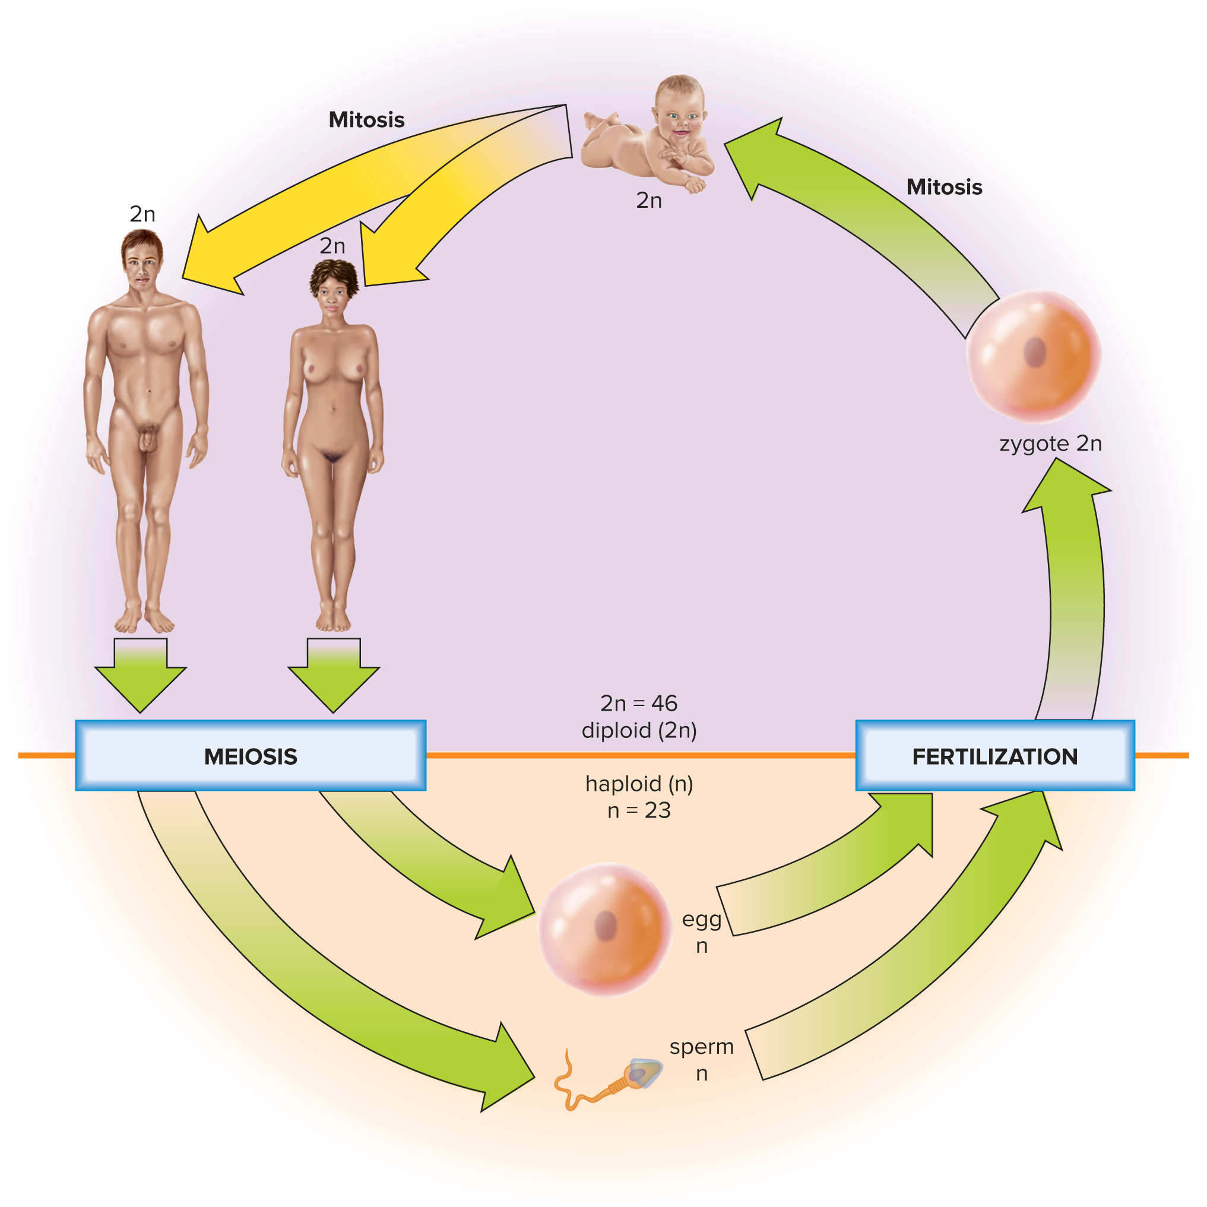
Figure 9.2 Life Cycle of Humans
Access the text alternative for slide images.

Slide 7

Overview of Meiosis 1
Results in four daughter cells
Before meiosis 1, each chromosome has duplicated.
Two divisions:
  Meiosis 1
  Homologous pairs line up during synapsis resulting in tetrad.
  Homologous chromosomes of each pair then separate.
  Meiosis II
  No duplication of chromosomes (no interphase)
  Chromosomes are dyads—composed of two sister chromatids.
  Sister chromatids are separated.
  Two daughter nuclei separate

Slide 8
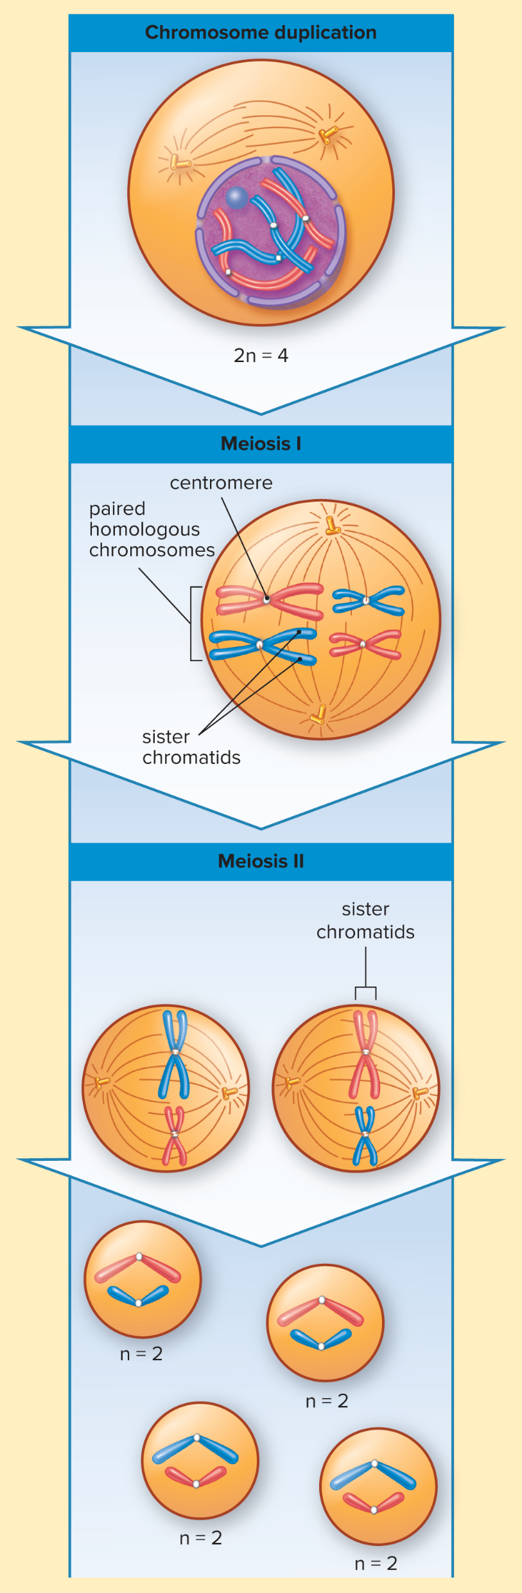
Figure 9.3 Overview of Meiosis
Access the text alternative for slide images.

Slide 9
Overview of Meiosis 2
Crossing-over
During prophase 1, homologous chromosomes pair up and form a tetrad, a process called synapsis.
  Each tetrad consists of two chromosomes, with each chromosome containing two chromatids, for a total of four chromatids.

Slide 10
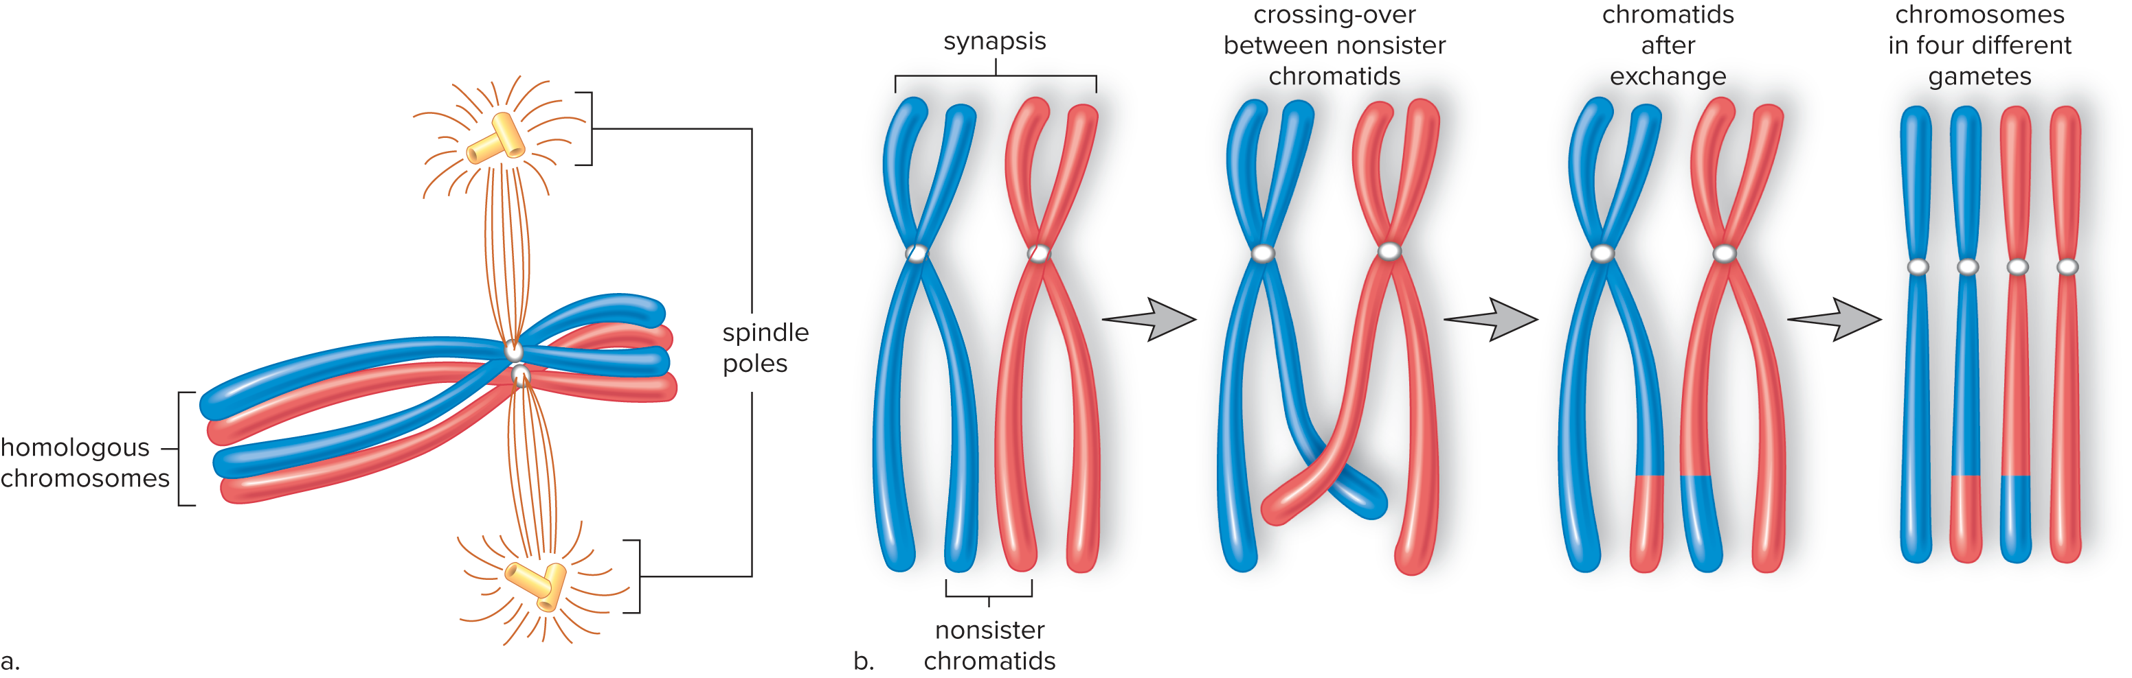
Figure 9.4a Synapsis and Crossing-Over

Slide 11
Crossing-over
When a tetrad forms during synapsis, chromatids from homologous chromosomes (nonsister chromatids) may exchange genetic material.
Increases variability of the gametes and, therefore, the offspring

Slide 12
Figure 9.4b Crossing-over
Access the text alternative for slide images.

Slide 13
The Importance of Meiosis
Chromosome number stays constant in each new generation by producing haploid gametes.
Generates genetic variations
  Crossing-over
  Every possible combination of chromosomes can occur in daughter cell.
  Fertilization produces new combinations.
or 70,368,744,000,000 chromosomally different zygotes are
possible, even assuming no crossing-over.

Slide 14
9.2 The Phases of Meiosis
Meiosis involves two divisions: meiosis 1 and meiosis II.
  Each division is broken down into four phases:
  Prophase (1 and II)
  Metaphase (1 and II)
  Anaphase (1 and II)
  Telophase (1 and II)

Slide 15
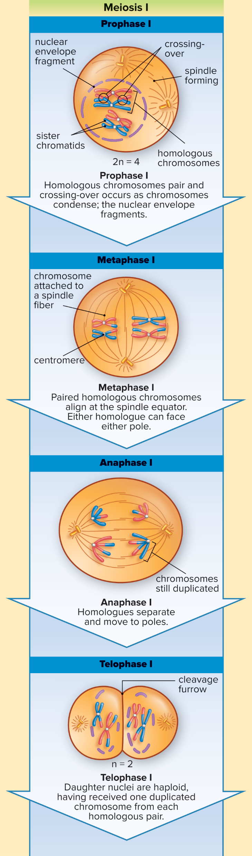
Figure 9.5 Meiosis 1
Access the text alternative for slide images.

Slide 16
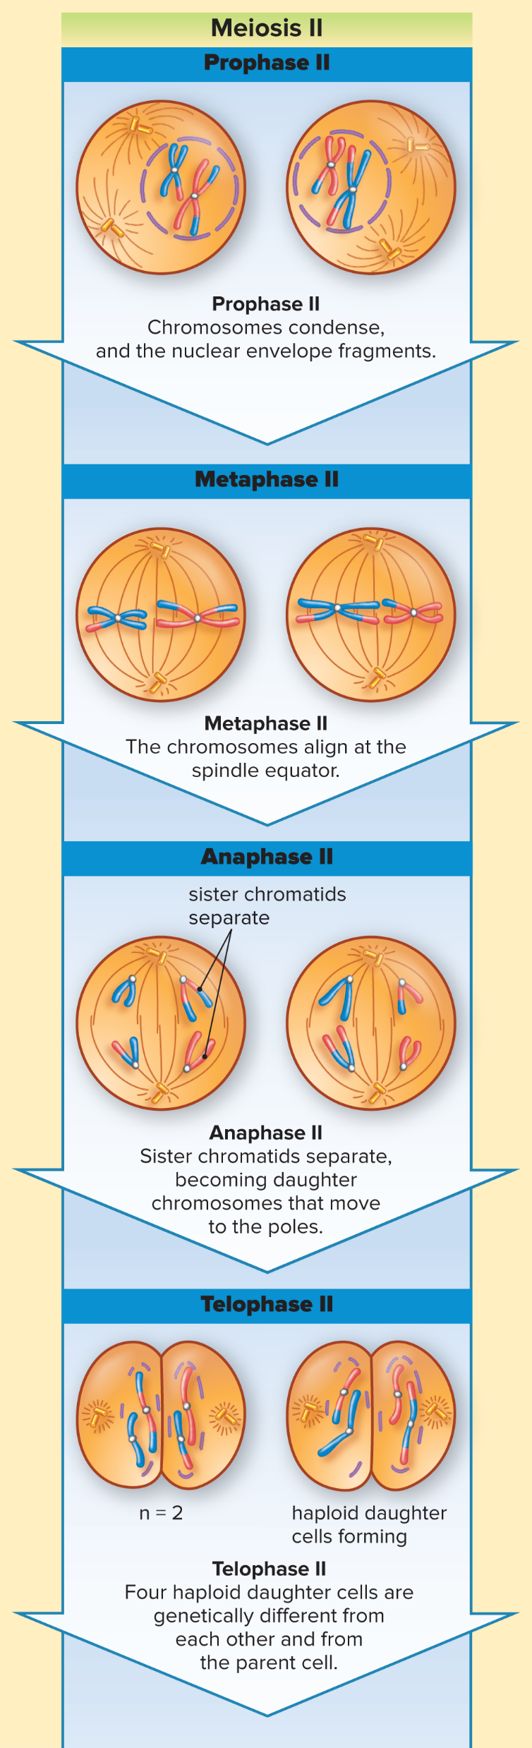
Figure 9.6 Meiosis II
Access the text alternative for slide images.

Slide 17
9.3 Meiosis Compared with Mitosis
Meiosis—two consecutive nuclear divisions; mitosis—only one nuclear division
Meiosis produces four daughter nuclei, and there are four daughter cells following cytokinesis. Mitosis followed by cytokinesis results in two daughter cells.
Following meiosis, the four daughter cells are haploid and have half the chromosome number as the parent cell. Following mitosis, the daughter cells have the same chromosome number as the parent cell.
Following meiosis, the daughter cells are genetically dissimilar to each other and to the parent cell. Following mitosis, the daughter cells are genetically identical to each other and to the parent cell.

Slide 18
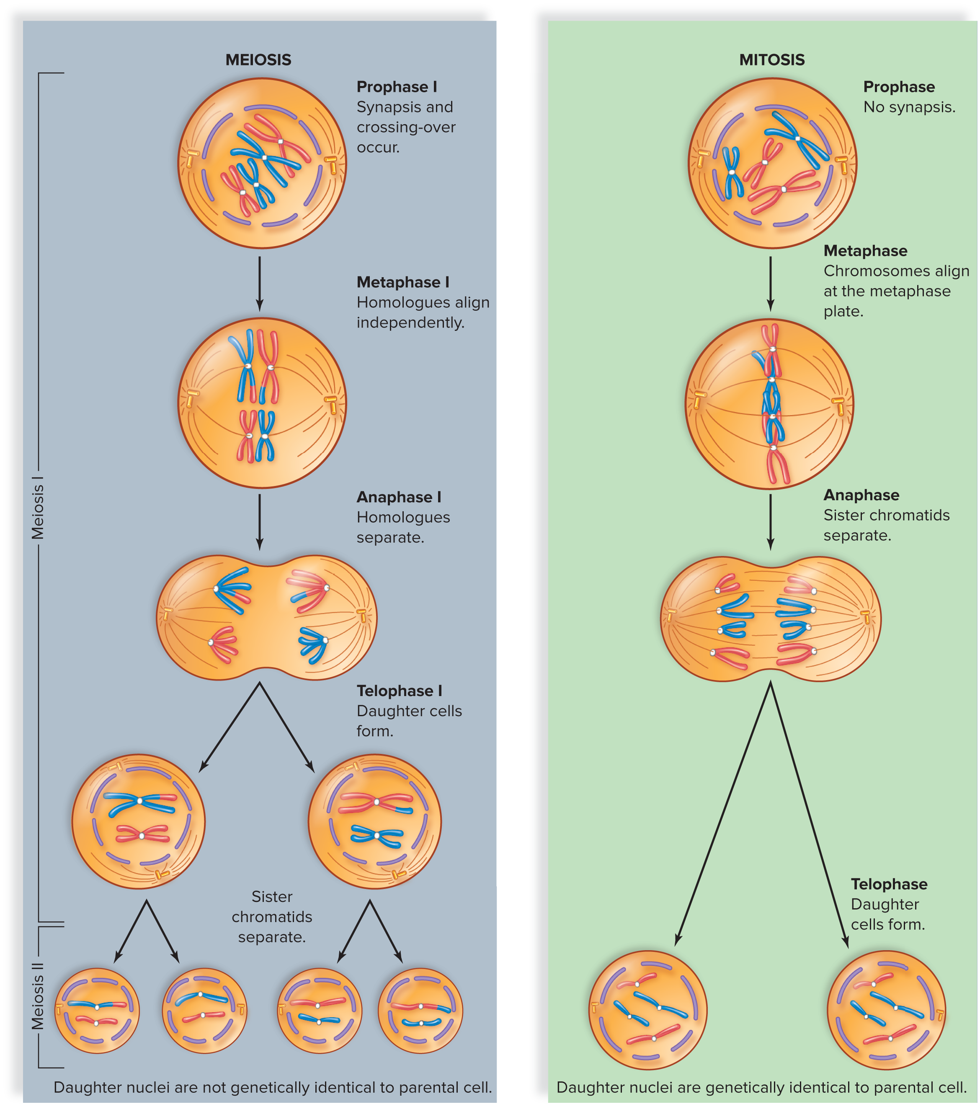
Figure 9.7 Meiosis Compared with Mitosis
Access the text alternative for slide images.

Slide 19

Meiosis 1 Compared to Mitosis
During prophase 1 of meiosis, synapsis occurs.
During metaphase 1 of meiosis, tetrads align at the spindle equator, with homologous chromosomes facing opposite spindle poles and the paired chromosomes have a total of four chromatids each. During metaphase in mitosis, dyads align separately at the spindle equator.
Sister chromatids do not separate during anaphase 1. During anaphase of mitosis, sister chromatids separate, becoming daughter chromosomes that move to opposite poles.

Slide 20
Meiosis II Compared to Mitosis
The events of meiosis II are just like those of mitosis except that in meiosis II, the cells have the haploid number of chromosomes.

Slide 21
Mitosis and Meiosis Occur at Different Times
Meiosis occurs only at certain times of the life cycle of sexually reproducing organisms and only in specialized tissues.
Mitosis is much more common.
  Occurs in all tissues during embryonic growth
  Also occurs during growth and repair

Slide 22
9.4 Changes in Chromosome Number
Nondisjunction
  Meiosis 1—both members of a pair go into the same daughter cell
  Meiosis II—sister chromatids fail to separate
Trisomy—three copies of a chromosome
  Down syndrome (trisomy 21)
  Monosomy—single copy of a chromosome

Slide 23
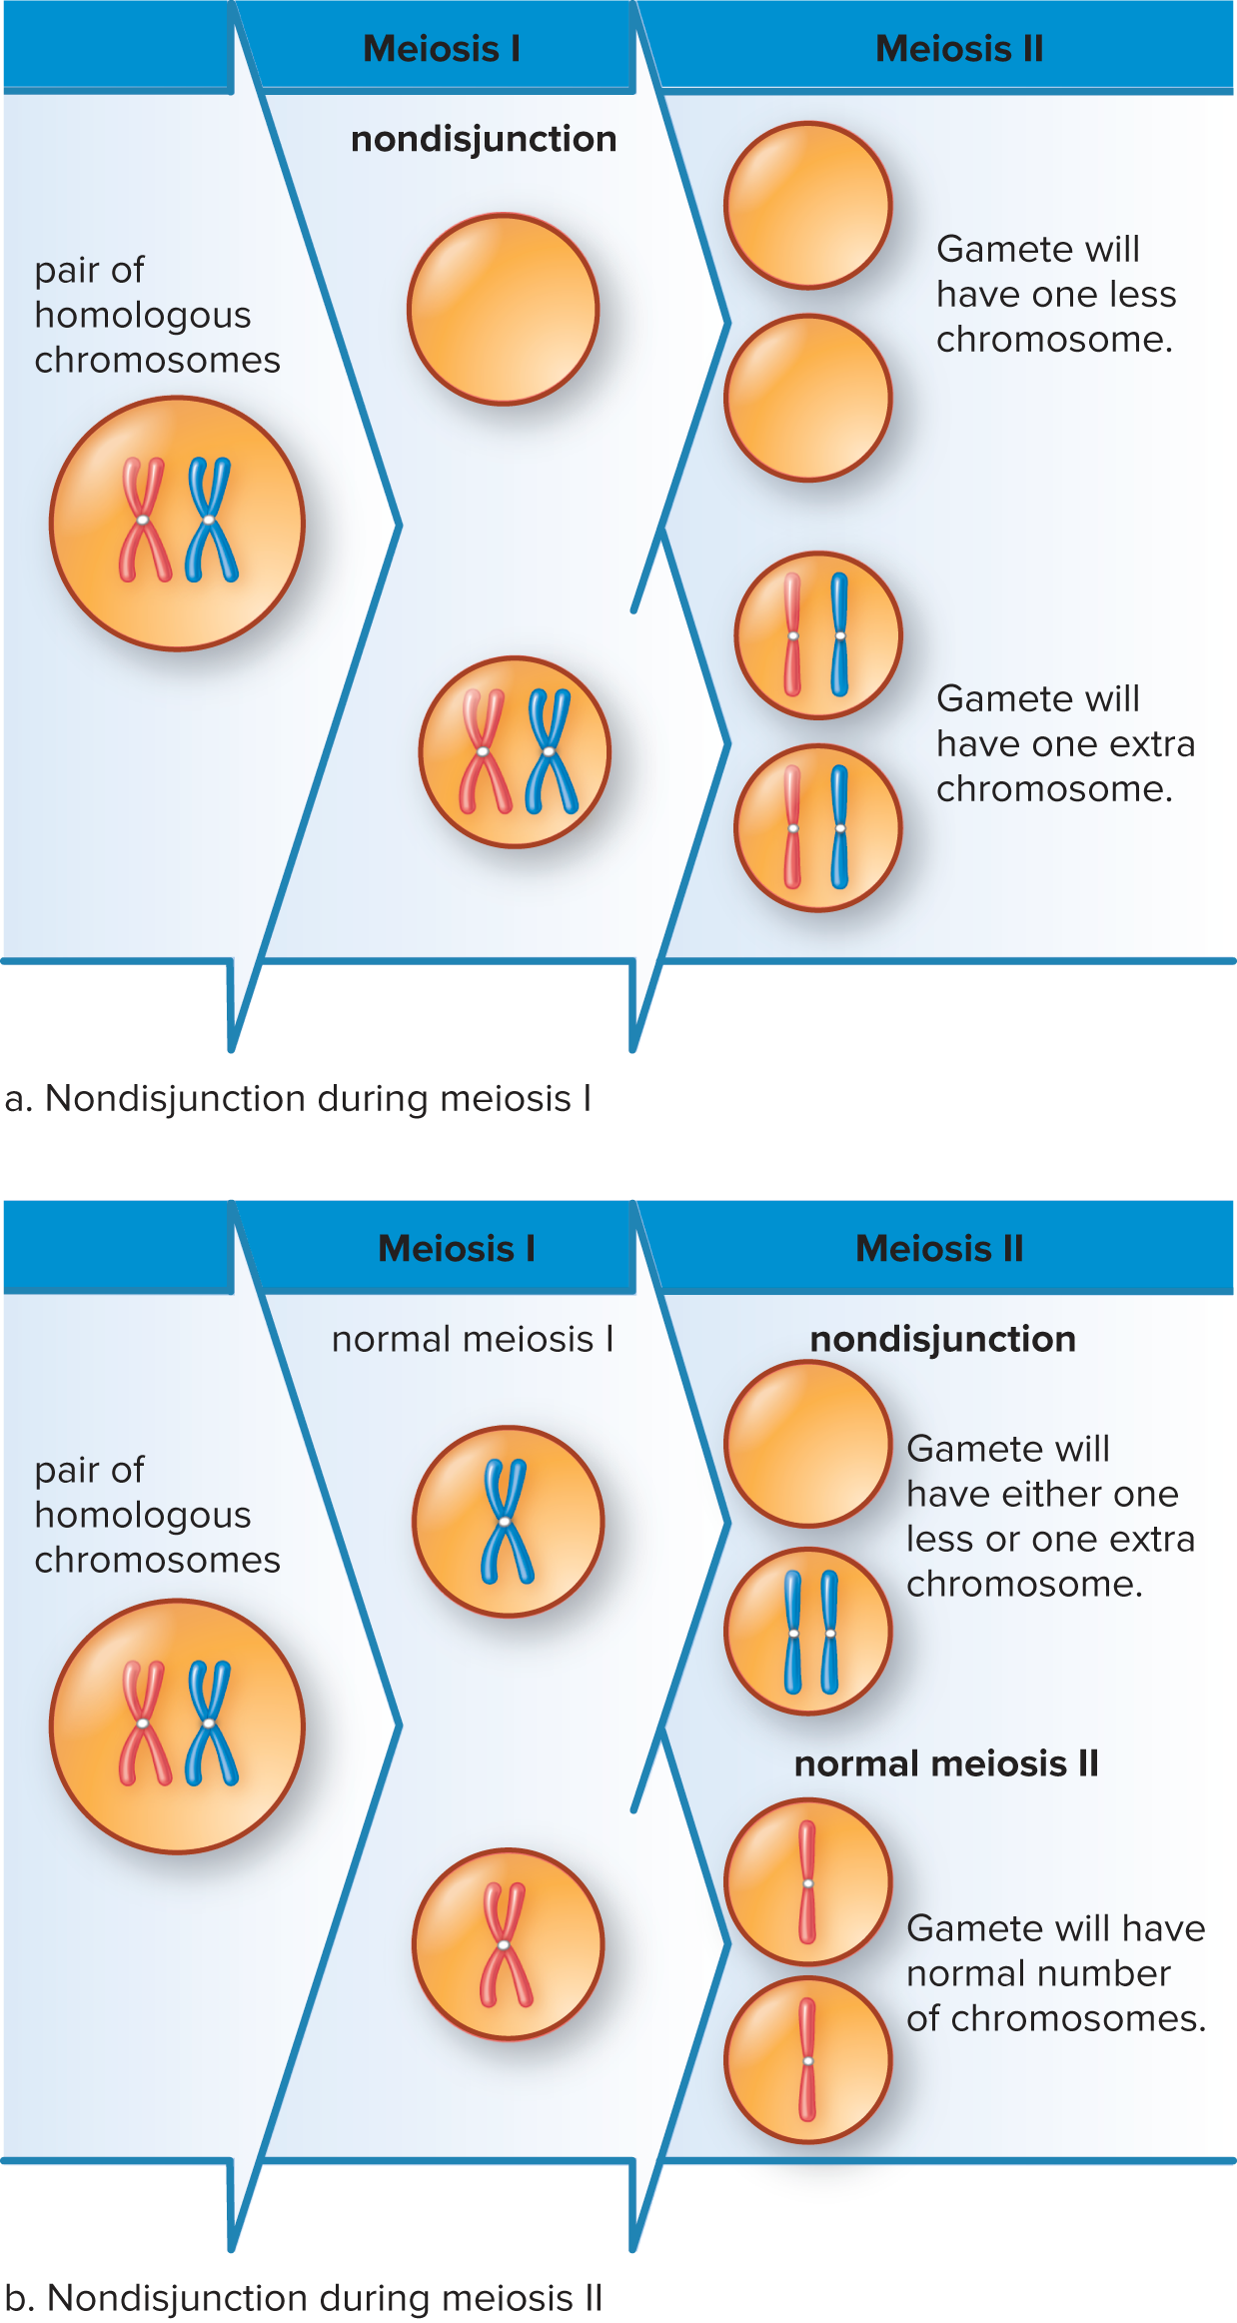
Figure 9.8a Nondisjunction During Meiosis 1
Access the text alternative for slide images.

Slide 24
Figure 9.8b Nondisjunction During Meiosis II
Access the text alternative for slide images.

Slide 25
Down Syndrome
Trisomy 21
Recognizable characteristics
  Short stature, eyelid fold, stubby fingers, mental disabilities
The chance of a woman having a Down syndrome child increases rapidly with age, starting at about 40.

Slide 26
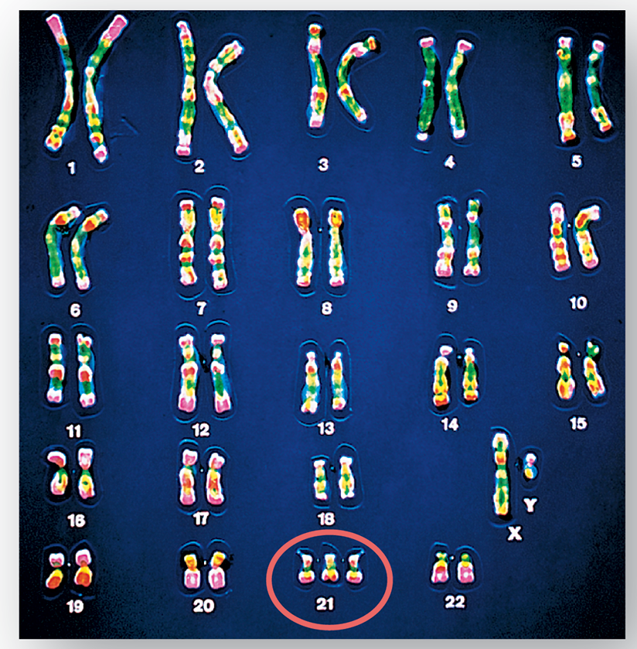
Figure 9.9 Down Syndrome
CNRI/Science Source

Slide 27
Abnormal Sex Chromosome Number 1
Too few or too many X or Y chromosomes
Newborns with abnormal sex chromosome numbers are more likely to survive than those with abnormal autosome numbers.
  Extra X chromosomes become Barr bodies—inactivated
Y determines maleness
  SRY (sex-determining region Y) gene on Y chromosome
Turner syndrome (45, XO)
  Absence of second sex chromosome
  Female
Klinefelter syndrome (47, XXY)
  Extra X inactivated as Barr body
  Male

Slide 28
Abnormal Sex Chromosome Number 2
Jacobs syndrome (XYY) in males
  Results from nondisjunction during spermatogenesis.
  Usually taller than average
  Persistent acne
  Speech and reading problems
  Fertile

Slide 29
End of Main Content
© McGraw Hill LLC. All rights reserved. No reproduction or distribution without the prior written consent of McGraw Hill LLC.

Slide 30
Accessibility Content: Text Alternatives for Images

Slide 31
Figure 9.1 A Human Karyotype - Text Alternative
Return to parent-slide containing images.
It shows the 22 pairs of chromosomes and the sex chromosomes. A magnified image of the fifth pair shows that each chromosome of the homologous autosome pair is composed of two sister chromatids and a centromere. A magnified image of the sex chromosomes pair show that the sex chromosomes are of different lengths in males.
Return to parent-slide containing images.

Slide 32
Figure 9.2 Life Cycle of Humans - Text Alternative
Return to parent-slide containing images.
The stages in the life cycle of humans are as follows:
The body of human males and females are diploid (2n) containing 46 chromosomes. On maturation (meiosis), both males and females produce haploid gametes, sperm (in males), and egg (in females) through meiosis. Gametes are haploid (n) in nature containing 23 chromosomes. When a haploid sperm fertilizes a haploid egg during fertilization, a diploid zygote is formed. The zygote develops into a newborn child through mitosis. Mitosis occurs throughout life during growth and development.
Return to parent-slide containing images.

Slide 33
Figure 9.3 Overview of Meiosis - Text Alternative
Return to parent-slide containing images.
The steps are discussed as follows:
Chromosome duplication: An enlarged cutaway diagram of an animal cell (2n equals 4) shows a nucleus containing duplicated chromosomes consisting of two sister chromatids, bound with centromere. Two centrioles are pulled in opposite directions.
Meiosis I: In meiosis 1, the pair of homologous chromosomes separate and place side by side. Each chromosome consists of two sister chromatids, bound with a centromere.
Meiosis II: In meiosis 2, sister chromatids separate and form 4 haploid (n equals 2) daughter cells.
Return to parent-slide containing images.

Slide 34
Figure 9.4b Crossing-over - Text Alternative
Return to parent-slide containing images.
The first step shows synapsis that results in an exchange of segments between non-sister chromatids of a homologous chromosome pair. Next, crossing-over occurs between non-sister chromatids. After crossing-over chromatids exchange segments between each other. The final step shows four chromosomes found in four different gametes.
Return to parent-slide containing images.

Slide 35
Figure 9.5 Meiosis 1 - Text Alternative
Return to parent-slide containing images.
The stages of meiosis I are as follows:
Prophase 1: It shows diploid chromosomes (2n=4). Here, homologous chromosomes pair and crossing-over occurs as chromosomes condense; the nuclear envelope fragments. Spindle forming and sister chromatids are also depicted in the stage.
Metaphase 1: In this stage, paired homologous chromosomes align at the spindle equator. Either homologue can face either pole. A centromere and chromosome attached to a spindle fiber are also shown in this stage.
Anaphase 1: In this stage, homologues separate, and move to poles. Chromosomes are still duplicated.
Telophase 1: Daughter nuclei are haploid, having received one duplicated chromosome from each homologous pair. A cleavage furrow is also present.
Return to parent-slide containing images.

Slide 36
Figure 9.6 Meiosis II - Text Alternative
Return to parent-slide containing images.
The stages of meiosis II are as follows:
Prophase 2: In this stage, chromosomes condense, and the nuclear envelope fragments. Spindle fibers are seen around the circular fragments of the nuclear envelope containing the chromosomes.
Metaphase 2: The chromosomes align at the spindle equator. Chromosomes horizontally aligned to the spindle equator are depicted.
Anaphase 2: Sister chromatids separate, becoming daughter chromosomes that move to the poles. Separated sister chromatids are depicted approaching the poles.
Telophase 2: In this stage, four haploid daughter cells are formed, that are genetically different from each other and from the parent cell. Daughter cells with cleavage furrows are depicted in this stage.
Return to parent-slide containing images.

Slide 37
Figure 9.7 Meiosis Compared with Mitosis - Text Alternative
Return to parent-slide containing images.
Meiosis involves the following: prophase 1: synapsis and crossing-over occur. metaphase 1: Homologues align independently. Anaphase 1: Homologues separate. Telophase 1: daughter cells are formed. Finally, sister chromatids separate. Daughter nuclei are genetically not identical to parental cell. Mitosis involves the following: prophase: no synapsis. Metaphase: chromosomes align at metaphase plate. Anaphase: sister chromatids separate. Telophase: Daughter cells are formed. Daughter nuclei are genetically identical to parental cell.
Return to parent-slide containing images.

Slide 38
Figure 9.8a Nondisjunction During Meiosis 1 - Text Alternative
Return to parent-slide containing images.
Nondisjunction during meiosis 1: Cell with pair of homologous chromosomes fail to separate due to non-disjunction during meiosis 1. As a result, in meiosis 2, gametes will have one less chromosome or gametes will have one extra chromosome.
Return to parent-slide containing images.

Slide 39
Figure 9.8b Nondisjunction During Meiosis II - Text Alternative
Return to parent-slide containing images.
b. Nondisjunction during meiosis 2: Cell with pair of homologous chromosomes performs normal meiosis 1. Due to the non-disjunction that occurs in meiosis 2, the gamete will have either one less or one extra chromosome. In normal meiosis 2, gamete will have normal number of chromosomes.
Return to parent-slide containing images.

