Slide 1
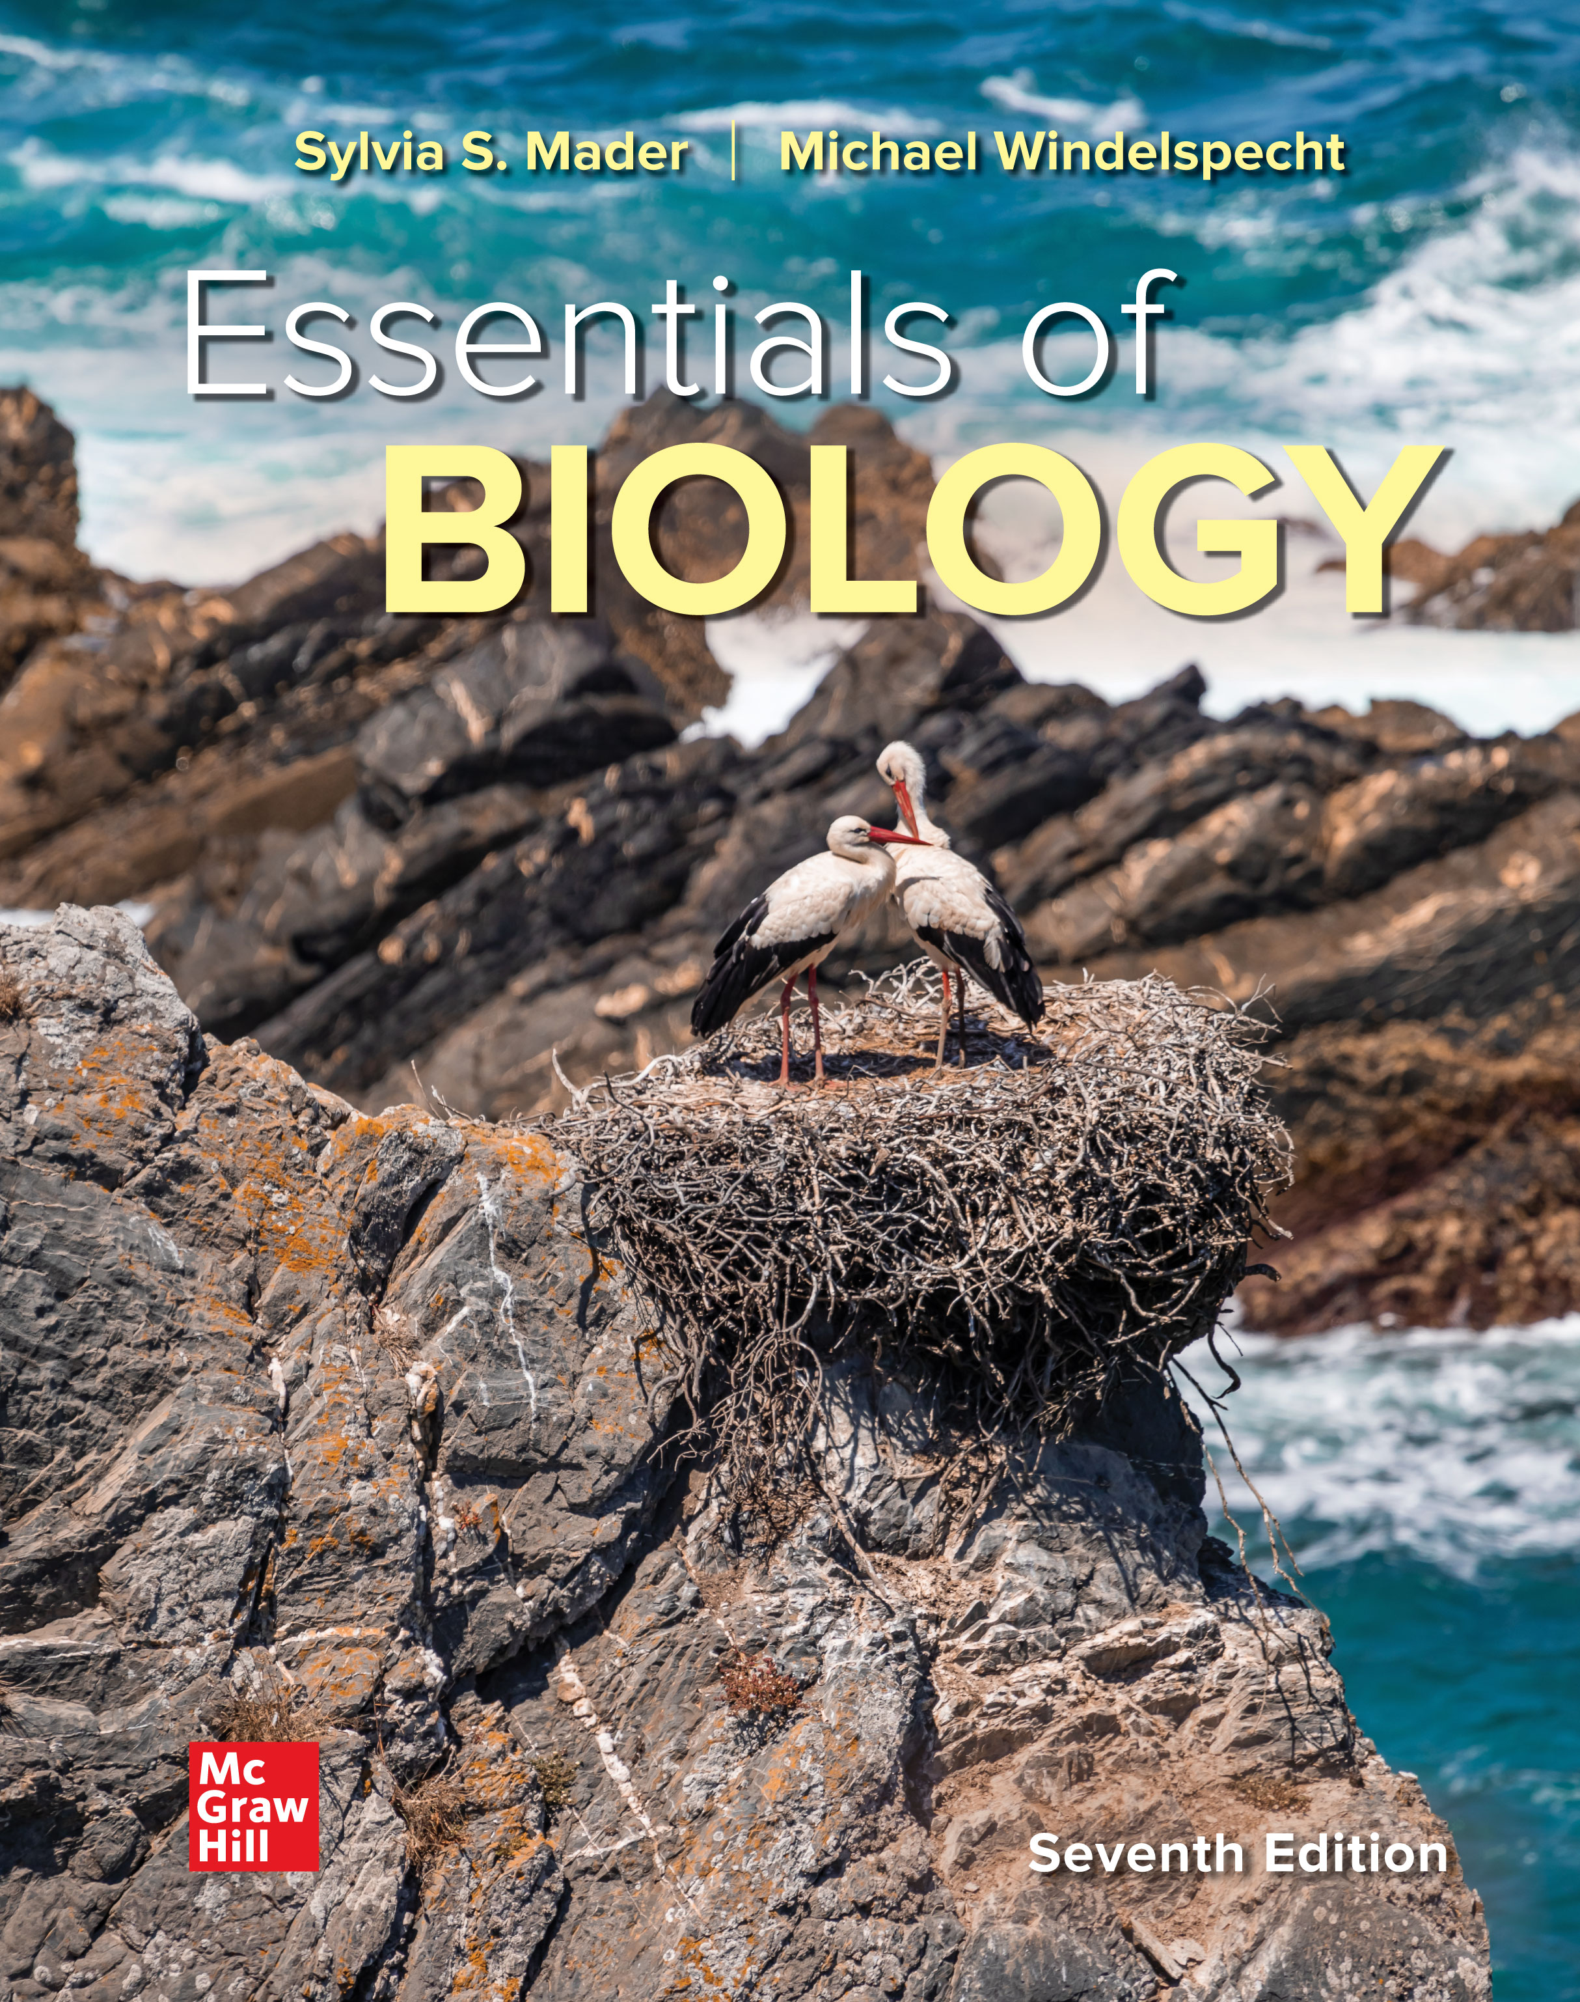
Chapter 3
The Organic Molecules of Life
Essentials of Biology
SEVENTH EDITION
Sylvia S. Mader
Michael Windelspecht
© McGraw Hill LLC. All rights reserved. No reproduction or distribution without the prior written consent of McGraw Hill LLC.

Slide 2
3.1 Organic Molecules
Organic chemistry
  Biological molecules
  Organic molecules contain carbon and hydrogen.
    Inorganic molecules do not contain a combination of carbon and hydrogen (H₂O and NaCl).

Slide 3
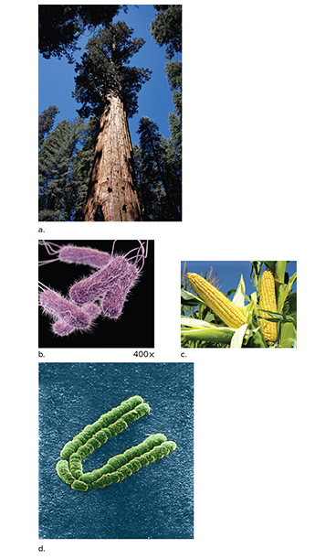
Figure 3.1 Organic Molecules Have a Variety of Functions
Access the text alternative for slide images.
(a): SuperStock/Alamy Stock Photo; (b): James Archer/CDC; (c): Zeljko Radojko/iStock/Getty Images; (d): Adrian T Sumner/Science Source

Slide 4
The Carbon Atom 1
Carbon atom:
  Total of six electrons—four in outer shell
  Almost always shares electrons with elements such as hydrogen, nitrogen, and oxygen
  Can bond with as many as four other elements
  Most often shares electrons with other carbon atoms
  Hydrocarbons—chains of carbon atoms bonded only to hydrogen atoms
  Isomers—same number and kinds of atoms in a variety of arrangements
    May have different properties

Slide 5
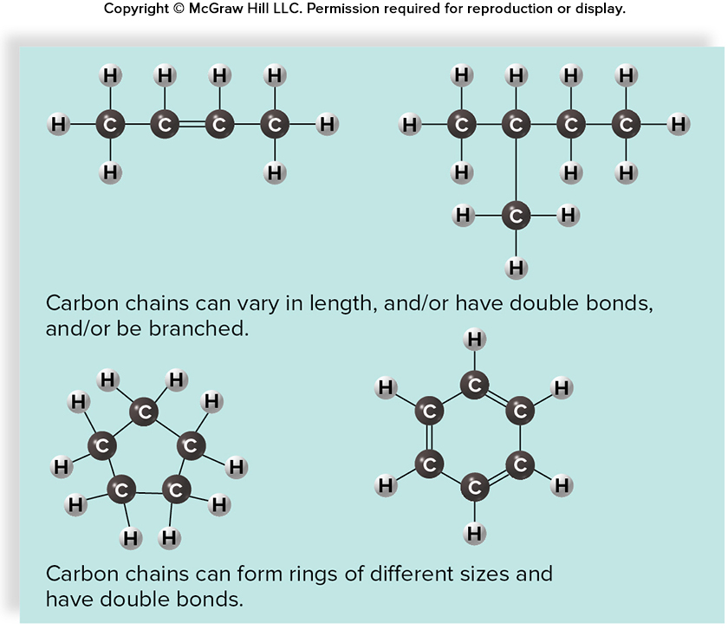
Figure 3.2 Hydrocarbons Are Highly Versatile
Access the text alternative for slide images.

Slide 6
The Carbon Atom 2
Carbon skeleton and functional groups
  Size and shape of carbon skeleton or backbone
  Functional group—specific combination of bonded atoms that always has the same chemical properties and always reacts the same way
    Reactivity of organic molecule largely dependent on attached functional groups
    Often use R to stand for the remainder of the molecule

Slide 7
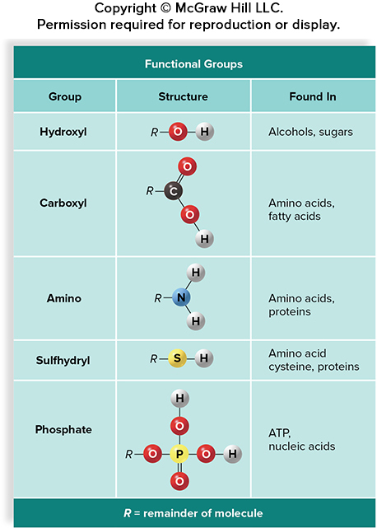
Figure 3.3 Common Functional Groups
Access the text alternative for slide images.

Slide 8
3.2 Carbohydrates and Lipids
There are four categories of biological molecules
Carbohydrates
Lipids
Proteins
Nucleic Acids
Digestion breaks these molecules into subunits to build the macromolecules that make up the body.

Slide 9
Building Complex Biological Molecules
Monomers—subunits
Polymer—monomers joined together
Dehydration synthesis reaction
    Joins monomers to form polymers; equivalent of removing a water molecule
  Hydrolysis Reaction
    O H group attaches to one monomer and H from water attaches to the other monomer; used to break bonds in a polymer.

Slide 10
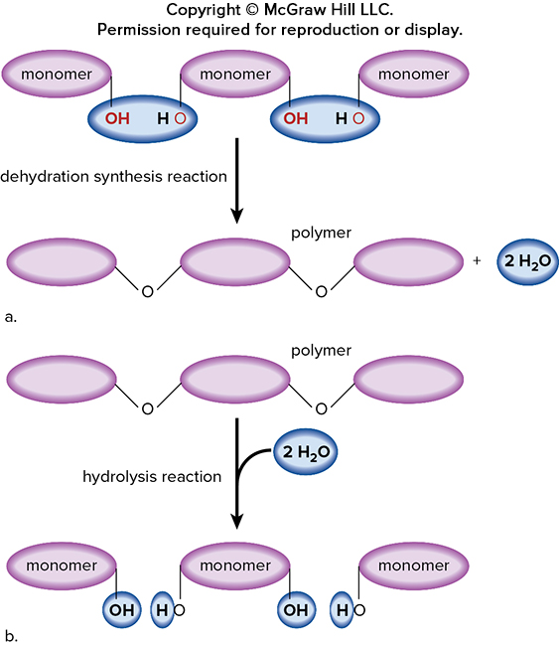
Figure 3.4 Synthesis and Breakdown of Polymers
Access the text alternative for slide images.

Slide 11
Carbohydrates 1
Carbohydrates are mainly used for immediate energy source.
May also be used for structural component
Carbohydrates are classified as
monosaccharides
disaccharides
polysaccharides

Slide 12
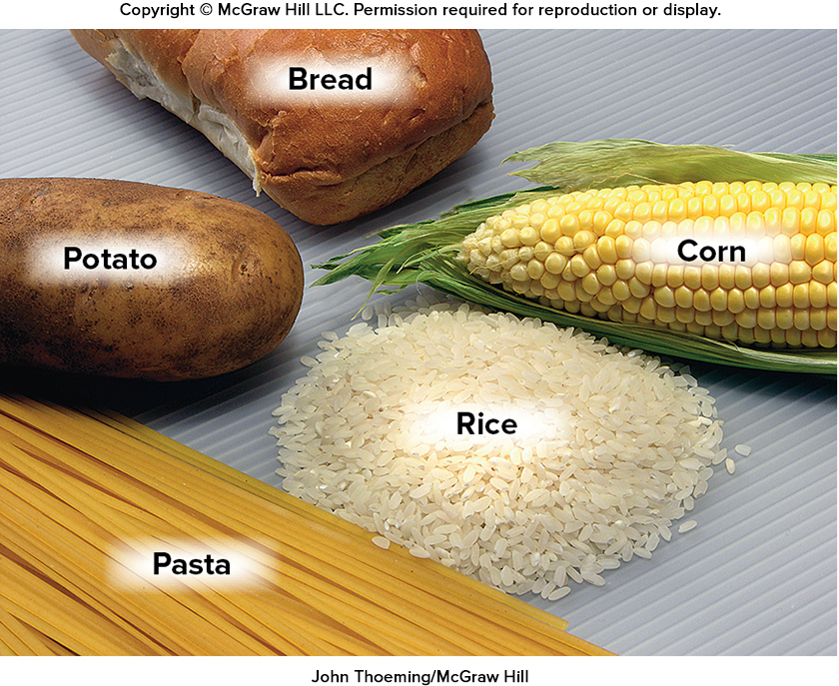
Figure 3.5 Carbohydrates
John Thoeming/McGraw Hill

Slide 13
Carbohydrates 2
Monosaccharides
  Single sugar molecule
  Simple sugars
  Three to seven carbon backbone
  Glucose C₆H₁₂O₆
    Two isomers—fructose and galactose
    Cells use glucose as the energy source of choice.
    Ribose and deoxyribose are found in RNA and DNA.

Slide 14
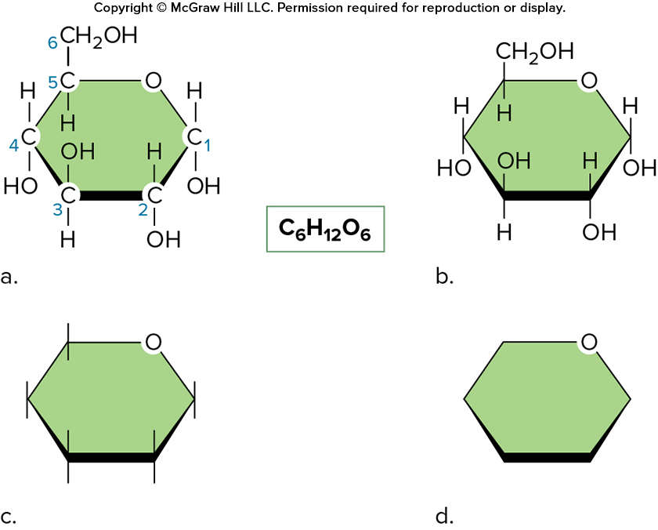
Figure 3.6 Glucose
Access the text alternative for slide images.

Slide 15
Disaccharides
Disaccharides:
  Two monosaccharides bonded together
  Maltose—yeast breaks down maltose in beer for energy and produces ethyl alcohol.
    Fermentation
  Sucrose—table sugar

Slide 16
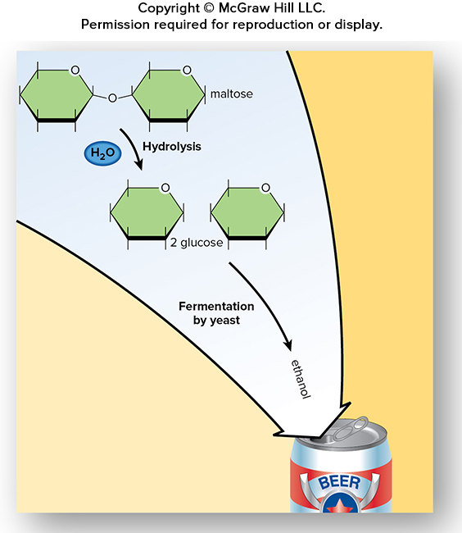
Figure 3.7 Converting Maltose to Ethanol
Access the text alternative for slide images.

Slide 17
Polysaccharides
Many polysaccharides are used as energy storage molecules.
  Polymers of monosaccharides
  Some function as energy storage molecules.
    Plants store glucose as starch.
    Animals store glucose as glycogen.
  Some function as structural components.
    Cellulose—plant cell walls
      Most abundant of all organic molecules
      Digested only by some microbes
    Chitin—crab, lobster, insect exoskeletons

Slide 18
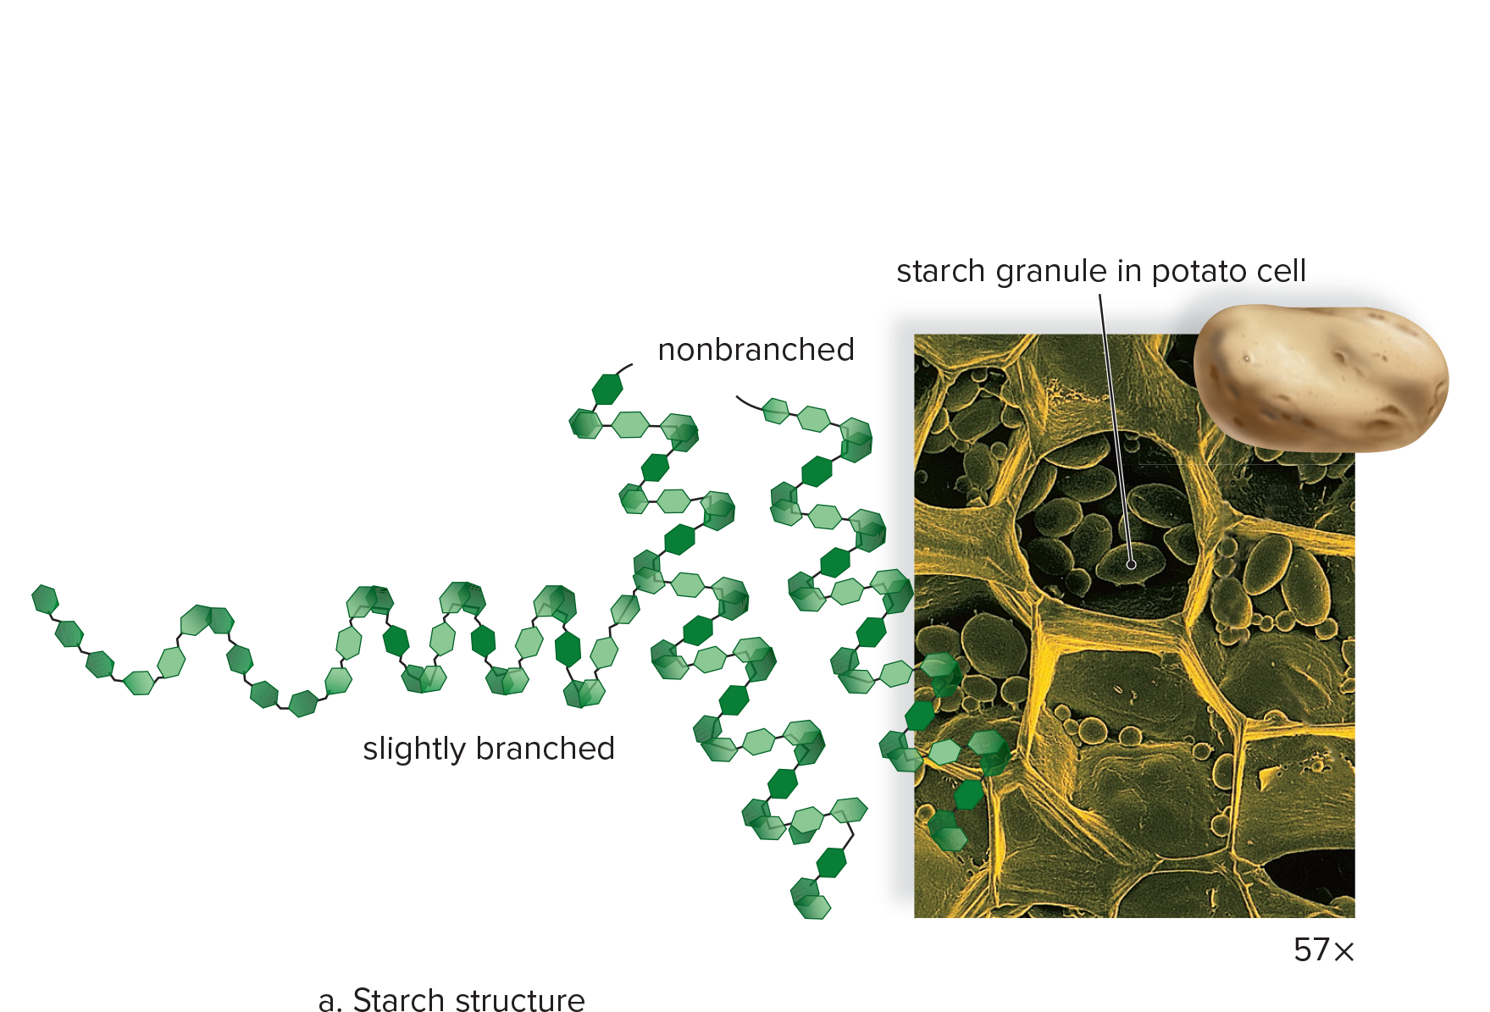
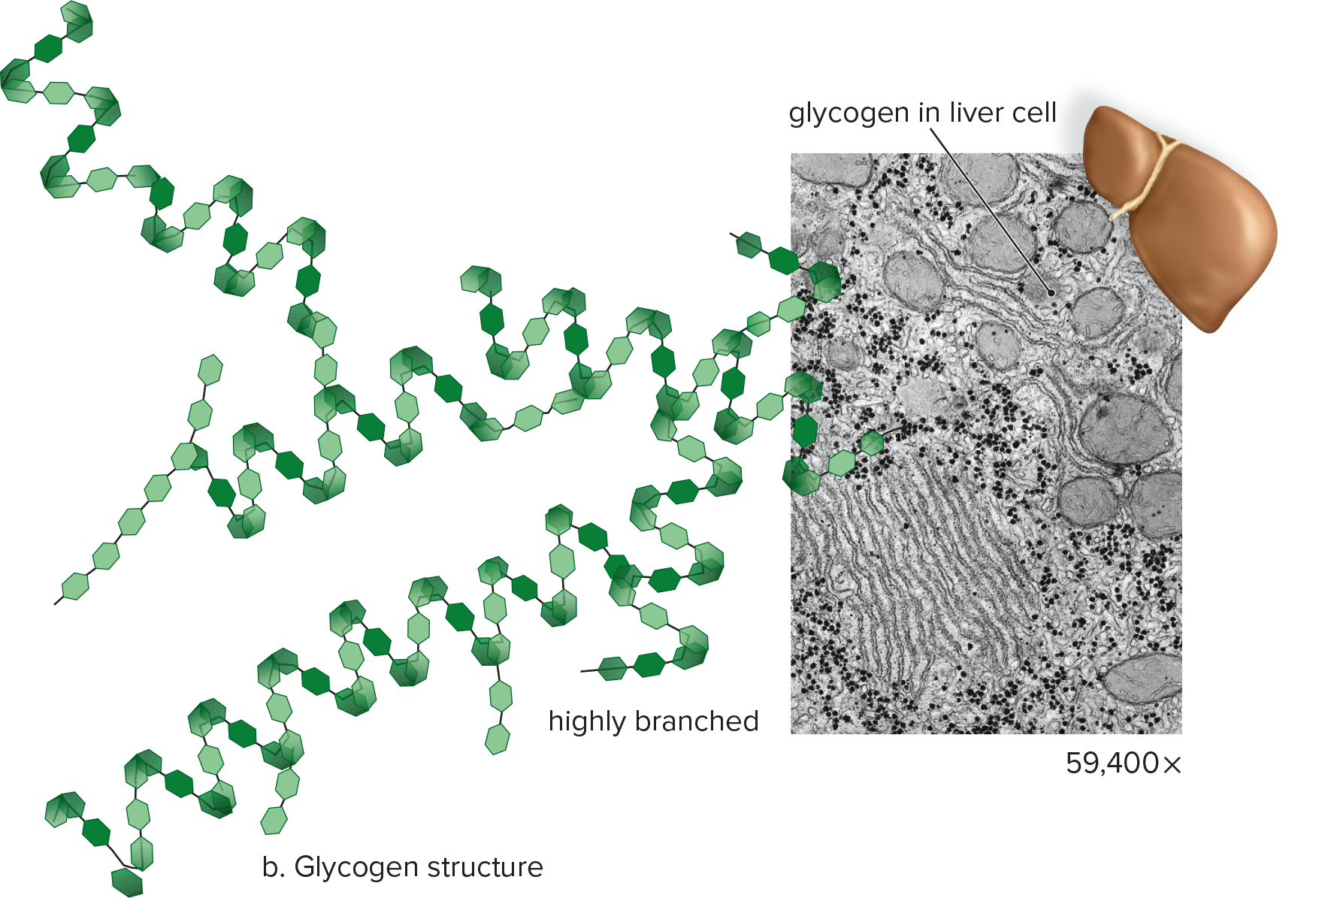
Figure 3.8 Starch and Glycogen Structure and Function
Access the text alternative for slide images.
(photos): (a): Dr. Jeremy Burgess/Science Source; (b): Don W. Fawcett/Science Source

Slide 19
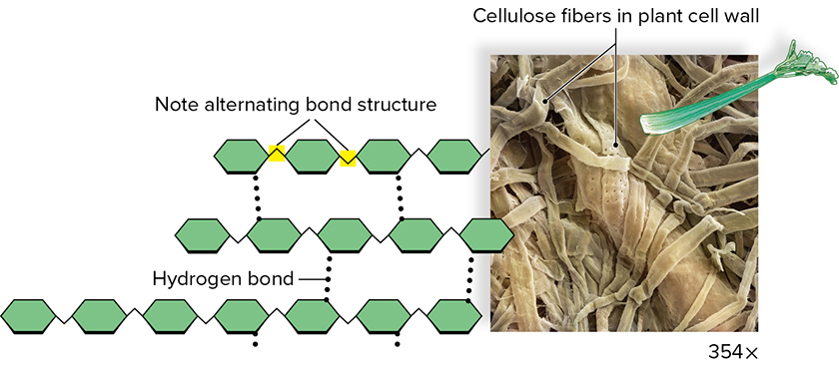
Figure 3.9 Cellulose Structure and Function
Access the text alternative for slide images.
(photo): Cheryl Power/Science Source

Slide 20
Lipids
Lipids:
  All are insoluble in water.
  Long nonpolar hydrocarbon chains
  Relative lack of hydrophilic functional groups
  Very diverse structures and functions
  Fats and oils used for long-term energy storage.
  Oil may help waterproof skin, hair, and feathers.

Slide 21
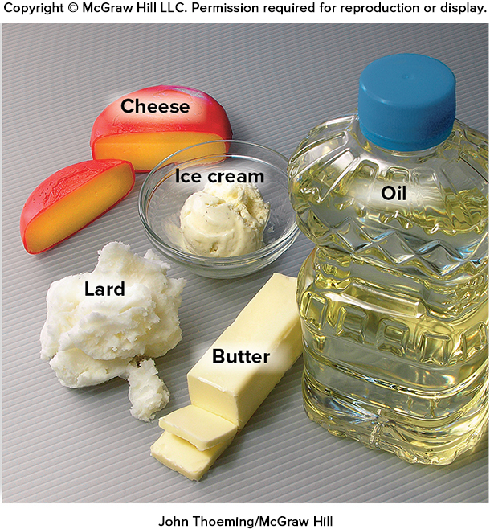
Figure 3.10 Lipid Foods
John Thoeming/McGraw Hill

Slide 22
Fats and Oils: Long-Term Energy Storage
Fats and oils are made up of molecules called triglycerides which contain two subunit molecules:
  Glycerol—three carbon chain that has three –O H groups
  Fatty acid—a long chain of carbon atoms bonded only to hydrogen, with a carboxyl group at one end
A triglyceride forms when the carboxyl portions of three fatty acids react with the –O H groups of glycerol.
This structure contains a lot of energy.
Fats and oils are the body’s primary long-term energy storage molecules.

Slide 23
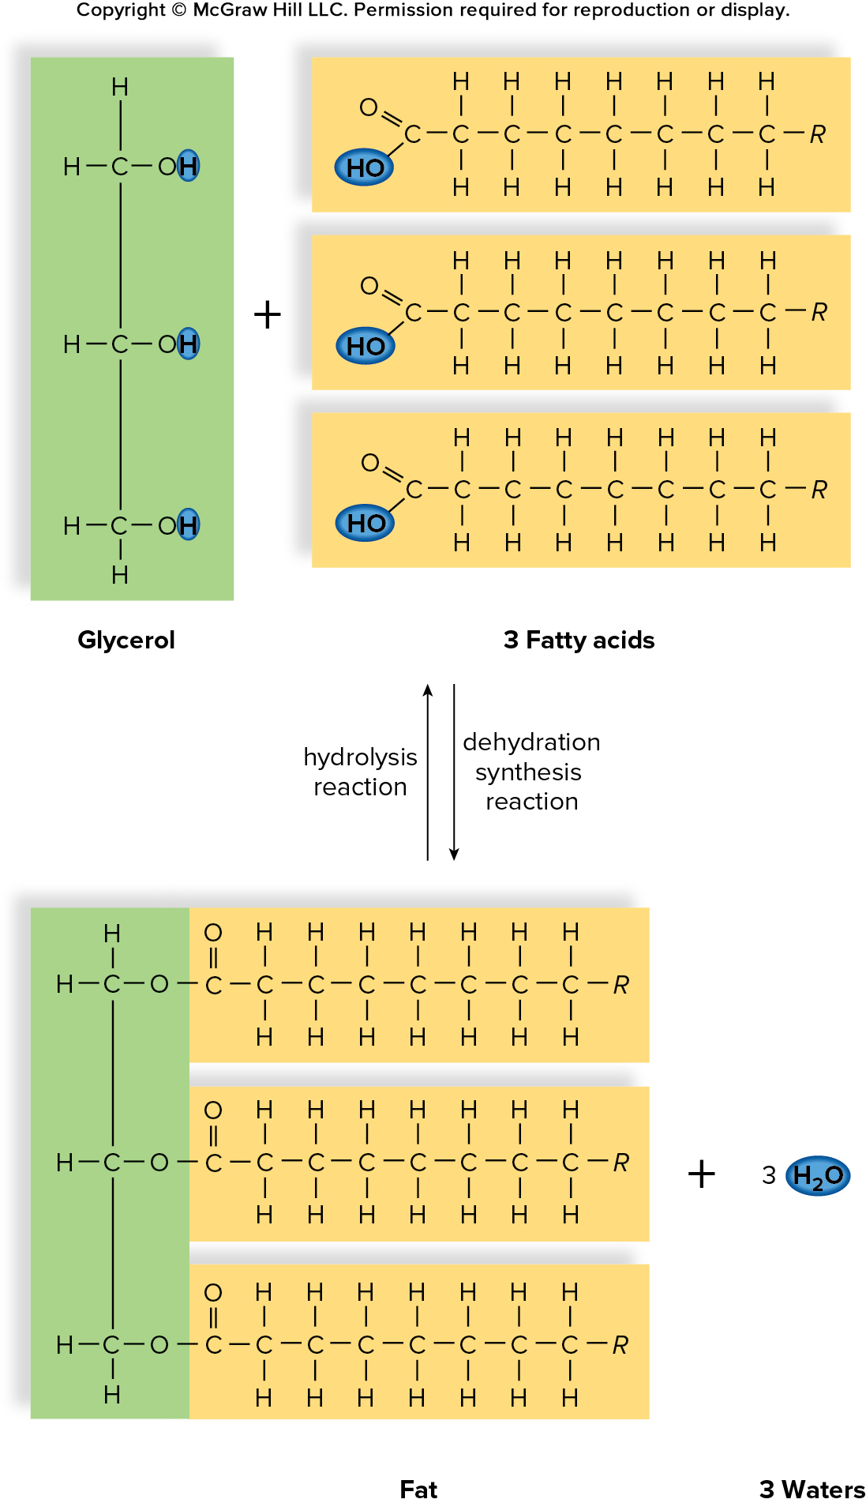
Figure 3.11 Synthesis and Breakdown of Fat
Access the text alternative for slide images.

Slide 24
Fatty Acids
Fatty acids are the primary component of fats and oils.
Unsaturated fats have double bonds in the carbon chain wherever the number of hydrogens is less than two per carbon atom.
Trans fat is an unsaturated fat (
) bond has H’s located
on opposite side of bond.
Saturated fatty acids have no double bonds between carbon atoms.

Slide 25
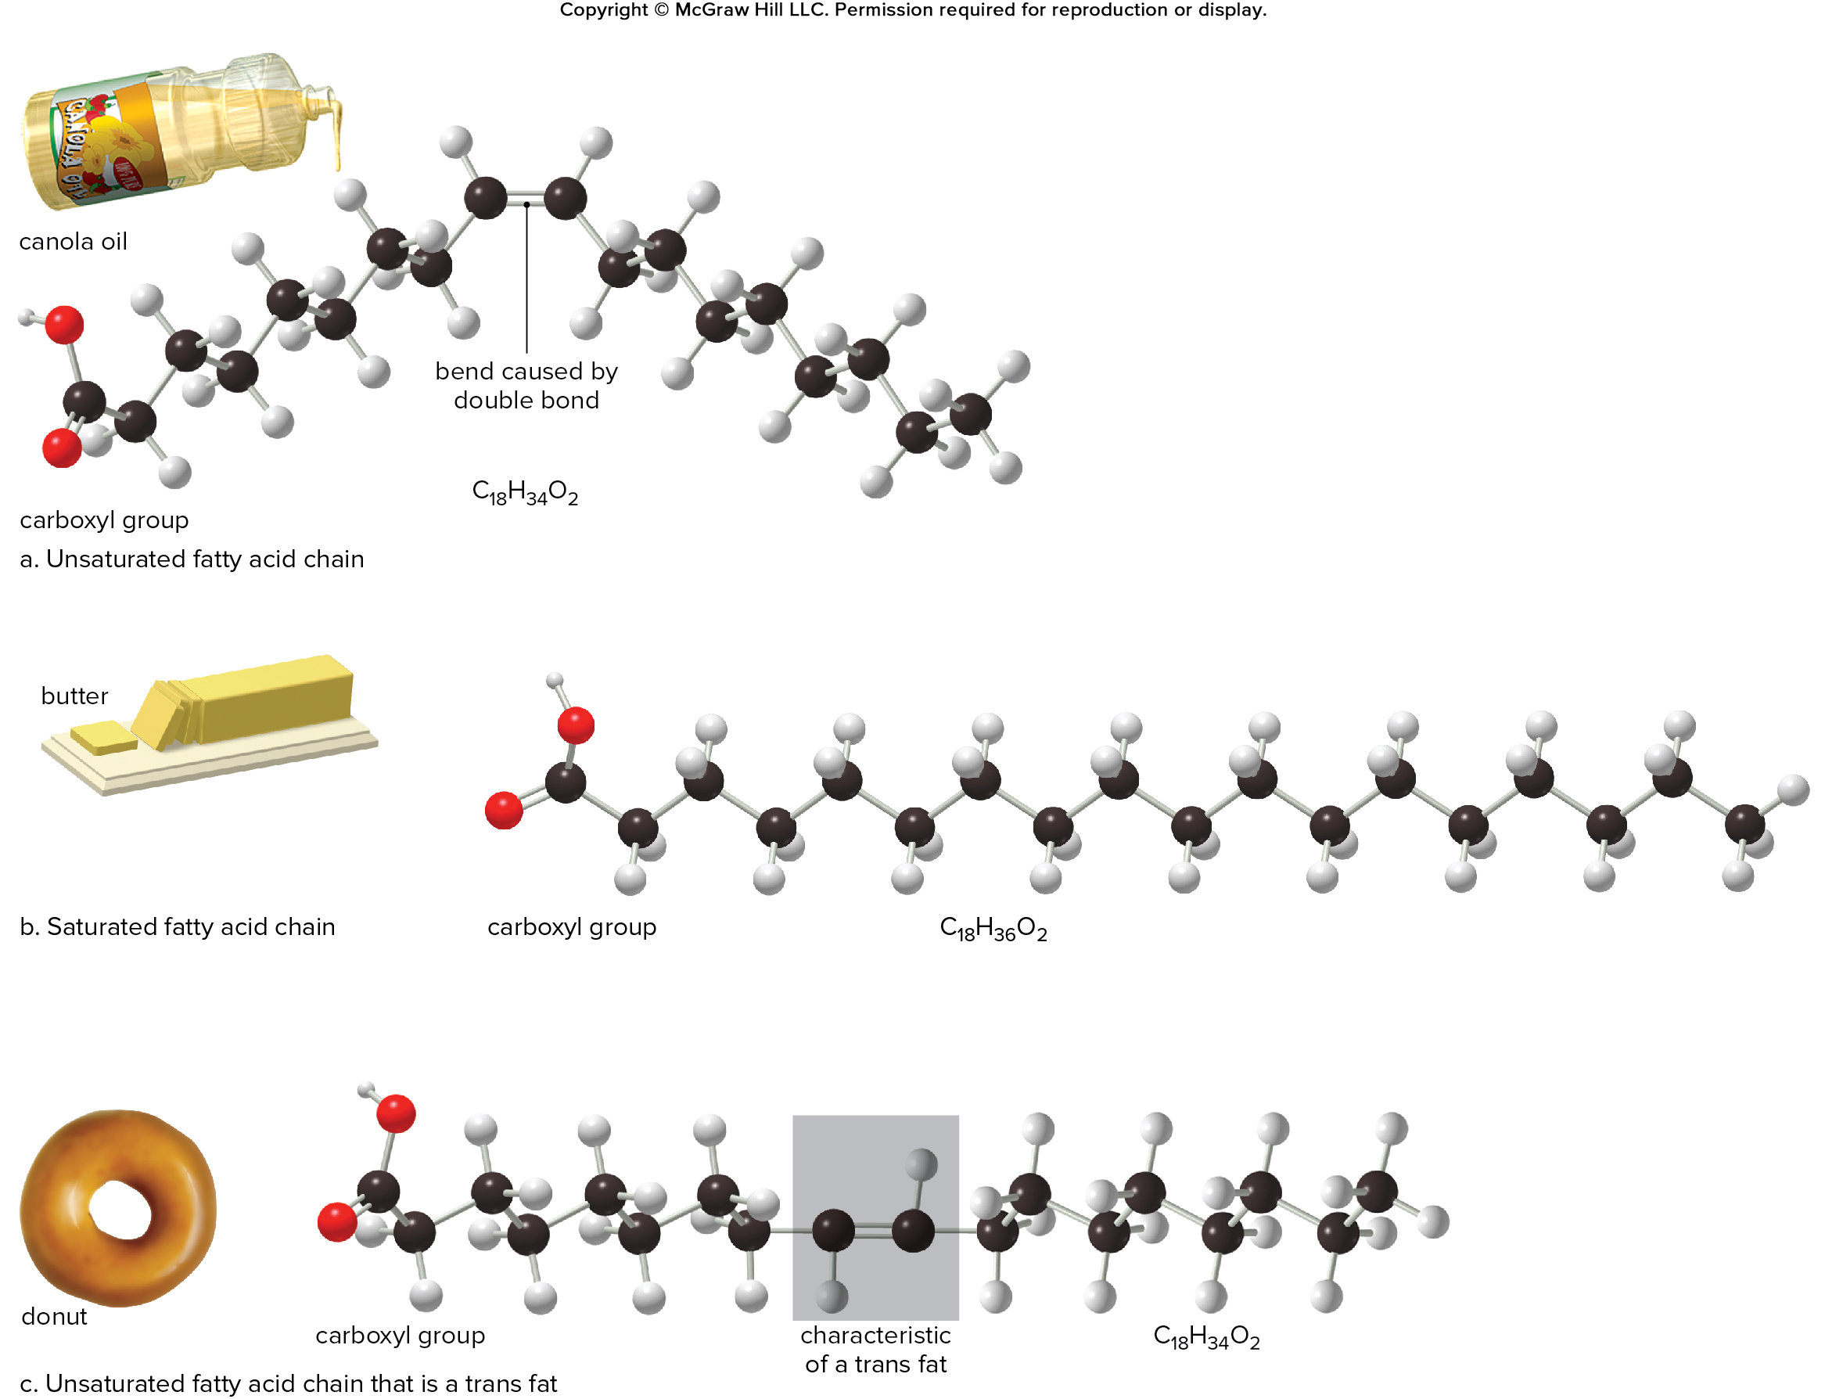
Figure 3.12 Fatty Acids
Access the text alternative for slide images.

Slide 26
Phospholipids: Membrane Components
Phospholipids
  Form the bulk of the plasma membrane
  One end of the molecule is water-soluble.
    Polar phosphate head
  Other end of the molecule is not water-soluble.
    Nonpolar fatty acid tails

Slide 27
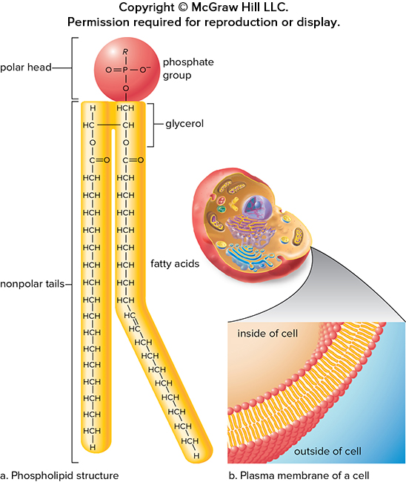
Figure 3.13 Phospholipids Form Membranes
Access the text alternative for slide images.

Slide 28
Steroids: Four Fused Rings
Steroids
  Lipids made of four fused rings.
  No fatty acids but are insoluble in water
  Derived from cholesterol
  Differ only in functional groups

Slide 29
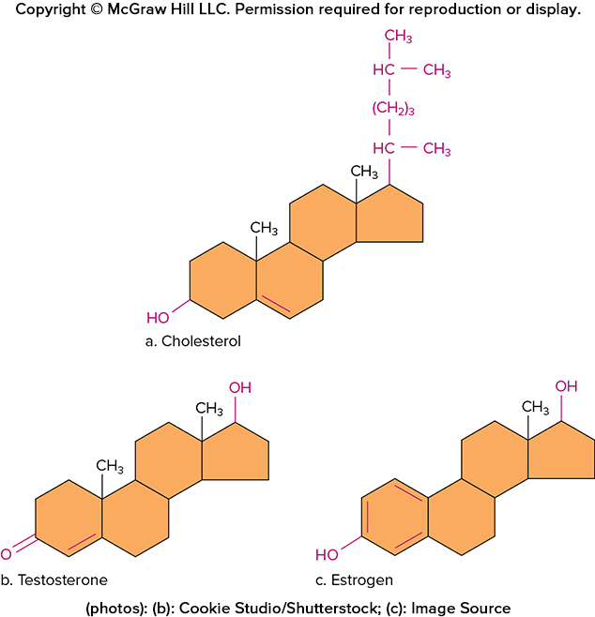
Figure 3.14 Steroid Diversity
Access the text alternative for slide images.

Slide 30
3.3 Proteins and Nucleic Acids
Proteins
  Many functions: support, metabolism, transport, defense, regulation, and motion
Proteins are composed of amino acid monomers.
Central carbon bonded to hydrogen atom, amino group, carboxyl group, and a side chain, or R group.
  20 different amino acids
  Differ according to R group

Slide 31
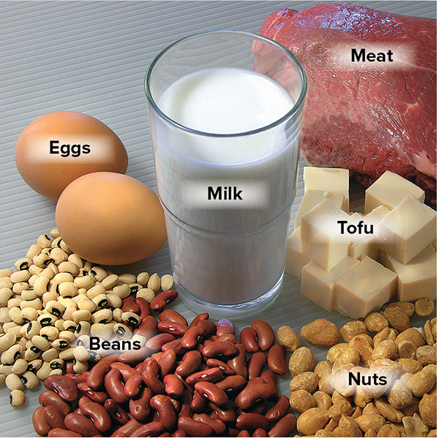
Figure 3.16 Protein Foods
John Thoeming/McGraw Hill

Slide 32
Amino Acids and Peptides
Peptides
  Peptide—two or more amino acids covalently linked
  Peptide bond—formed by dehydration reaction between two amino acid monomers
  Polypeptide—chain of many amino acids joined by peptide bonds
  Amino acid sequence determines the final three-dimensional shape of protein.

Slide 33
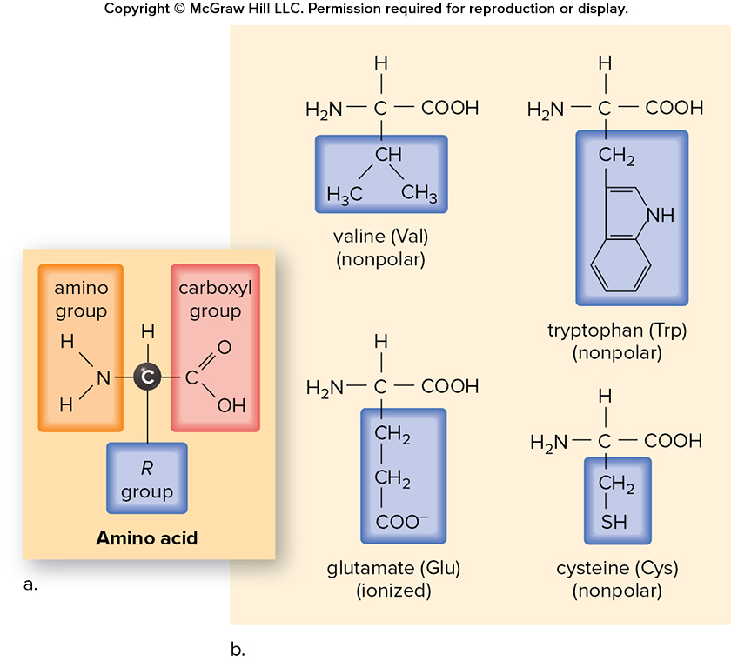
Figure 3.17 Amino Acids
Access the text alternative for slide images.

Slide 34
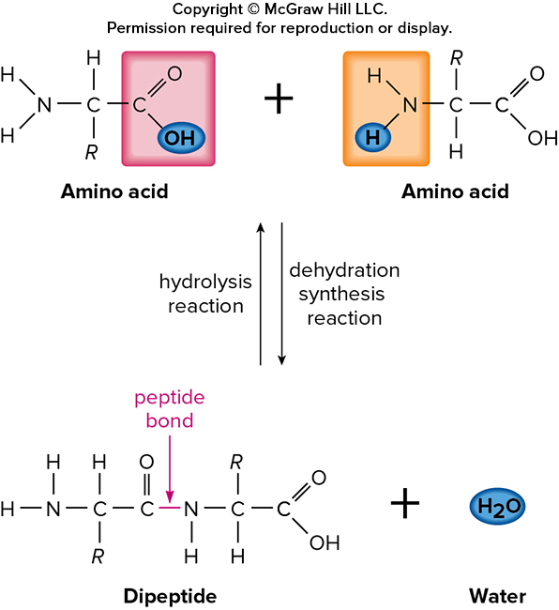
Figure 3.18 Synthesis and Degradation of Peptide
Access the text alternative for slide images.

Slide 35
Shape of Proteins 1
Shape of proteins
  Function determined by three-dimensional shape
    Loss of structure and function—denature
      Usually due to pH or temperature
  Primary structure—amino acid sequence

Slide 36
Shape of Proteins 2
  Secondary structure—portions of chain form helices or pleated sheets
  Tertiary structure—overall three-dimensional shape of interacting secondary structures
  Quaternary structure—more than one polypeptide chain interacting

Slide 37
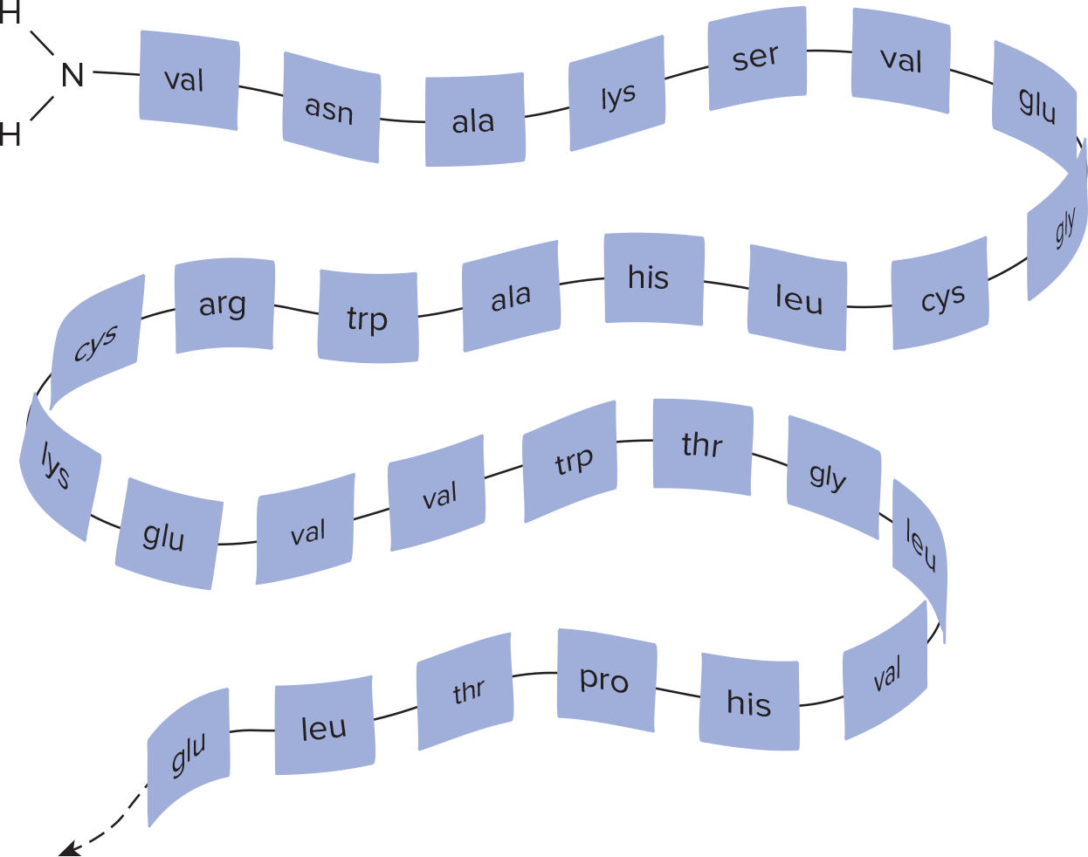
Figure 3.19 Levels of Protein Organization—Primary
Primary structure: sequence of amino acids
Access the text alternative for slide images.

Slide 38
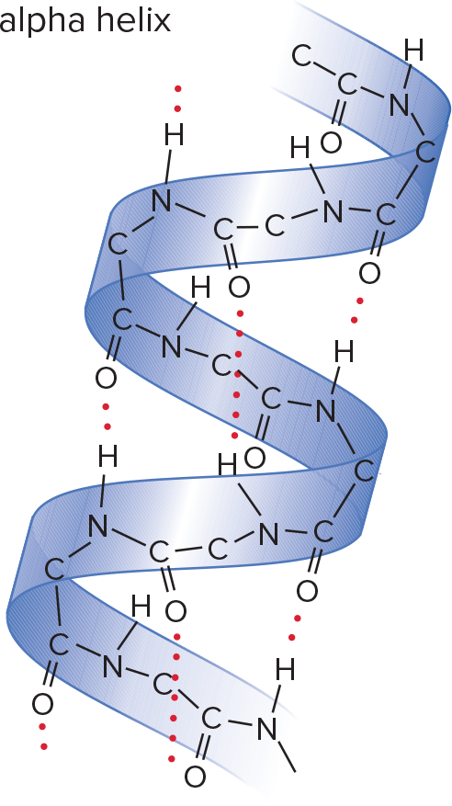
Figure 3.19 Levels of Protein Organization—Secondary
Secondary structure: alpha helix and pleated sheet
Access the text alternative for slide images.

Slide 39
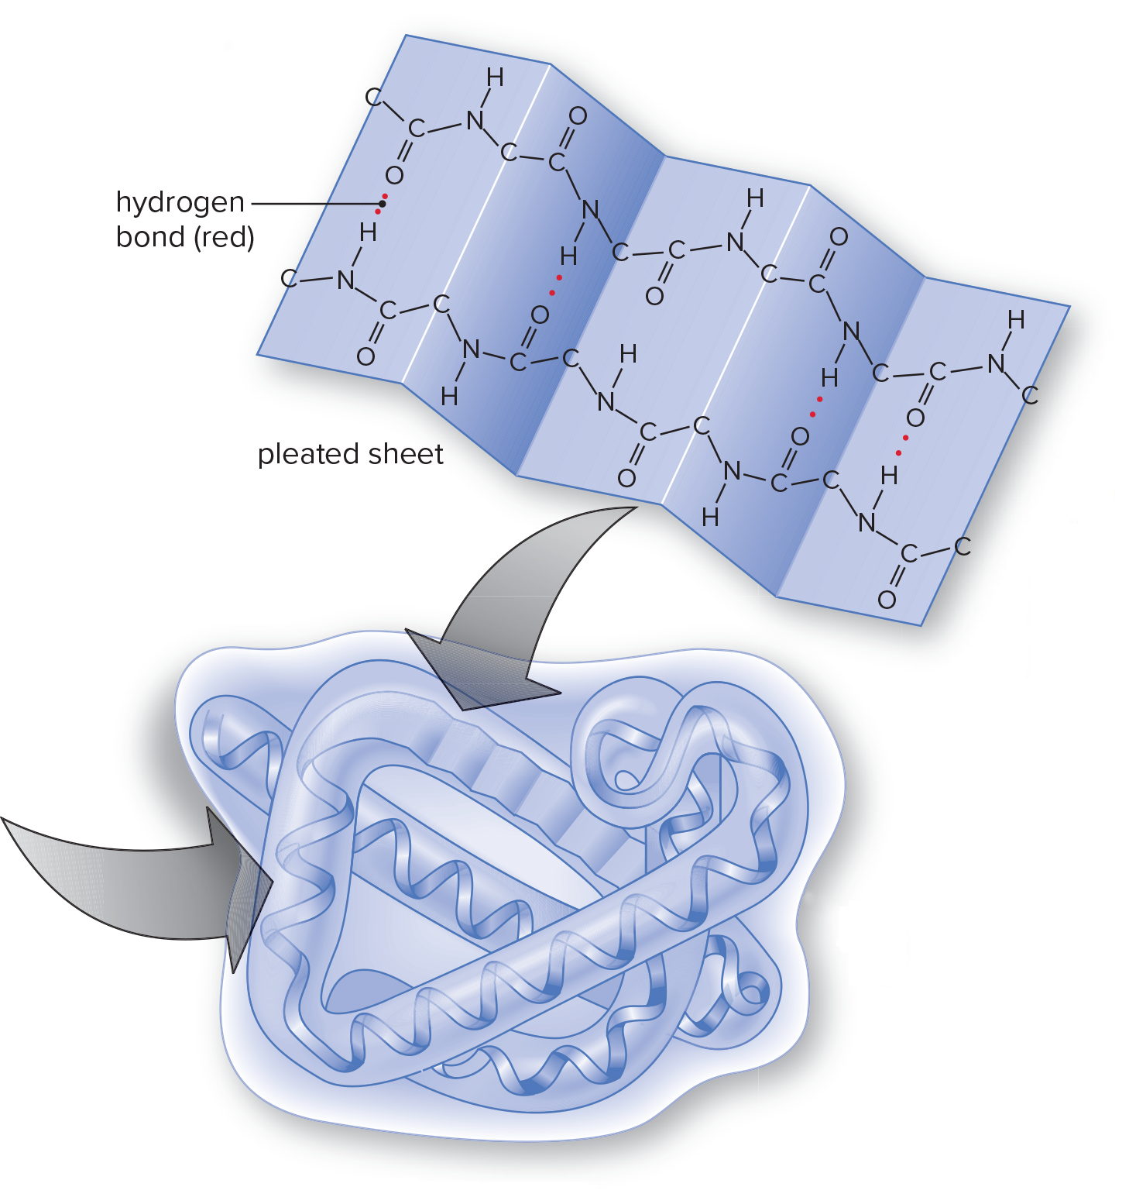
Figure 3.19 Levels of Protein Organization—Tertiary
Tertiary structure: globular shape
Access the text alternative for slide images.

Slide 40
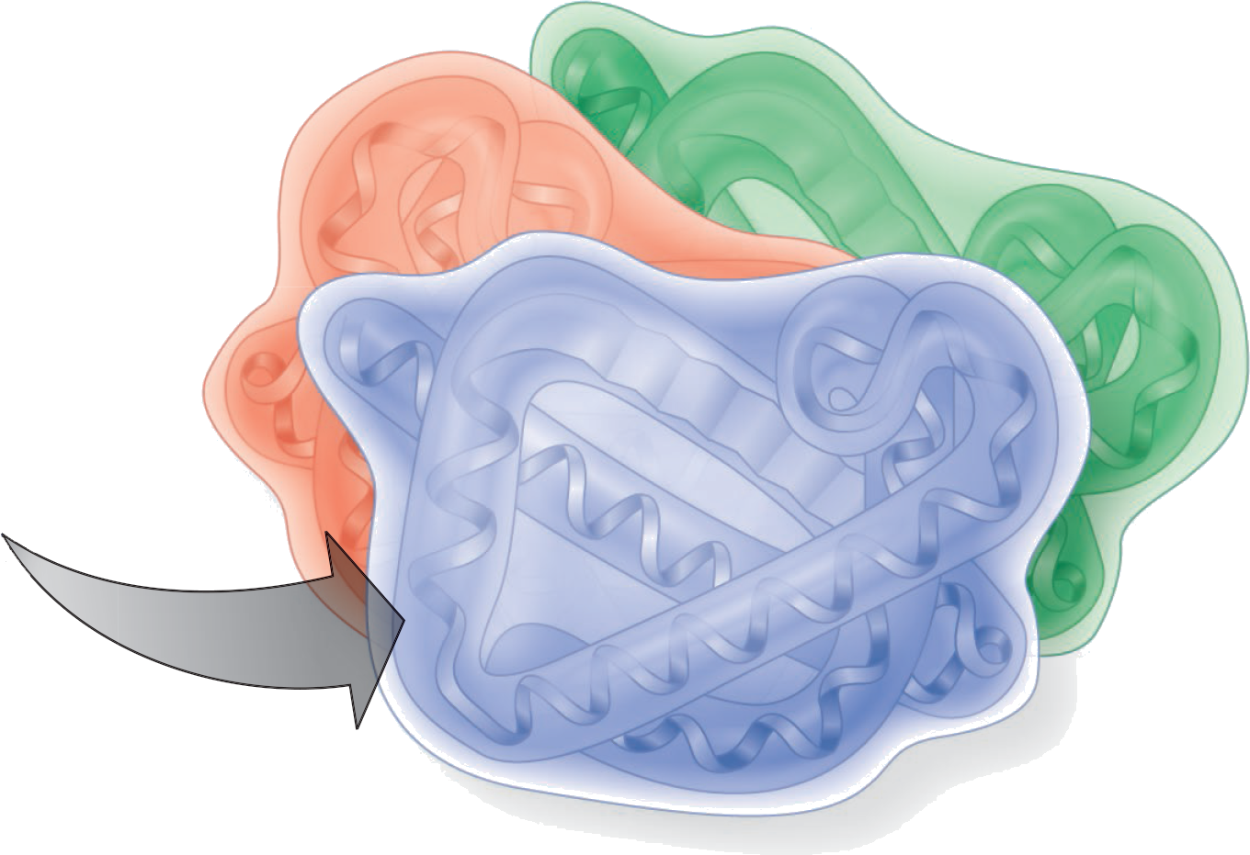
Figure 3.19 Levels of Protein Organization—Quaternary
Quaternary structure: more than one polypeptide
Access the text alternative for slide images.

Slide 41
Nucleic Acids
Nucleic acids
  Deoxyribonucleic acid (DNA)
    Stores genetic information
  Ribonucleic acid (RNA)
    Helps to make proteins
  Polymers of nucleotide monomers
    Nucleotide composed of a phosphate, 5-carbon sugar, and nitrogen-containing base
    Five types of bases—adenine (A), guanine (G), cytosine (C), and thymine (T) [DNA only], Uracil (U) [RNA only]

Slide 42
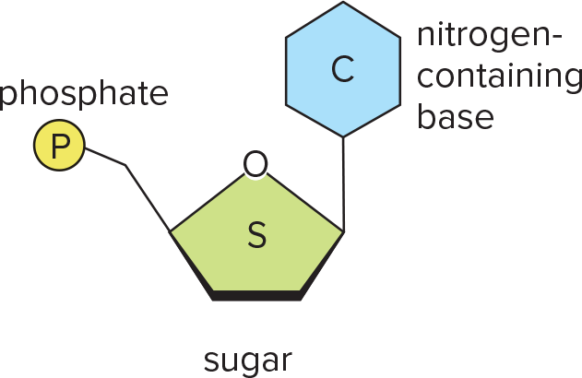
Figure 3.20a DNA Structure
Nucleotide

Slide 43
Structure of DNA
DNA
  Deoxyribose as sugar
  Double helix
  Complementary base pairing
    Adenine (A) with thymine (T)
    Cytosine (C) with guanine (G)
    Genetic information stored in sequence of bases

Slide 44
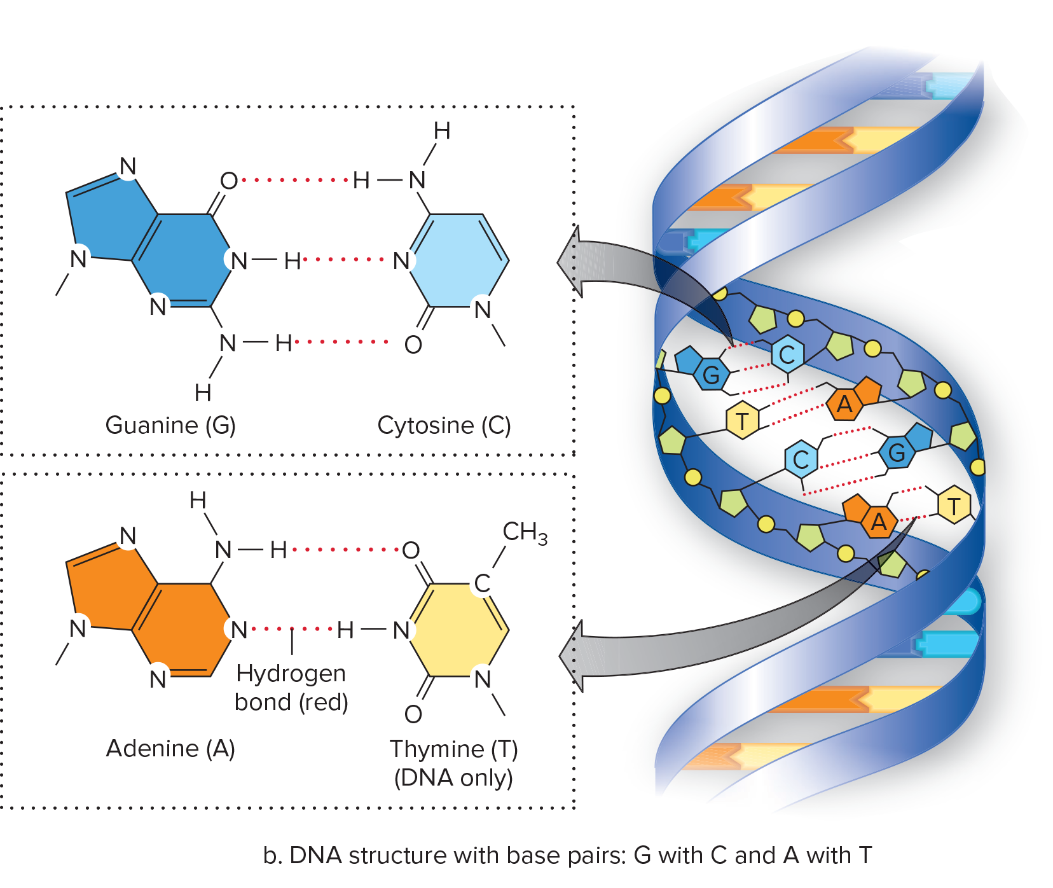
Figure 3.20b DNA Structure with Base Pairs
Access the text alternative for slide images.

Slide 45
RNA Bases
RNA
  Ribose as sugar
  Single-stranded
  Uses uracil (U) instead of thymine (T)

Slide 46
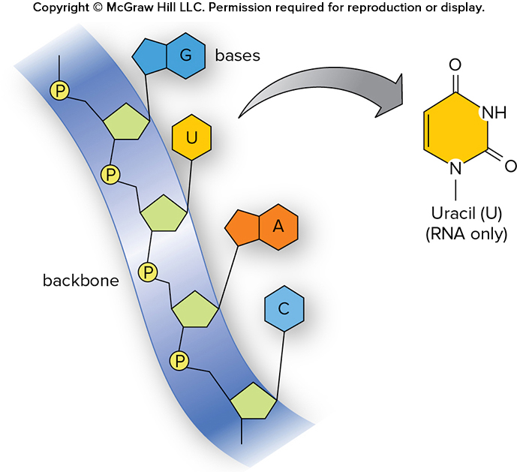
Figure 3.21 RNA Structure
Access the text alternative for slide images.

Slide 47
Comparing Proteins and Nucleic Acids
Relationship between proteins and nucleic acids
  Sequence of bases in DNA determines sequence of amino acids in a protein.
  Sequence of amino acids determines a protein's structure and function.
  Small changes in the DNA may cause large changes in a protein.
  Sickle-cell disease
    Individual’s red blood cells are sickle-shaped
    One amino acid difference
    Inherited disease

Slide 48
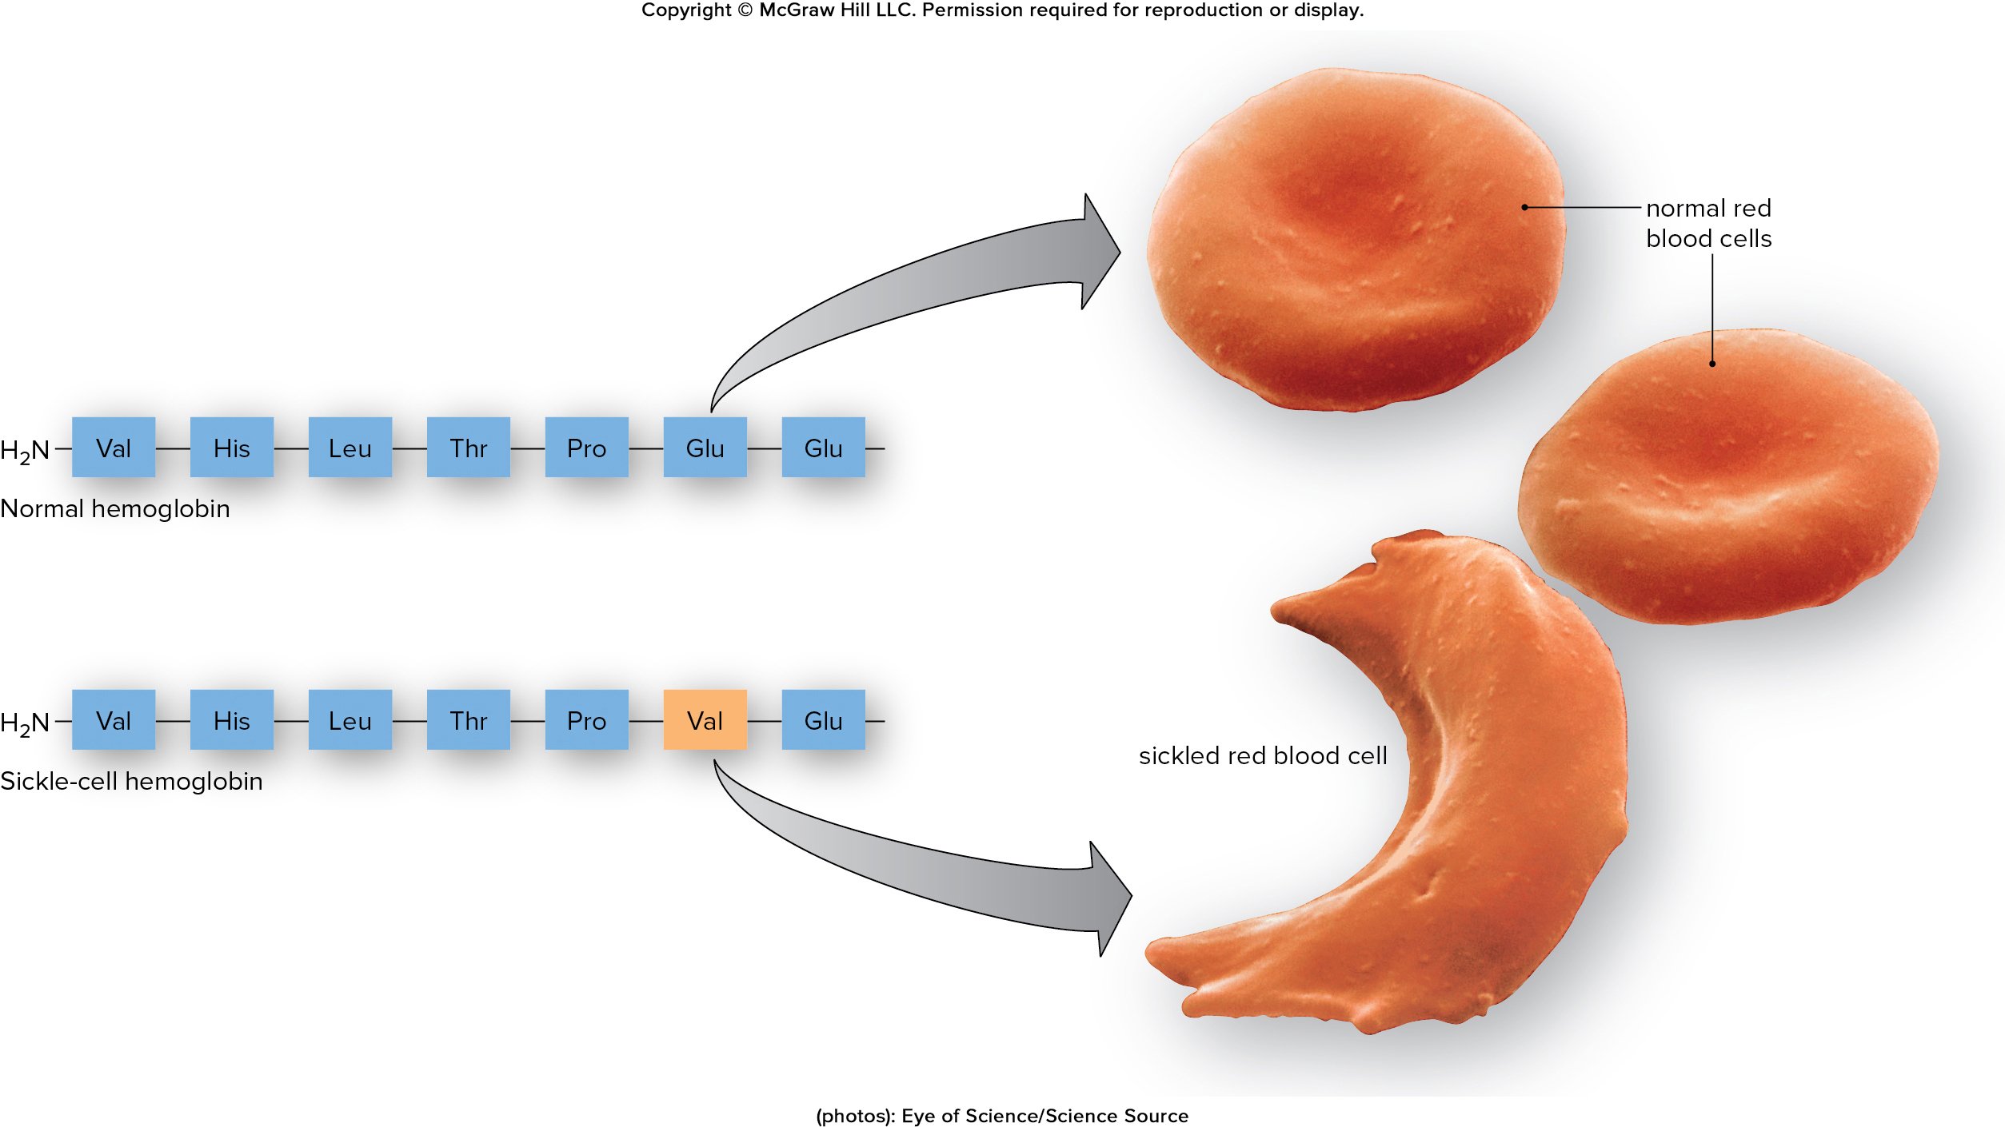
Figure 3.22 Sickle-Cell Disease
Access the text alternative for slide images.
(photos): Eye of Science/Science Source

Slide 49
End of Main Content
© McGraw Hill LLC. All rights reserved. No reproduction or distribution without the prior written consent of McGraw Hill LLC.

Slide 50
Accessibility Content: Text Alternatives for Images

Slide 51
Figure 3.1 Organic Molecules Have a Variety of Functions - Text Alternative
Return to parent-slide containing images.
The first image shows a tall tree, the second one is a micrograph of a bacteria, the third one shows corn kernels, and the fourth one shows a micrograph of DNA.
Return to parent-slide containing images.

Slide 52
Figure 3.2 Hydrocarbons Are Highly Versatile - Text Alternative
Return to parent-slide containing images.
From the top left, the first straight chain hydrocarbon contains four carbon with a double bond between the second and third carbons. Eight hydrogen atoms are singly bonded with these four carbons. The second straight chain hydrocarbon consists of five carbon atoms. Out of five carbons, four are in the same plane while one is branched at the second carbon position.
The bottom note reads: Carbon chains can vary in length, and/or have double bonds, and/or be branched.
From the bottom left, the first cyclic hydrocarbon consists of five carbon atoms bonded singly. Two hydrogen atoms are singly bonded with each carbon. The second cyclic chain has six carbon atoms bonded with each other with alternate single and double bonds. One hydrogen atom is singly bonded with each carbon atom.
The bottom note reads: Carbon chains can form rings of different sizes and have double bonds.
Return to parent-slide containing images.

Slide 53
Figure 3.3 Common Functional Groups - Text Alternative
Return to parent-slide containing images.
The data in the table are listed in the format: Group, Structure, Found in, as follows: Hydroxyl, R bonded to OH, alcohols and sugars. Carboxyl, R bonded to C which is bonded to OH and double bonded to O, amino acids, fatty acids. Amino, R bonded to N which is bonded to 2H, amino acids, proteins. Sulfhydryl, R bonded to S which is bonded to H, Amino acid, cysteine, proteins. Phosphate, R bonded to O which is bonded to a central P bonded to 2OH and double bonded to O, ATP, nucleic acids.
Return to parent-slide containing images.

Slide 54
Figure 3.4 Synthesis and Breakdown of Polymers - Text Alternative
Return to parent-slide containing images.
Three monomers undergo dehydration synthesis reaction to form a polymer and two molecules of water. The polymer undergoes hydrolysis in the presence of two water molecules to form three monomers.
Return to parent-slide containing images.

Slide 55
Figure 3.6 Glucose - Text Alternative
Return to parent-slide containing images.
A. The structure of glucose molecule shows a six-member closed ring made of one oxygen and five carbon atoms. There are a total of six carbon atoms, each numbered 1 through 6. C 1, C 2, and C 4 each are single-bonded with hydrogen at the top and a hydroxyl group, O H, at the bottom. C 3 is single-bonded with a hydroxyl group at the top and a hydrogen at the bottom. C 5 is single-bonded with C H 2 O H at the top and hydrogen at bottom.
B. The structure of glucose molecule shows a six-member closed ring made of one oxygen and five carbon atoms. There are a total of six carbon atoms in the glucose molecule. C 1, C 2, and C 4 each are single-bonded with hydrogen at the top and a hydroxyl group at the bottom. C 3 is single-bonded with a hydroxyl group at the top and a hydrogen at the bottom. C 5 is single-bonded with C H 2 O H at the top.
C. The closed-ring structure of a glucose molecule showing only one oxygen atom on the ring and a single bond on each of the five other vertices.
D. The closed-ring structure of a glucose molecule showing only one oxygen atom on the ring.
Return to parent-slide containing images.

Slide 56
Figure 3.7 Converting Maltose to Ethanol - Text Alternative
Return to parent-slide containing images.
The structure of maltose shows two six-member closed rings of glucose made of one oxygen and five carbon atoms. The C 1 of first glucose unit is bonded to C4 of second glucose unit with alpha 1,4 glycosidic linkage. On hydrolysis, maltose breaks into two glucose molecules with six-member closed rings made of one oxygen and five carbon atoms. After fermentation by yeast, glucose converts into ethanol used in making of beer.
Return to parent-slide containing images.

Slide 57
Figure 3.8 Starch and Glycogen Structure and Function - Text Alternative
Return to parent-slide containing images.
Starch consists of a slightly branched chains of glucose molecules. A micrograph beside shows a starch granule in a potato cell. Glycogen consists of highly branched chains of glucose molecules. A micrograph beside shows glycogen in a liver cell.
Return to parent-slide containing images.

Slide 58
Figure 3.9 Cellulose Structure and Function - Text Alternative
Return to parent-slide containing images.
A close-up view shows a micrograph labeled cellulose fibers in plant cell wall at 354 times magnification. Cellulose is composed of the unbranched polymeric chains of glucose arranged in a linear pattern with a highlighted label reading, note alternating bond structure. The chains of cellulose are arranged parallel to each other. The hydrogen bonds are formed between these chains to hold them together.
Return to parent-slide containing images.

Slide 59
Figure 3.11 Synthesis and Breakdown of Fat - Text Alternative
Return to parent-slide containing images.
In the reaction, glycerol combines with three fatty acids and undergoes dehydration reaction to give a fat molecule and three water molecules. Further, the fat molecule combines with three water molecules and undergoes hydrolysis reaction to give three fatty acids and glycerol.
Glycerol shows three carbon vertical chain with first and third carbon as hydroxymethyl group each. Second carbon is C H O H group. First molecule of fatty acid shows carboxylic group single-bonded with butyl group. Second molecule of fatty acid shows carboxylic group single-bonded with hexyl group. Third molecule of fatty acid shows carboxylic group single-bonded with methylene group which is single-bonded to C H group followed by double bond C H group which is single-bonded to methylene group. Further, methylene group is single-bonded to methyl group.
The hydrogen of each hydroxyl group of glycerol combines with hydroxyl group of carboxylic group in each fatty acid forming three molecules of water and the remaining part combines to form a fat molecule.
Return to parent-slide containing images.

Slide 60
Figure 3.12 Fatty Acids - Text Alternative
Return to parent-slide containing images.
The first one is the structure of an unsaturated fatty acid chain (canola oil). The structure (C₁₈H₃₄O₂) has a bend caused by double bond at the center and a carboxyl group on the left end. The second one is the structure of a saturated fatty acid chain C₁₈H₃₄O₂ (butter). It has a long chain structure with a carboxyl group on the left end. The third one is the structure of an C. Unsaturated fatty acid chain that is a trans fat (donut). The structure has a carboxyl group at the left end, and the hydrogen atoms in the double bond are arranged in a trans configuration.
Return to parent-slide containing images.

Slide 61
Figure 3.13 Phospholipids Form Membranes - Text Alternative
Return to parent-slide containing images.
The phospholipids consist of a polar head and nonpolar tails. The polar head is a phosphate group and the nonpolar tails are long chains of fatty acids which are connected with the phosphate group though glycerol. The phospholipids in the plasma membrane of a cell form a tightly packed bilayer around the cell.
Return to parent-slide containing images.

Slide 62
Figure 3.14 Steroid Diversity - Text Alternative
Return to parent-slide containing images.
The structure labeled a shows cholesterol. It consists of four fused ring structures with two exposed methyl groups at C 18 and C 19. C 17 is single-bonded with six carbon chain with C 20 linked with methyl group, C 22 through C 24 is a methylene group each, and C 25 is isopropyl group. A single-bonded hydroxyl group is linked to ring A at C 3.
The structure labeled b shows testosterone. It consists of four fused ring structures with methyl groups at C 18 and C 19, and a hydroxyl group at C 17. In ring A, ketone group is present at C 3.
The structure labeled c shows estrogen. It consists of four fused ring structures where ring A is benzene ring having hydroxyl group at C 3; a methyl group is at C 18, and a hydroxyl group is present at C 17.
Return to parent-slide containing images.

Slide 63
Figure 3.17 Amino Acids - Text Alternative
Return to parent-slide containing images.
Amino acid consists of an R group attached to an amino group and a carboxylic group. The proteins depicted are as follows: valine (val) nonpolar: a 3-carbon group attached to the amino group and the carboxylic group. Glutamate (glu) ionized: a C₃H₄O₂ chain attached to the amino group and the carboxylic group. Cysteine (cys) nonpolar: a CH₂ bonded to SH attached to the amino group and the carboxylic group. Tryptophan (trp) nonpolar: a CH₂ bonded to adjacent 5-carbon and 6-carbon rings attached to the amino group and the carboxylic group.
Return to parent-slide containing images.

Slide 64
Figure 3.18 Synthesis and Degradation of Peptide - Text Alternative
Return to parent-slide containing images.
Two amino acids combine in a reversible reaction (forward: dehydration synthesis, reverse: hydrolysis) to give a dipeptide and water. The dipeptide consists of a peptide bond that joins the amino acids.
Return to parent-slide containing images.

Slide 65
Figure 3.19 Levels of Protein Organization—Primary - Text Alternative
Return to parent-slide containing images.
The first one is the primary structure: sequence of amino acids. It consists of NH2 bonded to the sequence: val asn ala lys ser val leu cys his ala trp arg glu val val trp thr gly his pro thr leu glu leu gly val lys glu.
Return to parent-slide containing images.

Slide 66
Figure 3.19 Levels of Protein Organization—Secondary - Text Alternative
Return to parent-slide containing images.
The second one is the secondary structure: alpha helix and pleated sheet. It consists of the amino acids arranged in a helical strand structure. The hydrogen bonds in the structure are highlighted
Return to parent-slide containing images.

Slide 67
Figure 3.19 Levels of Protein Organization—Tertiary - Text Alternative
Return to parent-slide containing images.
The third one is the tertiary structure: globular. It consists of the amino acids arranged in a pleated sheet-like structure with the hydrogen bonds in the structure highlighted. The pleated sheets are then bound inside globular structure.
Return to parent-slide containing images.

Slide 68
Figure 3.19 Levels of Protein Organization—Quaternary - Text Alternative
Return to parent-slide containing images.
The fourth one is the quaternary structure: more than one polypeptide. It consists of three globular structures bound together.
Return to parent-slide containing images.

Slide 69
Figure 3.20b DNA Structure with Base Pairs - Text Alternative
Return to parent-slide containing images.
A double-helical structure of DNA strand is shown with the base pairs G bonded with C and A bonded with T. A magnified image shows guanine and cytosine bonded by three hydrogen bonds and thymine and adenine bonded by two hydrogen bonds.
Return to parent-slide containing images.

Slide 70
Figure 3.21 RNA Structure - Text Alternative
Return to parent-slide containing images.
The RNA consists phosphates bonded together to form the backbone. The bases G, U, A, and C are bonded to the backbone. The uracil consists of a hexagonal carbon ring with two double bonded O, NH, and N.
Return to parent-slide containing images.

Slide 71
Figure 3.22 Sickle-Cell Disease - Text Alternative
Return to parent-slide containing images.
Normal red blood cells are smooth and disc-shaped. The sickled cell red blood cells take the shape of a sickle or crescent. The abnormality in red blood cells occurs as sickle hemoglobin differs from normal hemoglobin by a single amino acid, valine that replaces glutamate at position 6.
Return to parent-slide containing images.

