Slide 1

MN7029: Financial Decision Making
2.2 Cost behaviour, pricing and budgets

Slide 2

Lecture recordings
This session is being recorded
You can access the weekly recording from Weblearn
This Photo by Unknown Author is licensed under CC BY-SA

Slide 3

Learning Outcomes
Define and distinguish different categories of cost
Understand how a fixed cost and a variable cost behave and deduce the break even point
Understand the benefits and limitations of using marginal contribution analysis and break even point
Discuss the impact for managers in decision making
Describe operation of full absorption costing and Activity Based Costing
Define a budget and show how budgets and strategy are related.

Slide 4
The Decision Making Process
4. Develop short term plans/budgets
3. Select option and consider long term plans
5. Implement the decisions
6. Review and monitor outcomes of decision
7. Act on differences from plan
2. Consider options available
1. Set aims and objective

Slide 5
What is the purpose of management accounting?
Allocate costs between costs of goods sold and inventory for reporting
Provide date for management decision making
Information for planning and performance review

Slide 6
Definition of cost
The amount of resources, usually measured in monetary terms, sacrificed to achieve a particular objective
For example:
A hotel uses resources such as food to make breakfast, labour to clean rooms and electricity to provide light to achieve the objective of providing a comfortable place to stay for customers

Slide 7
Examples of costs
Fixed and variable – we will discuss next
Direct and indirect – can it be exclusively identified with a cost object or is it an overhead?
Sunk Costs – costs incurred as a result of a past decision that cannot be reversed
Opportunity cost – benefit that is lost as a result of a choice of one course of action rather than another

Slide 8
Behaviour of costs
Helps managers to determine:
How many units to break even point – the number of items sold where costs are equivalent to revenue and therefore there is no profit or loss
Effect of reducing/increasing sales price
Effect of an increase or reduction in volume of sales
Effect of a incurring an additional cost of a marketing campaign or
How best to pay people

Slide 9
Two types of cost
Historic cost
A cost already incurred
Opportunity cost
The value of an opportunity forgone

Slide 10
Figure 7.1 Decision flow diagram for identifying relevant costs
Does the cost relate to the objectives of the business?
No
Yes
Does the cost relate to the future?
No
Yes
Does the cost vary with the decision?
No
Yes
Relevant cost
Irrelevant cost

Slide 11
The behaviour of costs
Costs may be classified as:
The value of costs incurred in producing one unit.
Remain constant (fixed) when changes occur to the volume of activity
Fixed
Vary according to the volume of activity
Variable

Slide 12

Fixed Costs
Fixed cost: total remains constant in proportion to the level of activity, within a relevant range (per unit decreases)
    For example: Rent
    Salaries
    Advertising
Example: I have rented a factory for £5,000 per month to make my cupcakes. If cake production goes up 10%, rent does not change.
Cost
Production

Slide 13
Figure 7.3 Graph of rent cost against
the volume of activity
Rent cost (£)
R
0
Volume of activity

Slide 14
Variable Costs
Variable cost: total changes in proportion to the level of activity (unit cost remains constant)
    For example: Number of units produced
    Hours worked
    Rooms occupied
Example: If I am making cake and each cake needs 200g of flour then if cake production goes up 10%, so does the quantity and total cost of flour.
Cost
Production

Slide 15
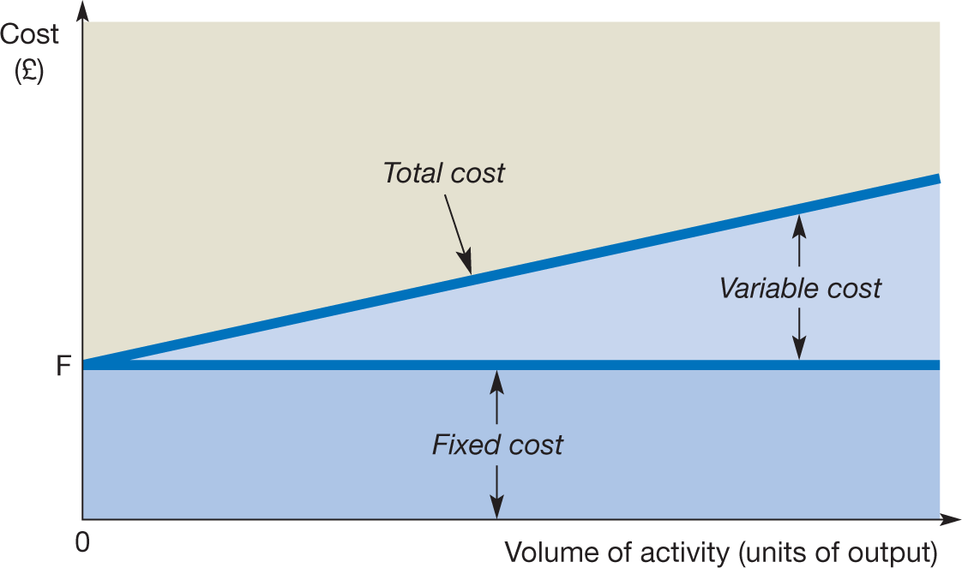
Figure 7.5 Graph of total cost against
the volume of activity

Slide 16
Graph of total sales revenue against
the volume of activity
Total sales £
Volume of activity

Slide 17
Figure 7.5 Graph of total cost against
the volume of activity

Slide 18
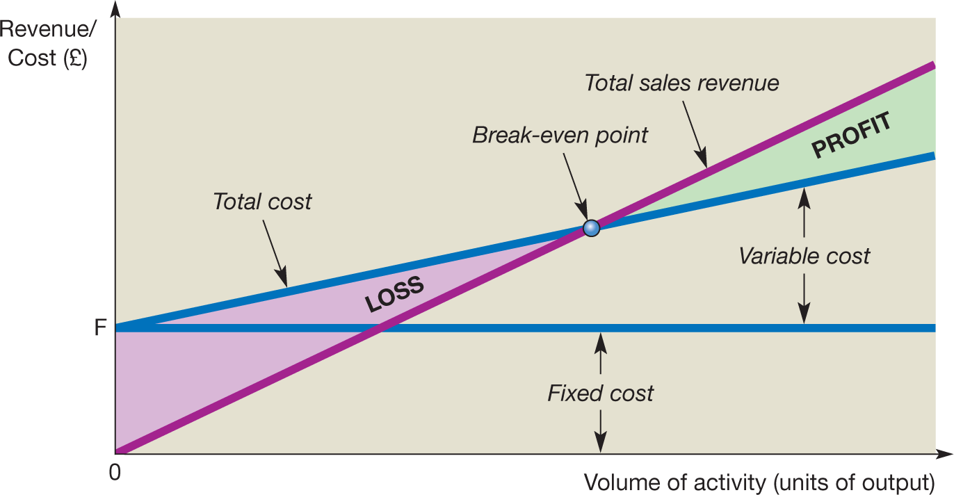
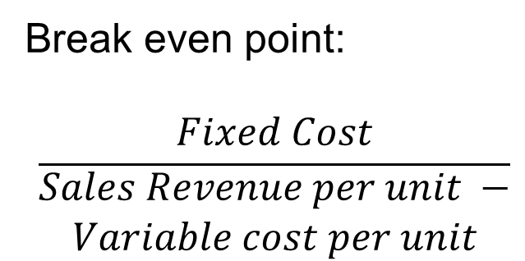
Figure 7.6 Break-even chart
Break even point:
$$\frac{Fixed Cost}{\begin{aligned}Sales Revenue per unit − \\ Variable cost per unit\end{aligned}}$$

Slide 19
Figure 7.7 Break-even and load factors at Ryanair
100
%
94
88
93
Per cent
80
82
83
70
72
72
72
73
60
40
20
0
2013
2014
2015
2016
2017
Break-even point
Load factor
Source: Based on information contained in Ryanair Holdings plc, Annual Report 2017.

Slide 20

Why does a manager need to know which costs are variable and which are fixed?
Prediction of costs
Traditional accounts separate costs on a functional rather than behavioural basis
The Contribution Approach
  Start with sales
  Deduct variable costs
  Contribution margin

Slide 21
Example CVP
 | Total | Per unit
Sales (1,000 cakes) | £10,000 | £10
Variable costs | £4,000 | £4
Contribution margin | £6,000 | £6
Fixed costs | £3,600
Profit | £2,400
Contribution margin shows the amount available to cover fixed costs and then provide profits.
If Contribution margin does not cover fixed costs the company makes a loss

Slide 22
CVP and Break even
To reach break even point, the company must make enough contribution margin to cover fixed costs
Since our cakes have a contribution margin of £6 per unit and fixed costs of £3,600 we can calculate that the break even point is 600 cakes (£3,600/£6)
 | Total | Per unit
Sales (600 cakes) | £6,000 | £10
Variable costs | £2,400 | £4
Contribution margin | £3,600 | £6
Fixed costs | £3,600
Profit | £0

Slide 23
CVP Chart

Slide 24
Example CVP
Above break even, each sale will increase profit by the contribution margin – so if we sell 601 cakes: profit = contribution margin = £6
 | Total | Per unit
Sales (601 cakes) | £6,010 | £10
Variable costs | £2,404 | £4
Contribution margin | £3,606 | £6
Fixed costs | £3,600
Profit | £6
Managers use this to work out budgets simply at different levels of activity – you just need to multiply the units over break even point by the contribution margin per unit to give the profit

Slide 25
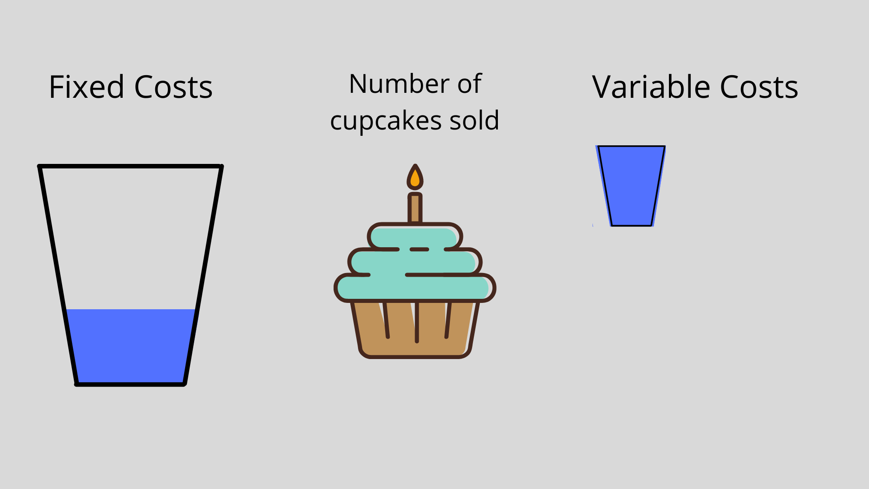
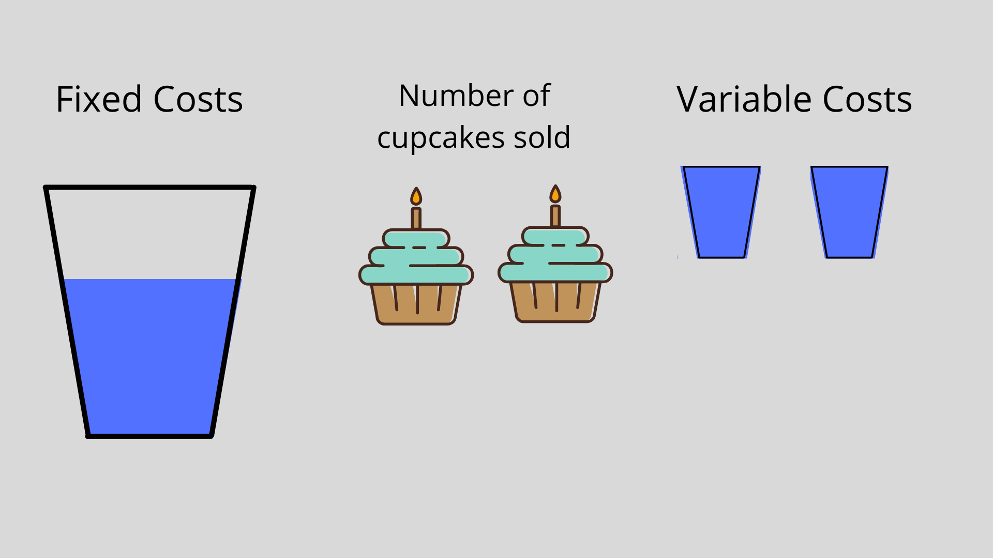
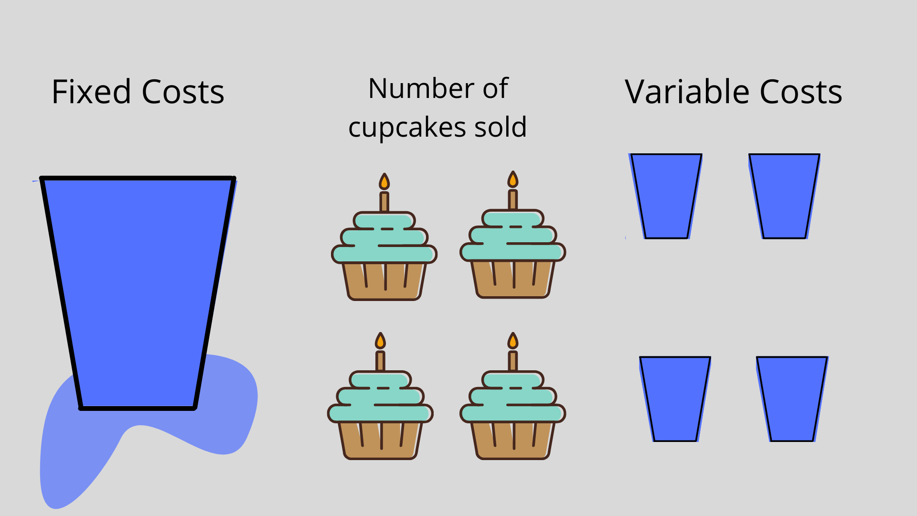
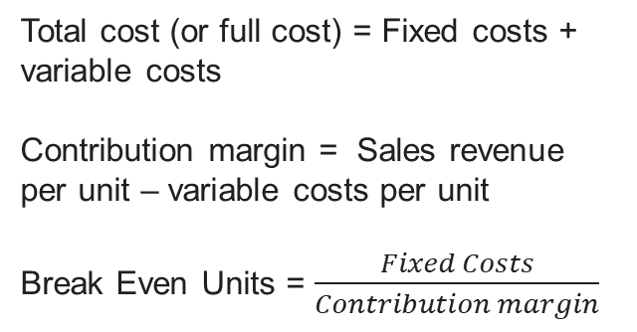
Cost Volume Profit Analysis recap
Total cost (or full cost) = Fixed costs + variable costs
Contribution margin = Sales revenue per unit – variable costs per unit
Break Even Units = $\frac{Fixed Costs}{Contribution margin}$

Slide 26
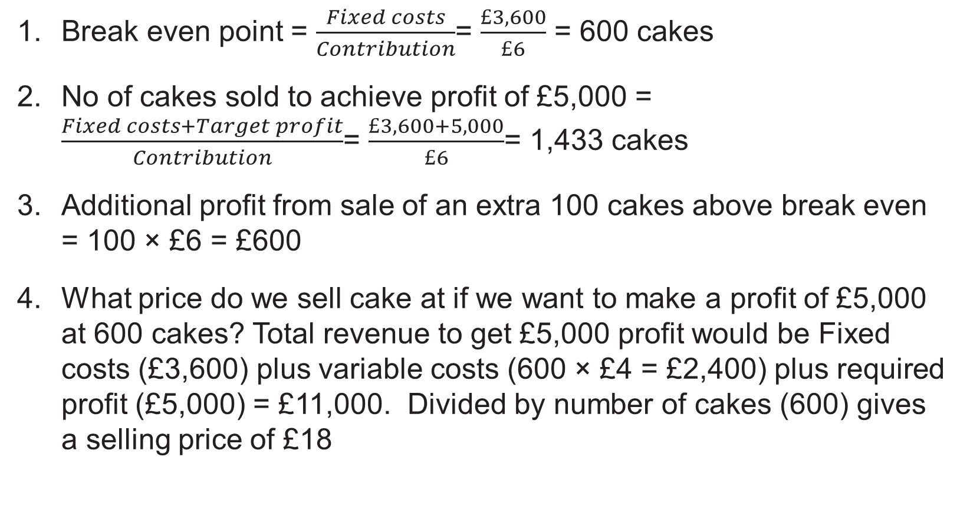
Examples of how to use CVP
Break even point = $\frac{Fixed costs}{Contribution}$= $\frac{£3,600}{£6}$ = 600 cakes
No of cakes sold to achieve profit of £5,000 = $\frac{Fixed costs+Target profit}{Contribution}$= $\frac{£3,600+5,000}{£6}$= 1,433 cakes
Additional profit from sale of an extra 100 cakes above break even = 100 × £6 = £600
What price do we sell cake at if we want to make a profit of £5,000 at 600 cakes? Total revenue to get £5,000 profit would be Fixed costs (£3,600) plus variable costs (600 × £4 = £2,400) plus required profit (£5,000) = £11,000. Divided by number of cakes (600) gives a selling price of £18

Slide 27
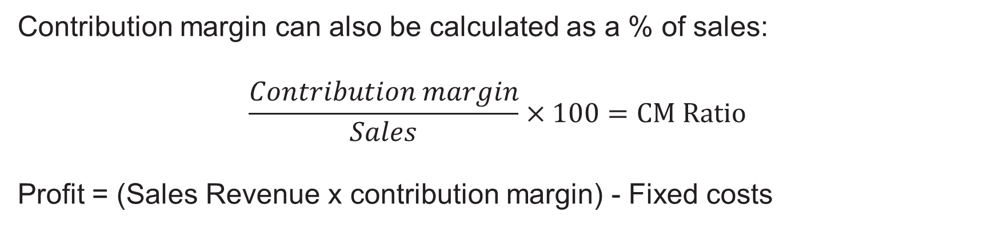
Contribution Margin Ratio
Contribution margin can also be calculated as a % of sales:
$$\frac{Contribution margin}{Sales}×100=CM Ratio$$
Profit = (Sales Revenue x contribution margin) - Fixed costs
 | Total | Percentage of sales
Sales (1,000 cakes) | £10,000 | 100
Variable costs | £4,000 | 40
Contribution margin | £6,000 | 60
Fixed costs | £3,600
Profit | £2,400

Slide 28
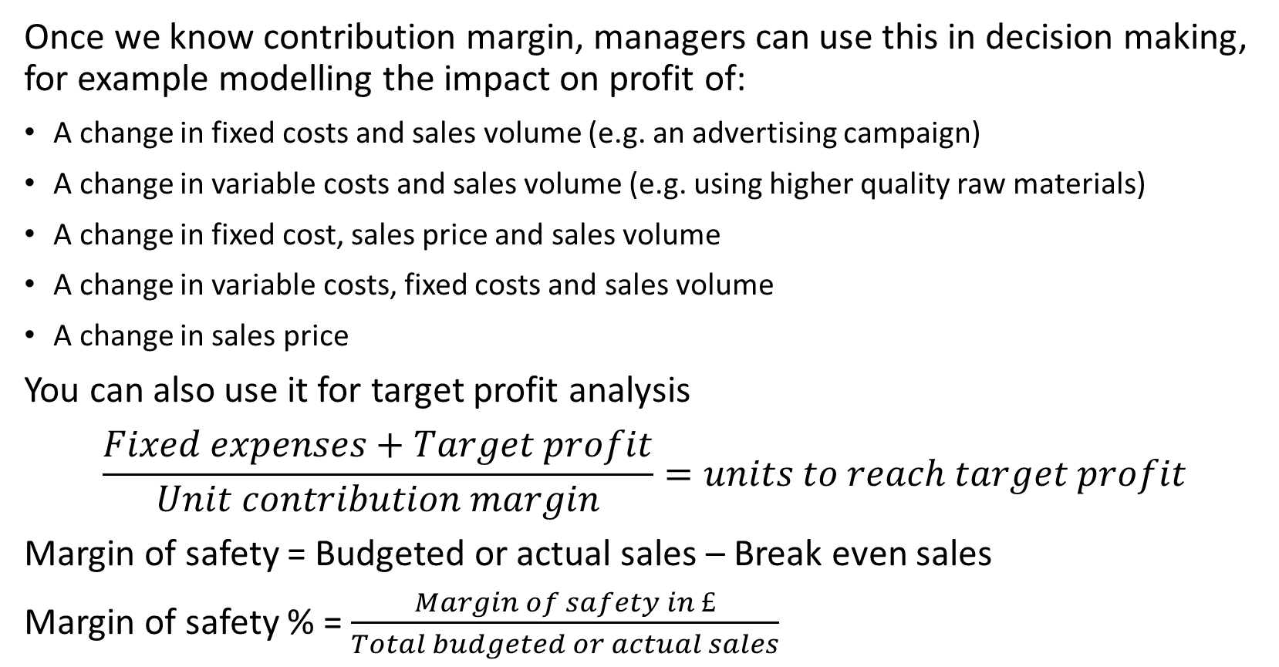
Application of CVP
Once we know contribution margin, managers can use this in decision making, for example modelling the impact on profit of:
A change in fixed costs and sales volume (e.g. an advertising campaign)
A change in variable costs and sales volume (e.g. using higher quality raw materials)
A change in fixed cost, sales price and sales volume
A change in variable costs, fixed costs and sales volume
A change in sales price
You can also use it for target profit analysis
$$\frac{Fixed expenses+Target profit}{Unit contribution margin}=units to reach target profit$$
Margin of safety = Budgeted or actual sales – Break even sales
Margin of safety % = $\frac{Margin of safety in £}{Total budgeted or actual sales}$

Slide 29
Practice question
 | Total | Per unit
Sales (1,000 cakes) | £10,000 | £10
Variable costs | £4,000 | £4
Contribution margin | £6,000 | £6
Fixed costs | £3,600
Profit | £2,400
Question 1: You decide to reduce variable costs by using a lower quality ingredients with a per unit cost of £2 but this will cause sales to fall to 700 cakes – should you do it?
Question 2: You decide to undertake an advertising campaign which will cost £1,000 but will increase sales to 1,200 units. Should you do it?

Slide 30
Practice question
Q1: You decide to reduce variable costs by using a lower quality ingredients with a per unit cost of £2 but this will cause sales to fall to 700 cakes – should you do it?
New contribution margin = 700 x £8 = £5,600
Present contribution margin = 1,000 x £6 = £6,000
Decrease in total contribution margin = £400
Q2: You decide to undertake an advertising campaign which will cost £1,000 but will increase sales to 1,200 units. Should you do it?
Incremental contribution margin = £6 x 200 = £1,200
Increase in fixed costs = £1,000
Increase in profit = £200

Slide 31
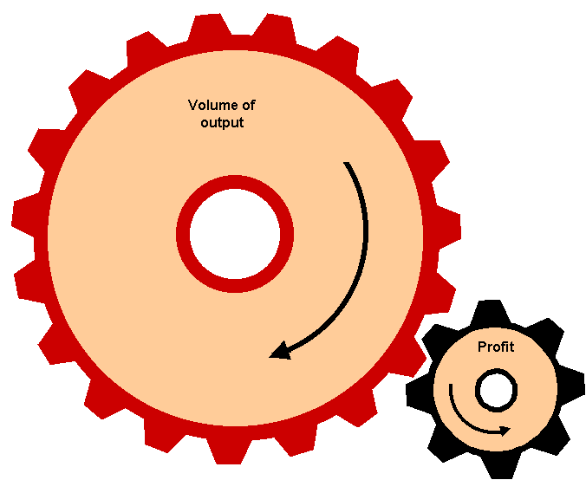
Figure 7.10 The effect of operating gearing
Volume of output
Profit

Slide 32
Cost Structure/Operating Gearing
What is the best trade off between fixed and variable costs
  E.g. buying in components rather than making yourself, automating by machinery rather than labour costs
In my cupcake factory I have the choice of using a individuals to make the cakes (high variable cost, lower fixed cost) or a machine to (low variable cost, high fixed cost)
As you can see at sales of 1,000 I get the same profit whatever I choose.
 | Total | Per unit | Total | Per Unit
Sales (1,000 cakes) | £10,000 | £10 | £10,000 | £10
Variable costs | £4,000 | £4 | £2,000 | £2
Contribution margin | £6,000 | £6 | £8,000 | £8
Fixed costs | £3,600 |  | £5,600
Profit | £2,400 |  | £2,400

Slide 33
Cost Structure/Operating Gearing
What happens if there is a 10% increase in sales?
 | Total | Per unit | Total | Per Unit
Sales (1,100 cakes) | £11,000 | £10 | £11,000 | £10
Variable costs | £4,400 | £4 | £2,200 | £2
Contribution margin | £6,600 | £6 | £8,800 | £8
Fixed costs | £3,600 |  | £5,600
Profit | £3,000 |  | £3,200
For a 10% increase in sales, option 1 gives a 25% increase in profit, option 2 gives a 33% increase in profit.

Slide 34
Cost Structure/Operating Gearing
What about a 10% decrease in sales?
 | Total | Per unit | Total | Per Unit
Sales (900 cakes) | £9,000 | £10 | £9,000 | £10
Variable costs | £3,600 | £4 | £1,800 | £2
Contribution margin | £5,400 | £6 | £7,200 | £8
Fixed costs | £3,600 |  | £5,600
Profit | £1,800 |  | £1,600
For a 10% decrease in sales, option 1 gives a 25% decrease in profit, option 2 gives a 33% decrease in profit.
Higher proportion of fixed costs mean a higher break even point and more profit volatility – more upside when things go well but also more downside…

Slide 35
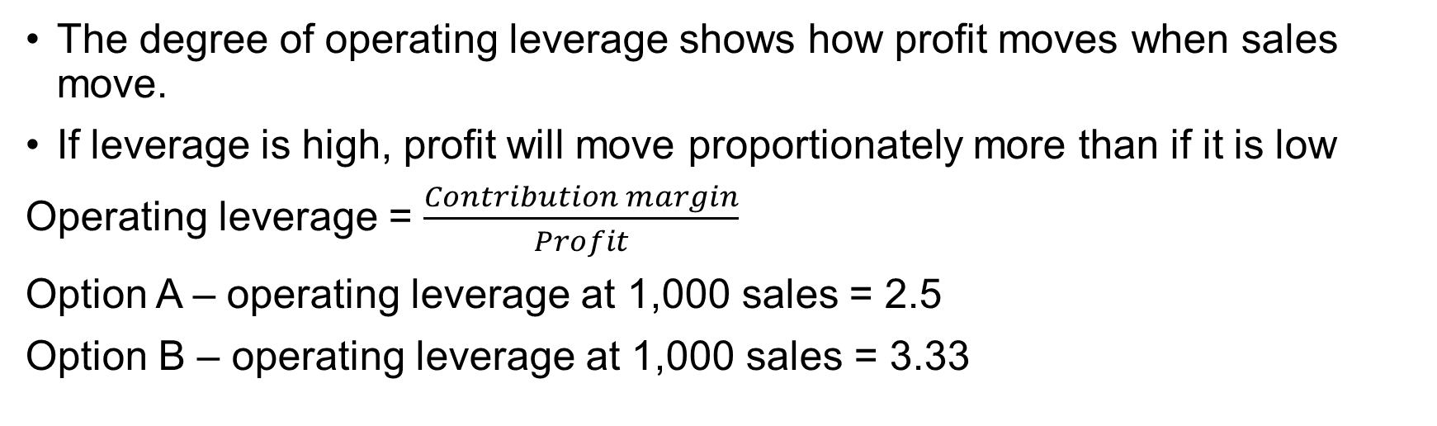
Operating leverage
The degree of operating leverage shows how profit moves when sales move.
If leverage is high, profit will move proportionately more than if it is low
Operating leverage = $\frac{Contribution margin}{Profit}$
Option A – operating leverage at 1,000 sales = 2.5
Option B – operating leverage at 1,000 sales = 3.33

Slide 36
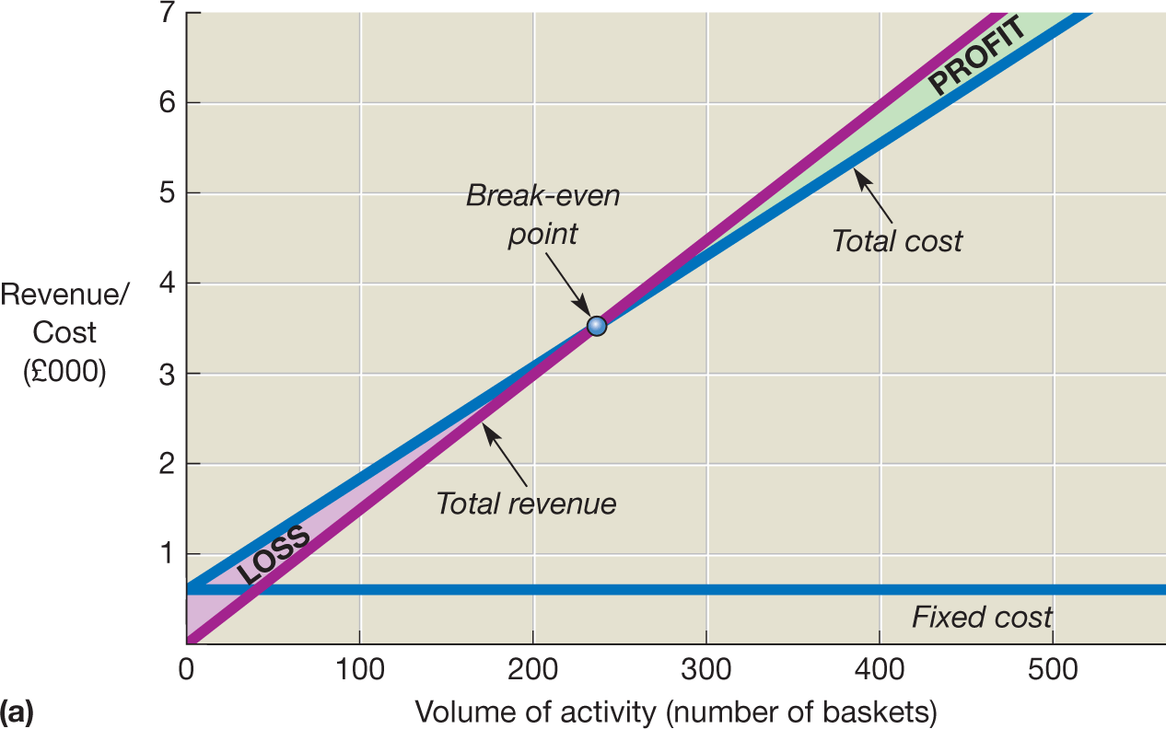
Figure 7.8a Break-even chart - low gearing

Slide 37
Figure 7.8b Break-even chart – high gearing
Revenue/Cost (£000)
PROFIT
6
Total
costs
5
Break-even
point
4
3
Fixed cost
2
LOSS
Total
revenue
1
0
100
200
300
400
500
600
Volume of activity (number of baskets)

Slide 38
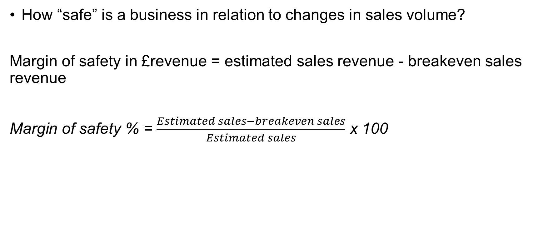
Margin of Safety
How “safe” is a business in relation to changes in sales volume?
Margin of safety in £revenue = estimated sales revenue - breakeven sales revenue
Margin of safety % = $\frac{Estimated sales−breakeven sales}{Estimated sales}$ x 100

Slide 39
Figure 7.9 Ryanair’s margin of safety
30
1600
29
29
1534
1460
1400
25
1200
22
1000
20
1043
Operating profit (in millions of euros)
Margin of safety (as a percentage of BEP)
17
800
15
15
718
600
659
10
400
5
200
0
2013
2014
2015
2016
2017
0
Margin of safety
Operating profit
Source: Derived from information contained in Ryanair Holdings plc 2013 Annual Report.

Slide 40
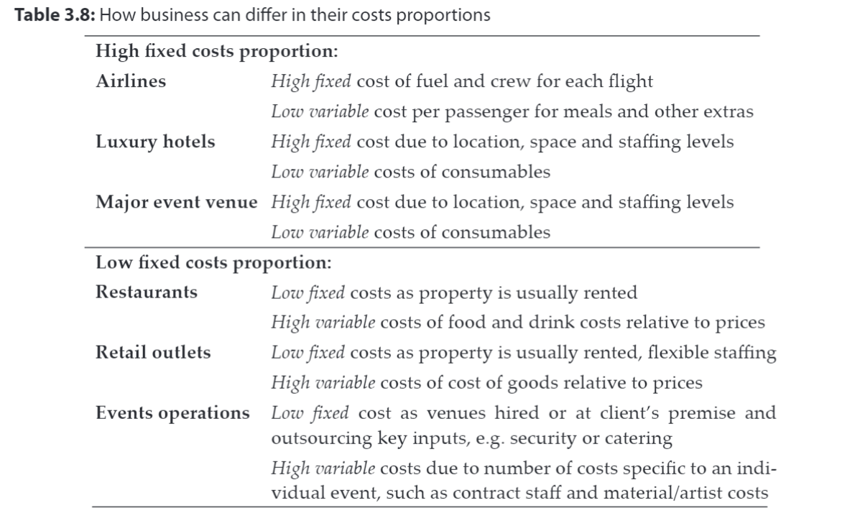
Examples of business with different gearing
Jones, T. (2012) Strategic managerial accounting: hospitality, tourism and events applications. Oxford, U.K.: Goodfellow p42

Slide 41
Weaknesses of break-even analysis
Three general problems
Non-linear relationships
Stepped fixed cost
Multi-product businesses

Slide 42
Decision making
Marginal cost – the cost of producing one more unit
Marginal analysis – only costs and revenues that vary with decision are considered, so fixed costs excluded.
Uses
Deciding whether to apply a discount to a particular order
Scare resources - calculate the contribution per unit
Deciding whether to buy a component or make in house
Considering whether to close departments

Slide 43

Why do we need to know the full cost of a product?

Slide 44
Figure 8.1 Uses of full cost by managers
Assessing relative efficiency
Pricing and output decisions
Uses of full cost
Exercising control
Assessing performance

Slide 45
Full costing
Earlier we looked top down:
Now we look bottom up:
Sales | X
Variable costs | (X)
Contribution to fixed costs | X
Direct costs | X
Allocation of indirect costs | X
Total cost of one unit | X

Slide 46
Direct and indirect cost
Categories of cost
Cost that can be identified with specific cost units – the effect of the cost can be measured in respect of each particular output
Direct cost
All other elements of cost, that is, those that cannot be directly measured in respect of each particular unit of output
Indirect cost or
overheads

Slide 47
Figure 8.2 Percentage of full cost contributed by direct and indirect cost
80
75
69
60
Percentage of full cost
49
51
40
31
20
25
0
All 176 businesses
Manufacturing businesses (91)
Service and retail businesses (85)
Direct cost
Indirect cost
Source: Al-Omiri, M. and Drury, C. (2007) ‘A survey of factors influencing the choice of product costing systems in UK organizations’, Management Accounting Research, December, pp. 399–424.

Slide 48
Figure 8.3 The relationship between direct cost and indirect cost
Direct cost of the job
Appropriate share of indirect cost (overheads)
Full cost of the job

Slide 49
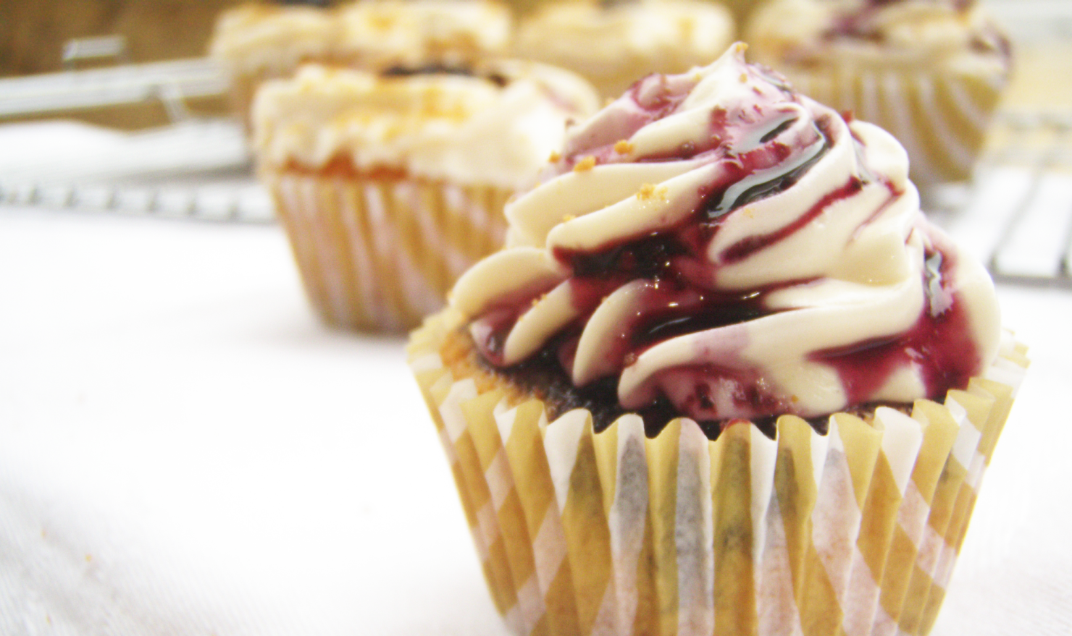
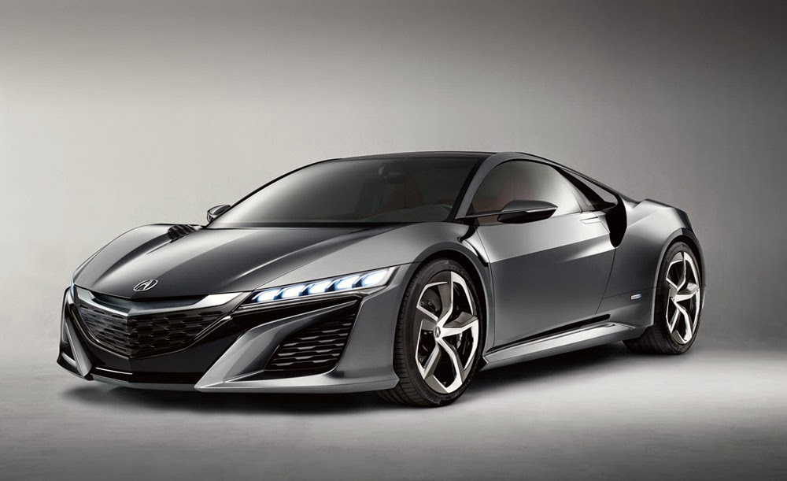
Why is this a problem?
If we produce one homogenous product (e.g. identical cupcakes) we could just split the overhead over units produced
E.g In my cupcake factory the overhead is £20,000 and I produce 10,000 cakes I could allocate £2 to every cake to determine price.
But if my factory produces cupcakes and cars and I produce 10,000 cakes and 500 cars with a total overhead of £500,000, is it fair to allocate £48 to each cupcake and each car?

Slide 50
Figure 8.5 The relationship between direct, indirect, variable and fixed costs of a particular job
Fixed cost
Variable cost
Indirect cost (overheads)
Total (or full) cost of a particular job
Direct cost

Slide 51
VARIABLE
FIXED
DIRECT (Traced to a product)
Raw materials; commissions
Some labour; rent for a production plant
Electricity for a whole factory
INDIRECT
Head office rent and salaries

Slide 52
Traditional full costing process
How do we assign an indirect cost to individual differing units?
Full costing sees overheads as a service to the end cost unit (e.g. factory overhead provides a service to the end product of keeping the machine operating, housing the product etc).
We need to choose something measurable on which to apportion the overhead
This could be
  Labour hours
  Machine hours
  Physical space
  Number of employees
  And so on…

Slide 53
Budgeting

Slide 54
Figure 9.1 The planning and control process
Establish mission and objectives
Undertake a position analysis
Identify and assess strategic options
Select strategic options and formulate
long-term (strategic) plans
Prepare budgets
Perform and collect information on actual performance
Identify variances between planned
(budgeted) and actual performance
Respond to variances and exercise control
Revise plans (and budgets) if necessary

Slide 55

Budgeting
  Plan the operations for the year – takes an organisational objective and quantifies it.
  Measure performance against targets (control)
  Coordination of different parts of the business
  Communicates expectations to unit managers
  Helps efficient allocation of resources
  Motivation to achieve organization’s goals
  Helps to control and authorize the ongoing activities
  Evaluate performance of individual managers

Slide 56
Figure 9.3 The interrelationship of operating budgets
Trade receivables budget
Cash budget
Trade payables budget
Capital expenditure budget
Direct labour budget
Raw materials purchases budget
Sales
budget
Overheads budget
Finished inventories budget
Raw materials inventories budget
Production budget

Slide 57
An example of a budget – the cash budget
Jan Feb Mar Apr May June
£000 £000 £000 £000 £000 £000
Receipts
Receivables 60 52 55 55 60 55
Payments
Payables (30) (30) (31) (26) (35) (31)
Salaries and wages (10) (10) (10) (10) (10) (10)
Electricity (14) (9)
Other overheads (2) (2) (2) (2) (2) (2)
Van purchase (11)
Total payments (42) (42) (68) (38) (47) (52)
Cash surplus 18 10 (13) 17 13 3
Opening balance 12 30 40 27 44 57
Cash balance 30 40 27 44 57 60

Slide 58
An example of the inventories budget
 | Jan £000 | Feb £000 | Mar £000 | Apr £000 | May £000 | June £000
Opening balance | 30 | 30 | 30 | 25 | 25 | 25
Purchases | 30 | 31 | 26 | 35 | 31 | 32
Inventories used | (30) | (31) | (31) | (35) | (31) | (32)
Closing balance | 30 | 30 | 25 | 25 | 25 | 25

Slide 59
Budget variances
 | Original budget | Actual
Output (production and sales) | 1,000 units | 900 units
 | £ | £
Sales revenue | 100,000 | 92,000
Direct materials | (40,000) | (36,900) (37,000m)
Direct labour | (20,000) | (17,500) (2,150 hr)
Fixed overheads | (20,000) | (20,700)
Operating profit | 20,000 | 16,900

Slide 60
Flexible budgets
A more valid comparison can be made between the budget (using the flexed figures) and the actual results.
 | Original budget | Flexed budget | Actual
Output (production and sales) | 1,000 units | 900 units | 900 units
 | £ | £ | £
Sales revenue | 100,000 | 90,000 | 92,000
Direct materials | (40,000) | (36,000) (36,000m) | (36,900) (37,000m)
Direct labour | (20,000) | (18,000) (2,250 hr) | (17,500) (2,150 hr)
Fixed overheads | (20,000) | (20,000) | (20,700)
Operating profit | 20,000 | 16,000 | 16,900

Slide 61
Figure 9.6 Relationship between the budgeted and
actual profit
Budgeted profit
plus
All favourable variances
minus
All adverse variances
equals
Actual profit

Slide 62
Behavioural issues of budgetary control
Budgets can improve job satisfaction and performance
Demanding, yet achievable, budget targets can motivate more than less demanding ones
Unrealistically demanding targets can adversely effect managers’ performance
Participation of managers in setting their targets can improve motivation and performance

Slide 63

Making Budgetary Control Effective
A serious attitude taken to the system.
Clear demarcation between areas of managerial responsibility.
Budget targets that are challenging yet achievable.
Established data collection, analysis and reporting routines.
Reports aimed at individual managers, rather than general-purpose documents.
Fairly short reporting periods.
Timely variance reports.
Action being taken to get operations back under control if they are shown to be out of control.

Slide 64
What’s Next…
7.30pm to 8.30pm – Review round 1 and prepare round 2.
8.30pm – Finish!
Next time:
Business Simulation round 2 submitted by 3pm Wednesday 14th December
Review Weblearn for extended learning questions
Read Atrill Ch 10
Consider: You run a business producing health food bars and selling them to supermarkets wholesale and customers online. What are the key elements of working capital management that you are concerned with?
"Buying goods on credit can be a good source of finance so it is good financial management practice to delay payment for as long as possible." Do you agree with this statement?

