Slide 1

MN7029 – Financial Decision Making
2.3 Working Capital Management

Slide 2

Lecture recordings
This session is being recorded
You can access the weekly recording from Weblearn
This Photo by Unknown Author is licensed under CC BY-SA

Slide 3

Learning Outcomes
Identify the main elements of working capital
Discuss the purpose of working capital and the nature of the working capital cycle
Explain the importance of establishing policies for the control of working capital
Explain the factors that have to be taken into account when managing each element of working capital

Slide 4
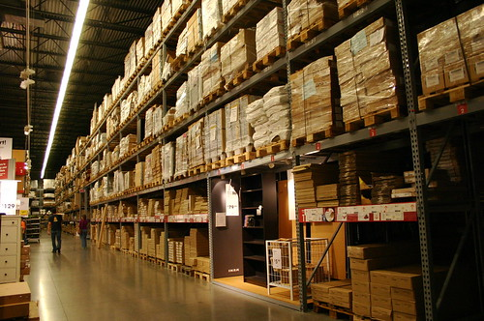
What are the components of working capital?

Slide 5
The nature and purpose of working capital
Major elements
Major elements
Inventories
Trade payables
Trade receivables
Bank overdrafts
Cash (in hand and at bank)
Working capital
Current assets
Current liabilities
equals
less

Slide 6
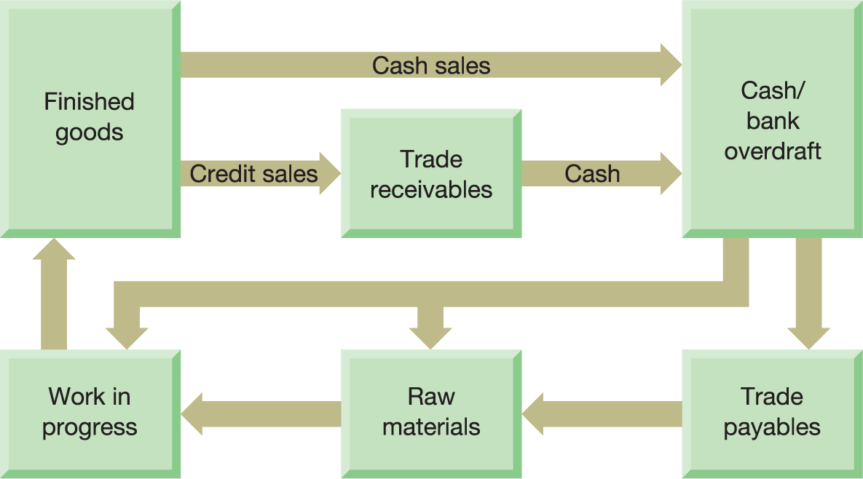
Figure 10.1 The working capital cycle
Notes:
Cash is used to pay trade payables for raw materials, or raw materials are bought for immediate cash settlement. Cash is also spent on labour and other items that turn raw materials into work in progress and, finally, into finished goods. The finished goods are sold to customers either for cash or on credit. In the case of credit customers, there will be a delay before the cash is received from the sales. Receipt of cash completes the cycle.

Slide 7
What can change amount or split of working capital?
Seasonality of business
Market demand
External economic factors
Changes in manufacturing technique
Interest rates
Change in attitude towards risk

Slide 8
Figure 10.2 Average investment (in days) for the main working capital elements
Trade receivables settlement period
Inventories turnover period
Trade payables settlement period
Days
80
70
68.0
67.7
60.4
62.9
58.9
58.2
60
56.4
58.8
51.9
51.8
53.1
54.0
47.9
48.1
50
41.0
40
30
20
10
2013
2014
2015
2016
2017
2013
2014
2015
2016
2017
2013
2014
2015
2016
2017
0
Source: Compiled from information in ‘Navigating uncertainty: PwC's annual global working capital study’, 2018/19, www.pwc.com.

Slide 9



Inventories
Opportunity cost
Finance cost
Storage and handling
Order costs
Obsolescence
Lost sales
Goodwill
Lost production

Slide 10
Inventories financing cost
Business | Type of operations | Cost of capital | Average inventories held | Financing cost of holding inventories | Operating profit/ (loss) | Financing cost as % of operating profit/(loss)
 |  | (a) | (b) | (a) × (b)
 |  | % |  |  |  | %
Associated British Foods | Food producer | 14.2 | £2,144m | £304.4m | £1,404m | 21.7
BT Group | Telecoms | 8.4 | £233m | £19.5m | £20,342m | 0.1
Go-Ahead | Transport | 5.2 | £17m | £0.9m | £161m | 0.6
Kingfisher | DIY | 10.1 | £2,437m | £246.1m | £685m | 35.9
Tesco | Supermarket | 9.5 | £2,282m | £216.8m | £1,837m | 11.8
Source: Annual reports of the businesses for the years ended during 2018.

Slide 11
Managing inventories
Procedures and techniques that can be used to ensure the proper management of inventories
Forecasting future demand
Financial ratios
Recording and reordering systems
Levels of control
Inventories management models
Enterprise resource planning (ERP) system
Just-in-time (JIT) inventories management

Slide 12

1. Forecasting future demand

Slide 13
2. Financial ratios
Average inventories turnover period
=
Average inventories held Cost of sales
× 365

Slide 14

3. Recording and reordering systems
Checks and procedures
Authorisation
Buffers
Lead time

Slide 15
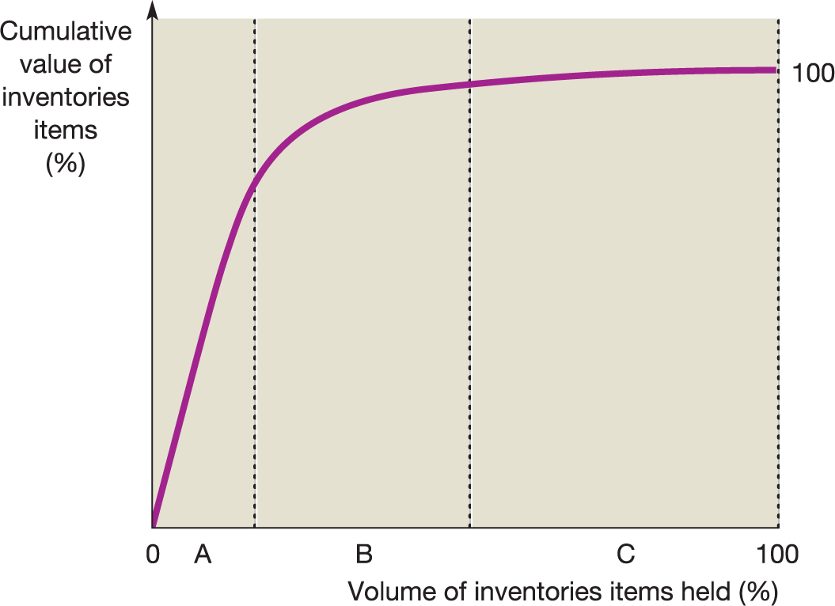
4. Levels of Control
Figure 10.4 ABC method of analysing and controlling inventories
Notes:
Category A contains inventories that, though relatively few in quantity, account for a large proportion of the total value. Category B inventories consist of those items that are less valuable but more numerous. Category C comprises those inventories items that are very numerous but relatively low in value. Different inventories’ control rules would be applied to each category. For example, only Category A inventories would attract the more expensive and sophisticated
controls.

Slide 16
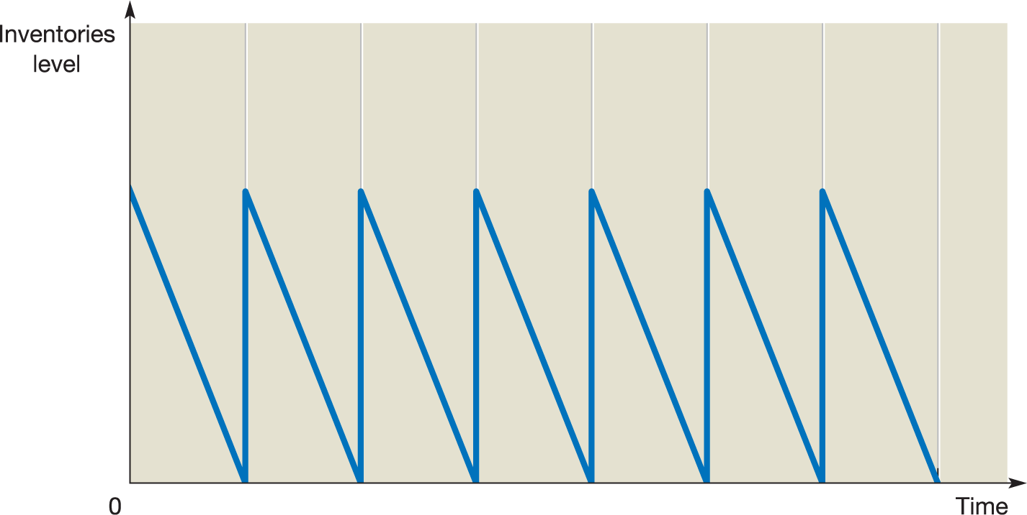
5. Inventories Management Models
Figure 10.5 Patterns of inventories movements over time
Notes:
Here, we assume that there is a constant rate of usage of the inventories item and that inventories are reduced to 0 just as new inventories arrive. At time 0, there is a full level of inventories. This is steadily used as time passes and just as it falls to 0 it is replaced. This pattern is then repeated.

Slide 17
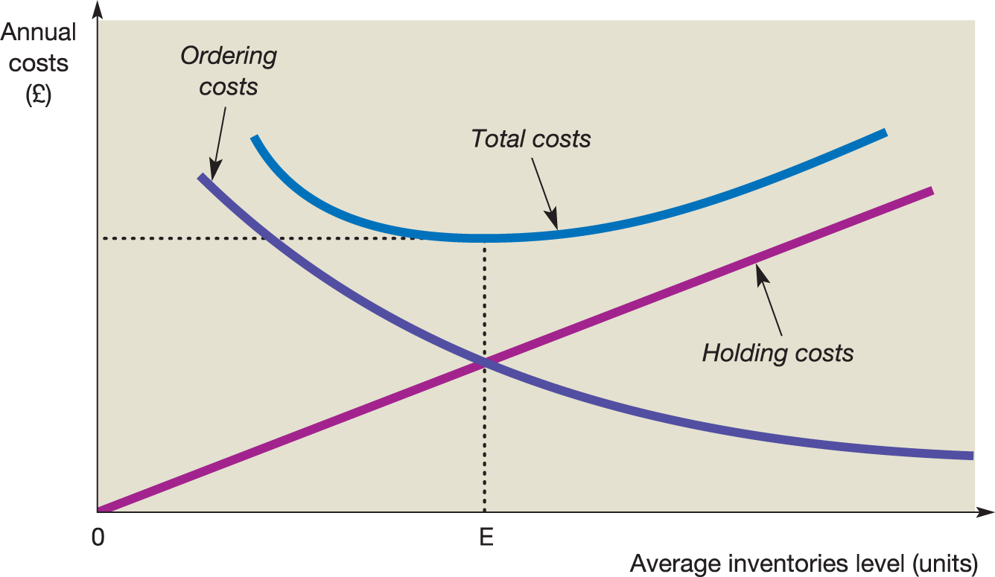
5. Inventories Management Models
Figure 10.6 Inventories holding and order costs
Notes:
Small inventories levels imply frequent reordering and high annual ordering costs. Small inventories levels also imply relatively low inventories holding costs. High inventories levels imply exactly the opposite. There is, in theory, an optimum order size that will lead to the sum of ordering and holding costs (total costs) being at a minimum.

Slide 18
The economic order quantity (EOQ) model
=
2DC
EOQ
H
Where:
D = the annual demand for the
inventories item (expressed in
units of the inventory item);
C = the cost of placing an order;
H = the cost of holding one unit of
the inventories item for one year

Slide 19

6. Enterprise Resource Planning Systems
Integrated software systems
Can manage inventory, logistics, pricing
Can be very expensive

Slide 20
7. Just-in-time inventories management
Requires close relationship with suppliers
May require re-engineering production process
May result in hidden costs (taking advantage of cheap sources of supply)
Can be seen as part of TQM approach

Slide 21

Toyota Production System (https://www.youtube.com/watch?v=nFu4FFgbMY4&t=1s)

Slide 22
Figure 10.7 Patterns of inventories demand
Category X
Category Y
Category Z
Demand (units)
Jan
Feb
Mar
Apr
May
June
July
Aug
Sept
Oct
Nov
Dec

Slide 23
Managing trade receivables
Questions to ask
Which customers should receive credit
How much credit should be offered
What length of credit it is prepared to offer
Whether discounts will be offered for prompt payment
What collection policies should be adopted
How the risk of non-payment can be reduced

Slide 24

What might you look at to determine whether you will offer credit to a particular customer?

Slide 25
Managing trade receivables
Questions to ask
Which customers should receive credit
How much credit should be offered
What length of credit it is prepared to offer
Whether discounts will be offered for prompt payment
What collection policies should be adopted
How the risk of non-payment can be reduced

Slide 26
Which customers should receive credit?
The five Cs of credit
Capital
Capacity
Collateral
Conditions
Character

Slide 27
Sources of credit information
Trade references
Bank references
Published financial statements
The customer
Credit agencies
Register of County Court Judgements
Other suppliers

Slide 28
Length of credit period
May be influenced by:
The typical credit terms operating within the industry
The degree of competition within the industry
The bargaining power of particular customers
The risk of non-payment
The capacity of the business to offer credit
The marketing strategy of the business

Slide 29
Collection policies
Develop customer relationships
Publicise credit terms
Issue invoices promptly
Monitor outstanding debts
Produce an ageing schedule of receivables
Answer queries quickly
Deal with slow payers

Slide 30
Financial ratios
Average settlement period for trade receivables
=
Average trade receivables
Credit sales
× 365

Slide 31
Financial ratios (Continued)
Trade receivables to sales
=
Trade receivables outstanding
Sales revenue for period
× 365

Slide 32
Ageing schedule of trade receivables at 31 December
Customer |  | Days | outstanding |  | Total
 | 1 to 30 days | 31 to 60 days | 61 to 90 days | More than 90 days
 | £ | £ | £ | £ | £
A Ltd | 12,000 | 13,000 | 14,000 | 18,000 | 57,000
B Ltd | 20,000 | 10,000 | - | - | 30,000
C Ltd | - | 24,000 | - | - | 24,000
Total | 32,000 | 47,000 | 14,000 | 18,000 | 111,000

Slide 33
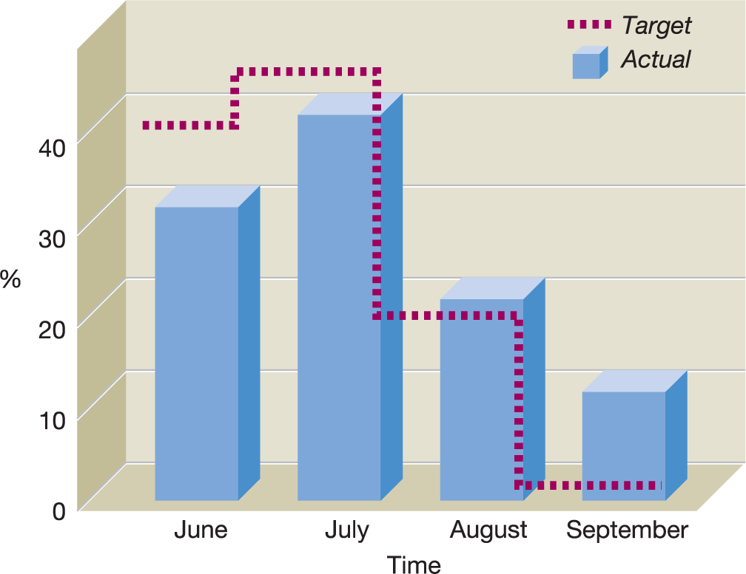
Figure 10.9 Comparison of actual and expected (target)
receipts over time for Example 10.5
Notes:
It can be seen that 30 per cent of the sales income for June is received in that month; the remainder is received in the following three months. The expected (target) pattern of cash receipts for June sales, which has been assumed, is also depicted. By comparing the actual and expected pattern of receipts, it is possible to see whether credit sales are being properly controlled and to decide whether corrective action is required.

Slide 34

Why does a business hold cash?
Should it hold as much cash as possible?

Slide 35
Why hold cash?
There are three reasons:
To meet day-to-day commitments
To deal with uncertain cash flows
To exploit profitable opportunities

Slide 36
Factors influencing the amount of cash held
Possible factors may include:
The nature of the business
The opportunity cost of holding cash
The level of inflation
The availability of near-liquid assets
The availability of borrowing
The cost of borrowing
Economic conditions
Relationships with suppliers

Slide 37
Managing cash
Main techniques
Controlling the cash balance (using control limits)
Preparing projected cash flow statements
Managing the operating cash cycle

Slide 38
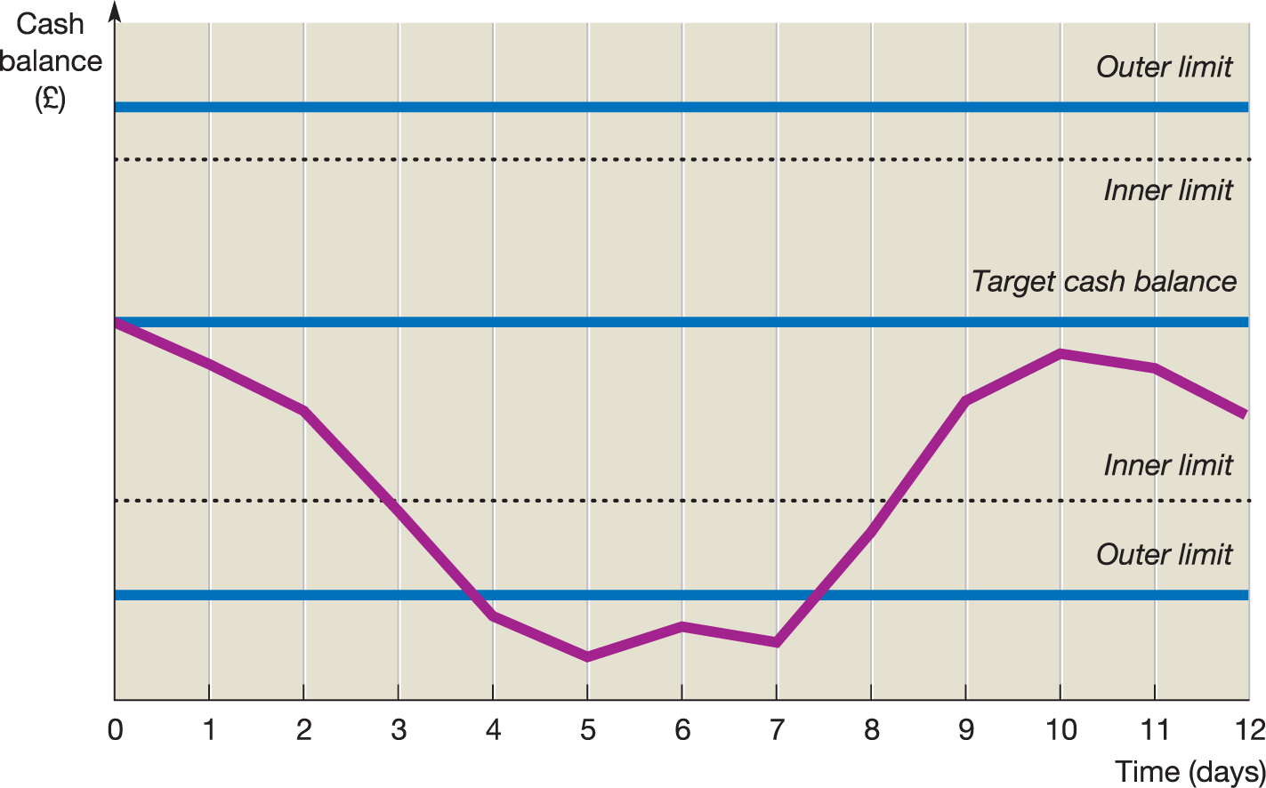
Figure 10.10 Controlling the cash balance
Notes:
Management sets the upper and lower limits for the business’s cash balance. When the balance goes beyond either of these limits, unless it is clear that the balance will return fairly quickly to within the limit, action will need to be taken. If the upper limit is breached, some cash will be placed on deposit or used to buy some marketable securities. If the lower limit is breached, the business will need to borrow some cash or sell some securities.

Slide 39
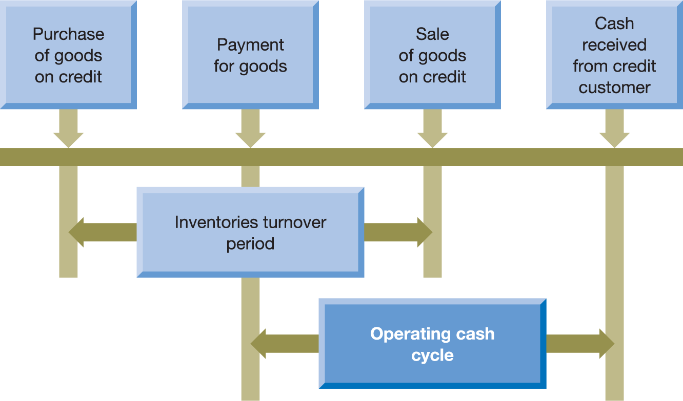
Figure 10.11 The operating cash cycle
Notes:
The OCC is the time lapse between paying for goods and receiving the cash from the sale of those goods. The length of the OCC has a significant impact on the amount of funds that the business needs to apply to working capital.

Slide 40
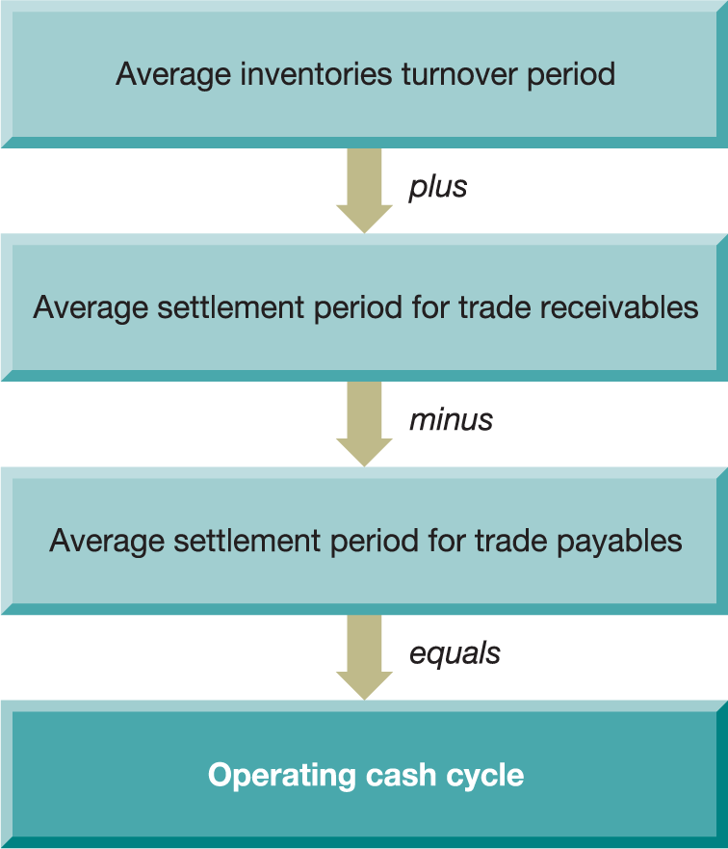
Figure 10.12 Calculating the operating cash cycle
Notes:
For businesses that buy and sell on credit, three ratios are required to calculate the OCC.

Slide 41
Figure 10.13 The average OCC of businesses
categorised according to size
100
85
88
88
84
80
80
66
68
69
67
67
Net working capital days
60
41
40
41
42
42
40
20
0
2013
2014
2015
2016
2017
Revenues <€500m
Revenues between
€500m and €1bn
Revenues >€1bn
Source: Compiled from information in ‘Navigating uncertainty: PwC's annual global working capital study’, 2018/19, www.wpc.com, p. 17.

Slide 42
Managing Trade Payables
Remember – one business’s trade receivable is another business’s trade payable…
Admin expenses of tracking payables dates;
Goodwill;
Prompt payments discounts – the other side;
Monitor through average settlement period for trade payables.

Slide 43

Discussion question
How might each of these affect levels of inventory held by a business?
Increase in number of production bottlenecks
Rise in business cost of capital
Decision to offer a narrower range of products
A switch of suppliers from overseas to local
Deterioration in quality and reliability of bought in components.

Slide 44
What’s Next…
7.30pm 8.30pm – Business Simulation Round 3
8.30pm – Finish!
For next time:
Business Simulation round 3 submitted by 3pm Friday 16th December
Business Simulation round 4 submitted by 3pm Sunday 8th January 2023
Assessment 1 – Thursday 12th January 2022
Review Weblearn for extended learning questions
Read Atrill Ch 4&5
Consider: In respect of a business you have worked in or know well, can you think of significant capital investment decisions that company has had to make?

Slide 45

Have a lovely break!
This Photo by Unknown Author is licensed under CC BY-SA

