Slide 1

MN7029 – Financial Decision Making
Welcome to Week 2.1!

Slide 2

Lecture recordings
This session is being recorded
You can access the weekly recording from Weblearn
This Photo by Unknown Author is licensed under CC BY-SA

Slide 3

Learning Outcomes
Look for clues in a company's financial statements about performance
Identify and calculate major ratios used for assessing financial performance
Discuss the use and limitations of such financial ratios.

Slide 4
Interpreting financial performance
 | Yr 1 | Yr 2 | Yr 3 | Yr 4 | Yr 5 | Yr 6
Sales | 50,000 | 100,000 | 120,000 | 150,000 | 180,000 | 210,000
Cost of sales | 25,000 | 40,000 | 55,000 | 82,000 | 100,000 | 120,000
Profit | 25,000 | 60,000 | 65,000 | 68,000 | 80,000 | 90,000
What can you tell me about this company’s performance?

Slide 5
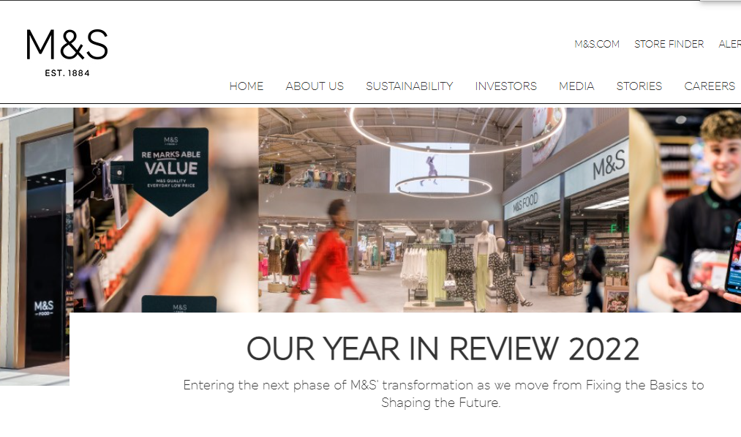

Consider the following….
In 2022 Marks & Spencer made £10.9bn in revenue and £391.7m in profit before tax
In 2021 Boden made £256m in revenue and £14m in profit
Which company is performing better?

Slide 6
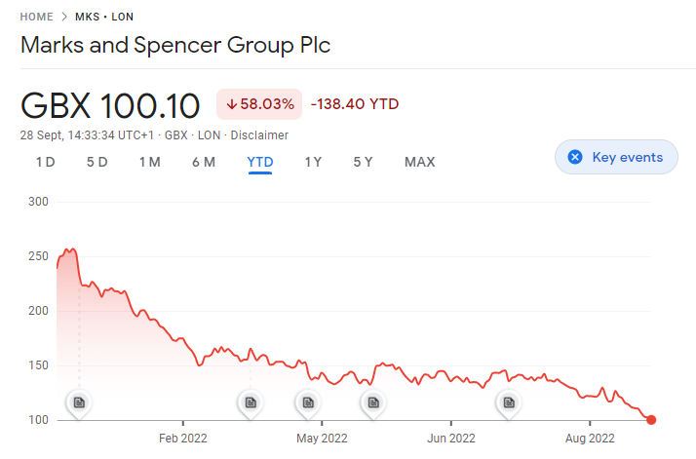
Consider the following….
How about if I told you in 2-21 M&S made £9.2bn in revenue and a loss of £209m and 2019 Boden made £295m in revenue and a profit of £14m?
Or showed you this graph of M&S share price over the last year?

Slide 7
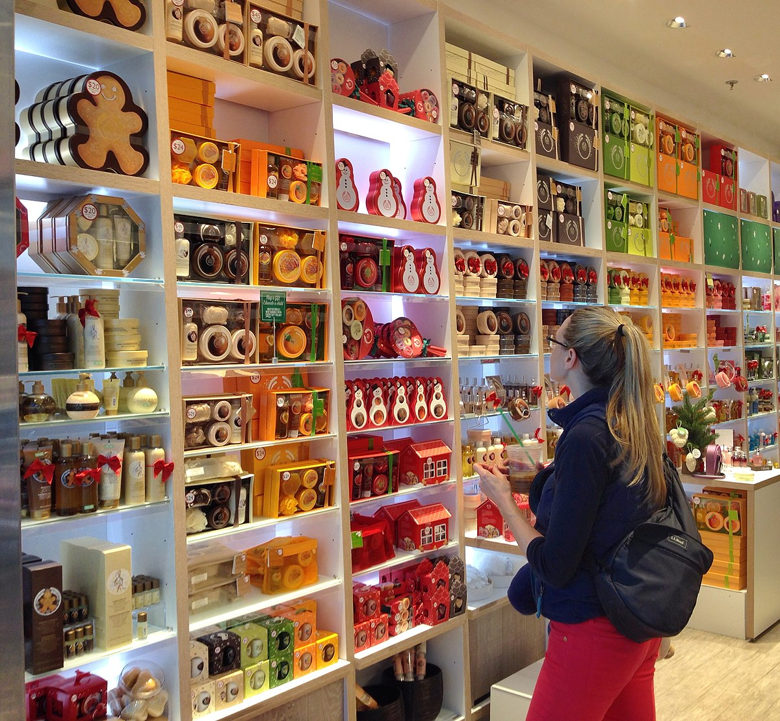

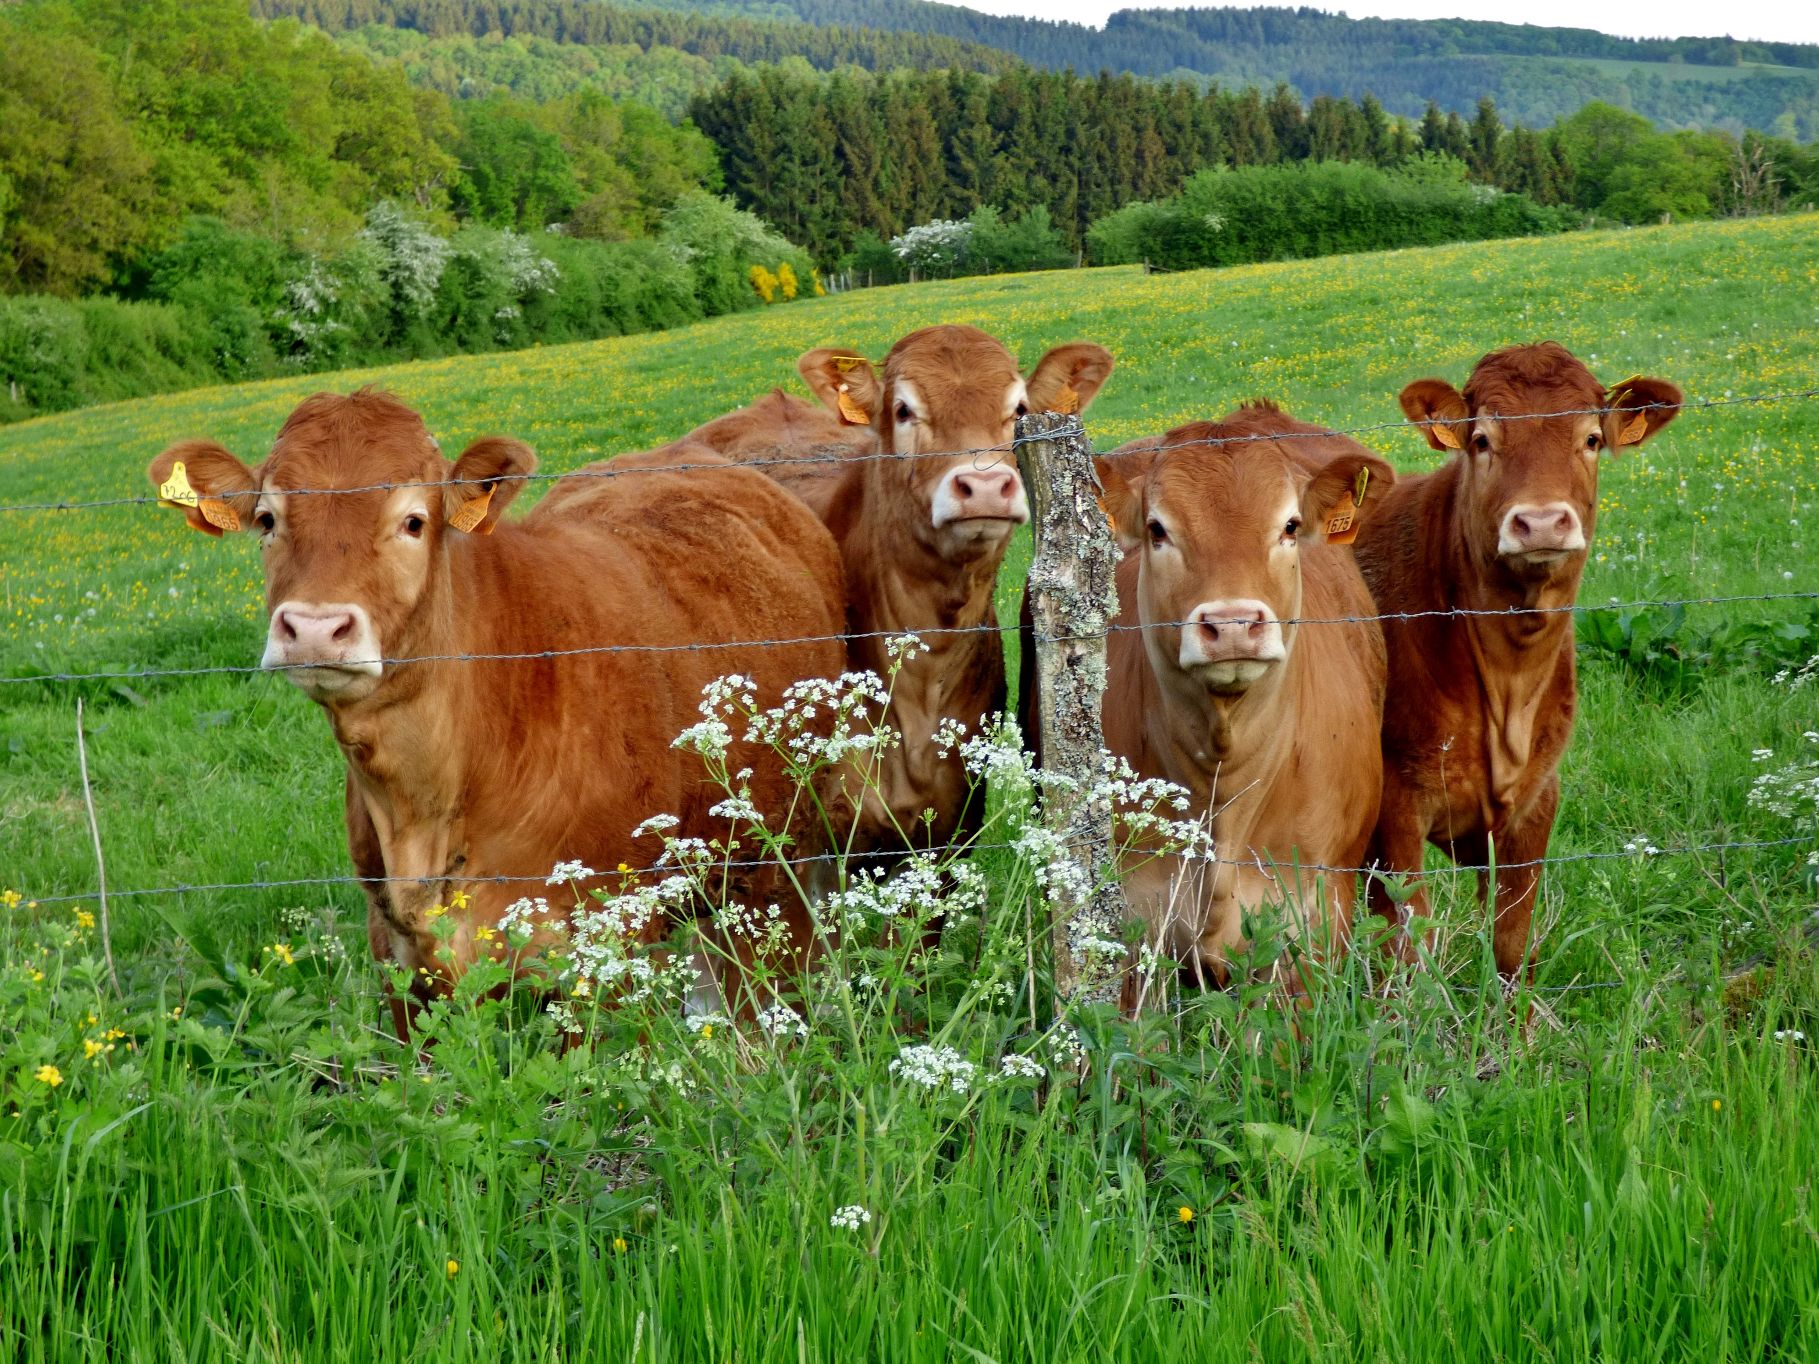

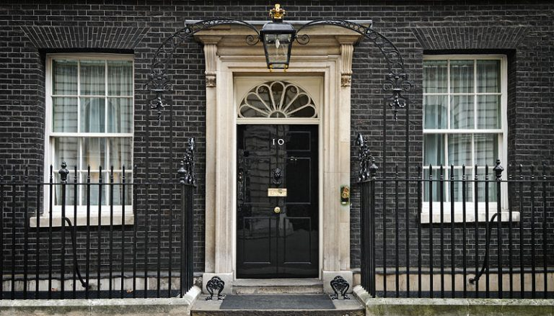
We learned in Session 2 that different groups of people use financial information for different reasons…

Slide 8
Interpreting financial performance
 | Yr 1 | Yr 2 | Yr 3 | Yr 4 | Yr 5 | Yr 6
Sales | 50,000 | 80,000 | 120,000 | 150,000 | 180,000 | 210,000
 |  | 60% | 50% | 25% | 20% | 17%
Cost of sales | 25,000 | 40,000 | 55,000 | 82,000 | 100,000 | 120,000
 |  | 60% | 37.5% | 49% | 22% | 20%
Profit | 25,000 | 40,000 | 65,000 | 68,000 | 80,000 | 90,000
 |  | 60% | 62.5% | 5% | 18% | 12.5%
What can you tell me about this company’s performance now?

Slide 9
Types of financial analysis
Scanning
Trend analysis
Common sized statements
Financial ratios

Slide 10
Financial Ratios
A ratio relates one figure in the financial statements to another (e.g. operating profit compared to sales revenue).
Means of assessing health of the company.
Comparison tools e.g. between periods or companies.
Eliminate the problem of scale.
Identify strength/weaknesses but do not explain them.
Ensure they are meaningful relationships.
Variations in choice and calculation.

Slide 11
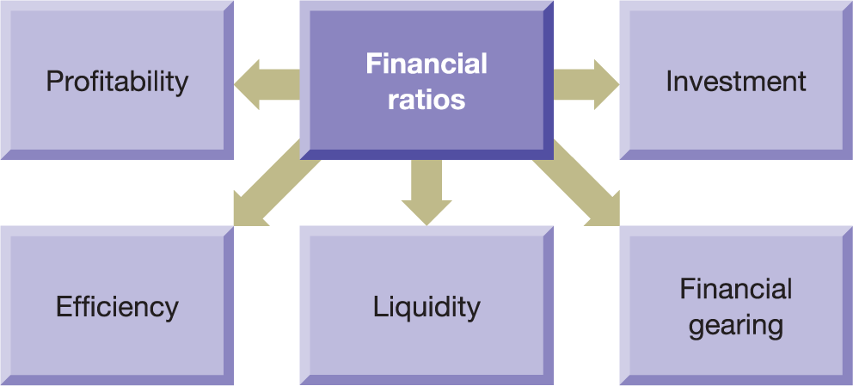
Figure 3.1 The key aspects of financial health

Slide 12
Categories of Ratio
Profitability – indication of how well company is generating profit or wealth for shareholders.
Efficiency (or activity) – how well the particular resources e.g. inventory have been used in the business.
Liquidity – relationship between liquid resources and what is due to be paid.
Financial gearing – relationship between shareholder capital and borrowing.
Investment – measuring return and performance of shares

Slide 13
Historical and Projected Financial Statement Users
Current/potential investors
Employees
Lenders
Suppliers
Customers
Government and regulators
The public
Management
Ratios
Profitability – indication of how well company is generating profit or wealth for shareholders.
Efficiency (or activity) – how well the particular resources e.g. inventory have been used in the business.
Liquidity – relationship between liquid resources and what is due to be paid.
Financial gearing – relationship between shareholder capital and borrowing.
Investment – measuring return and performance of shares

Slide 14
Comparison with what?
Past periods
  Improvement/deterioration in performance;
  Long term trends;
  But may not expose inefficiencies in comparison to other businesses;
  Does not consider trading conditions.
Similar businesses
  Compare efficiency to competitors;
  But may be differences in accounting policies;
  May not be able to get the information or sufficiently useful breakdown.
Planned performance
  Helps to set budgets and track achievement.

Slide 15
Calculating the ratios
Please have p94 Financial Management for Decision Making (9th edn) open (p87 in 8th edn).
Financial statements relating to Alexis Plc.

Slide 16
Profitability ratios
Return on ordinary shareholders’ funds (ROSF)
Profit for the year less any preference dividend
Ordinary share capital + Reserves
× 100
Return on capital employed (ROCE)
Operating profit
Share capital + Reserves + Non-current liabilities
× 100
Operating profit margin
Operating profit
Sales revenue
× 100
Gross profit margin
Gross profit
Sales revenue
× 100

Slide 17
Operating/Gross profit margin
Operating profit margin relates the profit to the sales revenue (notice that this ratio compares two income statement items).
Operating profit is used as it excludes financing costs but includes all general costs of running the business.
This ratio varies according to type of business e.g. supermarket versus jeweller.
Businesses often use target operating margins in budgets.
Gross profit margin relates the gross profit to the sales revenue (again this ratio compares two income statement items).
Measures profitability in producing goods before other general expenses.

Slide 18
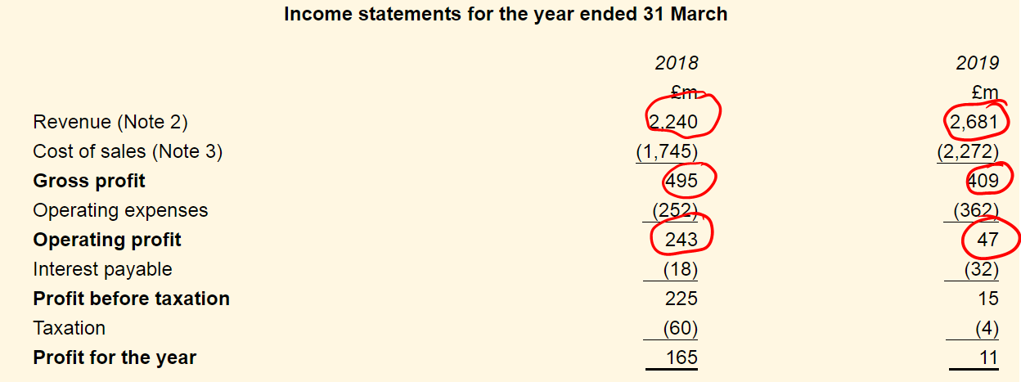
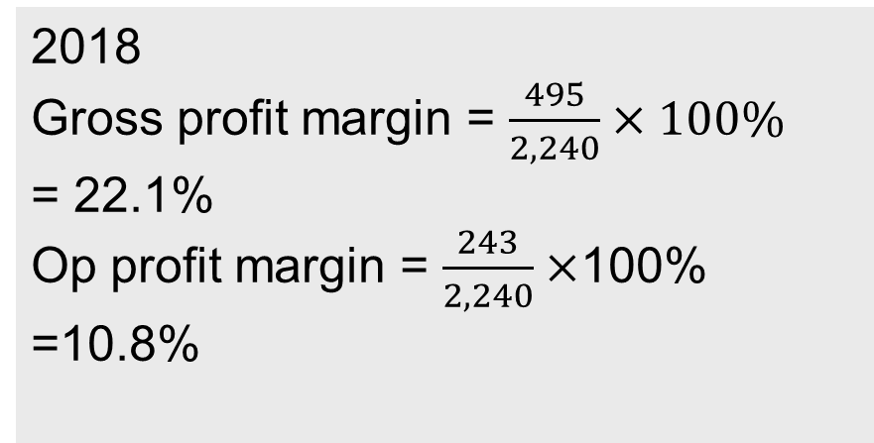
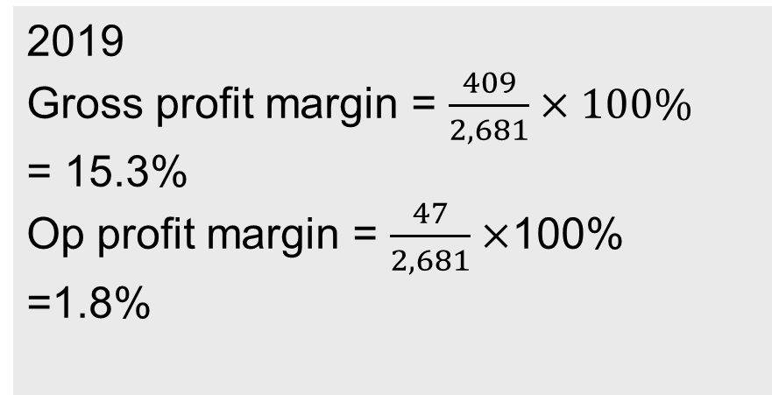
2018
Gross profit margin = $\frac{495}{2,240}×100\%$
= 22.1%
Op profit margin = $\frac{243}{2,240}×$100%
=10.8%
2019
Gross profit margin = $\frac{409}{2,681}×100\%$
= 15.3%
Op profit margin = $\frac{47}{2,681}×$100%
=1.8%

Slide 19
Return on Ordinary Shareholders’ Funds
Return on ordinary shareholders funds ratio (ROSF) compares the profit for the year with the owners’ average stake in the business.
An average figure is used for shareholder funds as it should be more representative but you may need to rely on year end if that is not available;
Business seek to generate as high as possible value for ROSF.

Slide 20
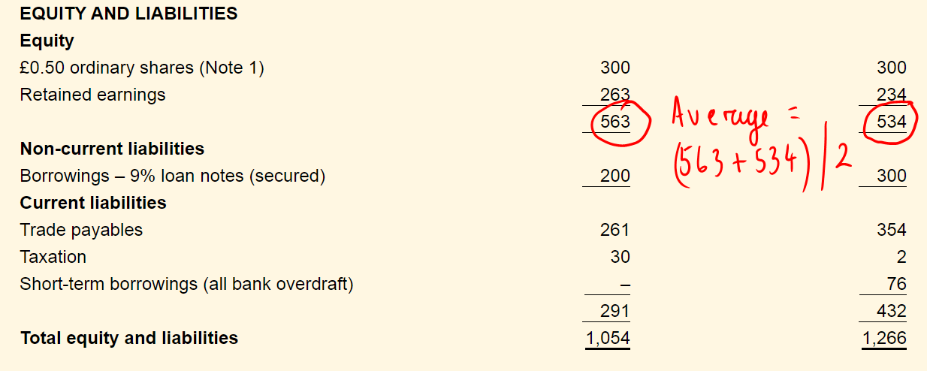
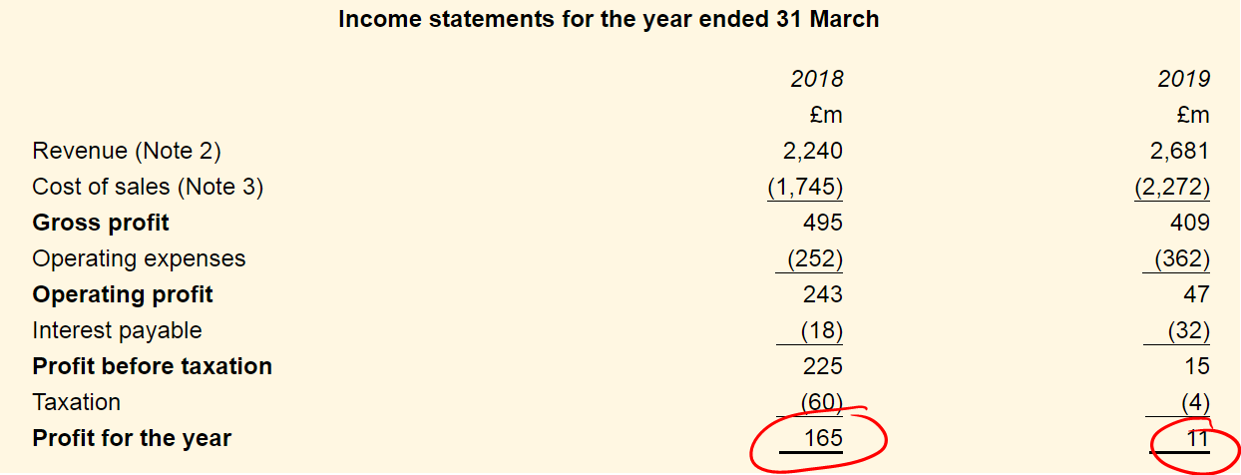
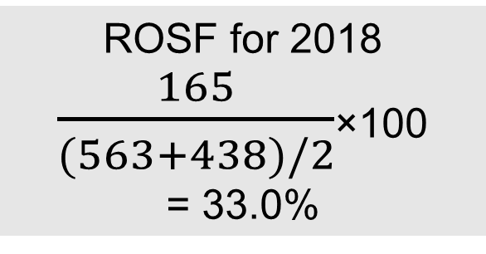
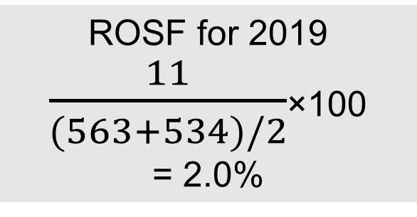
ROSF for 2019
$\frac{11}{(563+534)/2}$×100
= 2.0%
ROSF for 2018
$\frac{165}{(563+438)/2}$×100
= 33.0%

Slide 21
Return on Capital Employed
Return on Capital Employed (ROCE) compares the operating profit for the year with the average long term capital (so shareholder funds and long term loans).
We use Profit Before Interest and Tax as the top figure as this ratio is looking at the return to everyone before deductions of financing interest.
Again, an average figure is used for shareholder funds as it should be more representative but you may need to rely on year end if that is not available;
An important ratio as it compares inputs through capital with outputs (operating profit).

Slide 22
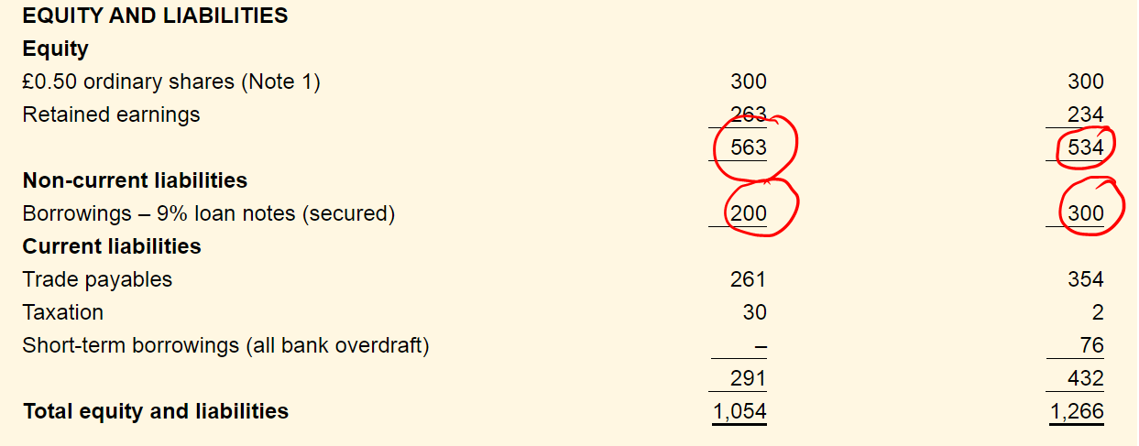
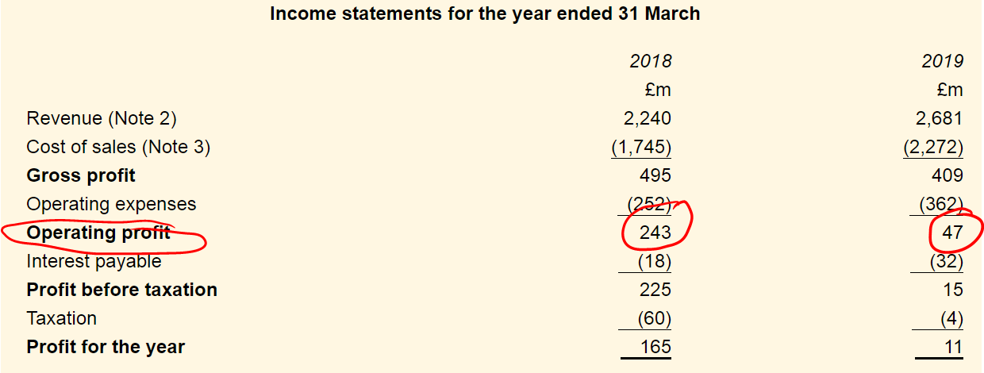
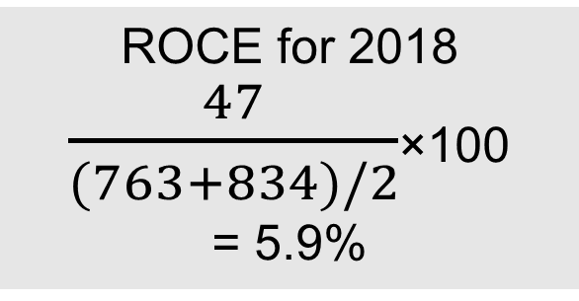
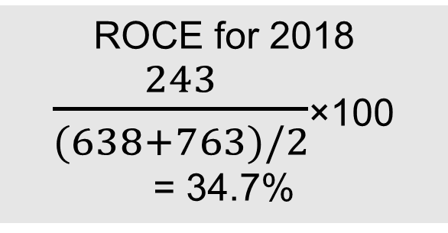
ROCE for 2018
$\frac{47}{(763+834)/2}$×100
= 5.9%
ROCE for 2018
$\frac{243}{(638+763)/2}$×100
= 34.7%

Slide 23
Profitability Summary
 | 2018 | 2019
ROSF | 33% | 2%
ROCE | 34.7% | 5.9%
Gross Profit Margin | 22.1% | 15.3%
Operating Profit Margin | 10.8% | 1.8%
Overall profitability indicators have declined quite severely
Both gross and operating profits declined, but operating profit declined proportionately more – what has caused increase in operating expenses? Could it be due to increasing employee numbers?
Revenue has increased, but cost of sales proportionately more – again what has caused this?

Slide 24
Efficiency ratios
Formula
Average inventories turnover period
Average inventories held
Cost of sales
× 365
Average settlement period
for trade receivables
Average trade receivables
Credit sales revenue
× 365
Average settlement period for trade payables
Average trade payables
Credit purchases
× 365
Sales revenue to
capital employed
Sales revenue________________
Share capital + Reserves + Non-current liabilities
Sales revenue per employee
Sales revenue
Number of employees

Slide 25
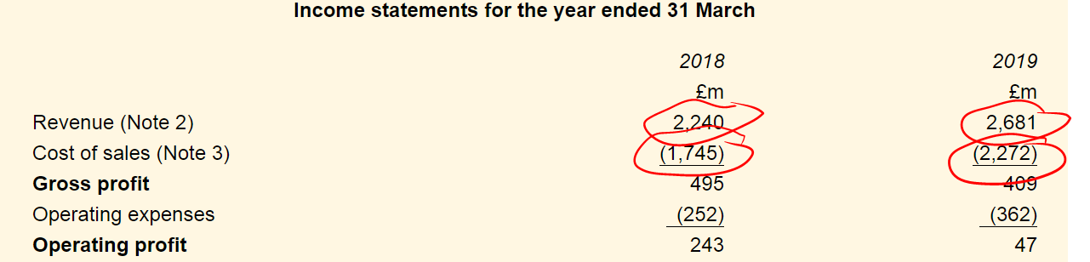
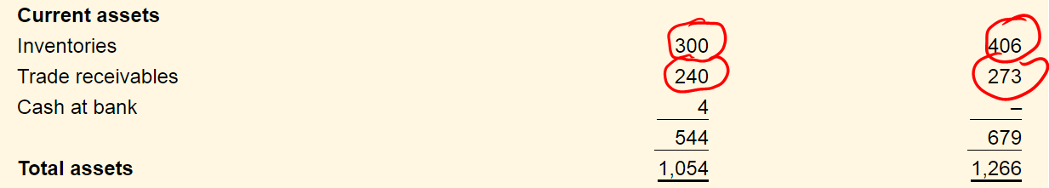
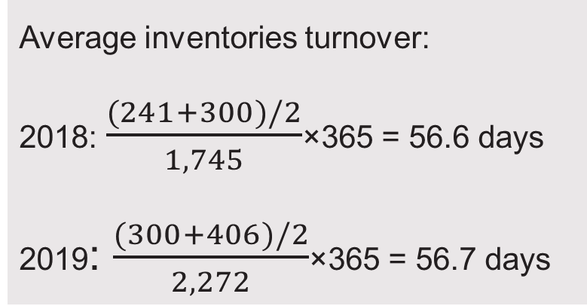
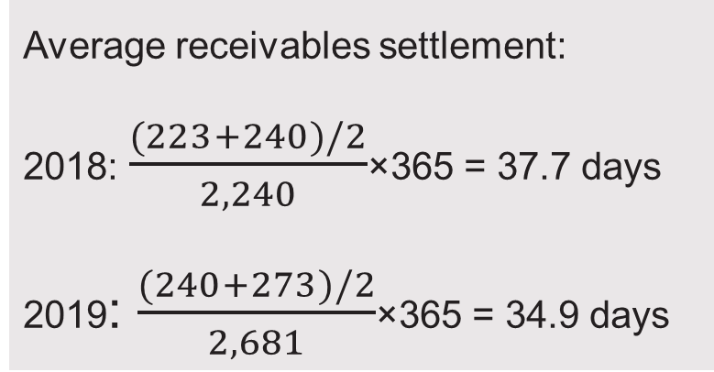
Average inventories turnover:
2018: $\frac{(241+300)/2}{1,745}$×365 = 56.6 days
2019: $\frac{(300+406)/2}{2,272}$×365 = 56.7 days
Average receivables settlement:
2018: $\frac{(223+240)/2}{2,240}$×365 = 37.7 days
2019: $\frac{(240+273)/2}{2,681}$×365 = 34.9 days

Slide 26
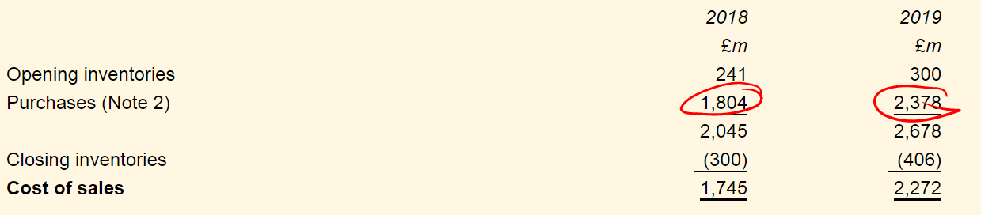
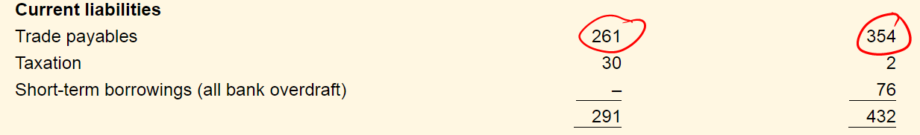
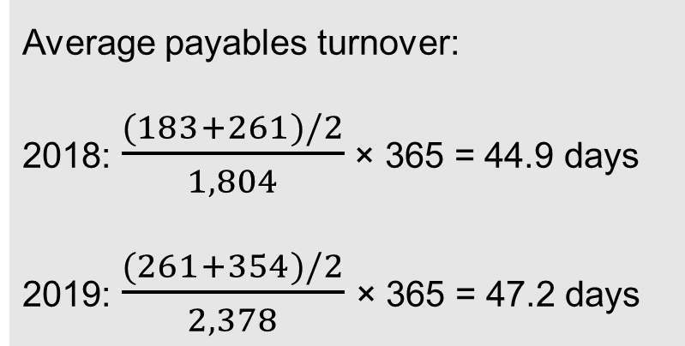
Average payables turnover:
2018: $\frac{(183+261)/2}{1,804}$ × 365 = 44.9 days
2019: $\frac{(261+354)/2}{2,378}$× 365 = 47.2 days

Slide 27
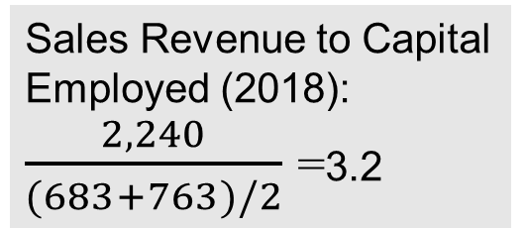
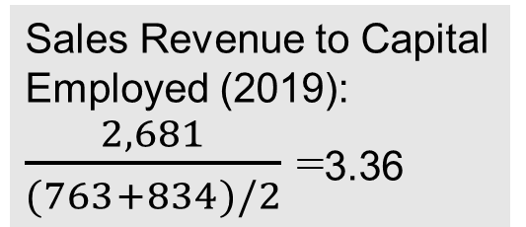
Sales Revenue to Capital Employed (2019): $\frac{2,681}{(763+834)/2}$ =3.36
Sales Revenue to Capital Employed (2018): $\frac{2,240}{(683+763)/2}$ =3.2

Slide 28
Summary of Efficiency Ratios
 | 2018 | 2019
Average inventories turnover period | 56.6 days | 56.7 days
Average settlement period for trade receivables | 37.7 days | 34.9 days
Average settlement period for trade payables | 44.9 days | 47.2 days
Sales revenue to capital employed (net asset turnover) | 3.20 times | 3.36 times
Sales revenue per employee | £160,057 | £143,962

Slide 29
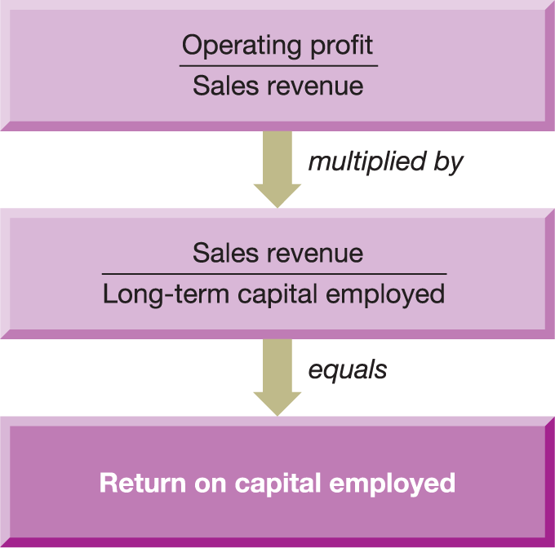
Figure 3.6 The main elements of the ROCE ratio
Operating profit margin ratio
Sales revenue to capital employed
Operating profit/Long term capital
Source: Atrill, P. and McLaney, E. (2010) Accounting and Finance for Non-specialists, 7th edn, Pearson Education.

Slide 30
Liquidity ratios
Formula
Current assets
Current liabilities
Current ratio
Acid test ratio
Current assets (excluding inventories) Current liabilities

Slide 31
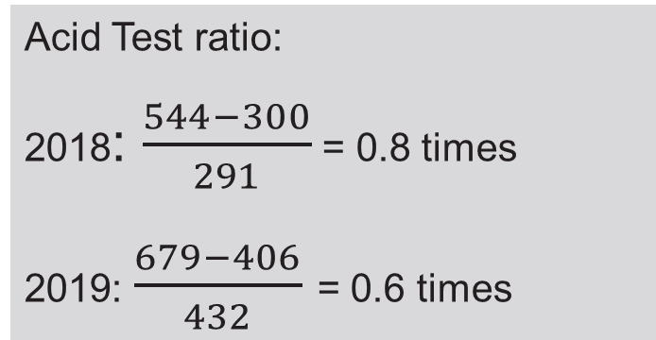
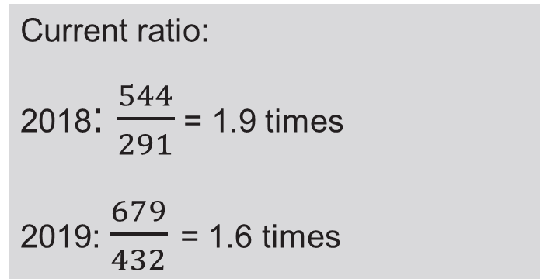
Current ratio:
2018: $\frac{544}{291}$ = 1.9 times
2019: $\frac{679}{432}$ = 1.6 times
Acid Test ratio:
2018: $\frac{544−300}{291}$ = 0.8 times
2019: $\frac{679−406}{432}$ = 0.6 times

Slide 32
Gearing ratios
Formula
Gearing ratio
Long-term (non-current) liabilities
Share capital + Reserves + Long-term (non-current) liabilities
× 100
Interest cover ratio
Operating profit
Interest payable

Slide 33
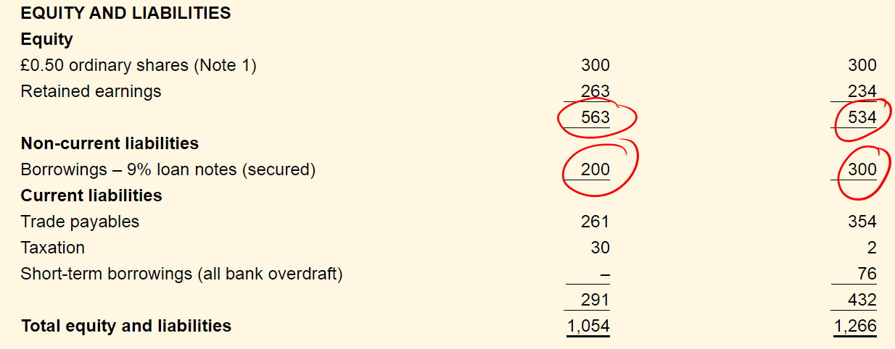
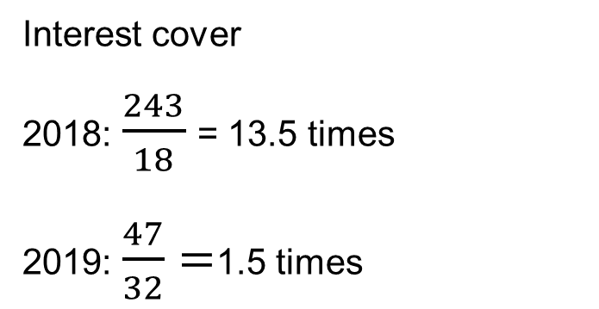
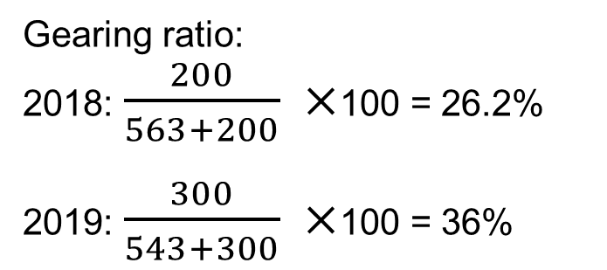
Interest cover
2018: $\frac{243}{18}$= 13.5 times
2019: $\frac{47}{32}=$1.5 times
Gearing ratio:
2018: $\frac{200}{563+200} ×$100 = 26.2%
2019: $\frac{300}{543+300} ×$100 = 36%

Slide 34
Investment ratios
Formula
Dividend payout ratio
Dividends announced for the year
Earnings for the year available for dividends
× 100
Dividend cover ratio
Earnings for the year available for dividends
Dividends announced for the year
Dividend yield ratio
Dividend per share
Market value per share
× 100

Slide 35
Investment ratios (Continued)
Formula
Earnings per share
Earnings available to ordinary shareholders
Number of ordinary shares in issue
Price/earnings ratio (P/E)
Market value per share Earnings per share

Slide 36

What is a dividend?
A payment to shareholders out of retained profit
Decided by directors
Directors may choose to keep profit in the business for growth
Shareholders
Company X
Management
Employees

Slide 37
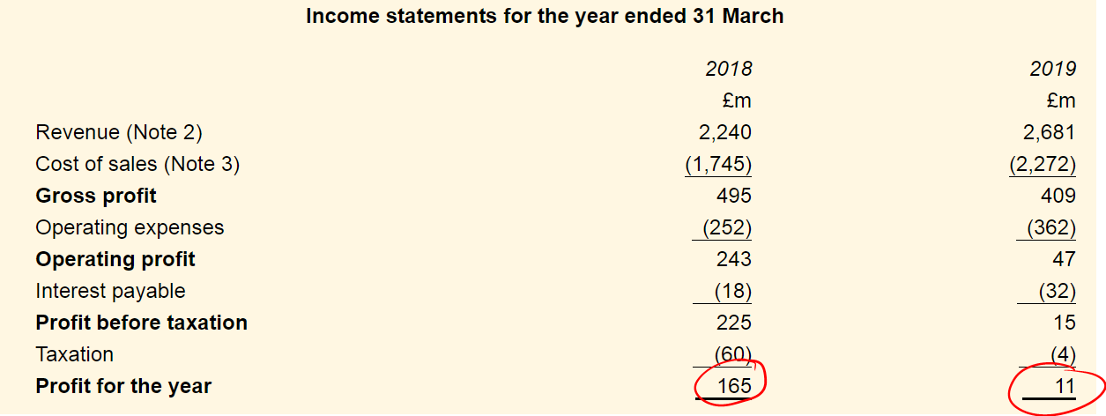
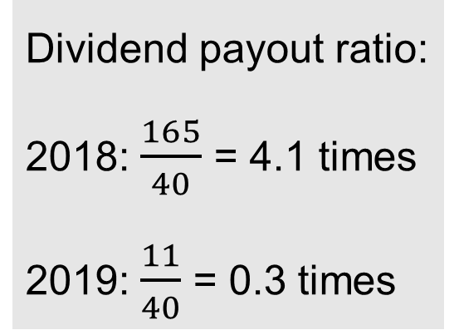
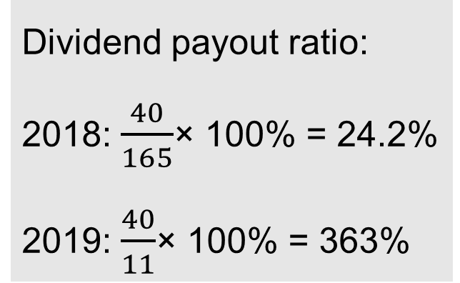
Dividend payout ratio:
2018: $\frac{40}{165}$× 100% = 24.2%
2019: $\frac{40}{11}$× 100% = 363%
Dividend payout ratio:
2018: $\frac{165}{40}$ = 4.1 times
2019: $\frac{11}{40}$ = 0.3 times

Slide 38
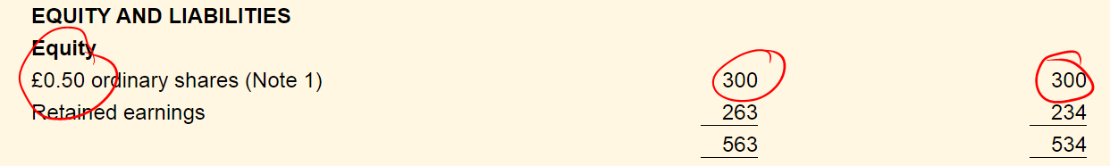
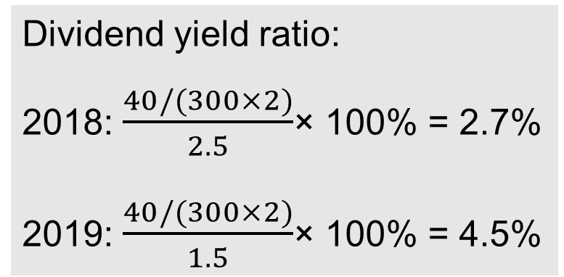
Dividend yield ratio:
2018: $\frac{40/(300×2)}{2.5}$× 100% = 2.7%
2019: $\frac{40/(300×2)}{1.5}$× 100% = 4.5%

Slide 39
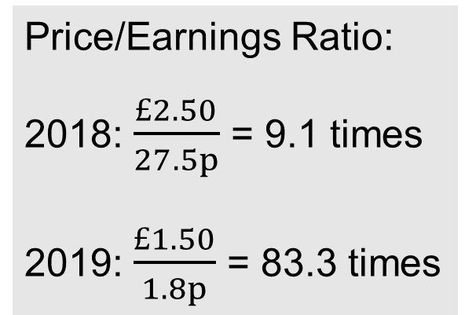
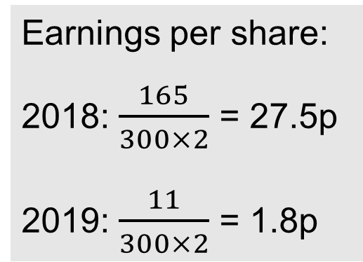
Earnings per share:
2018: $\frac{165}{300×2}$ = 27.5p
2019: $\frac{11}{300×2}$ = 1.8p
Price/Earnings Ratio:
2018: $\frac{£2.50}{27.5p}$ = 9.1 times
2019: $\frac{£1.50}{1.8p}$ = 83.3 times

Slide 40
Earnings Ratios
EPS relates the earnings for a period to the number of shares in issue;
This is a key ratio for investment analysts and they will track this over time to assess a business;
P/E ratio then relates the EPS to the market value of the share – the higher the ratio the greater the confidence in the future earnings and the more the investors are willing to pay in relation to its current earnings.

Slide 41
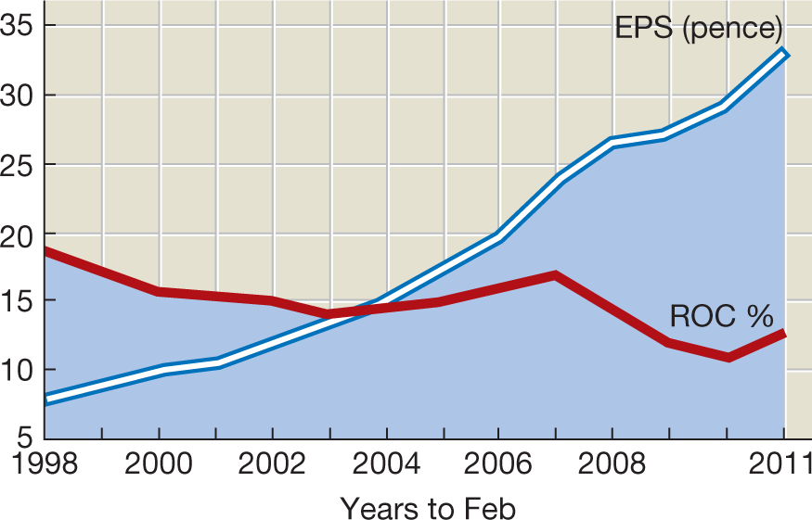
Figure 3.10 Tesco: The Leahy years
Source: Smith, T. (2014) ‘How investors ignored the warning signs at Tesco’, ft.com, 5 September.
© Terry Smith 2014. Reproduced by permission of the author. All Rights Reserved.

Slide 42
Figure 3.11 Average dividend yield ratios for business in a range of industries
7.0
6.52
Auto parts
6.0
Beverage (Soft)
Entertainment
Total market
Household products
Aerospace/Defence
Healthcare products
Drugs (Pharmaceutical)
Publishing & Newspapers
5.0
Coal & Related Energy
4.37
4.0
Dividend yield (%)
3.06
3.0
2.62
2.51
2.04
2.10
1.87
1.74
2.0
1.64
1.60
1.56
Oil/Gas Distribution
1.0
Utility (Water)
0
Source: Charts compiled from data in Damodaran, A., ‘Useful data sets’, www.stern.nyu.edu/~adamodar/New_Home_Page/data.html, accessed 9 January 2019.

Slide 43
Figure 3.12 Average price/earnings ratios for businesses in a range of industries
100.00
105.67
Auto parts
Coal & Related Energy
88.72
Utility (Water)
90.00
Beverage (Soft)
Total market
Healthcare products
Current PE (times)
Aerospace/Defence
Household products
Drugs (Pharmaceutical)
Publishing & Newspapers
80.00
74.89
70.00
60.00
52.05
50.00
46.52
40.00
30.91
29.61
32.81
30.00
26.73
29.16
20.00
Oil/Gas Distribution
11.39
Entertainment
12.66
10.00
Source: Charts compiled from data in Damodaran, A., ‘Useful data sets’, www.stern.nyu.edu/~adamodar/New_ Home_Page/data.html, accessed 9 January 2019.

Slide 44
Figure 3.14 Current ratio of three leading businesses
0.9
0.8
Tesco plc
Current ratio
0.7
J. Sainsbury
plc
0.6
0.5
William Morrison
0.4
0.3
0.2
0.1
2008
2009
2010
2011
2012
2013
2014
2015
2016
2017
2018
Source: Ratios calculated from information in the annual reports of the three businesses for each of the years 2008 to 2018.

Slide 45
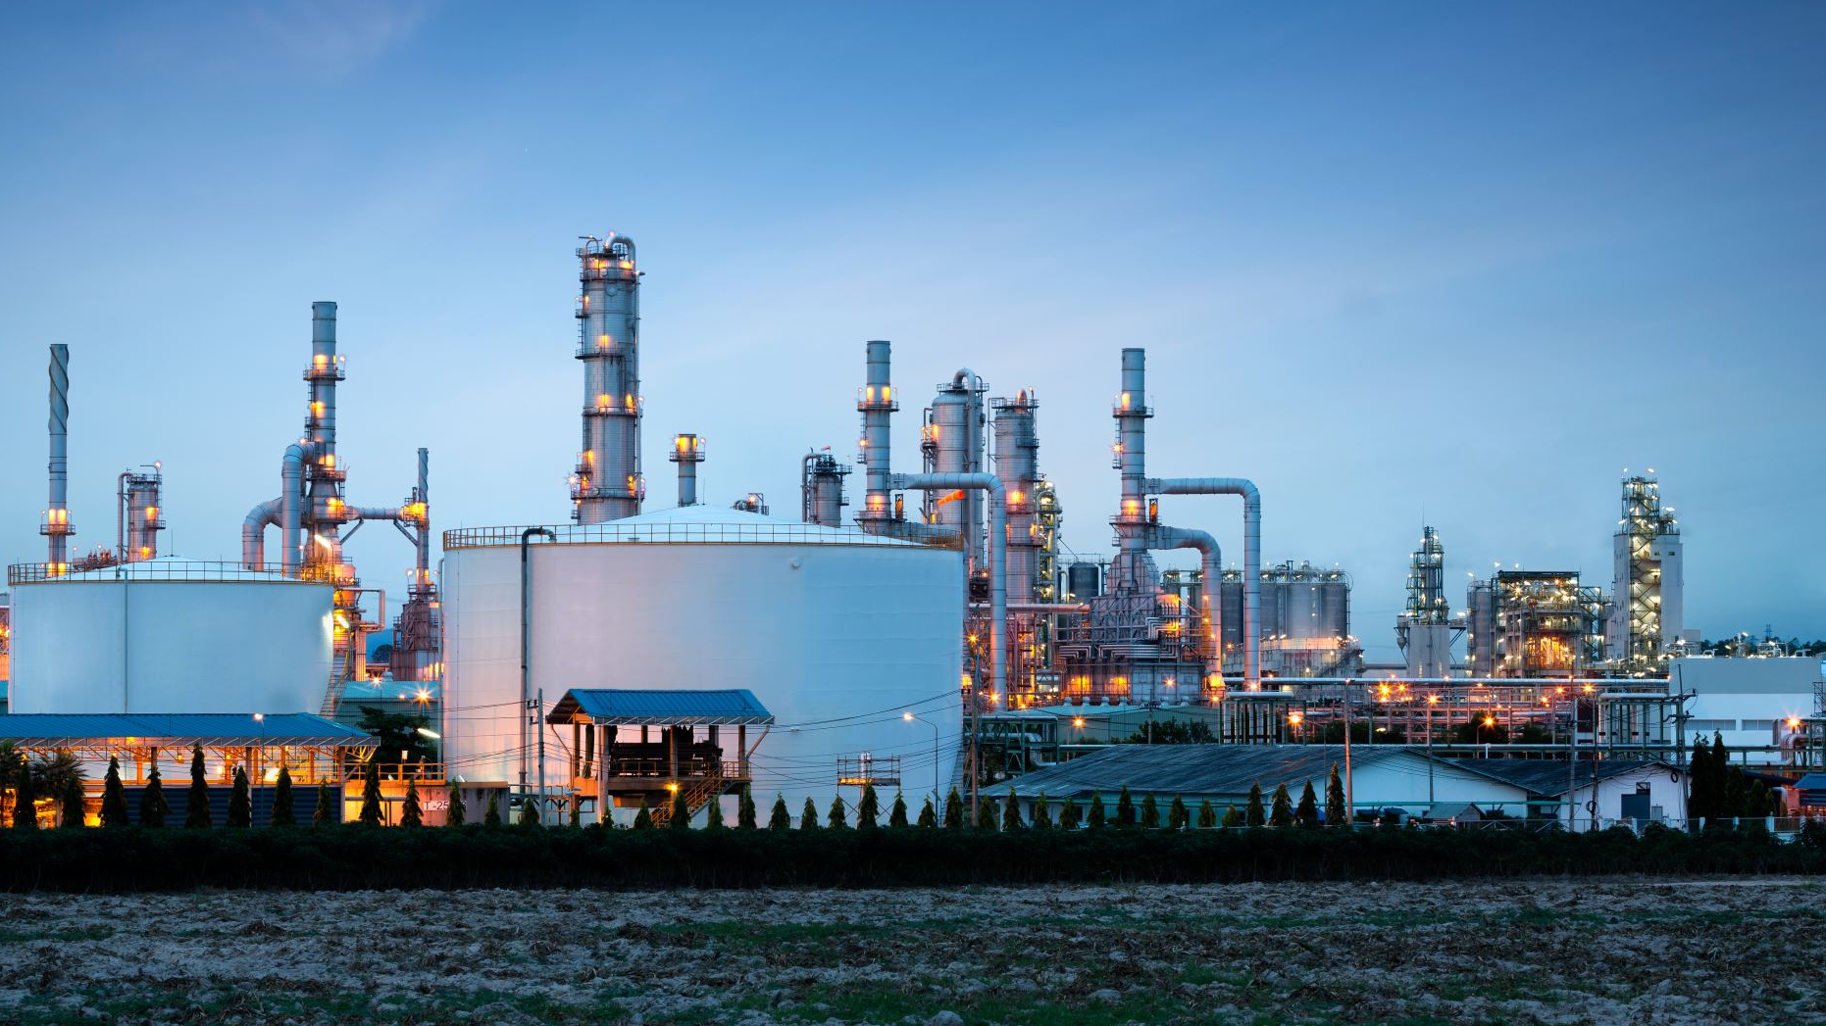
Which ratios will be important for different industries?

Slide 46
Overtrading
Overtrading occurs where a business is operating at an unsustainable level
May be due to expanding businesses that have not prepared, misjudgement on sales or costs levels, lack of access to further finance
Can cause liquidity problems and company may run out of cash
Can be spotted in low current ratios; low inventory turnover ratio, high settlement ratio for payables
Company must ensure that finance available is consistent with level of operations.

Slide 47
Overtrading and financial ratios
Overtrading may lead to a lower than expected:
Overtrading may lead to a higher than expected:
Current ratio
Average settlement period for trade payables
Acid test ratio
Sales to capital employed ratio
Average inventories turnover period
Average settlement period for trade receivables

Slide 48
Using Ratios to Predict Failure
An analyst will look at a combination of ratios to judge the health of a business.
Is it possible to develop a mathematical formula for failure?
Beaver’s research showed that some ratios exhibited differences between businesses that subsequently failed and this that didn’t.
Zmijewski found connection between failure and rates of return and gearing, but not liquidity in his study.

Slide 49
The Z-score model
Z =
1.2a + 1.4b + 3.3c + 0.6d + 1.0e
where:
a = Working capital/Total assets
b = Accumulated retained profits/Total assets
c = Operating profit/Total assets
d = Book (statement of financial position) value
of ordinary and preference shares/Total liabilities
at book (statement of financial position) value
e = Sales revenue/Total assets

Slide 50
Limitations of ratio analysis
Quality of financial statements
Creative accounting
Inflation
Over-reliance on ratios
Basis for comparison
Statement of financial position ratios

Slide 51
What’s Next…
5.30pm to 7.30pm – Cost behaviour, pricing and budgets (incl 10 minutes break).
7.30pm to 8.30pm – Review round 1 and prepare round 2.
8.30pm – Finish!

