Slide 1

MN7029 – Financial Decision Making
Welcome to Week 1.3!

Slide 2

Lecture recordings
This session is being recorded
You can access the weekly recording from Weblearn
This Photo by Unknown Author is licensed under CC BY-SA

Slide 3

What are the three main financial statements?
Notes:
Ask the class to see if they remember

Slide 4

Financial Statements
Statement of Financial Position
  A summary at a fixed point in time;
  Assets, liabilities and equity.
Statement of Profit or Loss
  Data for a period of time (accounting period);
  Shows income and expenditure for that period.
Cash Flow
  Data for a period of time (accounting period);
  Shows cash in and outflows for that period.
  Not profit

Slide 5

Learning Outcomes
Consider how management make business decisions
Look at the role of financial statements in decision making
Prepare projected financial statements
Consider how they can be adapted for uncertainty
Start to investigate how gearing impacts risks and return.

Slide 6

Natalie’s Restaurant
I set up a restaurant club.
On Thursday I spend £60 on ingredients.
I also spend £20 on new tablecloths which I can use for the foreseeable future.
On Friday I cook a meal with ¾ of the ingredients and charge 10 people £15 each for dinner.
Notes:
An example of putting together a simple set of financial statements

Slide 7
What are my cash flows?
My initial funding | £80
Money from the customers (£15x10) | £150
Cash inflow |  | £230
Money spent on ingredients | £60
Money spent on tablecloths | £20
Cash outflow |  | £(80)
Net Cash |  | £150
Cash balance at start |  | £0
Net cash inflow |  | £150
Cash balance at end |  | £150

Slide 8
What is my profit?
Sales revenue (£15 x 10) | £150
Cost of goods sold (3/4 of ingredients) | £(45)
Profit |  | £105

Slide 9
What is my financial position?
Tablecloths | £20
Cash | £150
Stock (unused food) | £15
Assets |  | £185
Equity (initial funding of £80 + profit £105) |  | £185

Slide 10

The Finance Function Contd.
To carry out the aforementioned functions requires managers to undertake a number of tasks namely:
Financial Planning
Investment Project Appraisal
Financing Decisions
Capital Market Operations
Financial Control
Notes:
This session we are focussed on the first of the main finance functions - planning

Slide 11

Why does a business need to plan?
Notes:
Ask the class – why does a business need to plan? Some ideas
So that it knows where it should be going
To decide what prices to charge so it can make a profit
So it doesn’t run out of money
To make sure all the different bits of the business are aligned

Slide 12
The Decision Making Process
5. Develop short term plans
4. Select option and consider long term plans
6. Implement the decisions
7. Review and monitor outcomes of decision
8. Act on differences from plan
2. Determine options available
1. Set aims and objective
3. Gather data and information on options

Slide 13



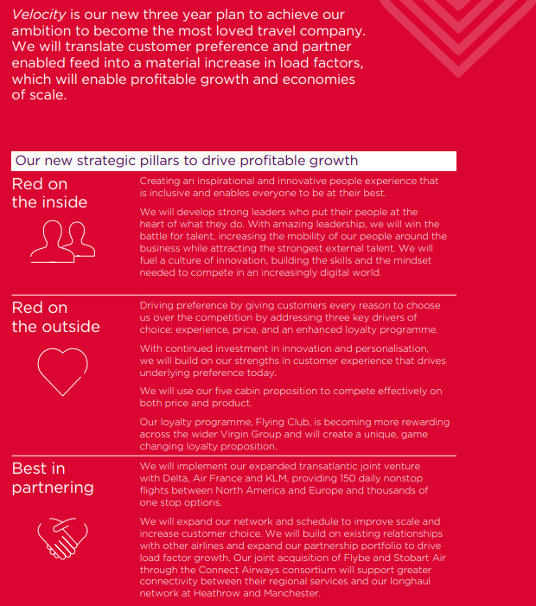
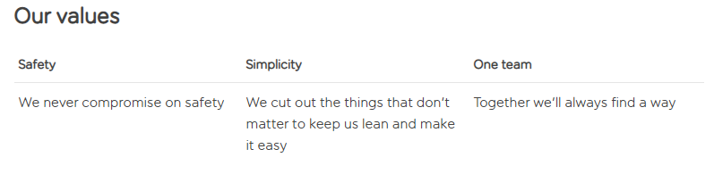

Notes:
Examples of how a businesses mission (or overarching aim and objective) needs to be taken account of when financial planning
For example, compare easyjet strategy (low cost affordable) with Virgin (most loved travel company) in the context of a management team deciding whether to invest in more luxurious seats on the plane, or whether to charge travellers for inflight meals. They are both airlines, but their different strategy means that they would have different answers to these questions.
Can also link in theories or competitive advantage – Virgin would not be competing with easyjet on price
Walt Disney company strategy is around creative minds and innovative technologies, so it’s financial decisions on how much to pay staff, who to recruit and spending money on R&D will also be influenced by this

Slide 14
Today…
4. Develop short term plans
3. Select option and consider long term plans
Notes:
In the discussion today we are focussed on these two steps

Slide 15
Projected financial statements
The projected financial statements
normally comprise:
Projected income statement
Projected statement of financial position (balance sheet)
Projected cash flow statement
Notes:
Projected financial statements look into the future and help a business to plan

Slide 16
Preparing projected financial statements
External variables:
Rate of taxation
Look at external info to identify rates;
Consider inflation rates for different items.
Interest rates for borrowings
Rate of inflation
Notes:
To prepare projections we need to start by looking at different variables, external and internal (next slide)

Slide 17
Preparing projected financial statements (Continued)
Internal variables:
Capital expenditure commitments
Financing agreements
Inventories holding policies
Credit period allowed to customers
Payment policies for trade payables
Accounting policies
Dividend policy

Slide 18
Steps in preparing projected financial statements
Identify the key variables affecting performance
Step 1
Step 2
Prepare sales forecasts
Prepare forecasts for remaining elements of financial statements
Step 3
Prepare projected
financial statements
Step 4
Notes:
Specific steps to prepare projections – after variables we start with sales and then go on from there

Slide 19

Why do we look at sales first?
Notes:
Question for class
Answer – because sales drives most of the other elements of the statements – in determines how much we need to spend on stock, staff, how much tax we eill pay etc

Slide 20
Preparing sales forecasts
Two main approaches:
Qualitative
Quantitative

Slide 21
Sales forecasts approaches
A qualitative approach uses subjective judgement to estimate forecasts, using for example:
  Information and predictions from the sales teams
  Managers opinions
  Consumer surveys
A quantitative approach uses a numerical analysis based on past performance, for example:
  Trend analysis
  Regression analysis
  Econometric models

Slide 22
Preparing projected financial statements
Projected financial statements may cover a short-term or long-term horizon:
Usually involves detailed forecasts of income, cash flows and financial position
Short-term
Usually involves making simplifying assumptions
Long-term

Slide 23
Projected Cash Flow Statement
Monitor changes in liquidity;
Help management to manage the impact of events on cash;
Indicate when business may need to raise more funds;
Indicate when funds will be available for projects;
Make sure it doesn't run out of cash!
Notes:
What would we use a projected cash flow for?

Slide 24
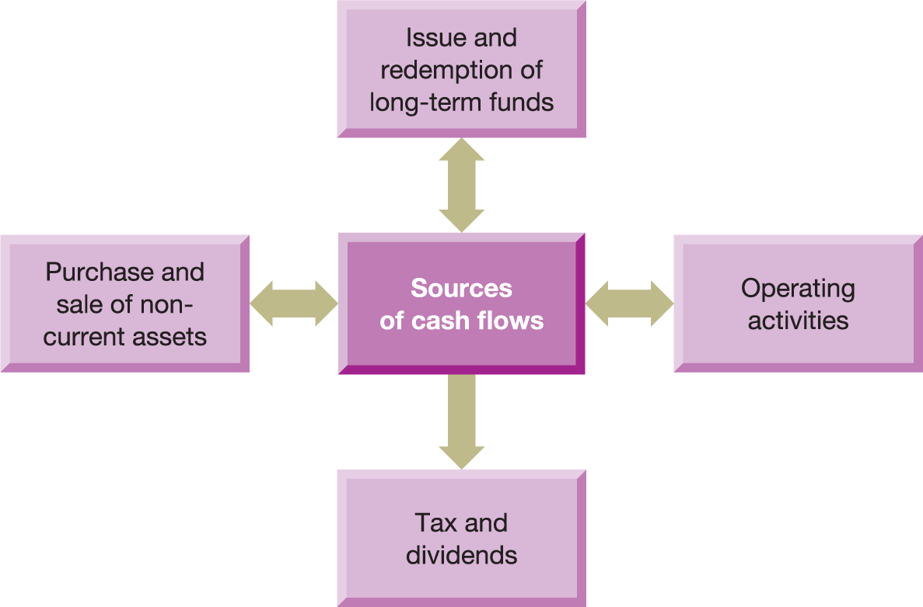
Figure 2.2 Sources of cash inflows and outflows
Notes:
Remember this statements is about cash not profit – these are some of the main sources of cash in and out flows

Slide 25
Projected cash flow statement for
the six months to 30 June
 | Jan £000 | Feb £000 | Mar £000 | Apr £000 | May £000 | June £000
Cash inflows
Issue of shares
Credit sales | ____ | ____ | ____ | ____ | ____ | ____
 | ____ | ____ | ____ | ____ | ____ | ____
Cash outflows
Credit purchases
Other costs
Rent and rates | ____ | ____ | ____ | ____ | ____ | ____
 | ____ | ____ | ____ | ____ | ____ | ____
Net cash flow
Opening balance | ____ | ____ | ____ | ____ | ____ | ____
Closing balance | ____ | ____ | ____ | ____ | ____ | ____
Notes:
Example proforma of a cash flow statement – note that this is on a monthly basis. Some businesses might even do this on a weekly or daily basis as cash management is so important. Cannot just do it on an annual basis

Slide 26
Cash flow items
January
Buy raw materials on 30 days credit
February
Pay supplier for raw materials
CASH OUTLOW
March
Sell product on 30 days credit
April
Recive cash for product
CASH INFLOW
Notes:
Example of how cash might not necessarily occur in the same month as the sale or the purchase

Slide 27
Projected income statement for
the six months to 30 June
 | £000 | £000
Credit sales revenue
Less Cost of sales
Opening inventories
Add Purchases | ____
Less Closing inventories | ____ | ____
Gross profit
Less
Credit card discounts
Rent and rates
Other costs
Depreciation of fittings |  | ____
Profit for the period |  | ____
Notes:
Example of projected income statement

Slide 28
Projected statement of financial position as at 30 June
 | £000
ASSETS
Non-current assets
Fittings
Less Accumulated depreciation | _____
 | _____
Current assets
Inventories
Trade receivables | _____
 | _____
Total assets | _____
EQUITY AND LIABILITIES
Equity
Share capital
Retained earnings | _____
 | _____
Current liabilities
Trade payables
Bank overdraft | _____
 | _____
Total equity and liabilities | _____

Slide 29
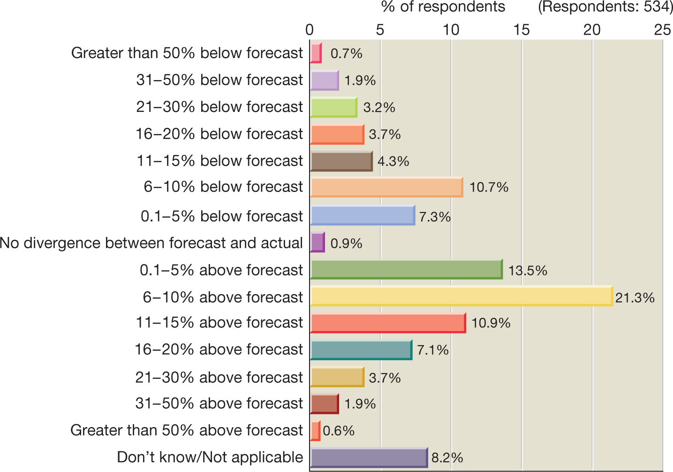
Figure 2.4 Variance between actual performance and forecast performance
Source: KPMG (2016) Forecasting with confidence, KPMG, p. 41 Reprinted with permission from Parker Scott.
Notes:
Just to illustrate that very few companies get projections spot on – all kinds of things could happen that means there is a divergence from projections.

Slide 30
Forecast financial statements and decision making
How were the projections developed?
What underlying assumptions have been made and are they valid?
Have all relevant items been included?
Notes:
As a manager if we are presented with a set of projections, what questions should we ask our team to determine the reliability of the statements and what questions do we ask to see what kind of decisions would flow from these?

Slide 31
Forecast financial statements and decision making (Continued)
Are the cash flows satisfactory?
Can they be improved by changing policies or plans?
Is there a need for additional financing?
Is it feasible to obtain the amount required?
Can any surplus funds be profitably reinvested?
Is the level of projected profit satisfactory in relation to the risks involved? If not, what could be done to improve matters?

Slide 32
Forecast financial statements and decision making (Continued)
Are the sales and individual expense items at a satisfactory level?
Is the financial position at the end of the period acceptable?
Is the level of borrowing acceptable?
Is the business too dependent on borrowing?

Slide 33
Projected financial statements and risk
Risk assessment may be undertaken using
Sensitivity analysis
Scenario analysis
Notes:
As financial projections are forward looking we might want to test out how much it would affect the business if they are wrong – this can be done with these methods

Slide 34


Sensitivity Analysis
Take a single variable and examine the effect of changes in that variable on overall performance
Shows how sensitive changes are for the projected outcome.
What happens if sales are 5% lower/higher?
What if sales price could be increased by 20%?
BUT – does not assign probability or consider changes to more than one variable at a time.

Slide 35
Scenario Analysis
Prepare projected statements according to different states of the world:
Optimistic view
Pessimistic view
"Most likely" view
Can change more than one variable
Does not identify likelihood of each occurring.

Slide 36
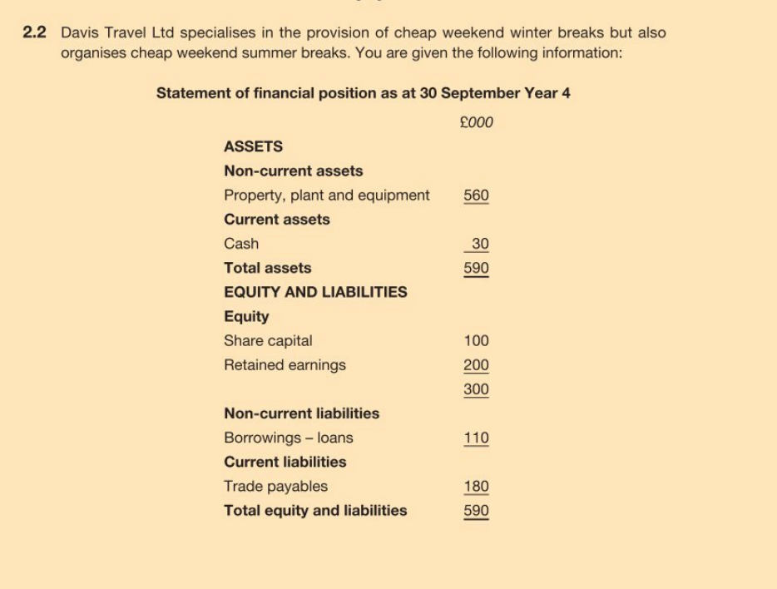
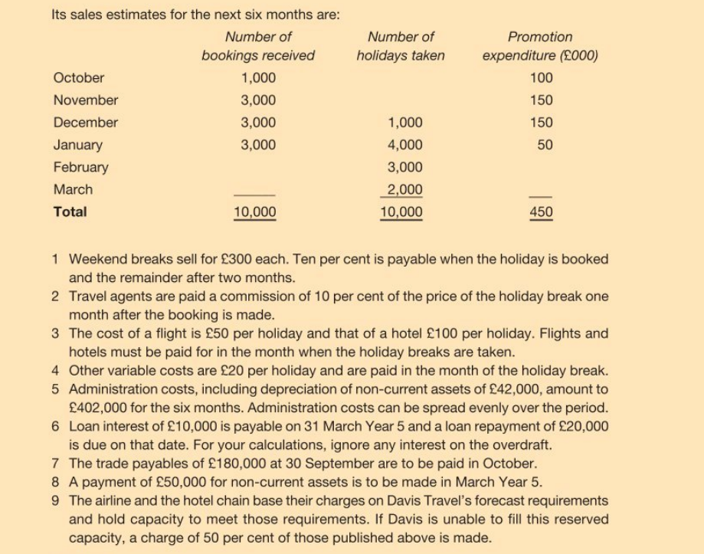
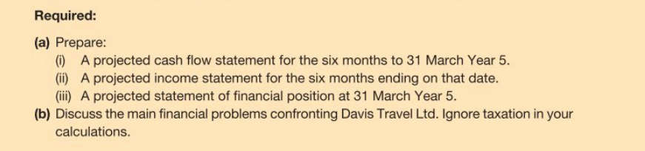
Practice Question
Notes:
If we have time this is an example that can be done in class or students can practice and home and the answer will be posted on weblearn

Slide 37
What’s Next…
Today
7.30pm 8.30pm – Business Simulation Round 1
8.30pm – Finish!
For next week:
Review Weblearn for additional reading and exercises
Read Atrill Ch 3
Consider: One advantage of using financial ratios is that the eliminate problems in comparing businesses of different sizes. Why might this be helpful to an investor?

