Slide 1

MN7029 – Financial Decision Making
1.2 Reviewing financial statements

Slide 2

Week 1.2 – Learning Outcomes
Explain the key statements within a company’s Financial Statements;
Describe the main users of financial statements and why they would use them;
Debate the limitations of financial statements

Slide 3

Agency & Stakeholder Theory - Enron
Who is responsible for the collapse of Enron?
What steps could be, or have been, taken to prevent this sort of failure in the future?
Notes:
I asked the students to read the Enron article as part of pre course reading. This discussion is a general discussion on what went wrong and what mechanism should have, and have now been put in place to stop this happening again. Get thoughts from students before moving onto suggested answers

Slide 4
Who is to blame?
The business environment – rapid growth
The CFO/CEO – set up the structure to enable fraudulent accounting (hiding debts/losses), failed to maintain control of operations
Executives – exercised share options at inflated share prices
The Board – pursued rapid growth and lost strategic focus
Audit committee – did not understand or question the complexity of the business
Auditors – close relationship, income from consultancy, failure to interrogate management
Stock analysts – had conflict of interest with investment banking side of their firm

Slide 5
What steps could be taken to prevent this happening?
Accounting for the substance not the form of the transaction (changes to accounting standards)
Stricter rules around audits
Independence of audit firms and investment banks
Independence of regulatory bodies – harsher penalties?
Stricter rules on director duties
More protection for whistleblowers
Embedding a culture of ethics
Independent audit committees and appointment of those with relevant skills

Slide 6

Types of business
Main types of business
Sole trader
Partnership
Company/corporation
In the UK we have
Sole trader
Partnership
Limited Liability Partnership (LLP)
Private company (Ltd)
Public Company (Plc)
We also have special designations e.g.:
Charities
Place of business
B Corp
Community Amateur Sports Club (CASC)
Notes:
Introduction to types of business structures in the UK

Slide 7


Example Ownership Structure
Investment Company Plc
20 shares = 20%
70 shares = 70%
10 shares = 10%
Nat’s International Company Ltd
Notes:
This is to break down in simple terms how a company issues shares to owners.
I set up Nat’s company with £20 and issue myself 20 shares of £1 each. At that stage I own 100% of the 20 shares in issue so I am the sole shareholder.
A friend offers to invest £70 in exchange for 70 shares and a separate investment company invests £10 in exchange for 10 shares. Now the ownership structure consist of 100 shares, of which I own 70 so I own 70% of the company.
I use the analogy of a pizza to describe this – the pizza is the whole company, but I can divide it up into as many slices as I like. People take a slice in exchange for putting money into the business. A pizza could have 4 slices (or shares) or 1 million slices and the amount of slices you hold indicates the level of influence you may have over the company.

Slide 8

Public v Private Companies
General Public?
Shareholders
Customers
Banks
General Public
Company X
Management
Employees
Suppliers
Notes:
Introducing the concept of private companies – companies where shares can be issued to and traded by members of the general public

Slide 9
Public or Private Company
A private company (in the UK a Ltd) is held privately, usually by founders or other private individual investors.
  The general public cannot buy or sell shares in Limited
  May invite specific people to invest (e.g. a Private Equity Fund or Business Angel)
  Does not appear on a Stock Exchange
A public company (in the UK a Plc) has sold some or all of its shares to the general public by way of an Initial Public Offering (IPO).
  Listed on a stock exchange
  Public can buy and sell shares on investment platforms
  Has a higher level of scrutiny

Slide 10




Public or Private Company
Public companies tend to be larger and have more access to funding, but there are some very large private companies
Notes:
Examples of large private companies – private companies does not necessarily correlate to small company

Slide 11

What is accounting?
A process of identifying, recording summarizing and reporting economic information or transactions to decision makers and stakeholders in the form of financial statements
There is a difference between financial accounting and management accounting
The accounting system is the steps performed to analyze, record, quantify and report economic events and their effects on an organization. It must be designed to meet the needs of the users
Notes:
Reiterating the role of accounting as taking many economic transactions in a business and presenting them in a way that is understandable, allowing management to make decisions and allowing interested parties to compare different businesses in the understanding that the companies will have applied standard principles to organising their transactions into this format.

Slide 12

What are Financial Statements?
Record of the company’s performance (in the form of economic information or transactions);
Key statements
  Statement of financial position (balance sheet);
  Profit or loss (income) statement;
  Statement of cash flows.
A historical record of past events;
Numerical data and explanatory notes;
Publicly available in the UK
Video – what are financial statements?
Notes:
Video is halfway down the linked page – you can show in class or the students can review later
Financial Statements: List of Types and How to Read Them (investopedia.com)

Slide 13

The Annual Report and Accounts
All UK companies are required to prepare accounts and file with UK Companies House (https://www.gov.uk/government/organisations/companies-house);
If a business is not a company they will still draw up financial statements;
Companies must draw up accounts based on UK GAAP or IFRS;
All UK companies require an audit unless subject to exemption (e.g. certain small co’s);
Additional publication requirements for public companies.
Notes:
Emphasise just how much information is publicly available in the UK – all UK company must prepare accounts and submit to Companies House and anyone can view – different in other jurisdictions – the US does not require private companies to make these publicly available.

Slide 14

Financial Statements
Statement of Financial Position
  A summary at a fixed point in time;
  Assets, liabilities and equity.
Statement of Profit or Loss
  Data for a period of time (accounting period);
  Shows income and expenditure for that period.
Cash Flow
  Data for a period of time (accounting period);
  Shows cash in and outflows for that period.
  Not profit

Slide 15
Financial Statements Cycle
12 month period
12 month period
12 month period
Income Statement
Cash Flow
Income Statement
Cash Flow
Income Statement
Cash Flow
Statement of Financial Position
Statement of Financial Position
Statement of Financial Position
Statement of Financial Position
Notes:
Emphasising that the Statement of financial position bookends the period

Slide 16
Who might use financial statements?
Notes:
Question for the class – get their ideas on who might use them

Slide 17
Users of financial statements
Notes:
This page can be used if you want to write up the students ideas on who the users might be or you can do it as a discussion

Slide 18

Pick a user – what might they use the financial statements for?
Notes:
Class input – why might people use the statements – this might have been discussed in the previous slide

Slide 19
Who uses financial statements and why?
Will I get paid?
Is the company meeting its company law and regulatory requirements?
What is the environmental and social impact of the company?
What level of profit did the company make?
Will the company be able to repay borrowings?
How much tax should the company pay?
Is the company in danger of insolvency?
Can the company continue to supply my goods?
Should I invest more/sell shares?
Is the company managed effectively?
Is the company growing?
Current/potential investors
Employees
Lenders
Suppliers
Customers
Government and regulators
The public
Notes:
Some ideas of users and what they use them for

Slide 20
Some key terms…
Revenue: Sales made to customers
Cost of goods sold: the cost of making the sales
Operating expenses: the cost of marketing the product or administering the business
Profit: Excess of revenue (sales, turnover) over expenditure (costs of good sold and operating expenses)
Assets: Business resources that the company owns or has use of
Equity: the investment or “stake” of the owner, the owner’s value in the business (initial investment in shares, retailed profits)
Inventory: Stock, goods for resale, raw materials
Receivables: money owed to the business
Payables: money the business owes to others

Slide 21
Statement of Financial Position (Balance Sheet)

Slide 22
Purpose of the balance sheet
The purpose of the balance sheet is to set out the financial position of a business at a particular point in time, the economic resources (assets) it controls and where its finance comes from (liabilities and equity).
It sets out the assets of the business and the claims against it (liabilities and owners’ equity) at a particular point in time.

Slide 23

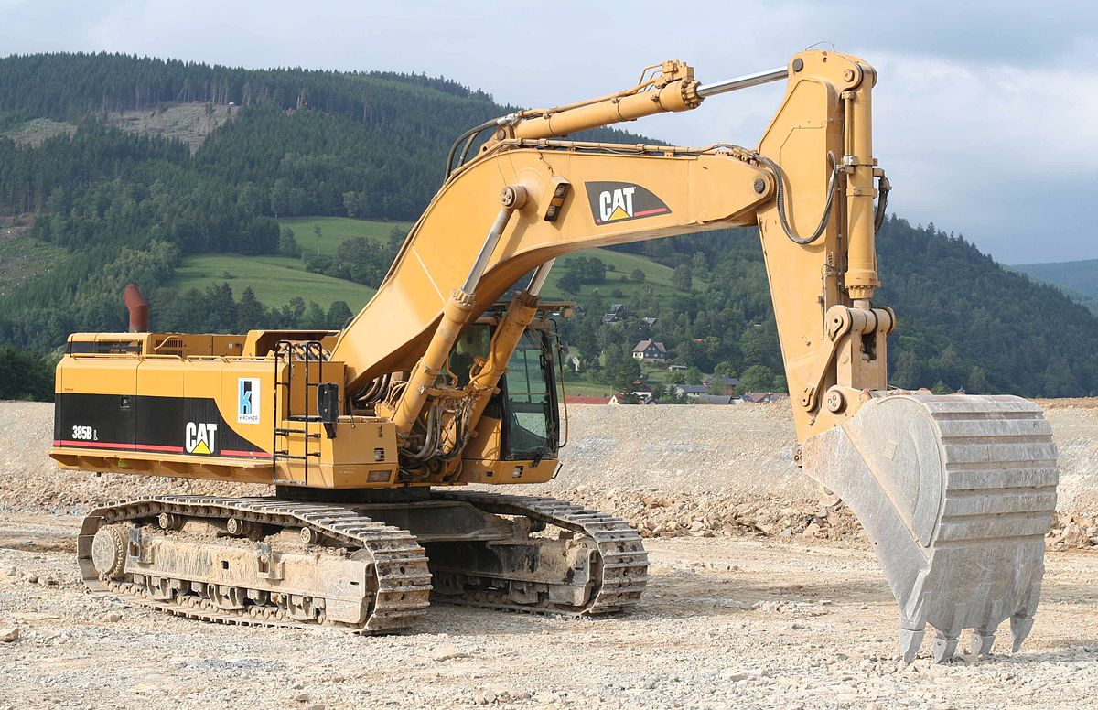



What types of assets might you find in a business?
Notes:
Ask the class to see if they can guess the assets that the pictures are clues to:
Cash
Property
Machinery
Inventory/stock/raw materials
Brand names or intangible assets

Slide 24
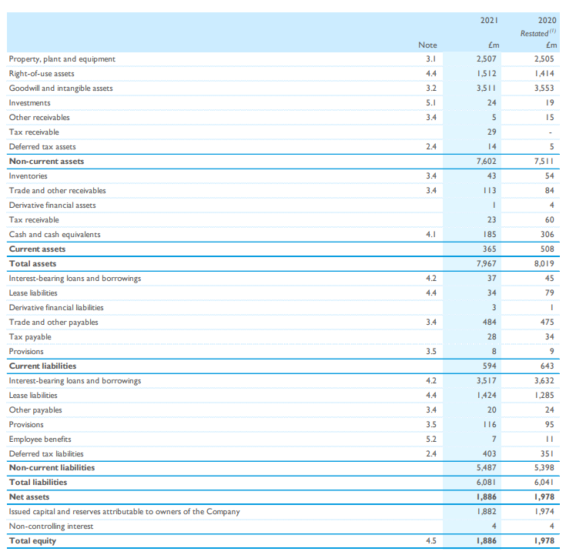
Merlin Entertainments Ltd – statement of financial position
Notes:
An example of a statement of financial position – Merlin owns and operates theme parks around the world – I usually highlight the property, intangible assets, inventories etc

Slide 25
Types of assets
Current
Held for sale or consumption
Lifespan of a year of less
Held principally for trading
Cash or liquid short term investments
Non Current
Held for longer term
Business may be done in or with them (i.e. not consumed)
Tangible and intangible

Slide 26
Figure 2.3 The circulating nature of current assets
Inventories
Cash
Trade receivables
Notes:
Circular nature of current assets – business uses cash to buy stock which it then sells for cash immediately (or cash to be received in the future – trade receivable)

Slide 27
Intangible assets
Goodwill:
Represents for example brand name, strong management team, business contacts, staff relations
Not possible to identify created goodwill separately from the business – subjective so cannot be recorded.
Purchased goodwill = price paid – (fair value of the assets – liabilities) – objective so can be recorded.
Subject to annual impairment review
Other intangibles:
For example, trademarks, patents.
Stated at cost and amortised over useful economic life

Slide 28
Typical assets
Land and buildings,
Machinery and equipment,
Fixtures and fittings,
Debtors (receivables),
Investments
Cash
Inventory

Slide 29
What is depreciation?

Slide 30
Depreciation
Depreciation is the allowance for wear and tear on some fixed assets like, plant and machinery. It is an allowance for:
  Wearing out,
  Consumption or
  other reductions in the useful economic life of a fixed asset,
NOT A CASH FLOW!!!!
Accumulated depreciation shows amount that the asset has lost in value since its purchase
You can depreciate on a straight line or a reducing balance (%) method.

Slide 31
Claims
Equity
The owner’s claim against the business.
Ordinary shares plus reserves
Capital.
Separate legal identity
Liabilities
Other parties
For example, money owed for raw materials, upfront customer prepayments

Slide 32
Types of claim
Current
Settled in a year or less
Arise from trading
Non Current
Held for longer term
May not arise from trading
(e.g. long term bank loan)

Slide 33
Typical claims
Long term loans
Wages payable
Deposits received
Trade creditors
Loans and debentures
Bank overdraft

Slide 34
The accounting equation
Assets
=
Equity
+
Liabilities
Notes:
The beauty of double entry accounting! The statement of financial position will always balance = assets must equal equity + liabilitirs

Slide 35
The effect of trading transactions on the
accounting equation
The accounting equation can be extended as follows:
+ (−)
Assets
=
Equity
Profit (Loss)
+
Liabilities

Slide 36
The income statement (profit & loss account)

Slide 37
Profit (or loss) for the period =
Total revenue for the period – Total expenses incurred in generating that revenue

Slide 38

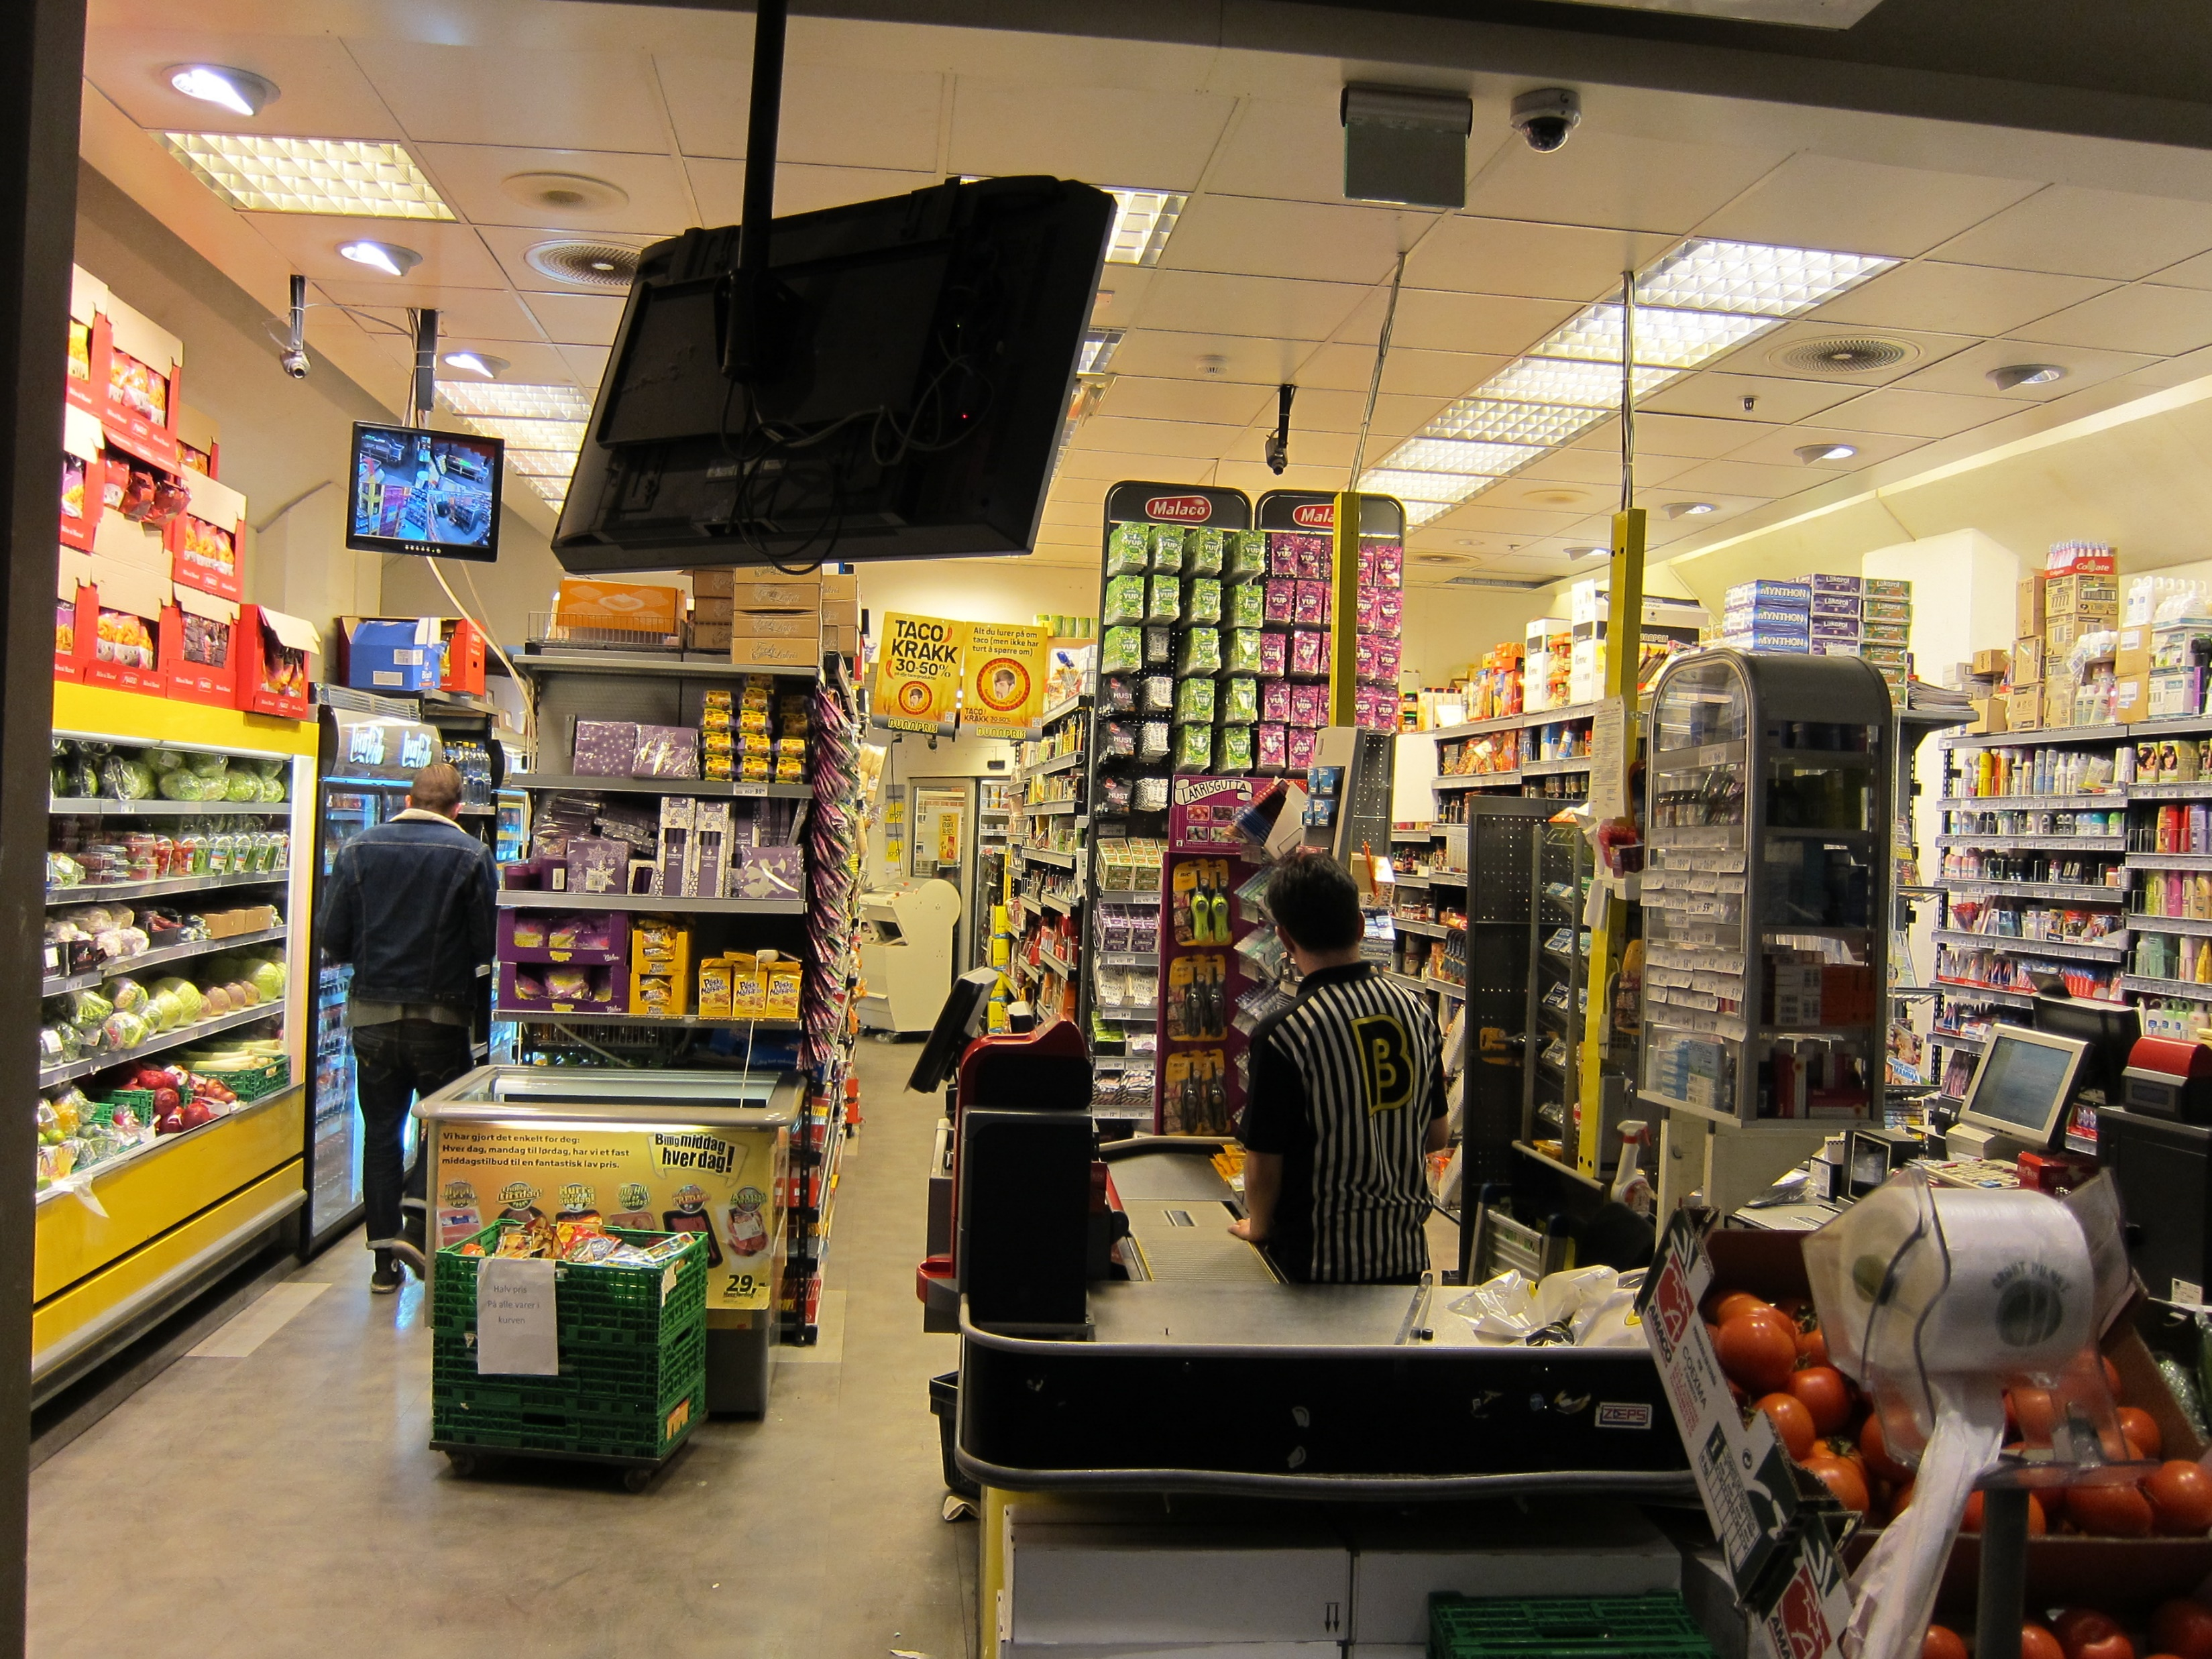




What types of income might we have in a business?
Notes:
Ask the class if they can guess the types of revenue a business might have:
Sales of goods (e.g. a supermarket)
Sales of subscriptions (Netflix, a gym)
Financial income (e.g. bank interest, or income from share investments)
Income from licencing (e.g. Disney might allow someone to use the image of Mickey Mouse on a pencil case and they pay to use that right)
Sales of services (e.g. an accountant or lawyers)
Rent (e.g. hotels renting rooms, or a landlord renting a property)
I like to compare how businesses have evolved their sales models e.g. Blockbuster video (sale/rental or physical product and late fees) v Netflix (subscriptions to view licecnced content)

Slide 39






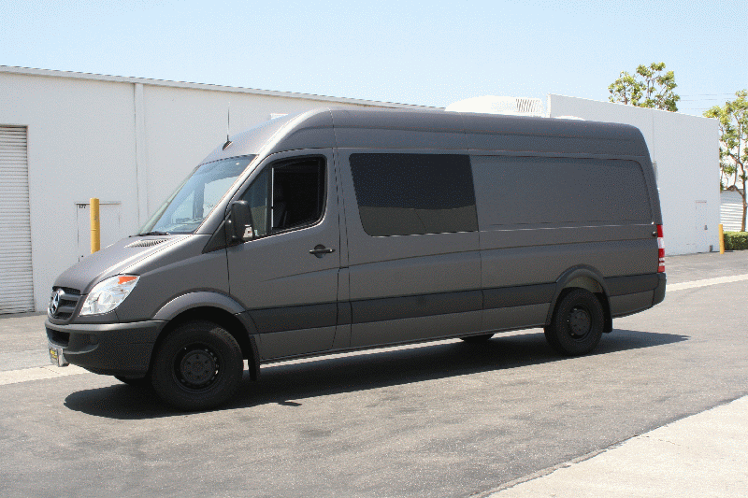
Expenses
Notes:
Ask the class if they can guess the types of revenue a business might have:
People, wages, salaries
Light and heat
Phone
Computing or cloud services (AWS)
Delivery costs
Rent of property or office
Raw materials

Slide 40
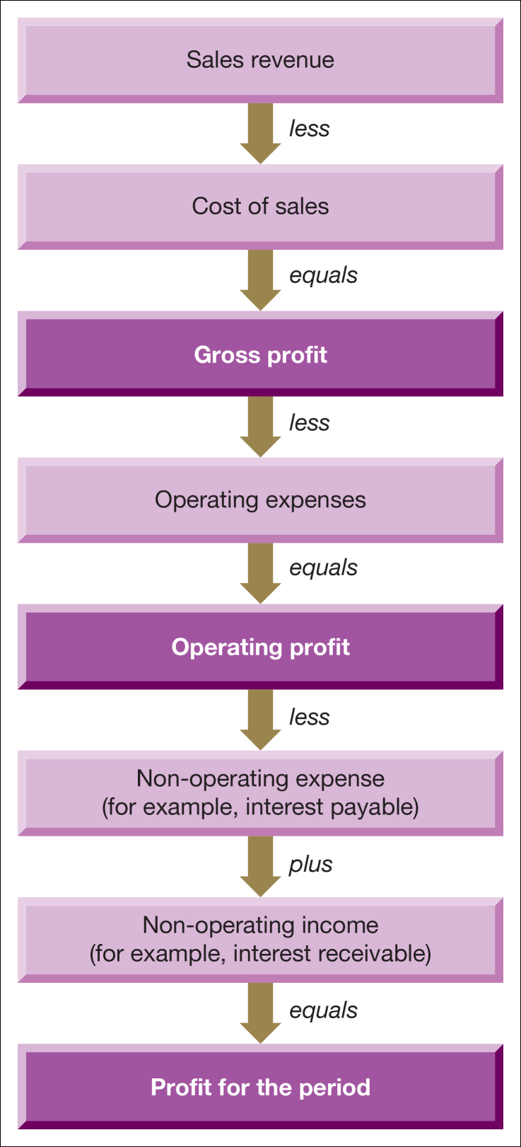
Figure 3.2
The layout of the income statement

Slide 41
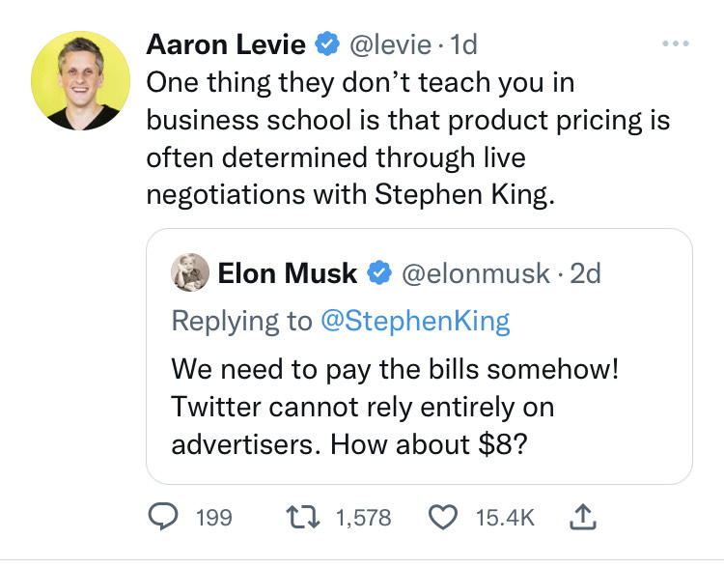
How does Twitter make money?
Notes:
This made me laugh – when Elon Musk bought Twitter he had to figure out how to make money from it and introduced the idea of paying for the blue tick. Lots of people complained, including the esteemed author Stephen King and Elon replied to that seemingly negotiating the price. I’m not sure how much product pricing is determined live online with Stephen King, but clearly some is!

Slide 42
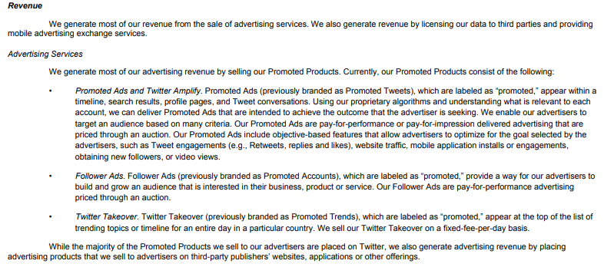
How does Twitter make money?
Notes:
How does Twitter make money though? It is free to users, so they are not asking for payment from users. Most of its money is made through advertising. Other companies pay Twitter to promote ads. Some money is also made by selling or licencing the data it collects to other companies who are interested in that data

Slide 43
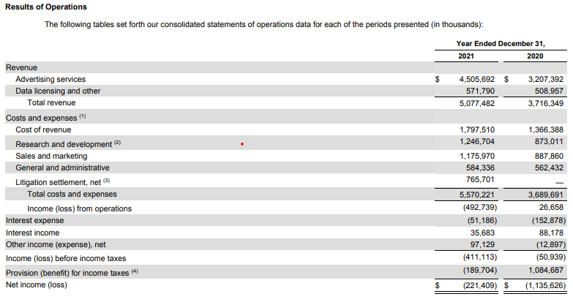
How does Twitter make money?
Notes:
In 2021 Twitter received revenue or sales of $4.5bn from advertising and $0.5bn from licencing data. Ask students to consider how business they use actually generate cash from sales? Will Twitter need to find a new model e.g. payment for users? Even though it made that money in sales in 2020 and 2021 it made a loss – revenue is not profit. Can a business survive if it continually makes a loss? Yes provided that people are willing to invest money, but when they are not and the cash runs out the business will fail. Lack of profits is not the ultimate killer of businesses it is lack of cash.

Slide 44
The cash flow statement

Slide 45
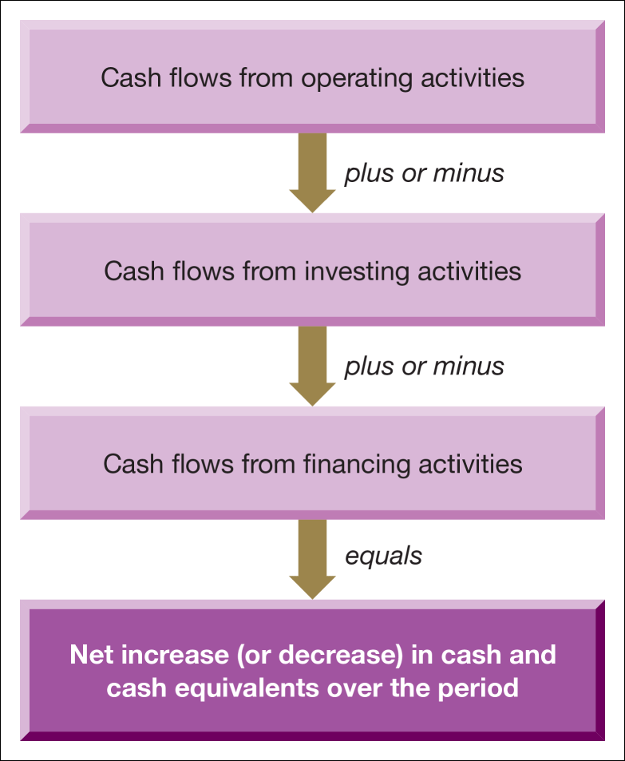
Figure 5.3
Standard presentation for the statement of cash flows
Notes:
Cash is not profit!!!

Slide 46
Operating examples
 | Profit | Cash
Receiving a loan from the bank
Profitable sale for cash
Profitable sale on credit
Buying a machine for cash
Depreciation of the machine
Buying inventory (stock) for cash
Issuing shares to investors for cash

Slide 47
Operating examples
 | Profit | Cash
Receiving a loan from the bank | None | Increase
Profitable sale for cash | Increase | Increase
Profitable sale on credit | Increase | None
Buying a machine for cash | None | Increase
Depreciation of the machine | Decrease | None
Buying inventory (stock) for cash | None | Decrease
Issuing shares to investors for cash | None | Increase

Slide 48

Financial Management
Also called cost and management accounting;
Using financial data to help make business decisions;
Fundamental qualities of financial information:
  Relevant
  Timely
  Understandable
  Comparable
  Verifiable
Notes:
We’ve so far looked at financial accounting – how do businesses present their annual economic transactions. Financial management or management accounting is using financial data to help the management team make decisions

Slide 49
Differences between financial management and financial accounting
Financial Statements
Users?
Rules?
Features?
Type?
Frequency?
Uses?
Whole company?
Timing?
Detail?
Notes:
Financial accounting and management accounting can differ in lots of ways – the crucial element is that the financial accounting tends to be historic and summarised and subject to rules about accounting standards and disclosure. Management need timely and often detailed and forward looking information to aid the decision making process. This may mean they want it to be presented in different ways.

Slide 50
Who might form part of a finance function?
REPORTING/HISTORICAL
FORECASTING/FUTURE
Financial Controller
Financial accountant
General ledger accountants
Cash book
Financial planning and analysis
Treasury manager
Risk management
Corporate strategy
CFO
FD
Notes:
CFO is known as Csuite – part of the Board of Directors,
Financial controller – oversees the accounts reporting team, responsible for budgets, analysis
Ginance/accounts manager – day to day running of the finance requirements
May also have general ledger accounts responsible for specific areas e.g. cash book
Strategic finance function:
FP&A:

