Slide 1

MN7029 – Financial Decision Making
Week 1.1
Welcome!

Slide 2
Purpose of Module and Learning Objects
Understand and use financial information to make effective business decisions;
Understand key financial management issues, performance indicators and methodologies;
Understand the preparation of and use of accounting;
Assess accounting information to evaluate business performance
Learning Objects
LO1: Critically evaluate company financial performance and make recommendations for improvement;
LO2: Demonstrate an understanding and use of the appropriate analytical techniques to be applied to business case development and investment appraisal; the raising of finance and the distribution of funds to investors;
LO3: Communicate financial information, analysis, issues and recommendations clearly and concisely.

Slide 3

Weblearn
Please make use of Weblearn.
For each session you will see:
  Introduction and learning objectives;
  Lecture slides;
  Additional reading.
You can also share ideas on the Discussion Board

Slide 4
Key Points
Please make sure you are familiar with the module handbook and timetable;
Please watch out for Announcements & Emails
If you have any questions about the course, please consider posting them on the discussion board
If you can’t make a class please let me know beforehand
The group assessment requires you to work in teams. Please be respectful of your teammates time and arrange sessions that work for you all

Slide 5

Any Questions?

Slide 6

Week 1 – Learning Outcomes
Consider the role of the finance function
Compare and contrast the differences between financial accounting and financial management;
Examine how a finance team will support managerial decisions;
Consider your interaction as a manager with the finance function in a business;
Identify and discuss possible objectives for a business;
Introduce the main purpose of corporate governance rules.

Slide 7
What do companies do?
They produce good or services
They use inputs (which need to be paid for) to produce outputs
They need money to pay for inputs (costs) and they receive money (revenue) for their outputs
Paying for inputs or receiving revenue is an economic transaction
Difference between costs and revenue is profit
Managers need to decide what to produce, what price, which supplier, how many workers, contracts, production technique

Slide 8
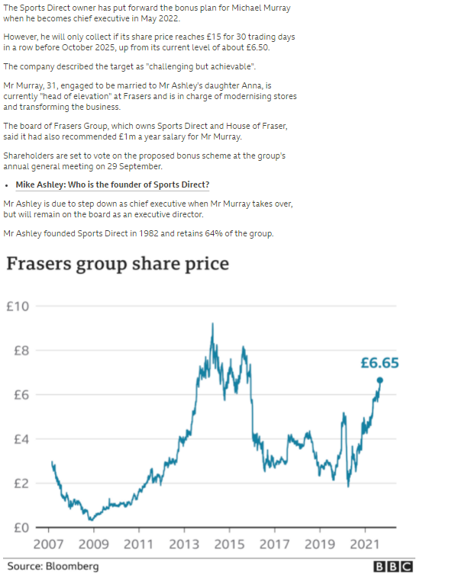
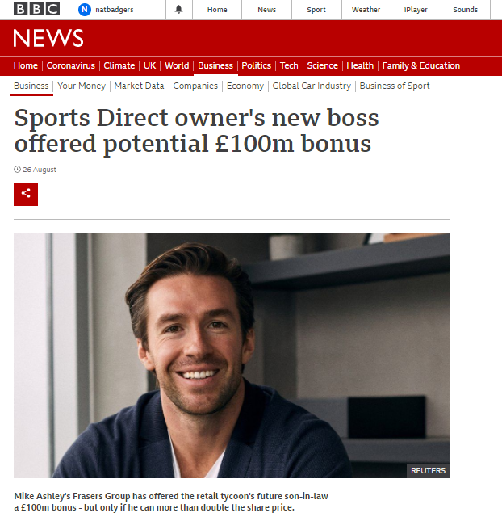
Financial decision making in the real world – how does a CEO improve share price?
https://www.bbc.co.uk/news/business-58340082
Notes:
Demonstrating the importance of financial decisions – this manager will have the opportunity to take home a big bonus if he can increase the share price of the company. But how do managers do this? Later we will look at the link between making decisions that increase the wealth of the company in relation to the wealth of the shareholders and therefore share price, but this will involve making pricing/investment decisions

Slide 9

What is accounting?
A process of identifying, recording summarizing and reporting economic information or transactions to decision makers and stakeholders in the form of financial statements
There is a difference between financial accounting and management accounting
The accounting system is the steps performed to analyze, record, quantify and report economic events and their effects on an organization. It must be designed to meet the needs of the users
Notes:
Emphasis on financial management as the ability to take possibly millions of economic transactions in a company and present them in a way that allows interpretation and decision making

Slide 10
The Finance Function
Managers understand, plan, control and make decisions
The finance function helps managers to manage
They do this through managerial activities in the organisation namely

Slide 11
The Finance Function
Strategic management – which requires the setting of long-term objectives and setting out how these objectives will be achieved
Operations management – which requires that things go to plan and putting in place the day to day control of activities in each functional area.
Risk management – which requires the managers to identify the risks faced by the entity and how to manage them.

Slide 12
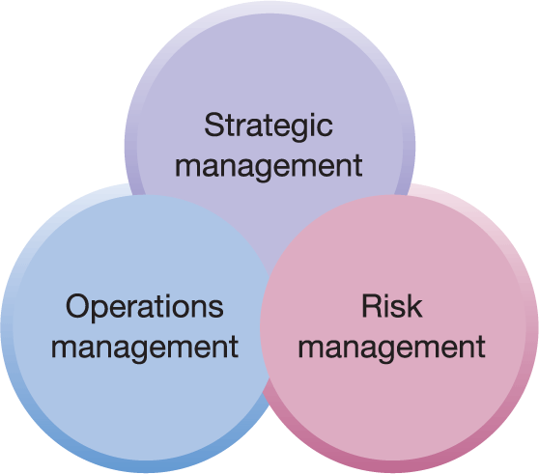
Figure 1.1 The role of managers
The three management activities can be depicted as shown. The figure shows clearly that they are not distinct and separate.

Slide 13
The Finance Function
To carry out the aforementioned functions requires managers to undertake a number of tasks namely:
Financial Planning
Investment Project Appraisal
Financing Decisions
Capital Market Operations
Financial Control

Slide 14

Financial Planning (Week 1.2)
This requires managers to assess the potential impact of their future investment projects on future financial performance and position using budgeted information to prepare key financial statements for the intended projects.

Slide 15

Investment Project Appraisal (Week 3.1)
Appraising the financial viability of each long term investment projects throws some light on whether or not the project should be undertaken. This will assist the manager to make informed decisions about whether to reject or accept the investment proposal.

Slide 16

Financing Decisions (Week 4.1)
These require managers to decide how projects will be financed. Will they be financed through internally or externally generated funds? What are the costs of each source? Which is most beneficial to the company? These are a few of the questions managers will ask.

Slide 17

Capital Markets Operations (Weeks 4.2)
Companies, especially Public Limited Companies (Plc), raise long term finance through the capital markets which invariably means that managers need to understand how these markets operate.

Slide 18

Financial Control (Week 2.2)
Once managers have taken the decision to implement a plan, they must ensure that things go according to plan. They this by asking subordinates to provide regular reports to them as things get under way. This will enable them to put in place control activities.

Slide 19
The Finance Function Contd.
The five areas looked at above can be depicted in pictorial form in the figure on the next slide. This should hopefully allow you to see the interrelationship of them all and the finance function.
They are all part of the three roles of managers we looked at above – Strategic, Operations and Risk Management.

Slide 20
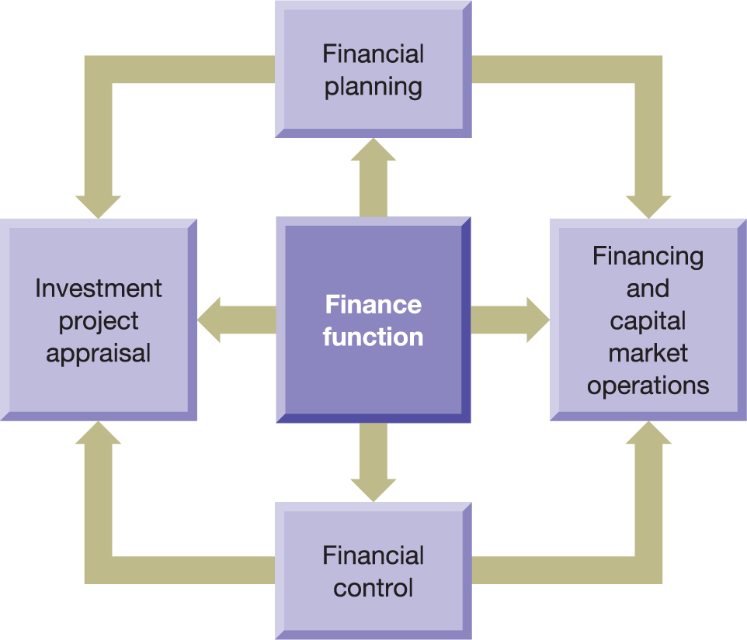
Figure 1.2 The tasks of the finance function

Slide 21
Who might form part of a finance function?
REPORTING/HISTORICAL
FORECASTING/FUTURE
Financial Controller
Financial accountant
General ledger accountants
Cash book
Financial planning and analysis
Treasury manager
Risk management
Corporate strategy
CFO
FD
Notes:
CFO is known as Csuite – part of the Board of Directors,
Financial controller – oversees the accounts reporting team, responsible for budgets, analysis
Ginance/accounts manager – day to day running of the finance requirements
May also have general ledger accounts responsible for specific areas e.g. cash book
Strategic finance function:
FP&A:

Slide 22

What is the objective of a company?
Notes:
Question for the class – can they come up with ideas about what a company’s objective or goal should be? Leading into the theories of Friedman and Freeman about only objective to be to maximise wealth or take account of stakeholder interests

Slide 23

The structure of a company
Shareholders
Customers
Banks
Company X
Management
Employees
General Public
Suppliers
Notes:
For students to help emphasis the relationships:
Company is a separate legal entity – it can contract in its own right and has its own transactions. A company is not its employees or managers – they have a contractual relationship with the company to perform duties or services
Shareholders are owners of the company – this might include some members of the management team but they can wear different hats whether they are acting as owner or manager – possibly conflicts of interest
Other people are stakeholders- they have an interest – it might be contractual e.g. a bank or more nebulous – how does your company affect the general public

Slide 24
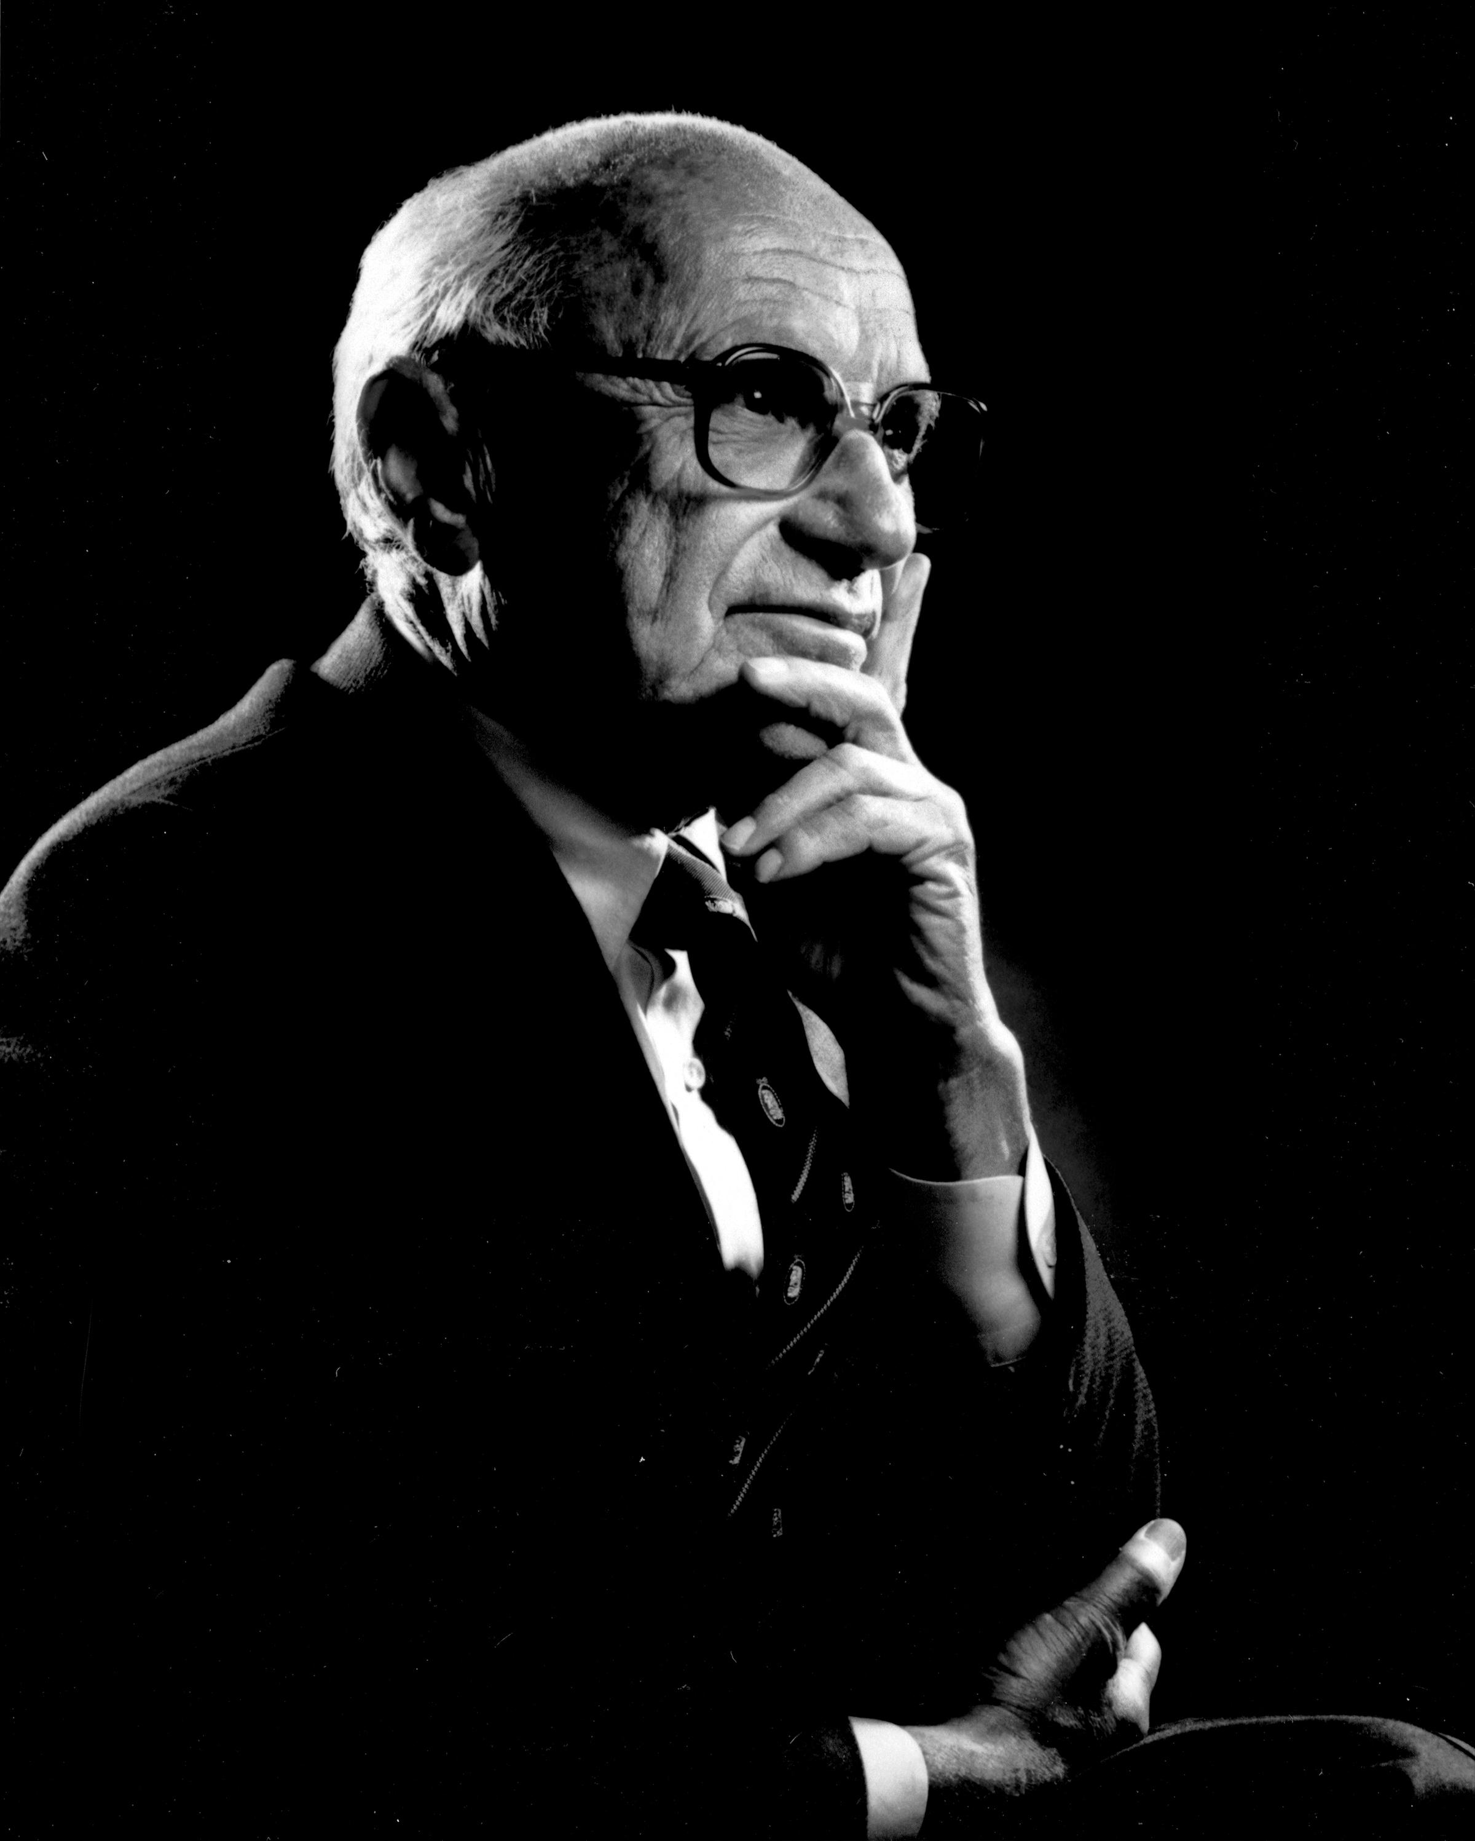
Milton Friedman’s Shareholder Theory
The management team are responsible for the business. They are employees of the owner of the business. The management’s prime responsibility is to the owners.
The goal of the owners (shareholders) is “to make as much money as possible while conforming to the basic rules of society, both those embodied in law and those embodied in ethical custom”
Therefore, the objective of the business is to use the resources of the company to increase or maximize the wealth of the shareholders.
If the managers account do not use the resources to maximize the wealth of the shareholders they will invest their money elsewhere.
How do we maximize value? By making economic decisions within the business that maximize the value of the business.

Slide 25
Primary objective
The primary objective of a business is shareholder wealth maximisation:
Not the same as profit maximisation
To achieve wealth maximisation the needs of other stakeholders must be considered
High ethical standards may be needed to maximise shareholder wealth

Slide 26
Shareholder wealth maximisation
Shareholders:
However, pursuit of this objective:
May encourage excessive cost cutting
Are the effective owners
Have a residual claim and bear the risk
May undermine the status of other stakeholders
Are incentivised to increase their residual claim through entrepreneurial activity
May encourage unethical behaviour

Slide 27
Profit maximisation problems
Profit is an imprecise term
Profit cannot be objectively determined
Period over which profit should be maximised is unclear
Profit takes no account of risk
Profit takes no account of opportunity cost

Slide 28
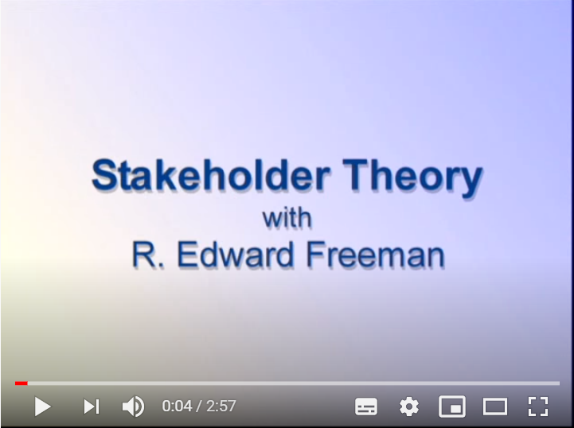
Video – R Edward Freeman on Stakeholder Theory
Notes:
https://www.youtube.com/watch?v=bIRUaLcvPe8

Slide 29
Stakeholder approach – problems
Does not offer clear-cut objectives
Increases problems of accountability
Raises difficult questions concerning who the stakeholders are and how they should be treated

Slide 30

Case study
Consider this article about the profits drug companies expect to make from the COVID vaccine (https://www.bbc.co.uk/news/business-55170756)
AstraZeneca has promised not to make a profit until the pandemic is over
Each group takes on the role of a stakeholder in AstraZeneca (shareholder, manager, government) spend 10 minutes discussing your view on the decision
One person report back to the group
Notes:
If time get the groups to discuss and report back or can do as a class discussion

Slide 31
The agency problem
In a company the owners (shareholders) are not the management (directors).
Directors are agents of the shareholders.
How can we protect shareholders if there is a difference of interests?
  Align interests/link reward
  Rules (UK governance code)
  Increasing shareholder involvement

Slide 32
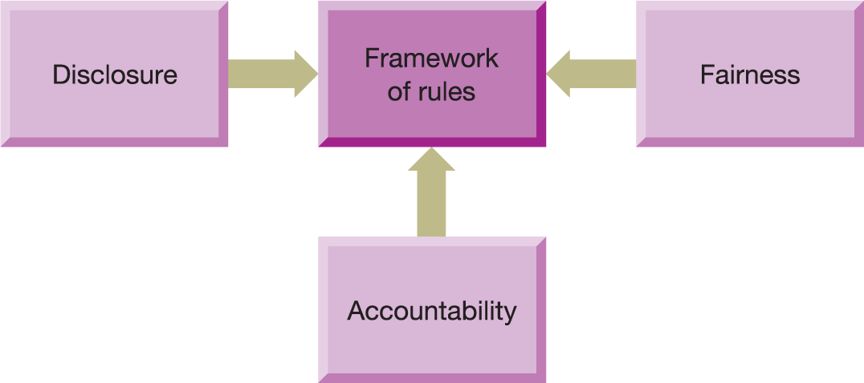
Figure 1.4 Principles underpinning a framework of rules
Notes:
Rules are set by individual jurisdictions, but generally will be underpinned by these principles
Disclosure of relevant information to parties who need to understand it
Fairness across different businesses (i.e. not unnecessary rules)
A mechanism to hold those responsible as accountable for their actions

Slide 33
The UK Corporate Governance Code
Aims to ensure that:
Powers and responsibilities of directors are clearly delineated
Appropriate checks and balances are in place
Source: Based on information in The UK Corporate Governance Code, July 2018, Financial reporting Council. www.frc.org.uk

Slide 34
The UK Corporate Governance Code
Covers five main areas
Board leadership and company purpose
Division of responsibilities
Composition succession and evaluation
Audit, risk and internal control
Remuneration
Source: Based on information in The UK Corporate Governance Code, July 2018, Financial reporting Council. www.frc.org.uk

Slide 35
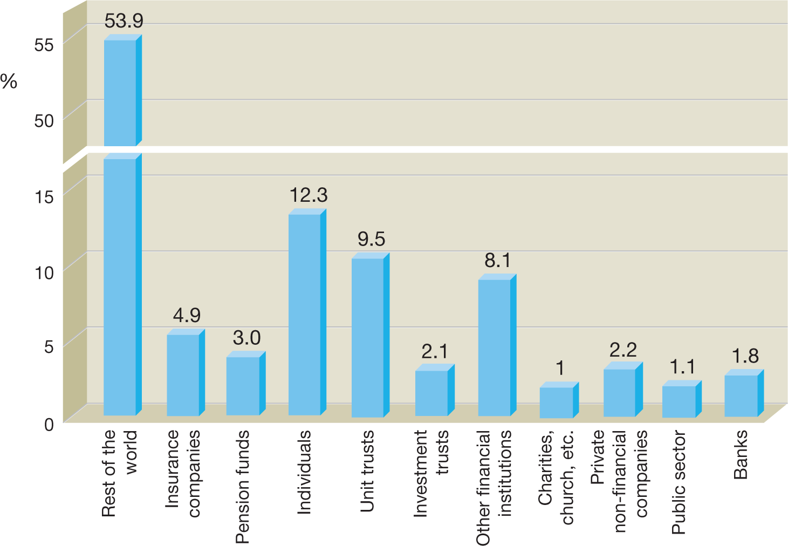
Figure 1.5 Ownership of UK listed shares, end of 2016
Source: Ownership of UK Quoted Shares 2016, Table 4, Office for National Statistics, 29 November 2017. Office for National Statistics licensed under
the Open Government Licence v3.0.

Slide 36
Exerting control over directors
Two main approaches available to shareholders:
Linking directors remuneration to share performance
Monitoring directors actions and controlling their use of business resources

Slide 37
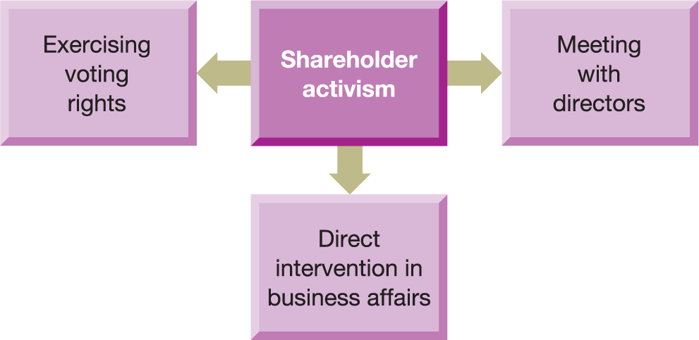
Figure 1.6 The main forms of shareholder activism

Slide 38
UK Stewardship Code
Relates to financial institutions:
establishing policies relating to stewardship and voting procedures, along with their periodic reporting
checking on investee businesses
deciding when stewardship activities should be intensified and when to act in concert with other shareholders
disclosing conflicts of interest arising from stewardship activities and how they are resolved

Slide 39
Coming Next…
4pm to 5pm – Introduction to the business simulation
5pm to 5.30pm - Break (Read the Enron article if you have not already done so)
5.30pm to 7.00pm – Financial Statements
7.00pm to 8.00pm - Simulation practice round in groups
8pm to 8.30pm – Live Q&A and feedback on simulation
8.30pm – Finish!

