Slide 1

MN7029 – Financial Decision Making
3.3 Financing a business (continued)

Slide 2

Lecture recordings
This session is being recorded
You can access the weekly recording from Weblearn
This Photo by Unknown Author is licensed under CC BY-SA

Slide 3

What sources or types of finance are available to a company?
Notes:
Reminder from last week – what can the students remember about sources/types of finance?

Slide 4
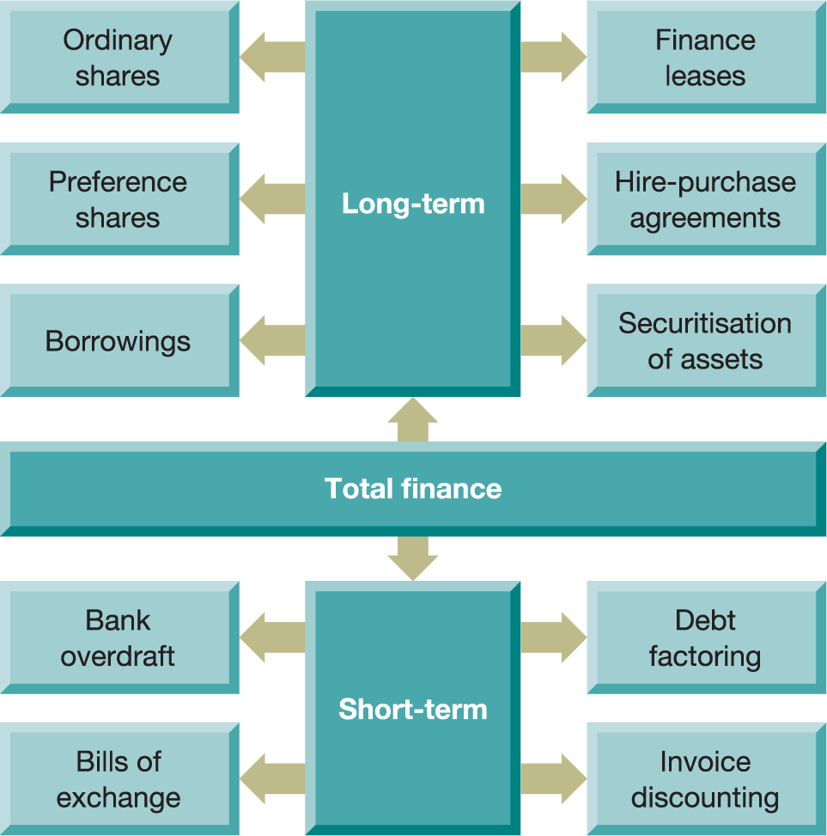
Figure 6.1 The major external sources of finance
Notes:
A reminder

Slide 5

What might a bank consider before lending money to a company?
Notes:
Question for class – what would a bank look at in a potential loan?

Slide 6
Bank lending
Attitude of lenders influenced by:
Profitability
Cash-generating ability
Security for the loan
Fixed cost commitments
Notes:
Lender will look at the profitability of the company, cash flows and whether there is any security available for the loan.

Slide 7
What can banks do to reduce risk?
Loan covenants may deal with such matters as:
Lenders may reduce the risk of lending by
Financial statements
Requiring security
(fixed or floating charge on assets)
Other borrowings
Including covenants in the loan contract
Dividend payments
Liquidity
Notes:
Examples of how bank reduce risk. They can take a security over a specific asset or assets in general (floating) like a mortgage, or they can put covenants into the loan agreement. Covenants tend to put restrictions on how a company will behave in order to protect the bank’s interests e.g. they need to provide the financial statements to the bank immediately after year end or they need to keep liquidity at a certain level, or they have restrictions on the dividend payments that can be made. If a company breaks covenants the bank can ask for the loan to be repaid immediately.

Slide 8
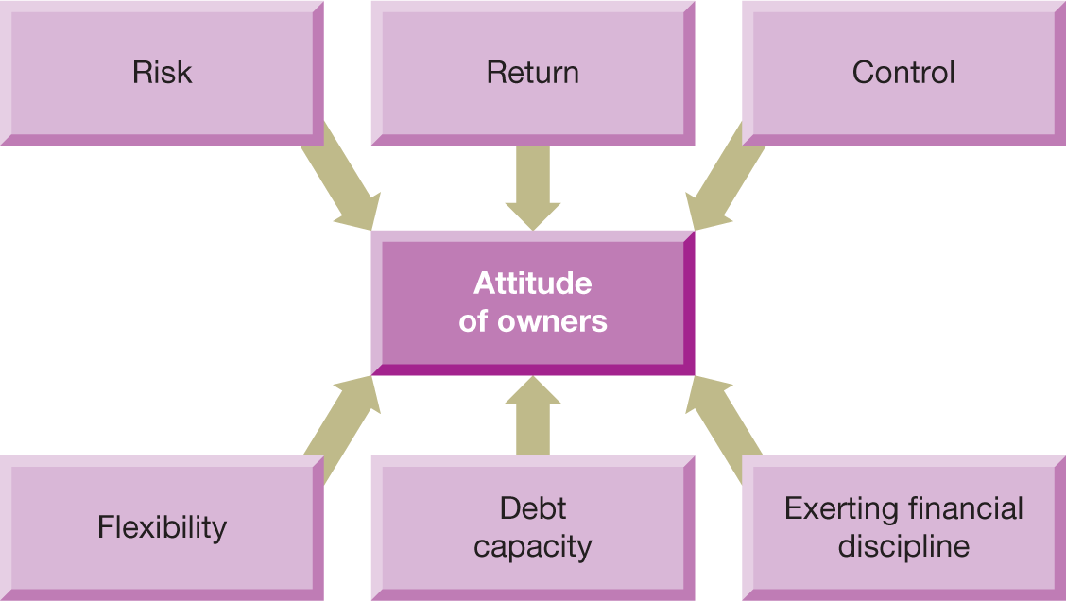
Figure 6.3 Factors influencing the attitude of owners towards borrowing
Notes:
These are some of the factors that can influence how the company feels about borrowing as a source of finance. It tends to have a lower return requirement than more risky equity finance and means that the existing owners do not need to give up ownership of the company (dilution of shareholdings). It can also be flexible (often loans have a draw down facility so that company’s only need to take the loan when they need it) and having a third party involved can encourage better financial discipline in the company. However, the company needs to be aware of how much capacity they have to take on extra debt – is the company already very highly geared and therefore lenders may be less disposed to lending more money due to risk?

Slide 9
Figure 6.1 The major external sources of finance
Notes:
There are other external sources of finance that a company can tap into. The next is finance leases, HP and securitisation

Slide 10
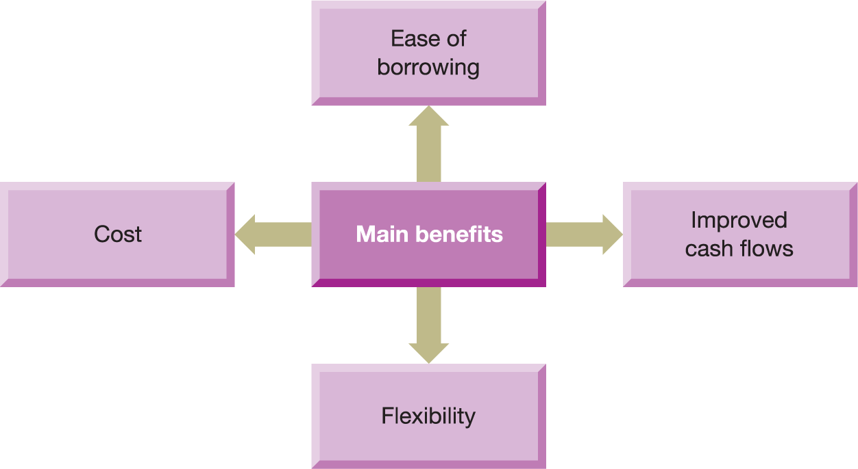
Figure 6.5 Benefits of finance leasing
Notes:
If a company for example wants to buy a fixed asset it could take out a loan and buy the asset. A finance lease on the other hand is where the financial institution buys the asset and rents it to the company, so the company never owns it. Often this can be easier than arranging a loan, it improves the company cash flows as the cost of the machine is spread across it’s life rather than all paid out to acquire the machine, and it gives flexibility e.g. if the company wants to upgrade to a better machine they don’t have to go through the bother of selling the original.

Slide 11
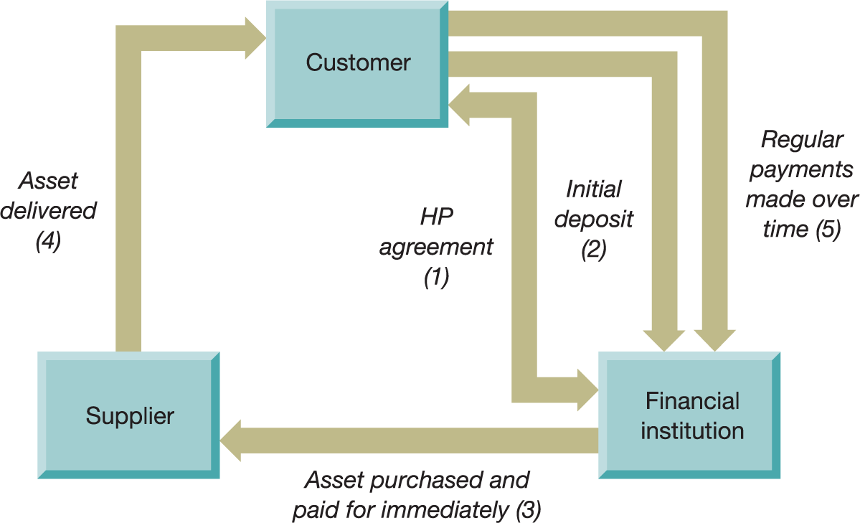
Figure 6.6 The hire purchase process
Notes:
HP is very similar – the financial institution buys the machine and the customer makes regular payments to the financial institution over the life of the asset. However, generally an HP agreements has a clause such that the company ends up owning the asset after a final payment is made.

Slide 12
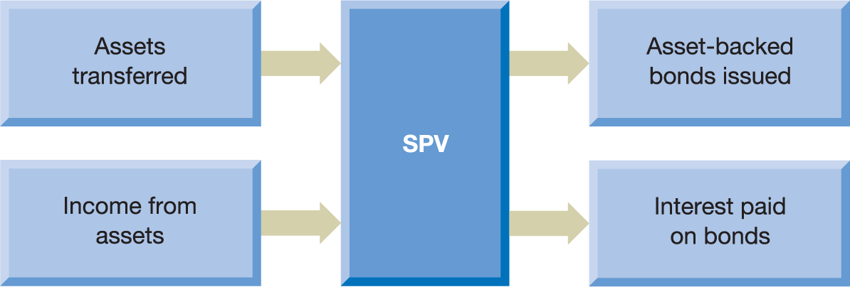
Figure 6.7 The securitisation process
Notes:
Securitisation is where a company creates a special purpose vehicle (SPV) which is usually a trust or a company, bundles up some assets and transfers them into the SPV and then issues bonds from the SPV to third parties. The assets in the SPV generate income which is then used to pay the interest on the bonds. It is a way generating capital from a bundle of assets and can be sued for example with a bunch of intangible assets such as licenses or IP. However this is similar to what happened during the financial crisis in 2008 when banks were bundling up bad mortgages and then selling bonds off the back of these bundles.

Slide 13
Figure 6.1 The major external sources of finance
Notes:
We can also consider short term external finance. A bank overdraft is fairly self explanatory – it is a short term loan which can be very flexible but may also be more expansive than properly arranging a loan facility with the bank. Bills of exchange are short term IOUs.

Slide 14
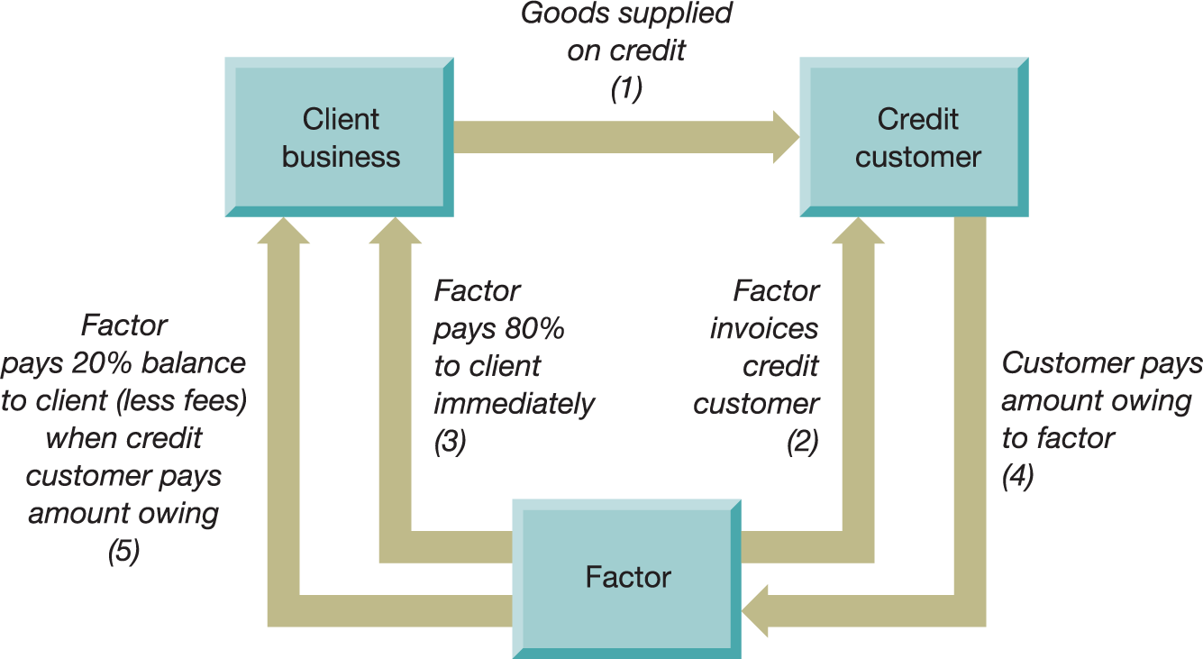
Figure 6.8 The factoring process
Notes:
Debt factoring is particularly popular with small businesses. Where a company supplies goods to customers on credit, it can enter into an arrangement with a financial institution or factor. The factor is responsible for invoicing the customer and pays 80% of the value of the invoice to the company immediately. Therefore the company does not need to wait until the credit period is up to get payment from customers. The factor then chases the customer for payment and when they pay the factor transfer the remaining 20% to the company less its factoring fees. This can be really useful for small companies who do not have a debt chasing department as it takes away all of that administrative work. However, it may also to signal to customers that the company is short of funding.

Slide 15
Debt factoring
Two types
Recourse factoring – where the business assumes responsibility for bad debts
Non-recourse factoring – where the factor assumes responsibility for bad debts
Notes:
Debt factoring can also be recourse – so if the debt factor does not get paid by the customer they can reclaim the money from the original company or non recourse where the debt factor bears the risk of an unpaid invoice – this is obviously preferable to the company but tends to be more expensive.

Slide 16
Invoice discounting
Invoice discounting is often preferred to debt factoring because:
It is confidential
Charges are lower
Control over all aspects of customer relationship is retained
Notes:
Invoice discounting is similar but the factor does not take over responsibility for issuing the invoice and chasing the debt – that remains with the original company, but the debt factor advances the money to the original company. This can be used when companies want to maintain control over their debt chasing

Slide 17
Long-term versus short-term borrowing
Considerations
Matching borrowing with assets held
Flexibility
Refunding risk
Interest rates
Notes:
Companies clearly have a choice between different methods of funding, some of which are long term and some short term. In deciding which is the most appropriate they might consider matching to borrowing with the asset – e.g. if it is for a long term capital investment project it might be best to look at a long term loan, rather than a bank overdraft. However if it is for a short term boost in stock they might go for a short term method such as bank overdraft. Short term finance can often be more flexible – the ability to repay an overdraft which you cannot necessarily do with a loan until it becomes due. Refunding risk occurs if a lender calls back the loan before maturity and the borrower cannot find a loan with a similar rate of interest and interest rates themselves might determine whether to do for short or long term, or equity v debt

Slide 18
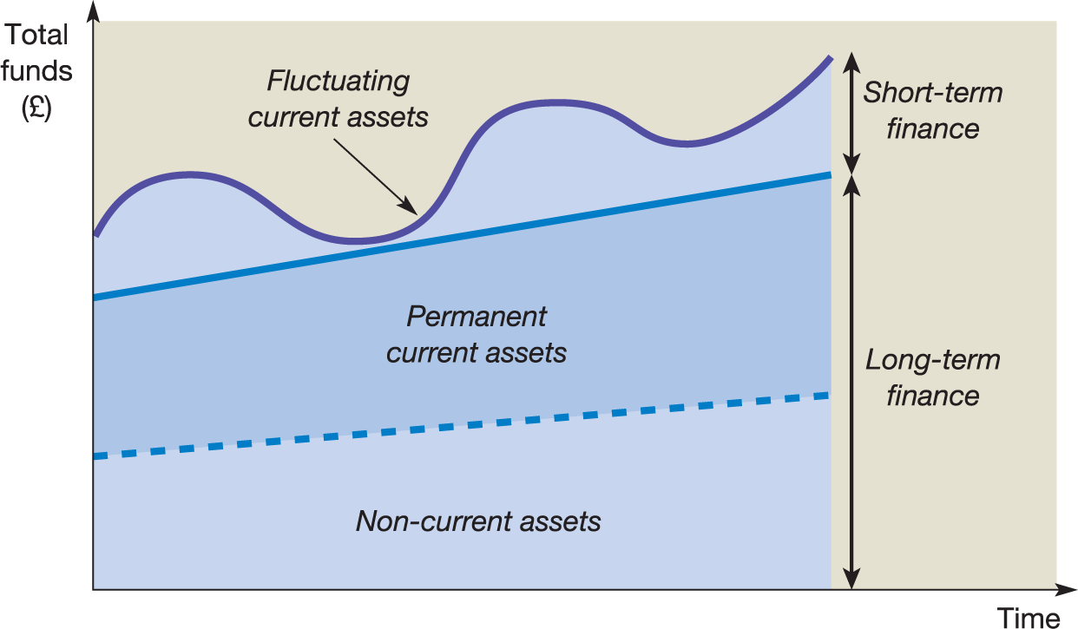
Figure 6.10 Short-term and long-term
financing requirements
Notes:
A typical; example of how short and long term financing might look might be to have a level of long term finance that covers both fixed assets and the permanent level of current assets e.g, the amount of stock that usually needs to be held. Short term finance is then used to finance any fluctuations in current assets.

Slide 19
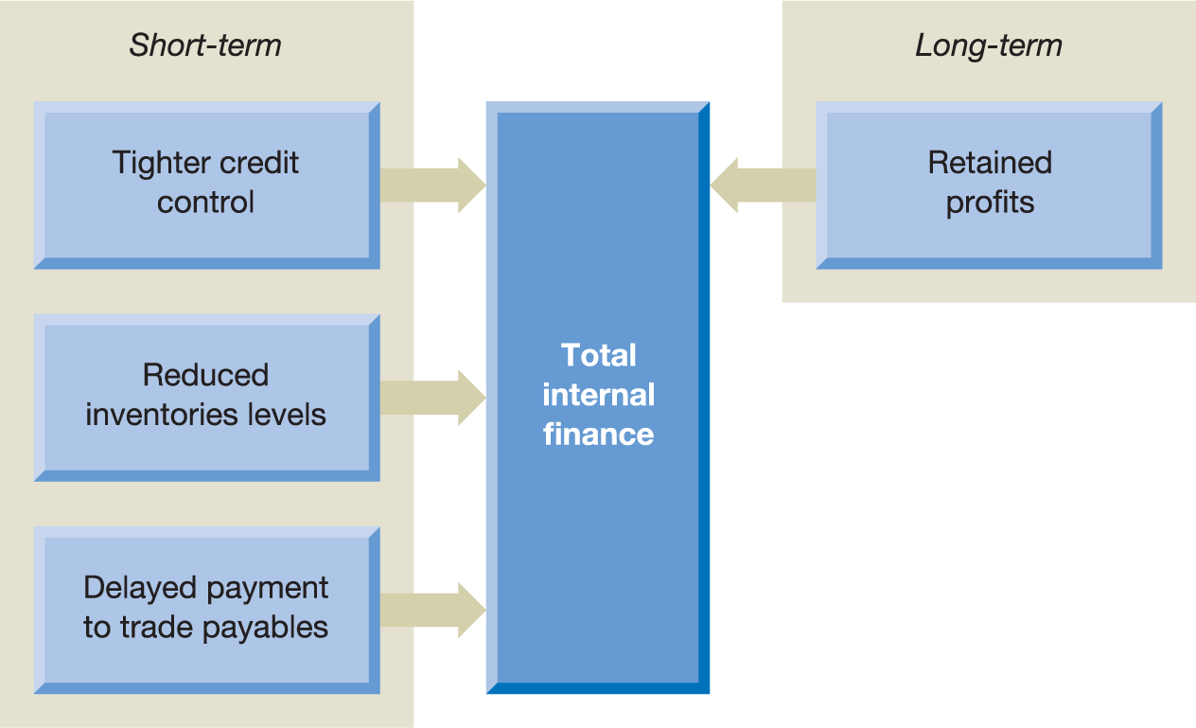
Figure 6.11 The major internal sources of finance
Notes:
We have looked so far only at external finance. However there are ways of generating finance without needing to go to third parties. On a short term basis reducing stock, collecting receivables and extending the period for trade payables will provide some financing. Ona long term kevel companies can choose to re-invest retained profits, however, always considering the impact of reinvestment on shareholder wealth.

Slide 20
Pecking order theory and long-term financing
Retained profits will be used to finance the business if possible
Where retained profits are insufficient, or unavailable, loan capital will be used
Where loan capital is insufficient, or unavailable, share capital will be used
Notes:
One final theory about how business use finance is Pecking order Theory. This states that businesses when requiring finding will first use retained profits as they are quick and easy to access, the loan capital as it is again relatively quick and more certain and finally share capital as this is the hardest and most costly to raise.

Slide 21

The funding journey
Notes:
In the next section e are going to look specially at funding for start up and early stage companies and where they might go to raise finance.

Slide 22






Start ups
Notes:
How does a start up raise initial funding – can you guess from the pictures. Answers clockwise from top left:
Friend and family
Seed money/venture capital
Bank loans
Grants or government incentives
Crowdfunding
Business angels

Slide 23
Figure 7.5 Long-term finance for smaller businesses
Financing smaller businesses
Crowdfunding
Venture
capital
Alternative
investment market
Business angels
Government

Slide 24

Hotel Chocolat (Video) https://www.youtube.com/watch?v=TOcxf7kL8VQ
Notes:
Video about how Hotel Chocolat raised initial funding – in particular I like to discuss with the class the innovation behind the Chocolate Bond and how they effectively self financed market research through the Chocolate club. You don’t need to watch the whole video – I generally stop it around 3:52.

Slide 25


Slide 26
Private equity – types of investment
Venture capital
Expansion capital
Replacement capital
Buy-out and buy-in capital
Rescue capital
Notes:
One course of funding for early stage, particularly tech companies is private equity. Private Equity refers to funds put together by financial institutions and generally funded by High Net Worth Individuals who invest in private companies. Private Equity covers a lot of different capital at different stages, but the most relevant for small companies is venture capital. This is private investment in early stage businesses who have the potential to grow. It can range from hundreds of thousands to millions and the fund will take a reasonable large slide of shares for the funding as it tends to be high risk. As businesses grow there are other forms of private equity available e.g expansion if the company is trying to grow or expand into a new jurisdiction, replacement capital where one fund buys out another, buy out capital which is provided if a management team want to buy the company from the existing owners or rescue capital for businesses in trouble.

Slide 27
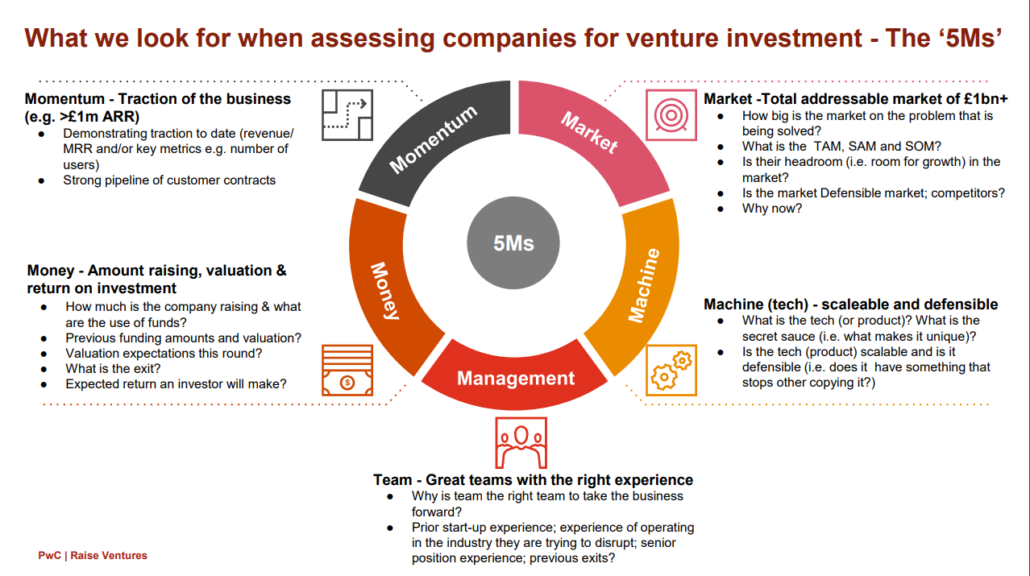
Notes:
This is a flier prepared by PwC to help companies understand what Venture capital firms are looking for when they consider an investment.

Slide 28
Problems of smaller businesses in raising finance
Lack of financial management skills
Lack of knowledge concerning the availability of finance
Inability to provide security
Inability to meet assessment criteria of lenders
Bureaucratic screening processes
Notes:
To sum up, some of the issues around smaller businesses raising capital – there is generally a lack of time and specific finance skills to understand where and how to raise capital as it can take a lot of time to secure a venture capital investment or a bank loan. Small business, particularly tech companies do not tend to have fixed assets they can offer as security and may not have much of track record or prior financial statements to convince lenders or inventors and for years many banks had quite bureaucratic screening processes which put small companies at a disadvantage.

Slide 29
Figure 7.9: External financing of small businesses
(2017/18)
18
16
Per cent
14
12
10
8
6
4
2
Bank loan/
commercial mortgage
Invoice finance
Grants
Loans from other third parties
Bank overdraft
Loans/equity from directors, family, friends
Credit cards
Leasing or
hire purchase
Source: British Business Bank 2017/18 (2018), ‘Small business finance markets (February)'. Figure B.16, p. 25, Used with permission.
Notes:
Overall, small businesses tend to rely on credit cards and bank overdrafts to get the business operational, but for those who have the potential for growth, seed funding, crowd funding or business angels may be available.

Slide 30

Cost of Capital
Notes:
In the next section we are going to look at the cost of the capital we have been discussing in the financing section.

Slide 31
What is cost of capital?
The cost to the business to of the finance needed.
Businesses tend to be financed through a mixture of equity (shareholder funds) or debt (bonds or borrowings from a bank, financial institution).
Shareholders will only invest if the business is likely to generate the return required by them. This is linked to the risk they perceive in the business and the opportunity cost of investing elsewhere. Therefore the cost of equity is the shareholders required return.
Banks or financial institutions require return in the form of interest on borrowings
The combined cost of these required returns is a company’s Cost of Capital

Slide 32
Video
Investopedia Cost of Capital explained
https://www.investopedia.com/terms/c/costofcapital.asp

Slide 33
Why do we need to know cost of capital?
It indicates the return required by shareholders and banks in order to provide funding
The cost of capital is therefore used as the discount rate for NPV;
If understated, may accept projects which decrease shareholder wealth;
If overstated may reject projects that would increase wealth.
Notes:
What is cost of capital? Ultimately it is the cost of all the company’s funding, both debt and equity as all types of funding carries a cost. However, it can be easier to think about it from the other angle – it is the return that a company needs to generate in order to satisfy the requirements of its debt and equity funders. If it cannot generate this return then they will not provide the funding to the company, therefore it doesn’t represent a cost in cash terms, but a return that the company needs to achieve
Practically speaking the cost of capital is the discount rate we use when we are calculating the Net present Value of a project. If we get it wrong we might make an incorrect decision. If we pick a rate that is too low we may go ahead with project that do not achieve the required return and therefore decrease shareholder value. If we get it too high we may reject projects that would otherwise have been wealth enhancing.
So far you have been given the discount rate or cost of capital but now we are going ton work out how to calculate it ourselves. The steps we take are to look at each form of long term capital, work out the cost of that particular type of capita and then calculate an overall cost for the business.

Slide 34
Steps to calculate cost of capital
  Identify each form of long term capital
  Deduce the cost of each form of capital
  Determine value of each form of long term capital;
  Calculate an overall cost of capital.
Notes:
The steps we take are to look at each form of long term capital, work out the cost of that particular type of capita and then calculate an overall cost for the business.

Slide 35
Cost of capital
The major forms of external long-term capital
Ordinary shares
Loan capital
In addition an important form of internal long-term capital is:
Retained earnings
Notes:
These are the 3 types of capital which we can calculate the cost of capital on. Next week we will look at how you deduce the cost of capital for each of these elements of long term finance

Slide 36
What’s Next…
Next week:
Session 4.1: Assessment 1 presentations
Session 4.2: Weighted Average Cost of Capital & Business simulation round 6

