Slide 1

MN7029 – Financial Decision Making for Managers
Session 3.1

Slide 2

Lecture recordings
This session is being recorded
You can access the weekly recording from Weblearn
This Photo by Unknown Author is licensed under CC BY-SA

Slide 3

Learning Outcomes
Explain the nature and importance of investment decision making
Identify and evaluate the four main investment appraisal methods
Use each of the four methods to reach a decision on a particular investment opportunity
Explain the key steps in the investment decision-making process

Slide 4




Maximising Shareholder Wealth
£1m funds available
Bank – interest rate ?%
Investment – return ??%
Dividend – shareholders decide where to invest… ??%
Notes:
A reminder – the role of the management is to maximise shareholder wealth. In order to do so excess funds either need to be invested in the bank, re-invested in the business in profitable opportunities or returned to the shareholders via dividend so they can make the decision where to invest for maximum return. To day we are looking at the second of these – investigating whether reinvestment in capital projects is going to achieve the aim of maximising the wealth of the shareholders so that the management team can decide whether to proceed.

Slide 5
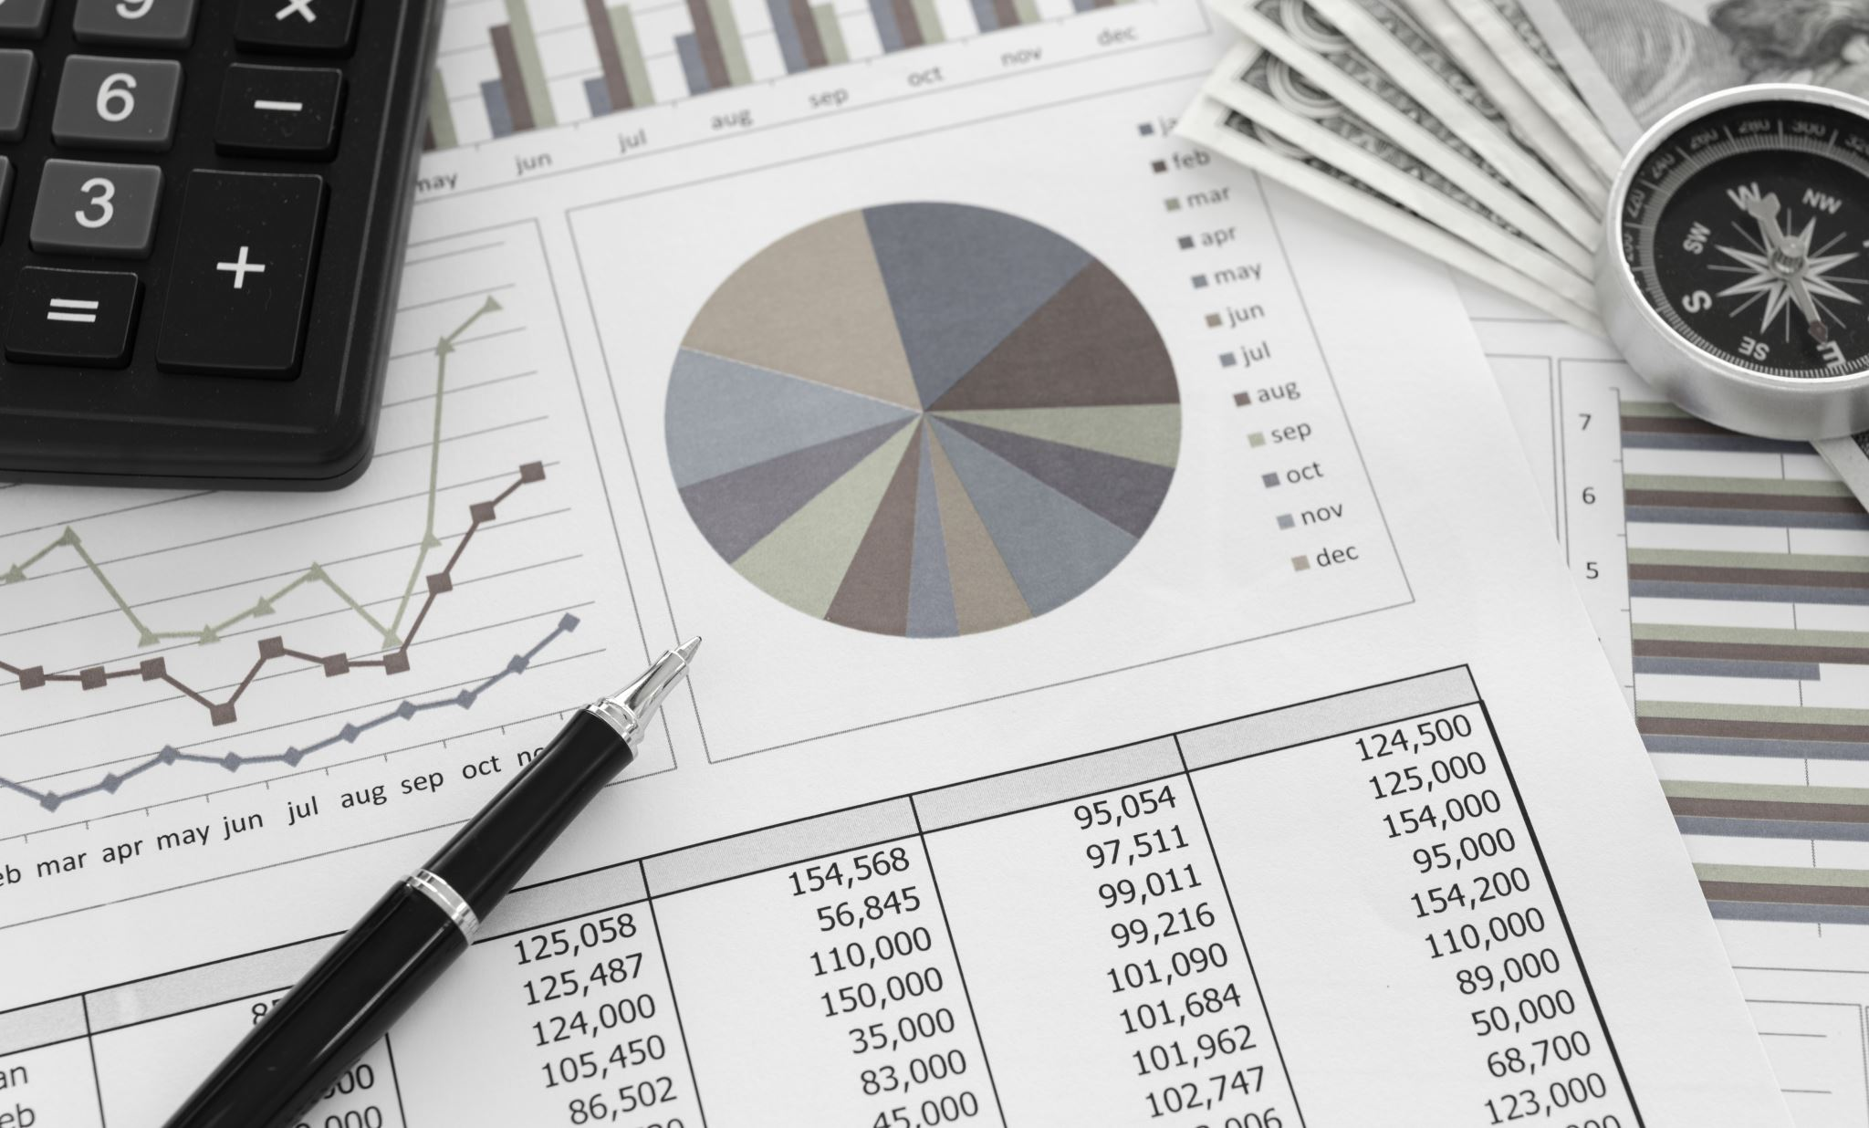
What is a capital investment project?
Notes:
Ask the class to see if any have ideas about what we are talking about

Slide 6

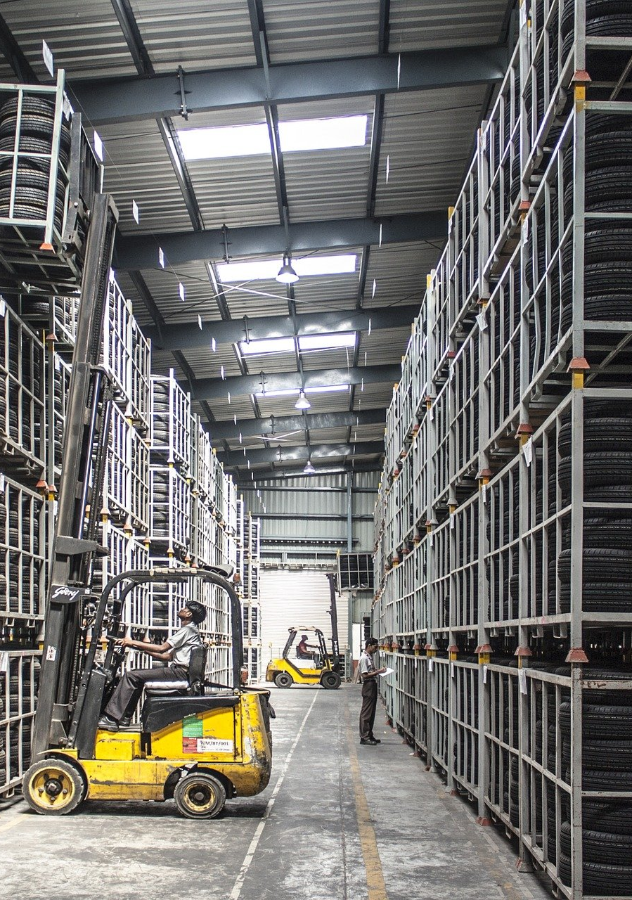

What is a capital investment?
Using money to buy fixed assets, or otherwise expand the business
Not day to day operational expenses (working capital)
Notes:
Capital investment is using money to buy fixed assets or expand the business in some way (e.g. undertake research in to a new product). It is not the working capital or every day expenses of the business

Slide 7
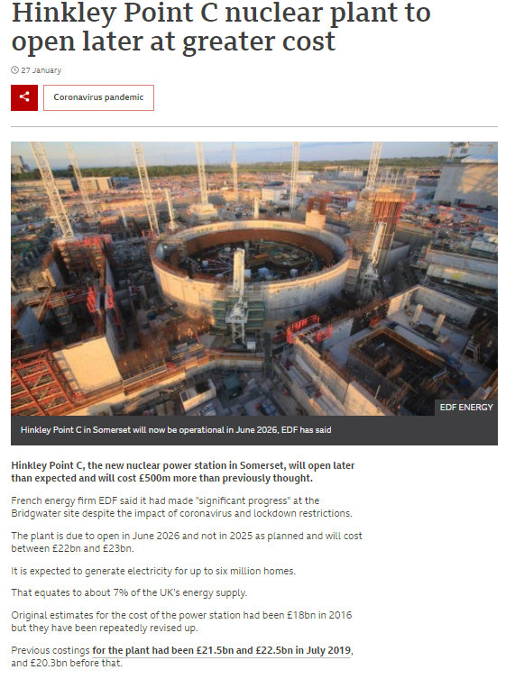

Sources: https://www.bbc.co.uk/news/uk-england-somerset-55823575
https://www.insidermedia.com/news/midlands/new-1.7m-starbucks-site-sold
Notes:
Some capital investment projects take years and years and cost huge amounts of money – building this nuclear plant is a capital investment project and will take 10 years and cost between £22 and £23bn. Starbucks opening a new coffee shop is also a capital investment project but only takes 6 months and costs £2.7m which is being funded from the company’s own available cash.

Slide 8
The nature & importance of investment decisions
Large amounts of resources are often involved
Relatively long timescales are involved
Often difficult or expensive to bale out of an investment once undertaken
Notes:
Why are these decisions important?

Slide 9
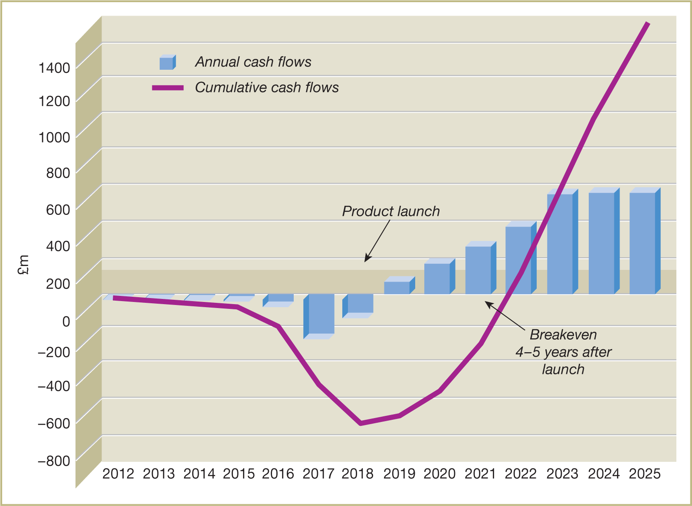
Figure 4.1 Annual and cumulative cash flows over time
for the development of a successful therapeutic drug
Source: Adapted from: ‘Biotech Economics and Valuation’ Massachusetts Biotechnology Council and L.E.K. Consulting, August 2009, p. 3. Reprinted with permission from L.E.K. Consulting. L.E.K. Consulting is a registered trademark of L.E.K. Consulting, LLC. All other products and brands mentioned in this document are properties of their respective owners.
© 2016 L.E.K. Consulting, LLC. All rights reserved.
Notes:
Research into new drugs is another example of a capital investment project which takes years. This example shows expenditure on drug research over 6 years before product launch and then another 4-5 years after the before the drug breaks even

Slide 10
Capital Budgeting
https://www.investopedia.com/terms/c/capitalbudgeting.asp
Notes:
Investopedia video on capital budgeting

Slide 11
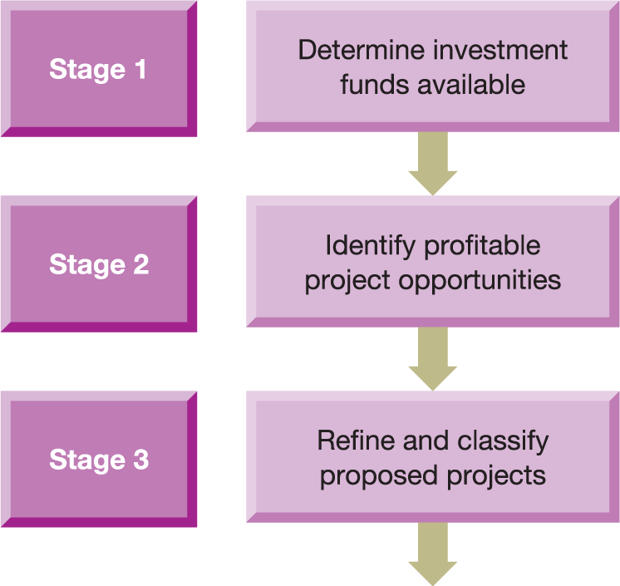
Figure 4.8 Managing the investment decision
Notes:
How does this fit into decision making? Companies will go through this process:
Determine how much cash is available
Identify projects that could be undertaken
Get more detail on each of the potential projects

Slide 12
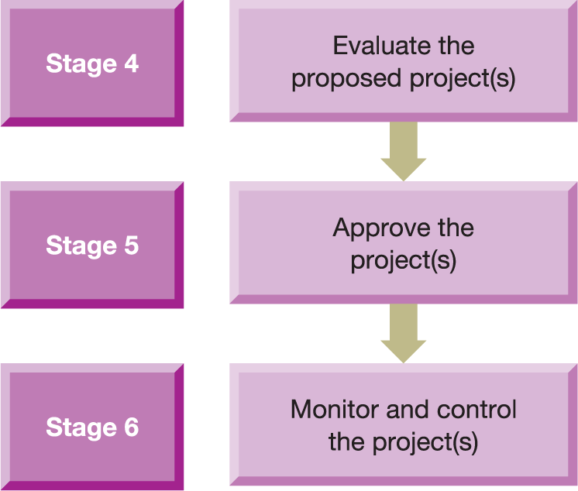
Figure 4.8 Managing the investment decision (Continued)
Notes:
4. Use the tools we are about to look at to evaluate and rate the projects
5. Make a decision on which one(s) to proceed
6. Monitor the budget and control the project

Slide 13
Investment appraisal methods
Four methods of evaluation
Accounting rate of return (ARR)
Payback period (PP)
Net present value (NPV)
Internal rate of return (IRR)
Notes:
These are the 4 methods we use to evaluate the projects – we will look at each one in turn

Slide 14
Accounting rate of return (ARR)
Average annual operating profit
Average investment to earn that profit
Average annual operating profit
Average investment to earn that profit
ARR =
ARR =
× 100%
× 100%
Notes:
The first is a traditional accounting method of project evaluation. This is the Accounting Rate of Return – it takes the average operating profit for each year of the project and divides by the average investment. This is then multiplied to give a percentage return. It is very similar to Return on Capital Employed which we looked at in financial ratios

Slide 15
ARR example
Year | Cost | Operating profit
Now (Year 0) | (160,000)
Year 1 |  | 20,000
Year 2 |  | 40,000
Year 3 |  | 60,000
Year 4 |  | 60,000
Total |  | 180,000
I am deciding whether to buy a new machine for £160,000
In years 1 to 4 it generates the profit to the left totalling £180,000. On average this is £45,000 per year
Average investment is (Cost of machine + any disposal value )/2 which is £80,000
$\frac{45,000}{80,000}$ x 100 = 56.25%
Notes:
A machine costs £160k. If I buy it now (which we refer to as Year 0) I will be able to generate profits for the next four years as per this table. The total profits generated are £180k and if we divide by 4 we get an average profit per year of £45k. The average investment is calculated by the value of the machine at the start (£160k) and the value at the end (in this case there is no scrap value so 0) and finding the average i.e. add together and divide by 2 (£80k). Finally the ARR is calculated by dividing the average profit by the average investment and multiplying it by 100. This project has an ARR of 56.25%, meaning a return of £56 earned on the average capital. This in itself does not tell us however whether we should proceed with the project.

Slide 16
ARR decision rule
For a project to be acceptable, it must achieve at least a minimum target ARR
Where competing projects exceed the minimum rate, the one with the highest ARR should be selected
Notes:
In order to decide whether to proceed we need a decision rule. In the case of ARR, companies need to set a target. If the project ARR exceeds the target it can go ahead. In the case of 2 projects, you would choose the one with the largest ARR.

Slide 17
Problems with ARR
Ignores the timing of cash flows
Use of average investment
Use of accounting profit
Competing investments
Notes:
Problems:
Uses accounting profit rather than cash (which is more subjective) and ignores the timing – we will talk much more on timing issues later
It also has uses average investment which is not a real cash flow and doesn’t necessarily help us choose between competing investmnets

Slide 18
Payback period (PP)
Time taken for initial investment to be repaid out of project net cash inflows
Payback period (PP)
Notes:
Payback period is even more simple – it calculates how long it takes for the cash spent on the project to be repaid by the cash flows coming in on the project.

Slide 19
Example 4.1 (Atrill p150)
Time |  | £’000 | Cumulative
Immediately | Cost of machine | (100)
In 1 year | Net cash inflow | 20
In 2 years | Net cash inflow | 40
In 3 years | Net cash inflow | 60
In 4 Years | Net cash inflow | 60
In 5 years | Net cash inflow | 20
Notes:
The easiest way to calculate this is to present it like this. In Year 0 we have a cash outflow as we have purchased a machine for £100k. We then get cash coming in from the project over the next 5 years. We add a cumulative column to see how long it takes tp offset the cash out.
Ask class to fill in a couple of cumulatives

Slide 20
Example 4.1 (Atrill p150)
Time |  | £’000 | Cumulative
Immediately | Cost of machine | (100) | (100)
In 1 year | Net cash inflow | 20 | (80)
In 2 years | Net cash inflow | 40 | (40)
In 3 years | Net cash inflow | 60 | 20
In 4 Years | Net cash inflow | 60 | 80
In 5 years | Net cash inflow | 20 | 100
Payback Period is 3 years. If we received the £60k evenly over year 3 (i.e. £5k per month) it would take 8 months to receive £40k and PP is therefore more accurately 2 years and 8 months

Slide 21
PP decision rule
Project should have a shorter payback period than the required maximum payback period
If competing projects have payback periods shorter than maximum payback period, the one with the shortest payback period is selected
Notes:
As with ARR the payback period itself doesn't give us an answer whether tp proceed with the project. We need a decision rule. Companies need to get a target payback period and provided the project payback period is shorter we can proceed. If we have two competing projects we would choose the one with the shorter period.

Slide 22
Problems with PP
Does not take timing of cash flows fully into account
Ignores cash flows after PP
Does not take risk fully into account
Not related to wealth maximisation objective
Arbitrarily determined target payback period
Notes:
This also has problems.
The first two are illustrated over the next slides
It is subjective because the company chooses the target and it doesn’t take into account risk – e.g. one project may have a shorter PP but be riskier.
It is not directly related to wealth maixmisation

Slide 23
Comparing 3 projects with Payback Period (p158)
Time |  | Project 1 £’000 | Project 2 £’000 | Project 3 £’000
Immediately | Cost of machine | (200) | (200) | (200)
In 1 years time | Cash inflow | 70 | 20 | 70
In 2 years time | Cash inflow | 60 | 20 | 100
In 3 years time | Cash inflow | 70 | 160 | 30
In 4 years time | Cash inflow | 80 | 30 | 200
In 5 Years time | Cash inflow | 90 | 30 | 460
Notes:
Take these three projects as an example. All have an initial outlay of £200k and generate cash flows as shown in the table

Slide 24
Comparing 3 projects with Payback Period (p158)
Time |  | Project 1 £’000 | Cumulative | Project 2 £’000 | Cumulative | Project 3 £’000 | Cumulative
Immediately | Cost of machine | (200) | (200) | (200) | (200) | (200) | (200)
In 1 years time | Cash inflow | 70 | (130) | 20 | (180) | 70 | (130)
In 2 years time | Cash inflow | 60 | (70) | 20 | (160) | 100 | (30)
In 3 years time | Cash inflow | 70 | 0 | 160 | 0 | 30 | 0
In 4 years time | Cash inflow | 80 |  | 30 |  | 200
In 5 Years time | Cash inflow | 90 |  | 30 |  | 460
Notes:
If we do the payback period calculation, all have a payback period of 3 years so we are indifferent as to which one we would chose.

Slide 25
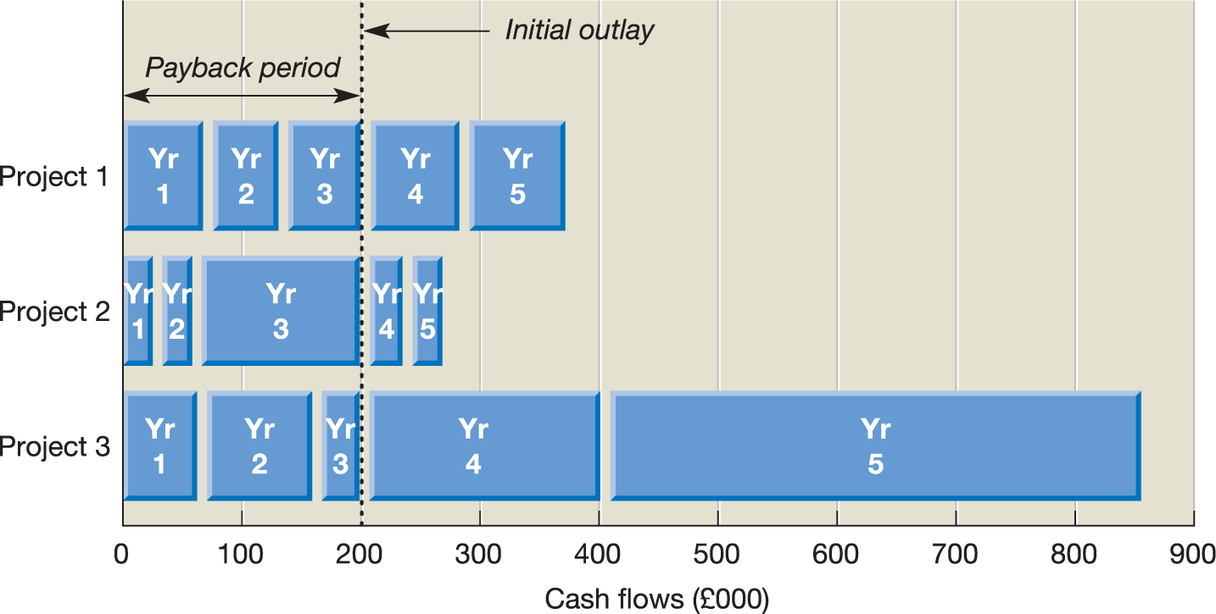
Figure 4.2 Cumulative cash flows for each
project in Activity 4.6
Source: Adapted from Atrill, P. and McLaney E. (2009) Accounting: An Introduction, 5th edn, Pearson Education.
Notes:
However if we present the payback like this we can see that project 3 has a much larger payout after the payback period – this is effectively ignored by the payback period method. Also Project 2 has most of the back in period 3, whereas project 1 and 3 have a more even spread. This problem with the payback period method leads us to consider the time value of money.

Slide 26

Both methods assume that £100 received in Year 4 is the same as £100 received in Year 1.
But is it?
Notes:
The methods we have looked at until now assume that £100 received in year 4 is the same as £100 received now. Is this the case.
As the class – If I offer you either £100 now or £100 in 4 years, which would you choose? Why?

Slide 27

Notes:
Video about time value of money

Slide 28
NPV investment appraisal method
Considers all of the cash flows for each investment opportunity
Makes a logical allowance for the timing of those cash flows
Notes:
The next methods we will consider is Net Present Value and this has an advantage over payback period as it takes into account all the cash flows and when they are received.

Slide 29
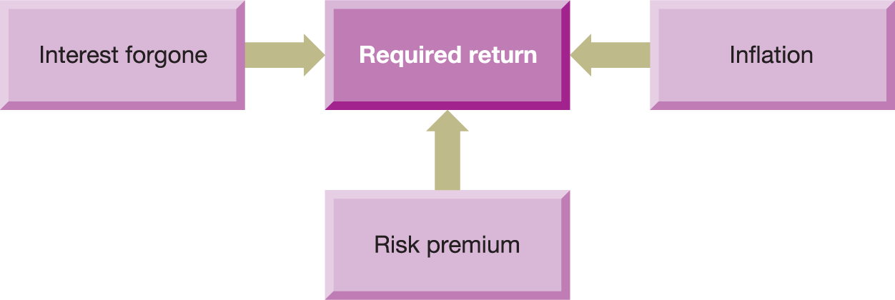
Figure 4.3 Factors influencing the return required by investors from a project
Source: Atrill, P. and McLaney, E. (2009) Accounting an Introduction, 5th edn, Pearson Education.
Notes:
What causes us to place different values on cash depending on when it is received? The three elements to the time value of money are as above (explained on next slide)

Slide 30
Time value of money
Interest lost – an investment return must exceed the opportunity cost of doing something else with the money e.g. if a company could get a return of 5% simply by putting it in the bank, they should only make the investment if the return exceeds that.
Risk – All investments have risk – there could be risks that the projections do not work out as planned, or that a piece of machine could break down, or a pandemic could hit… When making an investment the manger must consider the risk and will expect a higher return the higher the risk.
Inflation – the loss in the purchasing power of money means that £100 in one year will not be able to buy the same amount as £100 now, therefore returns must compensate for this.
Notes:
Explanation of time value

Slide 31
Maximising Shareholder Wealth
£1m funds available
Bank – interest rate 1%
Investment – return ??%
Dividend – shareholders decide where to invest… ??%
Rate of return > Pure Time Value + Inflation+ Risk Premium
Notes:
Going back to our decision making, the investment return must compensate for the opportunity cost, inflation and risk

Slide 32
The present value of a cash flow
The NPV method looks at each cash flow and when it arises in the future and assigns a present value to it.
For example receiving £105 in Year 1, might only be equivalent to receiving £100 today. We then add up all those cash flows to give a total value of the project today
PV of the cash flow of year n = actual cash flow of year n divided by (1 + r) ^{n}
Notes:
NPV applies time value by examining each future cash flow and assigning a value to it to represent what it is worth today (i.e. the present value). For example receiving £105 in a year’s time might be equivalent to receiving £100 today – we need to receive more in the future to equate to the same value. The equation for calculating today’s value of a future cash amount is shown here. r represents an appropriate discounting rate to take account of inflation, opportunity cost and risk

Slide 33
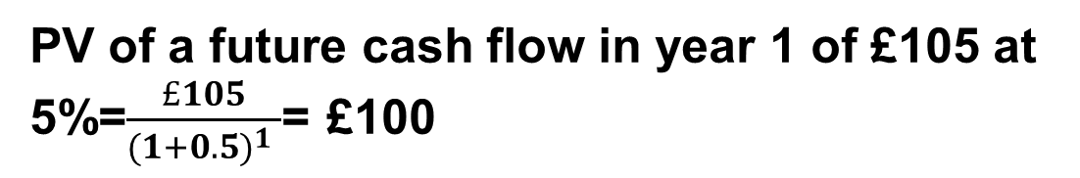

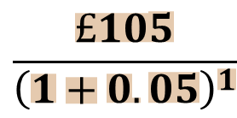
The future value of a deposit
FV of a deposit of £100 at 5%= £100(1+0.05)^{n}
In year 1 (n=1) the FV is £105, in year 2 the FV is £110.25 and so on
$$\frac{£105}{{\left(1+0.05\right)}^{1}}$$
Notes:
It can sometimes help to look at this in the other direction. If I deposit £100 today (Year 0) at a rate of 5% in one year the future value is £105, in 2 years £110.25. This is compounding forwards. Discounting works the other way – if I expect to receive £105 in one year at a rate of 5% how much do I need to deposit (or spend in the case of our capital investment) today to get that £105

Slide 34
Ways to calculate Present Value
Using discount tables
Using the formula
Using calculations in Excel
Using Excel formulas
Notes:
I am going to show you 4 ways to calculate the net present value of the future cash flows of an investment. All give the same answers so you can use whichever method you are most comfortable with.

Slide 35
Using discount tables
Prepare the cash flow for each year of the project
Select the column representing the discount rate (cost of capital) you will use in the table
For each period find the multiplier and multiply the cash flow for that period by it
Add up all of the present values to give you the Net Present Value (NPV)
Apply rule - If NPV is positive, it increases shareholder wealth therefore accept project.
Notes:
Steps to calculate NPV using discount tables

Slide 36
Example of NPV using 20%
Time | Cash flow £’000 | Multiplier (from the discount table) | Present value
Immediately (year 0) | (100) | 1 | (100)
1 Years time | 20 | 0.833 | 16.66
2 Years time | 40 | 0.694 | 27.76
3 Years time | 60 | 0.579 | 34.74
4 Years time | 60 | 0.482 | 28.92
5 Years time | 40 | 0.402 | 16.08
Total - NPV |  |  | 24.16
Time
Project 1 £’000
Project 2 £’000
Project 3 £’000
Investing in the machine will increase wealth of business and owners by £24,160 therefore accept.
Notes:
Walk through the example making sure students can identify where each multiplier is coming from on the discount table. Make the point that to finalise this NPV calc you need to add up the Present Value and deduct the original cost of the machine – students seem to forget the final step.

Slide 37
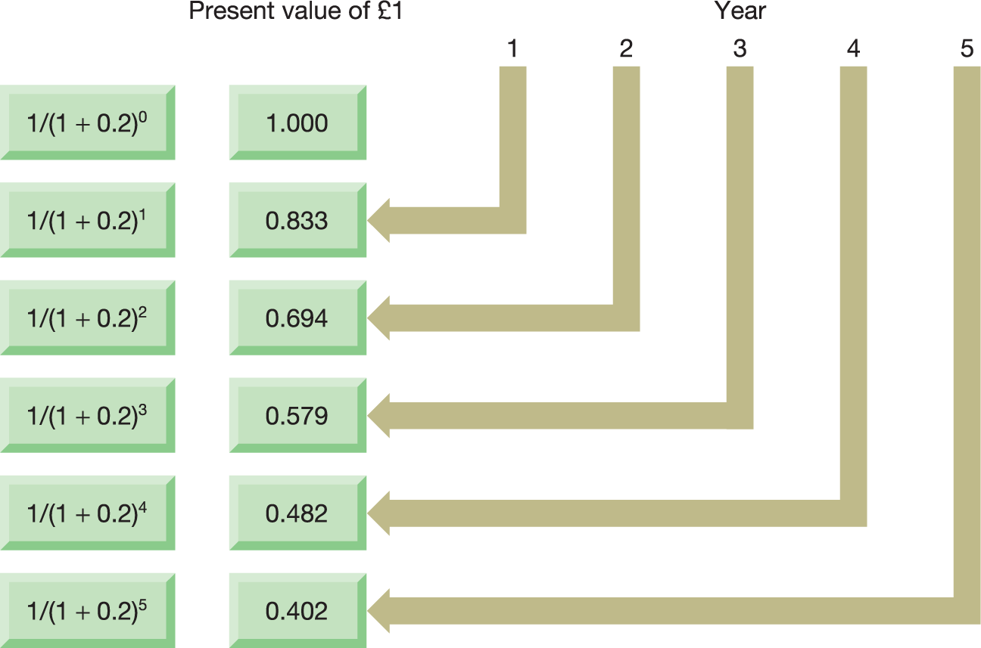
Figure 4.4 Present value of £1 receivable at
various times in the future, assuming an annual
financing cost of 20 per cent
Notes:
This demonstrates that the discount rates are really just a short cut to the formula that we look at next.

Slide 38
Using mathematical equation
Prepare the cash flow for each year of the project
Calculate the PV of each
Add up all of the present values to give you the Net Present Value (NPV)
Apply rule - If NPV is positive, it increases shareholder wealth therefore accept project.
Notes:
If you prefer, rather than using the discount rates, you can take a step even further back and use the equation that the discount rates are derived from. Again you still need to prepare a cash flow and then you calculate the PV for each year and then add them all up

Slide 39
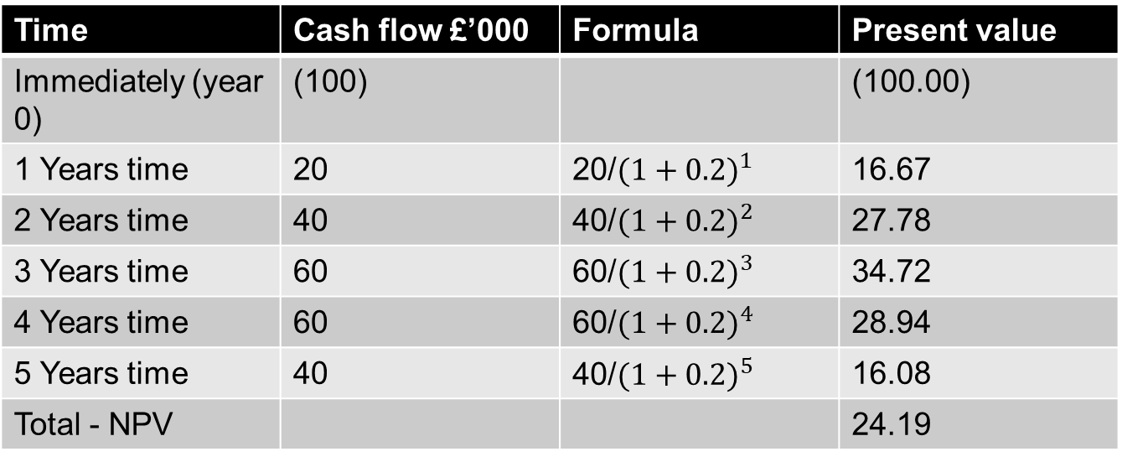
Time | Cash flow £’000 | Formula | Present value
Immediately (year 0) | (100) |  | (100.00)
1 Years time | 20 | 20/${(1+0.2)}^{1}$ | 16.67
2 Years time | 40 | 40/${(1+0.2)}^{2}$ | 27.78
3 Years time | 60 | 60/${(1+0.2)}^{3}$ | 34.72
4 Years time | 60 | 60/${(1+0.2)}^{4}$ | 28.94
5 Years time | 40 | 40/${(1+0.2)}^{5}$ | 16.08
Total - NPV |  |  | 24.19
Investing in the machine will increase wealth of business and owners by £24,190 therefore accept.
If NPV is positive, project should be accepted.
If comparing two projects with positive NPV accept the higher.
Notes:
You will get the same answer as using the discount tables – the tables are really just a short cut from this method.

Slide 40
Mathematical equation in excel
 | A |  |  | B
Time | Cash flow | 1 + discount rate | To the power of | Equals | Present value (A/B)
Year 0 | -100 | 1.2 | 0 | 1.00 | -100.00
Year 1 | 20 | 1.2 | 1 | 1.20 | 16.67
Year 2 | 40 | 1.2 | 2 | 1.44 | 27.78
Year 3 | 60 | 1.2 | 3 | 1.73 | 34.72
Year 4 | 60 | 1.2 | 4 | 2.07 | 28.94
Year 5 | 40 | 1.2 | 5 | 2.49 | 16.08
Total |  |  |  |  | 24.18
=POWER(1.2,1)
Notes:
If you like Excel you can calculate the present values using the POWER formula

Slide 41
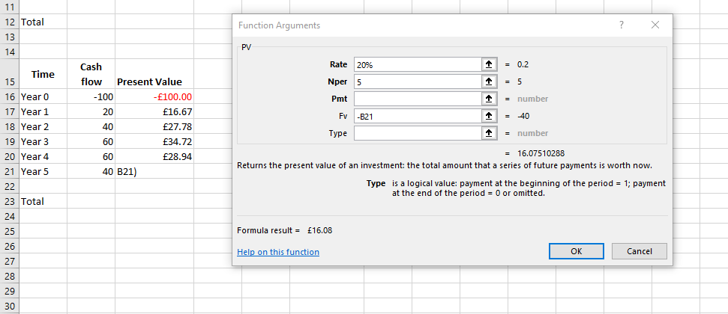
PV Function in Excel
Notes:
Even more easily you can use the function Present Value or PV in Excel. Once you have brough up the function box you fill in the rate, the year in Nper and the future value (i.e. the future cash flow) and the formula will calculate the PV for you.
There is a detailed step by step video on Weblearn showing you how to use this function in Excel.

Slide 42
NPV decision rule
If NPV is positive, it increases shareholder wealth therefore accept.
If competing projects are positive, the one with the highest NPV is selected
Notes:
NPV shows whether the future cash flows from a project will increase the value of a company at today’s values. Therefore, any project that has a positive NPV will increase the value of the company and increase shareholder wealth and should therefore be accepted. If there are competing projects you should choose the one with the higher NPV as that increases wealth more than the other.

Slide 43
Why NPV is better than ARR and PP
NPV fully addresses each of the following:
The timing of the cash flows
The whole of the relevant cash flows
The objectives of the business
Notes:
NPV has a number of advantages over the other methods so far

Slide 44
Internal rate of return (IRR)
The discount rate, which, when applied to the future project cash flows, produces a zero NPV
Internal rate of return (IRR)
Notes:
The final tool we use is linked to NPV. Internal Rate of Return shows the discount rate that would give a NPV of zero

Slide 45
Time | Cash flow | Present Value at 20% | Present Value at 25% | Present Value at 30% | Present Value at 35%
Year 0 | -100 | -£100.00 | -£100.00 | -£100.00 | -£100.00
Year 1 | 20 | £16.67 | £16.00 | £15.38 | £14.81
Year 2 | 40 | £27.78 | £25.60 | £23.67 | £21.95
Year 3 | 60 | £34.72 | £30.72 | £27.31 | £24.39
Year 4 | 60 | £28.94 | £24.58 | £21.01 | £18.06
Year 5 | 40 | £16.08 | £13.11 | £10.77 | £8.92
Total |  | £24.18 | £10.00 | -£1.86 | -£11.87
On a particular project, the higher the discount rate used, the lower the NPV, until it will eventually move into a loss
Notes:
This si easiest to see in an example. When we calculated the NPV of the project we calculated that at a rate of 20% the project had an NPV of £24,180. If we increased the discount rate then the NPV starts to fall, so at 25% it is £10,000 and eventually it becomes negative – at 30% it is negative £1,860. Therefore, there must be a discount rate that will give an NPV of Zero – i.e. the barrier between accepting and rejecting the project. This either needs to be done by trial and error – as above – we can guess that the IRR will be slightly lower that 30%, probably around 29% based on those figures, or we can use Excel and there is a video that shows you how to do this on Weblearn.

Slide 46
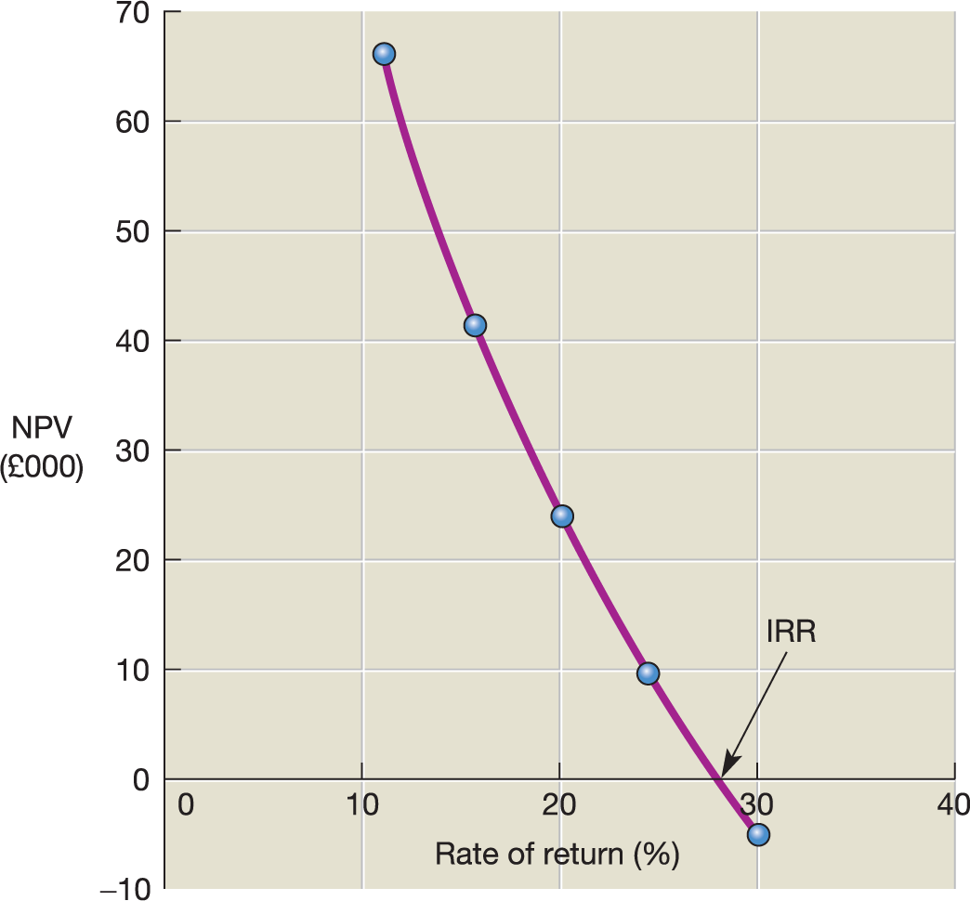
Figure 4.5 The relationship between
the NPV and IRR methods
Source: Adapted from Atrill, P. and McLaney E. (2009) Accounting: An Introduction, 5th edn, Pearson Education.
Notes:
If we wre to plot NPV and rate of return on a graph we can see where it crosses the X axis is the IRR

Slide 47
IRR decision rule
Project must meet a minimum IRR requirement
(The opportunity cost of finance)
If competing projects exceed minimum IRR requirement, the one with the highest IRR is selected
Notes:
Again we need a decision rule and again in this case it is a target set by the company.

Slide 48
IRR decision Making
Present Value at 30%
-£100.00
£15.38
£23.67
£27.31
£21.01
£10.77
-£1.86
On this project, IRR is about 30% - if this is higher than the minimum target the project should go ahead
If competing projects, the one with the highest IRR should be selected.
Notes:
Explanation of decision making

Slide 49

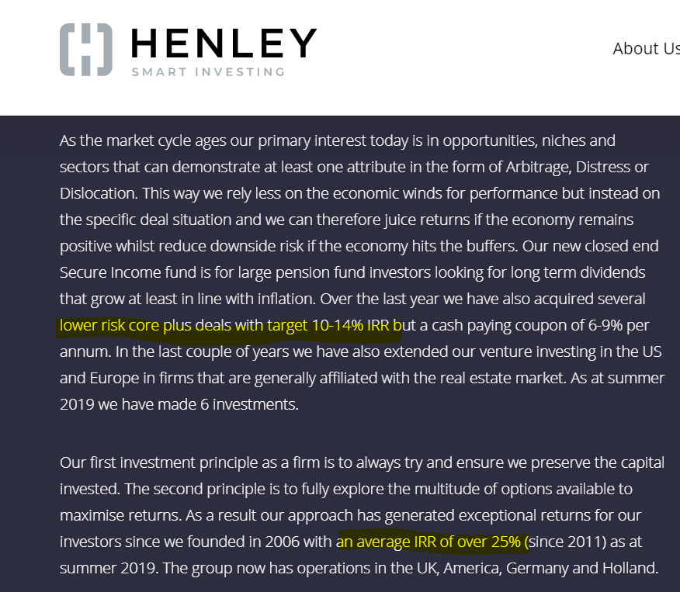
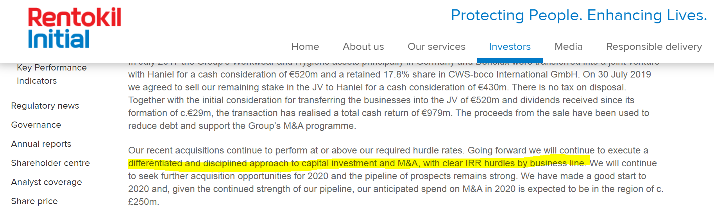
Notes:
An example of where companies use IRR in decision making e.g. Legoland owned by Merlin have a target IRR of 14% on their capital investments. Rentokill use IRR hurdles in different departments to reflect different risk profiles

Slide 50
Problems with IRR
Does not directly address wealth maximisation
Ignores the scale of investment
Has difficulty with unconventional cash flows
Notes:
Problems with IRR
Unconventional cash flows have two or more changes of sign in the cash flows

Slide 51
Some practical points related to investment appraisal
Cash flows not profit flows
Past costs
Common future costs
Year-end assumption
Opportunity costs
Interest payments
Taxation
Other factors
Notes:
Practical points:
Do not include past costs – these are gone. Only include future costs
Do not include common future costs e.g. if you have a worker on the project who you would need to pay anyway this does not get included in the calculation.
Do include opportunity costs. If buying a new machine means you can sell the old one, that is additional revenue you can include
Tax is something to consider in real life, but too complicated to go into here.
Remember NPV and IRR and PP use cash flows, not accounting profit
Year end assumptions relate to things like additional working capital needed, we have-not gone into this here
Interest payments again have not been looked at here
Remember that finance is just one element – there may be other factors you need to consider

Slide 52
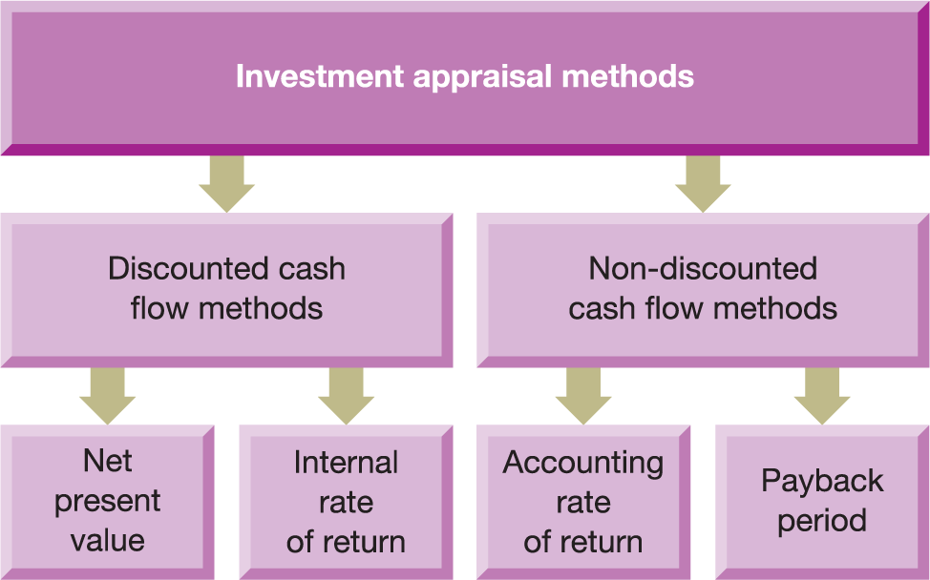
Figure 4.7 The main investment appraisal methods
Source: Adapted from Atrill, P. and McLaney, E. (2013) Accounting and Finance for Non-Specialists, 8th edn, Pearson Education.
Notes:
A summary of methods

Slide 53
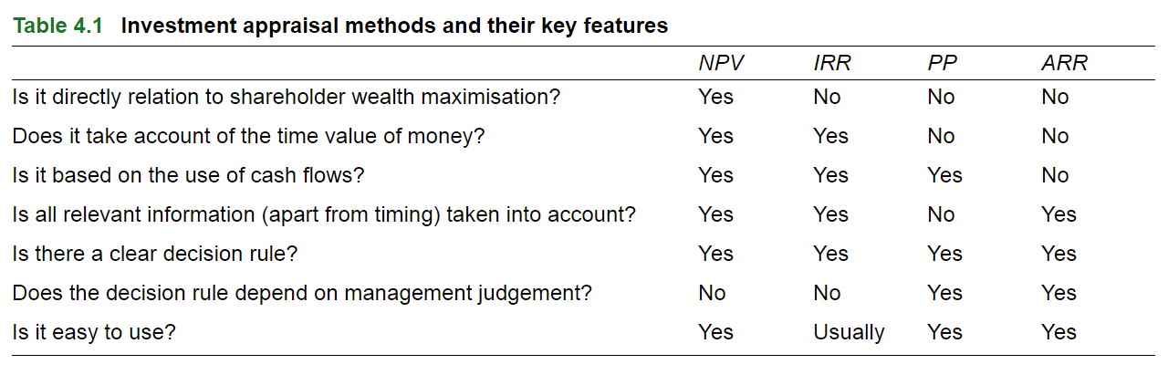
Notes:
Summary of the key features

Slide 54
Investment appraisal in practice
Many surveys have shown the following features:
Businesses tend to use more than one method
NPV and IRR have become increasingly popular
Continued popularity of the PP and ARR methods
Larger businesses rely more heavily on NPV and IRR than smaller businesses
Notes:
In practice…

Slide 55
Frequency of use of investment appraisal techniques
5
IRR
Response scale
NPV
4
PP
4.00
4.16
4.00
4.08
4.15
4.09
3.93
3.88
3.89
3.80
3.46
3.50
3.57
3.57
3.52
3.55
3.33
3.29
3
2
1 - never
5 - always
1
USA
UK
Germany
Canada
Japan
Average
Source: Based on information in G. Cohen and J. Yagil (2007) ‘A multinational survey of corporate financial policies’, Journal of Applied Finance. vol 17(1).
Notes:
In practice…

Slide 56
What’s Next…
Today
5.30 – 7.30 Capital Investment Decision Making continued
7.30 – 8.30 Business Simulation Round 5
8.30pm – Finish!
For next time:
Business Simulation round 5 submitted by 3pm Wednesday 11th January
Assessment 1 – Thursday 12th January 2022 for groups 1 & 2 and Friday 13th January for groups 3,4 & 5

