Slide 1
Market Research, Demographics, And Competing Forms Of Entertainment
Jameire Jordan
APUS

Slide 2
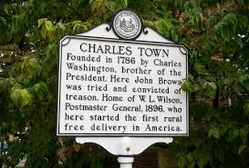
Introduction
This presentation aims to present detailed market research, demographic information, and an analysis of competing forms of entertainment in Charles Town, WV.
The insights gathered from this research will inform the marketing strategies
Notes:
Marketing for the Charles Town Patriots minor league baseball team will be done better to attract more fans and enhance community engagement. This marketing plan is designed to increase game attendance, foster community relationships, and improve the fan experience. It is proper to understand the local market and its unique characteristics to focus on creation of targeted marketing campaigns. All these processes will promote engagement with various community groups and leverage local media to promote the team effectively. The knowledge gained through market demographics provides valuable insights into the preferences and behaviors of potential fans. In this regard, it is proper to research the age, income, education levels, and interests of local residents to tailor marketing messages so that they can appeal directly to them.

Slide 3
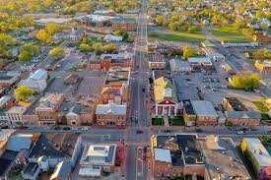
Population and Age Breakdown
Based on latest data, Charles Town, WV, has a total population of approximately 8,054 (CTWP, 2024).
This number is proper to manage the market size and potential reach for marketing efforts.
Notes:
Knowledge of the total population is essential to scale promotional activities and set realistic attendance goals.
The age distribution in Charles Town is as follows (CTWP, 2024):
Children (0-12 years) - Approximately 12.7% (1,022 individuals)
Teenagers (13-19 years) - Approximately 10% (805 individuals)
Adults (20-64 years) - Approximately 66.5% (5,357 individuals)
Seniors (65+ years) - Approximately 10.8% (870 individuals)
The age distribution is proper to determine the need for family-oriented promotions or youth engagement programs.

Slide 4
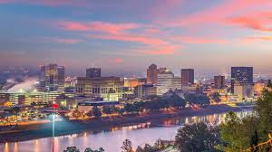
Population and Age Breakdown
Over the past few years, Charles Town has experienced significant growth.
The population has increased by 4.98% annually which translates to an increase of 1,528 people since 2020.
Notes:
Factors that contribute to the population trends include local economic conditions, housing developments, and job opportunities. It is proper to always to include these trends to be able to anticipate future market conditions and adjust marketing strategies accordingly. For instance, population growth may present opportunities for Charles Town MV to expand its fan base, while a more aggressive marketing approach might be necessary to maintain attendance levels in the face of potential population decline. Another example is that a larger adult population may indicate opportunities for corporate partnerships and adult-focused events. As such, the new prompt is that a substantial senior population might benefit from special senior discounts and community engagement initiatives.

Slide 5
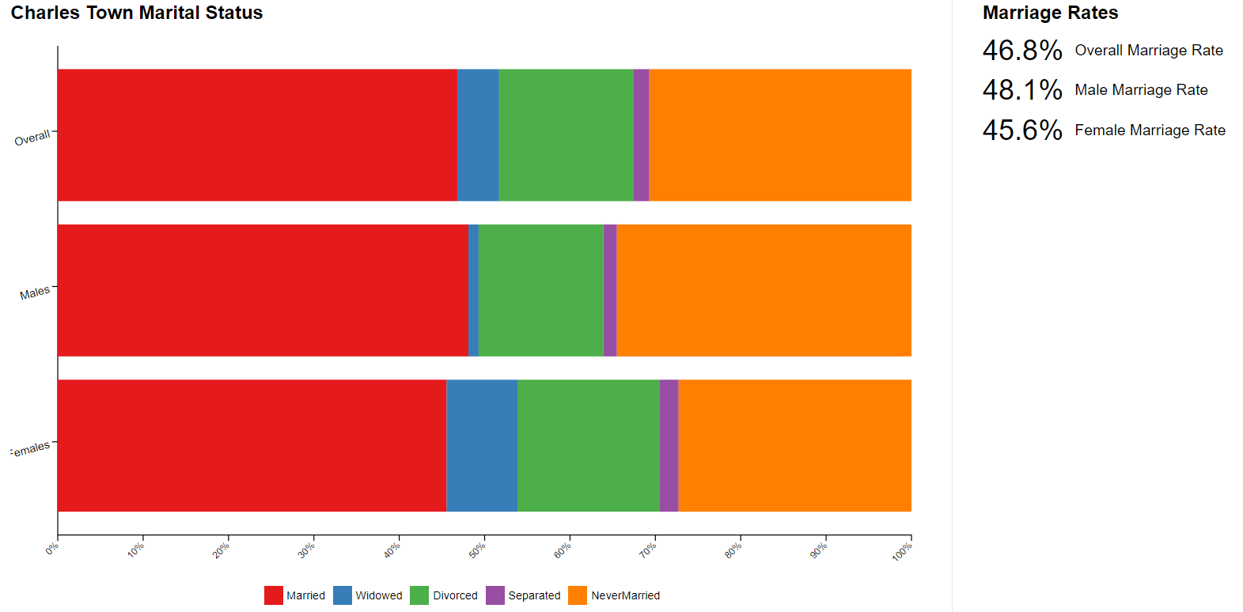
Marital Status, Education, Religion, and Geographic Location
Married persons are 46.8%
The educational attainment is as follows:
Bachelors degree: 23.75%
Graduate degree: 13.57%
9th to 12th grade, no diploma: 7.17%
Less than 9th grade: 1.9%
High school graduates: 26.29%
Notes:
More educational statistics : some college: 19.02%, associates degree: 8.29%
For the demographic with higher educational levels, the target audience is residents with bachelor's or graduate degrees. These kinds of people will required advanced learning opportunities, technology, premium services, and cultural activities.
Charles Town, WV, has a diverse religious denominations and faith communities but the most common ones are Protestant Christianity and Catholic. Still, there are smaller communities of Judaism, Islam, and non-religious groups (CTWP, 2024). Charles Town is a suburban area that has a smaller urban core that is focused on the historic downtown district.

Slide 6
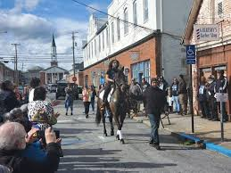
Gender and Racial Composition, and Languages Spoken
Gender Breakdown:
  Male: 48.34%
Female: 51.66%
Racial Composition:
White: 74.61%
Black or African American: 14.38%
Mixed or more races: 8.46%
Asian: 2.04%
Other race: 0.52%
Notes:
Marketing strategies need to acknowledge the significant presence of African American and multi-racial populations to ensure inclusive campaigns.
Major languages spoken: 91.81% speak only English, 5.12% speak Spanish, and 3.07% speak other languages (CTWP, 2024).
In the town, the small but notable Asian community can adhere to targeted marketing that acknowledges their cultural presence.
It is not mandatory to consider language barriers since 91.81% of residents speak only English but use of Spanish language may be beneficial for the 5.12% Spanish-speaking community.

Slide 7
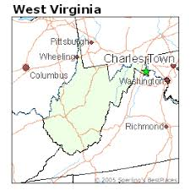
Political Views, Unemployment Rate, Income Distribution and Economic Status Of Residents
Since Charles Town is in West Virginia, it is accurate to associate with the data that has historically leaned towards the Republican Party in recent national elections (Ray, 2023).
The current unemployment rate in Charles Town is 7.3%.
The average household income in Charles Town is $107,341.
Notes:
It is proper to market to people who work in key industries in Charles Town like healthcare, retail, and education. Employment trends show a high participation rate in these sectors with a consistent growth in healthcare services and retail establishments.
The median income of families is $112,581 with a mean income of $127,452.
Households have a median income of $83,275 with a mean income of $107,341.
For non-family households, the median income of $51,806 was discovered and a mean income of $70,092.
The poverty rate in the town is 5.31%.

Slide 8
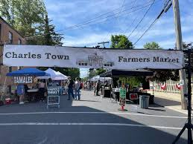
Average Disposable Income and Interest in Sports
The average household income of Charles Town is $107,341.
Its residents have substantial disposable income.
The figure is significantly higher than the national median household income, which was around $70,784 in 2021 according to the U.S. Census Bureau (Semega & Kollar, 2022).
Notes:
The high disposable income in Charles Town suggests that its residents are likely to spend more on leisure activities like entertainment and sports. It is possible to rely on this fact since national trends show that higher-income households allocate a greater portion of their budget to these areas (Post et al., 2023). Operations involved in local businesses, entertainment venues, and sports teams can benefit greatly from increased spending capacity. Such a process indicates a robust market for entertainment-related offerings. The community's interest in sports baseball is evident so families and individuals in Charles Town can invest time and money to attend local sports events. In this regard, it is possible for the town’s residents to purchase sports merchandise and participate in sports-related activities.

Slide 9
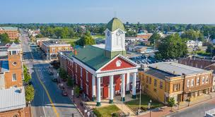
Competing Forms of Entertainment
At Charles Town area, high school sports like football and basketball are popular have a strong community support and attendance.
The town does not host any professional sports teams but its proximity to larger cities like Washington D.C. and Baltimore provides residents with access to professional sports events.
Notes:
In the town, there is the Charles Town Heritage Festival which is a major annual event that celebrates the history and culture of Charles Town. Main activities are parades, historical reenactments, live music, and local food vendors. As such, the festival attracts both residents and visitors which promotes community cohesion and local heritage. Another event is annual parades and community fairs which are organized by the local Chamber of Commerce. The fairs provide opportunities for local businesses and organizations to engage with the community and showcase their offerings. Proper examples include Fourth of July parade and Christmas parade which bring together diverse members of the community for entertainment.

Slide 10
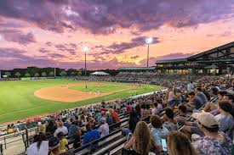
Analysis and Strategic Implications
A strategic for the team is use of the strong local interest in baseball to build a loyal and engaged fan base.
Such a process will emphasize the community aspect of the team to foster a sense of local pride and support.
Notes:
Another strategic action is to engage with community events and local businesses so that there can be sponsored local events like the Charles Town Heritage Festival, parades, and county fairs to increase visibility. A well-structured method to partner with local businesses for cross-promotions, discounts, and sponsorships will get implemented then facilitate a mutually beneficial relationship that enhances the team's presence in the community. The team will attract more promotional activities through collaboration with target demographics. Family-friendly promotions like discounted family tickets, activities for kids at games, and family event nights will attract families. It will then be possible to implement community outreach programs that involve hosting baseball clinics, charity events, and school visits to build a strong community connection.

Slide 11
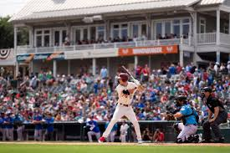
Conclusion
Tailored marketing strategies are imperative for that team since they can address the needs and interests of specific demographic groups.
Target of families and young adults through tailored promotions and events is the most imperative process.
Notes:
Use of digital marketing strategies to reach a broader audience is possible by leveraging social media platforms and targeted advertising. Such a process will implement organized events and promotions which have an advanced capability of positive returns. An accurate can get attained through promotions that appeal to families like discounted ticket packages and special game-day experiences. In this way, the marketing plan will facilitate partnerships that are advanced and capable to advance positive outcomes. As presented, strategic partnerships need to get formed with local businesses and community organizations to strengthen ties and increase the team's visibility. It will then be possible to collaborate on joint promotions, sponsorships, and community outreach initiatives so that there can be a sense of community pride and support for the Charles Town Patriots.

Slide 12
References
Charles Town, West Virginia Population 2024 (CTWP). (2024). World Population Review. https://worldpopulationreview.com/us-cities/charles-town-wv-population
Post, E. G., Rivera, M. J., Doss, D., & Eberman, L. E. (2023). Higher Levels of Income and Education are Associated with More Specialized Sport Participation Behaviors: Results from a Representative Sample of Youth Sport Parents from the United States. International Journal of Sports Physical Therapy, 18(5), 1196-1205. https://doi.org/10.26603/001c.86127
Ray, L. (2023). Are WV politicians running as Republicans because of values or because they want to win? https://westvirginiawatch.com/2023/10/17/are-wv-politicians-running-as-republicans-because-of-values-or-because-they-want-to-win/
Semega, J. & Kollar, M. (2022). Income in the United States: 2021. https://www.census.gov/library/publications/2022/demo/p60-276.html

