Slide 1

Welcome to IHP 501
Global Health and Diversity
Overview of Module Seven
Term 23TW4
IHP 501 Course Facilitator/Instructor/Professor
Dr. Johnstone

Slide 2


IHP 501 Module One: 7-1 Activity Persuasive Speech Short Paper
Overview
A persuasive speech can be one of the most challenging types of presentation. For this type of presentation, you need to persuade someone to buy into your idea or approve your proposal.
Your experience of composing a persuasive speech for this assignment will better prepare you to develop an effective research paper for your project.
At the beginning of this course, you were presented with four potential humanitarian aid trip options that could be funded by the SNHU Humanitarian Aid Foundation.
After reading the paper “Aggressive and Violent Behavior Among Military Personnel Deployed to Iraq and Afghanistan: Prevalence and Link With Deployment and Combat Exposure,” you are inspired to propose a new trip to the stakeholders (see page 3 for reference citation).
Image accessed from Image for Persuasive Speech - Bing

Slide 3


IHP 501 Module One: 7-1 Activity Persuasive Speech Short Paper
By investigating the scholarly literature, you will answer the questions:
What type of trip does this systematic review and meta-analysis inspire?
Since the paper is greater than five years old, does the current evidence suggest that these issues are still relevant?
What unique health challenge do you believe is feasible as a focus for improvement?
How are the elements of occupational health, environmental health, violence, and injury connected to this situation?
How could they be improved if a humanitarian aid trip were performed in this scenario?

Slide 4

IHP 501 Module One: 7-1 Activity Persuasive Speech Short Paper
Prompt
Read the paper provided in the overview section. Your challenge is to persuade the foundation to adopt this issue as a potential humanitarian aid trip option. Begin your persuasive speech with a summary of what you are requesting. Be clear and concise about the purpose.
Then, discuss how this trip addresses the elements of occupational health, environmental health, violence, and injury as presented in the module resources. Additionally, you should refrain from using the first person in order to maintain objectivity and professionalism in your presentation.
Note that you should cite at least three scholarly sources from your investigation. The evidence should not be older than five years. To access the Shapiro Library Guide: Nursing—Graduate, go to the Start Here section of the course.
Specifically, you must address the following rubric criteria:

Slide 5


IHP 501 Module One: 7-1 Activity Persuasive Speech Short Paper
Request Statement: Provide a clear, concise, and persuasive summary of your request statement.
  Explore the programs and resources published since systematic review and meta-analysis.
  Provide a brief summary of the trip you propose to address this situation, and briefly prepare the audience to hear your persuasive statement.
Population: Describe the population in this scenario. Be sure to include all relevant characteristics for painting a meaningful, detailed picture for your audience.
Health Challenges: Examine the unique health challenges facing this population.
Occupational Health: Explain the occupational health issues in connection to this situation
Image accessed from Request - Free of Charge Creative Commons Green Highway sign image (picserver.org)

Slide 6
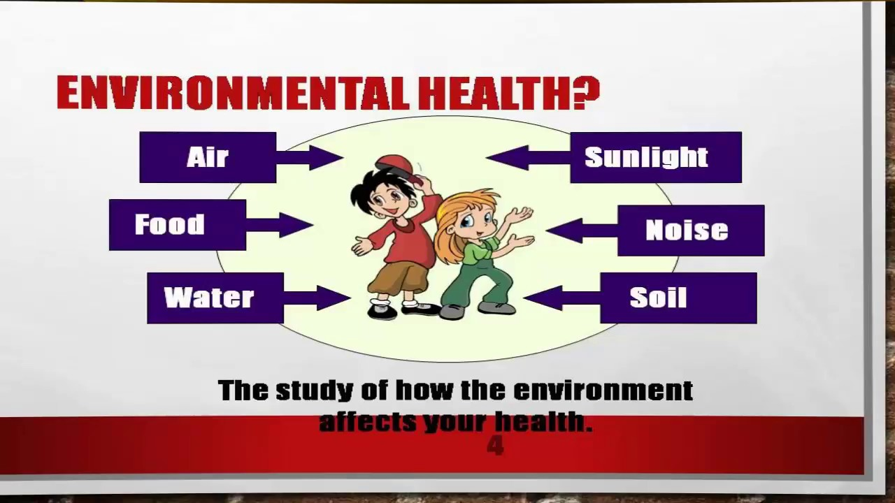

IHP 501 Module One: 7-1 Activity Persuasive Speech Short Paper
5. Environmental Health: Analyze the environmental contamination issues that contribute to this situation.
6. Violence and Injury: Explain how the elements of violence and injury are connected to this occupational exposure and environmental contamination.
7. Conclusion: Summarize and restate the request based on the evidence provided in your speech.
Image accessed from maxresdefault.jpg (1280×720) (ytimg.com)

Slide 7

Reference
MacManus, D., Rona, R., Dickson, H., Somaini, G., Fear, N., & Wessely, S. (2015, January 22).
Aggressive and violent behavior among military personnel deployed to Iraq and Afghanistan:
Prevalence and link with deployment and combat exposure. Epidemiologic Reviews, 37,
196-212. https://doi.org/10.1093/epirev/mxu006

Slide 8


APA Format Short Paper
Guidelines for Submission
Your short paper must be a 2- to 3-page Word document, not including the title page and references. It must be written in APA format. Use double spacing, 12-point Times New Roman font, and one-inch margins. All references must be cited in APA form
References (always starts on new or separate page)
Note that you should cite at least three scholarly sources from your investigation. The evidence should not be older than five years. To access the Shapiro Library Guide: Nursing—Graduate, go to the Start Here section of the course.

Slide 9


Reach out with any questions to Dr. Johnstone @ e.Johnstone@snhu.edu
Image accessed from https://seanheritage.com/blog/questions/

Slide 10

Thank You
2500 North River Road
Manchester, NH 03106
603.xxx.xxx
snhu.edu

