Slide 1
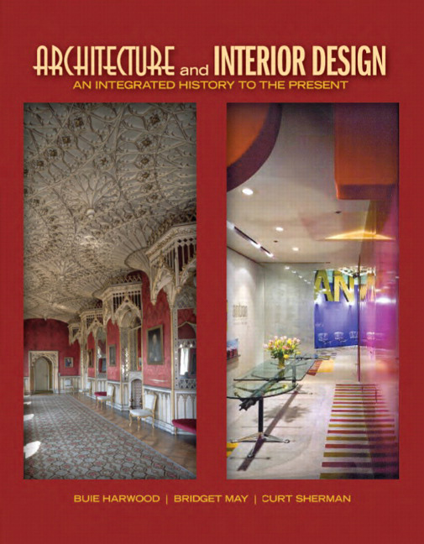

Architecture and Interior Design: An Integrated History to the Present
First Edition
Chapter 22
American Georgian
1700s – 1780s
Copyright © 2012 Pearson Education, Inc. All Rights Reserved
Notes:
If this PowerPoint presentation contains mathematical equations, you may need to check that your computer has the following installed:
1) Math Type Plugin
2) Math Player (free versions available)
3) NVDA Reader (free versions available)

Slide 2
American Georgian
Changes in design
  17th century traditional medieval & vernacular buildings, interiors, furniture with strong regional differences
  18th century learned, tasteful, refined classicism
  Similar across the colonies
More refined tastes of increasingly prosperous colonists along Eastern seaboard
  Strong connections to English heritage & tradition
  Copy & adapt English precedents to their needs & conditions

Slide 3
Concepts
Design influences from English nobility
  Elaborate houses show cultured tastes, refined by French court, travel to Europe, trade with Orient
  Rococo, Chinoiserie, Neo-Palladian design influences along with reason & refinement
More prosperous colonists better able to model English precedents
  Seek gentility, culture, manners, civility
Formal, classical houses and furnishings
  Support more refined society
Knowledge from immigrant artisans & architects, English pattern books; imported furniture & materials

Slide 4
Architecture
Classical traditions inspired by Andrea Palladio, Inigo Jones, James Gibbs
No more irregular, additive, utilitarian buildings of 17th century
18th-century structures—discipline, detailing, planned
Symmetrical, ordered, balanced
  Classical & Neo-Palladian details
  Common vocabulary so regional differences decline
Public & private buildings similar
  Smaller scale, simpler decoration than in England
  Urban in North; rural in South
Most live in one- or two-room wooden dwellings

Slide 5
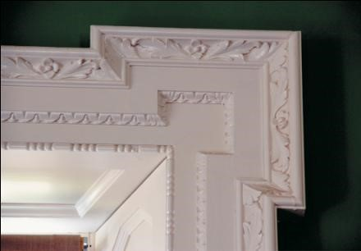
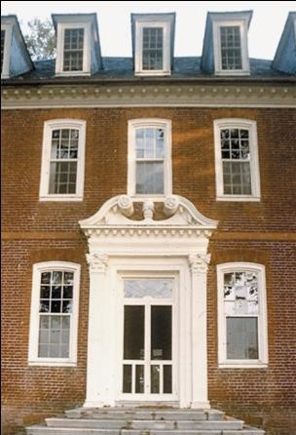
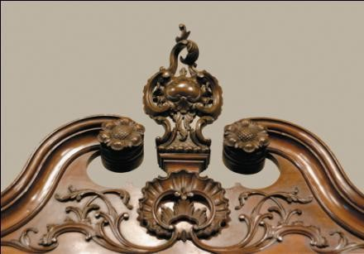
22.1
Architectural Details and Motifs: From top left, ear motif and door, Westover Plantation, 1730s-1750s and bottom: highboy detail. American Georgian.
Notes:
Long Description:
The door has a large frame with simple decorations. The columns on the left and the right have an ear motif. A broken pediment is on the top of the frame. The pediment has a spiral design and a carved flower at its center. Two arched windows on the left and the right of the door. Three arched windows are horizontally linear on the top story wall. Multiple chimneys with doors are lined up horizontally on the roof.

Slide 6
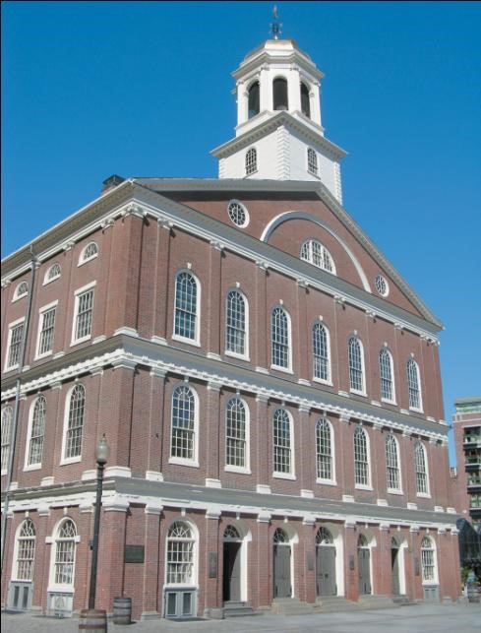
22.2
Faneuil Hall, 1740-1742; Boston, Massachusetts; John Smibert; enlarged and rebuilt in 1805 by Charles Bulfinch. American Georgian.
Notes:
Long Description:
The Faneuil hall is two-story building with multiple entrances on the ground floor. Two arched windows are on the left and right corners of the entrances. The first level and second level stories each have seven arched windows in series on the front wall. Multiple arched windows are on the side walls of each story. The roof has a pediment with an arched window and a double-eaved tower above the roof. The bottom eave is rectangular and the top eave is hexagonal with arched windows.

Slide 7
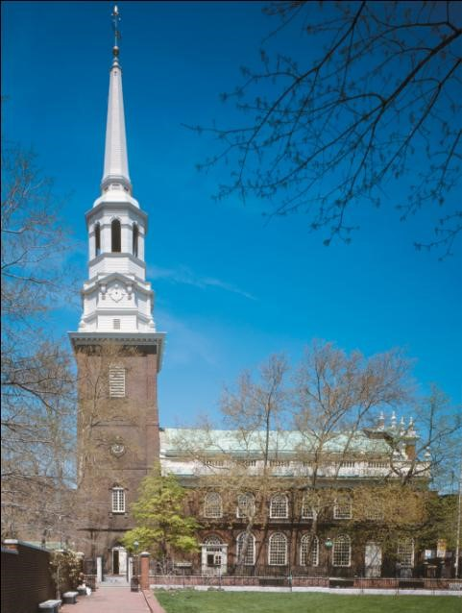
22.3
Christ Church, 1727-1754; Philadelphia, Pennsylvania. American Georgian.

Slide 8
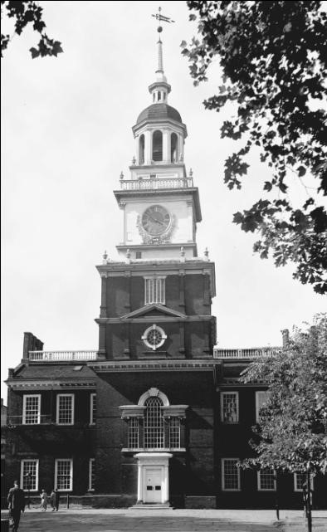
22.4
Independence Hall (originally Pennsylvania State House), 1731-1791; Philadelphia, Pennsylvania. American Georgian.

Slide 9
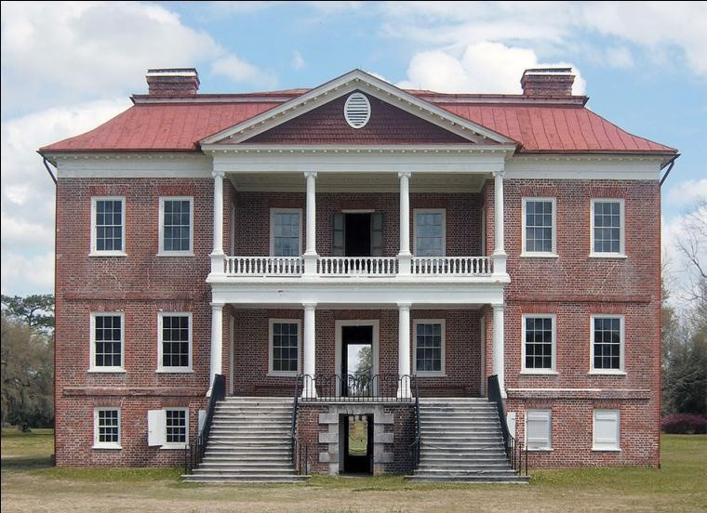
22.5
Drayton Hall, 1738-1742; Charleston, South Carolina. American Georgian.
Notes:
Long Description:
The portico on the top has a pediment supported by columns. The chimneys are on the left and the right corners of the hipped roof.

Slide 10
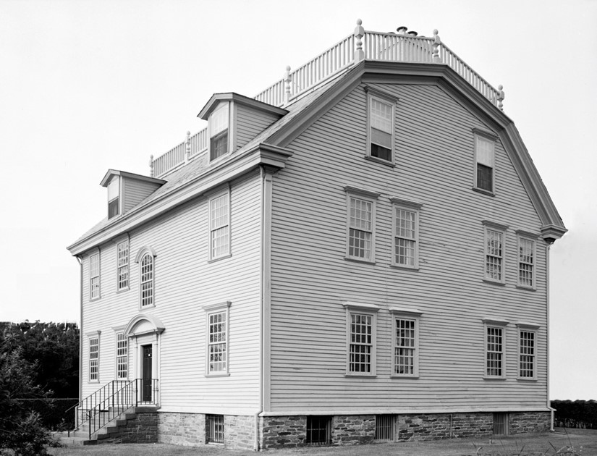
*22.6b
Hunter House, 1748; Newport, Rhode Island. American Georgian.
*Substitute image.

Slide 11
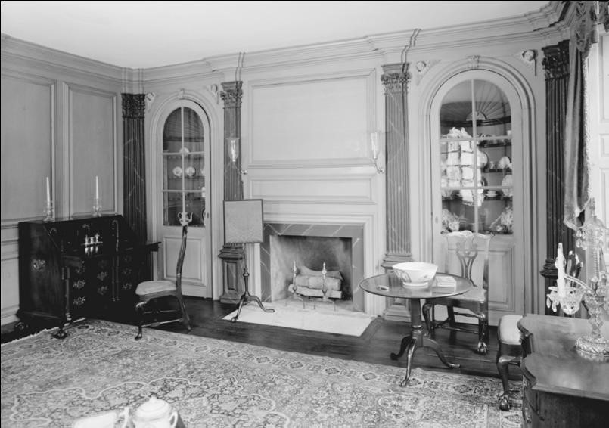
22.6b
Hunter House, Drawing Room,1748; Newport, Rhode Island. American Georgian.

Slide 12
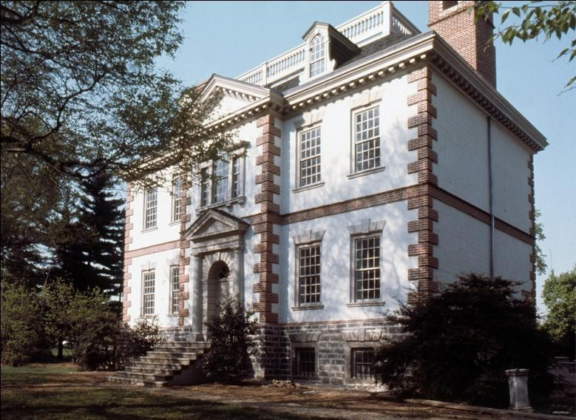
22.7a
Mount Pleasant floor plan, 1761-1762; Philadelphia, Pennsylvania. American Georgian.

Slide 13
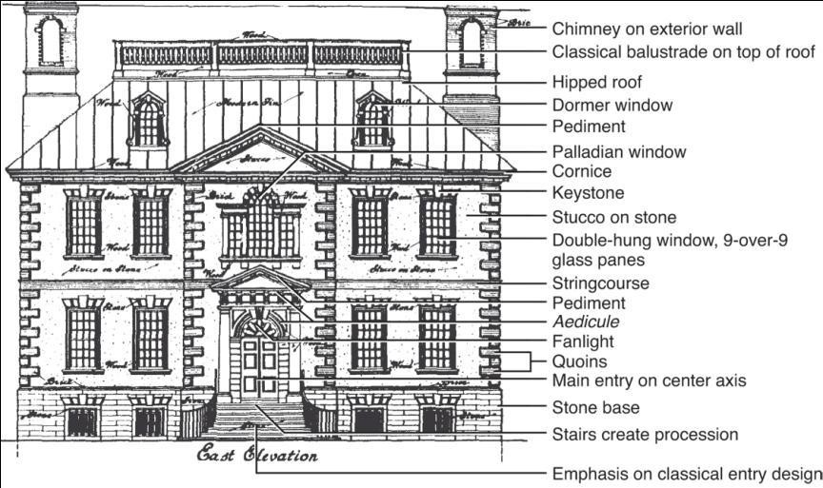
22.7b
Mount Pleasant, east elevation,1761-1762; Philadelphia, Pennsylvania. American Georgian.
Notes:
Long Description:
The Mount Pleasant has a chimney on the exterior wall, a classical balustrade on top of the roof, a hipped roof, and a dormer window. The pediments are on top of the central main entrance. The Palladian window on the top story above the main entrance. The top story has a cornice, keystone, stucco on stone, double hung window, and 9 over 9 glass panes and string course. The main entrance door has a pediment, aedicule, fanlight, quoins, and main entry on the center axis. The stone base is at the bottom. The stairs create procession and emphasis classical entry design.

Slide 14
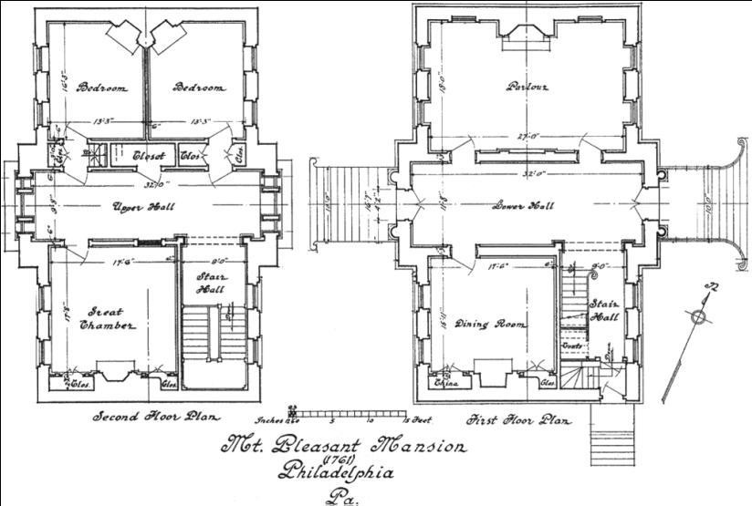
22.7c
Mount Pleasant, floor plan, 1761-1762; Philadelphia, Pennsylvania. American Georgian.
Notes:
Long Description:
The floor plan shows from the left to the right, the second-floor plan on the left, and the first-floor plan on the right. The second-floor plan shows two bedrooms on the top parallelly, and each room has a length of 13 feet and 3 inches. Next to the bedrooms, there are closet and a hall. A great chamber and the stair hall are opposite the bedrooms and next to the hall. The first-floor plan shows a Parlor on the top. A hall is next to the Parlor. A dining room and stair hall are opposite the Parlor and next to the hall. The text below the floor plans read Mount Pleasant Mansion (1761) Philadelphia, Pennsylvania.

Slide 15
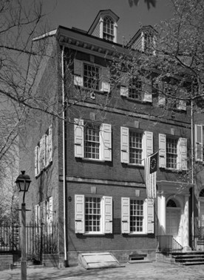
*22.8a
Powel House, 1767-1769; Philadelphia, Pennsylvania. American Georgian.
*Substitute image.
Notes:
Long Description:
The first level and the second level story have rectangular windows in series. The roof has chimneys in series.

Slide 16
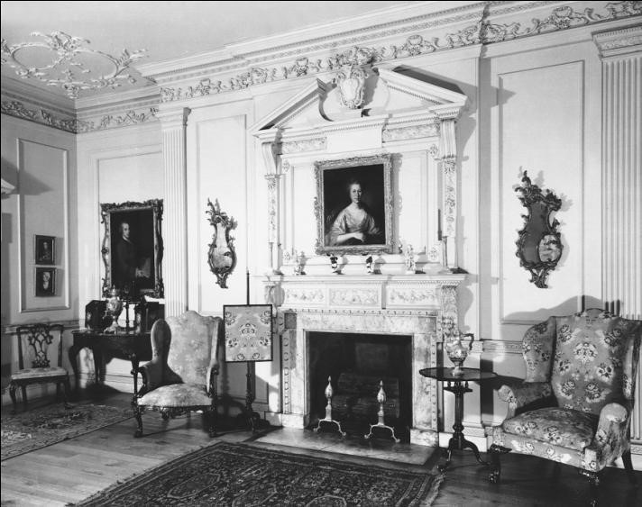
22.8b
Powel House, drawing room 1767-1769; Philadelphia, Pennsylvania. American Georgian.
Notes:
Long Description:
The ceiling is decorated with flower designs. The joints of the wall and the ceiling are decorated with leaves border. Thrones are arranged to the left and the right of the mantelpiece. A large painting of a man and two small paintings are on the wall.

Slide 17
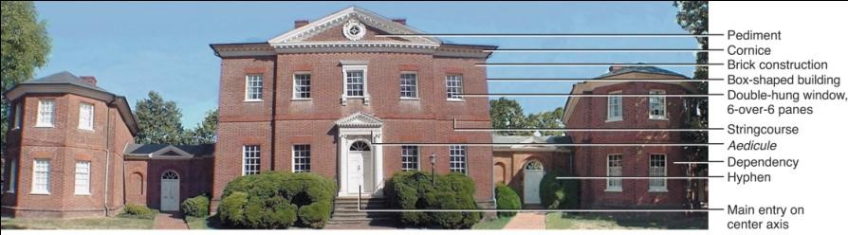
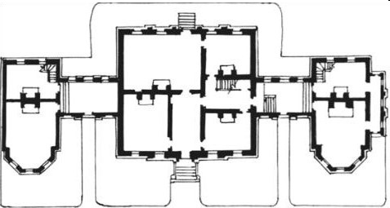
22.9a
Hammond-Harwood House and floor plan, 1773-1774; Annapolis, Maryland; William Buckland. American Georgian.
Notes:
Long Description:
The facade of the house has a pediment on the central part of the top story, and a pediment above the main entrance door. From the top to the bottom of the building, there are cornice, brick construction, box shaped building, double hung window, 6 over 6 panes, string course, aedicule, dependency, a hyphen, and main entry on the center axis.

Slide 18
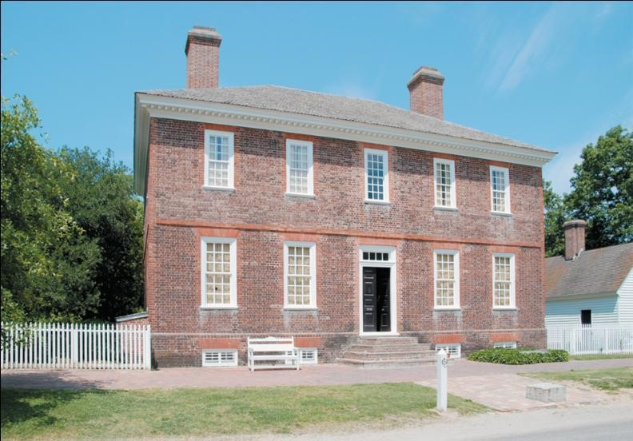
22.10
Wythe House, c. mid 1750s; Williamsburg, Virginia; probably by Richard Taliaferro. American Georgian.
Notes:
Long Description:
The one-story building has the main entrance at its ground level. The main entrance has a simple rectangular door. The simple rectangular windows are on the top story and ground level in series. The chimneys are on the roof and the roof of the dependency building. The balustrade fence is on the left.

Slide 19
Interiors
Interiors formal, classical, refined like English prototypes
  Reflect formality & classicism of exteriors
Treatments, preferences repeat English ones
Smaller, less ornate domestic interiors reflect Rococo in Europe & American practices
Fireplace dominates main wall & symmetrical openings
  Borders & outlines important to create unity
  Also on furniture
Each room treated separately with little relationship to adjoining ones
Public spaces display wealth & refinement

Slide 20
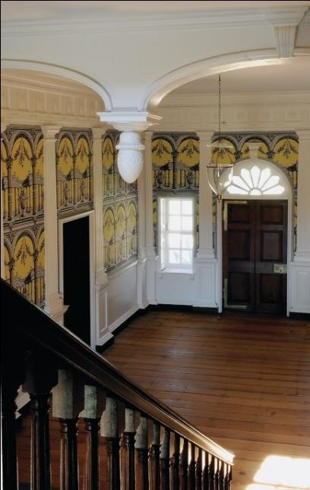
22.11ba
Hall passage, Gunston Hall, 1759-1787; Fairfax County, Virginia; William Buckland and William Bernard Sears. American Georgian.

Slide 21
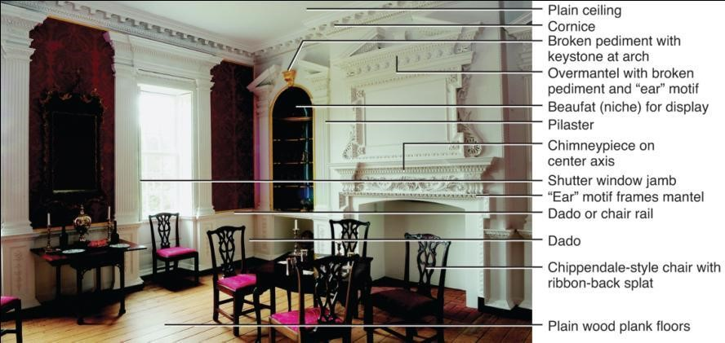
22.11b
Parlor, Gunston Hall, 1759-1787; Fairfax County, Virginia; William Buckland and William Bernard Sears. American Georgian.
Notes:
Long Description:
From the top to the bottom, there are plain ceiling, cornice, broken pediment with keystone at the arch, overmantel with broken pediment and ear motif, Beaufort (niche) for display, Pilaster, Chimneypiece on the center axis, shutter window jamb, ear motif frames mantel, dado or chair rail, dado, Chippendale style chair with ribbon back splat, and plain wood plank floors.

Slide 22
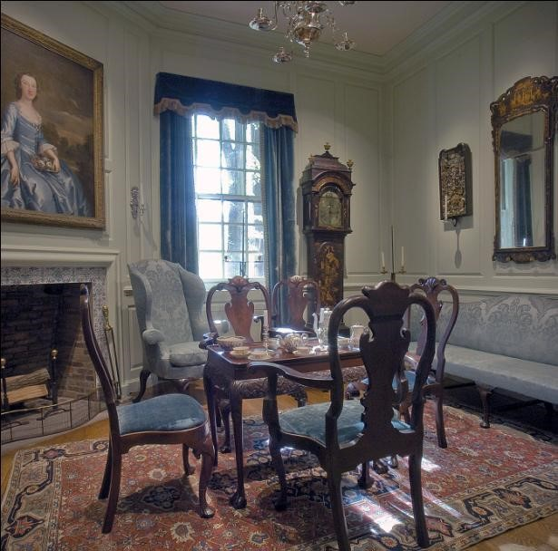
22.12
Readborne Parlor c, early to mid-18th century; paneling and fireplace originally from the Colonel James Hollyday House, 1733; Centreville, Maryland. American Georgian.
[Courtesy Winterthur Museum]
Notes:
Long Description:
The floor is furnished with decorated flower designs. The chairs around the dining table have splat with carved flowers. A chimneypiece is on the center axis.

Slide 23
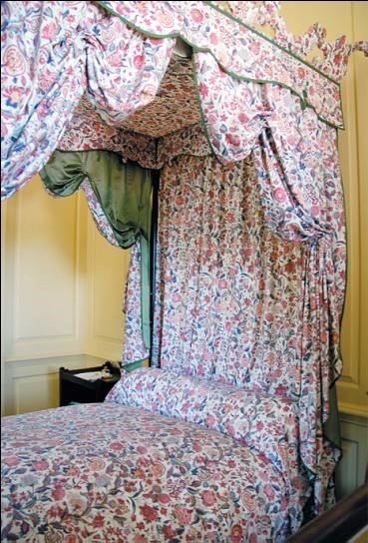
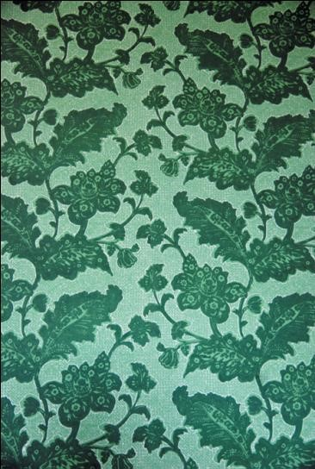
22.13
Textiles and Wallpaper: Indian print palampore, Governor’s Palace, mid-18th century; Williamsburg, Virginia; flocked wallpaper, Kenmore House, c. mid-18th century; Fredericksburg, Virginia. American Georgian.

Slide 24
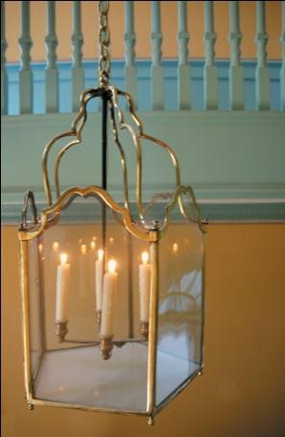
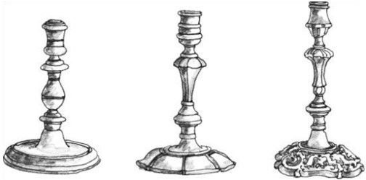
22.14
Lighting: brass candlesticks and lantern, Kenmore House, c. mid-18th century; United States. American Georgian.
Notes:
Long Description:
The first candlestick has a circular bottom with a concave surface, a holder that rises from the bottom with protrusions, and bulb shape centerpiece, and a holder. The second candle stick has a hipped bottom with partitions, a holder rises from the bottom with protrusions, a tapered end vase in the middle, and a holder on the top. The third candle stick has a highly decorated circular bottom, protrusions and a tapered end vase in the middle, and a holder on the top.

Slide 25
Furnishings and Decorative Arts
Furniture complements interior, imitates English prototypes, has high-style & vernacular forms
Draws from English Queen Anne, Early Georgian, & Chippendale
Two styles—Queen Anne (1720-1790) & Chippendale (1750-1790)
  Pieces may mix Queen Anne & Chippendale forms & details
Imported, copied from pattern books, made by recent immigrants or local cabinetmakers or carpenters
High styles closely imitate England with carving, gilding, attention to proportion, forms, details
Vernacular based on English prototypes, but simpler, cruder, of local woods, awkward proportions or ornament

Slide 26
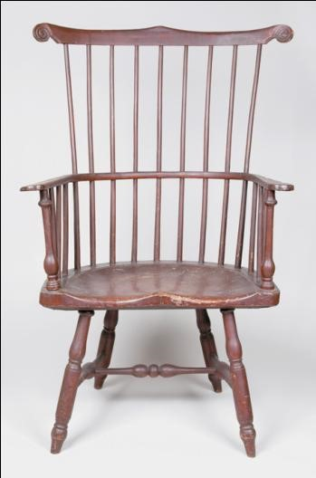
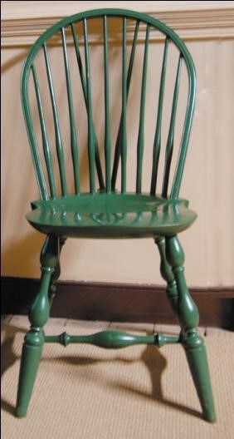
22.15
Windsor chairs, c. mid-18th century; United States. American Georgian.

Slide 27
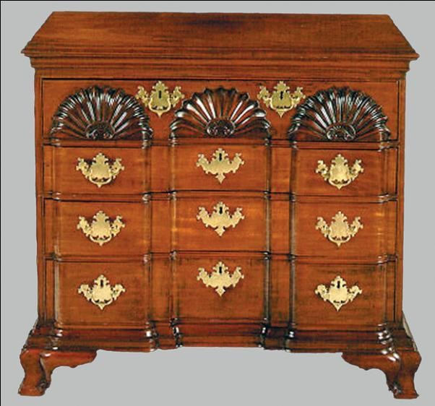
22.16
Chest of drawers, c. mid-18th century; Newport, Rhode Island; John Townsend and John Goddard. American Georgian.
[Courtesy of the Diplomatic Reception Rooms, U.S. Department of State]

Slide 28
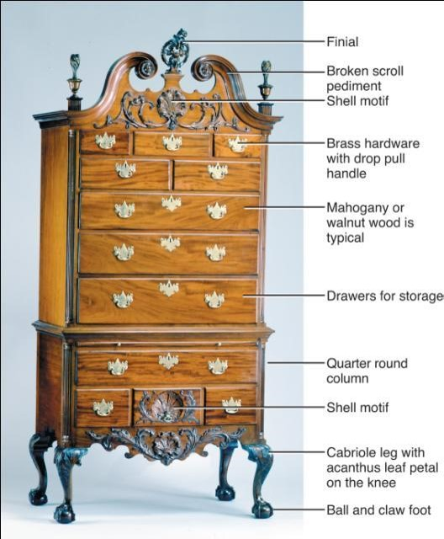
22.17
High chest of drawers (highboy), c. mid-18th century; United States. American Georgian.
[Courtesy of the Diplomatic Reception Rooms, U.S. Department of State]
Notes:
Long Description:
The drawers have a finial, broken scroll pediment, and a shell motif on the top. It has brass hardware with a drop pull handle. Mahogany or walnut wood is typical. It has drawers for storage, Quarter round column, and a shell motif. It has a cabriole leg with an acanthus leaf petal on the knee and a ball and claws foot.

Slide 29

Copyright
This work is protected by United States copyright laws and is provided solely for the use of instructors in teaching their courses and assessing student learning. Dissemination or sale of any part of this work (including on the World Wide Web) will destroy the integrity of the work and is not permitted. The work and materials from it should never be made available to students except by instructors using the accompanying text in their classes. All recipients of this work are expected to abide by these restrictions and to honor the intended pedagogical purposes and the needs of other instructors who rely on these materials.

