Slide 1
Staffing Organizations
Chapter 4: Job Analysis: Requirements, Competencies, and Rewards
Copyright 2022 © McGraw Hill LLC. All rights reserved. No reproduction or distribution without the prior written consent of McGraw Hill LLC.

Slide 2
Job Analysis and Rewards
The Need for Job Analysis

Slide 3
The Need for Job Analysis
The process of studying jobs in order to gather, analyze, synthesize, and report information about job requirements and rewards
The changing nature of jobs
  Jobs are constantly evolving
  Need for greater flexibility
  Team- based work
  Employees need to go beyond “tasks and duties as written”
Job analyses must be able to adapt to these conditions

Slide 4
Comparison of Types of Job Analysis
 | Job requirements | Competency | Job rewards
Method | Collect information on activities performed on the job to assess needed KSAOs for each job | Collect information on company strategy to determine KSAOs and behavioral capabilities across the organization | Collect information from employees on preferences and outcomes of jobs
Process | Collect data on tasks, duties, responsibilities from incumbents and supervisors, develop job requirements matrix | Discuss strategy with executives, then review how each job fits with the overall goals | Develop lists of potential rewards for a job and survey job incumbents and leaders
Staffing implications | Documents task requirements for legal purposes, determines specific KSAOs for selection | Links organizational strategy with planning process and determines broad KSAOs for selection | Provides guidance for how to develop recruiting materials and retention strategies
Table divided into four columns summarizes comparison of types of job analysis. Column 1 notes method, process, and staffing implications. Column headers from column two to four are marked as: Job requirements, competency, and job rewards.

Slide 5
Sources of Information
 | Job requirements | Competency | Job rewards
Organizational leaders | Remote or abstract knowledge of job-specific activities | Expertise in organizational strategies, goals, and future needs | Knowledge of organizational career paths and future rewards for continued development
Supervisors | Direct knowledge of how the job should be done | Mid-level perspective between overall organizational goals and specific activities in jobs | Control over providing job rewards and knowledge of how rewards relate to performance
Job Incumbents | Direct knowledge of how the job typically is done | May have difficulty assessing how immediate job tasks are linked to strategic goals | Recipient of job rewards for the position; direct knowledge of how rewards are perceived by others in the role
External SMEs | Expert information on occupations or work as a whole; knowledge regarding how to conduct analysis | Outsider perspective on how tasks are typically organized; fresh perspective, but lacking strategic and cultural expertise | May have knowledge of rewards to the job as perceived by individuals in other organizations
Table divided into four columns summarizes sources of information. Column 1 notes organizational leaders, supervisors, job incumbents, and external SMEs. Column headers from 2 to 4 are marked as: Job requirements, competency, and job rewards.

Slide 6
Job Analysis 1
Job Requirements Analysis

Slide 7
Job Requirements Analysis: Overview
Definition
  Process of studying jobs to gather, analyze, synthesize, and report information about job requirements
  Specific KSAOs for the job
Has different degrees of relevance to staffing activities
Support activity for staffing activities
Provides foundation for successful staffing systems

Slide 8
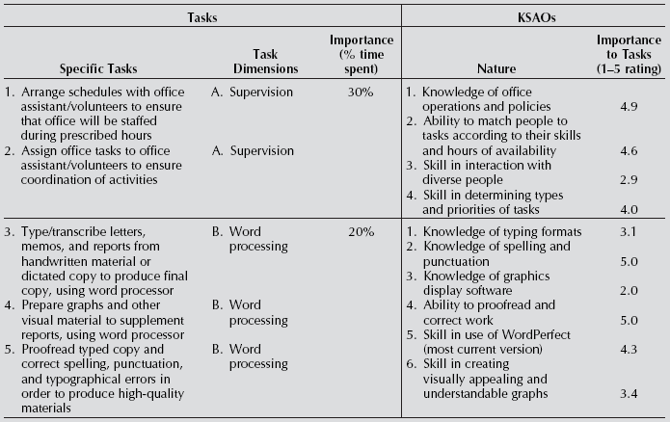
Job Requirements Matrix
Access the text alternative for slide images.

Slide 9
Task Statements, Dimensions, and Importance
Task Statements
  Objectively written descriptions of the behaviors or work activities engaged in by employees in order to perform the job
Task dimensions
  Involves grouping sets of task statements into dimensions, attaching a name to each dimension
  Other terms -- “duties,” “accountability areas,” “responsibilities,” and “performance dimensions”
Task/dimension importance
  Decide on attribute to be assessed in terms of importance
  Decide whether attribute will be measured in categorical or continuous terms

Slide 10
Knowledge, Skills, Abilities, and Other Characteristics
KSAO category | What is it? | Examples | Workplace relevance
Knowledge | Information that can be applied to tasks | -Knowing what a solid state drive is and why it’s useful for a computer -Knowing the steps in writing a job description | -Easily assessed with factual questions -Forms the basis for communication -Knowledgeable individuals can train others
Skill | Competence for working with or applying knowledge | -Skill in diagnosing and repairing problems with solid state drives -Skill in efficiently collecting job analysis information and writing task statements | -Assessed with job simulations or experience -Directly linked to performance of the job -Can be learned on-the-job with guidance
Ability | Underlying trait useful for learning about and performing a task | -Ability to perform fine motor activities -Ability to understand complex, multi-step instructions | -Assessed through abstract tests -Linked to future potential -Must be present at selection; very hard to develop
Other characteristic | Characteristics that guide or direct actions | -Motivation to perform well -Being responsible and organized -Values consistent with organizational norms | -Challenging to assess because subjective -Very important for turning KSA’s into performance
Table divided into three columns summarizes criteria for guiding choice of job analysis methods. The column headers are marked from left to right as: Method, source, and advantages and disadvantages.

Slide 11
Examples of Ways to Assess KSAO Importance
A. Importance to (acceptable) (superior) task performance
1 = minimal importance
2 = some importance
3 = average importance
4 = considerable importance
5 = extensive importance
B. Should the KSAO be assessed during recruitment/selection?
□ Yes
□ No
C. Is the KSAO required, preferred, or not required for recruitment/selection?
□ Required
Preferred
Not required(obtain on job and/or in training)

Slide 12
Criteria Guiding Choice of Job Analysis Methods
Method | Sources | Advantages and Disadvantages
Prior information | Current job descriptions, training manuals, performance appraisals, O*NET | Readily available, iInexpensive External sources may not match jobs in your organization, focus is on how jobs have been done previously
Observation | Trained job analysts or HR professionals | Thorough, rich information, does not rely on intermediary information sources Not appropriate for jobs that are largely mental, incumbents know they’re being observed
Interviews | HR professionals discuss job requirements with job incumbents and managers | Takes the incumbent’s knowledge of the position into account Time-consuming and costly, quality depends on interviewee and skill of the interviewer
Task questionnaire | Job incumbents, managers, and HR professionals complete a standardized form with questions regarding the job | Standardized method, combine information from large numbers of incumbents quickly Developing questionnaires can be expensive and time-consuming, incumbents must be capable of completing the forms accurately
Machine learning | Multiple, including prior information, observation, interviews, task questionnaires, and online databases | Efficiently combines large amounts of data from different sources, can demonstrate how groups of tasks and qualifications relate to one another across jobs Can be difficult to understand the process, requires expert decision makers
Committee or task force | Managers, representatives from HR, and incumbents meet to discuss job descriptions | Brings expertise of a variety of individuals into the process, increases reliability, enhances acceptance Significant investment of staff time
Table divided into three columns summarizes criteria for guiding choice of job analysis methods. The column headers are marked from left to right as: Method, source, and advantages and disadvantages.

Slide 13
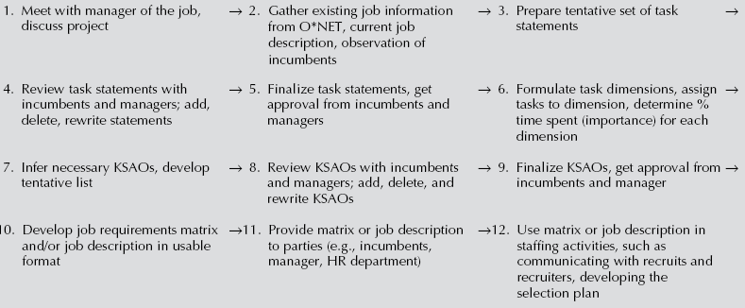
Example of the Job Requirements Job Analysis Process
Access the text alternative for slide images.

Slide 14
Job Analysis 2
Competency Modeling

Slide 15
Competency-Based Job Analysis
Nature of competencies
  an underlying characteristic of an individual that contributes to job or role performance and to organizational success
Usage reflects a desire to:
  connote job requirements that extend beyond the specific job itself
  describe and measure the organization’s workforce in more general terms
  as a way of increasing staffing flexibility in job assignments

Slide 16
Organization Use of Competencies
Organizations are experimenting with
  Developing competencies and competency models and
  Using them as underpinnings of several HR applications
Three strategic HR reasons for doing competency modeling
  Create awareness and understanding of need for change in business
  Enhance skill levels of workforce
  Improve teamwork and coordination
Emphasis -- Establishing general competencies

Slide 17
KSAOs or Competencies?
Similarities between competencies and KSAOs
  Both reflect an underlying ability to perform a job
Differences between competencies and KSAOs
  Competencies are much more general
  May contribute to success on multiple jobs
  Contribute not only to job performance but also to organizational success

Slide 18
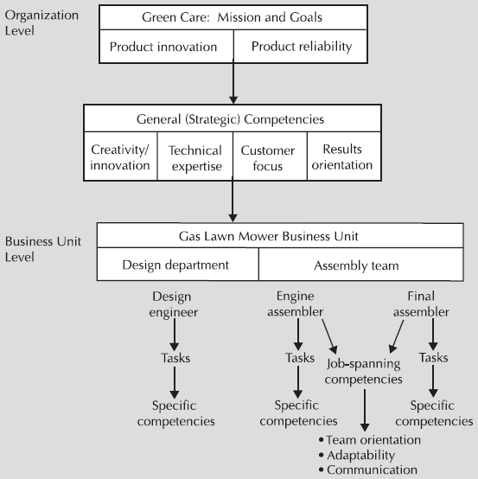
Examples of Competencies
Access the text alternative for slide images.

Slide 19
The “Great Eight” Competencies
Leading: initiates action, gives direction
Supporting: shows respect, puts people first
Presenting: communicates and networks effectively
Analyzing: thinks clearly, applies expertise
Creating: thinks broadly, handles situations creatively
Organizing: plans ahead, follows rules
Adapting: responds to change, copes with setbacks
Performing: focuses on results, shows understanding of organization

Slide 20
Strategic Competencies
Visioning (establishes and communicates a long-term view)
Alignment (considers multiple stakeholder perspectives in determining strategic direction)
Environmental awareness (understands external business influences)
Assessment and evaluation (uses economic, financial, industry, and customer data to identify opportunities)
Strategy creation (meets evolving goals and objectives)
Plan development (links objectives with plans for implementation)
Implementation (executes plans)

Slide 21
Example of the Competency-Based Job Analysis Process
Access the text alternative for slide images.

Slide 22
Job Analysis 3
Job Rewards

Slide 23
Job Rewards
Extrinsic rewards
  external to the job itself
  designed and granted to employees by the organization
  pay, benefits, work schedule, advancement, job security
Intrinsic rewards
  intangibles
  experienced by employees as an outgrowth of doing the job
  variety in work duties, autonomy, feedback, coworker and supervisor relations
Employee value proposition
  the “package” or “bundle” of rewards provided to employees and to which employees respond by joining, performing, and remaining with the organization

Slide 24
Collecting Job Rewards Information
Within the organization
  Interviews with employees
  Surveys with employees
Outside the organization
  SHRM survey
  Organizational practices

Slide 25
Examples of Job Rewards Interview Questions 1
Rewards Offered
  What are the most rewarding elements of your job? Consider both the work itself and the pay and benefits associated with your job.
  Looking ahead, are there any changes you can think of that would make your job more rewarding?
Reward Magnitude
  Describe the amount of potential for growth and development in your job.
  Do you feel like the pay and benefits provided for your job are adequate for the work you do, and if not, what would you change?

Slide 26
Examples of Job Rewards Interview Questions 2
Reward Mix
  If you could change the mix of rewards provided in your job, what would you add?
  Of the rewards associated with your job, which two are the most important to you?
Reward Distinctiveness
  Which rewards that you receive in your job are you most likely to tell others about?
  Which of our rewards really stand out to you? To job applicants?

Slide 27
Job Rewards Survey
Developing questions
  Should cover material identified in interviews
  Identify both extrinsic and intrinsic elements
Response options
  Importance of each type of reward for workers
  Extent to which each type of reward is provided on the job

Slide 28
Job Analysis 4
Legal Issues

Slide 29
Legal Issues
Job relatedness and court cases
  Recommendations -- Establishing job-related nature of staffing practices
Essential job functions
  fundamental job duties of the employment position the individual with a disability holds or desires
  the reason the position exists is to perform the function
  a limited number of employees available among whom the performance of that job function can be distributed
  the incumbent is hired for his or her expertise or ability to perform the particular function

Slide 30
Establishing Job-Related Nature of Staffing Practices
Job analysis must be performed and must be for the job for which the selection instrument is to be utilized
Analysis of job should be in writing
Job analysis should describe in detail the procedure used
Job data should be collected from a variety of current sources by knowledgeable job analysts

Slide 31
Establishing Job-Related Nature of Staffing Practices 2
Sample size should be large and representative of jobs for which selection instrument is used
Tasks, duties, and activities should be included in analysis
Most important tasks should be represented in selection devise
Competency levels of job performance for entry-level jobs should be specified
Knowledge, skills, and abilities should be specified, particularly if content validation model is followed

Slide 32
Ethical Issues in Staffing
Issue 1
  It has been suggested that ethical conduct be formally incorporated as a general competency requirement for any job within the organization. Discuss the pros and cons of this suggestion.
Issue 2
  Assume you are assisting in the conduct of job analysis as an HR department representative. You have encountered several managers who want to delete certain tasks and KSAOs from the formal job description having to do with employee safety, even though they clearly are job requirements. How should you handle this situation?

Slide 33
End of Main Content

