Slide 1
Staffing Organizations
Chapter 3:
Planning
Copyright 2022 © McGraw Hill LLC. All rights reserved. No reproduction or distribution without the prior written consent of McGraw Hill LLC.

Slide 2
Planning 1
Internal and External Influences

Slide 3
Internal Influences on Staffing
Organizational strategy
  Current financial and human resources
  Demand for products and/or services
  Competitors and partners
  Financial and marketing goals
Organizational culture
  Expressed vision of executives
  Degree of hierarchy and bureaucracy
  Style of communication

Slide 4
External Influences on Staffing
Labor markets
  Labor demand
  Labor supply
  Labor shortages and surpluses
  Employment arrangements
Technology
  Elimination of jobs
  Creation of jobs
  Changes in skill requirements

Slide 5
Internal Versus External Staffing
 | Advantages | Disadvantages
Internal | Positive employee reactions to promotion from within Quick method to identify job applicants Less expensive Less time required to reach full productivity | No new KSAOs into the organization May perpetuate current underrepresentation of minorities and women Small labor market to recruit from Inexperienced employees may require more training time
Externa | Brings in employees with new KSAOs Larger number of minorities and women to draw from Large labor market to draw from Experienced employees may require less training time | Negative reaction by internal applicants Time-consuming to identify applicants Expensive to search external labor market More time required to reach full productivity
Table divided into two sections of two columns each summarizes staffing philosophy: Internal versus external staffing. The first section summarizes internal staffing. The second section summarizes external staffing. The column headers are marked as: Advantages and disadvantages.

Slide 6
Major Workforce Trends
Creating better relationships between workers and technology
Continuing high cost of health care in the United States
Increased use of flexible work schedules
Increased attention to mental health issues
Addressing workforce skills gaps
Preparing the newest generations of workers for the workforce
Preventing burnout due to constant contact outside of regular work hours
Greater need for cross-cultural understanding in business settings

Slide 7
Planning 2
Human Resource Planning

Slide 8
Strategic Planning
Key considerations in strategic planning
  A vision based on organizational values and core competencies
  Strategies for achieving planning process goals
  Contingency plans
  Methods for measuring performance relative to goals and objectives
Implications of planning process
  Current and future competencies demanded
  Planning time frame
  Roles and responsibilities

Slide 9
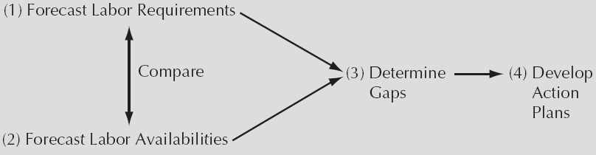
The Basic Elements of Human Resource Planning 1
Access the text alternative for slide images.

Slide 10
HRP: Forecasting Requirements 1
Statistical techniques
  Trend analysis
  Ratio analysis
  Regression analysis
Judgmental techniques
  “Top-down” approach
  “Bottom-up” approach
Scenario planning
  Incorporating manager judgment of potential future outcomes into statistical models

Slide 11
HRP: Forecasting Requirements 2
Trend Analysis
Gather data on staffing levels over time and arrange in a spreadsheet with one column for employment levels and another column for time.
Predict trend in employee demand by fitting a line to trends in historical staffing levels over time (this can be done by using regression or graphical methods in most spreadsheet programs).
Calculate period demand index by dividing each period’s demand by the average annual demand.
Example: January demand index = Avg. January FTE/Avg. annual FTE
Multiply the previous year’s FTEs by the trend figure, then multiply this figure by the period’s demand index.
Example: A retail store finds that the average number of employees over the past five years has been 142, 146, 150, 155, and 160. This represents a consistent 3% increase per year; to predict the next year’s average demand, multiply 160 by 1.03 to show a 3% expected increase. Over this same time period, the store averaged 150 FTEs per month, with an average of 200 FTEs in December. This means the December demand index is 200/150 = 1.33, so its estimate for next year’s
December FTE demand will be (160 × 1.03) × 1.3 = 219 FTEs.

Slide 12
HRP: Forecasting Requirements 3
Ratio Analysis
Examine historical ratios involving workforce size.
Assume ratio will be true in future.
Use ratio to predict future HR requirements.

Slide 13
HRP: Forecasting Requirements 4
Regression Analysis
Statistically identify historical predictors of workforce size.
Only use equations with predictors found to be statistically significant.
Predict future HR requirements, using equation.

Slide 14
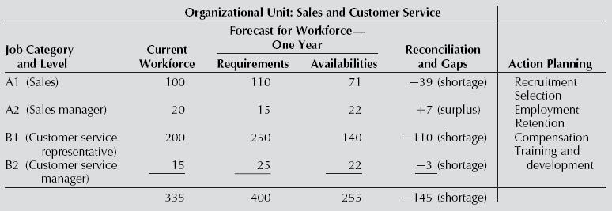
The Basic Elements of Human Resource Planning 2
Access the text alternative for slide images.

Slide 15
HRP: Forecasting Availabilities
External market availabilities
  Uses techniques of trend analysis and regression analysis
  Incorporate data from the Bureau of Labor Statistics
Internal market availabilities
  Markov analysis
  Judgmental techniques

Slide 16
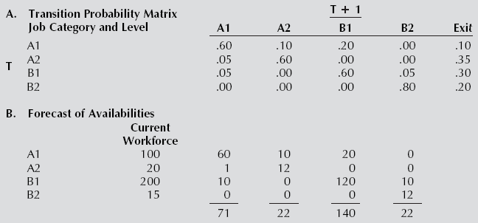
Use of Markov Analysis to Forecast Availability
Access the text alternative for slide images.

Slide 17
Reconciliation and Gaps
Access the text alternative for slide images.

Slide 18
Human Resource Planning
Reconciliation and Gaps
Action Planning
Coming to grips with projected gaps
Likely reasons for gaps
Assessing future implications
Set objectives
Generate alternative activities
Assess alternative activities
Choose alternative activities

Slide 19
Operational Format for Human Resource Planning
Access the text alternative for slide images.

Slide 20
Planning 3
Staffing Planning

Slide 21
Staffing Planning Process
Staffing objectives
  Quantitative objectives
  Qualitative objectives
Generate alternative staffing activities
  Staffing alternatives to deal with employee shortages and surpluses

Slide 22
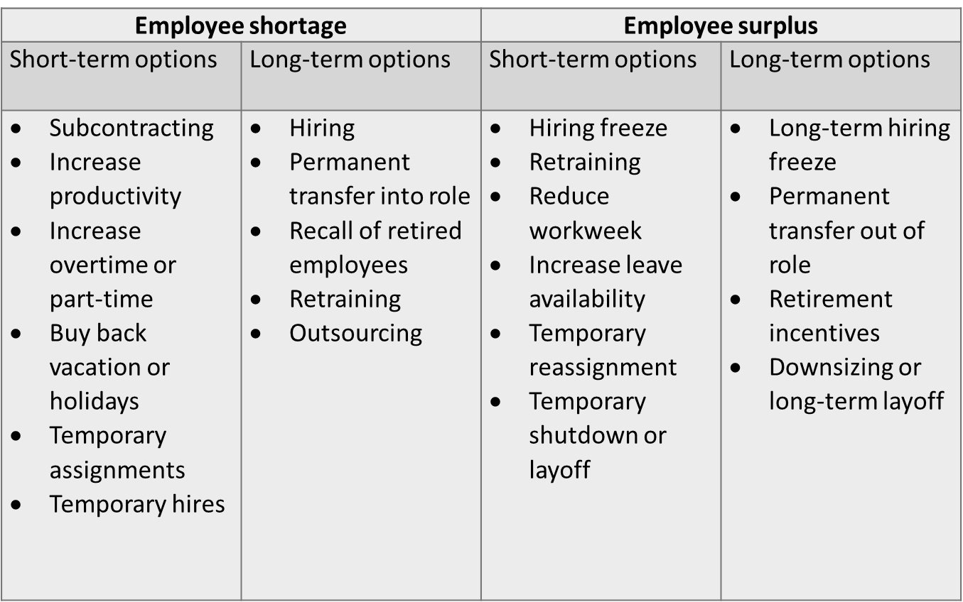
Staffing Alternatives to Deal With Employee Shortages and Surpluses
Access the text alternative for slide images.

Slide 23
Core Versus Flexible Workforce
Core workforce
Flexible workforce
Advantages
  Stability
  Continuity
  Predictability
  Sense of commitment
Disadvantages
  Locked in relationship
  Reduced flexibility
  Less inflow of new ideas
Includes staffing firms and contractors
Advantages
  Flexibility to address changing demand conditions
  Quickly staff new areas
  Fill in for core workers
Disadvantages
  Lower commitment
  Lower helping, creative suggestions, or extra effort
  Potential friction with core workers

Slide 24
Factors to Consider When Choosing a Staffing Firm
Agency and its reputation
Types of workers
Planning and lead time
Services: recruiting, selection, training, wages and benefits, supervision
Worker effectiveness
Cost

Slide 25
Staffing Planning: Outsourcing
Advantages
Disadvantages
Special issues
  Employer concerns regarding working conditions
  Loss of control over quality
  Offshoring

Slide 26
Planning 4
Individual Internal Staffing Plans

Slide 27
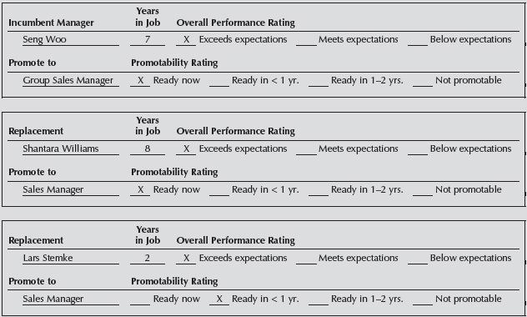
Replacement Chart
Access the text alternative for slide images.

Slide 28
Succession Plan
Organizational Unit: Merchandising—Soft Goods
Department: Menswear
Position to Be Filled: Department Sales Manager (A2)
Leadership Competencies Required
Plan work unit activities
Budget preparation and monitoring
Performance management of sales associates
Eligible Replacement | Promotability Rating | Competency Gaps | Development Plans
S. Williams | Ready now | Budget prep | Now completing in-house training course
L. Stemke | Ready in< 1 year | Plan work | Shadowing sales manager
 |  | Budget prep | Starting in-house training course
 |  | Perf. mgt. | Serving as sales manager 10 hours per week
 |  |  | Taking course on performance management at university extension
Table divided into four columns summarizes succession plan example. The column headers are marked from left to right as: Eligible replacement, promotability rating, competency gaps and development plans.

Slide 29
Planning
Diversity and Affirmative Action Planning

Slide 30
Diversity Planning
Recruiting implications
  Advertise in a variety of media sources
  Recruit at colleges and universities that have large numbers of individuals in underrepresented groups
  Demonstrate diversity in recruiting materials
Selection techniques
  Evaluate need for requirements that may eliminate a disproportionate number of underrepresented groups
  Focus on methods that minimize subjectivity

Slide 31
Ethical Issues in Staffing
Issue 1
  Does an organization have any ethical responsibility to share with all of its employees the results of its forecasting of HR requirements and availabilities? Does it have any ethical responsibility not to do this?
Issue 2
  Identify examples of ethical dilemmas an organization might confront when developing an affirmative action plan (AAP).

Slide 32
End of Main Content

