Slide 1
HOS301A Hotel Management Simulation
HOTEL MANAGEMENT REVIEW

Slide 2
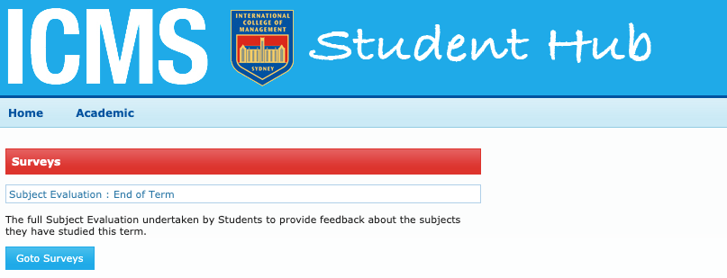
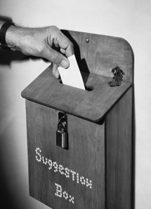
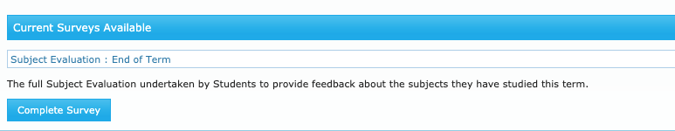
The Student Evaluation of Teaching and Unit
Go to the ICMS Student Hub Page by clicking here http://hub.icms.edu.au/
PLEASE NOTE - this log-in will only take you to the site – it will not identify you when you complete your surveys.
The surveys are anonymous.

Slide 3
HOTEL MANAGEMENT
Overview
Review
HOTS program
Notes:
Introduce the subject and the class lesson for today.

Slide 4
HOTEL
MANAGEMENT
Overseeing all aspects of the business and making adjustments as necessary.
  Marketing
  Revenue Management
  Finance
  Human Resources
  Operations
  Customer Service
Knowledge Areas

Slide 5
  SCOPE
  External Analysis
  Strategic Choices
  Strategic Planning
  Internal Analysis
  Strategic Decision
PESTEL
Trends
What can we do
Tactics
Plans
Budgets
SWOT
VRIO
Fit
Notes:
A framework to develop and select strategy.
This will be useful to follow this scope during the activity – Their hotel strategy development

Slide 6
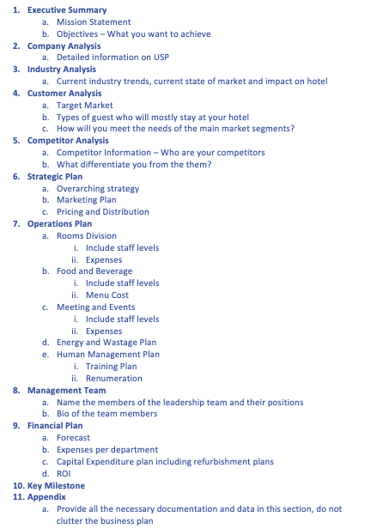
  Hotel Business Plan Template
Elements of the plan
Notes:
Refer the students to reading 2.2
Hotel Business Plan template

Slide 7
HOTEL MARKETING
STP
Segmentation
Targeting
Positioning
STEPS IN PROCESS
Notes:
Explain what STP stands for:
Segmentation – provide overview more detailed information in following slides
Target - provide overview more detailed information in following slides
Positioning - provide overview more detailed information in following slides

Slide 8
  The Four P’s
Accommodation
Product
Standard Room
Price
$100
Promotion
Social media
Place
Website & Expedia
Notes:
Work through the example provide:
Product – is standard room if they wish to include breakfast then this is a separate product same if they want to do weekday v weekend
Price – determine the price you will sell the standard room
Promotion – where will you advertise i.e. social media, print – explain to students to not confuse this with a promotions such as “bed and breakfast with parking”
Place – distribution where can consumers find the product – Expedia, booking. Com, hotel website.

Slide 9
HOTS
HOTS YEAR 3:
30 minutes
2 DECISION CYCLES
JANUARY FEBRUARY

Slide 10
Occupancy refers to the number of rooms occupied at any give of time.
Occupancy =
Rooms sold
Rooms available
Occupancy Formula

Slide 11
ADR
Average Daily Rate (ADR) is a metric that measure the average revenue earned per occupied room. This does not include F&B or other departmental revenue. It is rooms revenue only.
Average Daily Rate =
Total rooms revenue
Total rooms sold
ADR Formula

Slide 12
Revenue per available room (RevPAR) is a metric that measure the revenue earned per available room
RevPAR =
Total rooms revenue
Total available rooms
RevPAR Formula

Slide 13
GOPPAR
Gross operating profit per available room (GOPPAR) is a metric that measure the profitability per available room
GOPPAR =
Gross operating profit
Total available rooms
GOPPAR Formula

Slide 14
A diversified distribution strategy will allow hotels to reach a larger number of clients. This should be aligned with overall hotel and marketing strategy, know where your audience is.
Direct Channels
Indirect Channels
Hotel Website
Online Travel Agents
Reservations
Third Party Website
Walk In
Wholesalers / Travel Agents
Notes:
Talk to students about a balanced approach, not just relying one one channel over the other.

Slide 15
Competitor analysis provides you with a clear picture of what you are up against
Source: Zee absolute blog post
  SWOT
  Industry contacts / bodies / customers
  Study pricing
  Review digital platforms
  Subscribe and follow social platforms
  Subscribe to their mailing list
  Google Alerts
  Invest in monitoring tools
  STR
Competitor Analysis
Notes:
Refer to reading 5.4

Slide 16
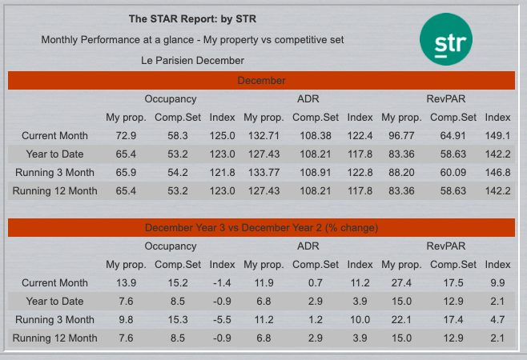
STR
  TEAM DECISION
The month’s data
Comparing previous year performance to current year performance

Slide 17
HOTS
HOTS YEAR 3:
30 minutes
2 DECISION CYCLES
MARCH APRIL

Slide 18
The main financial statements are designed to provide a picture of the overall financial position and performance of the hotel.
Source: Atrill, P., McLaney, E., & Harvey, D., Accounting: An Introduction, 6th Edition, Pearson Education Australia
  Statement of Cash Flow
  Statement of Income Statement
  Statement of financial position - Balance sheet
THRE REPORTS

Slide 19
SUMMARY
OPERATING
SCHEDULE
A report that summaries all the department operating schedules.
  Section one – displays income from three generating departments (accommodation, f&b, other)
  Section two – displays expenses from three departments (accommodation, f&b, other)
  Section three – displays undistributed operating expenses
  Section four – displays fixed charges

Slide 20
ROCE
A profitability ratio that expressing the operating profit as a percentage of the long term funds invested in the business.
Source: Atrill, P., McLaney, E., & Harvey, D., Accounting: An Introduction, 6th Edition, Pearson Education Australia
ROCE =
Operating Profit
Share of capital + Reserves + Non- Current Liabilities (Long term capital employed)
X 100

Slide 21
Working
Capital
Is usually defined as current assets less current liabilities. Represents a net investment in short term assets which continually flow in and out of the business and are essential for day to day operations
Source: Atrill, P., McLaney, E., & Harvey, D., Accounting: An Introduction, 6th Edition, Pearson Education Australia
Working Capital =
Current Assets – Current Liabilities

Slide 22
EBITDA
This metric is used to determine how profitable a hotel is. It is an indicator of a hotels financial performance and can be used to compare profitability.
EBITDA = Total Revenue – Expenses (excluding interest, taxes, depreciation, amortization)

Slide 23
Retained
Earnings
RE is profits made less any amounts drawn(dividends to shareholders) by the owners.
Source: Atrill, P., McLaney, E., & Harvey, D., Accounting: An Introduction, 6th Edition, Pearson Education Australia
Retained Earnings =
Beginning Period RE
+ Nett Income / Loss
Cash Dividends
Stock Dividends

Slide 24
The best hotel customer service may be defined by the following characteristics
Source: Cvent blog Maria Waida
  Attention to Detail
  Personalisation
  Creativity

Slide 25
HRM
  FORECASTING HUMAN CAPITAL NEEDS
  Determine Labour Demand
  Determine Labour Supply
  Determine Business Activity

Slide 26
  TRAINING & DEVELOPMENT
HRM
  Training – technical and refers to skills related to a person current role
  Development – building skills for a person's future role
  Learning – on going process of development of all employees

Slide 27
  GALLUP
  Description of Employees
HRM
  Engaged – work with passion
  Not Engaged – turn up and participate
  Disengaged - unhappy employees, affecting productivity

Slide 28
HOTS
HOTS YEAR 3:
30 minutes
2 DECISION CYCLES
MAY JUNE

Slide 29
Balanced Scorecard – Year 3 Half Year Review
Notes:
Review the first six (6) months of year three (3)– share the balanced score results for year 3 and 1 ½ year performance with rankings.

Slide 30

Next
Week
Teams to conduct detailed review of the hotel’s performance over the three (3)years
Teams to work on the presentation
Read presentation protocols in Moodle
Review presentation schedule an ensure that each team is ready to present at allocated time
Notes:
Remind students that this subject requires out of class work.

