Slide 1
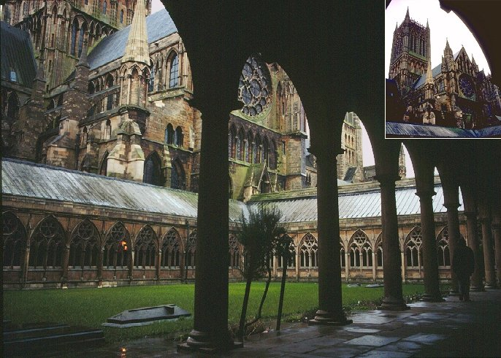
ANALYZING ARCHITECTURE
Understanding the Psychology & Aesthetics of Design
Understanding how to analyze architecture requires some knowledge of the basics of design principles. In this lecture the symbolism of architecture and forms of non-verbal communication, are also explored.
Notes:
INTRODUCTION
Understanding how to analyze architecture requires some knowledge of the basics of design principles. In this lecture the symbolism of architecture and forms of non-verbal communication, are also explored.
Judging a buildings artistic merits involves understanding how architects manipulate the essential visual elements of design.
A number of aspects must be considered in order to analyze or design an architectural form, including shape, mass size, scale, proportion, rhythm, texture, color, and light.
Knowing this, what really makes great architecture “great”, is the handling of factors like details, craftsmanship, materials, proportions, function, surface, color and texture, as well as its relationship to its site, space and light.
The works we will be studying are extraordinary, non-vernacular works of historical importance. You will be able to identify the prominent parts of the forms that make the structures function, known as the “physical aspects of architecture.
Even more difficult to difficult to assess are the psychological effects, which require more understanding of art than science. The architects creative manipulation of light and sound have created some of the most hauntingly beautiful and awe-inspiring structures on earth.
In addition, understanding “the how” also requires some background in the social & political background of an era, which will be discussed as well.
I want to make a note to tell you that this course will be covering primarily Western architecture- from Prehistoric to the Renaissance period. This is not to dismiss the great works of eastern and south American cultures, but the format of one survey course just makes it impossible to cover all the regions of the world! There are many other ancient cultures such as the Incas, Mayans, Aztecs and those from the ancient orient that I would have loved to explore in this course, but could not due to restraints of time and our textbook, which primarily discusses the European/western cultures regions. You will also notice an absence of female architects in this course. Unfortunately females, until just the last century, were not allowed to express creativity in this field; and as you know were often denied human and civil rights we now take for granted in our present society.

Slide 2
Design Elements of Arch/Art
It is the order that we feel when we look at a work of art or architecture. As the course progresses I will be pointing out design components in various works and explaining what they mean and how they are used by the architect to express their ideas.
LINE
RHYTHM
REPETITION
PROPORTION
PROXIMITY
SCALE
LIGHT
COLOR
ORNAMENT
SITE
SPACE
TEXTURE
WEIGHT/MASS
ACOUSTICS
The list above is one system, (there are others), for categorizing aspects of formal structure in the visual arts. The process of combining these elements and principles, is usually referred to as composition or design. How well ones does this often determines their talent. This "visual language" is the skeleton upon which any painting, drawing building, etc. is built, no matter what its subject matter may be.
Notes:
Just as written language uses letters, words, sentences, punctuation, syntax, etc. to organize information into understandable and expressive form, the visual arts use similar fundamental elements governed by organizational principles to create a coherent structural and visual order. The list above is one system, (there are others), for categorizing these aspects of formal structure in the visual arts. The process of combining these elements and principles, is usually referred to as composition or design. This "visual language" is the skeleton upon which any painting, drawing building, etc. is built, no matter what its subject matter may be.
It is the order that we feel when we look at a work of art or architecture. As the course progresses I will be pointing out design components in various works and explaining what they mean and how they are used by the architect to express their ideas.
SITE (PG 58) IMAGE:FALLINGWATER (ORGANIC ARCH) HARMONY WITH NATURE: IMAGE: KORAkuen VILLA, ORAYAMA JAPAN
SPACE:(PG 59)POSITIVE + NEGATIVE SPACE (IMAGE) CASA MIL'A -BY GAUDI, BARCELONA
TEXTURE: (PG 70) OPTICAL (VISUAL) AND TACTILE (FELT VIA TOUCH) TEXTURES 4.21 Alvar Aalto -Baker House MIT (IMAGE pg.73) 4.24 Kaufmann Residence/Falling Water RENAISSANCE RUSTIFIED STONE USE.
WEIGHT/MASS

Slide 3
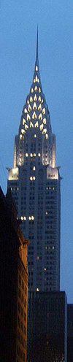
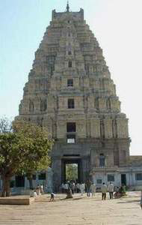
Perhaps the easiest element to recognize and perfect for the towers and skyscrapers is the element of line.
Vertical lines communicate a feeling of loftiness and spirituality. Erect lines seem to extend upwards beyond human reach, toward the sky. They often dominate public architecture, from cathedrals to corporate headquarters. Extended perpendicular lines suggest an overpowering grandeur, beyond ordinary human measure.
LINE-Vertical
The slide above are of the Virupaksha Temple and the great art deco masterpiece, the Chrysler Building in NYC.
Notes:
Perhaps the easiest element to recognize and perfect for the towers and skyscrapers is the element of line.
Vertical lines communicate a feeling of loftiness and spirituality. Erect lines seem to extend upwards beyond human reach, toward the sky. They often dominate public architecture, from cathedrals to corporate headquarters. Extended perpendicular lines suggest an overpowering grandeur, beyond ordinary human measure.
The slide above are of the Virupaksha Temple and the great art deco masterpiece, the Chrysler Building in NYC.
LINE (PG 58).

Slide 4
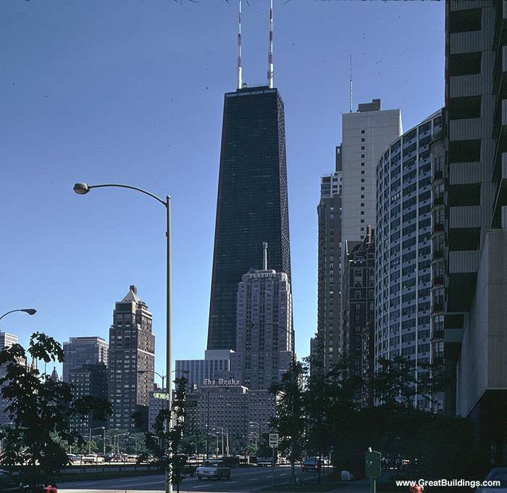
John Hancock Bldg, 1965-70
A great example of the use of vertical line to express power and prestige are the corporate skyscrapers of modern times. Above is the John Hancock tower, a great example.
Notes:
A great example of the use of vertical line to express power and prestige are the corporate skyscrapers of modern times. Above is the John Hancock tower, a great example.

Slide 5
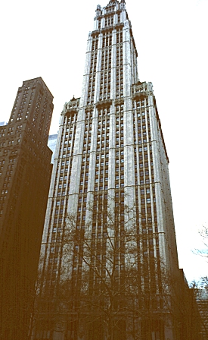
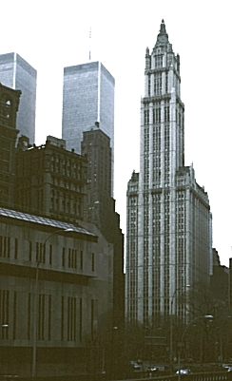
Woolworth Bldg, Cass Gilbert. 1913
In modern times when the metal-framed skyscraper was first developed, some architects utilized Gothic details in early skyscrapers to help emphasize and exaggerate their vertical character. In this slide of the Woolworth building, we see how Gilbert used vertically soaring Gothic details to express the height of this building as dramatically as possible.
Notes:
In modern times when the metal-framed skyscraper was first developed, some architects utilized Gothic details in early skyscrapers to help emphasize and exaggerate their vertical character. In this slide of the Woolworth building, we see how Gilbert used vertically soaring Gothic details to express the height of this building as dramatically as possible.

Slide 6
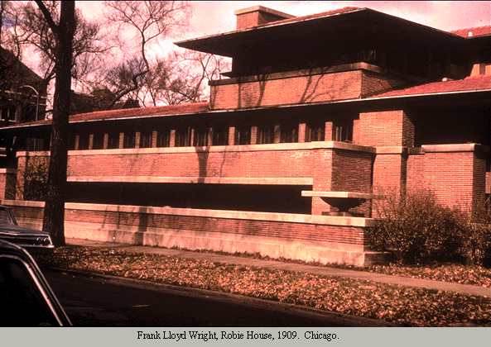
LINE- Horizontal
Horizontal lines in architecture can suggest a feeling of rest or repose. Objects parallel to the earth feel at rest in relation to gravity. Therefore compositions in which horizontal lines dominate tend to be quiet and restful in feeling. One of the hallmarks of Frank Lloyd Wright's architectural style is its use of strong horizontal elements which stress the relationship of the structure to the land. Wright exploited this technique extensively to convey a sense of domestic tranquility in his work.
Notes:
Horizontal lines in architecture can suggest a feeling of rest or repose. Objects parallel to the earth feel at rest in relation to gravity. Therefore compositions in which horizontal lines dominate tend to be quiet and restful in feeling. One of the hallmarks of Frank Lloyd Wright's architectural style is its use of strong horizontal elements which stress the relationship of the structure to the land. Wright exploited this technique extensively to convey a sense of domestic tranquility in his work.

Slide 7
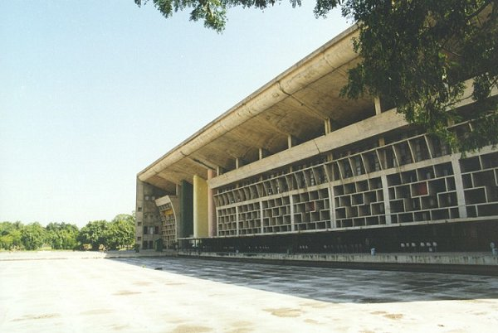
High Court @ Chandigarh,
Le Corbusier
Horizontal and vertical lines in combination communicate stability and solidity. Rectilinear forms stay put in relation to gravity, and are not likely to tip over. This stability suggests permanence, reliability and safety. Above is an excellent example of horizontal and vertical element utilized together.
Notes:
Horizontal and vertical lines in combination communicate stability and solidity. Rectilinear forms stay put in relation to gravity, and are not likely to tip over. This stability suggests permanence, reliability and safety.
Above is an excellent example of horizontal and vertical element utilized together.

Slide 8
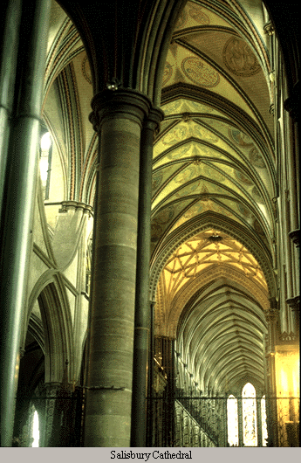
LINE- Diagonal
Diagonal lines in design suggest a feeling of movement or direction. The gothic cathedral like the one above, often combined diagonal line and vertical lines to create a sense of a reaching up toward the heavens…
Objects in a diagonal position generally appear unstable in relation to gravity; Being neither vertical nor horizontal, they appear as either about to fall, or to already be in motion. If a feeling of movement or speed or a feeling of activity is desired, diagonal lines can be used by architects to achieve this effect.
Notes:
Diagonal lines in design suggest a feeling of movement or direction. The gothic cathedral like the one above, often combined diagonal line and vertical lines to create a sense of a reaching up toward the heavens…
Objects in a diagonal position generally appear unstable in relation to gravity; Being neither vertical nor horizontal, they appear as either about to fall, or to already be in motion. If a feeling of movement or speed or a feeling of activity is desired, diagonal lines can be used by architects to achieve this effect.

Slide 9
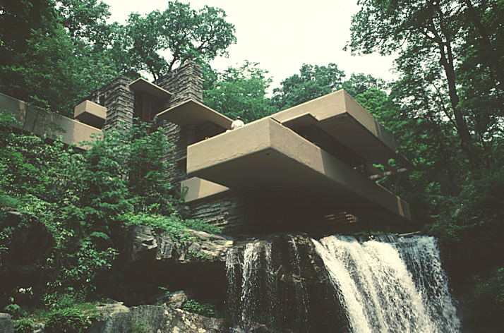
SITE - Falling Water-House and setting are spectacularly integrated.
Wright also created strong contrasts between the rough vertical masonry piers (with textured stone slabs to imitate the natural rock and bark textures around it), and the smooth horizontal concrete floor slabs. The residence brilliantly integrates into into surroundings, actually becoming almost part of the waterfall in which is directly built over! Notice how Wright also successfully uses natural colors, textures and a low horizontal structure line to all help it blend into the nature around it…
Notes:
Perhaps one of the best known successes of modern times is Frank L. Wrights Falling Water- a home built for the Kaufman family in Bear Run, Pennsylvania. Here house and setting are spectacularly integrated.
Wright also created strong contrasts between the rough vertical masonry piers (with textured stone slabs to imitate the natural rock and bark textures around it), and the smooth horizontal concrete floor slabs.
The residence brilliantly integrates into into surroundings, actually becoming almost part of the waterfall in which is directly built over!
Notice how Wright also successfully uses natural colors, textures and a low horizontal structure line to all help it blend into the nature around it…
Just image how many “bad” examples I could show you; Because unfortunately, this is the one area of architecture is the one that is most often ignored by many designers!

Slide 10
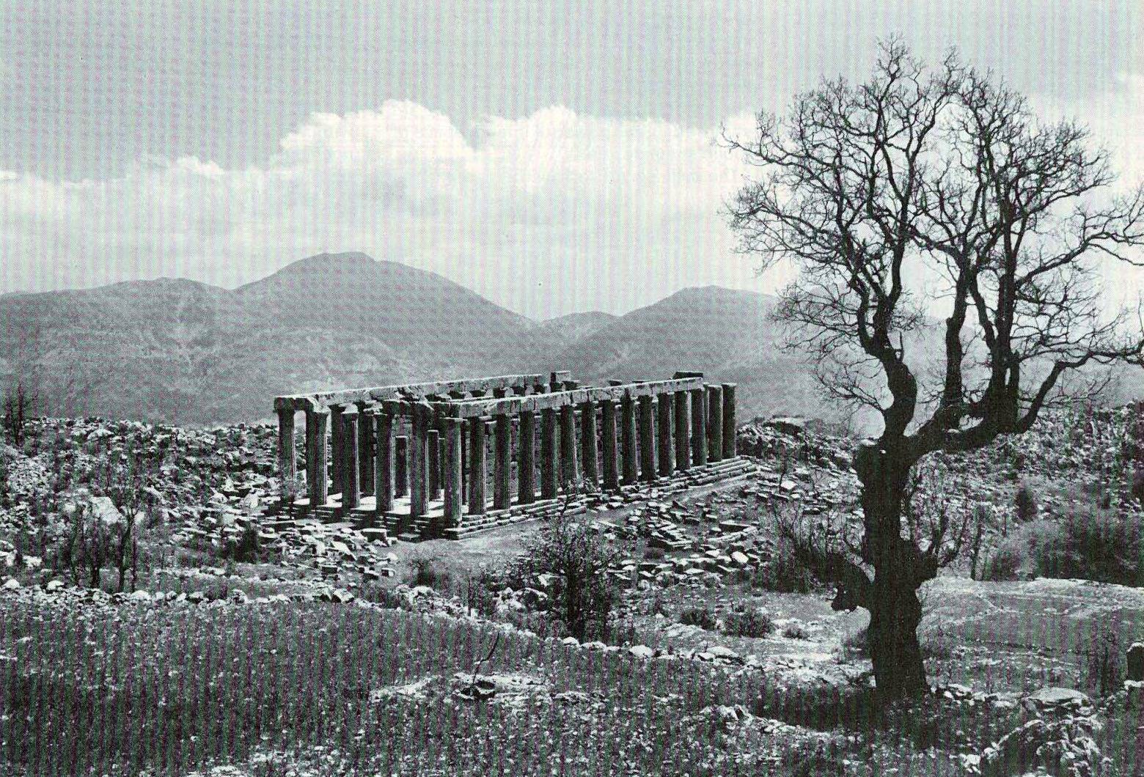
SITE & SPACE & PROXIMITY
A buildings surroundings and the building’s integration into it, is a crucial factor in good design.
The early Greeks intentionally set their temples in beautiful landscape/nature settings to create the proper “conditions” in which to approach their gods. Their ancient temples were never crowded by competing elements and were always strategically placed into positions on the land to provide amazing views, lighting effects and minimize wind or dust issues.
Notes:
SITE & PROXIMITY
A buildings surroundings and the building’s integration into it, is a crucial factor in good design.
The early Greeks intentionally set their temples in beautiful landscape/nature settings to create the proper “conditions” in which to approach their gods. Their ancient temples were never crowded by competing elements and were always strategically placed into positions on the land to provide amazing views, lighting effects and minimize wind or dust issues.
The Greeks clearly understood the importance of using positive and negative space (Also known as the figure-ground relationship)- they clearly realized that the shape of the surrounding space around the structure and creating a harmony between them, was just as important as the building, or the “positive” space.
PROXIMITY (PG 58)

Slide 11
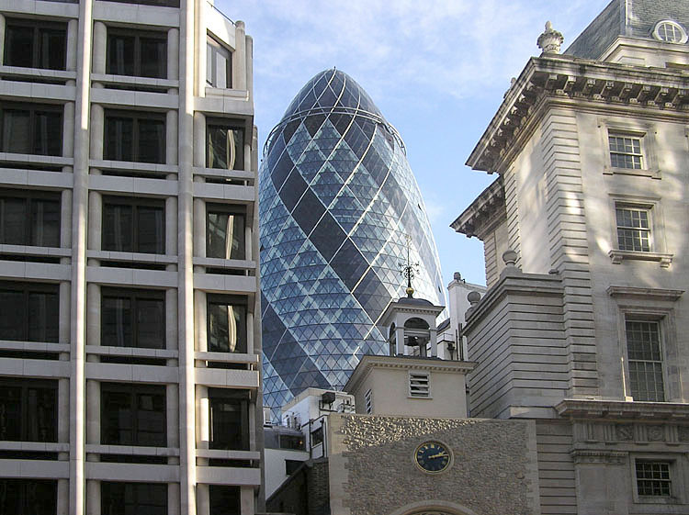
PROXIMITY
Here is an example of four totally different architectural styles in very close proximity in London, England, including the egg-shaped Swiss Re tower. (In 2004 this building’s architect won the Stirling Prize). Do you think the proximity works in this case? Why or why not?
Notes:
Here is an example of four totally different architectural styles in very close proximity in London, England, including the egg-shaped Swiss Re tower. (In 2004 this building’s architect won the Stirling Prize). Do you think the proximity works in this case? Why or why not?

Slide 12
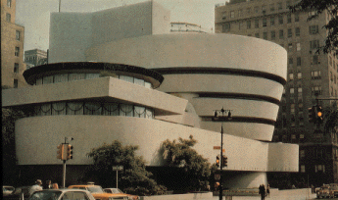
SHAPE AND MASS
A monumental masterpiece of successful mass and shape.
Guggenheim Museum, NY, F. L. Wright
Notes:
A monumental masterpiece of successful mass and shape.
The Guggenheim Museum, NY, by F. L. Wright.

Slide 13
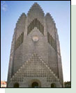
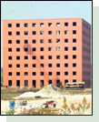
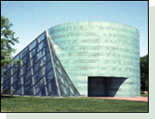
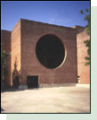
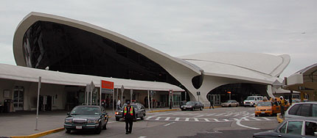
SHAPE: TWA Terminal at JFK by Eero Saarinen.
It shape perhaps makes it one of the most recognizable works of architecture. This building is considered an icon of great modern design - its shape mocks that of the image of flight- and brilliantly incorporated ancient elements of pointed Gothic arches in an new organic style that continues to influence architects today.
Notes:
Shape
Above From left to right: A Distinctive shape, A Cubic shape, A Cylindrical and pyramidal shape, and a Circle subtracted from cubic volume…
Above is the TWA Terminal at JFK.by Eero Saarinen.
It shape perhaps makes it one of the most recognizable works of architecture.
This building is considered an icon of great modern design - its shape mocks that of the image of flight- and brilliantly incorporated ancient elements of pointed Gothic arches in an new organic style that continues to influence architects today.
By definition, Shape refers to the configuration of surfaces and edges of a two- or three-dimensional objects. We perceive shape by the outside contour or silhouette of an object, rather than by its detail.
Primary shapes, the circle, triangle, and square, are often used in architecture to generate volumes known as "platonic solids." The Greeks, by the way, coined the term platonic meaning “in its pure form”.
A circle generates the sphere dome and cylinder, the triangle produces the cone and pyramid, and the square forms the cube or rectangle. Combinations of these platonic solids establish the basis for most architectural shapes and forms.
Shape preferences may be culturally based or rooted in personal memory, or convention. For example, a dome or steeple may connote religious architecture in some cultures, while an American child's drawing of a house often depicts a square shape with pitched roof—a shape that many houses do not possess in our culture.
Recent advances in digital technology have promoted the design and representation of more complex, non-platonic forms, such as the complex shape of the JFK airport above.

Slide 14
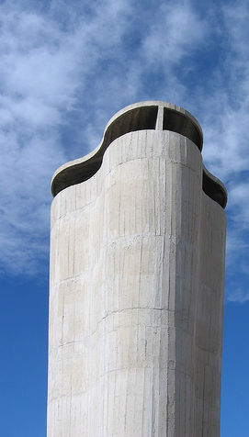
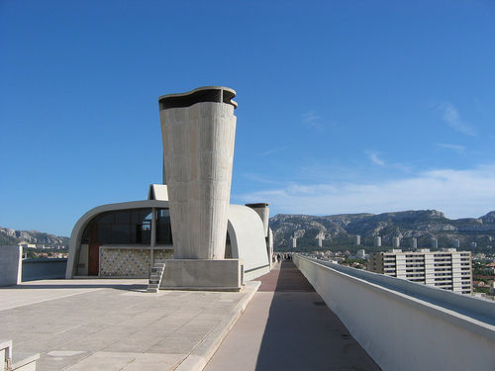
SHAPE L'unité d'habitation, Marseille by Le Corbusier.
It is another structure which shape makes it an extremely recognizable work of architecture. Note the effective use of texture as well- In my opinion Le Corbusier intentionally avoided the use of many colors so as to not take away from the unique shapes or textures he often gave to his structures…
Notes:
Shape
Above is the L'unité d'habitation, Marseille by Le Corbusier.
It is another structure which shape makes it an extremely recognizable work of architecture.
Note the effective use of texture as well- In my opinion Le Corbusier intentionally avoided the use of many colors so as to not take away from the unique shapes or textures he often gave to his structures…

Slide 15
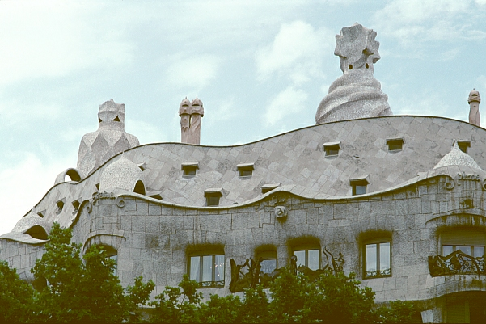
SHAPE
Another master of shape is the Spanish architect Antonio Gaudi. Above is his Casa Mila in Barcelona Spain-1905. His structures are immediately identifiable by their odd and uniquely incorporated organic forms. In this design, Gaudi sought to create an architecture that was modern, yet inspired by Moorish traditions and the history of the city of Barcelona. The layout and floorplan are almost entirely absent of straight lines.
(Page 453/454)
Notes:
Shape
Another master of shape is the Spanish architect Antonio Gaudi. Above is his Casa Mila in Barcelona Spain-1905. His structures are immediately identifiable by their odd and uniquely incorporated organic forms. In this design, Gaudi sought to create an architecture that was modern, yet inspired by Moorish traditions and the history of the city of Barcelona. The layout and floorplan are almost entirely absent of straight lines.
(Page 453/454)

Slide 16
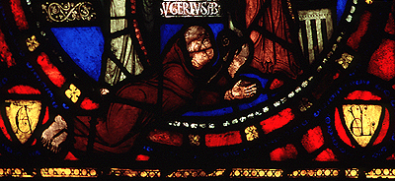
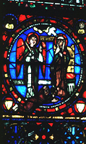
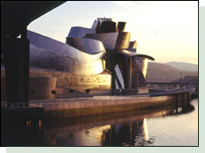
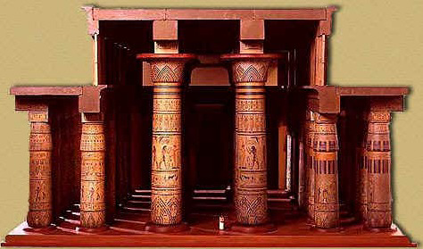
LIGHT
light is an element to be manipulated, so as to create a sense of mystery or drama, or accent focal points within the space. Light, whether natural or artificial, greatly clarifies and defines a space and form of a building, and early architects were quick to realize the dramatic effects they could create with light. It can create a sense of mystery and awe, or It is a tool to manipulate, that can also focus the eye on important points and highlight meaning, as well as provide visual delight.
The creative use of light also helps determines one’s perception of texture and form, creating both a physiological and a psychological mood.Light can effectively make an object appear much smaller or larger than it really is.
Notes:
LIGHT (PG 75)
Perhaps the most powerful element in our perception of architecture is light. For architects, light is an element to be manipulated, so as to create a sense of mystery or drama, or accent focal points within the space.
Light, whether natural or artificial, greatly clarifies and defines a space and form of a building, and early architects were quick to realize the dramatic effects they could create with light. It is an effective element in creating a sense of mystery and awe, or It is a tool to manipulate, that can also focus the eye on important points and highlight meaning, as well as provide visual delight, (eye-candy). For these reasons it was extensively used in the creation of many of the amazing shrines and religious buildings we will be looking at over the semester.
The creative use of light also helps determines one’s perception of texture and form, creating both a physiological and a psychological mood.Light can effectively make an object appear much smaller or larger than it really is.
Form is perceived differently depending on the light conditions within which the building is viewed.
In Baroque churches, architects like Bernini created theatrical lighting effects through hidden spotlights to heighten emotional impact. In fact, many of the early gothic churches used light and stained glass to create awe-inspiring effects and to keep their worshipers coming back for more! The light thru stained glass in gothic cathedrals softened the stone walls and also created an “other-worldly” effect.
Above are two masterpieces of Gothic period stained glass.
The top image is of the “Portrait of Suger”, at Saint-Denis in France- the lower one is the “Infancy Window,- Annunciation Panel” . The great cathedrals we will be studying made extensive use of light. When the gothic period arrived, its flying buttresses allowed the opening up of more space on its walls, leaving large areas where beautiful stained glass could be incorporated.
The use of light on a building form can also play light and shadow against one another to continuously modulate the exterior surface, like the example of Frank L. Wrights Biblio in Spain.
Above is a model of the Hypostyle Hall of the Great Temple of Ammon at Karnak, Eygpt c. 1312 bc.
The early Egyptians had specific lighting needs and consciously manipulated it when designing this great Hall: in order to admit light through the clerestory, the side avenues are purposely lower with columns 42 1/2 feet high and 8 feet 9 inches in diameter, instead of the larger ones placed in the center at 78 feet in height.

Slide 17
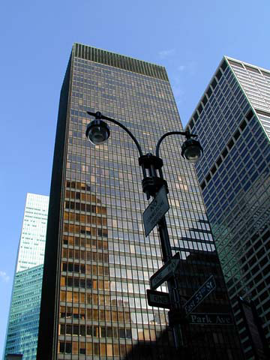
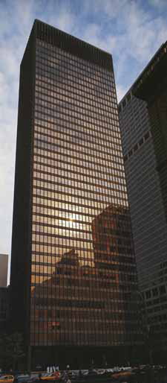
Seagrams Building 1954
Mies van der Rohe & Philip Johnson.
SITE & LIGHT
Notes:
Seagrams Building was a collaboration of two great architects, Mies van der Rohe & Philip Johnson. Built in 1954-58, it is considered the first modernist building in America. Johnson was very much into lighting, both natural and artificial and it is masterfully integrated in the design of this skyscraper.
The Seagram Building is constructed from the products of the industrial world: iron and glass- and modern glass was a new design element that Johnson fully exploited. This building also represents a new kind of temple - a temple to industrialization, and therefore to commerce. Any reference to the Parthenon or classical architecture is clearly absent. It is one of the first great icons to corporate culture.
The steel skeleton framed skyscraper, headquarters of the Seagram Liquor Company, established the basic form of the corporate tower for years to come. A brilliant design feature is that the curtain wall tower is not built to the edge of the site. It occupies only 40 percent of the allowable zoning envelope, freeing up space for a granite-paved public plaza enhanced by two reflecting pools and marble benches that is widely regarded as one of the most successful in the city. The plaza is an expensive aesthetic and symbolic gesture, especially significant in the dense urban environment which surrounds it.
In its monumental simplicity, expressed structural frame and rational use of repeated building elements, the building embodies Ludwig Mies van der Rohe's oft-repeated philosophy that "structure is spiritual" and "less is more." He believed that the more a building was pared to its essential structural and functional elements, and the less superfluous imagery is used, the more a building expresses its structure and form.

Slide 18
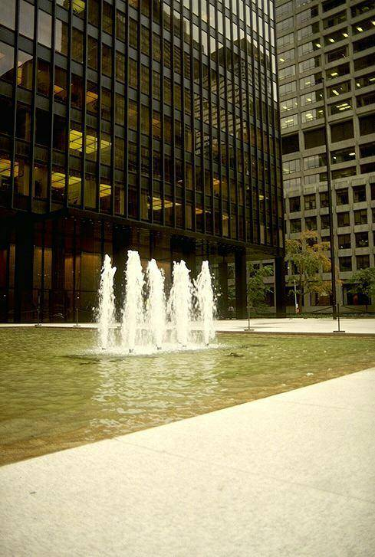
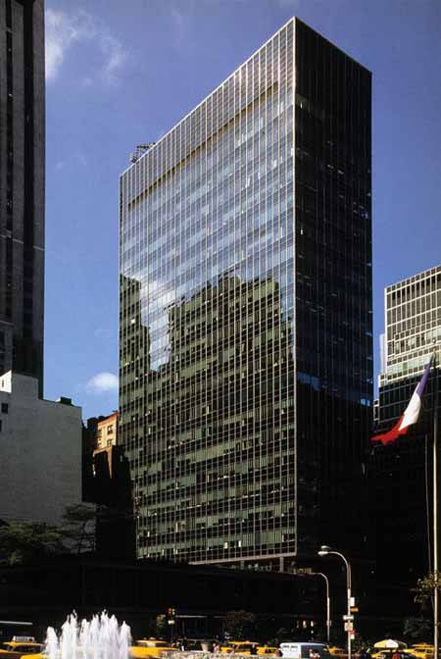
Johnson: expert in stylish high rises.
His genius is in that he has designed unique hybrids: sometimes abstract, yet aesthetically pleasing and highly powerful buildings.
Notes:
Johnson is an expert in stylish high rise buildings and became a corporate king of architectural buildings. His genius is in that he has designed unique hybrids: sometimes abstract, yet aesthetically pleasing and highly powerful buildings.
So we already know Johnson was very much into lighting, both natural and artificial. But he also greatly appreciated the effect water elements could have on a site and the way light could exaggerate the effect. Not surprisingly, he has designed several fountains that invite people to interact with them. He is into the volumes of space created by sculptural forms and thought a lot about the feeling one might experience while working or when passing through his buildings.
To quote Phillip Johnson:
"One thing that I really think runs as a thread is my passionate interest in processional space, space as apprehended by walking through it."
Johnson continued in the footsteps of Mies van der Rohe and became a master of the skyscraper. In 1979 he was the first recipient to the Pritzker Prize for Architecture a reward for architectural brilliance.

Slide 19
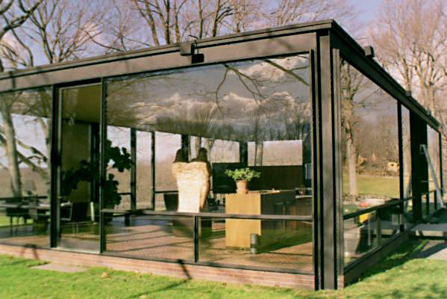
SITE and LIGHT
Philip Johnson House, 1945-49
Notes:
Phillip Johnson was so into Glass and light, (remember the Seagram Building?), he decided to build an entire weekend house for himself entirely out of glass. To gain the advantages of natural sunlight without roasting in it, he cleverly placed the house in a strategic position by a grouping of mature deciduous oak trees.. In the summer this would allow their foliage to shade the house to help cool it, and in the winter when the leaves dropped, the sun would enter in and help heat the house.
This house was revolutionary in that it proved to the haters of the modernist style that there was a way to build an entirely modern/abstract architecture and still integrate with it’s surrounding environment.
(& if you are wondering where the bathroom is like I did when I first saw it, it is concealed behind a small enclosure of brick) !

Slide 20
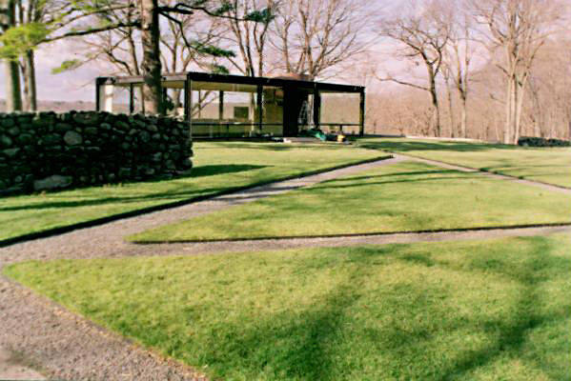
Philip Johnson House, 1945-49
This house was revolutionary in that it proved to the haters of the modernist style that there was a way to build an entirely modern/abstract architecture and still integrate with it’s surrounding environment. Here’s a view from a distance, showing the bare trees during the winter months.
Notes:
Here’s a view from a distance, showing the bare trees during the winter months.

Slide 21
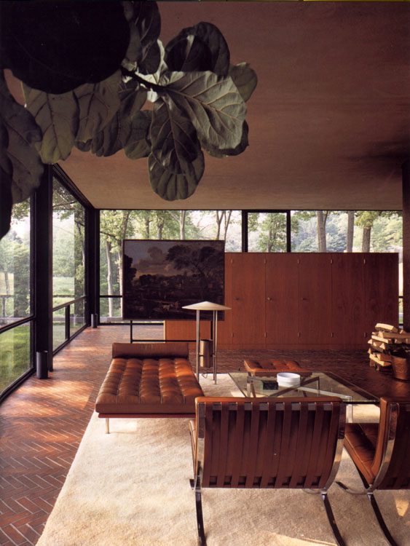
Philip Johnson House, 1949
A view of the interior and the well hidden enclosed bathroom area...
Notes:
A view of the interior and the enclosed bathroom area...

Slide 22
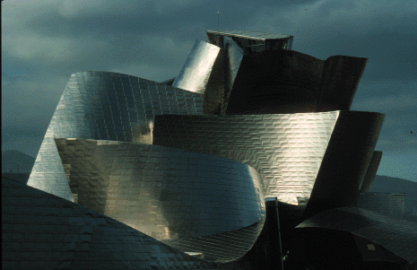
A Masterpiece of Light, Shape & Mass
Great masterpieces of architecture often manipulate many design elements. A perfect example of this is of the Guggenheim Museum in Spain, designed by Frank Gehry. Although it is extremely massive in literal size, his design employs a complex, non-rectilinear shape that uses form and surface articulation to dramatically reduce the appearance of the building’s overall scale. A masterful optical illusion. Gehry’s choice of a highly reflective titanium exterior cladding that covers the entire exterior further dematerializes the sense of its massiveness, and also creates an amazingly beautiful play of light and shadow on the form.
Notes:
Great masterpieces of architecture often manipulate many design elements. A perfect example of this is of the Guggenheim Museum in Spain, designed by Frank Gehry.
Although it is extremely massive in literal size, his design employs a complex, non-rectilinear shape that uses form and surface articulation to dramatically reduce the appearance of the building’s overall scale. A masterful optical illusion. Gehry’s choice of a highly reflective titanium exterior cladding that covers the entire exterior further dematerializes the sense of its massiveness, and also creates an amazingly beautiful play of light and shadow on the form.

Slide 23
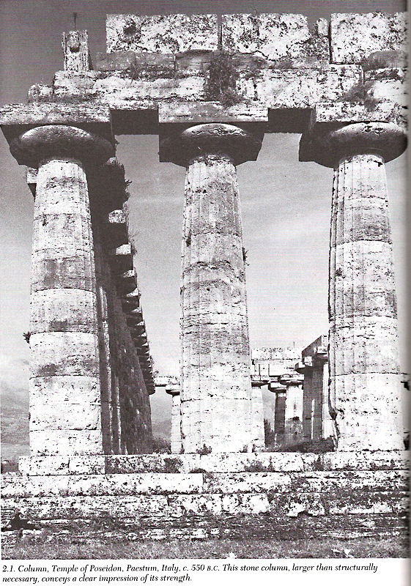
SCALE
Scale is said to be “how big a building is in relationship to an average human”. Architecture is definitely the largest and most encompassing of the visual arts, so naturally, it makes sense that scale is frequently used as a method by which architects manipulate our experience.
These massive stone columns at the temple of Poseidon, are clearly larger then are structurally needed, conveying a clear impression of strength and permanence to its viewer.
Notes:
SCALE:
Architecture is definitely the largest and most encompassing of the visual arts, so naturally, it makes sense that scale is frequently used as a method by which architects manipulate our experience.
Scale is said to be “how big a building is in relationship to an average human”.
These massive stone columns at the temple of Poseidon, are clearly larger then are structurally needed, conveying a clear impression of strength and permanence to its viewer.
SCALE (PG 66)

Slide 24
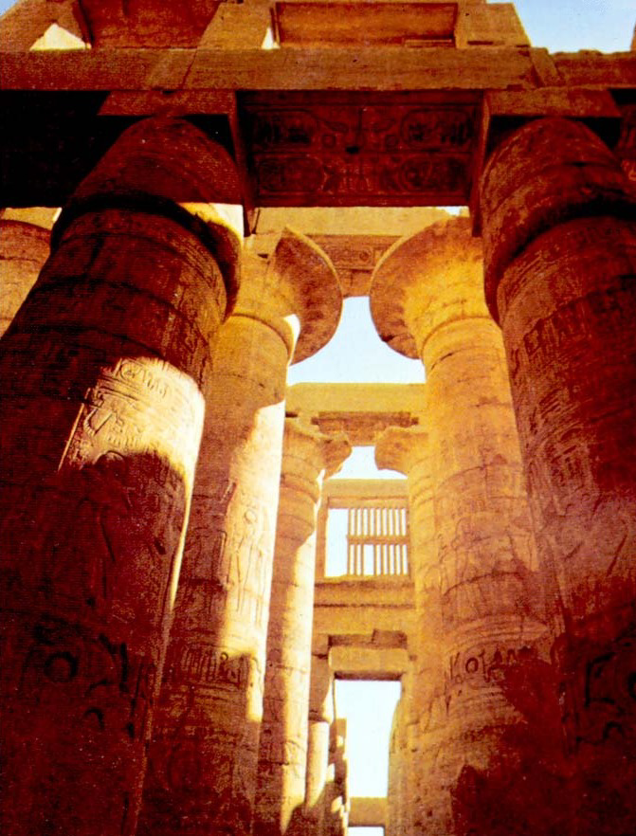
MASS- WEIGHT- SCALE
Mass combines with shape to define form. Mass refers to the size or physical bulk of a building, and can be understood as the actual size, or size relative to us. This is where scale comes into play- Scale is often just our perception of mass.
As we said, scale refers to a building’s size in relationship to the human body, as well as its surroundings. Architects manipulate scale to intentionally make a building appear cozy or overwhelming.
An excellent example of scale are the columns in the Egyptian temple of Amon at Karnak, which are hugely over-sized in relationship to the human body. The architects intent was to humble the egos of us mere mortals in the presence of their god Amon.
Notes:
Mass/Size
Mass combines with shape to define form. Mass refers to the size or physical bulk of a building, and can be understood as the actual size, or size relative to us. This is where scale comes into play- Scale is often just our perception of mass.
As we said, scale refers to a building’s size in relationship to the human body, as well as its surroundings. Architects manipulate scale to intentionally make a building appear cozy or overwhelming.
An excellent example of scale are the columns in the Egyptian temple of Amon at Karnak above, which are hugely over-sized in relationship to the human body. The architects intent was to humble the egos of us mere mortals in the presence of their god Amon.
Here are some size facts on the Temple of Amon at Karnak, (c. 1312-1301 BC)
Total size: 338 x 170 feet, 134 columns in 16 rows, the central avenues are about 78 feet in height, and have columns 69 feet high and 11 feet 9 inches in diameter, with capitals of the papyrus-flower or bell type, while in order to admit light through the clerestory, the side avenues are lower with columns 42 1/2 feet high and 8 feet 9 inches in diameter.

Slide 25
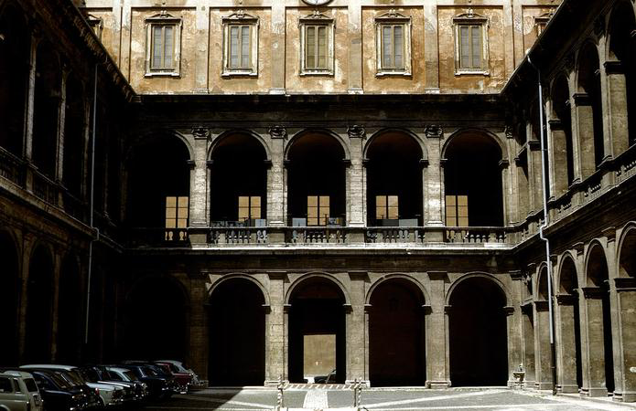
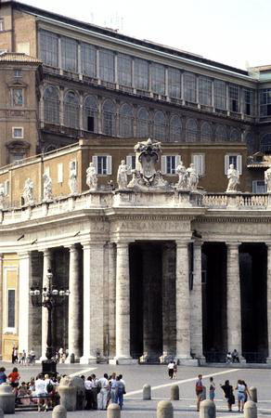
MASS- WEIGHT
Another example of scale seen above- Michelangelo’s Campidoglio: Where he used giant pilasters stretching over several stories to achieve a sense of vast scale. Michelangelo often deliberately used over-scaled elements like doors and windows over 2-3 times larger that expected, to reduce the number of parts and make it more difficult to judge the true scale of the building. Also notice how heavy the structures look- This effect Adds to a psychological sense of permanence and invulnerability.
Notes:
SCALE:
Another example of scale seen above- Michelangelo’s Campidoglio: Where he used giant pilasters stretching over several stories to achieve a sense of vast scale. Michelangelo often deliberately used over-scaled elements like doors and windows over 2-3 times larger that expected, to reduce the number of parts and make it more difficult to judge the true scale of the building. Also notice how heavy the structures look- This effect Adds to a psychological sense of permanence and invulnerability.

Slide 26
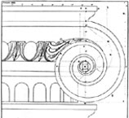
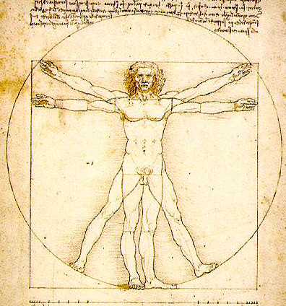
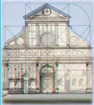
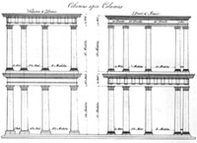
PROPORTION
BALANCE / HARMONY
Since Antiquity, architects have devised proportioning systems to visually unify all the parts of a building through the same set of proportions. The process creates an internal coherence and sense of order apparent in the building, even if the underlying proportioning system is not known to the observer. These systems can be arithmetic, geometric, or harmonic. The Greeks came the closest to refining this in their invention of the Golden Mean aka the Golden Section.
Notes:
PROPORTION / BALANCE / HARMONY
In general, proportion in architecture refers to the relationship of one part to the other parts, and to the whole building. Numerous architectural proportioning systems have developed over time and in diverse cultures, but just a few specific examples are listed below.
Proportioning Systems
Since Antiquity, architects have devised proportioning systems to visually unify all the parts of a building through the same set of proportions. The process creates an internal coherence and sense of order apparent in the building, even if the underlying proportioning system is not known to the observer. These systems can be arithmetic, geometric, or harmonic. The Greeks came the closest to refining this in their invention of the Golden Mean aka the Golden Section.
3 main Proportional systems:
1. Arithmetic:
The Ancient Greeks used clear mathematical ratios for both visible and auditory phenomena, such as architecture and music. For instance, Pythagoras emphasized the importance of numbers. Originating in Greek Antiquity, the "Golden Section" has been used by Renaissance theorists, modern and contemporary architects. The Golden Section or Golden Mean is both arithmetic and geometrical, and is prevalent in both the natural world and classical architectural design. It may be expressed as a:b = b (a+b). This relationship can be verbally described as: a is to b, as b is to the whole. The Golden Section is also apparent in the Fibonacci series of integers: 1,1,2,3,5,8,13,21,34,55, etc. Each succeeding number is the sum of two previous numbers. This series forms the basis for a spiral, as found in the snail's shell or the spiral volutes of ionic column capitals. (see column capital above).
2. Geometric:
In Classical architecture, the diameter of a classical column provided a unit of measurement that established all the dimensions of the building, from overall dimensions to fine detail. This system works for any size of building, since the column unit fluctuates while the internal relationships remain constant. Drawings of the "classical order" explain this set of relationships geometrically.
3. Harmonic: The ancient discovery of harmonic proportion in music was translated to architectural proportion. For instance, this system states that when the ratio of 1:2, 2:3, or 3:4 is applied to buildings or rooms, harmonious proportion results. The early Renaissance architect Alberti credited the harmony of Roman architecture and the universe to this system. The Renaissance architect Palladio, along with Venetian musical theorists, developed a more complex system of harmonic proportion based on the major and minor third—resulting in the ratio of 5:6 or 4:5.
Above IMAGES:
A sketch of an Ionic column capital of the Greek Doric order- It shows the incorporation of the Nautilus shell – a symbol representing the perfect proportions of the Golden Mean.
Leonardo DiVinci, inspired by the mathematician Vitruvius (Roman, 1st century BCE), drew this very famous picture of the Vitruvian Man — as an example of an ideally proportioned man, whose arm span is equal to his height — a ratio of one, or 1:1. B(ased off the mathematical principles of the Golden mean).

Slide 27
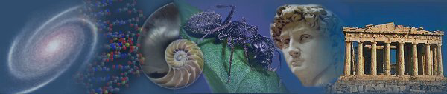
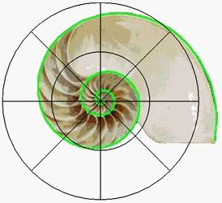
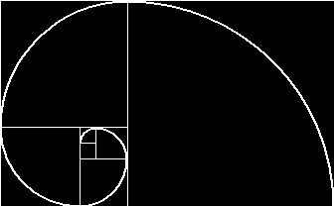
GOLDEN MEAN
It is believed that the pervasive appearance of phi in all we see and experience creates a sense of balance, harmony and beauty in the design of all we find in nature.
The Golden Mean produces a harmonic effect called “eurythmy” which is found in nature as well as in a wide variety of works of art and design. The dictionary defines eurythmy as: n. a harmony of proportion in architecture. Artists of various periods and cultures have found that dimensions determined by this formula are aesthetically appealing.
Notes:
c
It is believed that the pervasive appearance of phi in all we see and experience creates a sense of balance, harmony and beauty in the design of all we find in nature.
The Golden Mean produces a harmonic effect called “eurythmy” which is found in nature as well as in a wide variety of works of art and design. The dictionary defines eurythmy as: n. a harmony of proportion in architecture.
Artists of various periods and cultures have found that dimensions determined by this formula are aesthetically appealing.
The chambered nautilus above is an example found in nature of the Proportional Rules of the Golden Mean.
Not surprisingly, the Nautilus shell is one of the known shapes that universally symbolizes the golden mean number.

Slide 28


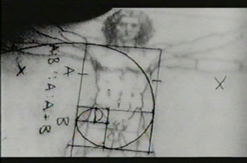
The Formula…
The Golden Section is also known as the Golden Mean, Golden Ratio and Divine Proportion.
It is a ratio or proportion defined by the number Phi ( = 1.618033988749895... )
In the diagram below, point C divides the line in such a way that the ratio of AC to CB is equal to the ratio of AB to AC. Some elementary algebra shows that in this case the ratio of AC to CB is equal to the irrational number 1.618 (precisely half the sum of 1 and the square root of 5).
Notes:
The golden mean number, also known as PHI – is 1.6180339...
A proportional relation (ratio) obtained by dividing a line so that the shorter part is to the longer part as the longer part is to the whole.
Another way to describe this: a proportion between the two dimensions of a plane figure or the two divisions of a line, in which the ratio of the smaller to the larger is the same as the ratio of the larger to the whole: a ratio of approximately 0.618 to 1.0.
The PHI is a number without arithmetic solution, the digit simply continues for eternity without repeating themselves. The uniqueness of the golden mean is that it can be found in all living forms such as the human skeleton, the shell and the sunflower seed.
Phi appears throughout life and the universe. Some believe that it is the most efficient outcome, the result of natural forces. Some believe it is a universal constant of design, the signature of God.
It should be no surprise then that mankind would use this same proportion found in nature to achieve balance, harmony and beauty in its own creations of art, architecture, colors, design, composition, space and even music.

Slide 29
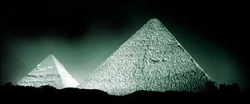
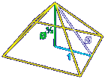
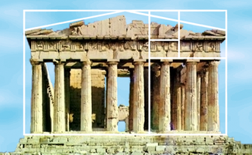
Golden ratio has been used for centuries…
Its use may have started as early as with the Egyptians in the design of the pyramids,
The Greeks recognized it as "dividing a line in the extreme and mean ratio” and used it for beauty and balance in the design of architecture…
The Parthenon used various golden rectangles in its design…
Notes:
Above is a picture of The Parthenon, Athens, and a great pyramid in ancient Egypt- Both superimposed with a diagram demonstrating the use of the Golden Mean in the Parthenon's design.
Even these early architects believed that Phi creates a sense of beauty and proportion.

Slide 30
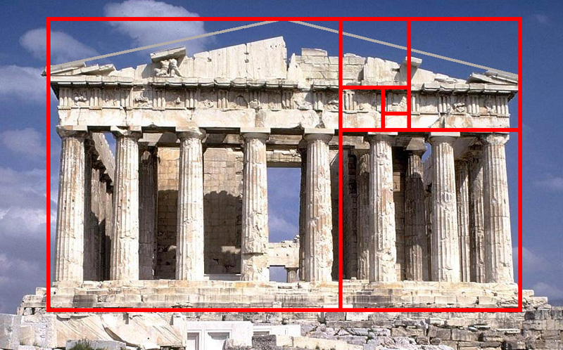
Parthenon & the Golden Mean
The Parthenon was a crowning example of proportion in architecture. It was produced by the proportions of the principles of the Golden Mean. Scholars still marvel at the logical and harmonious ratios in the whole building and its various parts. The Parthenon had been designed by Ictinus and Callicrates according to mathematical principles Its surrounding pillars were an example of "number" applied: 8 pillars in front, an even number, as Pythagoras had advised, so no central posts would block the view; but 17 pillars on each side, where it was all right to have an odd number. Some of its lines were deliberately curved and slanted to correct optical distortions.
Notes:
On the high Acropolis, against the shimmering sky, stood the beautiful temple called the Parthenon-the most wonderful monument of the Age of Pericles, the "perfect" building whose ruins enthrall us even today. The Parthenon had been designed by Ictinus and Callicrates according to mathematical principles Its surrounding pillars were an example of "number" applied: 8 pillars in front, an even number, as Pythagoras had advised, so no central posts would block the view; but 17 pillars on each side, where it was all right to have an odd number. Some of its lines were deliberately curved and slanted to correct optical distortions.
The Parthenon was a crowning example of proportion in architecture. It was produced by the proportions of the principles of the Golden Mean. Scholars still marvel at the logical and harmonious ratios in the whole building and its various parts.

Slide 31
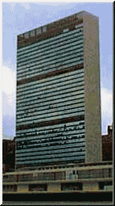



Golden Mean in Architecture..
Its use continues in modern architecture, as illustrated
in the United Nations
building..
The CN Tower in Toronto, the tallest tower and freestanding structure in the world, contains the golden ratio in its design. The ratio of observation deck at 342 meters to the total height of 553.33 is 0.618 -or the reciprocal of Phi!
It was used in the design of Notre Dame in Paris…
Notes:
Many architects throughout history and into modern times have continued to used the Golden Section in their designs. Le Corbusier" (French, 1887-1965), often used golden rectangles in his designs for buildings. One of these is the United Nations building in New York as pictured above. It was used in the design of Notre Dame in Paris…

Slide 32


Unite d’Habitation, Le Corbusier 1946.
Le Corbusier’s
diagram
of the
Modular Man,
1947
Le Corbusier used a mathematical proportioning system throughout much of his work in he called the “Modular”. The system he developed was based on the work by the Medieval mathematician Leonardo Fibonacci
(c. 1170-1240) and by its influence of the Golden Mean.
The Fibonacci numerical sequences are generated by starting with one, adding that to itself, and then generating the next number in the series by adding the preceding two numbers together…
Thus:
1, 2, 3, 5, 8 , 13, 21, 34- His theory was that the larger these numbers became, the closer the last two approached the Golden Section.
Notes:
Unite d’Habitation, Le Corbusier. 1946-52.
This entire apartment buildings design was based upon mathematical proportions of his Modular system.
Le Corbusier used a mathematical proportioning system throughout much of his work in he called the “Modular”. The system he developed was based on the work by the Medieval mathematician Leonardo Fibonacci (c. 1170-1240) and by its influence of the Golden Mean.
The Fibonacci numerical sequences are generated by starting with one, adding that to itself, and then generating the next number in the series by adding the preceding two numbers together…
Thus:
1, 2, 3, 5, 8 , 13, 21, 34- His theory was that the larger these numbers became, the closer the last two approached the Golden Section.
The Modular was supposed to provide a standardized system that would automatically confer harmonious proportions to everything, from door handles to high-rise buildings.

Slide 33




The Renaissance artists such as DaVinci knew it as the Divine Proportion and used it for beauty and balance in the design of art.
and continues today in many examples of art, architecture and design such modern art like as Dali and Kandinsky’s.
Notes:
The Golden Mean number is widely used in art, architecture and religious symbols. Artists like DaVinci and Kandinsky have used the golden mean in their paintings.
Many books claim that if you draw a rectangle around the face of Leonardo da Vinci's Mona Lisa, the ratio of the height to width of that rectangle is equal to the Golden Ratio. No documentation exists to indicate that Leonardo consciously used the Golden Ratio in the Mona Lisa's composition, nor to where precisely the rectangle should be drawn. Nevertheless, one has to acknowledge the fact that Leonardo was a close personal friend of Luca Pacioli, who published a three-volume treatise on the Golden Ratio in 1509 (entitled Divina Proportione).
Another painter, about whom there is very little doubt that he actually did deliberately include the Golden Ratio in his art, is the surrealist Salvador Dali. The ratio of the dimensions of Dali's painting Sacrament of the Last Supper is equal to the Golden Ratio. Dali also incorporated in the painting a huge dodecahedron (a twelve-faced Platonic solid in which each side is a pentagon) engulfing the supper table. The dodecahedron, which according to Plato is the solid "which the god used for embroidering the constellations on the whole heaven," is intimately related to the Golden Ratio - both the surface area and the volume of a dodecahedron of unit edge length are simple functions of the Golden Ratio.
These two examples are only the tip of the iceberg in terms of the appearances of the Golden Ratio in the arts.

Slide 34





It also appears in the physical proportions of the human body, movements in the stock market and many other aspects of life and the universe…
This approach can be used to explain the physical proportions of many life forms, but the most beautiful application is found in humans:
It appears that this "golden rule" is a common, if not universal, metric in the design of living organisms as well as built forms.
Notes:
But why would all of these artists (there are many more than mentioned above), even consider incorporating the Golden Ratio in their works? The attempts to answer this question have led to a long series of psychological experiments, designed to investigate a potential relationship between the human perception of "beauty" and mathematics.
Researchers have actually found that humans will consider more beautiful a piece of art work, architecture or even a face, that have the golden mean proportions.
Pioneering experiments in this field were conducted by the German physicist and psychologist Gustav Theodor Fechner in the 1860s. Fechner's experiment was simple: ten rectangles varying in their length-to-width ratios were placed in front of a subject, who was asked to select the most pleasing one. The results showed that 76% of all choices centered on the three rectangles having ratios of 1.75, 1.62, and 1.50, with a peak at the "Golden Rectangle" (with ratio 1.62). Fechner went further and measured the dimensions of thousands of rectangular-shaped objects (windows, picture frames in the museums, books in the library), and claimed (in his book Vorschule der Aesthetik) to have found the average ratio to be close to the Golden Ratio.

Slide 35

RHYTHM -PATTERN
Le Corbusier’s Unit de’ Habitation in France
Architects set up a pattern of rhythmic repetition of elements like solids and voids, walls and windows, projecting or proceeding parts. Placement of columns on a façade or arches in an arcade like we studied earlier for example, was usually regularly placed and symmetrical during the renaissance, and alternating in the mannerist period.
Rhythm produces A visual tempo or beat. The principle of design that refers to a regular repetition of elements of art to produce the look and feel of movement, and is also closely associated with the musical elements.
Notes:
Rhythm & Pattern
Architects set up a pattern of rhythmic repetition of elements like solids and voids, walls and windows, projecting or proceeding parts. Placement of columns on a façade or arches in an arcade like we studied earlier for example, was usually regularly placed and symmetrical during the renaissance, and alternating in the mannerist period.
Rhythm produces A visual tempo or beat. The principle of design that refers to a regular repetition of elements of art to produce the look and feel of movement, and is also closely associated with the musical elements. The appearance of rhythm is often achieved through the careful placement of repeated components which invite the viewer's eye to jump rapidly or glide smoothly from one element to the next.
The reoccurrence or repetition of architectural elements, shapes, structural bays, windows, etc. establishes a rhythm, which may be regular or complex. A static building possesses a rhythm, while the movement of inhabitants through a building may also establish a pattern or rhythm of human movement.
The repetition of any thing -- shapes, lines, or colors -- also called a motif, in a design; as such it is one of the principles of design.
Above is Le Corbusier’s Unit de’ Habitation in France which shows several good examples of pattern and rhythm produced by repeating architectural elements.

Slide 36




RHYTHM-PATTERN & “Fenestration”…
Notes:
Rhythm
Architects set up a pattern of rhythmic repetition of elements like solids and voids, walls and windows, projecting or proceeding parts. Placement of columns on a façade or arches in an arcade, for example, was usually regular and symmetrical during the renaissance, and syncopated in the mannerist period.
Rhythm produces a visual tempo or beat. The principle of design that refers to a regular repetition of elements of art to produce the look and feel of movement. It is often achieved through the careful placement of repeated components which invite the viewer's eye to jump rapidly or glide smoothly from one to the next.
The reoccurrence or repetition of architectural elements, shapes, structural bays, windows, etc. establishes a rhythm, which may be regular or complex. A static building possesses a rhythm, while the movement of inhabitants through a building may also establish a pattern or rhythm of human movement. See Fig. 13 for an example of how adjacent individual building rhythms also create a larger street wall rhythm.
The repetition of any thing -- shapes, lines, or colors -- also called a motif, in a design, creates a visual pattern;
The examples shown above, utilize a repetition of windows and shapes to produce patterns.

Slide 37

REPETITION
Repetition is defined by the equalities of spacing or distance- even when none actually exist, as in optical illusions. This is one reason why the Greeks made the corner columns of their temples intentionally a little thicker than the rest, and were also positioned a little closer to one another, so that what we would actually see what we “subconsciously WANT to see.. The illusion that the columns were perfectly aligned…Their carefully calculated sequences of inequalities gave the visual illusion of balance and perfection- Something extremely important to the Greeks.
Notes:
REPETITION (PG 58)
Closely related to Pattern is Repetition.
Repetition is defined by the equalities of spacing or distance- even when none actually exist, as in optical illusions. This is one reason why the Greeks made the corner columns of their temples intentionally a little thicker than the rest, and were also positioned a little closer to one another,
so that what we would actually see what we “subconsciously WANT to see.. The illusion that the columns were perfectly aligned…
Their carefully calculated sequences of inequalities gave the visual illusion of balance and perfection- Something extremely important to the Greeks.
Above is the Temple of Hephaestos; Greece, Athens 450-440 B.C.

Slide 38

Beinecke Rare Book Library, Yale University. 1963
This building shows a strong repetitive Architectural pattern created by intervals of elements such as windows, doors, etc.
Notes:
RHYTHM
This building shows a strong repetitive Architectural pattern created by intervals of elements such as windows, doors, etc. (BEINECKE RARE BOOK LIBRARY-YALE).

Slide 39

Beinecke Rare Book Library: The world balanced on a point?(The additional of Symbolism)…
Notes:
Beinecke Rare Book Library: The world balanced on a point?(The additional of Symbolism)…

Slide 40

Mathematical symbolism in concrete..Geometry patterns in design…
Notes:
Math in design…

Slide 41




TEXTURE
Notes:
Both texture and color are inherently linked to materials, and can be used to alter the perception of any given form. Consider how the shift from a light to dark paint color can radically reduce the apparent size of a room, or how a smooth stucco or rough brick finish can alter the size and visual weight of a house. As illustrated above, the same stone rendered smooth, rusticated, or intricately carved, results in different textures and colors.
TEXTURE - An element of art, texture is the surface quality or "feel" of an object, its smoothness, roughness, softness, etc. Textures may be actual or simulated. Actual textures can be felt with the fingers, while simulated textures are suggested by an artist in the painting of different areas of a picture — often in representing drapery, metals, rocks, hair, etc.
An extremly blatent recent use of texture effects was in Paul Rudolph’s Yale Art & Architecture building- This building is an icon of the modernist Brutalist style, which looks as aggressive as it sounds.
A detail of the front and the exposed aggregate of striated concrete is shown above.
Texture can also create an effect of solidarity or stability. In Renaissance times the bottom floors were constructed of rusticated stone to suggest A FIRM FOUNDATION AND IMPENETRATIBLE DEFENSES/ Higher floors were formed with smooth ashlar blocks with almost invisible joints between the blocks to represent the refinement of the living space.

Slide 42

Arts & Architecture Bldg. At Yale Univ.. Paul Rudolph. 1964
An extremely blatant recent use of texture effects was in Paul Rudolph’s Yale Art & Architecture building- This building is an icon of the modernist Brutalist style, which looks as aggressive as it sounds.
Notes:
Arts & Architecture Bldg. At Yale Univ.. Paul Rudolph. 1964

Slide 43


Arts & Arch. Bldg. at Yale University.
A detail of the stairwell and the exposed aggregate of striated concrete is shown above..
Notes:
A close-up of the stairwell entry….

Slide 44

Arts & Architecture Bldg. At Yale University. Paul Rudolph. 1958-64
Another view, showing its massive scale, as well as its texture..
Notes:
Another view, showing its massive scale, as well as its texture..

Slide 45

Baker House Dormitory, MIT ,MA 1949 Alvar Aalto
This building has a rich texture, caused by the use of randomly placed rough blocks. Aalto intentionally selected rough “clinker” brick- those that had become twisted and over burnt during the firing process and normally would have been rejected! At certain times during the day when the sun rakes over the surfaces, the protruding, misshapen bricks cast amazing shadows along the wall. The odd shape also follows the view of the ocean in the distance..creating views for all its occupants! , MIT, Cambridge, MA, 1947-49
Notes:
Baker House Dormitory, MIT, Cambridge, MA, 1947-49. Alvar Aalto, architect.
This building has a rich texture, caused by the use of randomly placed rough blocks. Aalto intentionally selected rough “clinker” brick- those that had become twisted and over burnt during the firing process and normally would have been rejected! At certain times during the day when the sun rakes over the surfaces, the protruding, misshapen brick cast amazing shadows along the wall.

Slide 46


COLOR
On the colorful Istar Gate of the ancient Myceneans, we see Lions and dragons, with the dragon Marduk as the symbol of the city decorating the gate. The brilliant dark blue bricks were glazed in a clay firing in a kiln (high temperature oven) that made clay bricks durable, colorful and water-resistant. The walls and towers were topped with crenellation. (“decorative notching”) an early form of ornamentation which was not structurally necessary. A round arch with heavy ornamentation was also used in the Gate.
Notes:
Both texture and color are inherently linked to materials, and architects use them both to alter the perception of their forms. Consider how the shift from a light to dark paint color can radically reduce the apparent size of a room, or how a smooth stucco or rough brick finish can alter the size and visual weight of a house. the same stone rendered smooth, rusticated, or intricately carved, results in different textures and colors.
COLOR
Colors can be used to differentiate various parts of a building, as in bands of contrasting stone that separate stories or room wings. Warm colors on the red-orange part of the color spectrum evoke a more heated-emotional response, while blue-green “cool” colors are perceived as restful or calming. As we’ll see later, the great Churches of the Byzantine era, with their vivid mosaics, or the Muslim mosques and Babylonian architecture with brightly glazed ceramic tiles used color extensively to great effect. This firing of clay was not only decorative, it provided greater durability and stability- something dull, unfired clay did not provide.
COLOR (PG 75) CHROMA, SHADE, TINT(PASTEL), WARM (EXCITED) & COOL (DEPRESSED) COLORS (PSYCHOLOGY OF COLOR) (IMAGE:COLOR WHEEL PLATE1 , CHARLES MOORE-PIAZZA,NEW ORLEANS PLATE 7 -pg 79).
On the colorful Istar Gate we see Lions and dragons, with the dragon Marduk as the symbol of the city, decorating the gate. The brilliant dark blue bricks were glazed in a clay firing in a kiln (high temperature oven) that made clay bricks durable, colorful and water-resistant. The walls and towers were topped with crenellation. (“decorative notching”) an early form of ornamentation which was not structurally necessary. A round arch with heavy ornamentation was also used in the Gate.

Slide 47

COLOR: Warm colors on the red-orange part of the color spectrum evoke a more heated-emotional response, while blue-green “cool” colors are perceived as restful or calming as in the smooth pastel like this fresco of the ancient Minoans.
Colors can be used to differentiate various parts of a building, as in bands of contrasting stone that separate stories or room wings. We’ll see later, in the great Churches of the Byzantine era, with their vivid mosaics, or Muslim mosques and Babylonian architecture with brightly glazed ceramic tiles.
Notes:
Both texture and color are inherently linked to materials, and architects use them both to alter the perception of their forms. Consider how the shift from a light to dark paint color can radically reduce the apparent size of a room, or how a smooth stucco or rough brick finish can alter the size and visual weight of a house. the same stone rendered smooth, rusticated, or intricately carved, results in different textures and colors.
COLOR
Colors can be used to differentiate various parts of a building, as in bands of contrasting stone that separate stories or room wings. Warm colors on the red-orange part of the color spectrum evoke a more heated-emotional response, while blue-green “cool” colors are perceived as restful or calming. As we’ll see later, the great Churches of the Byzantine era, with their vivid mosaics, or the Muslim mosques and Babylonian architecture with brightly glazed ceramic tiles used color extensively to great effect. This firing of clay was not only decorative, it provided greater durability and stability- something dull, unfired clay did not provide.
COLOR (PG 75) CHROMA, SHADE, TINT(PASTEL), WARM (EXCITED) & COOL (DEPRESSED) COLORS (PSYCHOLOGY OF COLOR) (IMAGE:COLOR WHEEL PLATE1 , CHARLES MOORE-PIAZZA,NEW ORLEANS PLATE 7 -pg 79).
On the colorful Istar Gate we see Lions and dragons, with the dragon Marduk as the symbol of the city, decorating the gate. The brilliant dark blue bricks were glazed in a clay firing in a kiln (high temperature oven) that made clay bricks durable, colorful and water-resistant. The walls and towers were topped with crenellation. (“decorative notching”) an early form of ornamentation which was not structurally necessary. A round arch with heavy ornamentation was also used in the Gate.

Slide 48

ORNAMENT
Paris Opera,
Charles Garnier 1875
Ornament is often a controversial subject in arch., especially today- The modernists often state that “ Ornament is crime”. Their complaint is that it distracts or takes away from the pure form of the structure.
But ornament can also serve practical purposes.. For instance, it can emphasize a structure by modeling light and shadow, or simply just exist to delight the viewer’s eyes. The gargoyles of the gothic buildings doubled as downspouts. And in Romanesque and Greek times sculptured ornament served as a way to tell religious stories to the many illiterate worshipers of the times. The temple of Zeus in ancient Greece had sculptural figures integrated in its pediment, depicting the story of battles between the centaurs and the mortal Lapiths.
Notes:
Paris Opera,
1861-75 (pg 434)
Charles Garnier- A perfect example of the overly ornate rococo period in art and architecture…
ORNAMENT
Ornament is often a controversial subject in arch., especially today- The modernists often state that “ Ornament is crime”. Their complaint is that it distracts or takes away from the pure form of the structure.
But ornament can also serve practical purposes.. For instance, it can emphasize a structure by modeling light and shadow, or simply just exist to delight the viewer’s eyes.
The gargoyles of the gothic buildings doubled as downspouts. And in Romanesque and Greek times sculptured ornament served as a way to tell religious stories to the many illiterate worshipers of the times. The temple of Zeus in ancient Greece had sculptural figures integrated in its pediment, depicting the story of battles between the centaurs and the mortal Lapiths.
ORNAMENT (PG 79) (4.33 WOOLWORTH BUILDING, NYC-PG 85) (4.34 NOTRE-DAME DE CHARTRES, FRANCE-PG 86)

Slide 49


Paris Opera (exterior), by Charles Garnier; and the Papal chair of the Pope; St. Peters.
Notes:
Exterior of the Paris Opera…and the Papal chair of the Pope; St. Peters.

Slide 50

Tassel Hotel,Town house
Horta, 1893-Brussels, Belgium
Interior expresses organic
Inspiration and use of Modern materials
Generally considered as the first true Art Nouveau building, ornamental use of metal & glass derived from plant forms, popular during the Art Nouveau period of the late 1800’s. Notice the floor mosaic with its integration of curves and lines- woven together in a continuous curvilinear pattern, and the columns with their bud-like capitals and tendril-like gas lighting fixtures… These objects, as highly decorative as they are, also are functional and serve a purpose…
Notes:
Ornamental use of metal & glass derived from plant forms, popular during the Art Nouveau period of the late 1800’s.
Notice the floor mosaic with its integration of curves and lines- woven together in a continuous curvilinear pattern, and the columns with their bud-like capitals and tendril-like gas lighting fixtures… These objects, as highly decorative as they are, also are functional and serve a purpose…generally considered as the first true Art Nouveau building.

Slide 51



West Pediment on Zeus Temple…
Greek sculptured ornament served as a way to tell religious stories to the illiterate worshipers of the times. Above is an example of the temple of Zeus.. It has many sculptural figures integrated in its pediment, depicting the story of battles like the one above between the centaurs and the mortal Lapiths.
Notes:
RECONSTRUCTION DRAWING and PHOTOS OF THE WEST PEDIMENT OF THE TEMPLE OF ZEUS
Like mentioned earlier, Greek sculptured ornament served as a way to tell religious stories to the many illiterate worshipers of the times. Above is an example of the temple of Zeus in ancient Greece. It has many sculptural figures integrated in its pediment, depicting the story of battles, like the one above between the centaurs and the mortal Lapiths.
It is made of marble and was colorfully painted at one time. It is also not commonly known that the ancient Greeks loved color and often painted their temples gaudy colors.

Slide 52

Steiner House, 1910 Adolf Loos
Adolf Loos, the architect of the above house, wrote the 1908 article “Ornament and Crime” , & equated the use of ornament in architecture with degeneracy and thought of it as little more than a type of graffiti! He felt that the natural evolution of mature architecture would correlate with the eventual elimination of ornamentation.
Notes:
Adolf Loos, the architect of the above house, wrote the 1908 article “Ornament and Crime” , & equated the use of ornament in architecture with degeneracy and thought of it as little more than a type of graffiti! He felt that the natural evolution of mature architecture would correlate with the eventual elimination of ornamentation.

Slide 53

Steiner House,
1910
Adolf Loos

Slide 54

Carson House in
Eureka, CA by
S. & J. Newsom. 1885
Using Loos theory, what are we to think of a building like the one above? At first glance one might think it excessive and the design of a wasteful or foolish designer. But the real story tells us that the house was actually built by the developer of the CA redwood industry. The start of the house actually was a time of an economic recession and the builder/owner kept his mill hands busy until the economy recovered by making the home an amazing example of what could be done with common redwood.
Notes:
Using Loos theory, what are we to think of a building like the one above? At first glance one might think it excessive and the design of a wasteful or foolish designer. But the real story tells us that the house was actually built by the developer of the CA redwood industry. The start of the house actually was a time of an economic recession and the builder/owner kept his mill hands busy until the economy recovered by making the home an amazing example of what could be done with common redwood.

Slide 55

Guaranty Bldg., Buffalo, NY
1895-
Sullivan
This building is simply an amazing example of excessive, yet beautiful exterior ornamentation use in architecture.
Notes:
Guaranty Bldg. Architect. Sullivan, Buffalo, NY- 1895.
This building is simply an amazing example of excessive, yet beautiful exterior ornamentation use in architecture.

Slide 56

Notre Dame:Paris Roof over nave and base of spire
Ornamentation can also have hidden utilitarian purposes, such as enhancing the longevity of a building. The gargoyles of the gothic buildings doubled as downspouts which threw the water collected from the upper roofs away from the building.. And in ancient times sculptured ornament served as a way to tell religious stories to the many illiterate worshipers of the time.
Notes:
Ornamentation can also have hidden utilitarian purposes, such as enhancing the longevity of a building. The gargoyles of the gothic buildings doubled as downspouts which threw the water collected from the upper roofs away from the building.. And in ancient times sculptured ornament served as a way to tell religious stories to the many illiterate worshipers of the time.

Slide 57



Notre Dame: Gargoyles & Grotesques
Another waterspout, disguised as a gargoyle..
Notes:
Another waterspout, disguised as a gargoyle..

Slide 58


Ornament and Acoustic Design…
Before…
After…
Ornament can also serve acoustical function. An excellent case study is Philharmonic Hall, designed by Harrison and Abramovitz in 1960 as part of the Lincoln Center in N.Y.(Home of the NY philharmonic.) The original design had a simple and modern design, but did not function well. The sound was so poor that many orchestras and soloists simply refused to perform there!
In 1971 Phillip Johnson and a renowned acoustical consultant were commissioned to redesign the interior of the hall. By converting the room to a more traditional rectangular shape and by incorporating large, solid ornamental reflecting panels, the acoustic results were made far superior; today the hall is now considered one of the foremost symphony halls in the world- But the mistake cost over 4.5 million just to correct!
Notes:
Ornament can also serve acoustical function. An excellent case study is Philharmonic Hall, designed by Harrison and Abramovitz in 1960 as part of the Lincoln Center in N.Y.(Home of the NY philharmonic.) The original design had a simple and modern design, but did not function well. The sound was so poor that many orchestras and soloists simply refused to perform there!
In 1971 Phillip Johnson and a renowned acoustical consultant were commissioned to redesign the interior of the hall. By converting the room to a more traditional rectangular shape and by incorporating large, solid ornamental reflecting panels, the acoustic results were made far superior; today the hall is now considered one of the foremost symphony halls in the world- But the mistake cost over 4.5 million just to correct!

Slide 59




ACOUSTICS Buildings are perceived not just with the eyes, but multiple senses.
Boston Symphony Hall - Superior Acoustics.
The first building ever that was entirely acoustically planned.
A room's acoustics are governed by the design of that room because of the physics of sound waves. In an enclosed space, musical sound reflects off surfaces: ceilings, floors, and balconies. Simply put, acoustics is inseparable from architecture.
The classic "shoebox” shaped music halls have long been touted for warmth, presence, immediacy, strong bass, good balance, clarity, and envelopment—the buzz words of popular acoustics. They share certain architectural characteristics: narrow width, high ceilings, and the use of massive materials such as plaster and brick that provides hard, non-absorbent surfaces.
Notes:
Buildings are perceived not just with the eyes, but by multiple senses.
A room's acoustics are governed by the architectural design of that room because of the physics of sound waves. In an enclosed space, musical sound reflects off surfaces: ceilings, floors, and balconies. Simply put, acoustics is inseparable from architecture.
The classic "shoebox” shaped music halls such as those in Vienna and Boston have long been touted for warmth, presence, immediacy, strong bass, good balance, clarity, and envelopment—the buzz words of popular acoustics. They share certain architectural characteristics: narrow width, high ceilings, and the use of massive materials such as plaster and brick that provides hard, non-absorbent surfaces.
ACOUSTICS
At its most basic level, sound behaves in the same manner as light, except that it travels much more slowly. When it hits a surface, the angle of incidence equals the angle of reflection. In a concert, most of what we hear is not direct sound (sound coming toward us directly from the source of the music-making), but sound reflected off the room boundaries (walls, ceilings, floors, floors, balcony fronts, etc.).
The development of early western music was directly effected by the form of church buildings and the acoustical effects caused by the reflection of sound off of the hard surfaces of marble and mosaics.
An excellent example of this is the Gregorian chants which developed because of the extended reverberation period of notes in the long naves covered with hard surfaces in the early Christian basilicas.
Because of experiences like this, polyphonic music was invented by Gabrieli to exploit echoes bounced between multiple choirs in the San Marco basilica in Venice.
In addition, the famous composer Bach’s complex cantatas were only made possible by the special acoustical qualities found in the St. Thomas church in Leipzig.
The photos above are of Boston Symphony Hall, the first building ever that was entirely acoustically planned. Its acoustical performance was mathematically calculated and many architectural elements were modified by an acoustical engineer long before it was ever close to being built.
Even buildings that are not generally equated with music or sound have design elements that enhances the acoustics of the structure..
The New Mexico Architect Antoine Predock, for instance, tries to engage all the senses. He often plants herbs and flowers to scent the air near his buildings and uses the sounds of water to relax and draw one deeper into the interior. The sounds of water elements have been used for thousands of years by architects in the far east to create a sense of mystery and harmony with nature.
Carlos Scarpa, one of my personal modern architects, was also a composer- So it is not surprising that he often uses the manipulation of sounds to create an amazingly “zen-like” quality and calming energy to his spaces.
ACOUSTICS (PG 91) THE SCIENCE OF SOUND- ACOUSTIC PLANNING -(5.3 ROYAL ALBERT HALL & 5.15 BOSTON SYMPHONY HALL)

Slide 60

ACOUSTIC DISASTER…
A classic example of a building where almost everything was done wrong in terms of acoustics, is the Royal Albert Hall in London. Because of its curved walls and ceiling this building actually turned out to be a acoustical nightmare! The building, a huge oval in plan view, is covered by an ellipsoidal dome, so there are curved surfaces in both in the plan and the dome. The problem was combination of its curves and its size. The results were that portions of the audience heard clear reflected images one fifth of a second late; well over the acceptable limit for echoes. Eventually a solution was developed to solve the problem by hanging a heavy drapery overhead to absorb the bulk of the sound formerly reflected by the dome…Later on we will see some brilliant examples of the first ancient theaters and amphitheaters of the Greeks and Romans, in which they masterfully manipulated sound well over 1400 years ago!
Notes:
A classic example of a building where almost everything was done wrong in terms of acoustics, is the Royal Albert Hall in London. (Seen above)..
Because of its curved walls and ceiling this building actually turned out to be a acoustical nightmare!
The building, a huge oval in plan view, is covered by an ellipsoidal dome, so there are curved surfaces in both in the plan and the dome. The problem was combination of its curves and its size. The results were that portions of the audience heard clear reflected images one fifth of a second late; well over the acceptable limit for echoes.
Eventually a solution was developed to solve the problem by hanging a heavy drapery overhead to absorb the bulk of the sound formerly reflected by the dome…
Later on we will see some brilliant examples of the first ancient theaters and amphitheaters of the Greeks and Romans, in which they masterfully manipulated sound well over 1400 years ago!

Slide 61
THE END

