Slide 1
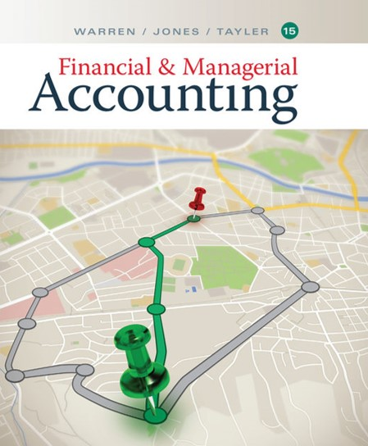

Financial & Managerial Accounting
Fifteenth Edition
Chapter 5
Accounting for Retail Businesses
Copyright © 2020 Cengage. All Rights Reserved.

Slide 2
Learning Objectives (1 of 2)
Obj. 1: Distinguish between the activities and financial statements of service and retail businesses.
Obj. 2: Describe and illustrate the accounting for retail transactions.
Obj. 3: Describe and illustrate the adjusting process of a retail business.
Obj. 4: Describe and illustrate the financial statements and closing entries for a retail business.
Obj. 5: Describe and illustrate the use of the asset turnover ratio in evaluating a company’s operating performance.

Slide 3
Learning Objectives (2 of 2)
Obj. App 1: Describe and illustrate the gross method of recording sales discounts.
Obj. App 2: Describe and illustrate the periodic system of accounting for retail transactions.

Slide 4
Nature of Retail Businesses
The activities of a service business differ from those of a retail business.
  These differences are reflected in the operating cycles of a service and retail business as well as in their financial statements.

Slide 5
Operating Cycle (1 of 2)
The operating cycle is the process by which a company spends cash, generates revenues, and receives cash from customers.
The operating cycle of a service and retail business differs in that a retail business must purchase merchandise for sale to customers.

Slide 6
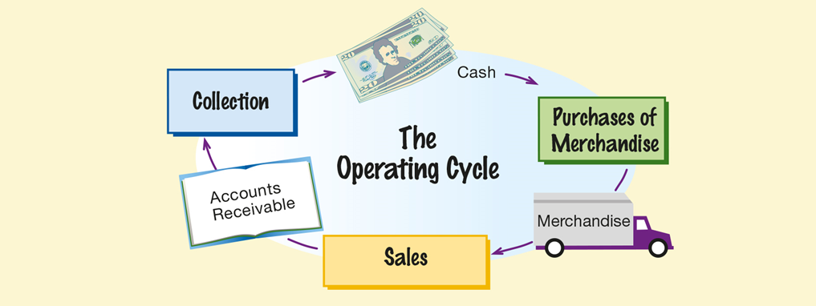
The Operating Cycle for a Retail Business

Slide 7
Operating Cycle (2 of 2)
The time in days to complete an operating cycle differs significantly among retail businesses.
  For example, many grocery items, such as milk, have a short operating cycle and must be sold within their expiration dates of a week or two.
  In contrast, jewelry stores often carry expensive items that are often displayed months before being sold to customers.

Slide 8
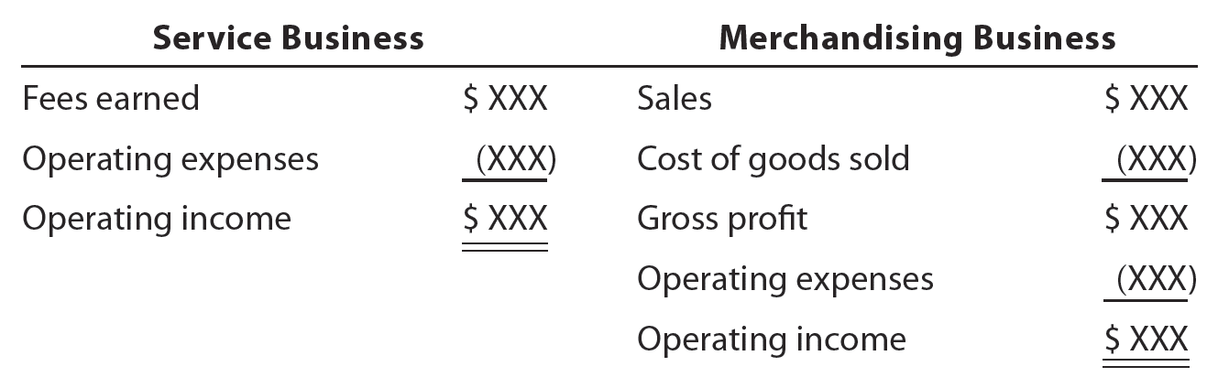
Financial Statements (1 of 4)
The differences between service and retail businesses are also reflected in their financial statements.

Slide 9
Financial Statements (2 of 4)
The revenue activities of a service business involve providing services to customers.
On the income statement for a service business, the revenues from services are reported as fees earned.
The operating expenses incurred in providing the services are subtracted from the fees earned to arrive at operating income.

Slide 10
Financial Statements (3 of 4)
In contrast, the revenue activities of a retail business involve the buying and selling of merchandise.
  A retail business first purchases merchandise to sell to its customers.
  When this merchandise is sold, the revenue is reported as sales, and its cost is recognized as an expense called cost of goods sold or cost of merchandise sold.
    The cost of goods sold is subtracted from sales to arrive at gross profit, which is the profit before deducting operating expenses.
      The operating expenses are subtracted from gross profit to arrive at operating income.

Slide 11
Financial Statements (4 of 4)
Merchandise on hand (not sold) at the end of an accounting period is called inventory or merchandise inventory.
  Inventory is reported as a current asset on the balance sheet.

Slide 12
Chart of Accounts for Retail Business (1 of 6)
Merchandise transactions are recorded in the accounts, using the rules of debit and credit; however, since merchandise transactions differ from those of a service business, NetSolutions adopted a new chart of accounts.
The accounts related to merchandising transactions are highlighted in blue.
The chart of accounts now consists of three-digit account numbers.
  The first digit indicates the major financial statement classification (1 for assets, 2 for liabilities, etc.).
  The second digit indicates the subclassification (e.g., 11 for current assets, 12 for noncurrent assets).
  The third digit identifies the specific account (e.g., 110 for cash).

Slide 13
Chart of Accounts for Retail Business (2 of 6)
Merchandise transactions are recorded in the accounts, using the rules of debit and credit; however, since merchandise transactions differ from those of a service business, NetSolutions adopted a new chart of accounts.
The accounts related to merchandising transactions are highlighted in blue.
The chart of accounts now consists of three-digit account numbers.
  The first digit indicates the major financial statement classification (1 for assets, 2 for liabilities, etc.).
  The second digit indicates the subclassification (e.g., 11 for current assets, 12 for noncurrent assets).
  The third digit identifies the specific account (e.g., 110 for cash).

Slide 14
Chart of Accounts for Retail Business (3 of 6)
Balance Sheet Accounts
100 Assets
110 Cash
112 Accounts Receivable
115 Inventory
116 Estimated Returns Inventory
117 Office Supplies
118 Prepaid Insurance 120 Land
123 Store Equipment
124 Accumulated Depreciation—Store Equipment
125 Office Equipment

Slide 15
Chart of Accounts for Retail Business (4 of 6)
126 Accumulated Depreciation—Office Equipment
200 Liabilities
210 Accounts Payable
211 Salaries Payable
212 Unearned Rent
213 Customer Refunds Payable 215 Notes Payable
300 Stockholders' Equity
310 Common Stock
311 Retained Earnings
312 Dividends

Slide 16
Chart of Accounts for Retail Business (5 of 6)
Income Statement Accounts
400 Revenues
410 Sales
500 Costs and Expenses
510 Cost of Goods Sold
520 Sales Salaries Expense
521 Advertising Expense
522 Depreciation Expense—Store Equipment
523 Delivery Expense
529 Miscellaneous Selling Expense

Slide 17
Chart of Accounts for Retail Business (6 of 6)
530 Office Salaries Expense
531 Rent Expense
532 Depreciation Expense—Office Equipment
533 Insurance Expense
534 Office Supplies Expense
539 Misc. Administrative Expense
600 Other Revenue 610 Rent Revenue
700 Other Expense
710 Interest Expense

Slide 18
Subsidiary Ledgers (1 of 4)
A separate account for each customer and creditor could be added to the ledger. However, as the number of customers and creditors increases, the ledger will become large and awkward to use.
  A large number of individual accounts with a common characteristic can be grouped together in a separate ledger, called a subsidiary ledger.
  The primary ledger, which contains all of the balance sheet and income statement accounts, is then called the general ledger.

Slide 19
Subsidiary Ledgers (2 of 4)
  Each subsidiary ledger is represented in the general ledger by a summarizing account, called a controlling account.
  The sum of the balances of the accounts in the subsidiary ledger must equal the balance of the related controlling account.
Common subsidiary ledgers are the:
  Accounts receivable subsidiary ledger
    The accounts receivable subsidiary ledger, or customers ledger, lists the individual customer accounts in alphabetical order.
    The controlling account in the general ledger is Accounts Receivable.

Slide 20
Subsidiary Ledgers (3 of 4)
  Accounts payable subsidiary ledger
    The accounts payable subsidiary ledger, or creditors ledger, lists individual creditor accounts in alphabetical order.
    The controlling account in the general ledger is Accounts Payable.
  Inventory subsidiary ledger
    The inventory subsidiary ledger, or inventory ledger, lists individual inventory by item (bar code) number.
    The controlling account in the general ledger is Inventory.

Slide 21
Subsidiary Ledgers (4 of 4)
  Most retail companies use computerized accounting systems that record similar transactions in separate journals called special journals. These journals generate purchase, sales, and inventory reports.

Slide 22
Purchases Transactions (1 of 4)
There are two systems for accounting for merchandise transactions: perpetual and periodic.
  In a perpetual inventory system, each purchase and sale of merchandise is recorded in the inventory account and related subsidiary ledger.
    In this way, the amount of merchandise available for sale and the amount sold are continuously (perpetually) updated in the inventory records.
  In a periodic inventory system, the inventory does not show the amount of merchandise available for sale and the amount sold.

Slide 23
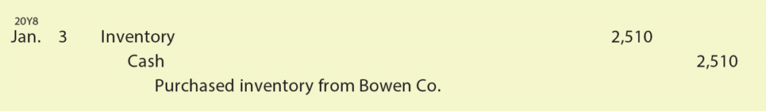
Purchases Transactions (2 of 4)
    Instead, a listing of inventory on hand, called a physical inventory, is prepared at the end of the accounting period.
      This physical inventory is used to determine the cost of inventory on hand at the end of the period and calculate the cost of goods sold during the period.
      Under the perpetual inventory system, cash purchases of merchandise are recorded as follows:

Slide 24

Purchases Transactions (3 of 4)
    Purchases of inventory on account are recorded as follows:
The terms of purchases on account are normally indicated on the invoice or bill that the seller sends the buyer.

Slide 25
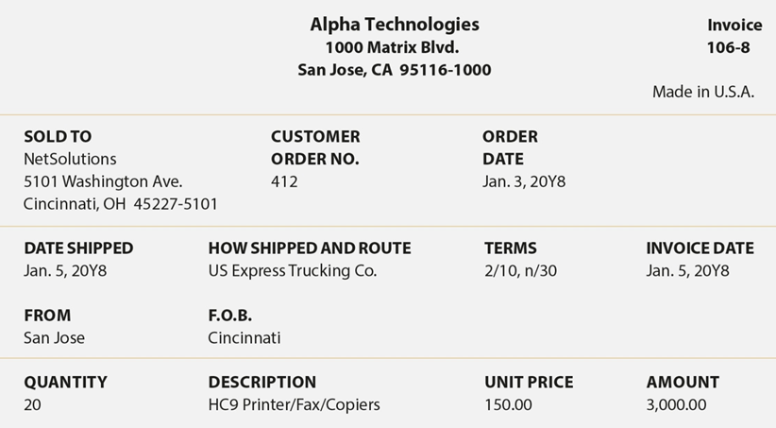
Invoice

Slide 26
Purchases Transactions (4 of 4)
The terms for when payments for merchandise are to be made are called the credit terms.
  If payment is required on delivery, the terms are cash or net cash.
  Otherwise, the buyer is allowed an amount of time, known as the credit period, in which to pay.
    The credit period usually begins with the date of the sale as shown on the invoice.

Slide 27
Purchases Discounts (1 of 6)
To encourage the buyer to pay before the end of the credit period, the seller may offer a discount.
  For example, a seller may offer a 2% discount if the buyer pays within 10 days of the invoice date. If the buyer does not take the discount, the total invoice amount is due within 30 days.
    The terms are expressed as 2/10, n/30 and are read as “2% discount if paid within 10 days, net amount due within 30 days.”

Slide 28
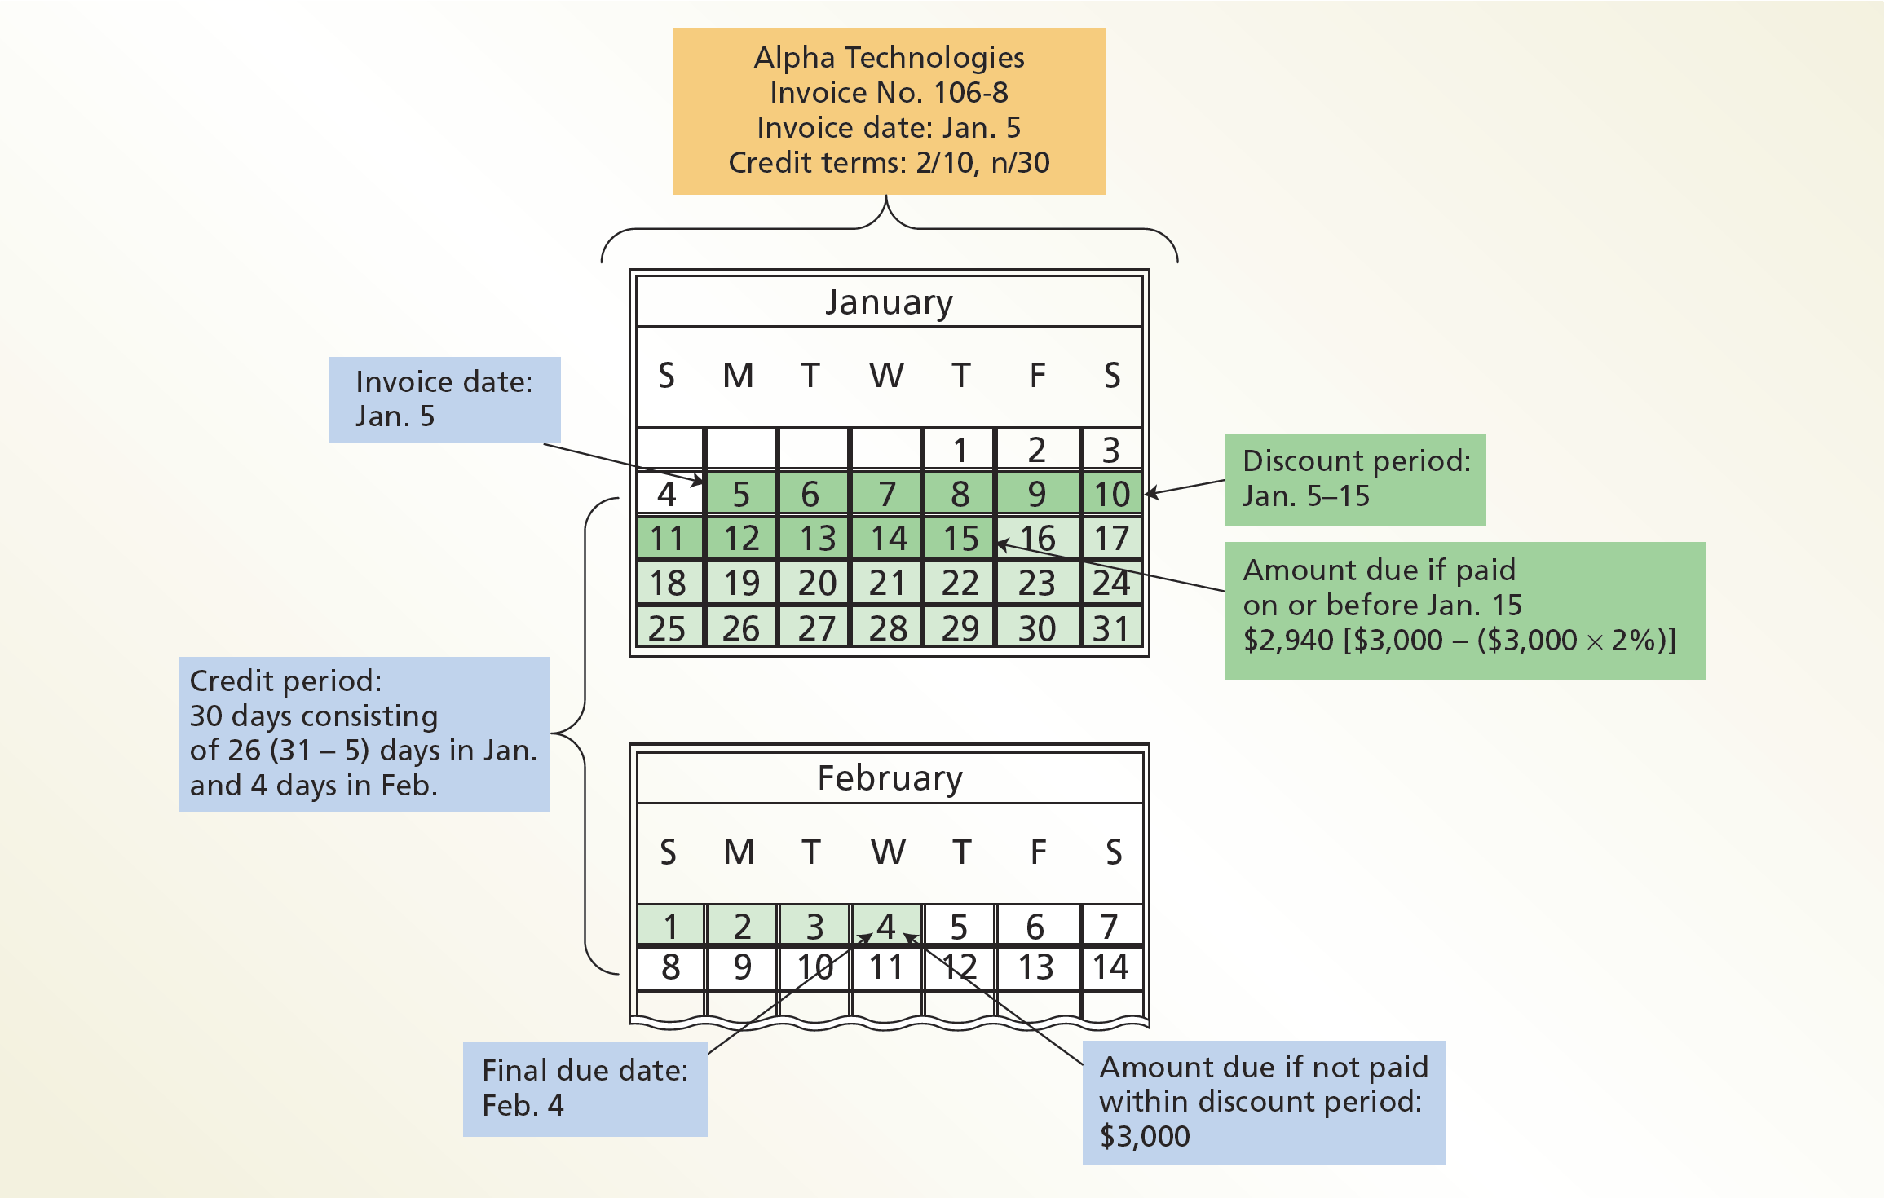
Credit Terms

Slide 29
Purchases Discounts (2 of 6)
Discounts taken by the buyer for early payment of an invoice are called purchases discounts.
  Purchases discounts taken by a buyer reduce the cost of the merchandise purchased.

Slide 30
Purchases Discounts (3 of 6)
  Assume that NetSolutions places an order from Alpha Technologies on January 5 with terms of 2/10, n/30. In order to pay the invoice on January 15 (the last day of the discount period), NetSolutions borrows $2,940, which is $3,000 less the discount of $60 ($3,000 × 2%). If an annual interest rate of 6% and a 360-day year is assumed, the interest on the loan of $2,940 for the remaining 20 days of the credit period is $9.80 ($2,940 × 6% × 20 ÷ 360).

Slide 31
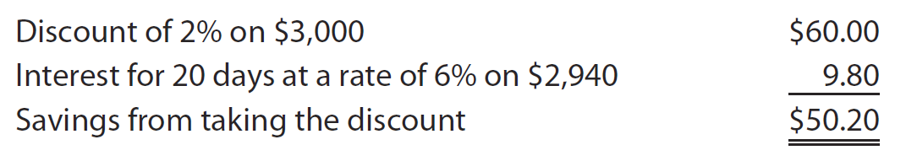
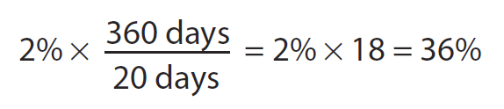
Purchases Discounts (4 of 6)
The net savings to NetSolutions of taking the discount is computed as follows:
The terms of purchases on account are normally indicated on the invoice or bill that the seller sends the buyer.

Slide 32
Purchases Discounts (5 of 6)
Since buyers normally take all purchases discounts, Inventory is debited for the net purchase price under the perpetual inventory system.
  That is, the buyer debits Inventory for the amount of the invoice less the discount.

Slide 33
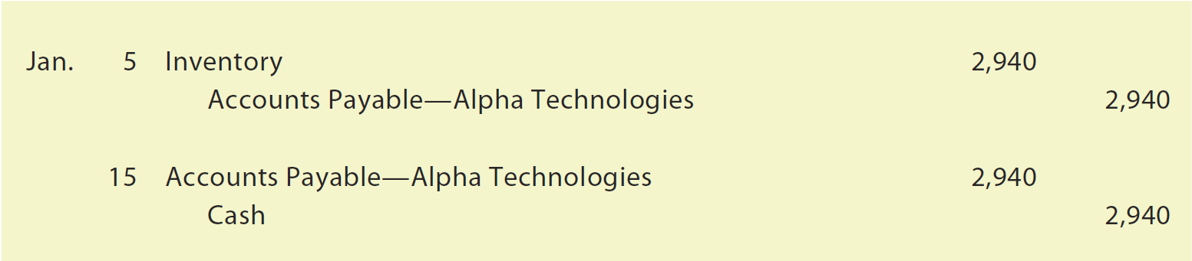
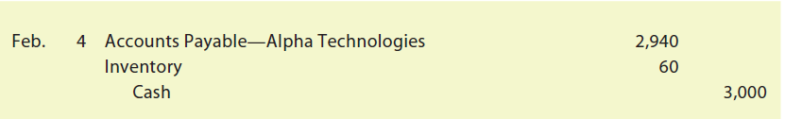
Purchases Discounts (6 of 6)
NetSolutions would record the Alpha Technologies invoice and its payment as follows:
If NetSolutions did not pay within the discount period, inventory would be debited for the amount of the missed discount.

Slide 34
Purchases Returns and Allowances (1 of 5)
A buyer may request an allowance for merchandise that is returned (purchases return) or a price allowance (purchases allowance) for damaged or defective merchandise. From a buyer’s perspective, such returns and allowances are called purchases returns and allowances.
  In both cases, the buyer normally sends the seller a debit memorandum, often called a debit memo, to notify the seller of reasons for the return (purchase return) or to request a price reduction (purchase allowance).
    A debit memo also informs the seller of the amount the buyer proposes to debit to the account payable due the seller and states the reasons for the return or the request for the price allowance.

Slide 35
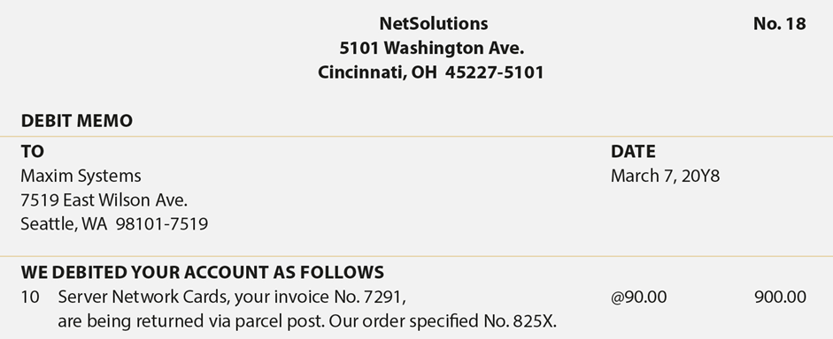
Debit Memo

Slide 36
Purchases Returns and Allowances (2 of 5)
The buyer may use the debit memo as the basis for recording the return or allowance or wait for approval from the seller (creditor).
  In either case, the buyer debits Accounts Payable and credits Inventory.

Slide 37
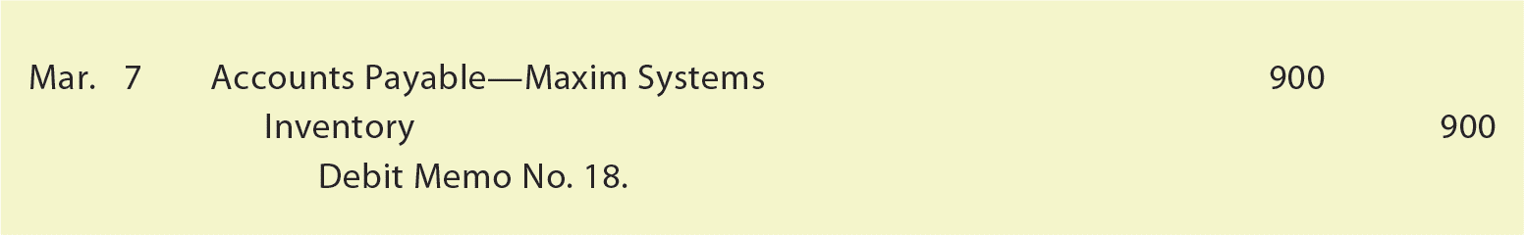
Purchases Returns and Allowances (3 of 5)
NetSolutions records the return of the inventory indicated in the debit memo on slide 31 as follows:

Slide 38
Purchases Returns and Allowances (4 of 5)
Before paying an invoice, a buyer may return inventory or be granted a price allowance for an invoice with a purchase discount.
  In this case, the amount of the return is recorded at its invoice amount less the discount.
Assume the following data concerning a purchase of inventory by NetSolutions on May 2:
  May 2. Purchased $5,000 of inventory on account from Delta Data Link, terms 2/10, n/30.

Slide 39
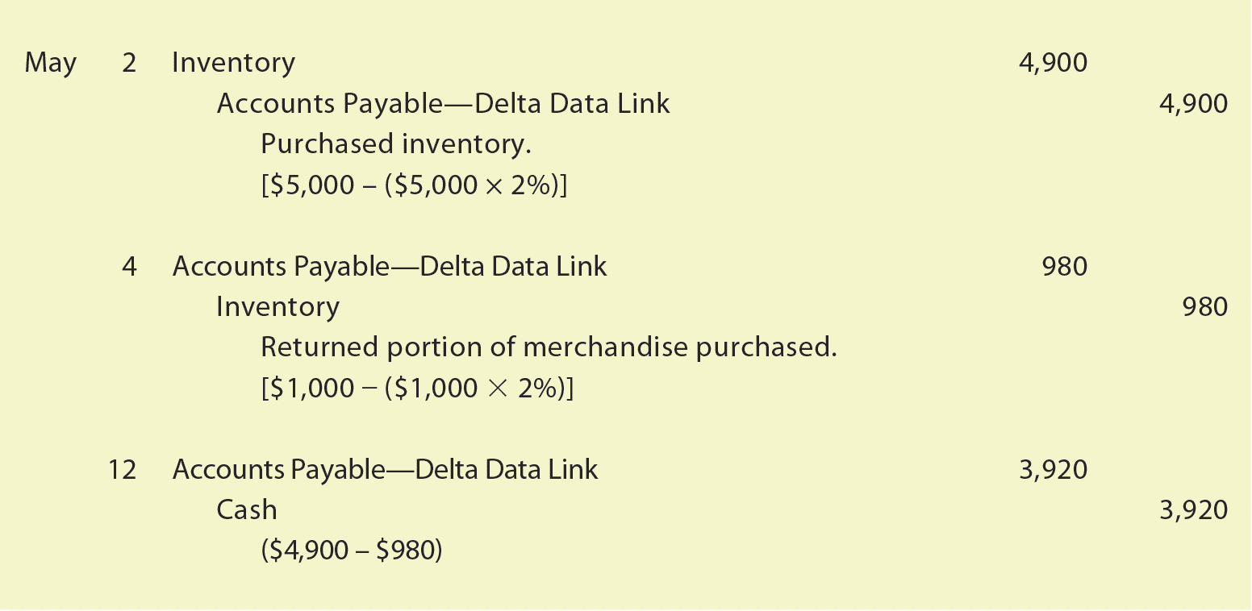
Purchases Returns and Allowances (5 of 5)
  May 4. Returned $1,000 of the inventory purchased on May 2.
  May 12. Paid for the purchase of May 2 less the return and discount.
  NetSolutions would record these transactions as follows:

Slide 40
Check Up Corner: Purchases Transactions (1 of 2)
On August 10, Knopfler Company purchased inventory on account from Fray Co. for $11,500, terms 2/10, n/30.
Knopfler returned inventory with an invoice amount of $2,500 on August 14 and received full credit.
Journalize Knopfler’s entries for (a) the purchase, (b) the return, and (c) the payment of the invoice on August 18.

Slide 41
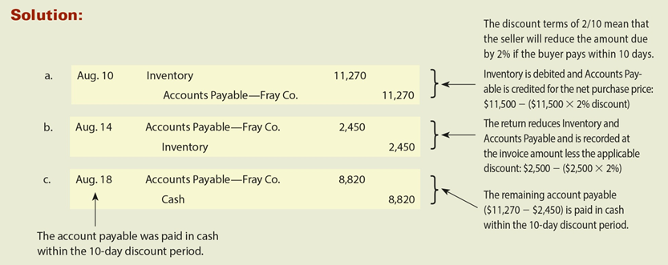
Check Up Corner: Purchases Transactions (2 of 2)

Slide 42
Sales Transactions
Revenue from merchandise sales is usually recorded as Sales.
  Sometimes a business may use the title Sales of Merchandise.

Slide 43
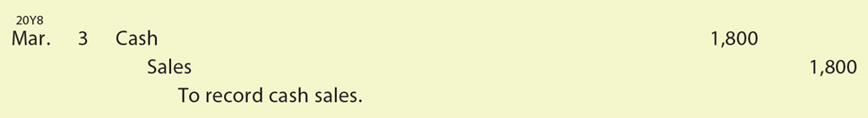
Cash Sales (1 of 7)
Assume that on March 3, NetSolutions sells merchandise for $1,800. These cash sales are recorded as follows:

Slide 44
Cash Sales (2 of 7)
Using the perpetual inventory system, the cost of goods sold and the decrease in inventory are also recorded.
  In this way, the inventory account indicates the amount of inventory on hand (not sold).

Slide 45
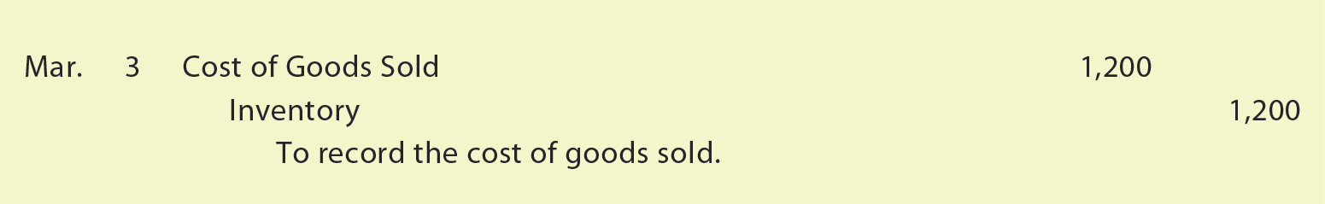
Cash Sales (3 of 7)
Assume that the cost of goods sold on March 3 is $1,200. The entry to record the cost of goods sold and the decrease in the inventory is as follows:

Slide 46
Cash Sales (4 of 7)
Sales may be made to customers using credit cards such as MasterCard or VISA.
  Such sales are recorded as cash sales.
    This is because these sales are normally processed by a clearinghouse that contacts the bank that issued the card. The issuing bank then electronically transfers cash directly to the retailer’s bank account. Thus, the retailer normally receives cash within a few days of making the credit card sale.

Slide 47
Cash Sales (5 of 7)
If customers use MasterCards to pay for their purchases, the sales would be recorded as shown in the March 3 entry on slide 41.

Slide 48
Cash Sales (6 of 7)
Any processing fees charged by the clearinghouse or issuing bank are periodically recorded as an expense.
  This expense is normally reported on the income statement as an administrative expense.

Slide 49
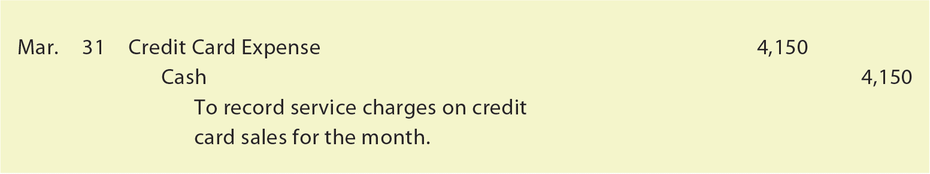
Cash Sales (7 of 7)
Assume that NetSolutions paid credit card processing fees of $4,150 on March 31. These fees would be recorded as follows:

Slide 50
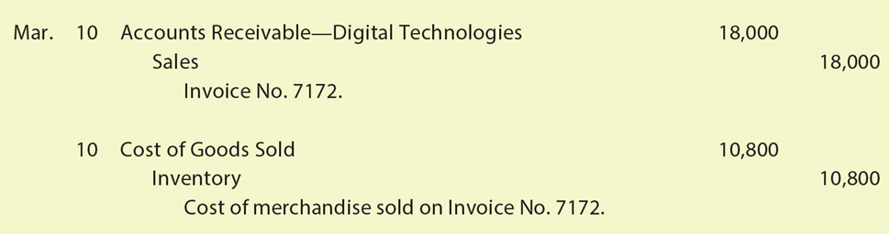
Sales on Account
NetSolutions sold merchandise on account for $18,000. The cost of goods sold was $10,800.

Slide 51
Customer Discounts (1 of 6)
A seller may grant customers a variety of discounts, called customer discounts, as incentives to encourage customers to act in a way benefiting the seller.
  For example, a seller may offer customer discounts to encourage customers to purchase in volume or order early.

Slide 52
Customer Discounts (2 of 6)
A sales discount encourages customers to pay their invoice early.
  For example, a seller may offer credit terms of 2/10, n/30, which provides a 2% sales discount if the invoice is paid within 10 days.

Slide 53
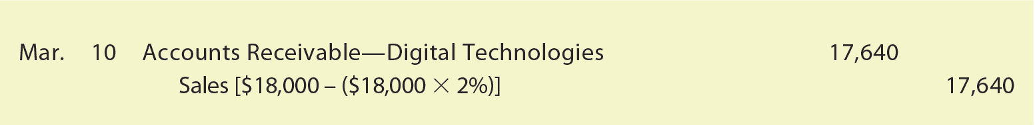
Customer Discounts (3 of 6)
Assume that NetSolutions sold $18,000 of merchandise to Digital Technologies on March 10 with credit terms 2/10, n/30.
  The March 10 sale would be recorded as follows:

Slide 54
Customer Discounts (4 of 6)
The sale to Digital Technologies is recorded by NetSolutions at the most likely amount expected to be received, which is $17,640.
  This is the invoice amount of $18,000 less the sales discount of $360 ($18,000 X 2%).
This method of recording sales discounts is called the net method.

Slide 55
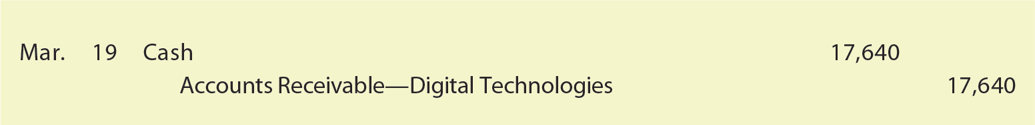
Customer Discounts (5 of 6)
The payment by Digital Technologies on March 19 is recorded as follows:

Slide 56
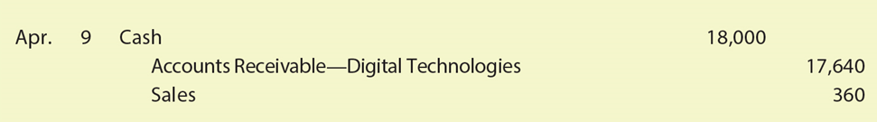
Customer Discounts (6 of 6)
If Digital Technologies did not pay within the discount period, NetSolutions would receive $18,000 and Sales would be credited for the amount of the discount.
The payment would be recorded as:

Slide 57
Cash Refunds and Allowances (1 of 6)
A buyer may receive merchandise that is defective, is damaged during shipment, or does not meet the buyer’s expectations.
  If the customer has already paid for the merchandise, the seller may pay the buyer a cash refund.
  If the customer purchased the merchandise on account, the seller may grant a customer allowance that reduces the accounts receivable owed on the original selling price.
  When this is done, the seller sends the buyer a credit memorandum, or credit memo, indicating its intent to credit the customer’s account receivable.

Slide 58

Cash Refunds and Allowances (2 of 6)
Assume that on March 4, NetSolutions pays Blake & Sons a refund of $900 for merchandise that was damaged in shipment. Blake & Sons has agreed to keep the merchandise and make any necessary repairs. NetSolutions would record the payment of the refund as follows:

Slide 59
Cash Refunds and Allowances (3 of 6)
Customer refunds payable is a liability account for estimated refunds that will be paid to customers in the future.
  It is recorded at the end of the accounting period as part of the adjusting process.

Slide 60
Cash Refunds and Allowances (4 of 6)
In some cases, a customer who is due a refund has an outstanding account receivable balance.
  Instead of paying a cash refund, the seller may grant the customer an allowance against the customer’s account receivable.
    When this is done, the seller normally sends the buyer a credit memorandum, or credit memo, indicating its intent to credit the customer’s account receivable.

Slide 61
Cash Refunds and Allowances (5 of 6)
Assume that instead of paying a cash refund to Blake & Sons, NetSolutions granted Blake & Sons a customer allowance of $900. NetSolutions notifies Blake & Sons of the allowance by issuing the credit memo shown on the next slide.

Slide 62
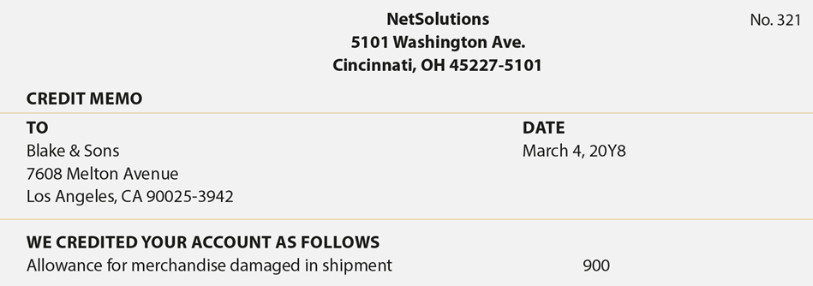
Credit Memo

Slide 63

Cash Refunds and Allowances (6 of 6)
NetSolutions would record the granting of the customer allowance as follows:

Slide 64
Customer Returns (1 of 2)
Estimated returns inventory is a current asset account that is reported on the balance sheet after Inventory.
  It represents an estimate of merchandise that will be returned by customers.
  It is recorded at the end of the accounting period as part of the adjusting process.

Slide 65
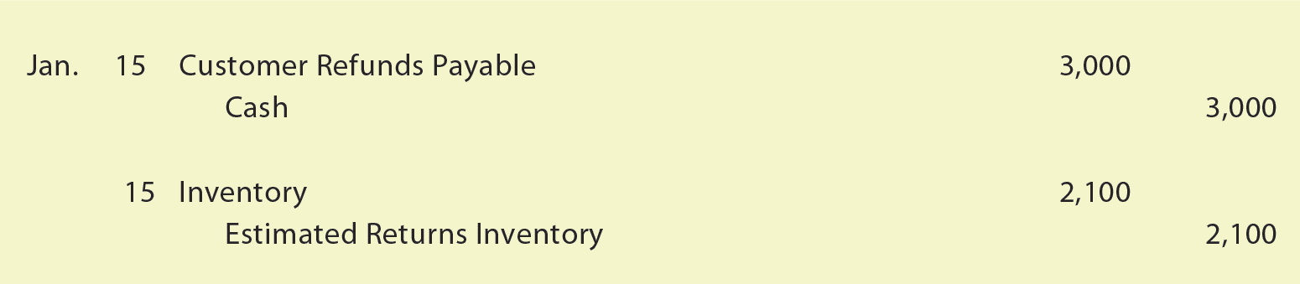
Customer Returns (2 of 2)
Assume that on January 15 Bormann Enterprises returned merchandise with a selling price of $3,000 for a cash refund. The merchandise originally cost NetSolutions $2,100. NetSolutions would record the cash refund and the return with the following two entries:

Slide 66
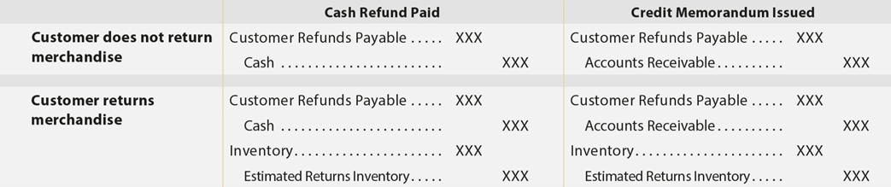
Journal Entries to Record Customer Refunds, Allowances, and Returns

Slide 67
Check Up Corner: Sales Transactions (1 of 2)
On December 30, Burrows Inc. sold $12,000 of merchandise to Wall Company on account, with terms 2/10, n/30. The merchandise originally cost Burrows $8,000. On January 3, Wall determines that a portion of the merchandise received does not operate properly, and Burrows issues a credit memo for the returned items. The invoice amount of the returned merchandise is $3,000. It originally cost Burrows $2,000. Journalize the entries by Burrows to record
(a) the December 30 sale, (b) the January 3 return, and (c) the receipt of the amount due from Wall on January 6.

Slide 68
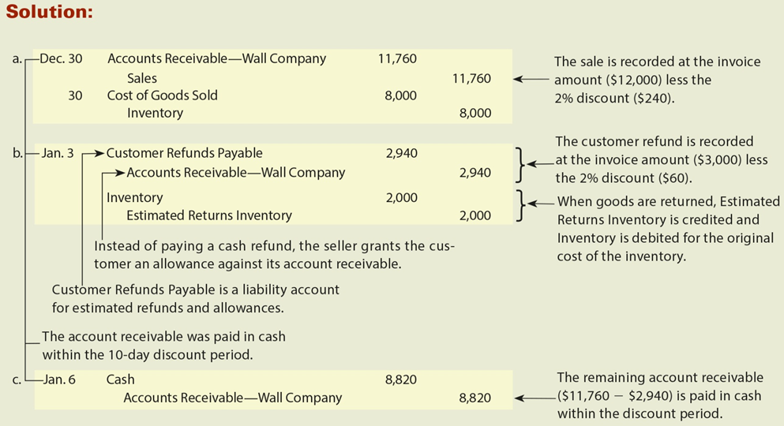
Check Up Corner: Sales Transactions (2 of 2)

Slide 69
Freight (1 of 9)
Purchases and sales of merchandise often involve freight.
The terms of a sale indicate when ownership (title and control) of the merchandise passes from the seller to the buyer.
  This point determines whether the buyer or the seller pays the freight costs.

Slide 70
Freight (2 of 9)
The ownership of the merchandise may pass to the buyer when the seller delivers the merchandise to the freight carrier.
  In this case, the terms are said to be FOB (free on board) shipping point.
    This term means that the buyer pays the freight costs from the shipping point to the final destination.
      Such costs are part of the buyer’s total cost of purchasing inventory and are added to the cost of the inventory by debiting Inventory.

Slide 71
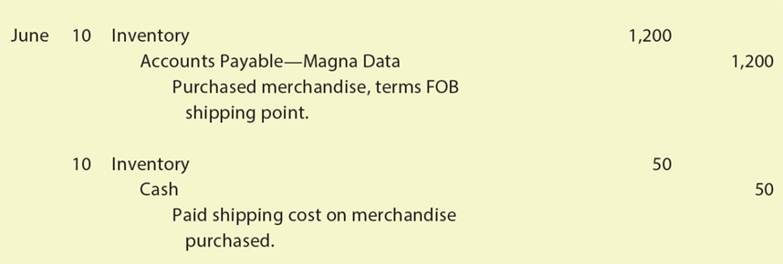
Freight (3 of 9)
Assume that on June 10, NetSolutions purchased merchandise as follows:
June 10. Purchased merchandise from Magna Data, $1,200 terms FOB shipping point.
10. Paid freight of $50 on June 10 purchase from Magna Data.
NetSolutions would record these two transactions as follows:

Slide 72
Freight (4 of 9)
The ownership of the merchandise may pass to the buyer when the buyer receives the merchandise.
  In this case, the terms are said to be FOB (free on board) destination.
    This term means that the seller pays the freight costs from the shipping point to the buyer’s final destination.
      When the seller pays the delivery charges, the seller debits Delivery Expense or Freight Out.
        Delivery Expense is reported on the seller’s income statement as a selling expense.

Slide 73
Freight (5 of 9)
Assume that NetSolutions sells merchandise as follows:
  June 15. Sold merchandise to Kranz Company on account, $700, terms FOB destination. The cost of the goods sold is $480.
  June 15. NetSolutions pays freight of $40 on the sale of June 15.
NetSolutions records the sale, the cost of the sale, and the freight cost as follows:

Slide 74
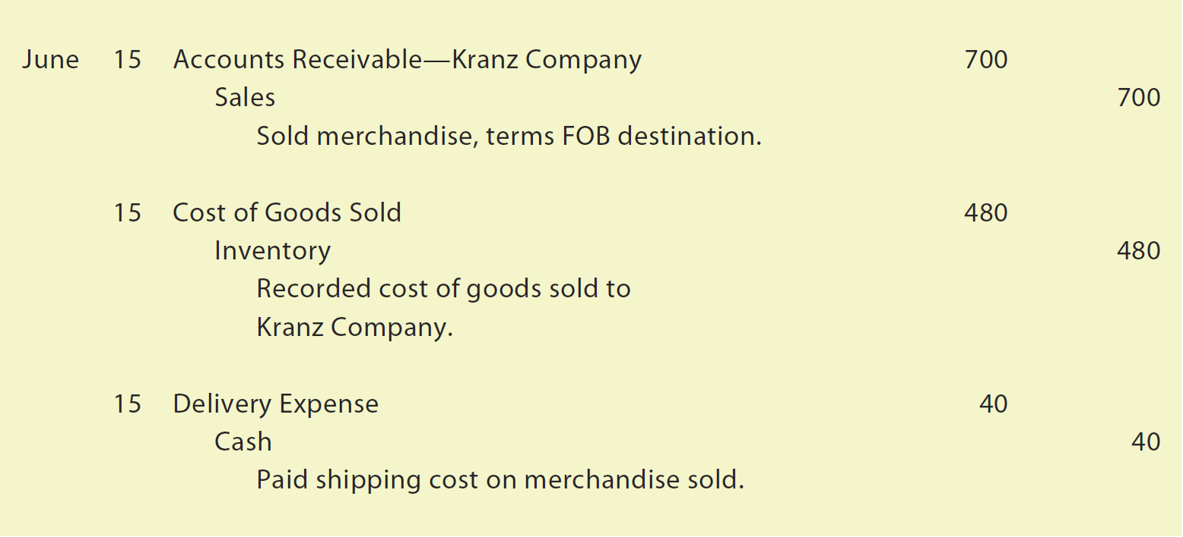
Freight (6 of 9)

Slide 75
Freight (7 of 9)
The seller may prepay the freight, even though the terms are FOB shipping point. The seller will then add the freight to the invoice.
  The buyer debits Inventory for the total amount of the invoice, including the freight.
  Any discount terms would not apply to the prepaid freight.

Slide 76
Freight (8 of 9)
Assume that NetSolutions sells merchandise as follows:
June 20. Sold merchandise to Planter Company on account, $800, terms FOB shipping point. NetSolutions paid freight of $45, which was added to the invoice. The cost of the goods sold is $360.
NetSolutions records the sale, the cost of the sale, and the freight as follows:

Slide 77
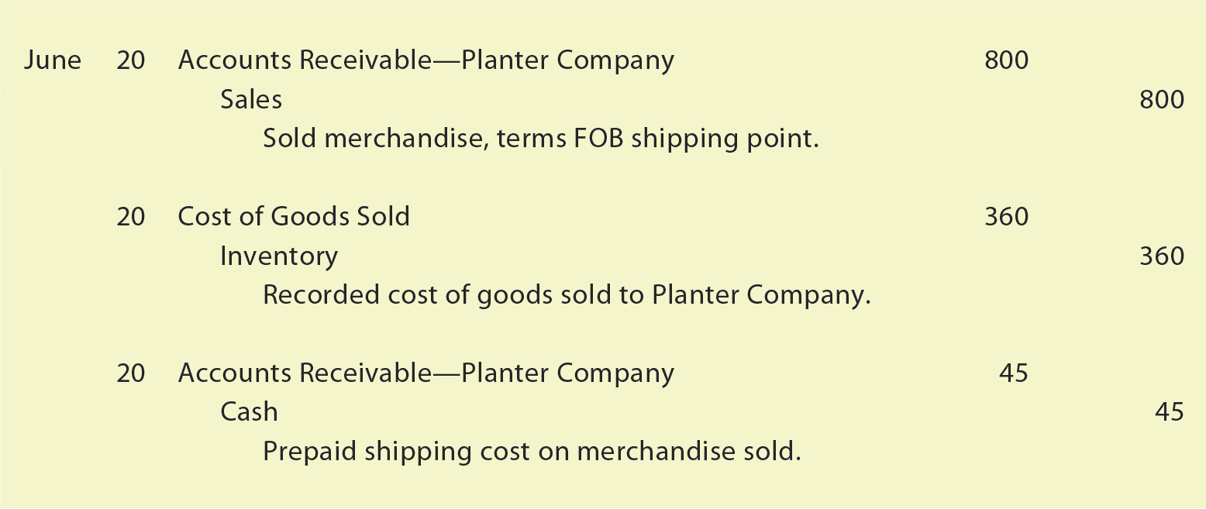
Freight (9 of 9)

Slide 78
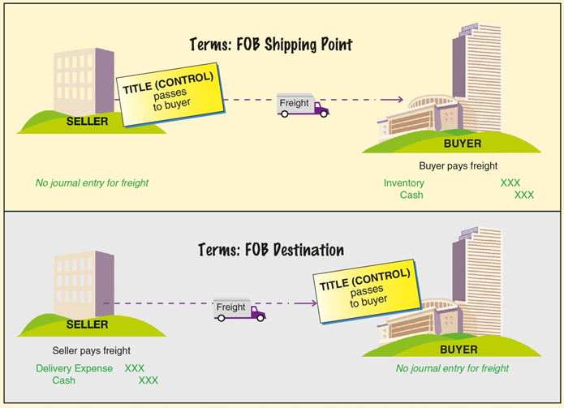
Freight Terms

Slide 79
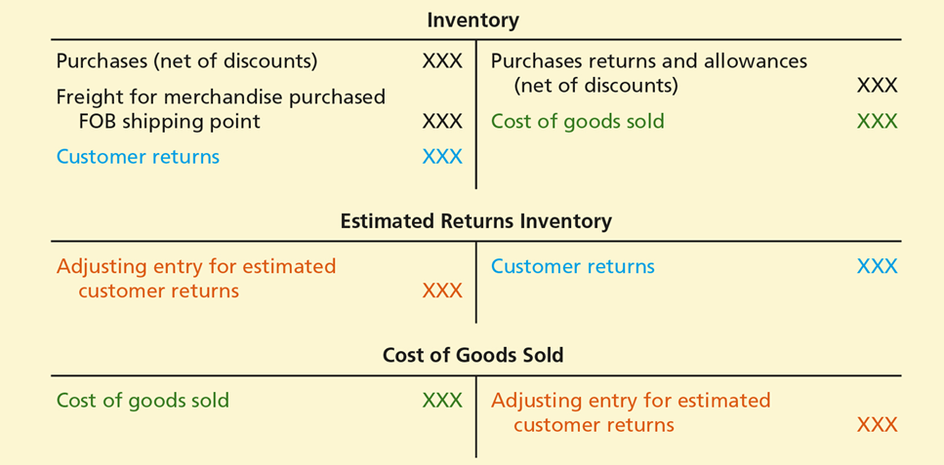
Recording Inventory Transactions

Slide 80
Dual Nature of Merchandise Transactions
Each merchandising transaction affects a buyer and a seller.

Slide 81
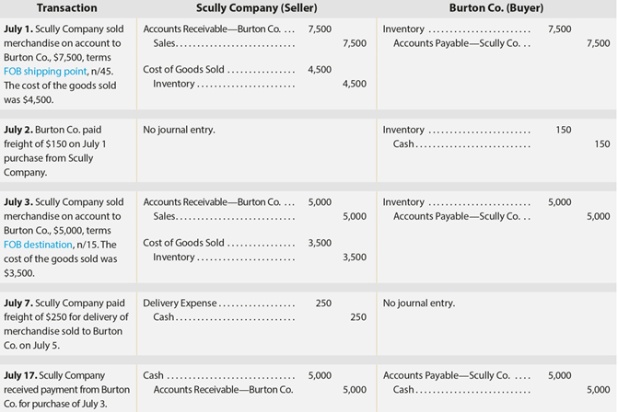
Illustration of Inventory Transactions for Seller and Buyer (1 of 2)

Slide 82
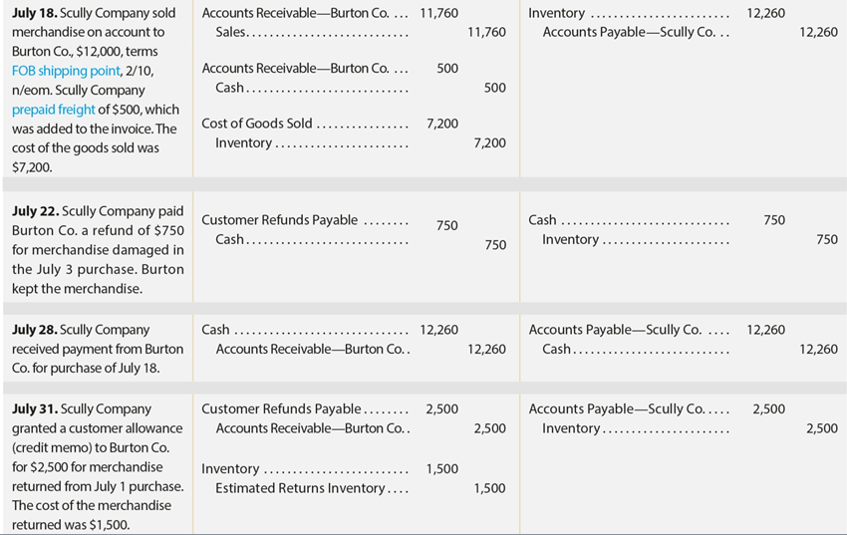
Illustration of Inventory Transactions for Seller and Buyer (2 of 2)

Slide 83
Sales Taxes (1 of 3)
Almost all states levy a tax on sales of merchandise.
The liability for the sales tax is incurred when the sale is made.
  At the time of a cash sale, the seller collects the sales tax.
  When a sale is made on account, the seller charges the tax to the buyer by debiting Accounts Receivable.
  The seller credits the sales account for the amount of the sale and credits the tax to Sales Tax Payable.

Slide 84
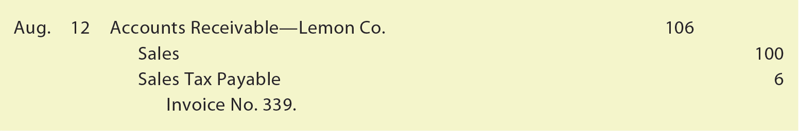
Sales Taxes (2 of 3)
The seller would record a sale of $100 on account, subject to a tax of 6%, as follows:

Slide 85
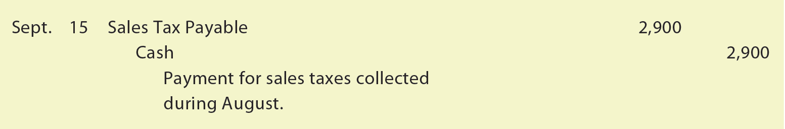
Sales Taxes (3 of 3)
On a regular basis, the seller pays to the taxing authority (state) the amount of the sales tax collected. The seller records such a payment as follows:

Slide 86
Trade Discounts (1 of 2)
Wholesalers are companies that sell merchandise to other businesses rather than to the public, called B2B transactions.
  Many wholesalers publish or upload sales catalogs online.
  Wholesalers often offer special discounts off list prices to government agencies or businesses that order large quantities.
    Such discounts are called trade discounts.

Slide 87
Trade Discounts (2 of 2)
Sellers and buyers do not normally record the list prices of merchandise and trade discounts in their accounts.
  For example, assume that an item has a list price of $1,000 and a 40% trade discount. The seller records the sale of the item at $600 [$1,000 less the trade discount of $400 ($1,000 × 40%)]. Likewise, the buyer records the purchase at $600.

Slide 88
Adjusting Entry for Inventory Shrinkage (1 of 3)
Under the perpetual inventory system, the inventory account is continually updated for purchase and sales transactions.
As a result, the balance of the inventory account is the amount of merchandise available for sale at that point in time.
However, retailers normally experience some loss of inventory due to shoplifting, employee theft, or errors.
Thus, the physical inventory on hand at the end of the accounting period is usually less than the balance of Inventory.
  This difference is called inventory shrinkage or inventory shortage.

Slide 89
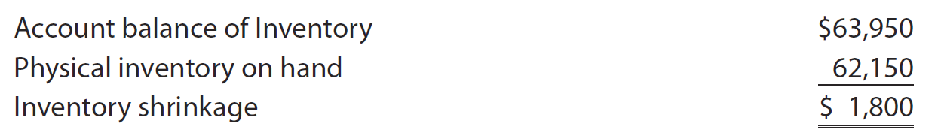
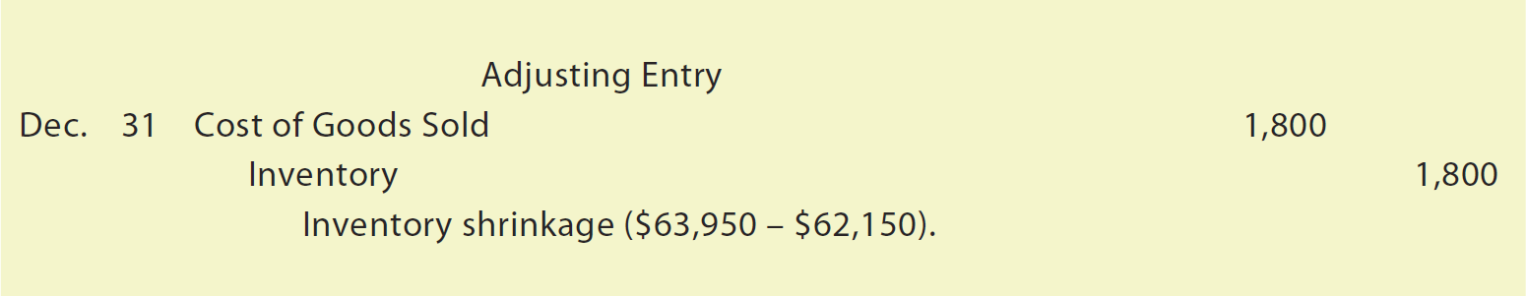
Adjusting Entry for Inventory Shrinkage (2 of 3)
NetSolutions’ inventory records indicate the following on December 31:
At the end of the accounting period, inventory shrinkage is recorded by the following adjusting entry:

Slide 90
Adjusting Entry for Inventory Shrinkage (3 of 3)
  After the preceding entry is recorded, the balance of Inventory agrees with the physical inventory on hand at the end of the period.

Slide 91
Adjusting Entries for Customer Refunds, Allowances, and Returns (1 of 4)
Sellers are required to estimate returns and allowances at the end of an accounting period and prepare two adjusting entries:
  The first adjusting entry reduces the sales account and creates a customer refund liability account for the estimated refunds and allowances that will be granted to customers in the future.
  The second adjusting entry creates an estimated returns inventory account for the cost of merchandise that is expected to be returned and reduces Cost of Goods Sold.

Slide 92
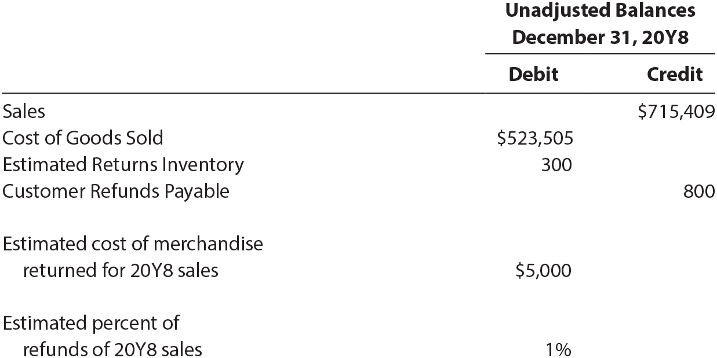
Adjusting Entries for Customer Refunds, Allowances, and Returns (2 of 4)
Assume the following for NetSolutions on December 31, 20Y8, before any adjustments:

Slide 93
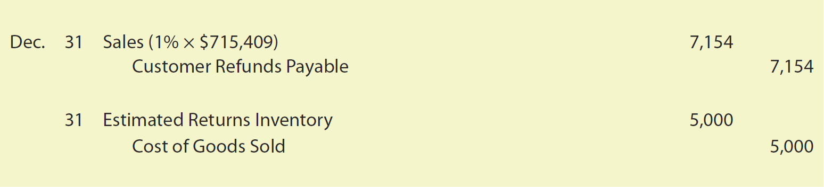
Adjusting Entries for Customer Refunds, Allowances, and Returns (3 of 4)
On December 31, 20Y8, NetSolutions makes the following two adjusting entries:

Slide 94
Adjusting Entries for Customer Refunds, Allowances, and Returns (4 of 4)
The first adjusting entry reduces 20Y8 sales by the amount of estimated refunds that may occur in 20Y9. Since 1% of sales are expected to be refunded, Sales is debited for $7,154 (1% × $715,409). In addition, a liability is recorded by crediting Customer Refunds Payable for the estimated customer refunds in 20Y9.
The second adjusting entry debits the asset Estimated Returns Inventory and reduces Cost of Goods Sold for the cost of merchandise that is expected to be returned in 20Y9 of $5,000.

Slide 95
Adjusted Trial Balance (1 of 2)
After the adjusting entries are posted to the ledger, an adjusted trial balance is prepared.
The adjusted trial balance for NetSolutions as of December 31, 20Y8 is shown on the next slide.

Slide 96
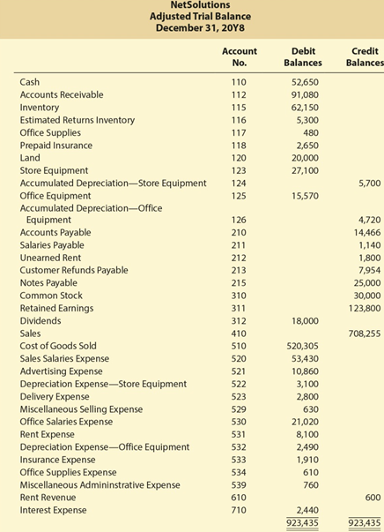
Adjusted Trial Balance (2 of 2)

Slide 97
Financial Statements for a Retail Business
Although merchandising transactions affect the balance sheet in reporting inventory, they primarily affect the income statement.
An income statement for a retail business is normally prepared using either a multiple-step or single-step format.

Slide 98
Multiple-Step Income Statement
The multiple-step income statement contains several sections, subsections, and subtotals, including the following:
  Sales
  Cost of Goods Sold
  Gross Profit
  Operating Income
  Other Revenue and Expense

Slide 99
Multiple-Step Income Statement—Sales
The total amount of sales to customers for cash and on account is reported in this section.

Slide 100
Multiple-Step Income Statement— Cost of Goods Sold
The amount of cost of goods sold to customers is reported in this section.
Cost of goods sold may also be reported as cost of merchandise sold or cost of sales.

Slide 101
Multiple-Step Income Statement—Gross Profit
The excess of sales over cost of goods sold is gross profit.

Slide 102
Multiple-Step Income Statement Operating Income (1 of 3)
Operating income, sometimes called income from operations, is determined by subtracting operating expenses from gross profit.
  Operating expenses are normally classified as either selling expenses or administrative expenses.

Slide 103
Multiple-Step Income Statement Operating Income (2 of 3)
Selling expenses are incurred directly in the selling of merchandise.
  Examples of selling expenses include:
    Sales salaries
    Store supplies used
    Depreciation of store equipment
    Delivery expense
    Advertising

Slide 104
Multiple-Step Income Statement Operating Income (3 of 3)
Administrative expenses, sometimes called general expenses, are incurred in the administration or general operations of the business.
  Examples of administrative expenses include:
    Office salaries
    Depreciation of office equipment
    Office supplies used

Slide 105
Multiple-Step Income Statement— Other Revenue and Expense (1 of 2)
Other income and expense items are not related to the primary operations of the business.
  Other revenue is revenue from sources other than the primary operating activity of a business.
    Examples of other income include:
      Income from interest
      Rent
      Gains resulting from the sale of fixed assets
      Other expense is an expense that cannot be traced directly to the normal operations of the business.

Slide 106
Multiple-Step Income Statement— Other Revenue and Expense (2 of 2)
    Examples of other expenses include:
      Interest expense
      Losses from disposing of fixed assets
Other income and other expense are offset against each other on the income statement.
  If the total of other income exceeds the total of other expense, the difference is added to income from operations to determine net income.
  If the total of other expense exceeds the total of other income, the difference is subtracted from income from operations to determine net income.

Slide 107
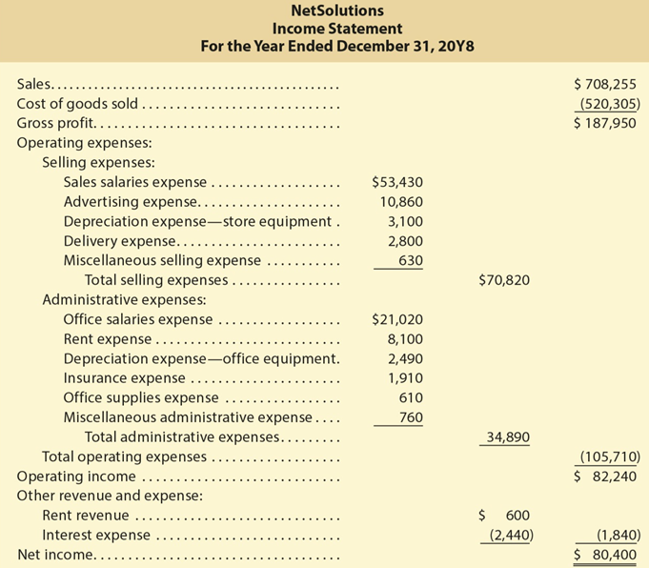
Multiple-Step Income Statement Illustrated

Slide 108
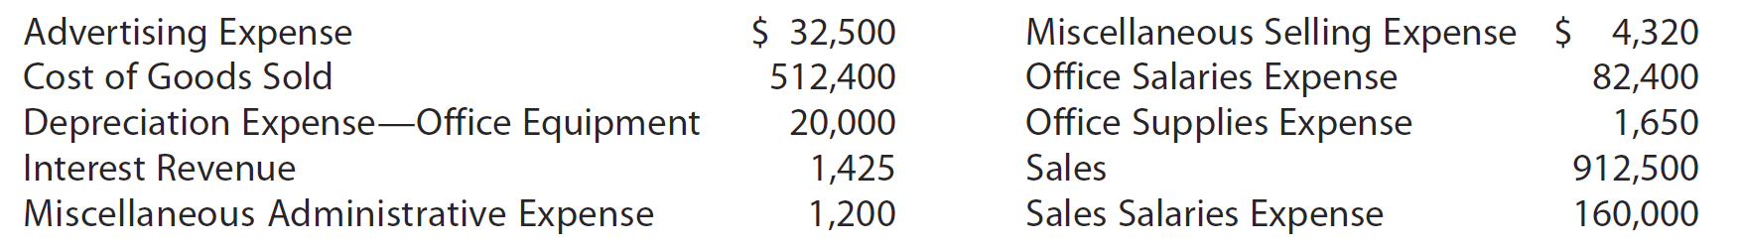
Check Up Corner: Multiple-Step Income Statement (1 of 2)
The following account balances were taken from the adjusted trial balance for Laser-Tek Company for the fiscal year ended December 31, 20Y2:
Prepare a multiple-step income statement for Laser-Tek Company.

Slide 109
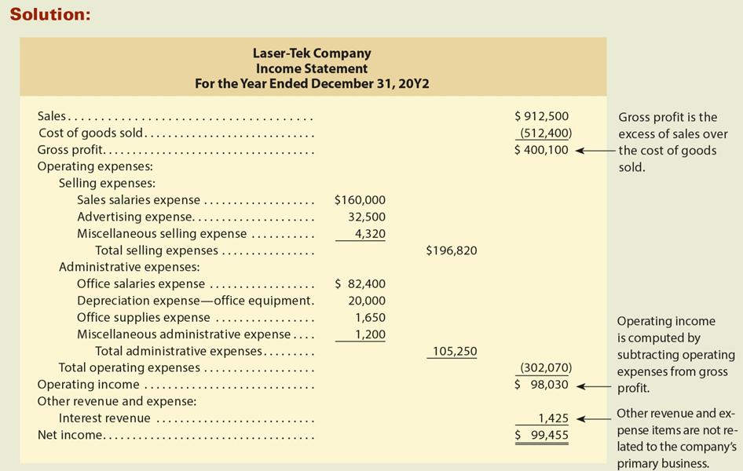
Check Up Corner: Multiple-Step Income Statement (2 of 2)

Slide 110
Single-Step Income Statement
An alternative form of income statement is the single-step income statement.
The single-step form deducts the total of all expenses in one step from the total of all revenues.
The single-step form emphasizes total revenues and total expenses in determining net income.
A criticism of the single-step form is that gross profit and income from operations are not reported.

Slide 111
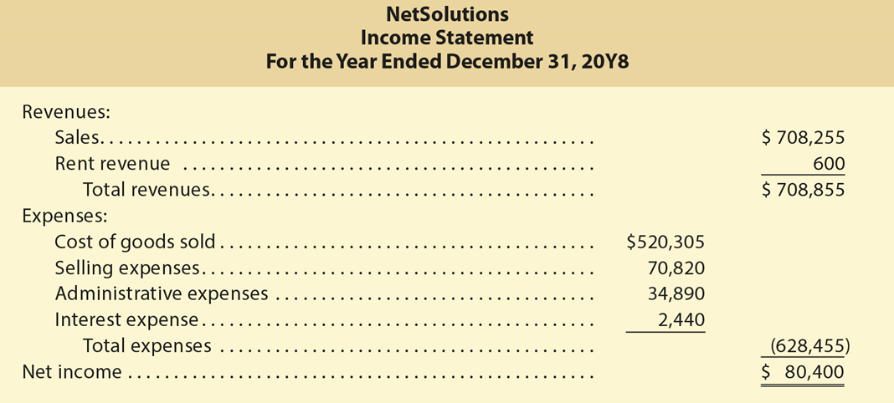
Single-Step Income Statement Illustrated

Slide 112
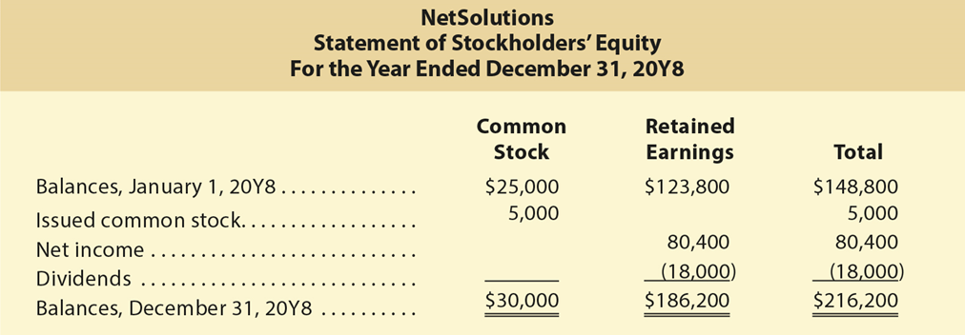
Statement of Stockholders’ Equity for Retail Business

Slide 113
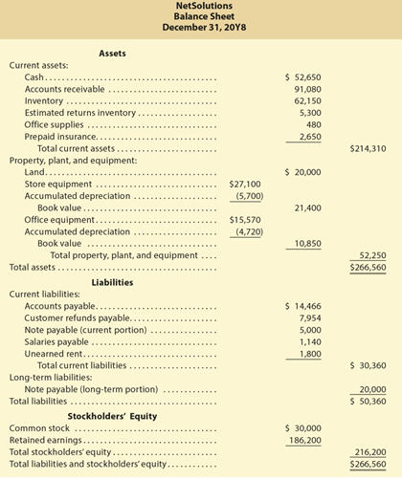
Balance Sheet for Retail Business

Slide 114
The Closing Process (1 of 3)
The two closing entries for a retail business are as follows:
  Debit each revenue account with for its balance, credit each expense account for its balance, and credit the retained earnings account for net income. Debit the retained earnings account for a net loss. Cost of Goods Sold is a temporary account and is closed like an expense account.
  Debit the retained earnings account for the balance of the dividends account and credit the dividends account.

Slide 115
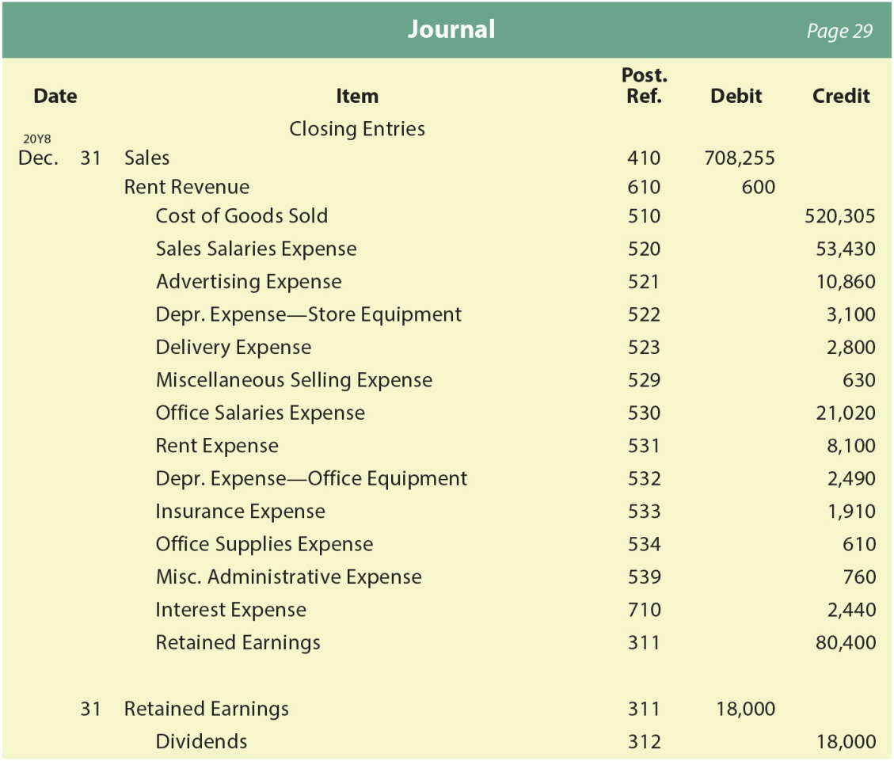
The Closing Process (2 of 3)
The two closing entries for NetSolutions follow:

Slide 116
The Closing Process (3 of 3)
After the closing entries are posted to the accounts, a post-closing trial balance is prepared.
  The only accounts that appear on the post-closing trial balance are the asset, contra asset, liability, and stockholders’ equity accounts with balances.
    These are the same accounts that appear on the end-of-period balance sheet.
  If the two totals of the trial balance columns are not equal, an error has occurred that must be found and corrected.

Slide 117
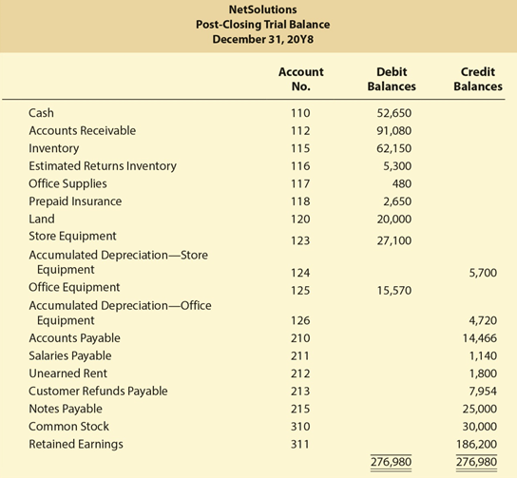
Post-Closing Trial Balance

Slide 118
Analysis for Decision Making: Asset Turnover Ratio (1 of 2)
The asset turnover ratio measures how effectively a business is using its assets to generate sales.
A high ratio indicates an effective use of assets.
The asset turnover ratio is computed as follows:

Slide 119
Analysis for Decision Making: Asset Turnover Ratio (2 of 2)
The following data (in millions) were taken from recent annual reports of Dollar Tree, Inc. (DLTR):
 | Year 2 | Year 1
Total sales | $ 15,498 | $ 8,602
Total assets:
Beginning of year | 3,493 | 2,772
End of year | 15,901 | 3,493
The asset turnover ratio for each year is as follows:
 | Year 2 | Year 1
Asset turnover ratio* | 1.60 {$ 15,498 ÷ [($3,493 + $15,901) ÷ 2]} | 2.75 {$ 8,602 ÷ [($2,772 + $3,493) ÷ 2]}

Slide 120
Appendix 1: Gross Method of Recording Sales Discounts—Transactions
Under the gross method, a sales invoice with credit terms granting a discount for early payment is recorded at the gross amount of the invoice.
The customer pays within the discount period, Cash is debited for the amount received, the discount is recorded as a debit to Sales, and Accounts Receivable is credited for the invoice amount.

Slide 121
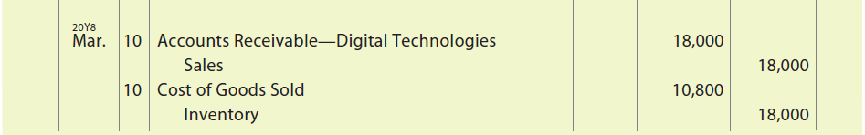
Appendix 1: Transactions (1 of 3)
Assume that NetSolutions uses the perpetual inventory system and sold $18,000 of merchandise to Digital Technologies on March 10, 20Y8, with credit terms of 2/10, n/30. The cost of the merchandise sold was $10,800. The sale would be recorded under the gross method as follows:

Slide 122
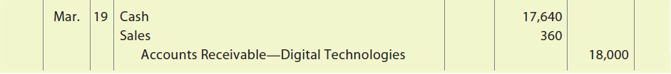
Appendix 1: Transactions (2 of 3)
Assuming that Digital Technologies pays within the discount period on March 19, the payment would be recorded as follows:
  Cash is debited for the amount received of $17,640, which is the invoice amount of $18,000 less the sales discount of $360 ($18,000 ×X 2%). Since cash of $17,640 was received, Sales must be decreased (debited) for the sales discount of $360. The customer’s account receivable is credited for its balance of $18,000.

Slide 123
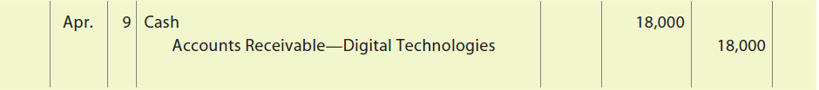
Appendix 1: Transactions (3 of 3)
Instead of paying within the discount period, assume that Digital Technologies pays the gross amount of $18,000 on April 9. The payment would be recorded as follows:

Slide 124
Adjusting Entry (1 of 5)
Since GAAP requires that revenue (sales) be recorded in the amount most likely to be received, the gross method requires an adjusting entry at the end of the accounting period.
The adjusting entry reduces Sales for the estimated sales discounts related to the current period’s sales that are expected to be taken in the next period.

Slide 125

Adjusting Entry (2 of 5)
NetSolutions should record the following adjusting entry on December 31, 20Y8:

Slide 126

Adjusting Entry (3 of 5)
The preceding adjusting entry debits Sales for $1,700 and credits Allowance for Sales Discounts.

Slide 127
Adjusting Entry (4 of 5)
Allowance for Sales Discounts is a contra asset account similar to the contra asset account Accumulated Depreciation.
Just as Accumulated Depreciation is a contra account to a fixed asset account, Allowance for Sales Discounts is a contra account to Accounts Receivable.

Slide 128
Adjusting Entry (5 of 5)
After the adjusting entry is posted, Allowance for Sales Discounts will have a credit balance of $1,800 ($100 + $1,700) and would be reported on the balance sheet as follows:
Accounts receivable | $92,880
Allowance for sales discounts | (1,800)
Net accounts receivable | 91,080

Slide 129
Subsequent Period (1 of 3)
Customers with outstanding accounts receivable balances on December 31, 20Y8, will pay their balances in 20Y9. If a customer pays within the discount period, Allowance for Sales Discounts is debited instead of Sales.

Slide 130

Subsequent Period (2 of 3)
Assume Jay Smith pays his December 31, 20Y8, account receivable of $2,000 on January 4, 20Y9, and takes a 2/10 sales discount. The payment would be recorded as follows:

Slide 131

Subsequent Period (3 of 3)
Assume instead that Jay Smith pays on January 20 and does not take the sales discount. The payment would be recorded as follows:

Slide 132
Comparison with the Net Method (1 of 2)
Both the gross method and the net method are acceptable under GAAP. However, the gross method is more complex in that it requires an adjusting entry and a contra asset account. The following is a comparison of the gross and net methods using the NetSolutions sale of $18,000.

Slide 133

Comparison with the Net Method (2 of 2)

Slide 134
Appendix 2: The Periodic Inventory System (1 of 2)
Small retail businesses, such as a local hardware store, may use a manual accounting system.
A manual perpetual inventory system is time consuming and costly to maintain.
In this case, the periodic inventory system may be used.

Slide 135
Appendix 2: The Periodic Inventory System (2 of 2)
Under the periodic inventory system, purchases are normally recorded at their invoice amount as a debit to Purchases.
  If the invoice is paid within the discount period, the discount is recorded as a credit in a separate account called Purchases Discounts.
  Likewise, purchases returns are recorded as a credit in a separate account called Purchases Returns and Allowances.

Slide 136
Chart of Accounts Under the Periodic Inventory System (1 of 5)
Balance Sheet Accounts
100 Assets 110 Cash
111 Notes Receivable
112 Accounts Receivable
115 Inventory
116 Estimated Returns Inventory
117 Office Supplies
118 Prepaid Insurance 120 Land
123 Store Equipment
124 Accumulated Depreciation—Store Equipment

Slide 137
Chart of Accounts Under the Periodic Inventory System (2 of 5)
125 Office Equipment
126 Accumulated Depreciation—Office Equipment
200 Liabilities
210 Accounts Payable
211 Salaries Payable
212 Unearned Rent
213 Customer Refunds Payable 215 Notes Payable
300 Stockholders' Equity
310 Common Stock
311 Retained Earnings

Slide 138
Chart of Accounts Under the Periodic Inventory System (3 of 5)
312 Dividends 400 Revenues
Income Statement Accounts
410 Sales
500 Costs and Expenses
510 Purchases
511 Purchases Returns and Allowances
512 Purchases Discounts
513 Freight In
520 Sales Salaries Expense
521 Advertising Expense

Slide 139
Chart of Accounts Under the Periodic Inventory System (4 of 5)
522 Depreciation Expense—Store Equipment
523 Delivery Expense
529 Miscellaneous Selling Expense
530 Office Salaries Expense
531 Rent Expense
532 Depreciation Expense—
Office Equipment
533 Insurance Expense
534 Office Supplies Expense

Slide 140
Chart of Accounts Under the Periodic Inventory System (5 of 5)
539 Misc. Administrative Expense
600 Other Revenue 610 Rent Revenue
700 Other Expense
710 Interest Expense

Slide 141
Appendix 2: Recording Merchandise Transactions Under the Periodic Inventory System (1 of 2)
Using the periodic inventory system, purchases of inventory are not recorded in the inventory account.
  Instead, purchases, purchases discounts, and purchases returns and allowances accounts are used.
In addition, the sales of merchandise are not recorded in the inventory account.
Thus, there is no detailed record of the amount of inventory on hand at any given time.
At the end of the period, a physical count of inventory on hand is taken.
  This physical count is used to determine the cost of goods sold.

Slide 142
Appendix 2: Recording Merchandise Transactions Under the Periodic Inventory System—Purchases
Purchases of inventory are recorded in a purchases account rather than in the inventory account.
Purchases is debited for the invoice amount of a purchase.

Slide 143
Appendix 2: Recording Merchandise Transactions Under the Periodic Inventory System—Purchases Discounts
Purchases discounts are normally recorded in a separate purchases discounts account.
The balance of the purchases discounts account is reported as a deduction from Purchases for the period.
Thus, Purchases Discounts is a contra (or offsetting) account to Purchases.

Slide 144
Appendix 2: Recording Merchandise Transactions Under the Periodic Inventory System—Purchases Returns and Allowances
A separate purchases returns and allowances account is used to record returns and allowances.
Purchases returns and allowances are reported as a deduction from Purchases for the period.
Thus, Purchases Returns and Allowances is a contra (or offsetting) account to Purchases.

Slide 145
Appendix 2: Recording Merchandise Transactions Under the Periodic Inventory System—Freight In
Under the periodic inventory system, freight paid when purchasing merchandise FOB shipping point is debited to Freight In, Transportation In, or a similar account.

Slide 146

Appendix 2: Recording Merchandise Transactions Under the Periodic Inventory System (2 of 2)
The preceding periodic inventory accounts and their effect on the cost of merchandise purchased are summarized as follows:

Slide 147

Transactions Using the Periodic Inventory System

Slide 148
Appendix 2: Adjusting Process Under the Periodic Inventory System (1 of 2)
The adjusting process is the same under the periodic and perpetual inventory systems except for the inventory shrinkage adjustment and customer refunds and allowances.
The ending inventory is determined by a physical count under both systems.

Slide 149
Appendix 2: Adjusting Process Under the Periodic Inventory System (2 of 2)
Under the perpetual inventory system, the ending inventory physical count is compared to the balance of Inventory.
  The difference is the amount of inventory shrinkage.
  The inventory shrinkage is then recorded as a debit to Cost of Goods Sold and a credit to Inventory.
Under the periodic inventory system, the inventory account is not kept up to date for purchases and sales.
  As a result, the inventory shrinkage cannot be directly determined.
  Instead, any inventory shrinkage is included indirectly in the computation of the cost of goods sold.

Slide 150
Appendix 2: Financial Statements Under the Periodic Inventory System
The financial statements are similar under the perpetual and periodic inventory systems.
When the multiple-step format of income statement is used, the cost of goods sold may be reported.

Slide 151

Determining Cost of Goods Sold Using the Periodic System

Slide 152
Appendix 2: Closing Entries Under the Periodic Inventory System (1 of 3)
The closing entries differ in the periodic inventory system in that there is no cost of goods sold account to close.
Instead, the purchases, purchases discounts, purchases returns and allowances, and freight in accounts are closed.
In addition, the inventory account is adjusted to the end-of-period physical inventory count during the closing process.
The estimated returns inventory account is also adjusted for the estimated returns from the current period’s sales.

Slide 153
Appendix 2: Closing Entries Under the Periodic Inventory System (2 of 3)
The two closing entries under the periodic inventory system are as follows:
  Entry one includes the following elements:
    Debit Inventory for its end-of-period balance based on the physical inventory.
    Debit Estimated Returns Inventory for the cost of the future estimated returns of the current period’s sales.
    Debit each revenue account and the following temporary periodic inventory accounts for their balances: Purchases Discounts and Purchases Returns and Allowances.

Slide 154
Appendix 2: Closing Entries Under the Periodic Inventory System (3 of 3)
    Credit Inventory for its balance as of the beginning of the period.
    Credit each expense account and the following temporary periodic inventory accounts for their balances: Purchases and Freight In accounts for their balances.
    Credit the retained earnings account for the net income, or debit the retained earnings account for a net loss.
  Debit the retained earnings account and credit the dividends account for its balance.

Slide 155

Closing Entries for Periodic Inventory, System
The periodic inventory accounts are those in blue. Under the perpetual inventory system, the highlighted periodic inventory accounts are replaced by the cost of goods sold account.

