Slide 1
Fair Trade Company
Brittany Gaudry, Karla Nechkash Hellenbrand,Abdulrahman Alsaffar,Waleed Alrabghi

Slide 2


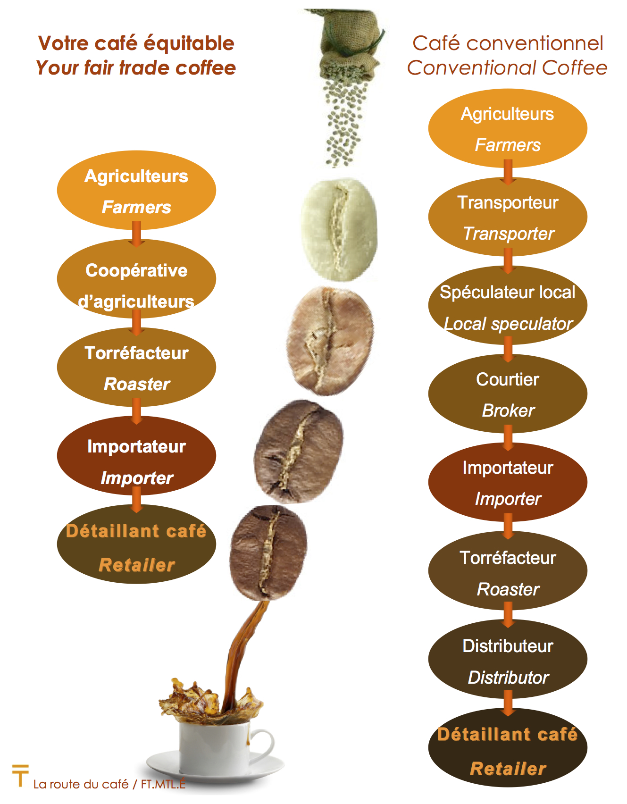

Definition of Fair Trade
- "trade in which fair prices are paid to producers in developing countries" (google)
- It is a tangible contribution to the fight against poverty, climate change and economic crisis (WFTO)
- a movement whose goal is to help producers in developing countries to get a fair price for their products so as to reduce poverty, provide for the ethical treatment of workers and farmers, and promote environmentally sustainable practices (Merrium Webster)

Slide 3
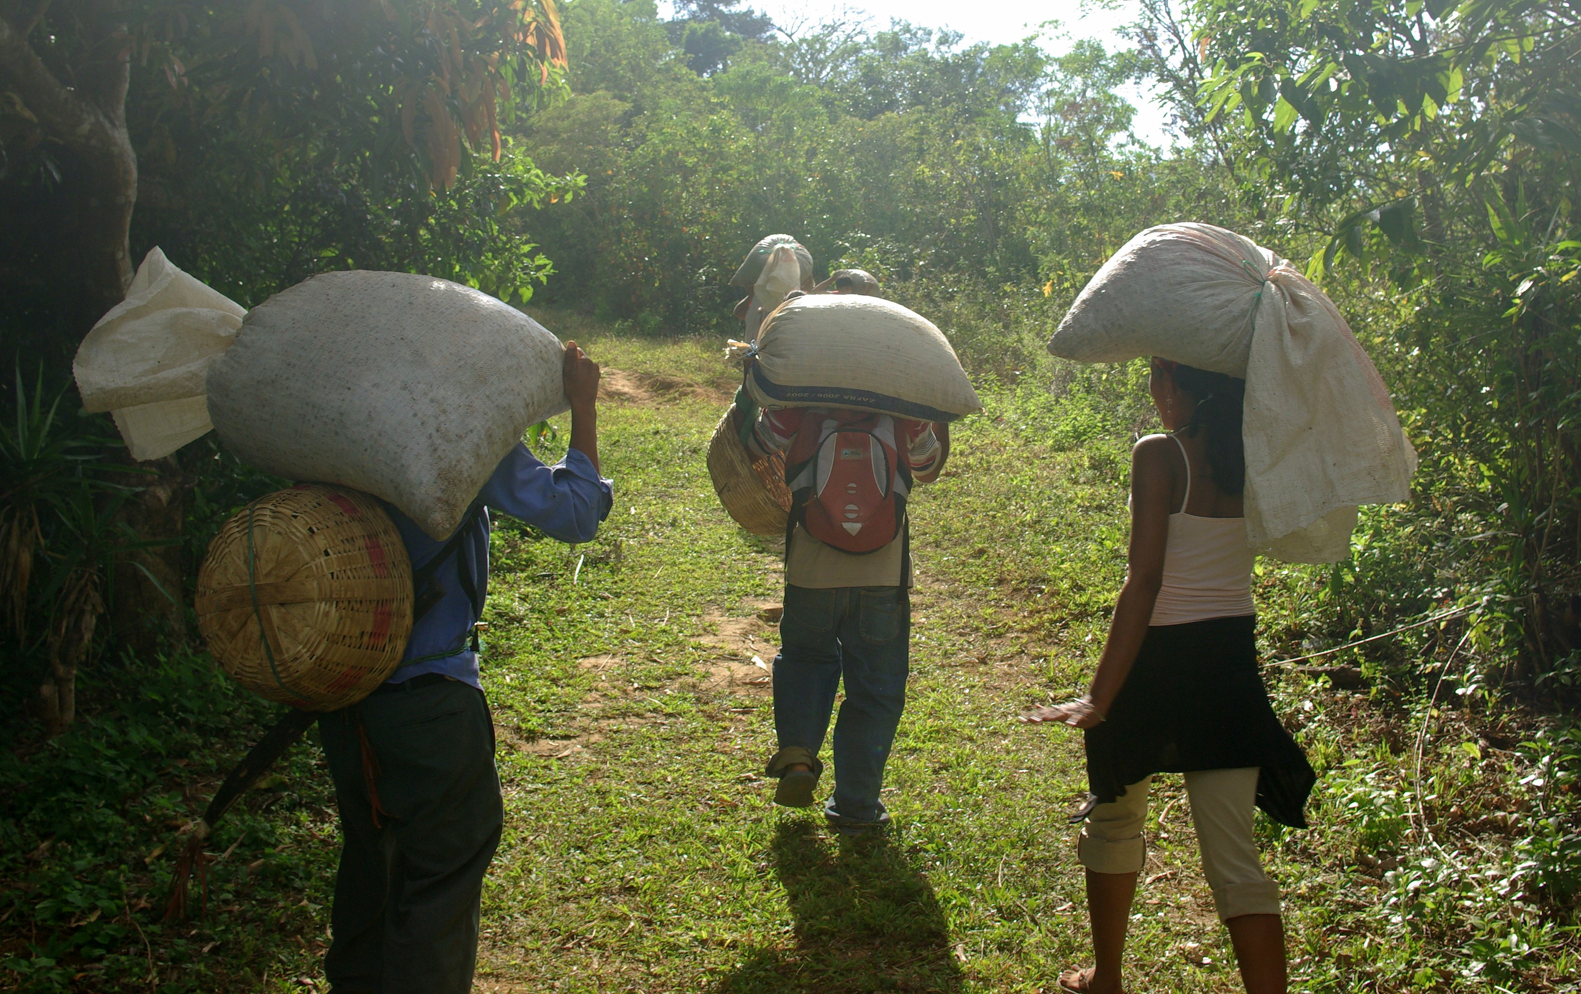
Key Principles
Opportunities for economically disadvantaged producers
Gender equityg- women properly paid
Transparency between importers and producers
Capacity building
Fair pay
Improved working conditions
Environmentally sustainable
Cocoa bean producers

Slide 4
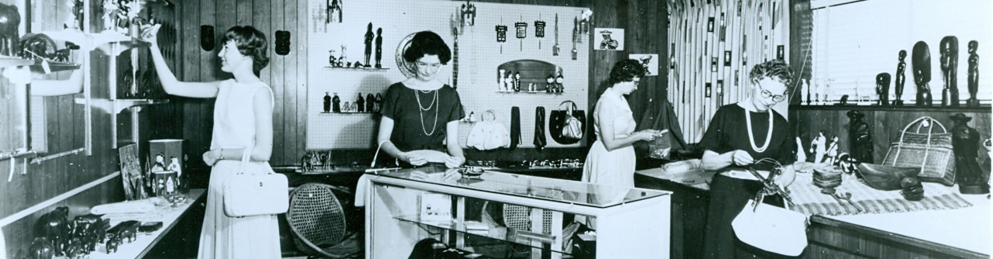
History
The first formal “Fair Trade” shop opened in 1958 in the USA
Awareness raising, campaigning and advocacy
Fair Trade Organizations and Fair Trade labelling

Slide 5
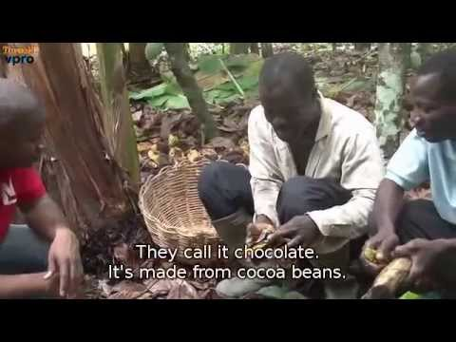

Slide 6
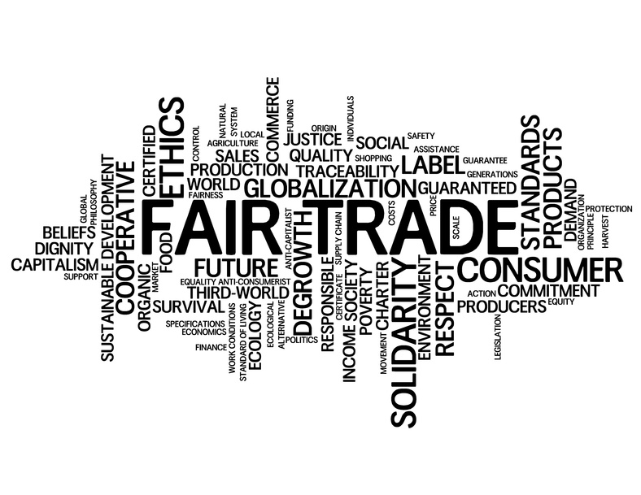
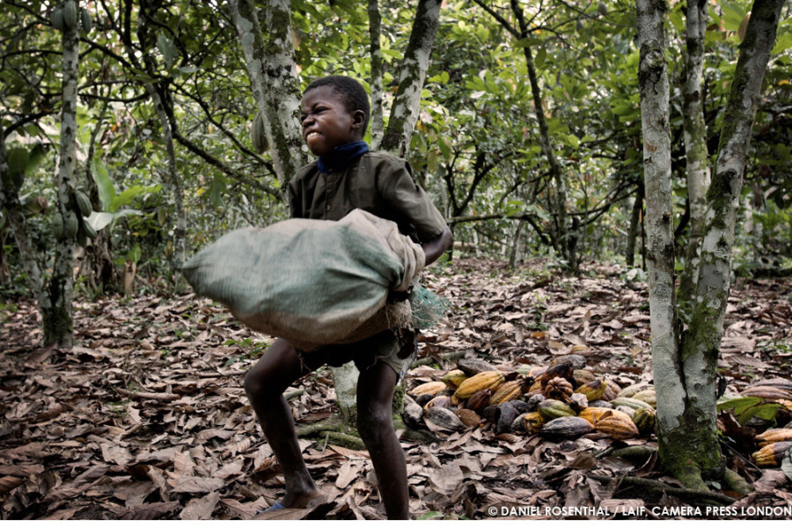
Future
z
Trade must put producer’s first
Fair Trade Organizations playing strong rule
Spread movement
More successes are to be expected

Slide 7
Organizations That Promote and Monitor
Abdulrahman

Slide 8
Stigma Towards Fair Trade Products
Abdulrahman

Slide 9
Fair Trade Company AKA People Tree

Slide 10
Percentage of Products That are Fair Trade Certified
Karla

Slide 11
Availability of Fair Trade Products
Karla

Slide 12
How To Know a Product is Fair Trade
Karla

Slide 13
Cost Difference of Fair Trade Vs Non-Fair Trade

Slide 14
GAME TIME

Slide 15
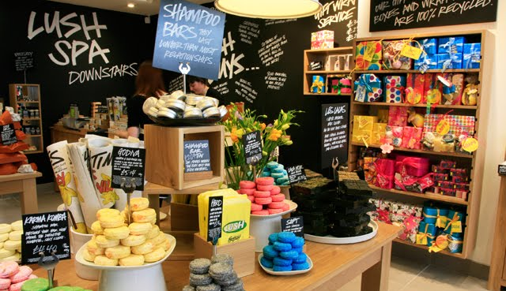
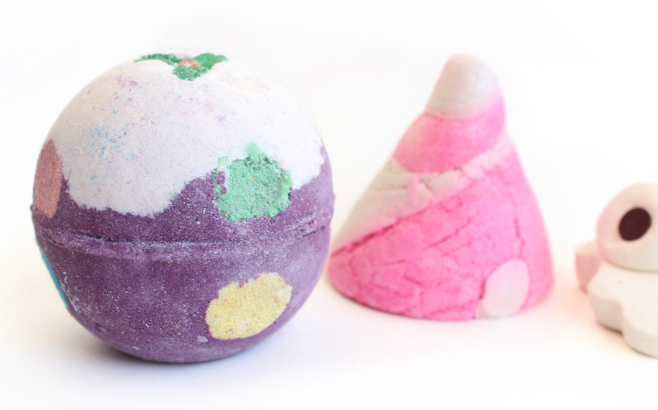
1. Lush
Chicago
Grand Rapids
Madison
Indianapolis

Slide 16
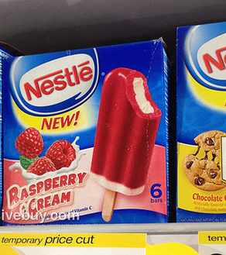
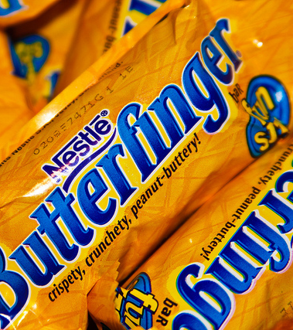
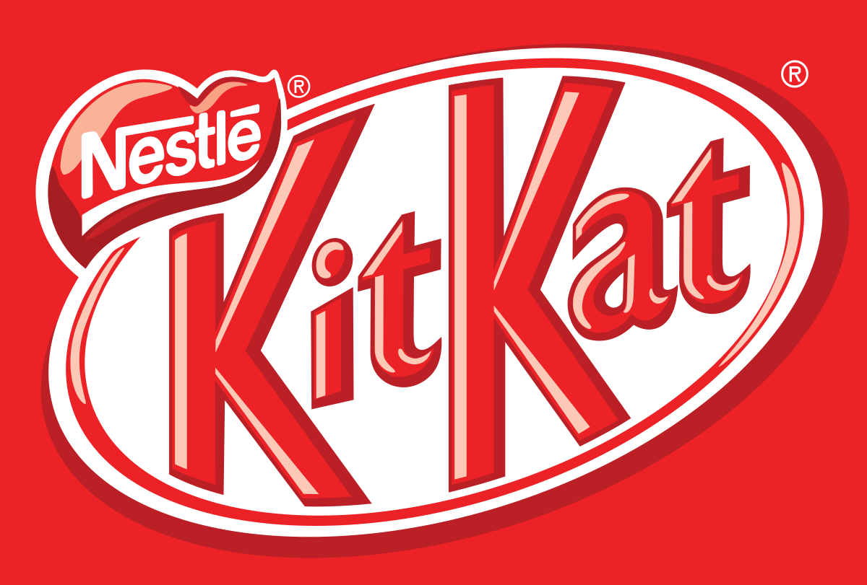
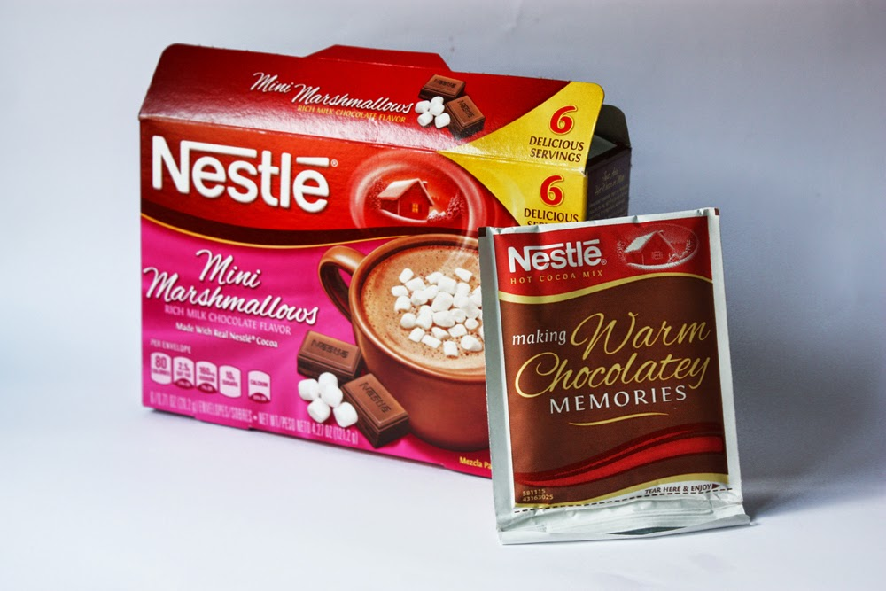
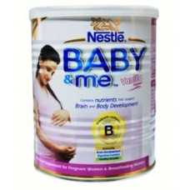
2. Nestle
z

Slide 17
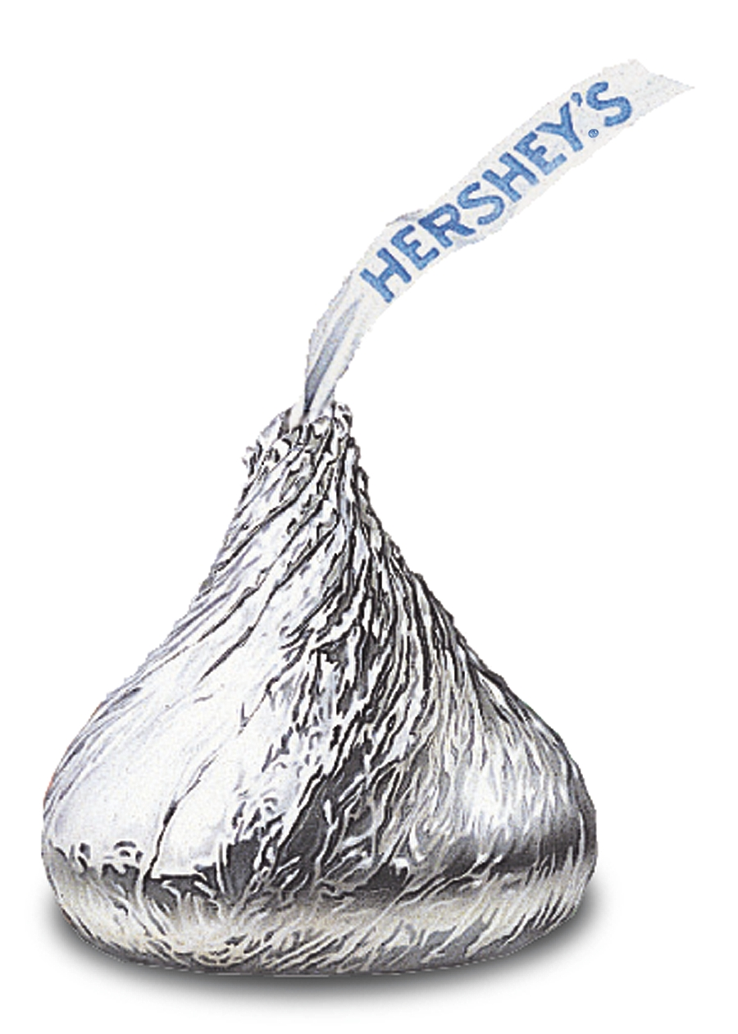
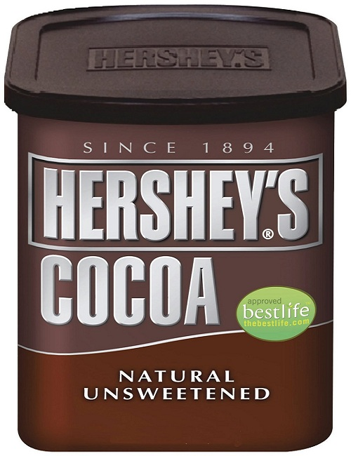
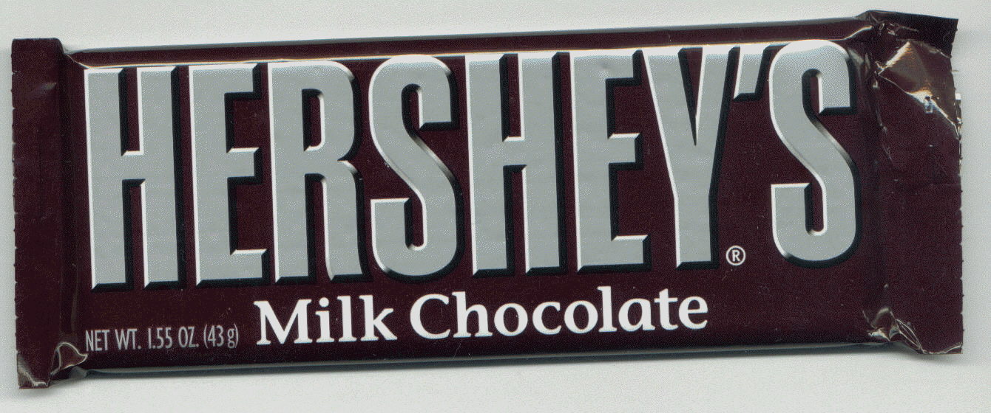
3. Hershey

Slide 18
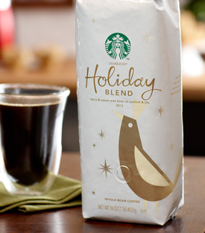
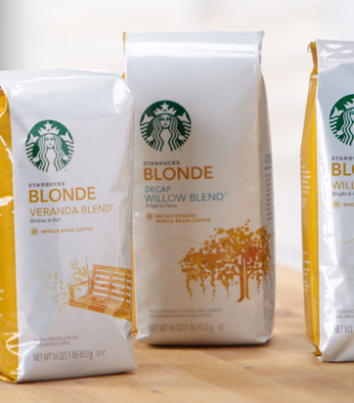
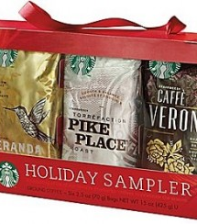
4. Starbucks
z
z

Slide 19
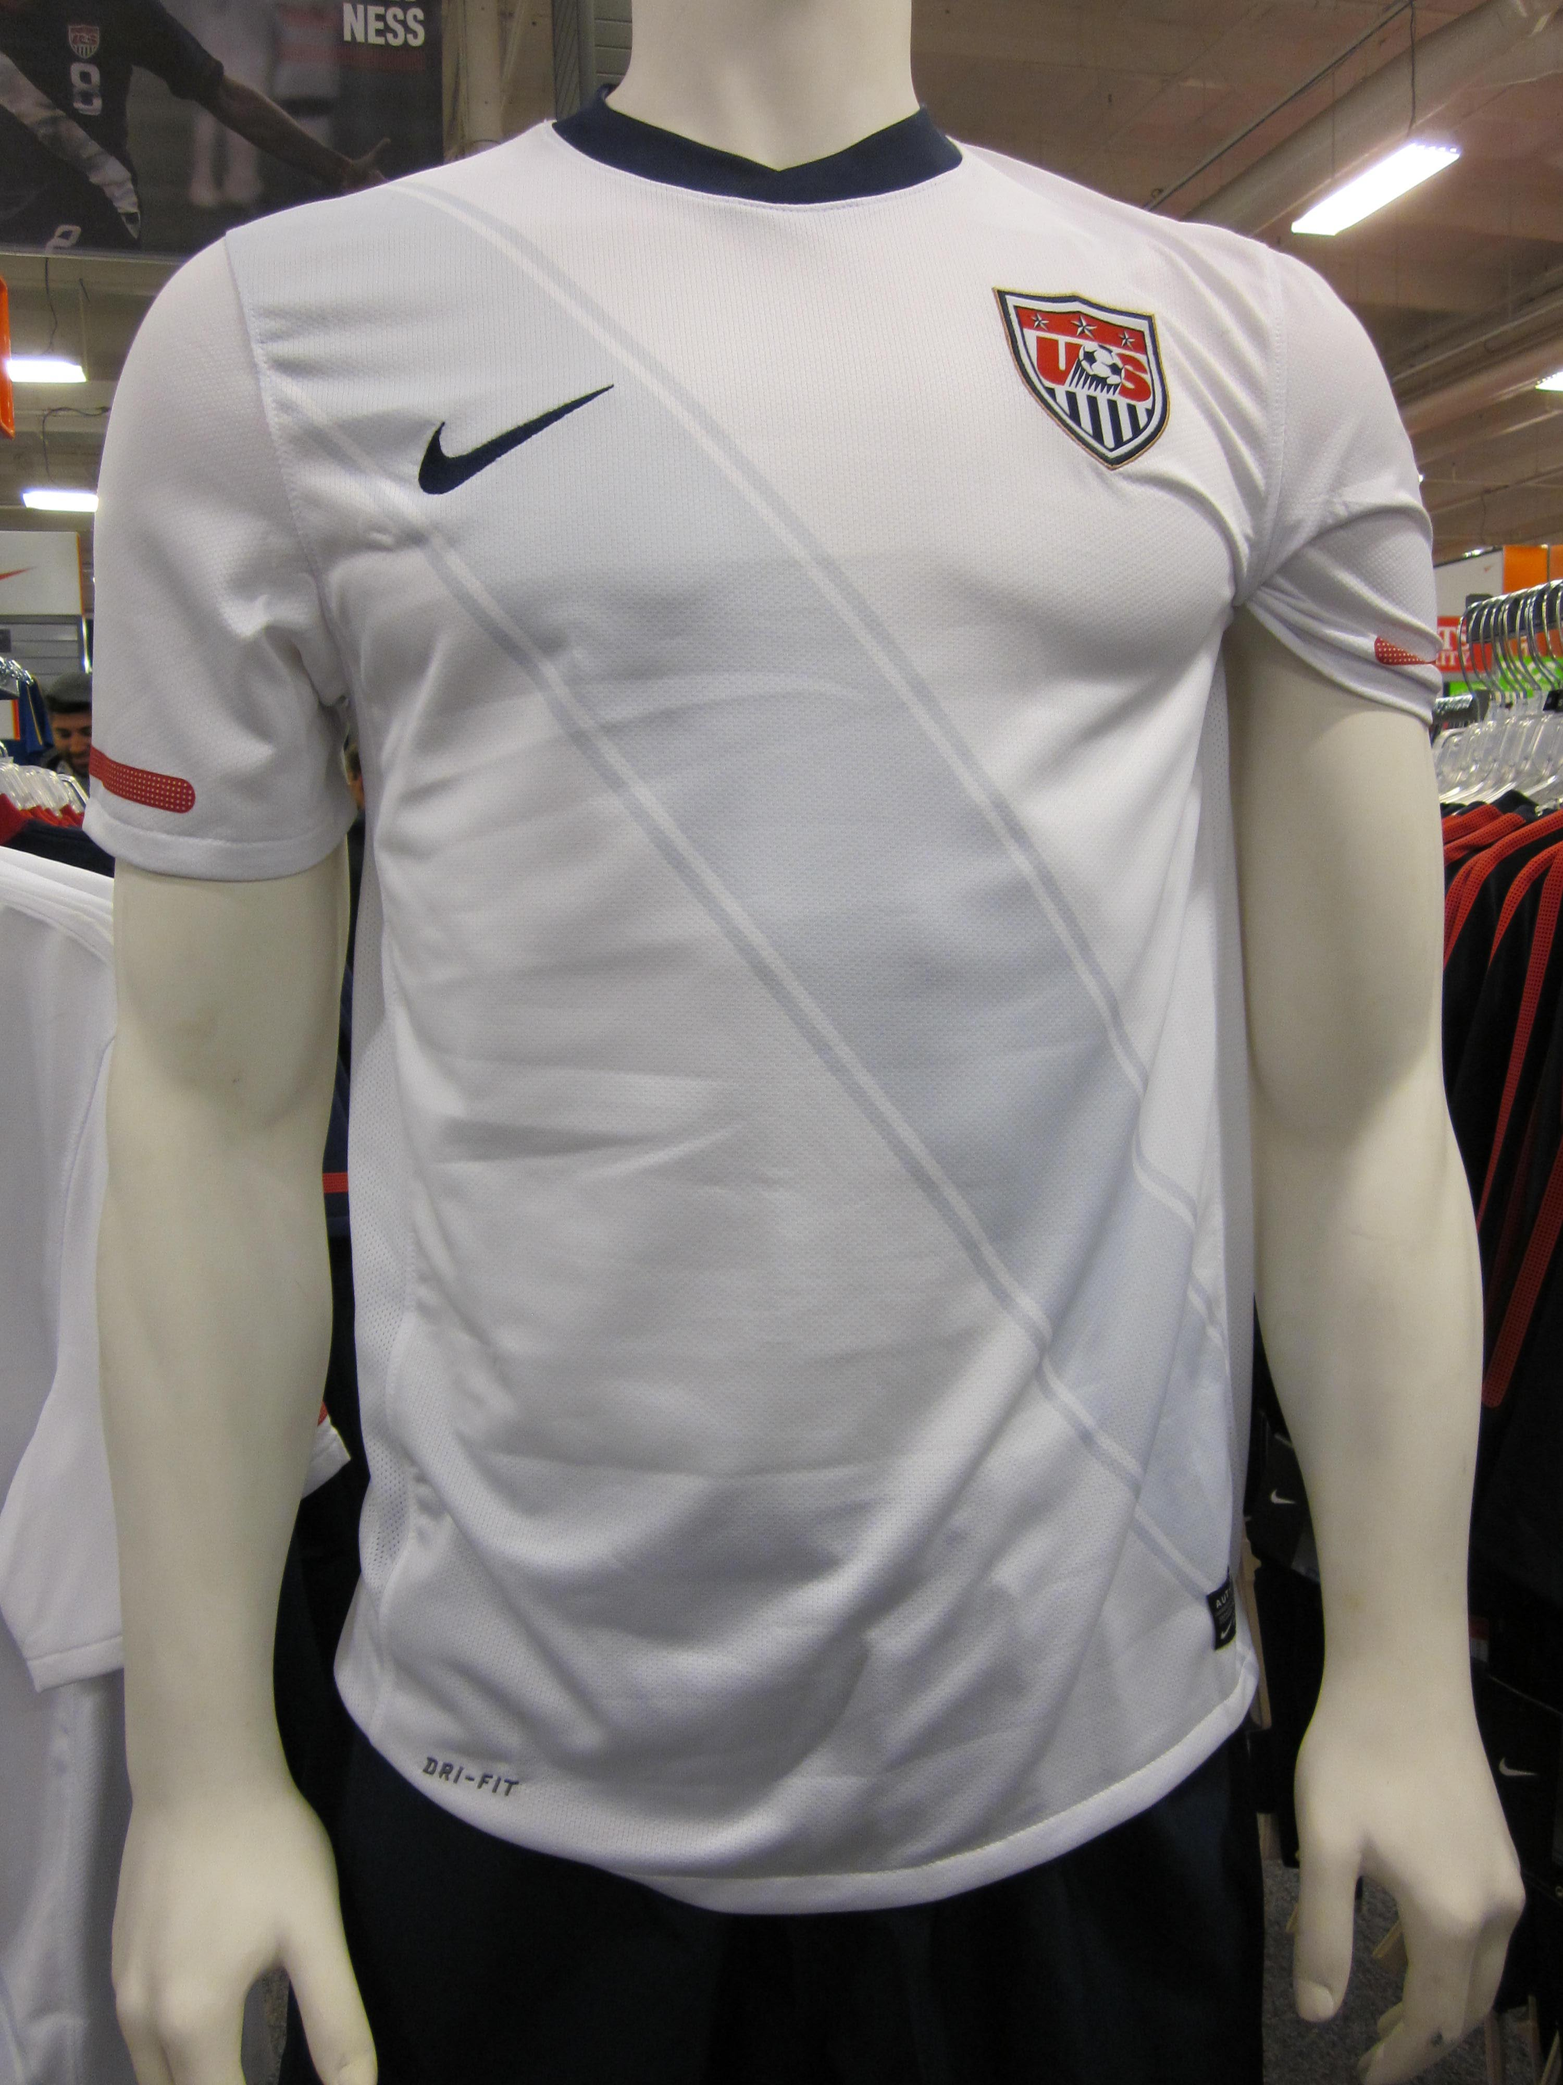
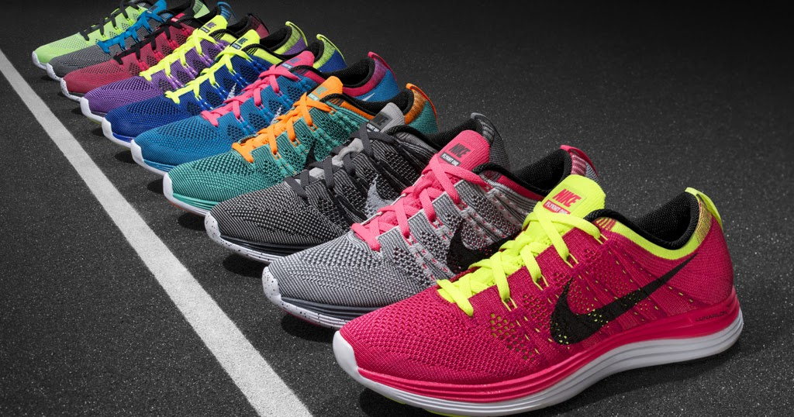
5. Nike
z

Slide 20

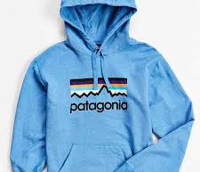
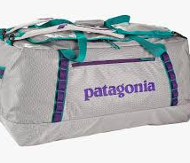
6. Petagonia
z

Slide 21
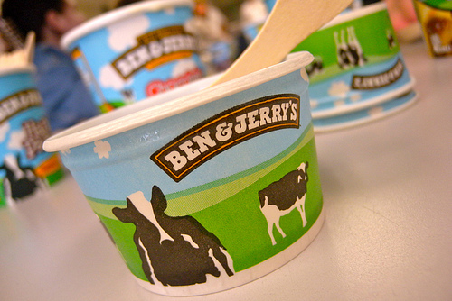
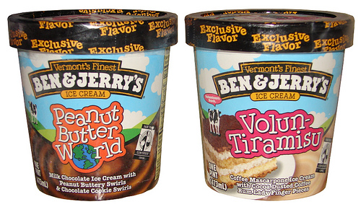
7. Ben and Jerry's
z
z

Slide 22
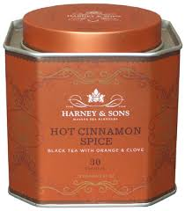
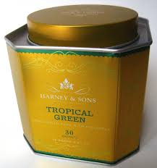
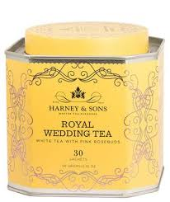
8. Harney and Sons
z

Slide 23
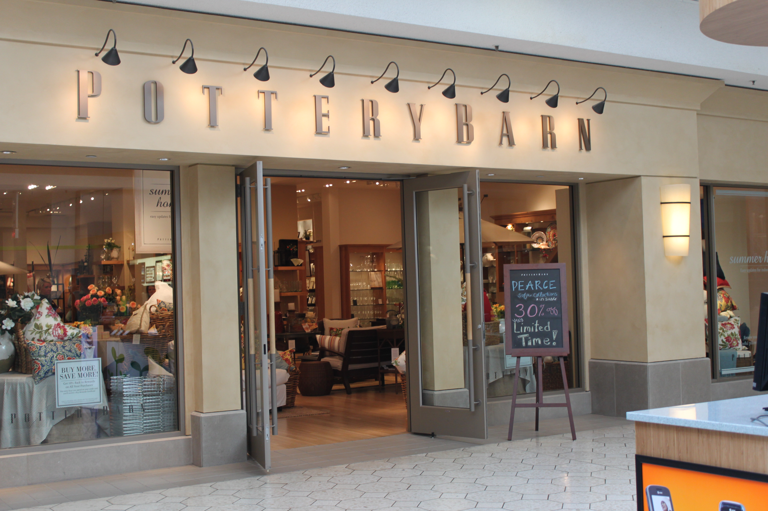


9. Pottery Barn
z

Slide 24
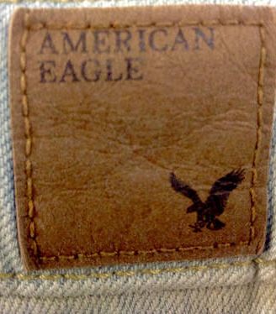
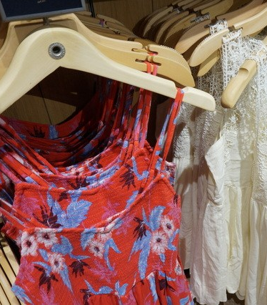
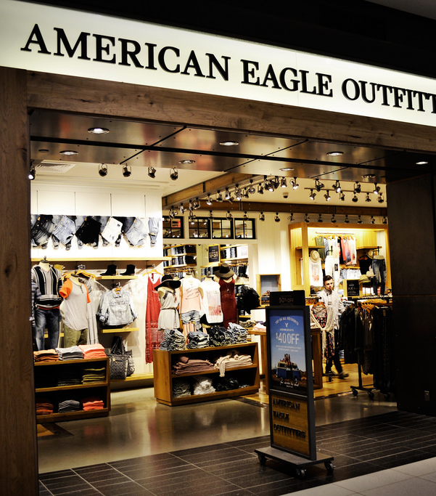
10. American Eagle outfitters
z
z

Slide 25
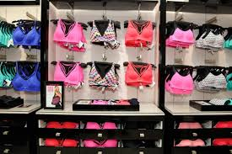
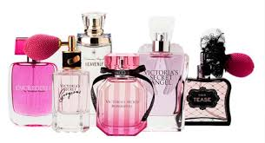
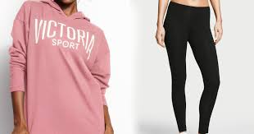
11. Victoria's Secret
z
z

Slide 26
References
Sarcauga, Michael. “DEFINITION OF FAIR TRADE.” World Fair Trade Organization, 12 Mar. 2018, wfto.com/fair-trade/definition-fair-trade.
“Fair-Trade.” Merriam-Webster, Merriam-Webster, www.merriam-webster.com/dictionary/fair-trade.
E. Mor Barak Michàlle. Managing Diversity: toward a Globally Inclusive Workplace. SAGE Publications Ltd., 2017.
“Cocoa For Good.” Corporate, www.thehersheycompany.com/en_us/shared-goodness/shared-business/cocoa-for-good.html.
“Hershey's and Fair Trade: Is It a Victory?” Global Exchange - Building People-to-People Ties, globalexchange.org/2013/05/07/hersheys-and-fair-trade-is-it-a-victory/.
“A Starbucks Boycott Percolates over Fair Trade and Organic Ingredients.” BINGHAMTONHOMEPAGE, BINGHAMTONHOMEPAGE, 23 July 2015, www.binghamtonhomepage.com/news/a-starbucks-boycott-percolates-over-fair-trade-and-organic-ingredients/188397633.

Slide 27
References Cont.
“Fair Trade Shopping Guides.” Fair Trade Certified, www.fairtradecertified.org/products/shopping-guides.
"Fair Trade Generation"www.globescan.com/generation-fairtrade-looking-to-the-future/.
"Fair Trade Media."Blog
www.fairtrade.org.uk/Media-Centre/Blog/2014/November/The-future-of-Fairtrade.
"The News." Fair Trade,
www.thenews.coop/112623/topic/equality/fairtrade-movement-preparing-future/.
"WFTO." Fair Trade,
wfto.com/about-us/history-wfto/history-fair-trade.
www.youtu.be/woAG4tp90Dc

